Slide 1
Workshop:
“Serving Businesses Across Partner Agencies”

Slide 2
WIOA and Employer Services
Business Services Provided through the One-Stop Career Center
Local areas must establish and develop relationships and networks with large and small employers and their intermediaries.
Local areas also must develop, convene, or implement industry or sector partnerships.
Presenters will share their strategies and techniques for engaging employers.

Slide 3
WIOA and Employer Services
Business Services Provided through the One-Stop Career Center
Allowable business services, consistent with each partner’s authorized
activities, include, but are not limited to:
Developing and implementing industry sector strategies;
Customized assistance or referral for assistance in the development of a registered apprenticeship program;
Developing and delivering innovative workforce services and strategies for area employers, including career pathways, skills upgrading, skill standard development and certification for recognized postsecondary credential, etc.

Slide 4
WIOA and Employer Services
Business Services Provided through the One-Stop Career Center
Assistance to area employers in managing reductions in force in
coordination with rapid response activities, including layoff
aversion strategies;
Marketing business services to appropriate area employers;
Assisting employers with accessing local, State, and Federal tax credits.
Workforce Partners may provide an array of other business services that meet the workforce investment needs of area employers
Customized business services may be provided to employers, employer associations or other such organizations, e.g. customized screening, referral, recruitment, Human Resources consultation, customized labor market information, etc.

Slide 5
WIOA and Employer Services
Business Services Provided through the One-Stop Career Center
Effective business services must be developed in a manner that supports engagement of employers of all sizes in the context of both regional and local economies.
Local Workforce Boards and Partners are encouraged to develop strategies to establish and sustain lasting partnerships and provision of business services.
Highly effective business services will avoid burdening employers; for example, with multiple uncoordinated points of contact.

Slide 6
Presenters
Carol Cullins, MCB, Employment Specialist
Ken Messina, DCS/Mass BizWorks
Jeff Turgeon, Central MA WIB

Slide 7
Massachusetts Commission
for the Blind
(MCB)
Carol Cullins
Employment Services Specialist

Slide 8
Partnerships and Collaboration
Regional Employment Collaboratives
Career Centers
Community partners, such as Carroll Center for the Blind and Perkins School for the Blind
Employer Partners

Slide 9
A Sampling of Employer Partners
State Street Corporation
VERC Enterprises
Office of the Secretary of the Commonwealth
Harvard University
Partners HealthCare
Dunkin Brands
MassMutual

Slide 10
Services for Businesses and Job Seekers
In-Services
Assistive Technology – information and accommodations
Orientation and Mobility
Pipeline to qualified candidate
OJE/OJT
Speaking opportunities
Job postings
Soft skills training
Informational interviews
Mock interviews
Internship
Employment
Speaking Opportunities

Slide 11
Services for Businesses
In-Services: Awareness and sensitivity training about legal blindness for employers
During in-services, present a video to employers called , “What Do You Do When You See a Blind Person?”
Provide information about Guide dog etiquette
Provide information about the many types of assistive technology available for people who are legally blind
Help employers to develop a pipeline of qualified applicants for positions
Provide pre-screened interns to help fill some employer needs

Slide 12
Assistive Technology
Conduct a workplace assistive technology assessment
Provide the adaptive equipment for little to no cost to the employer for use by registered legally blind employees and interns

Slide 13
Helping Employers Save Time
Provide Orientation and Mobility (O & M) to the newly hired employees or interns
Certified O & M Instructors can orient registered legally blind interns and employees so that supervisors can just focus on their regular on-boarding activities
O&M instructors will show them how to get to the supervisor’s office, restrooms, cafeteria, emergency exits and more
O&M instructors will also help the interns and job seekers learn the route to and from work and familiarize them to the areas outside the workplace, such as shopping, restaurants and more

Slide 14
Internships
Match appropriate pre-screened interns with employers to meet the employer’s needs while helping to build on the intern’s skills and interests
Provide the employers and interns with access to MCB staff to maximize the opportunity for a mutually successful endeavor: awareness and sensitivity training to internship site staff, assistive technology, O&M
Supervisors and staff learn first-hand about the abilities of people with visual impairments

Slide 15
On the Job Training
Employer can “try out” an employee for a posted position by providing On-the-Job Training, funded by MCB
The employer has the opportunity to see first-hand that the individual can do the work before actually transitioning the individual to the employer’s payroll
Win! Win!
The employer hires a qualified candidate!
The individual with a visual impairment gets a job!

Slide 16
Visibility and Good Citizenship
MCB provides visibility for businesses by inviting employers to speak in front of small and large groups of job seekers, interns, other businesses, and elected officials
MCB invites employers to conduct mock interviews and informational interviews of both interns and job seekers
MCB invites employers to provide job shadow opportunities and site visits

Slide 17
Get the Word Out!
When employers provide their job postings to MCB’s Employment Services Specialists, they reach not only people with visual impairment, but people with other disabilities as well. MCB often shares employers’ job postings with community partners who work with people who have disabilities; therefore the employers’ postings have the potential to reach numerous people with disabilities
Develop a pipeline of qualified applicants!

Slide 18
Business Partnerships… a team effort where everyone wins!
One can not work with
out the other!!

Slide 19
Strategies to Engage Businesses
It can be a challenge to convince employers of the benefits of participating in Workforce Development initiatives.

Slide 20
Mass BizWorks
Flow Chart

Slide 21
What is
Mass BizWorks is designed to meet business needs.
State and federal collaboration- TEAM Effort
Funded by USDOL’s Expanding Business Engagement
Connect businesses to resources
“We need to make it as easy as possible for Massachusetts business owners to take advantage of all of the services the state offers. Whether they are growing their business or downsizing, Mass BizWorks pulls all these services together in one easy to find place.”

Slide 22
Mass BizWorks
Providing Services Throughout the Business Cycle

Slide 23
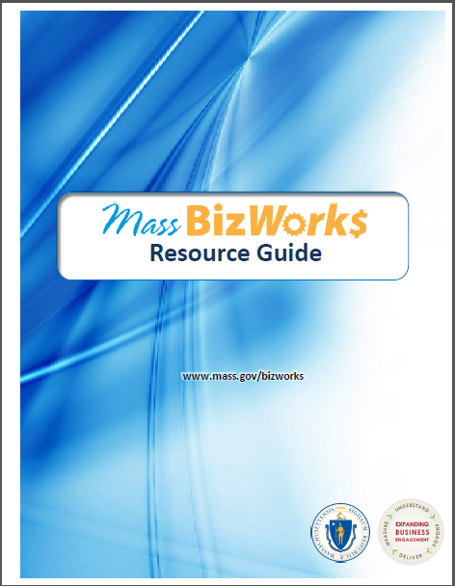
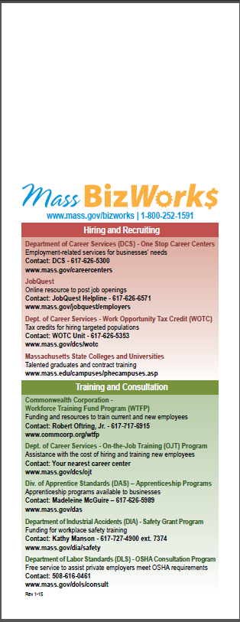

Slide 24
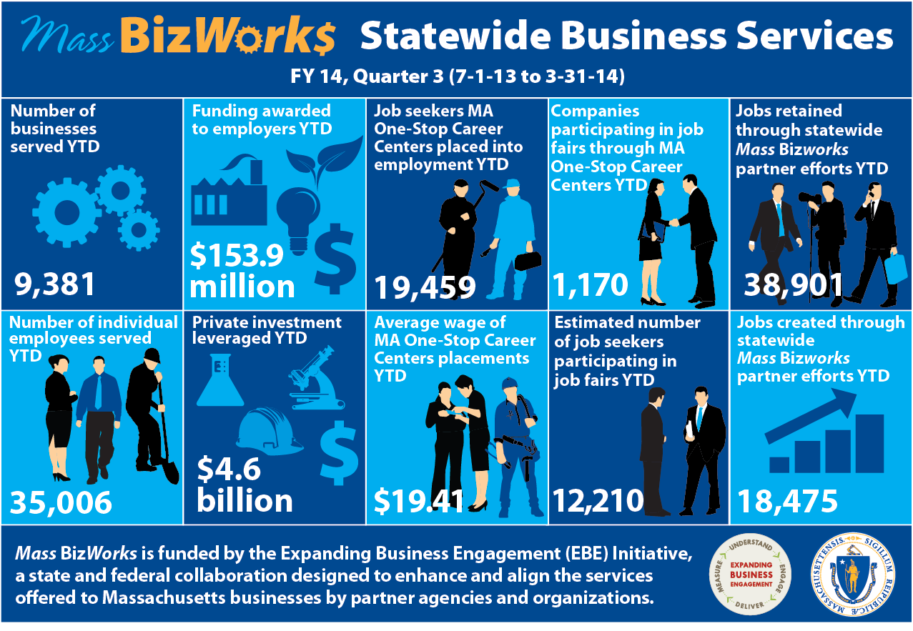

Slide 25
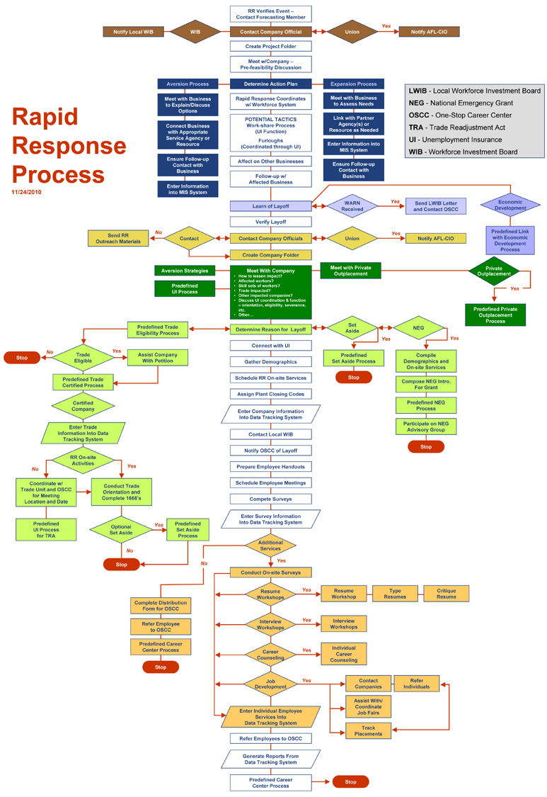
Rapid Response Flow Chart
LWIB - Local Workforce Investment Board
NEG - National Emergency Grant
OSCC - One-Stop Career Center
TRA - Trade Readjustment Act
UI - Unemployment Insurance
WIB - Workforce Investment Board

Slide 26
Programs Rapid Response initiates
Trade Act
National Dislocated Worker Grants
Workshare
Rapid Response Set Aside
DUA programs for employer/ employees

Slide 27
The Two Sides of Layoff Aversion:
Saving the Company or Jobs | BROADER IDEA: Lessening the Impact of Layoffs / incorporating the business cycle mindset
Lessen number of employees that company needs to layoff Work-share Furloughs ESOPs -Employee buyouts Finding a buyer for the closing business Linking with Economic Development Incumbent worker programs- based on affected company | Fewer people filing for UI benefits Linking with other companies that are hiring (Company Match) OJT programs-linking with growing companies Early warning networks Effective partnerships Linking Mass BizWorks services
27
1
2
Notes:
I want to ask for some audience input here. When you think layoff aversion, what do comes to mind? What does layoff aversion mean to you? A lot of people think that layoff aversion simply means preventing a layoff from happening, but in reality, there is so much more to it. There are two sides to layoff aversion. One is actually saving the company. This could be done by minimizing the number of employees that need to be laid off, work-share, company furloughs, employee-buyouts or finding a buyer, linking with economic development, or incumbent worker training programs based on the company. Then there’s the proactive side to layoff aversion, which is that you may not actually be able to save the company, but you can lessen the impact that a layoff event or closure has. This can be by lessening the number of people who file for unemployment insurance, company match, which is linking laid off employees with companies that need trained workers, linking On-the-job Training programs with growing companies, or broader incumbent worker programs. So layoff aversion is really a lot more expansive than simply stopping a layoff from happening.

Slide 28
Massachusetts Rapid Response Team Layoff Aversion Return on Investment
The Rapid Response Team has saved a significant amount of money to the Commonwealth of Massachusetts Unemployment Insurance benefits program by providing services to companies across the state, and successfully placing affected workers in new employment. Assuming the state’s average unemployment payment of $500 per week per affected worker, multiplied by the state’s average time on unemployment, 17.5 weeks, multiplied by the number of affected workers who have indicated they returned to work full time at each company Rapid Response has served, the results clearly show the savings to the Unemployment Insurance system. The numbers may be even higher due to workers returning to work full time and not contacting the Rapid Response Team with this information.
Project Cost Savings to Massachusetts Unemployment System
Advance Auto Parts, Sutton, MA $ 96,250
AstraZeneca, Westborough, MA $ 31,250
Cameron International, Millbury, MA $ 122,500
Cisco, Boxborough, MA $ 70,000
Cobham Sensor Systems, Lowell, MA $1,575,000
Quincy Medical Center, Quincy, MA $1,837,500
Veryfine/Sunny Delight, Littleton, MA $ 218,750

Slide 29
Mass Biz-Works-Staff Training and Development Group
Mass BizWorks Training
Modular One training- Trained over 350 business services Representatives
Modular Two Training – Trained over 170 business services Representatives
Modular Three training 150

Slide 30
Contact Information
Ken Messina
Department of Career services
Hurley Building
19 Staniford Street
Rapid Response/Business Services Manager
Boston, Mass 02114
617-626-5703
kmessina@detma.org

Slide 31
Redesigned Business Services in Central MA Massachusetts WIOA Partner Convening Dec. 6, 2016

Slide 32
Central MA Workforce Area

Slide 33
Theory of Action
With greater emphasis upon serving employers, we will open greater direct access to employment opportunities for our job seeking customers, ultimately, providing both customer groups with greater value. Achieving this greater value will in turn help drive greater demand and support for our services.
https://www.youtube.com/watch?v=bh1eULtwfVQ

Slide 34
Goals for the redesigned Career Center
An increase in the number and depth of employer relationships:
increased placement opportunities for WCCC referred candidates
increased usage of employer resources such as HITG, WTFP, and Apprenticeship.
Job Seekers moving through assessment, career action planning, and remediation of career readiness, technical, and academic skills – and then into employment
Alignment of the ACT/Career Ready 101 system with job openings and job seeker assessments
Development of new trainings offered to address the skill gaps identified through the new demand-facing model.

Slide 35
Redesign Team Working Groups:
New Job Seeker Services Flow
Job Seeker Online Services Portal
Staff Training
Staff Structure
What Services offered to whom & When
Member tools for job search, planning, and readiness
How many staff assigned for each function & how are they organized
Training for all staff on redesign, portal, and teamwork; training for business staff

Slide 36
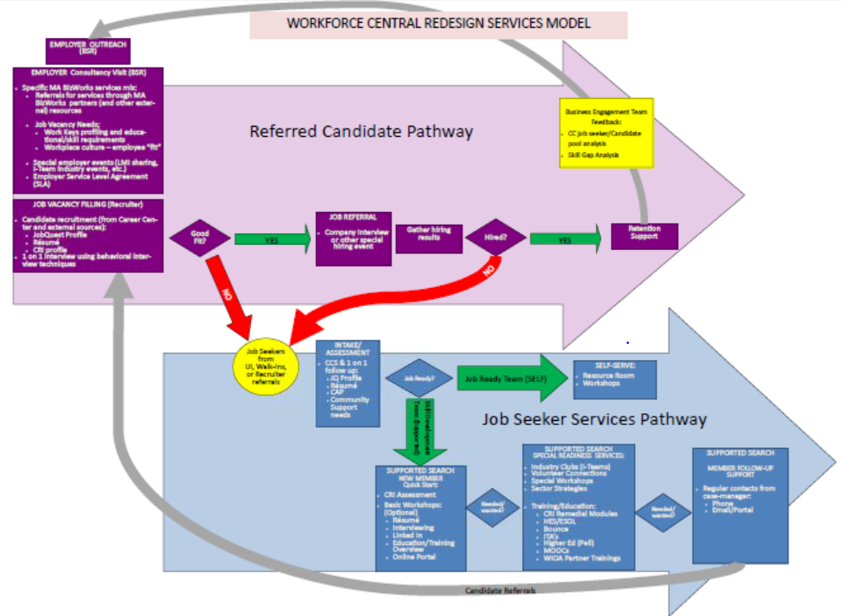
Customer Flow
Notes:
GREET participants
INTRODUCE presenters – Deb, Jenn, Kathy
STATE: We are going to approach this by taking the overall WFC Redesign Services Model and breaking it down step by step in order to cover all aspects of it as far as it relates to the interaction between our customers and ourselves within our various roles
TRANSITION: First we’ll start with the Job Seeker Services Pathway, which is shown in the blue

Slide 37
Job Seeker Services
JOBSEEKERS
Job Ready?
Self-Serve
Intake / Assessment
YES
NO
Supported Search
& RESEA
Notes:
SAY: We receive job seekers into the career center in a number of ways and for a variety of reasons. However, right now we’re going to focus on
people coming in for a CCS and
walk-ins
At a basic level, the jobseeker services pathway is based on the intake and assessment results identified by the counselors, who will recommend either the self-serve or supported search depending on the customers needs in terms of
education and employment goals,
barriers to employment,
eligibility for various programs and services, etc.
TRANSITION: For CCS attendees…

Slide 38
Job Seeker Services
JOBSEEKERS
CCS
IAI or JSSA (assessment)
CAP or IEP
JobQuest
Resume
Support needs
RESEA Review or Meet with EC
Notes:
SAY: …the assessment process happens immediately following the seminar.
Both RESEA and NON-RESEA customers will be treated the same way with variations in the MOSES data entry. All participants will receive an Initial Assessment Interview (RESEA) or Job Search Skills Assessment (Non-RESEA) where the counselor and member will begin developing a Career Action Plan (RESEA) or Individual Employment Plan. All members should be registered on JobQuest and have a resume. The counselor will address any support needs the customer has and a follow up meeting will be scheduled – either a RESEA Review or a Meet with Employment Counselor appointment.
For walk-in customers, the assessment will start at the front desk. These customers may be coming in for
Professor Teaches
Volunteer Connections
to use the Resource Room to gain access to online resources, such as JobQuest, various LMI sites, the WFC site, and the online portal
to use the fax or copier
TRANSITION: Self-serve customers…

Slide 39
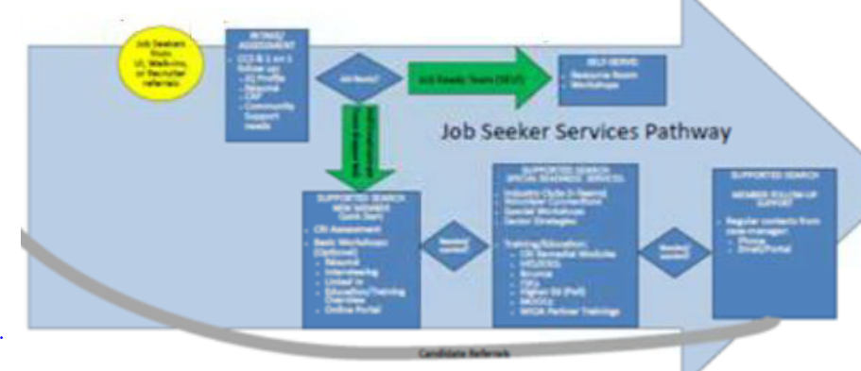
SELF-SERVE
Resource Room
Workshops
Fast Track Consult
Professor Teaches
Volunteer Connections
I-Teams
JOBSEEKERS
Notes:
SAY: are the customers from the CCS who are “job ready” or not interested in the job seeker services provided under supported search and just want to use the Resource Room or pick certain workshops they want to attend
OR
they might be walk-ins looking for a quick assessment or some guidance, in which case the “counselor on duty” would do a “fast track consultation” to provide things like:
Resume Critique
Interviewing Skills suggestions
Workshop referrals
Referral to Business Engagement Unit & determine if match for open opportunities
Review of Job Match feature in Job Quest
Referral to Temp Agencies for urgencies
Referral to community agencies for additional support
Note that fast track services will be indicated in MOSES by the counselors using a Career Center Specific field
EXAMPLE: Self-serve can be jobseekers who are “job-ready” or they could be people who decline other jobseeker services we offer
TRANSITION: if a customer chooses supported search…

Slide 40
QUICK START
AND/OR
SPECIAL READINESS
JOBSEEKERS
Notes:
SAY: …then dependent on their needs they can choose from the Quick Start (new member boot camp) AND / OR Special Readiness menus.
TRANSITION: The quick start menu…

Slide 41
Job Seeker Services
SUPPORTED SEARCH: QUICK START
JOBSEEKERS
Career Ready Assessment
Basic Workshops
Résumé Writing
Interviewing Skills
LinkedIn
Online Portal
Notes:
SAY: …includes the Career Ready Assessment, basic workshops such as Résumé Writing, Interviewing Skills and LinkedIn and access to the online portal.
TRANSITION: the special readiness menu includes…

Slide 42
Job Seeker Services
SUPPORTED SEARCH:
SPECIAL READINESS
JOBSEEKERS
Specialty Workshops
Sector Strategies
Career Ready Assessment
Bounce Readiness
Training / Education
ITA’s / TABE
ABE / HSE
Higher Ed / QCC Navigator
Online training
Partner Trainings
➔
Notes:
SAY: things like:
Industry Job Clubs
Volunteer Connections
Specialty Workshops like Bounce and Stress Reduction or other workshops that we don’t offer as frequently as the basic ones
Sector Strategies
Career Ready Assessment
AND
Training / Education options such as
ITA’s / TABE (note upcoming eligibility training for counselors)
ABE / HSE
Higher Ed / QCC Navigator
Online training opportunities
MOOCs and WIOA Partner trainings
TRANSITION: All jobseekers who are using the supported search options will be…

Slide 43
Job Seeker Services
SUPPORTED SEARCH:
FOLLOW UP SUPPORT
JOBSEEKERS
Notes:
SAY:…included in follow-up support. Counselors will conduct follow-ups with jobseekers in their caseloads according to an established schedule. The jobseekers in these caseloads will also be looked at for making job referrals.
TRANSITION: Now we’re going to move on to the Business Engagement Team section of the customer flow…

Slide 44
Customer Flow
Notes:
SAY: … which is the purple / pink section at the top of the model
TRANSITION: Starting with the Business Service Reps…

Slide 45
Referred
Candidate
Mass BizWorks
Business Needs?
Special Events
Vacancy
Notes:
SAY: The BSRs will be servicing the business community based on its needs – business contact includes maintaining existing employer relationships and conducting consultancy visits. This can be:
Contact by business to B.E.T
Inquiries to / from MA BizWorks
Internal targeted business outreach requests from counselors
Regardless of whether the business engagement is initiated by the employer or is the result of outreach, the BSR makes the determination on what is the best way to service them based on the request or business needs.
There are three primary options the BSR will offer:
Mass BizWorks resources
Special Events
And assistance with filling open jobs
TRANSITION: Mass BizWorks resources will be recommended if…

Slide 46
Referred
Candidate
Mass BizWorks
Business Needs?
Training & Consultation
Layoff Aversion & Management
Business Development / Partnerships
Important Websites
Notes:
SAY:…the business needs information or resources, such as:
Training & Consultation to include Workforce Training Fund, safety grants, and other training related resources available locally that the business can take advantage of.
Layoff Aversion & Management
Business Development / Partnerships
AND / OR
Important Websites
TRANSITION: BSR’s will collaborate or engage businesses to…

Slide 47
Referred
Candidate
Special Events
LMI sharing
Industry events
Job fairs / recruitments
Mass BizWorks information sessions
Business Needs?
Special Events
Notes:
SAY:…participate in special events, such as
LMI sharing
Industry events
Job fairs / recruitments
Mass BizWorks information sessions
TRANSITION: Finally, the BSR’s will…

Slide 48
Referred
Candidate
VACANCY
“Standard” job ads (orders)
Recruitment referral services
ie. Demand 2.0 implementation
Business Needs?
Vacancy
Notes:
SAY:…assist employers with filling their open positions.
Based on the request or business needs, the BSR will make a decision on which vacancies will be handled as standard job ads (orders) and which will be done using recruitment referral services based on established criteria (TBD).
TRANSITION: When recruitment referral services will be used…

Slide 49
Referred
Candidate
Recruitment referral services
Gather detailed job / company information
Complete Career Ready job profile
Determine preferred referral process
Secure Service Level Agreement
Add Confidential job order
Communicate information to Recruiter(s)
Notes:
SAY:…the BSRs will
Gather detailed job and relevant company (culture) information (Post consultation debrief report; must document meeting in MOSES and email BEM a copy of meeting summary (template TBD)
Complete Career Ready job profile for vacancies to be filled by the Recruiter
Determine the preferred referral process for connecting candidates with the company (passing on candidate name and info, conducting meet and greets or on-site interviews, etc.)
Complete and sign Services Level Agreement with the employer rep. (TBD)
Enter job lead into MOSES as a “confidential” job order.
Work with B.E.T members on proper assignment and corresponding communication for individual job order. (The BEM will develop a formal assignment process – by shared BSR/Recruiter teams, territories, industries, or something else??)
TRANSITION: The recruiter part of the process

Slide 50
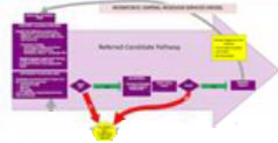
Recruitment
referral services
Internal candidates from Career Center counselor referrals
External candidates from community network (recruit into career center)
Interview & screen candidates
Notes:
SAY:…the Recruiters will:
Update a Recruited Job List which will be housed on a shared drive – this is expected to be done BY THE END OF THE DAY IT IS RECEIVED FROM THE BSR (or as soon as possible) – template TBD
Share the confidential job lead(s)s with WCCC counselors
When receiving candidate referrals from the Counselors – the recruiters will review job seeker’s MOSES casefile notes, counselor endorsement notes and CRI results. If necessary, they will contact counselors for validation.
Contact the candidate to schedule a telephone or in-person interview.
TRANSITION: we’re going to go back to the jobseeker services path for a moment…

Slide 51
Business
Engagement
Team
Feedback / Debrief Process:
Track hiring demand trends
Identify hard to fill – labor “gaps”
Notes:
SAY: BET feedback process between the recruiters and BSRs to assess the job seeker / candidate pool in order to determine the possibility of future skills training grants or to pursue job development with employers.
Recruiter: when the position for the job order is filled, or the hiring deadline has passed, or all referred candidates for the position have either been hired or recommended to WCCC, the Recruiter will update the “Recruited Job List” – cut the appropriate job order and paste it on to the Recruited Job List’s tab under “Placement Outcomes”, noting the total number of candidates referred to the position including the specific number of Hired vs. Not Hired
Weekly Business Engagement reports (these will roll up into monthly, quarterly and yearly reports):
# of businesses that utilize WCCC services
# referrals to MA BizWorks partners
# of jobs posted with WCCC
# of “Recruiter Assisted” openings
# of candidates assessed by B.E.T staff
# candidates referred to Job Openings
# job placements, referred candidates hired
TBD as required by ongoing WCCC demands
TRANSITION: this concludes our review of the customer flow. Final thought…

Slide 52
Central MA WIOA Partners planning
June 29, 2016

Slide 53
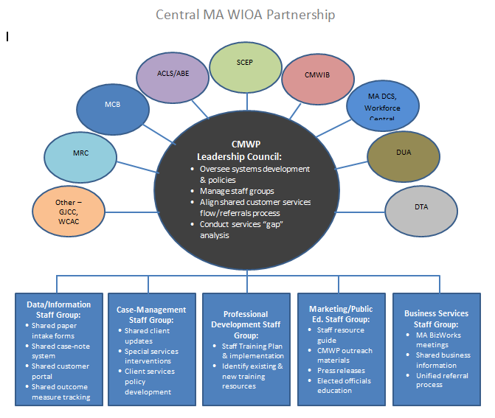

Slide 54
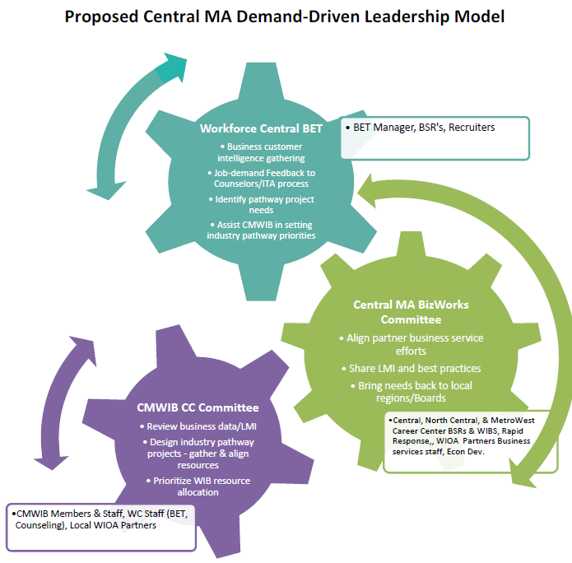

Slide 55
Workshop Small Groups Project

Slide 56
Questions????
Thank you!

