Slide 1

Disability Employment Initiative
Best Practices Conference
March 1, 2018
Successfully serving youth with disabilities within the workforce system
Heather Donovan, Young Adult Department Supervisor, Career Center of Lowell
Frances Bernier, Career Counselor, CareerPOINT
Jennifer Applebaum, Associate Director for Curriculum and Training, Youth Pathways
Kathy Petkauskos, Director, Work Without Limits
Sacha Stadhard, Department of Career Services, Executive Office of Labor and Workforce Development

Slide 2
Workshop Goals
To learn more about workforce development programs that are inclusive of serving youth with disabilities.
To hear from local areas that are currently implementing the DEI VII grant.
To understand how the Signal Success curriculum helps youth with disabilities develop crucial employability skills.
To receive information about scalable promising practices for serving youth with disabilities.

Slide 3


WIOA Youth Program
  Types of WIOA Funded programs:
  Alternative Education
  Work Experience
  Occupational Skills Training
  Work Readiness
Workforce development Strategies for youth:
Employer Engagement
Pre-Apprenticeship/Apprenticeship
Building Youth Program Capacity

Slide 4
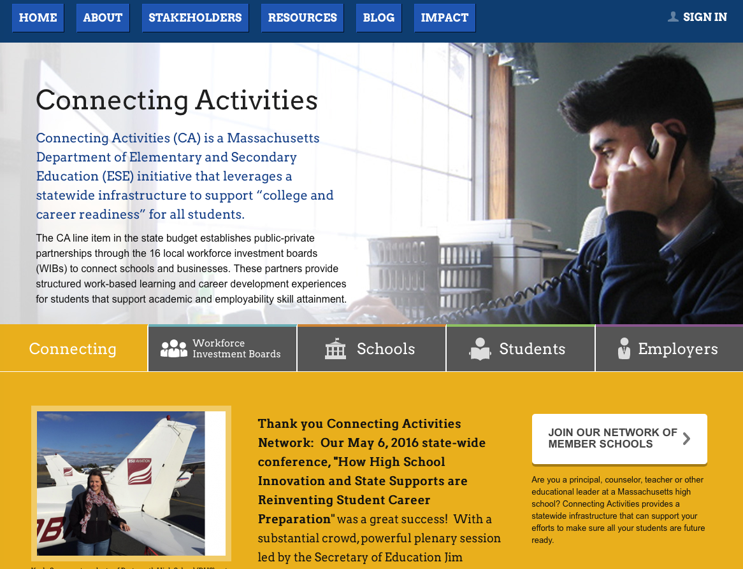


Youth Workforce Development Programs
www.massyouthbuild.org
http://www.massconnecting.org/wib-map
https://www.careeronestop.org/EducationTraining/Find/JobCorpsCenters.aspx
http://commcorp.org/programs/youthworks/

Slide 5
Disability Employment Initiative
(DEI) VII
To improve job placement outcomes for young adults (14–24) through career pathways strategies that prepare/support them for employment success that includes access to credential-based education and training pathways.
Expand access to short-term subsidized work through WBL internships & OJT.
2 Workforce Areas:
Hampden County
Greater Lowell

Slide 6
Lowell MA- DEI Project
The M and M Game! Grab a cup and use it to get a small amount of M and M’s!
Red- Favorite Superhero
Orange- Favorite Outdoor Activity
Blue- Favorite Food
Green- Favorite Vacation Spot
Brown- Favorite TV Show
Yellow- Why you absolutely love your agency/organization/company

Slide 7
Youth Programs in Lowell
YouthWorks Year Round
Summer Work Experience
Career Academy Internship Program
WIOA OSY Career Pathways Program
DEI VII
Collaborations-
  Local schools, post secondary, training providers, 90 plus employers throughout the city, 9 financial partners, MOU partners

Slide 8
DEI VII
Forty One young people between 14-24 years of age currently enrolled.
All striving to enter a Career Pathway identified by interests.
Seventeen on Paid Work Experiences in 4 locations across the city working on computers, culinary, healthcare and clerical assignments.
One completed an intensive A+ Networking training.

Slide 9
Signal Success
Soft skills work readiness program from Commonwealth Corporation that has been adapted to fit the needs of our particular collaboration.
Delivered weekly in a true collaboration with the Greater Lowell Technical High School teachers and the Career Center of Lowell’s Youth Advisor, Amy.

Slide 10
Success
Soft Skills Gains (rated on a 1-5 scale)
  Dependability- 2.87 at pre survey to 3.40 at post survey (increase of .63)
  Communication- 2.67 at pre survey to 3.47 at post survey (increase of .80)
  Collaboration – 2.53 at pre survey to 3.40 at post survey (increase of .87)

Slide 11
Self Assessments
What do you want to be doing in 5 or 10 years?
“Being able to talk more”
“Being independent, with a family and a job”
“Working in a sports store”
“Working at a zoo or with animals”

Slide 12
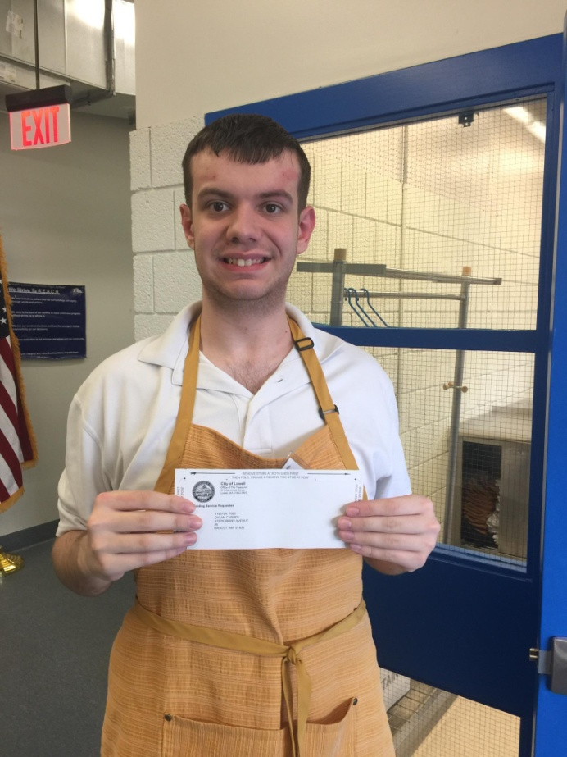
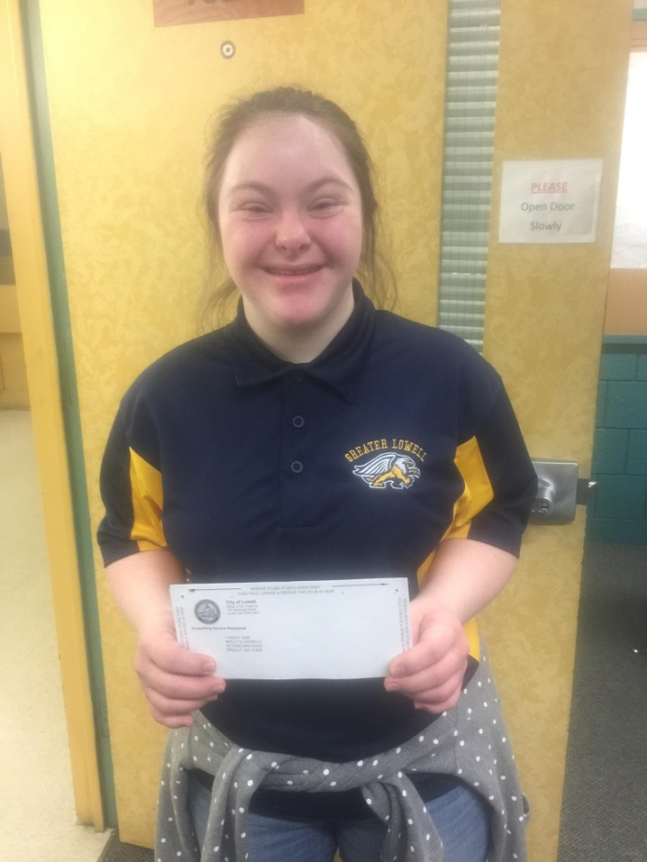
Final Thoughts
Every success, no matter the size, makes a difference.

Slide 13

HAMPDEN CAREER CENTER
A free program serving young people living with disabilities ages 14-24.
Programs and activities help young people with disabilities help explore and expand their options for post-secondary education, training and work
Benefits include:
♦ One-to-one career counseling
♦ Job Readiness Workshops
♦ Leadership Skills
♦ Communication & Social Skills
♦ On the job Training
♦ Job placement services
♦ Referrals to multiple agency resources

Slide 14

EMPOWERING THE ABILITY IN DISABILITY
Regional Disability Meetings occur bi-monthly to share concerns, progress, and best practices
Signal for Success Curriculum is sponsored by both FutureWorks and CareerPoint
BenePlan overviews are provided in schools and in both career centers
CareerPoint coordinates the Hawk Career Center at Dean Vocational High School and the Career Center at Westfield High School
Story
Together, let’s explore ways to find your pathways to a bright
future today

Slide 15


Commonwealth Corporation designs and executes workforce development programs across the state that strengthen the skills of Massachusetts youth and adults.
The Signal Success initiative helps
young people develop
crucial skills that employers want and young people need for
success today and tomorrow.

Slide 16
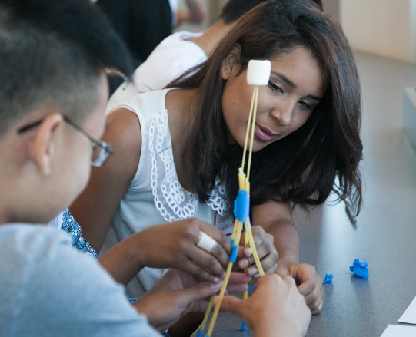
Signal Success workshops help
young people develop
crucial skills that employers want and young people need for
success today and tomorrow.

Slide 17
DEI VII Implementation Model
Needs Assessment
Goals
Constraints
Training & Support
Training
Site Visits
Feedback & Improvement
Staff & Student Feedback/ Data
Customization
Capacity Building
Adjustments
Notes:
“the best way to understand Signal Success is to experience it for yourselves”
Signal Success does much more than instructing youth how to create a resume or pick a career at random, it equips young people with the knowledge, skills, attitudes, and behaviors that they need to be successful.

Slide 18
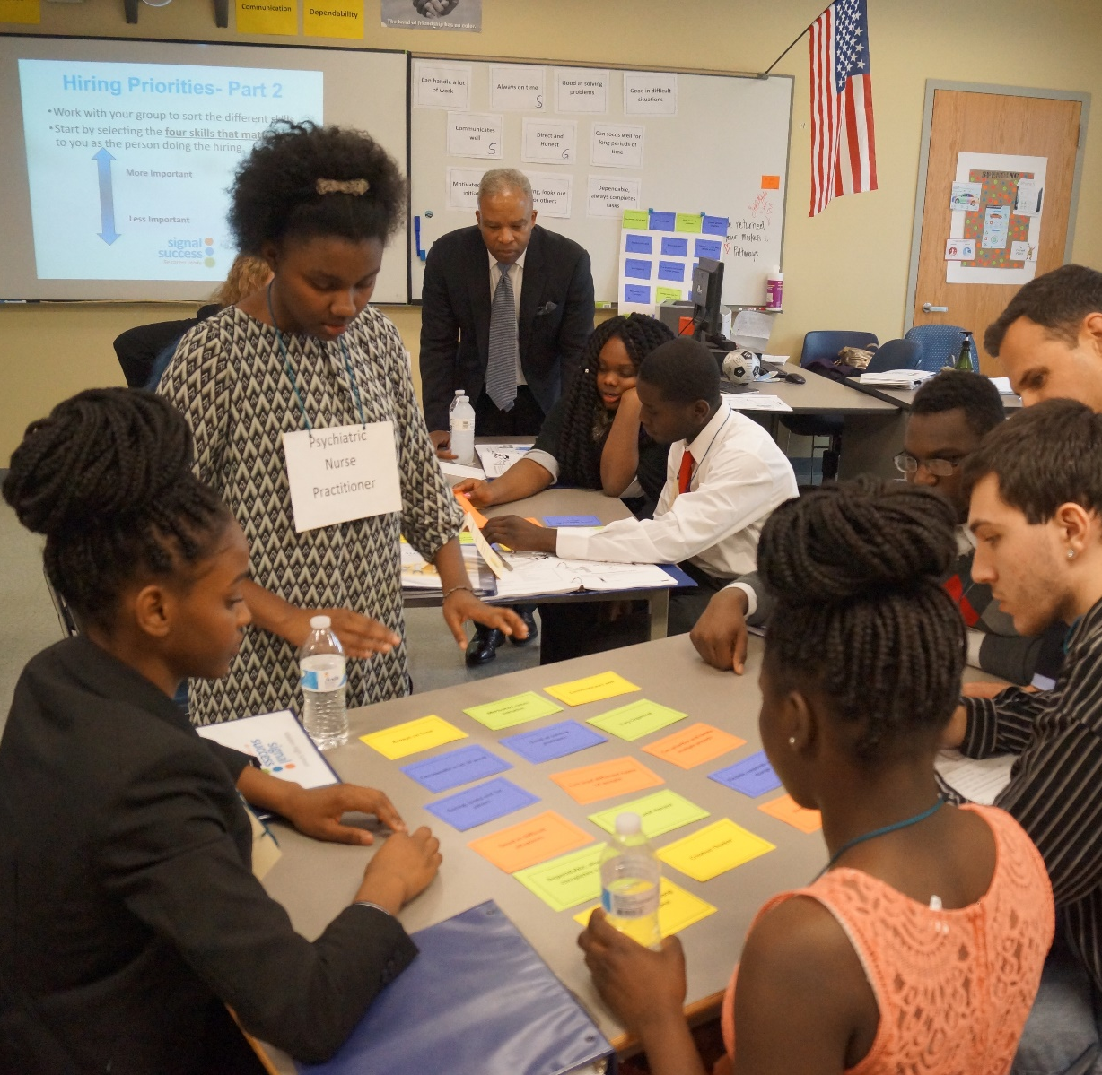
Students participating in the trainings make skill gain in:
Collaboration
Communication
Dependability
Initiative
Problem Solving
Self-Regulation
Self-Efficacy

Slide 19
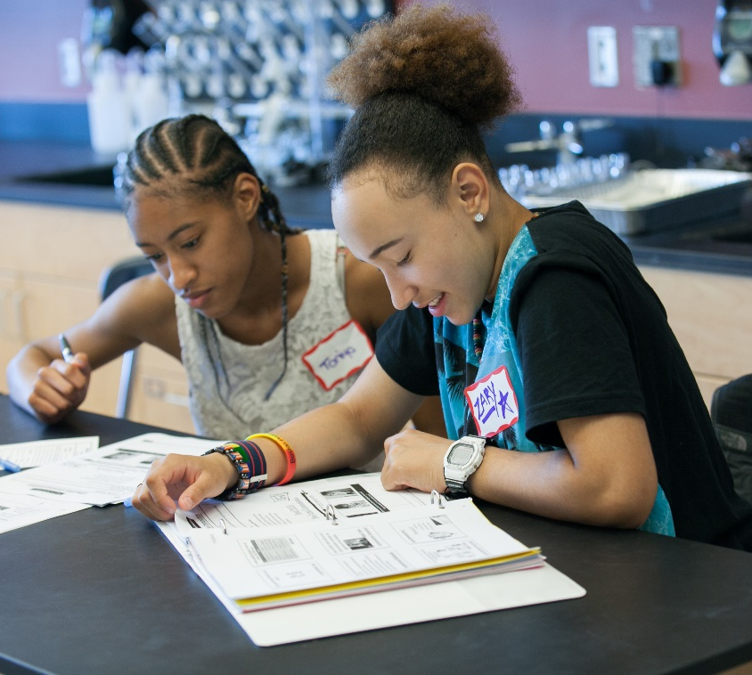
KSBA Balance
(Knowledge, Skills,
Behavior, Attitude)
Effective Soft Skill Instruction balances:
The introduction of new knowledge
Opportunities to build supporting skills
Judgment-free exploration of attitudes and examination of the role attitudes play
Ways to experiment, practice and reflect on behavior

Slide 20

Strategies & Promising Practices for serving youth and young adults with disabilities

Slide 21
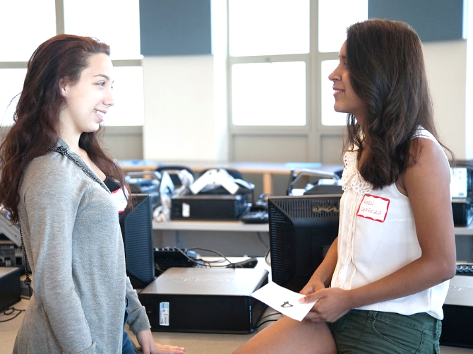
Strategy #1- Determine the right entry point for your population
Focus on which skills/ concepts have the greatest relatability and applicability first
Build in early success and work towards more challenging concepts

Slide 22
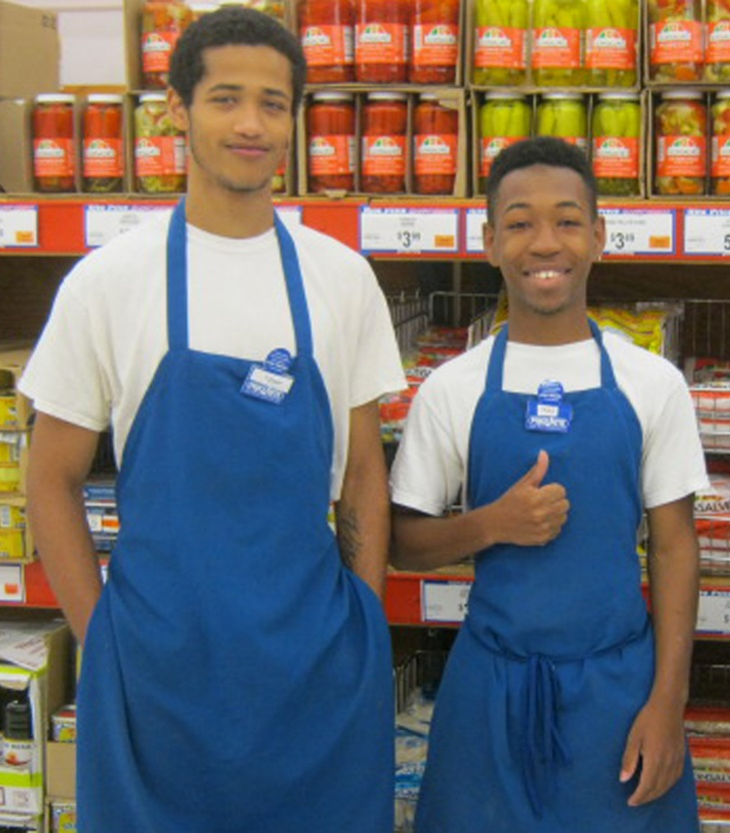
Strategy #2- Emphasize Application for Work/Community
Explore concepts like initiative, dependability, communication, advocacy in relevant work scenarios
Connect the training to workplace practice
Use practice as a way to build habits that support application of skills

Slide 23
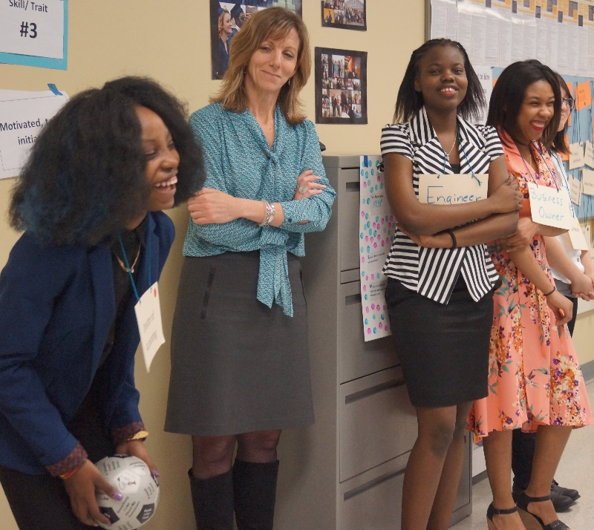
Strategy #3- Utilize Low Risk Practice to Build Skills for Employability & Independence
Work on underlying building blocks
Transition carefully toward more targeted, explicit practice
Build in self-monitoring and positive reinforcement

Slide 24
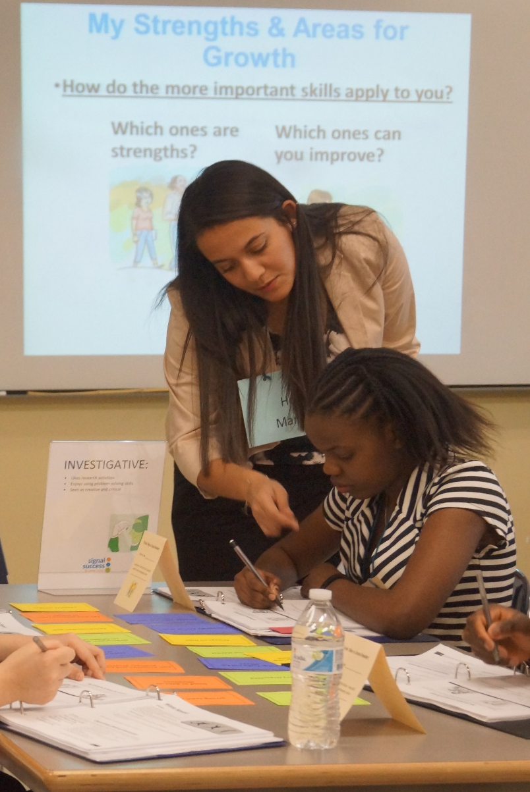
Strategy #4- Utilize Concrete and Immediate Feedback and Use a range of Assessments
Call positive attention to demonstration of target behavior in the moment
Talk about factors that contributed to success and plan for future application
Offer alternate ways to demonstrate skill gain and competency

Slide 25
Core Challenges
Meeting individual needs alongside capacity and program-level concerns
Non-linear nature of this type of skill gain
Utilizing valid, meaningful, and accessible assessments

Slide 26
During the Spring 2017 Semester Implementation at
Greater Lowell Technical HS:
86.7% of students improved at least a full level in one or more of the three core skills
80.0% of students improved at least a full level in two or more of the three core skills
40.0% of students improved at least a full level in all three core skills

Slide 27
Student Reflections on
Growth & Learning
“I used to have trouble with change, but now I can be flexible.”
“I learned to be the first to start.”
“I used to be shy, but now I can ask people if they need help”

Slide 28
Youth Initiatives in MA: Promising Practices
Work Without Limits (WWL) and the MA Business Leadership Network (MABLN)
  Disability Mentoring Day (DMD)
  Business to Higher Education (B2HE)
National Organization on Disability (NOD): Campus to Careers (C2C)
Partners for Youth with Disabilities (PYD): Campus Career Connect (C3)
Boston Public Schools: Boston Institute for Careers and Networking (Boston ICAN)

Slide 29


Disability Mentoring Day (DMD)
Friday, April 27, 2018 – 3rd Annual DMD!
Participating Employers - Eastern Bank, Federal Home Loan Bank of Boston, John Hancock, MassMutual, National Grid, TJX Companies, UMass Medical School
Purpose – Employers host students and adults with disabilities for a day of mentoring and career exploration
Mentors and Mentees encouraged to stay in touch after the event.
Mentoring is invaluable and beneficial for both the mentor and mentee, advancing career development and growth.
Mentees apply: http://www.surveygizmo.com/s3/4108898/Mentee-Application-2018

Slide 30
Business to Higher Ed (B2HE)
Goal/Purpose
Increase the number of college students and graduates who connect with MABLN companies
Progress to Date
Formed the WWL B2HE business advisory committee consisting of MABLN members
Shared college contacts; made introductions; advised on strategy and timelines
Outreached to and secured partnerships with colleges and universities; ongoing activity
Pilot event taking place on March 2, 2018

Slide 31






B2HE Employer Partners

Slide 32














B2HE College Partners

Slide 33
B2HE Pilot Recruitment Event
Date: Friday, March 2, 2018
Time: 9:00AM-1:00PM
Place: UMass Medical School, Worcester
Format:
Mock Interview & Resume Critique Sessions for Students – conducted by employer
Company overviews and recruiting 1:1 or in small groups of students
Criteria for Employer Participation:
MABLN Members Only
Have internship and entry level job opportunities for college students and recent graduates

Slide 34


Campus Career Connect (C3)
Goal/Purpose:
Improve employment outcomes for college students with disabilities
Increase employers’ commitment to disability inclusion
Include BLNs in MA, CT, ME, WY and KS
25 Mentors and 25 Mentees currently participating
Monthly webinars – resumes, interviews, disclosure, financial literacy, workplace culture and more!
Annual in-person networking event as part of WWL’s Oct. Career Fair day

Slide 35

Campus to Careers (C2C)
Goal/Purpose:
Create systemic change on campuses
Build capacity of employers and universities
Build talent pipeline for employers
Report out nationally; replicate in other parts of U.S.
Employers - Partners Healthcare, Spaulding Rehabilitation Network, Raytheon, Deloitte, Boston Children’s Hospital, PwC
Universities – Brandeis, Northeastern, Holy Cross, UMass Amherst, Dartmouth and Boston, Worcester and Westfield State
February 6, 2018 Kick Off Event held at Brandeis University
PYD to provide programming to C2C students via C3 online portal

Slide 36


Boston ICAN
Goal/Purpose:
Introduce BPS students with disabilities to a range of companies and occupations with opportunities for jobs and/or internships in the Boston area
Enable students to make professional contacts at participating companies that they can leverage as they transition from school to career
Provide participating companies the opportunity to hire qualified students or graduates into jobs or internships
Progress to Date:
Successful 2017 pilot, documentation of process, lessons learned, recommendations for improvement and replication
BPS repeating Boston ICAN in 2018 with plans to sustain it into the future
MAC and WWL consult with Somerville Public Schools to implement ICAN in Fall 2018

Slide 37







Boston ICAN Host Companies

Slide 38
Boston ICAN Pilot Outcomes
Career Choice
Pre - 53% were confident or very confident
Post - 73% were confident or very confident
What they would do after graduation?
Pre – 73% were confident or very confident
Post – 97% were confident or very confident
Do they have the skills employers are looking for?
Pre - 60% were confident or very confident
Post - 80% were confident or very confident

Slide 39

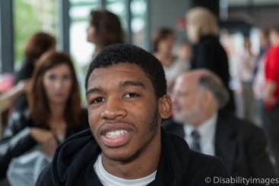

Boston ICAN Student Remarks
“By doing this program, I was able to gain confidence and believe in myself.”
“I liked how they taught me how to use my money but not use it all. And how the bank works with your money. I didn’t know that until today.”
“I learned that there are many opportunities to look forward to.”
“Working as a team and meeting new people.”
“As a result of using public transportation to and from each event, I am proud to say I am now able to travel independently on the T.”
“To be polite towards people by saying hi and introducing yourself.”
“The helpful tips on what you should and shouldn’t do in an interview.”
“I liked all the different opportunities from the different jobs.”

Slide 40
Turn and Talk
Based on what was shared today what resonated with you?
Share one challenge that you’ve had in successfully serving youth within the workforce system.
Discuss possible solutions.
How might you apply what was learned today in your efforts to assist youth with being successful in the workforce?

