Slide 1
Site Readiness Guidance Webinar
Community One Stop for Growth

Slide 2
Webinar Road Map
What is the Community One Stop for Growth?
Where does this program fit in the One Stop?
Important program parameters.
How to be competitive.
Examples of successful applications.
Completing the application.
Key dates and information.

Slide 3
What is the Community One Stop for Growth?
The Community One Stop for Growth is the main driver of economic development in the Commonwealth.
The One Stop is a single application portal and collaborative review process designed to streamline the experience for the applicant and better coordinate economic development programs and staff on engagement and grant making.

Slide 4
What is the Community One Stop for Growth?
Executive Office of Economic Development | MassDevelopment Finance Agency | Executive Office of Housing and Livable Communities
MassWorks Infrastructure Program Rural Development Fund Urban Agenda Grant Program Massachusetts Downtown Initiative | Underutilized Properties Program Site Readiness Program Collaborative Workspaces Program Brownfields Redevelopment Fund Real Estate Services Technical Assistance | HousingWorks Infrastructure Program Housing Choice Grant Program Community Planning Grants Program

Slide 5
Site Readiness Program Overview
MassDevelopment
MassDevelopment is the state’s development finance agency and land bank, working with businesses, nonprofits, banks, and municipalities to stimulate economic growth across the Commonwealth.
What We Offer
Finance
Bond Financing
Grants
Loans & Guarantees
Tax Credits
PACE Financing
The Commonwealth’s Land Bank
As a land bank, we help smaller and under-resourced communities address vacant properties; help address larger or more complex properties or projects across the state; and administer and distribute funding.
Real Estate
Development Projects
Technical Assistance
Site Readiness Program

Slide 6
Site Readiness Program Overview
Program Staff
Amanda Gregoire
Director of Site Planning
Email: agregoire@massdevelopment.com
Purpose of the program
To increase the Commonwealth’s inventory of large, well-located, project-ready sites; to accelerate private-sector investment in industrial, commercial, and mixed-use projects; and to support the conversion of abandoned sites and obsolete facilities into clean, actively used, tax-generating properties.
Who’s eligible?
Municipalities
Municipal agencies or authorities (Redevelopment Authority, Economic Development Industrial Corporation, Economic Development Authorities)
Non-profit entities

Slide 7
Where Does Site Readiness Fit in the One Stop?
Preparing for Growth |  |  | Catalyzing Specific Projects
Community Activation & Placemaking | Planning & Zoning | Site Preparation | Building | Infrastructure
Technical Assistance for Downtowns Downtown Design Consultant Services Downtown Mobility/Parking Consultant Services Downtown Wayfinding/Branding Consultant Services Economics of Downtown Consultant Services Pedestrian Orientation/Placemaking Consultant Services Small Business Support/E-commerce Consultant Services Forming a Downtown Management District Equitable Workforce and Business Development Programming Entrepreneurship and Small Business Development Workforce Development and Training Initiatives Community Organizing and Leadership Development | Community Plan Master Plan Neighborhood Plan Downtown Plan Urban Renewal Plan Housing Production Plan Regional Plan Corridor Plan Zoning Revision Zoning Revision to Comply with Section 3A of MGL c.40A Comprehensive Zoning Review & Revision Planning for Housing Housing Feasibility Plan Housing Site Master Plan Housing Infrastructure Plan Housing Site Design Plan District Redevelopment Technical Assistance Planning for Growth in a Commercial/Industrial or Mixed-Use District | Brownfield Site Clean Up Brownfields Site Assessment Brownfields Remediation Site Improvements to Unlock Development Site Readiness Pre-Construction Site Readiness Construction Municipal Surplus Property Disposition Municipal Surplus Property Disposition Study | Underutilized Property Rehabilitation Underutilized Property Pre-Construction Underutilized Property Construction Creating Collaborative Workspace Collaborative Workspace Feasibility Study Collaborative Workspace Fit-Out or Equipment Community Lead Housing Production Support Housing Production Support Housing Rehabilitation Support Housing Preservation | Public Infrastructure to Support Housing Growth (Residential Only) Pre-construction - Design / Engineering Documents Only Construction Public Infrastructure to Support Mixed-Use and Commercial/Industrial Growth Pre-construction - Design / Engineering Documents Only Construction Small Town Road Improvements to Enhance Public Safety (STRAP) Construction of Road Improvements to Enhance Public Safety

Slide 8
Project Parameters
Project Budget | Typical awards range from $50,000 to $500,000
Project Timeline Requirements | No maximum project duration, but a reasonable project timeline is required at contracting.
Eligible Use of Funds | Predevelopment and Permitting: Engineering documents, pre-permitting and permitting, pro-forma development, due diligence activities. Site Preparation: Site concept plans and feasibility studies, market analysis, site acquisition and related tasks, demolition, and construction of site related upgrades.
Funding Restrictions | Parking lots and parking structures may be ancillary to a development project, but should not be the focus of a Site Readiness application. Uses focused on the development of open space are not eligible for Site Readiness funding. Uses focused on municipal services, such as municipal campuses or buildings, are not competitive uses within the Site Readiness Program.

Slide 9
How to be Competitive
What is the key information that program reviewers take into consideration?
Community support for the proposed use type
As-of-right zoning or affirmative statement from applicant to seek as-of-right zoning
Regional impact and appropriateness
Potential level of private investment
Site access
Site control
Marketability of the site
Availability of matching funds
Are there any particularly important questions?
What is the size and scale of development proposed (the program is targeting at least 50,000 SF of developable space)?
Is this project consistent with existing municipal master plan and/or regional plans?
What attachments should applicants be prepared to include in their applications?
Site plans, building plans, parcel information, maps, photos, project budget

Slide 10
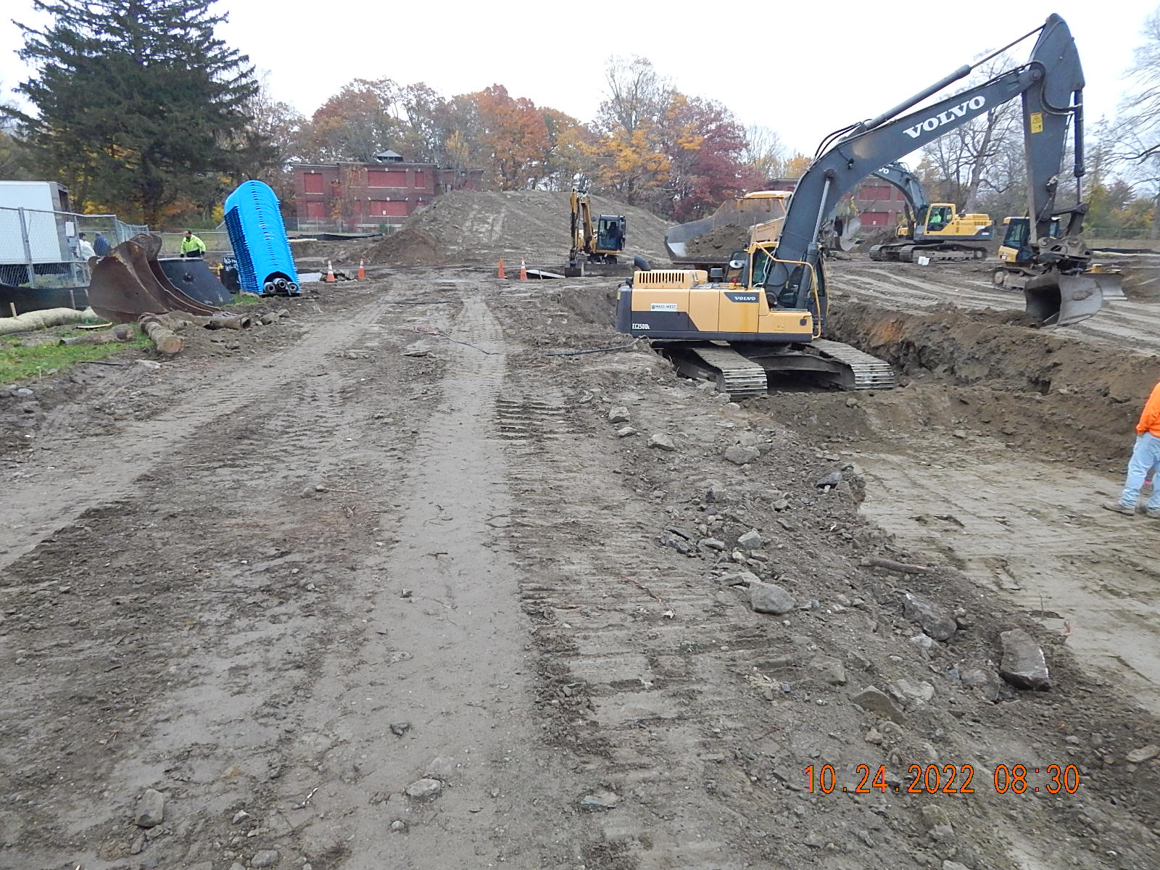
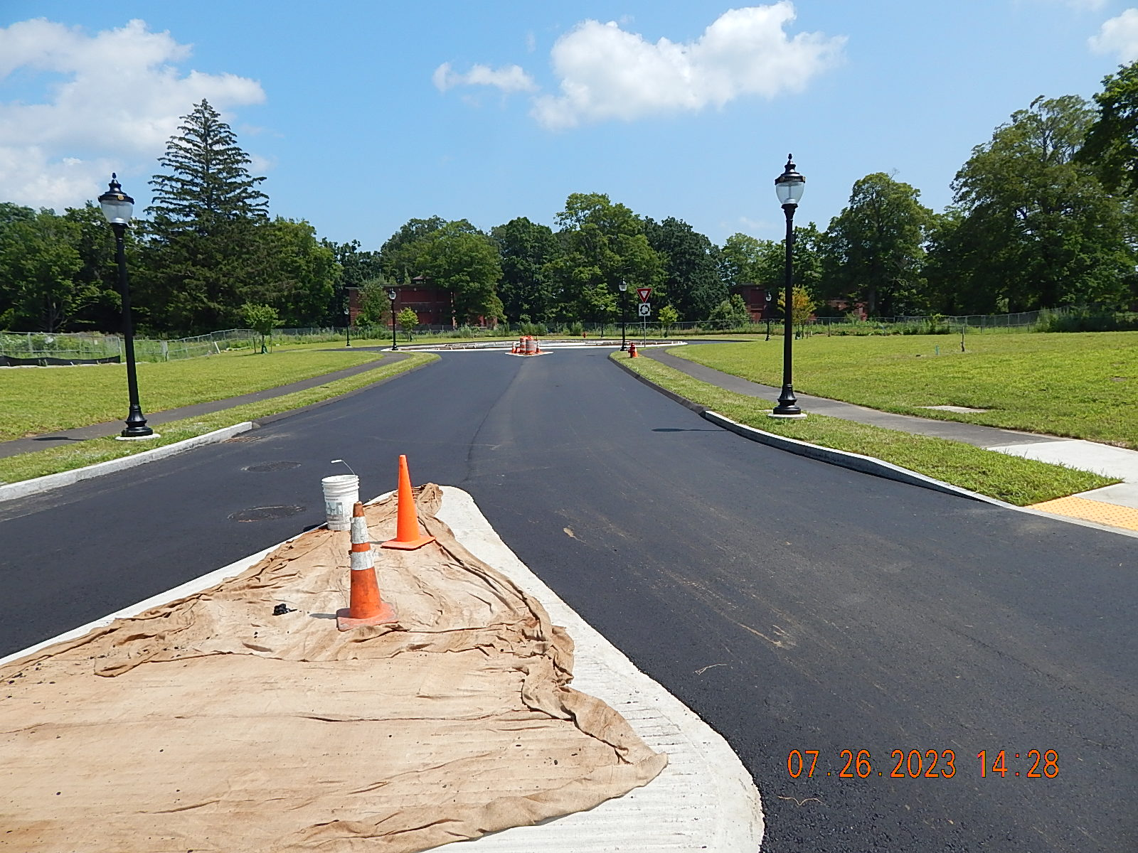
Successful Application Example #1
Applicant: | Belchertown Economic Development Industrial Corporation (BEDIC) Carriage Grove Industrial Park Infrastructure Improvements
Project description: | In 2020 the Belchertown Economic Development Industrial Corporation received a grant to support the construction of infrastructure improvements within the Carriage Grove industrial district including construction of a new roadway, sidewalks, utilities, and storm water improvements. Carriage Grove is the mixed-use redevelopment of the former Belchertown State School, which is a long-term MassDevelopment land bank project with the BEDIC and Town of Belchertown.
What made the project successful? | This funding helped leverage $550,000 from the U.S. Economic Development Agency Public Works grant program and supports 125,000 SF of future development on the 15-acre industrial district.

Slide 11
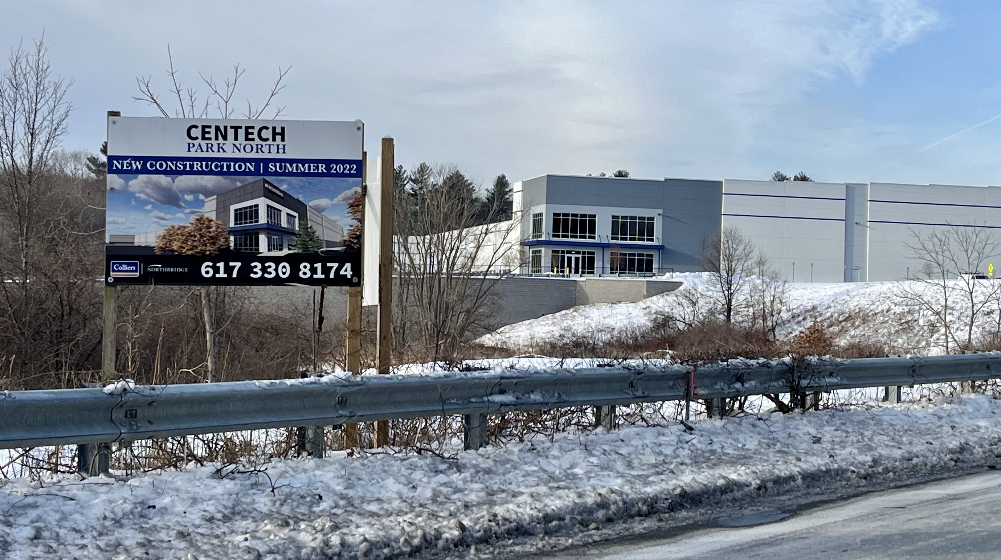
Successful Application Example #2
Applicant: | Town of Shrewsbury CenTech Park North Planning and Permitting
Project description: | The Town of Shrewsbury was awarded Site Readiness funds to carry out survey, roadway design and engineering, master planning, and Massachusetts Environmental Policy Act (MEPA) permitting for a 60-acre industrial park known as CenTech Park North. MassDevelopment staff provided technical assistance, project management and coordinated house doctors across multiple disciplines.
What made the project successful? | Project helped to ready the site and attract new private development. The campus is now complete and includes three buildings totaling roughly 310,000 square feet of logistics and office space, meeting the goals of the program.

Slide 12
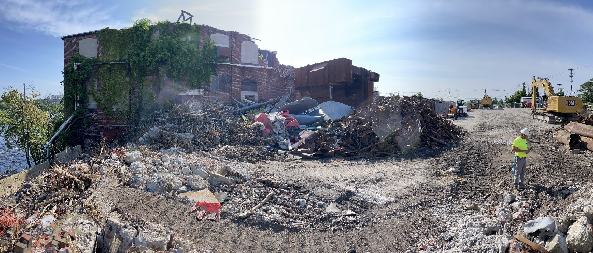
Successful Application Example #3
Applicant: | City of Lawrence Merrimac Paper Mill Demolition
Project description: | The City of Lawrence applied for Site Readiness funds to demolish a dilapidated mill complex and clean up hazardous materials in preparation for site redevelopment at the Merrimac Paper Mill. The site consisted of 18 buildings with over 1 million square feet of space across three separate parcels along the Merrimack River. Since it stopped producing paper in 2005 the vacant property deteriorated rapidly until a fire destroyed most of the remaining buildings in 2014.
What made the project successful? | This work represents a major development opportunity in Lawrence and prepares this large site for future redevelopment.

Slide 13
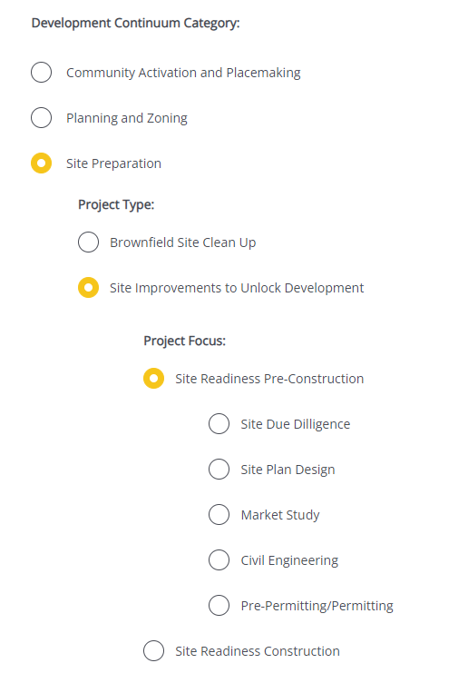
Completing the Full Application
Key Question: In Section 2 of the Full Application, applicants are asked to indicate the Project Category. To be reviewed by the Site Readiness Program in Pre-Construction, applicants should make the following selections in question 2.4:
Visit www.mass.gov/onestop to view: One Stop Webinar 2: Application Guidance
 | Site Readiness Pre-Construction Projects
Development Continuum: | Site Preparation
Project Type: | Site Improvements to Unlock Development
Project Focus: | Site Readiness Pre-Construction

Slide 14
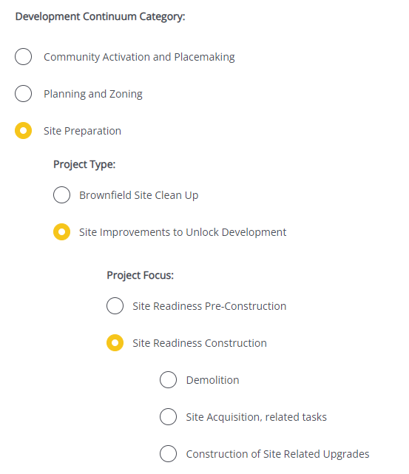
Completing the Full Application
Key Question: In Section 2 of the Full Application, applicants are asked to indicate the Project Category. To be reviewed by the Site Readiness Program in Construction, applicants should make the following selections in question 2.4:
Visit www.mass.gov/onestop to view: One Stop Webinar 2: Application Guidance
 | Site Readiness Construction Projects
Development Continuum: | Site Preparation
Project Type: | Site Improvements to Unlock Development
Project Focus: | Site Readiness Construction

Slide 15
FY25 Round Timeline
Jan.
Full Application and Expression of Interest Open (January) – The Full Application is the official form for submitting all funding requests. Applicants may now begin to work on applications in the IGX system, however applications will only be accepted during the submission period.
One Stop Guidance Phase (January – May) – A series of webinars will be hosted be both the One Stop Team and staff from each program within the One Stop. In addition, office hours will be hosted to answer applicant questions. Visit www.mass.gov/onestop for the full schedule of webinars and office hours.
Full Application Submission Period (May-June) – Applicants may submit their Full Application(s) beginning May 6, 2024. All applications must be submitted by the Full Application deadline of 11:59 p.m. on Wednesday, June 5.
Review and Evaluation (July – August) – All complete and eligible Full Applications submitted by the deadline will be reviewed and evaluated by the corresponding program managers at each state agency. The One Stop team will also conduct joint application reviews across agencies. Based on the program’s criteria, each program will prepare its list of applications recommended for funding, to be further reviewed and approved by agency and Secretariat leadership.
Notification of Grant Decisions (September) – Once final recommendation have been approved, applicants will be notified of grant decisions in writing, and announcement events will be scheduled.
Sept.

Slide 16
Opportunities for Guidance
Visit www.mass.gov/onestop for more information on:
Expression of Interest
Complete an Expression of Interest to see if your project(s) is eligible for funding through the One Stop and get tips for preparing your application.
One Stop and Program Webinars
Recordings of all One Stop webinars are now available on the One Stop website.
Office Hours
One Stop General Guidance Office Hours – One Stop staff will hold office hours to discuss general One Stop process and technology questions.
Program Office Hours – Staff from each program will hold an office hour to answer applicant questions related to the program.
Office hours: Wednesday, March 6th at 10AM

