Slide 1
Moving from MOLST to POLST in Massachusetts in 2024: Five things to know right now
April 2023
Notes:
Welcome to this brief overview of what's happening with the POLST form. In 2024, POLST will officially be arriving to Massachusetts. In the meantime, we wanted to make sure you were aware of some important things…. Including clinical test phase in 2 sites.
As you know, POLST stands for ‘Portable Order for Life Sustaining Treatment.’ POLST has some differences and similarities to the MOLST

Slide 2
1. Massachusetts is transitioning to the POLST in 2024
Alignment with National POLST
More unified system transferable across states and across care settings
More consistent & reliable system to ensure patient wishes respected, wherever treated
Notes:
There are a number of reasons why we are transitioning to the POLST--after over a decade of utilizing the MOLST form
Many states have already adopted POLST; the Commonwealth wants to align with national standards and best practices
POLST ensures that patient wishes are honored but does so within a unified system that is transferable across state lines.
For example, any MA resident who may need a POLST while traveling to one of these states can still have their wishes honored, whereas if they only had a MOLST, the document could only be enforced within the borders of Massachusetts
Transitioning to the POLST form will allow Massachusetts to have a more consistent and reliable system for ensuring that patient wishes are respected, regardless of where they may receive treatment.

Slide 3
2. The POLST form has similarities (and some differences) to the MOLST
It is a part of advance care planning process
It allows seriously ill patients to identify the treatment desired under specific circumstances
It is a medical order for use between care settings
Its decisions reached through “Goals of Care” Conversations
Notes:
POLST stands for ‘Portable Order for Life Sustaining Treatment.’ The first thing we want to know is about the similarities and differences between MOLST and POLST.
The 4 critical aspects of POLST are what we WERE ALREADY DOING with MOLST in the state, as shown on this slide.
Just like MOLST, a POLST Form is a part of the advance care planning process. When completed, it is a medical order that conveys specific decisions concerning medical care for seriously ill patients that must be honored by healthcare professionals across the care continuum. Through a properly filled and signed POLST Form, a seriously ill patient can identify which course of treatment they desire under specific circumstances.
These decisions are reached through a series of Goals of Care (POLST) Conversations between the patient, the patient’s family, medical professionals, and, in the case where the patient is not in a sufficient decision-making capacity, the patient’s healthcare proxy. As you know, the ultimate goal of this conversation is to document the patient’s wishes for medical treatment in a form that will be honored by all healthcare professionals.
.

Slide 4
Can be signed electronically
No pink paper
No Transport/ Do Not Transport choices
No intubation or ventilation patient choices
2. The POLST form has similarities (and some differences) to the MOLST
Notes:
Ultimately its aims are similar to the MOLST form you are familiar with---while there are many similarities between the two forms, there are also some key differences:
Can be signed electronically
No pink paper (WHY? we heard it couldn’t be easily copied or scanned)
No expiration date
Has additional patient identifiers
No Intubation or Ventilation patient choices
No Transport/Do Not Transport patient choices
We will take just a quick look at the POLST form now

Slide 5
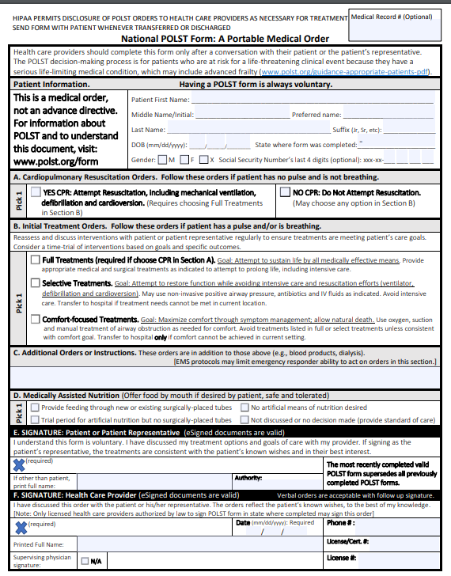
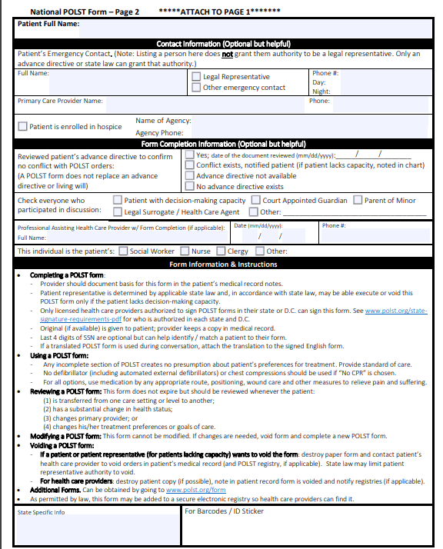
Notes:
This is what the POLST form looks like– we want to just highlight two important differences shown here in the pink boxes
A and B are dependent on each other
C and D are optional depending on patient’s situation
Regardless of your location, if you see a POLST, it must be honored; as we are entering a test phase in 2023 in 2 communities.

Slide 6
Massachusetts POLST program
Establish POLST as integral part of care planning continuum across the state
Support effective care planning conversations for people with serious illness and advancing frailty
Ensure clear, reliable documentation about the program
Improve integration across all care settings
Align with national standards and best practices
Continually improve the program
Notes:
The mission of the Massuchetts POLST program is to help people living with serious illnesses and advancing frailty engage in active planning with their clinicians and care teams to ensure that their treatment preferences are understood and honored, regardless of their point of care. The goals are as follows
Establish POLST as an integral part of care planning continuum across the state. This transition to POLST will enhance our ability to help those with serious illnesses ensure that their wished are honored.
Support effective care planning conversations for people with serious illness and advancing frailty: We want to make sure that all clinical staff have all the tools they need to have effective, compassionate, and thorough conversations with patients who are eligible for POLST.
Ensure clear, reliable documentation about the program: We want to ensure that all the components of the program are well documented and easily referenceable.
Improve integration across all care settings: One of the drawbacks of the current MOLST program is the difficulty of ensuring that the MOLST is honored across care settings. Having a paper-based system adds a level of complexity, which will be eliminated by transitioning to an ePOLST Registry in 2024. The statewide ePOLST registry will minimize paper-processes, improve interoperability, enable reporting and continuous quality improvement, and provide credential-based access to all users of the system ranging from clinicians to patients and patient healthcare proxies.
Align with national standards and best practices: At the national level, we have been learning about best practices to honor end-of-life treatment decisions. We plan to adopt the learnings and best practices as we proceed in MA. With so many states moving to POLST, transitioning the Commonwealth to POLST will facilitate the honoring of patient wishes not just within Massachusetts, but also across state lines.
Continually improve the program. This transition process is inherently iterative, and our goal is to continuously improve the process within the state and implement any new learnings as we proceed.

Slide 7
3. We are testing the use of the POLST in 2023
Fairview Hospital (Great Barrington)
Cooley-Dickinson (Northampton)
Each is working with
one skilled facility,
an EMS provider and
a specialty outpatient referral practice
Notes:
.

Slide 8
Clinical Test Sites
Fairview Hospital (Great Barrington)
Cooley-Dickinson (Northampton)

Slide 9
4. Starting in June 2023, you may see a POLST form
It is important that it be honored as you would a MOLST
Other than the clinical test sites, no other locations are issuing POLST forms
Notes:
Your facility may see a POLST from a patient who received care within the testing cohort system. It must be honored as you would a MOLST

Slide 10
ePOLST Statewide Registry
Integration with EMR
New regulations will be developed
Sunset of MOLST in 2026
Training will be available
5. Statewide changes are coming in 2024
Notes:
Until 2024, there are no changes to MOLST, so you do not have to be concerned right now We are excited to preview these 5 elements of the POLST program that will be rolled out next year.
1 and 2 The state is now developing ePOLST registry, streamlining operational and clinical processes around POLST, and ultimately ensuring that patients’ wishes are being honored accurately and consistently across the Commonwealth.
The statewide ePOLST registry which will minimize paper-processes, improve interoperability, enable reporting and continuous quality improvement, and provide credential-based access to all users of the system ranging from clinicians to patients and patient healthcare proxies.
3. As a part of this work, we are going to draft regulations and get public comment on them, before they become Final. These regulations will provide clear direction to health care institutions across the State
4. There will be training and training materials available to support sites in implementation
5. Once the ePOLST is launched, both MOLST and POLST forms will be acceptable. There will be an 18 month “sunset” period for paper MOLSTS and POLSTs.

Slide 11
MOLST to POLST in Massachusetts: Schedule
Spring- Summer 2023
Test sites start implementing POLST in their communities
EOEA selects vendor for ePOLST registry
Fall 2023
EOEA begins developing regulations for statewide use of POLST
EOEA evaluates test sites implementation
Winter 2023- Spring 2024
EOEA begins testing ePOLST registry
Summer 2024
State regulations released
EOEA launches ePOLST registry
EOEA and partners launch ePOLST education and outreach
Notes:
Here is a high level plan of the process

Slide 12
Questions?
Massachusetts MOLST-to-POLST Transition website https://www.mass.gov/molst-to-polst-transition
Massachusetts Executive Office of Elder Affairs Call Center
844 -771-1629
POLSTSupport@uhealthsolutions.org

