Slide 1
Municipal ADA Improvement Grant Program
April 11, 2024
Presented by:
Evan George, Grant Compliance Coordinator

Slide 2
Massachusetts Office on Disability
The Massachusetts Office on Disability (MOD) provides information, guidance, and training on disability-related civil rights and obligations.
We help people with disabilities understand their rights and opportunities to improve access.
We also help cities, towns, places that serve the public, and state government agencies understand their accessibility obligations.

Slide 3
Agenda
Grant Overview
Planning grants
Project grants
Tips to improve your score
Q&A

Slide 4
Overview
Municipal ADA Improvement Grant Program

Slide 5
What is the ADA Improvement Grant?
Reimbursement funding to municipalities for:
City-wide accessibility planning (ADA Self-Evaluation and/or Transition Plans) or
Individual projects to remove architectural or communication barriers

Slide 6
Eligibility
Eligible:
Massachusetts municipalities
Municipally owned properties
Not eligible:
Private businesses, private property, non-profit organizations, private homes, or other non-municipal properties
Items such as, but not limited to: design plans, feasibility studies, and applicant salaries

Slide 7
Program overview
Maximum Grant Award: $250,000
Grants can (but do not have to be) matching
Can be applied by any employee
Invoices must be dated after contract is signed and before June 30th, 2025
Be a member (or in process) of the Community Compact Cabinet (CCC)

Slide 8
Important dates: FY25 grant 1 of 2
May 1 – June 14, 2024
Fall 2024
Executive Office of Administration and Finance
Online application open
July - August 2024
Late Fall 2024
Review process begins:
Grant Selection Committee
FY24 Grant contracts issued to awarded communities

Slide 9
Types of grants
Planning grants
Project grants
These grants are for updating or creating a Self-Evaluation and/or Transition Plan as required under the Administrative Requirements of Title II of the ADA
These grants are for removal of architectural or communication barriers or physical/communication access improvements
Only municipal properties or municipally owned facilities are eligible

Slide 10
FY24 Grant metrics
Applications Received: 118
Applications Approved: 62
Total Amount Requested: $11.7 million
Total Amount Rewarded: $3.9 million

Slide 11
Planning grants
Creating or updating ADA Self-Evaluation or Transition Plans

Slide 12
Planning grants: Required documentation
Planning grants require the following supporting documentation at the time of application submission:
Designation of a Responsible Employee (ADA Coordinator)
Notice of Non-Discrimination and proof of posting
An ADA Grievance Procedure
Must be part of Community Compact Cabinet (CCC)

Slide 13
Resources: Title II compliance
ADAActionGuide.org
Documents, forms, how to create a grievance procedure, etc.
mass.gov/MOD
https://www.mass.gov/aab-rules-and-regulations

Slide 14
Planning grant application

Slide 15
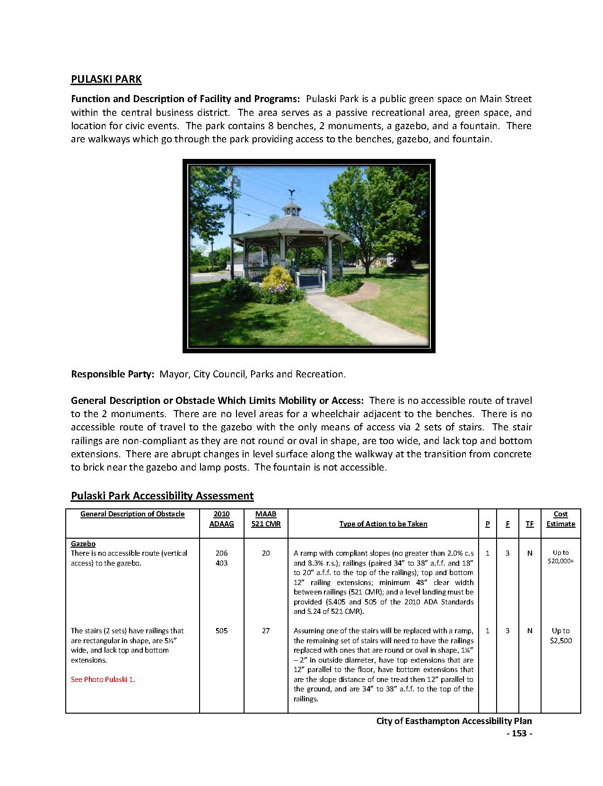
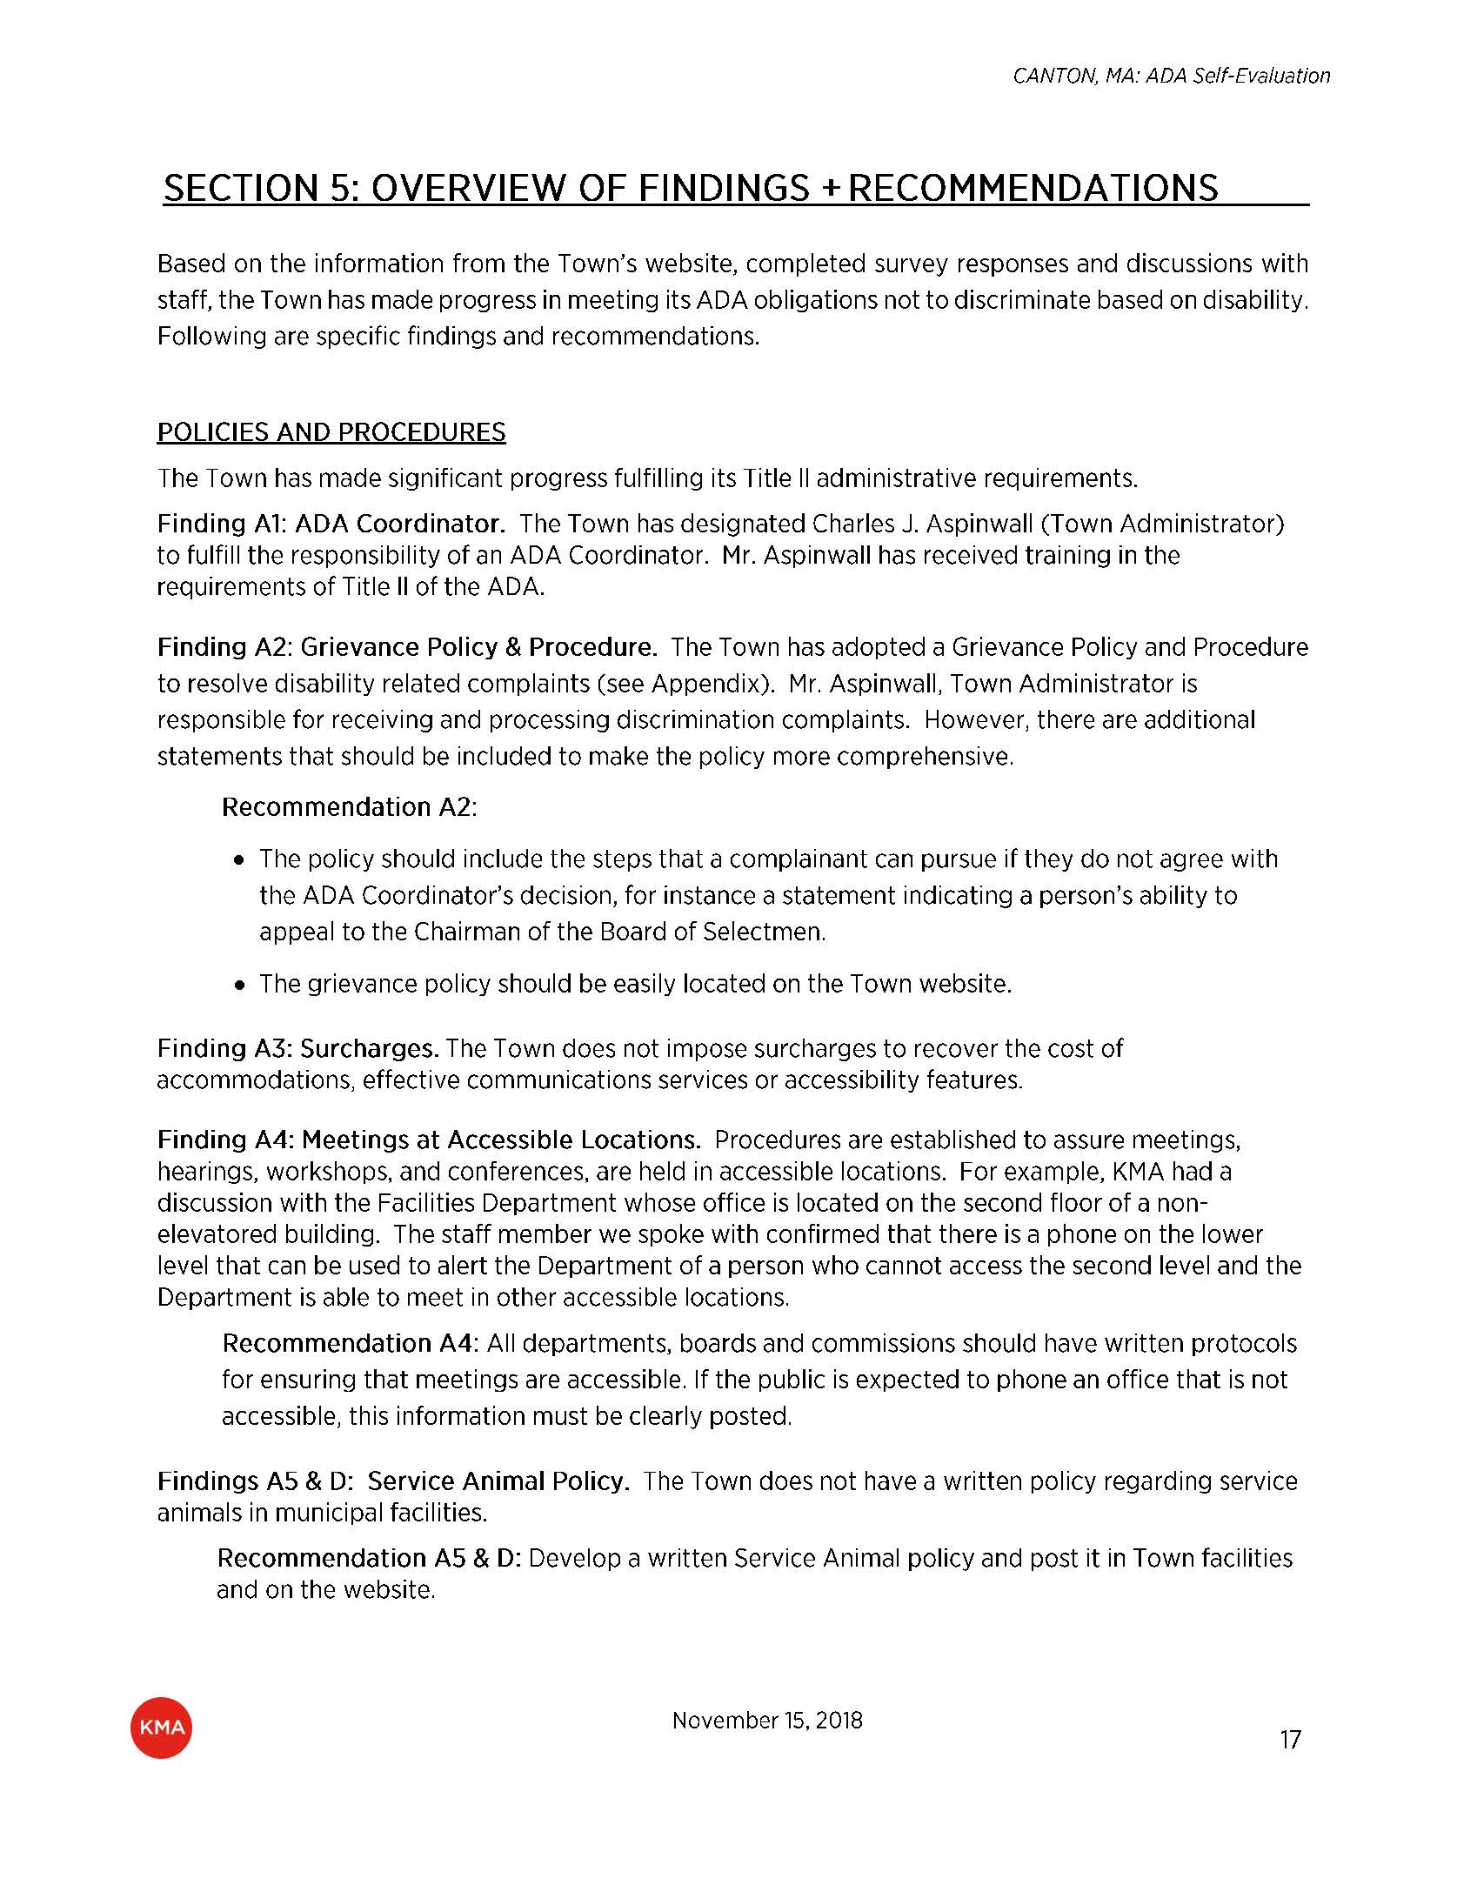
Former planning grants

Slide 16
Project grants
Removing architectural and communication barriers at municipal facilities

Slide 17
Project grants: Required documentation
Same as planning grant, plus:
Self-Evaluation Plan
Transition Plan

Slide 18
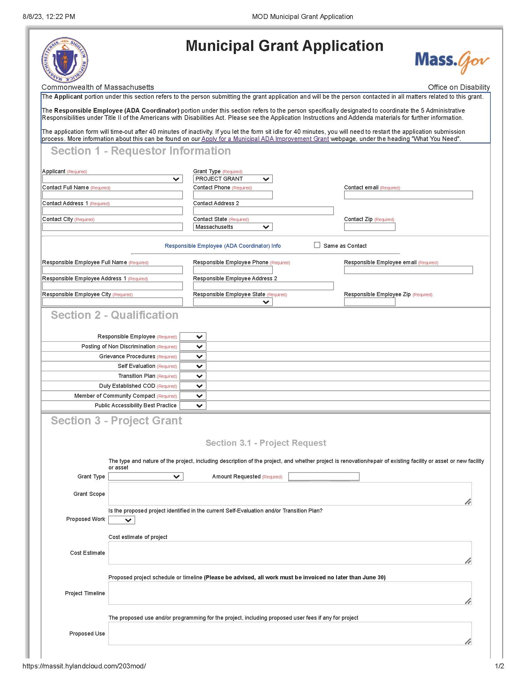
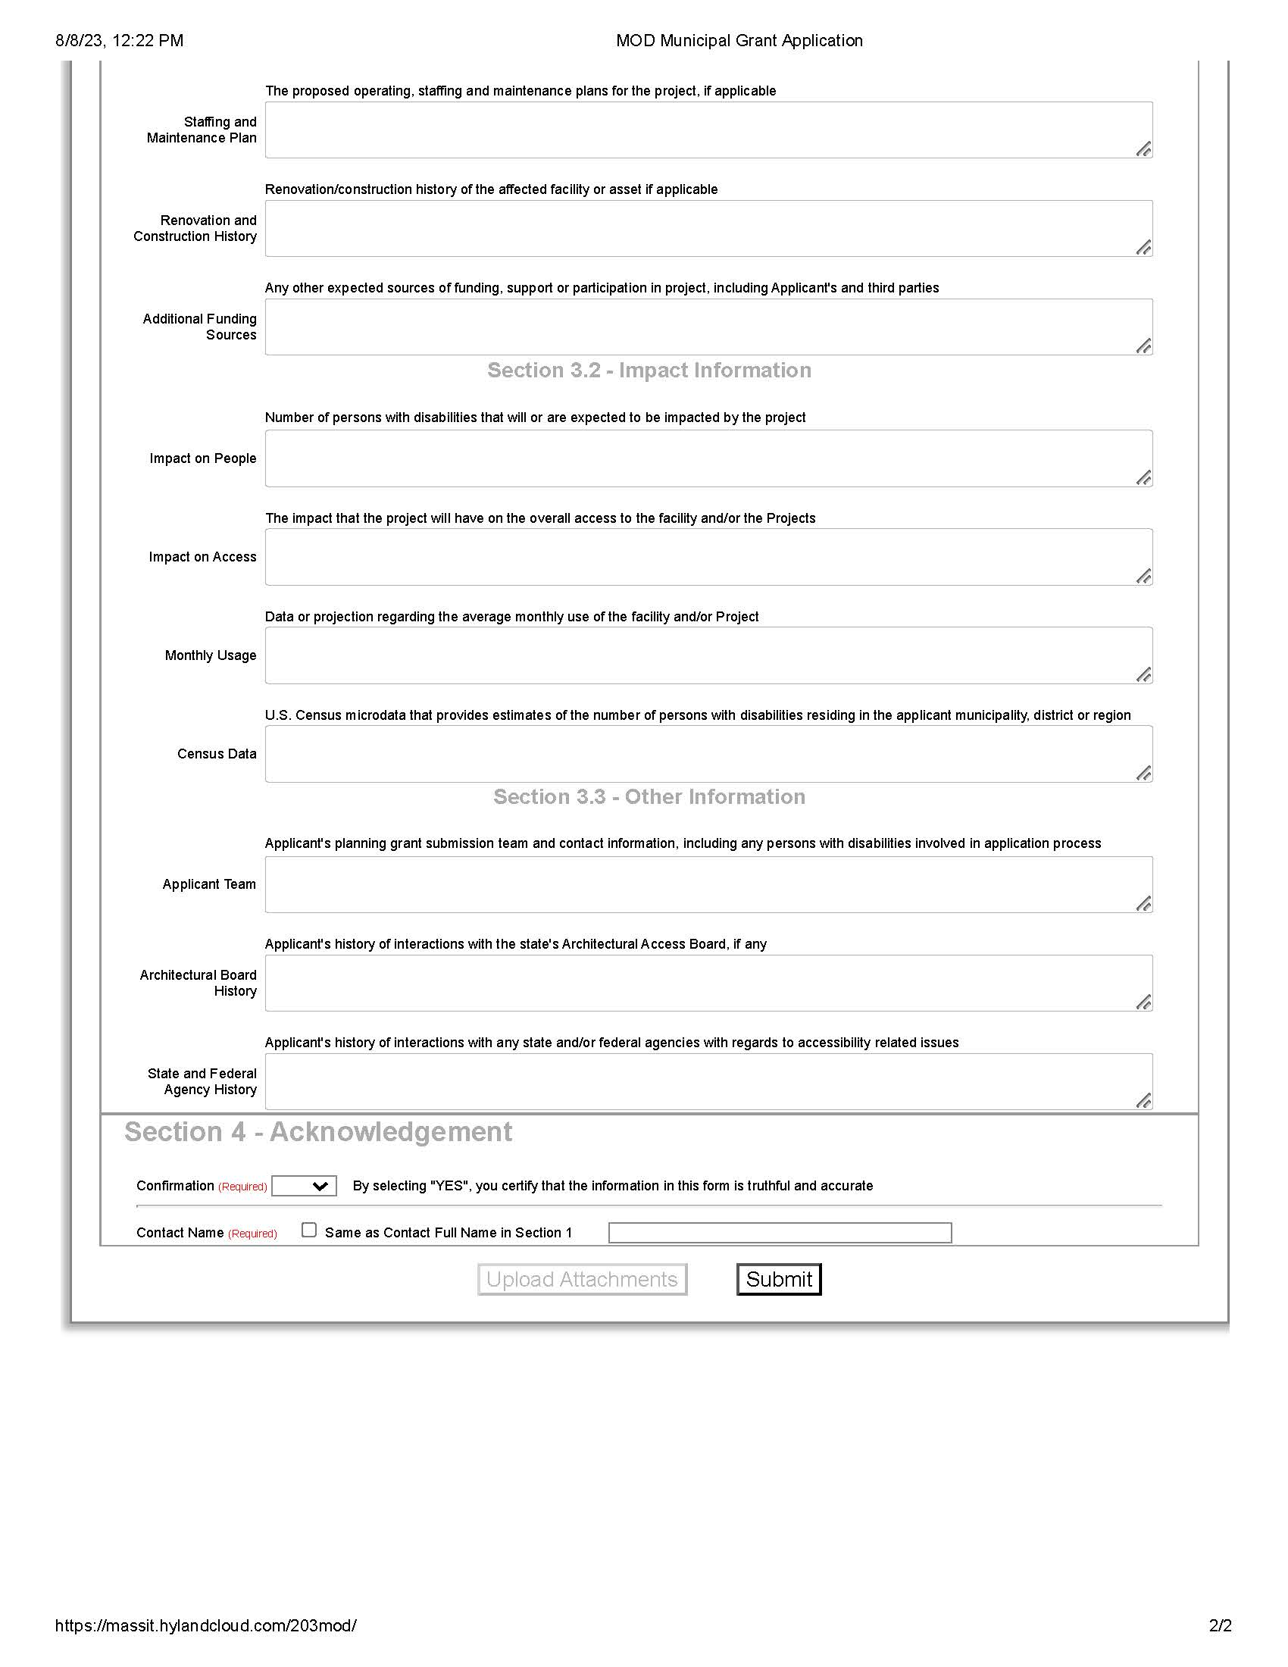
Project grant application

Slide 19
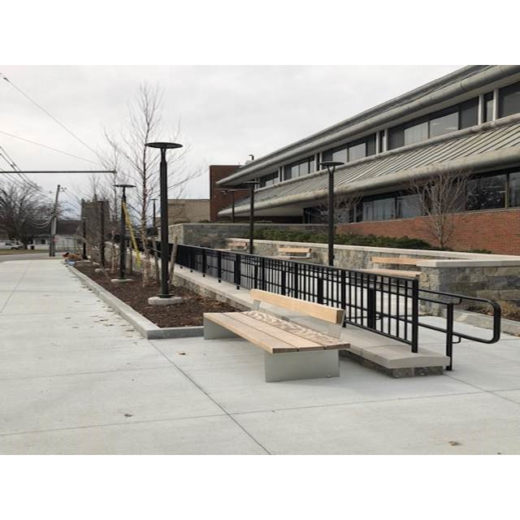
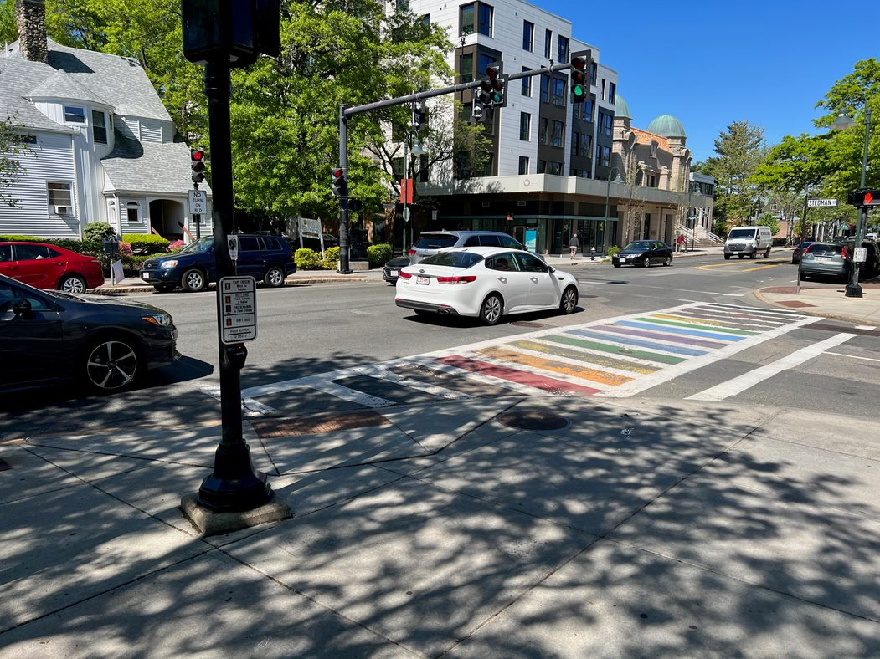
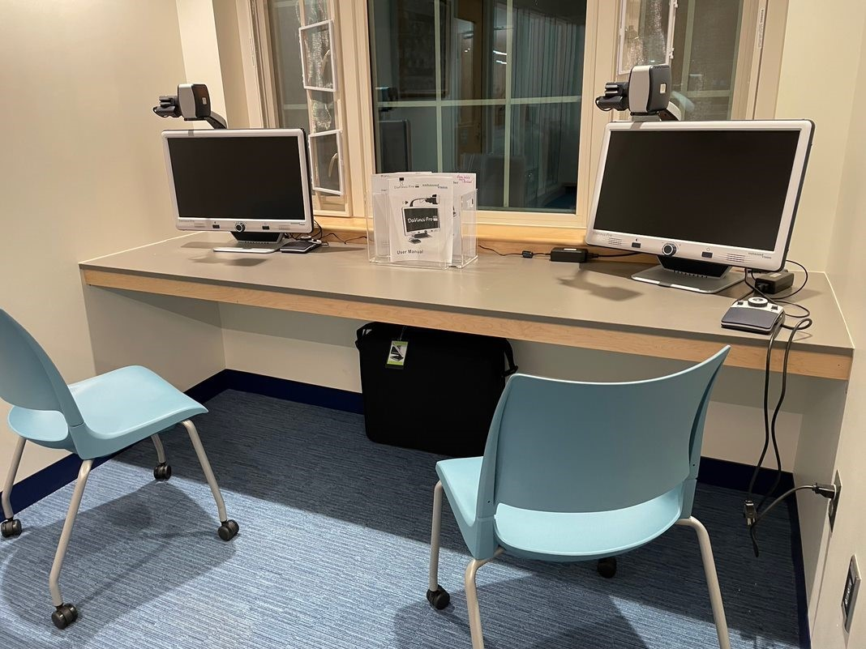
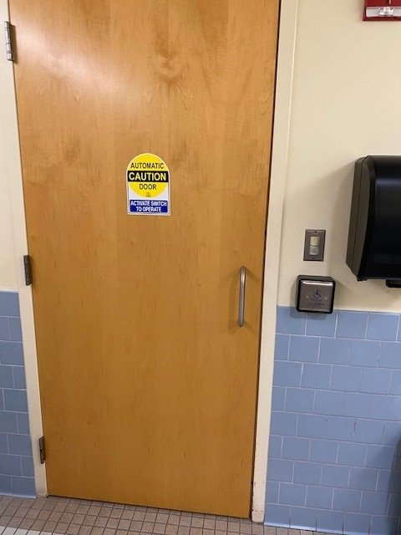
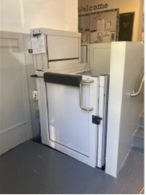
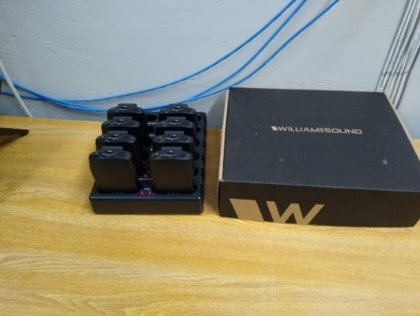
Former project grants

Slide 20
Submission tips
Once you click “Submit”, do not exit the page prior to receiving the application submission confirmation pop-up.
You will receive an email within 15 minutes confirming your application submission was received. Do not reply to the email. If you received both the confirmation screen and email, your application was successfully completed.
If you did NOT receive a confirmation email or see the appropriate screens mentioned above, your submission was unsuccessful, and you will need to resubmit.

Slide 21
Tips to improve your score

Slide 22
Top 3 tips to improve your score
1
2
3
Submit multiple project grants
CCC: Public accessibility best practice
Establish a Commission on Disability

Slide 23
Community Compact Cabinet (CCC)
mass.gov/best-practices-program
Voluntary, mutual agreement entered into between the Healey-Driscoll Administration and individual cities and towns of the Commonwealth
Option to select Public Accessibility Best Practice

Slide 24
Resources for Commissions on Disability (CODs)
mass.gov/MOD/COD
Email mod-communications@mass.gov to update your COD contact info with MOD

Slide 25
Important dates: FY25 grant 2 of 2
May 1 – June 14, 2024
Fall 2024
Executive Office of Administration and Finance
Online application open
July - August 2024
Late Fall 2024
Review process begins:
Grant Selection Committee
FY24 Grant contracts issued to awarded communities

Slide 26
Contact MOD
Evan George​
Grant Compliance Coordinator​
Office: 617-727-7440 ext. 27313
Cell: 857-248-7924​
Email: Evan.George@mass.gov​
Website: mass.gov/MOD

Slide 27
Q&A

