Slide 1
Massachusetts HIV Epidemiologic Profile: Data as of 1/1/2022 Population Report: Adolescents and Young Adults
Suggested citation:
Massachusetts Department of Public Health, Bureau of Infectious Disease and Laboratory Sciences. Massachusetts HIV Epidemiologic Profile: Data as of 1/1/2022, Population Report: Adolescents and Young Adults, https://www.mass.gov/lists/hivaids-epidemiologic-profiles Published April 2023. Accessed [date].
Bureau of Infectious Disease and Laboratory Sciences Massachusetts Department of Public Health
Jamaica Plain Campus/State Public Health Laboratory
305 South Street Jamaica Plain, MA 02130
Questions about this report
Tel: (617) 983-6560
To reach the Reporting and Partner Services Line*
Tel: (617) 983-6999
To speak to the on-call epidemiologist
Tel: (617) 983-6800
Questions about infectious disease reporting
Tel: (617) 983-6801
Requests for additional data
https://www.mass.gov/lists/infectious-disease-data-reports-and-requests
Slide sets for HIV Epidemiologic Profile Reports
https://www.mass.gov/lists/hivaids-epidemiologic-profiles
*Providers may use this number to report individuals newly diagnosed with a notifiable sexually transmitted infection, including HIV, or request partner services. Partner services is a free and confidential service for individuals recently diagnosed with a priority infection. The client-centered program offers counseling, linkage to other health and social services, anonymous notification of partners who were exposed and assistance with getting testing and treatment. For more information, see: https://www.mass.gov/service-details/partner-services-program-information-for-healthcare-providers)
Notes:
Massachusetts HIV Epidemiologic Profile:
Data as of 1/1/2022
Population Report: Adolescents and Young Adults
Suggested citation:
Massachusetts Department of Public Health, Bureau of Infectious Disease and Laboratory Sciences. Massachusetts HIV Epidemiologic Profile: Data as of 1/1/2022, Population Report: Adolescents and Young Adults, https://www.mass.gov/lists/hivaids-epidemiologic-profiles Published April 2023. Accessed [date].
Bureau of Infectious Disease and Laboratory Sciences Massachusetts Department of Public Health
Jamaica Plain Campus/State Public Health Laboratory
305 South Street Jamaica Plain, MA 02130
Questions about this report
Tel: (617) 983-6560
To reach the Reporting and Partner Services Line*
Tel: (617) 983-6999
To speak to the on-call epidemiologist
Tel: (617) 983-6800
Questions about infectious disease reporting
Tel: (617) 983-6801
Requests for additional data
https://www.mass.gov/lists/infectious-disease-data-reports-and-requests
Slide sets for HIV Epidemiologic Profile Reports
https://www.mass.gov/lists/hivaids-epidemiologic-profiles
*Providers may use this number to report individuals newly diagnosed with a notifiable sexually transmitted infection, including HIV, or request partner services. Partner services is a free and confidential service for individuals recently diagnosed with a priority infection. The client-centered program offers counseling, linkage to other health and social services, anonymous notification of partners who were exposed and assistance with getting testing and treatment. For more information, see: https://www.mass.gov/service-details/partner-services-program-information-for-healthcare-providers)

Slide 2
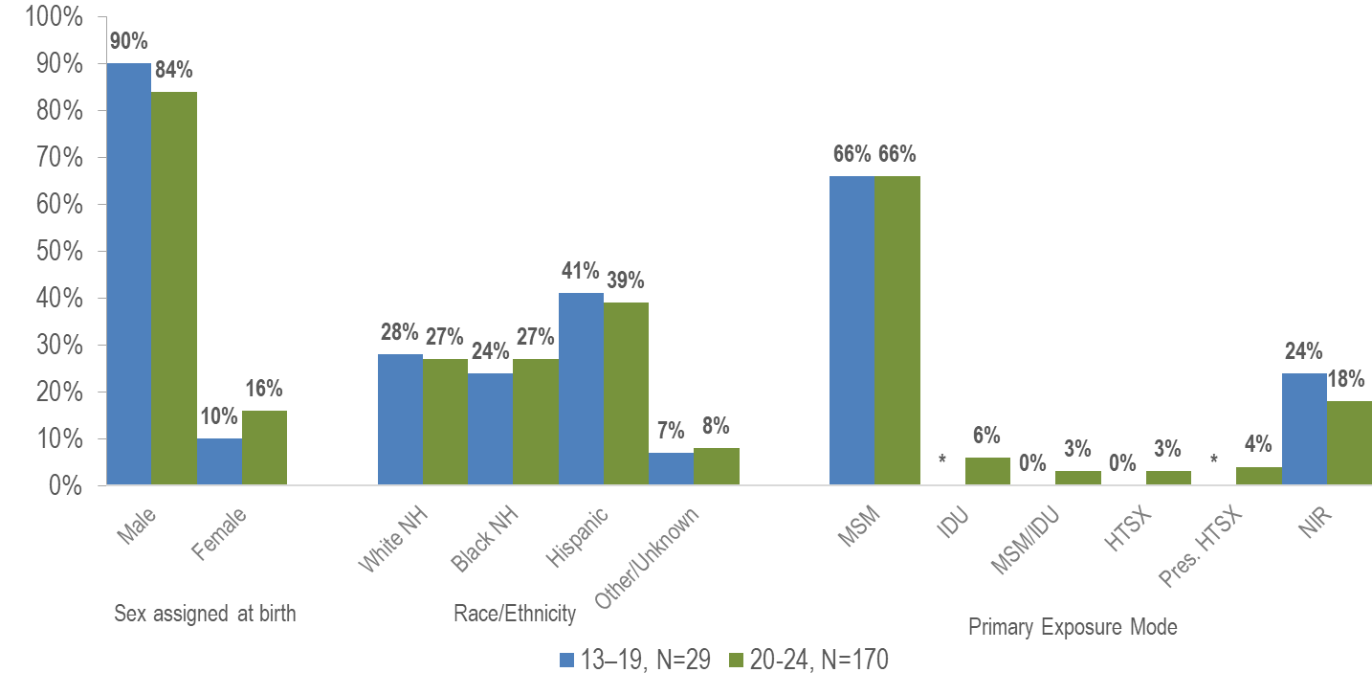
Individuals diagnosed with HIV infection at age 13–19 years vs. 20–24 years by sex assigned at birth, race/ethnicity, and exposure mode, Massachusetts 2018–2020*
* Values less than five are suppressed for populations less than 50,000 or for populations of unknown size. MSM=male-to-male sex; IDU=injection drug use; HTSX=heterosexual sex; Pres. HTSX=presumed heterosexual exposure, includes individuals assigned female at birth with a negative history of injection drug use who report having sex with an individual that identifies as male of unknown HIV status and risk; NIR=no identified risk
Data Source: MDPH Bureau of Infectious Disease and Laboratory Sciences, data are current as of 1/1/2022 *Please consider the impact of the COVID-19 pandemic on infectious disease screening, treatment, and surveillance in the interpretation of 2020 data.
Notes:
Among adolescents and young adults (aged 13–24 years) recently diagnosed with HIV infection (2018–2020), 85% (N=170) were 20 to 24 years of age and 15% (N=29) were 13 to 19 years of age. Additionally, 4% (N=8) were considered minors (under 18 years of age) and 96% (N=191) were 18 years of age or older.
A larger proportion of youth diagnosed with HIV infection at age 13–19 years than at age 20–24 years was assigned male at birth (90% vs. 84%), and a smaller proportion was assigned female at birth (10% vs. 16%).
The distribution by race/ethnicity was similar for youth recently diagnosed with HIV infection at age 13–19 years and those diagnosed at age 20–24 years.
The proportion of youth recently diagnosed with HIV infection at age 13–19 years with no identified risk for HIV exposure mode (24%) was greater than that among youth diagnosed at age 20–24 years (18%).

Slide 3
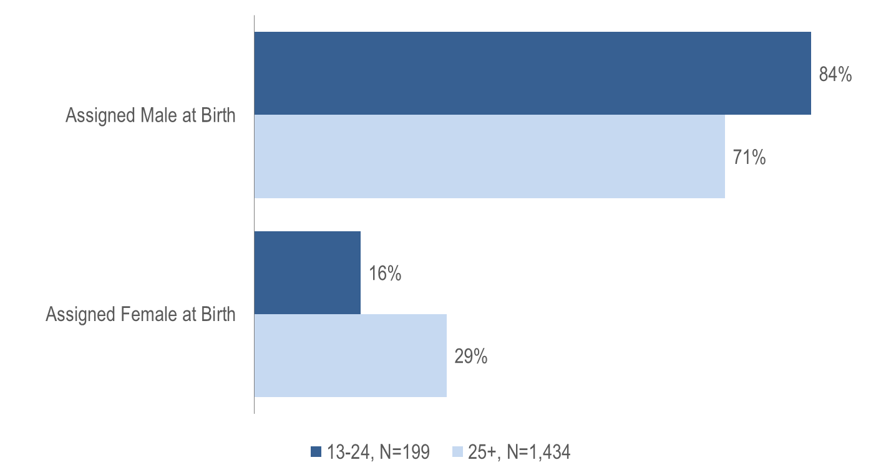
HIV infection diagnoses by age at HIV diagnosis and sex assigned at birth, Massachusetts 2018–2020*
Data Source: MDPH Bureau of Infectious Disease and Laboratory Sciences, data are current as of 1/1/2022
*Please consider the impact of the COVID-19 pandemic on infectious disease screening, treatment, and surveillance in the interpretation of 2020 data.
Notes:
A larger proportion of adolescents and young adults recently diagnosed with HIV infection at age 13–24 years (84%) than at age 25 years and older (71%) was assigned male at birth (AMAB).

Slide 4
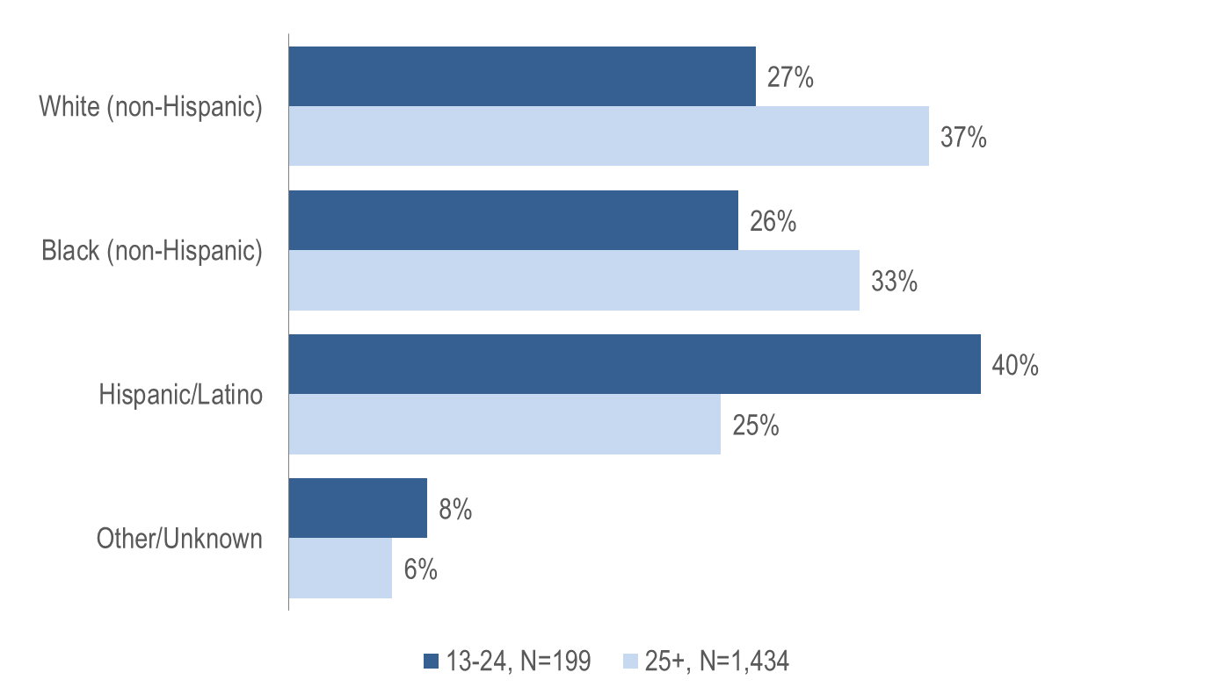
HIV infection diagnoses by age at HIV diagnosis and race/ethnicity, Massachusetts 2018–2020*
Data Source: MDPH Bureau of Infectious Disease and Laboratory Sciences, data are current as of 1/1/2022
*Please consider the impact of the COVID-19 pandemic on infectious disease screening, treatment, and surveillance in the interpretation of 2020 data.
Notes:
While the largest proportion of adolescents and young adults recently diagnosed with HIV infection at age 13–24 years was Hispanic/Latino (40%), the largest proportion of individuals recently diagnosed at age 25 years and older was white (non-Hispanic) (37%).

Slide 5
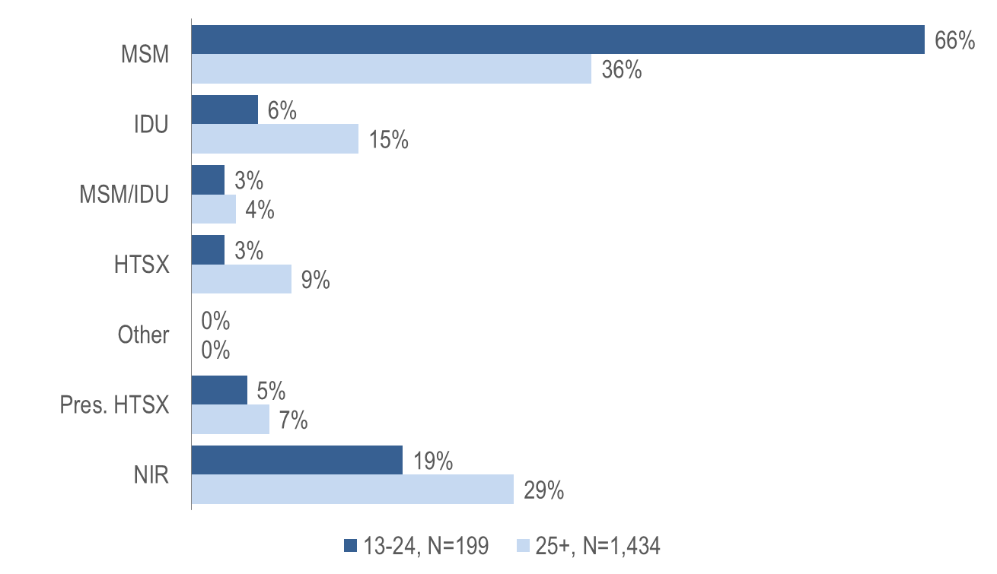
HIV infection diagnoses by age at HIV diagnosis and exposure mode, Massachusetts 2018–2020*
MSM=male-to-male sex; IDU=injection drug use; HTSX=heterosexual sex; Pres. HTSX=presumed heterosexual exposure, includes individuals assigned female at birth with a negative history of injection drug use who report having sex with an individual that identifies as male of unknown HIV status and risk; NIR=no identified risk; Data Source: MDPH Bureau of Infectious Disease and Laboratory Sciences, data are current as of 1/1/2022
*Please consider the impact of the COVID-19 pandemic on infectious disease screening, treatment, and surveillance in the interpretation of 2020 data.
Notes:
KEY FINDING
A larger proportion of individuals recently diagnosed with HIV infection at age 13–24 years (66%) than at age 25 years and older (36%) had MSM exposure mode.

Slide 6
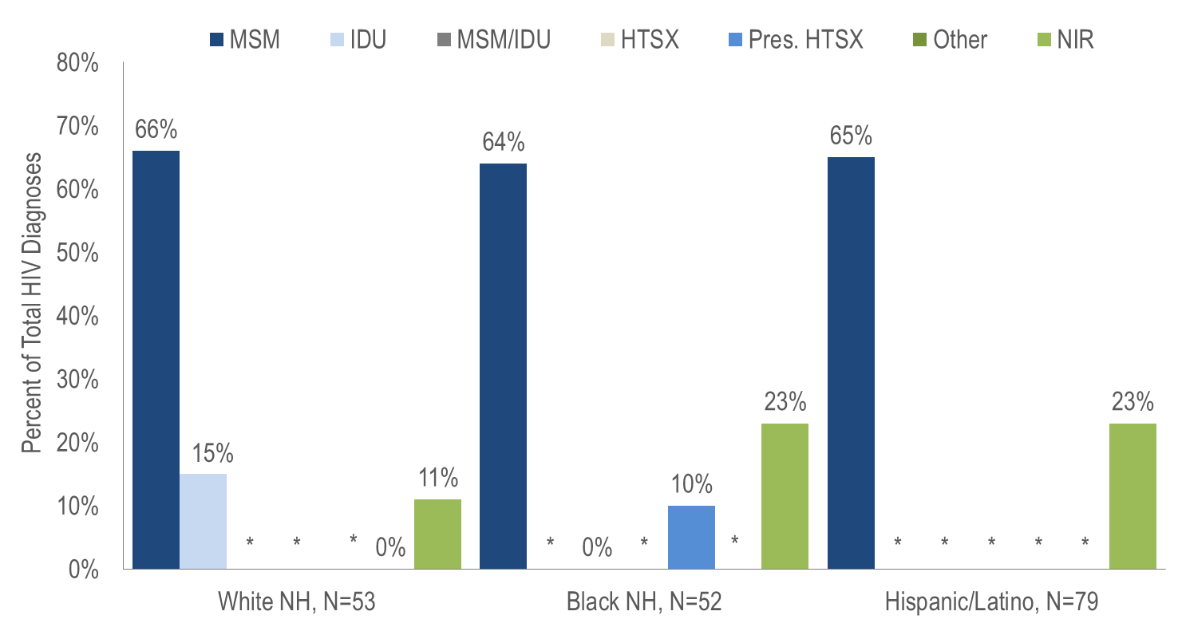
HIV infection diagnoses among individuals aged 13–24 years by race/ethnicity and exposure mode, Massachusetts 2018–2020**
*Values less than five are suppressed for populations less than 50,000 or for populations of unknown size. Percentages do not add up to 100% due to suppressed values. Data Source: MDPH Bureau of Infectious Disease and Laboratory Sciences, data are current as of 1/1/2022
**Please consider the impact of the COVID-19 pandemic on infectious disease screening, treatment, and surveillance in the interpretation of 2020 data.
Notes:
The proportion of adolescents and young adults (aged 13–24 years) recently diagnosed with MSM exposure mode was 66% among white (non-Hispanic) youth, 65% among Hispanic/Latino youth, and 64% among black (non-Hispanic) youth.
IDU was the exposure mode for a larger proportion of adolescents and young adults (aged 13–24 years) recently diagnosed with HIV among white (non-Hispanic) youth (15%) than among other race/ethnicities.

