Slide 1
Massachusetts HIV Epidemiologic Profile:
Data as of 7/1/2024
Adolescents and Young Adults
Notes:
Suggested citation:
Massachusetts Department of Public Health, Bureau of Infectious Disease and Laboratory Sciences. Massachusetts HIV Epidemiologic Profile: Data as of 7/1/2024, Population Report: Adolescents and Young Adults, https://www.mass.gov/lists/hivaids-epidemiologic-profiles Published December 2024. Accessed [date].
Bureau of Infectious Disease and Laboratory Sciences
Massachusetts Department of Public Health
Jamaica Plain Campus/State Public Health Laboratory
305 South Street
Jamaica Plain, MA 02130
Questions about this report
Tel: (617) 983-6560
To reach the Reporting and Partner Services Line*
Tel: (617) 983-6999
To speak to the on-call epidemiologist
Tel: (617) 983-6800
Questions about infectious disease reporting
Tel: (617) 983-6801
HIV Data Dashboard
https://www.mass.gov/info-details/hiv-data-dashboard
Requests for additional data
https://www.mass.gov/lists/infectious-disease-data-reports-and-requests
Slide sets for HIV Epidemiologic Profile Reports
https://www.mass.gov/lists/hivaids-epidemiologic-profiles
*Providers may use this number to report individuals newly diagnosed with a notifiable sexually transmitted infection, including HIV, or request partner services. Partner services is a free and confidential service for individuals recently diagnosed with a priority infection. The client-centered program offers counseling, linkage to other health and social services, anonymous notification of partners who were exposed and assistance with getting testing and treatment. For more information, see: https://www.mass.gov/service-details/partner-services-program-information-for-healthcare-providers)

Slide 2
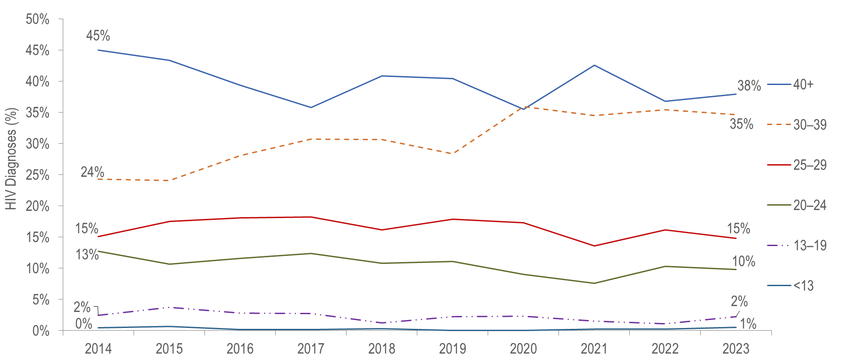
Individuals diagnosed with HIV infection by age at diagnosis and year of diagnosis, Massachusetts 2014–2023¹
¹ Please consider the impact of the COVID-19 pandemic on infectious disease screening, treatment, and surveillance in the interpretation of data from 2020 to 2023.
Individuals Diagnosed with HIV Infection 2014-2023: N=5,582
Data Source: Bureau of Infectious Disease and Laboratory Sciences. Data are current as of 7/1/2024 and subject to change.
Notes:
The figure is a trendline displaying the percentage distribution of HIV infection diagnoses by age category (<13, 13-19, 20-24, 25-29, 30-39, 40+) for each year of the ten-year period.
From 2014 to 2023, the proportion of individuals diagnosed with HIV infection at age 13–19 years remained relatively stable, ranging from 1% (2018 and 2022) to 4% (2015).
During the same time period, the proportion of individuals diagnosed with HIV infection at age 20–24 years also remained relatively stable, ranging from 8% (2021) to 13% (2014).

Slide 3
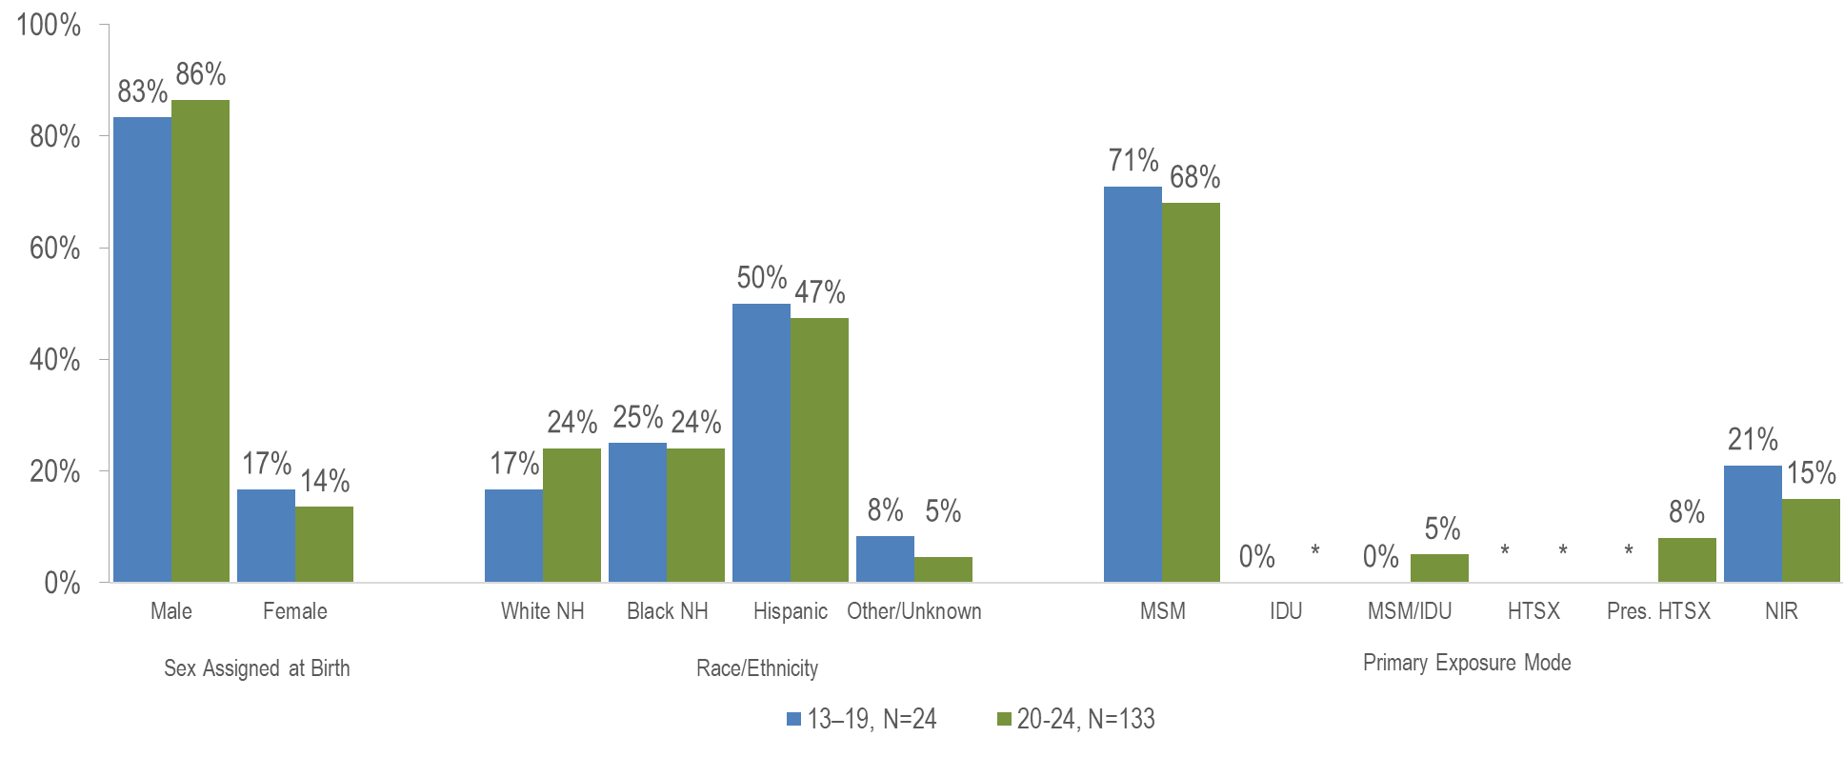
Individuals diagnosed with HIV infection at age 13–19 years vs. 20–24 years by sex assigned at birth, race/ethnicity, and exposure mode,
Massachusetts 2021–2023¹
¹ Please consider the impact of the COVID-19 pandemic on infectious disease screening, treatment, and surveillance in the interpretation of data from 2020 to 2023.
* Values less than five are suppressed for populations less than 50,000 or for populations of unknown size. Percentages do not add up to 100% due to suppressed value. MSM=male-to-male sex; IDU=injection drug use; HTSX=heterosexual sex; Pres. HTSX=presumed heterosexual exposure, includes individuals assigned female at birth with a negative history of injection drug use who report having sex with an individual that identifies as male of unknown HIV status and risk; NIR=no identified risk; Data Source: Bureau of Infectious Disease and Laboratory Sciences, data are current as of 7/1/2024 and subject to change
Notes:
The figure is a bar chart displaying the percentage distribution of individuals diagnosed at age 13-19 years (N=24) verses age 20-24 years (N=133) by sex assigned at birth (male, female), race/ethnicity (White (non-Hispanic), Black (non-Hispanic), Hispanic/Latinx, Other/Unknown), and primary exposure mode (male-to-male sex, injection drug use, male-to-male sex/injection drug use, heterosexual sex, presumed heterosexual sex, and no identified risk).
Among adolescents and young adults (aged 13–24 years) recently diagnosed with HIV infection (2021–2023),* 85% (N=133) were 20 to 24 years of age and 15% (N=24) were 13 to 19 years of age. Additionally, 2% (N=3) were considered minors (under 18 years of age) and 98% (N=154) were 18 years of age or older.
The distributions by assigned sex at birth, race/ethnicity, and HIV exposure mode were similar for youth recently diagnosed with HIV infection at age 13–19 years and those diagnosed at age 20–24 years.

Slide 4
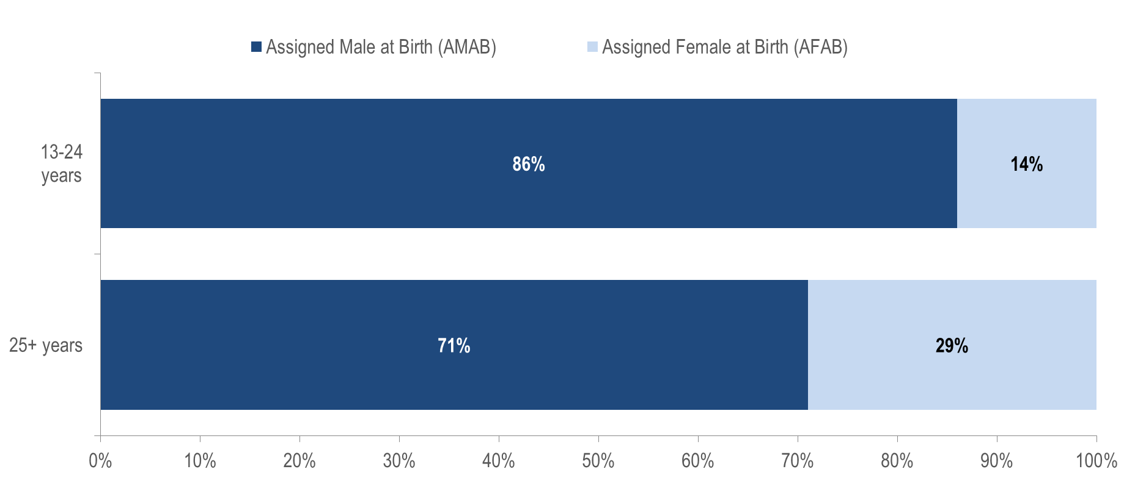
HIV infection diagnoses by sex assigned at birth and age at diagnosis:
13-24 years (N=157) and 25+ years (N=1,273), Massachusetts 2021–2023¹
¹ Please consider the impact of the COVID-19 pandemic on infectious disease screening, treatment, and surveillance in the interpretation of data from 2020 to 2023.
Data Source: Bureau of Infectious Disease and Laboratory Sciences, data are current as of 7/1/2024 and subject to change
Notes:
The figure is a stacked bar chart displaying the distribution by sex assigned at birth (Assigned Male at Birth, Assigned Female at Birth) of two groups: individuals diagnosed with HIV infection at age 13-24 years and individuals diagnosed with HIV infection aged 25+ years.
A larger proportion of adolescents and young adults recently diagnosed with HIV infection at age 13–24 years (86%) than those diagnosed at age 25 years and older (71%) was assigned male at birth (AMAB).

Slide 5
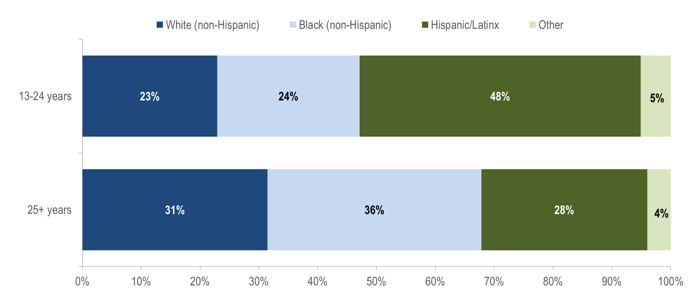
HIV infection diagnoses by race/ethnicity and age at diagnosis:
13-24 years (N=157) and 25+ years (N=1,273), Massachusetts 2021–2023¹
¹ Please consider the impact of the COVID-19 pandemic on infectious disease screening, treatment, and surveillance in the interpretation of data from 2020 to 2023.
Data Source: Bureau of Infectious Disease and Laboratory Sciences, data are current as of 7/1/2024 and subject to change
Notes:
The figure is a stacked bar chart displaying the distribution by race/ethnicity (White non-Hispanic, Black non-Hispanic, Hispanic/Latinx, Other/Unknown) of two groups: individuals diagnosed with HIV infection at age 13-24 years and individuals diagnosed with HIV infection aged 25+ years.
While the largest proportion of adolescents and young adults recently diagnosed with HIV infection at age 13–24 years was Hispanic/Latinx (48%), the largest proportion of individuals recently diagnosed at age 25 years and older was Black (non-Hispanic) (36%).

Slide 6
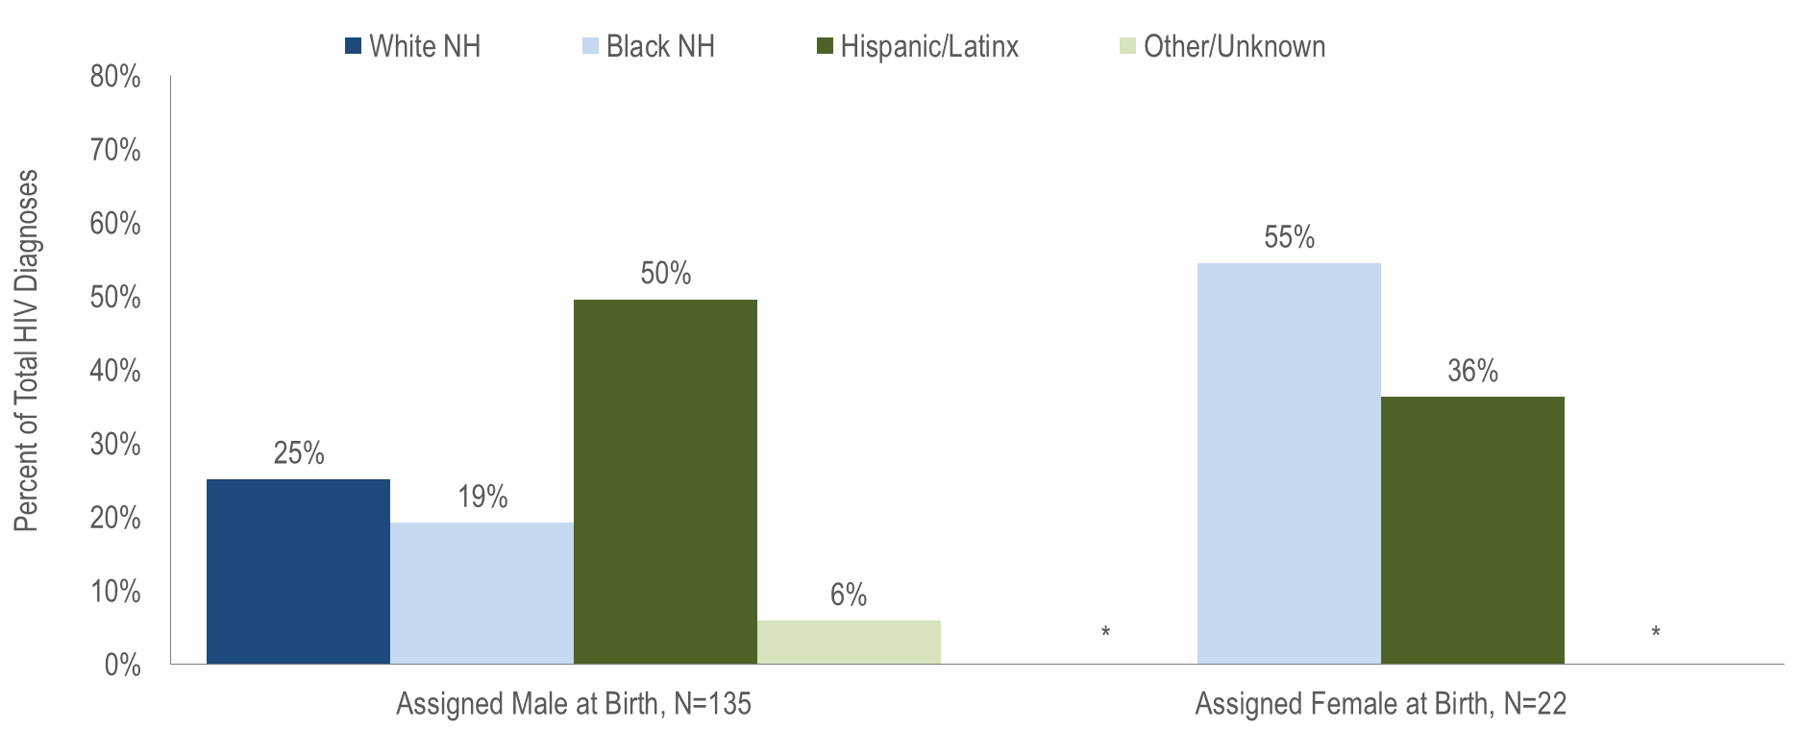
HIV infection diagnoses among individuals aged 13-24 years by sex assigned at birth and race/ethnicity, Massachusetts 2021–2023¹
¹ Please consider the impact of the COVID-19 pandemic on infectious disease screening, treatment, and surveillance in the interpretation of data from 2020 to 2023.
* Values less than five are suppressed for populations less than 50,000 or for populations of unknown size. Percentages do not add up to 100% due to suppressed values
Data Source: Bureau of Infectious Disease and Laboratory Sciences, data are current as of 7/1/2024 and subject to change
Notes:
The figure is a bar chart displaying the distribution by race/ethnicity (White non-Hispanic, Black non-Hispanic, Hispanic/Latinx, Other/Unknown) for two groups of individuals recently diagnosed with HIV infection at age 13-24 years: individuals AMAB (N=135) and individuals AFAB (N=22)
While the largest proportion of individuals AMAB recently diagnosed with HIV infection at age 13–24 years was Hispanic/Latinx (50%), the largest proportion of individuals AFAB recently diagnosed at age 13–24 years was Black (non-Hispanic) (55%).

Slide 7
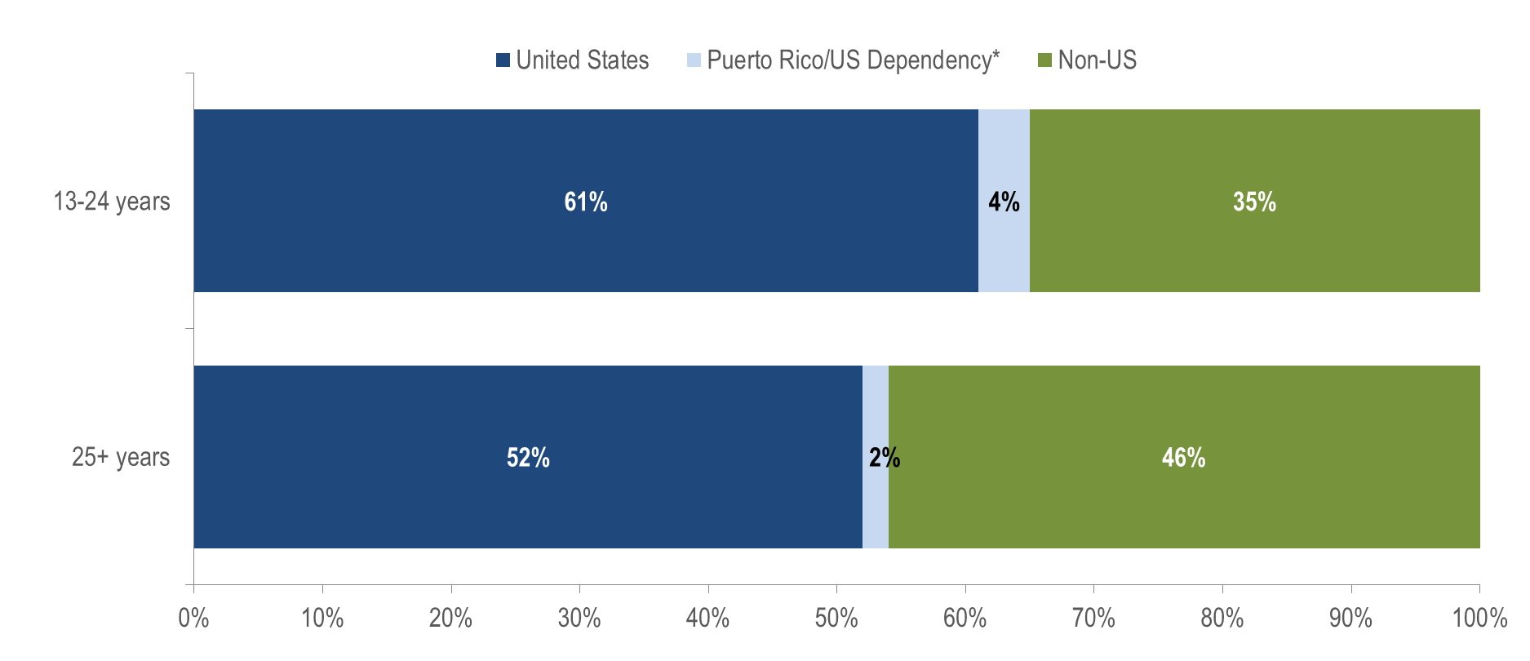
HIV infection diagnoses by place of birth and age at diagnosis:
13-24 years (N=157) and 25+ years (N=1,273), Massachusetts 2021–2023¹
¹ Please consider the impact of the COVID-19 pandemic on infectious disease screening, treatment, and surveillance in the interpretation of data from 2020 to 2023.
* 94% of individuals diagnosed with HIV infection from 2021–2023 who were born in a US dependency (USD) were born in Puerto Rico (PR).
Data Source: Bureau of Infectious Disease and Laboratory Sciences, data are current as of 7/1/2024 and subject to change
Notes:
The figure is a stacked bar chart displaying the distribution place of birth (United States, Puerto Rico/US Dependency, Non-US) of two groups: individuals diagnosed with HIV infection at age 13-24 years and individuals diagnosed with HIV infection aged 25+ years.
A larger proportion of adolescents and young adults recently diagnosed with HIV infection at age 13–24 years (61%) than those diagnosed at age 25 years and older (52%) was born in the US.

Slide 8
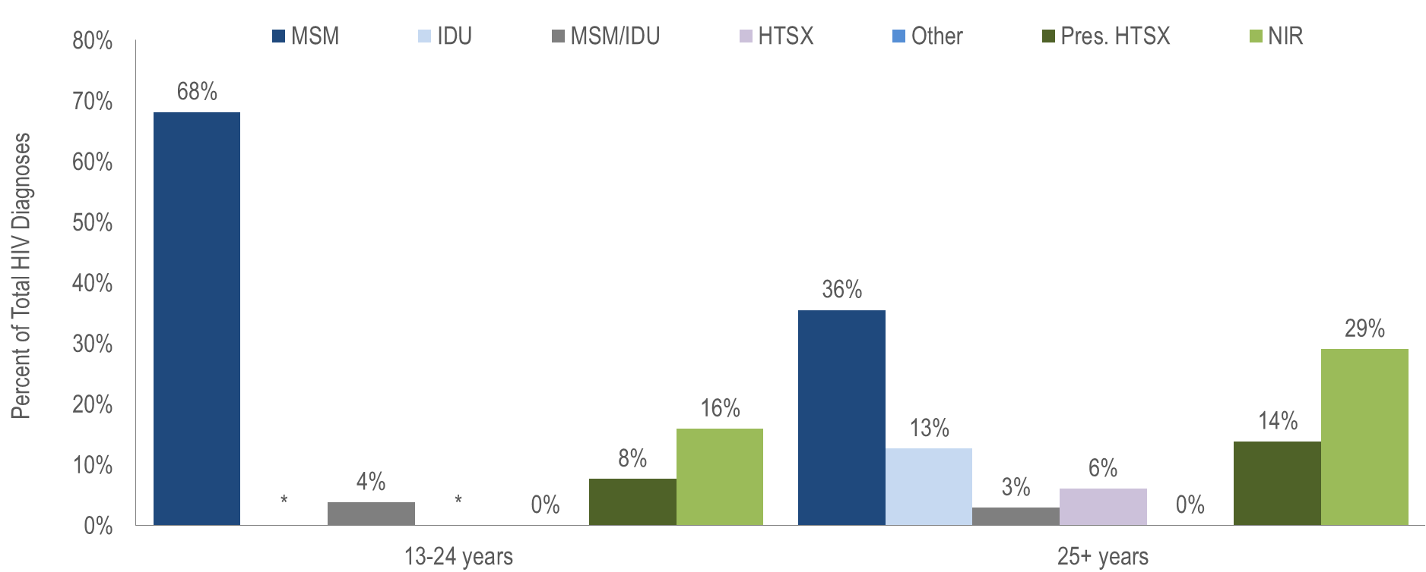
HIV infection diagnoses by exposure mode and age at diagnosis:
13-24 years (N=157) and 25+ years (N=1,273), Massachusetts 2021–2023¹
¹ Please consider the impact of the COVID-19 pandemic on infectious disease screening, treatment, and surveillance in the interpretation of data from 2020 to 2023.
* Values less than five are suppressed for populations less than 50,000 or for populations of unknown size. Percentages do not add up to 100% due to suppressed value. MSM=male-to-male sex; IDU=injection drug use; HTSX=heterosexual sex; Pres. HTSX=presumed heterosexual exposure, includes individuals assigned female at birth with a negative history of injection drug use who report having sex with an individual that identifies as male of unknown HIV status and risk; NIR=no identified risk; Data Source: Bureau of Infectious Disease and Laboratory Sciences, data are current as of 7/1/2024 and subject to change
Notes:
The figure is a bar chart displaying the distribution of individuals diagnosed at 13-24 years of age verses 25+ years of age by exposure mode (male-to-male sex (MSM), injection drug use (IDU), MSM/IDU, heterosexual sex, presumed heterosexual sex, no identified risk).
A larger proportion of individuals diagnosed with HIV infection at age 13–24 years (68%) than those diagnosed at age 25 years and older (36%) had MSM exposure mode and a smaller proportion had injection drug use (less than 5% vs. 13%) and no identified risk (16% verses 29%).

Slide 9
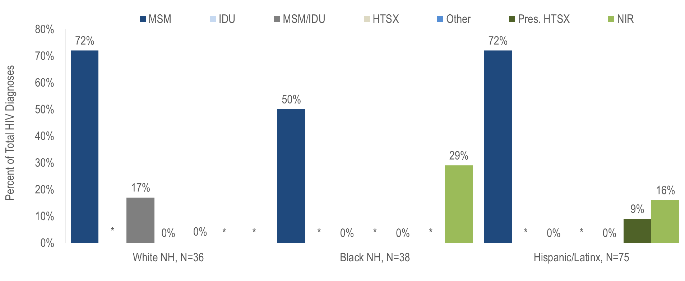
HIV infection diagnoses among individuals aged 13–24 years by race/ethnicity and exposure mode, Massachusetts 2021–2023¹
¹ Please consider the impact of the COVID-19 pandemic on infectious disease screening, treatment, and surveillance in the interpretation of data from 2020 to 2023.
* Values less than five are suppressed for populations less than 50,000 or for populations of unknown size. Percentages do not add up to 100% due to suppressed values
MSM=male-to-male sex; IDU=injection drug use; HTSX=heterosexual sex; Pres. HTSX=presumed heterosexual exposure, includes individuals assigned female at birth with a negative history of injection drug use who report having sex with an individual that identifies as male of unknown HIV status and risk; NIR=no identified risk
Data Source: Bureau of Infectious Disease and Laboratory Sciences, data are current as of 7/1/2024 and subject to change
Notes:
The figure is a bar chart displaying the distribution of individuals diagnosed with HIV infection at age 13-24 years by exposure mode (MSM, IDU, MSM/IDU, HTSX, Presumed HTSX, Other, NIR) for three groups: White NH (N=36), Black NH (N=38), and Hispanic/Latinx (N=75).
The proportion of adolescents and young adults (aged 13–24 years) recently diagnosed with MSM exposure mode was 72% among both White (non-Hispanic) and Hispanic/Latinx youth, and 50% among Black (non-Hispanic) youth.
The proportion with IDU exposure mode was less than 5% among White (non-Hispanic), Black (non-Hispanic), and Hispanic/Latinx youth. The proportion with MSM/IDU exposure mode was 17% among White (non-Hispanic) youth, compared to 0% among both Hispanic/Latinx youth and Black (non-Hispanic) youth.

Slide 10
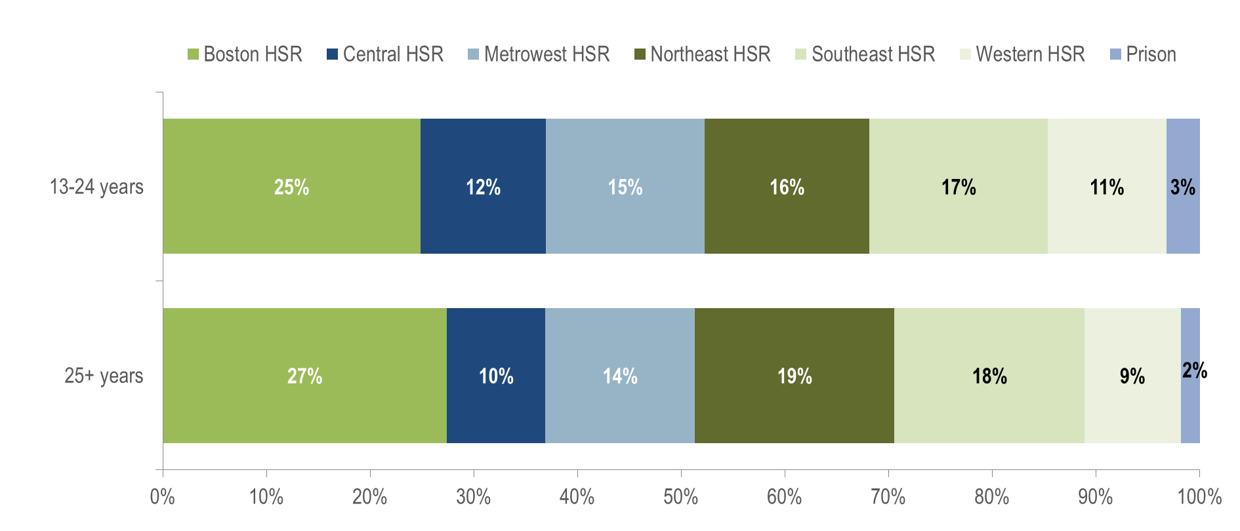
HIV infection diagnoses by Health Service Region (HSR) of residence and age at diagnosis:13-24 years (N=157) and 25+ years (N=1,273),
Massachusetts 2021–2023¹
¹ Please consider the impact of the COVID-19 pandemic on infectious disease screening, treatment, and surveillance in the interpretation of data from 2020 to 2023.
Data Source: Bureau of Infectious Disease and Laboratory Sciences, data are current as of 7/1/2024 and subject to change
Notes:
The figure is a stacked bar chart displaying the distribution by Health Service Region (Boston HSR, Central HSR, Metrowest HSR, Northeast HSR, Southeast HSR, Western HSR) of two groups: individuals diagnosed with HIV infection at age 13-24 years and individuals diagnosed with HIV infection aged 25+ years.
The distribution by Health Service Region of residence was similar for youth recently diagnosed with HIV infection at age 13–24 years and those diagnosed at age 25+ years.

