Slide 1
Massachusetts HIV Epidemiologic Profile:
Data as of 7/1/2025
Adolescents and Young Adults
Notes:
Suggested citation:
Massachusetts Department of Public Health, Bureau of Infectious Disease and Laboratory Sciences. Massachusetts HIV Epidemiologic Profile: Data as of 7/1/2025, Population Report: Adolescents and Young Adults, https://www.mass.gov/lists/hivaids-epidemiologic-profiles Published December 2025. Accessed [date].
Bureau of Infectious Disease and Laboratory Sciences
Massachusetts Department of Public Health
Jamaica Plain Campus/State Public Health Laboratory
305 South Street
Jamaica Plain, MA 02130
Questions about this report
Tel: (617) 983-6560
To reach the Reporting and Partner Services Line*
Tel: (617) 983-6999
To speak to the on-call epidemiologist
Tel: (617) 983-6800
Questions about infectious disease reporting
Tel: (617) 983-6801
HIV Data Dashboard
https://www.mass.gov/info-details/hiv-data-dashboard
Requests for additional data
https://www.mass.gov/lists/infectious-disease-data-reports-and-requests
Slide sets for HIV Epidemiologic Profile Reports
https://www.mass.gov/lists/hivaids-epidemiologic-profiles
*Providers may use this number to report individuals newly diagnosed with a notifiable sexually transmitted infection, including HIV, or request partner services. Partner services is a free and confidential service for individuals recently diagnosed with a priority infection. The client-centered program offers counseling, linkage to other health and social services, anonymous notification of partners who were exposed and assistance with getting testing and treatment. For more information, see: https://www.mass.gov/service-details/partner-services-program-information-for-healthcare-providers)
*Providers may use this number to report individuals newly diagnosed with a notifiable sexually transmitted infection, including HIV, or request partner services. Partner services is a free and confidential service for individuals recently diagnosed with a priority infection. The client-centered program offers counseling, linkage to other health and social services, anonymous notification of partners who were exposed and assistance with getting testing and treatment. For more information, see: https://www.mass.gov/service-details/partner-services-program-information-for-healthcare-providers)

Slide 2
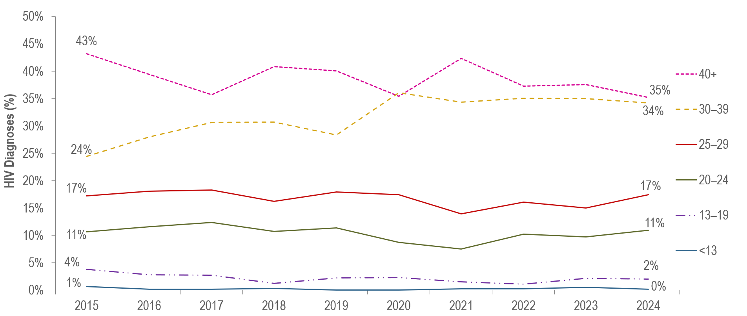
Individuals diagnosed with HIV infection by age at diagnosis and year of diagnosis, Massachusetts 2015–2024¹
¹ Please consider the impact of the COVID-19 pandemic on infectious disease screening, treatment, and surveillance in the interpretation of data from 2020 to 2022.
Individuals Diagnosed with HIV Infection 2015–2024: N=5,534
Data Source: Bureau of Infectious Disease and Laboratory Sciences. Data are current as of 7/1/2025 and subject to change.
Notes:
The figure is a trendline displaying the percentage distribution of HIV infection diagnoses by age category (<13, 13-19, 20-24, 25-29, 30-39, 40+) for each year of the ten-year period.
From 2014 to 2023, the proportion of individuals diagnosed with HIV infection at age 13–19 years remained relatively stable, ranging from 1% (2018 and 2022) to 4% (2015).
During the same time period, the proportion of individuals diagnosed with HIV infection at age 20–24 years also remained relatively stable, ranging from 8% (2021) to 13% (2014).

Slide 3
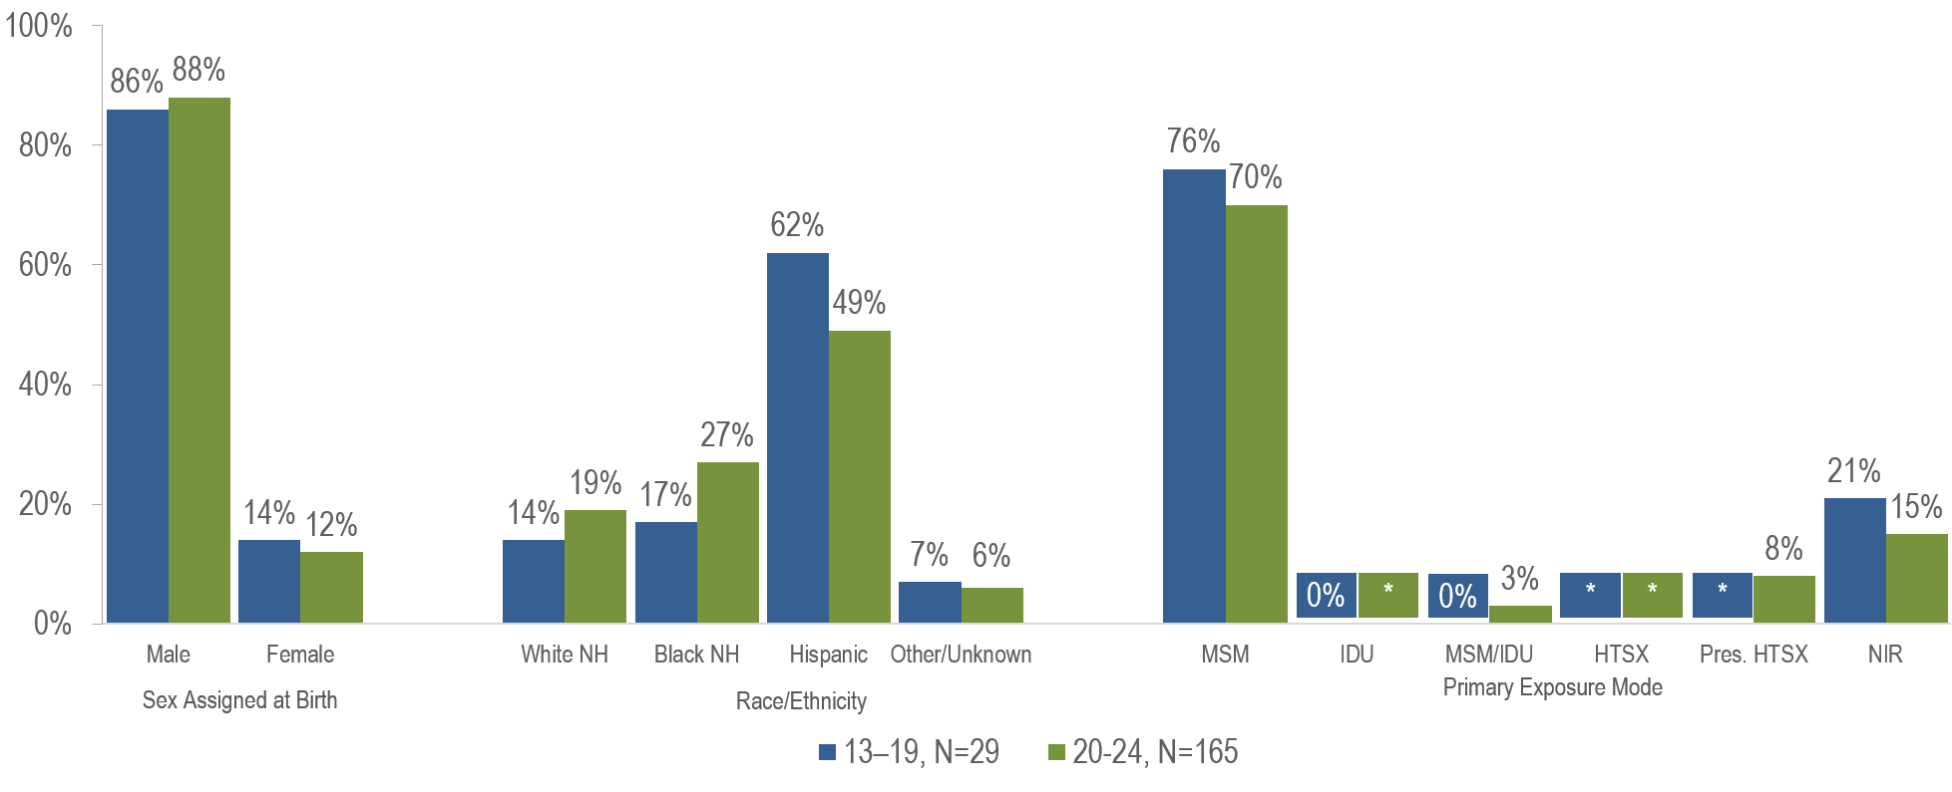
Individuals diagnosed with HIV infection at age 13–19 years vs. 20–24 years by sex assigned at birth, race/ethnicity, and exposure mode,
Massachusetts 2022–2024¹
¹ Please consider the impact of the COVID-19 pandemic on infectious disease screening, treatment, and surveillance in the interpretation of data from 2020 to 2022.
* Values less than five are suppressed for populations less than 50,000 or for populations of unknown size. Percentages do not add up to 100% due to suppressed value. MSM=male-to-male sex; IDU=injection drug use; HTSX=heterosexual sex; Pres. HTSX=presumed heterosexual exposure, includes individuals assigned female at birth with a negative history of injection drug use who report having sex with an individual that identifies as male of unknown HIV status and risk; NIR=no identified risk; Data Source: Bureau of Infectious Disease and Laboratory Sciences, data are current as of 7/1/2025 and subject to change
Notes:
The figure is a bar chart displaying the percentage distribution of individuals diagnosed at age 13-19 years (N=29) verses age 20-24 years (N=165) by sex assigned at birth (male, female), race/ethnicity (White (non-Hispanic), Black (non-Hispanic), Hispanic/Latinx, Other/Unknown), and primary exposure mode (male-to-male sex, injection drug use, male-to-male sex/injection drug use, heterosexual sex, presumed heterosexual sex, and no identified risk).
Among adolescents and young adults (aged 13–24 years) recently diagnosed with HIV infection (2022–2024), 85% (N=165) were 20 to 24 years of age and 15% (N=29) were 13 to 19 years of age. Additionally, 2% (N=4) were considered minors (under 18 years of age) and 98% (N=190) were 18 years of age or older.
A larger proportion of individuals recently diagnosed with HIV infection at age 13-19 years (62%) than at age 20-24 years (49%) was Hispanic/Latinx.
The distributions by assigned sex at birth and HIV exposure mode were similar for youth recently diagnosed with HIV infection at age 13–19 years and those diagnosed at age 20–24 years.

Slide 4
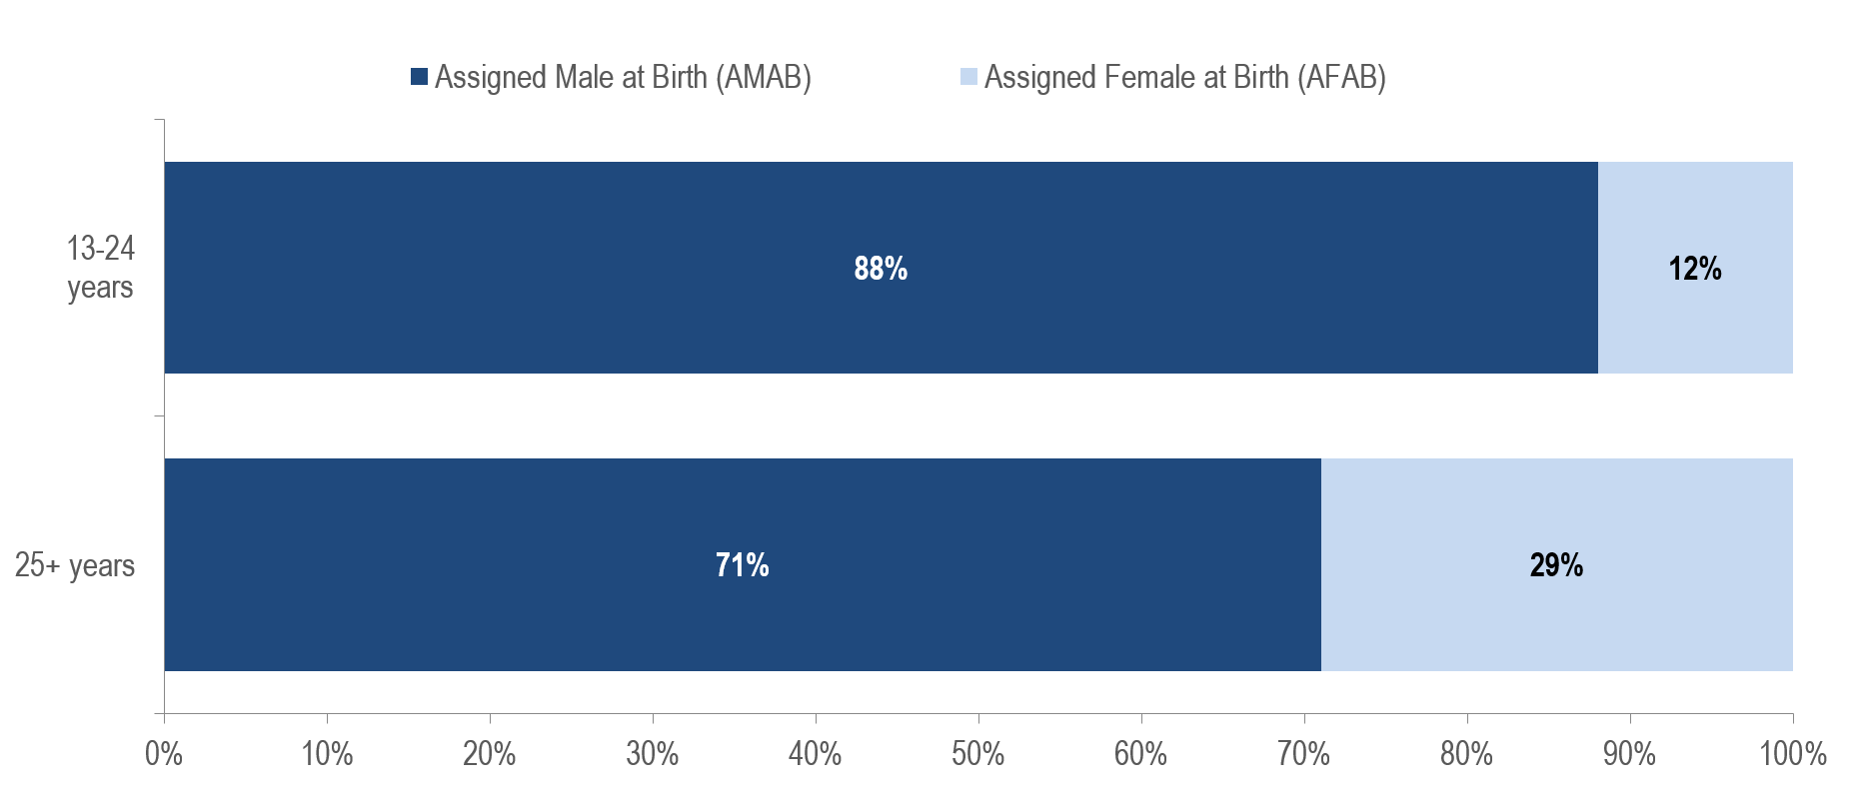
HIV infection diagnoses by sex assigned at birth and age at diagnosis:
13–24 years (N=194) and 25+ years (N=1,397), Massachusetts 2022–2024¹
¹ Please consider the impact of the COVID-19 pandemic on infectious disease screening, treatment, and surveillance in the interpretation of data from 2020 to 2022.
Data Source: Bureau of Infectious Disease and Laboratory Sciences, data are current as of 7/1/2025 and subject to change
Notes:
The figure is a stacked bar chart displaying the distribution by sex assigned at birth (Assigned Male at Birth, Assigned Female at Birth) of two groups: individuals diagnosed with HIV infection at age 13-24 years and individuals diagnosed with HIV infection aged 25+ years.
A larger proportion of adolescents and young adults recently diagnosed with HIV infection at age 13–24 years (88%) than those diagnosed at age 25 years and older (71%) was assigned male at birth (AMAB).

Slide 5
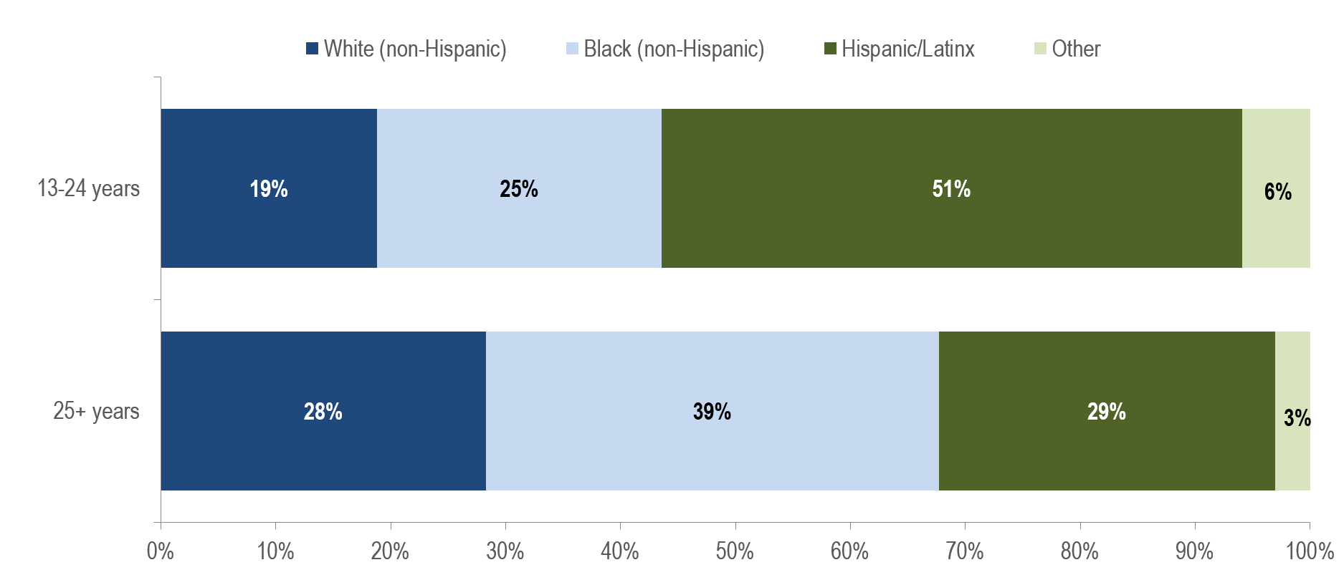
HIV infection diagnoses by race/ethnicity and age at diagnosis:
13–24 years (N=194) and 25+ years (N=1,397), Massachusetts 2022–2024¹
¹ Please consider the impact of the COVID-19 pandemic on infectious disease screening, treatment, and surveillance in the interpretation of data from 2020 to 2022.
Data Source: Bureau of Infectious Disease and Laboratory Sciences, data are current as of 7/1/2025 and subject to change
Notes:
The figure is a stacked bar chart displaying the distribution by race/ethnicity (White non-Hispanic, Black non-Hispanic, Hispanic/Latinx, Other/Unknown) of two groups: individuals diagnosed with HIV infection at age 13-24 years and individuals diagnosed with HIV infection aged 25+ years.
While the largest proportion of adolescents and young adults recently diagnosed with HIV infection at age 13–24 years was Hispanic/Latinx (51%), the largest proportion of individuals recently diagnosed at age 25 years and older was Black (non-Hispanic) (39%).

Slide 6
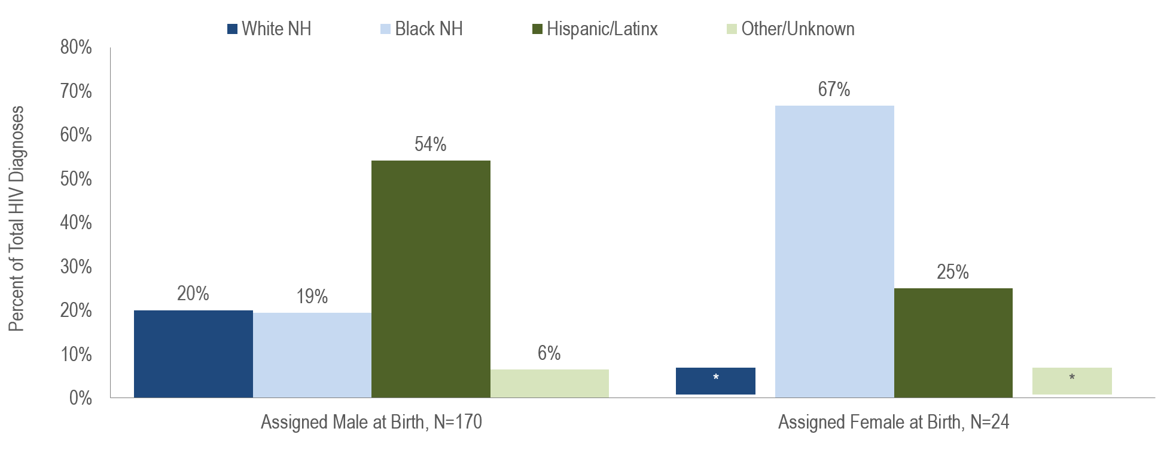
HIV infection diagnoses among individuals aged 13-24 years by sex assigned at birth and race/ethnicity, Massachusetts 2021–2023¹
¹ Please consider the impact of the COVID-19 pandemic on infectious disease screening, treatment, and surveillance in the interpretation of data from 2020 to 2022.
* Values less than five are suppressed for populations less than 50,000 or for populations of unknown size. Percentages do not add up to 100% due to suppressed values
Data Source: Bureau of Infectious Disease and Laboratory Sciences, data are current as of 7/1/2025 and subject to change
Notes:
The figure is a bar chart displaying the distribution by race/ethnicity (White non-Hispanic, Black non-Hispanic, Hispanic/Latinx, Other/Unknown) for two groups of individuals recently diagnosed with HIV infection at age 13-24 years: individuals AMAB (N=170) and individuals AFAB (N=24)
While the largest proportion of individuals AMAB recently diagnosed with HIV infection at age 13–24 years was Hispanic/Latinx (54%), the largest proportion of individuals AFAB recently diagnosed at age 13–24 years was Black (non-Hispanic) (67%).

Slide 7
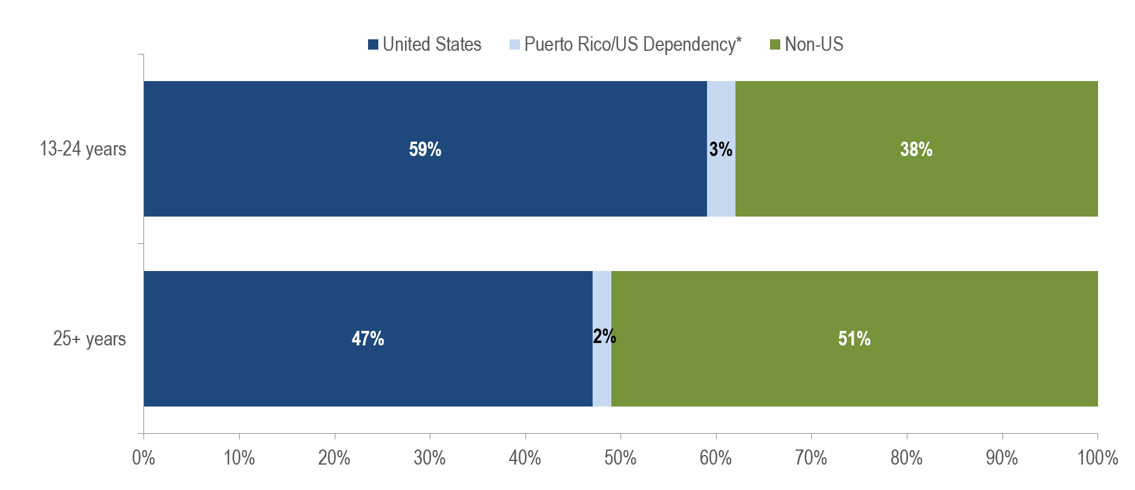
HIV infection diagnoses by place of birth and age at diagnosis:
13–24 years (N=194) and 25+ years (N=1,397), Massachusetts 2022–2024¹
¹ Please consider the impact of the COVID-19 pandemic on infectious disease screening, treatment, and surveillance in the interpretation of data from 2020 to 2022.
* 97% of individuals diagnosed with HIV infection from 2021–2023 who were born in a US dependency (USD) were born in Puerto Rico (PR).
Data Source: Bureau of Infectious Disease and Laboratory Sciences, data are current as of 7/1/2025 and subject to change
Notes:
The figure is a stacked bar chart displaying the distribution place of birth (United States, Puerto Rico/US Dependency, Non-US) of two groups: individuals diagnosed with HIV infection at age 13-24 years and individuals diagnosed with HIV infection aged 25+ years.
A larger proportion of adolescents and young adults recently diagnosed with HIV infection at age 13–24 years (59%) than those diagnosed at age 25 years and older (47%) was born in the US.

Slide 8
HIV infection diagnoses by exposure mode and age at diagnosis:
13–24 years (N=194) and 25+ years (N=1,397), Massachusetts 2022–2024¹
¹ Please consider the impact of the COVID-19 pandemic on infectious disease screening, treatment, and surveillance in the interpretation of data from 2020 to 2022.
* Values less than five are suppressed for populations less than 50,000 or for populations of unknown size. Percentages do not add up to 100% due to suppressed value. MSM=male-to-male sex; IDU=injection drug use; HTSX=heterosexual sex; Pres. HTSX=presumed heterosexual exposure, includes individuals assigned female at birth with a negative history of injection drug use who report having sex with an individual that identifies as male of unknown HIV status and risk; NIR=no identified risk; Data Source: Bureau of Infectious Disease and Laboratory Sciences, data are current as of 7/1/2025 and subject to change
Notes:
The figure is a bar chart displaying the distribution of individuals diagnosed at 13-24 years of age verses 25+ years of age by exposure mode (male-to-male sex (MSM), injection drug use (IDU), MSM/IDU, heterosexual sex, presumed heterosexual sex, no identified risk).
A larger proportion of individuals diagnosed with HIV infection at age 13–24 years (71%) than those diagnosed at age 25 years and older (37%) had MSM exposure mode and a smaller proportion had injection drug use (less than 5% versus 9%) and no identified risk (16% versus 31%).
KEY FINDING: Among individuals AMAB, a larger proportion of those diagnosed with HIV infection at age 13–24 years (81%, N=137/170) than those diagnosed at age 25 years and older (52%, N=515/990) had MSM exposure mode.

Slide 9
HIV infection diagnoses among individuals aged 13–24 years by race/ethnicity and exposure mode, Massachusetts 2022–2024¹
¹ Please consider the impact of the COVID-19 pandemic on infectious disease screening, treatment, and surveillance in the interpretation of data from 2020 to 2022.
* Values less than five are suppressed for populations less than 50,000 or for populations of unknown size. Percentages do not add up to 100% due to suppressed values
MSM=male-to-male sex; IDU=injection drug use; HTSX=heterosexual sex; Pres. HTSX=presumed heterosexual exposure, includes individuals assigned female at birth with a negative history of injection drug use who report having sex with an individual that identifies as male of unknown HIV status and risk; NIR=no identified risk
Data Source: Bureau of Infectious Disease and Laboratory Sciences, data are current as of 7/1/2025 and subject to change
Notes:
The figure is a bar chart displaying the distribution of individuals diagnosed with HIV infection at age 13-24 years by exposure mode (MSM, IDU, MSM/IDU, HTSX, Presumed HTSX, Other, NIR) for three groups: White NH (N=36), Black NH (N=49), and Hispanic/Latinx (N=98).
The proportion of adolescents and young adults (aged 13–24 years) recently diagnosed with MSM exposure mode was 79% among Hispanic/Latinx youth, 72% among White (non-Hispanic) youth, and 49% among Black (non-Hispanic) youth.
The proportion with IDU exposure mode was less than 5% among White (non-Hispanic), Black (non-Hispanic), and Hispanic/Latinx youth. The proportion with MSM/IDU exposure mode was 14% among White (non-Hispanic) youth, compared to 0% among both Hispanic/Latinx youth and Black (non-Hispanic) youth.

Slide 10
HIV infection diagnoses by Health Service Region (HSR) of residence and age at diagnosis: 13–24 years (N=194) and 25+ years (N=1,397), Massachusetts 2022–2024¹
¹ Please consider the impact of the COVID-19 pandemic on infectious disease screening, treatment, and surveillance in the interpretation of data from 2020 to 2022.
Data Source: Bureau of Infectious Disease and Laboratory Sciences, data are current as of 7/1/2025 and subject to change
Notes:
The figure is a stacked bar chart displaying the distribution by Health Service Region (Boston HSR, Central HSR, Metrowest HSR, Northeast HSR, Southeast HSR, Western HSR) of two groups: individuals diagnosed with HIV infection at age 13-24 years and individuals diagnosed with HIV infection aged 25+ years.
The distribution by Health Service Region of residence was similar for youth recently diagnosed with HIV infection at age 13–24 years and those diagnosed at age 25+ years.

