Slide 1
Massachusetts HIV Epidemiologic Profile: Data as of 7/1/2024
Population Report: Men Who Have Sex with Men
Notes:
Suggested citation:
Massachusetts Department of Public Health, Bureau of Infectious Disease and Laboratory Sciences. Massachusetts HIV Epidemiologic Profile: Data as of 7/1/2024, Population Report: Men Who Have Sex with Men, https://www.mass.gov/lists/hivaids-epidemiologic-profiles Published June 2025. Accessed [date].
Bureau of Infectious Disease and Laboratory Sciences
Massachusetts Department of Public Health
Jamaica Plain Campus/State Public Health Laboratory
305 South Street
Jamaica Plain, MA 02130
Questions about this report
Tel: (617) 983-6560
To reach the Reporting and Partner Services Line*
Tel: (617) 983-6999
To speak to the on-call epidemiologist
Tel: (617) 983-6800
Questions about infectious disease reporting
Tel: (617) 983-6801
HIV Data Dashboard
https://www.mass.gov/info-details/hiv-data-dashboard
Requests for additional data
https://www.mass.gov/lists/infectious-disease-data-reports-and-requests
Slide sets for HIV Epidemiologic Profile Reports
https://www.mass.gov/lists/hivaids-epidemiologic-profiles
*Providers may use this number to report individuals newly diagnosed with a notifiable sexually transmitted infection, including HIV, or request partner services. Partner services is a free and confidential service for individuals recently diagnosed with a priority infection. The client-centered program offers counseling, linkage to other health and social services, anonymous notification of partners who were exposed and assistance with getting testing and treatment. For more information, see: https://www.mass.gov/service-details/partner-services-program-information-for-healthcare-providers)

Slide 2
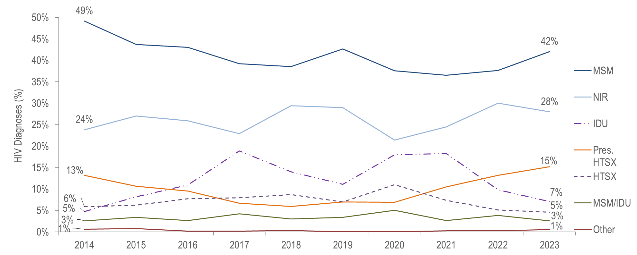
Percentage distribution of individuals diagnosed with HIV infection by exposure mode, Massachusetts 2014–2023¹
¹ Please consider the impact of the COVID-19 pandemic on infectious disease screening, treatment, and surveillance in the interpretation of data from 2020 to 2023.
Individuals Diagnosed with HIV Infection 2014–2023: N=5,582, MSM=Male-to-Male Sex; IDU=Injection Drug Use; HTSX=Heterosexual Sex; Pres. HTSX=presumed heterosexual exposure, includes individuals assigned female at birth with a negative history of injection drug use who report having sex with an individual that identifies as male of unknown HIV status and risk; NIR=No Identified Risk
Data Source: Bureau of Infectious Disease and Laboratory Sciences, data are current as of 7/1/2024 and subject to change
Notes:
The figure is a trendline displaying the percentage distribution of HIV infection diagnoses by exposure mode (male-to-male sex, injection drug use, male-to-male sex/injection drug use, heterosexual sex, no identified risk, and Other) for the most recent ten-year period.
Among individuals assigned male at birth (AMAB), MSM was the exposure mode for 54% (N=559/1,039), and MSM/IDU an additional 4% (N=43/1,039), of HIV infection diagnoses from 2021 to 2023.
KEY FACT
From 2014 to 2023, MSM exposure mode accounted for the largest percentage of HIV diagnoses each year (with a low of 37% [N=164/449] in 2021 and a high of 49% [N=320/651] in 2014).

Slide 3
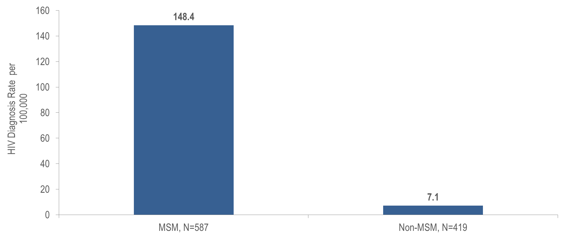
Estimated¹ average HIV diagnosis rate per 100,000 population, MSM compared to non-MSM (males only) ages 18–64 years, Massachusetts 2021–2023²
¹ Multiple source estimation method for MSM rate (2021-2023 BRFSS); as of 1/1/2020 BIDLS calculates rates using University of Massachusetts Donahue Institute population estimates using a modified Hamilton-Perry model. Note that rates calculated using previous population denominators cannot be compared to these. Please note that individuals AMAB with no identified risk for HIV infection were included in the non-MSM category for rate calculations.
² Please consider the impact of the COVID-19 pandemic on infectious disease screening, treatment, and surveillance in the interpretation of data from 2020 to 2023.
Data Source: Bureau of Infectious Disease and Laboratory Sciences, data are current as of 7/1/2024 and subject to change
Notes:
The figure is a bar chart displaying the average HIV diagnosis rate per 100,000 among MSM (N=587) compared to the rate among non-MSM (N=419).
KEY FACT
At 148.4 per 100,000 population (95% confidence interval [CI]: 123.0–190.8 per 100,000), the estimated average rate of HIV diagnosis from 2021 to 2023 among MSM (ages 18–64 years) was 21 times the rate of infection in men who did not report sex with men (7.1 per 100,000 [95% CI: 7.0–7.2 per 100,000]).

Slide 4
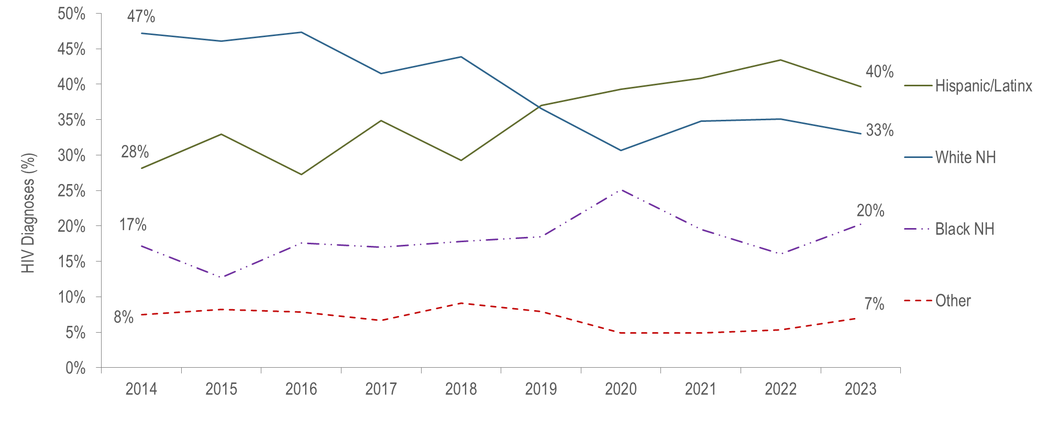
Individuals diagnosed with HIV infection with MSM exposure mode by race/ethnicity and year of diagnosis, Massachusetts 2014–2023¹
¹ Please consider the impact of the COVID-19 pandemic on infectious disease screening, treatment, and surveillance in the interpretation of data from 2020 to 2023.
MSM Diagnosed with HIV Infection 2014-2023: N=2,309, MSM=Male-to-male sex, NH=non-Hispanic
Data Source: Bureau of Infectious Disease and Laboratory Sciences, data are current as of 7/1/2024 and subject to change
Notes:
The figure is a trendline displaying the percentage distribution of HIV infection diagnoses among MSM by race/ethnicity (White (non-Hispanic), Black (non-Hispanic), Hispanic/Latino, and Other) for each year of the ten-year period.
KEY FACT
From 2014 to 2023, the proportion of individuals AMAB diagnosed with HIV infection with MSM exposure mode who identified as Hispanic/Latinx increased from 28% to 40%, while the proportion who identified as White (non-Hispanic) decreased from 47% to 33%. The proportion who identified as Black (non-Hispanic) fluctuated, increasing from 17% in 2014 to 25% in 2020 and then decreasing to 20% in 2023.

Slide 5
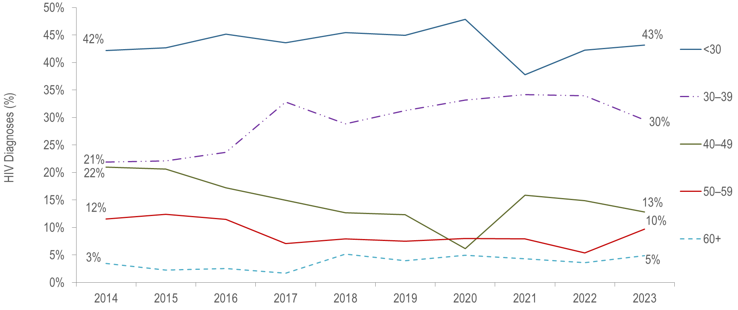
Individuals diagnosed with HIV infection with MSM exposure mode by age at diagnosis and year of diagnosis, Massachusetts 2014–2023¹
¹ Please consider the impact of the COVID-19 pandemic on infectious disease screening, treatment, and surveillance in the interpretation of data from 2020 to 2023.
MSM Diagnosed with HIV Infection 2014-2023: N=2,309
Data Source: Bureau of Infectious Disease and Laboratory Sciences, data are current as of 7/1/2024 and subject to change
Notes:
Individuals diagnosed with HIV infection with MSM exposure mode by age at diagnosis and year of diagnosis: Massachusetts, 2014–2023
The figure is a trendline displaying the percentage distribution of HIV infection diagnoses among MSM by race/ethnicity (White (non-Hispanic), Black (non-Hispanic), Hispanic/Latino, and Other) for each year of the ten-year period.
KEY FACT
Every year from 2014 to 2023, the largest proportion of MSM who were diagnosed with HIV infection were younger than 30 years of age.

Slide 6
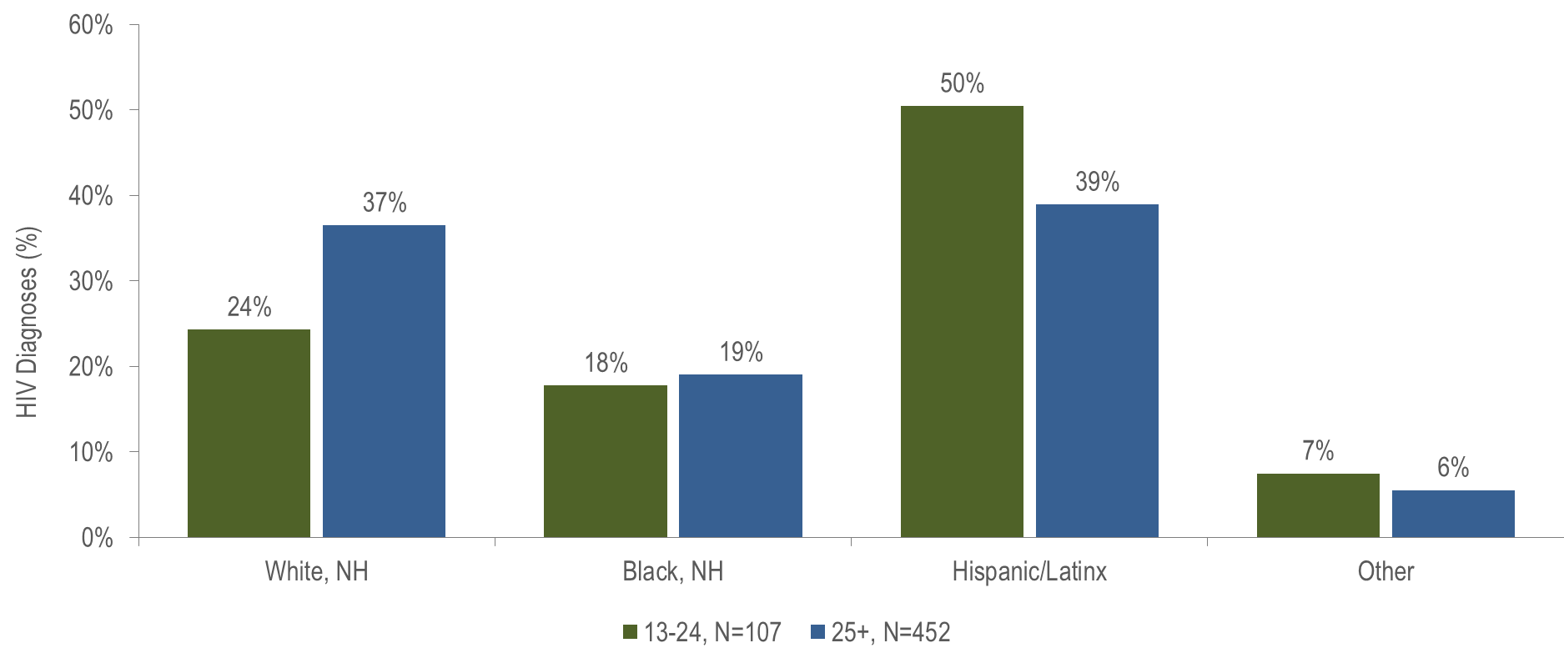
Individuals diagnosed with HIV infection with MSM exposure mode by age at diagnosis and race/ethnicity, Massachusetts 2021–2023¹
¹ Please consider the impact of the COVID-19 pandemic on infectious disease screening, treatment, and surveillance in the interpretation of data from 2020 to 2023.
Other includes Asian/Pacific Islander, American Indian/Alaska Native, and unknown. NH = Non-Hispanic
Data Source: Bureau of Infectious Disease and Laboratory Sciences, data are current as of 7/1/2024 and subject to change
Notes:
The figure is a bar chart displaying the percentage of MSM diagnosed at age 13-24 years (N=107) verses age 25+ years (N=452) for each of four racial/ethnic groups: White (non-Hispanic), Black (non-Hispanic), Hispanic/Latino, and Other.
A larger proportion of MSM diagnosed with HIV infection between the ages of 13 and 24 years was Hispanic/Latinx (50%), as compared to MSM diagnosed at age 25 years or older (39%).

Slide 7
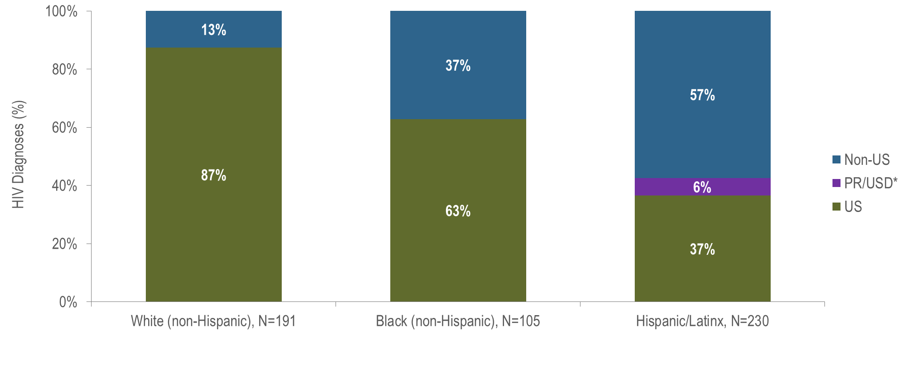
Individuals diagnosed with HIV infection with MSM exposure mode by race/ethnicity and place of birth, Massachusetts 2021–2023¹
¹ Please consider the impact of the COVID-19 pandemic on infectious disease screening, treatment, and surveillance in the interpretation of data from 2020 to 2023.
* 94% of individuals diagnosed with HIV infection from 2021–2023 who were born in a US dependency were born in Puerto Rico, PR/USD=Puerto Rico/US Dependency
Data Source: Bureau of Infectious Disease and Laboratory Sciences, data are current as of 7/1/2024 and subject to change
Notes:
The figure is a stacked bar chart displaying the distribution of recent HIV diagnoses by place of birth (non-US, Puerto Rico/US Dependency, or US) for each of three racial/ethnic groups: White NH (N=191), Black NH (N=105), and Hispanic/Latino (N=230).
KEY FACT
Fifty-seven percent of Hispanic/Latinx MSM recently diagnosed with HIV infection were non-US born, compared to 37% of Black (non-Hispanic) MSM and 13% of White (non-Hispanic) MSM. An additional 6% of Hispanic/Latinx MSM were born in Puerto Rico, compared to none of White (non-Hispanic) and Black (non-Hispanic) MSM.

Slide 8
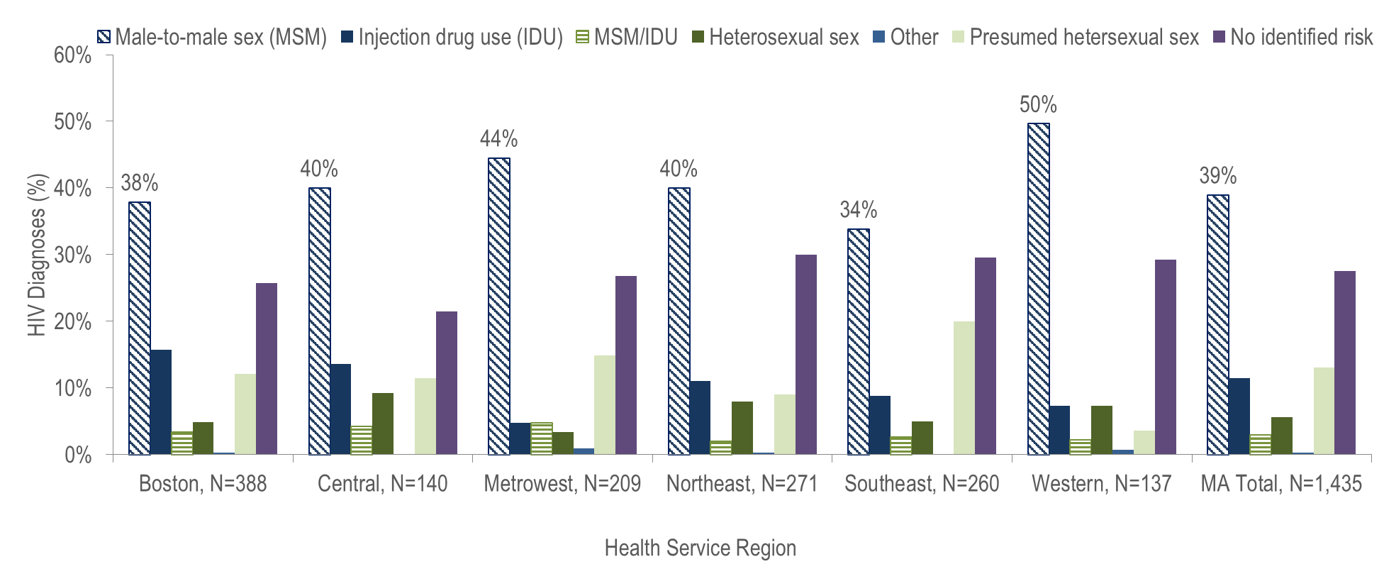
HIV infection diagnoses by Health Service Region¹ and exposure mode, Massachusetts 2021–2023²
¹ HSR is based on residence at HIV infection diagnosis.
² Please consider the impact of the COVID-19 pandemic on infectious disease screening, treatment, and surveillance in the interpretation of data from 2020 to 2023.
Data Source: Bureau of Infectious Disease and Laboratory Sciences, data are current as of 7/1/2024 and subject to change
Notes:
The figure is a bar chart displaying the distribution of recent HIV infection diagnoses by exposure mode for Massachusetts total and each of six health service regions: Boston (N=388), Central (N=140), Metrowest (N=209), Northeast, (N=271), Southeast (N=260), Western (N=137).
MSM was the predominant exposure mode for HIV infection in all Health Service Regions of Massachusetts.

