Slide 1
Massachusetts HIV Epidemiologic Profile:
Data as of 7/1/2024
Population Report: Older Individuals
Notes:
Suggested citation:
Massachusetts Department of Public Health, Bureau of Infectious Disease and Laboratory Sciences. Massachusetts HIV Epidemiologic Profile: Data as of 7/1/2024, Population Report: Older Individuals, https://www.mass.gov/lists/hivaids-epidemiologic-profiles Published June 2025. Accessed [date].
Bureau of Infectious Disease and Laboratory Sciences
Massachusetts Department of Public Health
Jamaica Plain Campus/State Public Health Laboratory
305 South Street
Jamaica Plain, MA 02130
Questions about this report
Tel: (617) 983-6560
To reach the Reporting and Partner Services Line*
Tel: (617) 983-6999
To speak to the on-call epidemiologist
Tel: (617) 983-6800
Questions about infectious disease reporting
Tel: (617) 983-6801
HIV Data Dashboard
https://www.mass.gov/info-details/hiv-data-dashboard
Requests for additional data
https://www.mass.gov/lists/infectious-disease-data-reports-and-requests
Slide sets for HIV Epidemiologic Profile Reports
https://www.mass.gov/lists/hivaids-epidemiologic-profiles
*Providers may use this number to report individuals newly diagnosed with a notifiable sexually transmitted infection, including HIV, or request partner services. Partner services is a free and confidential service for individuals recently diagnosed with a priority infection. The client-centered program offers counseling, linkage to other health and social services, anonymous notification of partners who were exposed and assistance with getting testing and treatment. For more information, see: https://www.mass.gov/service-details/partner-services-program-information-for-healthcare-providers)

Slide 2
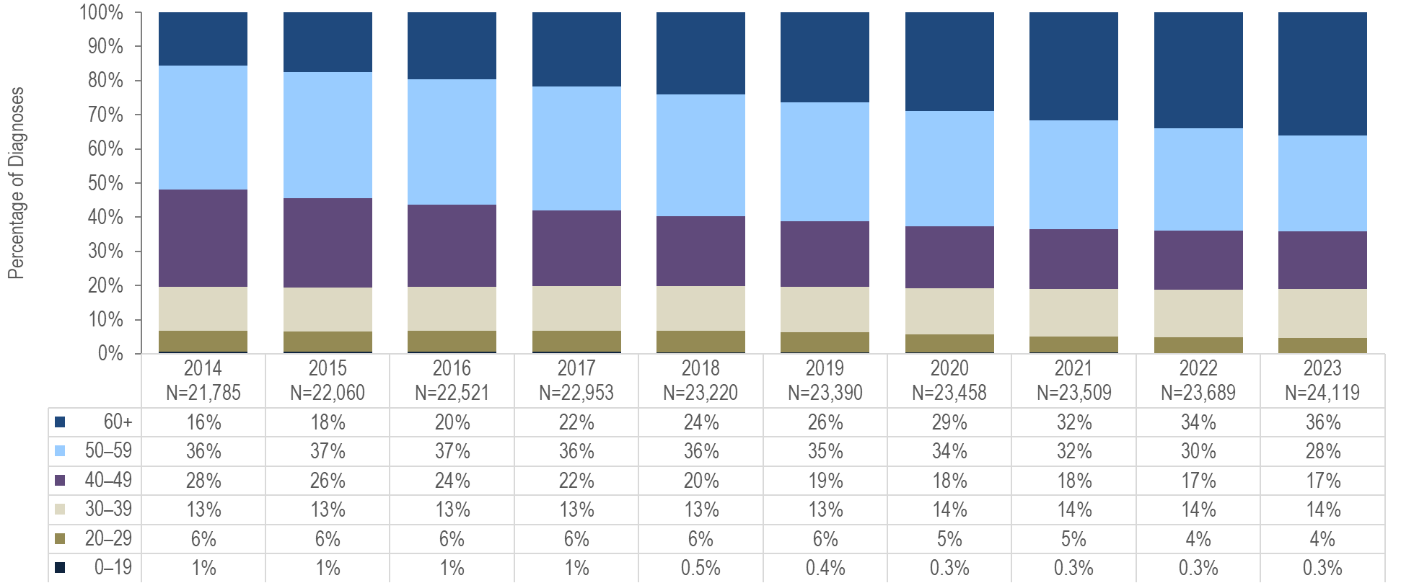
Percentage distribution of persons living with HIV infection by age, Massachusetts 2014–2023¹
¹ Please consider the impact of the COVID-19 pandemic on infectious disease screening, treatment, and surveillance in the interpretation of data from 2020 to 2023.
Data Source: Bureau of Infectious Disease and Laboratory Sciences, data are current as of 7/1/2024 and subject to change
Notes:
The figure is a stacked bar chart displaying the percentage distribution of persons living with HIV infection by age (0-19, 20-29, 30-39, 40-49, 50-59, 60+ years) for each year of the ten-year period.
From 2014 to 2023, the proportion of persons living with HIV infection (PLWH) who were aged 60+ years increased from 16% to 36% and who were aged 50+ years from 52% to 64%.

Slide 3
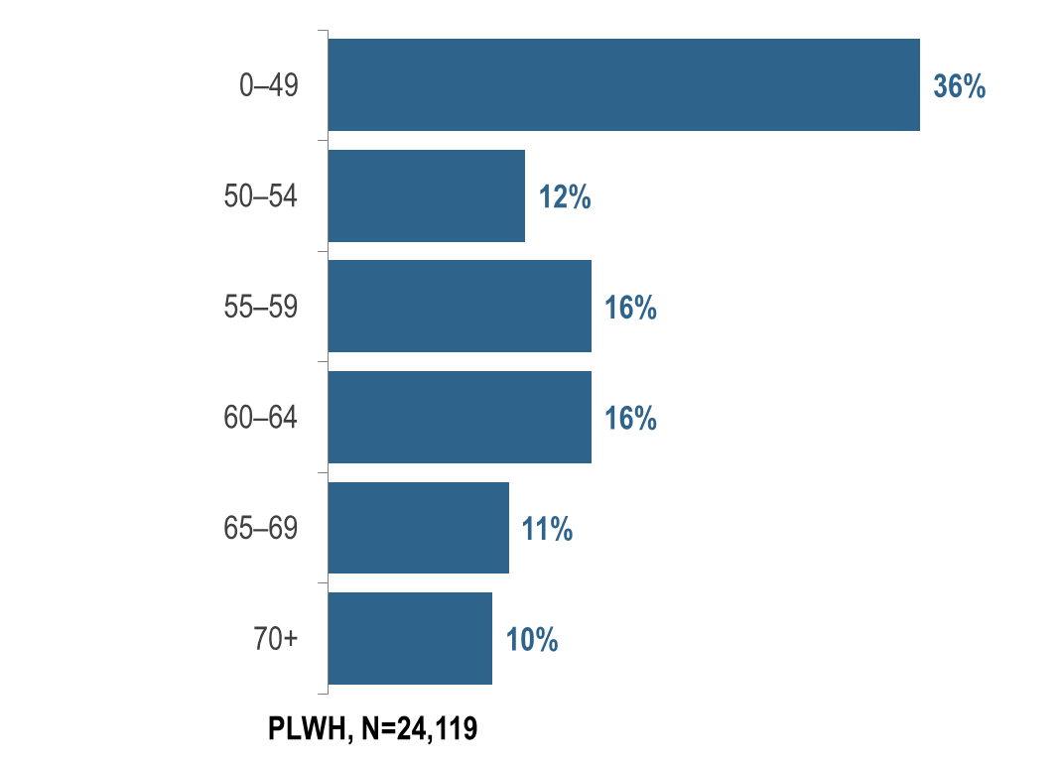
Persons living with HIV infection by expanded older age categories, Massachusetts 2023¹ (N=24,119)
¹ Please consider the impact of the COVID-19 pandemic on infectious disease screening, treatment, and surveillance in the interpretation of data from 2020 to 2023.
Data Source: Bureau of Infectious Disease and Laboratory Sciences, data are current as of 7/1/2024 and subject to change
Notes:
The figure is a bar chart displaying the percentage distribution of persons living with HIV infection by age category.
In 2023, 20% (N=4,891) of PLWH were aged 65 years or older, the age of eligibility for Medicare for individuals without a disability.

Slide 4
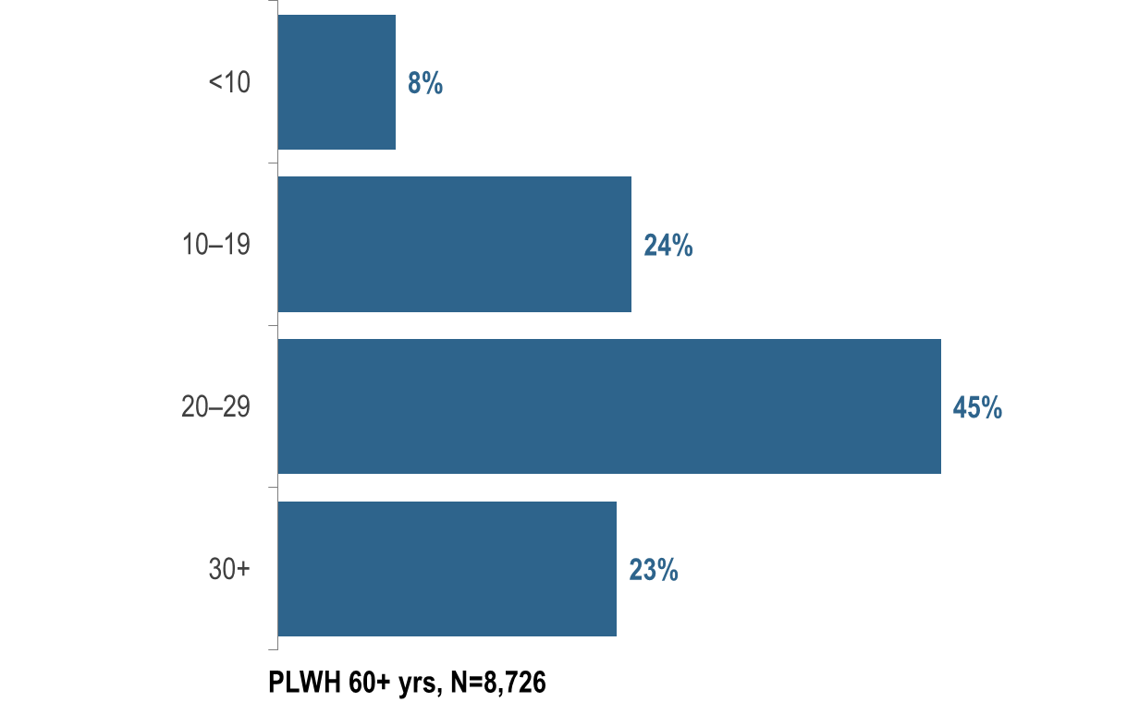
Number of years since HIV infection diagnosis among individuals aged 60+ years living with HIV infection, Massachusetts 2023¹ (N=8,726)
¹ Please consider the impact of the COVID-19 pandemic on infectious disease screening, treatment, and surveillance in the interpretation of data from 2020 to 2023.
Data Source: Bureau of Infectious Disease and Laboratory Sciences, data are current as of 7/1/2024 and subject to change
Notes:
The figure is a bar chart displaying the percentage distribution of persons living with HIV infection aged 60+years by number of years since HIV infection diagnosis.
KEY FINDING
In 2023, the majority (68%) of PLWH aged 60 years and older were diagnosed with HIV infection at least 20 years ago. The average number of years since HIV infection diagnosis among PLWH aged 60 years and older was 22.8 years.

Slide 5
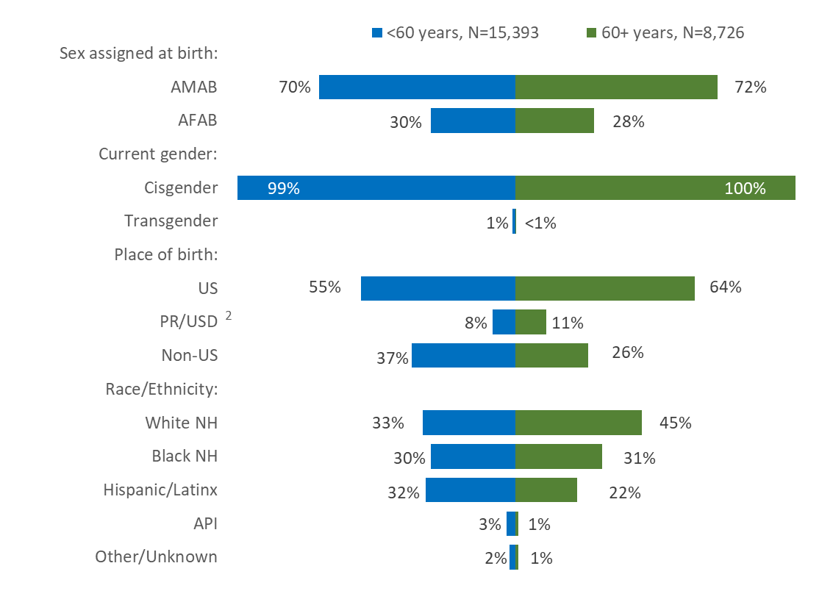
People aged 60+ years and living with HIV infection compared to people aged under 60 years by sex assigned at birth, current gender, and race/ethnicity, Massachusetts 2023¹
¹ Please consider the impact of the COVID-19 pandemic on infectious disease screening, treatment, and surveillance in the interpretation of data from 2020 to 2023.
² PR/USD = Puerto Rico/US Dependencies, 98% persons living with HIV infection on 12/31/2023 who were born in PR/USD were born in Puerto Rico
AMAB = assigned male at birth; AFAB = assigned female at birth; NH = non-Hispanic; API = Asian/Pacific Islander
Data Source: Bureau of Infectious Disease and Laboratory Sciences, data are current as of 7/1/2024 and subject to change
Notes:
The figure is a butterfly graph comparing the percentage distribution of people under 60 years to people aged 60+ years and living with HIV infection by sex assigned at birth, gender, place of birth, and race/ethnicity
In 2023, the distributions of people living with HIV infection by place of birth and race/ethnicity varied by age:
A larger proportion of individuals aged 60+ years (64%) than those aged under 60 years (55%) was born in the US.
A larger proportion of individuals aged 60+ years (45%) than those aged under 60 years (33%) was White (non-Hispanic), and a smaller proportion was Hispanic/Latinx (22% vs. 32%).
The distributions of people living with HIV infection by sex assigned at birth and current gender identity were similar for both age groups in 2023.

Slide 6
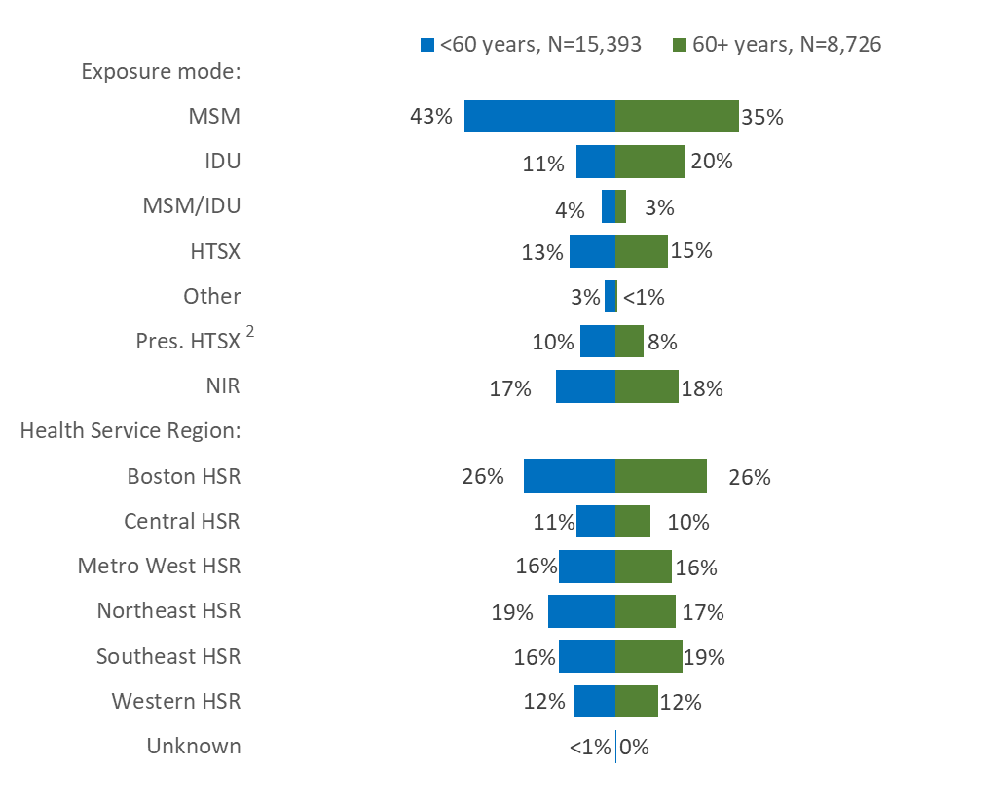
People aged 60+ years and living with HIV infection compared to people aged under 60 years by exposure mode and Health Service Region,
Massachusetts 2023¹
¹ Please consider the impact of the COVID-19 pandemic on infectious disease screening, treatment, and surveillance in the interpretation of data from 2020 to 2023.
² Pres. HTSX=presumed heterosexual exposure, includes individuals assigned female at birth with a negative history of injection drug use who report having sex with an individual that identifies as male of unknown HIV status and risk
MSM=male-to-male sex; IDU=injection drug use; HTSX=heterosexual sex; NIR=no identified risk
Data Source: Bureau of Infectious Disease and Laboratory Sciences, data are current as of 7/1/2024 and subject to change
Notes:
The figure is a butterfly graph comparing the percentage distribution of people under 60 years to people aged 60+ years and living with HIV infection by exposure mode and Health Service Region.
In 2023, the distributions of people living with HIV infection by exposure mode varied by age:
A larger proportion of individuals aged 60+ years (20%) than those aged under 60 years (11%) had injection drug use exposure mode and a smaller proportion had MSM exposure mode (35% vs. 43%). However, MSM was still the most frequently reported exposure mode for both age groups. The proportion with no identified risk (NIR) was similar for both age groups. Individuals aged 60+ years with NIR were predominantly assigned male at birth (81%), non-US born (51%), and Black (non-Hispanic) (51%).
The distributions of people living with HIV infection by health service region of current residence were similar for both age groups in 2023.

Slide 7
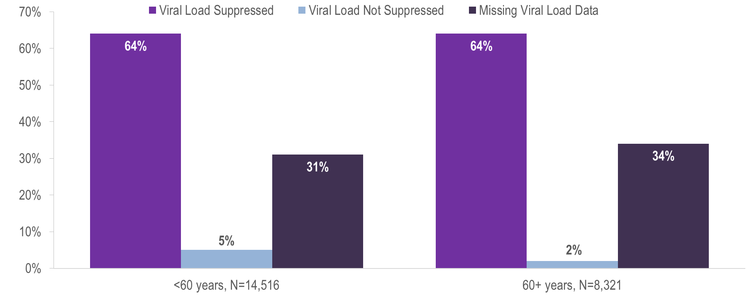
Viral load status among persons living with HIV infection by age (<60 years vs. 60+ years) Massachusetts, 2023¹
¹ Please consider the impact of the COVID-19 pandemic on infectious disease screening, treatment, and surveillance in the interpretation of data from 2020 to 2023.
HIV care continuum among persons living with HIV infection (PLWH) in Massachusetts: “PLWH” refers to individuals diagnosed through 2022, alive through 12/31/2023, and living in Massachusetts based on last known address. “Engaged in Care” is defined as having ≥1 VL or CD4 test result in 2023. “Retained in Care” is defined as having ≥2 VL or CD4 test results at least 3 months apart in 2023. “Virally Suppressed” is defined as having a VL <200 copies/mL for the most recent VL test drawn in 2023.
Data Source: Bureau of Infectious Disease and Laboratory Sciences, data are current as of 7/1/2024 and subject to change
Notes:
The figure is a bar chart displaying the percentage distribution by viral load status for two groups: persons living with HIV infection under age 60 years (N=14,516) and persons living with HIV infection aged 60 years and above (N=8,321).
Among 8,321 persons living with HIV infection (PLWH) aged 60+ years in Massachusetts at the end of 2023 (and diagnosed through 2022), 64% were virally suppressed, 2% were not virally suppressed, and 34% did not have a viral load test in 2023. This compares to 14,516 PLWH aged under 60 years, among whom 64% were virally suppressed, 5% were not virally suppressed and 31% did not have a viral load test in 2023.

Slide 8
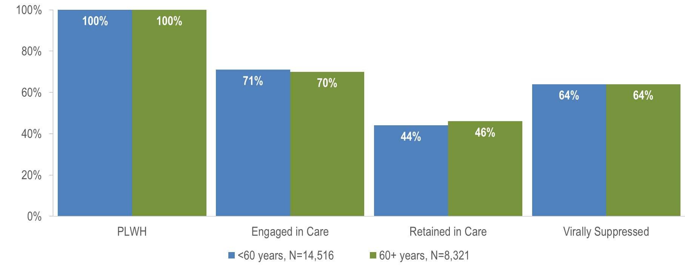
Stages of HIV care among persons living with HIV infection by age (<60 years vs. 60+ years) Massachusetts, 2023¹
¹ Please consider the impact of the COVID-19 pandemic on infectious disease screening, treatment, and surveillance in the interpretation of data from 2020 to 2023.
HIV care continuum among persons living with HIV infection (PLWH) in Massachusetts: “PLWH” refers to individuals diagnosed through 2022, alive through 12/31/2023, and living in Massachusetts based on last known address. “Engaged in Care” is defined as having ≥1 VL or CD4 test result in 2023. “Retained in Care” is defined as having ≥2 VL or CD4 test results at least 3 months apart in 2023. “Virally Suppressed” is defined as having a VL <200 copies/mL for the most recent VL test drawn in 2023.
Data Source: Bureau of Infectious Disease and Laboratory Sciences, data are current as of 7/1/2024 and subject to change
Notes:
The figure is a bar chart displaying percentage distribution by the stages of care (all persons living with HIV infection, engaged in care, retained in care, and virally suppressed) for two groups: persons living with HIV infection under age 60 years (N=14,516) and persons living with HIV infection aged 60 years and above (N=8,321).
Proportions of care engagement and retention were similar among individuals aged 60+ years and those aged under 60 years in 2023 (70% vs. 71% and 46% vs. 44%, respectively). Please note that the total number of PLWH used to calculate these proportions includes all individuals who have ever been reported with HIV infection in Massachusetts with no evidence of death or having moved out of the state or country. Routine quality assurance efforts are ongoing and the number of PLWH used for this and other care continuum analyses may be updated based on these efforts.*
* Routine quality assurance and follow up are conducted to update mortality status and the current residence of PLWH.

Slide 9
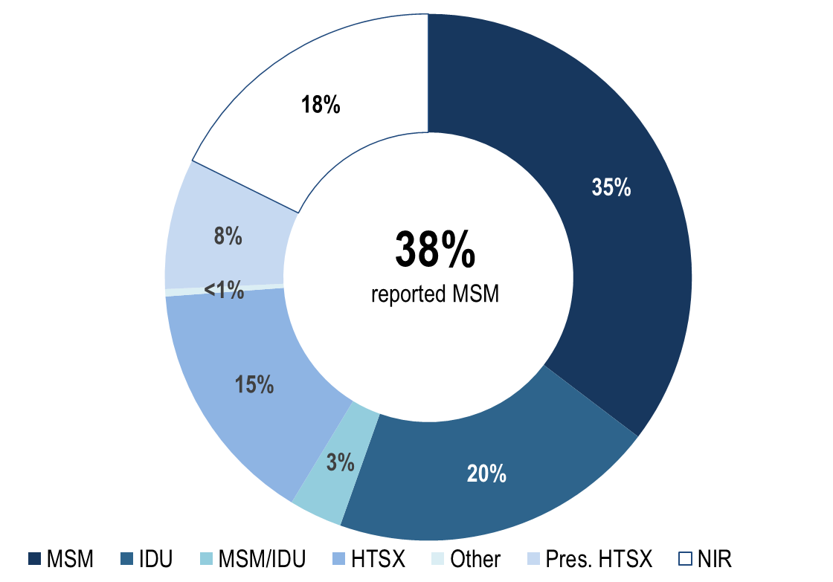
People aged 60+ years living with HIV infection by exposure mode, Massachusetts 2023¹ (N=8,726)
¹ Please consider the impact of the COVID-19 pandemic on infectious disease screening, treatment, and surveillance in the interpretation of data from 2020 to 2023.
Data Source: Bureau of Infectious Disease and Laboratory Sciences, data are current as of 7/1/2024 and subject to change
Notes:
The figure is an open pie chart which displays the distribution by exposure mode of persons aged 60+ years living with HIV infection. Text in the center of the pie chart reads, “38% reported MSM".
Individuals with MSM exposure mode accounted for the largest proportion of PLWH aged 60+ years. In 2023,^{i} 35% of PLWH aged 60+ years were reported with an exposure mode of MSM and an additional 3% were reported with an exposure mode of MSM/IDU. This compares to 43% and 4% respectively for individuals aged under 60 years.
Twenty percent of persons aged 60+ years were reported with an exposure mode of IDU and an additional 3% were reported with an exposure mode MSM/IDU. This compares to 11% and 4%, respectively, for individuals aged under 60 years.

Slide 10
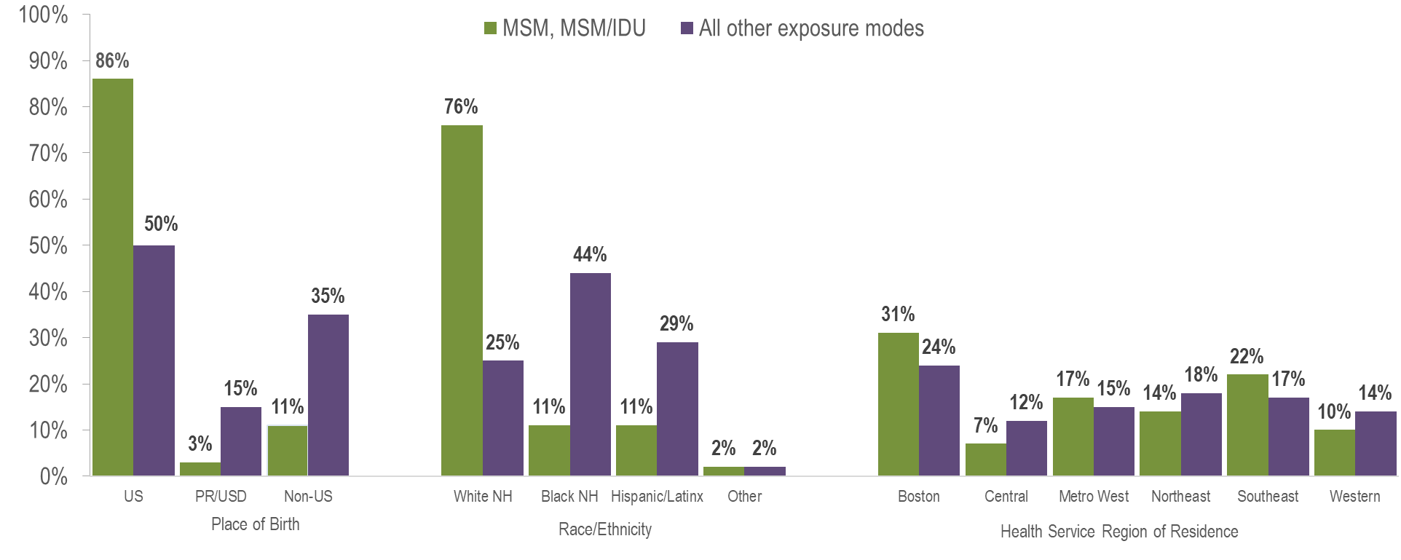
PLWH aged 60+ years with MSM or MSM/IDU exposure mode (N=3,374) compared to PLWH aged 60+ years with other exposure modes (N=5,352) by selected demographics, Massachusetts 2023¹
¹ Please consider the impact of the COVID-19 pandemic on infectious disease screening, treatment, and surveillance in the interpretation of data from 2020 to 2023.
Data Source: Bureau of Infectious Disease and Laboratory Sciences, data are current as of 7/1/2024 and subject to change
Notes:
The figure is a bar chart which compares the percentage distribution of PLWH aged 60+ years with MSM and MSM/IDU exposure modes to PLWH aged 60+ years with all other exposure modes by place of birth (US, PR/USD, non-US), Race/ethnicity (White NH, Black NH, Hispanic/Latinx, Other), and Health Service Region of Residence (Boston, Central, Metro West, Northeast, Southeast, Western).
In 2023, a larger proportion of older PLWH with MSM exposure modes:*
was born in the United States, as compared to older PLWH with other exposure modes (86% vs. 50%);
was White (non-Hispanic), as compared to older PLWH with other exposure modes (76% vs. 25%); and
was living in the Boston or Southeast Health Service Regions, as compared to older PLWH with other exposure modes (31% and 22%, respectively vs. 24% and 17%, respectively).
* Includes MSM and MSM/IDU exposure modes

Slide 11
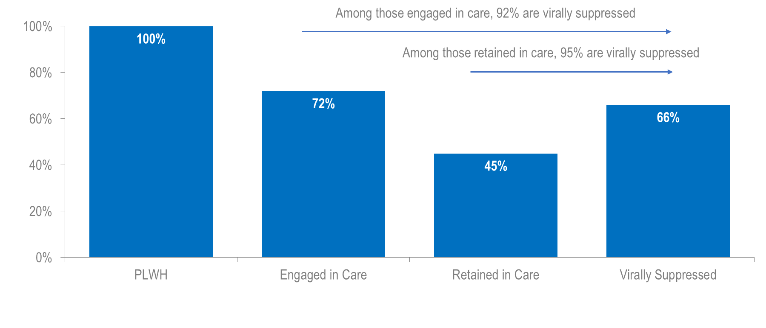
Stages of HIV care among MSM (including MSM/IDU) aged 60+ years living with HIV infection, Massachusetts 2023¹ (N=3,257)
¹ Please consider the impact of the COVID-19 pandemic on infectious disease screening, treatment, and surveillance in the interpretation of data from 2020 to 2023.
HIV care continuum among persons living with HIV infection (PLWH) in Massachusetts: “PLWH” refers to individuals diagnosed through 2022, alive through 12/31/2023, and living in Massachusetts based on last known address. “Engaged in Care” is defined as having ≥1 VL or CD4 test result in 2023. “Retained in Care” is defined as having ≥2 VL or CD4 test results at least 3 months apart in 2023. “Virally Suppressed” is defined as having a VL <200 copies/mL for the most recent VL test drawn in 2023.
Data Source: Bureau of Infectious Disease and Laboratory Sciences, data are current as of 7/1/2024 and subject to change
Notes:
The figure is a bar chart displaying the percentage of MSM (including MSM/IDU) aged 60+ years living with HIV infection in Massachusetts in 2023 who were engaged in care (72%), retained in care (45%), and virally suppressed (66%).
In Massachusetts, among 3,257 PLWH aged 60+ years in 2023^{ii} (and diagnosed through 2022) with MSM exposure modes,^{iii} 66% were virally suppressed, 2% were not virally suppressed, and 33% did not have a viral load test in 2023. Among those older PLWH with MSM exposure modes who were engaged in care (N=2,338) and retained in care (N=1,471), rates of viral suppression were higher at 92% and 95%, respectively. Engagement in care and viral suppression proportions were slightly higher among older PLWH with MSM exposure modes (72% and 66%, respectively) as compared to older PLWH with all other exposure modes (69% and 64%, respectively, data not shown). In 2023, engagement in care and viral suppression among older PLWH with MSM exposure modes differed by place of birth, race/ethnicity, and health service region of residence. Both were lowest among MSM born outside the US and those of Hispanic/Latinx ethnicity. Engagement in care and viral suppression rates were higher in the Western HSR compared to other HSRs.

Slide 12
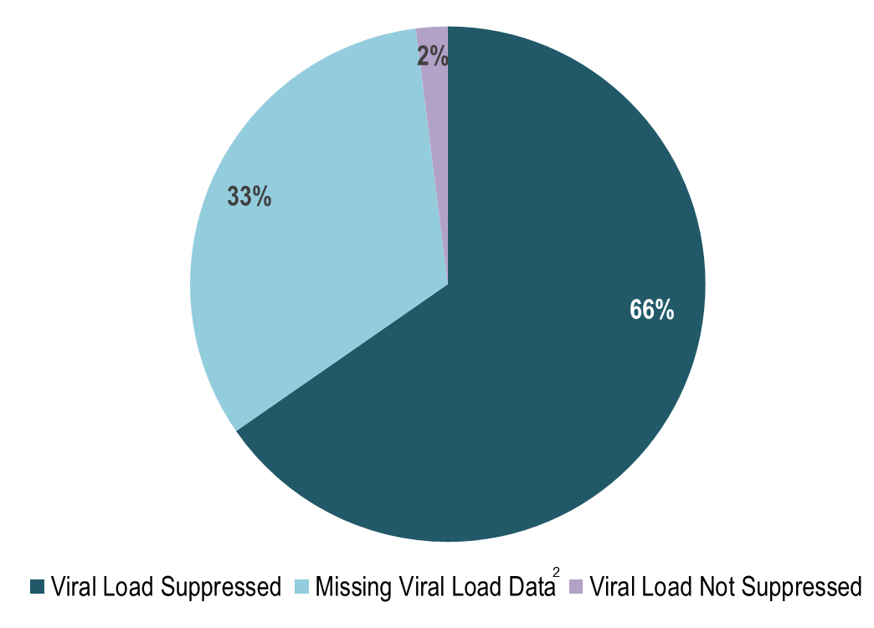
Viral load status MSM (including MSM/IDU) aged 60+ years living with HIV infection, Massachusetts 2023¹ (N=3,257)
¹ Please consider the impact of the COVID-19 pandemic on infectious disease screening, treatment, and surveillance in the interpretation of data from 2020 to 2023.
² Includes individuals who had not had a lab reported in the past year.
HIV care continuum among persons living with HIV infection (PLWH) in Massachusetts: “PLWH” refers to individuals diagnosed through 2022, alive through 12/31/2023, and living in Massachusetts based on last known address. “Engaged in Care” is defined as having ≥1 VL or CD4 test result in 2023. “Retained in Care” is defined as having ≥2 VL or CD4 test results at least 3 months apart in 2023. “Virally Suppressed” is defined as having a VL <200 copies/mL for the most recent VL test drawn in 2023.
Data Source: Bureau of Infectious Disease and Laboratory Sciences, data are current as of 7/1/2024 and subject to change
Notes:
The figure is a pie chart indicating the proportion of MSM (including MSM/IDU) aged 60+ years living with HIV infection in Massachusetts in 2023 who were virally suppressed (66%), missing viral load data (2%), or for whom viral load was not suppressed (33%). NOTE: Missing viral load data includes individuals who have not had a lab reported in the past year.
In Massachusetts, among 3,257 PLWH aged 60+ years in 2023^{ii} (and diagnosed through 2022) with MSM exposure modes, 66% were virally suppressed, 2% were not virally suppressed, and 33% did not have a viral load test in 2023. Among those older PLWH with MSM exposure modes who were engaged in care (N=2,338) and retained in care (N=1,471), rates of viral suppression were higher at 92% and 95%, respectively. Engagement in care and viral suppression proportions were slightly higher among older PLWH with MSM exposure modes (72% and 66%, respectively) as compared to older PLWH with all other exposure modes (69% and 64%, respectively, data not shown). In 2023, engagement in care and viral suppression among older PLWH with MSM exposure modes differed by place of birth, race/ethnicity, and health service region of residence. Both were lowest among MSM born outside the US and those of Hispanic/Latinx ethnicity. Engagement in care and viral suppression rates were higher in the Western HSR compared to other HSRs.

Slide 13
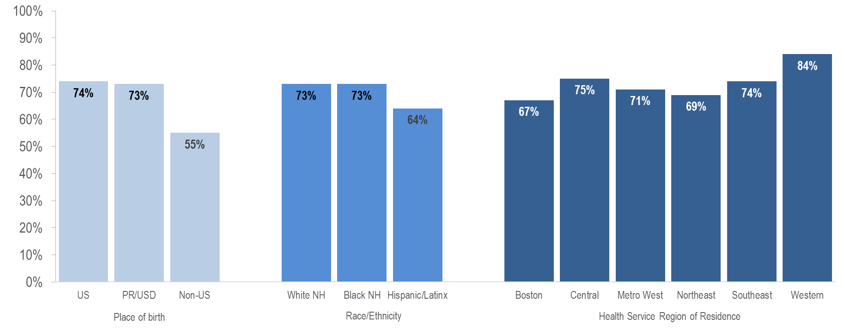
Engagement in care among MSM (including MSM/IDU) aged 60+ years living with HIV infection by place of birth, race/ethnicity, and Health Service Region of residence, Massachusetts 2023¹ (N=3,257)
¹ Please consider the impact of the COVID-19 pandemic on infectious disease screening, treatment, and surveillance in the interpretation of data from 2020 to 2023.
HIV care continuum among persons living with HIV infection (PLWH) in Massachusetts: “PLWH” refers to individuals diagnosed through 2022, alive through 12/31/2023, and living in Massachusetts based on last known address. “Engaged in Care” is defined as having ≥1 VL or CD4 test result in 2023. “Retained in Care” is defined as having ≥2 VL or CD4 test results at least 3 months apart in 2023. “Virally Suppressed” is defined as having a VL <200 copies/mL for the most recent VL test drawn in 2023.
Data Source: Bureau of Infectious Disease and Laboratory Sciences, data are current as of 7/1/2024 and subject to change
Notes:
The figure is a bar chart which displays the percentage of individuals who were engaged in care among MSM (including MSM/IDU) aged 60+ years living with HIV infection in Massachusetts by place of birth (US, PR/USD, Non-US), race/ethnicity (White NH, Black NH, Hispanic/Latinx), and Health Service Region (Boston, Central, Metro West, Northeast, Southeast, and Western).
Only 55% (N=196/354) of non-US born older MSM living with HIV infection were engaged in care, compared to 74% (N=2,072/2,807) of older US born MSM and 73% (N=70/96) of older MSM born in Puerto Rico/US Dependencies.

Slide 14
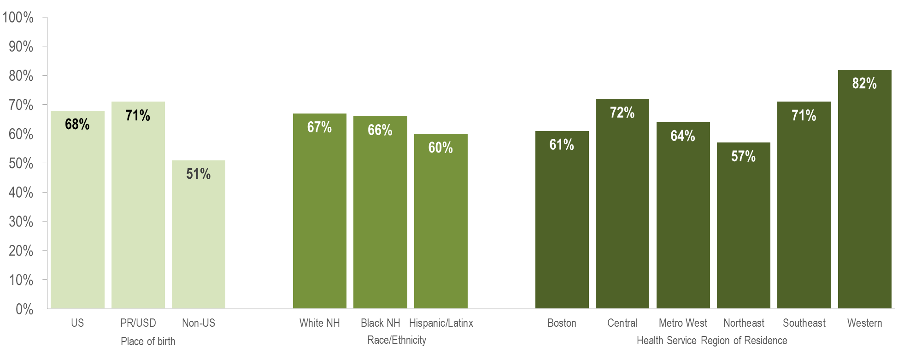
Viral suppression among MSM (including MSM/IDU) aged 60+ years living with HIV infection by place of birth, race/ethnicity, and Health Service Region of residence, Massachusetts 2023¹ (N=3,257)
¹ Please consider the impact of the COVID-19 pandemic on infectious disease screening, treatment, and surveillance in the interpretation of data from 2020 to 2023.
HIV care continuum among persons living with HIV infection (PLWH) in Massachusetts: “PLWH” refers to individuals diagnosed through 2022, alive through 12/31/2023, and living in Massachusetts based on last known address. “Engaged in Care” is defined as having ≥1 VL or CD4 test result in 2023. “Retained in Care” is defined as having ≥2 VL or CD4 test results at least 3 months apart in 2023. “Virally Suppressed” is defined as having a VL <200 copies/mL for the most recent VL test drawn in 2023.
Data Source: Bureau of Infectious Disease and Laboratory Sciences, data are current as of 7/1/2024 and subject to change
Notes:
The figure is a bar chart which displays the percentage of individuals who were virally suppressed among MSM (including MSM/IDU) aged 60+ years living with HIV infection in Massachusetts by place of birth (US, PR/USD, Non-US), race/ethnicity (White NH, Black NH, Hispanic/Latinx), and Health Service Region (Boston, Central, Metro West, Northeast, Southeast, and Western).
Only 51% (N=181/354) of non-US born older MSM living with HIV infection were virally suppressed, compared to 68% (N=1,896/2,807) of older US born MSM and 71% (N=68/96) of older MSM born in Puerto Rico/US Dependencies. However, it is important to note that a much greater proportion of older non-US born MSM living with HIV infection were missing viral load information (47%) compared to those born in the US (31%) or Puerto Rico/US dependencies (29%) and that the proportion known to be not virally suppressed was similar for all groups (2% for US born and Non-US born and 0% for those born in Puerto Rico/US Dependencies). This difference may highlight limited access to clinical documentation and/or less access to viral load testing in the country of origin for non-US born individuals, particularly those who have recently arrived.

Slide 15
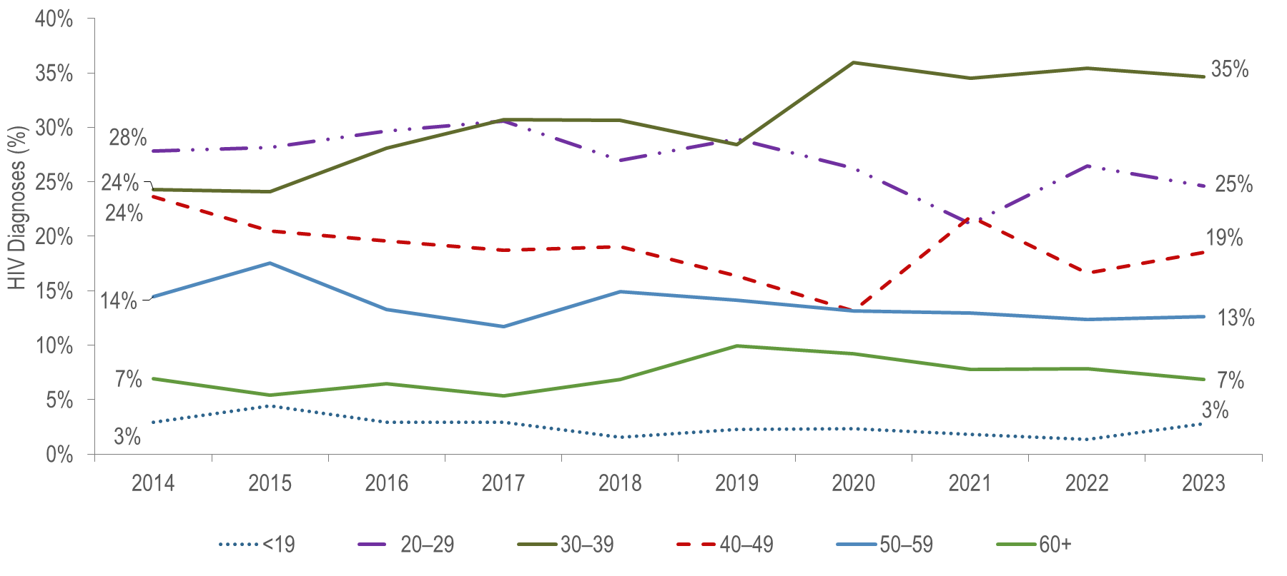
Individuals diagnosed with HIV infection by age at diagnosis, Massachusetts 2014 – 2023¹
¹ Please consider the impact of the COVID-19 pandemic on infectious disease screening, treatment, and surveillance in the interpretation of data from 2020 to 2023.
Data Source: Bureau of Infectious Disease and Laboratory Sciences, data are current as of 7/1/2024 and subject to change
Notes:
The figure is a trendline displaying the percentage distribution by age at diagnosis (<19, 20-29, 30-39, 40-49, 50-59, 60+) for individuals diagnosed with HIV infection for each year of the ten-year period.
From 2014 to 2023, the proportion of HIV infection diagnoses among 30–39 year-olds increased from 24% to 35%, while it decreased from 28% to 25% among 20–29 year-olds and from 24% to 19% among 40–49 year-olds.
During the same time period, the percentage of HIV infection diagnoses among individuals aged 50–59 years and individuals aged 60+ years remained relatively stable.
The average age at HIV infection diagnosis from 2014 to 2023 ranged from 36.9 years (2017) to 39.1 years (2021). Among individuals 60 years of age and older the average age at diagnosis ranged from 64.4 years (2020 and 2021) to 66.5 years (2022) (data not shown).

Slide 16
. Percentage of individuals diagnosed with HIV infection by age at diagnosis (<60 years [N=1,328] vs. 60+ years [N=107]) and sex assigned at birth,
Massachusetts 2021 – 2023¹
¹ Please consider the impact of the COVID-19 pandemic on infectious disease screening, treatment, and surveillance in the interpretation of data from 2020 to 2023.
Data Source: Bureau of Infectious Disease and Laboratory Sciences, data are current as of 7/1/2024 and subject to change
Notes:
The figure is a stacked bar chart displaying the distribution by sex assigned at birth (assigned male, assigned female) of two groups: individuals diagnosed with HIV infection at under 60 years of age and individuals diagnosed with HIV infection at age 60+ years of age.
KEY FINDING
A larger proportion of individuals recently diagnosed with HIV infection aged 60+ years (47%) than those aged under 60 years (26%) was assigned female at birth.

Slide 17
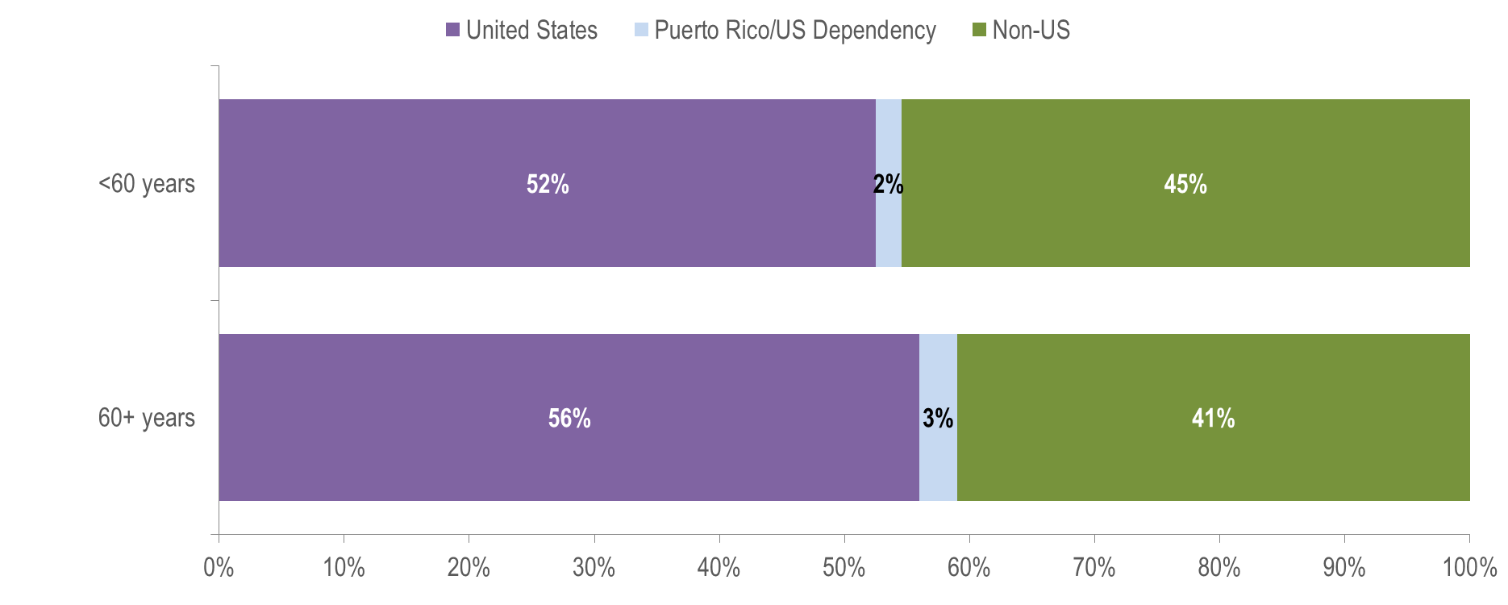
Percentage of individuals diagnosed with HIV infection by age at diagnosis (<60 years [N=1,328] vs. 60+ years [N=107]) and place of birth,
Massachusetts 2021 – 2023¹
¹ Please consider the impact of the COVID-19 pandemic on infectious disease screening, treatment, and surveillance in the interpretation of data from 2020 to 2023.
Data Source: Bureau of Infectious Disease and Laboratory Sciences, data are current as of 7/1/2024 and subject to change
Notes:
The figure is a stacked bar chart displaying the distribution by place of birth (United States, Puerto Rico, Non-US) of two groups: individuals diagnosed with HIV infection at under 60 years of age and individuals diagnosed with HIV infection at age 60+ years of age.
KEY FINDING
Forty-one percent of individuals aged 60+ years recently diagnosed with HIV infection were born outside the United States, compared to 45% of individuals aged under 60 years. Among individuals aged 60+ years recently diagnosed with HIV infection and born outside the United States, 32% were assigned male at birth (AMAB) and 68% were assigned female at birth (AFAB).

Slide 18
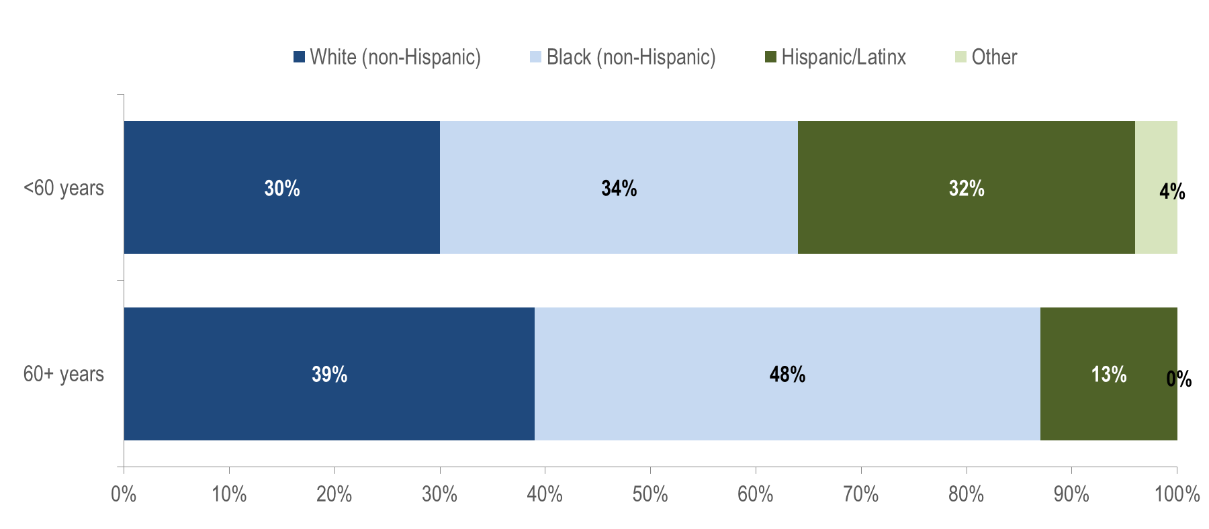
Percentage of individuals diagnosed with HIV infection by age at diagnosis (<60 years [N=1,328] vs. 60+ years [N=107]) and race/ethnicity,
Massachusetts 2021 – 2023¹
¹ Please consider the impact of the COVID-19 pandemic on infectious disease screening, treatment, and surveillance in the interpretation of data from 2020 to 2023.
Data Source: Bureau of Infectious Disease and Laboratory Sciences, data are current as of 7/1/2024 and subject to change
Notes:
The figure is a stacked bar chart displaying the distribution by race/ethnicity (white non-Hispanic, black non-Hispanic, Hispanic/Latinx, and other) of two groups: individuals diagnosed with HIV infection at under 60 years of age and individuals diagnosed with HIV infection at age 60+ years of age.
KEY FINDING
Forty-eight percent of individuals aged 60+ years recently diagnosed with HIV infection were Black (non-Hispanic), compared to 34% of individuals aged under 60 years.

Slide 19
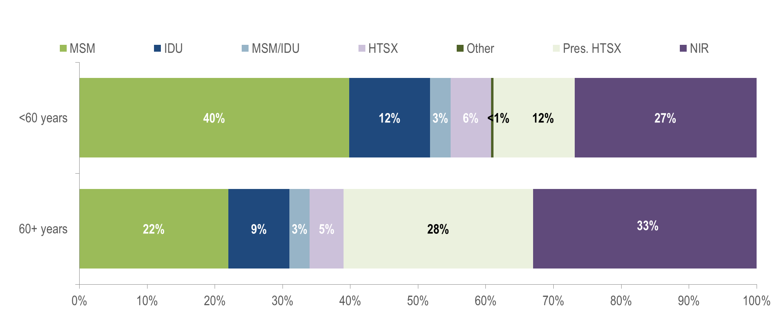
Percentage of individuals diagnosed with HIV infection by age at diagnosis (<60 years [N=1,328] vs. 60+ years [N=107]) and exposure mode,
Massachusetts 2021 – 2023¹
¹ Please consider the impact of the COVID-19 pandemic on infectious disease screening, treatment, and surveillance in the interpretation of data from 2020 to 2023.
Data Source: Bureau of Infectious Disease and Laboratory Sciences, data are current as of 7/1/2024 and subject to change
Notes:
The figure is a stacked bar chart displaying the distribution by exposure mode (male-to-male sex, injection drug use, MSM/IDU, heterosexual sex, Other, presumed heterosexual, and no identified risk) of two groups: individuals diagnosed with HIV infection at under 60 years of age and individuals diagnosed with HIV infection at age 60+ years of age.
KEY FINDING
Thirty-three percent (N=35/107) of individuals recently diagnosed with HIV infection at age 60+ years did not have exposure mode information reported that met CDC-defined categories, compared to 27% among individuals diagnosed under age 60 years. This highlights challenges in assigning primary exposure modes for the older adult population. Individuals aged 60+ years recently diagnosed without reported exposure mode information consisted predominantly of individuals AMAB (66%), individuals born outside the US (54%), and individuals of Black (non-Hispanic) (74%) race.

Slide 20
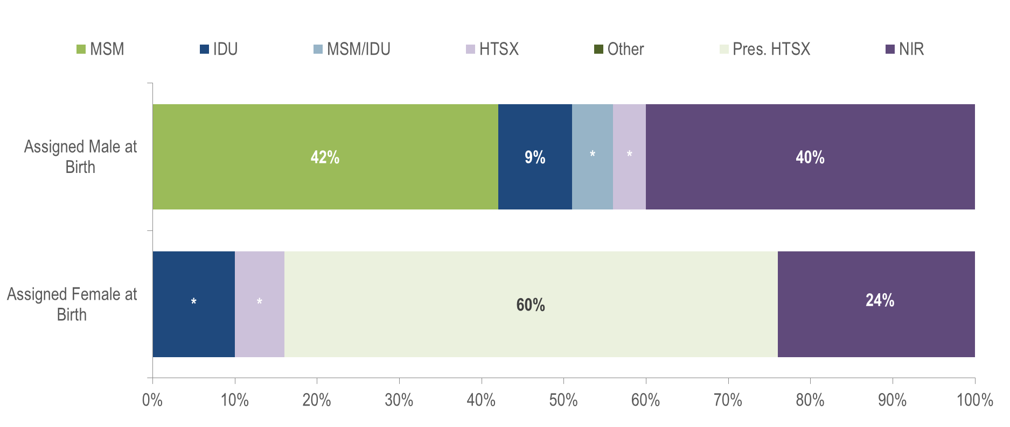
Percentage of individuals diagnosed with HIV infection at 60+ years (N=107) by sex assigned at birth and exposure mode, Massachusetts 2021 – 2023¹
¹ Please consider the impact of the COVID-19 pandemic on infectious disease screening, treatment, and surveillance in the interpretation of data from 2020 to 2023.
* Values less than five are suppressed for populations less than 50,000 or for populations of unknown size. Percentages do not add up to 100% due to suppressed value.
Data Source: Bureau of Infectious Disease and Laboratory Sciences, data are current as of 7/1/2024 and subject to change
Notes:
The figure is a stacked bar chart displaying the distribution by exposure mode (male-to-male sex, injection drug use, MSM/IDU, heterosexual sex, Other, presumed heterosexual, and no identified risk) of two groups: individuals AMAB and individuals AFAB diagnosed with HIV infection at age 60+ years of age.
Forty percent (N=23/57) of individuals AMAB recently diagnosed with HIV infection at age 60+ years did not have exposure mode information reported that met CDC-defined categories, compared to 24% (N=12/50) among individuals AFAB diagnosed at age 60+ years. Among individuals AMAB aged 60+ years recently diagnosed with HIV infection without exposure mode information, 52% were born outside the US. Comparatively, among individuals AFAB aged 60+ years recently diagnosed with HIV infection without exposure mode information, 58% were born outside the US.

Slide 21
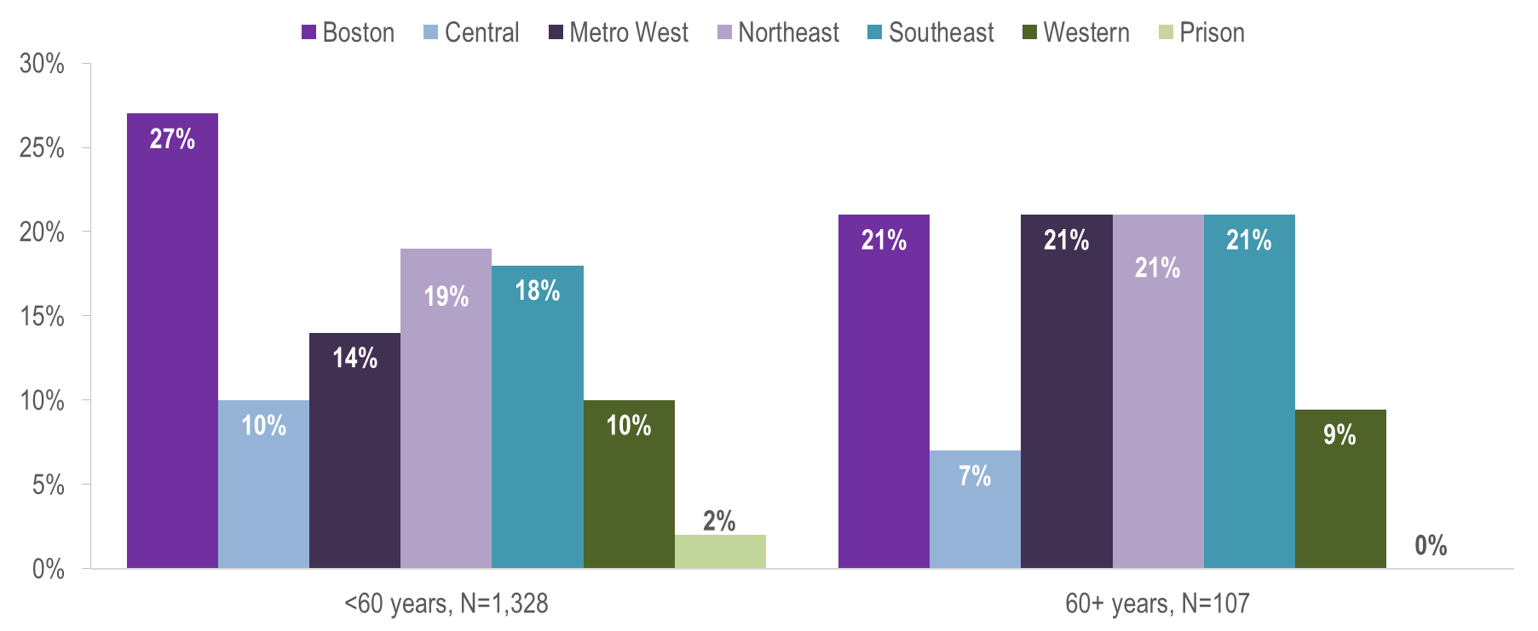
Percentage of individuals diagnosed with HIV infection by age at diagnosis (<60 years [N=1,328] vs. 60+ years [N=107]) and by Health Service Region (HSR) of residence, Massachusetts 2021 – 2023¹
¹ Please consider the impact of the COVID-19 pandemic on infectious disease screening, treatment, and surveillance in the interpretation of data from 2020 to 2023.
Data Source: Bureau of Infectious Disease and Laboratory Sciences, data are current as of 7/1/2024 and subject to change
Notes:
The figure is a bar chart displaying the percentage distribution by health service region (Boston, Central, Metro West, Northeast, Southeast, Western, and Prison) for two groups: individuals diagnosed with HIV infection at under 60 years of age and individuals diagnosed with HIV infection at age 60+ years of age.
A larger proportion of individuals recently diagnosed with HIV infection aged 60+ years (21%) than those aged under 60 years (14%) were living in the Metrowest HSR and a smaller proportion were living in the Boston HSR (21% vs. 27%).

