Slide 1
Massachusetts HIV Epidemiologic Profile:
Data as of 1/1/2023
Population Report: People Born Outside the United States
Notes:
Suggested citation:
Massachusetts Department of Public Health, Bureau of Infectious Disease and Laboratory Sciences. Massachusetts HIV/AIDS Epidemiologic Profile: Data as of 1/1/2023, Population Report: People Born Outside the United States, https://www.mass.gov/lists/hivaids-epidemiologic-profiles Published March 2024. Accessed [date].
Bureau of Infectious Disease and Laboratory Sciences Massachusetts Department of Public Health
Jamaica Plain Campus/State Public Health Laboratory
305 South Street Jamaica Plain, MA 02130
Questions about this report
Tel: (617) 983-6560
To reach the Reporting and Partner Services Line*
Tel: (617) 983-6999
To speak to the on-call epidemiologist
Tel: (617) 983-6800
Questions about infectious disease reporting
Tel: (617) 983-6801
Requests for additional data
https://www.mass.gov/lists/infectious-disease-data-reports-and-requests
Slide sets for HIV Epidemiologic Profile Reports
https://www.mass.gov/lists/hivaids-epidemiologic-profiles
* Providers may use this number to report individuals newly diagnosed with a notifiable sexually transmitted infection, including HIV, or request partner services. Partner services is a free and confidential service for individuals recently diagnosed with a priority infection. The client-centered program offers counseling, linkage to other health and social services, anonymous notification of partners who were exposed and assistance with getting testing and treatment. For more information, see: https://www.mass.gov/service-details/partner-services-program-information-for-healthcare-providers)

Slide 2
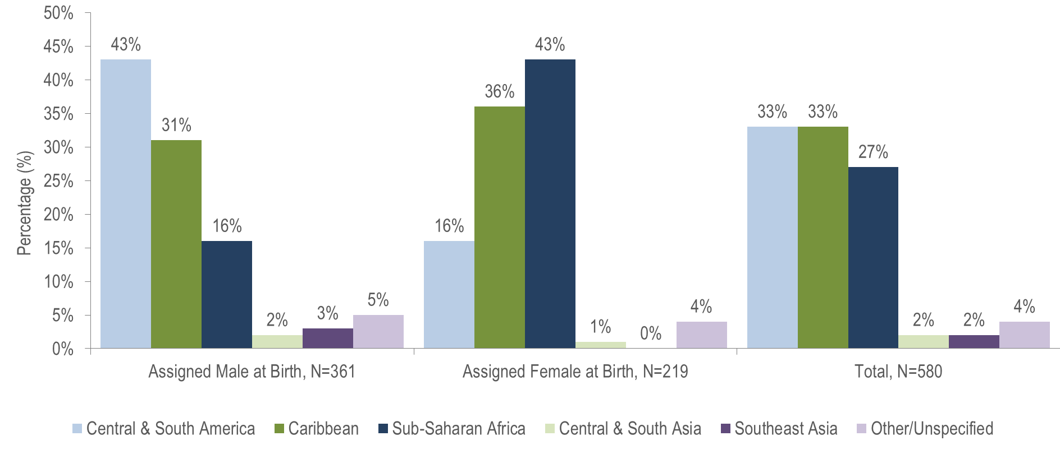
HIV diagnoses among people born outside the United States by sex assigned at birth and world region of birth, Massachusetts 2019–2021¹
¹ Please consider the impact of the COVID-19 pandemic on infectious disease screening, treatment, and surveillance in the interpretation of data from 2020 to 2021.
Data Source: Bureau of Infectious Disease and Laboratory Sciences, data are current as of 1/1/2023 and subject to change
Notes:
The figure is a bar chart displaying the percentage distribution of individuals assigned male at birth (N=361), individuals assigned female at birth (N=219), and all individuals (N=580) born outside the US by world region of birth (sub-Saharan Africa, Caribbean, Central and South America, Southeast Asia, Central and South Asia, and Other/Unspecified).
KEY FACT
People born outside the United States and diagnosed with HIV infection in Massachusetts from 2019 to 2021 were primarily from Central and South America (33%), the Caribbean (33%), and Sub-Saharan Africa (27%).

Slide 3
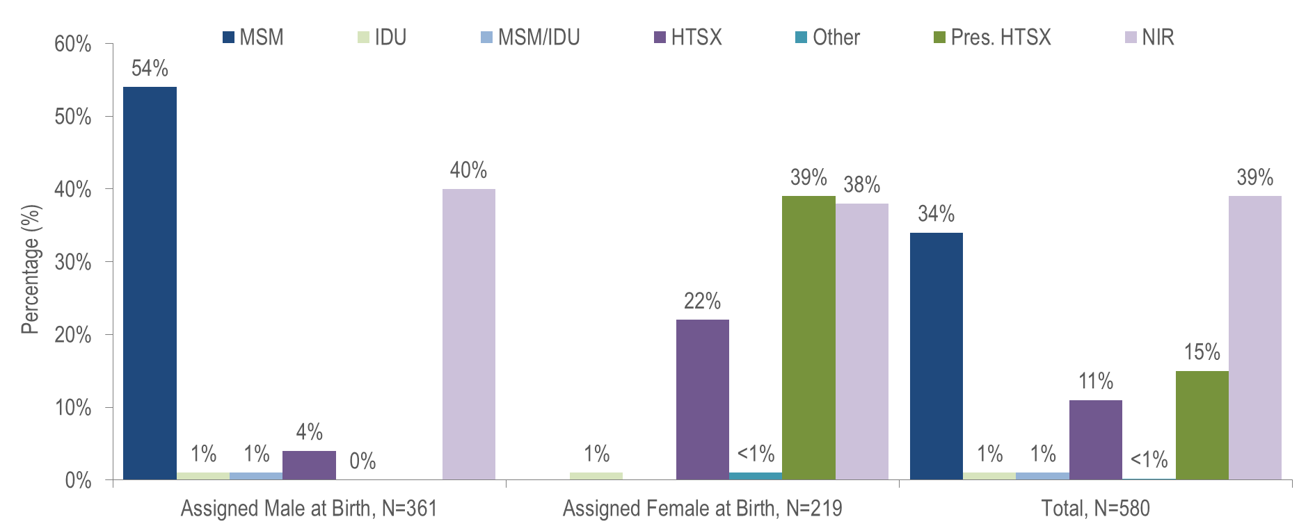
HIV diagnoses among people born outside the United States by sex assigned at birth and exposure mode, Massachusetts 2019–2021¹
¹ Please consider the impact of the COVID-19 pandemic on infectious disease screening, treatment, and surveillance in the interpretation of data from 2020 to 2021.
MSM=Male-to-Male Sex; IDU=Injection Drug Use; HTSX=Heterosexual Sex; Pres. HTSX=presumed heterosexual exposure, includes individuals assigned female at birth with a negative history of injection drug use who report having sex with an individual that identifies as male of unknown HIV status and risk; NIR=No Identified Risk
Data Source: Bureau of Infectious Disease and Laboratory Sciences, data are current as of 1/1/2023 and subject to change
Notes:
The figure is a bar chart displaying the percentage distribution of individuals assigned male at (N=361), individuals assigned female at birth (N=219), and all individuals (N=580) born outside the US by exposure mode (Male-to-Male Sex, Injection Drug Use, Male-to-Male Sex/Injection Drug Use, Heterosexual Sex, Other, Presumed Heterosexual Sex, and No Identified Risk).
KEY FACT
Thirty-nine percent of the 580 non-US born individuals recently diagnosed with HIV infection (2019–2021) did not have exposure mode information reported that met CDC-defined categories, indicating challenges in assigning primary exposure modes for this population.

Slide 4
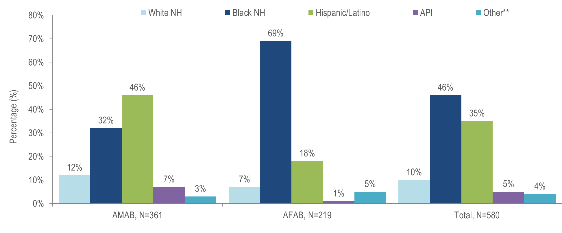
HIV diagnoses among people born outside the US by sex assigned at birth and race/ethnicity, Massachusetts 2019–2021¹
¹ Please consider the impact of the COVID-19 pandemic on infectious disease screening, treatment, and surveillance in the interpretation of data from 2020 to 2021.
** Other includes more than one race/ethnicity, unknown, and other race/ethnicities (Native American/Alaska Native), API=Asian/Pacific Islander, NH=Non-Hispanic, AMAB=Assigned Male at Birth, AFAB=Assigned Female at Birth
Data Source: Bureau of Infectious Disease and Laboratory Sciences, data are current as of 1/1/2023 and subject to change
Notes:
The figure is a bar chart displaying the percentage distribution of individuals assigned male at birth (N=361), individuals assigned female at birth (N=219), and all individuals (N=580) born outside the US by race/ethnicity (White (non-Hispanic), Black (non-Hispanic), Hispanic/Latino, Asian/Pacific Islander, Other/Unknown).
Among individuals AMAB born outside the US and newly diagnosed with HIV infection in Massachusetts from 2019 to 2021, 46% were Hispanic/Latino and 32% were black (non-Hispanic).
The majority (69%) of individuals AFAB born outside the US and newly diagnosed with HIV infection in Massachusetts from 2019 to 2021 were black (non-Hispanic).

Slide 5
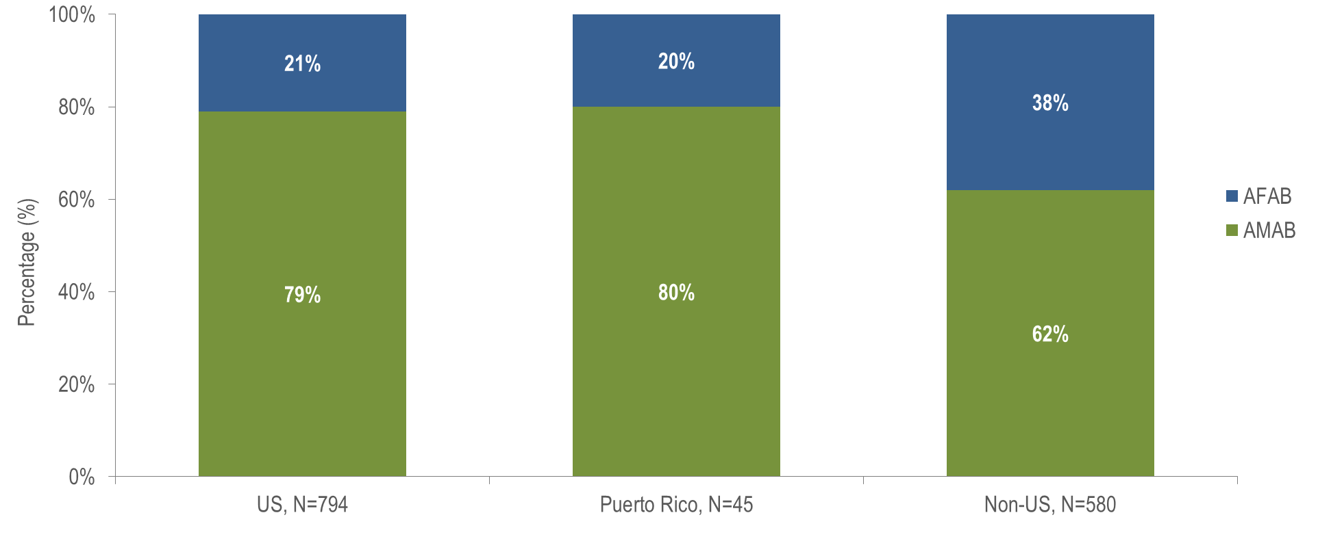
HIV diagnoses by sex assigned at birth and place of birth, Massachusetts 2019–2021¹
¹ Please consider the impact of the COVID-19 pandemic on infectious disease screening, treatment, and surveillance in the interpretation of data from 2020 to 2021. AMAB=Assigned Male at Birth, AFAB=Assigned Female at Birth
Data Source: Bureau of Infectious Disease and Laboratory Sciences, data are current as of 1/1/2023 and subject to change
Notes:
The figure is a stacked bar chart displaying the percentage distribution by sex assigned at birth (female, male) for three groups: US born individuals (N=794), individuals born in Puerto Rico (N=45), and non-US born individuals (N=580).
Thirty-eight percent of non-US born individuals diagnosed with HIV infection from 2019 to 2021 were AFAB, compared to 21% of US born individuals and 20% of individuals born in Puerto Rico.

Slide 6
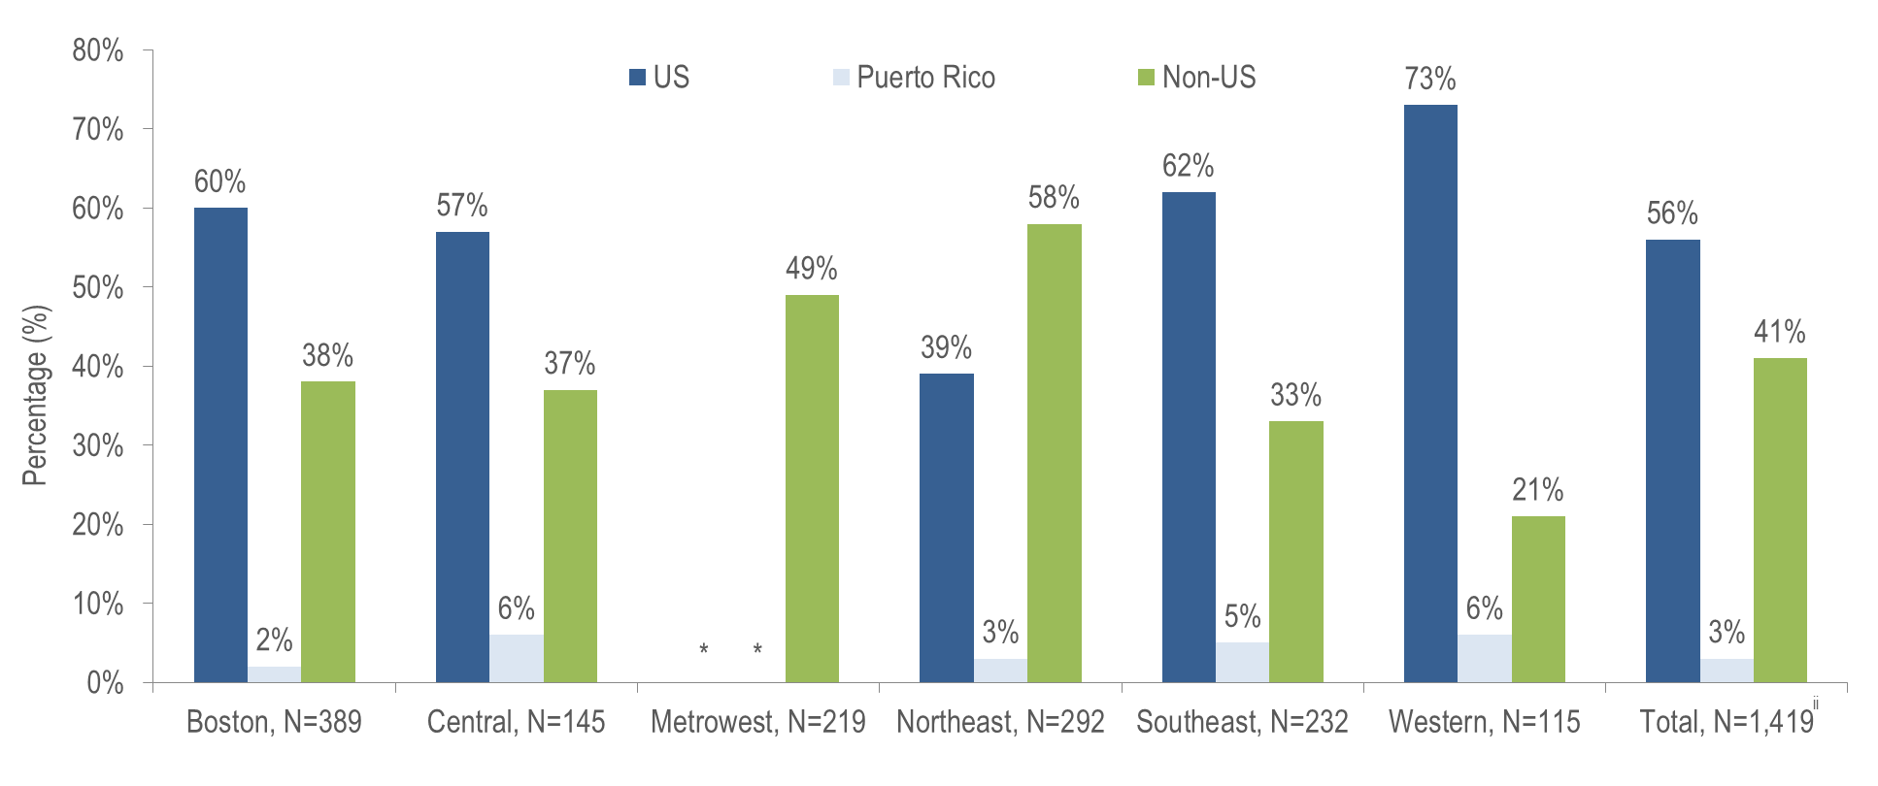
HIV infection diagnoses by Health Service Region^{i} and place of birth, Massachusetts 2019–2021¹
¹ Please consider the impact of the COVID-19 pandemic on infectious disease screening, treatment, and surveillance in the interpretation of data from 2020 to 2021.
^{i} HSR is based on residence at HIV infection diagnosis.
^{ii} Total includes individuals diagnosed in a correctional facility.
* Values less than five are suppressed for populations less than 50,000 or for populations of unknown size. Additional values may be suppressed to protect privacy
Data Source: Bureau of Infectious Disease and Laboratory Sciences, data are current as of 1/1/2023 and subject to change
Notes:
The figure is a bar chart displaying the percentage distribution by place of birth (US, Puerto Rico/US Dependency, Non-US) for Massachusetts Total (N=1,419) and six Health Service Regions: Boston (N=389), Central (N=145), Metrowest (N=219), Northeast, (N=292), Southeast (N=232), and Western (N=115).
The Northeast (58%) and Metrowest (49%) Health Service Regions had the largest proportions of individuals recently diagnosed with HIV infection who were born outside the United States.

