Slide 1
Massachusetts HIV Epidemiologic Profile:
Data as of 7/1/2023
Population Report: People Born Outside the United States
Notes:
Suggested citation:
Massachusetts Department of Public Health, Bureau of Infectious Disease and Laboratory Sciences. Massachusetts HIV Epidemiologic Profile: Data as of 7/1/2024, Population Report: People Born Outside the United States, https://www.mass.gov/lists/hivaids-epidemiologic-profiles Published June 2025. Accessed [date].
Bureau of Infectious Disease and Laboratory Sciences
Massachusetts Department of Public Health
Jamaica Plain Campus/State Public Health Laboratory
305 South Street
Jamaica Plain, MA 02130
Questions about this report
Tel: (617) 983-6560
To reach the Reporting and Partner Services Line*
Tel: (617) 983-6999
To speak to the on-call epidemiologist
Tel: (617) 983-6800
Questions about infectious disease reporting
Tel: (617) 983-6801
HIV Data Dashboard
https://www.mass.gov/info-details/hiv-data-dashboard
Requests for additional data
https://www.mass.gov/lists/infectious-disease-data-reports-and-requests
Slide sets for HIV Epidemiologic Profile Reports
https://www.mass.gov/lists/hivaids-epidemiologic-profiles
* Providers may use this number to report individuals newly diagnosed with a notifiable sexually transmitted infection, including HIV, or request partner services. Partner services is a free and confidential service for individuals recently diagnosed with a priority infection. The client-centered program offers counseling, linkage to other health and social services, anonymous notification of partners who were exposed and assistance with getting testing and treatment. For more information, see: https://www.mass.gov/service-details/partner-services-program-information-for-healthcare-providers)

Slide 2
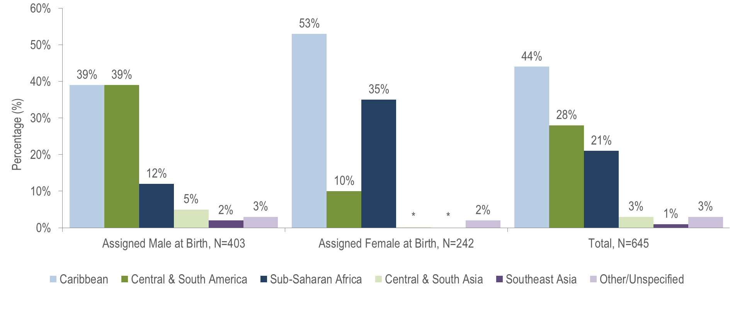
HIV diagnoses among people born outside the United States by sex assigned at birth and world region of birth, Massachusetts 2021–2023¹
* Values less than five are suppressed for populations less than 50,000 or for populations of unknown size. Percentages do not add up to 100% due to suppressed value
¹ Please consider the impact of the COVID-19 pandemic on infectious disease screening, treatment, and surveillance in the interpretation of data from 2020 to 2023.
Data Source: Bureau of Infectious Disease and Laboratory Sciences, data are current as of 7/1/2024 and subject to change
Notes:
The figure is a bar chart displaying the percentage distribution of individuals assigned male at birth (N=403), individuals assigned female at birth (N=242), and all individuals (N=645) born outside the US by world region of birth (sub-Saharan Africa, Caribbean, Central and South America, Southeast Asia, Central and South Asia, and Other/Unspecified).
KEY FACT
People born outside the United States and diagnosed with HIV infection in Massachusetts from 2021 to 2023 were primarily from the Caribbean (44%), Central and South America (28%), and Sub-Saharan Africa (21%).
There were differences in the distribution of individuals assigned male at birth (AMAB) and individuals assigned female at birth (AFAB) recently diagnosed with HIV infection by world region of birth. The largest proportion of individuals AFAB was from the Caribbean (53%), while the largest proportion of individuals AMAB was equally from the Caribbean and Central and South America (both 39%).

Slide 3
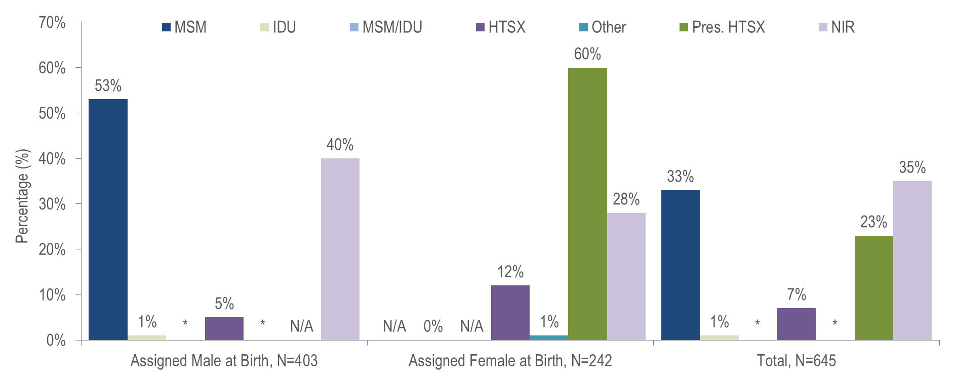
HIV diagnoses among people born outside the United States by sex assigned at birth and exposure mode, Massachusetts 2021–2023¹
¹ Please consider the impact of the COVID-19 pandemic on infectious disease screening, treatment, and surveillance in the interpretation of data from 2020 to 2023.
* Values less than five are suppressed for populations less than 50,000 or for populations of unknown size. Percentages do not add up to 100% due to suppressed value. MSM=Male-to-Male Sex; IDU=Injection Drug Use; HTSX=Heterosexual Sex; Pres. HTSX=presumed heterosexual exposure, includes individuals assigned female at birth with a negative history of injection drug use who report having sex with an individual that identifies as male of unknown HIV status and risk; NIR=No Identified Risk; N/A = not applicable; Data Source: Bureau of Infectious Disease and Laboratory Sciences, data are current as of 7/1/2024 and subject to change
Notes:
The figure is a bar chart displaying the percentage distribution of individuals assigned male at birth (N=403), individuals assigned female at birth (N=242), and all individuals (N=645) born outside the US by exposure mode (Male-to-Male Sex, Injection Drug Use, Male-to-Male Sex/Injection Drug Use, Heterosexual Sex, Other, Presumed Heterosexual Sex, and No Identified Risk).
KEY FACT
Thirty-five percent of the 645 non-US born individuals recently diagnosed with HIV infection (2021–2023)^{i} did not have exposure mode information reported that met CDC-defined categories, indicating challenges in assigning primary exposure modes for this population.

Slide 4
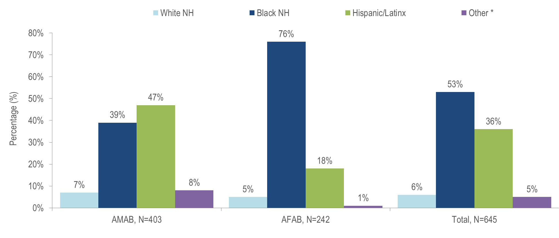
HIV diagnoses among people born outside the US by sex assigned at birth and race/ethnicity, Massachusetts 2021–2023¹
¹ Please consider the impact of the COVID-19 pandemic on infectious disease screening, treatment, and surveillance in the interpretation of data from 2020 to 2023.
* Other includes more than one race/ethnicity, unknown, and other race/ethnicities (Native American/Alaska Native), API=Asian/Pacific Islander, NH=Non-Hispanic, AMAB=Assigned Male at Birth, AFAB=Assigned Female at Birth
Data Source: Bureau of Infectious Disease and Laboratory Sciences, data are current as of 7/1/2024 and subject to change
Notes:
The figure is a bar chart displaying the percentage distribution of individuals assigned male at birth (N=403), individuals assigned female at birth (N=242), and all individuals (N=645) born outside the US by race/ethnicity (White (non-Hispanic), Black (non-Hispanic), Hispanic/Latinx, Other).
Among individuals AMAB born outside the US and newly diagnosed with HIV infection in Massachusetts from 2021 to 2023, 47% were Hispanic/Latinx and 39% were Black (non-Hispanic).
The majority (76%) of individuals AFAB born outside the US and newly diagnosed with HIV infection in Massachusetts from 2021 to 2023 were Black (non-Hispanic).

Slide 5
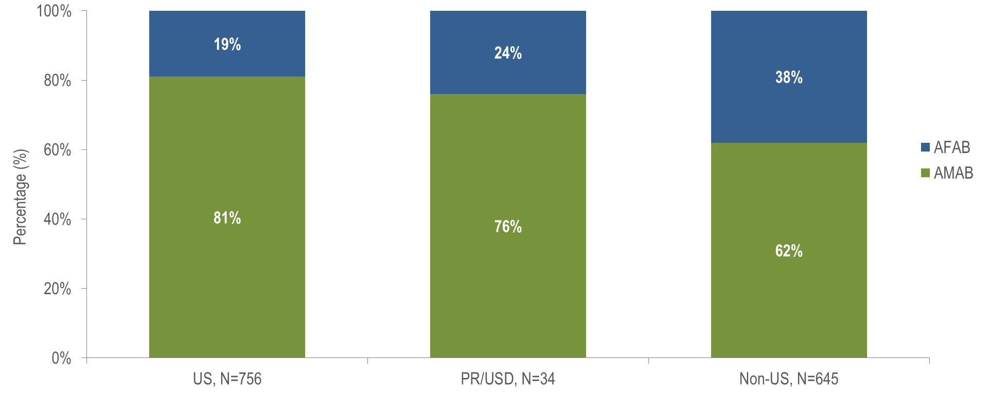
HIV diagnoses by sex assigned at birth and place of birth,
Massachusetts 2021–2023¹
¹ Please consider the impact of the COVID-19 pandemic on infectious disease screening, treatment, and surveillance in the interpretation of data from 2020 to 2023. AMAB=Assigned Male at Birth, AFAB=Assigned Female at Birth
Data Source: Bureau of Infectious Disease and Laboratory Sciences, data are current as of 7/1/2024 and subject to change
Notes:
The figure is a stacked bar chart displaying the percentage distribution by sex assigned at birth (female, male) for three groups: US born individuals (N=756), individuals born in Puerto Ric/US Dependencies (N=34), and non-US born individuals (N=645).
Thirty-eight percent of non-US born individuals diagnosed with HIV infection from 2021 to 2023 were AFAB, compared to 19% of US born individuals and 24% of individuals born in Puerto Rico/US Dependencies.

Slide 6
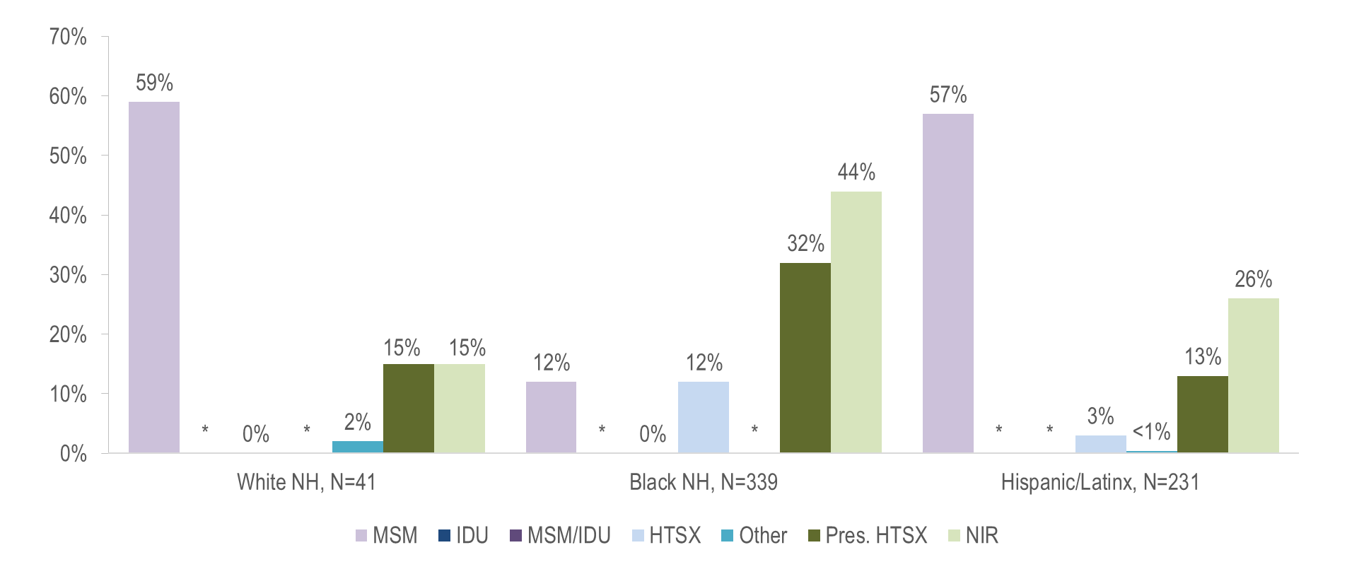
HIV diagnoses among individuals born outside the US by exposure mode and race/ethnicity, Massachusetts 2021–2023¹
¹ Please consider the impact of the COVID-19 pandemic on infectious disease screening, treatment, and surveillance in the interpretation of data from 2020 to 2023.
* Values less than five are suppressed for populations less than 50,000 or for populations of unknown size. Percentages do not add up to 100% due to suppressed value. MSM=Male-to-Male Sex; IDU=Injection Drug Use; HTSX=Heterosexual Sex; Pres. HTSX=presumed heterosexual exposure, includes individuals assigned female at birth with a negative history of injection drug use who report having sex with an individual that identifies as male of unknown HIV status and risk; NIR=No Identified Risk; Data Source: Bureau of Infectious Disease and Laboratory Sciences, data are current as of 7/1/2024 and subject to change
Notes:
The figure is a bar chart displaying the distribution of recent HIV diagnoses by exposure mode for each of three racial/ethnic groups among people born outside the US: White NH (N=41), Black NH (N=339), and Hispanic/Latinx (N=231).
While the predominant exposure mode among White (non-Hispanic) and Hispanic/Latinx individuals born outside the US and recently diagnosed with HIV infection was MSM (59% and 57%, respectively), the largest proportion of Black (non-Hispanic) individuals was assigned no identified risk for exposure mode (44%).

Slide 7
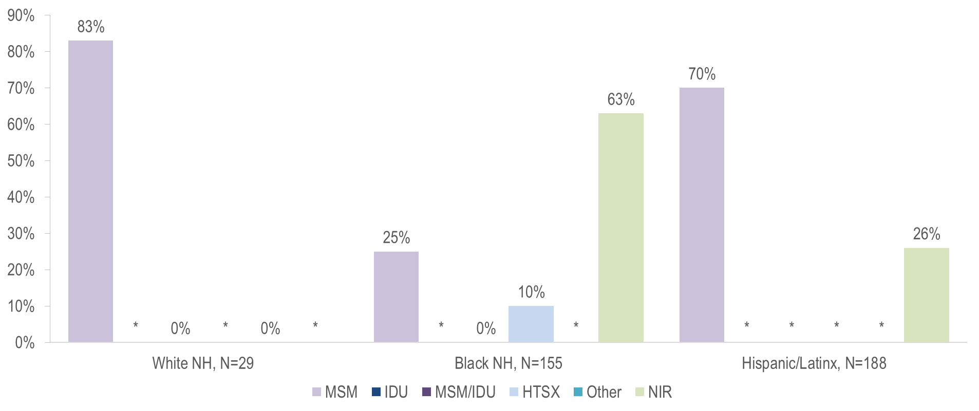
HIV diagnoses among individuals AMAB born outside the US by exposure mode and race/ethnicity, Massachusetts 2021–2023¹
¹ Please consider the impact of the COVID-19 pandemic on infectious disease screening, treatment, and surveillance in the interpretation of data from 2020 to 2023.
* Values less than five are suppressed for populations less than 50,000 or for populations of unknown size. Percentages do not add up to 100% due to suppressed value. MSM=Male-to-Male Sex; IDU=Injection Drug Use; HTSX=Heterosexual Sex; NIR=No Identified Risk Data Source: Bureau of Infectious Disease and Laboratory Sciences, data are current as of 7/1/2024 and subject to change
Notes:
The figure is a bar chart displaying the distribution of recent HIV diagnoses among individuals assigned male at birth and born outside the US by exposure mode for each of three racial/ethnic groups: White NH (N=29), Black NH (N=155), and Hispanic/Latinx (N=188).
MSM was the most frequently reported exposure mode among White (non-Hispanic) (83%) and Hispanic/Latinx (70%) individuals AMAB born outside the US, while NIR accounted for the largest proportion among Black (non-Hispanic) individuals AMAB (63%).

Slide 8
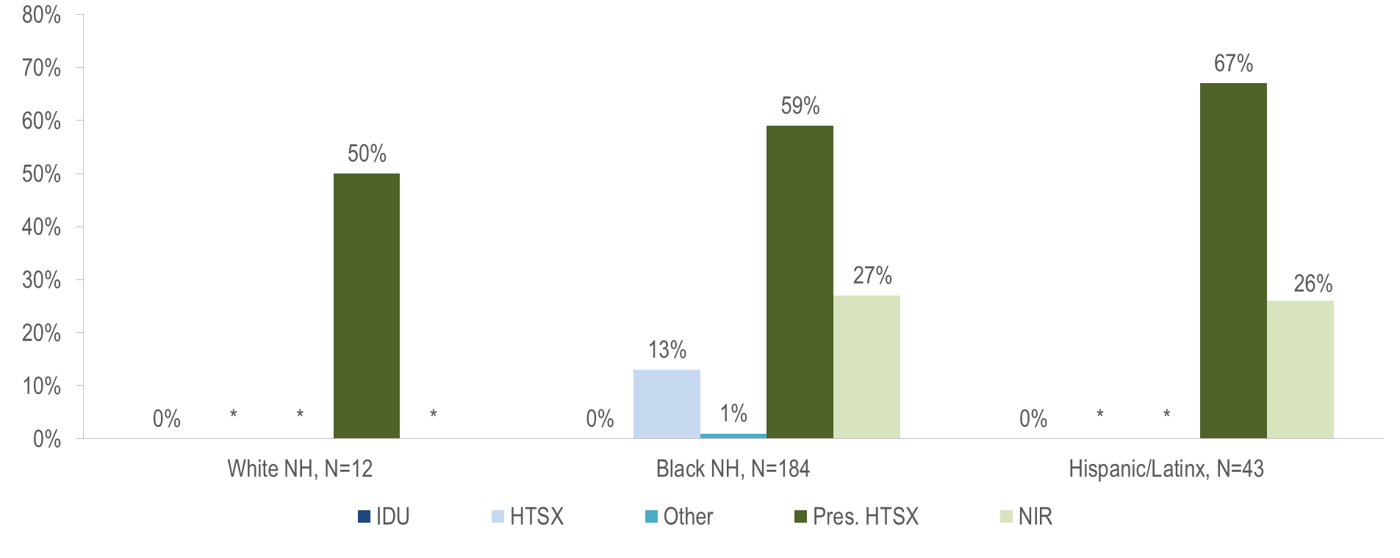
HIV diagnoses among individuals AFAB born outside the US by exposure mode and race/ethnicity, Massachusetts 2021–2023¹
¹ Please consider the impact of the COVID-19 pandemic on infectious disease screening, treatment, and surveillance in the interpretation of data from 2020 to 2023.
* Values less than five are suppressed for populations less than 50,000 or for populations of unknown size. Percentages do not add up to 100% due to suppressed value. IDU=Injection Drug Use; HTSX=Heterosexual Sex; Pres. HTSX=presumed heterosexual exposure, includes individuals assigned female at birth with a negative history of injection drug use who report having sex with an individual that identifies as male of unknown HIV status and risk; NIR=No Identified Risk;
Data Source: Bureau of Infectious Disease and Laboratory Sciences, data are current as of 7/1/2024 and subject to change
Notes:
The figure is a bar chart displaying the distribution of recent HIV diagnoses among individuals assigned female at birth and born outside the US by exposure mode for each of three racial/ethnic groups: White NH (N=12), Black NH (N=184), and Hispanic/Latinx (N=43).
Presumed heterosexual sex was the predominant exposure mode among White (non-Hispanic) (50%), Black (non-Hispanic) (59%), and Hispanic/Latinx (67%) individuals AFAB born outside the US and diagnosed with HIV infection from 2021 to 2023.^{i}

Slide 9
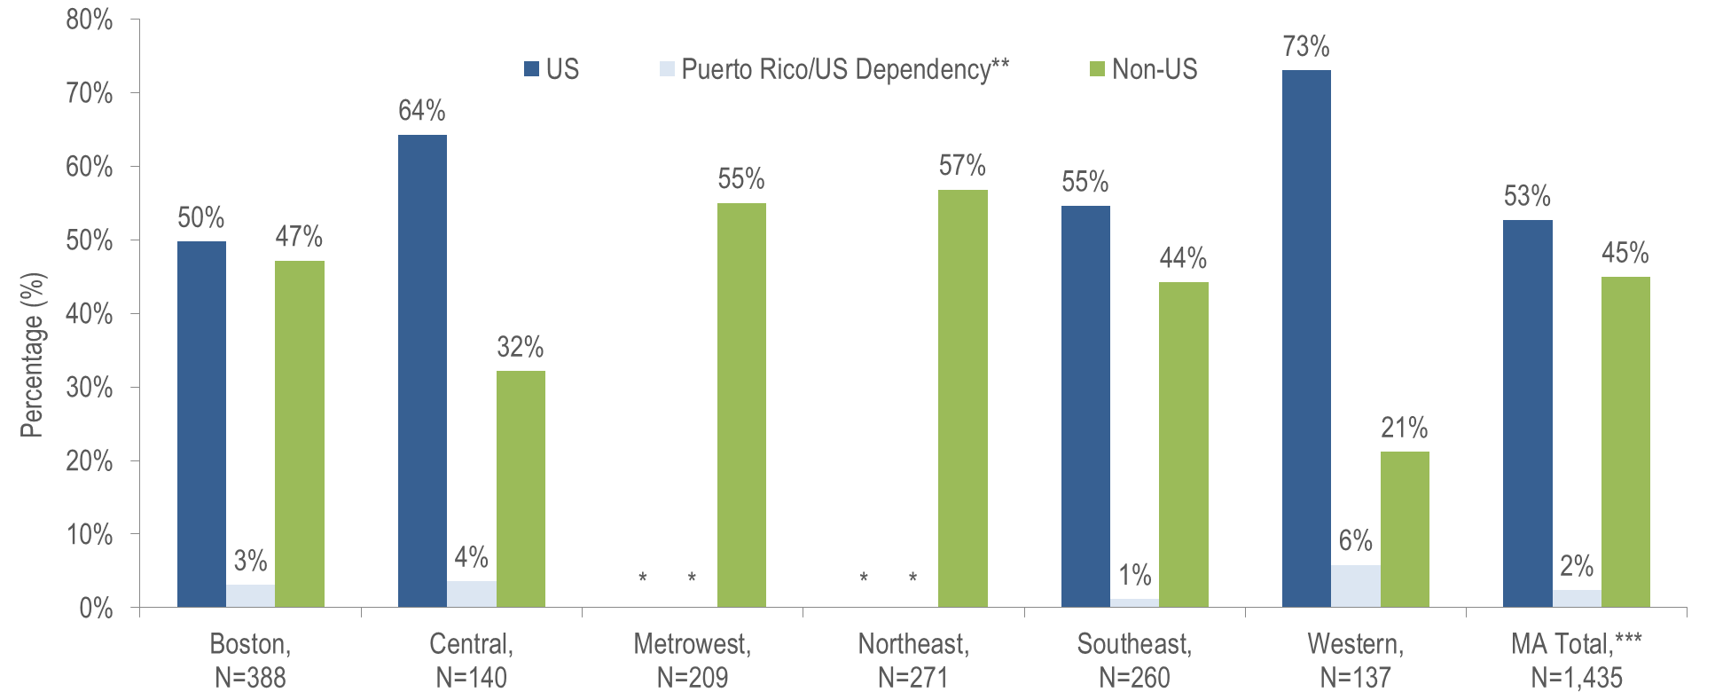
HIV infection diagnoses by Health Service Region and place of birth, Massachusetts 2021–2023¹
¹ Please consider the impact of the COVID-19 pandemic on infectious disease screening, treatment, and surveillance in the interpretation of data from 2020 to 2023. HSR is based on residence at HIV infection diagnosis.
* Values less than five are suppressed for populations less than 50,000 or for populations of unknown size. Percentages do not add up to 100% due to suppressed value.
** 94% of individuals diagnosed with HIV infection from 2021–2023 who were born in a US dependency (USD) were born in Puerto Rico (PR).
*** Total includes individuals diagnosed in a correctional facility. Data Source: Bureau of Infectious Disease and Laboratory Sciences, data are current as of 7/1/2024 and subject to change
Notes:
The figure is a bar chart displaying the percentage distribution by place of birth (US, Puerto Rico/US Dependency, Non-US) for Massachusetts Total (N=1,435) and six Health Service Regions: Boston (N=388), Central (N=140), Metrowest (N=209), Northeast, (N=271), Southeast (N=260), Western (N=137).
The Northeast (57%) and Metrowest (55%) Health Service Regions had the largest proportions of individuals recently diagnosed with HIV infection who were born outside the United States.

