Slide 1
Massachusetts HIV Epidemiologic Profile:
Data as of 7/1/2025
Population Report: People Born Outside the United States
Notes:
Suggested citation:
Massachusetts Department of Public Health, Bureau of Infectious Disease and Laboratory Sciences. Massachusetts HIV Epidemiologic Profile: Data as of 7/1/2025, Population Report: People Born Outside the United States, https://www.mass.gov/lists/hivaids-epidemiologic-profiles Published December 2025. Accessed [date].
Bureau of Infectious Disease and Laboratory Sciences
Massachusetts Department of Public Health
Jamaica Plain Campus/State Public Health Laboratory
305 South Street
Jamaica Plain, MA 02130
Questions about this report
Tel: (617) 983-6560
To reach the Reporting and Partner Services Line*
Tel: (617) 983-6999
To speak to the on-call epidemiologist
Tel: (617) 983-6800
Questions about infectious disease reporting
Tel: (617) 983-6801
HIV Data Dashboard
https://www.mass.gov/info-details/hiv-data-dashboard
Requests for additional data
https://www.mass.gov/lists/infectious-disease-data-reports-and-requests
Slide sets for HIV Epidemiologic Profile Reports
https://www.mass.gov/lists/hivaids-epidemiologic-profiles
*Providers may use this number to report individuals newly diagnosed with a notifiable sexually transmitted infection, including HIV, or request partner services. Partner services is a free and confidential service for individuals recently diagnosed with a priority infection. The client-centered program offers counseling, linkage to other health and social services, anonymous notification of partners who were exposed and assistance with getting testing and treatment. For more information, see: https://www.mass.gov/service-details/partner-services-program-information-for-healthcare-providers)

Slide 2
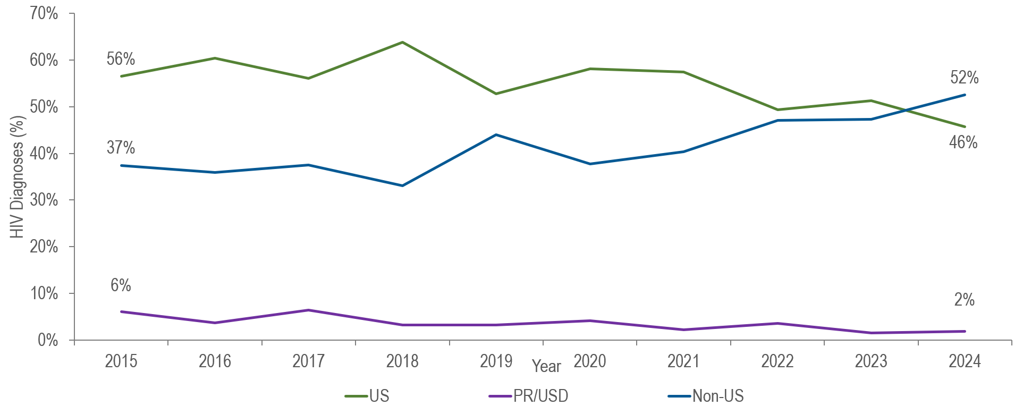
Percentage distribution of individuals diagnosed with HIV infection by place of birth, Massachusetts 2015–2024¹
¹ Please consider the impact of the COVID-19 pandemic on infectious disease screening, treatment, and surveillance in the interpretation of data from 2020 to 2022.
Data Source: Bureau of Infectious Disease and Laboratory Sciences, data are current as of 7/1/2025 and subject to change
Notes:
The figure is a trendline displaying the percentage distribution of HIV infection diagnoses by place of birth (US, PR/USD, Non-US) for the most recent ten-year period.
KEY FACT
The proportion of people diagnosed with HIV infection in Massachusetts and born outside the United States increased from 37% in 2015 to 52% in 2024.

Slide 3
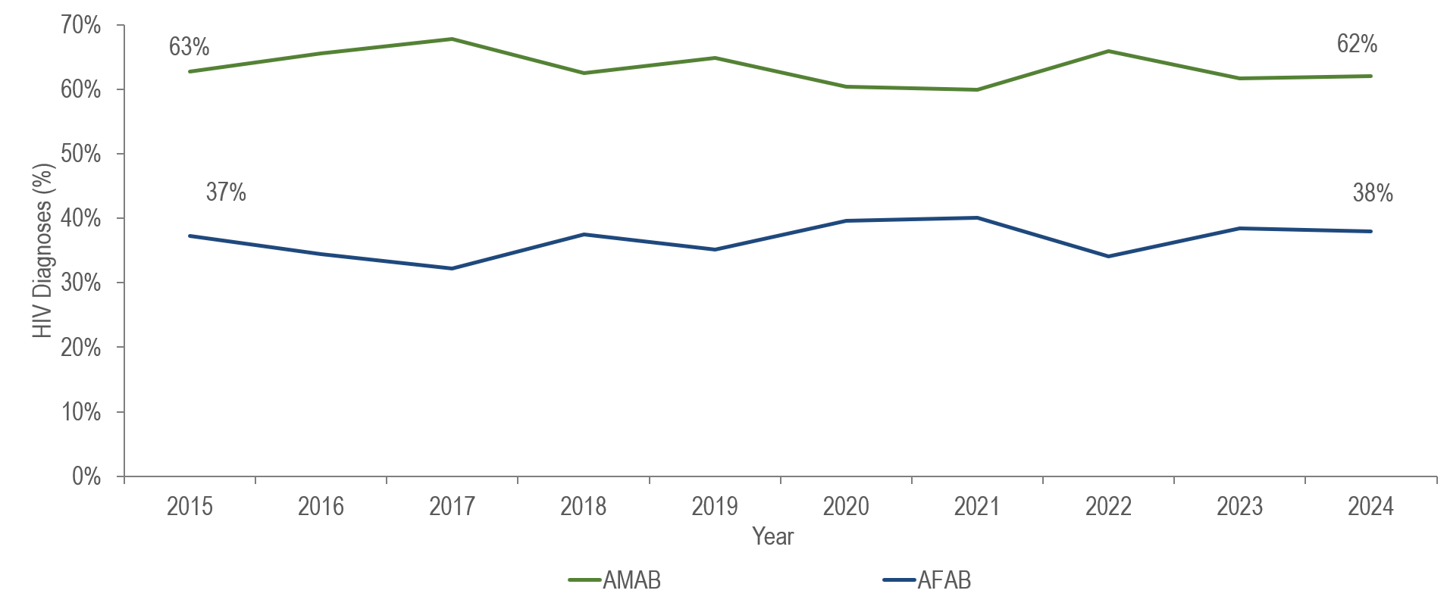
Percentage distribution of non-US born individuals diagnosed with HIV infection by sex assigned at birth, Massachusetts 2015–2024¹
¹ Please consider the impact of the COVID-19 pandemic on infectious disease screening, treatment, and surveillance in the interpretation of data from 2020 to 2022.
Data Source: Bureau of Infectious Disease and Laboratory Sciences, data are current as of 7/1/2025 and subject to change
Notes:
The figure is a trendline displaying the percentage distribution of HIV infection diagnoses by sex assigned at birth (assigned male at birth, assigned female at birth) for the most recent ten-year period.
From 2015 to 2024, the distribution by sex assigned at birth among non-US born people diagnosed with HIV infection remained relatively stable with the proportion among individuals assigned male at birth (AMAB) ranging from 60% to 68% and the proportion among individuals assigned female at birth (AFAB) ranging from 32% to 40%.

Slide 4
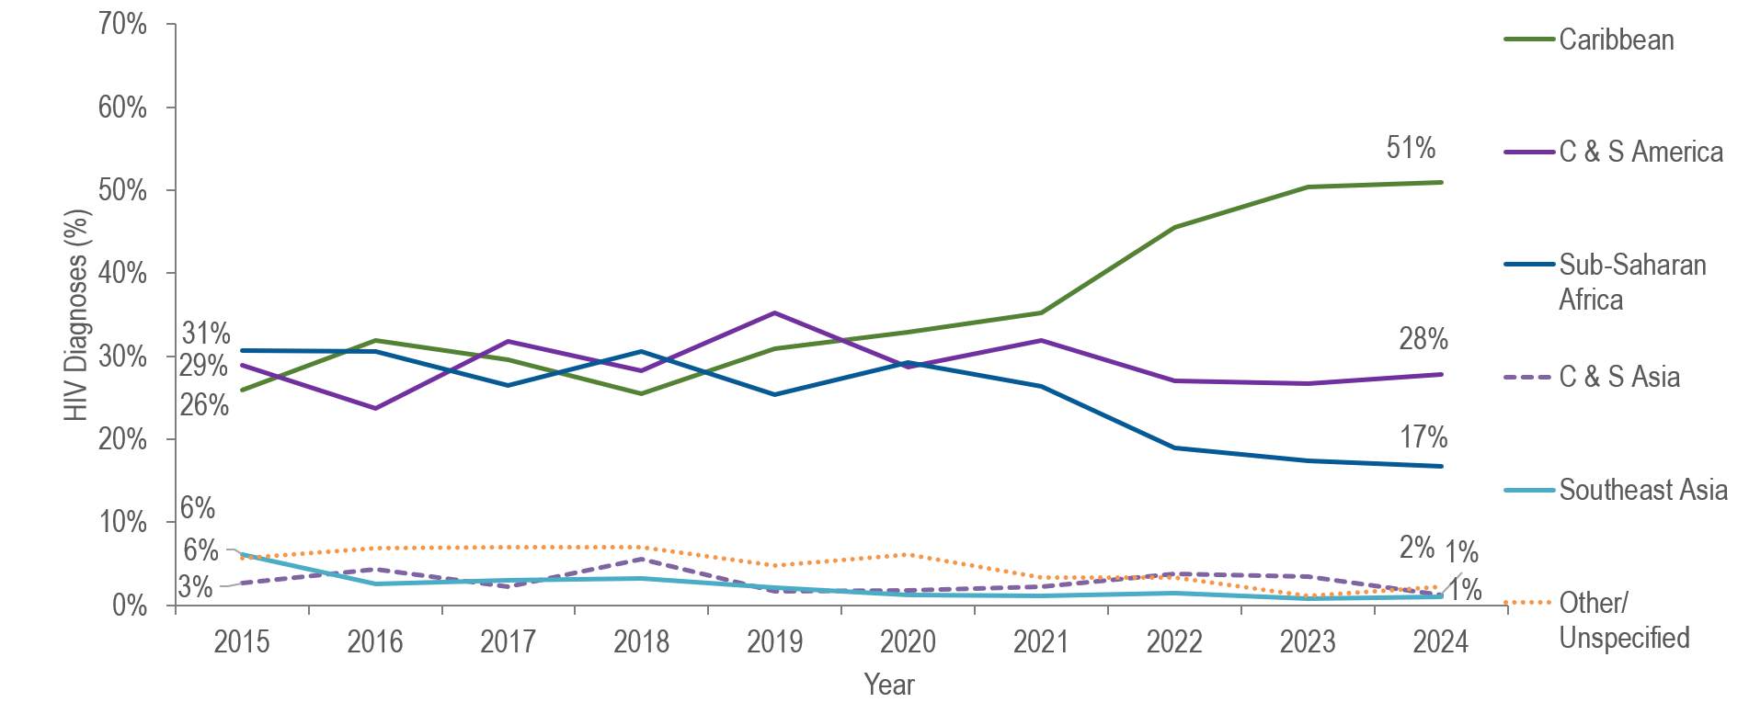
HIV diagnoses among people born outside the United States by world region of birth, Massachusetts 2015–2024¹
¹ Please consider the impact of the COVID-19 pandemic on infectious disease screening, treatment, and surveillance in the interpretation of data from 2020 to 2022.
Note: Note: Non-US born individuals diagnosed with HIV infection 2015–2024: N=2,270; C=Central, S=South
Data Source: Bureau of Infectious Disease and Laboratory Sciences, data are current as of 7/1/2025 and subject to change
Notes:
The figure is a trendline displaying the percentage distribution of HIV infection diagnoses by world region of birth (Caribbean, Central and South America, Sub-Saharan Africa, Central and South Asia, Southeast Asia, Other/Unspecified) for the most recent ten-year period
KEY FACT
The proportion of people born outside the US and diagnosed with HIV infection in Massachusetts from the Caribbean increased from 26% in 2015 to 51% in 2024, while the proportion from Sub-Saharan Africa decreased from 31% to 17%. In 2024, 71% (N=115/160) of individuals born in the Caribbean and diagnosed with HIV infection in Massachusetts were from Haiti.

Slide 5
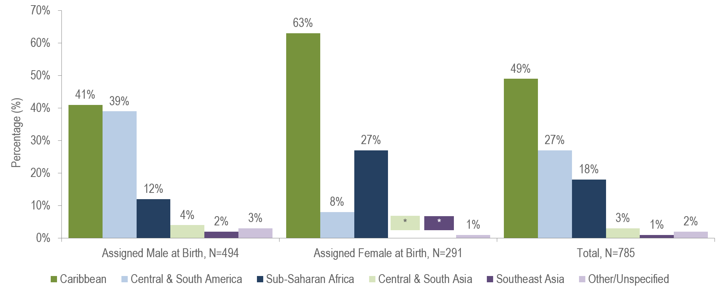
HIV diagnoses among people born outside the United States by sex assigned at birth and world region of birth, Massachusetts 2022–2024¹
* Values less than five are suppressed for populations less than 50,000 or for populations of unknown size. Percentages do not add up to 100% due to suppressed value
¹ Please consider the impact of the COVID-19 pandemic on infectious disease screening, treatment, and surveillance in the interpretation of data from 2020 to 2022.
Data Source: Bureau of Infectious Disease and Laboratory Sciences, data are current as of 7/1/2025 and subject to change
Notes:
The figure is a bar chart displaying the percentage distribution of individuals assigned male at birth (N=494), individuals assigned female at birth (N=291), and all individuals (N=785) born outside the US by world region of birth (sub-Saharan Africa, Caribbean, Central and South America, Southeast Asia, Central and South Asia, and Other/Unspecified).
KEY FACT
People born outside the United States and diagnosed with HIV infection in Massachusetts from 2022 to 2024 were primarily from the Caribbean (49%), Central and South America (27%), and Sub-Saharan Africa (18%).
There were differences in the distribution of individuals assigned male at birth (AMAB) and individuals assigned female at birth (AFAB) recently diagnosed with HIV infection by world region of birth. The largest proportion of individuals AFAB was from the Caribbean (63%), while the largest proportions of individuals AMAB were from the Caribbean (41%) and Central and South America (39%).

Slide 6
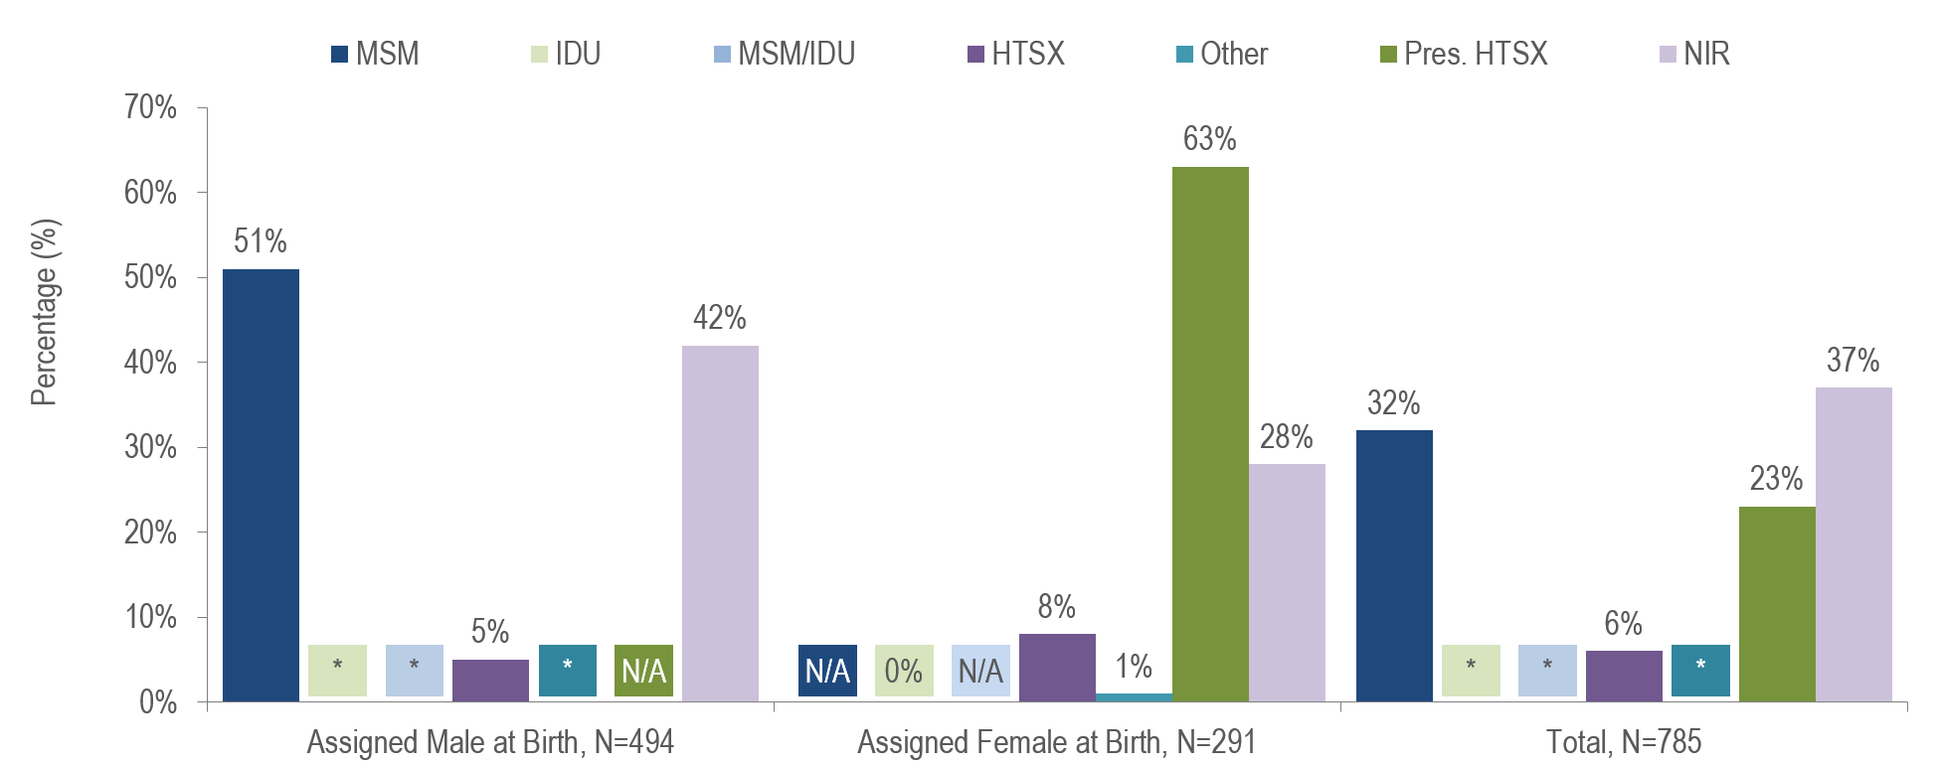
HIV diagnoses among people born outside the United States by sex assigned at birth and exposure mode, Massachusetts 2022–2024¹
¹ Please consider the impact of the COVID-19 pandemic on infectious disease screening, treatment, and surveillance in the interpretation of data from 2020 to 2022.
* Values less than five are suppressed for populations less than 50,000 or for populations of unknown size. Percentages do not add up to 100% due to suppressed value. MSM=Male-to-Male Sex; IDU=Injection Drug Use; HTSX=Heterosexual Sex; Pres. HTSX=presumed heterosexual exposure, includes individuals assigned female at birth with a negative history of injection drug use who report having sex with an individual that identifies as male of unknown HIV status and risk; NIR=No Identified Risk; N/A = not applicable; Data Source: Bureau of Infectious Disease and Laboratory Sciences, data are current as of 7/1/2025 and subject to change
Notes:
The figure is a bar chart displaying the percentage distribution of individuals assigned male at birth (N=494), individuals assigned female at birth (N=291), and all individuals (N=785) born outside the US by exposure mode (Male-to-Male Sex, Injection Drug Use, Male-to-Male Sex/Injection Drug Use, Heterosexual Sex, Other, Presumed Heterosexual Sex, and No Identified Risk).
KEY FACT
Thirty-seven percent of the 785 non-US born individuals recently diagnosed with HIV infection (2022–2024) did not have exposure mode information reported that met CDC-defined categories, indicating challenges in assigning primary exposure modes for this population.
Please consider the impact of the COVID-19 pandemic on infectious disease screening, treatment, and surveillance in the interpretation of data from 2020 to 2022

Slide 7
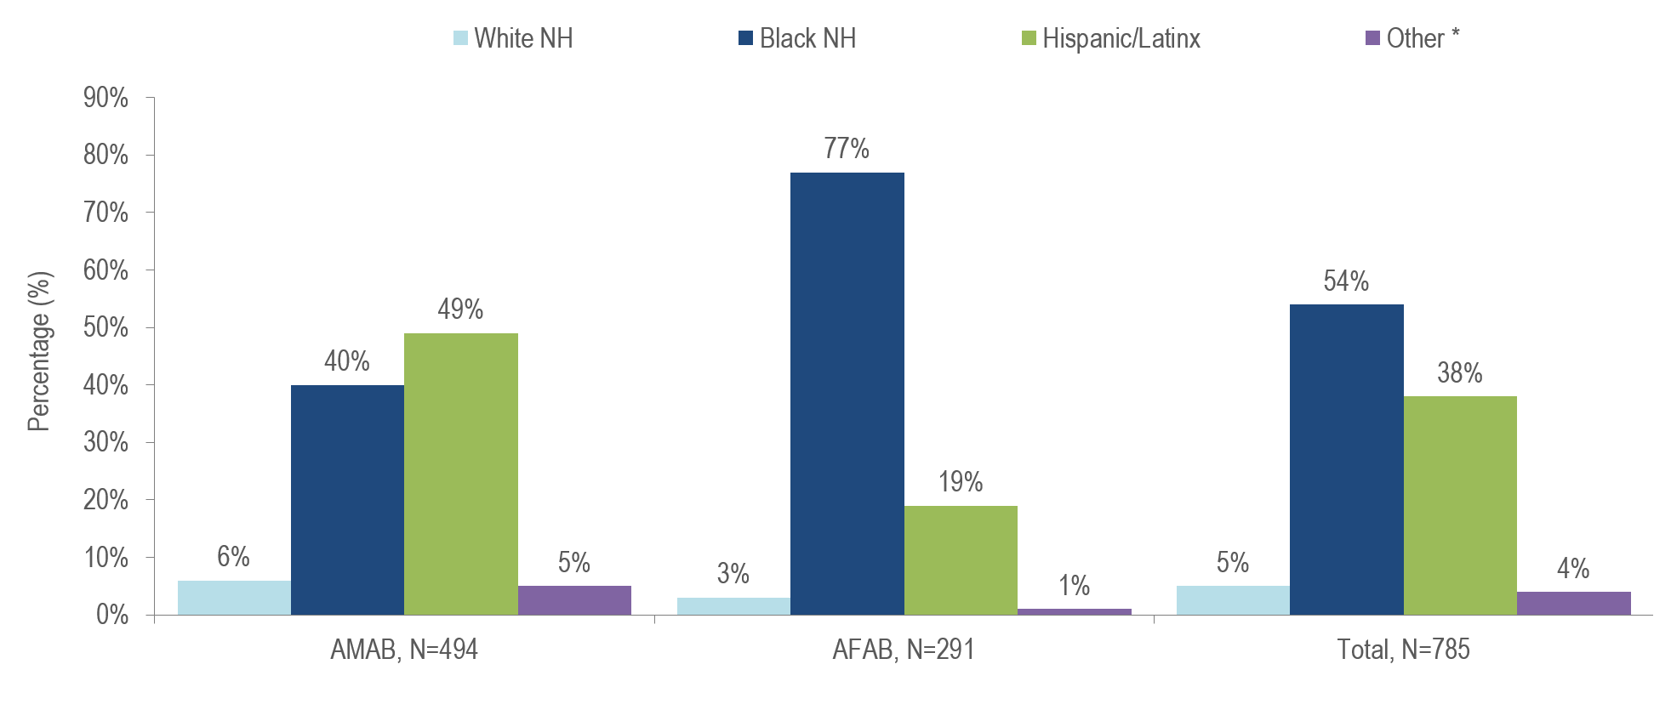
HIV diagnoses among people born outside the US by sex assigned at birth and race/ethnicity, Massachusetts 2022–2024¹
¹ Please consider the impact of the COVID-19 pandemic on infectious disease screening, treatment, and surveillance in the interpretation of data from 2020 to 2022.
* Other includes more than one race/ethnicity, unknown, and other race/ethnicities (Native American/Alaska Native), API=Asian/Pacific Islander, NH=Non-Hispanic, AMAB=Assigned Male at Birth, AFAB=Assigned Female at Birth
Data Source: Bureau of Infectious Disease and Laboratory Sciences, data are current as of 7/1/2025 and subject to change
Notes:
The figure is a bar chart displaying the percentage distribution of individuals assigned male at birth (N=494), individuals assigned female at birth (N=291), and all individuals (N=785) born outside the US by race/ethnicity (White (non-Hispanic), Black (non-Hispanic), Hispanic/Latinx, Other/Unknown).
Among individuals AMAB born outside the US and newly diagnosed with HIV infection in Massachusetts from 2022 to 2024, 49% were Hispanic/Latinx and 40% were Black (non-Hispanic)
The majority (77%) of individuals AFAB born outside the US and newly diagnosed with HIV infection in Massachusetts from 2022 to 2024 were Black (non-Hispanic).

Slide 8
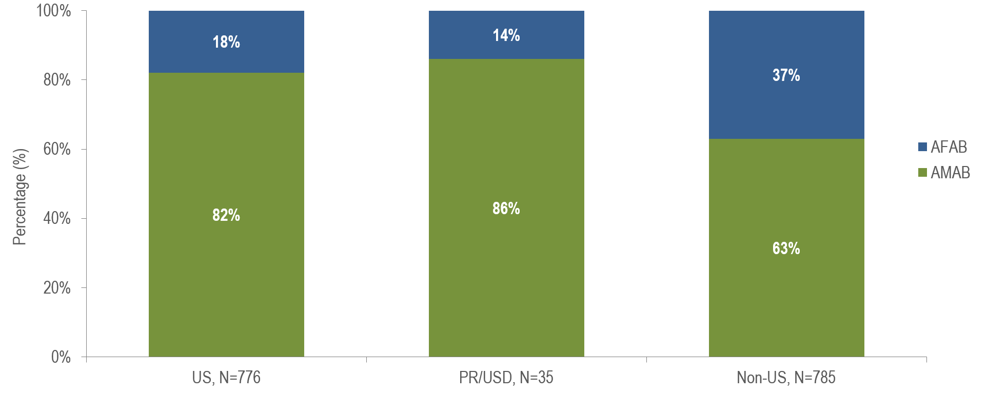
HIV diagnoses by sex assigned at birth and place of birth,
Massachusetts 2022–2024¹
¹ Please consider the impact of the COVID-19 pandemic on infectious disease screening, treatment, and surveillance in the interpretation of data from 2020 to 2022.
PR/USD = Puerto Rico/US Dependency, 97% of individuals diagnosed with HIV infection from 2022–2024 who were born in a US dependency (USD) were born in Puerto Rico (PR). AMAB=Assigned Male at Birth, AFAB=Assigned Female at Birth
Data Source: Bureau of Infectious Disease and Laboratory Sciences, data are current as of 7/1/2025 and subject to change
Notes:
The figure is a stacked bar chart displaying the percentage distribution by sex assigned at birth (female, male) for three groups: US born individuals (N=776), individuals born in Puerto Ric/US Dependencies (N=35), and non-US born individuals (N=785).
Thirty-seven percent of non-US born individuals diagnosed with HIV infection from 2022 to 2024 were AFAB, compared to 18% of US born individuals and 14% of individuals born in Puerto Rico/US Dependencies.*
*97% of individuals diagnosed with HIV infection from 2022–2024 who were born in a US dependency (USD) were born in Puerto Rico (PR).

Slide 9
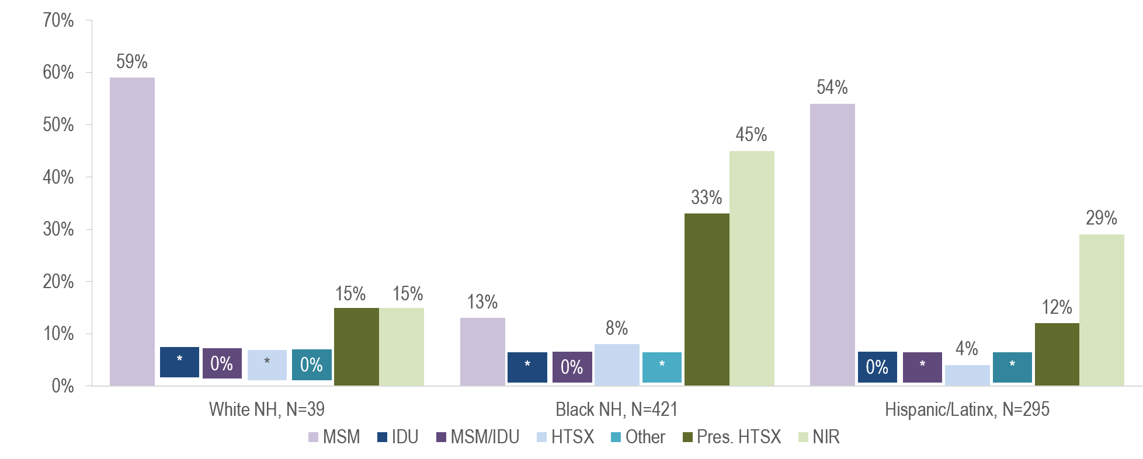
HIV diagnoses among individuals born outside the US by exposure mode and race/ethnicity, Massachusetts 2022–2024¹
¹ Please consider the impact of the COVID-19 pandemic on infectious disease screening, treatment, and surveillance in the interpretation of data from 2020 to 2022.
* Values less than five are suppressed for populations less than 50,000 or for populations of unknown size. Percentages do not add up to 100% due to suppressed value. MSM=Male-to-Male Sex; IDU=Injection Drug Use; HTSX=Heterosexual Sex; Pres. HTSX=presumed heterosexual exposure, includes individuals assigned female at birth with a negative history of injection drug use who report having sex with an individual that identifies as male of unknown HIV status and risk; NIR=No Identified Risk; Data Source: Bureau of Infectious Disease and Laboratory Sciences, data are current as of 7/1/2025 and subject to change
Notes:
The figure is a bar chart displaying the distribution of recent HIV diagnoses by exposure mode for each of three racial/ethnic groups among people born outside the US: White NH (N=39), Black NH (N=421), and Hispanic/Latinx (N=295).
While the predominant exposure mode among White (non-Hispanic) and Hispanic/Latinx individuals born outside the US and recently diagnosed with HIV infection was MSM (59% and 54%, respectively), the largest proportion of Black (non-Hispanic) individuals was assigned no identified risk for exposure mode (45%).

Slide 10
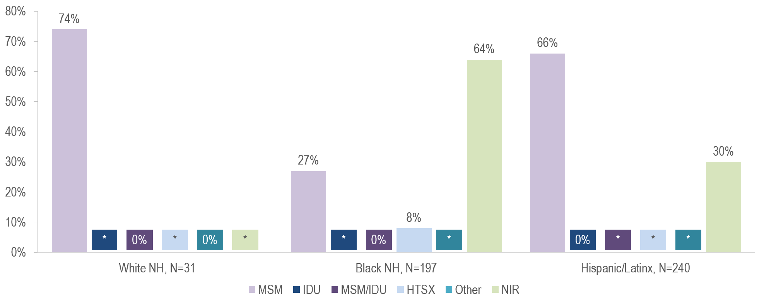
HIV diagnoses among individuals AMAB born outside the US by exposure mode and race/ethnicity, Massachusetts 2022–2024¹
¹ Please consider the impact of the COVID-19 pandemic on infectious disease screening, treatment, and surveillance in the interpretation of data from 2020 to 2022.
* Values less than five are suppressed for populations less than 50,000 or for populations of unknown size. Percentages do not add up to 100% due to suppressed value. MSM=Male-to-Male Sex; IDU=Injection Drug Use; HTSX=Heterosexual Sex; NIR=No Identified Risk Data Source: Bureau of Infectious Disease and Laboratory Sciences, data are current as of 7/1/2025 and subject to change
Notes:
The figure is a bar chart displaying the distribution of recent HIV diagnoses among individuals assigned male at birth and born outside the US by exposure mode for each of three racial/ethnic groups: White NH (N=31), Black NH (N=197), and Hispanic/Latinx (N=240).
MSM was the most frequently reported exposure mode among White (non-Hispanic) (74%) and Hispanic/Latinx (66%) individuals AMAB born outside the US and recently diagnosed with HIV infection, while NIR accounted for the largest proportion among Black (non-Hispanic) individuals AMAB (64%).

Slide 11
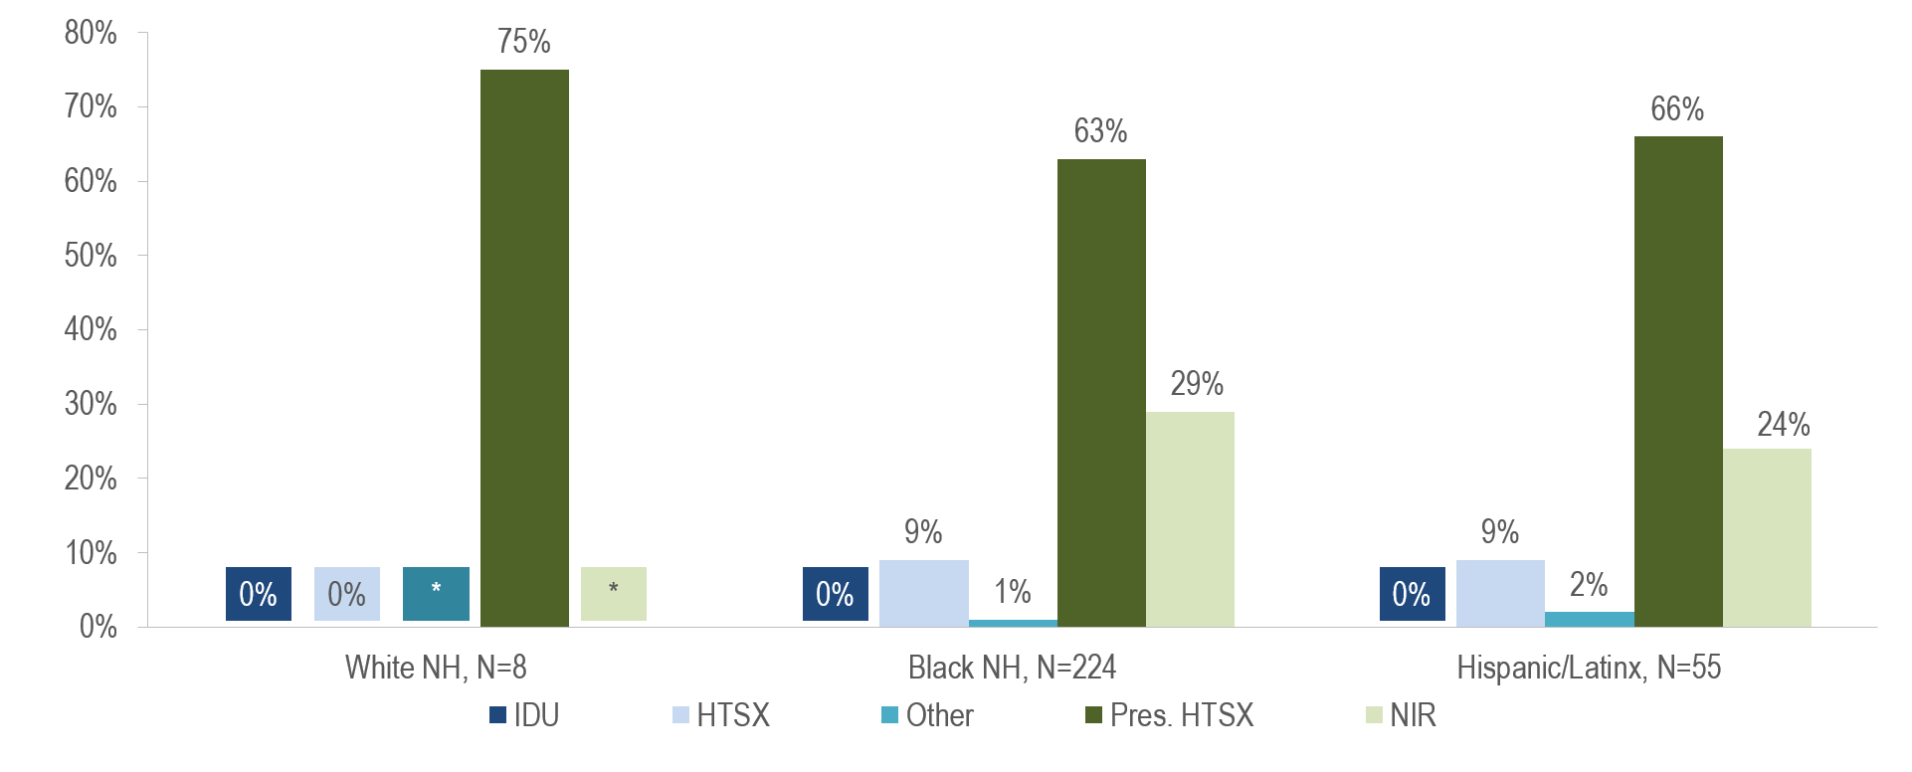
HIV diagnoses among individuals AFAB born outside the US by exposure mode and race/ethnicity, Massachusetts 2022–2024¹
¹ Please consider the impact of the COVID-19 pandemic on infectious disease screening, treatment, and surveillance in the interpretation of data from 2020 to 2022.
* Values less than five are suppressed for populations less than 50,000 or for populations of unknown size. Percentages do not add up to 100% due to suppressed value. IDU=Injection Drug Use; HTSX=Heterosexual Sex; Pres. HTSX=presumed heterosexual exposure, includes individuals assigned female at birth with a negative history of injection drug use who report having sex with an individual that identifies as male of unknown HIV status and risk; NIR=No Identified Risk;
Data Source: Bureau of Infectious Disease and Laboratory Sciences, data are current as of 7/1/2025 and subject to change
Notes:
The figure is a bar chart displaying the distribution of recent HIV diagnoses among individuals assigned female at birth and born outside the US by exposure mode for each of three racial/ethnic groups: White NH (N=8), Black NH (N=224), and Hispanic/Latinx (N=55).
Presumed heterosexual sex was the predominant exposure mode among White (non-Hispanic) (75%), Black (non-Hispanic) (63%), and Hispanic/Latinx (66%) individuals AFAB born outside the US and recently diagnosed with HIV infection.

Slide 12
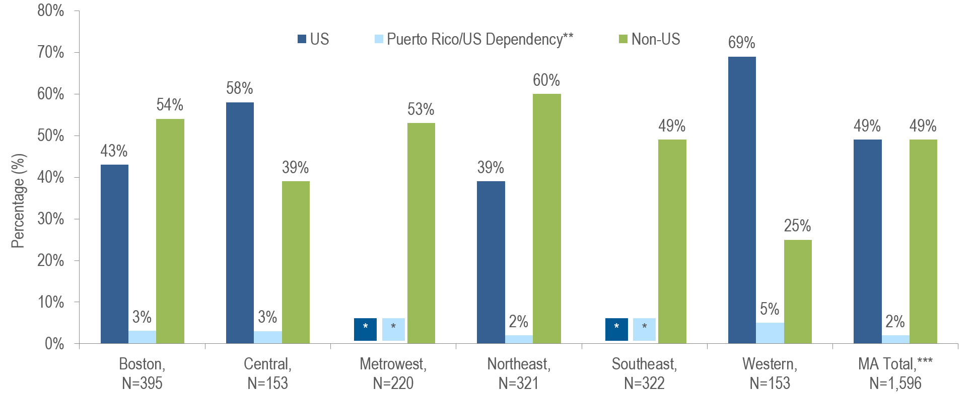
HIV infection diagnoses by Health Service Region and place of birth, Massachusetts 2022–2024¹
¹ Please consider the impact of the COVID-19 pandemic on infectious disease screening, treatment, and surveillance in the interpretation of data from 2020 to 2022. HSR is based on residence at HIV infection diagnosis.
* Values less than five are suppressed for populations less than 50,000 or for populations of unknown size. Percentages do not add up to 100% due to suppressed value.
** 97% of individuals diagnosed with HIV infection from 2022–2024 who were born in a US dependency (USD) were born in Puerto Rico (PR).
*** Total includes individuals diagnosed in a correctional facility. Data Source: Bureau of Infectious Disease and Laboratory Sciences, data are current as of 7/1/2025 and subject to change
Notes:
The figure is a bar chart displaying the percentage distribution by place of birth (US, Puerto Rico/US Dependency, Non-US) for Massachusetts Total (N=1,596) and six Health Service Regions: Boston (N=395), Central (N=153), Metrowest (N=220), Northeast, (N=321), Southeast (N=322), Western (N=153).
The Northeast (60%), Boston (54%), and Metrowest (53%) Health Service Regions had the largest proportions of individuals recently diagnosed with HIV infection who were born outside the United States.

