Slide 1
Massachusetts HIV Epidemiologic Profile: Data as of 1/1/2022 Population Report: Persons Who Inject Drugs
Suggested citation:
Massachusetts Department of Public Health, Bureau of Infectious Disease and Laboratory Sciences. Massachusetts HIV Epidemiologic Profile: Data as of 1/1/2022, Population Report: Persons Who Inject Drugs, https://www.mass.gov/lists/hivaids-epidemiologic-profiles Published December 2022. Accessed [date].
Bureau of Infectious Disease and Laboratory Sciences Massachusetts Department of Public Health
Jamaica Plain Campus/State Public Health Laboratory
305 South Street Jamaica Plain, MA 02130
Questions about this report
Tel: (617) 983-6560
To reach the Reporting and Partner Services Line^{i}
Tel: (617) 983-6999
To speak to the on-call epidemiologist
Tel: (617) 983-6800
Questions about infectious disease reporting
Tel: (617) 983-6801
Requests for additional data
https://www.mass.gov/lists/infectious-disease-data-reports-and-requests
Slide sets for HIV Epidemiologic Profile Reports
https://www.mass.gov/lists/hivaids-epidemiologic-profiles
^{i} Providers may use this number to report individuals newly diagnosed with a notifiable sexually transmitted infection, including HIV, or request partner services. Partner services is a free and confidential service for individuals recently diagnosed with a priority infection. The client-centered program offers counseling, linkage to other health and social services, anonymous notification of partners who were exposed and assistance with getting testing and treatment. For more information, see: https://www.mass.gov/service-details/partner-services-program-information-for-healthcare-providers)
Notes:
Suggested citation:
Massachusetts Department of Public Health, Bureau of Infectious Disease and Laboratory Sciences. Massachusetts HIV Epidemiologic Profile: Data as of 1/1/2022, Population Report: Persons Who Inject Drugs, https://www.mass.gov/lists/hivaids-epidemiologic-profiles Published December 2022. Accessed [date].
Bureau of Infectious Disease and Laboratory Sciences Massachusetts Department of Public Health
Jamaica Plain Campus/State Public Health Laboratory
305 South Street Jamaica Plain, MA 02130
Questions about this report
Tel: (617) 983-6560
To reach the Reporting and Partner Services Line^{i}
Tel: (617) 983-6999
To speak to the on-call epidemiologist
Tel: (617) 983-6800
Questions about infectious disease reporting
Tel: (617) 983-6801
Requests for additional data
https://www.mass.gov/lists/infectious-disease-data-reports-and-requests
Slide sets for HIV Epidemiologic Profile Reports
https://www.mass.gov/lists/hivaids-epidemiologic-profiles
^{i} Providers may use this number to report individuals newly diagnosed with a notifiable sexually transmitted infection, including HIV, or request partner services. Partner services is a free and confidential service for individuals recently diagnosed with a priority infection. The client-centered program offers counseling, linkage to other health and social services, anonymous notification of partners who were exposed and assistance with getting testing and treatment. For more information, see: https://www.mass.gov/service-details/partner-services-program-information-for-healthcare-providers)

Slide 2
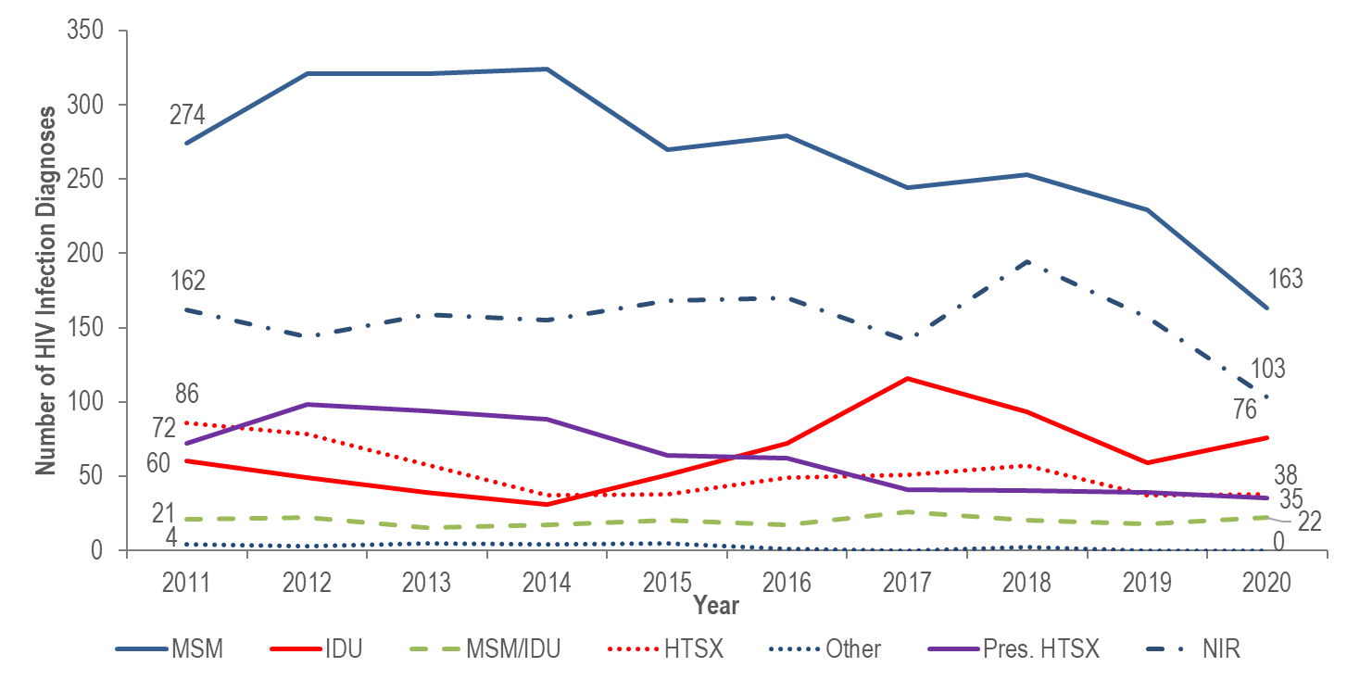
Individuals diagnosed with HIV infection by exposure mode, Massachusetts 2011–2020*
MSM=male-to-male sex; IDU=injection drug use; HTSX=heterosexual sex; Pres. HTSX=presumed heterosexual exposure, includes individuals assigned female at birth with a negative history of injection drug use who report having sex with an individual that identifies as male of unknown HIV status and risk; NIR=no identified risk; Data Source: MDPH Bureau of Infectious Disease and Laboratory Sciences, data are current as of 1/1/2022 *Please consider the impact of the COVID-19 pandemic on infectious disease screening, treatment, and surveillance in the interpretation of 2020 data.
Notes:
KEY FINDING
After declining by 48% from 2011 (N=60) to 2014 (N=31), the number of reported cases with injection drug use (IDU) as the primary exposure mode peaked at 116 in 2017, decreased to 59 in 2019, and then increased again to 76 in 2020.

Slide 3
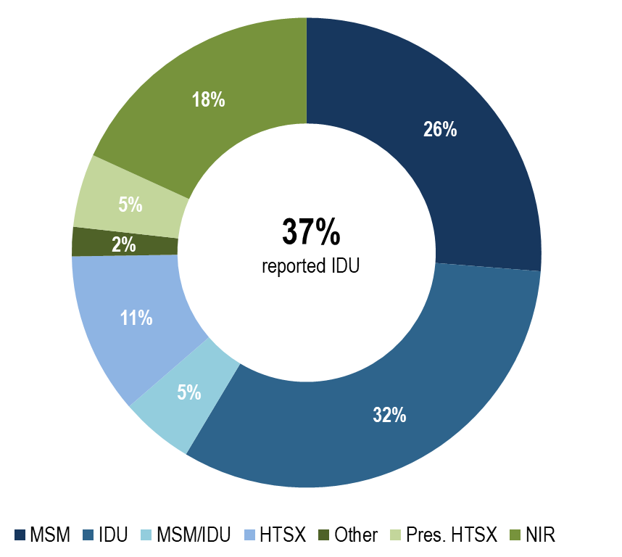
Deaths among individuals reported with HIV by exposure mode, Massachusetts 2020 (N=314)
MSM=male-to-male sex; IDU=injection drug use; HTSX=heterosexual sex; Pres. HTSX=presumed heterosexual exposure, includes individuals assigned female at birth with a negative history of injection drug use who report having sex with an individual that identifies as male of unknown HIV status and risk; NIR=no identified risk; Data Source: MDPH Bureau of Infectious Disease and Laboratory Sciences, data are current as of 1/1/2022 *Please consider the impact of the COVID-19 pandemic on infectious disease screening, treatment, and surveillance in the interpretation of 2020 data.
Notes:
KEY FINDING
Individuals with IDU exposure mode accounted for the largest proportion of deaths among individuals reported with HIV. In 2020, 32% of deaths among individuals with HIV were among individuals who reported IDU as their mode of exposure and an additional 5% who reported MSM/IDU as their mode of exposure, compared to 17% and 5%, respectively, of 2020 HIV infection diagnoses.

Slide 4
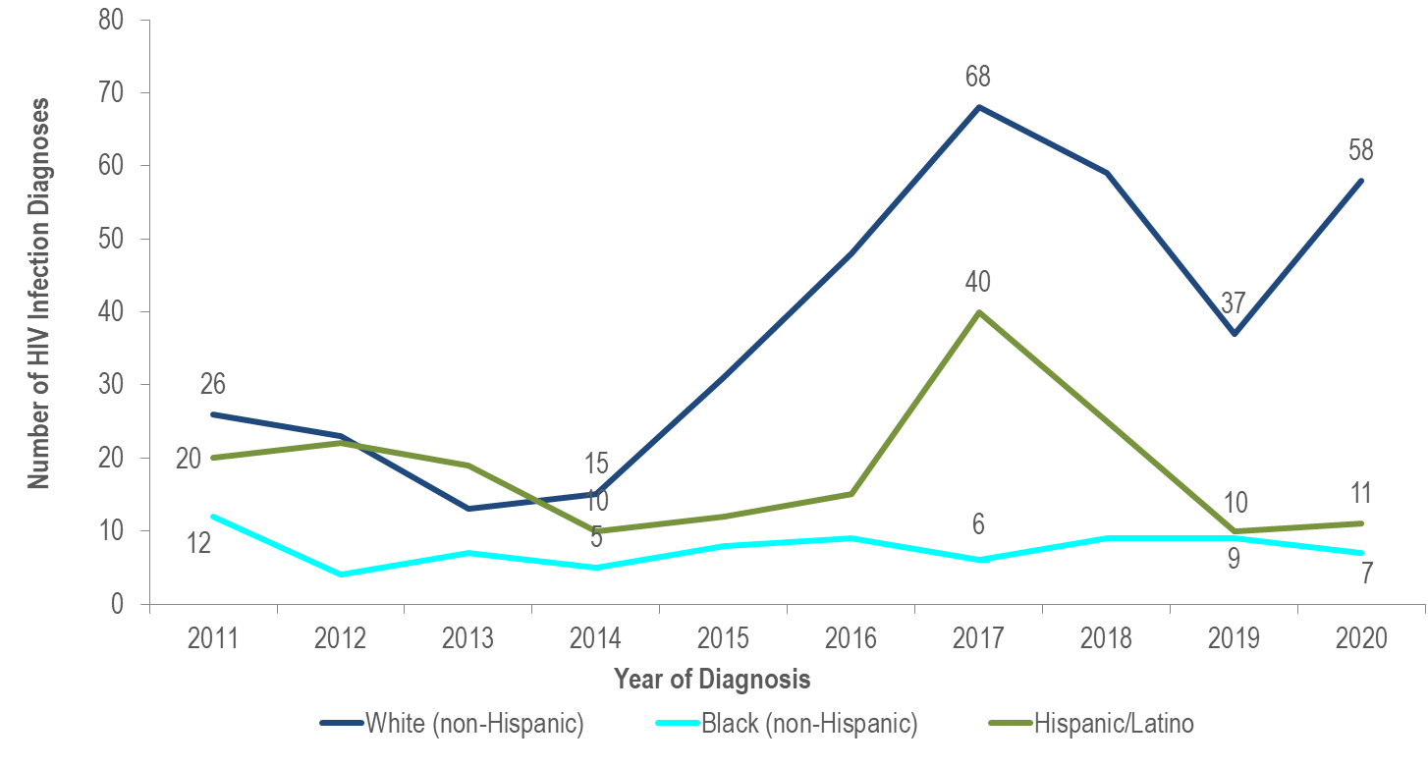
Number of individuals diagnosed with HIV infection with IDU exposure mode by race/ethnicity and year of diagnosis, Massachusetts 2011–2020*
Data Source: MDPH Bureau of Infectious Disease and Laboratory Sciences, data are current as of 1/1/2022
*Please consider the impact of the COVID-19 pandemic on infectious disease screening, treatment, and surveillance in the interpretation of 2020 data.
Notes:
KEY FINDING
The number of HIV infection diagnoses with IDU exposure mode among white (non-Hispanic) individuals quadrupled from 2014 to 2017, decreased by 46% in 2019 and then increased by 57% in 2020. The number of HIV infection diagnoses with IDU exposure mode among Hispanic/Latino individuals quadrupled from 2014 to 2017, decreased by 75% in 2019 and then remained relatively stable through 2020. The number of HIV infection diagnoses with IDU exposure mode among black (non-Hispanic) individuals remained relatively stable from 2014 to 2020.

Slide 5
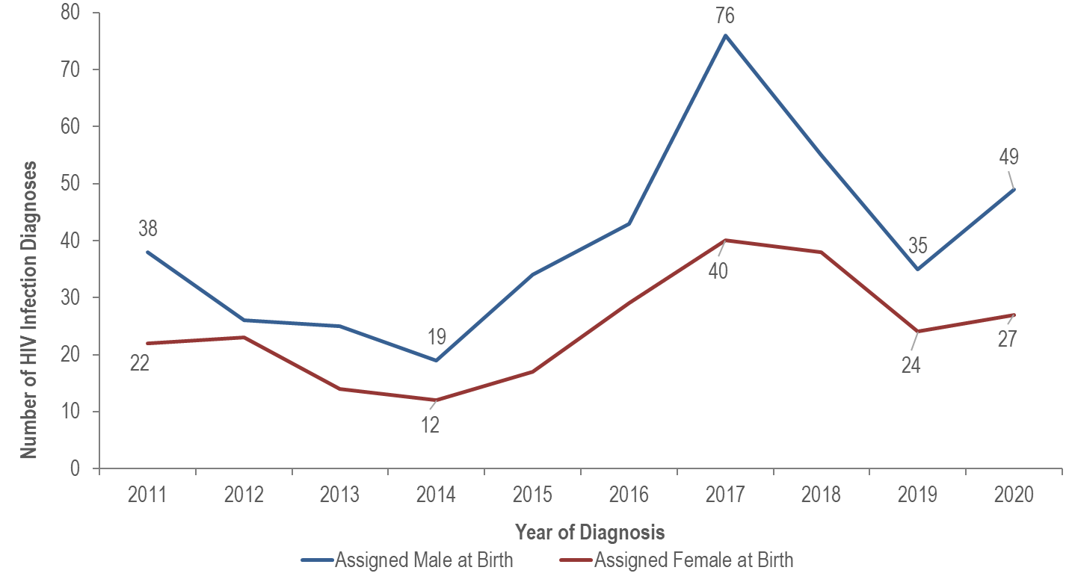
HIV diagnoses among individuals with IDU exposure mode by sex assigned at birth, Massachusetts 2011–2020*
Data Source: MDPH Bureau of Infectious Disease and Laboratory Sciences, data are current as of 1/1/2022
*Please consider the impact of the COVID-19 pandemic on infectious disease screening, treatment, and surveillance in the interpretation of 2020 data.
Notes:
The number of HIV infection diagnoses with IDU exposure mode among individuals AMAB quadrupled from 2014 to 2017, decreased by 54% in 2019, and then increased by 40% in 2020. The number of diagnoses with IDU exposure mode among individuals AFAB more than tripled from 2014 to 2017, decreased by 40% in 2019, and then increased by 13% in 2020.

Slide 6
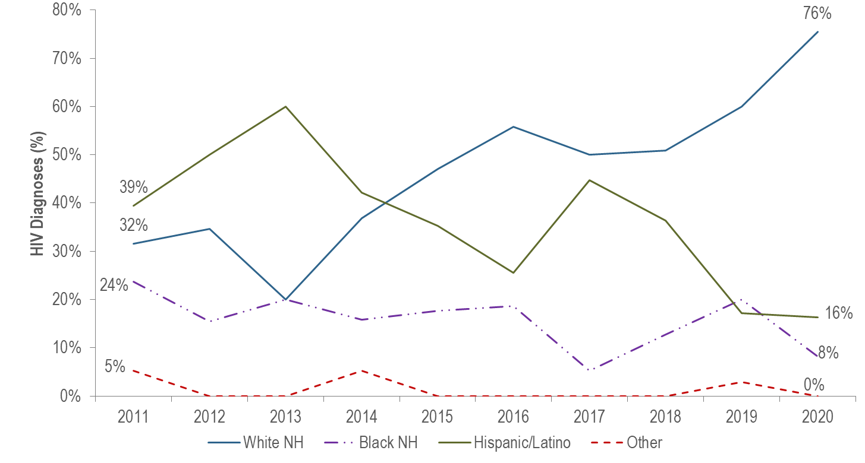
Individuals AMAB and diagnosed with HIV infection with IDU exposure mode by race/ethnicity and year of diagnosis, Massachusetts 2011–2020*
AMAB=Assigned Male at Birth, IDU=Injection Drug Use, NH=non-Hispanic
Individuals AMAB diagnosed with HIV infection with IDU exposure mode 2011-2020: N=400
Data Source: MDPH Bureau of Infectious Disease and Laboratory Sciences, data are current as of 1/1/2022
*Please consider the impact of the COVID-19 pandemic on infectious disease screening, treatment, and surveillance in the interpretation of 2020 data.
Notes:
From 2011 to 2020, the proportion of individuals AMAB diagnosed with HIV infection with IDU exposure mode who identified as white (non-Hispanic) increased from 32% to 76%, while the proportion who identified as Hispanic/Latino decreased from 39% to 16% and as black (non-Hispanic) from 24% to 8%.

Slide 7
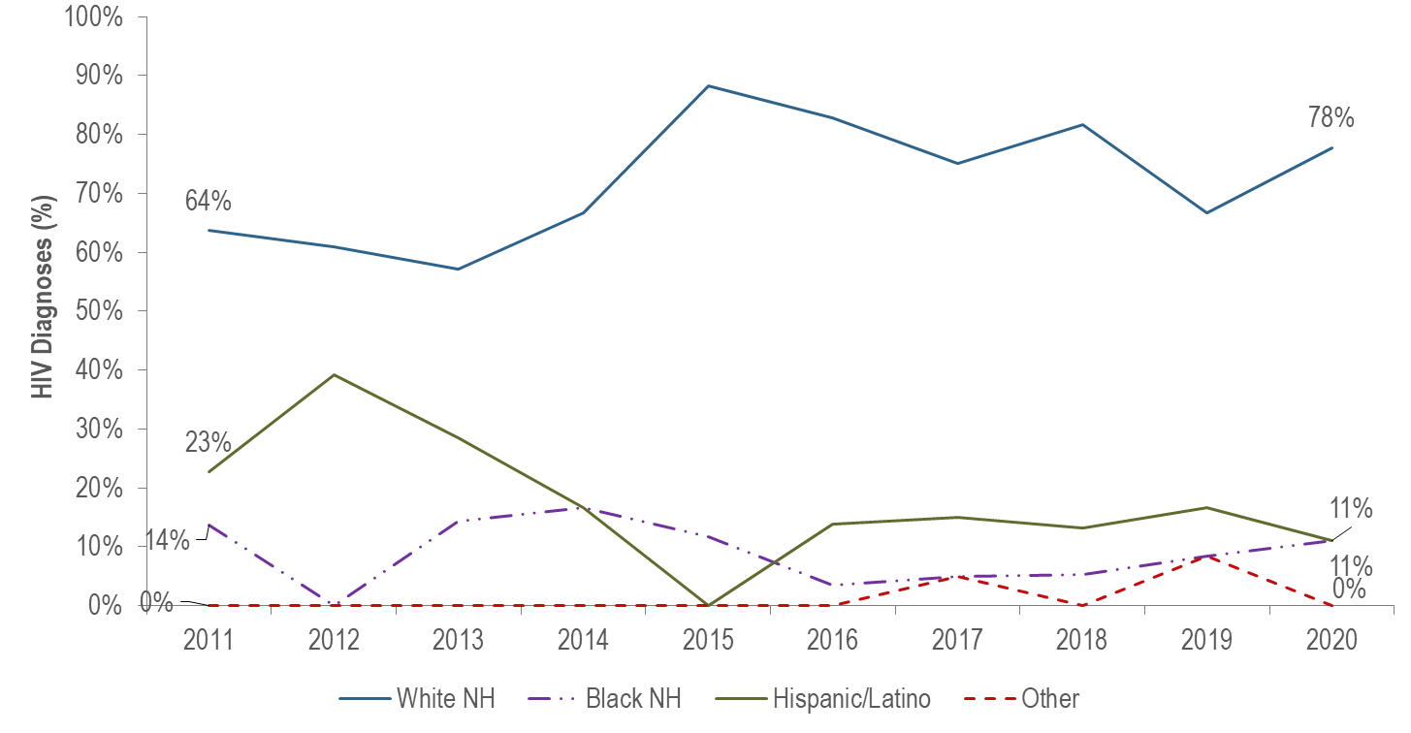
Individuals AFAB and diagnosed with HIV infection with IDU exposure mode by race/ethnicity and year of diagnosis, Massachusetts 2011–2020*
AFAB=Assigned Female at Birth, IDU=Injection Drug Use, NH=non-Hispanic
Individuals AFAB diagnosed with HIV infection with IDU exposure mode 2011-2020: N=246
Data Source: MDPH Bureau of Infectious Disease and Laboratory Sciences, data are current as of 1/1/2022
*Please consider the impact of the COVID-19 pandemic on infectious disease screening, treatment, and surveillance in the interpretation of 2020 data.
Notes:
From 2011 to 2020, the proportion of individuals AFAB diagnosed with HIV infection with IDU exposure mode who identified as white (non-Hispanic) increased from 64% to 78%, while the proportion who identified as Hispanic/Latina decreased from 23% to 11%.

Slide 8
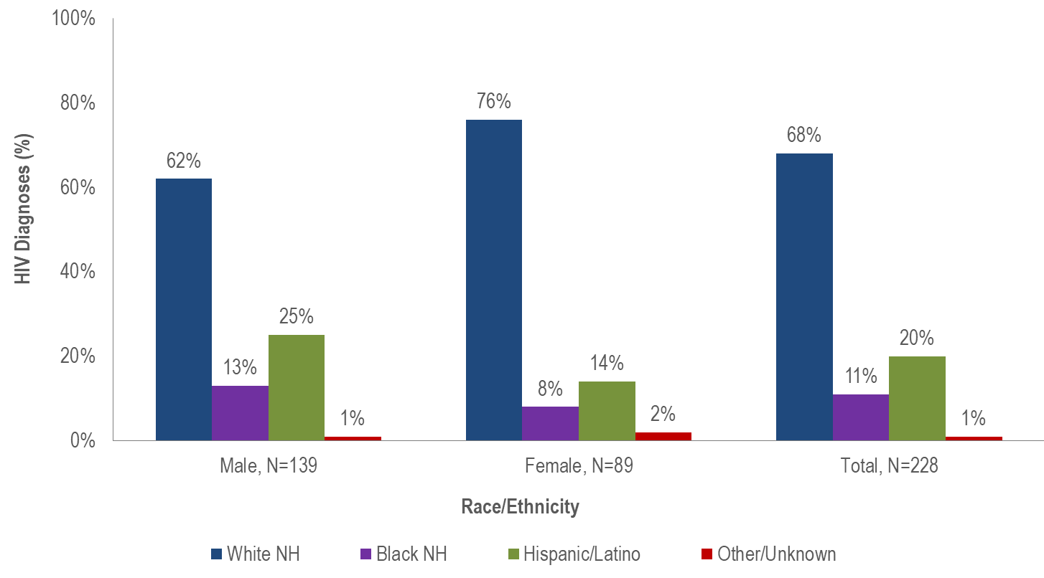
Percentage distribution of individuals diagnosed with HIV infection with IDU exposure mode by sex assigned at birth and race/ethnicity, Massachusetts 2018–2020*
IDU=Injection Drug Use, NH=non-Hispanic
Data Source: MDPH Bureau of Infectious Disease and Laboratory Sciences, data are current as of 1/1/2022
*Please consider the impact of the COVID-19 pandemic on infectious disease screening, treatment, and surveillance in the interpretation of 2020 data.
Notes:
Seventy-six percent of individuals AFAB diagnosed with HIV infection with IDU exposure mode during 2018 to 2020 were white (non-Hispanic), 14% were Hispanic/Latina, and 8% were black (non-Hispanic), compared to 62%, 25%, and 13% of individuals AMAB, respectively.

Slide 9
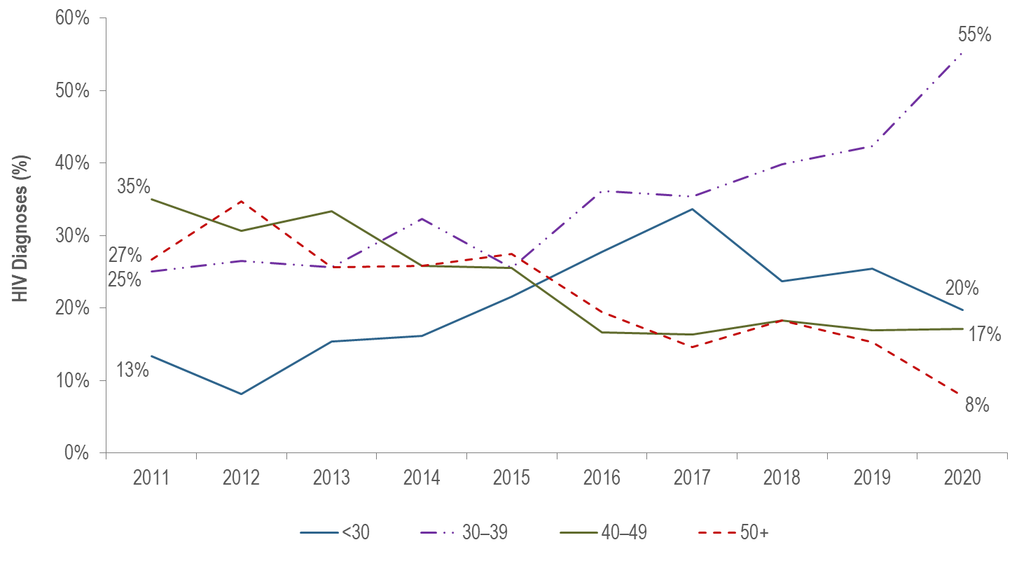
HIV diagnoses among individuals with IDU exposure mode by age at diagnosis, Massachusetts 2011–2020* (N=646)
IDU=Injection Drug Use
Data Source: MDPH Bureau of Infectious Disease and Laboratory Sciences, data are current as of 1/1/2022
*Please consider the impact of the COVID-19 pandemic on infectious disease screening, treatment, and surveillance in the interpretation of 2020 data.
Notes:
The percentage of HIV infection diagnoses with IDU exposure mode among individuals under 30 years of age increased from 13% in 2011 to 34% in 2017 and then decreased to 20% in 2020.*
The percentage of HIV infection diagnoses with IDU exposure mode among individuals 30–39 years of age increased from 25% in 2011 to 55% in 2020. It has been the largest percentage for the past five years (2016 to 2020).

