Slide 1
Massachusetts HIV Epidemiologic Profile:
Data as of 7/1/2025
Population Report: Persons Who Inject Drugs
Notes:
Suggested citation:
Massachusetts Department of Public Health, Bureau of Infectious Disease and Laboratory Sciences. Massachusetts HIV Epidemiologic Profile: Data as of 7/1/2025, Population Report: Persons Who Inject Drugs, https://www.mass.gov/lists/hivaids-epidemiologic-profiles Published December 2025. Accessed [date].
Bureau of Infectious Disease and Laboratory Sciences
Massachusetts Department of Public Health
Jamaica Plain Campus/State Public Health Laboratory
305 South Street
Jamaica Plain, MA 02130
Questions about this report
Tel: (617) 983-6560
To reach the Reporting and Partner Services Line*
Tel: (617) 983-6999
To speak to the on-call epidemiologist
Tel: (617) 983-6800
Questions about infectious disease reporting
Tel: (617) 983-6801
HIV Data Dashboard
https://www.mass.gov/info-details/hiv-data-dashboard
Requests for additional data
https://www.mass.gov/lists/infectious-disease-data-reports-and-requests
Slide sets for HIV Epidemiologic Profile Reports
https://www.mass.gov/lists/hivaids-epidemiologic-profiles
*Providers may use this number to report individuals newly diagnosed with a notifiable sexually transmitted infection, including HIV, or request partner services. Partner services is a free and confidential service for individuals recently diagnosed with a priority infection. The client-centered program offers counseling, linkage to other health and social services, anonymous notification of partners who were exposed and assistance with getting testing and treatment. For more information, see: https://www.mass.gov/service-details/partner-services-program-information-for-healthcare-providers)

Slide 2
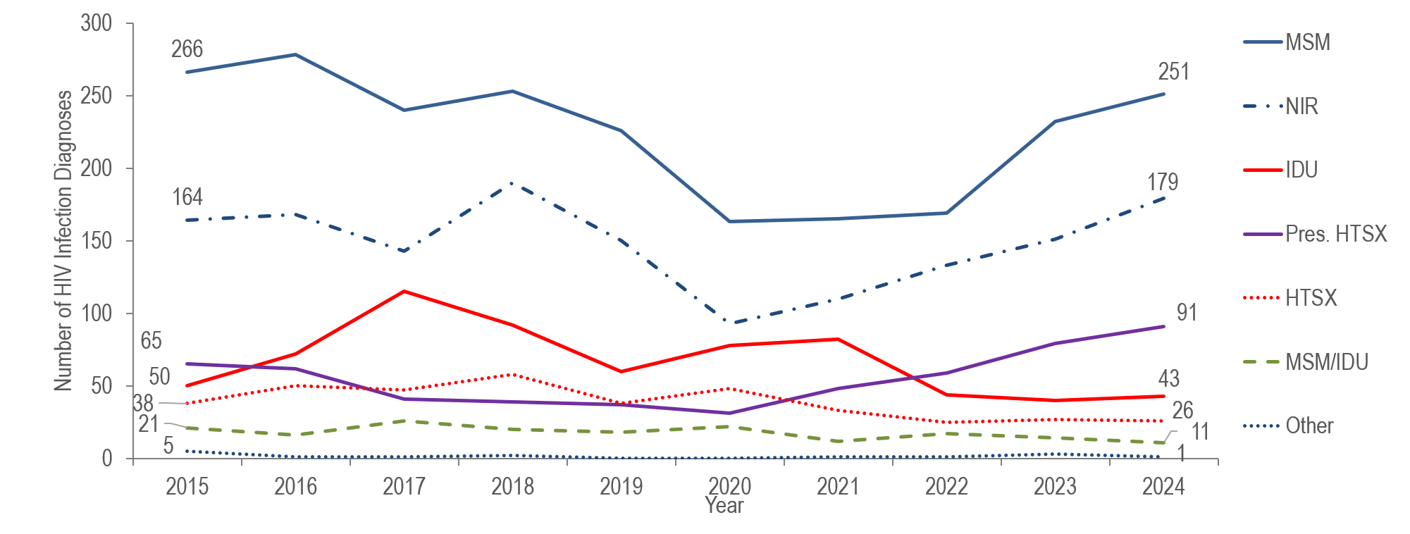
Individuals diagnosed with HIV infection by exposure mode, Massachusetts 2015–2024¹
¹ Please consider the impact of the COVID-19 pandemic on infectious disease screening, treatment, and surveillance in the interpretation of data from 2020 to 2022.
MSM=male-to-male sex; IDU=injection drug use; HTSX=heterosexual sex; Pres. HTSX=presumed heterosexual exposure, includes individuals assigned female at birth with a negative history of injection drug use who report having sex with an individual that identifies as male of unknown HIV status and risk; NIR=no identified risk
Data Source: Bureau of Infectious Disease and Laboratory Sciences, data are current as of 7/1/2025 and subject to change
Notes:
The figure is a trendline displaying the number of HIV infection diagnoses by exposure mode (male-to-male sex, injection drug use, male-to-male sex/injection drug use, heterosexual sex, no identified risk, and Other) for the most recent ten-year period.
OUTBREAKS AMONG persons who inject drugs (PWID)
The number of reported cases with injection drug use (IDU) as the primary exposure mode increased from 50 in 2015 to a peak of 115 in 2017 and then decreased to 60 in 2019. The increase in 2017 was primarily due to an outbreak among persons who inject drugs (PWID) in the northeast part of the state between 2016 and 2018.* Following a focused public health response, the number of HIV infection diagnoses attributed to IDU in the northeast decreased. However, in early 2019, a new cluster of HIV infection was identified in Boston among PWID who were experiencing or had experienced recent homelessness, and the total statewide number of reported cases with IDU as the primary exposure increased to 82 in 2021. Following another focused public health response, the number of HIV infection diagnoses attributed to IDU decreased by 48% to 43 cases in 2024.
As of July 1, 2025, a total of 239 cases diagnosed since November 2018 have been investigated and identified as part of the Boston cluster. As it is an active cluster of concern, additional cases will continue to be investigated and added. Continuing trends among those newly diagnosed in the Boston cluster (N=16 cases diagnosed in 2024) include an increase in polysubstance and methamphetamine use.**
*For more information, see: Charles Alpren et al. “Opioid Use Fueling HIV Transmission in an Urban Setting: An Outbreak of HIV Infection Among People Who Inject Drugs—Massachusetts, 2015–2018”, American Journal of Public Health 110, no. 1 (January 1, 2020): pp. 37-44. https://doi.org/10.2105/AJPH.2019.305366
**For more information, see: Joint MDPH and BPHC Clinical Advisory: Increase in newly diagnosed HIV infections among persons who inject drugs in Boston, March 15, 2021, available at: https://www.mass.gov/doc/joint-mdph-and-bphc-clinical-advisory-hiv-transmission-through-injection-drug-use-in-boston-march-15-2021/download
* For more information, see: Charles Alpren et al. “Opioid Use Fueling HIV Transmission in an Urban Setting: An Outbreak of HIV Infection Among People Who Inject Drugs—Massachusetts, 2015–2018”, American Journal of Public Health 110, no. 1 (January 1, 2020): pp. 37-44. https://doi.org/10.2105/AJPH.2019.305366
** For more information, see: Joint MDPH and BPHC Clinical Advisory: Increase in newly diagnosed HIV infections among persons who inject drugs in Boston, March 15, 2021, available at: https://www.mass.gov/doc/joint-mdph-and-bphc-clinical-advisory-hiv-transmission-through-injection-drug-use-in-boston-march-15-2021/download

Slide 3
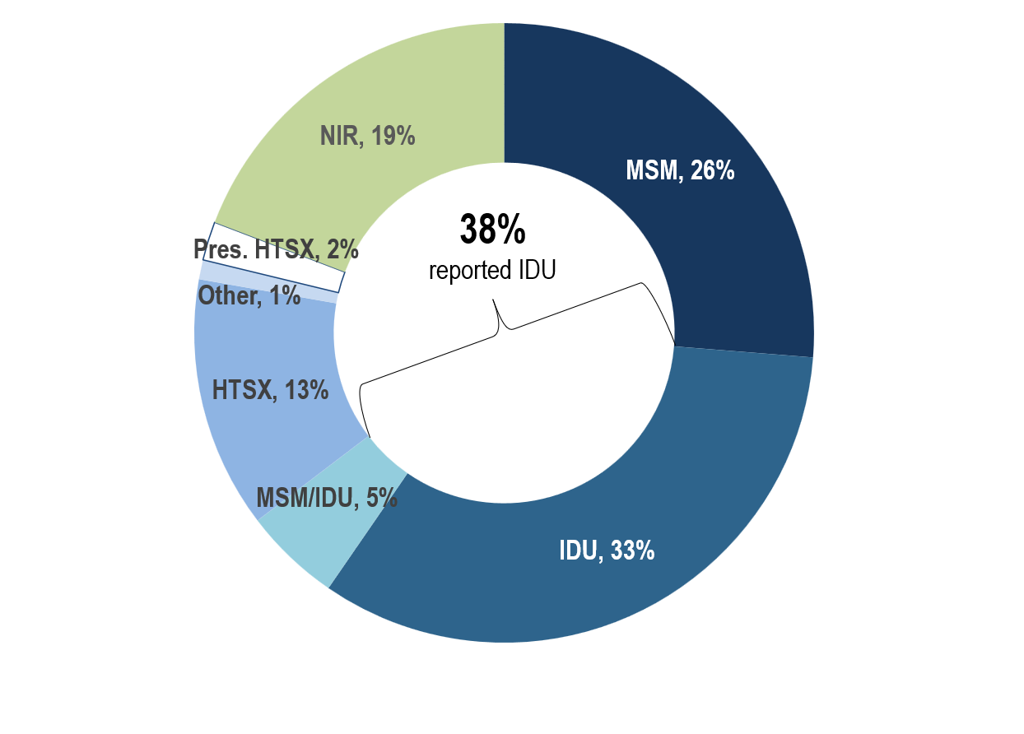
Deaths among individuals reported with HIV by exposure mode, Massachusetts 2024 (N=330)
MSM=male-to-male sex; IDU=injection drug use; HTSX=heterosexual sex; Pres. HTSX=presumed heterosexual exposure, includes individuals assigned female at birth with a negative history of injection drug use who report having sex with an individual that identifies as male of unknown HIV status and risk; NIR=no identified risk; Data Source: Bureau of Infectious Disease and Laboratory Sciences, data are current as of 7/1/2025 and subject to change
Notes:
The figure is an open pie chart which displays the distribution by exposure mode of deaths among individuals reported with HIV for 2024. A text box in the center of the pie chart reads, “38% reported IDU".
KEY FINDING
Individuals with IDU exposure mode accounted for the largest proportion of deaths among individuals reported with HIV. In 2024, 33% of deaths among individuals with HIV were reported with an exposure mode of IDU and an additional 5% were reported with an exposure mode of MSM/IDU, compared to 7% and 2%, respectively, of 2024 HIV infection diagnoses. The leading causes of death among individuals reported with HIV infection with IDU and MSM/IDU exposure mode who died in 2023 (with a known cause) were external causes of injuries and poisonings (which includes opioid overdoses) which accounted for 37% (N=45/122) of deaths, cancer which accounted for 17% (N=21/122) of deaths, and HIV which accounted for 13% (N=16/122) of deaths.
Final cause of death is not yet available for all 2024 deaths among individuals with HIV as of 7/1/2025

Slide 4
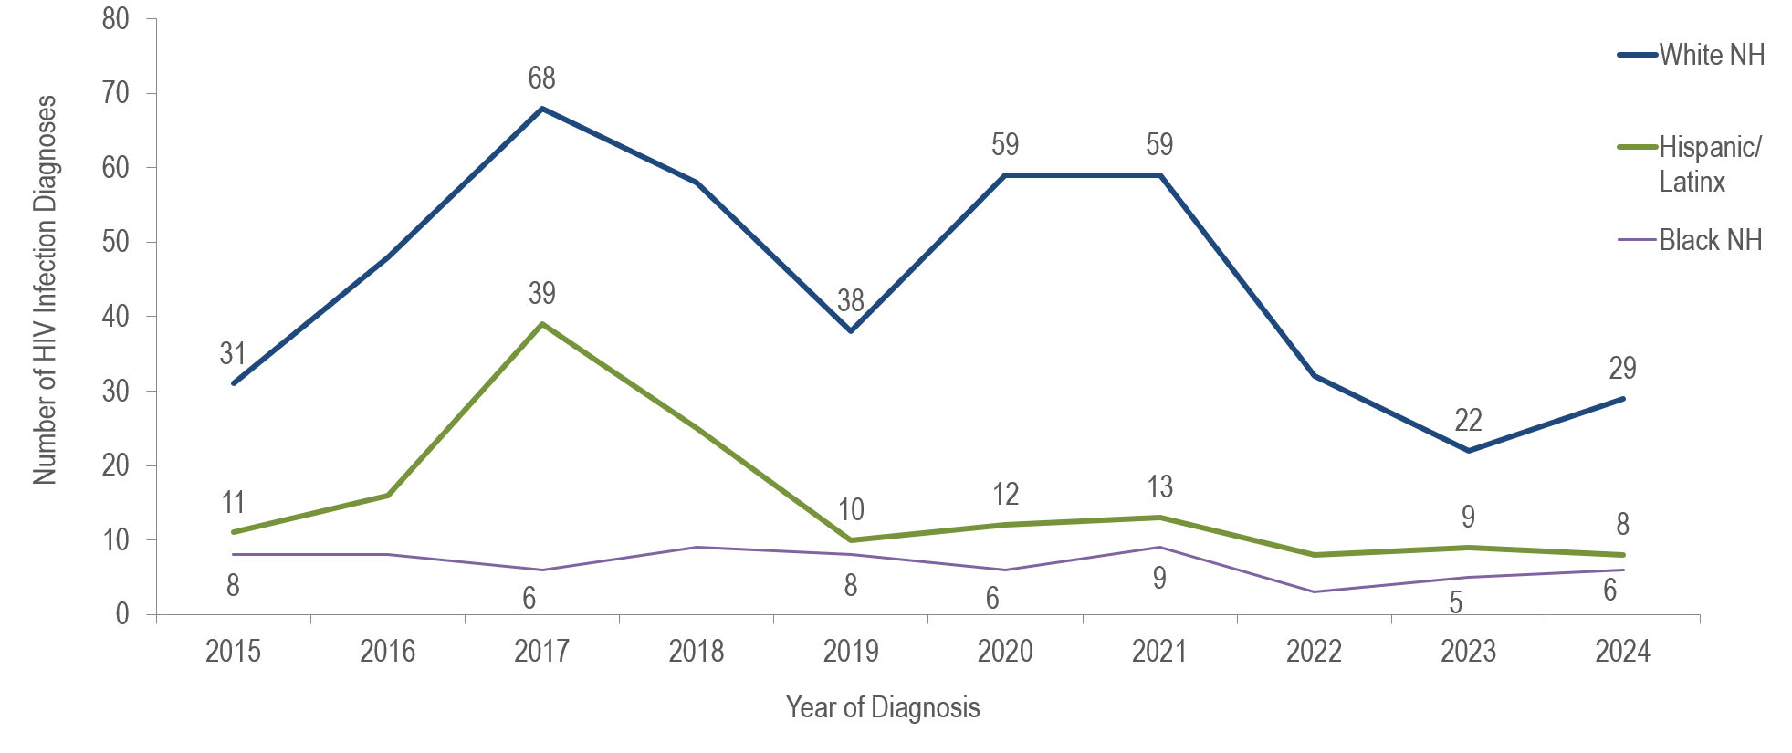
Number of individuals diagnosed with HIV infection with IDU exposure mode by race/ethnicity and year of diagnosis, Massachusetts 2015–2024¹
¹ Please consider the impact of the COVID-19 pandemic on infectious disease screening, treatment, and surveillance in the interpretation of data from 2020 to 2022.
NH = Non-Hispanic; Data Source: Bureau of Infectious Disease and Laboratory Sciences, data are current as of 7/1/2025 and subject to change
Notes:
The figure is a trendline displaying the number of HIV infection diagnoses among individuals diagnosed with IDU exposure mode by race/ethnicity (White NH, Black NH, Hispanic/Latinx) for each year from 2015 to 2024.
KEY FINDING
The number of HIV infection diagnoses with IDU exposure mode among White (non-Hispanic) individuals more than doubled from 2015 to 2017, decreased by 44% in 2019, increased by 55% in 2021, and then decreased by 51% in 2024. The number of HIV infection diagnoses with IDU exposure mode among Hispanic/Latinx individuals more than tripled from 2015 to 2017, decreased by 74% in 2019 and then remained relatively stable through 2024. The outbreak of HIV infection in the northeastern cities of Lawrence and Lowell among PWID may have contributed to the increase and subsequent decrease among Hispanic/Latinx individuals. The number of HIV infection diagnoses with IDU exposure mode among Black (non-Hispanic) individuals remained relatively stable from 2015 to 2024.

Slide 5
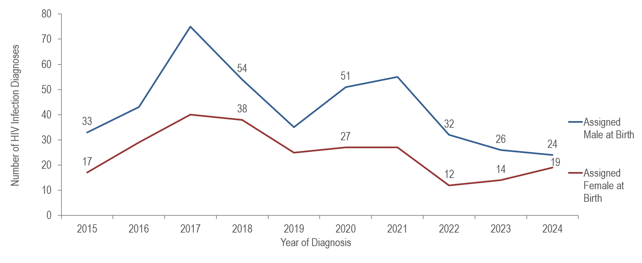
HIV diagnoses among individuals with IDU exposure mode by sex assigned at birth, Massachusetts 2015–2024¹
¹ Please consider the impact of the COVID-19 pandemic on infectious disease screening, treatment, and surveillance in the interpretation of data from 2020 to 2022.
Data Source: Bureau of Infectious Disease and Laboratory Sciences, data are current as of 7/1/2025 and subject to change
Notes:
The figure is a trendline displaying the number of HIV infection diagnoses among individuals with IDU exposure mode by sex assigned at birth (male, female) for each year from 2015 to 2024.
The number of HIV infection diagnoses with IDU exposure mode among individuals AMAB more than doubled from 2015 to 2017, decreased by 53% in 2019, increased by 57% in 2021, and decreased by 56% in 2024. The number of diagnoses with IDU exposure mode among individuals AFAB more than doubled from 2015 to 2017, decreased by 38% in 2019, remained relatively stable through 2021, decreased by 56% in 2022, and then increased by 58% in 2024.

Slide 6
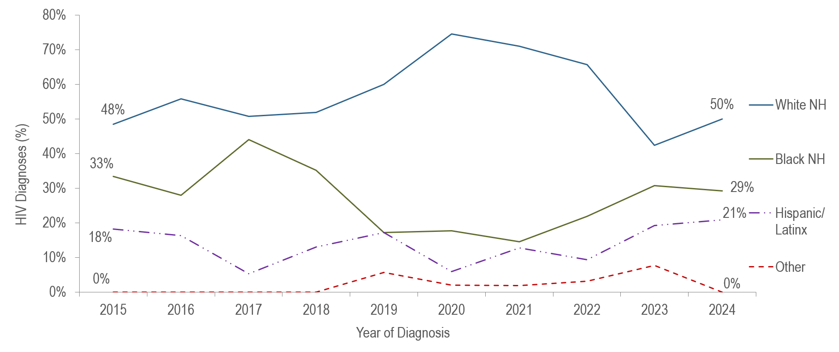
Individuals AMAB and diagnosed with HIV infection with IDU exposure mode by race/ethnicity and year of diagnosis, Massachusetts 2015–2024¹
¹ Please consider the impact of the COVID-19 pandemic on infectious disease screening, treatment, and surveillance in the interpretation of data from 2020 to 2022.
Individuals AMAB : N=428, NH=non-Hispanic; Data Source: Bureau of Infectious Disease and Laboratory Sciences, data are current as of 7/1/2025 and subject to change
Notes:
The figure is a trendline displaying the percentage distribution by race ethnicity (White NH, Black NH, Hispanic/Latina, other/unknown) for individuals AMAB for each year from 2015 to 2024.
Each year from 2015 to 2024, the largest proportion of individuals AMAB diagnosed with HIV infection with IDU exposure mode was White (non-Hispanic) (42%–75%), followed by Hispanic/Latinx (15%–44%), Black (non-Hispanic) (5%–21%), and other or unknown race/ethnicity (0%–8%).

Slide 7
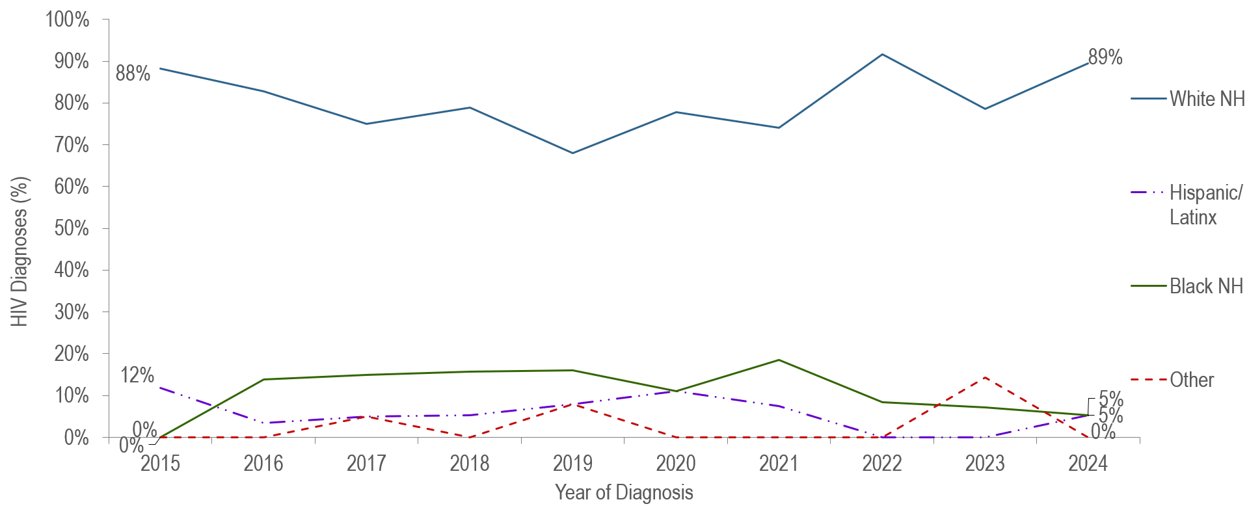
Individuals AFAB and diagnosed with HIV infection with IDU exposure mode by race/ethnicity and year of diagnosis, Massachusetts 2015–2024¹
¹ Please consider the impact of the COVID-19 pandemic on infectious disease screening, treatment, and surveillance in the interpretation of data from 2020 to 2022.
Individuals AFAB: N=248, NH=non-Hispanic; Data Source: Bureau of Infectious Disease and Laboratory Sciences, data are current as of 7/1/2025 and subject to change
Notes:
The figure is a trendline displaying the percentage distribution by race ethnicity (White NH, Black NH, Hispanic/Latinx, other/unknown) for individuals AFAB for each year from 2015 to 2024.
Each year from 2015 to 2024, the majority (68%–92%) of individuals AFAB diagnosed with HIV infection with IDU exposure mode have been White (non-Hispanic).

Slide 8
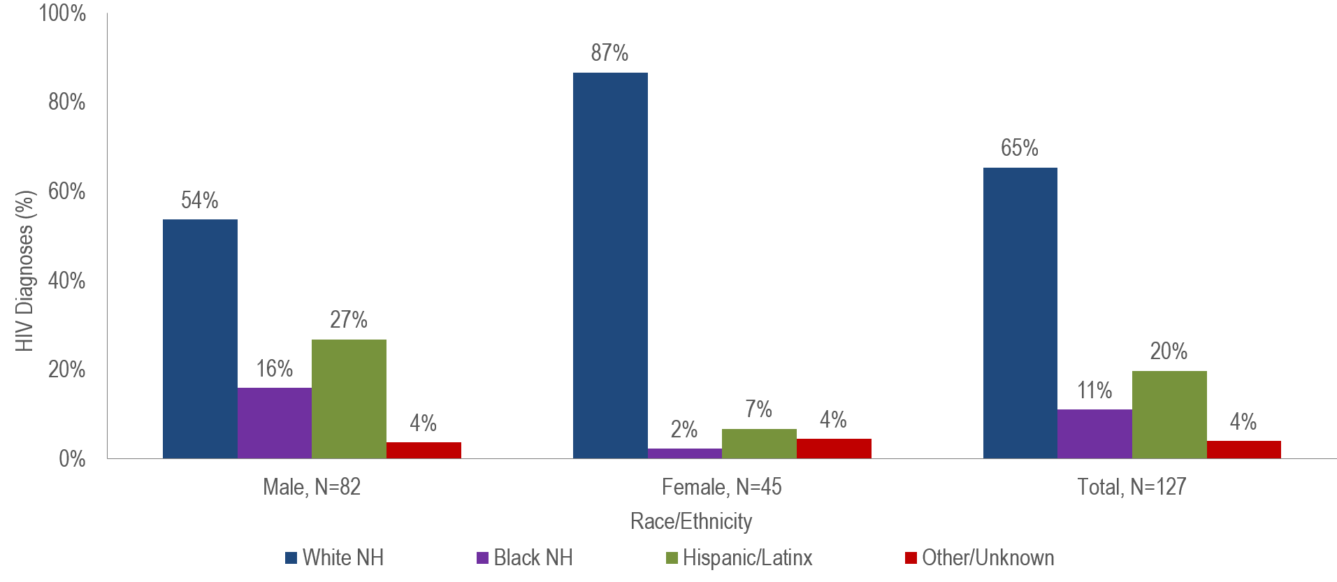
Percentage distribution of individuals diagnosed with HIV infection with IDU exposure mode by sex assigned at birth and race/ethnicity,
Massachusetts 2022–2024¹
¹ Please consider the impact of the COVID-19 pandemic on infectious disease screening, treatment, and surveillance in the interpretation of data from 2020 to 2022.
NH = Non-Hispanic; Data Source: Bureau of Infectious Disease and Laboratory Sciences, data are current as of 7/1/2025 and subject to change
Notes:
The figure is a bar chart displaying the percentage distribution by race ethnicity (White NH, Black NH, Hispanic/Latinx, other/unknown) for three groups: male (N=82), female (N=45), and total (N=127).
A larger percentage of individuals AFAB (87%) than individuals AMAB (54%) diagnosed with HIV infection during 2022 to 2024 with IDU exposure mode was White (non-Hispanic).

Slide 9
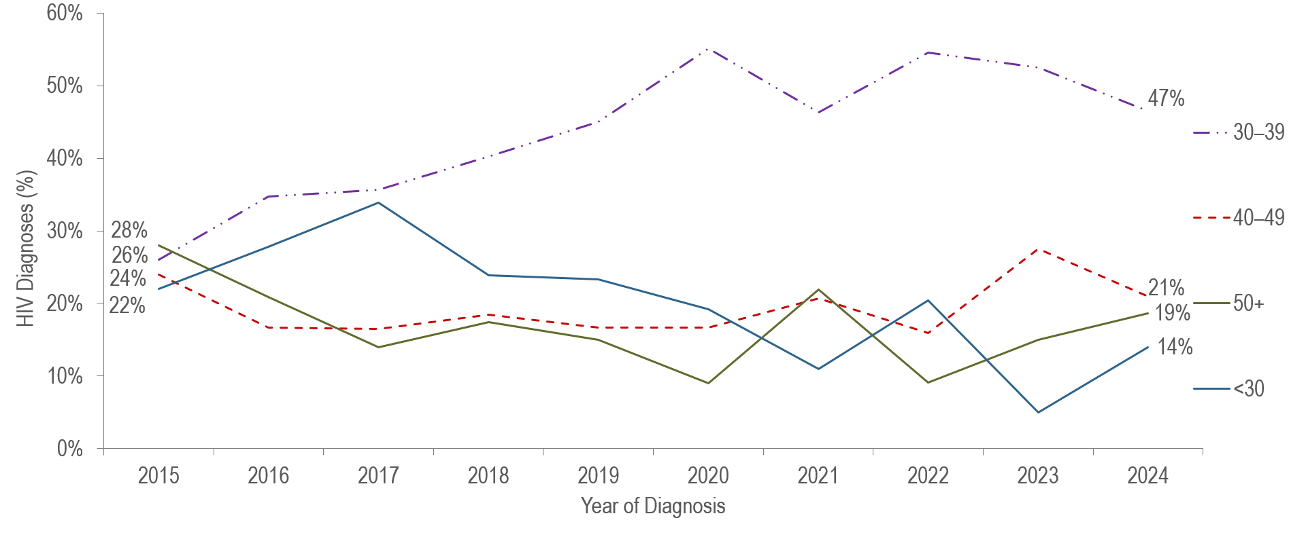
HIV diagnoses among individuals with IDU exposure mode by age at diagnosis, Massachusetts 2015–2024 (N=676)¹
¹ Please consider the impact of the COVID-19 pandemic on infectious disease screening, treatment, and surveillance in the interpretation of data from 2020 to 2022.
Data Source: Bureau of Infectious Disease and Laboratory Sciences, data are current as of 7/1/2025 and subject to change
Notes:
The figure is a trendline displaying the percentage distribution of individuals diagnosed with HIV infection with IDU exposure mode by age at diagnosis (<30, 30-39, 40-49, 50+) for each year from 2015 to 2024.
The percentage of HIV infection diagnoses with IDU exposure mode among individuals under 30 years of age increased from 22% in 2015 to 34% in 2017 and then decreased to 14% in 2024.
The percentage of HIV infection diagnoses with IDU exposure mode among individuals 30–39 years of age increased from 26% in 2015 to 47% in 2024.

Slide 10
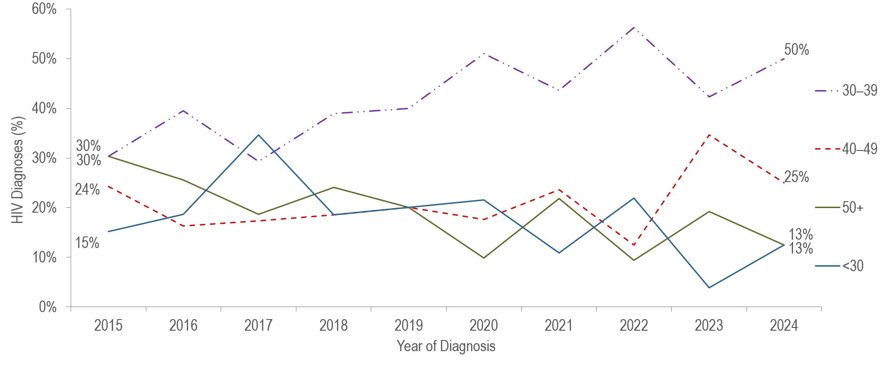
HIV diagnoses among individuals AMAB with IDU exposure mode by age at diagnosis, Massachusetts 2015–2024 (N=428)¹
¹ Please consider the impact of the COVID-19 pandemic on infectious disease screening, treatment, and surveillance in the interpretation of data from 2020 to 2022.
Data Source: Bureau of Infectious Disease and Laboratory Sciences, data are current as of 7/1/2025 and subject to change
Notes:
The figure is a trendline displaying the percentage distribution of individuals AMAB diagnosed with HIV infection with IDU exposure mode by age at diagnosis (<30, 30-39, 40-49, 50+) for each year from 2015 to 2024.
The percentage of HIV infection diagnoses with IDU exposure mode among individuals AMAB under 30 years of age increased from 15% in 2015 to 35% in 2017 and then decreased to 13% in 2024.
The percentage of HIV infection diagnoses with IDU exposure mode among individuals AMAB 30–39 years of age increased from 30% in 2015 to 50% in 2024.

Slide 11
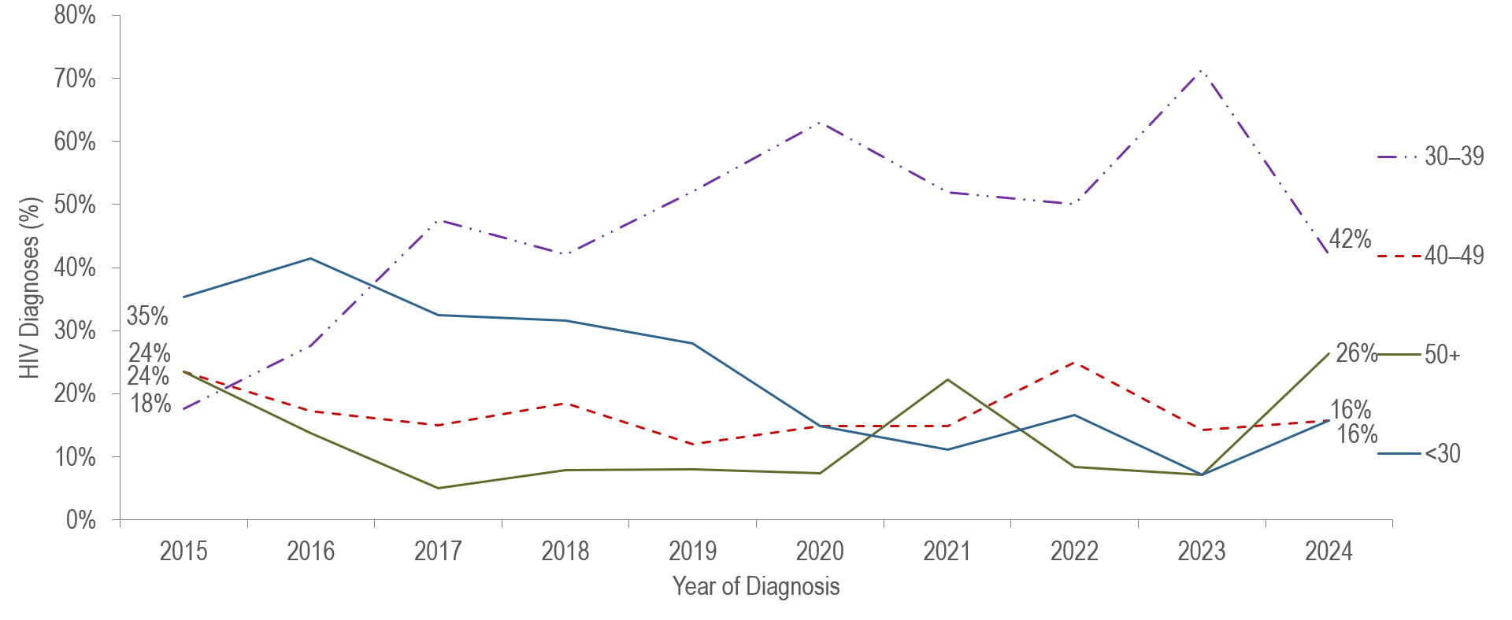
HIV diagnoses among individuals with IDU exposure mode by age at diagnosis, Massachusetts 2015–2024 (N=248)¹
¹ Please consider the impact of the COVID-19 pandemic on infectious disease screening, treatment, and surveillance in the interpretation of data from 2020 to 2022.
Data Source: Bureau of Infectious Disease and Laboratory Sciences, data are current as of 7/1/2025 and subject to change
Notes:
The figure is a trendline displaying the percentage distribution of individuals AFAB diagnosed with HIV infection with IDU exposure mode by age at diagnosis (<30, 30-39, 40-49, 50+) for each year from 2015 to 2024.
The percentage of HIV infection diagnoses with IDU exposure mode among individuals AFAB under 30 years of age decreased from 35% in 2015 to 16% in 2024.
The percentage of HIV infection diagnoses with IDU exposure mode among individuals AFAB 30–39 years of age increased from 18% in 2015 to 42% in 2024.

