Slide 1
Massachusetts HIV Epidemiologic Profile:
Data as of 7/1/2025
Population Report:
Racial and Ethnic Minorities
Notes:
Suggested citation:
Massachusetts Department of Public Health, Bureau of Infectious Disease and Laboratory Sciences. Massachusetts HIV Epidemiologic Profile: Data as of 7/1/2025, Population Report: Racial and Ethnic Groups, https://www.mass.gov/lists/hivaids-epidemiologic-profiles Published December 2025. Accessed [date].
Bureau of Infectious Disease and Laboratory Sciences
Massachusetts Department of Public Health
Jamaica Plain Campus/State Public Health Laboratory
305 South Street
Jamaica Plain, MA 02130
Questions about this report
Tel: (617) 983-6560
To reach the Reporting and Partner Services Line*
Tel: (617) 983-6999
To speak to the on-call epidemiologist
Tel: (617) 983-6800
Questions about infectious disease reporting
Tel: (617) 983-6801
HIV Data Dashboard
https://www.mass.gov/info-details/hiv-data-dashboard
Requests for additional data
https://www.mass.gov/lists/infectious-disease-data-reports-and-requests
Slide sets for HIV Epidemiologic Profile Reports
https://www.mass.gov/lists/hivaids-epidemiologic-profiles
*Providers may use this number to report individuals newly diagnosed with a notifiable sexually transmitted infection, including HIV, or request partner services. Partner services is a free and confidential service for individuals recently diagnosed with a priority infection. The client-centered program offers counseling, linkage to other health and social services, anonymous notification of partners who were exposed and assistance with getting testing and treatment. For more information, see: https://www.mass.gov/service-details/partner-services-program-information-for-healthcare-providers)

Slide 2
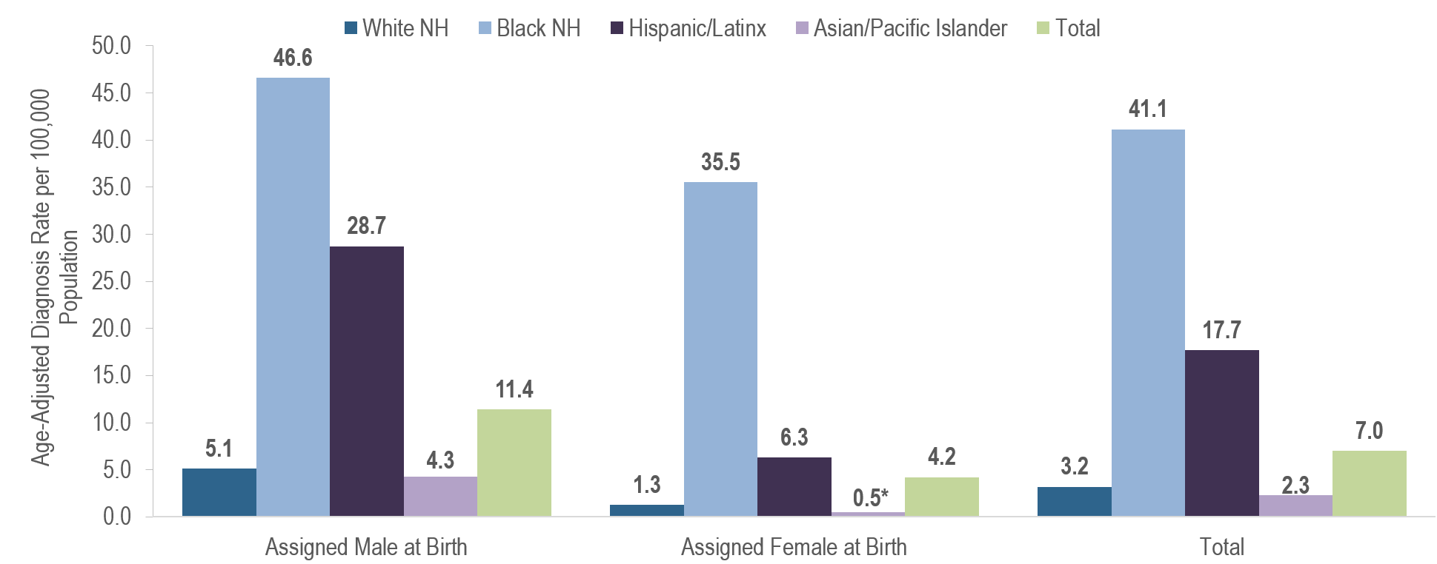
Average annual age-adjusted HIV diagnosis rates per 100,000 population¹ by sex assigned at birth and race/ethnicity, Massachusetts 2022 – 2024² (N=1,596)
*Rates based on numerators <12 are marked with an asterisk (*) and should be interpreted with caution.
¹ As of 1/1/2020, BIDLS calculates rates per 100,000 population using denominators estimated by the University of Massachusetts Donahue Institute using a modified Hamilton-Perry model (Strate S, et al. Small Area Population Estimates for 2011 through 2020, report published Oct 2016). Note that rates and trends calculated using previous methods cannot be compared to these. All rates are age-adjusted using the 2000 US standard population.
² Please consider the impact of the COVID-19 pandemic on infectious disease screening, treatment, and surveillance in the interpretation of 2020–2022 data; NH = non-Hispanic; API = Asian/Pacific Islander
Data Source: Bureau of Infectious Disease and Laboratory Sciences, data are current as of 7/1/2025 and subject to change
Notes:
The figure is a bar chart displaying the average annual HIV diagnosis rates per 100,000 among individuals assigned male at birth, individuals assigned female at birth, and the Massachusetts total population for four racial/ethnic groups: White NH, Black NH, Hispanic/Latinx, and Asian/Pacific Islander.
KEY FINDINGS
There were large disparities in average annual age-adjusted HIV diagnosis rates for 2022 to 2024 by race/ethnicity. Compared to the rate among White (non-Hispanic) individuals, the rate among:
Black (non-Hispanic) individuals was 13 times greater, and
Hispanic/Latinx individuals was six times greater.
With respect to differences based on race/ethnicity and sex assigned at birth, the average annual age-adjusted HIV diagnosis rate for 2022 to 2024 among:
Black (non-Hispanic) individuals assigned male at birth (AMAB) was nine times that of White (non-Hispanic) individuals AMAB,
Hispanic/Latinx individuals AMAB was six times that of White (non-Hispanic) individuals AMAB,
Black (non-Hispanic) individuals assigned female at birth (AFAB) was 28 times that of White (non-Hispanic) individuals AFAB, and
Hispanic/Latinx individuals AFAB was five times that of White (non-Hispanic) individuals AFAB.

Slide 3
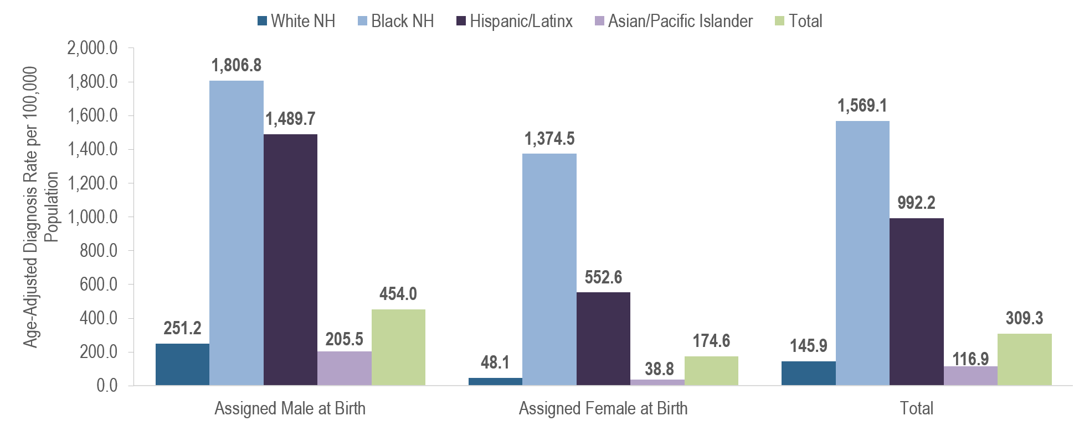
Age-adjusted HIV prevalence rates per 100,000 population¹ by sex assigned at birth and race/ethnicity, Massachusetts 2024 (N= 24,838)
¹ As of 1/1/2020, BIDLS calculates rates per 100,000 population using denominators estimated by the University of Massachusetts Donahue Institute using a modified Hamilton-Perry model (Strate S, et al. Small Area Population Estimates for 2011 through 2020, report published Oct 2016). Note that rates and trends calculated using previous methods cannot be compared to these. All rates are age-adjusted using the 2000 US standard population.
NH = non-Hispanic; API = Asian/Pacific Islander
Data Source: Bureau of Infectious Disease and Laboratory Sciences, data are current as of 7/1/2025 and subject to change
Notes:
The figure is a bar chart displaying the age-adjusted HIV prevalence rates per 100,000 population among individuals assigned male at birth, individuals assigned female at birth, and the Massachusetts total population for four racial/ethnic groups: White NH, Black NH, Hispanic/Latinx, and Asian/Pacific Islander.
KEY FINDINGS
In 2024, there were large disparities in age-adjusted prevalence rates by race/ethnicity. Compared to the rate among White (non-Hispanic) individuals, the rate among:
Black (non-Hispanic) individuals was 11 times greater, and
Hispanic/Latinx individuals was seven times greater.
With respect to differences based on race/ethnicity and sex assigned at birth, the age-adjusted HIV prevalence rate among:
Black (non-Hispanic) individuals AMAB was seven times that of White (non-Hispanic) individuals AMAB,
Hispanic/Latinx individuals AMAB was six times that of White (non-Hispanic) individuals AMAB,
Black (non-Hispanic) individuals AFAB was 29 times that of White (non-Hispanic) individuals AFAB, and
Hispanic/Latinx individuals AFAB was 11 times that of White (non-Hispanic) individuals AFAB.

Slide 4
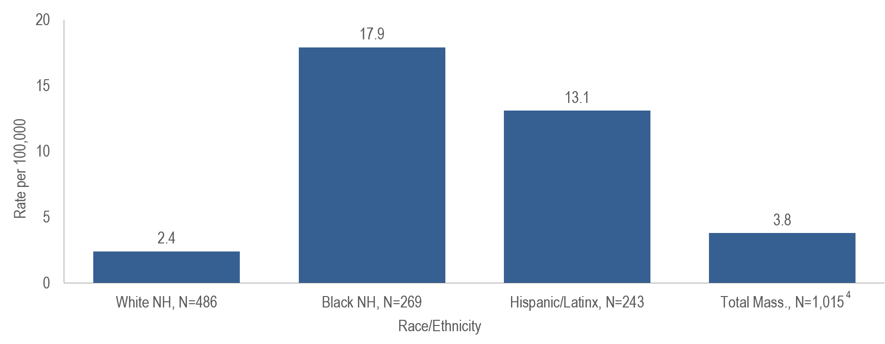
Average age-adjusted death rate per 100,000 population¹ among people reported with HIV by race/ethnicity,² Massachusetts 2022–2024³
¹ As of 1/1/2020, BIDLS calculates rates per 100,000 population using denominators estimated by the University of Massachusetts Donahue Institute using a modified Hamilton-Perry model. Note that rates and trends calculated using previous methods cannot be compared to these. All rates are age-adjusted using the 2000 US standard population.
² Death rate for Asian/Pacific Islander (API) is not presented because the numerator <12 and therefore must be interpreted with caution.
³ Please consider the impact of the COVID-19 pandemic on infectious disease screening, treatment, and surveillance in the interpretation of data from 2020 to 2022.
⁴ Total includes API and individuals of other/unknown race/ethnicity (N=17); NH=non-Hispanic
Data Source: Bureau of Infectious Disease and Laboratory Sciences, data are current as of 7/1/2025 and subject to change
Notes:
The figure is a bar chart displaying the average annual age-adjusted death rate among individuals reported with HIV/AIDS per 100,000 for Massachusetts total, White NH individuals, Black NH individuals, and Hispanic/Latinx individuals.
The age-adjusted average all-cause death rate from 2022 to 2024 among:
Black (non-Hispanic) individuals reported with HIV was seven times that of White (non-Hispanic) individuals, and
Hispanic/Latinx individuals reported with HIV was five times that of White (non-Hispanic) individuals.

Slide 5
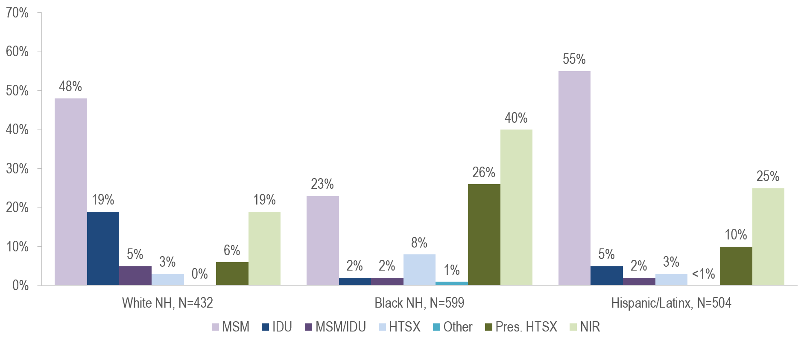
Individuals diagnosed with HIV infection by exposure mode and race/ethnicity, Massachusetts 2022–2024¹
¹ Please consider the impact of the COVID-19 pandemic on infectious disease screening, treatment, and surveillance in the interpretation of data from 2020 to 2022.
MSM=male-to-male sex; IDU=injection drug use; HTSX=heterosexual sex; Pres. HTSX=presumed heterosexual exposure, includes individuals assigned female at birth with a negative history of injection drug use who report having sex with an individual that identifies as male of unknown HIV status and risk; NIR=no identified risk
Data Source: Bureau of Infectious Disease and Laboratory Sciences, data are current as of 7/1/2025 and subject to change
Notes:
The figure is a bar chart displaying the distribution of recent HIV diagnoses by exposure mode for each of three racial/ethnic groups: White NH (N=432), Black NH (N=599), and Hispanic/Latinx (N=504).
While the predominant exposure mode among White (non-Hispanic) and Hispanic/Latinx individuals recently diagnosed with HIV infection was MSM (48% and 55%, respectively), the largest proportion of Black (non-Hispanic) individuals was assigned no identified risk for exposure mode (40%). Of the Black (non-Hispanic) individuals assigned NIR, 79% (N=190/239) were non-US born.

Slide 6
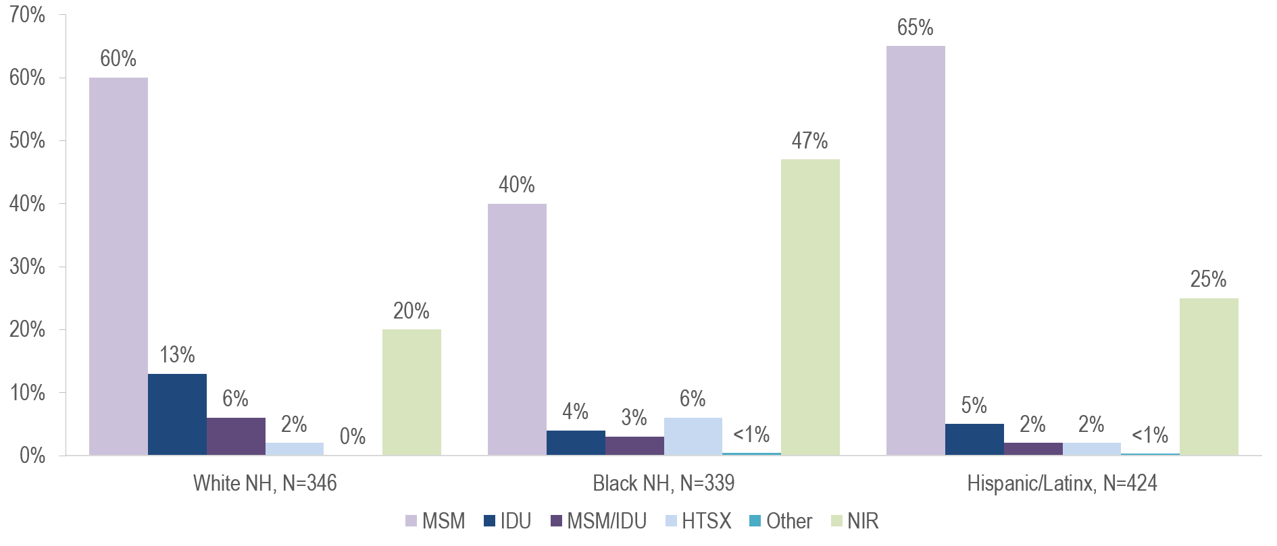
Individuals assigned male at birth diagnosed with HIV infection by exposure mode and race/ethnicity, Massachusetts 2022–2024¹
¹ Please consider the impact of the COVID-19 pandemic on infectious disease screening, treatment, and surveillance in the interpretation of data from 2020 to 2022.
MSM=male-to-male sex; IDU=injection drug use; HTSX=heterosexual sex; NIR=no identified risk
Data Source: Bureau of Infectious Disease and Laboratory Sciences, data are current as of 7/1/2025 and subject to change
Notes:
The figure is a bar chart displaying the distribution of recent HIV diagnoses among individuals assigned male at birth by exposure mode for each of three racial/ethnic groups: White NH (N=346), Black NH (N=339), and Hispanic/Latinx (N=424).
MSM was the most frequently reported exposure mode among White (non-Hispanic) (60%) and Hispanic/Latinx (65%) individuals AMAB, while NIR accounted for the largest proportion among Black (non-Hispanic) individuals AMAB (47%).

Slide 7
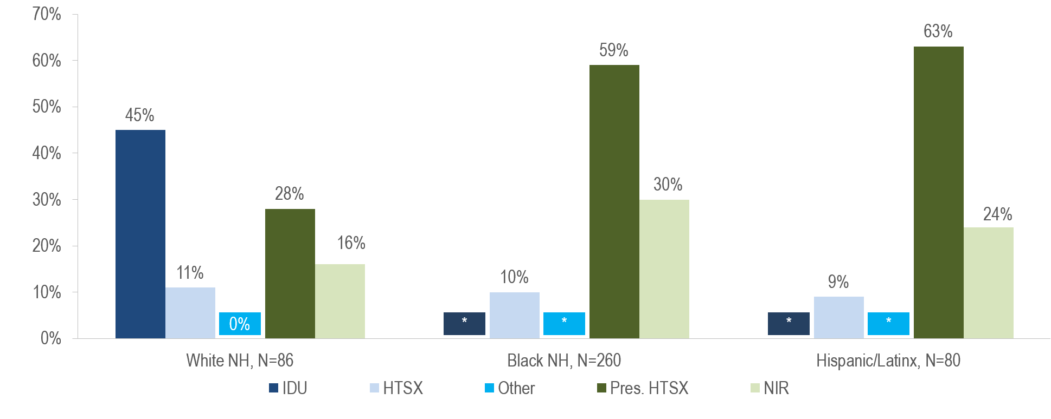
Individuals assigned female at birth diagnosed with HIV infection by exposure mode and race/ethnicity, Massachusetts 2022–2024¹
¹ Please consider the impact of the COVID-19 pandemic on infectious disease screening, treatment, and surveillance in the interpretation of data from 2020 to 2022.
IDU=injection drug use; HTSX=heterosexual sex; Pres. HTSX=presumed heterosexual exposure, includes individuals assigned female at birth with a negative history of injection drug use who report having sex with an individual that identifies as male of unknown HIV status and risk; NIR=no identified risk
Data Source: Bureau of Infectious Disease and Laboratory Sciences, data are current as of 7/1/2025 and subject to change
Notes:
The figure is a bar chart displaying the distribution of recent HIV diagnoses among individuals assigned female at birth by exposure mode for each of three racial/ethnic groups: White NH (N=86), Black NH (N=260), and Hispanic/Latinx (N=80).
Injection drug use was the predominant exposure mode among White (non-Hispanic) individuals AFAB recently diagnosed with HIV infection (45%), while presumed heterosexual sex accounted for the largest proportions among Black (non-Hispanic) (59%) and Hispanic/Latinx (63%) individuals AFAB.

Slide 8
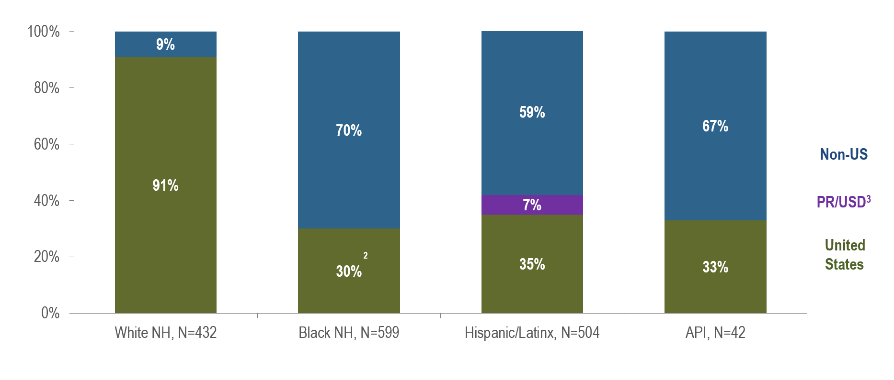
Percentage of individuals diagnosed with HIV infection by race/ethnicity and place of birth, Massachusetts 2022–2024¹
¹ Please consider the impact of the COVID-19 pandemic on infectious disease screening, treatment, and surveillance in the interpretation of data from 2020 to 2022. NH=non-Hispanic
² US born and Puerto Rico/USD categories are combined for Black (non-Hispanic) individuals due to small numbers to adhere to cell suppression rules.
³ 97% of individuals diagnosed with HIV infection from 2022–2024 who were born in a US dependency (USD) were born in Puerto Rico (PR).
Data Source: Bureau of Infectious Disease and Laboratory Sciences, data are current as of 7/1/2025 and subject to change
Notes:
The figure is a stacked bar chart displaying the distribution of recent HIV diagnoses by place of birth (non-US, Puerto Rico/US Dependency, or US) for each of four racial/ethnic groups: White NH (N=432), Black NH (N=599), Hispanic/Latinx (N=504), and Asian/Pacific Islander (N=42).
KEY FINDING
Seventy percent of Black (non-Hispanic) individuals diagnosed with HIV infection during 2022–2024 were born outside the US, compared to 67% of Asian/Pacific Islander, 59% of Hispanic/Latinx, and 9% of White (non-Hispanic) individuals.
Please consider the impact of the COVID-19 pandemic on infectious disease screening, treatment, and surveillance in the interpretation of data from 2020 to 2022.

Slide 9
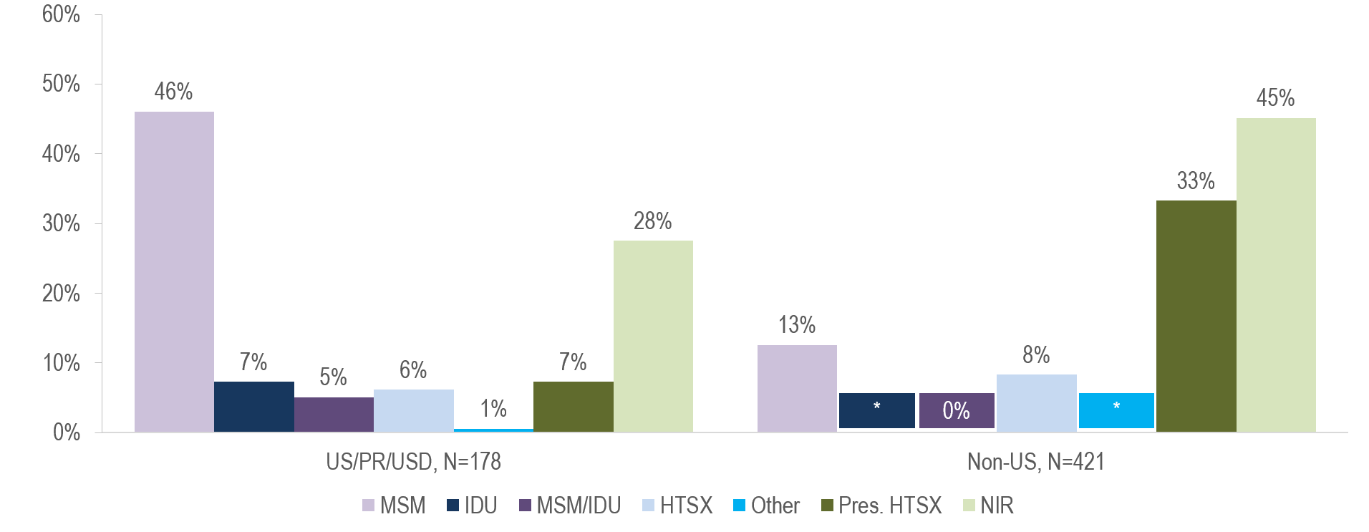
HIV diagnoses among Black (non-Hispanic) individuals diagnosed with HIV infection by exposure mode and place of birth, Massachusetts 2022–2024¹
¹ Please consider the impact of the COVID-19 pandemic on infectious disease screening, treatment, and surveillance in the interpretation of data from 2020 to 2022. MSM=male-to-male sex; IDU=injection drug use; HTSX=heterosexual sex; Pres. HTSX=presumed heterosexual exposure, includes individuals assigned female at birth with a negative history of injection drug use who report having sex with an individual that identifies as male of unknown HIV status and risk; NIR=no identified risk. US born and Puerto Rico/USD categories are combined for Black non-Hispanic individuals due to small numbers to adhere to cell suppression rules.
* Values less than five are suppressed for populations less than 50,000 or for populations of unknown size; Puerto Rico/US Dependency is not presented due to small numbers
Data Source: Bureau of Infectious Disease and Laboratory Sciences, data are current as of 7/1/2025 and subject to change
Notes:
The figure is a bar chart displaying the distribution of recent HIV diagnoses by exposure mode among Black (non-Hispanic) individuals for each of two places of birth: US/PR/USD (N=178), and Non-US (N=421).
While the predominant exposure mode among Black (non-Hispanic) individuals recently diagnosed with HIV infection and born in the US, Puerto Rico, and other US dependencies was MSM (46%), the largest proportion of Black (non-Hispanic) individuals born outside the US was assigned no identified risk for exposure mode (45%). Sixty-nine percent (N=131/190) of HIV diagnoses among non-US born Black (non-Hispanic) individuals with NIR exposure mode were born in Haiti.

Slide 10
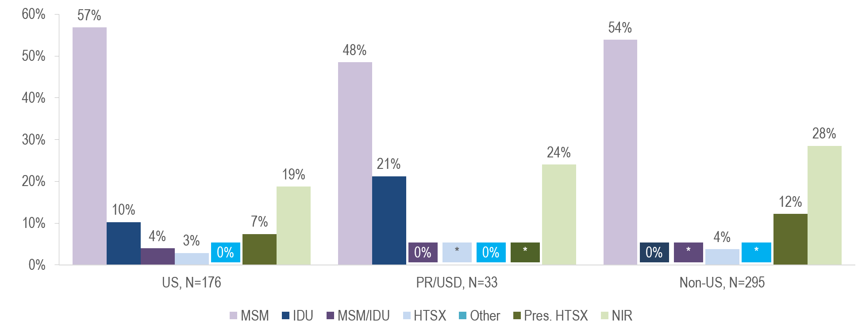
HIV diagnoses among Hispanic/Latinx individuals diagnosed with HIV infection by exposure mode and place of birth, Massachusetts 2022–2024¹
¹ Please consider the impact of the COVID-19 pandemic on infectious disease screening, treatment, and surveillance in the interpretation of data from 2020 to 2022. MSM=male-to-male sex; IDU=injection drug use; HTSX=heterosexual sex; Pres. HTSX=presumed heterosexual exposure, includes individuals assigned female at birth with a negative history of injection drug use who report having sex with an individual that identifies as male of unknown HIV status and risk; NIR=no identified risk.
* Values less than five are suppressed for populations less than 50,000 or for populations of unknown size; Puerto Rico/US Dependency is not presented due to small numbers
Data Source: Bureau of Infectious Disease and Laboratory Sciences, data are current as of 7/1/2025 and subject to change
Notes:
The figure is a bar chart displaying the distribution of recent HIV diagnoses by exposure mode among Hispanic/Latinx individuals for each of three places of birth: US (N=176), PR/USD (N=33), and Non-US (N=295).
MSM was the predominant exposure mode among Hispanic/Latinx individuals recently diagnosed with HIV infection for all places of birth: US (57%), Puerto Rico (48%), and non-US (54%). Twenty-five percent (N=39/159) of HIV diagnoses among non-US born Hispanic/Latinx individuals with MSM exposure mode were born in Brazil, 18% (N=29/159) were born in Colombia, 14% (N=23/159) were born in the Dominican Republic, and 9% (N=14/159) were born in El Salvador.

Slide 11
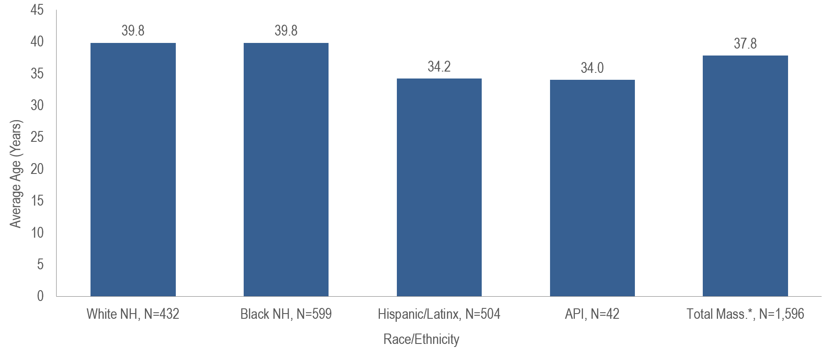
Average age at HIV infection diagnosis by race/ethnicity,
Massachusetts 2022–2024¹
¹ Please consider the impact of the COVID-19 pandemic on infectious disease screening, treatment, and surveillance in the interpretation of data from 2020 to 2022.
* Total includes individuals of other/unknown race/ethnicity (N=19)
Data Source: Bureau of Infectious Disease and Laboratory Sciences, data are current as of 7/1/2025 and subject to change
Notes:
The figure is a bar chart displaying the average age at diagnosis for each of four racial/ethnic groups: White NH (N=432), Black NH (N=599), and Hispanic/Latinx (N=504) and Asian/Pacific Islander (N=42) and for the Massachusetts total (N=1,596).
The average age at HIV diagnosis from 2022 to 2024 was younger for Asian/Pacific Islander (34.0 years) and Hispanic/Latinx individuals (34.2 years) diagnosed with HIV infection compared to Black (non-Hispanic) and White (non-Hispanic) individuals (both 39.8 years).

