Slide 1
Massachusetts HIV Epidemiologic Profile:
Data as of 1/1/2023
Population Report: Racial and Ethnic Minorities
Notes:
Suggested citation:
Massachusetts Department of Public Health, Bureau of Infectious Disease and Laboratory Sciences. Massachusetts HIV/AIDS Epidemiologic Profile: Data as of 1/1/2023, Population Report: Population Report: Racial and Ethnic Minorities, https://www.mass.gov/lists/hivaids-epidemiologic-profiles Published March 2024. Accessed [date].
Bureau of Infectious Disease and Laboratory Sciences Massachusetts Department of Public Health
Jamaica Plain Campus/State Public Health Laboratory
305 South Street Jamaica Plain, MA 02130
Questions about this report
Tel: (617) 983-6560
To reach the Reporting and Partner Services Line*
Tel: (617) 983-6999
To speak to the on-call epidemiologist
Tel: (617) 983-6800
Questions about infectious disease reporting
Tel: (617) 983-6801
Requests for additional data
https://www.mass.gov/lists/infectious-disease-data-reports-and-requests
Slide sets for HIV Epidemiologic Profile Reports
https://www.mass.gov/lists/hivaids-epidemiologic-profiles
* Providers may use this number to report individuals newly diagnosed with a notifiable sexually transmitted infection, including HIV, or request partner services. Partner services is a free and confidential service for individuals recently diagnosed with a priority infection. The client-centered program offers counseling, linkage to other health and social services, anonymous notification of partners who were exposed and assistance with getting testing and treatment. For more information, see: https://www.mass.gov/service-details/partner-services-program-information-for-healthcare-providers)

Slide 2
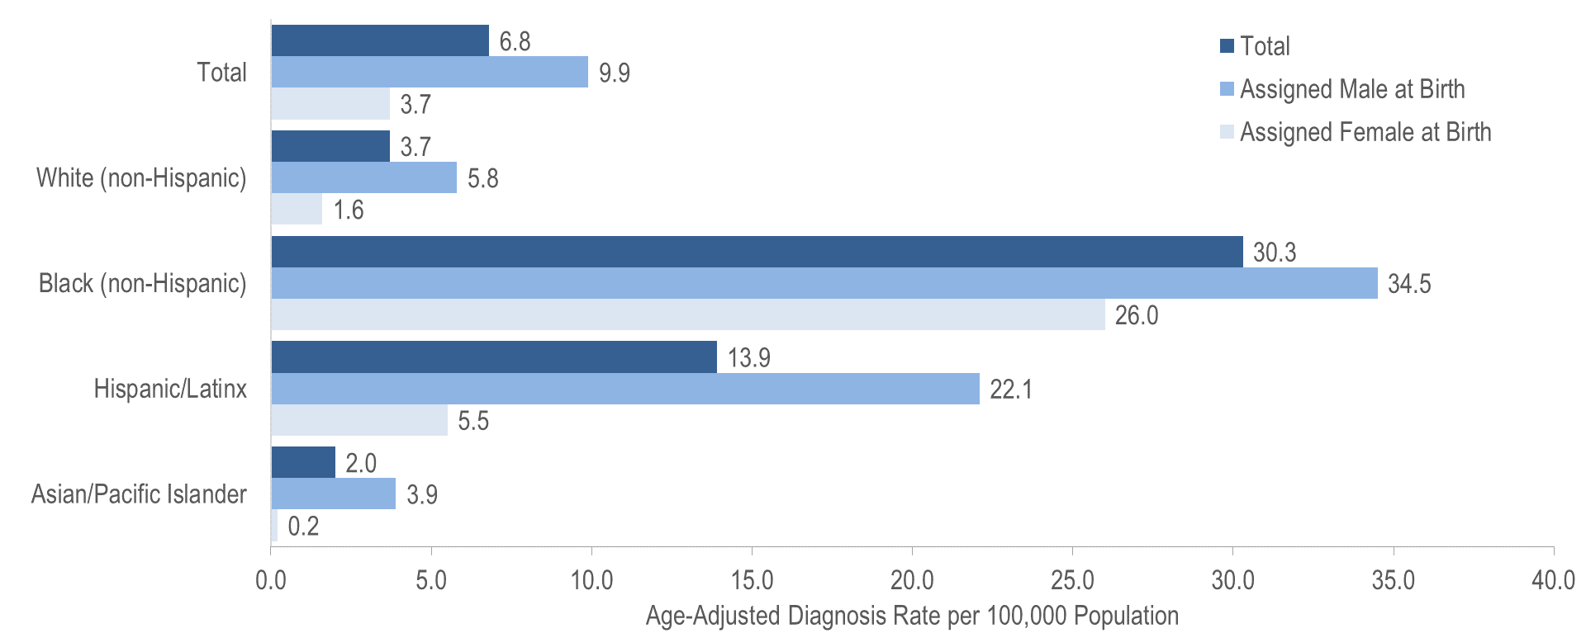
Average age-adjusted HIV diagnosis rate per 100,000 population¹ by sex assigned at birth and race/ethnicity, Massachusetts 2019 – 2021 (N=1,419)²
¹ As of 1/1/2020, BIDLS calculates rates per 100,000 population using denominators estimated by the University of Massachusetts Donahue Institute using a modified Hamilton-Perry model (Strate S, et al. Small Area Population Estimates for 2011 through 2020, report published Oct 2016). Note that rates and trends calculated using previous methods cannot be compared to these. All rates are age-adjusted using the 2000 US standard population.
² Please consider the impact of the COVID-19 pandemic on infectious disease screening, treatment, and surveillance in the interpretation of data from 2020 to 2021.
Data Source: Bureau of Infectious Disease and Laboratory Sciences, data are current as of 1/1/2023 and subject to change
Notes:
The figure is a bar chart displaying the average annual HIV diagnosis rates per 100,000 among individuals assigned male at birth, individuals assigned female at birth, and Massachusetts total population for four racial/ethnic groups: white NH, black NH, Hispanic/Latinx, and Asian/Pacific Islander.
KEY FINDINGS
There were large disparities in average annual age-adjusted HIV diagnosis rates for 2019 to 2021^{ii} by race/ethnicity. Compared to the rate among white (non-Hispanic) individuals, the rate among:
black (non-Hispanic) individuals was eight times greater, and
Hispanic/Latinx individuals was four times greater.
With respect to differences based on race/ethnicity and sex assigned at birth, the average annual age-adjusted HIV diagnosis rate for 2019 to 2021 among:
black (non-Hispanic) individuals assigned male at birth (AMAB), was six times that of white (non-Hispanic) individuals AMAB,
Hispanic/Latinx individuals AMAB was four times that of white (non-Hispanic) individuals AMAB,
black (non-Hispanic) individuals assigned female at birth (AFAB) was 16 times that of white (non-Hispanic) individuals AFAB, and
Hispanic/Latinx individuals AFAB was three times that of white (non-Hispanic) individuals AFAB.

Slide 3
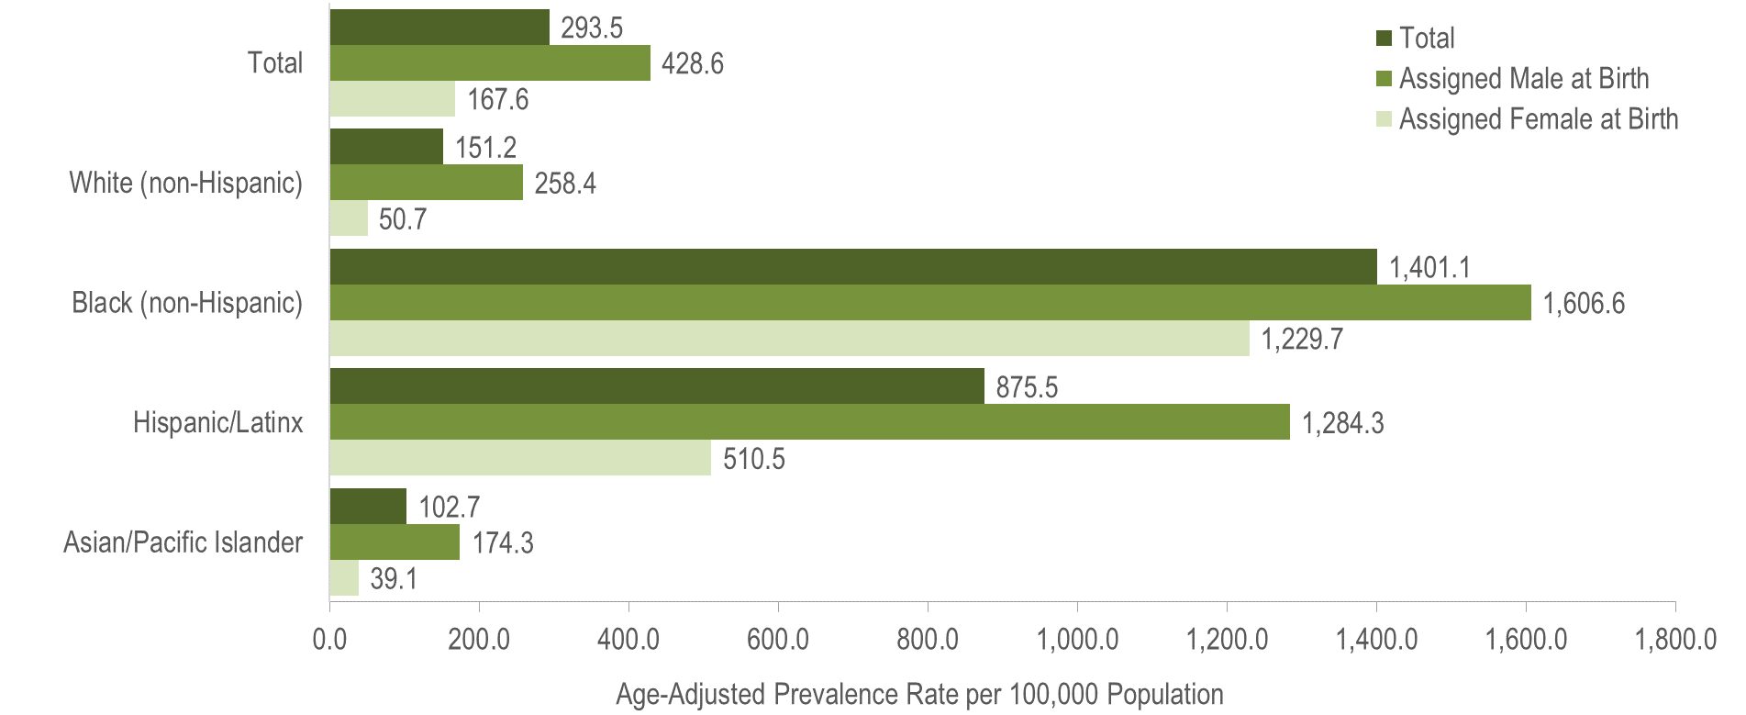
Age-adjusted HIV prevalence rates per 100,000 population¹ by sex assigned at birth and race/ethnicity, Massachusetts 2021 (N= 23,393)²
¹ As of 1/1/2020, BIDLS calculates rates per 100,000 population using denominators estimated by the University of Massachusetts Donahue Institute using a modified Hamilton-Perry model (Strate S, et al. Small Area Population Estimates for 2011 through 2020, report published Oct 2016). Note that rates and trends calculated using previous methods cannot be compared to these. All rates are age-adjusted using the 2000 US standard population.
² Please consider the impact of the COVID-19 pandemic on infectious disease screening, treatment, and surveillance in the interpretation of data from 2020 to 2021.
Data Source: Bureau of Infectious Disease and Laboratory Sciences, data are current as of 1/1/2023 and subject to change
Notes:
The figure is a bar chart displaying the age-adjusted prevalence rates per 100,000 population among individuals assigned male at birth, individuals assigned female at birth, and the Massachusetts total population for four racial/ethnic groups: white NH, black NH, Hispanic/Latinx, and Asian/Pacific Islander.
KEY FINDINGS
In 2021, there were large disparities in age-adjusted prevalence rates by race/ethnicity. Compared to the rate among white (non-Hispanic) individuals, the rate among:
black (non-Hispanic) individuals was nine times greater, and
Hispanic/Latinx individuals was six times greater.
With respect to differences based on race/ethnicity and sex assigned at birth, the age-adjusted HIV prevalence rate among:
black (non-Hispanic) individuals AFAB was 24 times that of white (non-Hispanic) individuals AFAB,
Hispanic/Latinx individuals AFAB was 10 times that of white (non-Hispanic) individuals AFAB,
black (non-Hispanic) individuals AMAB was six times that of white (non-Hispanic) individuals AMAB, and
Hispanic/Latinx individuals AMAB was five times that of white (non-Hispanic) individuals AMAB.

Slide 4
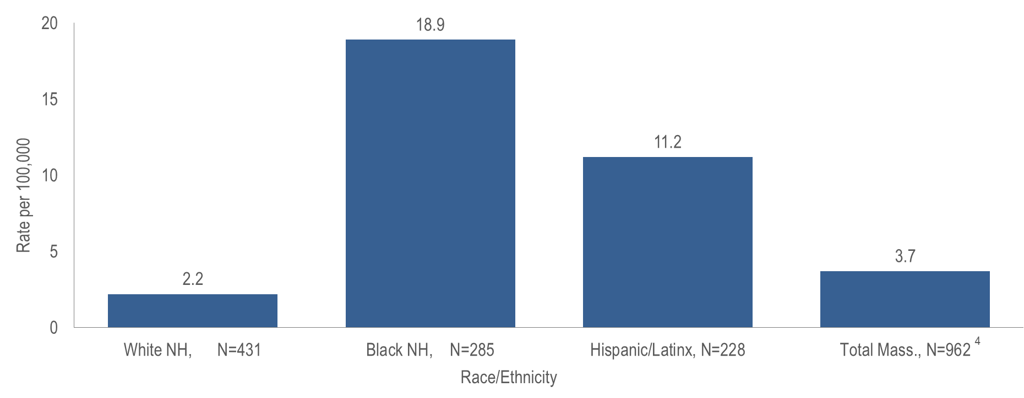
Average age-adjusted death rate per 100,000 population¹ among people reported with HIV by race/ethnicity,² Massachusetts 2019–2021³
¹ As of 1/1/2020, BIDLS calculates rates per 100,000 population using denominators estimated by the University of Massachusetts Donahue Institute using a modified Hamilton-Perry model. Note that rates and trends calculated using previous methods cannot be compared to these. All rates are age-adjusted using the 2000 US standard population.
² Death rate for Asian/Pacific Islander (API) is not presented because the numerator <12 and therefore must be interpreted with caution.
³ Please consider the impact of the COVID-19 pandemic on infectious disease screening, treatment, and surveillance in the interpretation of data from 2020 to 2021.
⁴ Total includes API and individuals of other/unknown race/ethnicity (N=18); NH=non-Hispanic
Data Source: Bureau of Infectious Disease and Laboratory Sciences, data are current as of 1/1/2023 and subject to change
Notes:
The figure is a bar chart displaying the average annual age-adjusted death rate among individuals reported with HIV/AIDS per 100,000 for Massachusetts total, white NH individuals, black NH individuals, and Hispanic/Latinx individuals.
The age-adjusted average all-cause death rate from 2019 to 2021 among:
black (non-Hispanic) individuals reported with HIV was nine times that of white (non-Hispanic) individuals, and
Hispanic/Latinx individuals reported with HIV was five times that of white (non-Hispanic) individuals.

Slide 5
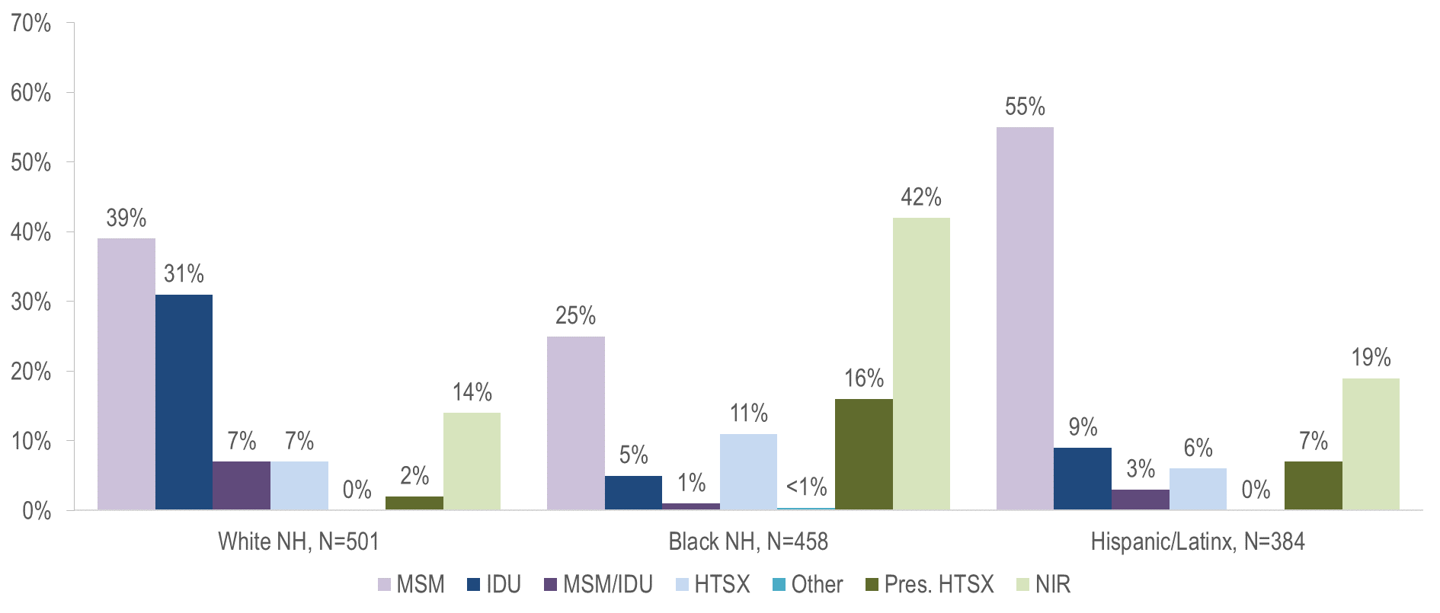
Individuals diagnosed with HIV infection by exposure mode and race/ethnicity, Massachusetts 2019–2021¹
¹ Please consider the impact of the COVID-19 pandemic on infectious disease screening, treatment, and surveillance in the interpretation of data from 2020 to 2021.
MSM=male-to-male sex; IDU=injection drug use; HTSX=heterosexual sex; Pres. HTSX=presumed heterosexual exposure, includes individuals assigned female at birth with a negative history of injection drug use who report having sex with an individual that identifies as male of unknown HIV status and risk; NIR=no identified risk
Data Source: Bureau of Infectious Disease and Laboratory Sciences, data are current as of 1/1/2023 and subject to change
Notes:
The figure is a bar chart displaying the distribution of recent HIV diagnoses by exposure mode for each of three racial/ethnic groups: white NH (N=501), black NH (N=458), and Hispanic/Latinx (N=384).
While the predominant exposure mode among white (non-Hispanic) and Hispanic/Latinx individuals recently diagnosed with HIV infection was MSM (39% and 55%, respectively), the largest proportion of black (non-Hispanic) individuals was assigned no identified risk for exposure mode (42%).

Slide 6
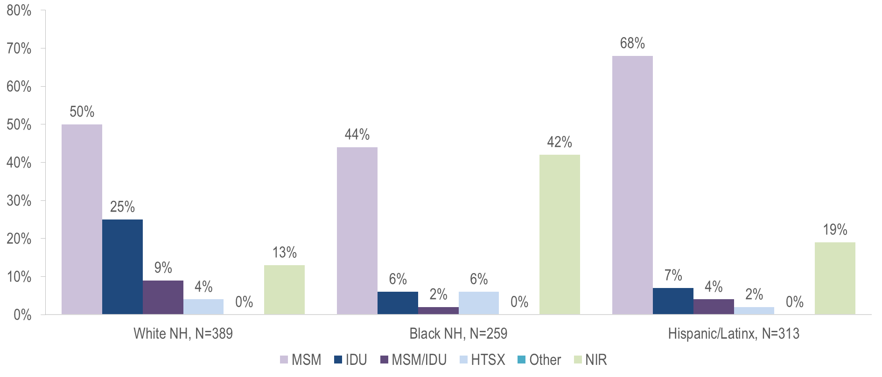
Individuals assigned male at birth diagnosed with HIV infection by exposure mode and race/ethnicity, Massachusetts 2019–2021¹
¹ Please consider the impact of the COVID-19 pandemic on infectious disease screening, treatment, and surveillance in the interpretation of data from 2020 to 2021.
MSM=male-to-male sex; IDU=injection drug use; HTSX=heterosexual sex; NIR=no identified risk
Data Source: Bureau of Infectious Disease and Laboratory Sciences, data are current as of 1/1/2023 and subject to change
Notes:
The figure is a bar chart displaying the distribution of recent HIV diagnoses among individuals assigned male at birth by exposure mode for each of three racial/ethnic groups: white NH (N=389), black NH (N=259), and Hispanic/Latinx (N=313).
MSM was the most frequently reported exposure mode among white (non-Hispanic) (50%), black (non-Hispanic) (44%), and Hispanic/Latinx (68%) individuals AMAB. A nearly equal proportion of black (non-Hispanic) individuals AMAB had NIR for exposure mode (42%).

Slide 7
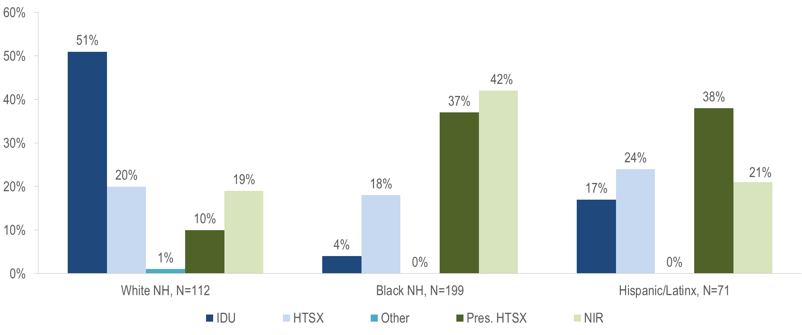
Individuals assigned female at birth diagnosed with HIV infection by exposure mode and race/ethnicity, Massachusetts 2019–2021¹
¹ Please consider the impact of the COVID-19 pandemic on infectious disease screening, treatment, and surveillance in the interpretation of data from 2020 to 2021.
IDU=injection drug use; HTSX=heterosexual sex; Pres. HTSX=presumed heterosexual exposure, includes individuals assigned female at birth with a negative history of injection drug use who report having sex with an individual that identifies as male of unknown HIV status and risk; NIR=no identified risk
Data Source: Bureau of Infectious Disease and Laboratory Sciences, data are current as of 1/1/2023 and subject to change
Notes:
The figure is a bar chart displaying the distribution of recent HIV diagnoses among individuals assigned female at birth by exposure mode for each of three racial/ethnic groups: white NH (N=112), black NH (N=199), and Hispanic/Latinx (N=71).
Injection drug use was the predominant exposure mode among white (non-Hispanic) individuals AFAB recently diagnosed with HIV infection, while NIR, followed by presumed heterosexual sex, accounted for the largest proportions among black (non-Hispanic) individuals AFAB, and presumed heterosexual sex accounted for the largest proportion among Hispanic/Latinx individuals AFAB.

Slide 8
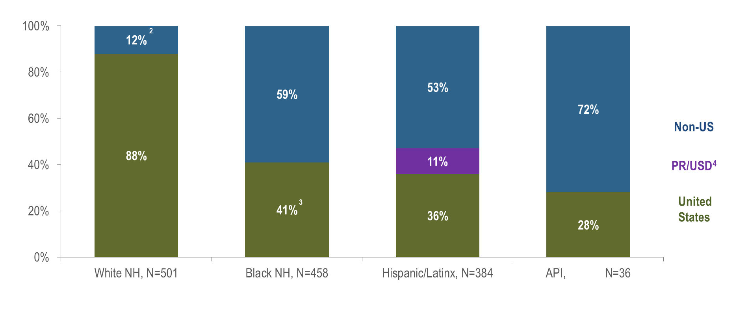
Percentage of individuals diagnosed with HIV infection by race/ethnicity and place of birth, Massachusetts 2019–2021¹
¹ Please consider the impact of the COVID-19 pandemic on infectious disease screening, treatment, and surveillance in the interpretation of data from 2020 to 2021. API=Asian/Pacific Islander, NH=non-Hispanic
² Non-US born and Puerto Rico/USD categories are combined for white non-Hispanic individuals due to small numbers to adhere to cell suppression rules
³ US born and Puerto Rico/USD categories are combined for black non-Hispanic individuals due to small numbers to adhere to cell suppression rules.
⁴ All individuals diagnosed with HIV infection from 2019–2021 who were born in a US dependency (USD) were born in Puerto Rico (PR).
Data Source: Bureau of Infectious Disease and Laboratory Sciences, data are current as of 1/1/2023 and subject to change
Notes:
The figure is a stacked bar chart displaying the distribution of recent HIV diagnoses by place of birth (non-US, Puerto Rico/US Dependency, or US) for each of four racial/ethnic groups: white NH (N=501), black NH (N=458), Hispanic/Latinx (N=384), and Asian/Pacific Islander (N=36).
KEY FINDING
Seventy-two percent of Asian/Pacific Islander individuals diagnosed with HIV infection during 2019–2021 were born outside the US, compared to 59% of black (non-Hispanic) and 53% of Hispanic/Latinx individuals. Twelve percent of white (non-Hispanic) individuals were born outside the US or in Puerto Rico.

Slide 9
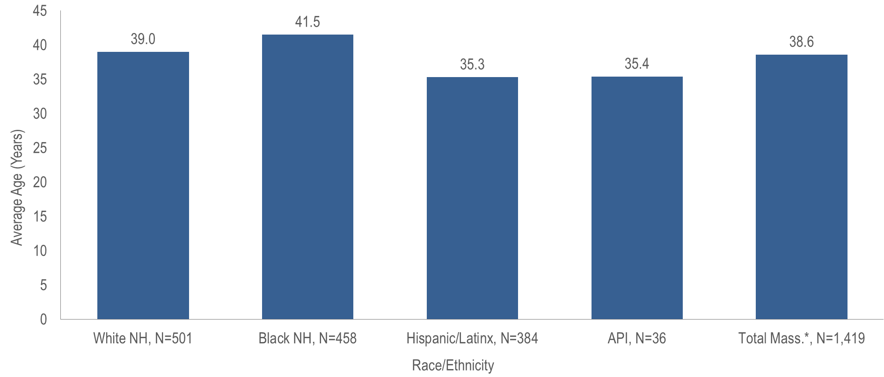
Average age at HIV infection diagnosis by race/ethnicity, Massachusetts 2019–2021¹
¹ Please consider the impact of the COVID-19 pandemic on infectious disease screening, treatment, and surveillance in the interpretation of data from 2020 to 2021.
* Total includes individuals of other/unknown race/ethnicity (N=40)
Data Source: Bureau of Infectious Disease and Laboratory Sciences, data are current as of 1/1/2023 and subject to change
Notes:
The figure is a bar chart displaying the average age at diagnosis for each of four racial/ethnic groups: white NH (N=501), black NH (N=458), Hispanic/Latinx (N=384), and Asian/Pacific Islander (N=36) and for the Massachusetts total (N=1,419).
The average age at HIV diagnosis from 2019 to 2021 was younger for Hispanic/Latinx and Asian/Pacific Islander individuals diagnosed with HIV infection (35.3 and 35.4 years, respectively) compared to black (non-Hispanic) and white (non-Hispanic) individuals (41.5 and 39.0 years, respectively).

