Slide 1
Massachusetts HIV Epidemiologic Profile – Data as of 1/1/2022
Massachusetts HIV Epidemiologic Profile
Regional Report – Data as of 1/1/2022
Suggested citation:
Massachusetts Department of Public Health, Bureau of Infectious Disease and Laboratory Sciences. Massachusetts HIV Epidemiologic Profile, Regional Report – Data as of 1/1/2022,
https://www.mass.gov/lists/hivaids-epidemiologic-profiles Published December 2022. Accessed [date].
Bureau of Infectious Disease and Laboratory Sciences Massachusetts Department of Public Health
Jamaica Plain Campus/State Public Health Laboratory
305 South Street Jamaica Plain, MA 02130
To reach the Reporting and Partner Services Line*
Tel: (617) 983-6999
Questions about this report
Tel: (617) 983-6560
To speak to the on-call epidemiologist
Tel: (617) 983-6800
Questions about infectious disease reporting
Tel: (617) 983-6801
Requests for additional data
https://www.mass.gov/lists/infectious-disease-data-reports-and-requests
Slide sets for Epidemiologic Profile Reports
https://www.mass.gov/lists/hivaids-epidemiologic-profiles
*Providers may use this number to report individuals newly diagnosed with a notifiable sexually transmitted infection, including HIV, or request partner services. Partner services is a free and confidential service for individuals recently diagnosed with a priority infection. The client-centered program offers counseling, linkage to other health and social services, anonymous notification of partners who were exposed and assistance with getting testing and treatment. For more information, see: https://www.mass.gov/service-details/partner-services-program-information-for-healthcare-providers)
Notes:
Massachusetts HIV Epidemiologic Profile
Regional Report – Data as of 1/1/2022
Suggested citation:
Massachusetts Department of Public Health, Bureau of Infectious Disease and Laboratory Sciences. Massachusetts HIV Epidemiologic Profile, Regional Report – Data as of 1/1/2022,
https://www.mass.gov/lists/hivaids-epidemiologic-profiles Published December 2022. Accessed [date].
Bureau of Infectious Disease and Laboratory Sciences Massachusetts Department of Public Health
Jamaica Plain Campus/State Public Health Laboratory
305 South Street Jamaica Plain, MA 02130
To reach the Reporting and Partner Services Line
Tel: (617) 983-6999
Questions about this report
Tel: (617) 983-6560
To speak to the on-call epidemiologist
Tel: (617) 983-6800
Questions about infectious disease reporting
Tel: (617) 983-6801
Requests for additional data
https://www.mass.gov/lists/infectious-disease-data-reports-and-requests
Slide sets for Epidemiologic Profile Reports
https://www.mass.gov/lists/hivaids-epidemiologic-profiles Providers may use this number to report individuals newly diagnosed with a notifiable sexually transmitted infection, including HIV, or request partner services. Partner services is a free and confidential service for individuals recently diagnosed with a priority infection. The client-centered program offers counseling, linkage to other health and social services, anonymous notification of partners who were exposed and assistance with getting testing and treatment. For more information, see: https://www.mass.gov/service-details/partner-services-program-information-for-healthcare-providers)

Slide 2
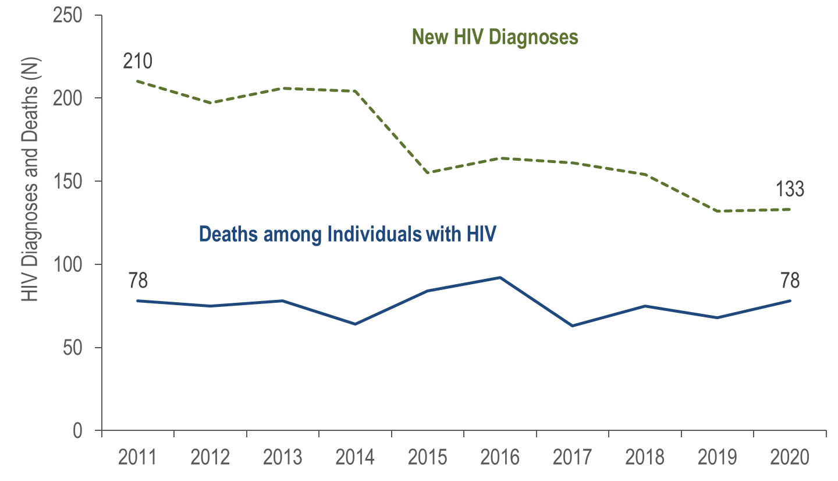
New HIV Infection Diagnoses and Deaths among Individuals Reported with HIV, Boston HSR, Massachusetts 2011–2020*
Data Source: MDPH Bureau of Infectious Disease and Laboratory Sciences, data are current as of 1/1/2022 and may be subject to change.
*Please consider the impact of the COVID-19 pandemic on infectious disease screening, treatment, and surveillance in the interpretation of 2020 data.
Notes:
In the Boston HSR from 2011 to 2020, the annual number of new HIV diagnoses decreased by 37% (from 210 to 133), and deaths among individuals reported with HIV remained stable. However, caution should be used in the interpretation of these trends due to the impact of COVID-19 on access to HIV testing and care services, and case surveillance activities, in 2020.

Slide 3
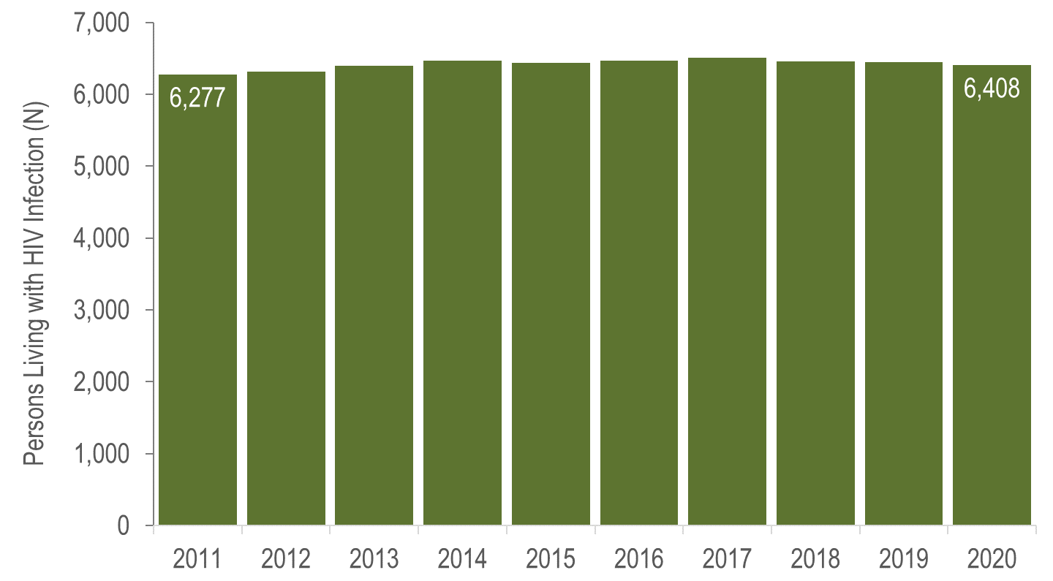
Persons Living with HIV Infection, Boston HSR, Massachusetts 2011–2020*
Data Source: MDPH Bureau of Infectious Disease and Laboratory Sciences, data are current as of 1/1/2022 and may be subject to change.
*Please consider the impact of the COVID-19 pandemic on infectious disease screening, treatment, and surveillance in the interpretation of 2020 data.
Notes:
The number of persons living with HIV infection at the end of these years also remained relatively stable. However, caution should be used in the interpretation of these trends due to the impact of COVID-19 on access to HIV testing and care services, and case surveillance activities, in 2020.

Slide 4
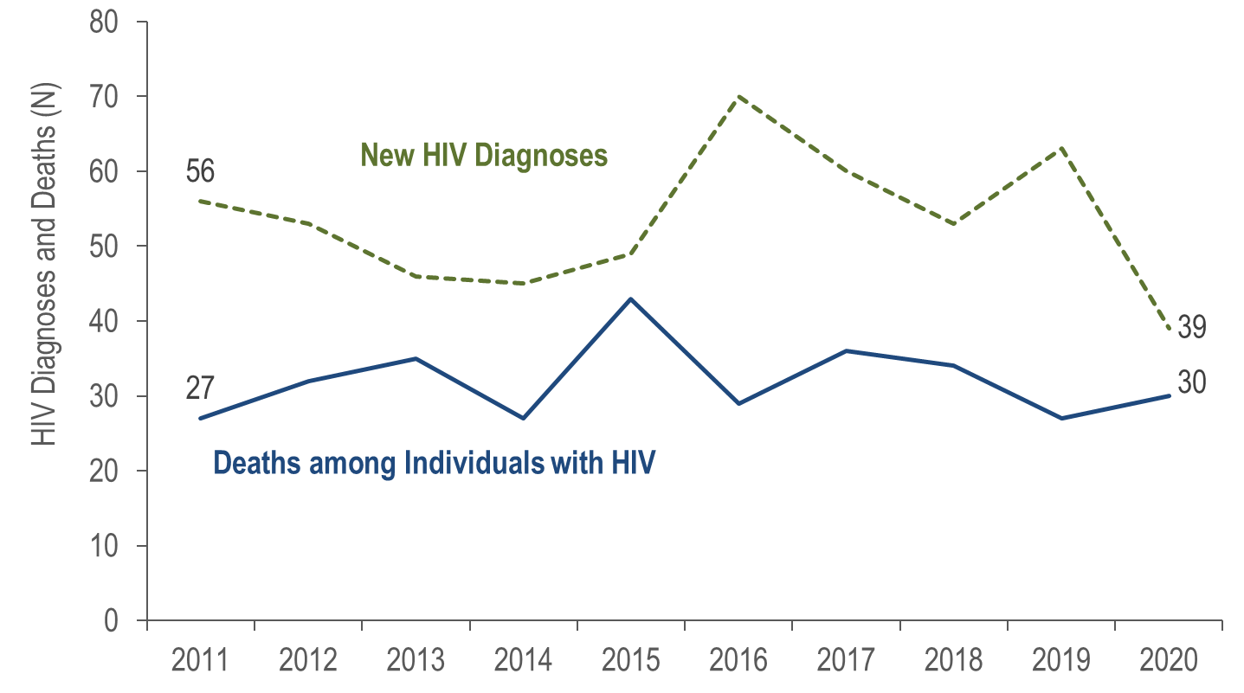
New HIV Infection Diagnoses and Deaths among Individuals Reported with HIV, Central HSR, Massachusetts 2011–2020*
Data Source: MDPH Bureau of Infectious Disease and Laboratory Sciences, data are current as of 1/1/2022 and may be subject to change.
*Please consider the impact of the COVID-19 pandemic on infectious disease screening, treatment, and surveillance in the interpretation of 2020 data.
Notes:
In the Central HSR from 2011 to 2020, the annual number of new HIV diagnoses decreased by 30% (from 56 to 39), and deaths among individuals reported with HIV remained stable. However, caution should be used in the interpretation of these trends due to the impact of COVID-19 on access to HIV testing and care services, and case surveillance activities, in 2020.

Slide 5
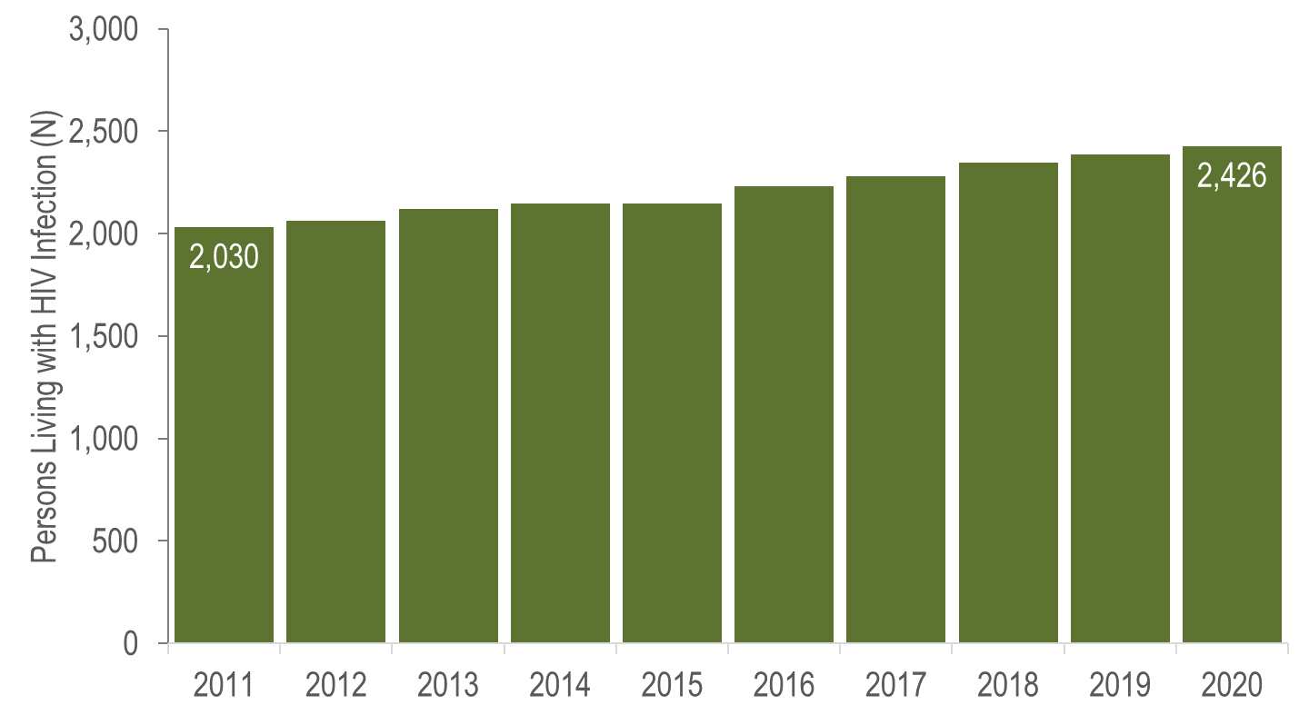
Persons Living with HIV Infection, Central HSR, Massachusetts 2011–2020*
Data Source: MDPH Bureau of Infectious Disease and Laboratory Sciences, data are current as of 1/1/2022 and may be subject to change.
*Please consider the impact of the COVID-19 pandemic on infectious disease screening, treatment, and surveillance in the interpretation of 2020 data.
Notes:
In the Central HSR from 2011 to 2020, the number of persons living with HIV infection at the end of these years increased by 20% (from 2,030 to 2,426). However, caution should be used in the interpretation of these trends due to the impact of COVID-19 on access to HIV testing and care services, and case surveillance activities, in 2020.

Slide 6
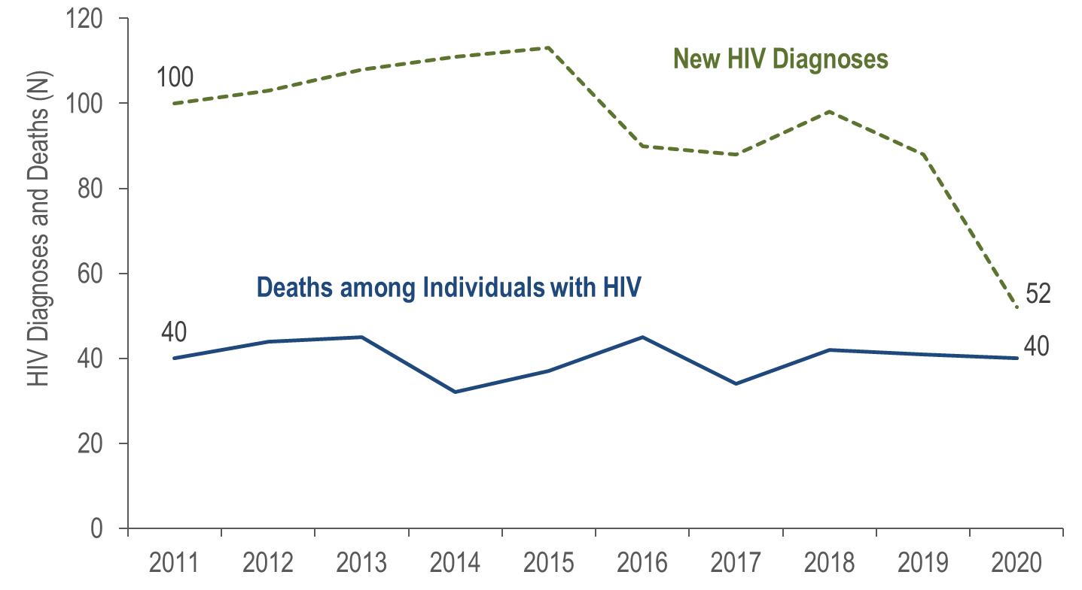
New HIV Infection Diagnoses and Deaths among Individuals Reported with HIV, Metrowest HSR, Massachusetts 2011–2020*
Data Source: MDPH Bureau of Infectious Disease and Laboratory Sciences, data are current as of 1/1/2022 and may be subject to change.
*Please consider the impact of the COVID-19 pandemic on infectious disease screening, treatment, and surveillance in the interpretation of 2020 data.
Notes:
In the Metrowest HSR from 2011 to 2020, the annual number of new HIV diagnoses decreased by 48% (from 100 to 52), and deaths among individuals reported with HIV remained stable. However, caution should be used in the interpretation of these trends due to the impact of COVID-19 on access to HIV testing and care services, and case surveillance activities, in 2020.

Slide 7
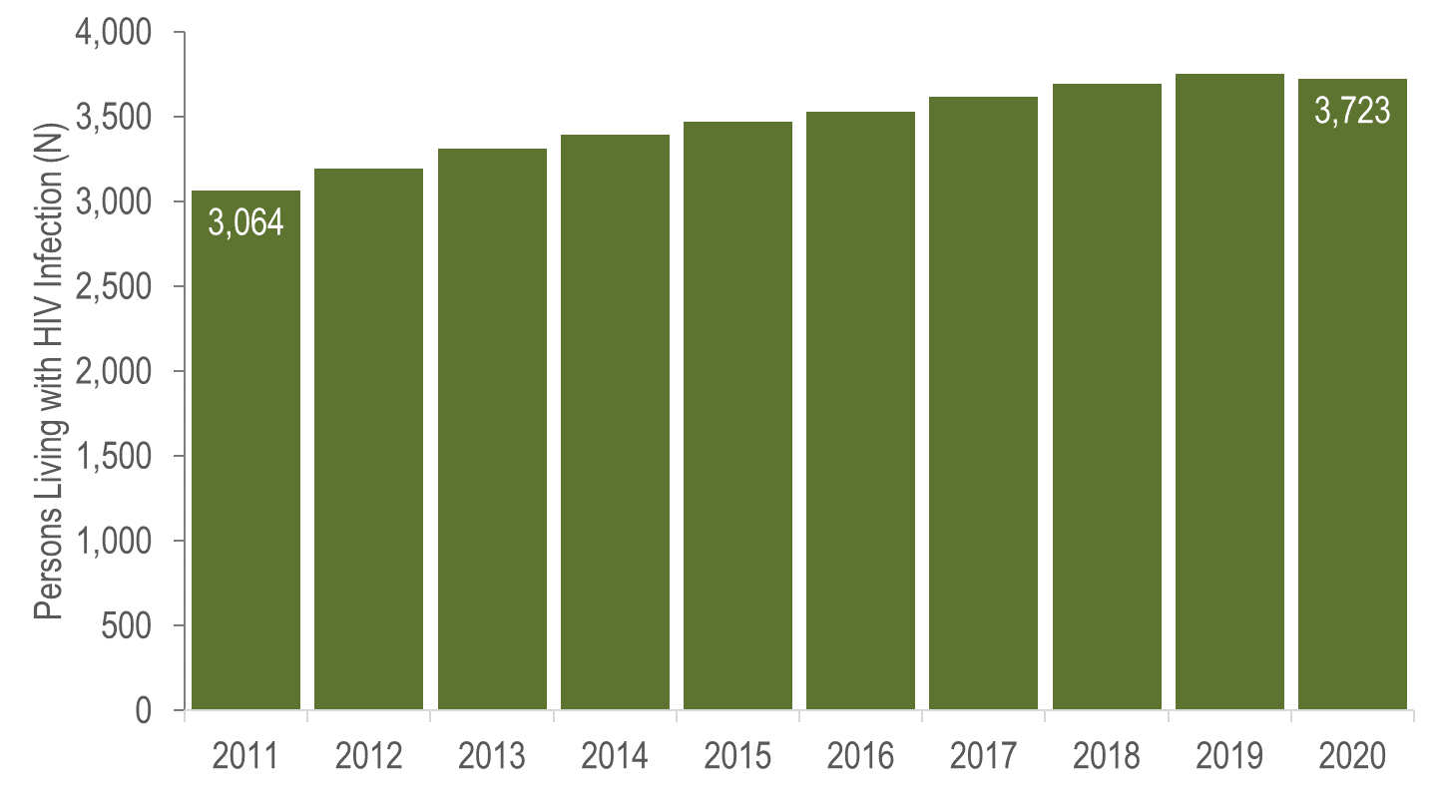
Persons Living with HIV Infection, Metrowest HSR, Massachusetts 2011–2020*
Data Source: MDPH Bureau of Infectious Disease and Laboratory Sciences, data are current as of 1/1/2022 and may be subject to change.
*Please consider the impact of the COVID-19 pandemic on infectious disease screening, treatment, and surveillance in the interpretation of 2020 data.
Notes:
In the Metrowest HSR from 2011 to 2020, the number of persons living with HIV infection at the end of these years increased by 22% (from 3,064 to 3,723). However, caution should be used in the interpretation of these trends due to the impact of COVID-19 on access to HIV testing and care services, and case surveillance activities, in 2020.

Slide 8
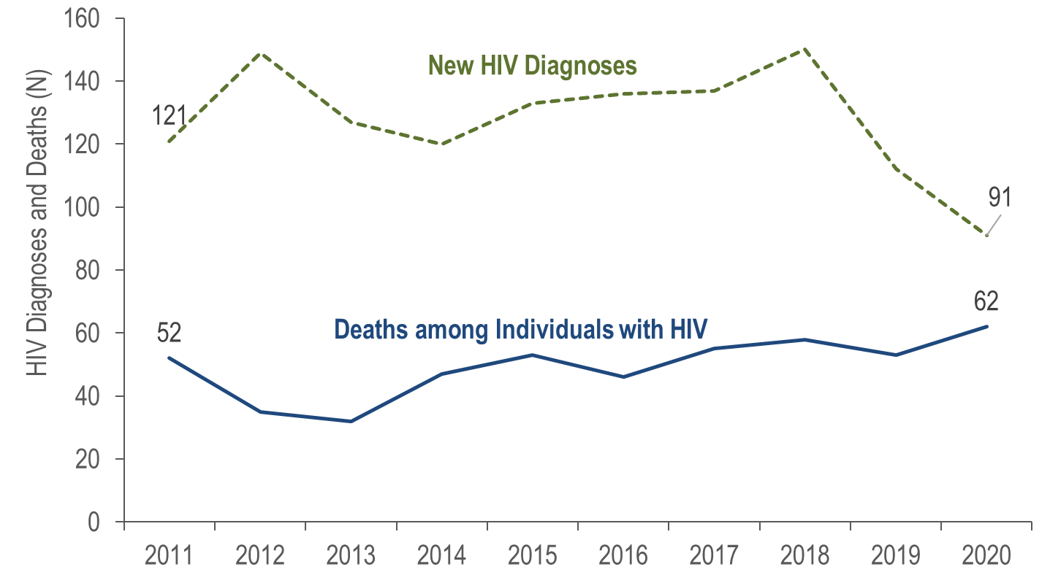
New HIV Infection Diagnoses and Deaths among Individuals Reported with HIV, Northeast HSR, Massachusetts 2011–2020*
Data Source: MDPH Bureau of Infectious Disease and Laboratory Sciences, data are current as of 1/1/2022 and may be subject to change.
*Please consider the impact of the COVID-19 pandemic on infectious disease screening, treatment, and surveillance in the interpretation of 2020 data.
Notes:
The number of annual new HIV diagnoses in the Northeast HSR increased from 121 in 2011 to 149 in 2012, then decreased to 120 in 2014. Annual HIV diagnoses again increased to 150 in 2018 primarily due to an outbreak among persons who inject drugs (PWID) in the northeast part of the state between 2016 and 2018. Following an intensive and targeted public health response, the number of HIV infection diagnoses in the Northeast decreased to 112 in 2019. The number of new HIV diagnoses declined further to 91 in 2020, although caution should be used in the interpretation of this decline due to the impact of COVID-19 on access to HIV testing and care services and case surveillance activities.
In the Northeast HSR from 2011 to 2020, deaths among individuals reported with HIV increased by 19% (from 52 to 62). The number of persons living with HIV infection at the end of these years increased by 29% (from 3,249 to 4,200).
For more information about this outbreak see: Charles Alpren et al. “Opioid Use Fueling HIV Transmission in an Urban Setting: An Outbreak of HIV Infection Among People Who Inject Drugs—Massachusetts, 2015–2018”, American Journal of Public Health 110, no. 1 (January 1, 2020): pp. 37-44. https://doi.org/10.2105/AJPH.2019.305366.

Slide 9
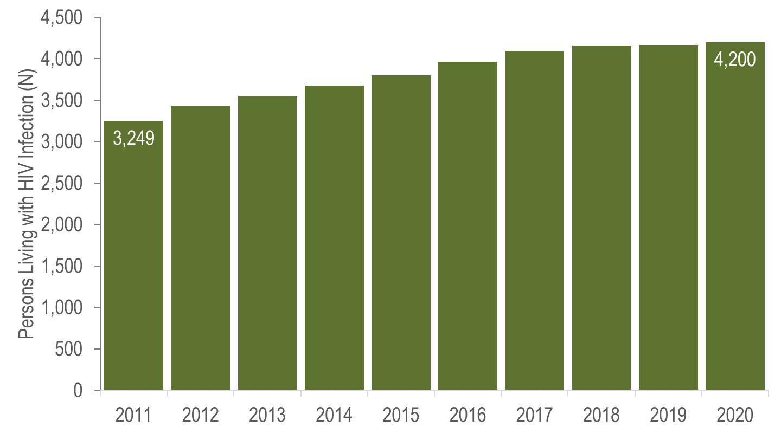
Persons Living with HIV Infection, Northeast HSR, Massachusetts 2011–2020*
Data Source: MDPH Bureau of Infectious Disease and Laboratory Sciences, data are current as of 1/1/2022 and may be subject to change.
*Please consider the impact of the COVID-19 pandemic on infectious disease screening, treatment, and surveillance in the interpretation of 2020 data.
Notes:
In the Northeast HSR from 2011 to 2020, the number of persons living with HIV infection at the end of these years increased by 29% (from 3,249 to 4,200), although caution should be used in the interpretation of this decline due to the impact of COVID-19 on access to HIV testing and care services and case surveillance activities.

Slide 10
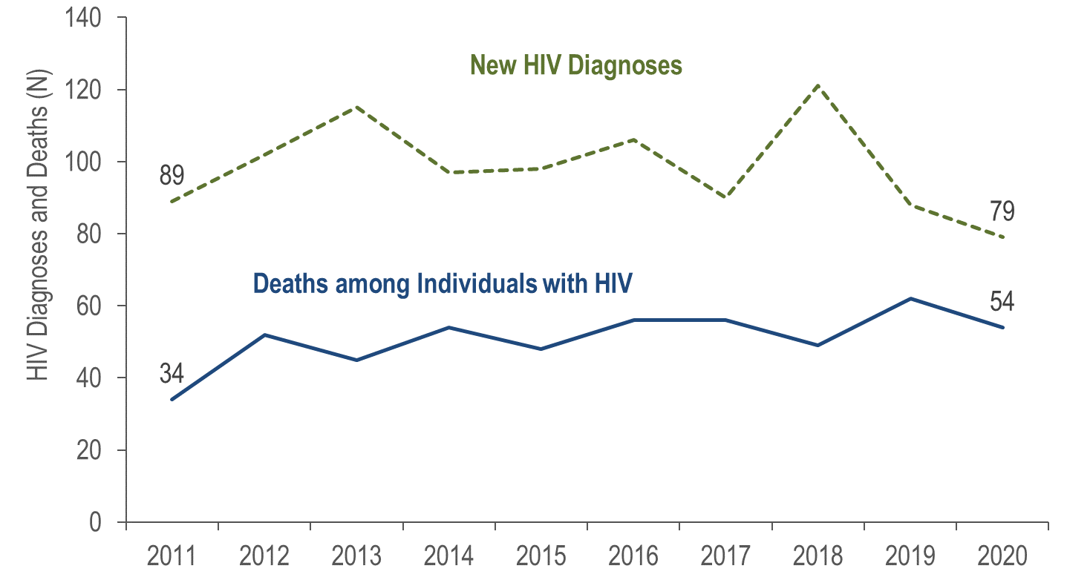
New HIV Infection Diagnoses and Deaths among Individuals Reported with HIV, Southeast HSR, Massachusetts 2011–2020*
Data Source: MDPH Bureau of Infectious Disease and Laboratory Sciences, data are current as of 1/1/2022 and may be subject to change.
*Please consider the impact of the COVID-19 pandemic on infectious disease screening, treatment, and surveillance in the interpretation of 2020 data.
Notes:
In the Southeast HSR from 2011 to 2020, the annual number of new HIV diagnoses decreased slightly overall by 11% (from 89 to 79). However, there was a 34% increase in HIV diagnoses from 2017 (N=90) to 2018 (N=121), followed by a 35% decrease from 2018 to 2020 (N=79). Both the increase and following decrease were primarily among individuals with male-to-male sex (MSM) exposure mode (from N=27 in 2017 to N=45 in 2018 to N=24 in 2020). However, caution should be used in the interpretation of these trends due to the impact of COVID-19 on access to HIV testing and care services, and case surveillance activities, in 2020.
From 2011 to 2020, the annual number of deaths among individuals reported with HIV in the Southeast HSR increased by 59% (from 34 to 54).

Slide 11
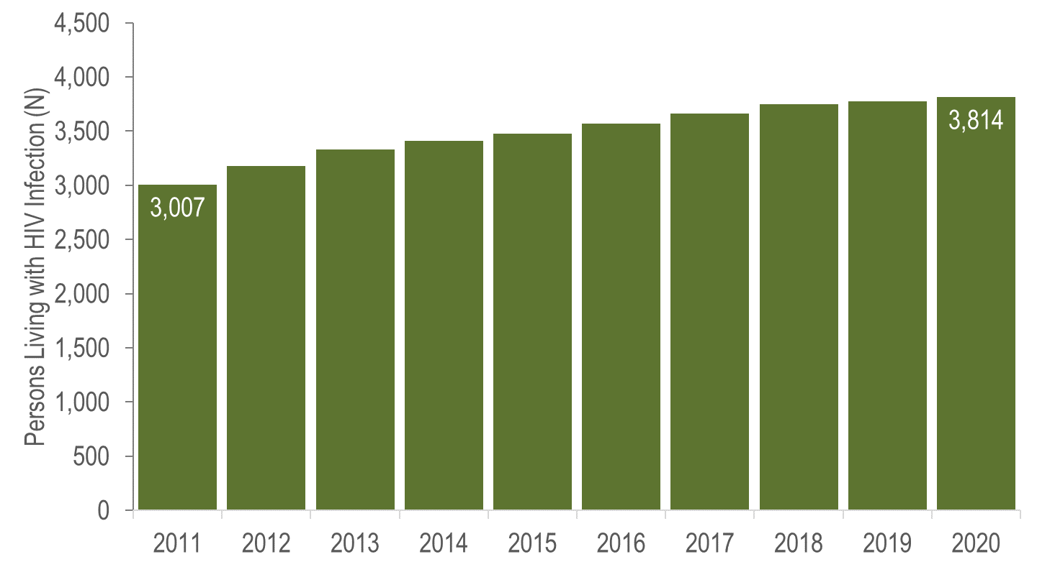
Persons Living with HIV Infection, Southeast HSR, Massachusetts 2011–2020*
Data Source: MDPH Bureau of Infectious Disease and Laboratory Sciences, data are current as of 1/1/2022 and may be subject to change.
*Please consider the impact of the COVID-19 pandemic on infectious disease screening, treatment, and surveillance in the interpretation of 2020 data.
Notes:
From 2011 to 2020, the number persons living with HIV infection at the end of these years increased by 27% (from 3,007 to 3,814). However, caution should be used in the interpretation of these trends due to the impact of COVID-19 on access to HIV testing and care services, and case surveillance activities, in 2020.

Slide 12
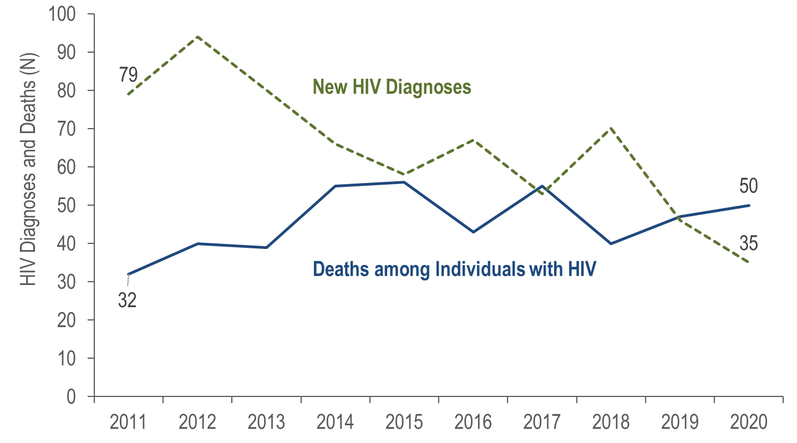
New HIV Infection Diagnoses and Deaths among Individuals Reported with HIV, Western HSR, Massachusetts 2011–2020*
Data Source: MDPH Bureau of Infectious Disease and Laboratory Sciences, data are current as of 1/1/2022 and may be subject to change.
*Please consider the impact of the COVID-19 pandemic on infectious disease screening, treatment, and surveillance in the interpretation of 2020 data.
Notes:
In the Western HSR from 2011 to 2020, the annual number of new HIV diagnoses decreased by 56% (from 79 to 35), and deaths among individuals reported with HIV increased also by 56% (from 32 to 50). However, caution should be used in the interpretation of these trends due to the impact of COVID-19 on access to HIV testing and care services, and case surveillance activities, in 2020.

Slide 13
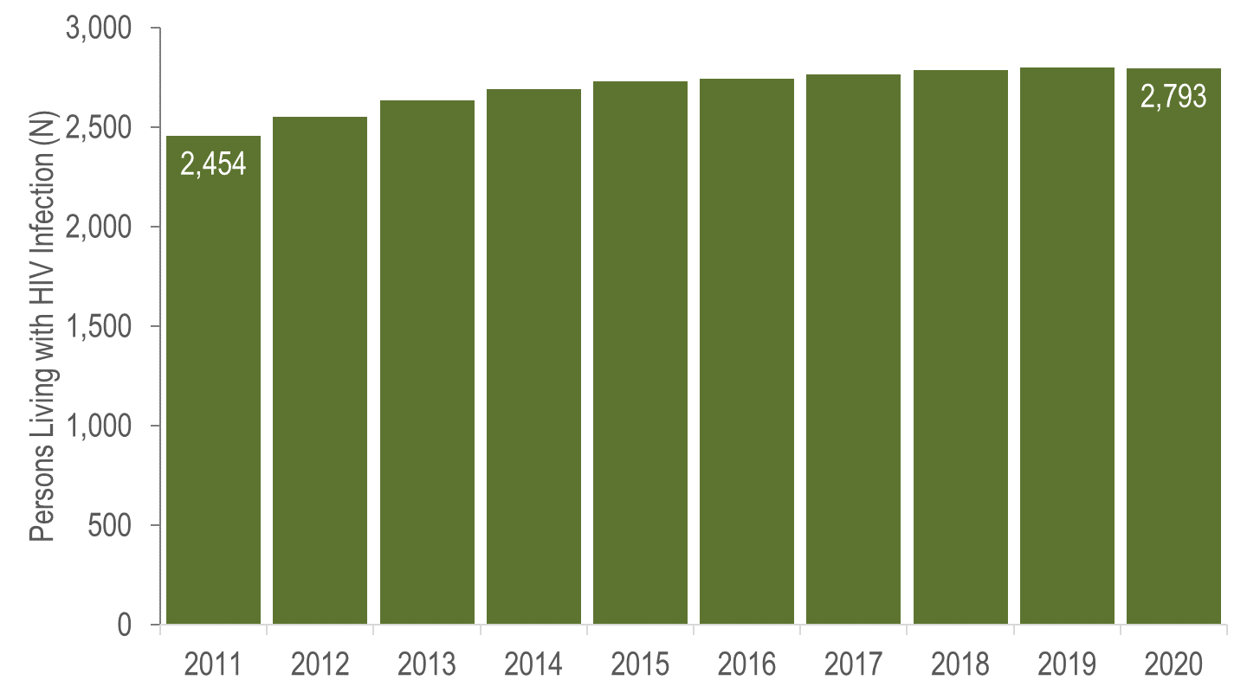
Persons Living with HIV Infection, Western HSR, Massachusetts 2011–2020*
Data Source: MDPH Bureau of Infectious Disease and Laboratory Sciences, data are current as of 1/1/2022 and may be subject to change.
*Please consider the impact of the COVID-19 pandemic on infectious disease screening, treatment, and surveillance in the interpretation of 2020 data.
Notes:
In the Western HSR from 2011 to 2020, the number of persons living with HIV infection at the end of these years increased by 14% (from 2,454 to 2,793). However, caution should be used in the interpretation of these trends due to the impact of COVID-19 on access to HIV testing and care services, and case surveillance activities, in 2020.

Slide 14
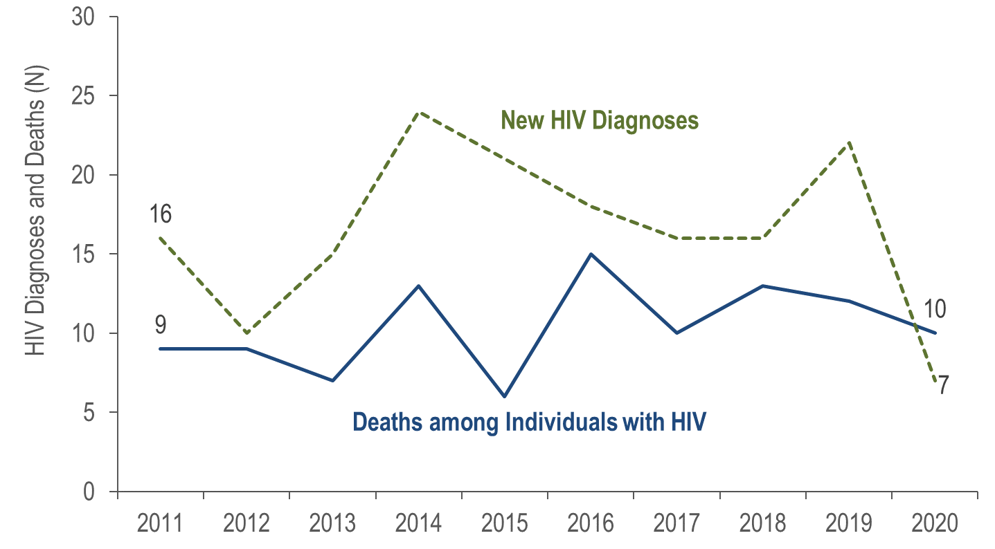
New HIV Infection Diagnoses and Deaths among Individuals Reported with HIV, Barnstable, Dukes, and Nantucket Counties, Massachusetts 2011–2020*
Data Source: MDPH Bureau of Infectious Disease and Laboratory Sciences, data are current as of 1/1/2022 and may be subject to change.
*Please consider the impact of the COVID-19 pandemic on infectious disease screening, treatment, and surveillance in the interpretation of 2020 data.
Notes:
In Barnstable, Dukes, and Nantucket Counties from 2011 to 2020, the annual number of new HIV diagnoses decreased from 16 to seven, and deaths among individuals reported with HIV remained relatively stable. However, caution should be used in the interpretation of these trends due to the impact of COVID-19 on access to HIV testing and care services, and case surveillance activities, in 2020.

Slide 15
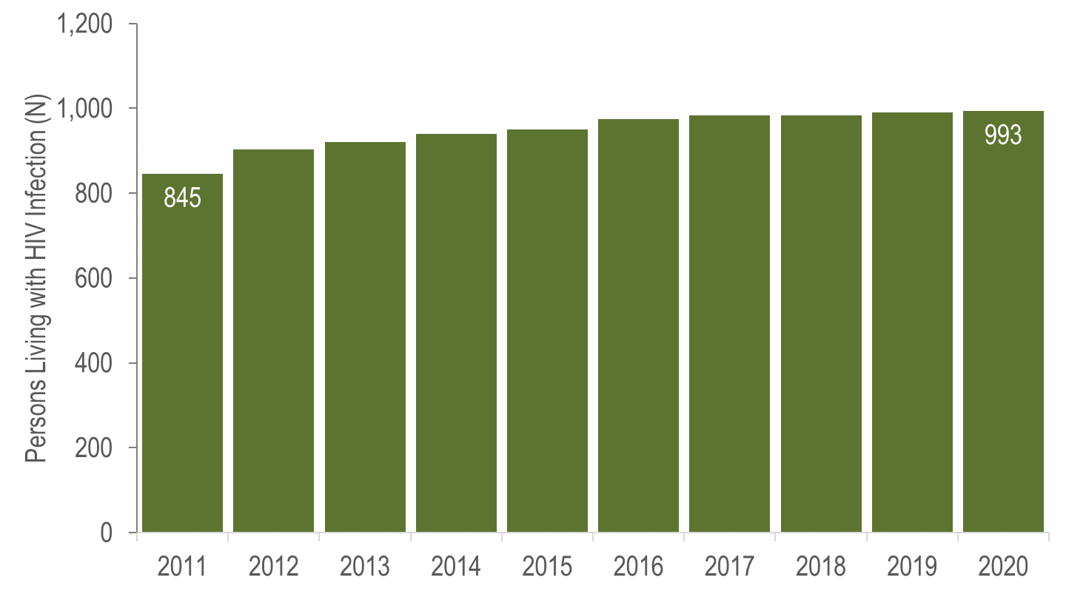
Persons Living with HIV Infection, Barnstable, Dukes, and Nantucket Counties, Massachusetts 2011–2020*
Data Source: MDPH Bureau of Infectious Disease and Laboratory Sciences, data are current as of 1/1/2022 and may be subject to change.
*Please consider the impact of the COVID-19 pandemic on infectious disease screening, treatment, and surveillance in the interpretation of 2020 data.
Notes:
In Barnstable, Dukes, and Nantucket Counties from 2011 to 2020, the number of persons living with HIV infection at the end of these years increased by 18% (from 845 to 993). However, caution should be used in the interpretation of these trends due to the impact of COVID-19 on access to HIV testing and care services, and case surveillance activities, in 2020.

Slide 16
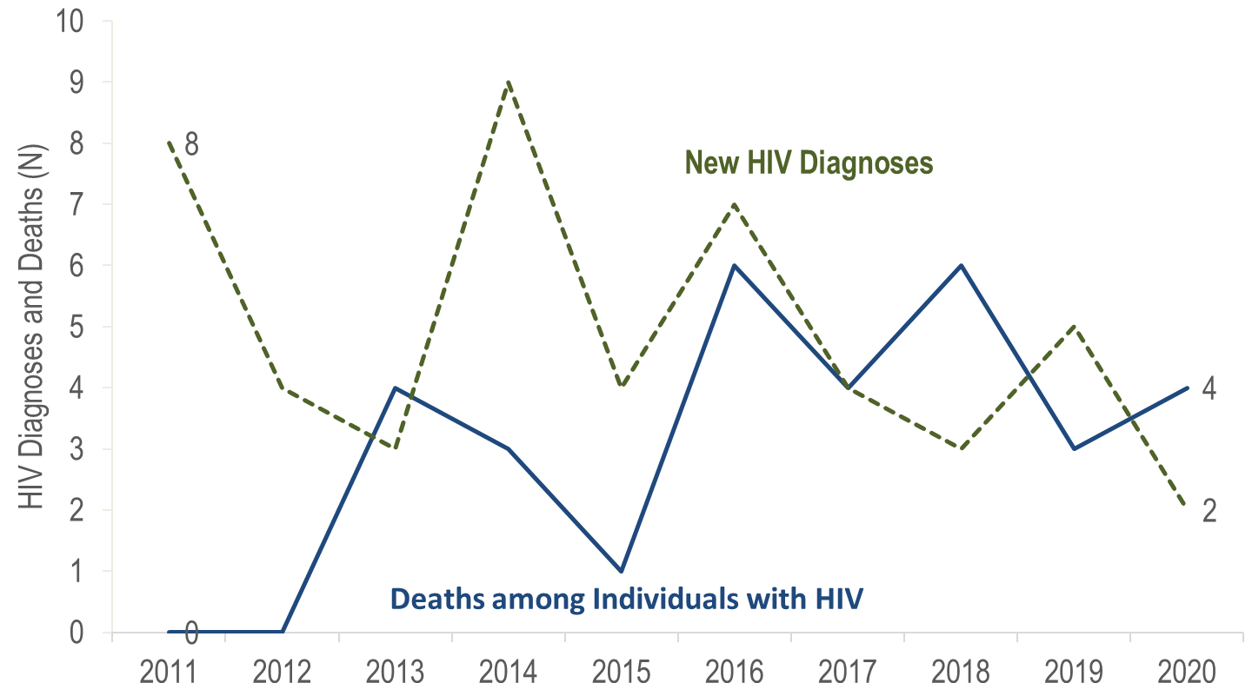
New HIV Infection Diagnoses and Deaths among Individuals Reported with HIV, Berkshire County, Massachusetts 2011–2020*
Data Source: MDPH Bureau of Infectious Disease and Laboratory Sciences, data are current as of 1/1/2022 and may be subject to change.
*Please consider the impact of the COVID-19 pandemic on infectious disease screening, treatment, and surveillance in the interpretation of 2020 data.
Notes:
In Berkshire County from 2011 to 2020, the annual number of new HIV diagnoses remained between two and nine, and deaths among individuals reported with HIV remained at six or fewer. The number of persons living with HIV infection at the end of these years increased from 168 to 226. However, caution should be used in the interpretation of these trends due to the impact of COVID-19 on access to HIV testing and care services, and case surveillance activities, in 2020.

Slide 17
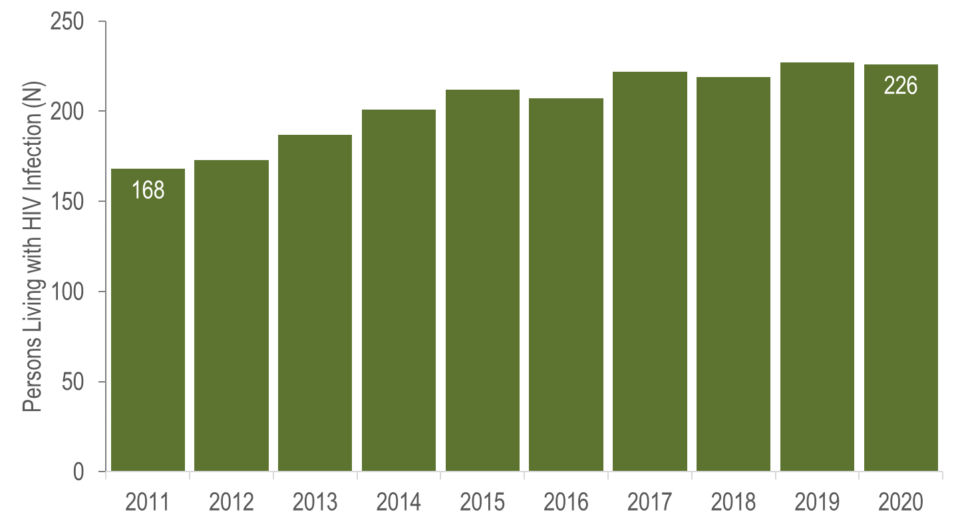
Persons Living with HIV Infection, Berkshire County, Massachusetts 2011–2020*
Data Source: MDPH Bureau of Infectious Disease and Laboratory Sciences, data are current as of 1/1/2022 and may be subject to change.
*Please consider the impact of the COVID-19 pandemic on infectious disease screening, treatment, and surveillance in the interpretation of 2020 data.
Notes:
In Berkshire County from 2011 to 2020, the number of persons living with HIV infection at the end of these years increased from 168 to 226. However, caution should be used in the interpretation of these trends due to the impact of COVID-19 on access to HIV testing and care services, and case surveillance activities, in 2020.

Slide 18
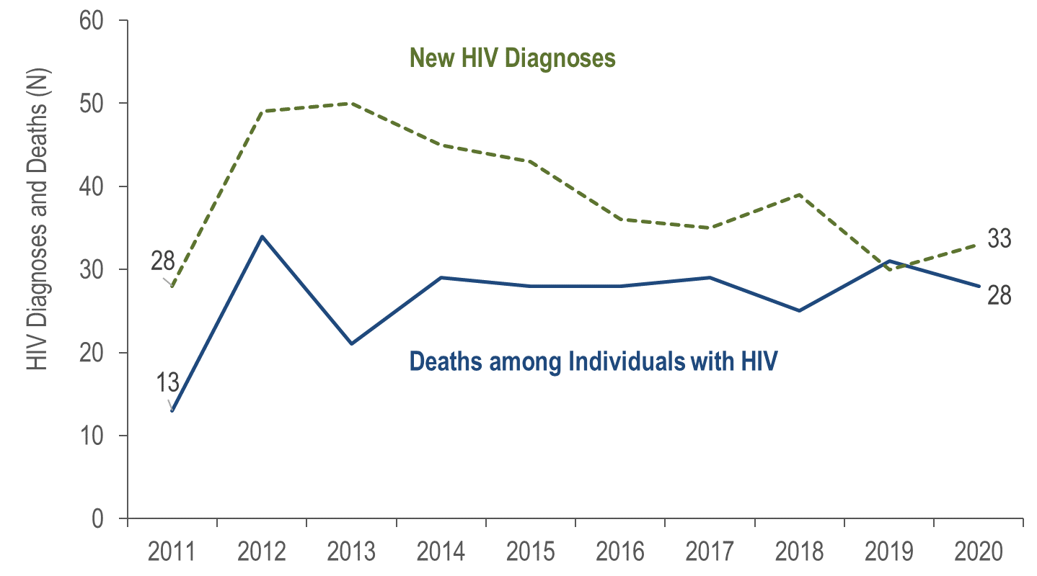
New HIV Infection Diagnoses and Deaths among Individuals Reported with HIV, Bristol County, Massachusetts 2011–2020*
Data Source: MDPH Bureau of Infectious Disease and Laboratory Sciences, data are current as of 1/1/2022 and may be subject to change.
*Please consider the impact of the COVID-19 pandemic on infectious disease screening, treatment, and surveillance in the interpretation of 2020 data.
Notes:
In Bristol County from 2011 to 2020, the annual number of new HIV diagnoses increased by 18% (from 28 to 33), and deaths among individuals reported with HIV more than doubled (from 13 to 28). However, caution should be used in the interpretation of these trends due to the impact of COVID-19 on access to HIV testing and care services, and case surveillance activities, in 2020.

Slide 19
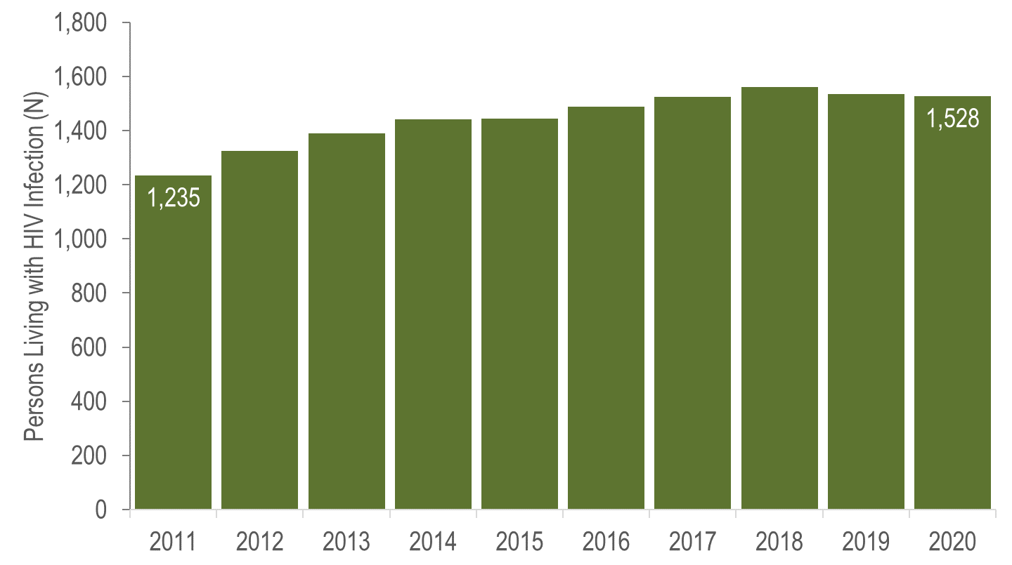
Persons Living with HIV Infection, Bristol County, Massachusetts 2011–2020*
Data Source: MDPH Bureau of Infectious Disease and Laboratory Sciences, data are current as of 1/1/2022 and may be subject to change.
*Please consider the impact of the COVID-19 pandemic on infectious disease screening, treatment, and surveillance in the interpretation of 2020 data.
Notes:
In Bristol County from 2011 to 2020, the number of persons living with HIV infection at the end of these years increased by 24% (from 1,235 to 1,528). However, caution should be used in the interpretation of these trends due to the impact of COVID-19 on access to HIV testing and care services, and case surveillance activities, in 2020.

Slide 20
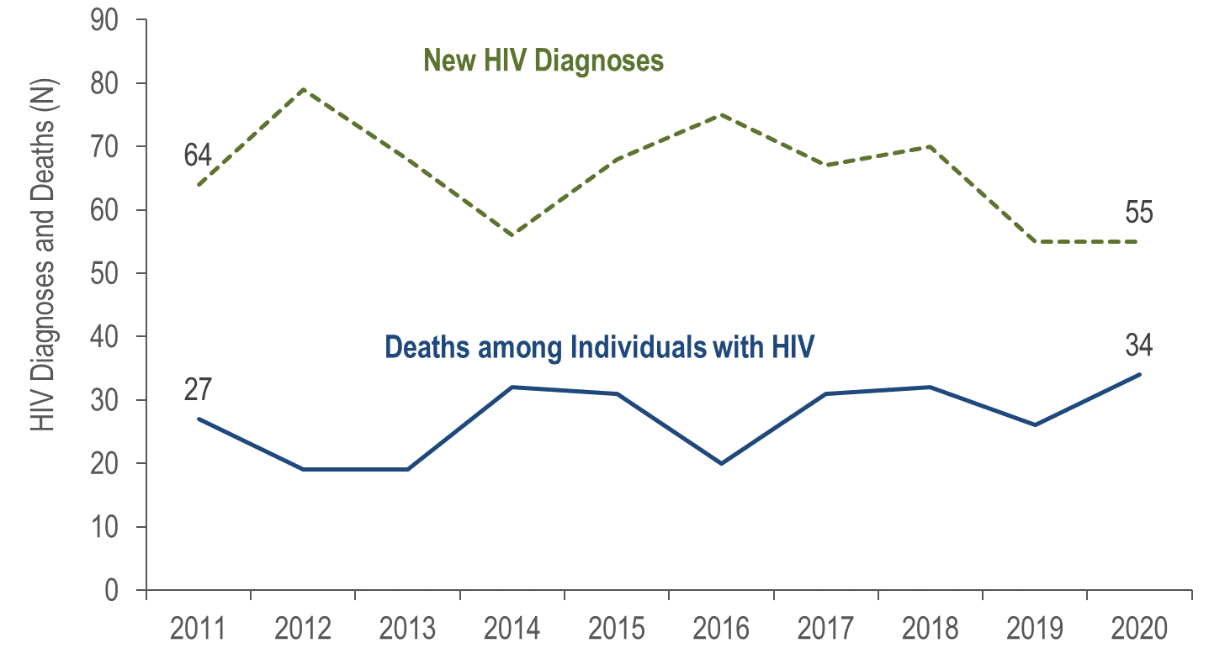
New HIV Infection Diagnoses and Deaths among Individuals Reported with HIV, Essex County, Massachusetts 2011–2020*
Data Source: MDPH Bureau of Infectious Disease and Laboratory Sciences, data are current as of 1/1/2022 and may be subject to change.
*Please consider the impact of the COVID-19 pandemic on infectious disease screening, treatment, and surveillance in the interpretation of 2020 data.
Notes:
In Essex County from 2011 to 2020, the annual number of new HIV diagnoses decreased by 14% (from 64 to 55), and deaths among individuals reported with HIV increased by 26% (from 27 to 34). However, caution should be used in the interpretation of these trends due to the impact of COVID-19 on access to HIV testing and care services, and case surveillance activities, in 2020.

Slide 21
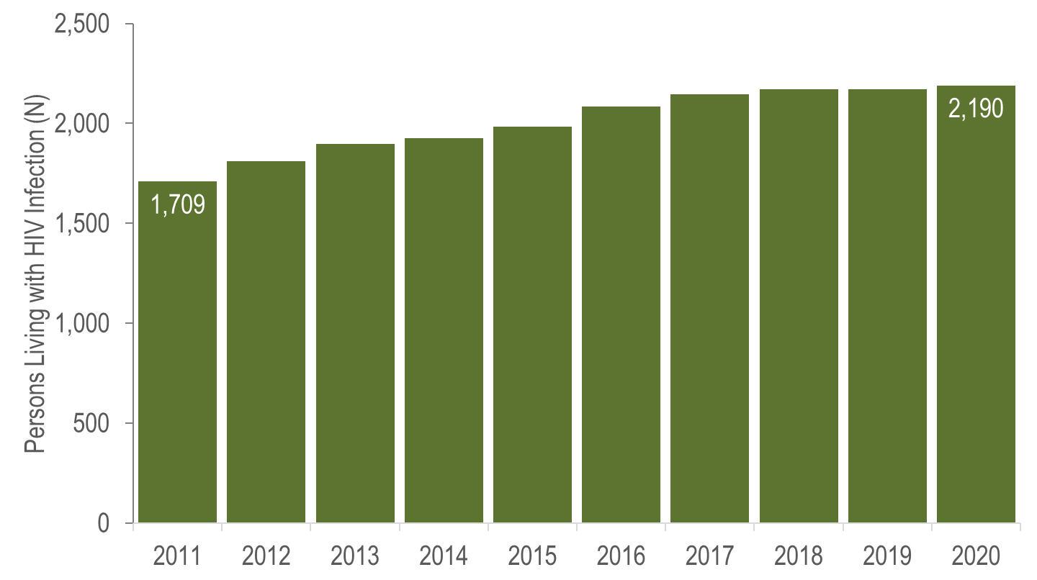
Persons Living with HIV Infection, Essex County, Massachusetts 2011–2020*
Data Source: MDPH Bureau of Infectious Disease and Laboratory Sciences, data are current as of 1/1/2022 and may be subject to change.
*Please consider the impact of the COVID-19 pandemic on infectious disease screening, treatment, and surveillance in the interpretation of 2020 data.
Notes:
In Essex County from 2011 to 2020, the number of persons living with HIV infection at the end of these years increased by 28% (from 1,709 to 2,190). However, caution should be used in the interpretation of these trends due to the impact of COVID-19 on access to HIV testing and care services, and case surveillance activities, in 2020.

Slide 22
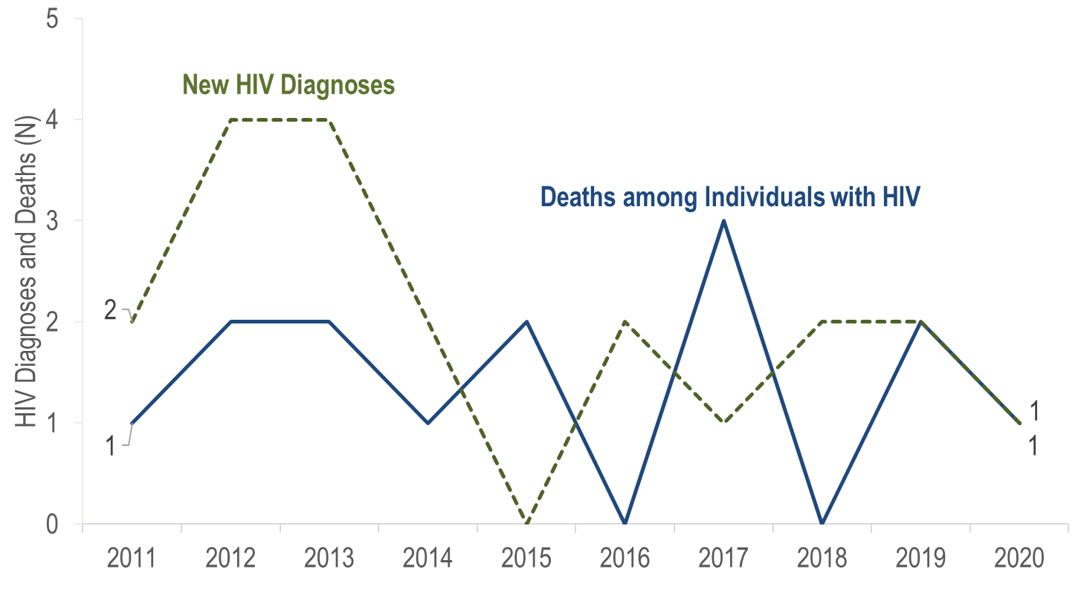
New HIV Infection Diagnoses and Deaths among Individuals Reported with HIV, Franklin County, Massachusetts 2011–2020*
Data Source: MDPH Bureau of Infectious Disease and Laboratory Sciences, data are current as of 1/1/2022 and may be subject to change.
*Please consider the impact of the COVID-19 pandemic on infectious disease screening, treatment, and surveillance in the interpretation of 2020 data.
Notes:
In Franklin County from 2011 to 2020, the annual number of new HIV diagnoses remained between zero and four, and deaths among individuals reported with HIV remained between zero and three. However, caution should be used in the interpretation of these trends due to the impact of COVID-19 on access to HIV testing and care services, and case surveillance activities, in 2020.

Slide 23
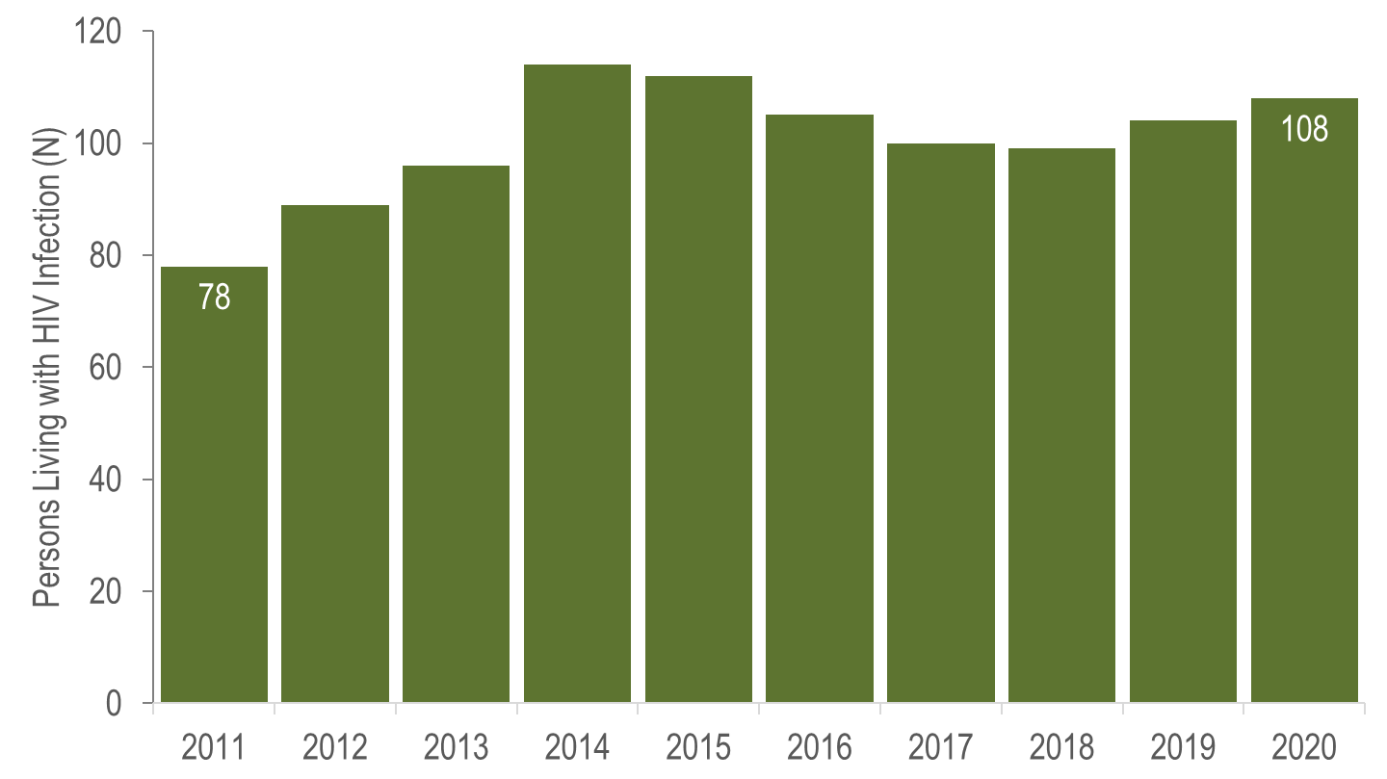
Persons Living with HIV Infection, Franklin County, Massachusetts 2011–2020*
Data Source: MDPH Bureau of Infectious Disease and Laboratory Sciences, data are current as of 1/1/2022 and may be subject to change.
*Please consider the impact of the COVID-19 pandemic on infectious disease screening, treatment, and surveillance in the interpretation of 2020 data.
Notes:
In Franklin County from 2011 to 2020, the number of persons living with HIV infection at the end of these years increased from 78 to 108. However, caution should be used in the interpretation of these trends due to the impact of COVID-19 on access to HIV testing and care services, and case surveillance activities, in 2020.

Slide 24
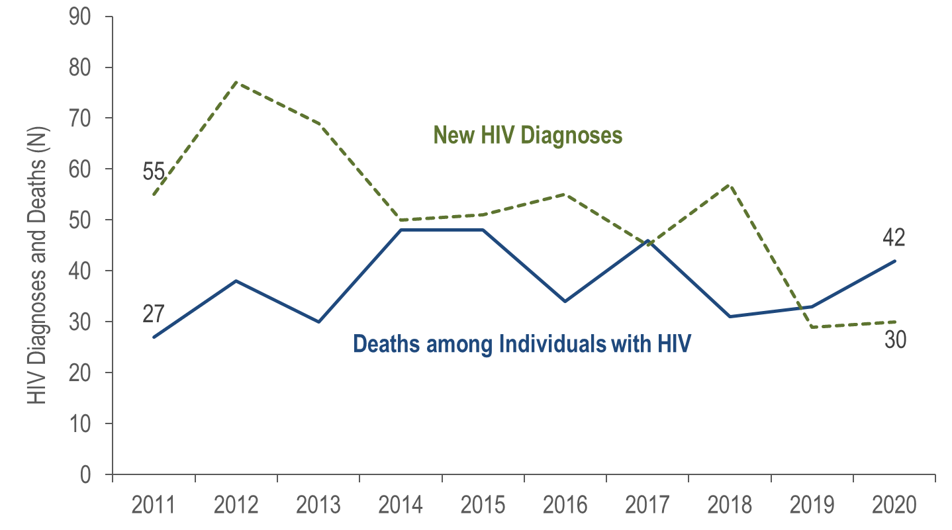
New HIV Infection Diagnoses and Deaths among Individuals Reported with HIV, Hampden County, Massachusetts 2011–2020*
Data Source: MDPH Bureau of Infectious Disease and Laboratory Sciences, data are current as of 1/1/2022 and may be subject to change.
*Please consider the impact of the COVID-19 pandemic on infectious disease screening, treatment, and surveillance in the interpretation of 2020 data.
Notes:
In Hampden County from 2011 to 2020, the annual number of new HIV diagnoses decreased by 45% (from 55 to 30), and deaths among individuals reported with HIV increased by 56% (from 27 to 42). However, caution should be used in the interpretation of these trends due to the impact of COVID-19 on access to HIV testing and care services, and case surveillance activities, in 2020.

Slide 25
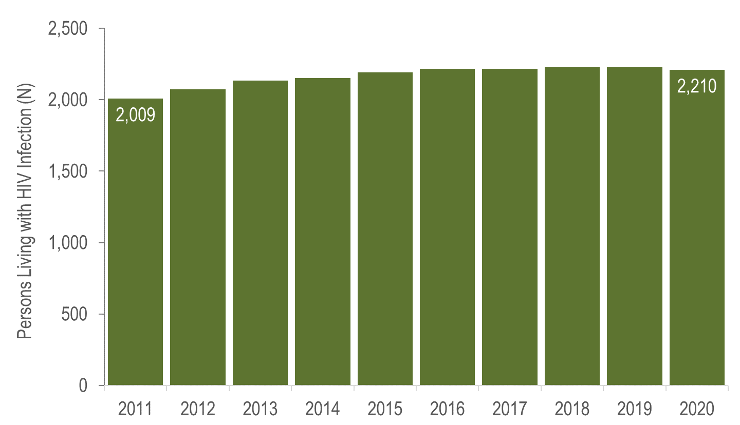
Persons Living with HIV Infection, Hampden County, Massachusetts 2011–2020*
Data Source: MDPH Bureau of Infectious Disease and Laboratory Sciences, data are current as of 1/1/2022 and may be subject to change.
*Please consider the impact of the COVID-19 pandemic on infectious disease screening, treatment, and surveillance in the interpretation of 2020 data.
Notes:
In Hampden County from 2011 to 2020, the number of persons living with HIV infection at the end of these years increased by 10% (from 2,009 to 2,210). However, caution should be used in the interpretation of these trends due to the impact of COVID-19 on access to HIV testing and care services, and case surveillance activities, in 2020.

Slide 26
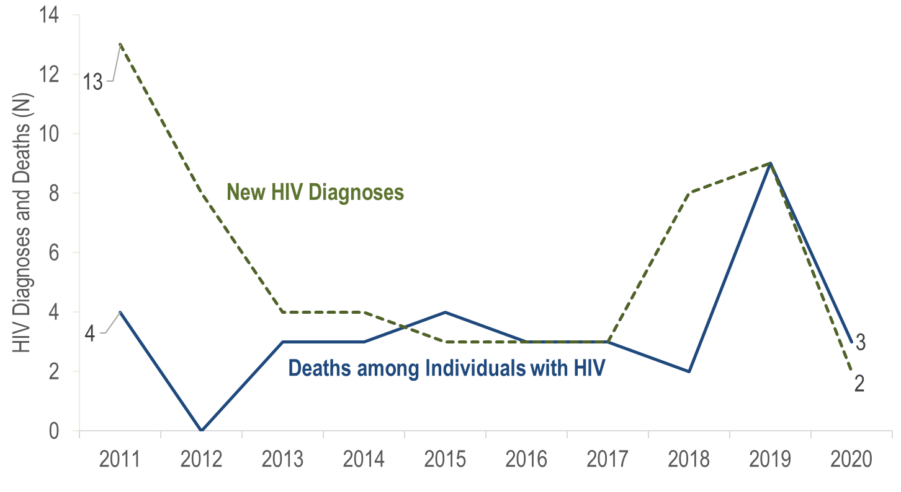
New HIV Infection Diagnoses and Deaths among Individuals Reported with HIV, Hampshire County, Massachusetts 2011–2020*
Data Source: MDPH Bureau of Infectious Disease and Laboratory Sciences, data are current as of 1/1/2022 and may be subject to change.
*Please consider the impact of the COVID-19 pandemic on infectious disease screening, treatment, and surveillance in the interpretation of 2020 data.
Notes:
In Hampshire County from 2011 to 2020, the annual number of new HIV diagnoses remained between two and 13, and deaths among individuals reported with HIV remained between zero and nine. However, caution should be used in the interpretation of these trends due to the impact of COVID-19 on access to HIV testing and care services, and case surveillance activities, in 2020.

Slide 27
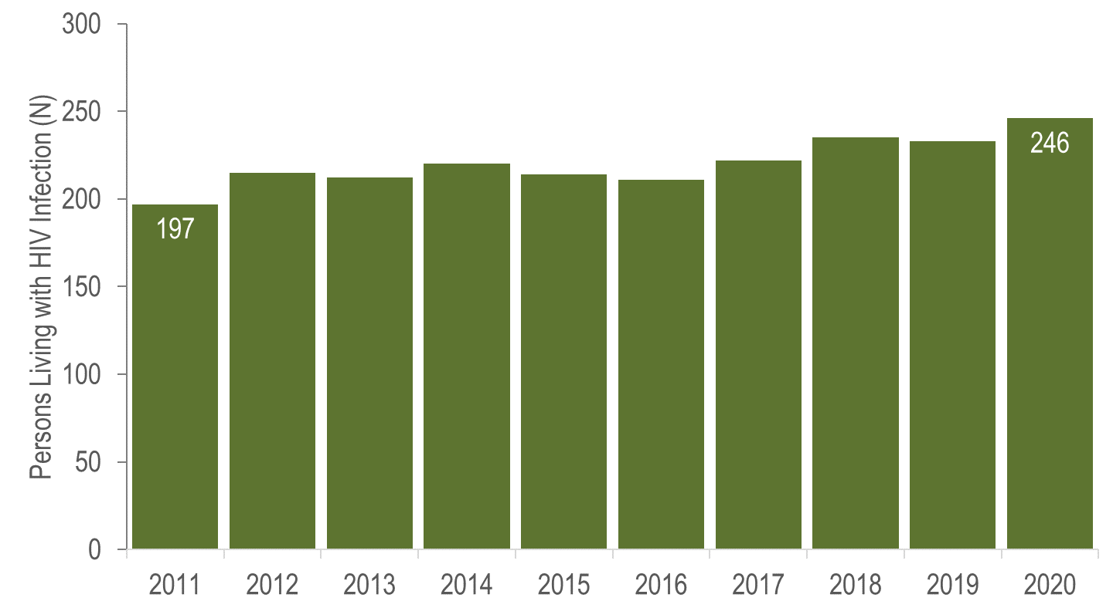
Persons Living with HIV Infection, Hampshire County, Massachusetts 2011–2020*
Data Source: MDPH Bureau of Infectious Disease and Laboratory Sciences, data are current as of 1/1/2022 and may be subject to change.
*Please consider the impact of the COVID-19 pandemic on infectious disease screening, treatment, and surveillance in the interpretation of 2020 data.
Notes:
In Hampshire County from 2011 to 2020, the number of persons living with HIV infection at the end of these years increased from 197 to 246. However, caution should be used in the interpretation of these trends due to the impact of COVID-19 on access to HIV testing and care services, and case surveillance activities, in 2020.

Slide 28
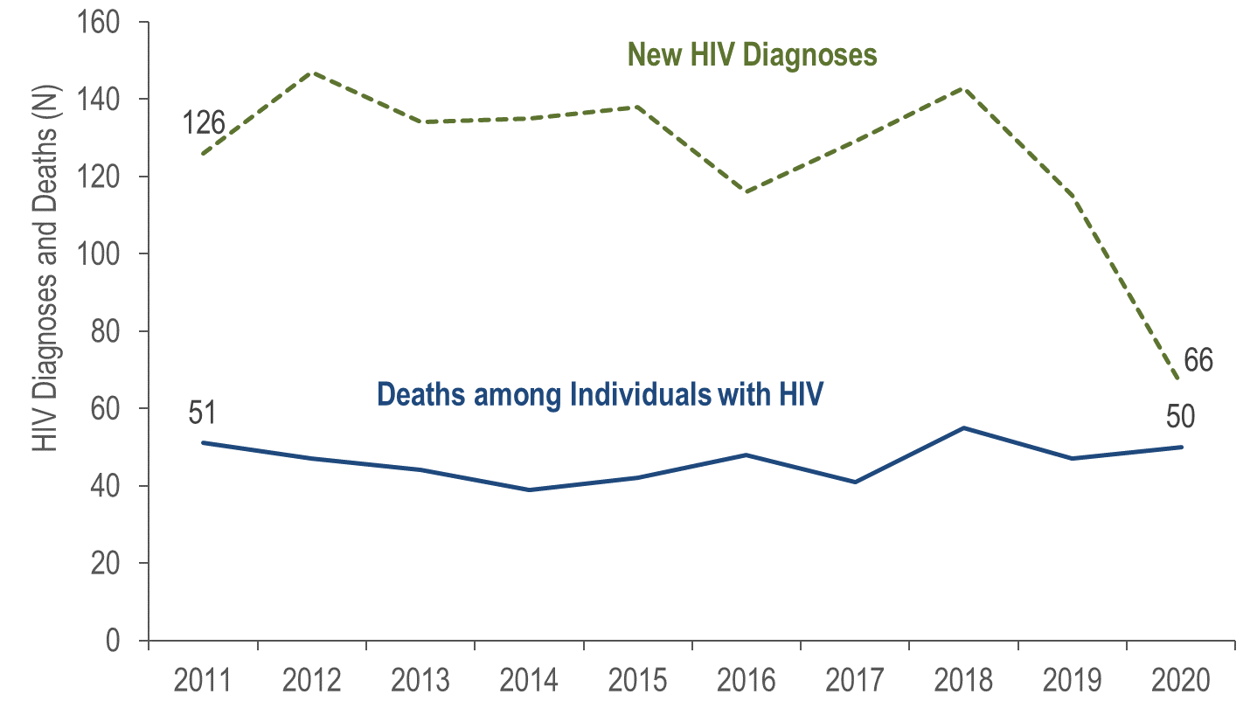
New HIV Infection Diagnoses and Deaths among Individuals Reported with HIV, Middlesex County, Massachusetts 2011–2020*
Data Source: MDPH Bureau of Infectious Disease and Laboratory Sciences, data are current as of 1/1/2022 and may be subject to change.
*Please consider the impact of the COVID-19 pandemic on infectious disease screening, treatment, and surveillance in the interpretation of 2020 data.
Notes:
In Middlesex County from 2011 to 2020, the annual number of new HIV diagnoses decreased by 48% (from 126 to 66), and deaths among individuals reported with HIV remained relatively stable. However, caution should be used in the interpretation of these trends, particularly the decrease in HIV diagnoses, due to the impact of COVID-19 on access to HIV testing and care services, and case surveillance activities, in 2020.

Slide 29
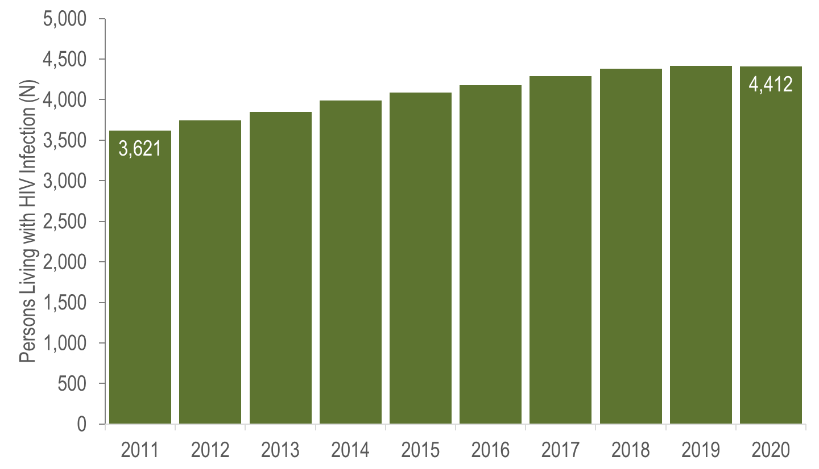
Persons Living with HIV Infection, Middlesex County, Massachusetts 2011–2020*
Data Source: MDPH Bureau of Infectious Disease and Laboratory Sciences, data are current as of 1/1/2022 and may be subject to change.
*Please consider the impact of the COVID-19 pandemic on infectious disease screening, treatment, and surveillance in the interpretation of 2020 data.
Notes:
In Middlesex County from 2011 to 2020, the number of persons living with HIV infection at the end of these years increased by 22% (from 3,621 to 4,412). However, caution should be used in the interpretation of these trends, particularly the decrease in HIV diagnoses, due to the impact of COVID-19 on access to HIV testing and care services, and case surveillance activities, in 2020.

Slide 30
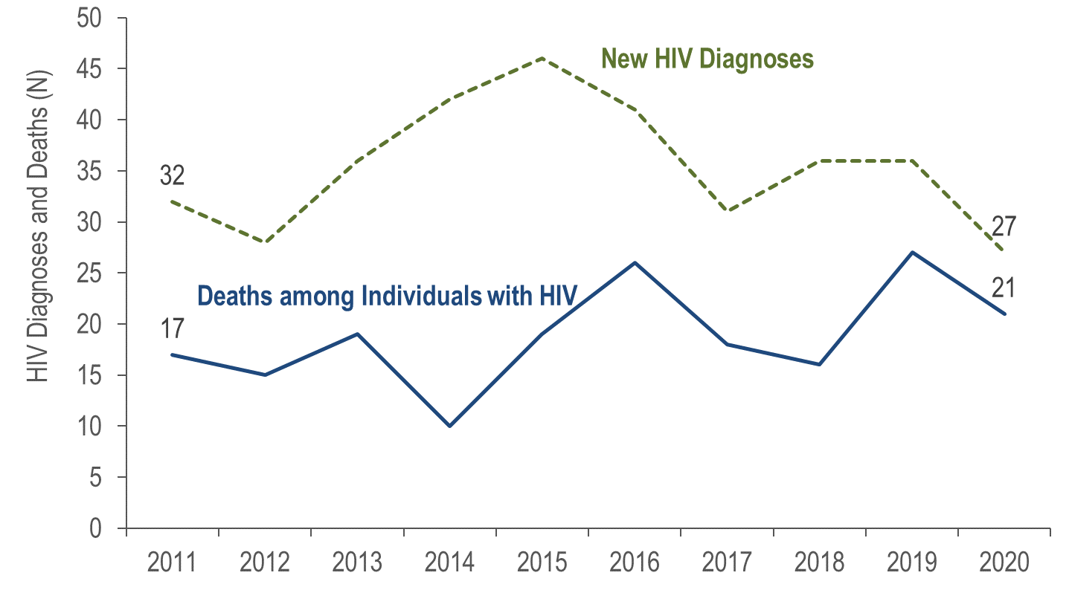
New HIV Infection Diagnoses and Deaths among Individuals Reported with HIV, Norfolk County, Massachusetts 2011–2020*
Data Source: MDPH Bureau of Infectious Disease and Laboratory Sciences, data are current as of 1/1/2022 and may be subject to change.
*Please consider the impact of the COVID-19 pandemic on infectious disease screening, treatment, and surveillance in the interpretation of 2020 data.
Notes:
In Norfolk County from 2011 to 2020, the annual number of new HIV diagnoses decreased by 16% (from 32 to 27), and deaths among individuals reported with HIV increased by 24% (from 17 to 21). The number of persons living with HIV infection at the end of these years increased by 36% (from 1,118 to 1,521). However, caution should be used in the interpretation of these trends, particularly the decrease in HIV diagnoses, due to the impact of COVID-19 on access to HIV testing and care services, and case surveillance activities, in 2020.

Slide 31
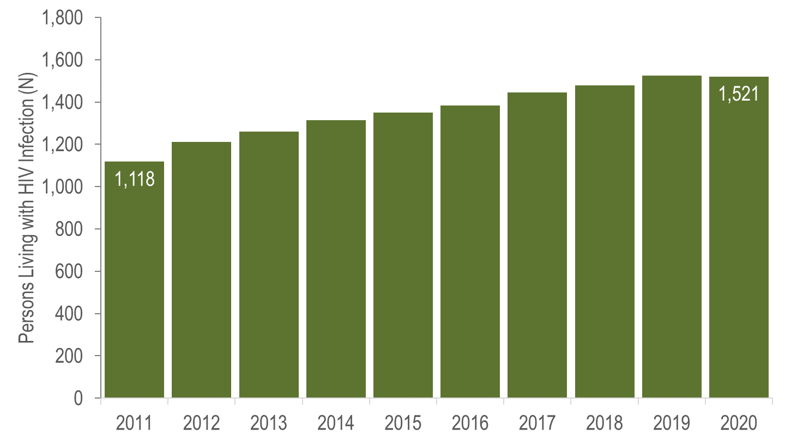
Persons Living with HIV Infection, Norfolk County, Massachusetts 2011–2020*
Data Source: MDPH Bureau of Infectious Disease and Laboratory Sciences, data are current as of 1/1/2022 and may be subject to change.
*Please consider the impact of the COVID-19 pandemic on infectious disease screening, treatment, and surveillance in the interpretation of 2020 data.
Notes:
In Norfolk County from 2011 to 2020, the number of persons living with HIV infection at the end of these years increased by 36% (from 1,118 to 1,521). However, caution should be used in the interpretation of these trends, particularly the decrease in HIV diagnoses, due to the impact of COVID-19 on access to HIV testing and care services, and case surveillance activities, in 2020.

Slide 32
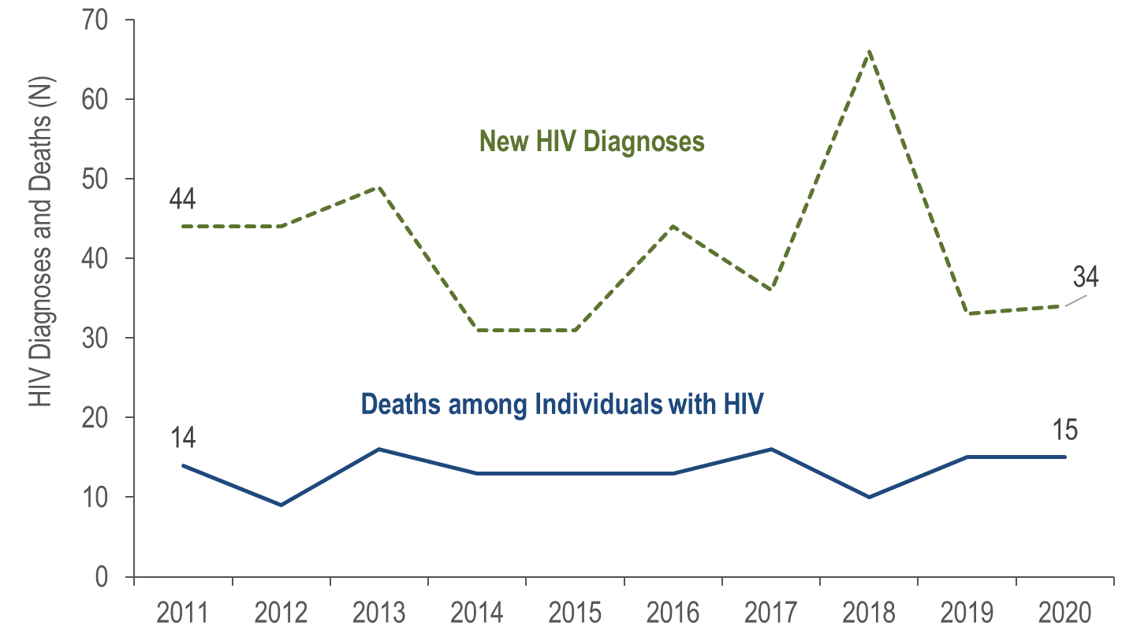
New HIV Infection Diagnoses and Deaths among Individuals Reported with HIV, Plymouth County, Massachusetts 2011–2020*
Data Source: MDPH Bureau of Infectious Disease and Laboratory Sciences, data are current as of 1/1/2022 and may be subject to change.
*Please consider the impact of the COVID-19 pandemic on infectious disease screening, treatment, and surveillance in the interpretation of 2020 data.
Notes:
The annual number of new HIV diagnoses in Plymouth County decreased 23% from 2011 (N=44) to 2020 (N=34). However, there were large year-to-year fluctuations, particularly from 2017 (N=36) to 2018 (N=66), when the number of HIV diagnoses increased by 83%. By exposure mode, the largest increase in HIV diagnoses from 2017 to 2018 was among individuals with male-to-male sex (MSM) exposure mode (from 6 to 18), followed by presumed heterosexual (from <5 to 8), and injection drug use (from 5 to 11) exposure modes.
From 2011 to 2020, the number of deaths among individuals reported with HIV remained relatively stable. However, caution should be used in the interpretation of these trends due to the impact of COVID-19 on access to HIV testing and care services, and case surveillance activities, in 2020.

Slide 33
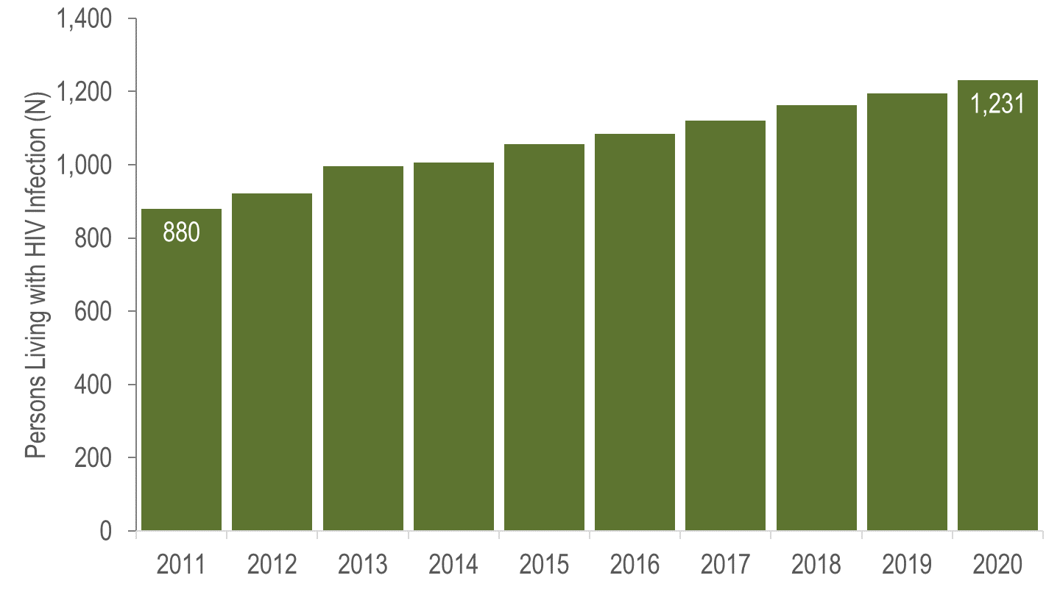
Persons Living with HIV Infection, Plymouth County, Massachusetts 2011–2020*
Data Source: MDPH Bureau of Infectious Disease and Laboratory Sciences, data are current as of 1/1/2022 and may be subject to change.
*Please consider the impact of the COVID-19 pandemic on infectious disease screening, treatment, and surveillance in the interpretation of 2020 data.
Notes:
From 2011 to 2020, the number of persons living with HIV infection at the end of these years increased by 40% (from N=880 to N=1,231). However, caution should be used in the interpretation of these trends due to the impact of COVID-19 on access to HIV testing and care services, and case surveillance activities, in 2020.

Slide 34
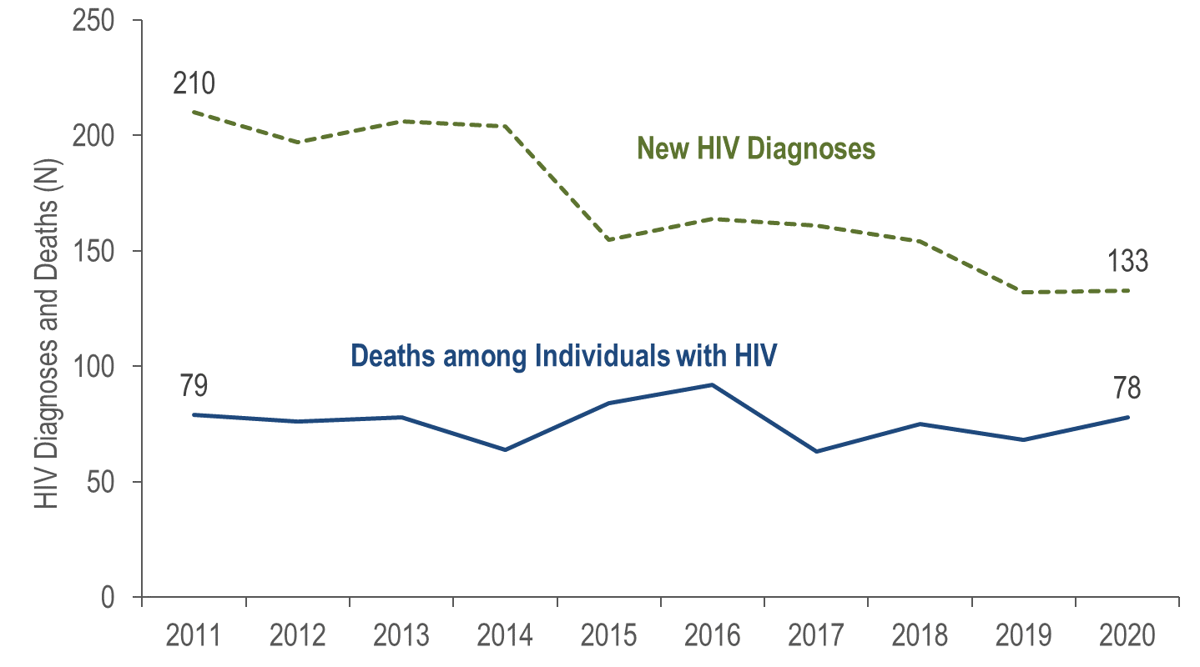
New HIV Infection Diagnoses and Deaths among Individuals Reported with HIV, Suffolk County, Massachusetts 2011–2020*
Data Source: MDPH Bureau of Infectious Disease and Laboratory Sciences, data are current as of 1/1/2022 and may be subject to change.
*Please consider the impact of the COVID-19 pandemic on infectious disease screening, treatment, and surveillance in the interpretation of 2020 data.
Notes:
In Suffolk County from 2011 to 2020, the annual number of new HIV diagnoses decreased by 37% (from 210 to 133). The number of deaths among individuals reported with HIV remained relatively stable. However, caution should be used in the interpretation of these trends due to the impact of COVID-19 on access to HIV testing and care services, and case surveillance activities, in 2020.

Slide 35
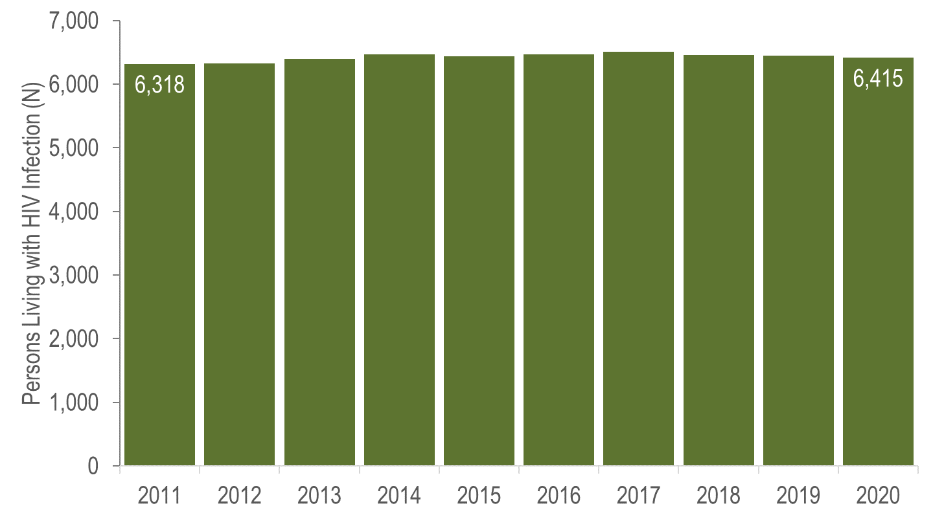
Persons Living with HIV Infection, Suffolk County, Massachusetts 2011–2020*
Data Source: MDPH Bureau of Infectious Disease and Laboratory Sciences, data are current as of 1/1/2022 and may be subject to change.
*Please consider the impact of the COVID-19 pandemic on infectious disease screening, treatment, and surveillance in the interpretation of 2020 data.
Notes:
In Suffolk County from 2011 to 2020, the annual number of persons living with HIV infection at the end of these years remained relatively stable. However, caution should be used in the interpretation of these trends due to the impact of COVID-19 on access to HIV testing and care services, and case surveillance activities, in 2020.

Slide 36
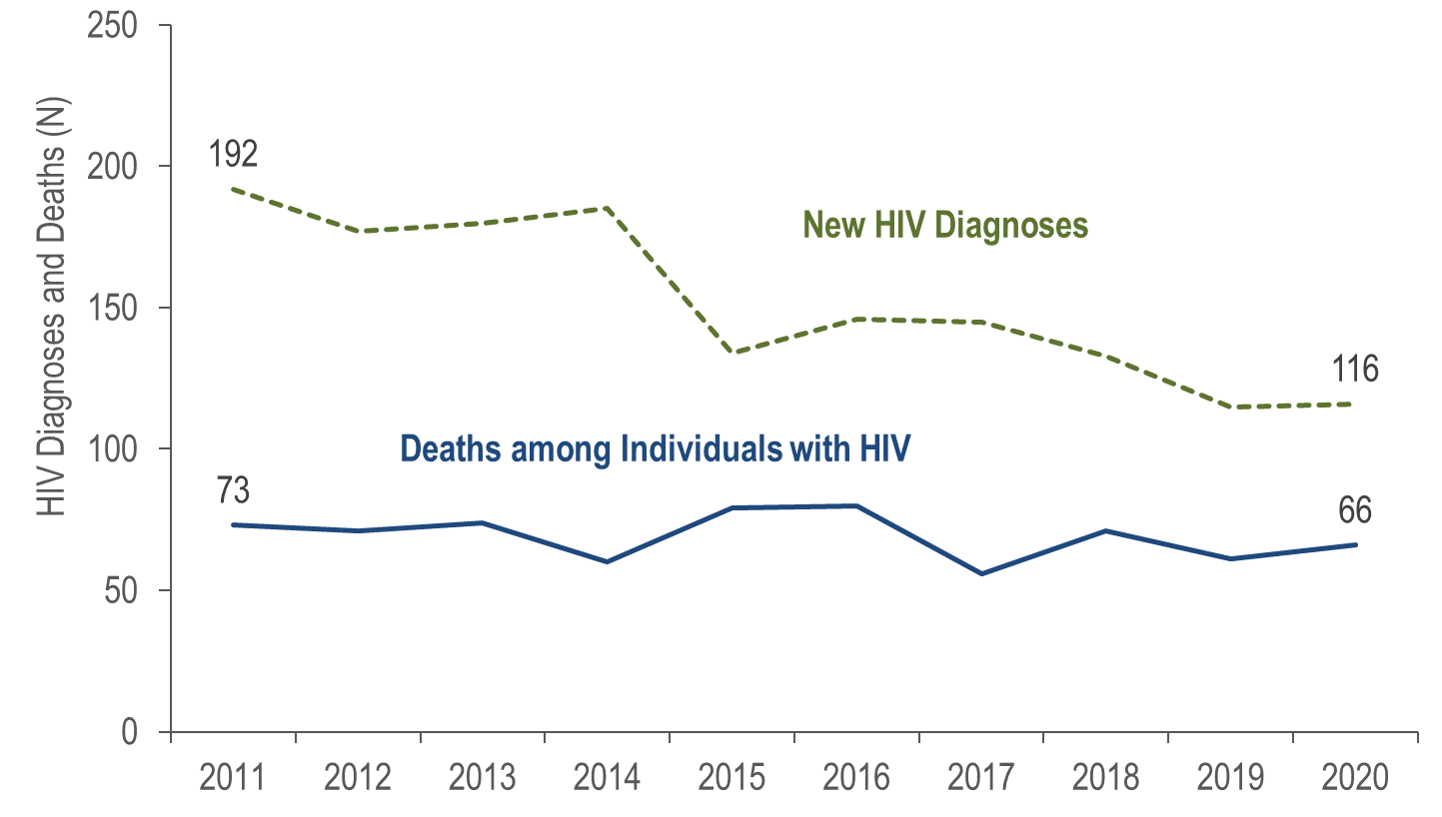
New HIV Infection Diagnoses and Deaths among Individuals Reported with HIV, City of Boston, Massachusetts 2011–2020*
Data Source: MDPH Bureau of Infectious Disease and Laboratory Sciences, data are current as of 1/1/2022 and may be subject to change.
*Please consider the impact of the COVID-19 pandemic on infectious disease screening, treatment, and surveillance in the interpretation of 2020 data.
Notes:
In Boston from 2011 to 2020, the annual number of new HIV diagnoses decreased by 40% (from 192 to 116), and deaths among individuals reported with HIV decreased by 10% (from 73 to 66). However, caution should be used in the interpretation of these trends due to the impact of COVID-19 on access to HIV testing and care services, and case surveillance activities, in 2020.

Slide 37
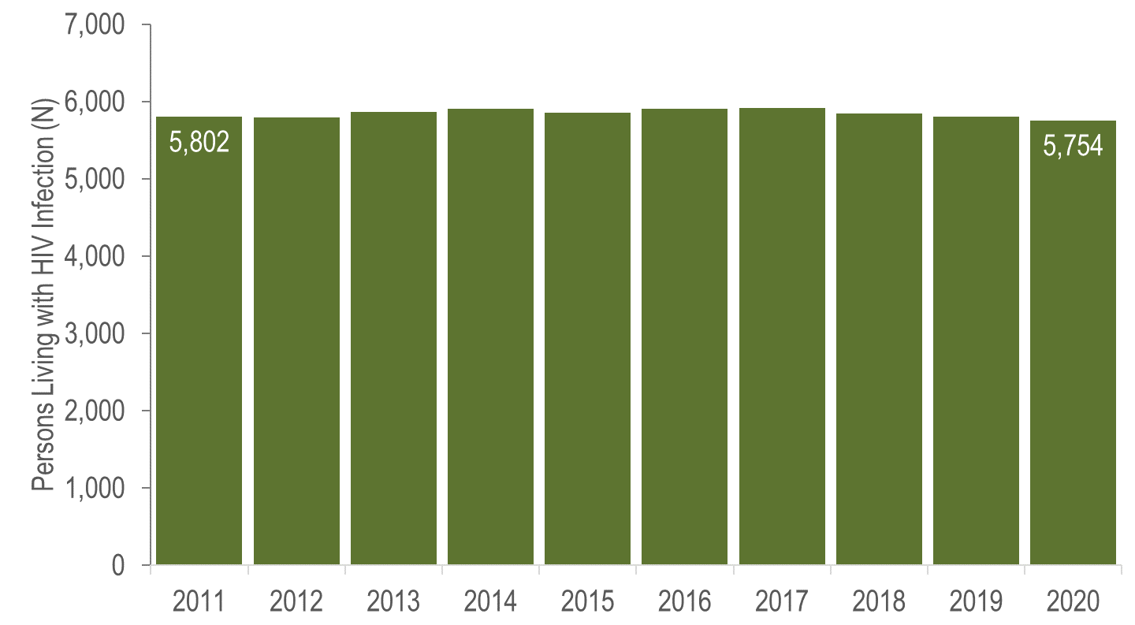
Persons Living with HIV Infection, City of Boston, Massachusetts 2011–2020*
Data Source: MDPH Bureau of Infectious Disease and Laboratory Sciences, data are current as of 1/1/2022 and may be subject to change.
*Please consider the impact of the COVID-19 pandemic on infectious disease screening, treatment, and surveillance in the interpretation of 2020 data.
Notes:
In Boston from 2011 to 2020, the number of persons living with HIV infection at the end of these years remained relatively stable. However, caution should be used in the interpretation of these trends due to the impact of COVID-19 on access to HIV testing and care services, and case surveillance activities, in 2020.

Slide 38
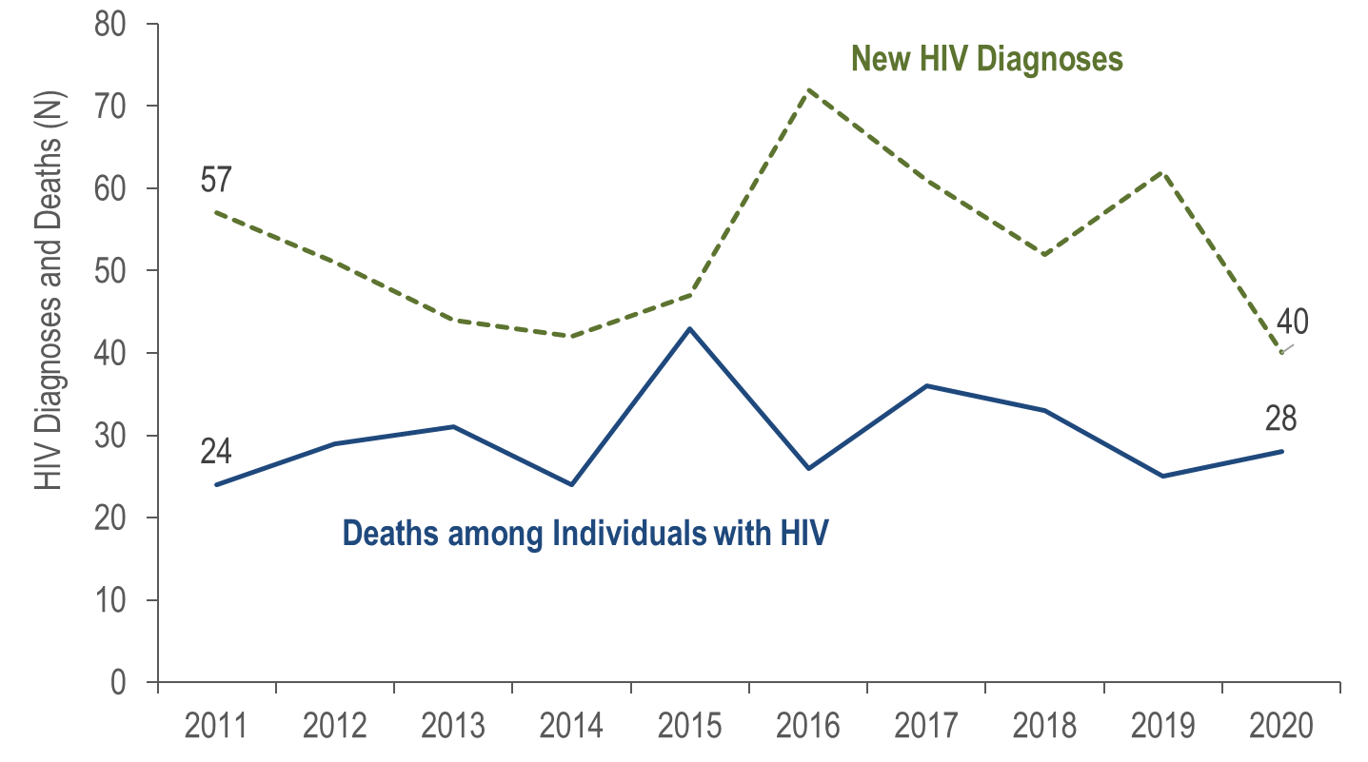
New HIV Infection Diagnoses and Deaths among Individuals Reported with HIV, Worcester County, Massachusetts 2011–2020*
Data Source: MDPH Bureau of Infectious Disease and Laboratory Sciences, data are current as of 1/1/2022 and may be subject to change.
*Please consider the impact of the COVID-19 pandemic on infectious disease screening, treatment, and surveillance in the interpretation of 2020 data.
Notes:
In Worcester County from 2011 to 2020, the annual number of new HIV diagnoses decreased by 30% (from 57 to 40), and deaths among individuals reported with HIV remained relatively stable. However, caution should be used in the interpretation of these trends due to the impact of COVID-19 on access to HIV testing and care services, and case surveillance activities, in 2020.

Slide 39
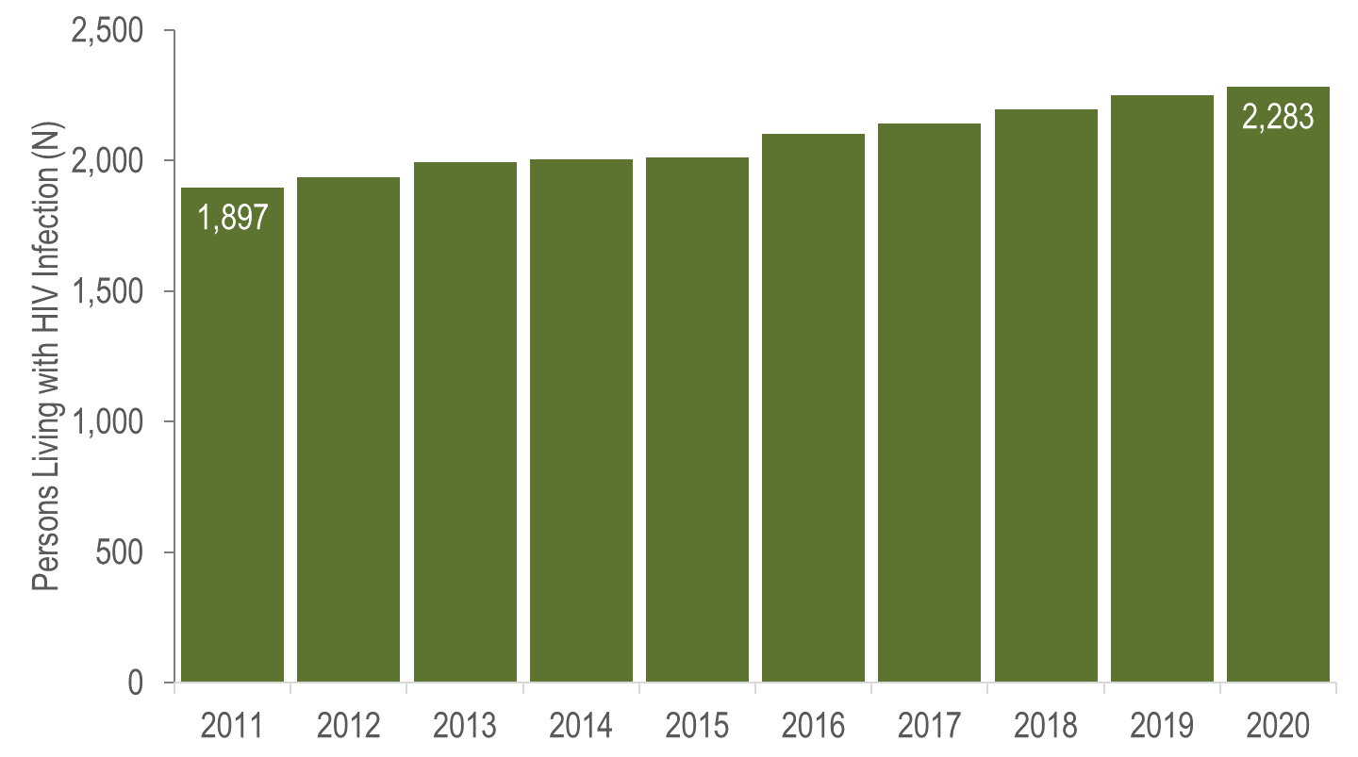
Persons Living with HIV Infection, Worcester County, Massachusetts 2011–2020*
Data Source: MDPH Bureau of Infectious Disease and Laboratory Sciences, data are current as of 1/1/2022 and may be subject to change.
*Please consider the impact of the COVID-19 pandemic on infectious disease screening, treatment, and surveillance in the interpretation of 2020 data.
Notes:
In Worcester County from 2011 to 2020, the number of persons living with HIV infection at the end of these years increased by 20% (from 1,897 to 2,283). However, caution should be used in the interpretation of these trends due to the impact of COVID-19 on access to HIV testing and care services, and case surveillance activities, in 2020.

