Slide 1
Massachusetts HIV Epidemiologic Profile:
Data as of 1/1/2023
Regional Report
Notes:
Suggested citation:
Massachusetts Department of Public Health, Bureau of Infectious Disease and Laboratory Sciences. Massachusetts HIV Epidemiologic Profile, Regional Report – Data as of 1/1/2023,
https://www.mass.gov/lists/hivaids-epidemiologic-profiles Published June 2024. Accessed [date].
Bureau of Infectious Disease and Laboratory Sciences
Massachusetts Department of Public Health
Jamaica Plain Campus/State Public Health Laboratory
305 South Street
Jamaica Plain, MA 02130
To reach the Reporting and Partner Services Line*
Tel: (617) 983-6999
Questions about this report
Tel: (617) 983-6560
To speak to the on-call epidemiologist
Tel: (617) 983-6800
Questions about infectious disease reporting
Tel: (617) 983-6801
Requests for additional data
https://www.mass.gov/lists/infectious-disease-data-reports-and-requests
Slide sets for Epidemiologic Profile Reports
https://www.mass.gov/lists/hivaids-epidemiologic-profiles
* Providers may use this number to report individuals newly diagnosed with a notifiable sexually transmitted infection, including HIV, or request partner services. Partner services is a free and confidential service for individuals recently diagnosed with a priority infection. The client-centered program offers counseling, linkage to other health and social services, anonymous notification of partners who were exposed and assistance with getting testing and treatment. For more information, see: https://www.mass.gov/service-details/partner-services-program-information-for-healthcare-providers)

Slide 2
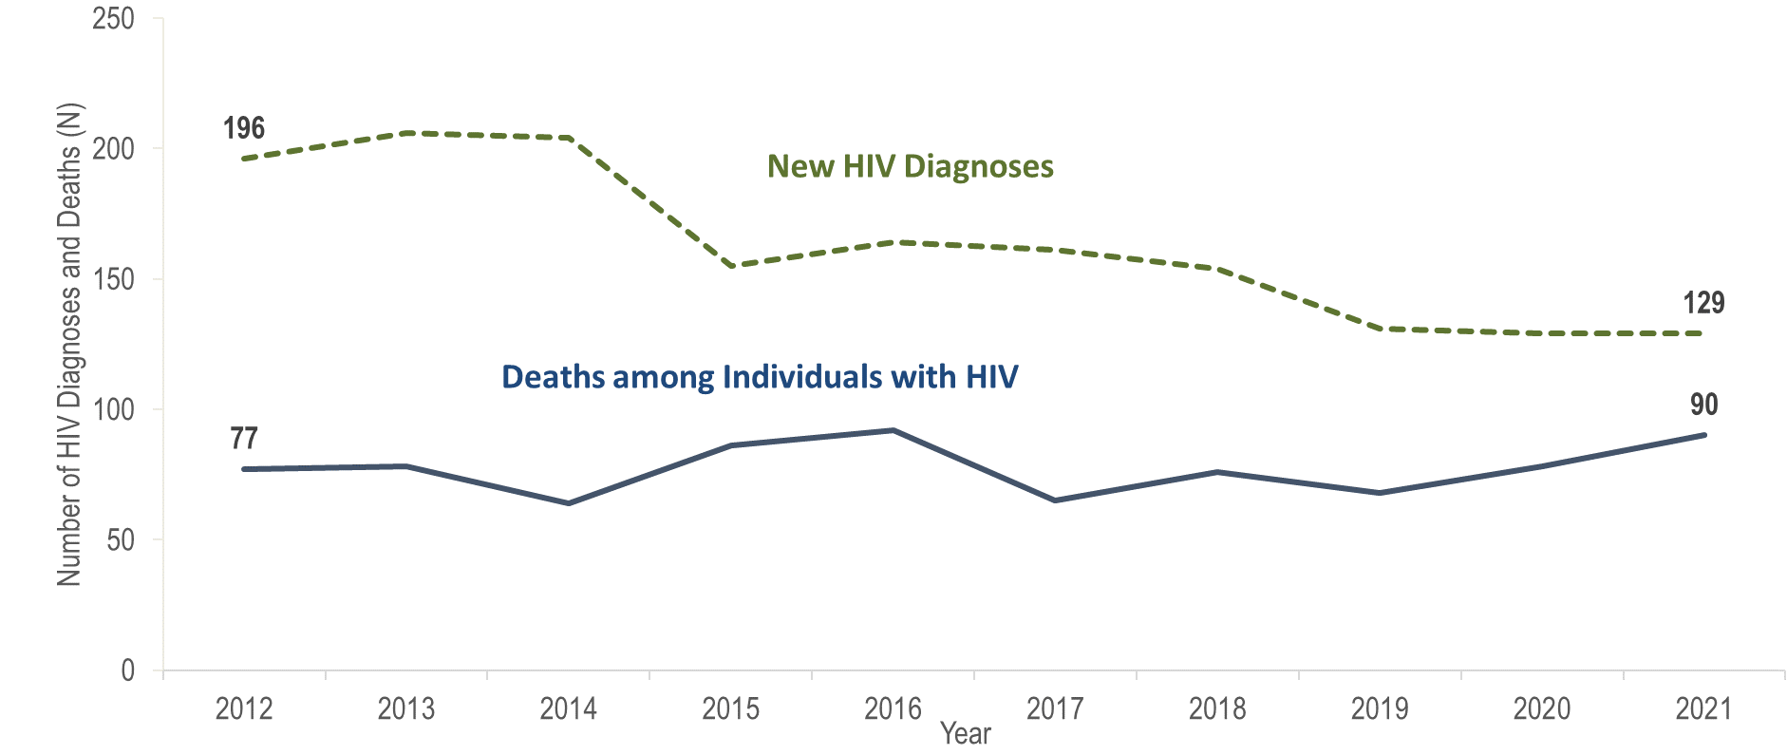
Number of new HIV infection diagnoses and deaths among individuals reported with HIV infection, Boston HSR, Massachusetts 2012–2021¹
¹ Please consider the impact of the COVID-19 pandemic on infectious disease screening, treatment, and surveillance in the interpretation of data from 2020 to 2021.
Data Source: Bureau of Infectious Disease and Laboratory Sciences, data are current as of 1/1/2023 and subject to change
Notes:
The figure is a trendline displaying the annual number of new HIV diagnoses and deaths among individuals with HIV for the most recent ten-year period.
In the Boston HSR from 2012 to 2021, the annual number of new HIV diagnoses decreased by 34% (from 196 to 129), and deaths among individuals increased by 17% (from 77 to 90). However, caution should be used in the interpretation of these trends due to the impact of COVID-19 on access to HIV testing and care services, and case surveillance activities, in 2020 and 2021.

Slide 3
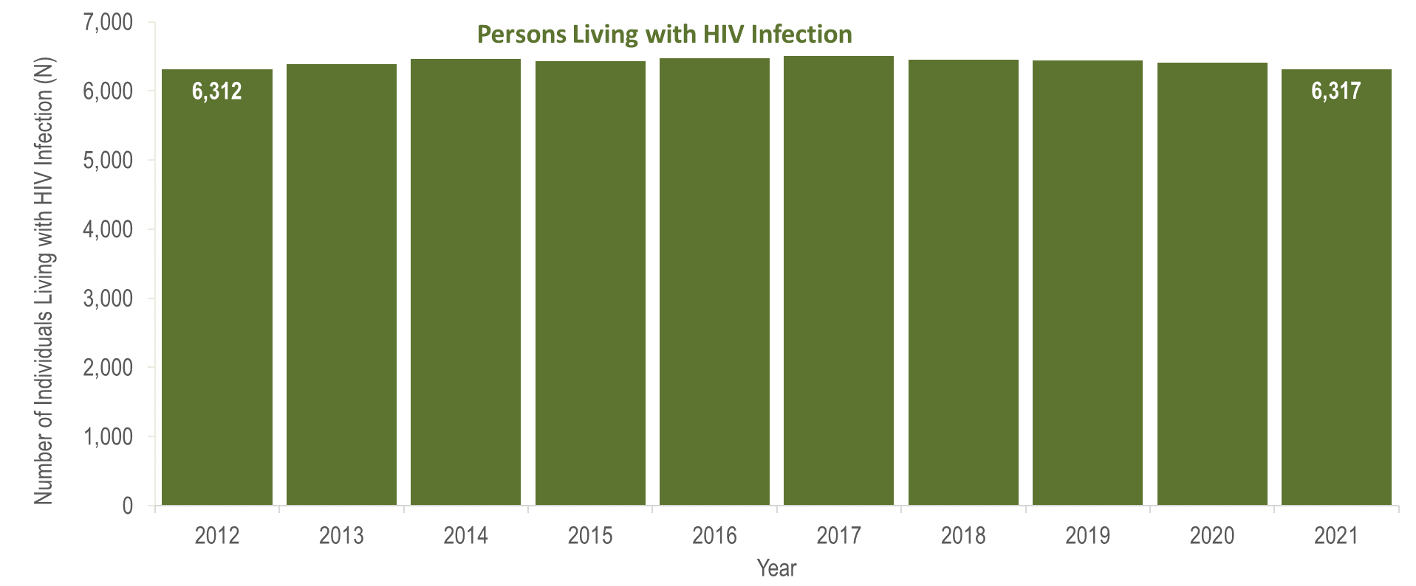
Number of persons living with HIV infection,¹
Boston HSR, Massachusetts 2012–2021²
¹ Number of persons living with HIV infection on 12/31 of each year.
² Please consider the impact of the COVID-19 pandemic on infectious disease screening, treatment, and surveillance in the interpretation of data from 2020 to 2021.
Data Source: Bureau of Infectious Disease and Laboratory Sciences, data are current as of 1/1/2023 and subject to change
Notes:
The figure is a bar chart displaying a trend in the annual number of individuals living with HIV infection for the most recent ten-year period.
The number of persons living with HIV infection at the end of these years remained relatively stable. However, caution should be used in the interpretation of these trends due to the impact of COVID-19 on access to HIV testing and care services, and case surveillance activities, in 2020 and 2021.

Slide 4
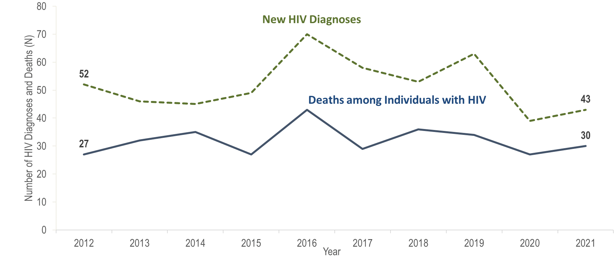
Number of new HIV infection diagnoses and deaths among individuals reported with HIV infection, Central HSR, Massachusetts 2012–2021¹
¹ Please consider the impact of the COVID-19 pandemic on infectious disease screening, treatment, and surveillance in the interpretation of data from 2020 to 2021.
Data Source: Bureau of Infectious Disease and Laboratory Sciences, data are current as of 1/1/2023 and subject to change
Notes:
The figure is a trendline displaying the annual number of new HIV diagnoses and deaths among individuals with HIV for the most recent ten-year period.
In the Central HSR from 2012 to 2021, the annual number of new HIV diagnoses decreased by 17% (from 52 to 43), and deaths among individuals reported with HIV remained relatively stable overall with year-to-year fluctuations. However, caution should be used in the interpretation of these trends due to the impact of COVID-19 on access to HIV testing and care services, and case surveillance activities, in 2020 and 2021.

Slide 5
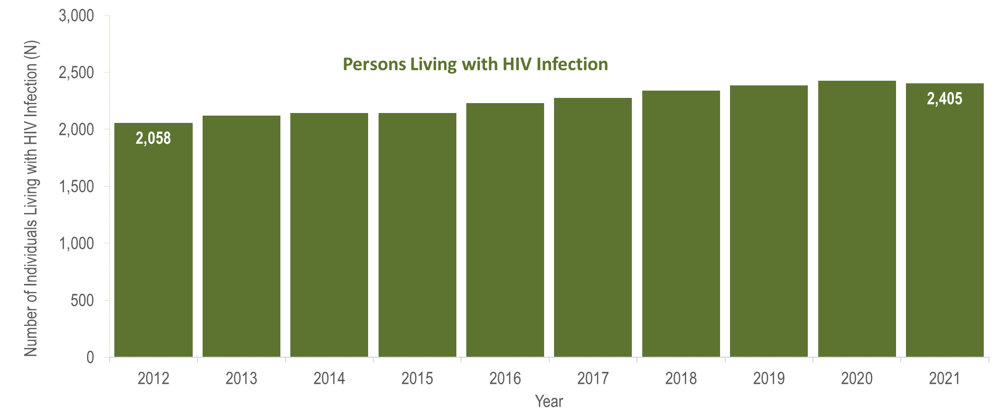
Number of persons living with HIV infection,¹
Central HSR, Massachusetts 2012–2021²
¹ Number of persons living with HIV infection on 12/31 of each year.
² Please consider the impact of the COVID-19 pandemic on infectious disease screening, treatment, and surveillance in the interpretation of data from 2020 to 2021.
Data Source: Bureau of Infectious Disease and Laboratory Sciences, data are current as of 1/1/2023 and subject to change
Notes:
The figure is a bar chart displaying a trend in the annual number of individuals living with HIV infection for the most recent ten-year period.
The number of persons living with HIV infection at the end of these years increased by 17% (from 2,058 to 2,405). However, caution should be used in the interpretation of these trends due to the impact of COVID-19 on access to HIV testing and care services, and case surveillance activities, in 2020 and 2021.

Slide 6
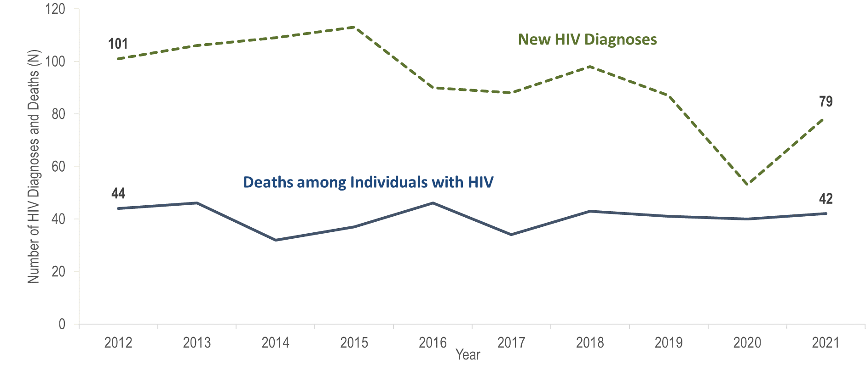
Number of new HIV infection diagnoses and deaths among individuals reported with HIV infection, Metrowest HSR, Massachusetts 2012–2021¹
¹ Please consider the impact of the COVID-19 pandemic on infectious disease screening, treatment, and surveillance in the interpretation of data from 2020 to 2021.
Data Source: Bureau of Infectious Disease and Laboratory Sciences, data are current as of 1/1/2023 and subject to change
Notes:
The figure is a trendline displaying the annual number of new HIV diagnoses and deaths among individuals with HIV for the most recent ten-year period.
In the Metrowest HSR, the annual number of new HIV diagnoses decreased by 48% from 101 in 2012 to 50 in 2020, and then rebounded increasing by 49% to 79 in 2021. Deaths among individuals reported with HIV remained stable from 2012 to 2021. However, caution should be used in the interpretation of these trends due to the impact of COVID-19 on access to HIV testing and care services, and case surveillance activities, in 2020 and 2021.

Slide 7
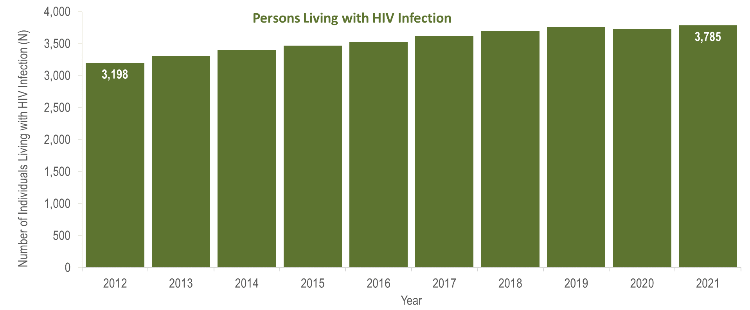
Number of persons living with HIV infection,¹
Metrowest HSR, Massachusetts 2012–2021²
¹ Number of persons living with HIV infection on 12/31 of each year.
² Please consider the impact of the COVID-19 pandemic on infectious disease screening, treatment, and surveillance in the interpretation of data from 2020 to 2021.
Data Source: Bureau of Infectious Disease and Laboratory Sciences, data are current as of 1/1/2023 and subject to change
Notes:
The figure is a bar chart displaying a trend in the annual number of individuals living with HIV infection for the most recent ten-year period.
The number of persons living with HIV infection at the end of these years increased by 18% (from 3,198 to 3,785). However, caution should be used in the interpretation of these trends due to the impact of COVID-19 on access to HIV testing and care services, and case surveillance activities, in 2020 and 2021.

Slide 8
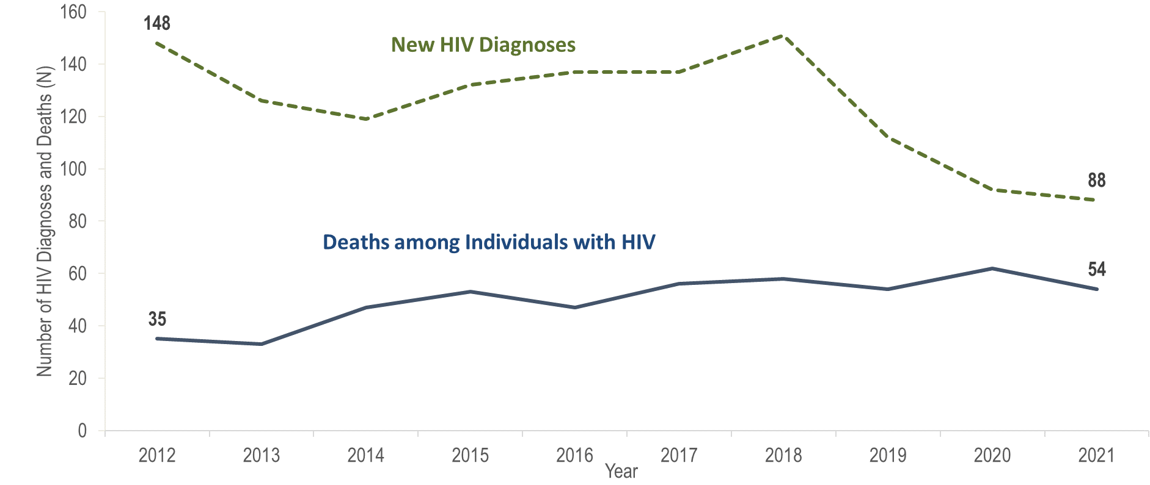
Number of new HIV infection diagnoses and deaths among individuals reported with HIV infection, Northeast HSR, Massachusetts 2012–2021¹
¹ Please consider the impact of the COVID-19 pandemic on infectious disease screening, treatment, and surveillance in the interpretation of data from 2020 to 2021.
Data Source: Bureau of Infectious Disease and Laboratory Sciences, data are current as of 1/1/2023 and subject to change
Notes:
The figure is a trendline displaying the annual number of new HIV diagnoses and deaths among individuals with HIV for the most recent ten-year period.
The number of annual new HIV diagnoses in the Northeast HSR decreased from 148 in 2012 to 119 in 2014 then increased to 150 in 2018 primarily due to an outbreak among persons who inject drugs (PWID) in the northeast part of the state between 2016 and 2018. Following a focused public health response, the number of HIV infection diagnoses in the Northeast decreased by 42% (from 150 in 2018) to 88 in 2021. However, caution should be used in the interpretation of this decline due to the impact of COVID-19 on access to HIV testing and care services and case surveillance activities, in 2020 and 2021.
In the Northeast HSR from 2012 to 2021, deaths among individuals reported with HIV increased by 54% (from 35 to 54).
For more information about this outbreak see: Charles Alpren et al. “Opioid Use Fueling HIV Transmission in an Urban Setting: An Outbreak of HIV Infection Among People Who Inject Drugs—Massachusetts, 2015–2018”, American Journal of Public Health 110, no. 1 (January 1, 2020): pp. 37-44. https://doi.org/10.2105/AJPH.2019.305366.

Slide 9
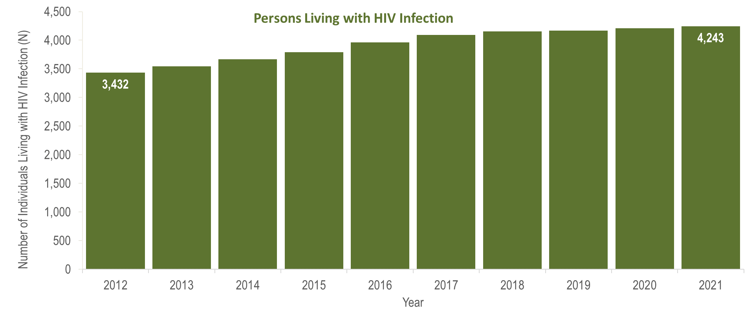
Number of persons living with HIV infection,¹
Northeast HSR, Massachusetts 2012–2021²
¹ Number of persons living with HIV infection on 12/31 of each year.
² Please consider the impact of the COVID-19 pandemic on infectious disease screening, treatment, and surveillance in the interpretation of data from 2020 to 2021.
Data Source: Bureau of Infectious Disease and Laboratory Sciences, data are current as of 1/1/2023 and subject to change
Notes:
The figure is a bar chart displaying a trend in the annual number of individuals living with HIV infection for the most recent ten-year period.
The number of persons living with HIV infection at the end of these years increased by 24% (from 3,432 to 4,243).

Slide 10
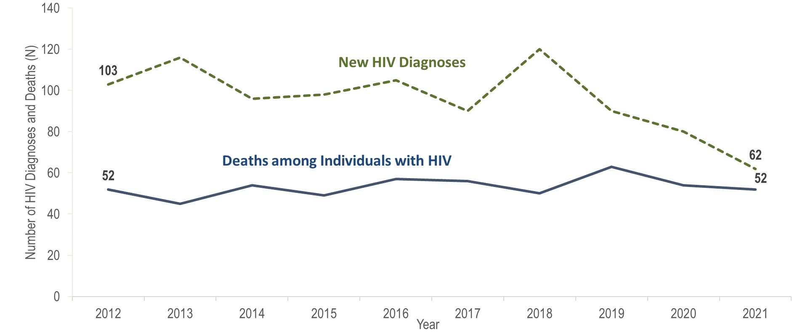
Number of new HIV infection diagnoses and deaths among individuals reported with HIV infection, Southeast HSR, Massachusetts 2012–2021¹
¹ Please consider the impact of the COVID-19 pandemic on infectious disease screening, treatment, and surveillance in the interpretation of data from 2020 to 2021.
Data Source: Bureau of Infectious Disease and Laboratory Sciences, data are current as of 1/1/2023 and subject to change
Notes:
The figure is a trendline displaying the annual number of new HIV diagnoses and deaths among individuals with HIV for the most recent ten-year period.
In the Southeast HSR from 2012 to 2021, the annual number of new HIV diagnoses decreased by 40% (from 103 to 62) and the annual number of deaths among individuals reported with HIV remained stable. However, caution should be used in the interpretation of these trends due to the impact of COVID-19 on access to HIV testing and care services, and case surveillance activities, in 2020 and 2021.

Slide 11
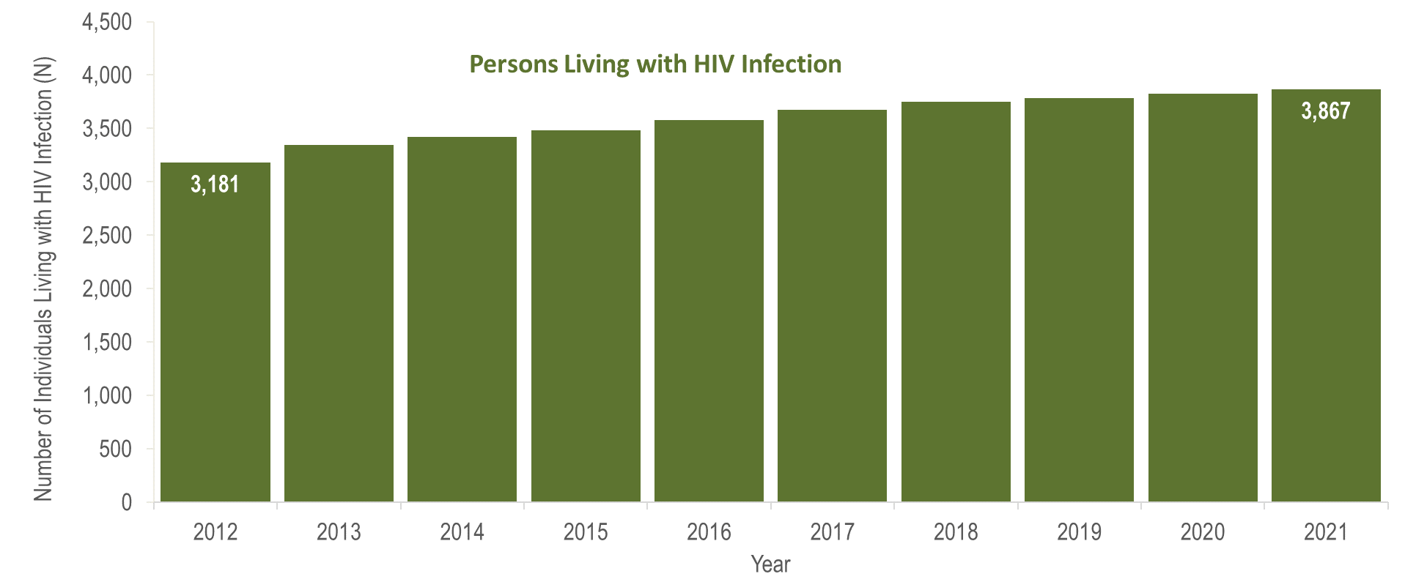
Number of persons living with HIV infection,¹
Southeast HSR, Massachusetts 2012–2021²
¹ Number of persons living with HIV infection on 12/31 of each year.
² Please consider the impact of the COVID-19 pandemic on infectious disease screening, treatment, and surveillance in the interpretation of data from 2020 to 2021.
Data Source: Bureau of Infectious Disease and Laboratory Sciences, data are current as of 1/1/2023 and subject to change
Notes:
The figure is a bar chart displaying a trend in the annual number of individuals living with HIV infection for the most recent ten-year period.
In the Southeast HSR the number of persons living with HIV infection at the end of these years increased by 22% (from 3,181 to 3,867). However, caution should be used in the interpretation of these trends due to the impact of COVID-19 on access to HIV testing and care services, and case surveillance activities, in 2020 and 2021.

Slide 12
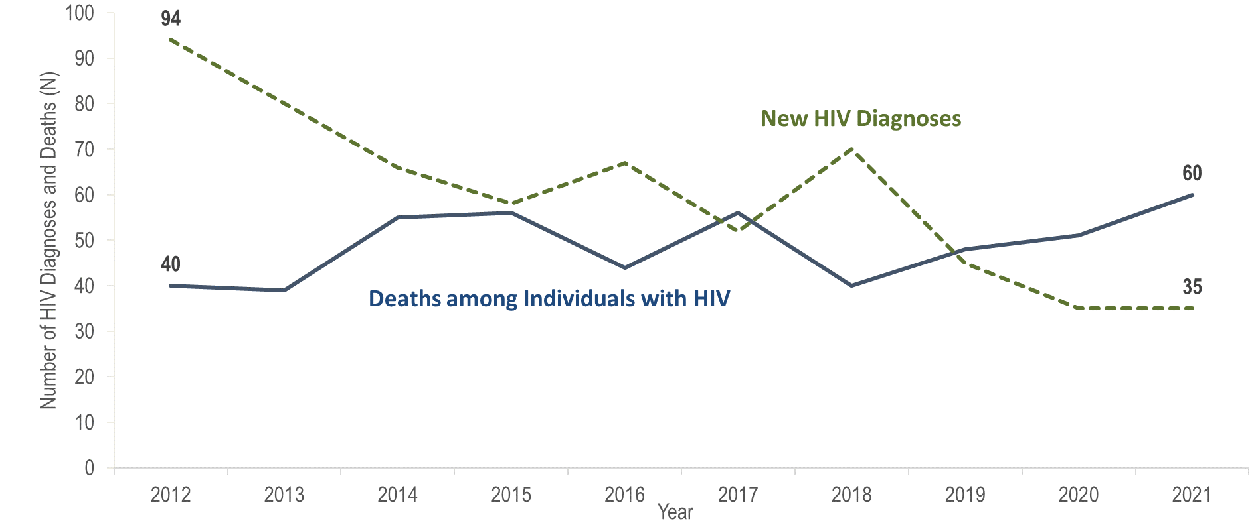
Number of new HIV infection diagnoses and deaths among individuals reported with HIV infection, Western HSR, Massachusetts 2012–2021¹
¹ Please consider the impact of the COVID-19 pandemic on infectious disease screening, treatment, and surveillance in the interpretation of data from 2020 to 2021.
Data Source: Bureau of Infectious Disease and Laboratory Sciences, data are current as of 1/1/2023 and subject to change
Notes:
The figure is a trendline displaying the annual number of new HIV diagnoses and deaths among individuals with HIV for the most recent ten-year period.
In the Western HSR from 2012 to 2021, the annual number of new HIV diagnoses decreased by 63% (from 94 to 35), and deaths among individuals reported with HIV increased by 50% (from 40 to 60). However, caution should be used in the interpretation of these trends due to the impact of COVID-19 on access to HIV testing and care services, and case surveillance activities, in 2020 and 2021.

Slide 13
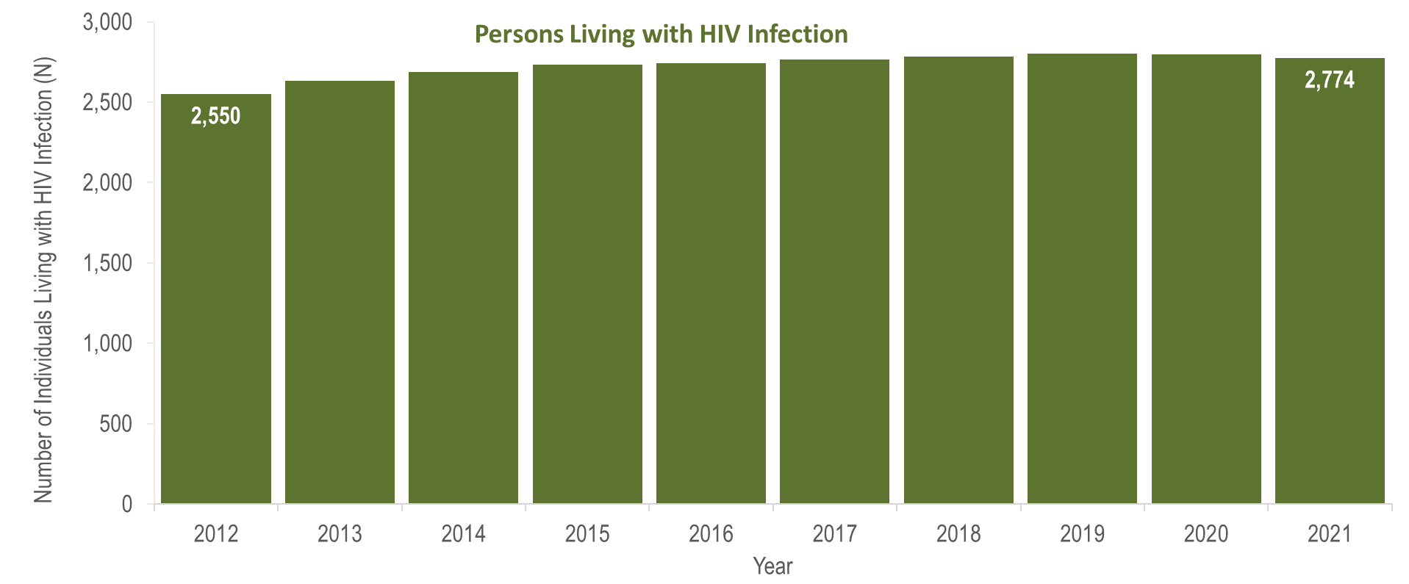
Number of persons living with HIV infection,¹
Western HSR, Massachusetts 2012–2021²
¹ Number of persons living with HIV infection on 12/31 of each year.
² Please consider the impact of the COVID-19 pandemic on infectious disease screening, treatment, and surveillance in the interpretation of data from 2020 to 2021.
Data Source: Bureau of Infectious Disease and Laboratory Sciences, data are current as of 1/1/2023 and subject to change
Notes:
The figure is a bar chart displaying a trend in the annual number of individuals living with HIV infection for the most recent ten-year period.
In the Western HSR from 2012 to 2021, the number of persons living with HIV infection at the end of these years increased by 9% (from 2,550 to 2,774). However, caution should be used in the interpretation of these trends due to the impact of COVID-19 on access to HIV testing and care services, and case surveillance activities, in 2020 and 2021.

Slide 14
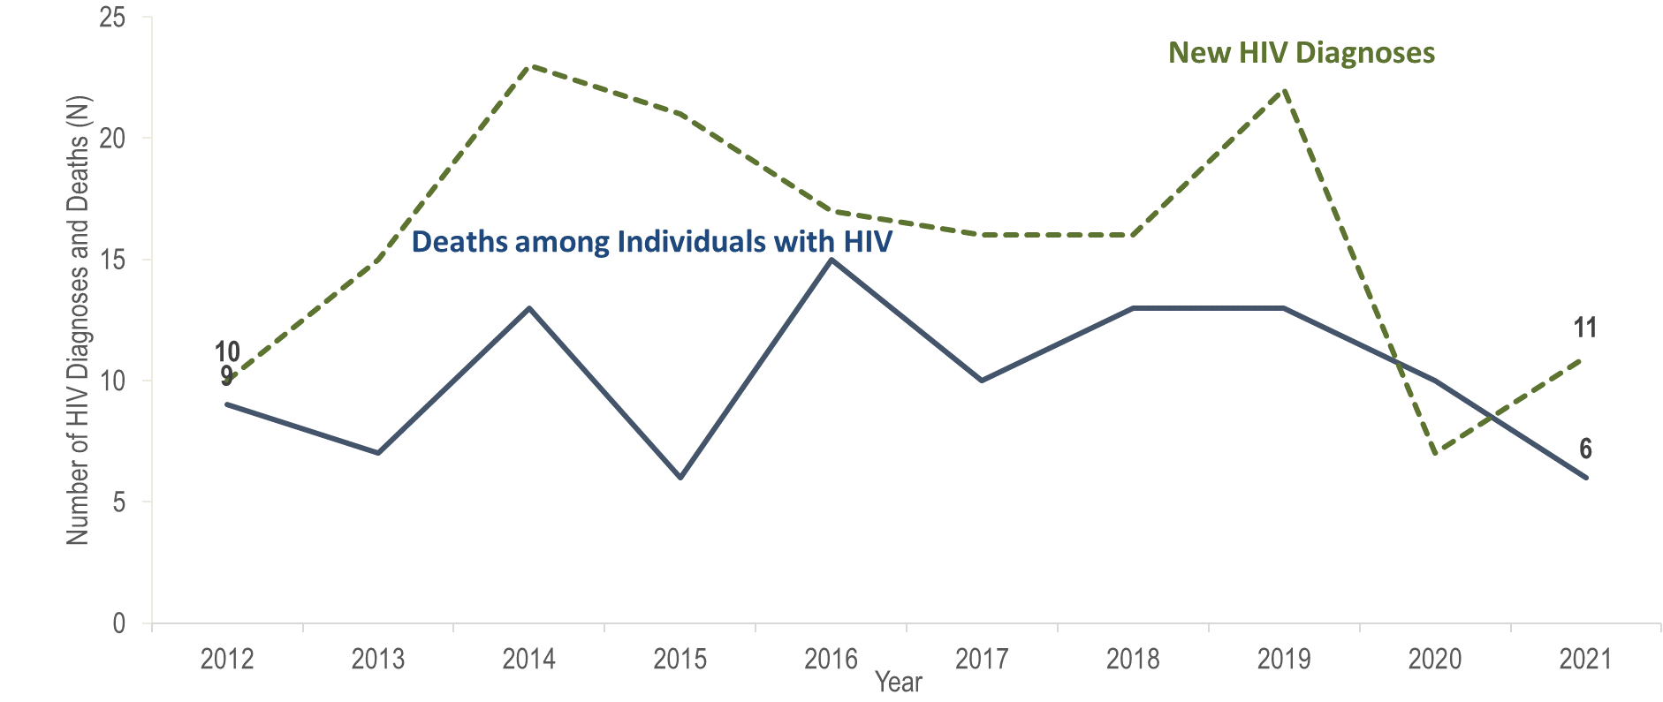
Number of new HIV infection diagnoses and deaths among individuals reported with HIV infection, Barnstable, Dukes, and Nantucket Counties,
Massachusetts 2012–2021¹
¹ Please consider the impact of the COVID-19 pandemic on infectious disease screening, treatment, and surveillance in the interpretation of data from 2020 to 2021.
Data Source: Bureau of Infectious Disease and Laboratory Sciences, data are current as of 1/1/2023 and subject to change
Notes:
The figure is a trendline displaying the annual number of new HIV diagnoses and deaths among individuals with HIV for the most recent ten-year period.
In Barnstable, Dukes, and Nantucket Counties from 2012 to 2021, the annual number of new HIV diagnoses fluctuated between seven (2020) and 23 (2014), and deaths among individuals reported with HIV fluctuated between six (2015 and 2021) and 15 (2016). However, caution should be used in the interpretation of these trends due to the impact of COVID-19 on access to HIV testing and care services, and case surveillance activities, in 2020 and 2021.

Slide 15
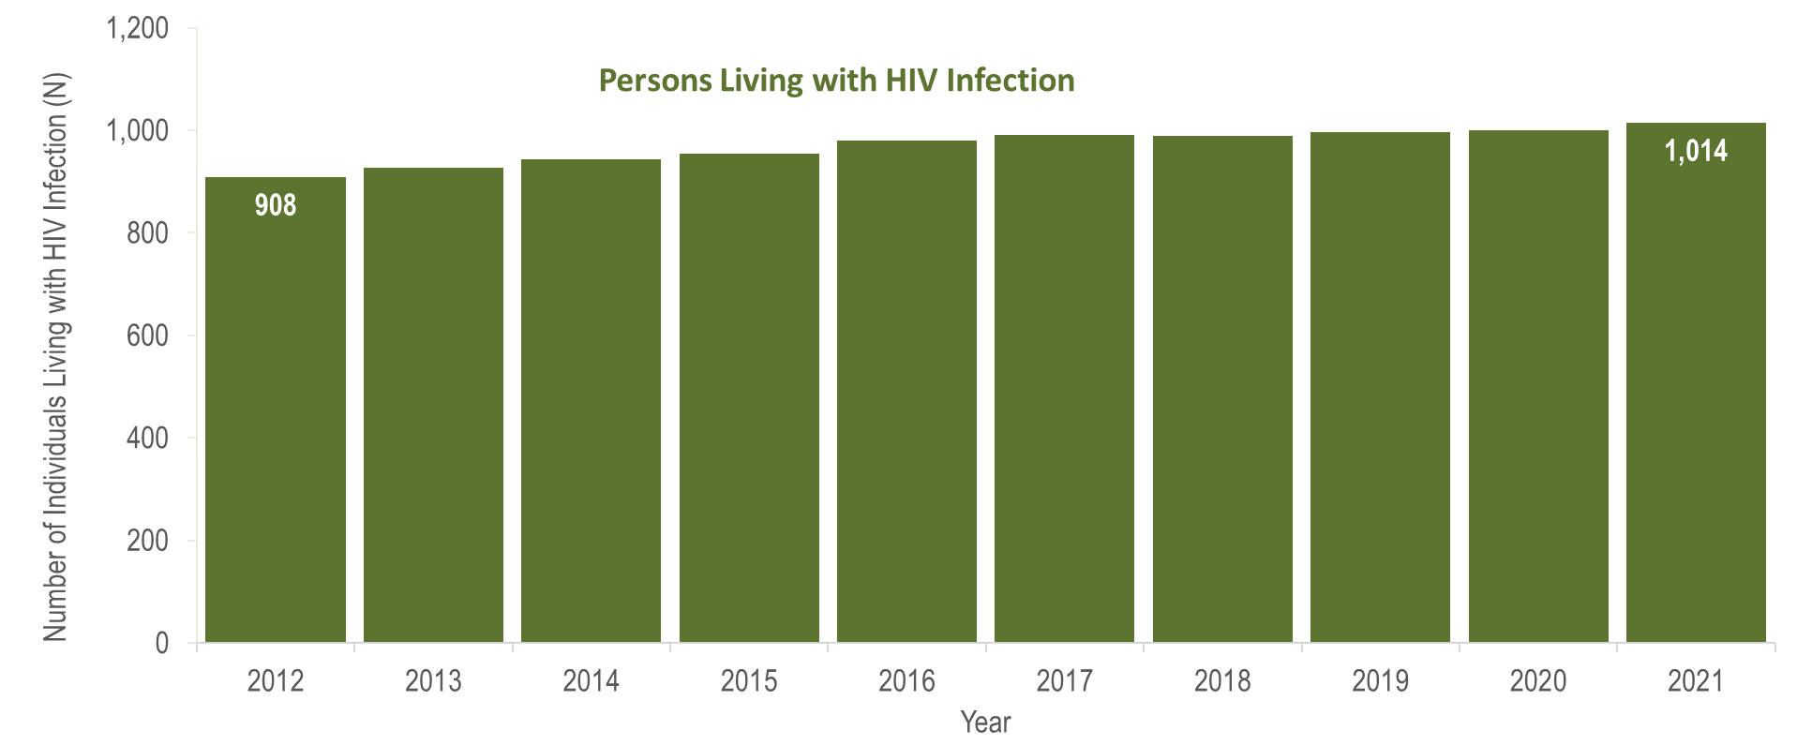
Number of persons living with HIV infection,¹
Barnstable, Dukes, and Nantucket Counties, Massachusetts 2012–2021²
¹ Number of persons living with HIV infection on 12/31 of each year.
² Please consider the impact of the COVID-19 pandemic on infectious disease screening, treatment, and surveillance in the interpretation of data from 2020 to 2021.
Data Source: Bureau of Infectious Disease and Laboratory Sciences, data are current as of 1/1/2023 and subject to change
Notes:
The figure is a bar chart displaying a trend in the annual number of individuals living with HIV infection for the most recent ten-year period.
In Barnstable, Dukes, and Nantucket Counties from 2012 to 2021, the number of persons living with HIV infection at the end of these years increased by 12% (from 908 to 1,014). However, caution should be used in the interpretation of these trends due to the impact of COVID-19 on access to HIV testing and care services, and case surveillance activities, in 2020 and 2021.

Slide 16
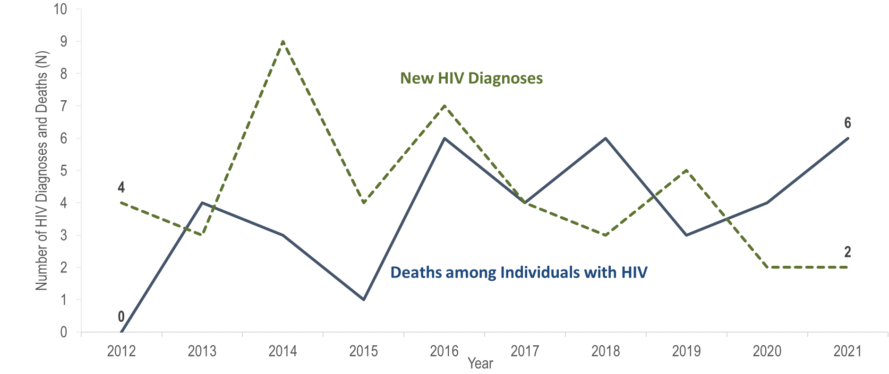
Number of new HIV infection diagnoses and deaths among individuals reported with HIV infection, Berkshire County, Massachusetts 2012–2021¹
¹ Please consider the impact of the COVID-19 pandemic on infectious disease screening, treatment, and surveillance in the interpretation of data from 2020 to 2021.
Data Source: Bureau of Infectious Disease and Laboratory Sciences, data are current as of 1/1/2023 and subject to change
Notes:
The figure is a trendline displaying the annual number of new HIV diagnoses and deaths among individuals with HIV for the most recent ten-year period.
In Berkshire County from 2012 to 2021, the annual number of new HIV diagnoses remained between two and nine, and deaths among individuals reported with HIV remained at six or fewer. However, caution should be used in the interpretation of these trends due to the impact of COVID-19 on access to HIV testing and care services, and case surveillance activities, in 2020 and 2021.

Slide 17
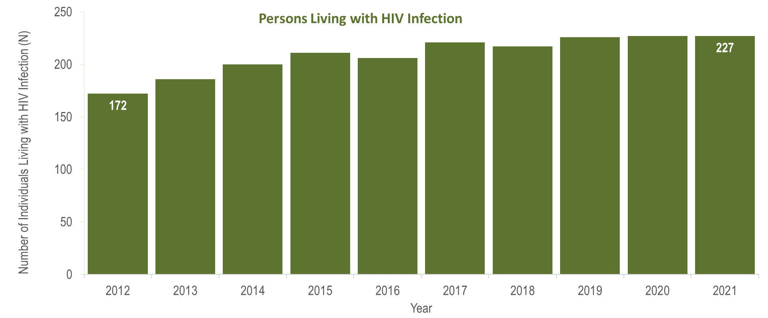
Number of persons living with HIV infection,¹
Berkshire County, Massachusetts 2012–2021²
¹ Number of persons living with HIV infection on 12/31 of each year.
² Please consider the impact of the COVID-19 pandemic on infectious disease screening, treatment, and surveillance in the interpretation of data from 2020 to 2021.
Data Source: Bureau of Infectious Disease and Laboratory Sciences, data are current as of 1/1/2023 and subject to change
Notes:
The figure is a bar chart displaying a trend in the annual number of individuals living with HIV infection for the most recent ten-year period.
In Berkshire County from 2012 to 2021, the number of persons living with HIV infection at the end of these years increased from 172 to 227. However, caution should be used in the interpretation of these trends due to the impact of COVID-19 on access to HIV testing and care services, and case surveillance activities, in 2020 and 2021.

Slide 18
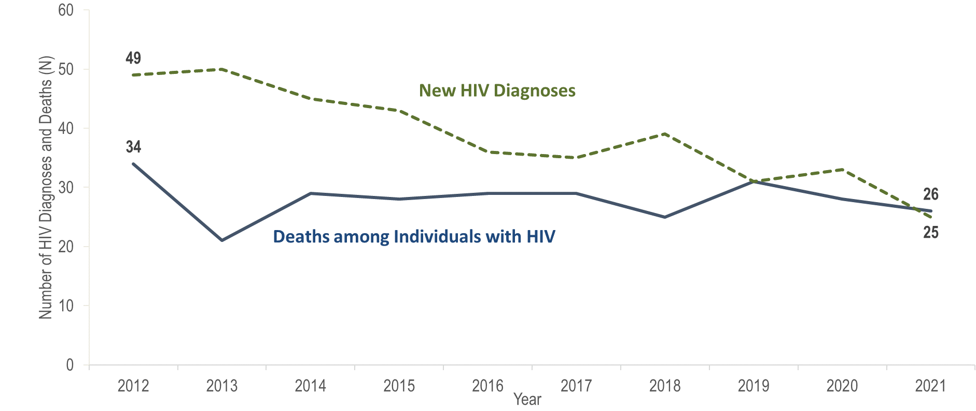
Number of new HIV infection diagnoses and deaths among individuals reported with HIV infection, Bristol County, Massachusetts 2012–2021¹
¹ Please consider the impact of the COVID-19 pandemic on infectious disease screening, treatment, and surveillance in the interpretation of data from 2020 to 2021.
Data Source: Bureau of Infectious Disease and Laboratory Sciences, data are current as of 1/1/2023 and subject to change
Notes:
The figure is a trendline displaying the annual number of new HIV diagnoses and deaths among individuals with HIV for the most recent ten-year period.
In Bristol County from 2012 to 2021, the annual number of new HIV diagnoses decreased by 49% (from 49 to 25), and deaths among individuals reported with HIV decreased by 24% (from 24 to 26). However, caution should be used in the interpretation of these trends due to the impact of COVID-19 on access to HIV testing and care services, and case surveillance activities, in 2020 and 2021.

Slide 19
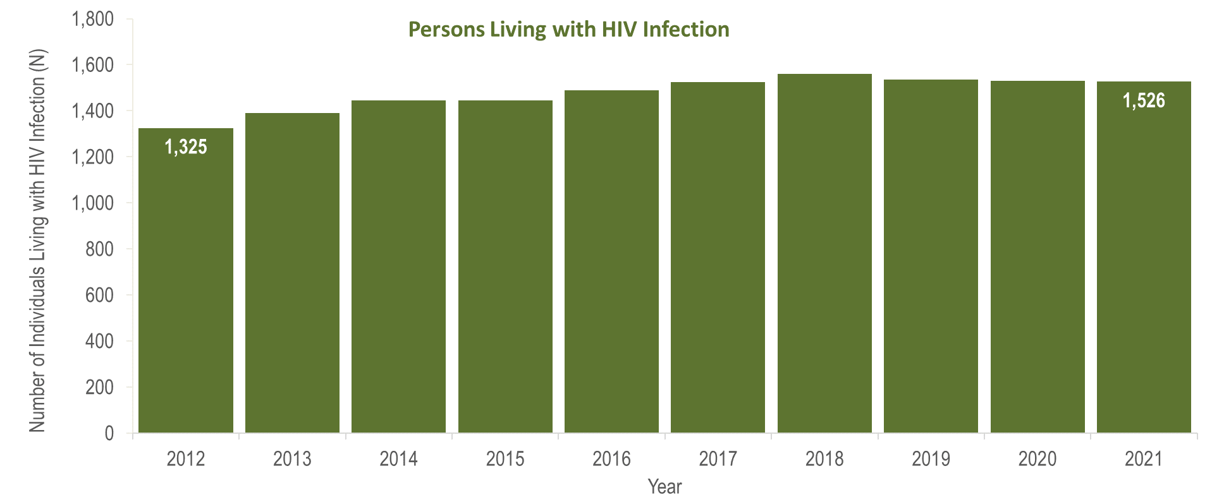
Number of persons living with HIV infection,¹
Bristol County, Massachusetts 2012–2021²
¹ Number of persons living with HIV infection on 12/31 of each year.
² Please consider the impact of the COVID-19 pandemic on infectious disease screening, treatment, and surveillance in the interpretation of data from 2020 to 2021.
Data Source: Bureau of Infectious Disease and Laboratory Sciences, data are current as of 1/1/2023 and subject to change
Notes:
The figure is a bar chart displaying a trend in the annual number of individuals living with HIV infection for the most recent ten-year period.
In Bristol County from 2012 to 2021, the number of persons living with HIV infection at the end of these years increased by 15% (from 1,325 to 1,526). However, caution should be used in the interpretation of these trends due to the impact of COVID-19 on access to HIV testing and care services, and case surveillance activities, in 2020 and 2021.

Slide 20
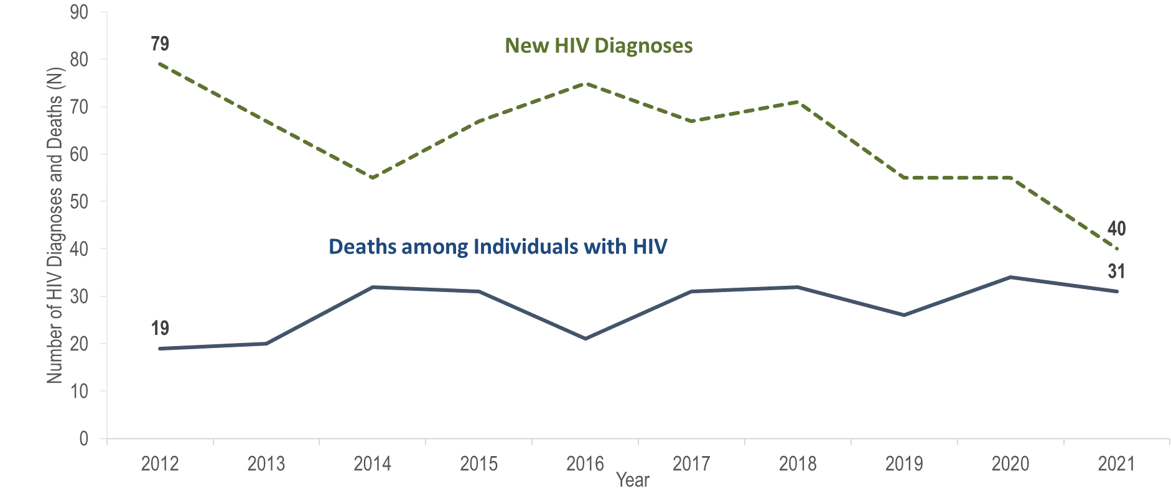
Number of new HIV infection diagnoses and deaths among individuals reported with HIV infection, Essex County, Massachusetts 2012–2021¹
¹ Please consider the impact of the COVID-19 pandemic on infectious disease screening, treatment, and surveillance in the interpretation of data from 2020 to 2021.
Data Source: Bureau of Infectious Disease and Laboratory Sciences, data are current as of 1/1/2023 and subject to change
Notes:
The figure is a trendline displaying the annual number of new HIV diagnoses and deaths among individuals with HIV for the most recent ten-year period.
In Essex County from 2012 to 2022, the annual number of new HIV diagnoses decreased by 49% (from 79 to 40), and deaths among individuals reported with HIV increased by 63% (from 19 to 31). However, caution should be used in the interpretation of these trends due to the impact of COVID-19 on access to HIV testing and care services, and case surveillance activities, in 2020 and 2021.

Slide 21
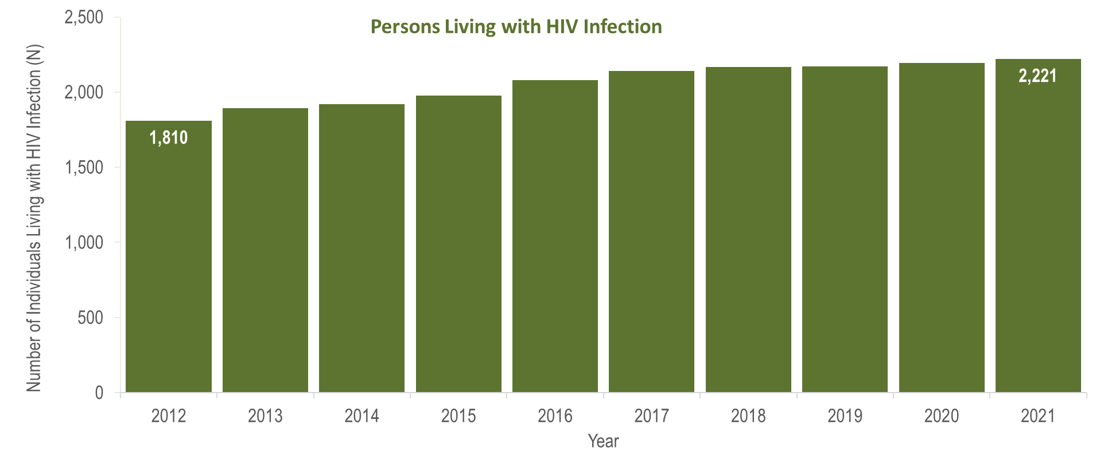
Number of persons living with HIV infection,¹
Essex County, Massachusetts 2012–2021²
¹ Number of persons living with HIV infection on 12/31 of each year.
² Please consider the impact of the COVID-19 pandemic on infectious disease screening, treatment, and surveillance in the interpretation of data from 2020 to 2021.
Data Source: Bureau of Infectious Disease and Laboratory Sciences, data are current as of 1/1/2023 and subject to change
Notes:
The figure is a bar chart displaying a trend in the annual number of individuals living with HIV infection for the most recent ten-year period.
In Essex County from 2012 to 2022, the number of persons living with HIV infection at the end of these years increased by 23% (from 1,810 to 2,221). However, caution should be used in the interpretation of these trends due to the impact of COVID-19 on access to HIV testing and care services, and case surveillance activities, in 2020 and 2021.

Slide 22
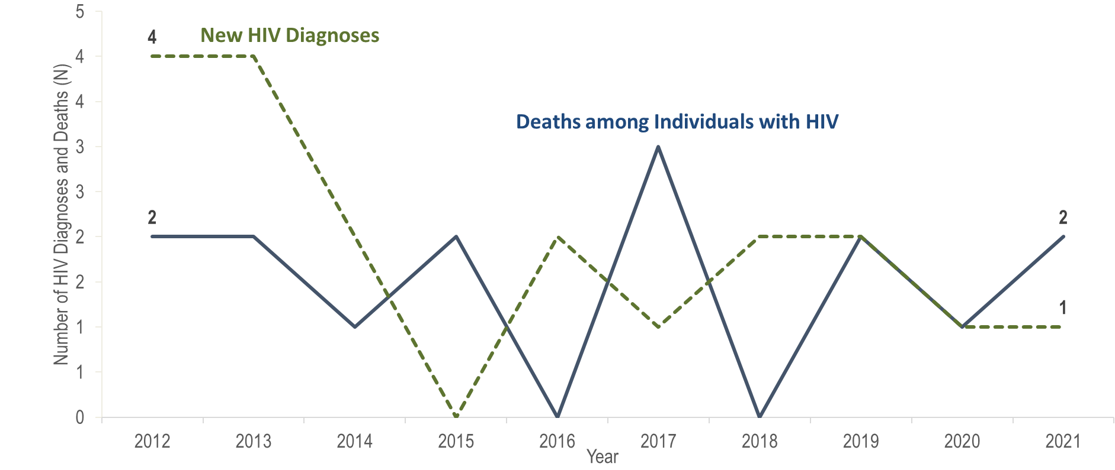
Number of new HIV infection diagnoses and deaths among individuals reported with HIV infection, Franklin County, Massachusetts 2012–2021¹
¹ Please consider the impact of the COVID-19 pandemic on infectious disease screening, treatment, and surveillance in the interpretation of data from 2020 to 2021.
Data Source: Bureau of Infectious Disease and Laboratory Sciences, data are current as of 1/1/2023 and subject to change
Notes:
The figure is a trendline displaying the annual number of new HIV diagnoses and deaths among individuals with HIV for the most recent ten-year period.
In Franklin County from 2012 to 2021, the annual number of new HIV diagnoses remained between zero and four, and deaths among individuals reported with HIV remained between zero and three. However, caution should be used in the interpretation of these trends due to the impact of COVID-19 on access to HIV testing and care services, and case surveillance activities, in 2020 and 2021.

Slide 23
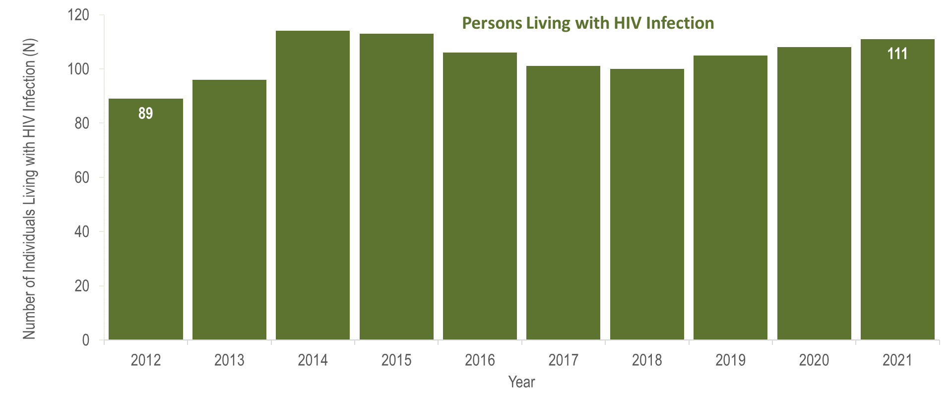
Number of persons living with HIV infection,¹
Franklin County, Massachusetts 2012–2021²
¹ Number of persons living with HIV infection on 12/31 of each year.
² Please consider the impact of the COVID-19 pandemic on infectious disease screening, treatment, and surveillance in the interpretation of data from 2020 to 2021.
Data Source: Bureau of Infectious Disease and Laboratory Sciences, data are current as of 1/1/2023 and subject to change
Notes:
The figure is a bar chart displaying a trend in the annual number of individuals living with HIV infection for the most recent ten-year period.
In Franklin County from 2012 to 2021, the number of persons living with HIV infection at the end of these years increased from 89 to 111. However, caution should be used in the interpretation of these trends due to the impact of COVID-19 on access to HIV testing and care services, and case surveillance activities, in 2020 and 2021.

Slide 24
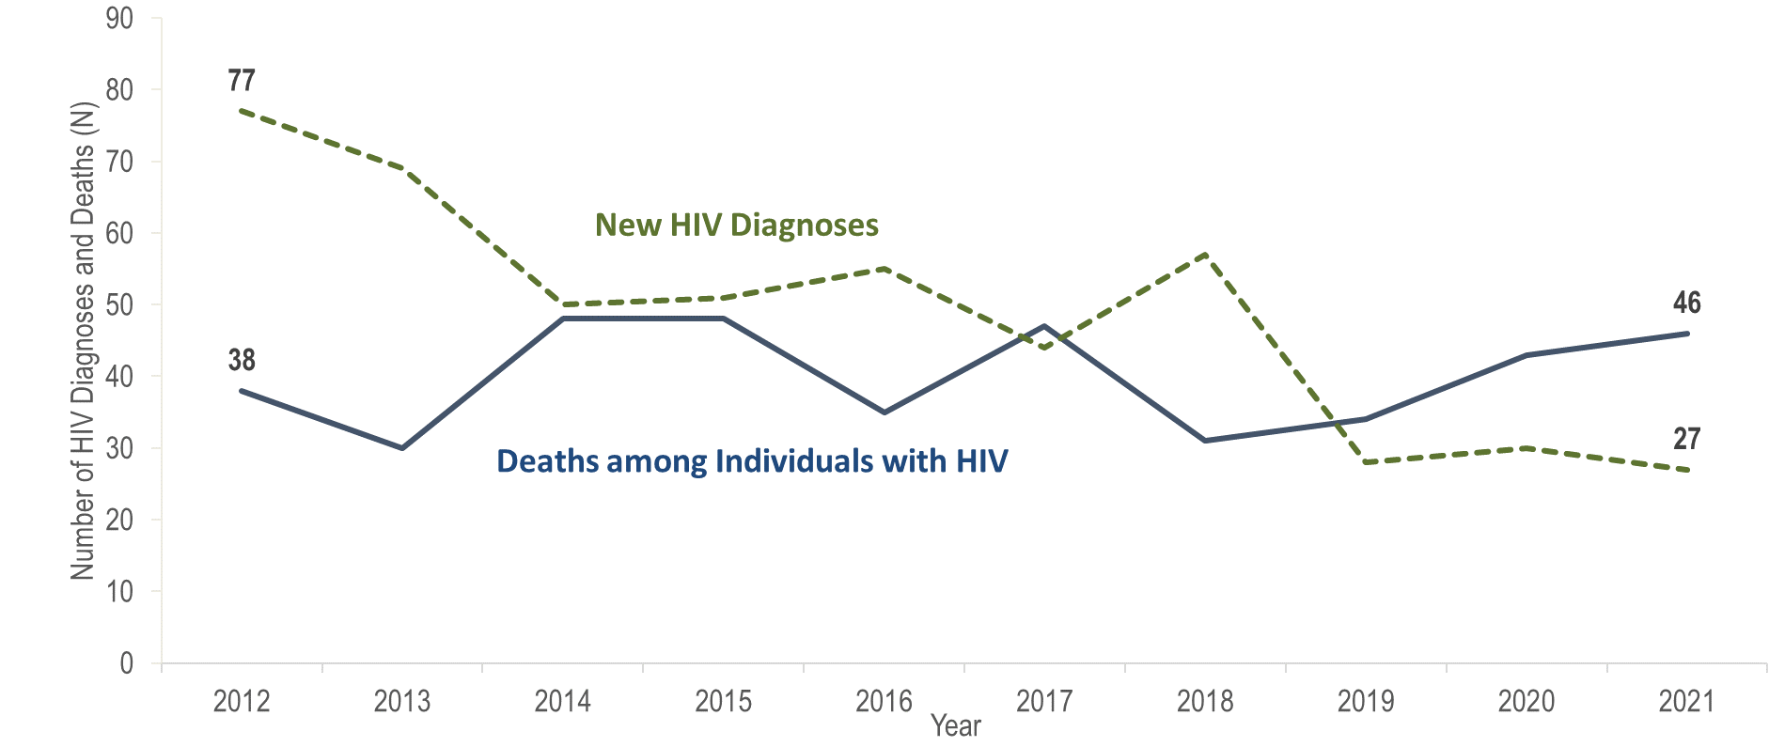
Number of new HIV infection diagnoses and deaths among individuals reported with HIV infection, Hampden County, Massachusetts 2012–2021¹
¹ Please consider the impact of the COVID-19 pandemic on infectious disease screening, treatment, and surveillance in the interpretation of data from 2020 to 2021.
Data Source: Bureau of Infectious Disease and Laboratory Sciences, data are current as of 1/1/2023 and subject to change
Notes:
The figure is a trendline displaying the annual number of new HIV diagnoses and deaths among individuals with HIV for the most recent ten-year period.
In Hampden County from 2012 to 2021, the annual number of new HIV diagnoses decreased by 65% (from 77 to 27), and deaths among individuals reported with HIV increased by 21% (from 38 to 46). However, caution should be used in the interpretation of these trends due to the impact of COVID-19 on access to HIV testing and care services, and case surveillance activities, in 2020 and 2021.

Slide 25
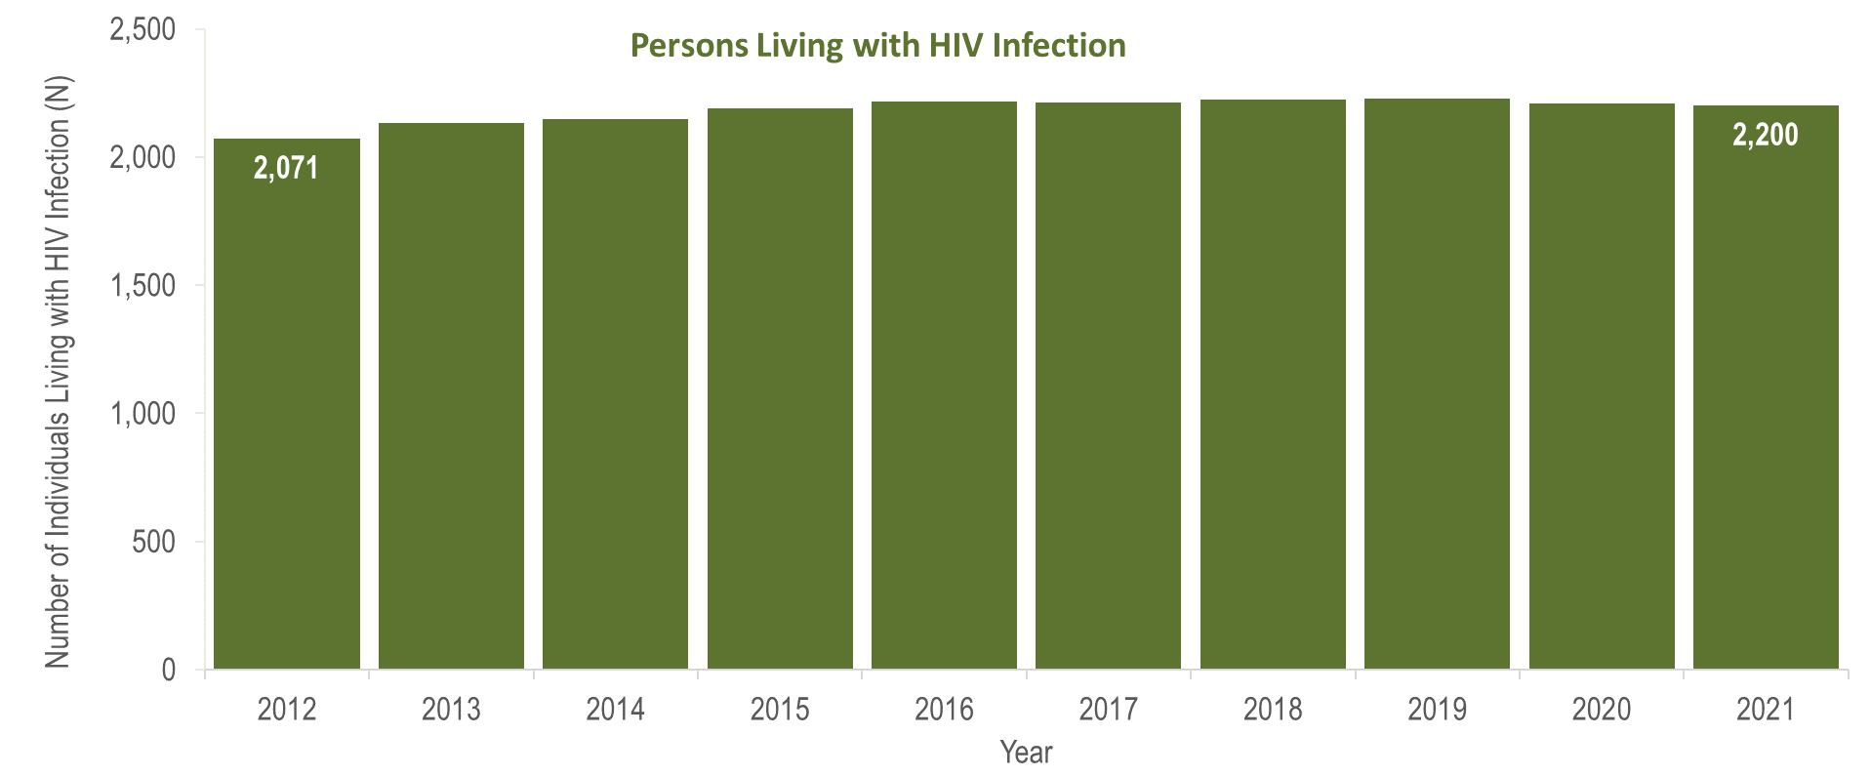
Number of persons living with HIV infection,¹
Hampden County, Massachusetts 2012–2021²
¹ Number of persons living with HIV infection on 12/31 of each year.
² Please consider the impact of the COVID-19 pandemic on infectious disease screening, treatment, and surveillance in the interpretation of data from 2020 to 2021.
Data Source: Bureau of Infectious Disease and Laboratory Sciences, data are current as of 1/1/2023 and subject to change
Notes:
The figure is a bar chart displaying a trend in the annual number of individuals living with HIV infection for the most recent ten-year period.
In Hampden County from 2012 to 2021, the number of persons living with HIV infection at the end of these years increased by 6% (from 2,071 to 2,200). However, caution should be used in the interpretation of these trends due to the impact of COVID-19 on access to HIV testing and care services, and case surveillance activities, in 2020 and 2021.

Slide 26
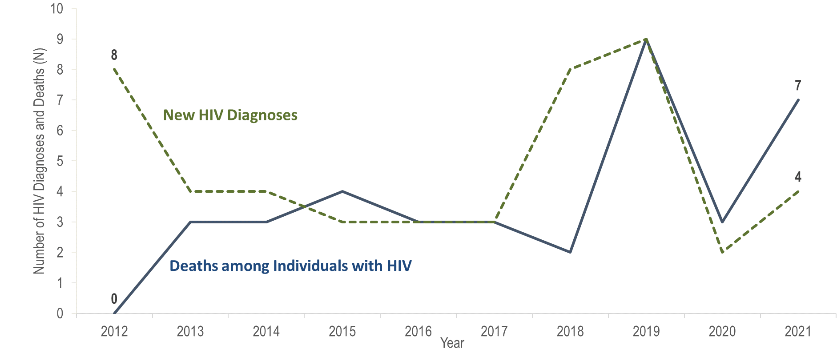
Number of new HIV infection diagnoses and deaths among individuals reported with HIV infection, Hampshire County, Massachusetts 2012–2021¹
¹ Please consider the impact of the COVID-19 pandemic on infectious disease screening, treatment, and surveillance in the interpretation of data from 2020 to 2021.
Data Source: Bureau of Infectious Disease and Laboratory Sciences, data are current as of 1/1/2023 and subject to change
Notes:
The figure is a trendline displaying the annual number of new HIV diagnoses and deaths among individuals with HIV for the most recent ten-year period.
In Hampshire County from 2012 to 2021, the annual number of new HIV diagnoses remained between two and nine, and deaths among individuals reported with HIV remained between zero and nine. However, caution should be used in the interpretation of these trends due to the impact of COVID-19 on access to HIV testing and care services, and case surveillance activities, in 2020 and 2021.

Slide 27
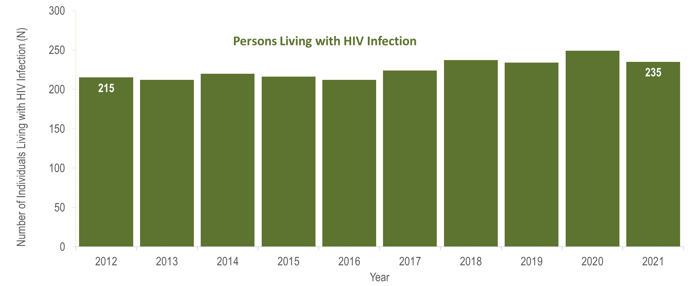
Number of persons living with HIV infection,¹
Hampshire County, Massachusetts 2012–2021²
¹ Number of persons living with HIV infection on 12/31 of each year.
² Please consider the impact of the COVID-19 pandemic on infectious disease screening, treatment, and surveillance in the interpretation of data from 2020 to 2021.
Data Source: Bureau of Infectious Disease and Laboratory Sciences, data are current as of 1/1/2023 and subject to change
Notes:
The figure is a bar chart displaying a trend in the annual number of individuals living with HIV infection for the most recent ten-year period.
In Hampshire County from 2012 to 2021, the number of persons living with HIV infection at the end of these years remained between 212 and 249. However, caution should be used in the interpretation of these trends due to the impact of COVID-19 on access to HIV testing and care services, and case surveillance activities, in 2020 and 2021.

Slide 28
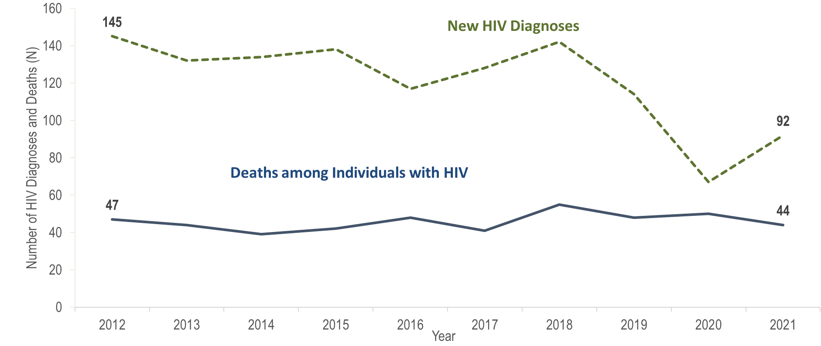
Number of new HIV infection diagnoses and deaths among individuals reported with HIV infection, Middlesex County, Massachusetts 2012–2021¹
¹ Please consider the impact of the COVID-19 pandemic on infectious disease screening, treatment, and surveillance in the interpretation of data from 2020 to 2021.
Data Source: Bureau of Infectious Disease and Laboratory Sciences, data are current as of 1/1/2023 and subject to change
Notes:
The figure is a trendline displaying the annual number of new HIV diagnoses and deaths among individuals with HIV for the most recent ten-year period.
The annual number of new HIV diagnoses in Middlesex County decreased by 54% from 145 in 2012 to 67 in 2020, then increased by 37% to 92 in 2021. From 2012 to 2021, deaths among individuals reported with HIV remained relatively stable. However, caution should be used in the interpretation of these trends, particularly the decrease and rebound in HIV diagnoses, due to the impact of COVID-19 on access to HIV testing and care services, and case surveillance activities, in 2020 and 2021.

Slide 29
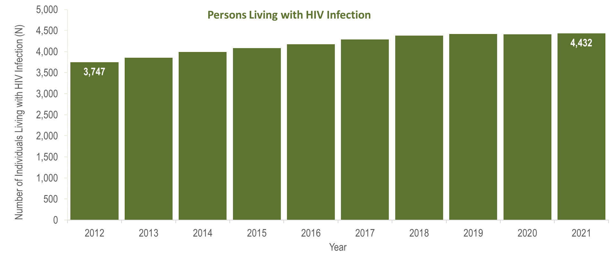
Number of persons living with HIV infection,¹
Middlesex County, Massachusetts 2012–2021²
¹ Number of persons living with HIV infection on 12/31 of each year.
² Please consider the impact of the COVID-19 pandemic on infectious disease screening, treatment, and surveillance in the interpretation of data from 2020 to 2021.
Data Source: Bureau of Infectious Disease and Laboratory Sciences, data are current as of 1/1/2023 and subject to change
Notes:
The figure is a bar chart displaying a trend in the annual number of individuals living with HIV infection for the most recent ten-year period.
From 2012 to 2021, the number of persons living with HIV infection at the end of these years increased by 18% (from 3,747 to 4,432). However, caution should be used in the interpretation of these trends, particularly the decrease and rebound in HIV diagnoses, due to the impact of COVID-19 on access to HIV testing and care services, and case surveillance activities, in 2020 and 2021.

Slide 30
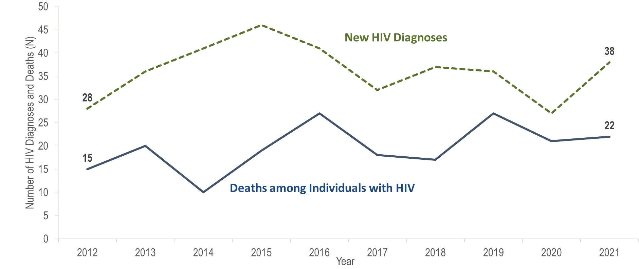
Number of new HIV infection diagnoses and deaths among individuals reported with HIV infection, Norfolk County, Massachusetts 2012–2021¹
¹ Please consider the impact of the COVID-19 pandemic on infectious disease screening, treatment, and surveillance in the interpretation of data from 2020 to 2021.
Data Source: Bureau of Infectious Disease and Laboratory Sciences, data are current as of 1/1/2023 and subject to change
Notes:
The figure is a trendline displaying the annual number of new HIV diagnoses and deaths among individuals with HIV for the most recent ten-year period.
In Norfolk County from 2012 to 2021, the annual number of new HIV diagnoses increased by 36% (from 28 to 38), and deaths among individuals reported with HIV increased by 47% (from 15 to 22). However, caution should be used in the interpretation of these trends, particularly the increase in HIV diagnoses, due to the impact of COVID-19 on access to HIV testing and care services, and case surveillance activities, in 2020 and 2021.

Slide 31
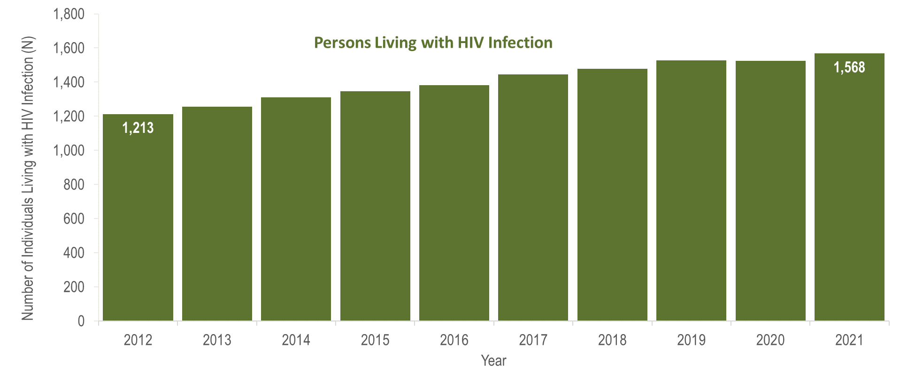
Number of persons living with HIV infection,¹
Norfolk County, Massachusetts 2012–2021²
¹ Number of persons living with HIV infection on 12/31 of each year.
² Please consider the impact of the COVID-19 pandemic on infectious disease screening, treatment, and surveillance in the interpretation of data from 2020 to 2021.
Data Source: Bureau of Infectious Disease and Laboratory Sciences, data are current as of 1/1/2023 and subject to change
Notes:
The figure is a bar chart displaying a trend in the annual number of individuals living with HIV infection for the most recent ten-year period.
In Norfolk County from 2012 to 2021, the number of persons living with HIV infection at the end of these years increased by 29% (from 1,213 to 1,568). However, caution should be used in the interpretation of these trends, particularly the increase in HIV diagnoses, due to the impact of COVID-19 on access to HIV testing and care services, and case surveillance activities, in 2020 and 2021.

Slide 32
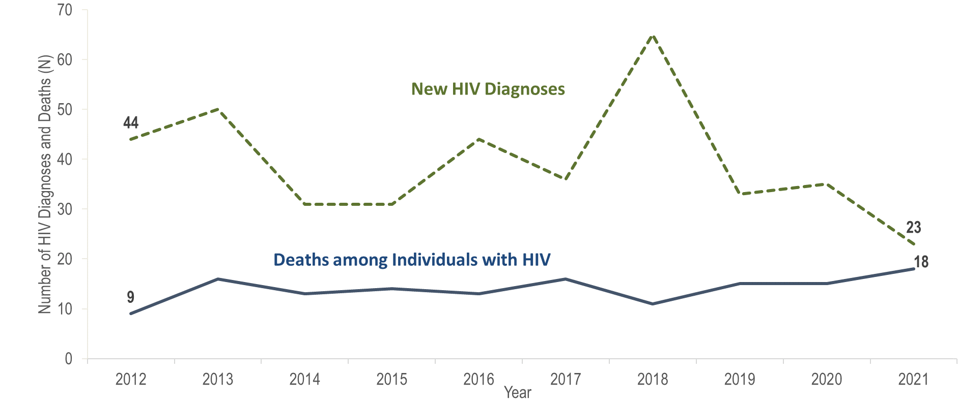
Number of new HIV infection diagnoses and deaths among individuals reported with HIV infection, Plymouth County, Massachusetts 2012–2021¹
¹ Please consider the impact of the COVID-19 pandemic on infectious disease screening, treatment, and surveillance in the interpretation of data from 2020 to 2021.
Data Source: Bureau of Infectious Disease and Laboratory Sciences, data are current as of 1/1/2023 and subject to change
Notes:
The figure is a trendline displaying the annual number of new HIV diagnoses and deaths among individuals with HIV for the most recent ten-year period.
The annual number of new HIV diagnoses in Plymouth County decreased 48% from 2012 (N=44) to 2021 (N=23). However, there were large year-to-year fluctuations, particularly from 2017 (N=36) to 2018 (N=66), when the number of HIV diagnoses increased by 83%. By exposure mode, the largest increase in HIV diagnoses from 2017 to 2018 was among individuals with male-to-male sex (MSM) exposure mode (from 6 to 17), followed by presumed heterosexual (from <5 to 8), and injection drug use (from 5 to 11) exposure modes.
From 2012 to 2021, the number of deaths among individuals reported with HIV doubled (from nine to 18). However, caution should be used in the interpretation of these trends due to the impact of COVID-19 on access to HIV testing and care services, and case surveillance activities, in 2020 and 2021.

Slide 33
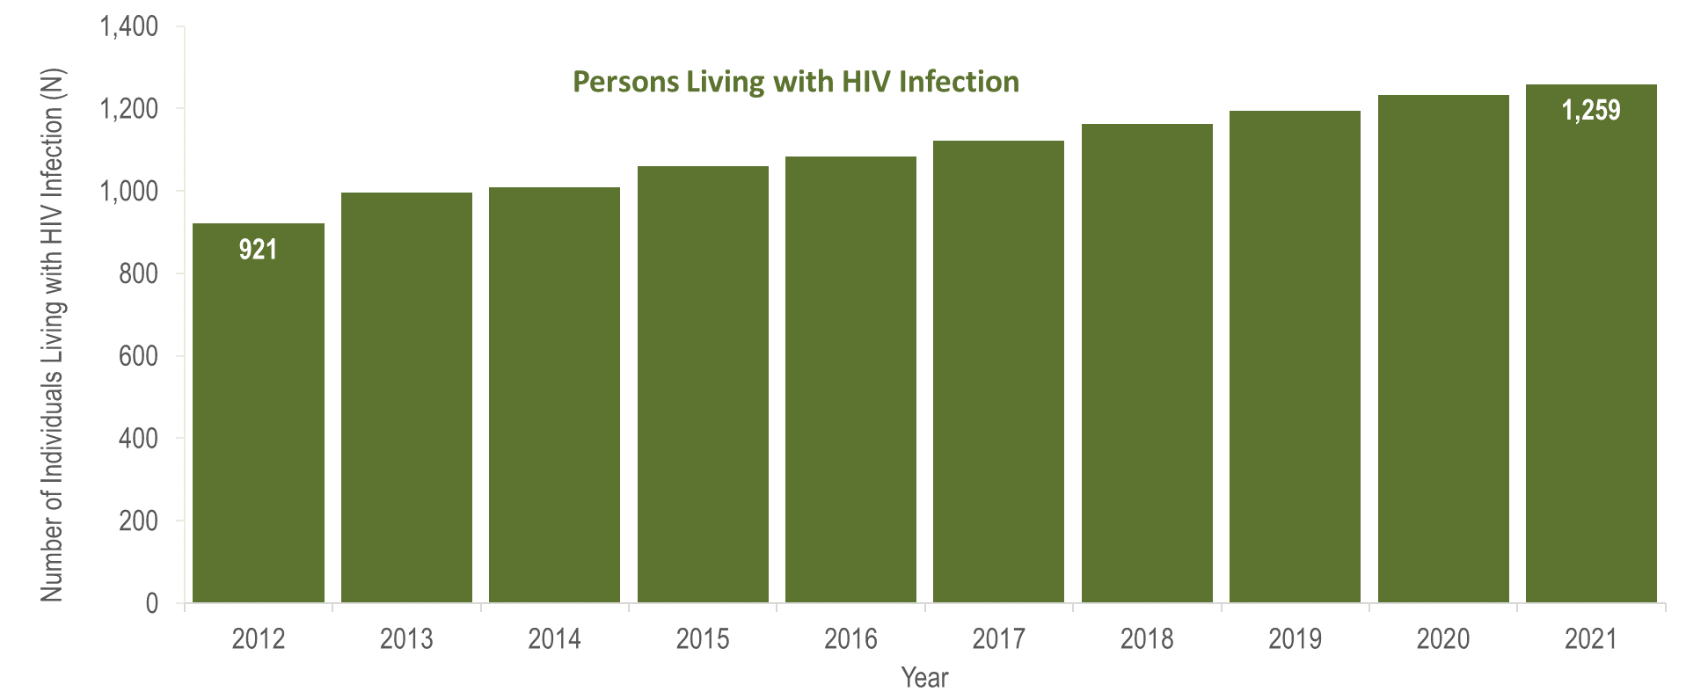
Number of persons living with HIV infection,¹
Plymouth County, Massachusetts 2012–2021²
¹ Number of persons living with HIV infection on 12/31 of each year.
² Please consider the impact of the COVID-19 pandemic on infectious disease screening, treatment, and surveillance in the interpretation of data from 2020 to 2021.
Data Source: Bureau of Infectious Disease and Laboratory Sciences, data are current as of 1/1/2023 and subject to change
Notes:
The figure is a bar chart displaying a trend in the annual number of individuals living with HIV infection for the most recent ten-year period.
From 2012 to 2021, the number of persons living with HIV infection at the end of these years increased by 37% (from N=921 to N=1,259). However, caution should be used in the interpretation of these trends due to the impact of COVID-19 on access to HIV testing and care services, and case surveillance activities, in 2020 and 2021.

Slide 34

Number of new HIV infection diagnoses and deaths among individuals reported with HIV infection, Suffolk County, Massachusetts 2012–2021¹
¹ Please consider the impact of the COVID-19 pandemic on infectious disease screening, treatment, and surveillance in the interpretation of data from 2020 to 2021.
Data Source: Bureau of Infectious Disease and Laboratory Sciences, data are current as of 1/1/2023 and subject to change
Notes:
The figure is a trendline displaying the annual number of new HIV diagnoses and deaths among individuals with HIV for the most recent ten-year period.
Suffolk County was selected as one of 48 counties nationally that is prioritized for funding in the U.S. Health and Human Services’ Initiative “Ending the HIV Epidemic (EHE): A Plan for America”. In 2021, 29% (N=130/446) of individuals diagnosed with HIV infection, 26% (N=90/345) of individuals reported with HIV who died, and 27% (N=6,324/23,393) of individuals living with HIV infection in Massachusetts were residents of Suffolk County.
In Suffolk County from 2012 to 2021, the annual number of new HIV diagnoses decreased by 34% (from 196 to 130). The number of deaths among individuals reported with HIV increased by 15% (from 78 to 90). However, caution should be used in the interpretation of these trends due to the impact of COVID-19 on access to HIV testing and care services, and case surveillance activities, in 2020 and 2021.

Slide 35

Number of persons living with HIV infection,¹
Suffolk County, Massachusetts 2012–2021²
¹ Number of persons living with HIV infection on 12/31 of each year.
² Please consider the impact of the COVID-19 pandemic on infectious disease screening, treatment, and surveillance in the interpretation of data from 2020 to 2021.
Data Source: Bureau of Infectious Disease and Laboratory Sciences, data are current as of 1/1/2023 and subject to change
Notes:
The figure is a bar chart displaying a trend in the annual number of individuals living with HIV infection for the most recent ten-year period.
In Suffolk County from 2012 to 2021, the annual number persons living with HIV infection at the end of these years remained relatively stable. However, caution should be used in the interpretation of these trends due to the impact of COVID-19 on access to HIV testing and care services, and case surveillance activities, in 2020 and 2021.

Slide 36
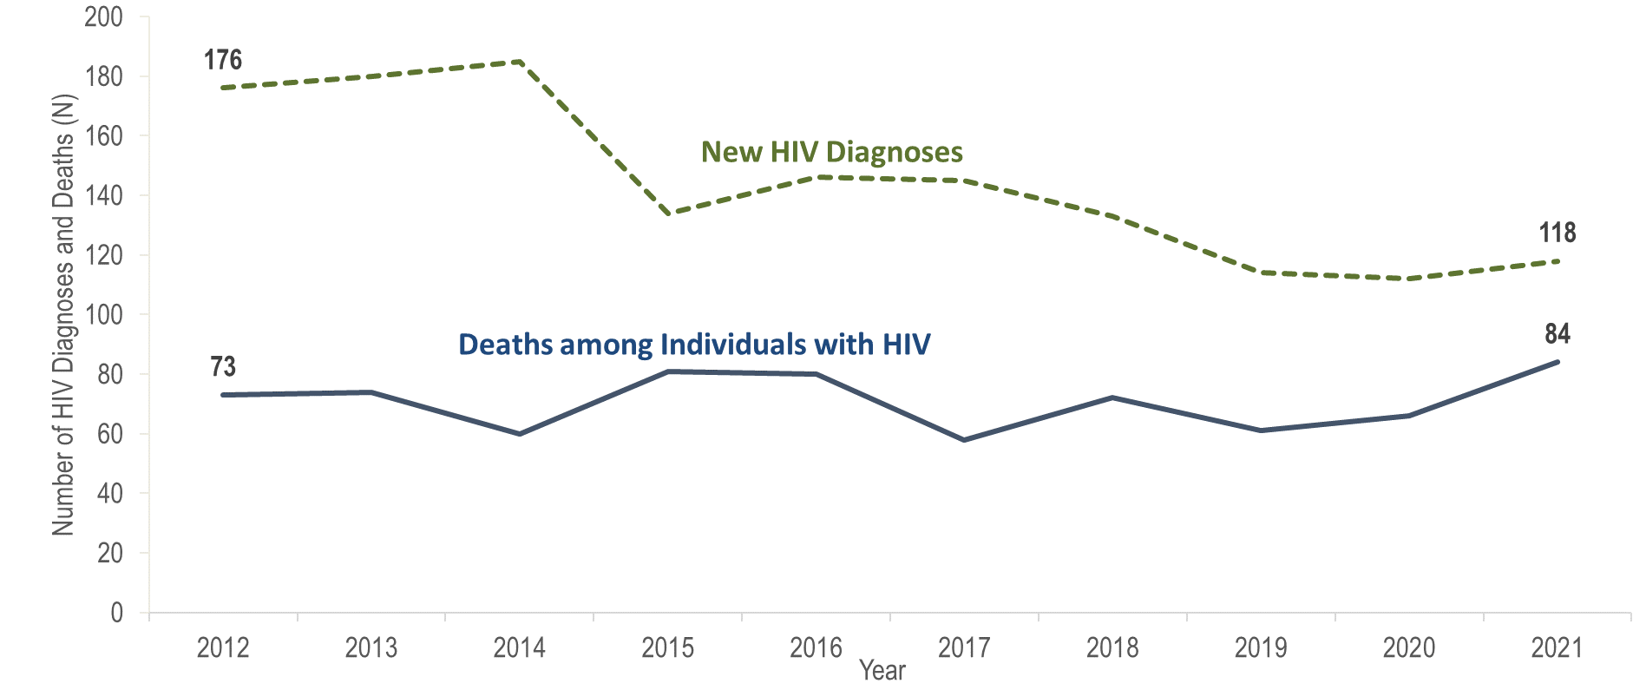
Number of new HIV infection diagnoses and deaths among individuals reported with HIV infection, City of Boston, Massachusetts 2012–2021¹
¹ Please consider the impact of the COVID-19 pandemic on infectious disease screening, treatment, and surveillance in the interpretation of data from 2020 to 2021.
Data Source: Bureau of Infectious Disease and Laboratory Sciences, data are current as of 1/1/2023 and subject to change
Notes:
The figure is a trendline displaying the annual number of new HIV diagnoses and deaths among individuals with HIV for the most recent ten-year period.
In Boston from 2012 to 2021, the annual number of new HIV diagnoses decreased by 33% (from 176 to 118), and deaths among individuals reported with HIV increased by 10% (from 73 to 84). However, caution should be used in the interpretation of these trends due to the impact of COVID-19 on access to HIV testing and care services, and case surveillance activities, in 2020 and 2021.

Slide 37
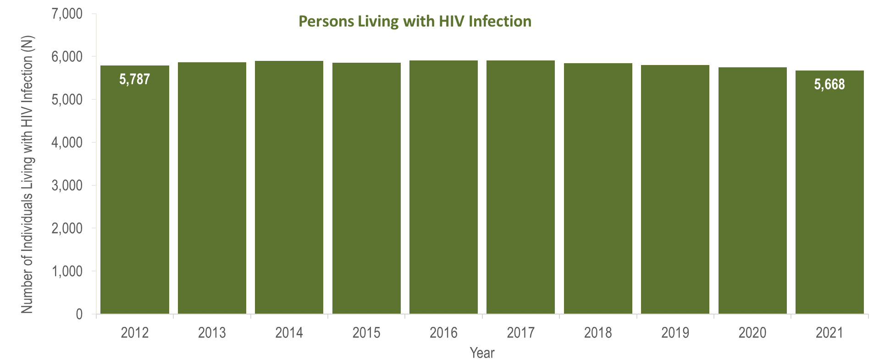
Number of persons living with HIV infection,¹
City of Boston, Massachusetts 2012–2021²
¹ Number of persons living with HIV infection on 12/31 of each year.
² Please consider the impact of the COVID-19 pandemic on infectious disease screening, treatment, and surveillance in the interpretation of data from 2020 to 2021.
Data Source: Bureau of Infectious Disease and Laboratory Sciences, data are current as of 1/1/2023 and subject to change
Notes:
The figure is a bar chart displaying a trend in the annual number of individuals living with HIV infection for the most recent ten-year period.
In Boston from 2012 to 2021, the number of persons living with HIV infection at the end of these years remained relatively stable. However, caution should be used in the interpretation of these trends due to the impact of COVID-19 on access to HIV testing and care services, and case surveillance activities, in 2020 and 2021.

Slide 38
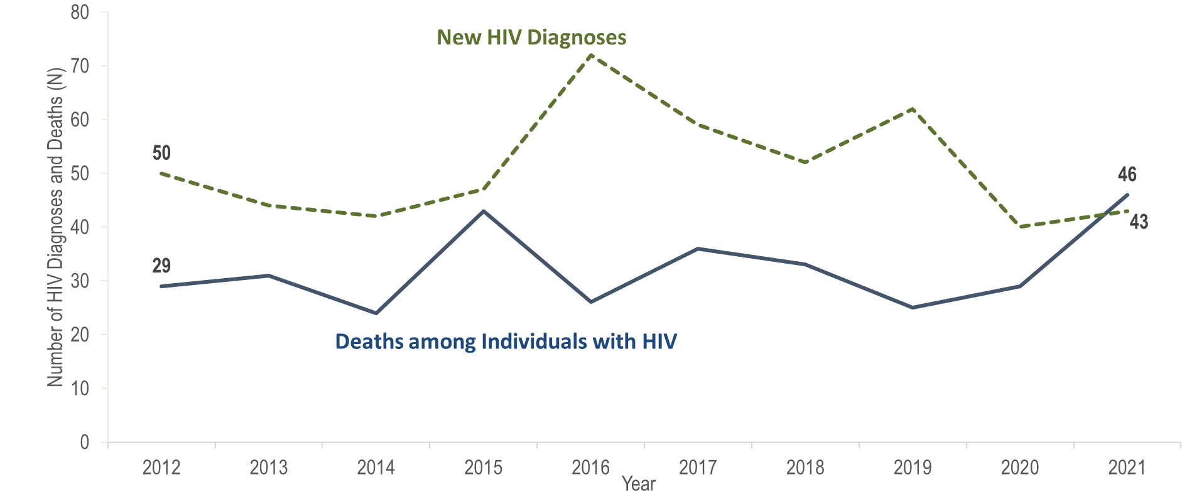
Number of new HIV infection diagnoses and deaths among individuals reported with HIV infection, Worcester County, Massachusetts 2012–2021¹
¹ Please consider the impact of the COVID-19 pandemic on infectious disease screening, treatment, and surveillance in the interpretation of data from 2020 to 2021.
Data Source: Bureau of Infectious Disease and Laboratory Sciences, data are current as of 1/1/2023 and subject to change
Notes:
The figure is a trendline displaying the annual number of new HIV diagnoses and deaths among individuals with HIV for the most recent ten-year period.
In Worcester County from 2012 to 2021, the annual number of new HIV diagnoses decreased by 14% (from 50 to 43), and deaths among individuals reported with HIV increased by 59% (from 29 to 46). However, caution should be used in the interpretation of these trends due to the impact of COVID-19 on access to HIV testing and care services, and case surveillance activities, in 2020 and 2021.

Slide 39
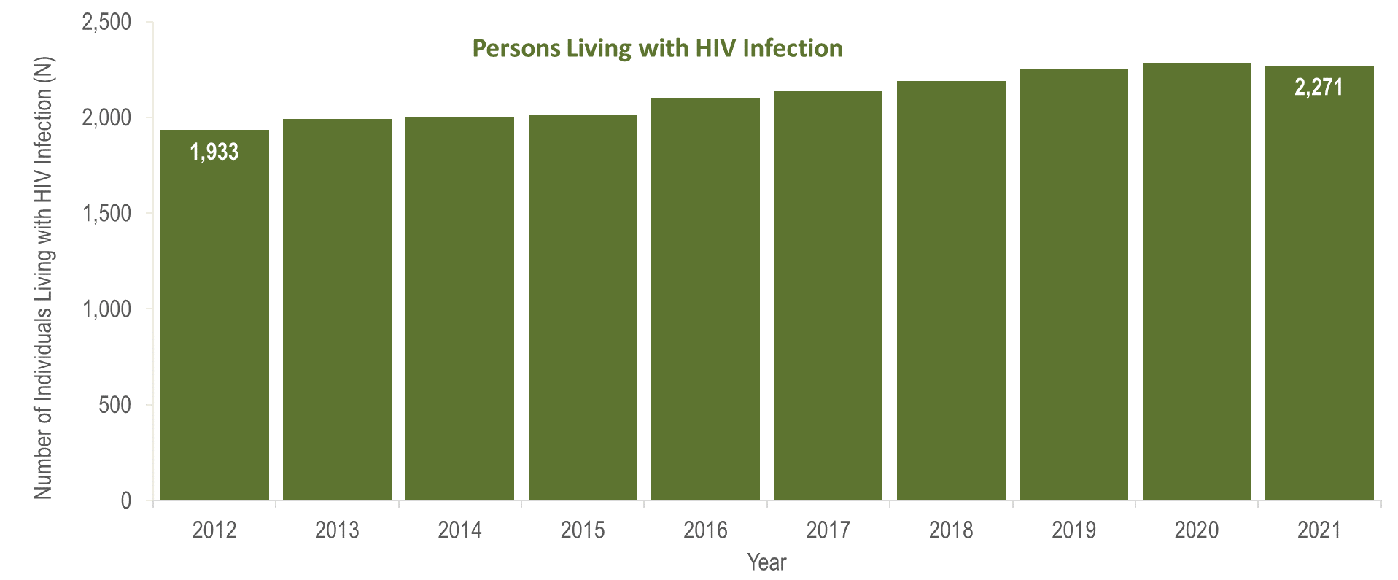
Number of persons living with HIV infection,¹
Worcester County, Massachusetts 2012–2021²
¹ Number of persons living with HIV infection on 12/31 of each year.
² Please consider the impact of the COVID-19 pandemic on infectious disease screening, treatment, and surveillance in the interpretation of data from 2020 to 2021.
Data Source: Bureau of Infectious Disease and Laboratory Sciences, data are current as of 1/1/2023 and subject to change
Notes:
The figure is a bar chart displaying a trend in the annual number of individuals living with HIV infection for the most recent ten-year period.
In Worcester County from 2012 to 2021, the number of persons living with HIV infection at the end of these years increased by 17% (from 1,933 to 2,271). However, caution should be used in the interpretation of these trends due to the impact of COVID-19 on access to HIV testing and care services, and case surveillance activities, in 2020 and 2021.

