Slide 1
Massachusetts HIV Epidemiologic Profile:
Data as of 7/1/2024
Regional Report
Notes:
Massachusetts HIV Epidemiologic Profile
Regional Report – Data as of 7/1/2024
Suggested citation:
Massachusetts Department of Public Health, Bureau of Infectious Disease and Laboratory Sciences. Massachusetts HIV Epidemiologic Profile, Regional Report – Data as of 7/1/2024,
https://www.mass.gov/lists/hivaids-epidemiologic-profiles Published June 2025. Accessed [date].
Bureau of Infectious Disease and Laboratory Sciences
Massachusetts Department of Public Health
Jamaica Plain Campus/State Public Health Laboratory
305 South Street
Jamaica Plain, MA 02130
To reach the Reporting and Partner Services Line*
Tel: (617) 983-6999
Questions about this report
Tel: (617) 983-6560
To speak to the on-call epidemiologist
Tel: (617) 983-6800
Questions about infectious disease reporting
Tel: (617) 983-6801
HIV Data Dashboard
https://www.mass.gov/info-details/hiv-data-dashboard
Requests for additional data
https://www.mass.gov/lists/infectious-disease-data-reports-and-requests
Slide sets for Epidemiologic Profile Reports
https://www.mass.gov/lists/hivaids-epidemiologic-profiles
*Providers may use this number to report individuals newly diagnosed with a notifiable sexually transmitted infection, including HIV, or request partner services. Partner services is a free and confidential service for individuals recently diagnosed with a priority infection. The client-centered program offers counseling, linkage to other health and social services, anonymous notification of partners who were exposed and assistance with getting testing and treatment. For more information, see: https://www.mass.gov/service-details/partner-services-program-information-for-healthcare-providers)

Slide 2
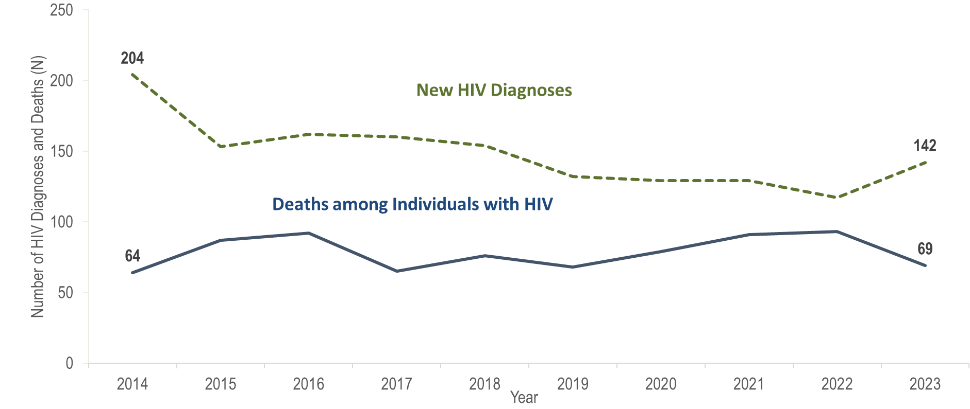
Number of new HIV infection diagnoses and deaths among individuals reported with HIV infection, Boston HSR, Massachusetts 2014–2023¹
¹ Please consider the impact of the COVID-19 pandemic on infectious disease screening, treatment, and surveillance in the interpretation of data from 2020 to 2023.
Data Source: Bureau of Infectious Disease and Laboratory Sciences, data are current as of 7/1/2024 and subject to change
Notes:
The figure is a trendline displaying the annual number of new HIV diagnoses and deaths among individuals with HIV for the most recent ten-year period.
In the Boston HSR, the annual number of new HIV diagnoses decreased by 43% from 204 in 2014 to 117 in 2022. However, caution should be used in the interpretation of this decline due to the impact of COVID-19 on access to HIV testing and care services, and case surveillance activities. In 2023, the number of new HIV diagnoses (N=142) returned to pre-pandemic levels, increasing by 25 cases, or 21%, compared to the prior year. There was also a statewide increase in HIV diagnoses of 21% during the same time period. The largest increase in HIV diagnoses from 2022 to 2023 in the Boston HSR was among individuals with male-to-male sex (MSM) exposure mode (from 43 to 63).
From 2014 to 2023, the number of deaths due to any cause among individuals reported with HIV infection fluctuated ranging from a low of 64 in 2014 to a high of 93 in 2022; there were 69 deaths in 2023. The number of persons living with HIV infection at the end of these years remained relatively stable, with year-to-year changes of one percent or less.

Slide 3
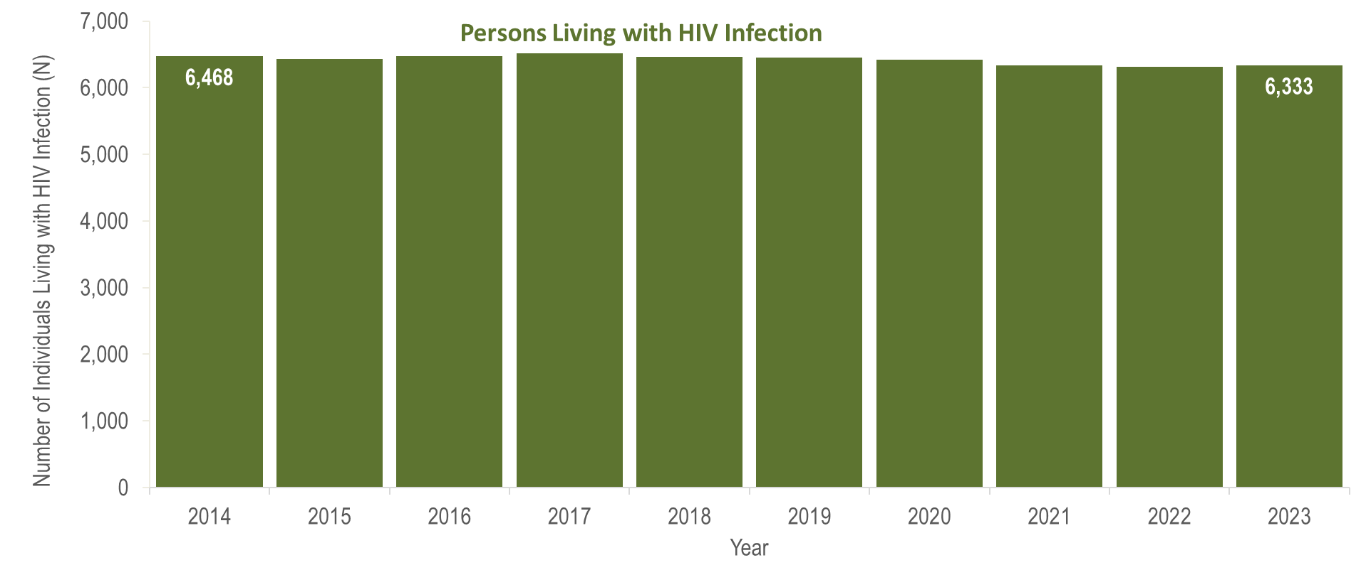
Number of persons living with HIV infection,¹
Boston HSR, Massachusetts 2014–2023²
¹ Number of persons living with HIV infection on 12/31 of each year.
² Please consider the impact of the COVID-19 pandemic on infectious disease screening, treatment, and surveillance in the interpretation of data from 2020 to 2023.
Data Source: Bureau of Infectious Disease and Laboratory Sciences, data are current as of 7/1/2024 and subject to change
Notes:
The figure is a bar chart displaying a trend in the annual number of individuals living with HIV infection for the most recent ten-year period.
From 2014 to 2023, the number of persons living with HIV infection at the end of these years remained relatively stable, with year-to-year changes of one percent or less.

Slide 4
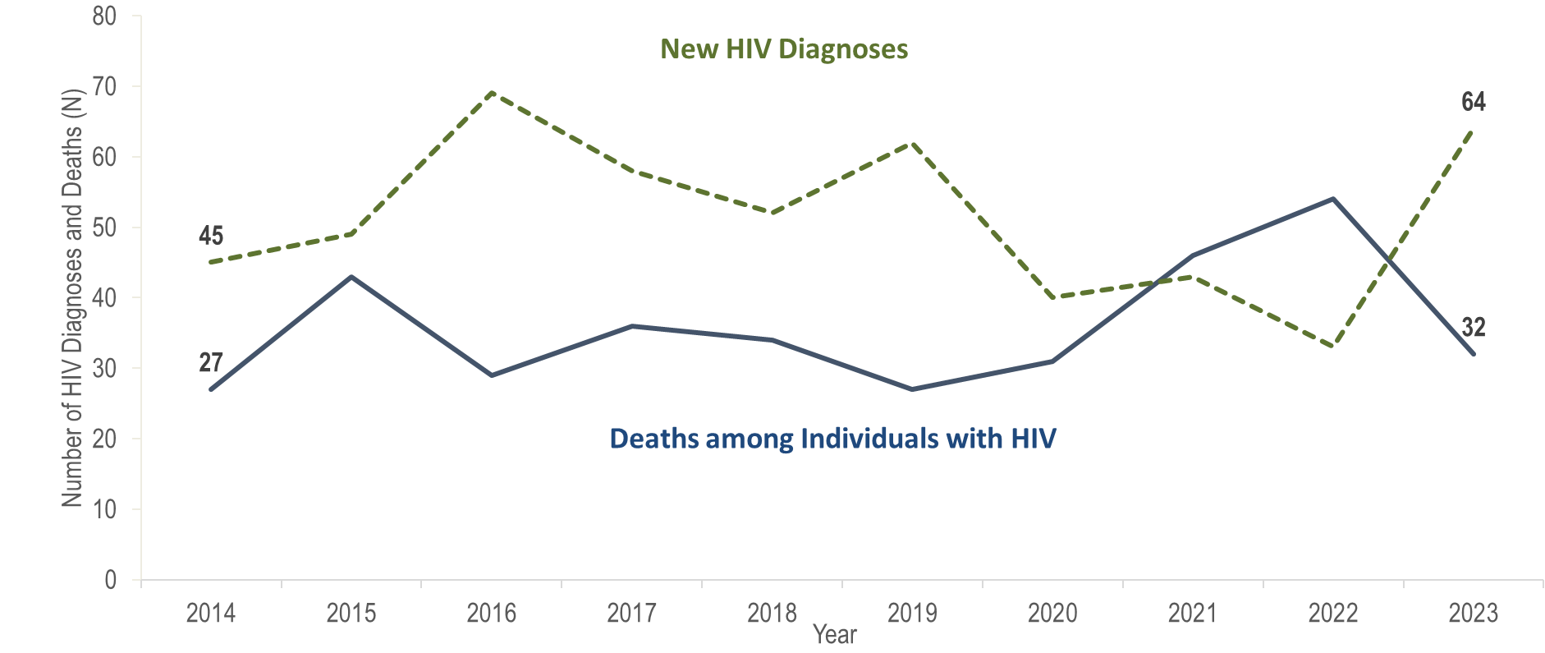
Number of new HIV infection diagnoses and deaths among individuals reported with HIV infection, Central HSR, Massachusetts 2014–2023¹
¹ Please consider the impact of the COVID-19 pandemic on infectious disease screening, treatment, and surveillance in the interpretation of data from 2020 to 2023.
Data Source: Bureau of Infectious Disease and Laboratory Sciences, data are current as of 7/1/2024 and subject to change
Notes:
The figure is a trendline displaying the annual number of new HIV diagnoses and deaths among individuals with HIV for the most recent ten-year period.
In the Central HSR, the annual number of new HIV diagnoses increased by 53% from 45 in 2014 to 69 in 2016 and then decreased by 52% to 33 in 2022. However, caution should be used in the interpretation of this decline due to the impact of COVID-19 on access to HIV testing and care services, and case surveillance activities. In 2023, the number of new HIV diagnoses (N=64) returned to pre-pandemic levels, increasing by 31 cases, or 94%, compared to the prior year. This compares to a statewide increase in HIV diagnoses of 21% during the same time period. The largest increases in HIV diagnoses from 2022 to 2023 in the Central HSR were among non-US born individuals (from 8 to 24), Black (non-Hispanic) individuals (from 6 to 23), and individuals with no identified risk for HIV exposure mode (from 4 to 17).
The number of deaths due to any cause among individuals reported with HIV infection increased by 100% from 27 in 2014 to 54 in 2022 and then decreased by 41% to 32 in 2023.

Slide 5
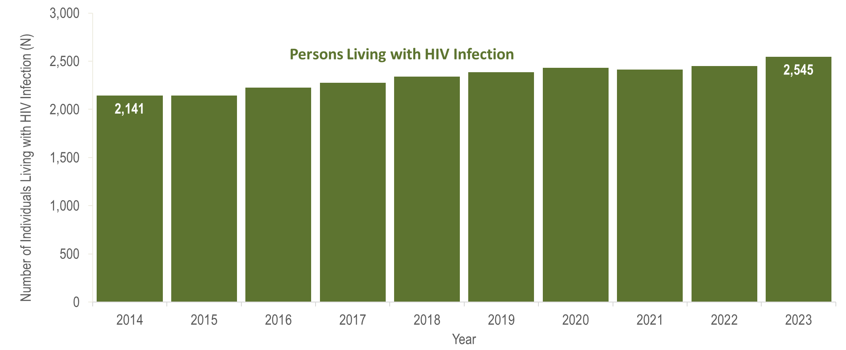
Number of persons living with HIV infection,¹
Central HSR, Massachusetts 2014–2023²
¹ Number of persons living with HIV infection on 12/31 of each year.
² Please consider the impact of the COVID-19 pandemic on infectious disease screening, treatment, and surveillance in the interpretation of data from 2020 to 2023.
Data Source: Bureau of Infectious Disease and Laboratory Sciences, data are current as of 7/1/2024 and subject to change
Notes:
The figure is a bar chart displaying a trend in the annual number of individuals living with HIV infection for the most recent ten-year period.
From 2014 to 2023, the number of persons living with HIV infection at the end of these years increased by 19% (from 2,141 to 2,545).

Slide 6
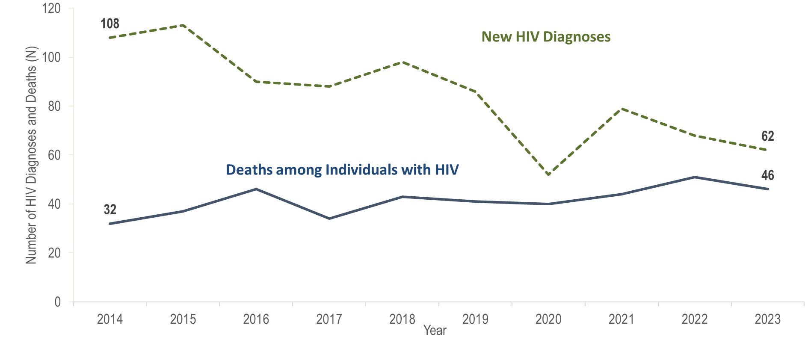
Number of new HIV infection diagnoses and deaths among individuals reported with HIV infection, Metrowest HSR, Massachusetts 2014–2023¹
¹ Please consider the impact of the COVID-19 pandemic on infectious disease screening, treatment, and surveillance in the interpretation of data from 2020 to 2023.
Data Source: Bureau of Infectious Disease and Laboratory Sciences, data are current as of 7/1/2024 and subject to change
Notes:
The figure is a trendline displaying the annual number of new HIV diagnoses and deaths among individuals with HIV for the most recent ten-year period.
In the Metrowest HSR, the annual number of new HIV diagnoses decreased by 52% from 108 in 2014 to 52 in 2020, increased by 52% to 79 in 2021, and then decreased by 22% to 62 in 2023. However, caution should be used in the interpretation of data from 2020 to 2023 due to the impact of COVID-19 on access to HIV testing and care services, and case surveillance activities. The continued decrease in HIV diagnoses in the Metrowest HSR from 2021 to 2023 was not mirrored in the Commonwealth as a whole, or the other Health Service Regions, where HIV diagnoses increased from 2022 to 2023.
The number of deaths due to any cause among individuals reported with HIV increased by 44% from 32 in 2014 to 46 in 2024.

Slide 7
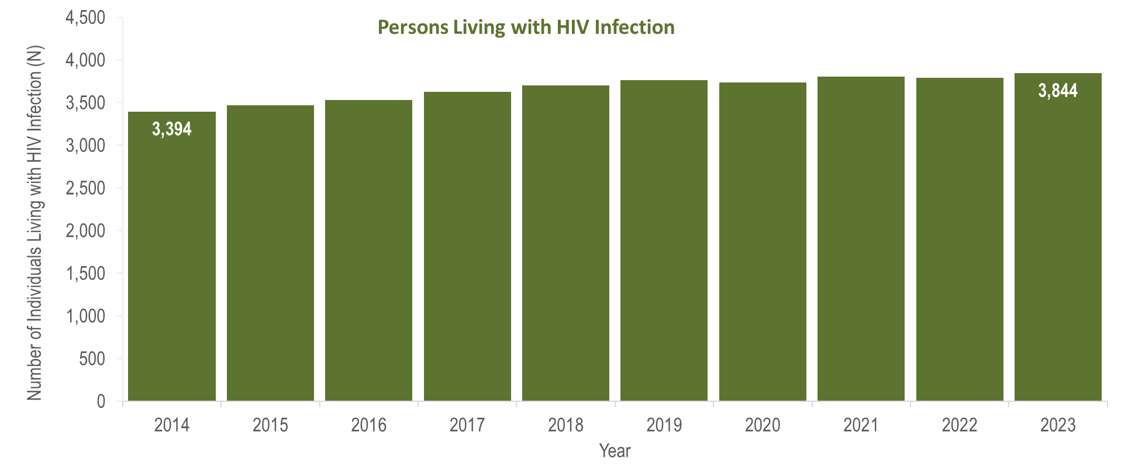
Number of persons living with HIV infection,¹
Metrowest HSR, Massachusetts 2014–2023²
¹ Number of persons living with HIV infection on 12/31 of each year.
² Please consider the impact of the COVID-19 pandemic on infectious disease screening, treatment, and surveillance in the interpretation of data from 2020 to 2023.
Data Source: Bureau of Infectious Disease and Laboratory Sciences, data are current as of 7/1/2024 and subject to change
Notes:
The figure is a bar chart displaying a trend in the annual number of individuals living with HIV infection for the most recent ten-year period.
From 2014 to 2023, the number of persons living with HIV infection at the end of these years increased by 13% (from 3,394 to 3,844).

Slide 8
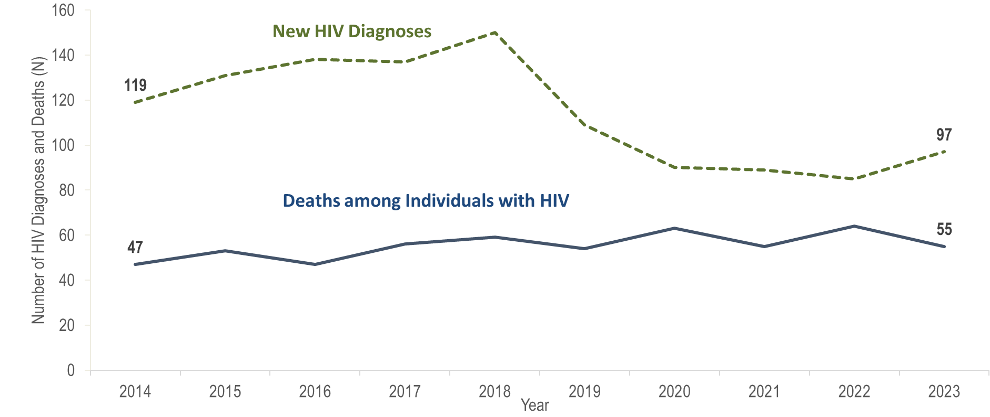
Number of new HIV infection diagnoses and deaths among individuals reported with HIV infection, Northeast HSR, Massachusetts 2014–2023¹
¹ Please consider the impact of the COVID-19 pandemic on infectious disease screening, treatment, and surveillance in the interpretation of data from 2020 to 2023.
Data Source: Bureau of Infectious Disease and Laboratory Sciences, data are current as of 7/1/2024 and subject to change
Notes:
The figure is a trendline displaying the annual number of new HIV diagnoses and deaths among individuals with HIV for the most recent ten-year period.
The number of new HIV diagnoses in the Northeast HSR increased by 26% from 119 in 2014 to 150 in 2018 primarily due to an outbreak among persons who inject drugs (PWID) in the northeast part of the state between 2016 and 2018.* Following a focused public health response, the number of HIV infection diagnoses in the Northeast decreased by 43% (from 150 in 2018) to 85 in 2022. However, caution should be used in the interpretation of this decline due to the impact of COVID-19 on access to HIV testing and care services, and case surveillance activities. In 2023, the number of new HIV diagnoses increased by 12 cases, or 14%, compared to the prior year. This compares to a statewide increase in HIV diagnoses of 21% during the same time period. The largest increases in HIV diagnoses from 2022 to 2023 in the Northeast HSR were among Hispanic/Latinx individuals (from 28 to 38) and individuals with an exposure mode exposure mode of male-to-male sex (MSM) (from 29 to 41).
From 2014 to 2023, the number of deaths due to any cause among individuals reported with HIV infection fluctuated, ranging from a low of 47 in 2014 and 2016 to a high of 64 in 2022; there were 55 deaths in 2023.
*For more information about this outbreak see: Charles Alpren et al. “Opioid Use Fueling HIV Transmission in an Urban Setting: An Outbreak of HIV Infection Among People Who Inject Drugs—Massachusetts, 2015–2018”, American Journal of Public Health 110, no. 1 (January 1, 2020): pp. 37-44. https://doi.org/10.2105/AJPH.2019.305366.

Slide 9
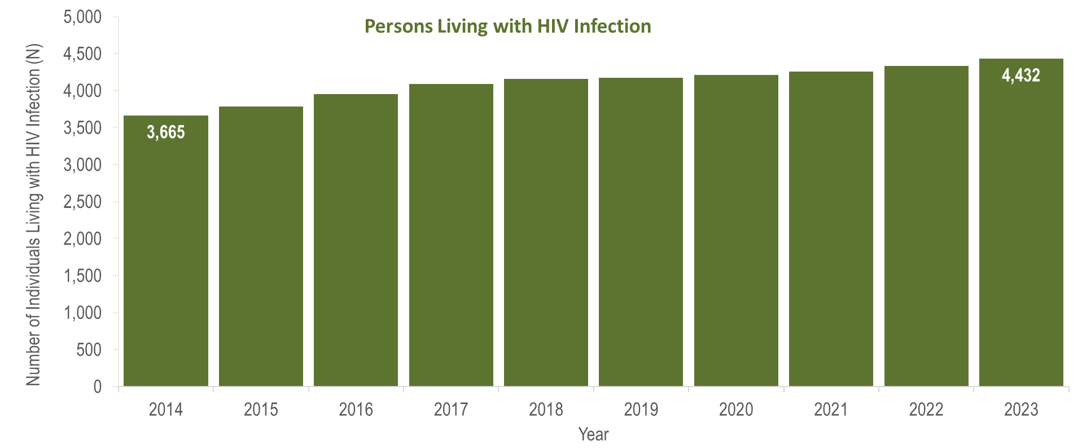
Number of persons living with HIV infection,¹
Northeast HSR, Massachusetts 2014–2023²
¹ Number of persons living with HIV infection on 12/31 of each year.
² Please consider the impact of the COVID-19 pandemic on infectious disease screening, treatment, and surveillance in the interpretation of data from 2020 to 2023.
Data Source: Bureau of Infectious Disease and Laboratory Sciences, data are current as of 7/1/2024 and subject to change
Notes:
The figure is a bar chart displaying a trend in the annual number of individuals living with HIV infection for the most recent ten-year period.
From 2014 to 2023, the number of persons living with HIV infection at the end of these years increased by 21% (from 3,665 to 4,432).

Slide 10
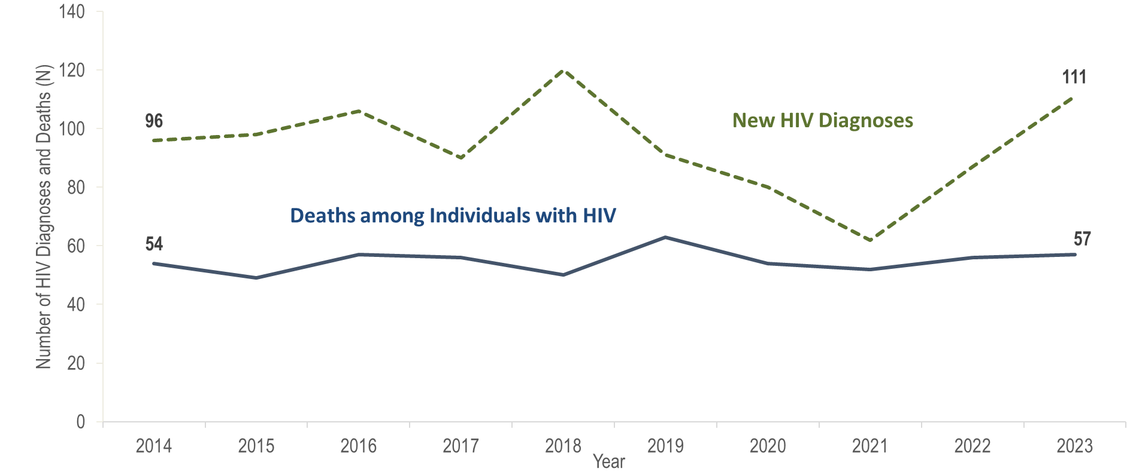
Number of new HIV infection diagnoses and deaths among individuals reported with HIV infection, Southeast HSR, Massachusetts 2014–2023¹
¹ Please consider the impact of the COVID-19 pandemic on infectious disease screening, treatment, and surveillance in the interpretation of data from 2020 to 2023.
Data Source: Bureau of Infectious Disease and Laboratory Sciences, data are current as of 7/1/2024 and subject to change
Notes:
The figure is a trendline displaying the annual number of new HIV diagnoses and deaths among individuals with HIV for the most recent ten-year period.
In the Southeast HSR, the annual number of new HIV diagnoses increased by 25% from 96 in 2014 to 120 in 2018 and then decreased by 48% to 62 in 2021. However, caution should be used in the interpretation of this decline due to the impact of COVID-19 on access to HIV testing and care services, and case surveillance activities. From 2021 to 2023, the number of new HIV diagnoses increased by 49 cases, or 79%, to 111. The largest increases in HIV diagnoses from 2021 to 2023 in the Southeast HSR were among non-US born individuals (from 23 to 50) and Black (non-Hispanic) individuals (from 24 to 54).
From 2014 to 2023, the number of deaths due to any cause among individuals reported with HIV infection remained relatively stable ranging from a low of 49 in 2015 to a high of 63 in 2019; there were 57 deaths in 2023.

Slide 11
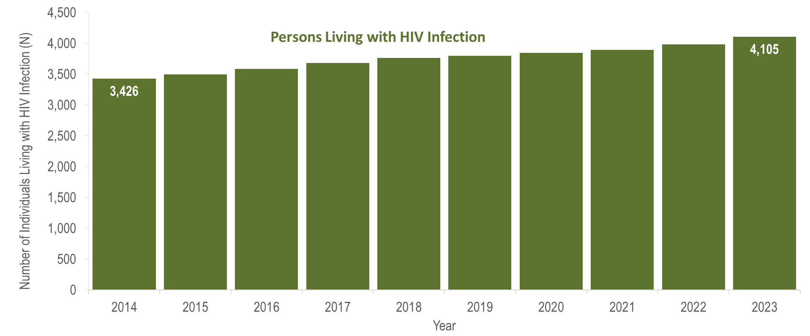
Number of persons living with HIV infection,¹
Southeast HSR, Massachusetts 2014–2023²
¹ Number of persons living with HIV infection on 12/31 of each year.
² Please consider the impact of the COVID-19 pandemic on infectious disease screening, treatment, and surveillance in the interpretation of data from 2020 to 2023.
Data Source: Bureau of Infectious Disease and Laboratory Sciences, data are current as of 7/1/2024 and subject to change
Notes:
The figure is a bar chart displaying a trend in the annual number of individuals living with HIV infection for the most recent ten-year period.
From 2014 to 2023, the number of persons living with HIV infection at the end of these years increased by 20% (from 3,426 to 4,105).

Slide 12
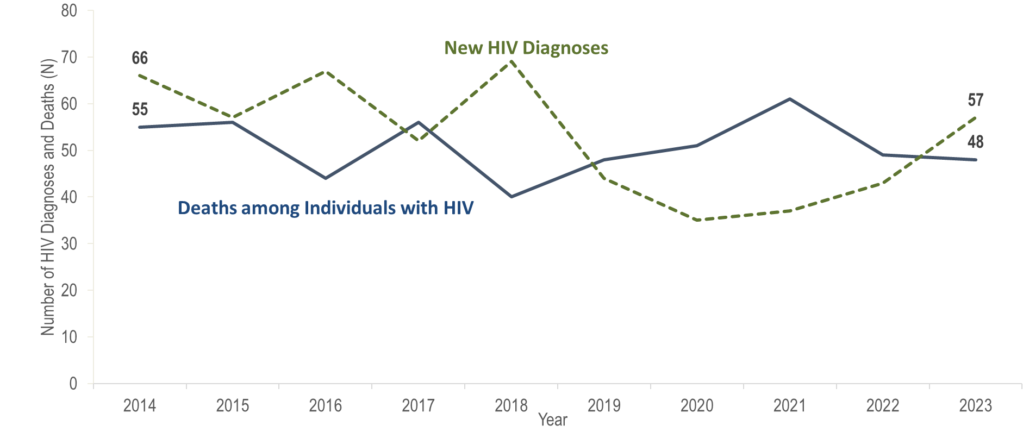
Number of new HIV infection diagnoses and deaths among individuals reported with HIV infection, Western HSR, Massachusetts 2014–2023¹
¹ Please consider the impact of the COVID-19 pandemic on infectious disease screening, treatment, and surveillance in the interpretation of data from 2020 to 2023.
Data Source: Bureau of Infectious Disease and Laboratory Sciences, data are current as of 7/1/2024 and subject to change
Notes:
The figure is a trendline displaying the annual number of new HIV diagnoses and deaths among individuals with HIV for the most recent ten-year period.
In the Western HSR, the annual number of new HIV diagnoses decreased by 47% from 66 in 2014 to 35 in 2020. However, caution should be used in the interpretation of this decline due to the impact of COVID-19 on access to HIV testing and care services, and case surveillance activities. From 2020 to 2023, the number of new HIV diagnoses increased by 22 cases, or 63%. The largest increases in HIV diagnoses from 2020 to 2023 in the Western HSR were among Hispanic/Latinx individuals (from 12 to 21), individuals with male-to-male sex (MSM) exposure mode (from 13 to 27), and individuals aged 20–29 years (from 8 to 20).
From 2014 to 2023, the number of deaths due to any cause among individuals reported with HIV infection fluctuated but overall decreased by 13% from 55 to 48.

Slide 13
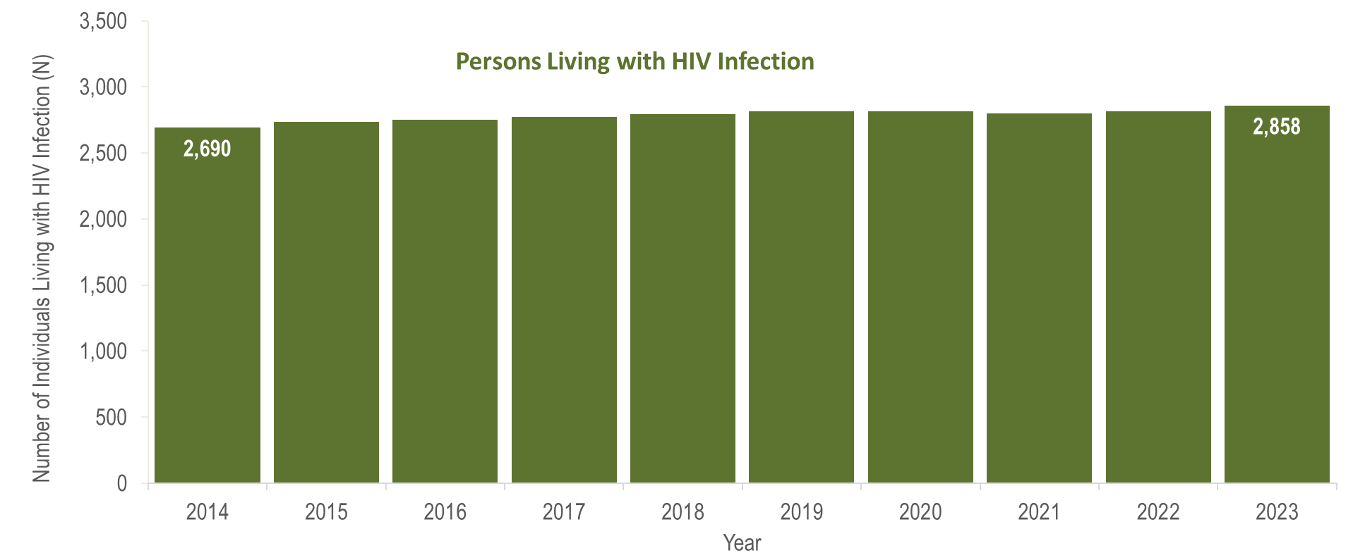
Number of persons living with HIV infection,¹
Western HSR, Massachusetts 2014–2023²
¹ Number of persons living with HIV infection on 12/31 of each year.
² Please consider the impact of the COVID-19 pandemic on infectious disease screening, treatment, and surveillance in the interpretation of data from 2020 to 2023.
Data Source: Bureau of Infectious Disease and Laboratory Sciences, data are current as of 7/1/2024 and subject to change
Notes:
The figure is a bar chart displaying a trend in the annual number of individuals living with HIV infection for the most recent ten-year period.
From 2014 to 2023, the number of persons living with HIV infection at the end of these years increased by 6% (from 2,690 to 2,858).

Slide 14
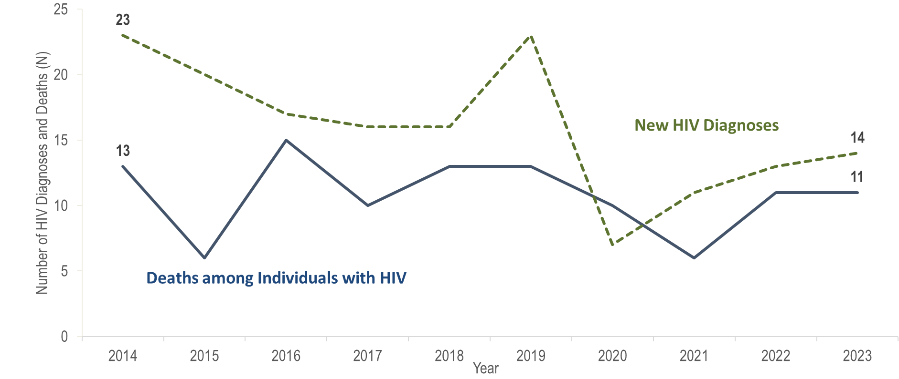
Number of new HIV infection diagnoses and deaths among individuals reported with HIV infection, Barnstable, Dukes, and Nantucket Counties,
Massachusetts 2014–2023¹
¹ Please consider the impact of the COVID-19 pandemic on infectious disease screening, treatment, and surveillance in the interpretation of data from 2020 to 2023.
Data Source: Bureau of Infectious Disease and Laboratory Sciences, data are current as of 7/1/2024 and subject to change
Notes:
The figure is a trendline displaying the annual number of new HIV diagnoses and deaths among individuals with HIV for the most recent ten-year period.
In Barnstable, Dukes, and Nantucket Counties from 2014 to 2023, the annual number of new HIV diagnoses ranged between seven and 23, and deaths from all causes among individuals reported with HIV infection remained between six and 15. The number of persons living with HIV infection at the end of these years increased by 14% (from 950 to 1,084). However, caution should be used in the interpretation of these trends due to the impact of COVID-19 on access to HIV testing and care services, and case surveillance activities, from 2020 to 2023.

Slide 15
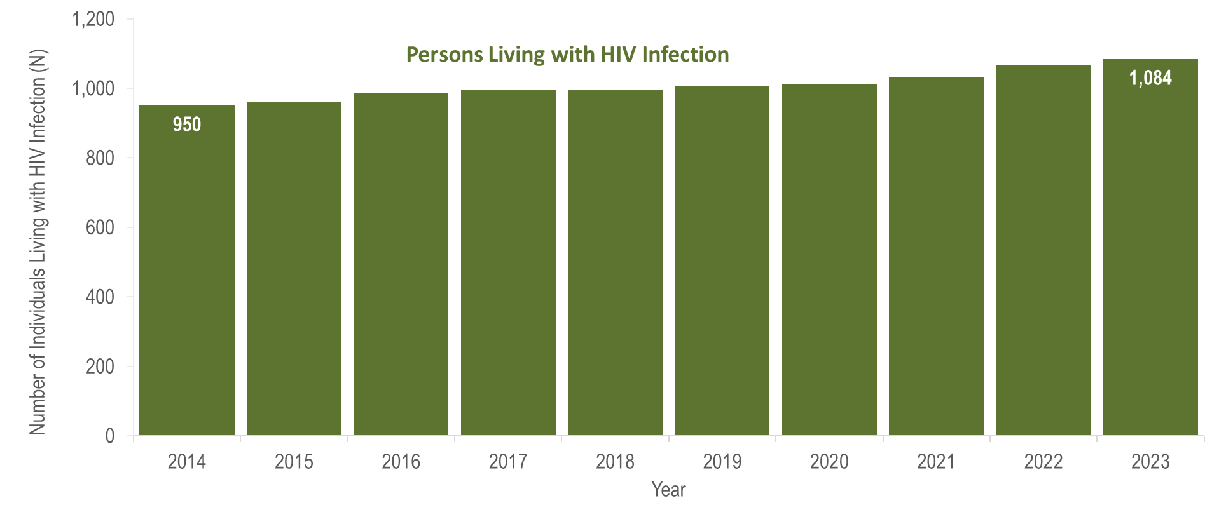
Number of persons living with HIV infection,¹
Barnstable, Dukes, and Nantucket Counties, Massachusetts 2014–2023²
¹ Number of persons living with HIV infection on 12/31 of each year.
² Please consider the impact of the COVID-19 pandemic on infectious disease screening, treatment, and surveillance in the interpretation of data from 2020 to 2023.
Data Source: Bureau of Infectious Disease and Laboratory Sciences, data are current as of 7/1/2024 and subject to change
Notes:
The figure is a bar chart displaying a trend in the annual number of individuals living with HIV infection for the most recent ten-year period.
In Barnstable, Dukes, and Nantucket Counties from 2014 to 2023, the number of persons living with HIV infection at the end of these years increased by 14% (from 950 to 1,084). However, caution should be used in the interpretation of these trends due to the impact of COVID-19 on access to HIV testing and care services, and case surveillance activities, from 2020 to 2023.

Slide 16
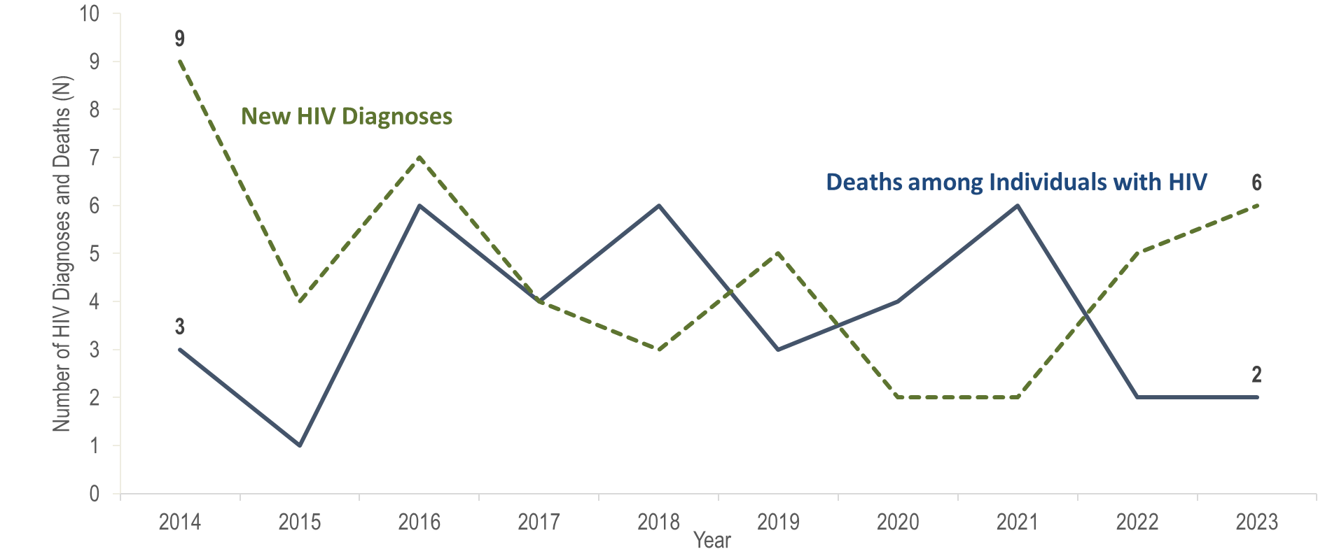
Number of new HIV infection diagnoses and deaths among individuals reported with HIV infection, Berkshire County, Massachusetts 2014–2023¹
¹ Please consider the impact of the COVID-19 pandemic on infectious disease screening, treatment, and surveillance in the interpretation of data from 2020 to 2023.
Data Source: Bureau of Infectious Disease and Laboratory Sciences, data are current as of 7/1/2024 and subject to change
Notes:
The figure is a trendline displaying the annual number of new HIV diagnoses and deaths among individuals with HIV for the most recent ten-year period.
In Berkshire County from 2014 to 2023, the annual number of new HIV diagnoses ranged between two and nine, and deaths from all causes among individuals reported with HIV infection remained at six or fewer. However, caution should be used in the interpretation of these trends due to the impact of COVID-19 on access to HIV testing and care services, and case surveillance activities, from 2020 to 2023.

Slide 17
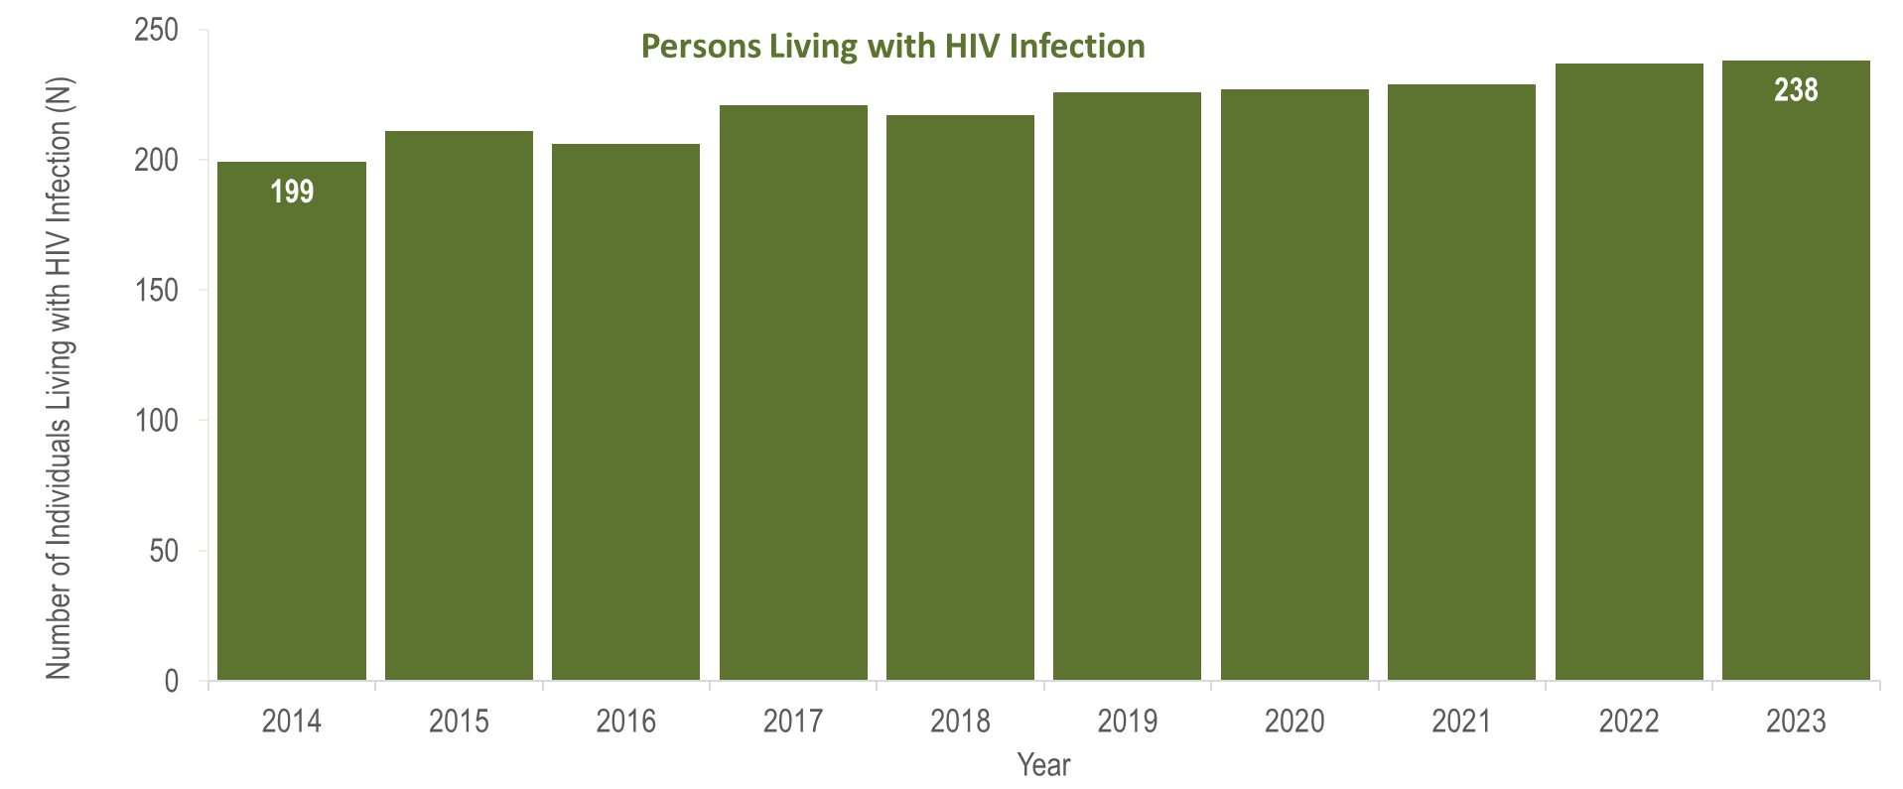
Number of persons living with HIV infection,¹
Berkshire County, Massachusetts 2014–2023²
¹ Number of persons living with HIV infection on 12/31 of each year.
² Please consider the impact of the COVID-19 pandemic on infectious disease screening, treatment, and surveillance in the interpretation of data from 2020 to 2023.
Data Source: Bureau of Infectious Disease and Laboratory Sciences, data are current as of 7/1/2024 and subject to change
Notes:
The figure is a bar chart displaying a trend in the annual number of individuals living with HIV infection for the most recent ten-year period.
In Berkshire County from 2014 to 2023, the number of persons living with HIV infection at the end of these years increased from 199 to 238. However, caution should be used in the interpretation of these trends due to the impact of COVID-19 on access to HIV testing and care services, and case surveillance activities, from 2020 to 2023.

Slide 18
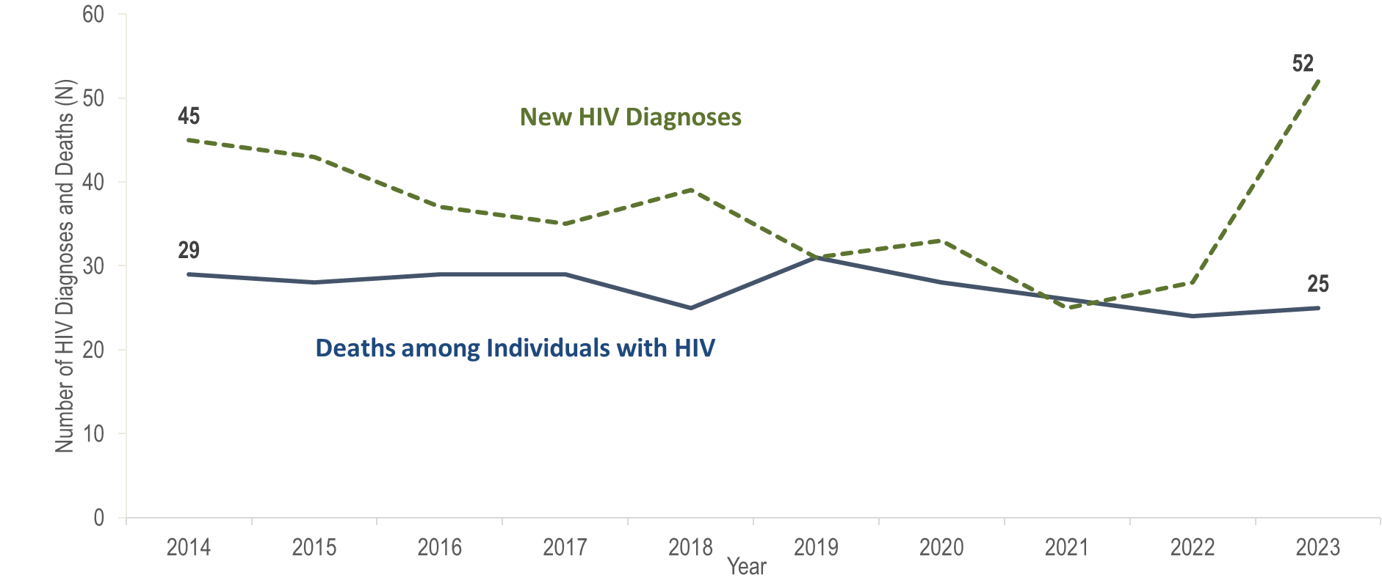
Number of new HIV infection diagnoses and deaths among individuals reported with HIV infection, Bristol County, Massachusetts 2014–2023¹
¹ Please consider the impact of the COVID-19 pandemic on infectious disease screening, treatment, and surveillance in the interpretation of data from 2020 to 2023.
Data Source: Bureau of Infectious Disease and Laboratory Sciences, data are current as of 7/1/2024 and subject to change
Notes:
The figure is a trendline displaying the annual number of new HIV diagnoses and deaths among individuals with HIV for the most recent ten-year period.
In Bristol County, the annual number of new HIV diagnoses decreased by 44% from 45 in 2014 to 25 in 2021. However, caution should be used in the interpretation of this decline due to the impact of COVID-19 on access to HIV testing and care services, and case surveillance activities. From 2021 to 2023, the number of new HIV diagnoses increased by 27 cases, or 108%, to a ten-year high of 52. The largest increases in HIV diagnoses from 2021 to 2023 in Bristol County were among individuals assigned male at birth (AMAB) (from 18 to 38), Black (non-Hispanic) individuals (from 6 to 18), individuals with no identified risk for HIV exposure mode (from 5 to 14), and individuals aged 30–39 years old (from 8 to 18).
In Bristol County, from 2014 to 2023, the number of deaths due to any cause among individuals reported with HIV infection remained relatively stable, ranging from a low of 24 in 2022 to a high of 31 in 2019. There were 25 deaths in 2023.

Slide 19
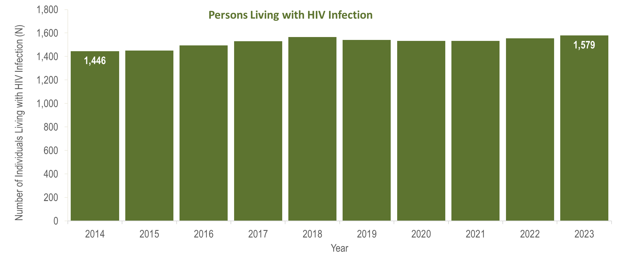
Number of persons living with HIV infection,¹
Bristol County, Massachusetts 2014–2023²
¹ Number of persons living with HIV infection on 12/31 of each year.
² Please consider the impact of the COVID-19 pandemic on infectious disease screening, treatment, and surveillance in the interpretation of data from 2020 to 2023.
Data Source: Bureau of Infectious Disease and Laboratory Sciences, data are current as of 7/1/2024 and subject to change
Notes:
The figure is a bar chart displaying a trend in the annual number of individuals living with HIV infection for the most recent ten-year period.
From 2014 to 2023, the number of persons living with HIV infection at the end of these years increased by 9% (from 1,446 to 1,579).

Slide 20
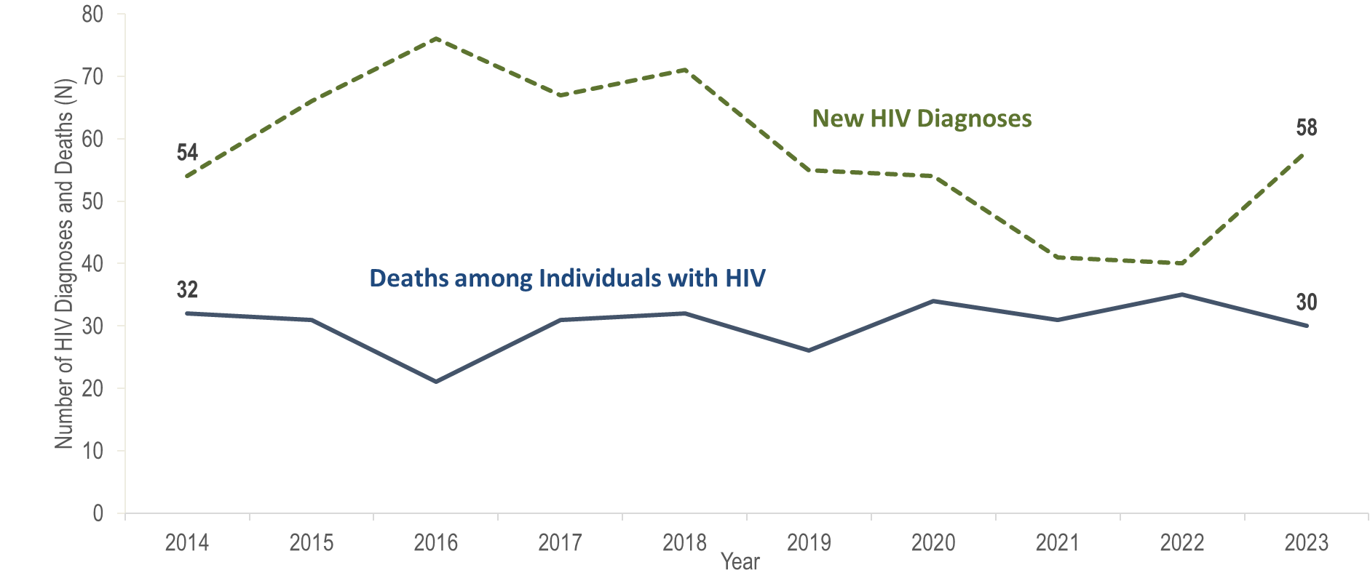
Number of new HIV infection diagnoses and deaths among individuals reported with HIV infection, Essex County, Massachusetts 2014–2023¹
¹ Please consider the impact of the COVID-19 pandemic on infectious disease screening, treatment, and surveillance in the interpretation of data from 2020 to 2023.
Data Source: Bureau of Infectious Disease and Laboratory Sciences, data are current as of 7/1/2024 and subject to change
Notes:
The figure is a trendline displaying the annual number of new HIV diagnoses and deaths among individuals with HIV for the most recent ten-year period.
In Essex County, the annual number of new HIV diagnoses increased by 41% from 54 in 2014 to 76 in 2016 and then decreased by 47% to 40 in 2022. However, caution should be used in the interpretation of this decline due to the impact of COVID-19 on access to HIV testing and care services, and case surveillance activities. In 2023, the number of new HIV diagnoses (N=58) returned to pre-pandemic levels, increasing by 18 cases, or 45%, compared to the prior year. This compares to a statewide increase in HIV diagnoses of 21% during the same time period. The largest increases in HIV diagnoses from 2022 to 2023 in Essex County were among non-US born individuals (from 20 to 31), Black (non-Hispanic) individuals (from 6 to 18), individuals with male-to-male sex (MSM) exposure mode (from 11 to 24), and individuals aged 50–59 years (from 6 to 10) and 30–39 years (from 15 to 24).
In Essex County, from 2014 to 2023, the number of deaths due to any cause among individuals reported with HIV infection remained relatively stable, ranging from a low of 21 in 2016 to a high of 35 in 2022. There were 30 deaths reported in 2023.

Slide 21
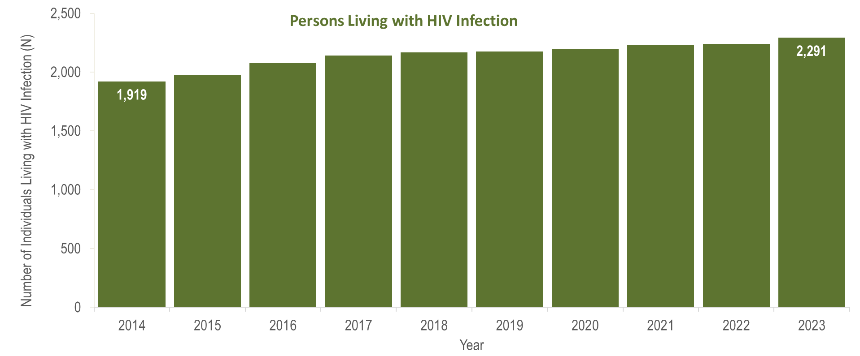
Number of persons living with HIV infection,¹
Essex County, Massachusetts 2014–2023²
¹ Number of persons living with HIV infection on 12/31 of each year.
² Please consider the impact of the COVID-19 pandemic on infectious disease screening, treatment, and surveillance in the interpretation of data from 2020 to 2023.
Data Source: Bureau of Infectious Disease and Laboratory Sciences, data are current as of 7/1/2024 and subject to change
Notes:
The figure is a bar chart displaying a trend in the annual number of individuals living with HIV infection for the most recent ten-year period.
From 2014 to 2023, the number of persons living with HIV infection at the end of these years increased by 19% (from 1,919 to 2,291).

Slide 22
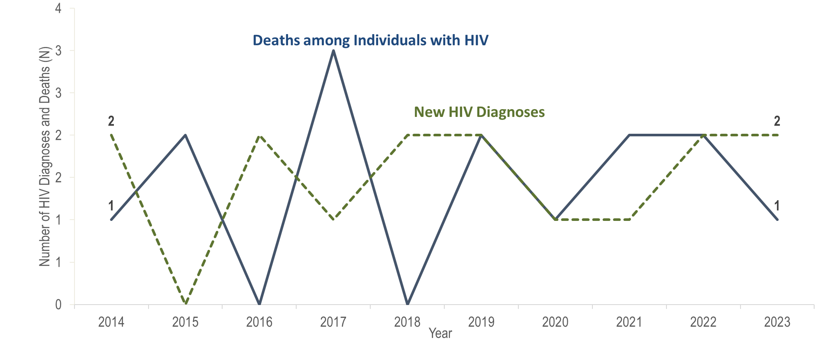
Number of new HIV infection diagnoses and deaths among individuals reported with HIV infection, Franklin County, Massachusetts 2014–2023¹
¹ Please consider the impact of the COVID-19 pandemic on infectious disease screening, treatment, and surveillance in the interpretation of data from 2020 to 2023.
Data Source: Bureau of Infectious Disease and Laboratory Sciences, data are current as of 7/1/2024 and subject to change
Notes:
The figure is a trendline displaying the annual number of new HIV diagnoses and deaths among individuals with HIV for the most recent ten-year period.
In Franklin County from 2014 to 2023, the annual number of new HIV diagnoses remained between zero and two, and deaths among individuals reported with HIV remained between zero and three. However, caution should be used in the interpretation of these trends due to the impact of COVID-19 on access to HIV testing and care services, and case surveillance activities, from 2020 to 2023.

Slide 23
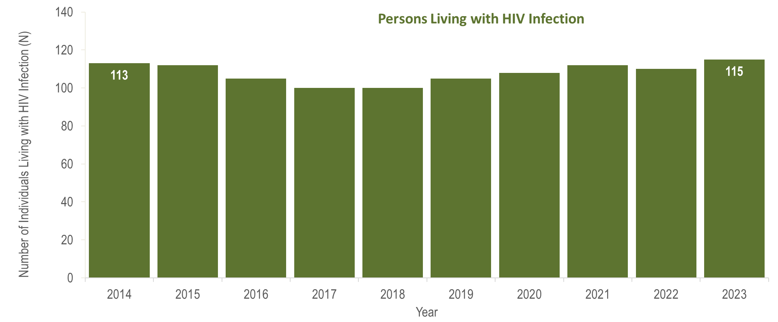
Number of persons living with HIV infection,¹
Franklin County, Massachusetts 2014–2023²
¹ Number of persons living with HIV infection on 12/31 of each year.
² Please consider the impact of the COVID-19 pandemic on infectious disease screening, treatment, and surveillance in the interpretation of data from 2020 to 2023.
Data Source: Bureau of Infectious Disease and Laboratory Sciences, data are current as of 7/1/2024 and subject to change
Notes:
The figure is a bar chart displaying a trend in the annual number of individuals living with HIV infection for the most recent ten-year period.
In Franklin County from 2014 to 2023, the number of persons living with HIV infection at the end of these years ranged from 100 to 115. However, caution should be used in the interpretation of these trends due to the impact of COVID-19 on access to HIV testing and care services, and case surveillance activities, from 2020 to 2023.

Slide 24
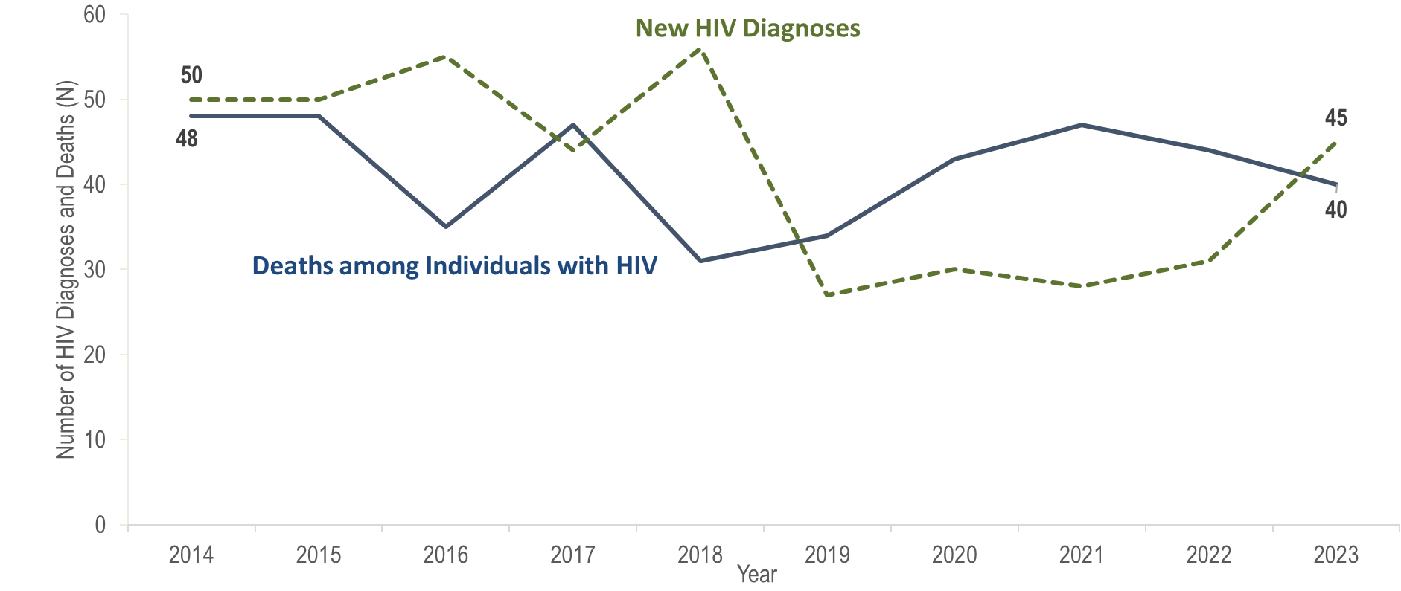
Number of new HIV infection diagnoses and deaths among individuals reported with HIV infection, Hampden County, Massachusetts 2014–2023¹
¹ Please consider the impact of the COVID-19 pandemic on infectious disease screening, treatment, and surveillance in the interpretation of data from 2020 to 2023.
Data Source: Bureau of Infectious Disease and Laboratory Sciences, data are current as of 7/1/2024 and subject to change
Notes:
The figure is a trendline displaying the annual number of new HIV diagnoses and deaths among individuals with HIV for the most recent ten-year period.
In Hampden County, the annual number of new HIV diagnoses ranged from 44 (2017) to 56 (2018) from 2014 to 2018, then declined to a lower range of 27 (2019) to 31 (2022) from 2019 to 2022. In 2023, the number of new HIV diagnoses (N=45) increased by 14 cases, or 45%, compared to the prior year. This compares to a statewide increase in HIV diagnoses of 21% during the same time period. The largest increases in HIV diagnoses from 2022 to 2023 in Hampden County were among Hispanic/Latinx individuals (from 11 to 19), individuals with male-to-male sex (MSM) exposure mode (from 13 to 21), and individuals aged 20–29 years old (from 7 to 17).
From 2014 to 2023, the number of deaths due to any cause among individuals reported with HIV infection ranged from a low of 31 in 2018 to a high of 48 in 2014 and 2015; there were 40 deaths reported in 2023.

Slide 25
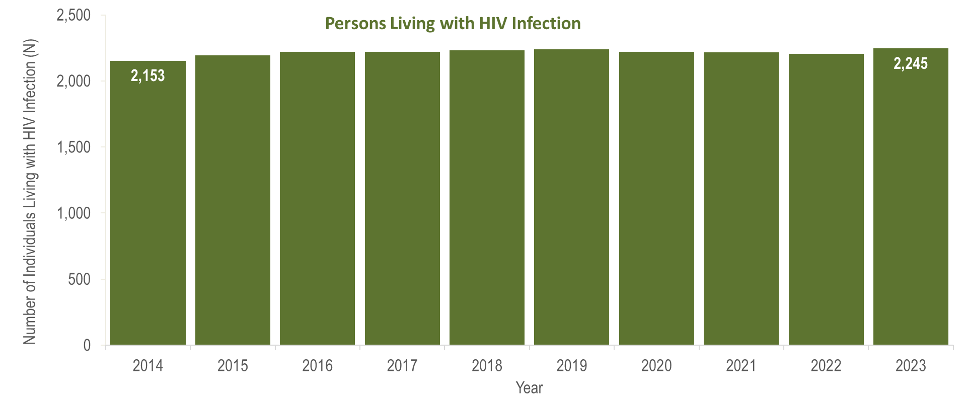
Number of persons living with HIV infection,¹
Hampden County, Massachusetts 2014–2023²
¹ Number of persons living with HIV infection on 12/31 of each year.
² Please consider the impact of the COVID-19 pandemic on infectious disease screening, treatment, and surveillance in the interpretation of data from 2020 to 2023.
Data Source: Bureau of Infectious Disease and Laboratory Sciences, data are current as of 7/1/2024 and subject to change
Notes:
The figure is a bar chart displaying a trend in the annual number of individuals living with HIV infection for the most recent ten-year period.
In Hampden County from 2014 to 2023, the number of persons living with HIV infection at the end of these years increased by 4% (from 2,153 to 2,245).

Slide 26
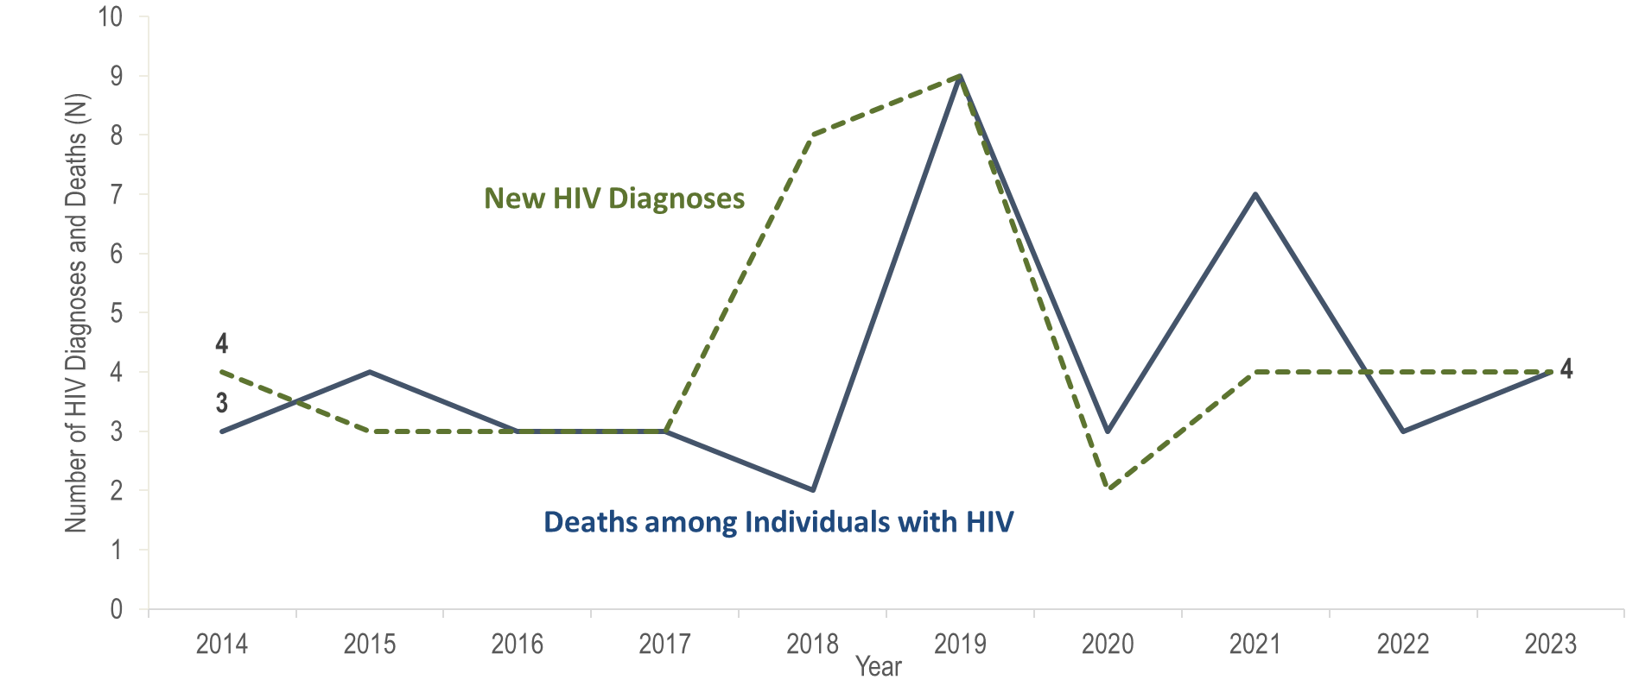
Number of new HIV infection diagnoses and deaths among individuals reported with HIV infection, Hampshire County, Massachusetts 2014–2023¹
¹ Please consider the impact of the COVID-19 pandemic on infectious disease screening, treatment, and surveillance in the interpretation of data from 2020 to 2023.
Data Source: Bureau of Infectious Disease and Laboratory Sciences, data are current as of 7/1/2024 and subject to change
Notes:
The figure is a trendline displaying the annual number of new HIV diagnoses and deaths among individuals with HIV for the most recent ten-year period.
In Hampshire County from 2014 to 2023, the annual number of both new HIV diagnoses and deaths among individuals reported with HIV remained between two and nine. However, caution should be used in the interpretation of these trends due to the impact of COVID-19 on access to HIV testing and care services, and case surveillance activities, from 2020 to 2023.

Slide 27
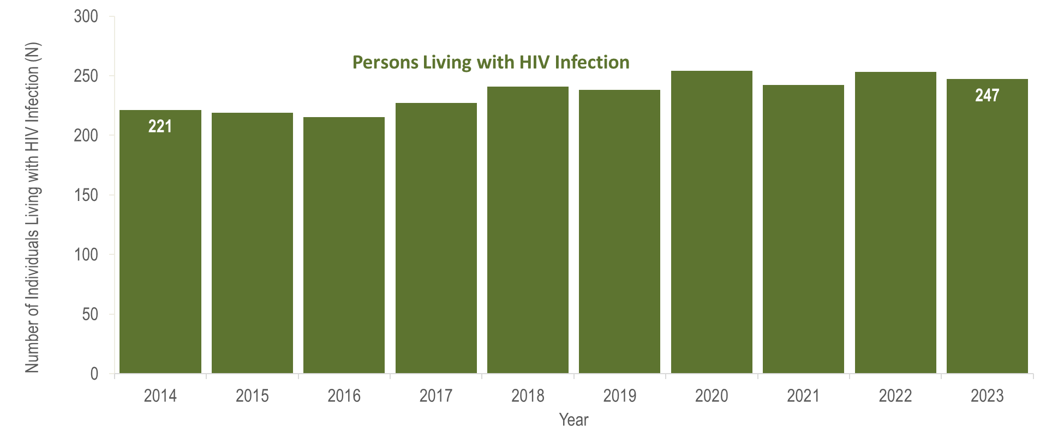
Number of persons living with HIV infection,¹
Hampshire County, Massachusetts 2014–2023²
¹ Number of persons living with HIV infection on 12/31 of each year.
² Please consider the impact of the COVID-19 pandemic on infectious disease screening, treatment, and surveillance in the interpretation of data from 2020 to 2023.
Data Source: Bureau of Infectious Disease and Laboratory Sciences, data are current as of 7/1/2024 and subject to change
Notes:
The figure is a bar chart displaying a trend in the annual number of individuals living with HIV infection for the most recent ten-year period.
In Hampshire County from 2014 to 2023, the number of persons living with HIV infection at the end of these years increased from 221 to 247. However, caution should be used in the interpretation of these trends due to the impact of COVID-19 on access to HIV testing and care services, and case surveillance activities, from 2020 to 2023.

Slide 28
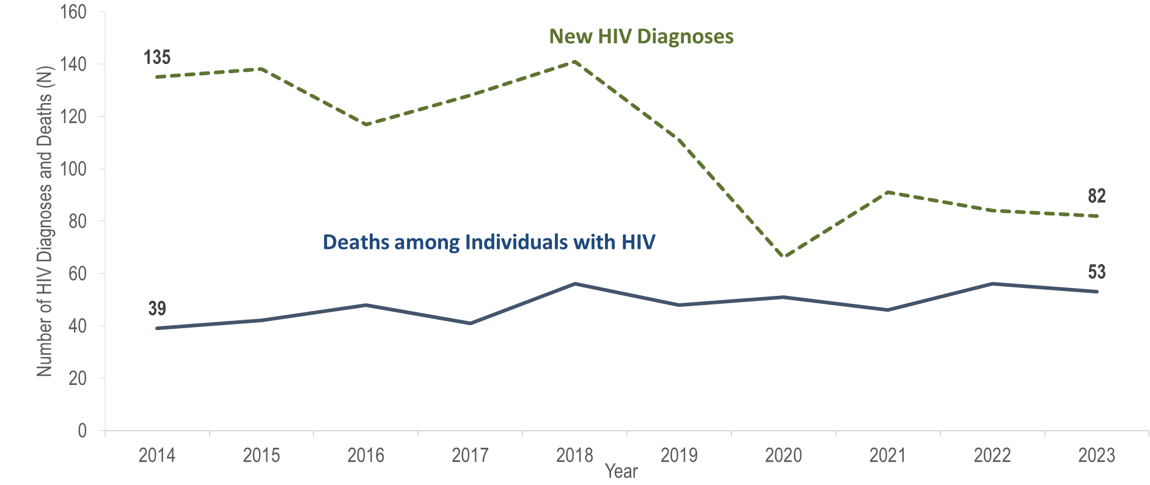
Number of new HIV infection diagnoses and deaths among individuals reported with HIV infection, Middlesex County, Massachusetts 2014–2023¹
¹ Please consider the impact of the COVID-19 pandemic on infectious disease screening, treatment, and surveillance in the interpretation of data from 2020 to 2023.
Data Source: Bureau of Infectious Disease and Laboratory Sciences, data are current as of 7/1/2024 and subject to change
Notes:
The figure is a trendline displaying the annual number of new HIV diagnoses and deaths among individuals with HIV for the most recent ten-year period.
In Middlesex County, the annual number of new HIV diagnoses fluctuated but increased overall from 135 in 2014 to a peak of 141 in 2018 and then decreased by 53% to 66 in 2020. However, caution should be used in the interpretation of this decline due to the impact of COVID-19 on access to HIV testing and care services, and case surveillance activities. The number of new HIV diagnoses increased to 91 in 2021 and then decreased by 10% to 82 in 2023. The continued decrease in HIV diagnoses in Middlesex County from 2021 to 2023 was not mirrored in the Commonwealth as a whole, where HIV diagnoses increased by 21% from 2022 to 2023.
From 2014 to 2023, the number of deaths due to any cause among individuals reported with HIV infection ranged from a low of 39 in 2014 to a high of 56 in 2018 and 2022; there were 53 deaths reported in 2023. From 2014 to 2023, the number of persons living with HIV infection at the end of these years increased by 15% (from 3,984 to 4,586).

Slide 29
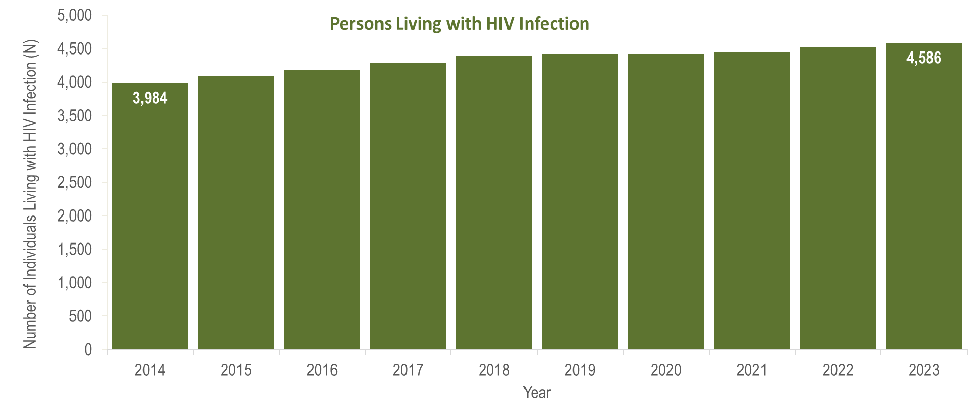
Number of persons living with HIV infection,¹
Middlesex County, Massachusetts 2014–2023²
¹ Number of persons living with HIV infection on 12/31 of each year.
² Please consider the impact of the COVID-19 pandemic on infectious disease screening, treatment, and surveillance in the interpretation of data from 2020 to 2023.
Data Source: Bureau of Infectious Disease and Laboratory Sciences, data are current as of 7/1/2024 and subject to change
Notes:
The figure is a bar chart displaying a trend in the annual number of individuals living with HIV infection for the most recent ten-year period.
In Middlesex County, from 2014 to 2023, the number of persons living with HIV infection at the end of these years increased by 15% (from 3,984 to 4,586).

Slide 30
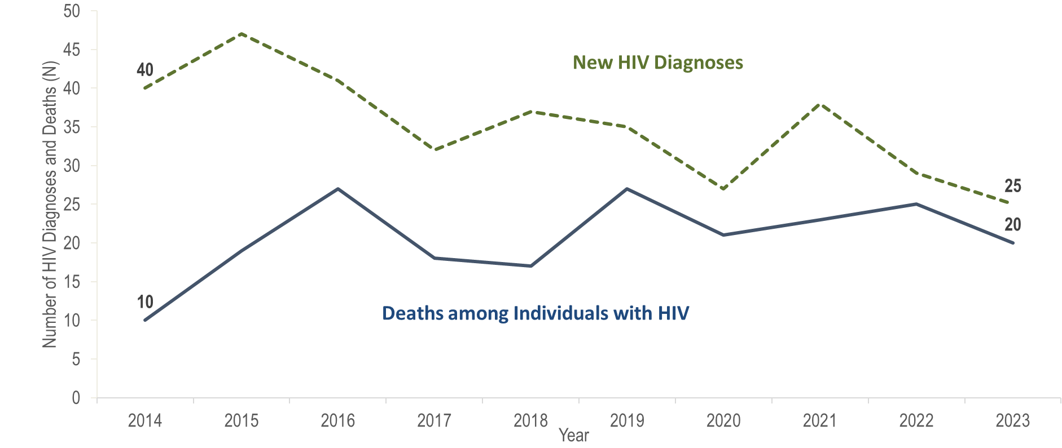
Number of new HIV infection diagnoses and deaths among individuals reported with HIV infection, Norfolk County, Massachusetts 2014–2023¹
¹ Please consider the impact of the COVID-19 pandemic on infectious disease screening, treatment, and surveillance in the interpretation of data from 2020 to 2023.
Data Source: Bureau of Infectious Disease and Laboratory Sciences, data are current as of 7/1/2024 and subject to change
Notes:
The figure is a trendline displaying the annual number of new HIV diagnoses and deaths among individuals with HIV for the most recent ten-year period.
In Norfolk County, the annual number of new HIV diagnoses decreased by 33% from 40 in 2014 to 27 in 2020, increased by 41% to 38 in 2021, and then decreased by 34% to a ten-year low of 25 in 2023. However, caution should be used in the interpretation of data from 2020 to 2023 due to the impact of COVID-19 on access to HIV testing and care services, and case surveillance activities. The continued decrease in HIV diagnoses in Norfolk County from 2021 to 2023 was not mirrored in the Commonwealth as a whole, where HIV diagnoses increased from 2022 to 2023.
The number of deaths due to any cause among individuals reported with HIV in Norfolk County increased by 170% from a ten-year low of 10 in 2014 to a peak of 27 in 2016; from 2017 to 2023, deaths ranged from 17 to 27 per year, with 20 deaths reported in 2023.

Slide 31
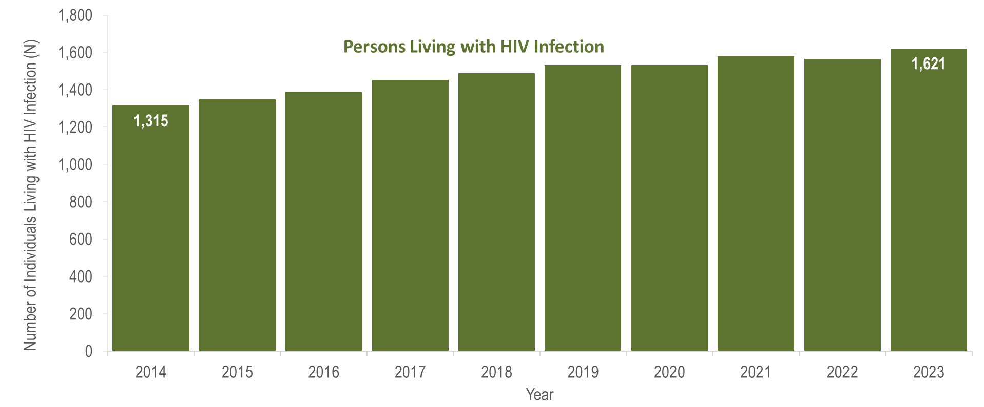
Number of persons living with HIV infection,¹
Norfolk County, Massachusetts 2014–2023²
¹ Number of persons living with HIV infection on 12/31 of each year.
² Please consider the impact of the COVID-19 pandemic on infectious disease screening, treatment, and surveillance in the interpretation of data from 2020 to 2023.
Data Source: Bureau of Infectious Disease and Laboratory Sciences, data are current as of 7/1/2024 and subject to change
Notes:
The figure is a bar chart displaying a trend in the annual number of individuals living with HIV infection for the most recent ten-year period.
In Norfolk County, from 2014 to 2023, the number of persons living with HIV infection at the end of these years increased by 23% (from 1,315 to 1,621).

Slide 32
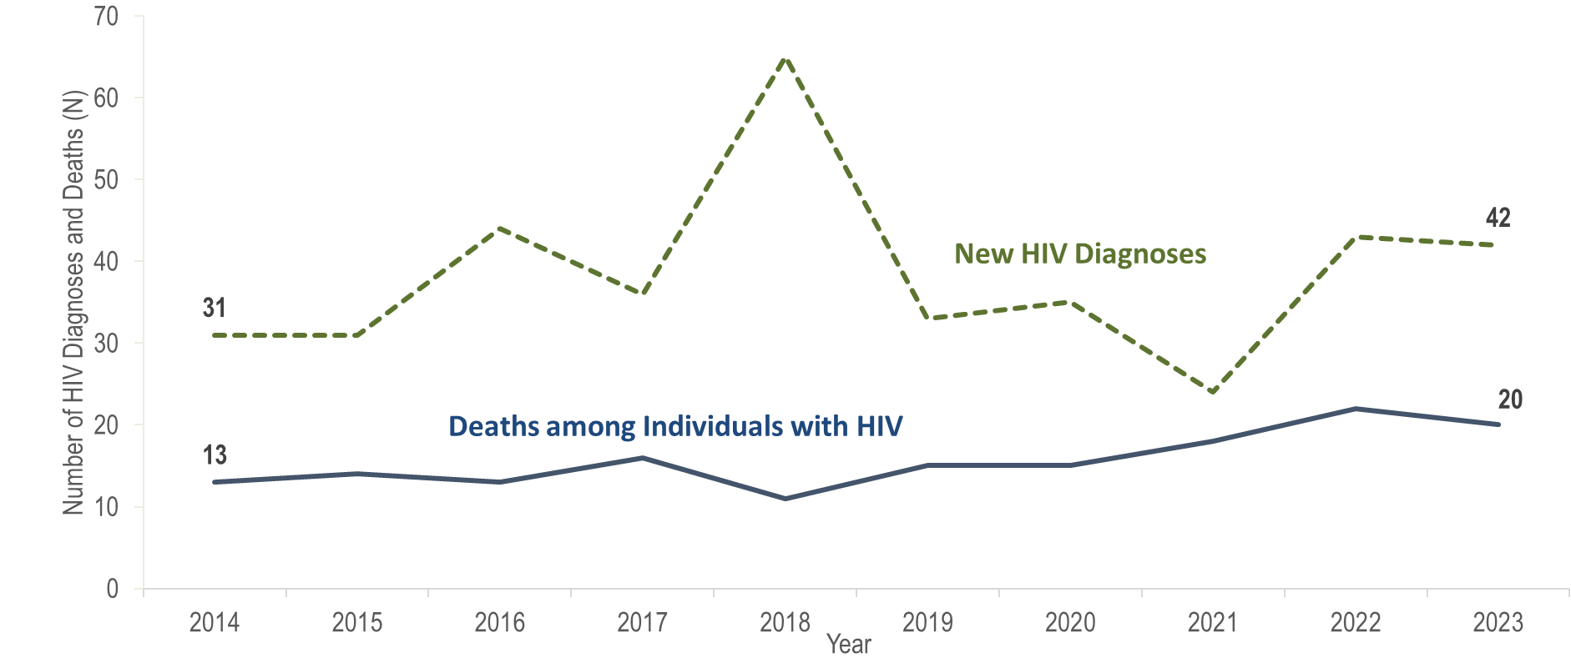
Number of new HIV infection diagnoses and deaths among individuals reported with HIV infection, Plymouth County, Massachusetts 2014–2023¹
¹ Please consider the impact of the COVID-19 pandemic on infectious disease screening, treatment, and surveillance in the interpretation of data from 2020 to 2023.
Data Source: Bureau of Infectious Disease and Laboratory Sciences, data are current as of 7/1/2024 and subject to change
Notes:
The figure is a trendline displaying the annual number of new HIV diagnoses and deaths among individuals with HIV for the most recent ten-year period.
The annual number of new HIV diagnoses in Plymouth County increased by 110% from 31 in 2014 to a ten-year high of 65 in 2018 and then decreased by 63% to a ten-year low of 24 cases in 2021. However, caution should be used in the interpretation of this decline due to the impact of COVID-19 on access to HIV testing and care services, and case surveillance activities. The number of new HIV diagnoses returned to pre-pandemic levels in 2022 (N=43), increasing by 19 cases, or 79%, compared to the prior year, and remained at this level in 2023 (N=42). The largest increases in HIV diagnoses from 2021 to 2022 in Plymouth County were among non-US born individuals (from 14 to 29) and Black (non-Hispanic) individuals (from 14 to 27).
The number of deaths due to any cause among individuals reported with HIV infection increased by 54% from 13 in 2014 to 20 in 2023.

Slide 33
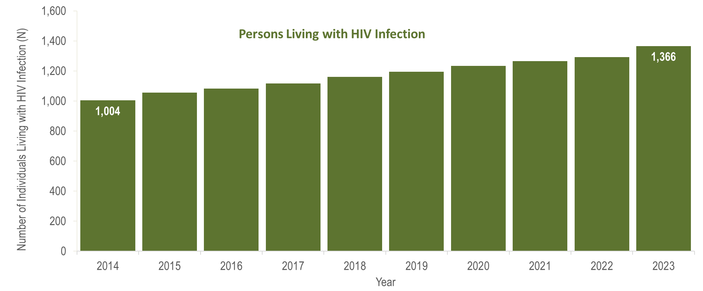
Number of persons living with HIV infection,¹
Plymouth County, Massachusetts 2014–2023²
¹ Number of persons living with HIV infection on 12/31 of each year.
² Please consider the impact of the COVID-19 pandemic on infectious disease screening, treatment, and surveillance in the interpretation of data from 2020 to 2023.
Data Source: Bureau of Infectious Disease and Laboratory Sciences, data are current as of 7/1/2024 and subject to change
Notes:
The figure is a bar chart displaying a trend in the annual number of individuals living with HIV infection for the most recent ten-year period.
From 2014 to 2023, the number of persons living with HIV infection at the end of these years increased by 36% (from 1,004 to 1,366).

Slide 34
Number of new HIV infection diagnoses and deaths among individuals reported with HIV infection, Suffolk County, Massachusetts 2014–2023¹
¹ Please consider the impact of the COVID-19 pandemic on infectious disease screening, treatment, and surveillance in the interpretation of data from 2020 to 2023.
Data Source: Bureau of Infectious Disease and Laboratory Sciences, data are current as of 7/1/2024 and subject to change
Notes:
The figure is a trendline displaying the annual number of new HIV diagnoses and deaths among individuals with HIV for the most recent ten-year period.
Suffolk County was selected as one of 48 counties nationally that is prioritized for funding in the U.S. Health and Human Services’ Initiative “Ending the HIV Epidemic (EHE): A Plan for America”. In 2023, 26% (N=142/540) of individuals diagnosed with HIV infection, 23% (N=69/307) of individuals reported with HIV who died, and 26% (N=6,340/24,119) of individuals living with HIV infection in Massachusetts were residents of Suffolk County.
In Suffolk County, the annual number of new HIV diagnoses decreased by 43% from 204 in 2014 to 117 in 2022. However, caution should be used in the interpretation of this decline due to the impact of COVID-19 on access to HIV testing and care services, and case surveillance activities. In 2023, the number of new HIV diagnoses (N=142) returned to pre-pandemic levels, increasing by 25 cases, or 21%, compared to the prior year. There was also a statewide increase in HIV diagnoses of 21% during the same time period. The largest increase in HIV diagnoses from 2022 to 2023 in Suffolk County was among individuals with male-to-male sex (MSM) exposure mode (from 43 to 63).
From 2014 to 2023, the number of deaths due to any cause among individuals reported with HIV infection fluctuated, ranging from a low of 64 in 2014 to a high of 93 in 2022; there were 69 deaths reported in 2023.

Slide 35

Number of persons living with HIV infection,¹
Suffolk County, Massachusetts 2014–2023²
¹ Number of persons living with HIV infection on 12/31 of each year.
² Please consider the impact of the COVID-19 pandemic on infectious disease screening, treatment, and surveillance in the interpretation of data from 2020 to 2023.
Data Source: Bureau of Infectious Disease and Laboratory Sciences, data are current as of 7/1/2024 and subject to change
Notes:
The figure is a bar chart displaying a trend in the annual number of individuals living with HIV infection for the most recent ten-year period.
From 2014 to 2023, the number of persons living with HIV infection at the end of these years remained relatively stable, with year-to-year changes of one percent or less.

Slide 36
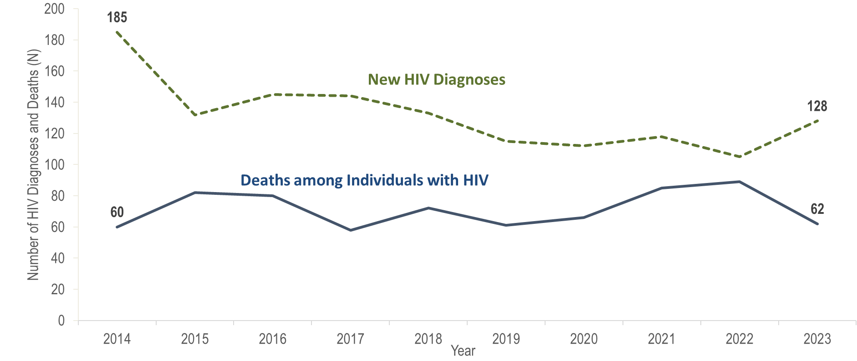
Number of new HIV infection diagnoses and deaths among individuals reported with HIV infection, City of Boston, Massachusetts 2014–2023¹
¹ Please consider the impact of the COVID-19 pandemic on infectious disease screening, treatment, and surveillance in the interpretation of data from 2020 to 2023.
Data Source: Bureau of Infectious Disease and Laboratory Sciences, data are current as of 7/1/2024 and subject to change
Notes:
The figure is a trendline displaying the annual number of new HIV diagnoses and deaths among individuals with HIV for the most recent ten-year period.
In 2023, 24% (N=128/540) of individuals diagnosed with HIV infection, 20% (N=62/307) of individuals reported with HIV who died, and 23% (N=5,651/24,119) of individuals living with HIV infection in Massachusetts were residents of the City of Boston.
In Boston, the annual number of new HIV diagnoses decreased by 43% from 185 in 2014 to 105 in 2022. However, caution should be used in the interpretation of this decline due to the impact of COVID-19 on access to HIV testing and care services, and case surveillance activities. In 2023, the number of new HIV diagnoses (N=128) returned to pre-pandemic levels, increasing by 23 cases, or 22%, compared to the prior year. This is comparable to a statewide increase in HIV diagnoses of 21% during the same time period. The largest increase in HIV diagnoses from 2022 to 2023 in Boston was among individuals with male-to-male sex (MSM) exposure mode (from 38 to 53).
From 2014 to 2023, the number of deaths due to any cause among individuals reported with HIV infection fluctuated, ranging from a low of 58 in 2017 to a high of 89 in 2022; there were 62 deaths reported in 2023.

Slide 37
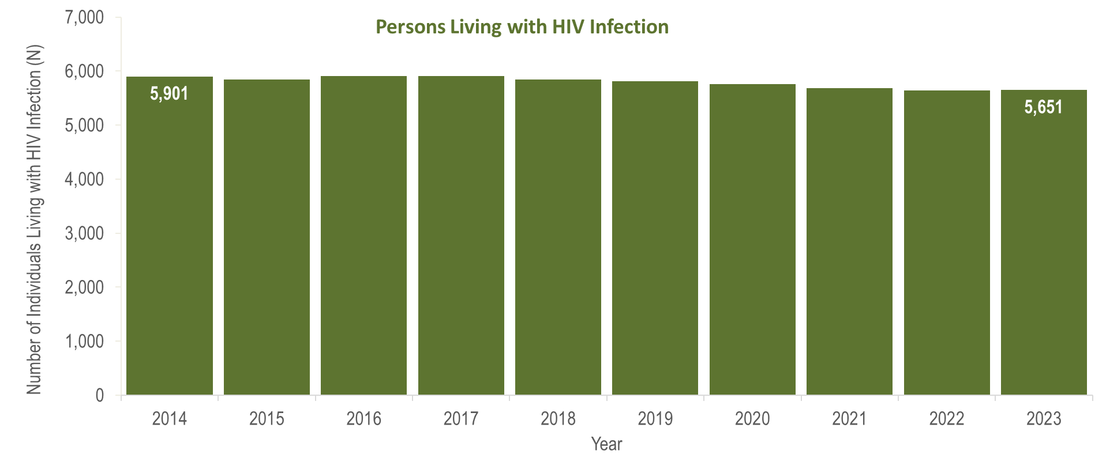
Number of persons living with HIV infection,¹
City of Boston, Massachusetts 2014–2023²
¹ Number of persons living with HIV infection on 12/31 of each year.
² Please consider the impact of the COVID-19 pandemic on infectious disease screening, treatment, and surveillance in the interpretation of data from 2020 to 2023.
Data Source: Bureau of Infectious Disease and Laboratory Sciences, data are current as of 7/1/2024 and subject to change
Notes:
The figure is a bar chart displaying a trend in the annual number of individuals living with HIV infection for the most recent ten-year period.
In Boston, from 2014 to 2023, the number of persons living with HIV infection at the end of these years remained relatively stable, with year-to-year changes of one percent or less.

Slide 38
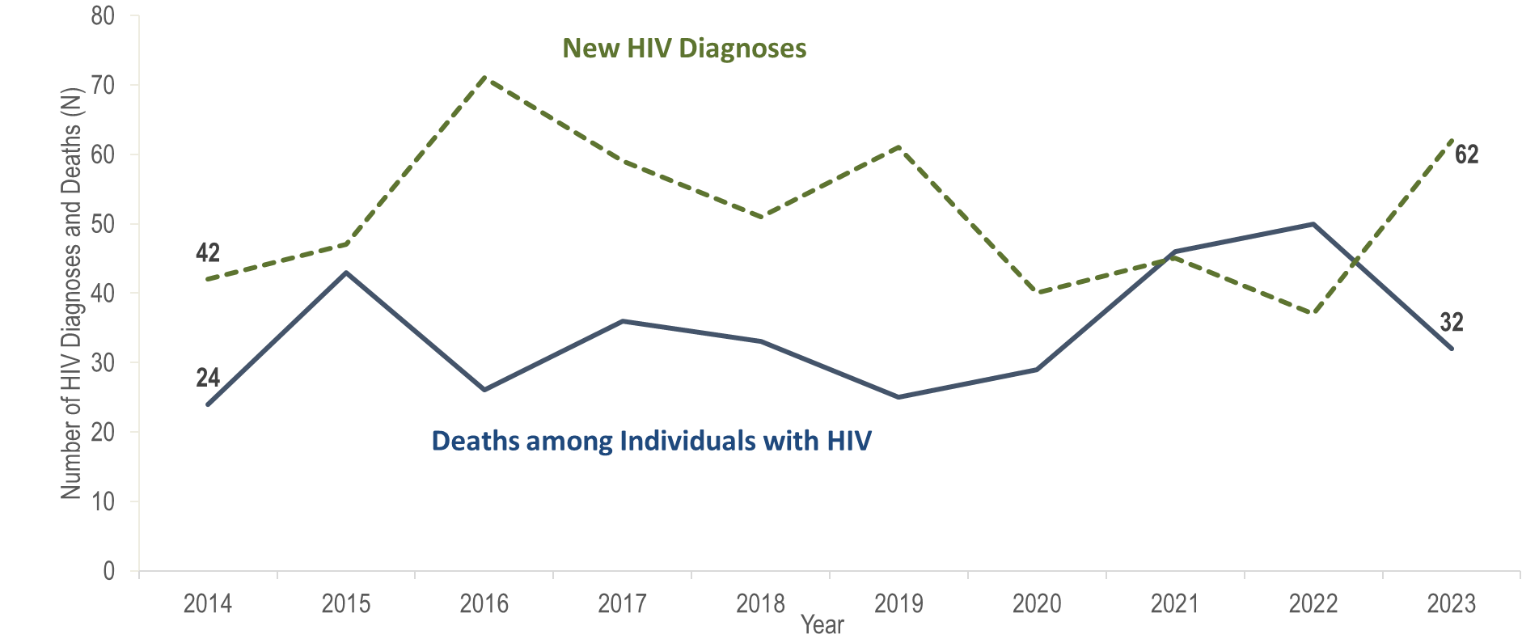
Number of new HIV infection diagnoses and deaths among individuals reported with HIV infection, Worcester County, Massachusetts 2014–2023¹
¹ Please consider the impact of the COVID-19 pandemic on infectious disease screening, treatment, and surveillance in the interpretation of data from 2020 to 2023.
Data Source: Bureau of Infectious Disease and Laboratory Sciences, data are current as of 7/1/2024 and subject to change
Notes:
The figure is a trendline displaying the annual number of new HIV diagnoses and deaths among individuals with HIV for the most recent ten-year period.
In Worcester County, the annual number of new HIV diagnoses increased by 69% from 42 in 2014 to 71 in 2016 and then decreased by 48% to 37 in 2022. However, caution should be used in the interpretation of this decline due to the impact of COVID-19 on access to HIV testing and care services, and case surveillance activities. In 2023, the number of new HIV diagnoses (N=62) returned to pre-pandemic levels, increasing by 25 cases, or 68%, compared to the prior year. This compares to a statewide increase in HIV diagnoses of 21% during the same time period. The largest increases in HIV diagnoses from 2022 to 2023 in Worcester County were among non-US born individuals (from 10 to 25) and Black (non-Hispanic) individuals (from 6 to 23).
The number of deaths due to any cause among individuals reported with HIV infection fluctuated, ranging from a low of 24 in 2014 to a high of 50 in 2022; there were 32 deaths reported in 2023.

Slide 39
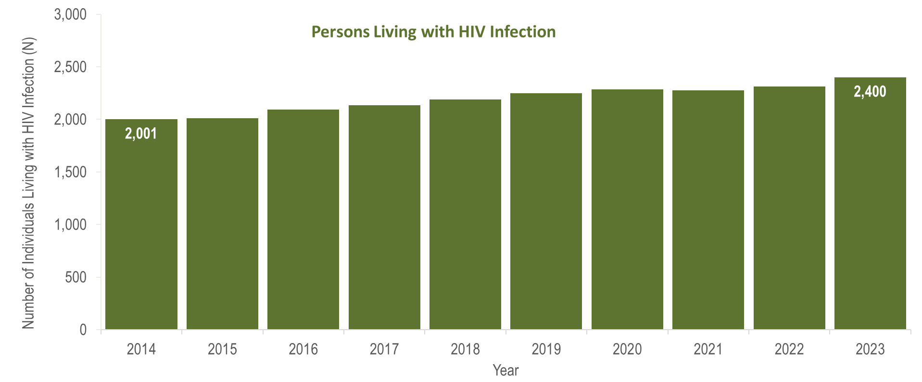
Number of persons living with HIV infection,¹
Worcester County, Massachusetts 2014–2023²
¹ Number of persons living with HIV infection on 12/31 of each year.
² Please consider the impact of the COVID-19 pandemic on infectious disease screening, treatment, and surveillance in the interpretation of data from 2020 to 2023.
Data Source: Bureau of Infectious Disease and Laboratory Sciences, data are current as of 7/1/2024 and subject to change
Notes:
The figure is a bar chart displaying a trend in the annual number of individuals living with HIV infection for the most recent ten-year period.
In Worcester County from 2014 to 2023, the number of persons living with HIV infection at the end of these years increased by 20% (from 2,001 to 2,400).

