Slide 1
Massachusetts HIV Epidemiologic Profile:
Data as of 7/1/2025
Regional Report
Notes:
Massachusetts HIV Epidemiologic Profile
Regional Report – Data as of 7/1/2025
Suggested citation:
Massachusetts Department of Public Health, Bureau of Infectious Disease and Laboratory Sciences. Massachusetts HIV Epidemiologic Profile, Regional Report – Data as of 7/1/2025,
https://www.mass.gov/lists/hivaids-epidemiologic-profiles Published June 2026. Accessed [date].
Bureau of Infectious Disease and Laboratory Sciences
Massachusetts Department of Public Health
Jamaica Plain Campus/State Public Health Laboratory
305 South Street
Jamaica Plain, MA 02130
To reach the Reporting and Partner Services Line*
Tel: (617) 983-6999
Questions about this report
Tel: (617) 983-6560
To speak to the on-call epidemiologist
Tel: (617) 983-6800
Questions about infectious disease reporting
Tel: (617) 983-6801
HIV Data Dashboard
https://www.mass.gov/info-details/hiv-data-dashboard
Requests for additional data
https://www.mass.gov/lists/infectious-disease-data-reports-and-requests
Slide sets for Epidemiologic Profile Reports
https://www.mass.gov/lists/hivaids-epidemiologic-profiles
*Providers may use this number to report individuals newly diagnosed with a notifiable sexually transmitted infection, including HIV, or request partner services. Partner services is a free and confidential service for individuals recently diagnosed with a priority infection. The client-centered program offers counseling, linkage to other health and social services, anonymous notification of partners who were exposed and assistance with getting testing and treatment. For more information, see: https://www.mass.gov/service-details/partner-services-program-information-for-healthcare-providers)

Slide 2
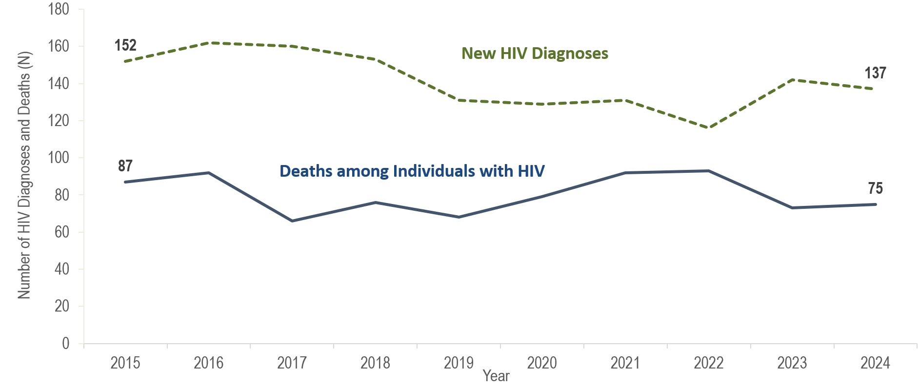
Number of new HIV infection diagnoses and deaths among individuals reported with HIV infection, Boston HSR, Massachusetts 2015–2024¹
¹ Please consider the impact of the COVID-19 pandemic on infectious disease screening, treatment, and surveillance in the interpretation of data from 2020 to 2022.
Data Source: Bureau of Infectious Disease and Laboratory Sciences, data are current as of 7/1/2025 and subject to change
Notes:
The figure is a trendline displaying the annual number of new HIV diagnoses and deaths among individuals with HIV for the most recent ten-year period.
In the Boston HSR, the annual number of new HIV diagnoses decreased by 24% from 152 in 2015 to 116 in 2022. However, caution should be used in the interpretation of this decline due to the impact of COVID-19 on access to HIV testing and care services, and case surveillance activities. The number of new HIV diagnoses returned to pre-pandemic levels in 2023 (N=142), increasing by 22%, compared to the prior year, and then remained at this higher level in 2024 (N=137), with a slight decrease of five diagnoses (4%, compared to 2023). Statewide, there was a 22% increase in HIV diagnoses from 2022 to 2023, followed by an additional 10% increase from 2023 to 2024. The largest increase in HIV diagnoses from 2022 to 2024 in the Boston HSR was among individuals AMAB (from 83 to 102), non-US born individuals (from 61 to 79), Black (non-Hispanic) individuals (from 51 to 66), and individuals with male-to-male sex (MSM) exposure mode (from 42 to 61).
From 2015 to 2024, the number of deaths due to any cause among individuals reported with HIV infection fluctuated ranging from a low of 66 in 2017 to a high of 93 in 2022; there were 75 deaths in 2024.

Slide 3
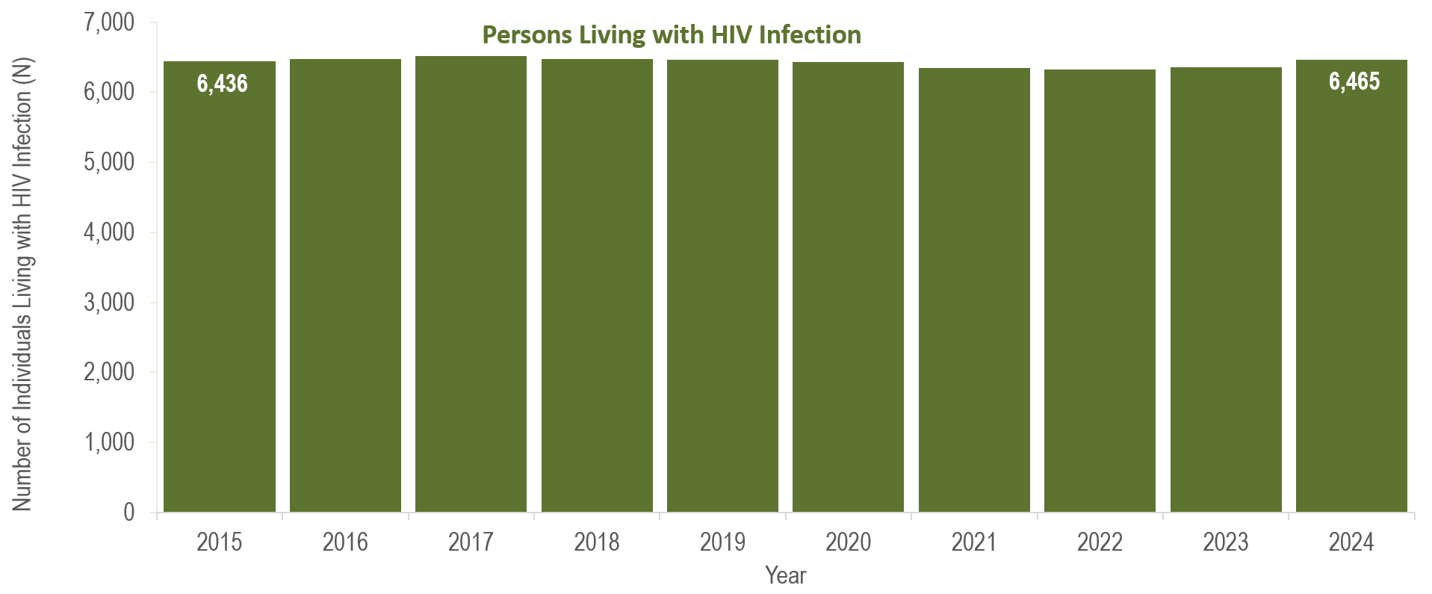
Number of persons living with HIV infection,¹
Boston HSR, Massachusetts 2015–2024²
¹ Number of persons living with HIV infection on 12/31 of each year.
² Please consider the impact of the COVID-19 pandemic on infectious disease screening, treatment, and surveillance in the interpretation of data from 2020 to 2022.
Data Source: Bureau of Infectious Disease and Laboratory Sciences, data are current as of 7/1/2025 and subject to change
Notes:
The figure is a bar chart displaying a trend in the annual number of individuals living with HIV infection for the most recent ten-year period.
From 2015 to 2024, the number of persons living with HIV infection at the end of these years remained relatively stable, with year-to-year changes of two percent or less. .

Slide 4
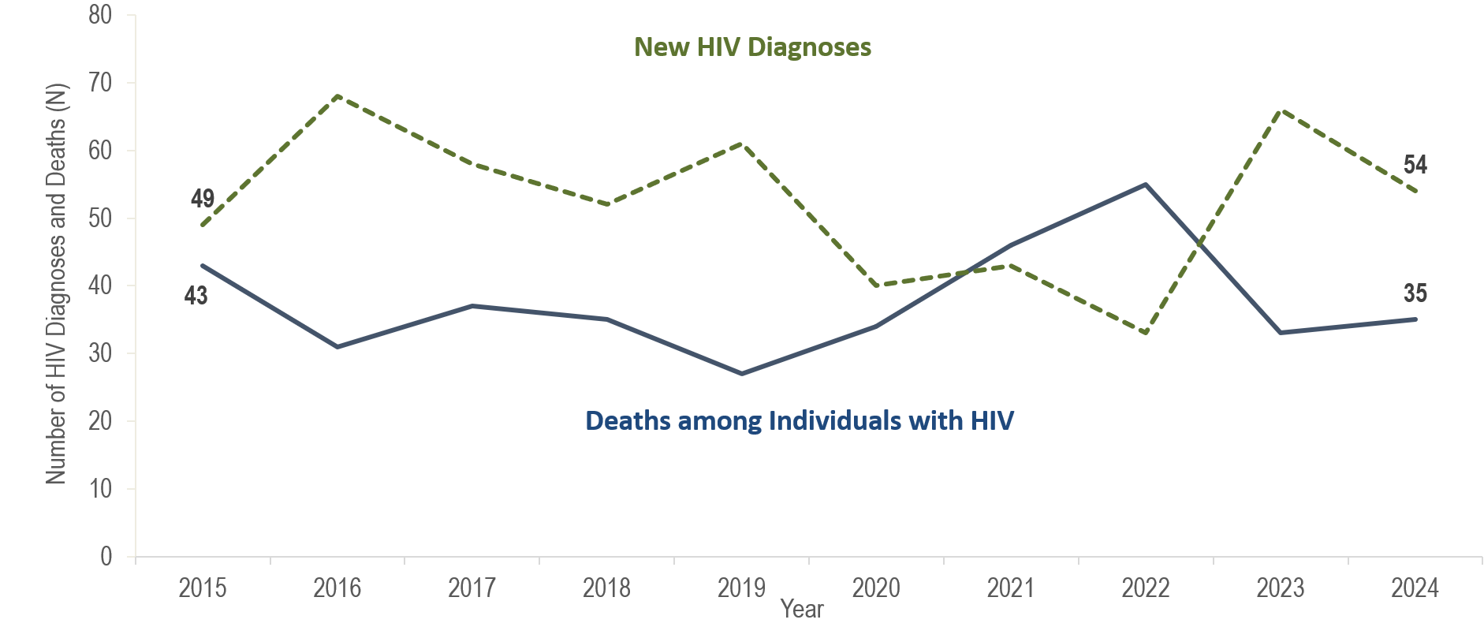
Number of new HIV infection diagnoses and deaths among individuals reported with HIV infection, Central HSR, Massachusetts 2015–2024¹
¹ Please consider the impact of the COVID-19 pandemic on infectious disease screening, treatment, and surveillance in the interpretation of data from 2020 to 2022.
Data Source: Bureau of Infectious Disease and Laboratory Sciences, data are current as of 7/1/2025 and subject to change
Notes:
The figure is a trendline displaying the annual number of new HIV diagnoses and deaths among individuals with HIV for the most recent ten-year period.
In the Central HSR, the annual number of new HIV diagnoses increased by 39% from 49 in 2015 to a peak of 68 in 2016 and then decreased by 51% to 33 in 2022. However, caution should be used in the interpretation of this decline due to the impact of COVID-19 on access to HIV testing and care services, and case surveillance activities. The number of new HIV diagnoses (N=66) returned to pre-pandemic levels, increasing by 33 cases, or 100%, compared to the prior year, and then decreased by 18% in 2024 (N=54). This compares to a 22% statewide increase in HIV diagnoses from 2022 to 2023, followed by an additional 10% increase from 2023 to 2024. The largest increases in HIV diagnoses from 2022 to 2023 in the Central HSR were among non-US born individuals (from 9 to 25), Black (non-Hispanic) individuals (from 6 to 24), and individuals with no identified risk for HIV exposure mode (from 4 to 18).
The number of deaths due to any cause among individuals reported with HIV infection decreased by 37% from 43 in 2015 to 27 in 2019, increased by 104% to a peak of 55 in 2022, and then decreased by 36% to 35 in 2024.

Slide 5
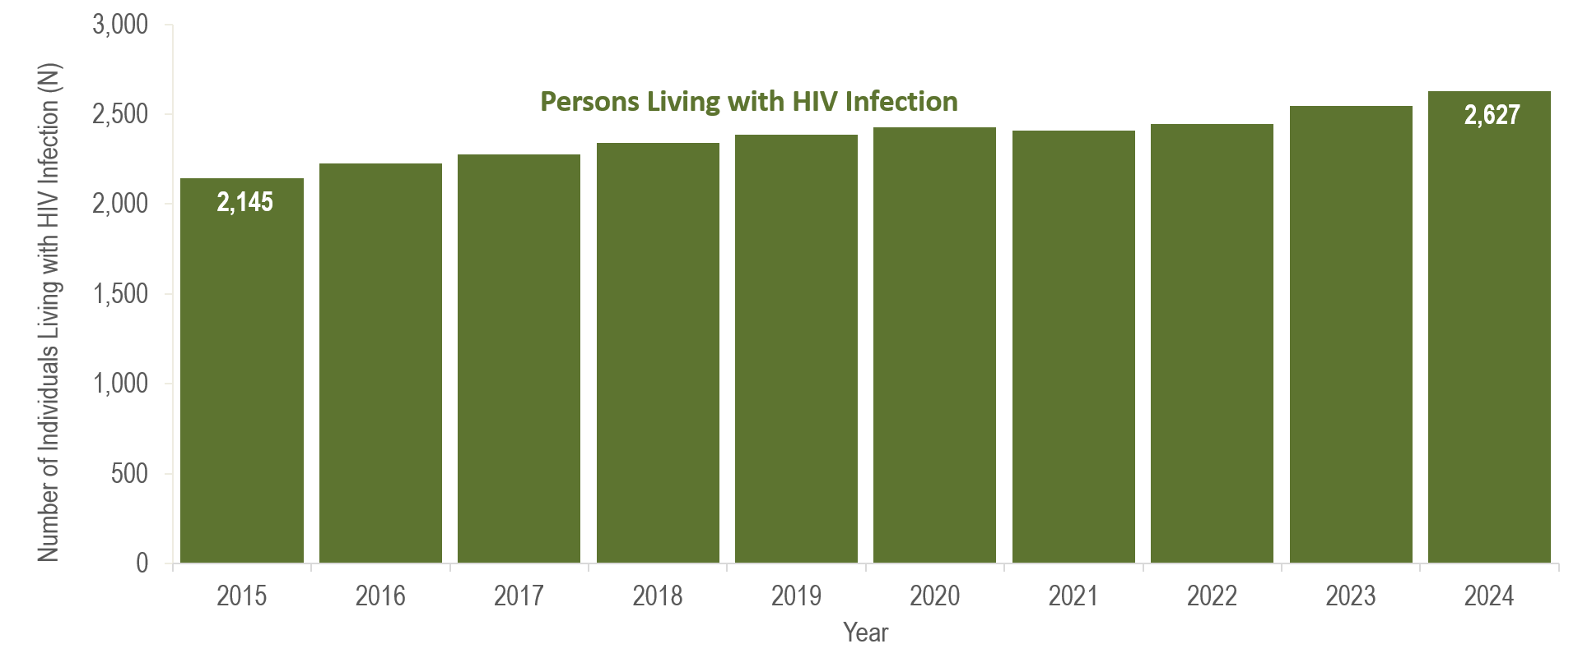
Number of persons living with HIV infection,¹
Central HSR, Massachusetts 2015–2024²
¹ Number of persons living with HIV infection on 12/31 of each year.
² Please consider the impact of the COVID-19 pandemic on infectious disease screening, treatment, and surveillance in the interpretation of data from 2020 to 2022.
Data Source: Bureau of Infectious Disease and Laboratory Sciences, data are current as of 7/1/2025 and subject to change
Notes:
The figure is a bar chart displaying a trend in the annual number of individuals living with HIV infection for the most recent ten-year period.
From 2015 to 2024, the number of persons living with HIV infection at the end of these years increased by 22% (from 2,145 to 2,627).

Slide 6
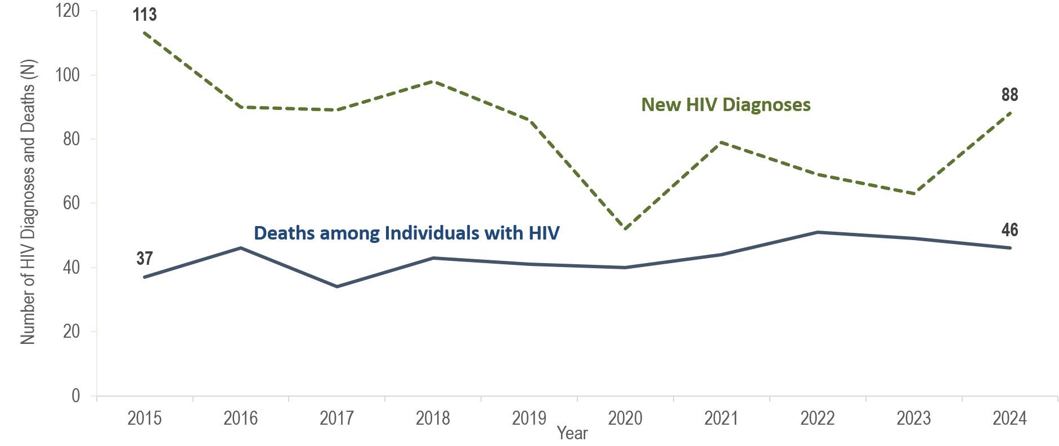
Number of new HIV infection diagnoses and deaths among individuals reported with HIV infection, Metrowest HSR, Massachusetts 2015–2024¹
¹ Please consider the impact of the COVID-19 pandemic on infectious disease screening, treatment, and surveillance in the interpretation of data from 2020 to 2022.
Data Source: Bureau of Infectious Disease and Laboratory Sciences, data are current as of 7/1/2025 and subject to change
Notes:
The figure is a trendline displaying the annual number of new HIV diagnoses and deaths among individuals with HIV for the most recent ten-year period.
In the Metrowest HSR, the annual number of new HIV diagnoses decreased by 54% from 113 in 2015 to 52 in 2020, increased by 52% to 79 in 2021, and then decreased by 20% to 63 in 2023. However, caution should be used in the interpretation of data from 2020 to 2022 due to the impact of COVID-19 on access to HIV testing and care services, and case surveillance activities. The continued decrease in HIV diagnoses in the Metrowest HSR from 2021 to 2023 was not mirrored in the Commonwealth as a whole, or the other Health Service Regions, where HIV diagnoses increased from 2022 to 2023. However, the number of HIV diagnoses in the Metrowest HSR in 2024 (N=88) represents a 40% increase compared to the prior year. This compares to a statewide increase of 10% in the number of HIV diagnoses from 2023 to 2024.
The number of deaths due to any cause among individuals reported with HIV increased by 24% from 37 in 2015 to 46 in 2024.

Slide 7
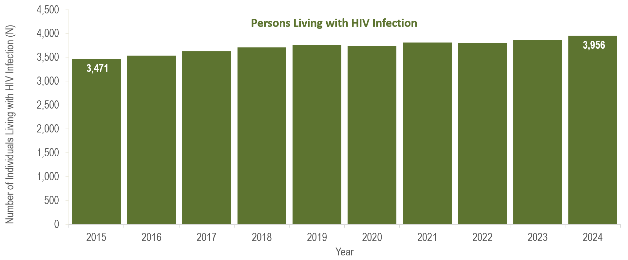
Number of persons living with HIV infection,¹
Metrowest HSR, Massachusetts 2015–2024²
¹ Number of persons living with HIV infection on 12/31 of each year.
² Please consider the impact of the COVID-19 pandemic on infectious disease screening, treatment, and surveillance in the interpretation of data from 2020 to 2022.
Data Source: Bureau of Infectious Disease and Laboratory Sciences, data are current as of 7/1/2025 and subject to change
Notes:
The figure is a bar chart displaying a trend in the annual number of individuals living with HIV infection for the most recent ten-year period.
From 2015 to 2024, the number of persons living with HIV infection at the end of these years increased by 14% (from 3,471 to 3,956).

Slide 8
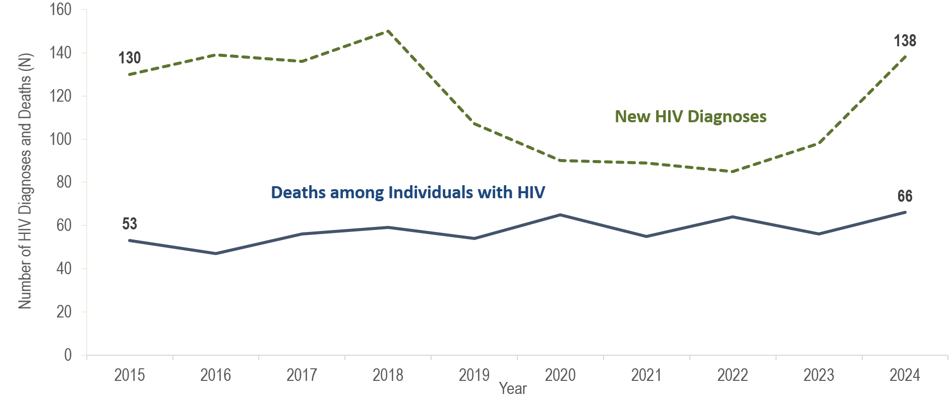
Number of new HIV infection diagnoses and deaths among individuals reported with HIV infection, Northeast HSR, Massachusetts 2015–2024¹
¹ Please consider the impact of the COVID-19 pandemic on infectious disease screening, treatment, and surveillance in the interpretation of data from 2020 to 2022.
Data Source: Bureau of Infectious Disease and Laboratory Sciences, data are current as of 7/1/2025 and subject to change
Notes:
The figure is a trendline displaying the annual number of new HIV diagnoses and deaths among individuals with HIV for the most recent ten-year period.
The number of new HIV diagnoses in the Northeast HSR increased by 15% from 130 in 2015 to a peak of 150 in 2018 primarily due to an outbreak among persons who inject drugs (PWID) in the northeast part of the state between 2016 and 2018.* Following a focused public health response, the number of HIV infection diagnoses in the Northeast decreased by 43% (from 150 in 2018) to 85 in 2022. However, caution should be used in the interpretation of this decline due to the impact of COVID-19 on access to HIV testing and care services, and case surveillance activities. Subsequently, the number of new HIV diagnoses increased by 15% in 2023 (N=98) and by an additional 41% in 2024 (N=138). This compares to a statewide increase in HIV diagnoses of 22% in 2023 and 10% in 2024. The largest increases in HIV diagnoses from 2023 to 2024 in the Northeast HSR were among individuals AFAB (from 26 to 51), individuals born outside the US (from 56 to 86), Black (non-Hispanic) individuals (from 28 to 47), and individuals with an exposure mode exposure mode of presumed heterosexual sex (from 14 to 27).
*For more information about this outbreak see: Charles Alpren et al. “Opioid Use Fueling HIV Transmission in an Urban Setting: An Outbreak of HIV Infection Among People Who Inject Drugs—Massachusetts, 2015–2018”, American Journal of Public Health 110, no. 1 (January 1, 2020): pp. 37-44. https://doi.org/10.2105/AJPH.2019.305366.
The number of deaths due to any cause among individuals reported with HIV increased by 25% from 53 in 2015 to 66 in 2024.

Slide 9
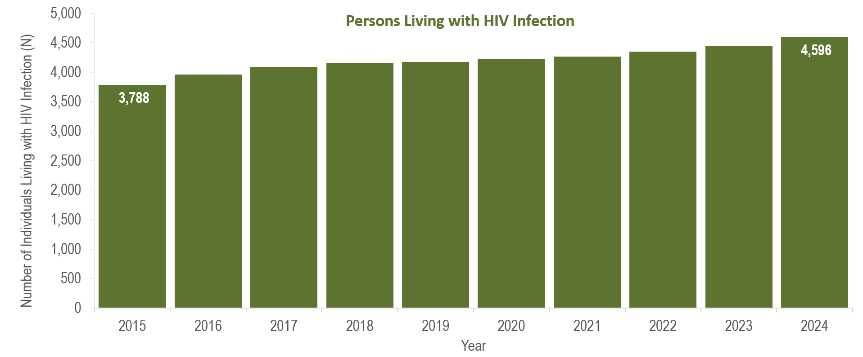
Number of persons living with HIV infection,¹
Northeast HSR, Massachusetts 2015–2024²
¹ Number of persons living with HIV infection on 12/31 of each year.
² Please consider the impact of the COVID-19 pandemic on infectious disease screening, treatment, and surveillance in the interpretation of data from 2020 to 2022.
Data Source: Bureau of Infectious Disease and Laboratory Sciences, data are current as of 7/1/2025 and subject to change
Notes:
The figure is a bar chart displaying a trend in the annual number of individuals living with HIV infection for the most recent ten-year period.
From 2015 to 2024, the number of persons living with HIV infection at the end of these years increased by 21% (from 3,788 to 4,596).

Slide 10
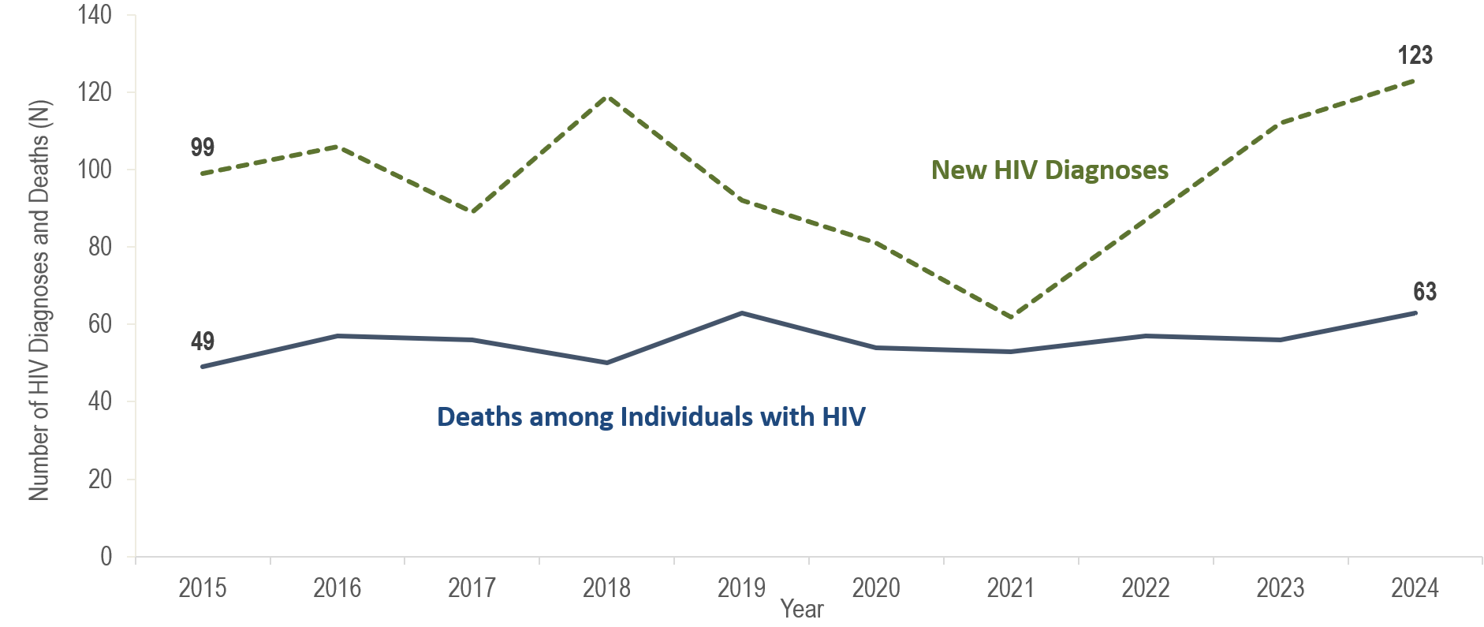
Number of new HIV infection diagnoses and deaths among individuals reported with HIV infection, Southeast HSR, Massachusetts 2015–2024¹
¹ Please consider the impact of the COVID-19 pandemic on infectious disease screening, treatment, and surveillance in the interpretation of data from 2020 to 2022.
Data Source: Bureau of Infectious Disease and Laboratory Sciences, data are current as of 7/1/2025 and subject to change
Notes:
The figure is a trendline displaying the annual number of new HIV diagnoses and deaths among individuals with HIV for the most recent ten-year period.
In the Southeast HSR, the annual number of new HIV diagnoses increased by 20% from 99 in 2015 to 119 in 2018 and then decreased by 48% to 62 in 2021. However, caution should be used in the interpretation of this decline due to the impact of COVID-19 on access to HIV testing and care services, and case surveillance activities. From 2021 to 2024, the number of new HIV diagnoses increased by 61 cases, or 98%, to 123. The largest increases in HIV diagnoses from 2021 to 2024 in the Southeast HSR were among non-US born individuals (from 23 to 63), Black (non-Hispanic) individuals (from 24 to 62), and individuals with NIR for exposure mode (from 17 to 45).
The number of deaths due to any cause among individuals reported with HIV increased by 29% from 49 in 2015 to 63 in 2024.

Slide 11
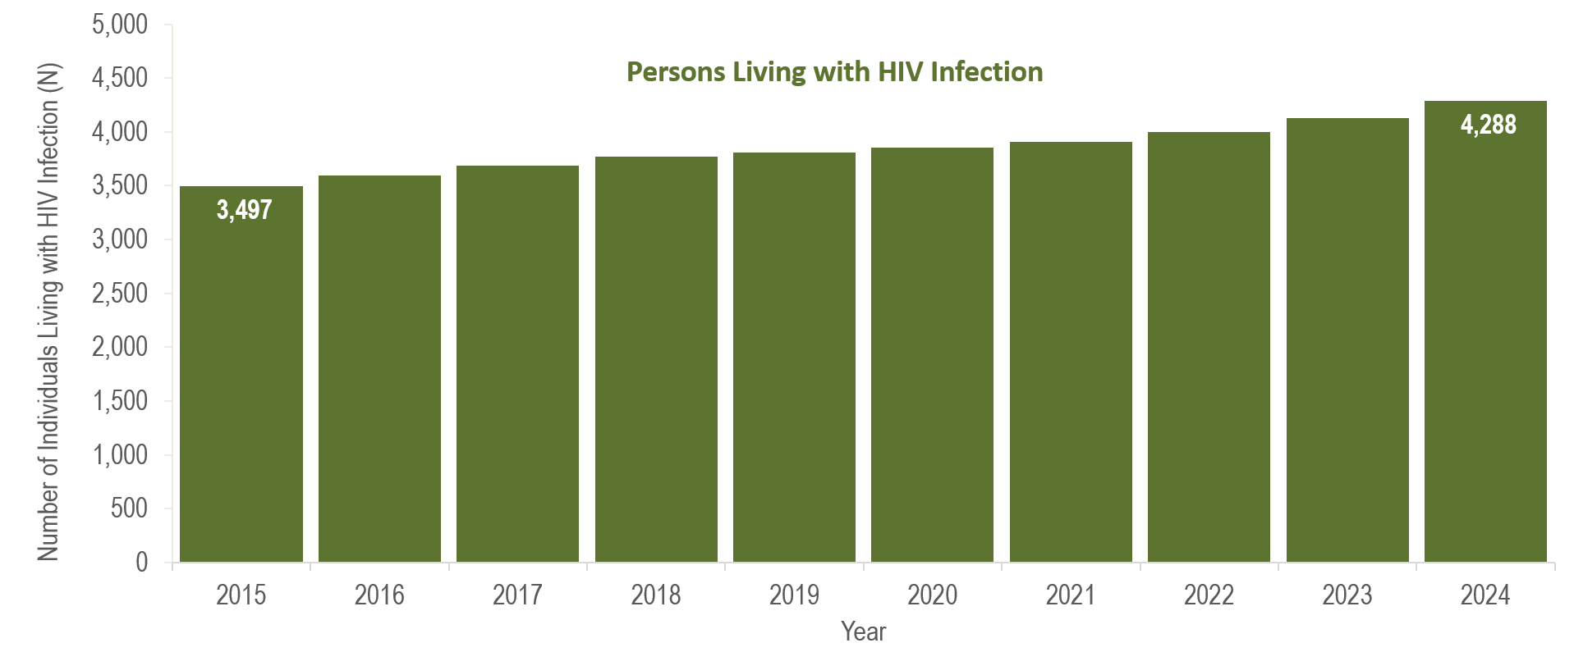
Number of persons living with HIV infection,¹
Southeast HSR, Massachusetts 2015–2024²
¹ Number of persons living with HIV infection on 12/31 of each year.
² Please consider the impact of the COVID-19 pandemic on infectious disease screening, treatment, and surveillance in the interpretation of data from 2020 to 2022.
Data Source: Bureau of Infectious Disease and Laboratory Sciences, data are current as of 7/1/2025 and subject to change
Notes:
The figure is a bar chart displaying a trend in the annual number of individuals living with HIV infection for the most recent ten-year period.
From 2015 to 2024, the number of persons living with HIV infection at the end of these years increased by 23% (from 3,497 to 4,288).

Slide 12
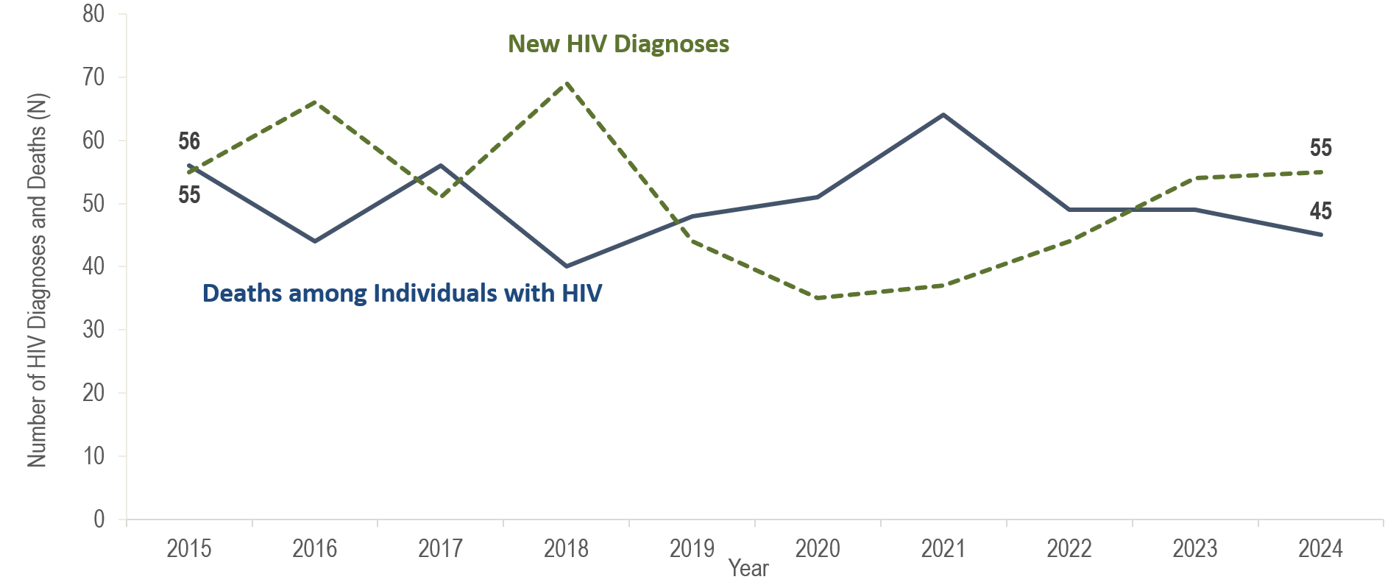
Number of new HIV infection diagnoses and deaths among individuals reported with HIV infection, Western HSR, Massachusetts 2015–2024¹
¹ Please consider the impact of the COVID-19 pandemic on infectious disease screening, treatment, and surveillance in the interpretation of data from 2020 to 2022.
Data Source: Bureau of Infectious Disease and Laboratory Sciences, data are current as of 7/1/2025 and subject to change
Notes:
The figure is a trendline displaying the annual number of new HIV diagnoses and deaths among individuals with HIV for the most recent ten-year period.
In the Western HSR, the annual number of new HIV diagnoses decreased by 36% from 55 in 2015 to 35 in 2020. However, caution should be used in the interpretation of this decline due to the impact of COVID-19 on access to HIV testing and care services, and case surveillance activities. Subsequently, the number of new HIV diagnoses increased by 57% from 2020 (N=35) to 2024 (N=55). The largest increases in HIV diagnoses from 2020 to 2024 in the Western HSR were among individuals AMAB (from 25 to 47), Hispanic/Latinx individuals (from 12 to 25), individuals with male-to-male sex (MSM) exposure mode (from 13 to 34), and individuals aged 20–29 years (from 8 to 19).
From 2015 to 2024, the number of deaths due to any cause among individuals reported with HIV infection fluctuated but overall decreased by 20% from 56 to 45.

Slide 13
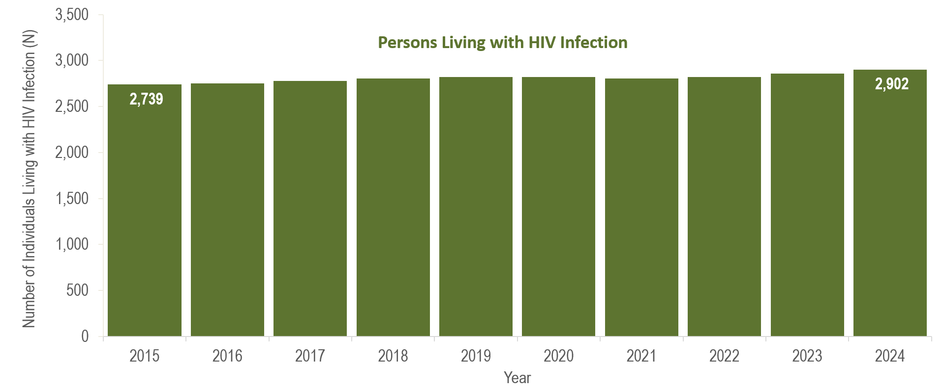
Number of persons living with HIV infection,¹
Western HSR, Massachusetts 2015–2024²
¹ Number of persons living with HIV infection on 12/31 of each year.
² Please consider the impact of the COVID-19 pandemic on infectious disease screening, treatment, and surveillance in the interpretation of data from 2020 to 2022.
Data Source: Bureau of Infectious Disease and Laboratory Sciences, data are current as of 7/1/2025 and subject to change
Notes:
The figure is a bar chart displaying a trend in the annual number of individuals living with HIV infection for the most recent ten-year period.
From 2015 to 2024, the number of persons living with HIV infection at the end of these years increased by 6% (from 2,739 to 2,902).

Slide 14
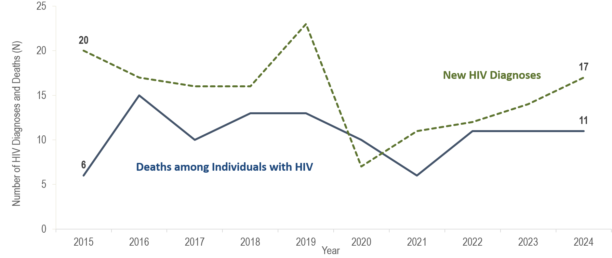
Number of new HIV infection diagnoses and deaths among individuals reported with HIV infection, Barnstable, Dukes, and Nantucket Counties,
Massachusetts 2015–2024¹
¹ Please consider the impact of the COVID-19 pandemic on infectious disease screening, treatment, and surveillance in the interpretation of data from 2020 to 2022.
Data Source: Bureau of Infectious Disease and Laboratory Sciences, data are current as of 7/1/2025 and subject to change
Notes:
The figure is a trendline displaying the annual number of new HIV diagnoses and deaths among individuals with HIV for the most recent ten-year period.
In Barnstable, Dukes, and Nantucket Counties from 2015 to 2024, the annual number of new HIV diagnoses ranged between seven and 23, and deaths from all causes among individuals reported with HIV infection remained between six and 15.

Slide 15
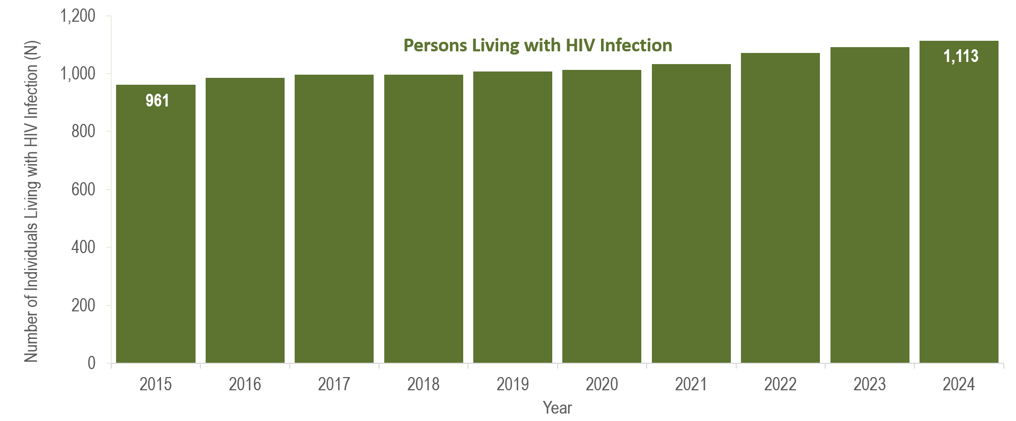
Number of persons living with HIV infection,¹
Barnstable, Dukes, and Nantucket Counties, Massachusetts 2015–2024²
¹ Number of persons living with HIV infection on 12/31 of each year.
² Please consider the impact of the COVID-19 pandemic on infectious disease screening, treatment, and surveillance in the interpretation of data from 2020 to 2022.
Data Source: Bureau of Infectious Disease and Laboratory Sciences, data are current as of 7/1/2025 and subject to change
Notes:
The figure is a bar chart displaying a trend in the annual number of individuals living with HIV infection for the most recent ten-year period.
In Barnstable, Dukes, and Nantucket Counties from 2015 to 2024, the number of persons living with HIV infection at the end of these years increased by 16% (from 951 to 1,113).

Slide 16
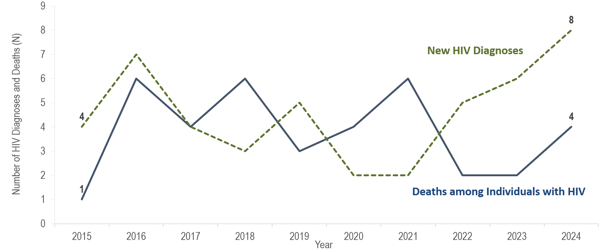
Number of new HIV infection diagnoses and deaths among individuals reported with HIV infection, Berkshire County, Massachusetts 2015–2024¹
¹ Please consider the impact of the COVID-19 pandemic on infectious disease screening, treatment, and surveillance in the interpretation of data from 2020 to 2022.
Data Source: Bureau of Infectious Disease and Laboratory Sciences, data are current as of 7/1/2025 and subject to change
Notes:
The figure is a trendline displaying the annual number of new HIV diagnoses and deaths among individuals with HIV for the most recent ten-year period.
In Berkshire County from 2015 to 2024, the annual number of new HIV diagnoses ranged between two and eight, and deaths from all causes among individuals reported with HIV infection remained at six or fewer. The number of persons living with HIV infection at the end of these years increased by 20% from 211 to 254.

Slide 17
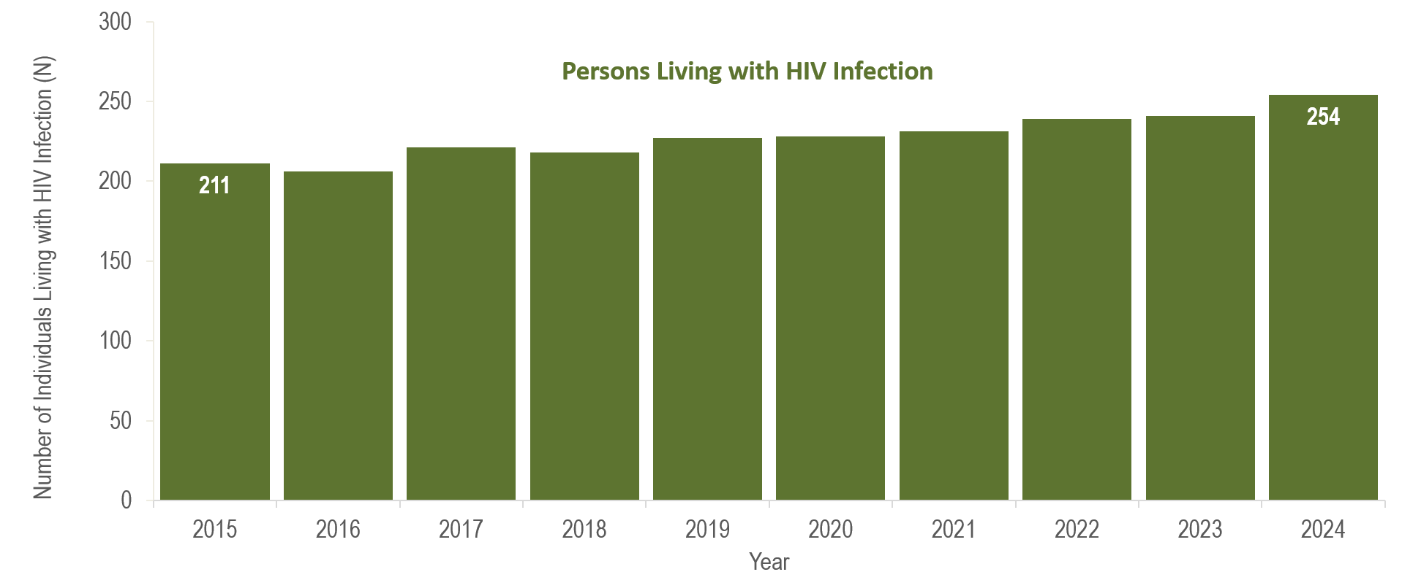
Number of persons living with HIV infection,¹
Berkshire County, Massachusetts 2015–2024²
¹ Number of persons living with HIV infection on 12/31 of each year.
² Please consider the impact of the COVID-19 pandemic on infectious disease screening, treatment, and surveillance in the interpretation of data from 2020 to 2022.
Data Source: Bureau of Infectious Disease and Laboratory Sciences, data are current as of 7/1/2025 and subject to change
Notes:
The figure is a bar chart displaying a trend in the annual number of individuals living with HIV infection for the most recent ten-year period.
In Berkshire County from 2015 to 2024, the number of persons living with HIV infection at the end of these years increased by 20% from 211 to 254.

Slide 18
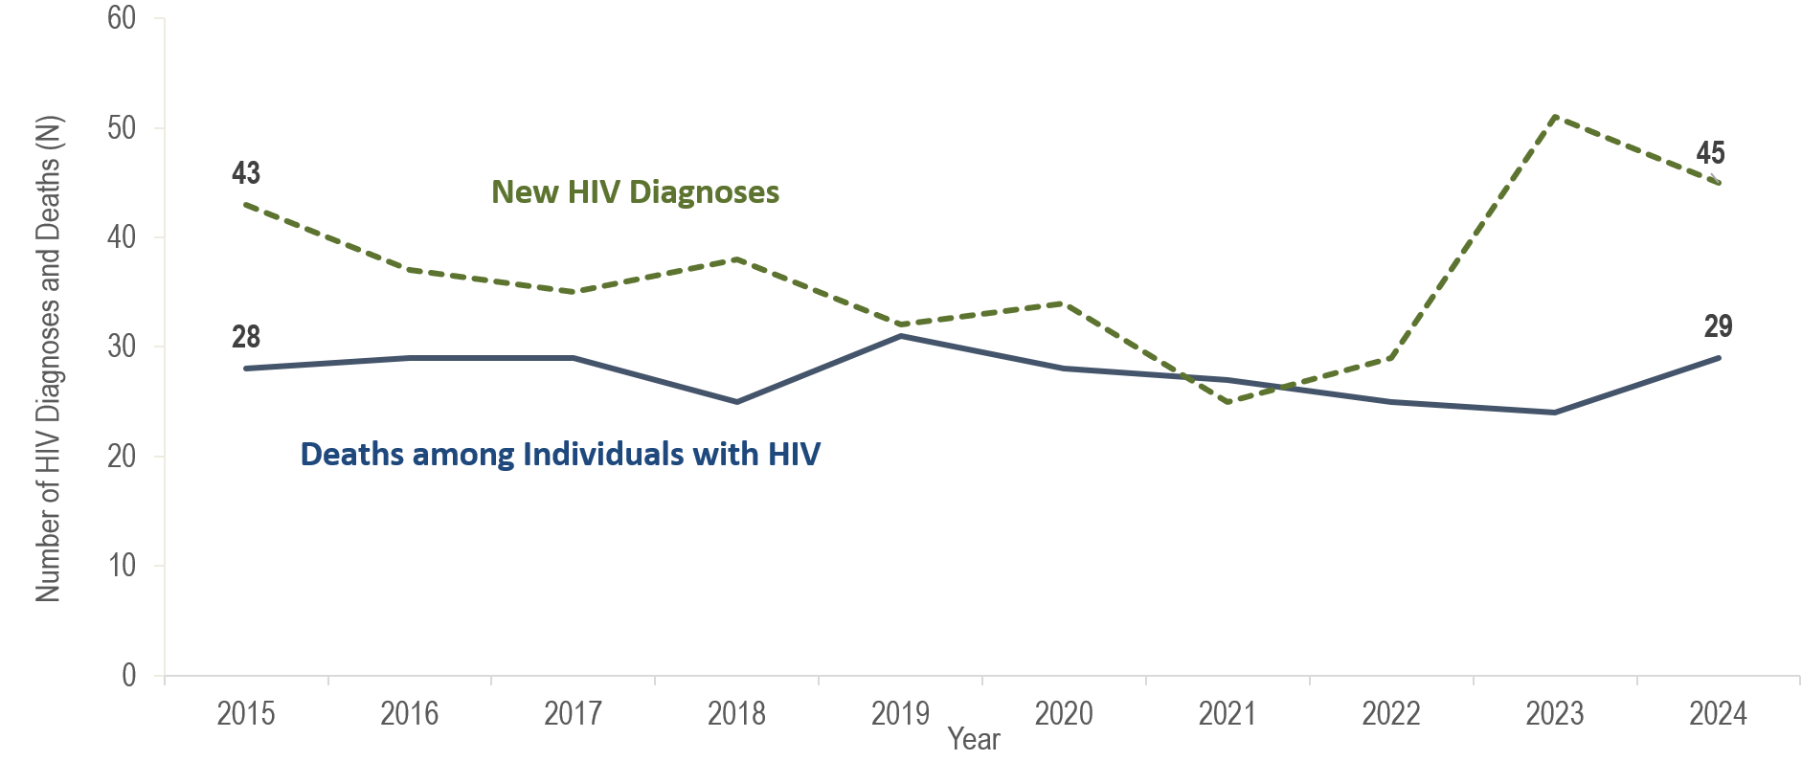
Number of new HIV infection diagnoses and deaths among individuals reported with HIV infection, Bristol County, Massachusetts 2015–2024¹
¹ Please consider the impact of the COVID-19 pandemic on infectious disease screening, treatment, and surveillance in the interpretation of data from 2020 to 2022.
Data Source: Bureau of Infectious Disease and Laboratory Sciences, data are current as of 7/1/2025 and subject to change
Notes:
The figure is a trendline displaying the annual number of new HIV diagnoses and deaths among individuals with HIV for the most recent ten-year period.
In Bristol County, the annual number of new HIV diagnoses decreased by 42% from 43 in 2015 to 25 in 2021. However, caution should be used in the interpretation of this decline due to the impact of COVID-19 on access to HIV testing and care services, and case surveillance activities. The number of new HIV diagnoses increased by 26 cases, or 104%, from 25 in 2021 to a ten-year high of 51 in 2023 and then decreased by 12% to 45 in 2024. The largest increases in HIV diagnoses from 2021 to 2023 in Bristol County were among individuals assigned male at birth (AMAB) (from 18 to 38), Black (non-Hispanic) individuals (from 6 to 16) and White (non-Hispanic) individuals (from 15 to 24), and individuals with MSM exposure mode (from 11 to 20) and NIR for exposure mode (from 5 to 13), and individuals aged 30–39 years old (from 8 to 18).
In Bristol County, from 2015 to 2024, the number of deaths due to any cause among individuals reported with HIV infection remained relatively stable, ranging from a low of 24 in 2023 to a high of 31 in 2019. There were 29 deaths in 2024.

Slide 19
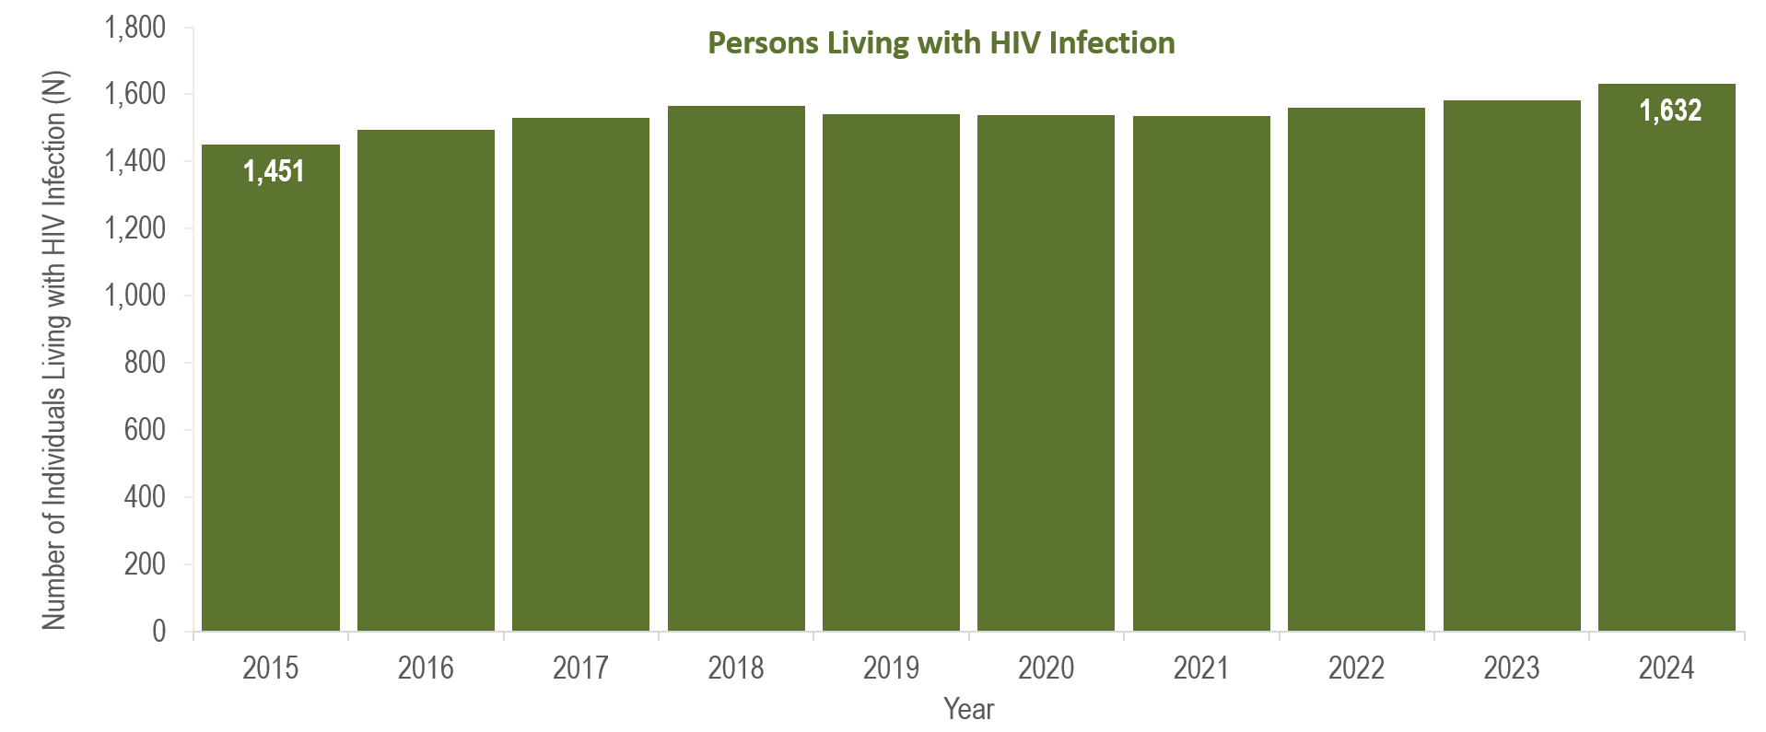
Number of persons living with HIV infection,¹
Bristol County, Massachusetts 2015–2024²
¹ Number of persons living with HIV infection on 12/31 of each year.
² Please consider the impact of the COVID-19 pandemic on infectious disease screening, treatment, and surveillance in the interpretation of data from 2020 to 2022.
Data Source: Bureau of Infectious Disease and Laboratory Sciences, data are current as of 7/1/2025 and subject to change
Notes:
The figure is a bar chart displaying a trend in the annual number of individuals living with HIV infection for the most recent ten-year period.
From 2015 to 2024, the number of persons living with HIV infection at the end of these years increased by 13% (from 1,451 to 1,632).

Slide 20
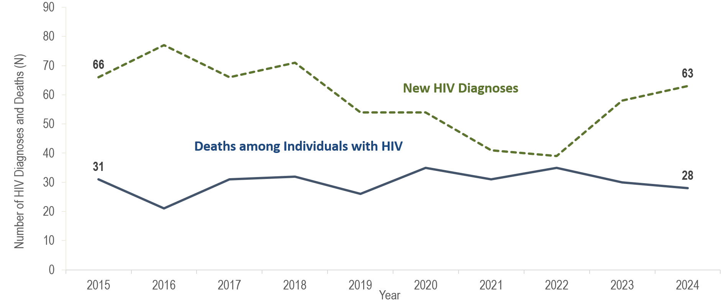
Number of new HIV infection diagnoses and deaths among individuals reported with HIV infection, Essex County, Massachusetts 2015–2024¹
¹ Please consider the impact of the COVID-19 pandemic on infectious disease screening, treatment, and surveillance in the interpretation of data from 2020 to 2022.
Data Source: Bureau of Infectious Disease and Laboratory Sciences, data are current as of 7/1/2025 and subject to change
Notes:
The figure is a trendline displaying the annual number of new HIV diagnoses and deaths among individuals with HIV for the most recent ten-year period.
In Essex County, the annual number of new HIV diagnoses decreased by 41% from 66 in 2015 to 39 in 2022. However, caution should be used in the interpretation of this decline due to the impact of COVID-19 on access to HIV testing and care services, and case surveillance activities. The number of new HIV diagnoses returned to pre-pandemic levels in 2023 (N=58), increasing by 49% compared to the prior year, and then by an additional 9% in 2024 (N=63). This compares to a statewide increase in HIV diagnoses of 22% in 2023 and 10% in 2024. The largest increases in HIV diagnoses from 2022 to 2024 in Essex County were among individuals AFAB (from to 8 to 27), non-US born individuals (from 19 to 38), Hispanic/Latinx individuals (from 18 to 30), and individuals with presumed heterosexual sex exposure mode (from <5 to 15).
In Essex County, from 2015 to 2024, the number of deaths due to any cause among individuals reported with HIV infection remained relatively stable, ranging from a low of 21 in 2016 to a high of 35 in 2020 and 2022. There were 28 deaths reported in 2024.

Slide 21
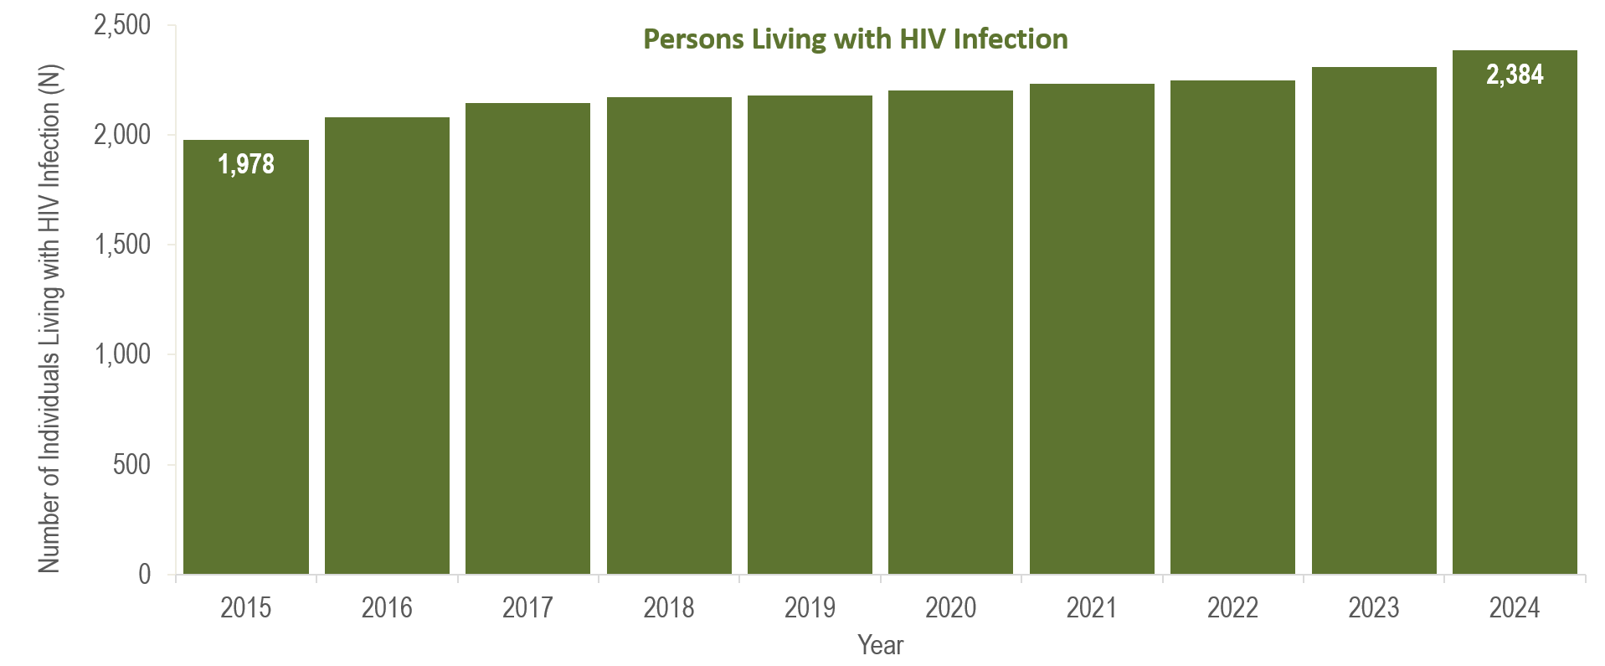
Number of persons living with HIV infection,¹
Essex County, Massachusetts 2015–2024²
¹ Number of persons living with HIV infection on 12/31 of each year.
² Please consider the impact of the COVID-19 pandemic on infectious disease screening, treatment, and surveillance in the interpretation of data from 2020 to 2022.
Data Source: Bureau of Infectious Disease and Laboratory Sciences, data are current as of 7/1/2025 and subject to change
Notes:
The figure is a bar chart displaying a trend in the annual number of individuals living with HIV infection for the most recent ten-year period.
From 2015 to 2024, the number of persons living with HIV infection at the end of these years increased by 21% (from 1,978 to 2,384).

Slide 22
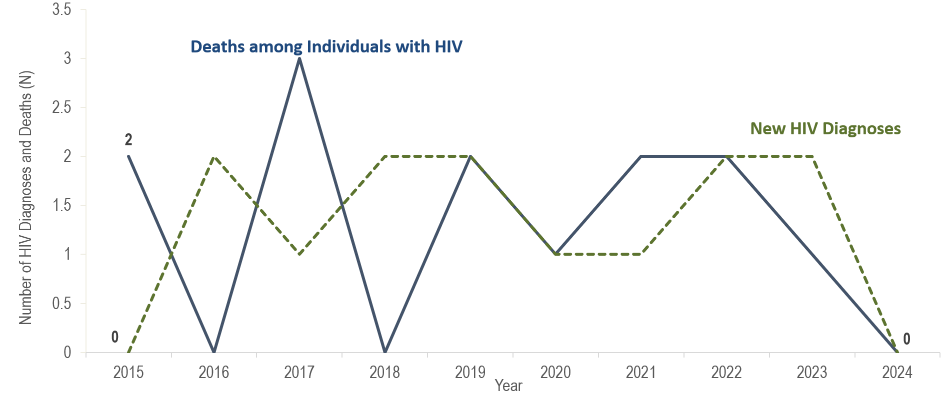
Number of new HIV infection diagnoses and deaths among individuals reported with HIV infection, Franklin County, Massachusetts 2015–2024¹
¹ Please consider the impact of the COVID-19 pandemic on infectious disease screening, treatment, and surveillance in the interpretation of data from 2020 to 2022.
Data Source: Bureau of Infectious Disease and Laboratory Sciences, data are current as of 7/1/2025 and subject to change
Notes:
The figure is a trendline displaying the annual number of new HIV diagnoses and deaths among individuals with HIV for the most recent ten-year period.
In Franklin County from 2015 to 2024, the annual number of new HIV diagnoses remained between zero and two, and deaths among individuals reported with HIV remained between zero and three.

Slide 23
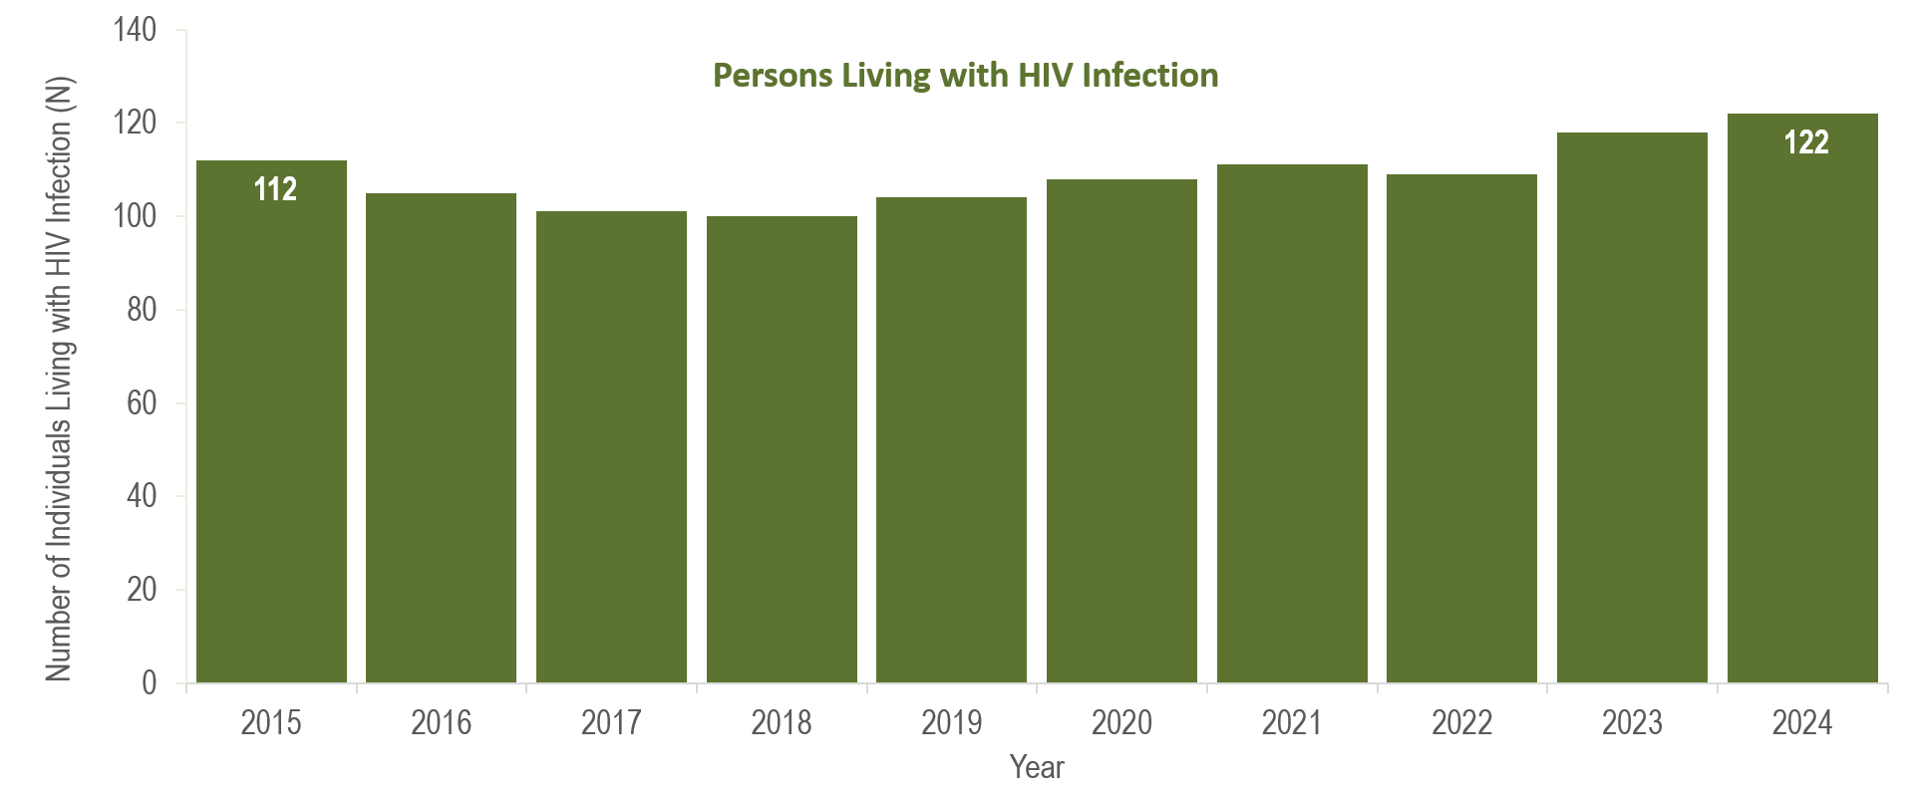
Number of persons living with HIV infection,¹
Franklin County, Massachusetts 2015–2024²
¹ Number of persons living with HIV infection on 12/31 of each year.
² Please consider the impact of the COVID-19 pandemic on infectious disease screening, treatment, and surveillance in the interpretation of data from 2020 to 2022.
Data Source: Bureau of Infectious Disease and Laboratory Sciences, data are current as of 7/1/2025 and subject to change
Notes:
The figure is a bar chart displaying a trend in the annual number of individuals living with HIV infection for the most recent ten-year period.
In Franklin County from 2015 to 2024, the number of persons living with HIV infection at the end of these years ranged from 100 to 122.

Slide 24
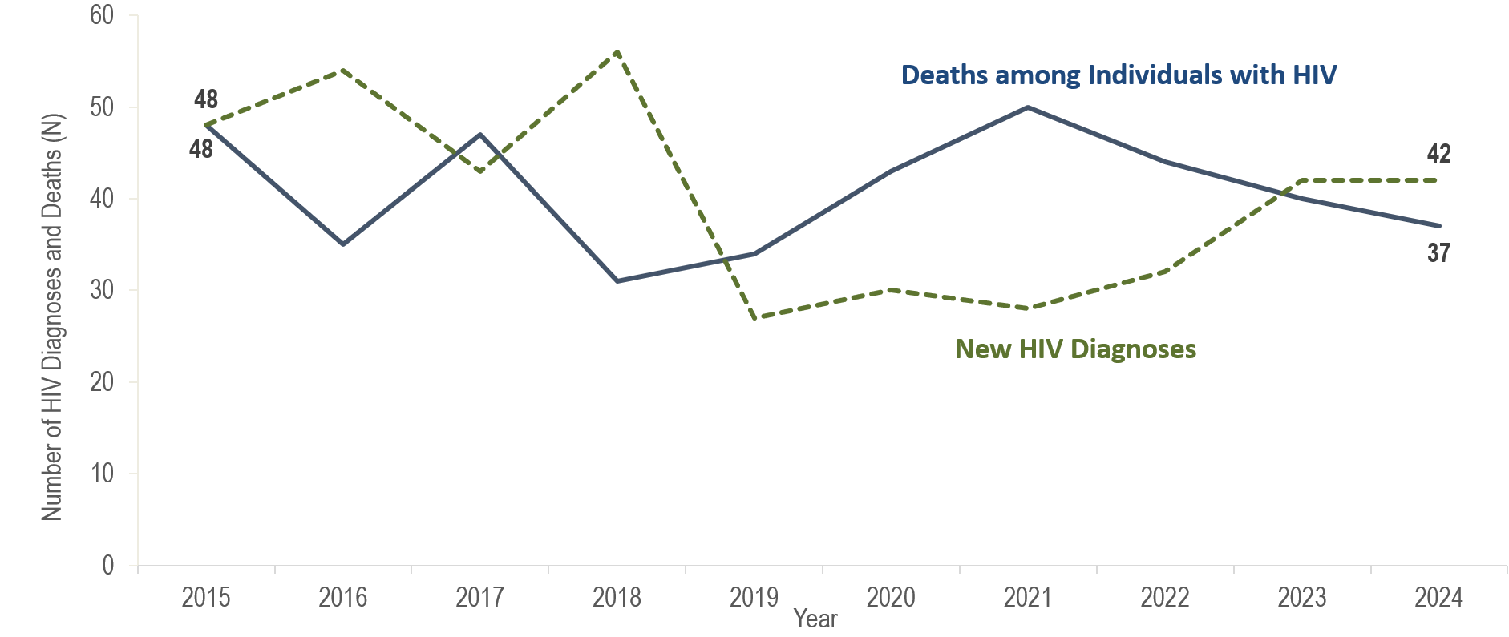
Number of new HIV infection diagnoses and deaths among individuals reported with HIV infection, Hampden County, Massachusetts 2015–2024¹
¹ Please consider the impact of the COVID-19 pandemic on infectious disease screening, treatment, and surveillance in the interpretation of data from 2020 to 2022.
Data Source: Bureau of Infectious Disease and Laboratory Sciences, data are current as of 7/1/2025 and subject to change
Notes:
The figure is a trendline displaying the annual number of new HIV diagnoses and deaths among individuals with HIV for the most recent ten-year period.
In Hampden County, the annual number of new HIV diagnoses ranged from 43 (2017) to 56 (2018) from 2015 to 2018, then declined to a lower range of 27 (2019) to 32 (2022) from 2019 to 2022. Subsequently, the number of new HIV diagnoses increased by 31% to 42 in 2023 (compared to the prior year) and then remained at 42 in 2024. This compares to a statewide increase in HIV diagnoses of 22% from 2022 to 2023, followed by an additional 10% increase from 2023 to 2024. The largest increases in HIV diagnoses from 2022 to 2024 in Hampden County were among individuals AMAB (from 24 to 38), Hispanic/Latinx individuals (from 13 to 21), individuals with male-to-male sex (MSM) exposure mode (from 13 to 28), and individuals aged 20–29 years old (from 7 to 17).
From 2015 to 2024, the number of deaths due to any cause among individuals reported with HIV infection ranged from a low of 31 in 2018 to a high of 50 in 2022; there were 37 deaths reported in 2024.

Slide 25
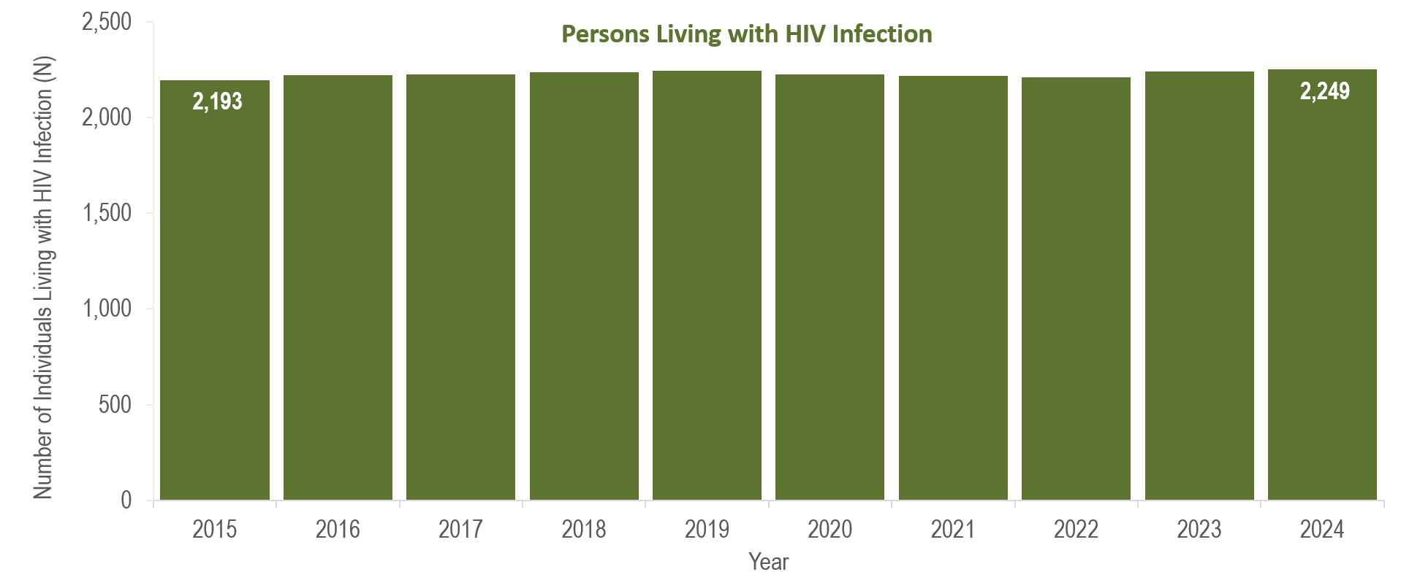
Number of persons living with HIV infection,¹
Hampden County, Massachusetts 2015–2024²
¹ Number of persons living with HIV infection on 12/31 of each year.
² Please consider the impact of the COVID-19 pandemic on infectious disease screening, treatment, and surveillance in the interpretation of data from 2020 to 2022.
Data Source: Bureau of Infectious Disease and Laboratory Sciences, data are current as of 7/1/2025 and subject to change
Notes:
The figure is a bar chart displaying a trend in the annual number of individuals living with HIV infection for the most recent ten-year period.
In Hampden County from 2015 to 2024, the number of persons living with HIV infection at the end of these years increased by 3% (from 2,193 to 2,249.

Slide 26
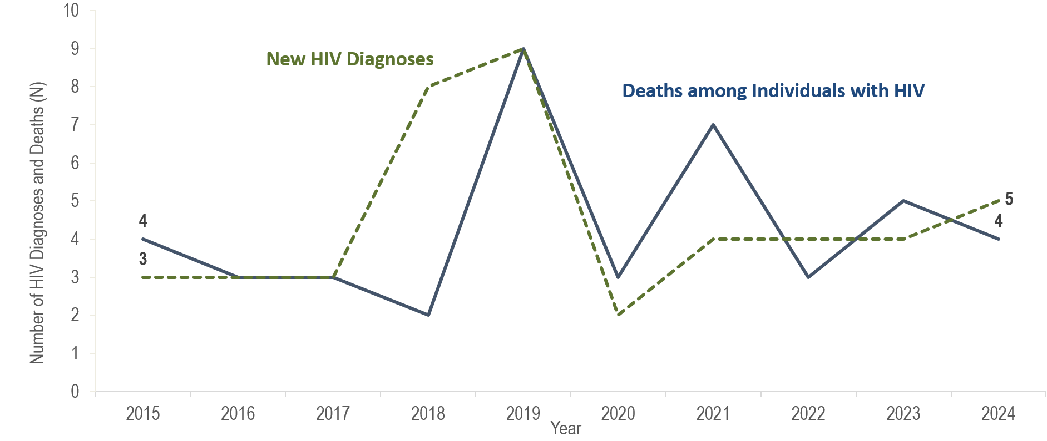
Number of new HIV infection diagnoses and deaths among individuals reported with HIV infection, Hampshire County, Massachusetts 2015–2024¹
¹ Please consider the impact of the COVID-19 pandemic on infectious disease screening, treatment, and surveillance in the interpretation of data from 2020 to 2022.
Data Source: Bureau of Infectious Disease and Laboratory Sciences, data are current as of 7/1/2025 and subject to change
Notes:
The figure is a trendline displaying the annual number of new HIV diagnoses and deaths among individuals with HIV for the most recent ten-year period.
In Hampshire County from 2015 to 2024, the annual number of both new HIV diagnoses and deaths among individuals reported with HIV remained between two and nine.

Slide 27
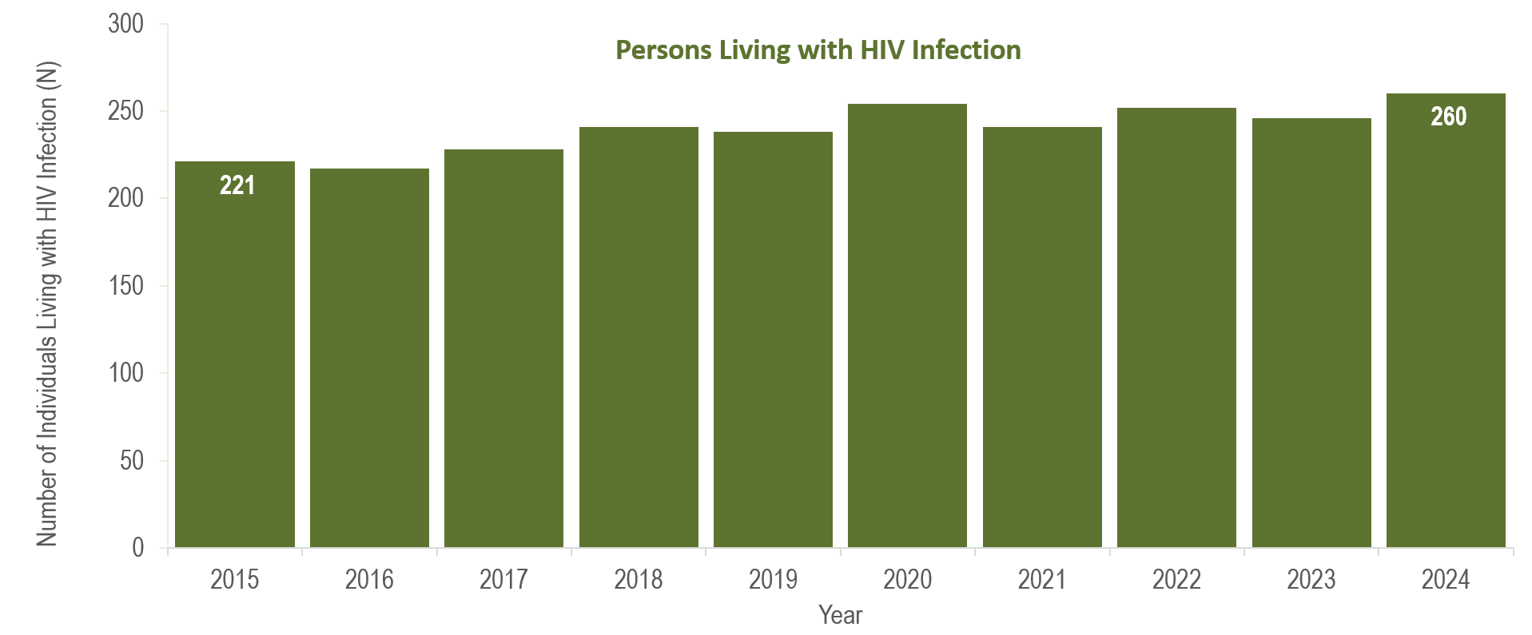
Number of persons living with HIV infection,¹
Hampshire County, Massachusetts 2015–2024²
¹ Number of persons living with HIV infection on 12/31 of each year.
² Please consider the impact of the COVID-19 pandemic on infectious disease screening, treatment, and surveillance in the interpretation of data from 2020 to 2022.
Data Source: Bureau of Infectious Disease and Laboratory Sciences, data are current as of 7/1/2025 and subject to change
Notes:
The figure is a bar chart displaying a trend in the annual number of individuals living with HIV infection for the most recent ten-year period.
In Hampshire County from 2015 to 2024, the number of persons living with HIV infection at the end of these years increased from 221 to 260.

Slide 28
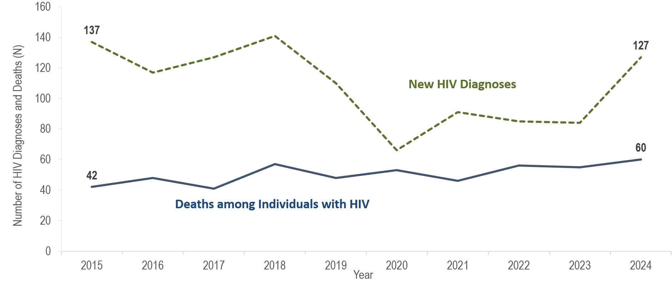
Number of new HIV infection diagnoses and deaths among individuals reported with HIV infection, Middlesex County, Massachusetts 2015–2024¹
¹ Please consider the impact of the COVID-19 pandemic on infectious disease screening, treatment, and surveillance in the interpretation of data from 2020 to 2022.
Data Source: Bureau of Infectious Disease and Laboratory Sciences, data are current as of 7/1/2025 and subject to change
Notes:
The figure is a trendline displaying the annual number of new HIV diagnoses and deaths among individuals with HIV for the most recent ten-year period.
In Middlesex County, the annual number of new HIV diagnoses decreased by 52% from 137 in 2015 to 66 in 2020. However, caution should be used in the interpretation of this decline due to the impact of COVID-19 on access to HIV testing and care services, and case surveillance activities. Subsequently, the number of new HIV diagnoses increased from 66 in 2020 to 84 in 2023 (27% increase), then by an additional 51% to 127 in 2024. The largest increases in HIV diagnoses from 2023 to 2024 in Middlesex County were among Black (non-Hispanic) individuals (from 19 to 43), individuals with NIR for exposure mode (from 18 to 35), and individuals aged 20–29 years old (from 20 to 42).

Slide 29
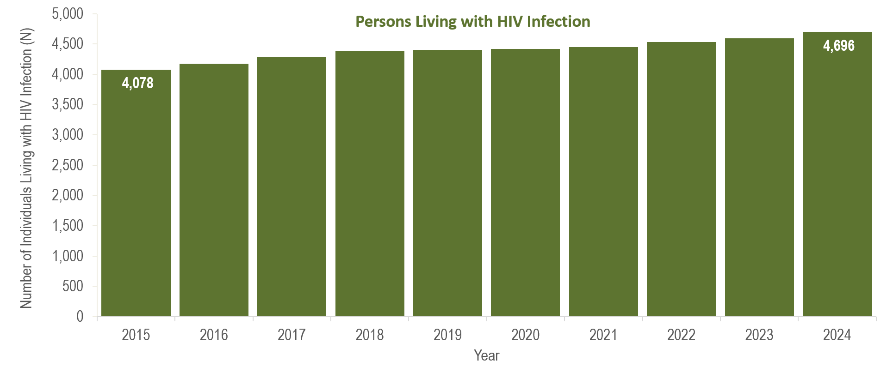
Number of persons living with HIV infection,¹
Middlesex County, Massachusetts 2015–2024²
¹ Number of persons living with HIV infection on 12/31 of each year.
² Please consider the impact of the COVID-19 pandemic on infectious disease screening, treatment, and surveillance in the interpretation of data from 2020 to 2022.
Data Source: Bureau of Infectious Disease and Laboratory Sciences, data are current as of 7/1/2025 and subject to change
Notes:
The figure is a bar chart displaying a trend in the annual number of individuals living with HIV infection for the most recent ten-year period.
In Middlesex County, from 2015 to 2024, the number of deaths due to any cause among individuals reported with HIV infection increased by 43% (from 42 to 60). From 2015 to 2024, the number of persons living with HIV infection at the end of these years increased by 15% (from 4,078 to 4,696).

Slide 30
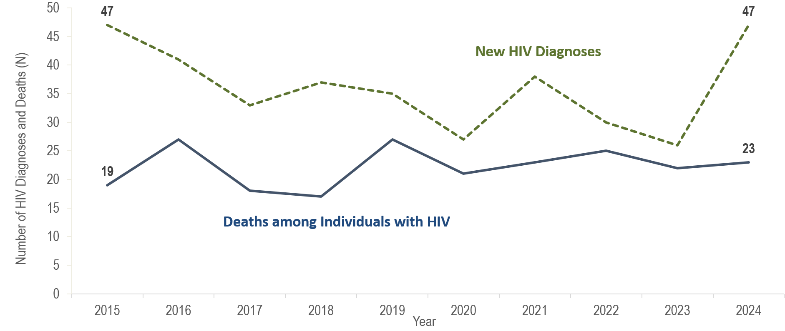
Number of new HIV infection diagnoses and deaths among individuals reported with HIV infection, Norfolk County, Massachusetts 2015–2024¹
¹ Please consider the impact of the COVID-19 pandemic on infectious disease screening, treatment, and surveillance in the interpretation of data from 2020 to 2022.
Data Source: Bureau of Infectious Disease and Laboratory Sciences, data are current as of 7/1/2025 and subject to change
Notes:
The figure is a trendline displaying the annual number of new HIV diagnoses and deaths among individuals with HIV for the most recent ten-year period.
In Norfolk County, the annual number of new HIV diagnoses decreased by 45% from 47 in 2015 to a ten-year low of 26 in 2023. However, caution should be used in the interpretation of this decline due to the impact of COVID-19 on access to HIV testing and care services, and case surveillance activities. Subsequently, the number of new HIV diagnoses increased by 81% to 47 in 2024 (compared to the prior year). The largest increases in HIV diagnoses from 2023 to 2024 in Norfolk County were among individuals AMAB (from 16 to 37), non-US born individuals (from 14 to 26), Black (non-Hispanic) individuals (from 11 to 28), and individuals with MSM (from 9 to 18) or NIR for exposure mode (from 8 to 18).
The number of deaths due to any cause among individuals reported with HIV in Norfolk County fluctuated from 2015 to 2024, ranging from a low of 17 (in 2018) to a high of 27 (in 2016 and 2019); there were 23 deaths reported in 2024.

Slide 31
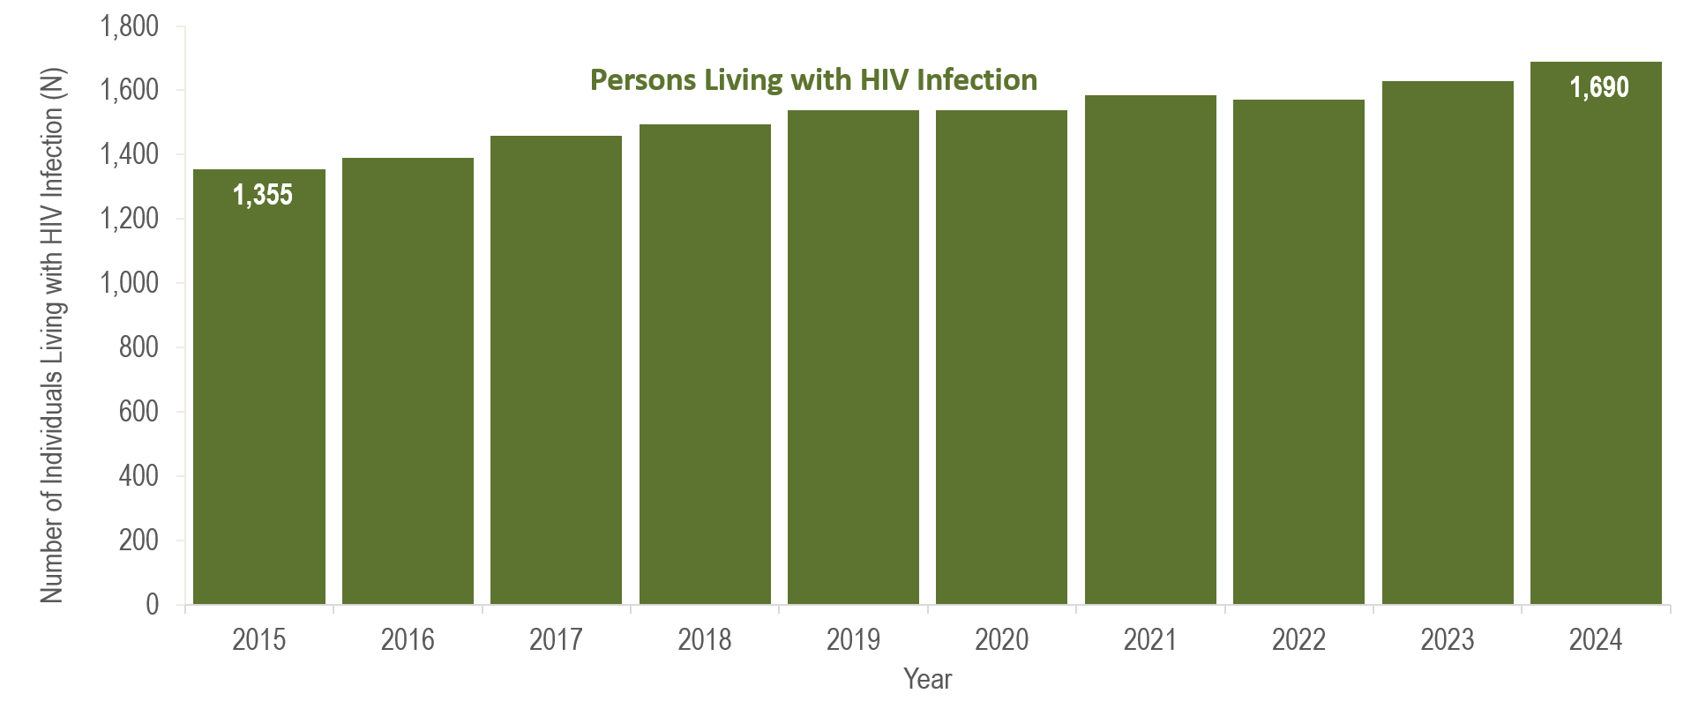
Number of persons living with HIV infection,¹
Norfolk County, Massachusetts 2015–2024²
¹ Number of persons living with HIV infection on 12/31 of each year.
² Please consider the impact of the COVID-19 pandemic on infectious disease screening, treatment, and surveillance in the interpretation of data from 2020 to 2022.
Data Source: Bureau of Infectious Disease and Laboratory Sciences, data are current as of 7/1/2025 and subject to change
Notes:
The figure is a bar chart displaying a trend in the annual number of individuals living with HIV infection for the most recent ten-year period.
In Norfolk County, from 2015 to 2024, the number of persons living with HIV infection at the end of these years increased by 25% (from 1,355 to 1,690).

Slide 32
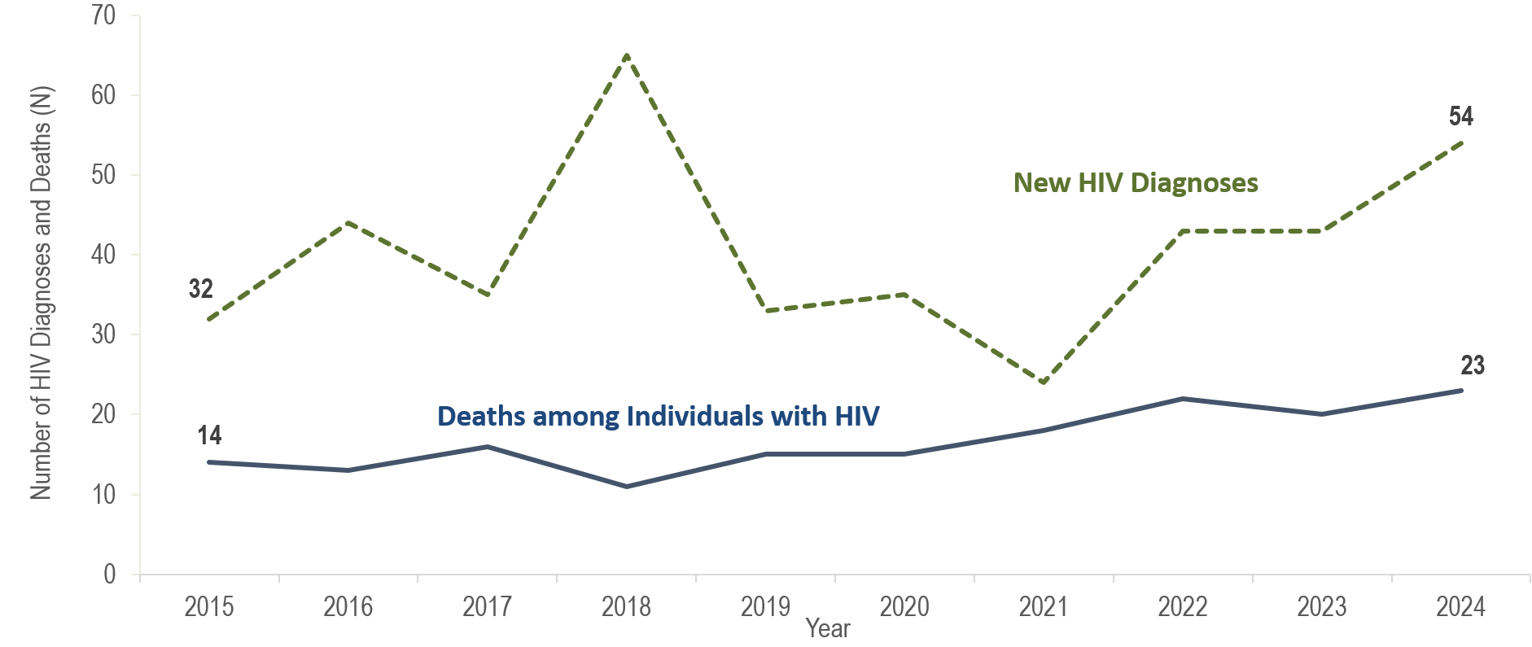
Number of new HIV infection diagnoses and deaths among individuals reported with HIV infection, Plymouth County, Massachusetts 2015–2024¹
¹ Please consider the impact of the COVID-19 pandemic on infectious disease screening, treatment, and surveillance in the interpretation of data from 2020 to 2022.
Data Source: Bureau of Infectious Disease and Laboratory Sciences, data are current as of 7/1/2025 and subject to change
Notes:
The figure is a trendline displaying the annual number of new HIV diagnoses and deaths among individuals with HIV for the most recent ten-year period.
The annual number of new HIV diagnoses in Plymouth County increased by 103% from 32 in 2015 to a ten-year high of 65 in 2018 and then decreased by 63% to a ten-year low of 24 cases in 2021. However, caution should be used in the interpretation of this decline due to the impact of COVID-19 on access to HIV testing and care services, and case surveillance activities. The number of new HIV diagnoses returned to pre-pandemic levels in 2022 (N=43), increasing by 19 cases, or 79%, compared to the prior year, remained at this level in 2023 (N=43), and then increased by 11 cases, or 26%, in 2024 (N=54). The largest increases in HIV diagnoses from 2023 to 2024 in Plymouth County were among US born individuals (from 14 to 22), White (non-Hispanic) individuals (from 11 to 16), and individuals with MSM exposure mode (from 12 to 18).
The number of deaths due to any cause among individuals reported with HIV infection increased by 64% from 14 in 2015 to 23 in 2024.

Slide 33
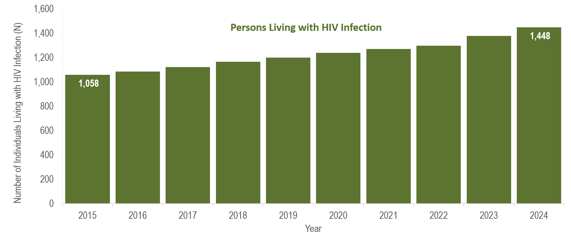
Number of persons living with HIV infection,¹
Plymouth County, Massachusetts 2015–2024²
¹ Number of persons living with HIV infection on 12/31 of each year.
² Please consider the impact of the COVID-19 pandemic on infectious disease screening, treatment, and surveillance in the interpretation of data from 2020 to 2022.
Data Source: Bureau of Infectious Disease and Laboratory Sciences, data are current as of 7/1/2025 and subject to change
Notes:
The figure is a bar chart displaying a trend in the annual number of individuals living with HIV infection for the most recent ten-year period.
From 2015 to 2024, the number of persons living with HIV infection at the end of these years increased by 37% (from 1,058 to 1,448).

Slide 34
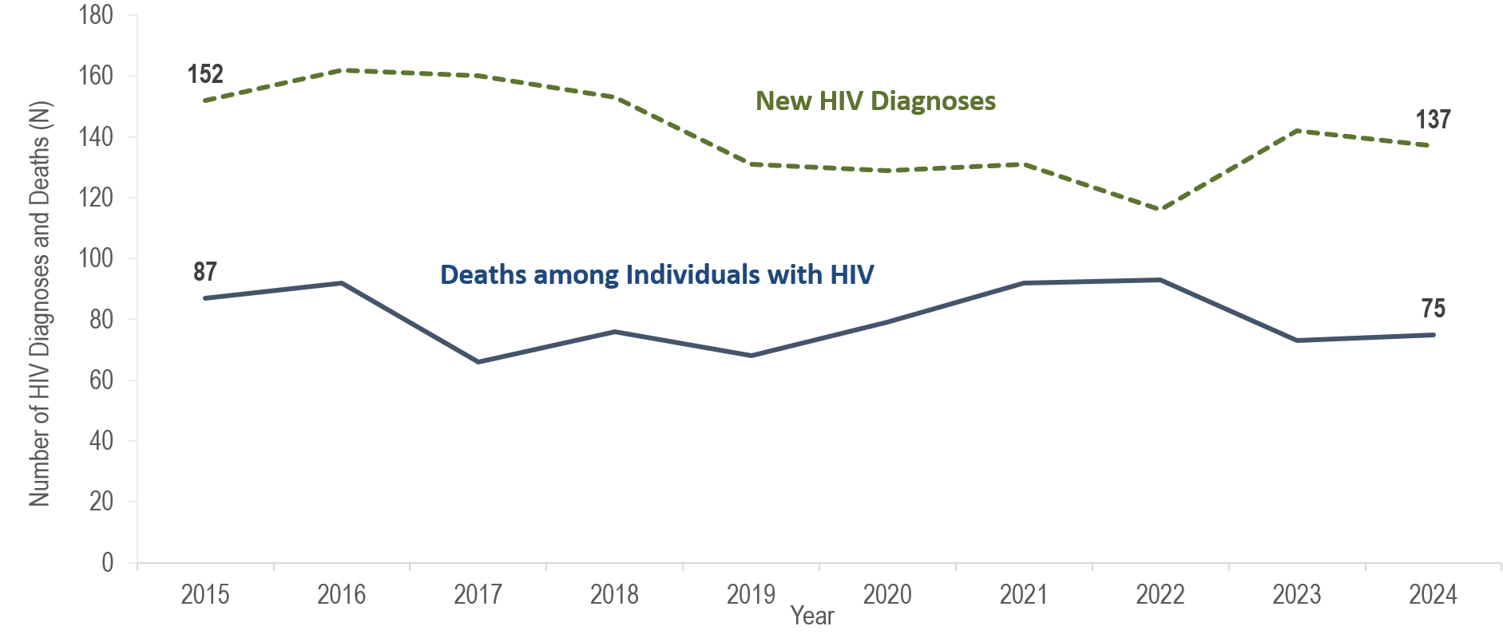
Number of new HIV infection diagnoses and deaths among individuals reported with HIV infection, Suffolk County, Massachusetts 2015–2024¹
¹ Please consider the impact of the COVID-19 pandemic on infectious disease screening, treatment, and surveillance in the interpretation of data from 2020 to 2022.
Data Source: Bureau of Infectious Disease and Laboratory Sciences, data are current as of 7/1/2025 and subject to change
Notes:
The figure is a trendline displaying the annual number of new HIV diagnoses and deaths among individuals with HIV for the most recent ten-year period.
Suffolk County was selected as one of 48 counties nationally that is prioritized for funding in the U.S. Health and Human Services’ Initiative “Ending the HIV Epidemic (EHE): A Plan for America”. In 2024, 23% (N=137/602) of individuals diagnosed with HIV infection, 23% (N=75/330) of individuals reported with HIV who died, and 26% (N=6,472/24,838) of individuals living with HIV infection in Massachusetts were residents of Suffolk County.
In Suffolk County, the annual number of new HIV diagnoses decreased by 24% from 152 in 2015 to 116 in 2022. However, caution should be used in the interpretation of this decline due to the impact of COVID-19 on access to HIV testing and care services, and case surveillance activities. The number of new HIV diagnoses returned to pre-pandemic levels in 2023 (N=142), increasing by 22%, compared to the prior year, and then remained at this higher level in 2024 (N=137), with a slight decrease of five diagnoses (4%, compared to 2023). Statewide, there was a 22% increase in HIV diagnoses from 2022 to 2023, followed by an additional 10% increase from 2023 to 2024. The largest increase in HIV diagnoses from 2022 to 2024 in Suffolk County was among individuals AMAB (from 83 to 102), non-US born individuals (from 61 to 79), Black (non-Hispanic) individuals (from 51 to 66), and individuals with male-to-male sex (MSM) exposure mode (from 42 to 61).
From 2015 to 2024, the number of deaths due to any cause among individuals reported with HIV infection fluctuated ranging from a low of 66 in 2017 to a high of 93 in 2022; there were 75 deaths in 2024.

Slide 35
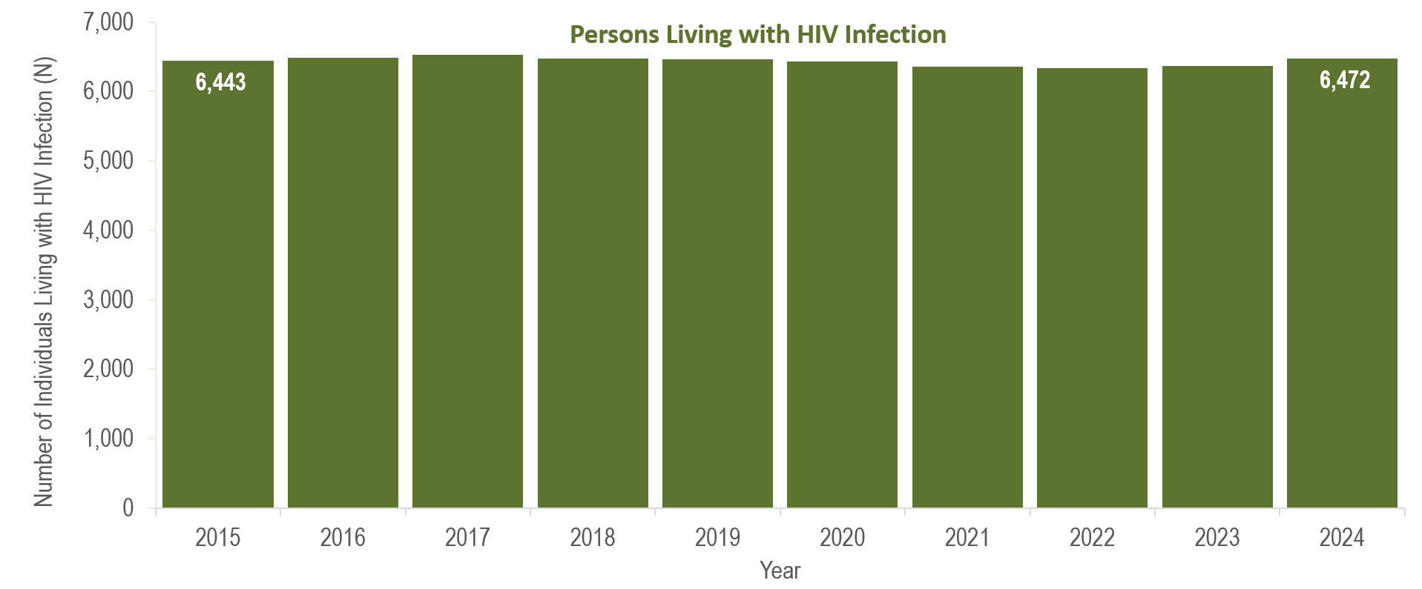
Number of persons living with HIV infection,¹
Suffolk County, Massachusetts 2015–2024²
¹ Number of persons living with HIV infection on 12/31 of each year.
² Please consider the impact of the COVID-19 pandemic on infectious disease screening, treatment, and surveillance in the interpretation of data from 2020 to 2022.
Data Source: Bureau of Infectious Disease and Laboratory Sciences, data are current as of 7/1/2025 and subject to change
Notes:
The figure is a bar chart displaying a trend in the annual number of individuals living with HIV infection for the most recent ten-year period.
From 2015 to 2024, the number of persons living with HIV infection at the end of these years remained relatively stable, with year-to-year changes of two percent or less.

Slide 36
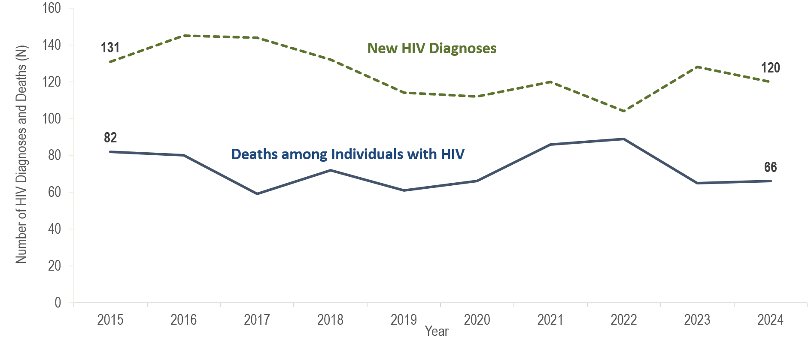
Number of new HIV infection diagnoses and deaths among individuals reported with HIV infection, City of Boston, Massachusetts 2015–2024¹
¹ Please consider the impact of the COVID-19 pandemic on infectious disease screening, treatment, and surveillance in the interpretation of data from 2020 to 2022.
Data Source: Bureau of Infectious Disease and Laboratory Sciences, data are current as of 7/1/2025 and subject to change
Notes:
The figure is a trendline displaying the annual number of new HIV diagnoses and deaths among individuals with HIV for the most recent ten-year period.
In Boston, the annual number of new HIV diagnoses decreased by 26% from 131 in 2015 to 104 in 2022. However, caution should be used in the interpretation of this decline due to the impact of COVID-19 on access to HIV testing and care services, and case surveillance activities. The number of new HIV diagnoses returned to pre-pandemic levels in 2023 (N=128), increasing by 23%, compared to the prior year, and then remained at this higher level in 2024 (N=120), with a small decrease of eight diagnoses (6%, compared to 2023). Statewide, there was a 22% increase in HIV diagnoses from 2022 to 2023, followed by an additional 10% increase from 2023 to 2024. The largest increase in HIV diagnoses from 2022 to 2024 in Boston was among individuals AMAB (from 73 to 87), non-US born individuals (from 54 to 67), Black (non-Hispanic) individuals (from 50 to 64), and individuals with male-to-male sex (MSM) exposure mode (from 37 to 48).
From 2015 to 2024, the number of deaths due to any cause among individuals reported with HIV infection fluctuated ranging from a low of 59 in 2017 to a high of 89 in 2022; there were 66 deaths in 2024. The number of persons living with HIV infection at the end of these years remained relatively stable, with year-to-year changes of two percent or less.

Slide 37
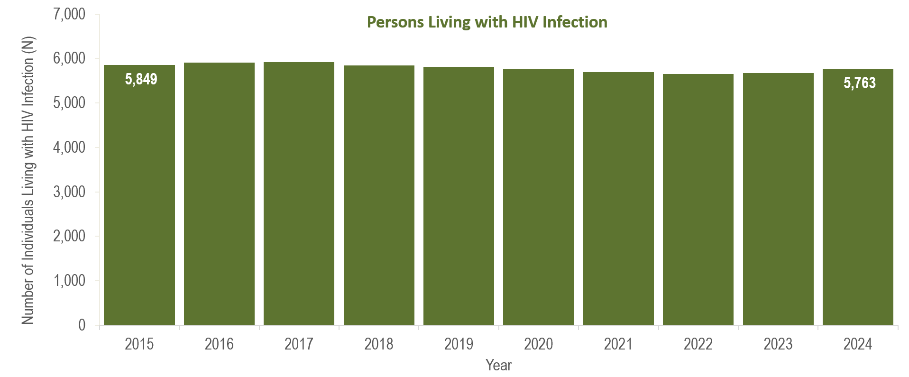
Number of persons living with HIV infection,¹
City of Boston, Massachusetts 2015–2024²
¹ Number of persons living with HIV infection on 12/31 of each year.
² Please consider the impact of the COVID-19 pandemic on infectious disease screening, treatment, and surveillance in the interpretation of data from 2020 to 2022.
Data Source: Bureau of Infectious Disease and Laboratory Sciences, data are current as of 7/1/2025 and subject to change
Notes:
The figure is a bar chart displaying a trend in the annual number of individuals living with HIV infection for the most recent ten-year period.
In Boston, from 2015 to 2024, the number of persons living with HIV infection at the end of these years remained relatively stable, with year-to-year changes of two percent or less.

Slide 38
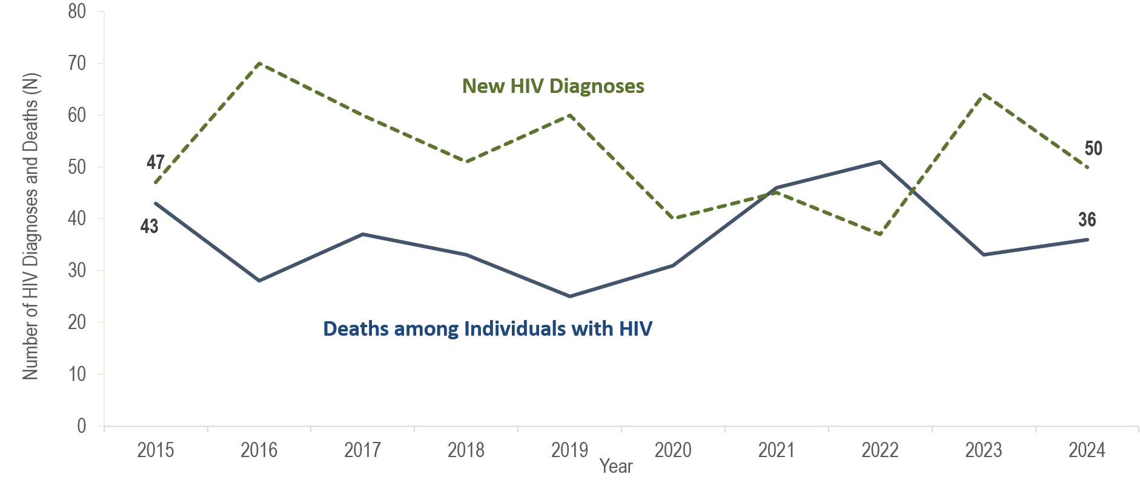
Number of new HIV infection diagnoses and deaths among individuals reported with HIV infection, Worcester County, Massachusetts 2015–2024¹
¹ Please consider the impact of the COVID-19 pandemic on infectious disease screening, treatment, and surveillance in the interpretation of data from 2020 to 2022.
Data Source: Bureau of Infectious Disease and Laboratory Sciences, data are current as of 7/1/2025 and subject to change
Notes:
The figure is a trendline displaying the annual number of new HIV diagnoses and deaths among individuals with HIV for the most recent ten-year period.
In Worcester County, the annual number of new HIV diagnoses increased by 49% from 47 in 2015 to 70 in 2016 and then decreased by 47% to 37 in 2022. However, caution should be used in the interpretation of this decline due to the impact of COVID-19 on access to HIV testing and care services, and case surveillance activities. In 2023, the number of new HIV diagnoses (N=64) returned to pre-pandemic levels, increasing by 27 cases, or 73%, compared to the prior year. This compares to a statewide increase in HIV diagnoses of 21% during the same time period. The largest increases in HIV diagnoses from 2022 to 2023 in Worcester County were among individuals AMAB (from 24 to 47), non-US born individuals (from 11 to 26), Black (non-Hispanic) individuals (from 6 to 24), and individuals with NIR for exposure mode (from <5 to 18). In 2024, the number of new HIV diagnoses (N=50) in Worcester County decreased by 14 cases, or 22%, compared to the prior year. Statewide, HIV diagnoses increased by 10% from 2023 to 2024.
The number of deaths due to any cause among individuals reported with HIV infection fluctuated, ranging from a low of 25 in 2019 to a high of 51 in 2022; there were 36 deaths reported in 2024.

Slide 39
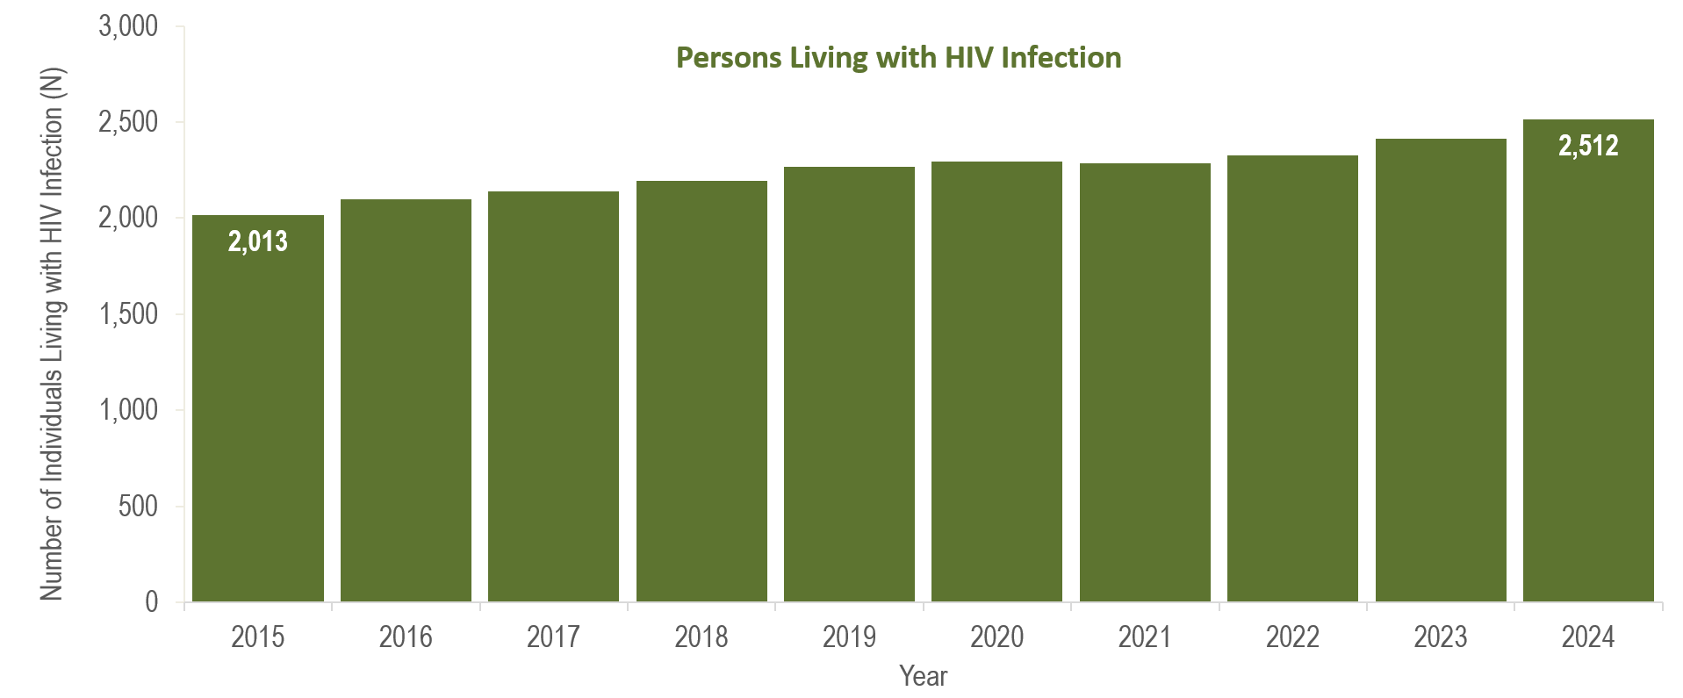
Number of persons living with HIV infection,¹
Worcester County, Massachusetts 2015–2024²
¹ Number of persons living with HIV infection on 12/31 of each year.
² Please consider the impact of the COVID-19 pandemic on infectious disease screening, treatment, and surveillance in the interpretation of data from 2020 to 2022.
Data Source: Bureau of Infectious Disease and Laboratory Sciences, data are current as of 7/1/2025 and subject to change
Notes:
The figure is a bar chart displaying a trend in the annual number of individuals living with HIV infection for the most recent ten-year period.
From 2015 to 2024, the number of persons living with HIV infection at the end of these years increased by 25% (from 2,013 to 2,512).

