Slide 1
Massachusetts HIV Epidemiologic Profile:
Data as of 1/1/2024
Statewide Report
Notes:
Suggested citation:
Massachusetts Department of Public Health, Bureau of Infectious Disease and Laboratory Sciences. Massachusetts HIV Epidemiologic Profile, Statewide Report – Data as of 1/1/2024 https://www.mass.gov/lists/hivaids-epidemiologic-profiles Published June 2024. Accessed [date].
Bureau of Infectious Disease and Laboratory Sciences
Massachusetts Department of Public Health
Jamaica Plain Campus/State Public Health Laboratory
305 South Street
Jamaica Plain, MA 02130
Questions about this report
Tel: (617) 983-6560
To reach the Reporting and Partner Services Line^{i}
Tel: (617) 983-6999
To speak to the on-call epidemiologist
Tel: (617) 983-6800
Questions about infectious disease reporting
Tel: (617) 983-6801
Requests for additional data
https://www.mass.gov/lists/infectious-disease-data-reports-and-requests
HIV Data Dashboard
https://www.mass.gov/info-details/hiv-data-dashboard
Slide sets for HIV Epidemiologic Profile Reports
https://www.mass.gov/lists/hivaids-epidemiologic-profiles
* Providers may use this number to report individuals newly diagnosed with a notifiable sexually transmitted infection, including HIV, or request partner services. Partner services is a free and confidential service for individuals recently diagnosed with a priority infection. The client-centered program offers counseling, linkage to other health and social services, anonymous notification of partners who were exposed and assistance with getting testing and treatment. For more information, see: https://www.mass.gov/service-details/partner-services-program-information-for-healthcare-providers)

Slide 2
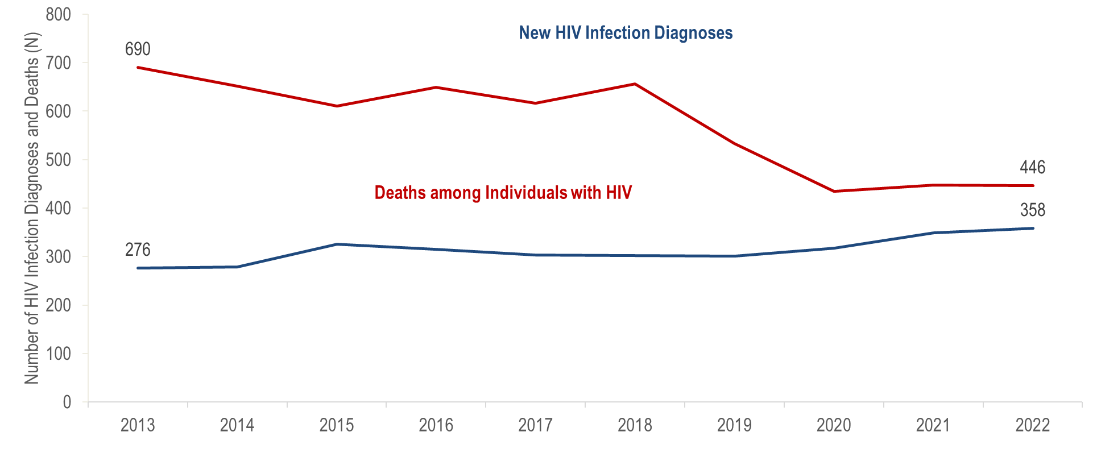
Number of new HIV infection diagnoses and deaths among individuals reported with HIV infection, Massachusetts 2013–2022¹
¹ Please consider the impact of the COVID-19 pandemic on infectious disease screening, treatment, and surveillance in the interpretation of 2020–2022 data.
Data Source: Bureau of Infectious Disease and Laboratory Sciences, data are current as of 1/1/2024 and subject to change
Notes:
The figure displays trends in the annual number of new HIV diagnoses and deaths among individuals with HIV/AIDS from 2013-2022.
After decreasing from 690 diagnoses in 2013 to approximately 640 diagnoses per year from 2014 to 2018 (five-year average = 637), the number of new HIV infection diagnoses declined to a ten-year low of 533 in 2019. In 2020, the number of new HIV infection diagnoses further declined to 435 and then remained at this lower level in 2021 and 2022, when there were 448 and 446 diagnoses, respectively. However, caution should be used in the interpretation of this decline and following stabilization due to the impact of COVID-19 on access to HIV testing and care services, and case surveillance activities. The number of deaths due to any cause among individuals reported with HIV infection increased by 30% from 276 in 2013 to 358 in 2022.

Slide 3
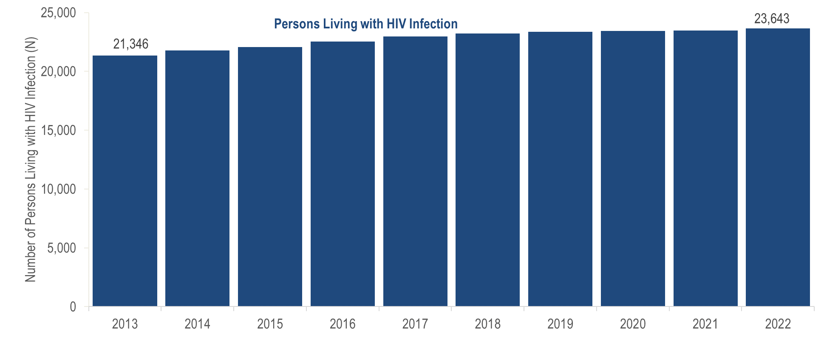
Number of persons living with HIV infection, Massachusetts 2013–2022¹
¹ Please consider the impact of the COVID-19 pandemic on infectious disease screening, treatment, and surveillance in the interpretation of 2020–2022 data.
Data Source: Bureau of Infectious Disease and Laboratory Sciences, data are current as of 1/1/2024 and subject to change
Notes:
The figure displays a trend in the annual number of persons living with HIV infection from 2013-2022.
The number of persons living with HIV infection (PLWH) in Massachusetts increased by 11% from 21,346 in 2013 to 23,643 in 2022.

Slide 4
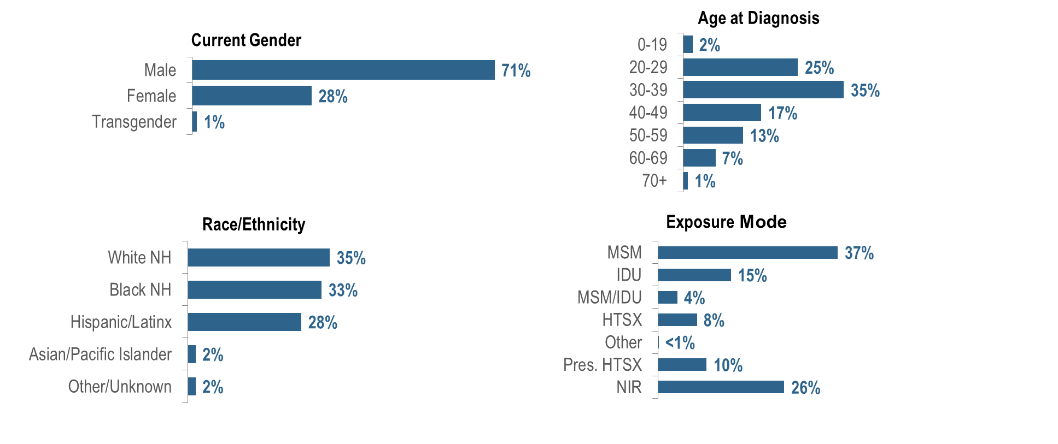
Percentage of individuals diagnosed with HIV infection by current gender, age, race/ethnicity, and exposure mode, Massachusetts 2020 – 2022 (N=1,329)¹
¹ Please consider the impact of the COVID-19 pandemic on infectious disease screening, treatment, and surveillance in the interpretation of 2020–2022 data.
NH = non-Hispanic; MSM=male-to-male sex; IDU=injection drug use; HTSX=heterosexual sex; Pres. HTSX=presumed heterosexual exposure, includes individuals assigned female at birth with a negative history of injection drug use who report having sex with an individual that identifies as male of unknown HIV status and risk; NIR=no identified risk; Data Source: Bureau of Infectious Disease and Laboratory Sciences, data are current as of 1/1/2024 and subject to change
Notes:
The figure is a series of bar charts displaying the distribution of recent HIV diagnoses by current gender, age, race/ethnicity, and exposure mode.
The number of individuals diagnosed with HIV infection has decreased over the past decade in Massachusetts, but disparities persist by current gender, exposure mode, and race/ethnicity. Individuals newly diagnosed with HIV infection in Massachusetts during 2020–2022^{i} were predominantly male (71%), young (25% 20–29 year-olds and 35% 30–39 year-olds), White (non-Hispanic) (35%) or Black (non-Hispanic) (33%), with an exposure mode of MSM (37%). While MSM was the leading exposure mode, a large percentage of new HIV infection diagnoses had no identified risk (26%).

Slide 5
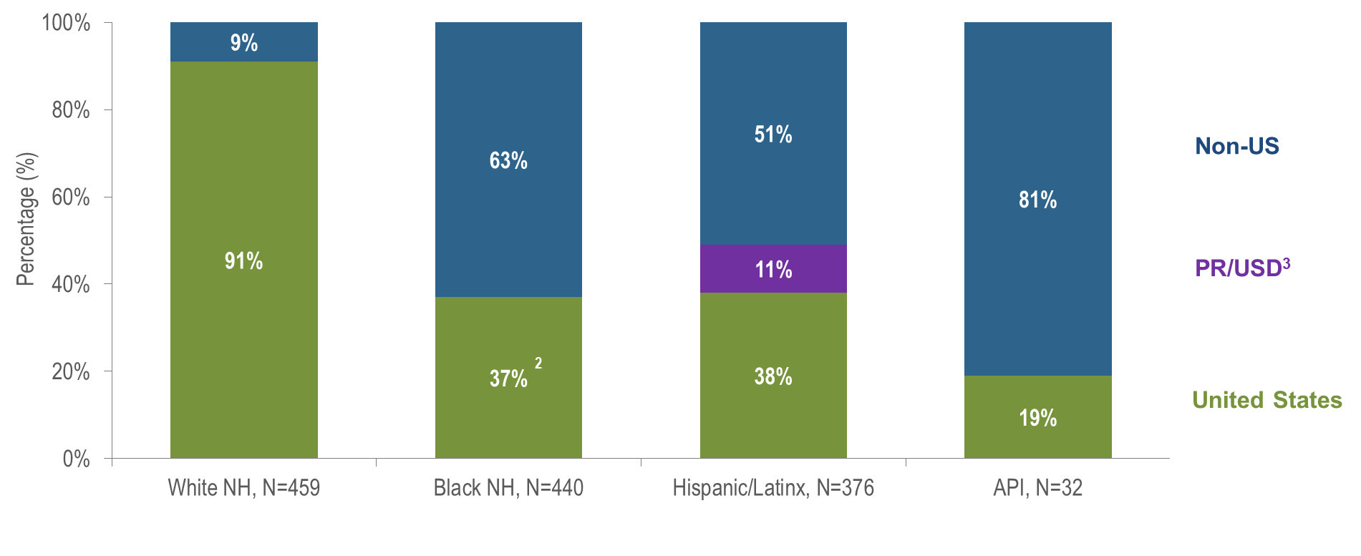
Percentage of individuals diagnosed with HIV infection by race/ethnicity and place of birth, Massachusetts 2020 – 2022¹
¹ Please consider the impact of the COVID-19 pandemic on infectious disease screening, treatment, and surveillance in the interpretation of 2020–2022 data.
² US born and Puerto Rico/USD categories are combined for Black non-Hispanic individuals due to small numbers to adhere to cell suppression rules.
³ 96% of individuals diagnosed with HIV infection from 2020–2022 who were born in a US dependency (USD) were born in Puerto Rico (PR).Data Source: Bureau of Infectious Disease and Laboratory Sciences, data are current as of 1/1/2024 and subject to change, NH = non-Hispanic; API = Asian/Pacific Islander
Notes:
The figure is a stacked bar chart displaying the distribution of recent HIV diagnoses by place of birth (non-US, Puerto Rico/US Dependency, or US) for each of four racial/ethnic groups: White NH (N=459), Black NH (N=440), Hispanic/Latinx (N=376), and Asian/Pacific Islander (N=32).
Eighty-one percent of Asian/Pacific Islander individuals diagnosed with HIV infection during 2020–2022 were born outside the US, compared to 63% of Black (non-Hispanic), 51% of Hispanic/Latinx, and 9% of White (non-Hispanic) individuals.
Please consider the impact of the COVID-19 pandemic on infectious disease screening, treatment, and surveillance in the interpretation of 2020–2022 data.

Slide 6
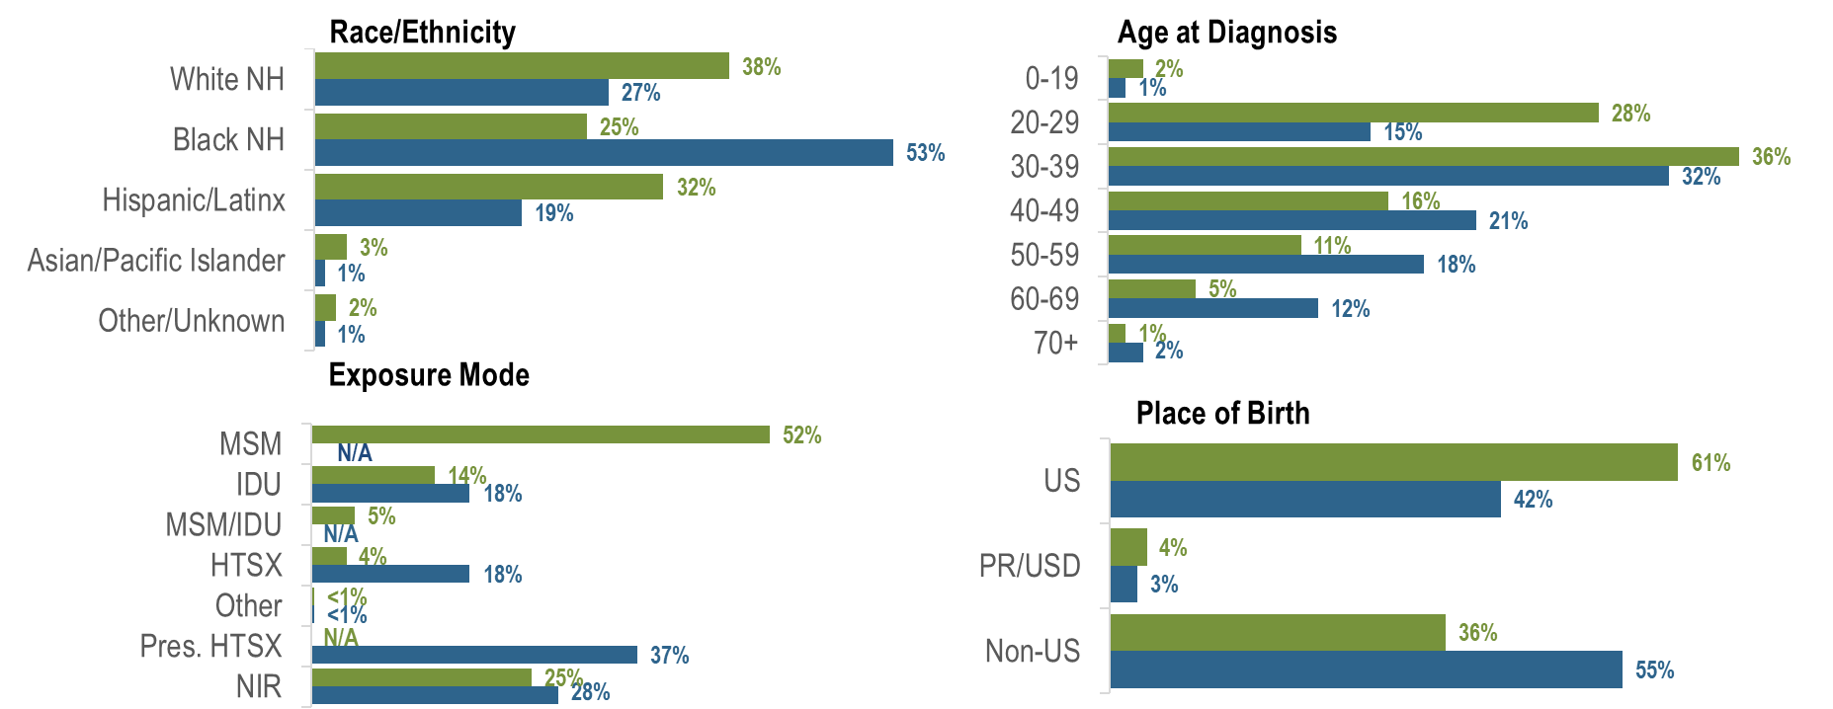
Percentage of individuals diagnosed with HIV infection by race/ethnicity, age, exposure mode, and place of birth by sex assigned at birth,
Massachusetts 2020 – 2022¹
AMAB, N=952; AFAB, N=377
¹ Please consider the impact of the COVID-19 pandemic on infectious disease screening, treatment, and surveillance in the interpretation of 2020–2022 data.
AMAB = assigned male at birth; AFAB = assigned female at birth; NH = non-Hispanic; MSM=male-to-male sex; IDU=injection drug use; HTSX=heterosexual sex; Pres. HTSX=presumed heterosexual exposure, includes individuals assigned female at birth with a negative history of injection drug use who report having sex with an individual that identifies as male of unknown HIV status and risk; NIR=no identified risk
Data Source: Bureau of Infectious Disease and Laboratory Sciences, data are current as of 1/1/2024 and subject to change
Notes:
The figure is a series of bar charts displaying a comparison of the distribution of recent HIV diagnoses for individuals assigned male at birth (AMAB) and individuals assigned female at birth (AFAB) by race/ethnicity, age, exposure mode, and place of birth.
The distributions of new HIV infection diagnoses by race/ethnicity, age, exposure mode, and place of birth varied by sex assigned at birth: the largest proportion of individuals assigned male at birth (AMAB) was White (non-Hispanic) (38%), while the largest proportion of individuals assigned female at birth (AFAB) was Black (non-Hispanic) (53%). A larger proportion of individuals AMAB (28%) than AFAB (15%) was diagnosed between the ages of 20 and 29 years. MSM was the predominant exposure mode among individuals AMAB (52%), while presumed heterosexual sex was the predominant exposure mode among individuals AFAB. A larger proportion of individuals AFAB (55%) than AMAB (36%) was born outside the US.

Slide 7
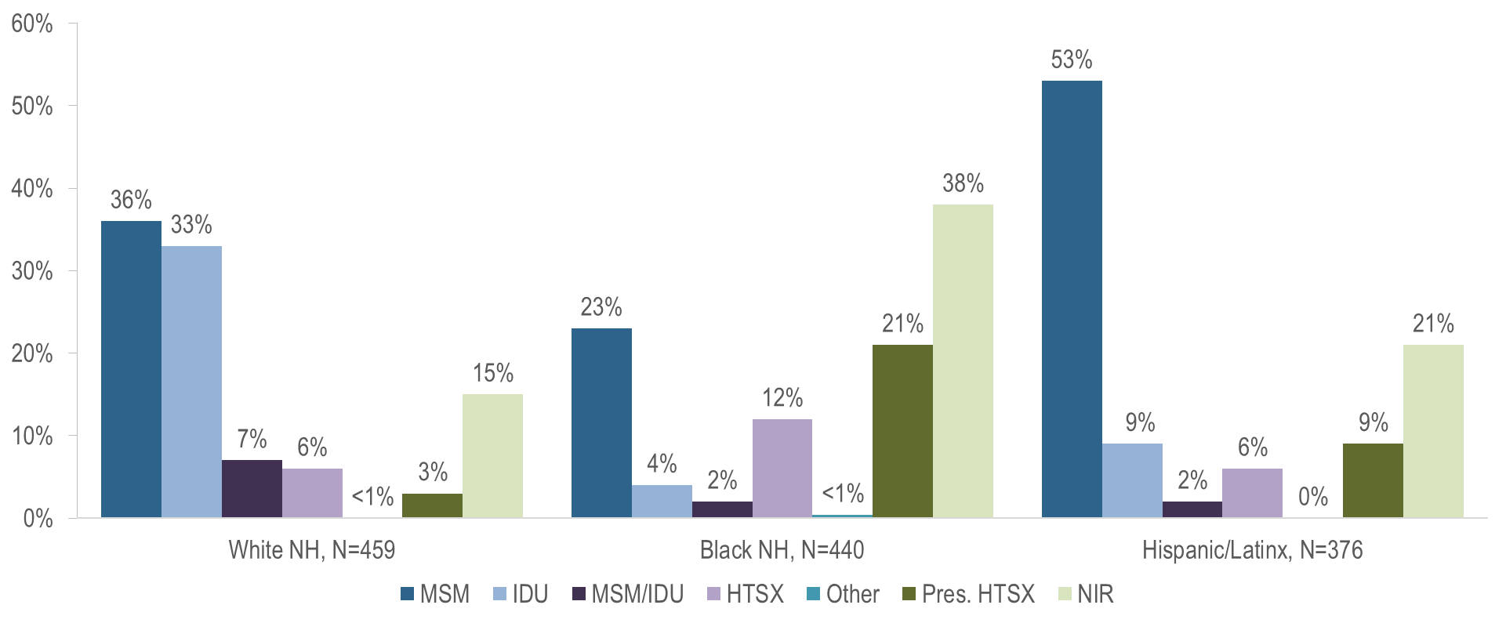
Percentage of individuals diagnosed with HIV infection by exposure mode and race/ethnicity, Massachusetts 2020 – 2022¹
¹ Please consider the impact of the COVID-19 pandemic on infectious disease screening, treatment, and surveillance in the interpretation of 2020–2022 data.
NH = non-Hispanic; MSM=male-to-male sex; IDU=injection drug use; HTSX=heterosexual sex; Pres. HTSX=presumed heterosexual exposure, includes individuals assigned female at birth with a negative history of injection drug use who report having sex with an individual that identifies as male of unknown HIV status and risk; NIR=no identified risk
Data Source: Bureau of Infectious Disease and Laboratory Sciences, data are current as of 1/1/2024 and subject to change
Notes:
The figure is a bar chart displaying the distribution of recent HIV diagnoses by exposure mode for each of three racial/ethnic groups: White NH (N=459), Black NH (N=440), and Hispanic/Latinx (N=376).
While the predominant exposure modes among individuals recently diagnosed with HIV infection were MSM (36%) and IDU (33%) among White (non-Hispanic) individuals and MSM (53%) among Hispanic/Latinx individuals, the largest proportion of Black (non-Hispanic) individuals was assigned no identified risk for exposure mode (38%). Of the Black NH individuals assigned NIR, 75% (N=126/169) were non-US born.

Slide 8
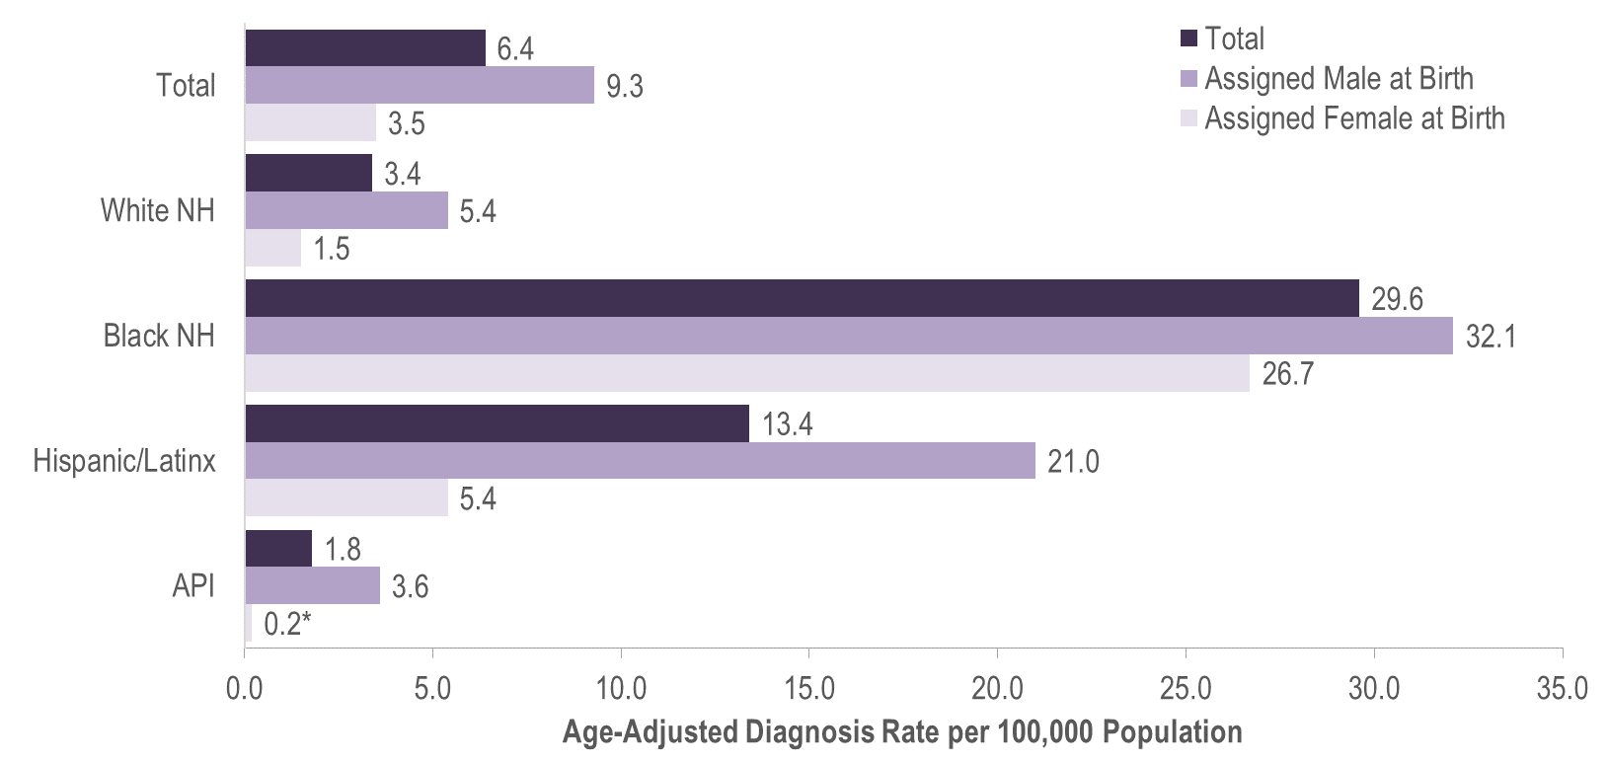
Average annual age-adjusted HIV diagnosis rates per 100,000 population¹ by sex assigned at birth and race/ethnicity, Massachusetts 2020 – 2022² (N=1,419)
*Rates based on numerators <12 are marked with an asterisk (*) and should be interpreted with caution.
¹ As of 1/1/2020, BIDLS calculates rates per 100,000 population using denominators estimated by the University of Massachusetts Donahue Institute using a modified Hamilton-Perry model (Strate S, et al. Small Area Population Estimates for 2011 through 2020, report published Oct 2016). Note that rates and trends calculated using previous methods cannot be compared to these. All rates are age-adjusted using the 2000 US standard population.
² Please consider the impact of the COVID-19 pandemic on infectious disease screening, treatment, and surveillance in the interpretation of 2020–2022 data; NH = non-Hispanic; API = Asian/Pacific Islander
Data Source: Bureau of Infectious Disease and Laboratory Sciences, data are current as of 1/1/2024 and subject to change
Notes:
The figure is a bar chart displaying the average annual HIV diagnosis rates per 100,000 among individuals assigned male at birth, individuals assigned female at birth, and the Massachusetts total population for four racial/ethnic groups: White NH, Black NH, Hispanic/Latinx, and Asian/Pacific Islander.
In 2020 – 2022,^{i} the average annual age-adjusted HIV diagnosis rate per 100,000 population of individuals assigned male at birth (AMAB) was three times that of individuals assigned female at birth (AFAB).
There were large disparities in average annual age-adjusted HIV diagnosis rates for 2020 to 2022 by race/ethnicity. Compared to the rate among White (non-Hispanic) individuals, the rate among:
Black (non-Hispanic) individuals was nine times greater, and
Hispanic/Latinx individuals was four times greater.
With respect to differences based on race/ethnicity and sex assigned at birth, the average annual age-adjusted HIV diagnosis rate for 2020 to 2022 among:
Black (non-Hispanic) individuals assigned male at birth (AMAB), was six times that of White (non-Hispanic) individuals AMAB,
Hispanic/Latinx individuals AMAB was four times that of White (non-Hispanic) individuals AMAB,
Black (non-Hispanic) individuals assigned female at birth (AFAB) was 18 times that of White (non-Hispanic) individuals AFAB, and
Hispanic/Latinx individuals AFAB was four times that of White (non-Hispanic) individuals AFAB.

Slide 9
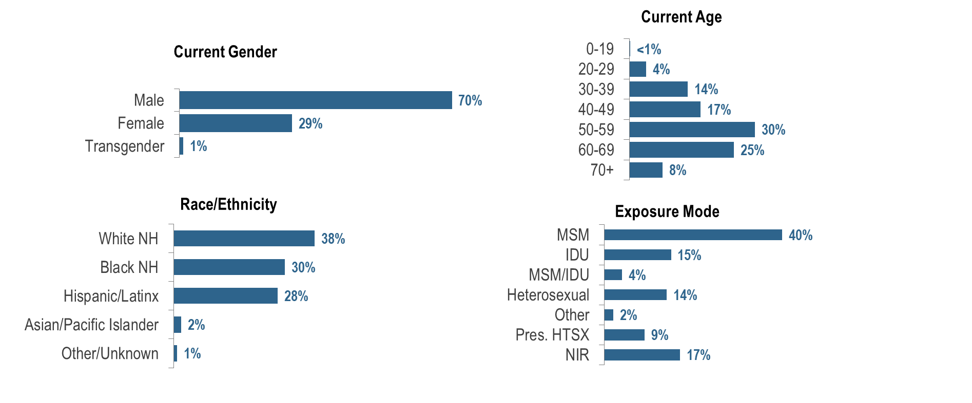
Percentage of PLWH by current gender, age, race/ethnicity, and exposure mode, Massachusetts 2022 (N=23,643)¹
¹ Please consider the impact of the COVID-19 pandemic on infectious disease screening, treatment, and surveillance in the interpretation of 2020–2022 data.
NH = non-Hispanic; MSM=male-to-male sex; IDU=injection drug use; HTSX=heterosexual sex; Pres. HTSX=presumed heterosexual exposure, includes individuals assigned female at birth with a negative history of injection drug use who report having sex with an individual that identifies as male of unknown HIV status and risk; NIR=no identified risk; Data Source: Bureau of Infectious Disease and Laboratory Sciences, data are current as of 1/1/2024 and subject to change
Notes:
The figure is a series of bar charts displaying the distribution of persons living with HIV infection by current gender, age, race/ethnicity, and exposure mode.
Racial/ethnic disparities persist among PLWH, and marked differences exist by current gender, age, and exposure mode. PLWH in Massachusetts are predominantly male (70%), older (30% among 50–59 year-olds), and White non-Hispanic (38%). Male-to-male sex was the most frequently reported exposure mode, at 40%.

Slide 10
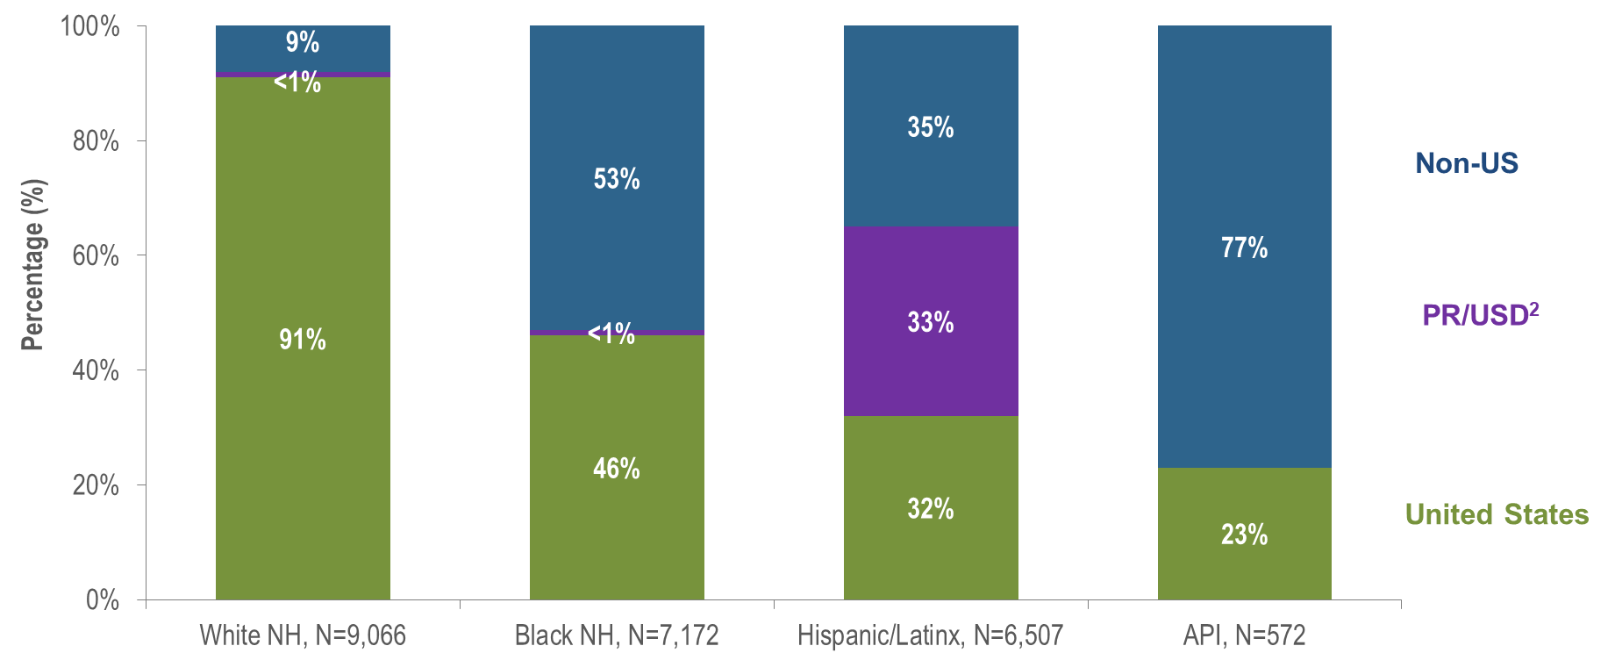
Percentage of PLWH by race/ethnicity and place of birth,
Massachusetts 2022¹
¹ Please consider the impact of the COVID-19 pandemic on infectious disease screening, treatment, and surveillance in the interpretation of 2020–2022 data.
² PR/USD = Puerto Rico/US Dependencies, 98% persons living with HIV infection on 12/31/2022 who were born in PR/USD were born in Puerto Rico; NH = non-Hispanic; API = Asian/Pacific Islander;
Data Source: Bureau of Infectious Disease and Laboratory Sciences, data are current as of 1/1/2024 and subject to change
Notes:
The figure is a series of bar charts displaying the distribution of persons living with HIV infection by current gender, age, race/ethnicity, and exposure mode.
A total of 77% of Asian/Pacific Islander PLWH in Massachusetts in 2022 were born outside the US, compared to 53% of Black (non-Hispanic), 35% of Hispanic/Latinx, and 9% of White (non-Hispanic) PLWH.

Slide 11
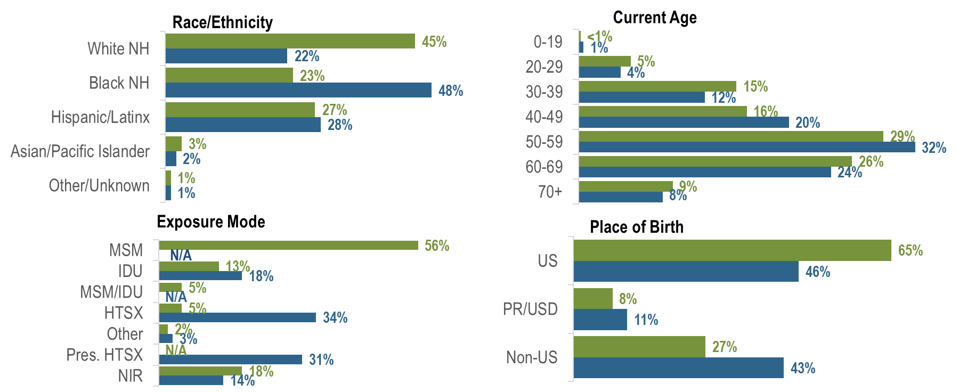
Percentage of persons living with HIV infection (PLWH) by race/ethnicity, age, exposure mode, and place of birth by sex assigned at birth, Massachusetts 2022¹
Assigned Male at Birth, N= 16,791; Assigned Female at Birth, N= 6,852
¹ Please consider the impact of the COVID-19 pandemic on infectious disease screening, treatment, and surveillance in the interpretation of 2020–2022 data.
NH = non-Hispanic; MSM=male-to-male sex; IDU=injection drug use; HTSX=heterosexual sex; Pres. HTSX=presumed heterosexual exposure, includes individuals assigned female at birth with a negative history of injection drug use who report having sex with an individual that identifies as male of unknown HIV status and risk; NIR=no identified risk; Data Source: Bureau of Infectious Disease and Laboratory Sciences, data are current as of 1/1/2024 and subject to change
Notes:
The figure is a series of bar charts displaying a comparison of the distribution of persons living with HIV infection for individuals assigned male at birth (AMAB) and individuals assigned female at birth (AFAB) by race/ethnicity, age, exposure mode, and place of birth.
The distributions of PLWH by race/ethnicity, exposure mode, and place of birth varied by sex assigned at birth: the largest proportion of individuals assigned male at birth (AMAB) living with HIV infection was White (non-Hispanic) (45%), while the largest proportion of individuals assigned female at birth (AFAB) was Black (non-Hispanic) (48%). MSM (56%) was the predominant exposure mode among individuals AMAB compared to heterosexual sex (34%) and presumed heterosexual sex (31%) among individuals AFAB. A larger proportion of individuals AFAB (43%) than AMAB (27%) was born outside the US.

Slide 12
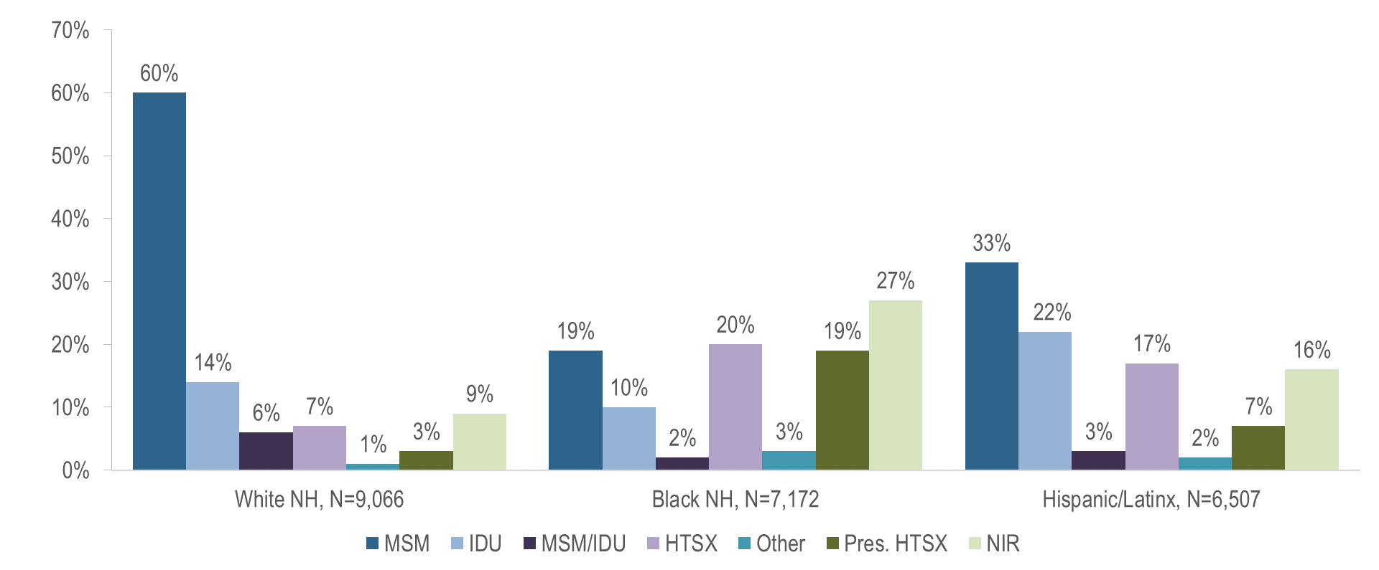
Percentage of PLWH by exposure mode and race/ethnicity,
Massachusetts 2022¹
¹ Please consider the impact of the COVID-19 pandemic on infectious disease screening, treatment, and surveillance in the interpretation of 2020–2022 data.
NH = non-Hispanic; MSM=male-to-male sex; IDU=injection drug use; HTSX=heterosexual sex; Pres. HTSX=presumed heterosexual exposure, includes individuals assigned female at birth with a negative history of injection drug use who report having sex with an individual that identifies as male of unknown HIV status and risk; NIR=no identified risk; Data Source: Bureau of Infectious Disease and Laboratory Sciences, data are current as of 1/1/2024 and subject to change
Notes:
The figure is a bar chart displaying the distribution of persons living with HIV infection by exposure mode for each of three racial/ethnic groups: White NH (N=9,066), Black NH (N=7,172), and Hispanic/Latinx (N=6,507).
The predominant exposure mode among White (non-Hispanic) PLWH was MSM (60%). Among Black (non-Hispanic) PLWH, the largest proportion was reported with no identified risk (27%), followed by heterosexual sex (20%), presumed heterosexual sex (19%), and MSM (19%). Among Hispanic/Latinx PLWH, the largest proportion was MSM (33%), followed by IDU (22%).

Slide 13
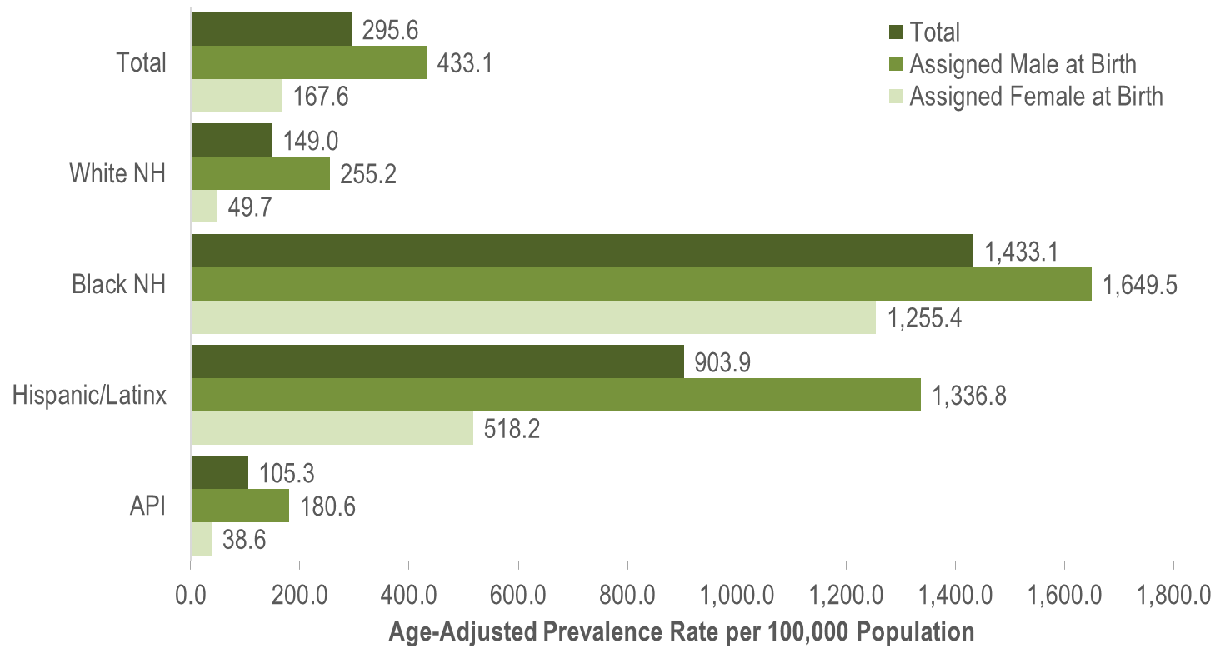
Age-adjusted HIV prevalence rates per 100,000 population¹ by sex assigned at birth and race/ethnicity, Massachusetts 2022 (N=23,643)²
¹ As of 1/1/2020, BIDLS calculates rates per 100,000 population using denominators estimated by the University of Massachusetts Donahue Institute using a modified Hamilton-Perry model (Strate S, et al. Small Area Population Estimates for 2011 through 2020, report published Oct 2016). Note that rates and trends calculated using previous methods cannot be compared to these. All rates are age-adjusted using the 2000 US standard population.
² Please consider the impact of the COVID-19 pandemic on infectious disease screening, treatment, and surveillance in the interpretation of 2020–2022 data; NH = non-Hispanic; API = Asian/Pacific Islander
Data Source: Bureau of Infectious Disease and Laboratory Sciences, data are current as of 1/1/2024 and subject to change
Notes:
The figure is a bar chart displaying the age-adjusted HIV prevalence rates per 100,000 population among individuals assigned male at birth, individuals assigned female at birth, and the Massachusetts total population for four racial/ethnic groups: White NH, Black NH, Hispanic/Latinx, and Asian/Pacific Islander.
In 2022, the age-adjusted HIV prevalence rate per 100,000 population of individuals assigned male at birth (AMAB) was three times that of individuals assigned female at birth (AFAB). There were large disparities in age-adjusted prevalence rates by race/ethnicity. Compared to the rate among White (non-Hispanic) individuals, the rate among:
Black (non-Hispanic) individuals was ten times greater, and
Hispanic/Latinx individuals was six times greater.
With respect to differences based on race/ethnicity and sex assigned at birth, the age-adjusted HIV prevalence rate among:
Black (non-Hispanic) individuals AMAB was six times that of White (non-Hispanic) individuals AMAB,
Hispanic/Latinx individuals AMAB was five times that of White (non-Hispanic) individuals AMAB,
Black (non-Hispanic) individuals AFAB was 25 times that of White (non-Hispanic) individuals AFAB, and
Hispanic/Latinx individuals AFAB was 10 times that of White (non-Hispanic) individuals AFAB.

Slide 14
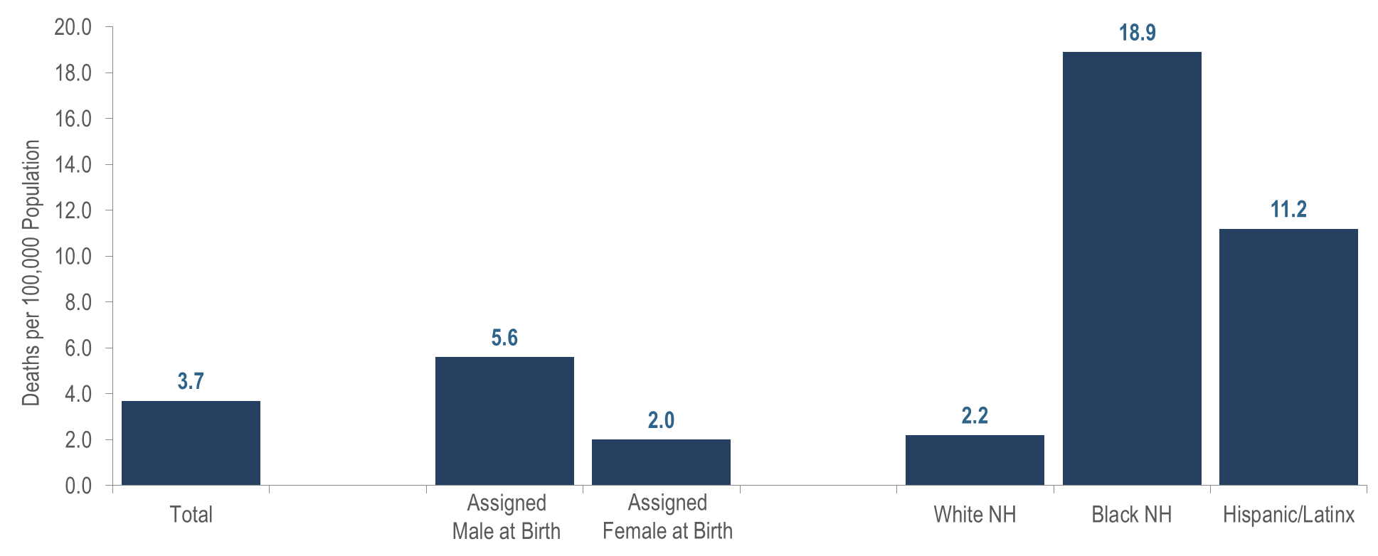
Average annual age-adjusted death rates among individuals reported with HIV per 100,000 population¹ by sex assigned at birth and race/ethnicity, Massachusetts 2020–2022²
(Total number of deaths among individuals reported with HIV from 2020–2022=1,024)
¹ As of 1/1/2020, BIDLS calculates rates per 100,000 population using denominators estimated by the University of Massachusetts Donahue Institute using a modified Hamilton-Perry model (Strate S, et al. Small Area Population Estimates for 2011 through 2020, report published Oct 2016). Note that rates and trends calculated using previous methods cannot be compared to these. All rates are age-adjusted using the 2000 US standard population.
² Please consider the impact of the COVID-19 pandemic on infectious disease screening, treatment, and surveillance in the interpretation of 2020–2022 data; NH = non-Hispanic
Data Source: Bureau of Infectious Disease and Laboratory Sciences, data are current as of 1/1/2024 and subject to change
Notes:
The figure is a bar chart displaying the average annual age-adjusted death rate (2020–2022) among individuals reported with HIV per 100,000 for Massachusetts total, individuals assigned male at birth, individuals assigned female at birth, White NH individuals, Black NH individuals, and Hispanic/Latinx individuals.
Age-Adjusted Rates
In 2020 – 2022, the average annual age-adjusted death rate per 100,000 population for individuals assigned male at birth reported with HIV was three times that for individuals assigned female at birth. There were also large disparities in death rates by race/ethnicity: the rates among Black (non-Hispanic) individuals and Hispanic/Latinx individuals were eight and five times that of White (non-Hispanic) individuals, respectively.

Slide 15
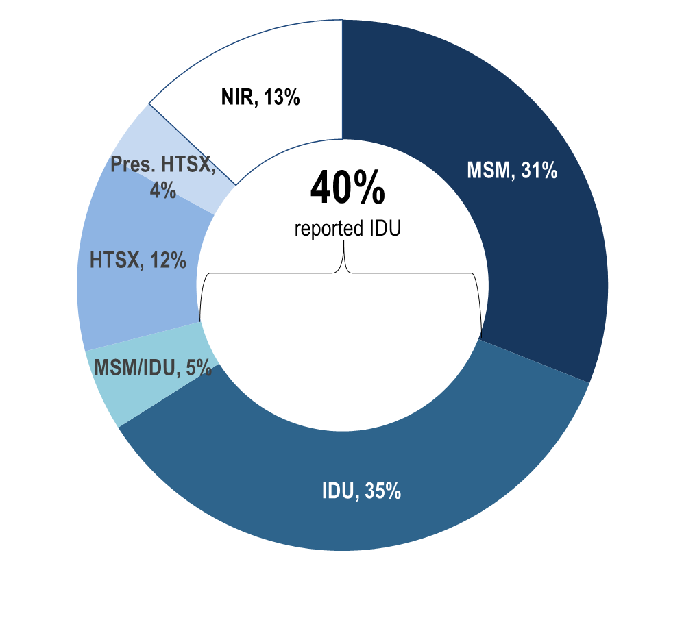
Deaths among individuals reported with HIV by exposure mode, Massachusetts 2022 (N=358)¹
¹ Please consider the impact of the COVID-19 pandemic on infectious disease screening, treatment, and surveillance in the interpretation of 2020–2022 data.
MSM=male-to-male sex; IDU=injection drug use; HTSX=heterosexual sex; Pres. HTSX=presumed heterosexual exposure, includes individuals assigned female at birth with a negative history of injection drug use who report having sex with an individual that identifies as male of unknown HIV status and risk; NIR=no identified risk; Data Source: Bureau of Infectious Disease and Laboratory Sciences, data are current as of 1/1/2024 and subject to change
Notes:
The figure is an open pie chart which displays the distribution by exposure mode of deaths among individuals reported with HIV/AIDS for 2022. A text box in the center of the pie chart reads, “41% reported IDU".
Exposure Mode
Individuals with IDU exposure mode accounted for the largest proportion of deaths among individuals reported with HIV. In 2022, 35% of deaths among individuals with HIV were reported with an exposure mode of IDU and an additional 5% were reported with an exposure mode of MSM/IDU, compared to 10% and 4%, respectively, of 2022 HIV infection diagnoses. The leading causes of death among individuals reported with HIV infection with IDU and IDU/MSM exposure mode who died in 2021 (with a known cause) were external causes of injuries and poisonings (which includes opioid overdoses) which accounted for 31% (N=41/133) of deaths, cancer which accounted for 11% (N=15/133) of deaths, heart disease which accounted for 11% (N=15/133), and HIV which accounted for 9% (N=12/133) of deaths (cause of death is not yet available for 2022 deaths among individuals with HIV as of 1/1/2024).

Slide 16
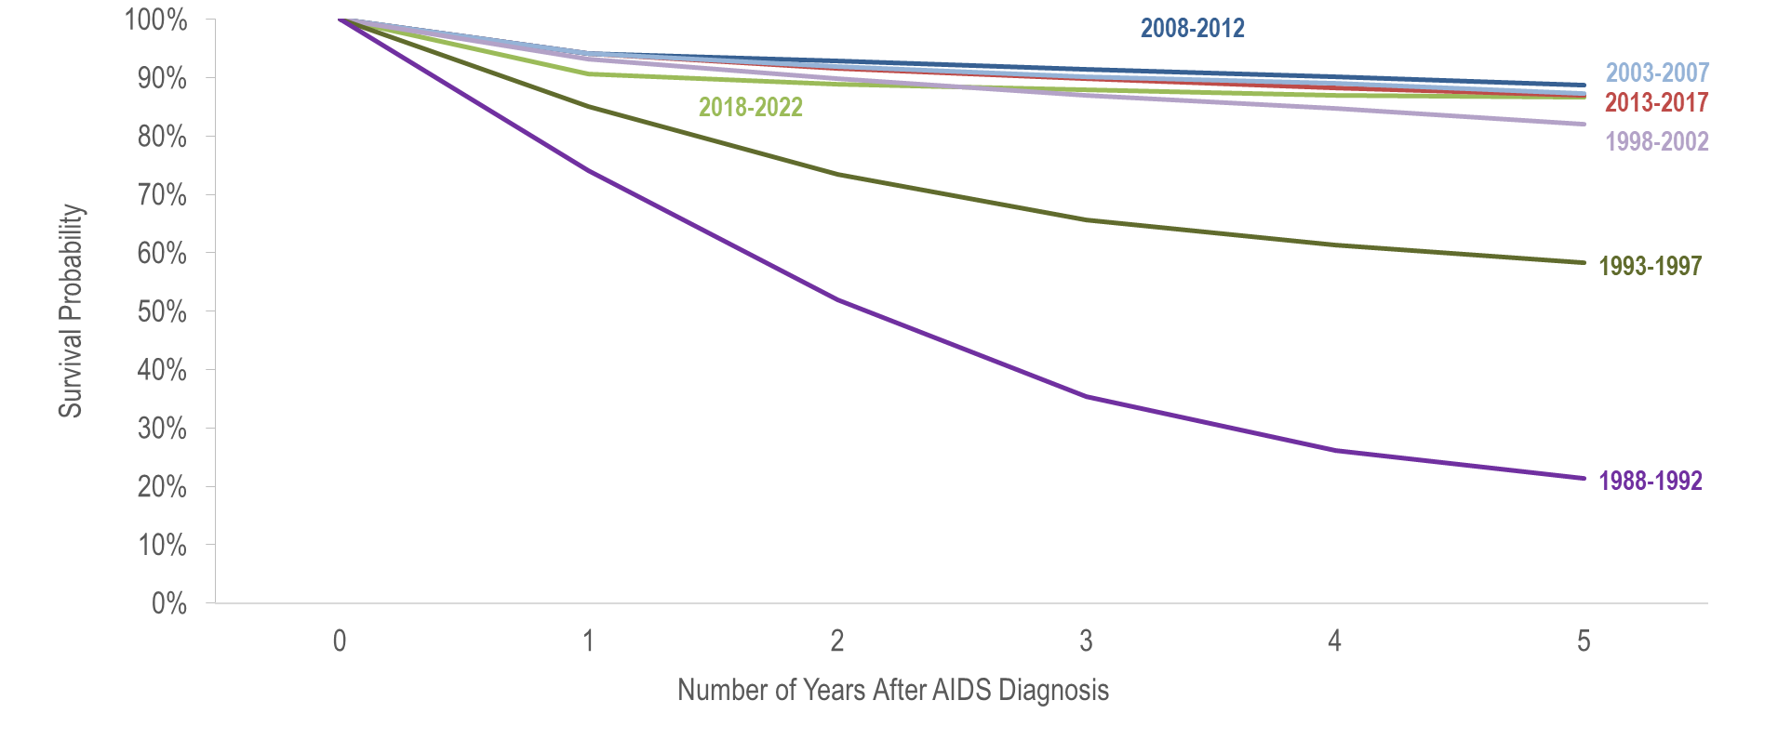
Five-year survival among with individuals with AIDS by year of diagnosis, Massachusetts 1988–2022¹
(Total number of AIDS diagnoses from 1988–2022, N=24,464)
¹ Please consider the impact of the COVID-19 pandemic on infectious disease screening, treatment, and surveillance in the interpretation of 2020–2022 data.
Data Source: Bureau of Infectious Disease and Laboratory Sciences, data are current as of 1/1/2024 and subject to change
Notes:
The figure is a trendline that displays the percent of individuals alive less than 1, 1, 2, 3, 4, and 5 years after AIDS diagnosis for 7 cohorts by year of AIDS diagnosis: 1988-1992, 1993-1997, 1998-2002, 2003-2007, 2008-2012, 2013-2017, 2018-2022.
Survival among individuals diagnosed with AIDS
Survival of individuals diagnosed with AIDS has increased over time. In the earliest cohort of AIDS diagnoses (1988–1992), estimated survival at five years after AIDS diagnosis was 21%, compared to 87% in the most recent cohort (2018–2022).

Slide 17
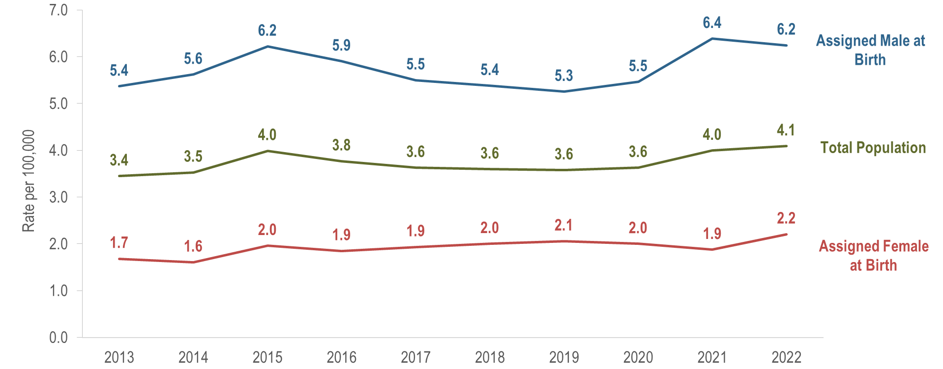
Age-adjusted rate of death per 100,000 population¹ among individuals reported with HIV by sex assigned at birth, Massachusetts 2013–2022²
(Total number of deaths among individuals reported with HIV from 2013–2022=3,125)
¹ As of 1/1/2020, BIDLS calculates rates per 100,000 population using denominators estimated by the University of Massachusetts Donahue Institute using a modified Hamilton-Perry model (Strate S, et al. Small Area Population Estimates for 2011 through 2020, report published Oct 2016). Note that rates and trends calculated using previous methods cannot be compared to these. All rates are age-adjusted using the 2000 US standard population.
² Please consider the impact of the COVID-19 pandemic on infectious disease screening, treatment, and surveillance in the interpretation of 2020–2022 data.
Data Source: Bureau of Infectious Disease and Laboratory Sciences, data are current as of 1/1/2024 and subject to change
Notes:
The figure is a trendline displaying the age-adjusted rate of death per 100,000 population among individuals reported with HIV/AIDS for 2012 to 2021 for three groups: individuals assigned male at birth, individuals assigned female at birth, and the total population.
Trends in Age-Adjusted Rates of Death
Over the last 10 years of available data, the age-adjusted rate of death per 100,000 population of individuals assigned male at birth (AMAB) reported with HIV has remained 2.5 to 3.5 times that of individuals assigned female at birth (AFAB). In 2022, the age-adjusted rate of individuals AMAB (6.2 per 100,000) was 2.8 times the rate of individuals AFAB (2.2 per 100,000).

Slide 18
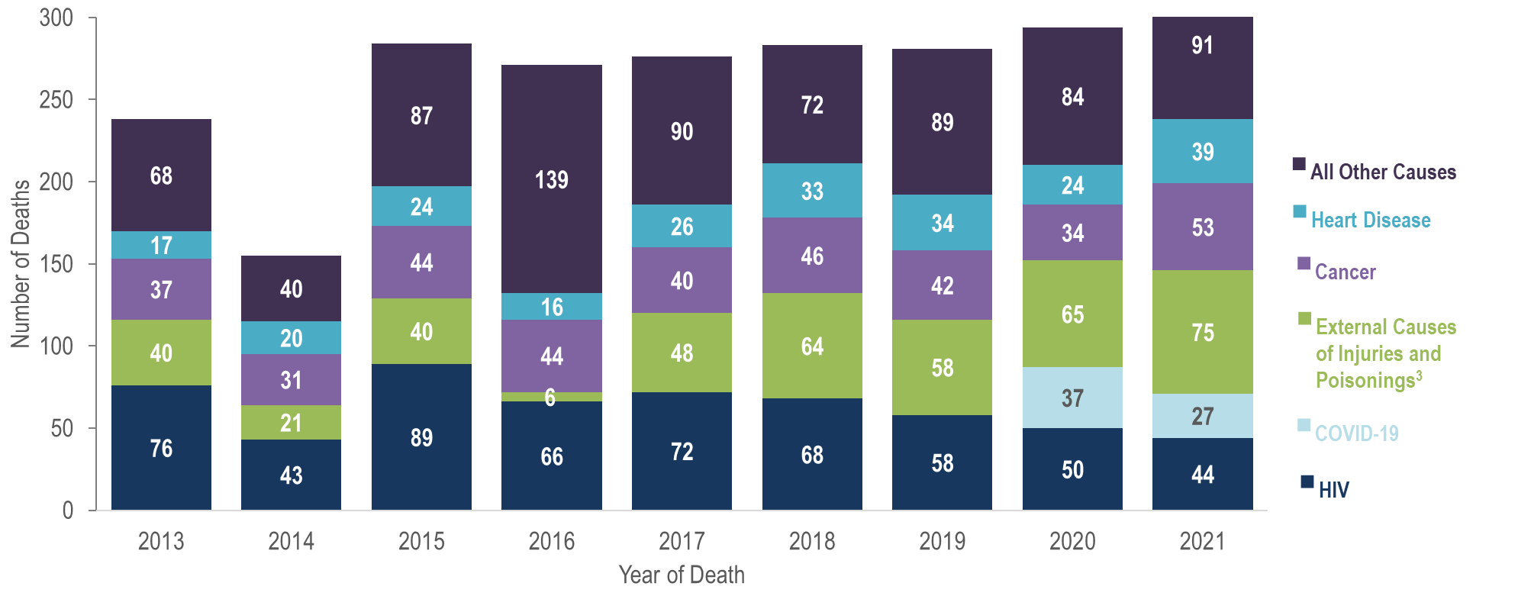
Trends in causes of death among individuals reported with HIV infection, Massachusetts 2013–2021 (N=2,411)^{1,2}
¹ Deaths among individuals reported with HIV infection with a missing cause of death are excluded from this analysis (2013–2021 N=356). Data are presented for the most recent nine-year period for which cause of death data was available.
² Please consider the impact of the COVID-19 pandemic on infectious disease screening, treatment, and surveillance in the interpretation of 2020–2022 data.
³ External causes of injuries includes intentional injuries (e.g., homicide and suicide), unintentional injuries (e.g., motor vehicle and non-transport related accidents), and injuries of undetermined intent.
Data Source: Bureau of Infectious Disease and Laboratory Sciences, data are current as of 1/1/2024 and subject to change
Notes:
The figure is a stacked bar chart displaying the number of deaths by cause of death for each year from 2013 to 2021. Six causes of death are included in the chart: HIV, COVID-19, External causes of injuries and poisonings, Cancer, Heart disease, and All other causes.
Trends in Causes of Death
In 2021,^{i} the leading causes of death among persons reported with HIV infection (with a known cause) were external causes of injuries^{ii} and poisonings (which includes opioid overdoses) which accounted for 23% (N=75/329) of deaths, followed by cancer which accounted for 16% (N=53/329), HIV which accounted for 13% (N=44/329), and heart disease which accounted for 12% (N=39/329). While COVID-19 was the third leading cause of death among persons reported with HIV infection in 2020, it was the sixth leading cause of death in 2021, accounting for 8% (N=27/329) of deaths in that year. By comparison, the leading causes of death in 2021 among the general population of Massachusetts were cancer which accounted for 18% (N=12,466/68,158) of deaths, heart disease which accounted for 18% (N=11,954/68,158), COVID-19, which accounted for 7% (N=4,888/68,158), and unintentional injuries^{iii} which accounted for 7% (N=4,636/63,158).^{iv}
^{i} Please consider the impact of the COVID-19 pandemic on infectious disease screening, treatment, and surveillance in the interpretation of 2020 and 2021 data
^{ii} External causes of injuries includes intentional injuries (e.g., homicide and suicide), unintentional injuries (e.g., motor vehicle and non-transport related accidents), and injuries of undetermined intent.
^{iii} Source: Massachusetts Department of Public Health, Office of Population Health. Massachusetts Deaths 2021; October 2023. available at: https://www.mass.gov/doc/2021-death-report-pdf/download

Slide 19
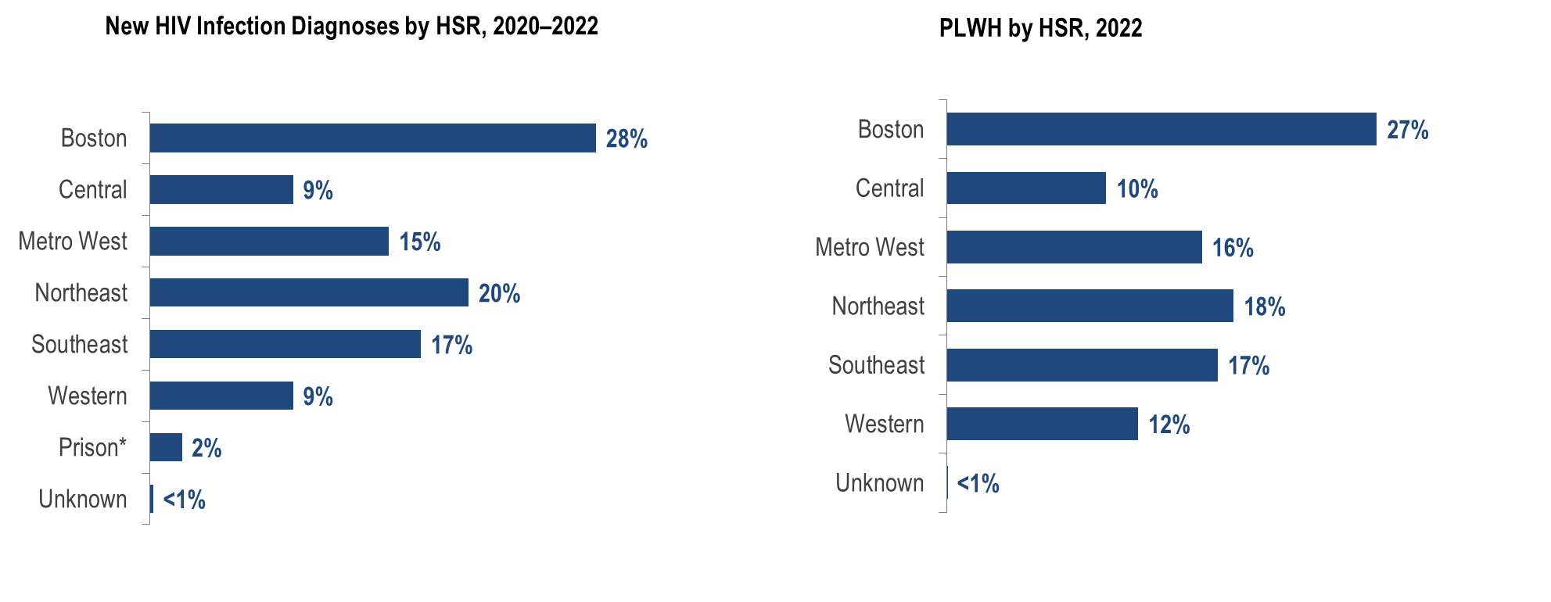
Percentage distributions of 2020–2022 HIV infection diagnoses (N=1,329) and 2022 persons living with HIV infection (PLWH, N=23,643) by Health Service Region (HSR), Massachusetts¹
¹ Please consider the impact of the COVID-19 pandemic on infectious disease screening, treatment, and surveillance in the interpretation of 2020–2022 data.
*.HSRs are regions defined geographically to facilitate focused health service planning. While prisons are not an HSR, the prison population is presented separately in this analysis because of its unique service planning needs. The prisons category represents persons who were diagnosed with HIV infection while in a correctional facility. As these data do not reflect current incarceration status, the category is not included for persons living with HIV infection.
Data Source: Bureau of Infectious Disease and Laboratory Sciences, data are current as of 1/1/2024 and subject to change
Notes:
The figure is a series of bar charts showing the percentage distribution of recent HIV diagnoses and people living with HIV infection by health service region.
The greatest proportion of new HIV infection diagnoses in 2020 – 2022^{i} was among residents of the Boston HSR (28%), followed by the Northeast HSR (20%), the Southeast HSR (17%), and the Metro West HSR (15%). Similar geographic distributions were observed for persons living with HIV infection (PLWH). The Boston HSR had the highest proportion of PLWH in 2021 (27%), followed by the Northeast HSR (18%), Southeast HSR (17%), and the Metro West HSR (16%).

Slide 20
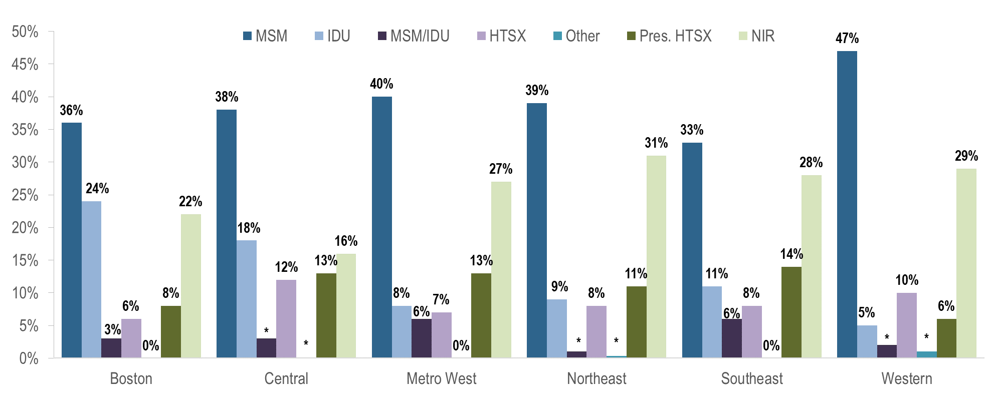
Percentage distribution of HIV infection diagnoses by Health Service Region (HSR) and exposure mode, Massachusetts 2020–2022 (N=1,329)¹
¹ Please consider the impact of the COVID-19 pandemic on infectious disease screening, treatment, and surveillance in the interpretation of 2020–2022 data.
Data Source: Bureau of Infectious Disease and Laboratory Sciences, data are current as of 1/1/2024 and subject to change
Notes:
The figure is a bar chart displaying the percentage distribution of recent HIV diagnoses by exposure mode for each of six health service regions: Boston, Central, MetroWest, Northeast, Southeast, and Western.
MSM was the most frequently reported exposure mode in all regions of Massachusetts for individuals diagnosed with HIV infection during 2020 to 2022, accounting for 47% of diagnoses in the Western HSR, 40% in the Metro West HSR, 39% in the Northeast HSR, 38% in the Central HSRs, 36% in the Boston HSR, and 33% in the Southeast HSR. The Boston HSR had the highest proportion of individuals with IDU exposure mode at 24%, followed by the Central HSR at 18%. IDU accounted for 5% to 11% of HIV infection diagnoses in the remaining regions.

Slide 21
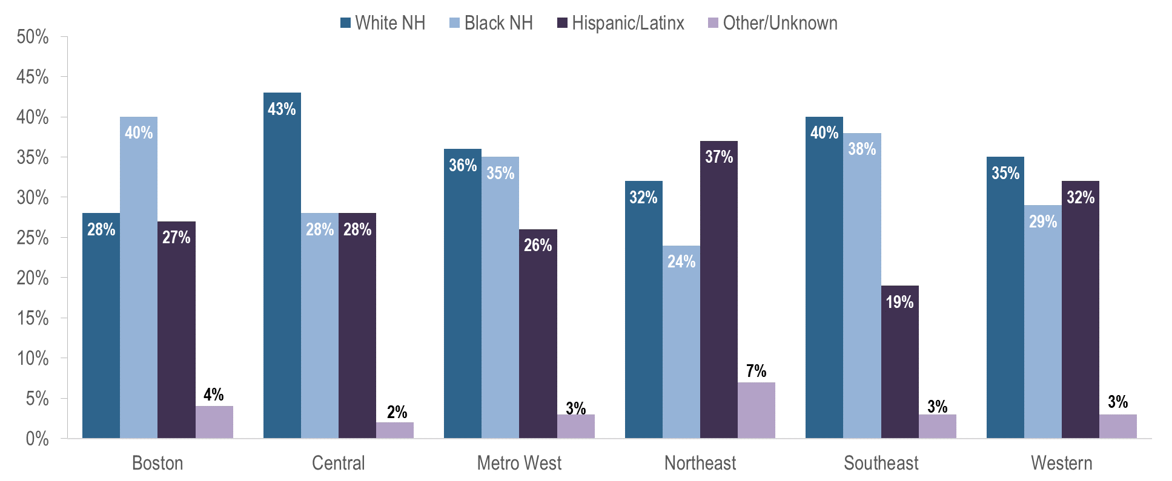
Percentage distribution of HIV infection diagnoses by Health Service Region (HSR) and race/ethnicity, Massachusetts 2020–2022 (N=1,329)¹
¹ Please consider the impact of the COVID-19 pandemic on infectious disease screening, treatment, and surveillance in the interpretation of 2020–2022 data.
Data Source: Bureau of Infectious Disease and Laboratory Sciences, data are current as of 1/1/2024 and subject to change
Notes:
The figure is a bar chart displaying the percentage distribution of recent HIV diagnoses by race/ethnicity for each of six health service regions: Boston, Central, MetroWest, Northeast, Southeast, and Western.
The Southeast HSR had the highest proportion of recent HIV infection diagnoses (2020–2022) among White (non-Hispanic) individuals at 43%, while the Boston HSR had the highest proportion among Black non-Hispanic individuals at 40%, and the Northeast HSR had the highest proportion among Hispanic/Latinx individuals at 37%.

Slide 22
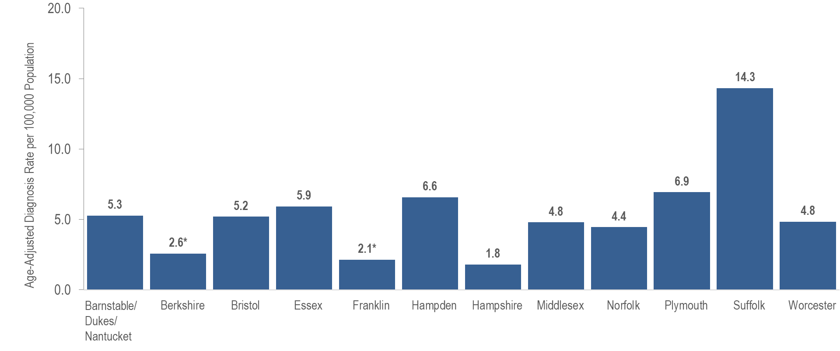
Average annual age-adjusted rate of HIV infection diagnosis per 100,000 population by county, Massachusetts 2020–2022¹
¹ Please consider the impact of the COVID-19 pandemic on infectious disease screening, treatment, and surveillance in the interpretation of 2020–2022 data.
*Rates based on numerators <12 are marked with an asterisk (*) and should be interpreted with caution.
Barnstable, Dukes and Nantucket Counties are combined because of small numbers.
Data Source: Bureau of Infectious Disease and Laboratory Sciences, data are current as of 1/1/2024 and subject to change
Notes:
The figure is a bar chart that displays the average annual rate of HIV diagnosis per 100,000 population for all Massachusetts counties: Barnstable/Dukes/Nantucket (5.3), Berkshire (2.6), Bristol (5.2), Essex (5.9), Franklin (2.1), Hampden (6.6), Hampshire (1.8), Middlesex (4.8), Norfolk (4.4), Plymouth (6.9), Suffolk (14.3), and Worcester (4.8).
Recently, Suffolk County, in which Boston is the biggest city, was selected as one of 48 counties nationally that is prioritized for funding in the U.S. Department of Health and Human Services’ initiative “Ending the HIV Epidemic (EHE): A Plan for America”. This is a ten-year initiative beginning in 2020 to achieve a 75% reduction in new HIV infections in five years and at least a 90% reduction in ten years. For more information about EHE, see https://www.hrsa.gov/ending-hiv-epidemic and https://jri.org/ending-the-hiv-epidemic-in-Massachusetts#:~:text=EHE%20efforts%20in%20Massachusetts%20aim,new%20HIV%20infections%2C%20and%20end for the Suffolk County EHE Plan. Suffolk County had the highest average age-adjusted rate of HIV infection diagnosis during 2020 to 2022 among all Massachusetts counties at 14.3 per 100,000, as well as the highest prevalence rate of persons living with HIV infection in 2022 at 779.9 per 100,000.

Slide 23
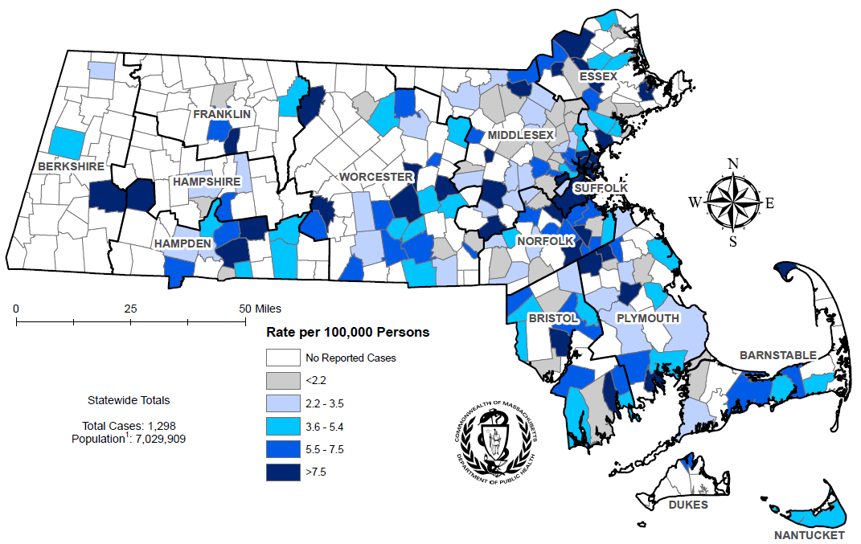
Average annual rate of HIV infection diagnosis per 100,000 population¹ by city/town, Massachusetts 2020–2022²
Note: regional HIV data exclude individuals diagnosed in a correctional facility
¹ As of 1/1/2020, BIDLS calculates rates per 100,000 population using denominators estimated by the University of Massachusetts Donahue Institute using a modified Hamilton-Perry model.
² Please consider the impact of the COVID-19 pandemic on infectious disease screening, treatment, and surveillance in the interpretation of 2020–2022 data.
Data Source: Bureau of Infectious Disease and Laboratory Sciences, data are current as of 1/1/2024 and subject to change
Notes:
The figure is a rate map of Massachusetts displaying the average annual rate of diagnosis per 100,000 population by city/town. Cities and towns are in one of six categories: no reported cases, less than 2.2 per 100,000, 2.2-3.5 per 100,000, 3.6-5.4 per 100,000, 5.5-7.5 per 100,000, or greater than 7.5 per 100,000.
The cities and towns with the highest average annual rate of HIV infection diagnosis during 2020 to 2022 included Brockton (20.8 per 100,000), Boston (16.6), Malden (15.6), Chelsea (15.5), and Everett (14.3). Boston had the highest number of new HIV infection diagnoses from 2020–2022 (N=335), followed by Brockton (N=66), and Worcester (N=65).
Please consider the impact of the COVID-19 pandemic on infectious disease screening, treatment, and surveillance in the interpretation of 2020–2022 data.
Among cities that reported at least 12 HIV infections during 2020–2022.
^{ii} Please consider the impact of the COVID-19 pandemic on infectious disease screening, treatment, and surveillance in the interpretation of 2020 and 2021 data
^{iii} Among cities that reported at least 12 HIV infections during 2020–2022.

Slide 24
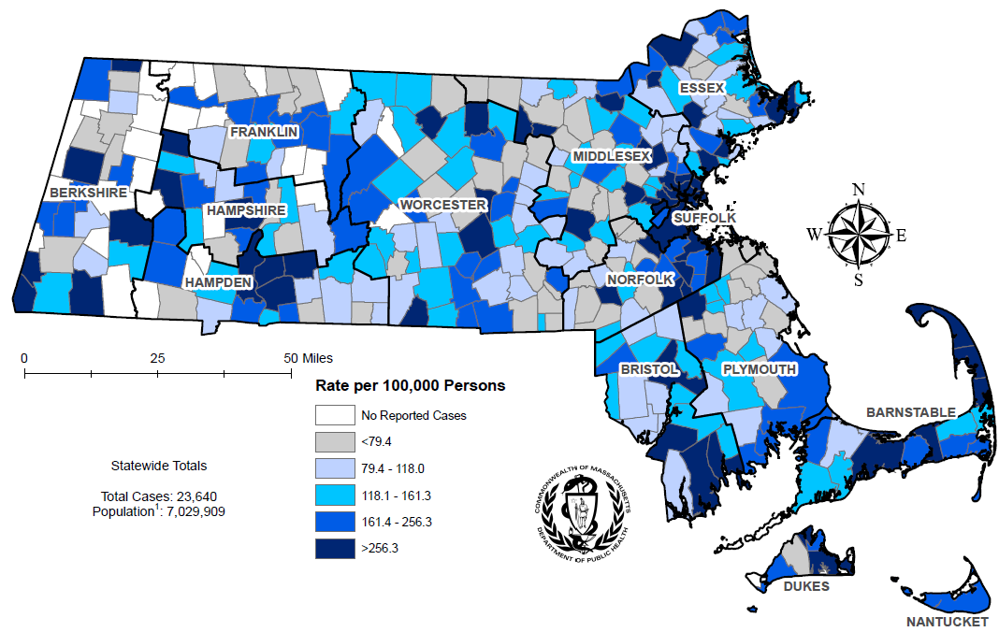
Prevalence rate of persons living with HIV infection (PLWH) per 100,000 population¹ by city/town, Massachusetts 2022²
Note: Regional HIV data may include PLWH who may have been incarcerated in 2022
¹ As of 1/1/2020, BIDLS calculates rates per 100,000 population using denominators estimated by the University of Massachusetts Donahue Institute using a modified Hamilton-Perry model.
² Please consider the impact of the COVID-19 pandemic on infectious disease screening, treatment, and surveillance in the interpretation of 2020–2022 data.
Data Source: Bureau of Infectious Disease and Laboratory Sciences, data are current as of 1/1/2024 and subject to change
Notes:
The figure is a rate map of Massachusetts displaying the HIV prevalence rate per 100,000 population by city/town. Cities and towns are in one of six categories: no reported cases, less than 79.4 per 100,000, 79.4-118.0 per 100,000, 118.1-161.3 per 100,000, 161.4-256.3 per 100,000, or greater than 256.3 per 100,000.
The cities and towns in Massachusetts with the highest prevalence rate of PLWH in 2022 included Provincetown (11,958.7 per 100,000), Boston (833.4), Springfield (832.4), Shirley (794.0), and Ayer (754.8). Boston and Springfield had the highest numbers of PLWH in 2022, at 5,631 and 1,298, respectively. Among cities that reported at least 50 PLWH as of 12/31/2022. Note: The rates of HIV prevalence for Provincetown, Shirley, and Ayer are high because of small population sizes (3,663, 7,431, and 8,479, respectively), as opposed to the number of cases (438, 59, and 64, respectively).

Slide 25
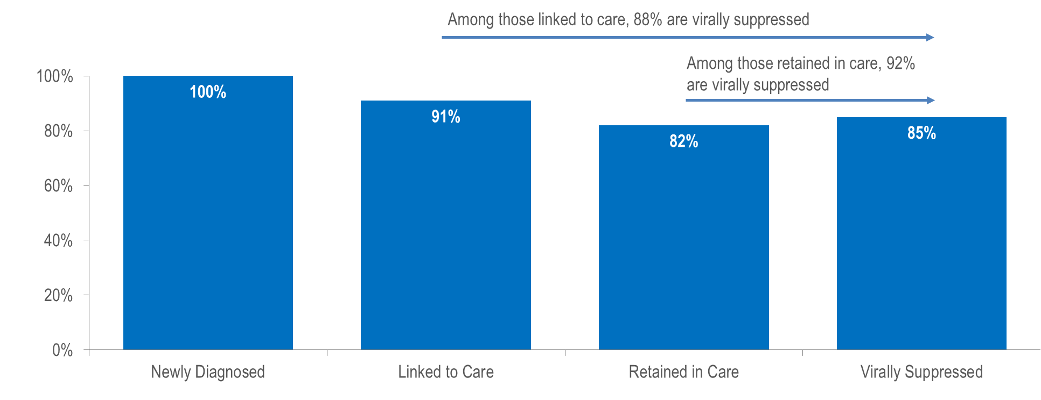
Stages of HIV care among individuals newly diagnosed with HIV infection in Massachusetts, 2021 (N=418)¹
¹ Please consider the impact of the COVID-19 pandemic on infectious disease screening, treatment, and surveillance in the interpretation of 2020–2022 data.
“Virally Suppressed” is defined as having a VL <200 copies/mL for the most recent VL test drawn during the 12-month period after diagnosis.
“Linked to Care” is defined as having ≥1 viral load (VL) or CD4 test result within 3 months of diagnosis.
“Retained in Care” is defined as having ≥2 VL or CD4 test results at least 3 months apart during the 12-month period after diagnosis.
Data Source: Bureau of Infectious Disease and Laboratory Sciences, data are current as of 1/1/2024 and subject to change
Notes:
The figure is a bar chart displaying the percentage of individuals newly diagnosed with HIV infection in Massachusetts in 2020 who were linked to care (91%), retained in care (82%), and virally suppressed (85%).
Among 418 individuals newly diagnosed with HIV infection in 2021 (and alive in Massachusetts through 2022), 85% were virally suppressed, 13% were not virally suppressed, and 2% did not have a viral load test in the year after diagnosis. Among those newly diagnosed individuals who were linked to care (N=381) and retained in care (N=343), rates of viral suppression were higher at 88% and 92%, respectively. Among individuals diagnosed with HIV infection in 2021, timely linkage to care differed by exposure mode. Viral suppression was lowest among individuals aged 60–69 years and under 19 years and with male-to-male sex/injection drug use and injection drug use exposure mode.

Slide 26
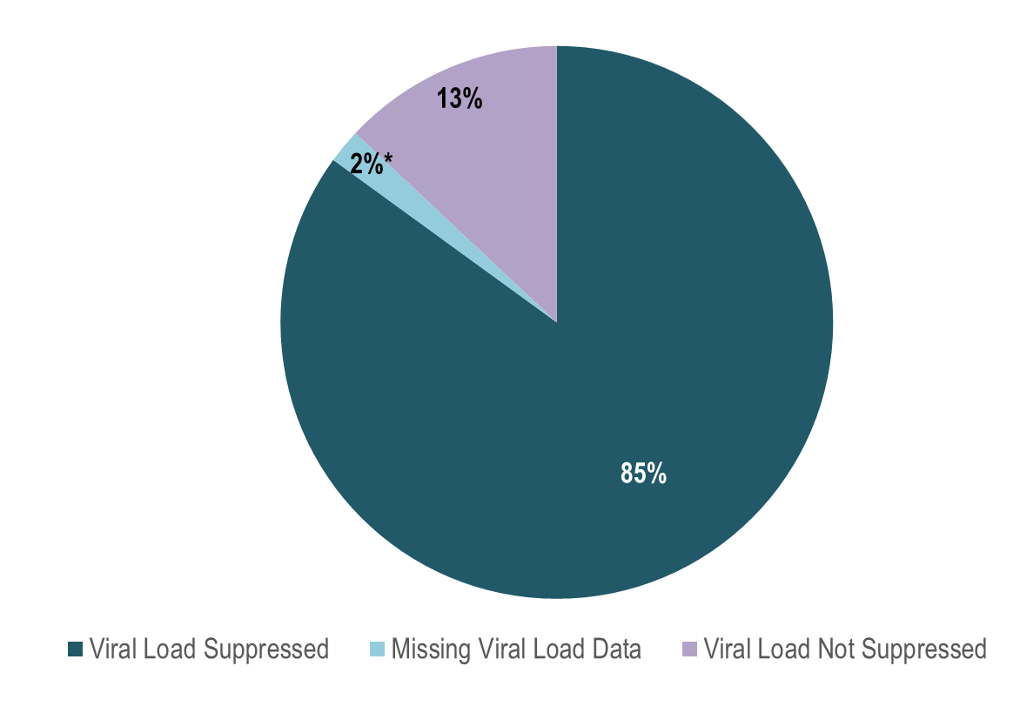
Viral load status among individuals newly diagnosed with HIV infection in Massachusetts, 2021 (N=418)¹
¹ Please consider the impact of the COVID-19 pandemic on infectious disease screening, treatment, and surveillance in the interpretation of 2020–2022 data.
* Includes individuals who had not had a lab reported in the past year
“Virally Suppressed” is defined as having a VL <200 copies/mL for the most recent VL test drawn during the 12-month period after diagnosis.
Data Source: Bureau of Infectious Disease and Laboratory Sciences, data are current as of 1/1/2024 and subject to change
Notes:
The figure is a pie chart indicating the proportion of individuals who were newly diagnosed with HIV infection in 2021 who were virally suppressed (85%), missing viral load data (2%), or for whom viral load was not suppressed (13%). NOTE: Missing viral load data includes individuals who have not had a lab reported in the past year.
Among 418 individuals newly diagnosed with HIV infection in 2021 (and alive in Massachusetts through 2022), 85% were virally suppressed, 13% were not virally suppressed, and 2% did not have a viral load test in the year after diagnosis. Among those newly diagnosed individuals who were linked to care (N=381) and retained in care (N=343), rates of viral suppression were higher at 88% and 92%, respectively. Among individuals diagnosed with HIV infection in 2021, timely linkage to care differed by exposure mode. Viral suppression was lowest among individuals aged 60–69 years and under 19 years and with male-to-male sex/injection drug use and injection drug use exposure mode.

Slide 27
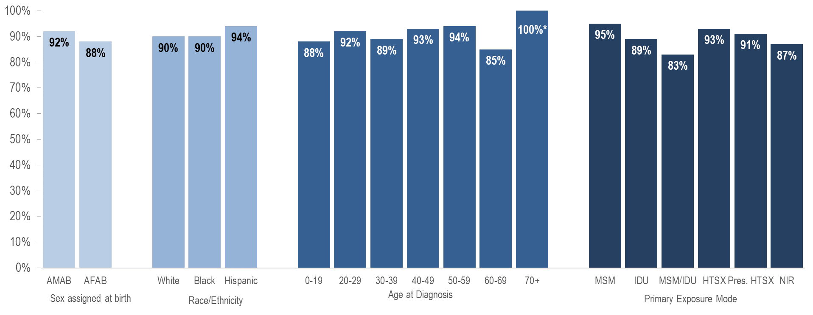
Linkage to care among individuals newly diagnosed with HIV infection by sex assigned at birth, race/ethnicity, age, and exposure mode, Massachusetts 2021 (N=418)¹
¹ Please consider the impact of the COVID-19 pandemic on infectious disease screening, treatment, and surveillance in the interpretation of 2020–2022 data.
“Linked to Care” is defined as having ≥1 viral load (VL) or CD4 test result within 3 months of diagnosis.
* Percentages based on numerators <5 are marked with an asterisk (*) and should be interpreted with caution
Data Source: Bureau of Infectious Disease and Laboratory Sciences, data are current as of 1/1/2024 and subject to change
Notes:
The figure is a bar chart which displays the percentage of individuals who were linked to care among those newly diagnosed with HIV infection by: sex assigned at birth (individuals AMAB and AFAB), race/ethnicity (White NH, Black NH, and Hispanic/Latinx individuals); age at diagnosis (individuals aged 0-19 years, 20-29 years, 30-39 years, 40-49 years, 50-59 years, 60-69 years, and aged 70+ years), and exposure mode (individuals with MSM, IDU, MSM/IDU, HTSX, Pres. HTSX, and NIR exposure modes).
Among individuals diagnosed with HIV infection in 2021, timely linkage to care differed by exposure mode..

Slide 28
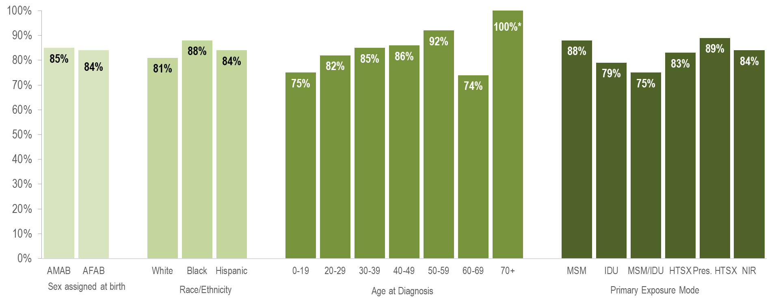
Viral suppression among individuals newly diagnosed with HIV infection by sex, race/ethnicity, age, and exposure mode, Massachusetts 2021 (N=418)¹
¹ Please consider the impact of the COVID-19 pandemic on infectious disease screening, treatment, and surveillance in the interpretation of 2020–2022 data.
“Virally Suppressed” is defined as having a VL <200 copies/mL for the most recent VL test drawn during the 12-month period after diagnosis.
* Percentages based on numerators <5 are marked with an asterisk (*) and should be interpreted with caution
Data Source: Bureau of Infectious Disease and Laboratory Sciences, data are current as of 1/1/2024 and subject to change
Notes:
The figure is a bar chart which displays the percentage of individuals who were virally suppressed among those newly diagnosed with HIV infection by: sex assigned at birth (individuals AMAB and AFAB), race/ethnicity (White NH, Black NH, and Hispanic/Latinx individuals); age at diagnosis (individuals aged 0-19 years, 20-29 years, 30-39 years, 40-49 years, 50-59 years, 60-69 years, and aged 70+ years), and exposure mode (individuals with MSM, IDU, MSM/IDU, HTSX, Pres. HTSX, and NIR exposure modes).
Viral suppression was lowest among individuals aged 60–69 years and under 19 years and with male-to-male sex/injection drug use and injection drug use exposure mode.

Slide 29
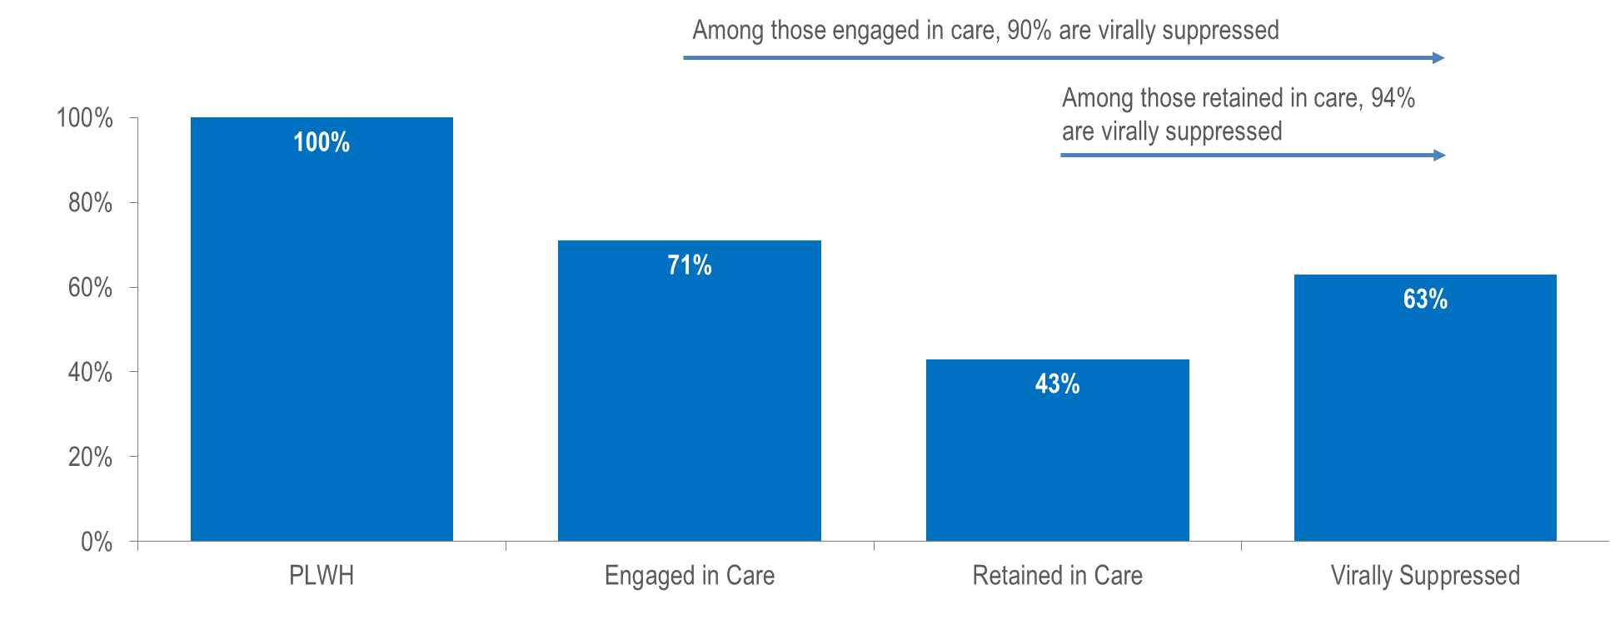
Stages of HIV care among persons living with HIV infection in Massachusetts, 2022 (N=22,455)¹
¹ Please consider the impact of the COVID-19 pandemic on infectious disease screening, treatment, and surveillance in the interpretation of 2020–2022 data.
“Virally Suppressed” is defined as having a VL <200 copies/mL for the most recent VL test drawn in 2022.
“Engaged in Care” is defined as having ≥1 VL or CD4 test result in 2022.
“Retained in Care” is defined as having ≥2 VL or CD4 test results at least 3 months apart in 2022.
Data Source: Bureau of Infectious Disease and Laboratory Sciences, data are current as of 1/1/2024 and subject to change
Notes:
The figure is a bar chart displaying the percentage of individuals living with HIV infection in Massachusetts in 2022 who were engaged in care (71%), retained in care (43%), and virally suppressed (63%).
Among 22,455 persons living with HIV infection (PLWH) in Massachusetts at the end of 2022 (and diagnosed through 2021), 63% were virally suppressed, 4% were not virally suppressed, and 33% did not have a viral load test in 2022. Rates of care engagement and retention were lower in 2022 (71% and 43%, respectively), 2021 (72% and 45%, respectively) and 2020 (69% and 39%, respectively) than in 2019 (75% and 54% respectively), likely due to the effects of the COVID-19 pandemic. However, please note that the total number of PLWH used to calculate these rates includes all individuals who have ever been diagnosed with HIV infection in Massachusetts with no evidence of death or having moved out of the state or country. Quality assurance efforts are currently being conducted to update the number of PLWH used for this analysis.

Slide 30
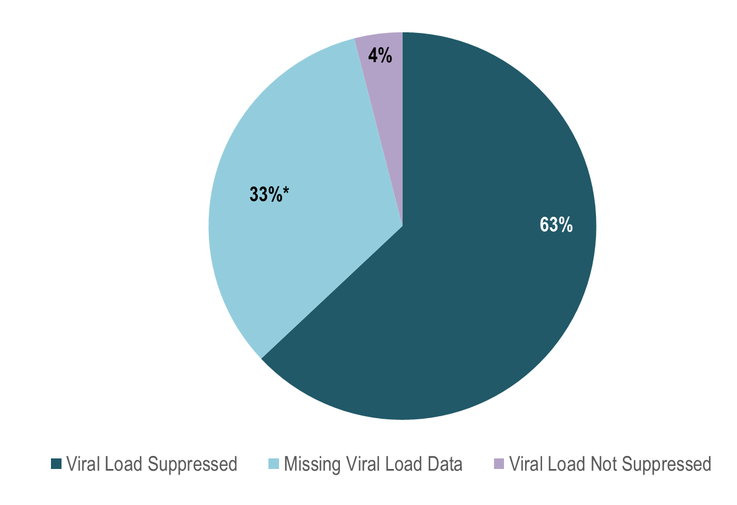
Viral load status among persons living with HIV infection in Massachusetts, 2022 (N=22,455)¹
¹ Please consider the impact of the COVID-19 pandemic on infectious disease screening, treatment, and surveillance in the interpretation of 2020–2022 data.
* Includes individuals who had not had a lab reported in the past year
“Virally Suppressed” is defined as having a VL <200 copies/mL for the most recent VL test drawn in 2021.
Data Source: Bureau of Infectious Disease and Laboratory Sciences, data are current as of 1/1/2024 and subject to change
Notes:
The figure is a pie chart indicating the proportion of individuals who were living with HIV infection in 2022 who were virally suppressed (63%), missing viral load data (33%), or for whom viral load was not suppressed (4%). NOTE: Missing Viral Load Data includes individuals who have not had a lab reported in the past year.
Among 22,455 persons living with HIV infection (PLWH) in Massachusetts at the end of 2022^{i} (and diagnosed through 2021), 63% were virally suppressed, 4% were not virally suppressed, and 33% did not have a viral load test in 2022.

Slide 31
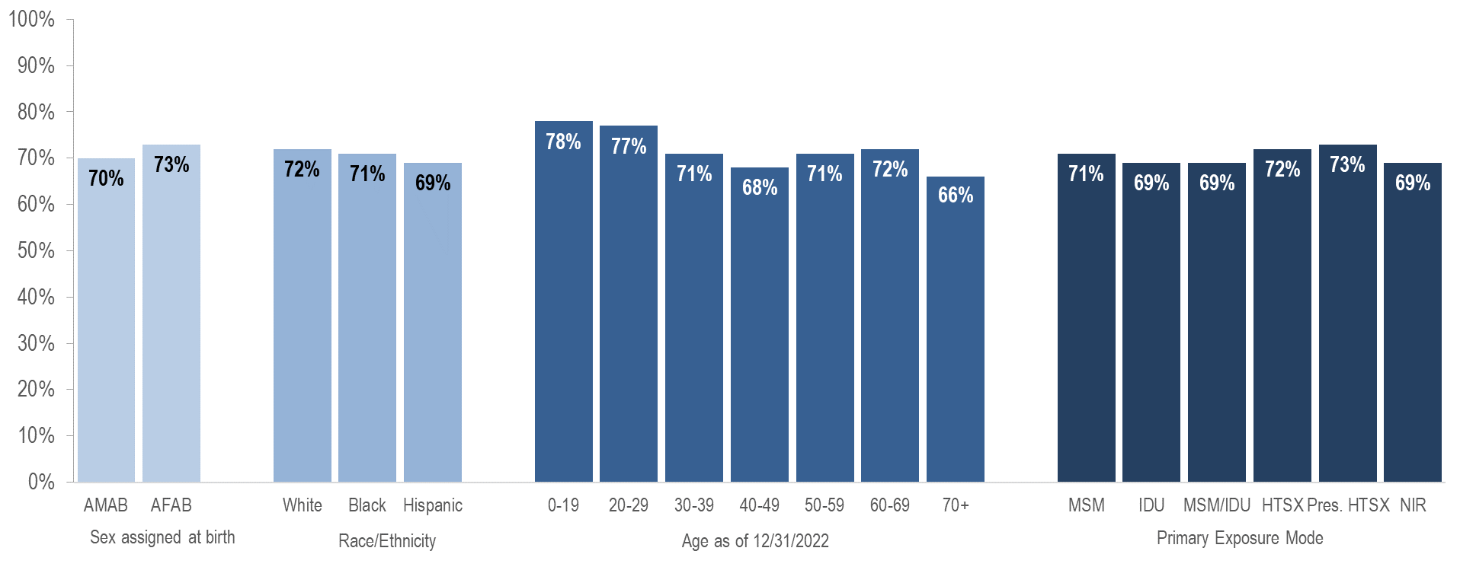
Engagement in care among persons living with HIV infection by sex assigned at birth, race/ethnicity, age, and exposure mode, Massachusetts 2022, (N=22,455)¹
“Engaged in Care” is defined as having ≥1 VL or CD4 test result in 2022.
Data Source: Bureau of Infectious Disease and Laboratory Sciences, data are current as of 1/1/2024 and subject to change
Notes:
The figure is a bar chart which displays the percentage of individuals who were engaged in care among those living with HIV infection for: individuals AMAB (71%), individuals AFAB (74%); White NH (74%), Black NH (72%), and Hispanic/Latinx (69%) individuals; individuals aged 0-19 years (88%), 20-29 years (76%), 30-39 years (72%), 40-49 years (70%), 50-59 years (71%), 60-69 years (74%), and aged 70+ years (68%); and individuals with MSM (72%), IDU (71%), MSM/IDU (69%), HTSX (74%), Pres. HTSX (74%), and NIR (69%) exposure modes.
In 2022, engagement in care and viral suppression among PLWH differed by age.

Slide 32
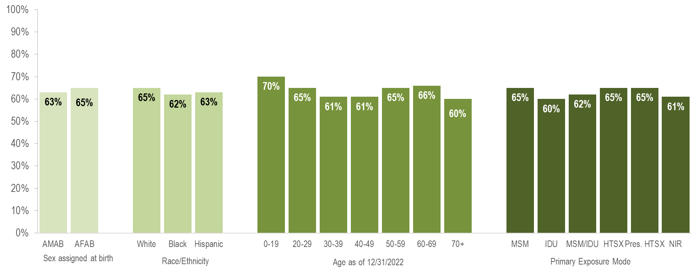
Viral suppression among persons living with HIV infection by sex assigned at birth, race/ethnicity, age, and exposure mode, Massachusetts 2022 (N=22,455)¹
¹ Please consider the impact of the COVID-19 pandemic on infectious disease screening, treatment, and surveillance in the interpretation of 2020–2022 data.
“Virally Suppressed” is defined as having a VL <200 copies/mL for the most recent VL test drawn in 2022.
Data Source: Bureau of Infectious Disease and Laboratory Sciences, data are current as of 1/1/2024 and subject to change
Notes:
The figure is a bar chart which displays the percentage of individuals who were virally suppressed among those living with HIV infection by: sex assigned at birth (individuals AMAB and AFAB), race/ethnicity (White NH, Black NH, and Hispanic/Latinx individuals); current age (individuals aged 0-19 years, 20-29 years, 30-39 years, 40-49 years, 50-59 years, 60-69 years, and aged 70+ years), and exposure mode (individuals with MSM, IDU, MSM/IDU, HTSX, Pres. HTSX, and NIR exposure modes).
In 2022, engagement in care and viral suppression among PLWH differed by age.

Slide 33
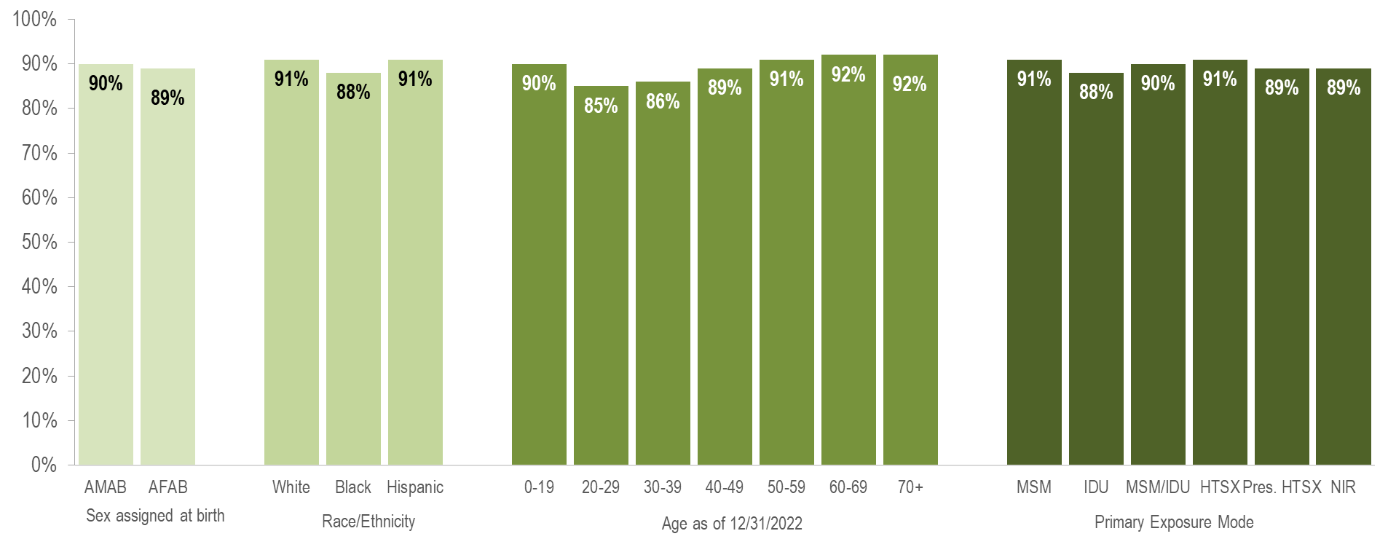
Viral suppression among persons living with HIV infection engaged in care by sex assigned at birth, race/ethnicity, age, and exposure mode, Massachusetts 2022 (N=15,936)¹
¹ Please consider the impact of the COVID-19 pandemic on infectious disease screening, treatment, and surveillance in the interpretation of 2020–2022 data.
“Virally Suppressed” is defined as having a VL <200 copies/mL for the most recent VL test drawn in 2021.
Data Source: Bureau of Infectious Disease and Laboratory Sciences, data are current as of 1/1/2024 and subject to change
Notes:
The figure is a bar chart which displays the percentage of individuals who were virally suppressed among those living with HIV infection and engaged in care by: sex assigned at birth (individuals AMAB and AFAB), race/ethnicity (White NH, Black NH, and Hispanic/Latinx individuals); current age (individuals aged 0-19 years, 20-29 years, 30-39 years, 40-49 years, 50-59 years, 60-69 years, and aged 70+ years), and exposure mode (individuals with MSM, IDU, MSM/IDU, HTSX, Pres. HTSX, and NIR exposure modes).
Among 15,849 persons living with HIV infection (PLWH) and engaged in care in Massachusetts at the end of 2022,^{i} viral suppression did not differ substantially by sex assigned at birth, race/ethnicity, age or exposure mode among PLWH engaged in care.

Slide 34
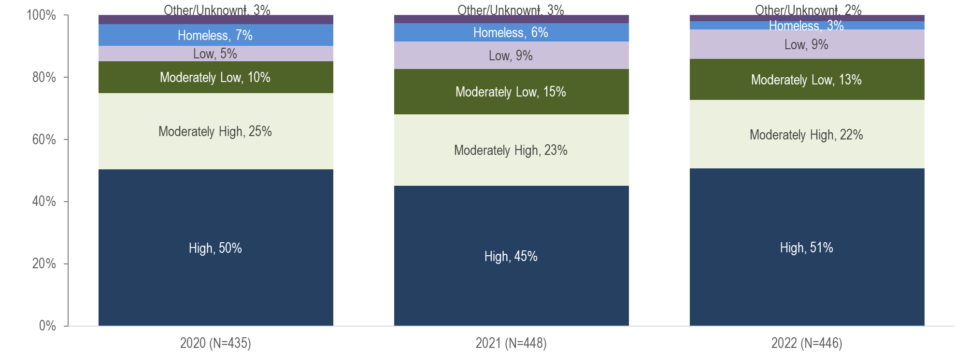
HIV infection diagnoses by Social Vulnerability Index*, Massachusetts 2020–2022¹
¹ Please consider the impact of the COVID-19 pandemic on infectious disease screening, treatment, and surveillance in the interpretation of 2020–2022 data.
* Census tract level overall SVI values for 2020 were obtained from CDC/Agency for Toxic Substance and Disease Registry (CDC/ATSDR) and assigned to all cases based on their street address at diagnosis. Values range from 0 to 1, with higher values implying greater social vulnerability. SVI rankings were grouped into quartiles (low, <0.25; mid low, 0.25 - <0.5; mid high, 0.5 - <0.75; high >0.75).
ⱡ Other/Unknown includes correctional facility addresses, P.O. Box addresses, hospital addresses and addresses that could not be geocoded
Data Source: Bureau of Infectious Disease and Laboratory Sciences, data are current as of 1/1/2024 and subject to change
Notes:
The figure is a stacked bar chart displaying the distribution of HIV infection diagnoses by the social vulnerability index. The distribution of social vulnerability by six categories (high, moderately high, moderately low, low, homeless, other/unknown) is displayed for each year.
The social vulnerability index (SVI)^{i} is a tool to identify socially vulnerable communities that was created by CDC and the Agency for Toxic Substances and Disease Registry (ATSDR). The CDC/ATSDR SVI uses U.S. Census data to determine the social vulnerability of every census tract. The SVI ranks each tract on 16 social factors, including poverty, lack of vehicle access, and crowded housing, and groups them into four related themes: socioeconomic status, household characteristics, racial and ethnic minority status, and housing type/transportation. Each census tract receives a separate ranking for each of the four themes, as well as an overall ranking. Originally developed to incorporate social determinants of health into emergency response and recovery efforts for environmental and natural disasters, more recently, higher SVI has been linked to higher HIV diagnosis rates,^{ii} COVID-19 mortality, and lower COVID-19 vaccination coverage.^{iii}
Social Vulnerability Index
The majority of individuals recently diagnosed with HIV infection in Massachusetts were diagnosed in areas with high (51% in 2022) or moderately high (22% in 2022) social vulnerability.^{iv}
^{i} For more information, see: https://www.atsdr.cdc.gov/placeandhealth/svi/index.html
^{ii} Gant, Z., Dailey, A., Hu, X. et al. A Census Tract–Level Examination of Diagnosed HIV Infection and Social Vulnerability among Black/African American, Hispanic/Latinx, and White Adults, 2018: United States. J. Racial and Ethnic Health Disparities (2022). https://doi.org/10.1007/s40615-022-01456-7
^{iii} Dasgupta S, Bowen VB, Leidner A, et al. Association Between Social Vulnerability and a County’s Risk for Becoming a COVID-19 Hotspot — United States, June 1–July 25, 2020. MMWR Morb Mortal Wkly Rep 2020;69:1535–1541. DOI: http://dx.doi.org/10.15585/mmwr.mm6942a3
^{iv} Please consider the impact of the COVID-19 pandemic on infectious disease screening, treatment, and surveillance in the interpretation of 2020 and 2021 data

