Slide 1
Massachusetts HIV Epidemiologic Profile: Data as of 1/1/2023
Population Report: Transgender Individuals
Notes:
Suggested citation:
Massachusetts Department of Public Health, Bureau of Infectious Disease and Laboratory Sciences. Massachusetts HIV/AIDS Epidemiologic Profile: Data as of 1/1/2023, Population Report: Transgender Individuals, https://www.mass.gov/lists/hivaids-epidemiologic-profiles Published March 2024. Accessed [date].
Bureau of Infectious Disease and Laboratory Sciences Massachusetts Department of Public Health
Jamaica Plain Campus/State Public Health Laboratory
305 South Street Jamaica Plain, MA 02130
Questions about this report
Tel: (617) 983-6560
To reach the Reporting and Partner Services Line*
Tel: (617) 983-6999
To speak to the on-call epidemiologist
Tel: (617) 983-6800
Questions about infectious disease reporting
Tel: (617) 983-6801
Requests for additional data
https://www.mass.gov/lists/infectious-disease-data-reports-and-requests
Slide sets for HIV Epidemiologic Profile Reports
https://www.mass.gov/lists/hivaids-epidemiologic-profiles
* Providers may use this number to report individuals newly diagnosed with a notifiable sexually transmitted infection, including HIV, or request partner services. Partner services is a free and confidential service for individuals recently diagnosed with a priority infection. The client-centered program offers counseling, linkage to other health and social services, anonymous notification of partners who were exposed and assistance with getting testing and treatment. For more information, see: https://www.mass.gov/service-details/partner-services-program-information-for-healthcare-providers)

Slide 2
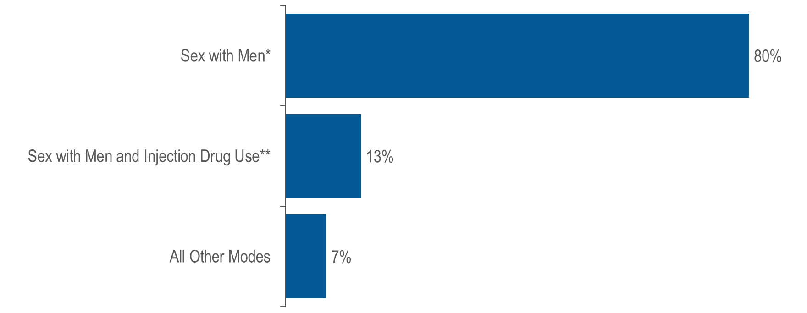
Transgender women living with HIV infection by exposure mode, Massachusetts 2021 (N=130)¹
¹ Please consider the impact of the COVID-19 pandemic on infectious disease screening, treatment, and surveillance in the interpretation of data from 2020 to 2021.
* Note: For the purposes of categorizing sexual risk in transgender women reporting sex with men only, this exposure mode category is reported on this fact sheet as “sex with men”. For the purposes of official reporting in the MA HIV/AIDS Surveillance System and to CDC, exposure mode for transgender women is based on sex assigned at birth and therefore would be reported as male-to-male sex.
** Note: For the purposes of categorizing sexual risk in transgender women reporting both sex with men and injection drug use, this exposure mode category is reported on this fact sheet as “sex with men and injection drug use”. For the purposes of official reporting in the MA HIV/AIDS Surveillance System and to CDC, exposure mode for transgender
women is based on sex assigned at birth and therefore would be reported as male-to-male sex/injection drug use.
Data Source: Bureau of Infectious Disease and Laboratory Sciences, data are current as of 1/1/2023 and subject to change
Notes:
The figure is a bar chart displaying the distribution of transgender women by exposure mode (sex with men, sex with men and injection drug use, and all other modes).
Sex with men^{iii} was the exposure mode for the majority (80%) of transgender women reported to be living with HIV infection. By comparison, male-to-male sex was the leading exposure mode for all persons living with HIV infection at 39%.
^{iii} Note: For the purposes of categorizing sexual risk in transgender women reporting sex with men only, this exposure mode category is reported on this fact sheet as “sex with men”. For the purposes of official reporting in the MA HIV/AIDS Surveillance System and to CDC, exposure mode for transgender women is based on sex assigned at birth and therefore would be reported as male-to-male sex.
^{iv} Note: For the purposes of categorizing sexual risk in transgender women reporting both sex with men and injection drug use, this exposure mode category is reported on this fact sheet as “sex with men and injection drug use”. For the purposes of official reporting in the MA HIV/AIDS Surveillance System and to CDC, exposure mode for transgender
women is based on sex assigned at birth and therefore would be reported as male-to-male sex/injection drug use.

Slide 3
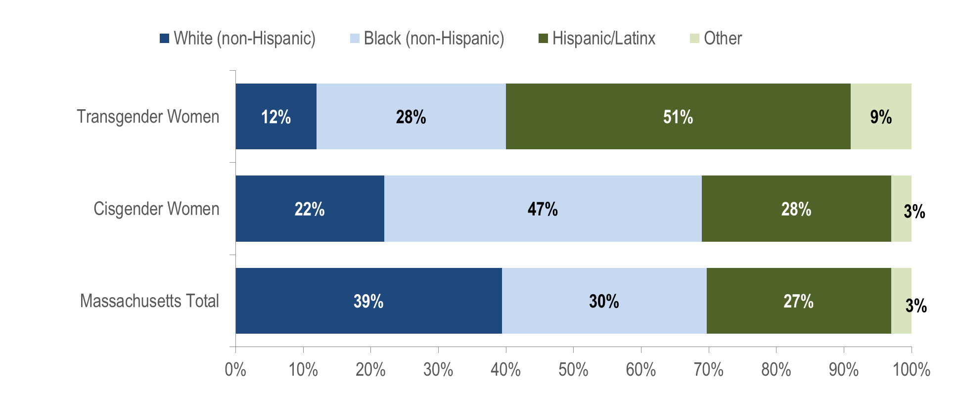
Persons living with HIV infection on December 31, 2021 by race/ethnicity: transgender women (N=130), cisgender women (N=6,763), and Massachusetts total (N=23,393)¹
¹ Please consider the impact of the COVID-19 pandemic on infectious disease screening, treatment, and surveillance in the interpretation of data from 2020 to 2021.
Data Source: Bureau of Infectious Disease and Laboratory Sciences, data are current as of 1/1/2023 and subject to change
Notes:
The figure is a stacked bar chart displaying the distribution by race/ethnicity (White NH, Black NH, Hispanic/Latino, Other) of three groups: transgender women, cisgender women, and Massachusetts Total.
Fifty-one percent of transgender women living with HIV infection were Hispanic/Latinx, compared to 28% of cisgender^{ii} women and 27% of all persons living with HIV infection.

Slide 4
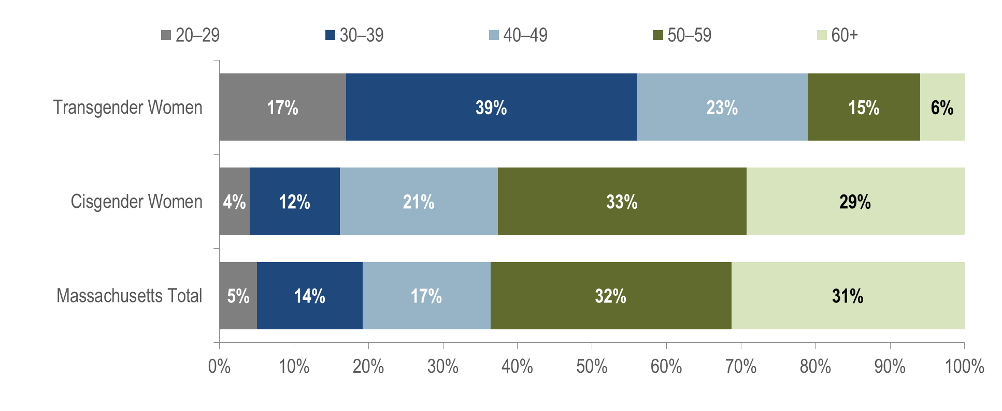
Persons living with HIV infection on December 31, 2021 by age (years): transgender women (N=130), cisgender women (N=6,763), and Massachusetts total (N=23,393)¹
¹ Please consider the impact of the COVID-19 pandemic on infectious disease screening, treatment, and surveillance in the interpretation of data from 2020 to 2021.
Data Source: Bureau of Infectious Disease and Laboratory Sciences, data are current as of 1/1/2023 and subject to change
Notes:
The figure is a stacked bar chart displaying the distribution by age (20-29 years, 30-39 years, 40-49 years, 50-59 years, and 60+ years) of three groups: transgender women, cisgender women, and Massachusetts Total.
KEY FINDING
The majority of transgender women living with HIV infection in Massachusetts were under 40 years old. A total of 56% of transgender women were ages 20–39 years old as of December 31, 2021, compared to 16% of cisgender women and 19% of all persons living with HIV infection in Massachusetts.

Slide 5
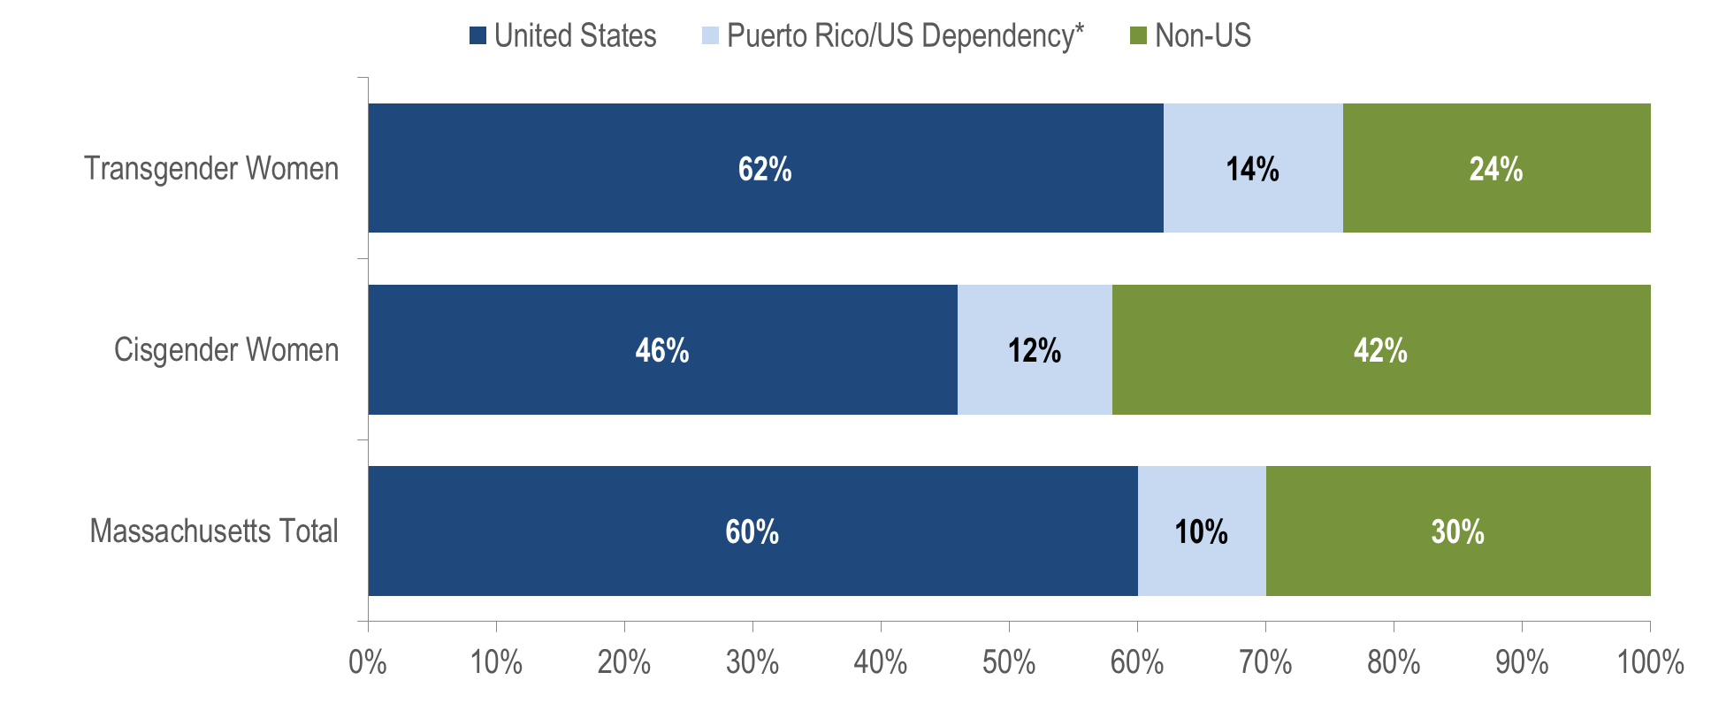
Persons living with HIV infection on December 31, 2021i by place of birth: transgender women ((N=130), cisgender women (N=6,763), and Massachusetts total (N=23,393)¹
¹ Please consider the impact of the COVID-19 pandemic on infectious disease screening, treatment, and surveillance in the interpretation of data from 2020 to 2021.
* 98% of individuals living with HIV infection on 12/31/2021 who were born in a US dependency were born in Puerto Rico
Data Source: Bureau of Infectious Disease and Laboratory Sciences, data are current as of 1/1/2023 and subject to change
Notes:
The figure is a stacked bar chart displaying the distribution by place of birth (United States, Puerto Rico/US Dependency, Non-US) of three groups: transgender women, cisgender women, and Massachusetts Total.
The distribution of place of birth among transgender women living with HIV infection on December 31, 2021 was more similar to that of all persons living with HIV infection (PLWH) in Massachusetts than cisgender women. Sixty-two percent of transgender women were born in the United States compared to 60% of all PLWH and 46% of cisgender women.

Slide 6
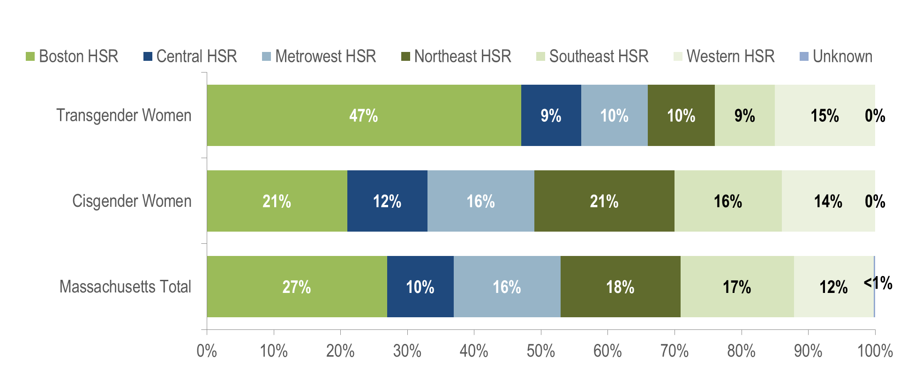
Persons living with HIV infection on December 31, 2021 by Health Service Region (HSR) of residence: transgender women (N=130), cisgender women (N=6,763), and Massachusetts total (N=23,393)¹
¹ Please consider the impact of the COVID-19 pandemic on infectious disease screening, treatment, and surveillance in the interpretation of data from 2020 to 2021.
Data Source: Bureau of Infectious Disease and Laboratory Sciences, data are current as of 1/1/2023 and subject to change
Notes:
The figure is a stacked bar chart displaying the distribution by Health Service Region (HSR) of residence (Boston HSR, Central HSR, Metrowest HSR, Northeast HSR, Southeast HSR, Western HSR, and Unknown) of three groups: transgender women, cisgender women, and Massachusetts Total.
Forty-seven percent of transgender women reported to be living with HIV infection in Massachusetts on December 31, 2021 were living in the Boston HSR, compared to 21% of cisgender women and 27% of all persons living with HIV infection. A total of 14% of transgender women were living in the Western HSR, 10% in both the Metrowest and Northeast HSRs, and 9% in both the Central and Southeast HSRs.

