Slide 1
Massachusetts HIV Epidemiologic Profile: Data as of 7/1/2024
Population Report: Transgender Individuals
Notes:
Suggested citation:
Massachusetts Department of Public Health, Bureau of Infectious Disease and Laboratory Sciences. Massachusetts HIV Epidemiologic Profile: Data as of 7/1/2024, Population Report: Transgender Individuals, https://www.mass.gov/lists/hivaids-epidemiologic-profiles Published December 2024. Accessed [date].
Bureau of Infectious Disease and Laboratory Sciences
Massachusetts Department of Public Health
Jamaica Plain Campus/State Public Health Laboratory
305 South Street
Jamaica Plain, MA 02130
Questions about this report
Tel: (617) 983-6560
To reach the Reporting and Partner Services Line*
Tel: (617) 983-6999
To speak to the on-call epidemiologist
Tel: (617) 983-6800
Questions about infectious disease reporting
Tel: (617) 983-6801
HIV Data Dashboard
https://www.mass.gov/info-details/hiv-data-dashboard
Requests for additional data
https://www.mass.gov/lists/infectious-disease-data-reports-and-requests
Slide sets for HIV Epidemiologic Profile Reports
https://www.mass.gov/lists/hivaids-epidemiologic-profiles
*Providers may use this number to report individuals newly diagnosed with a notifiable sexually transmitted infection, including HIV, or request partner services. Partner services is a free and confidential service for individuals recently diagnosed with a priority infection. The client-centered program offers counseling, linkage to other health and social services, anonymous notification of partners who were exposed and assistance with getting testing and treatment. For more information, see: https://www.mass.gov/service-details/partner-services-program-information-for-healthcare-providers

Slide 2
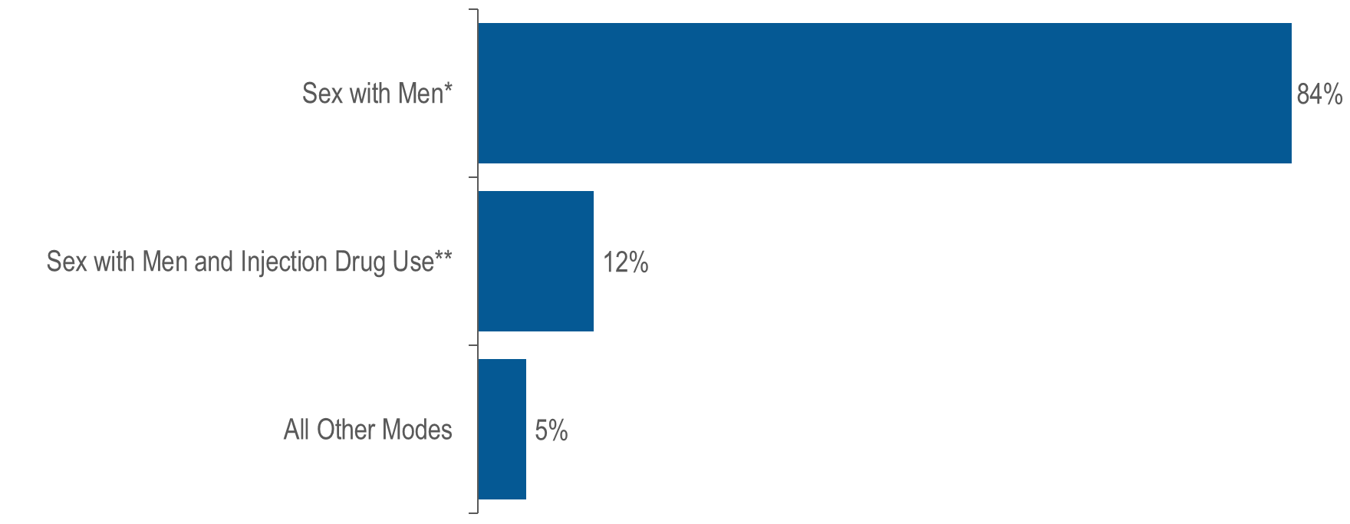
Transgender women living with HIV infection by exposure mode, Massachusetts 2023 (N=122)¹
¹ Please consider the impact of the COVID-19 pandemic on infectious disease screening, treatment, and surveillance in the interpretation of data from 2020 to 2023.
* Note: For the purposes of categorizing sexual risk in transgender women reporting sex with men only, this exposure mode category is reported on this fact sheet as “sex with men”. For the purposes of official reporting in the MA HIV/AIDS Surveillance System and to CDC, exposure mode for transgender women is based on sex assigned at birth and therefore would be reported as male-to-male sex.
** Note: For the purposes of categorizing sexual risk in transgender women reporting both sex with men and injection drug use, this exposure mode category is reported on this fact sheet as “sex with men and injection drug use”. For the purposes of official reporting in the MA HIV/AIDS Surveillance System and to CDC, exposure mode for transgender
women is based on sex assigned at birth and therefore would be reported as male-to-male sex/injection drug use.
Data Source: Bureau of Infectious Disease and Laboratory Sciences, data are current as of 7/1/2024 and subject to change
Notes:
The figure is a bar chart displaying the distribution of transgender women by exposure mode (sex with men, sex with men and injection drug use, and all other modes).
Sex with men^{iii} was the exposure mode for the majority (84%) of transgender women reported to be living with HIV infection.
^{iii} Note: For the purposes of categorizing sexual risk in transgender women reporting sex with men only, this exposure mode category is reported on this fact sheet as “sex with men”. For the purposes of official reporting in the MA HIV/AIDS Surveillance System and to CDC, exposure mode for transgender women is based on sex assigned at birth and therefore would be reported as male-to-male sex.
^{iv} Note: For the purposes of categorizing sexual risk in transgender women reporting both sex with men and injection drug use, this exposure mode category is reported on this fact sheet as “sex with men and injection drug use”. For the purposes of official reporting in the MA HIV/AIDS Surveillance System and to CDC, exposure mode for transgender
women is based on sex assigned at birth and therefore would be reported as male-to-male sex/injection drug use.

Slide 3
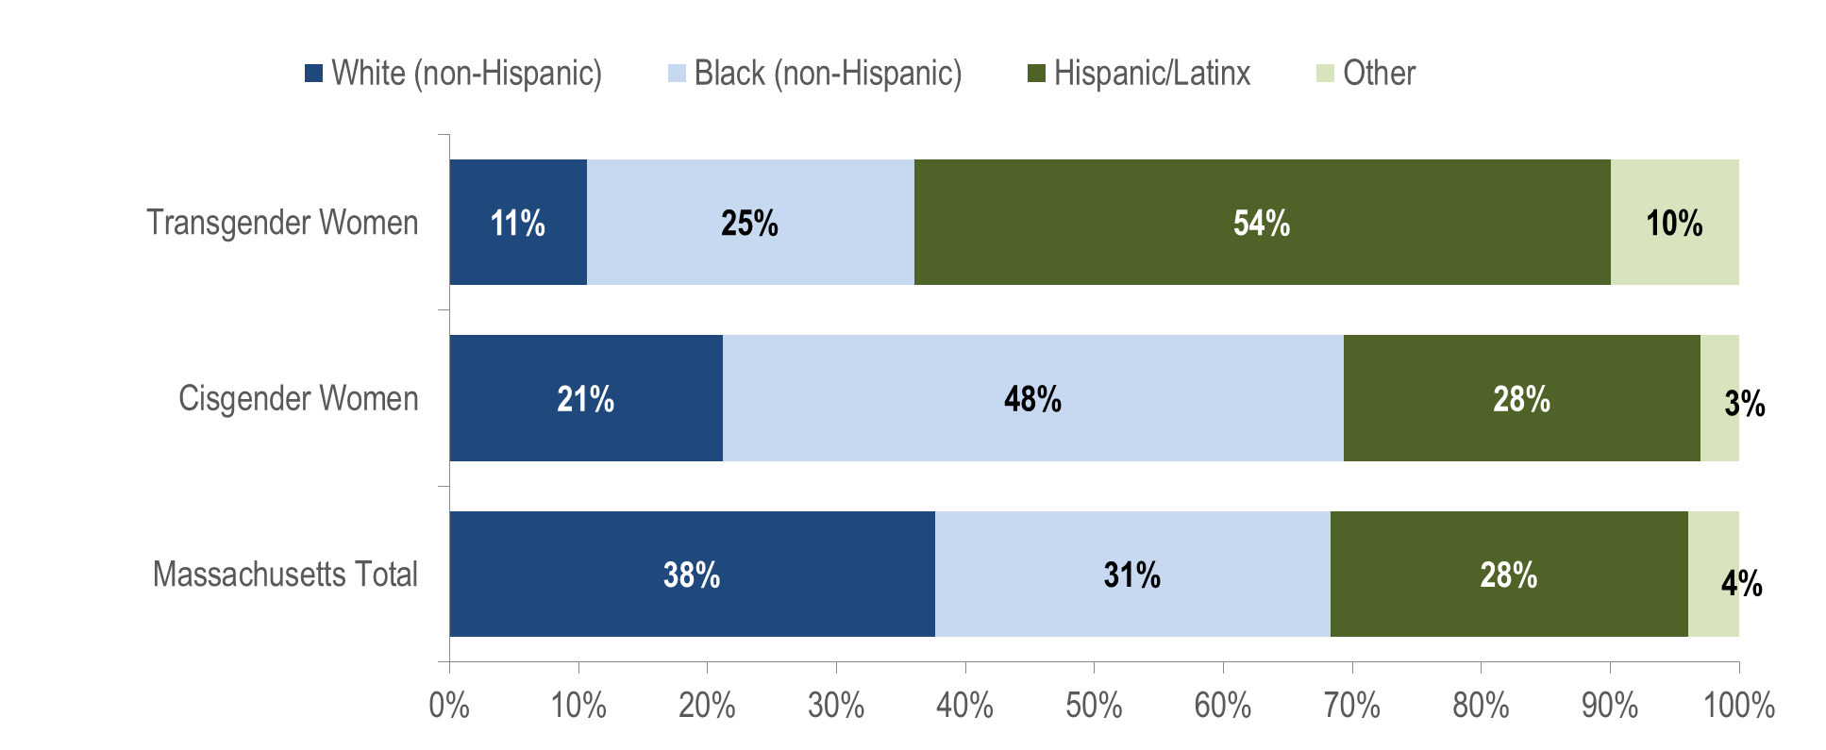
Persons living with HIV infection on December 31, 2023 by race/ethnicity: transgender women (N=122), cisgender women (N=7,009), and Massachusetts total (N=24,119)¹
¹ Please consider the impact of the COVID-19 pandemic on infectious disease screening, treatment, and surveillance in the interpretation of data from 2020 to 2023.
Data Source: Bureau of Infectious Disease and Laboratory Sciences, data are current as of 7/1/2024 and subject to change
Notes:
The figure is a stacked bar chart displaying the distribution by race/ethnicity (White NH, Black NH, Hispanic/Latino, Other) of three groups: transgender women, cisgender women, and Massachusetts Total.
KEY FINDING
Fifty-four percent of transgender women living with HIV infection were Hispanic/Latinx, compared to 28% of both cisgender women and all persons living with HIV infection.

Slide 4
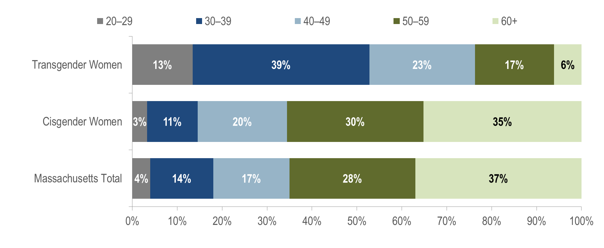
Persons living with HIV infection on December 31, 2023 by age (years): transgender women (N=122), cisgender women (N=7,009), and Massachusetts total (N=24,119)¹
¹ Please consider the impact of the COVID-19 pandemic on infectious disease screening, treatment, and surveillance in the interpretation of data from 2020 to 2023.
Data Source: Bureau of Infectious Disease and Laboratory Sciences, data are current as of 7/1/2024 and subject to change
Notes:
The figure is a stacked bar chart displaying the distribution by age (20-29 years, 30-39 years, 40-49 years, 50-59 years, and 60+ years) of three groups: transgender women, cisgender women, and Massachusetts Total.
KEY FINDING
The majority of transgender women living with HIV infection in Massachusetts were under 40 years old. A total of 52% of transgender women were ages 20–39 years old as of December 31, 2023, compared to 14% of cisgender women and 18% of all persons living with HIV infection in Massachusetts.

Slide 5
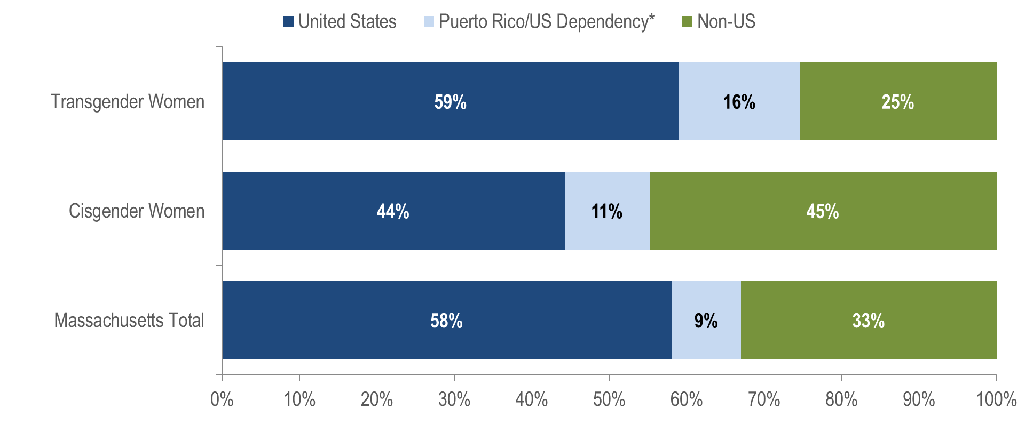
Persons living with HIV infection on December 31, 2023 by place of birth: transgender women ((N=122), cisgender women (N=7,009), and Massachusetts total (N=24,119)¹
¹ Please consider the impact of the COVID-19 pandemic on infectious disease screening, treatment, and surveillance in the interpretation of data from 2020 to 2023.
* 98% of individuals living with HIV infection on 12/31/2023 who were born in a US dependency were born in Puerto Rico
Data Source: Bureau of Infectious Disease and Laboratory Sciences, data are current as of 7/1/2024 and subject to change
Notes:
The figure is a stacked bar chart displaying the distribution by place of birth (United States, Puerto Rico/US Dependency, Non-US) of three groups: transgender women, cisgender women, and Massachusetts Total.
The distribution of place of birth among transgender women living with HIV infection on December 31, 2023 was more similar to the distribution of all persons living with HIV infection (PLWH) in Massachusetts than to the distribution of cisgender women. Fifty-nine percent of transgender women were born in the United States compared to 58% of all PLWH and 44% of cisgender women.

Slide 6
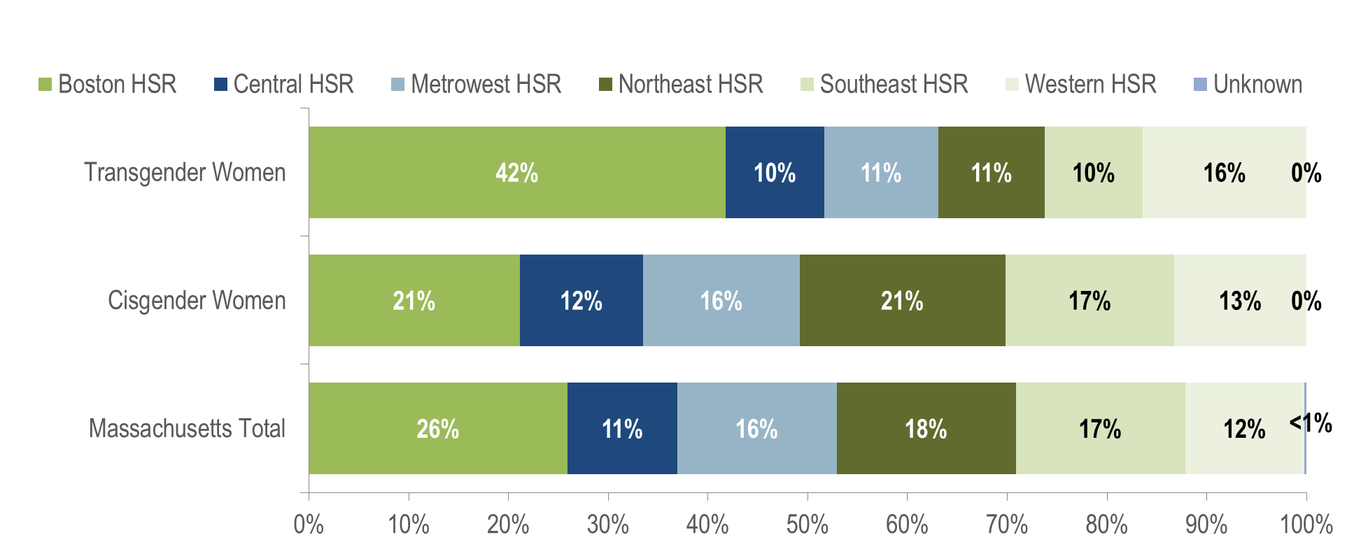
Persons living with HIV infection on December 31, 2023 by Health Service Region (HSR) of residence: transgender women (N=122), cisgender women (N=7,009), and Massachusetts total (N=24,119)¹
¹ Please consider the impact of the COVID-19 pandemic on infectious disease screening, treatment, and surveillance in the interpretation of data from 2020 to 2023.
Data Source: Bureau of Infectious Disease and Laboratory Sciences, data are current as of 7/1/2024 and subject to change
Notes:
The figure is a stacked bar chart displaying the distribution by Health Service Region (HSR) of residence (Boston HSR, Central HSR, Metrowest HSR, Northeast HSR, Southeast HSR, Western HSR, and Unknown) of three groups: transgender women, cisgender women, and Massachusetts Total.
Forty-two percent of transgender women reported to be living with HIV infection in Massachusetts on December 31, 2023 were living in the Boston HSR, compared to 21% of cisgender women and 26% of all persons living with HIV infection. A total of 16% of transgender women were living in the Western HSR, 11% in both the Metrowest and Northeast HSRs, and 10% in both the Central and Southeast HSRs.

