Slide 1
Massachusetts HIV Epidemiologic Profile:
Data as of 7/1/2025
Population Report: Women
Notes:
Suggested citation:
Massachusetts Department of Public Health, Bureau of Infectious Disease and Laboratory Sciences. Massachusetts HIV Epidemiologic Profile: Data as of 7/1/2025, Population Report: Women, https://www.mass.gov/lists/hivaids-epidemiologic-profiles Published December 2025. Accessed [date].
Bureau of Infectious Disease and Laboratory Sciences
Massachusetts Department of Public Health
Jamaica Plain Campus/State Public Health Laboratory
305 South Street
Jamaica Plain, MA 02130
Questions about this report
Tel: (617) 983-6560
To reach the Reporting and Partner Services Line*
Tel: (617) 983-6999
To speak to the on-call epidemiologist
Tel: (617) 983-6800
Questions about infectious disease reporting
Tel: (617) 983-6801
HIV Data Dashboard
https://www.mass.gov/info-details/hiv-data-dashboard
Requests for additional data
https://www.mass.gov/lists/infectious-disease-data-reports-and-requests
Slide sets for HIV Epidemiologic Profile Reports
https://www.mass.gov/lists/hivaids-epidemiologic-profiles
*Providers may use this number to report individuals newly diagnosed with a notifiable sexually transmitted infection, including HIV, or request partner services. Partner services is a free and confidential service for individuals recently diagnosed with a priority infection. The client-centered program offers counseling, linkage to other health and social services, anonymous notification of partners who were exposed and assistance with getting testing and treatment. For more information, see: https://www.mass.gov/service-details/partner-services-program-information-for-healthcare-providers)

Slide 2
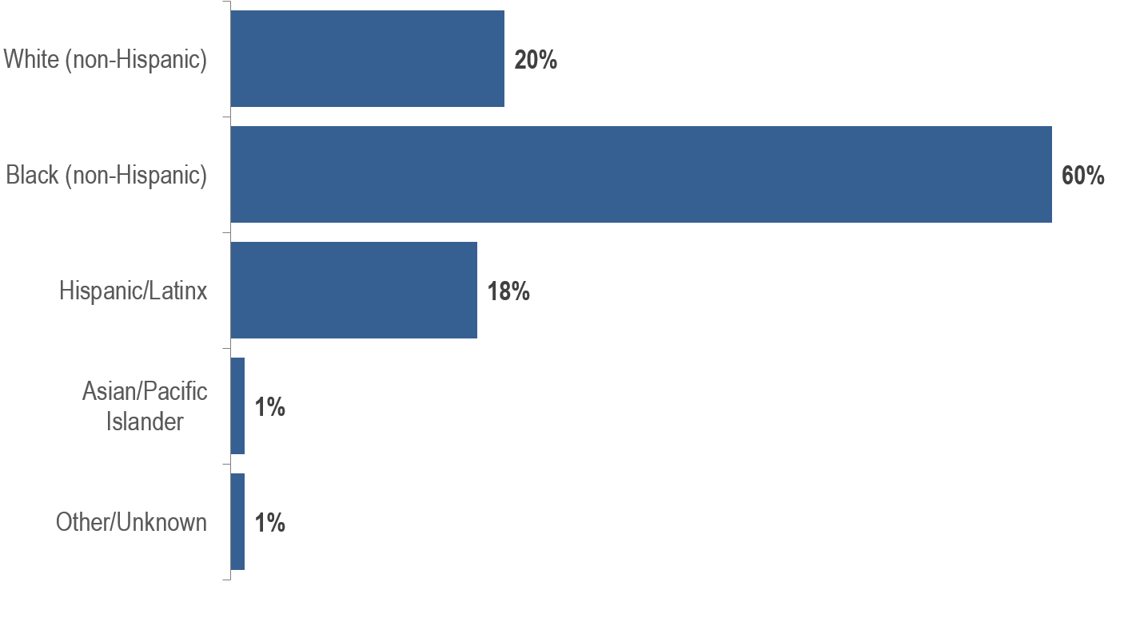
Percentage of individuals AFAB diagnosed with HIV infection by race/ethnicity, Massachusetts 2022–2024 (N=434)¹
¹ Please consider the impact of the COVID-19 pandemic on infectious disease screening, treatment, and surveillance in the interpretation of data from 2020 to 2022. AFAB = assigned female at birth
Data Source: Bureau of Infectious Disease and Laboratory Sciences, data are current as of 7/1/2025 and subject to change
Notes:
The figure is a bar chart displaying the distribution of recent HIV diagnoses by race/ethnicity.
Sixty percent of individuals AFAB recently diagnosed with HIV infection were Black (non-Hispanic), 20% were White (non-Hispanic), 18% were Hispanic/Latinx,1% were Asian/Pacific Islander, and 1% were other/unknown race/ethnicity.

Slide 3
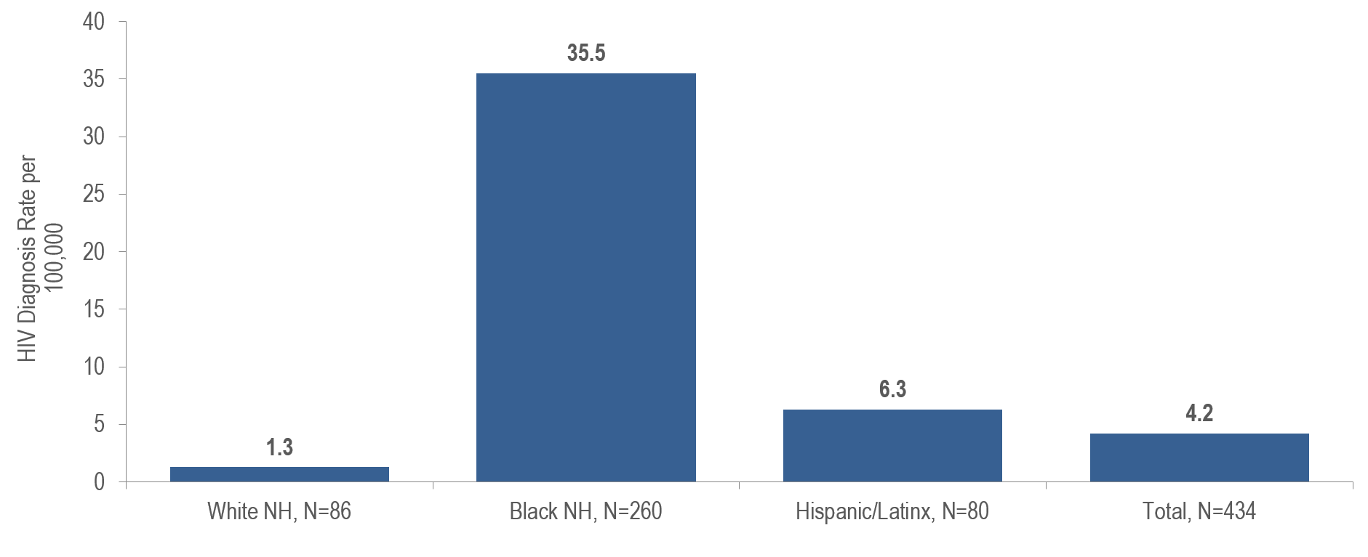
Average age-adjusted rate of HIV infection diagnosis per 100,000 population¹ among individuals AFAB by race/ethnicity, Massachusetts 2022–2024²
¹ As of 1/1/2020, BIDLS calculates rates per 100,000 population using denominators estimated by the University of Massachusetts Donahue Institute using a modified Hamilton-Perry model (Strate S, et al. Small Area Population Estimates for 2011 through 2020, report published Oct 2016). Note that rates and trends calculated using previous methods cannot be compared to these. All rates are age-adjusted using the 2000 US standard population. AFAB = assigned female at birth
² Please consider the impact of the COVID-19 pandemic on infectious disease screening, treatment, and surveillance in the interpretation of data from 2020 to 2022.
Total includes other/unknown race/ethnicities (N=8)
Data Source: Bureau of Infectious Disease and Laboratory Sciences, data are current as of 7/1/2025 and subject to change
Notes:
The figure is a bar chart displaying the average annual HIV diagnosis rates per 100,000 for four racial/ethnic groups: White NH (N=86), Black NH (N=260), Hispanic/Latinx (N=80), and Total (N=434).
KEY FINDING
The average annual age-adjusted HIV diagnosis rate for 2022 to 2024 among Black (non-Hispanic) individuals AFAB was 28 times, and among Hispanic/Latinx individuals AFAB was five times, that of White (non-Hispanic) individuals AFAB.

Slide 4
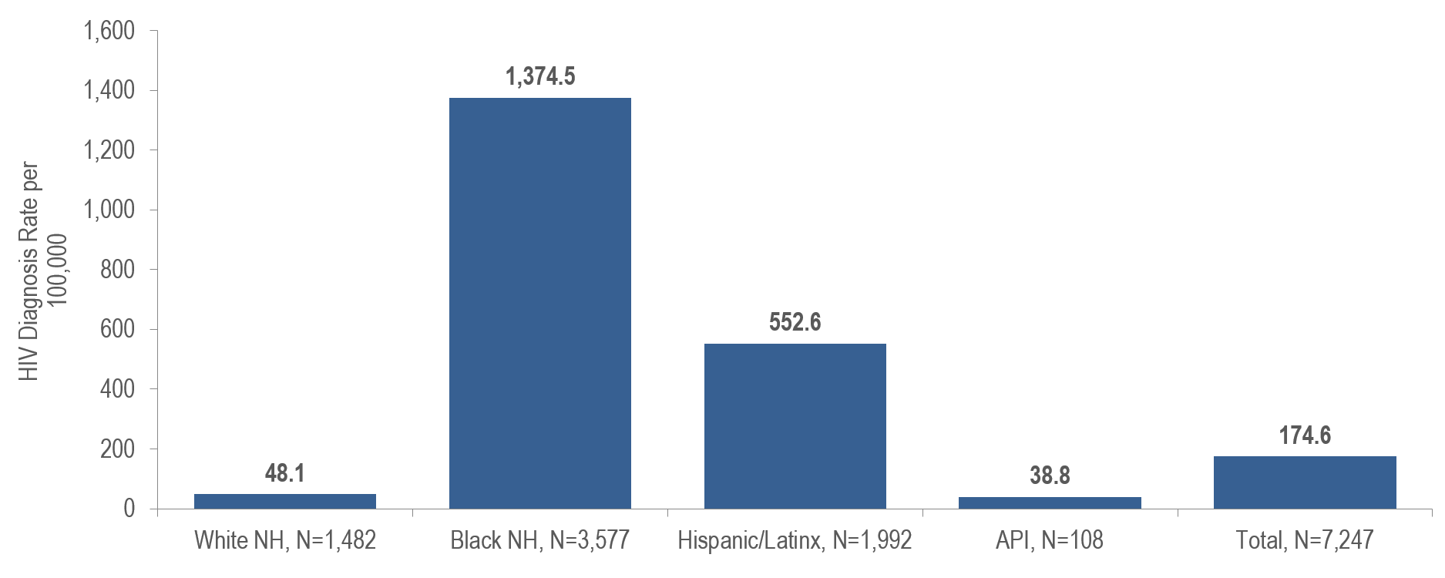
Age-adjusted HIV prevalence rate per 100,000 population¹ among individuals AFAB by race/ethnicity, Massachusetts 2024
¹ As of 1/1/2020, BIDLS calculates rates per 100,000 population using denominators estimated by the University of Massachusetts Donahue Institute using a modified Hamilton-Perry model (Strate S, et al. Small Area Population Estimates for 2011 through 2020, report published Oct 2016). Note that rates and trends calculated using previous methods cannot be compared to these. All rates are age-adjusted using the 2000 US standard population. AFAB = assigned female at birth
Total includes other/unknown race/ethnicities (N=88)
Data Source: Bureau of Infectious Disease and Laboratory Sciences, data are current as of 7/1/2025 and subject to change
Notes:
The figure is a bar chart displaying the average age-adjusted prevalence rates per 100,000 for four racial/ethnic groups: White NH (N=1,482), Black NH (N=3,577), Hispanic/Latinx (N=1,992), Asian/Pacific Islander (N=108), and Total (N=7,247).
KEY FINDING
The age-adjusted prevalence rate of HIV infection among Black (non-Hispanic) individuals AFAB was 29 times, and among Hispanic/Latinx individuals AFAB was 11 times, greater than the rate among White (non-Hispanic) individuals AFAB.

Slide 5
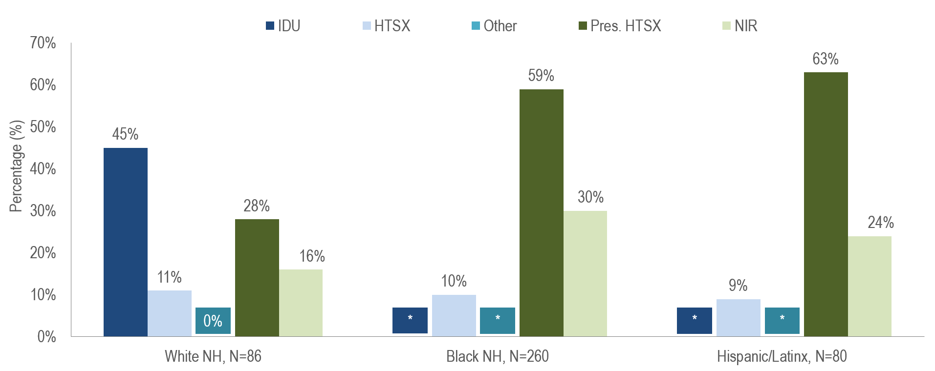
Individuals AFAB diagnosed with HIV infection by exposure mode and race/ethnicity, Massachusetts 2022–2024¹
¹ Please consider the impact of the COVID-19 pandemic on infectious disease screening, treatment, and surveillance in the interpretation of data from 2020 to 2022.
AFAB=assigned female at birth; IDU=injection drug use; HTSX=heterosexual sex; Pres. HTSX=presumed heterosexual exposure, includes individuals assigned female at birth with a negative history of injection drug use who report having sex with an individual that identifies as male of unknown HIV status and risk; NIR=no identified risk,
Data Source: Bureau of Infectious Disease and Laboratory Sciences, data are current as of 7/1/2025 and subject to change
Notes:
The figure is a bar chart displaying the distribution of recent HIV diagnoses among individuals assigned female at birth by exposure mode for each of three racial/ethnic groups: White NH (N=86), Black NH (N=260), and Hispanic/Latinx (N=80).
Injection drug use was the predominant exposure mode among White (non-Hispanic) individuals AFAB recently diagnosed with HIV infection (45%), while presumed heterosexual sex accounted for the largest proportions among Black (non-Hispanic) (59%) and Hispanic/Latinx (63%) individuals AFAB.

Slide 6
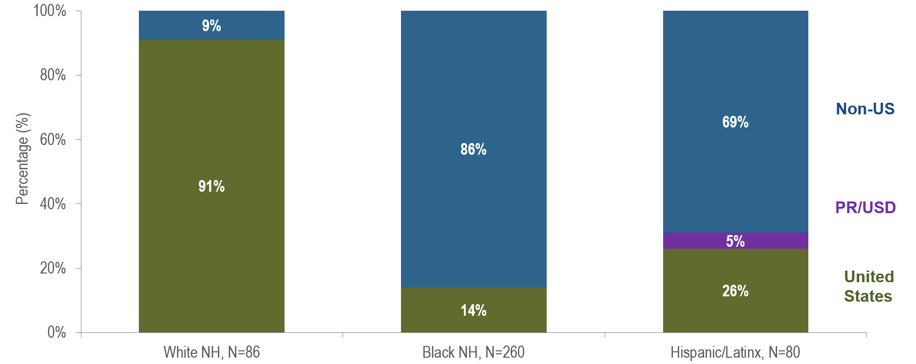
Percentage of individuals AFAB diagnosed with HIV infection by race/ethnicity and place of birth, Massachusetts 2022–2024¹
¹ Please consider the impact of the COVID-19 pandemic on infectious disease screening, treatment, and surveillance in the interpretation of data from 2020 to 2022.
AFAB = assigned female at birth; PR/USD = Puerto Rico/US Dependency, 97% of individuals diagnosed with HIV infection from 2022–2024 who were born in a US dependency were born in Puerto Rico.
Data Source: Bureau of Infectious Disease and Laboratory Sciences, data are current as of 7/1/2025 and subject to change
Notes:
The figure is a stacked bar chart displaying the distribution of recent HIV diagnoses by place of birth (non-US, Puerto Rico/US Dependency, or US) for each of three racial/ethnic groups: White NH (N=86), Black NH (N=260), and Hispanic/Latinx (N=80).
KEY FINDING
Eighty-six percent of Black (non-Hispanic) individuals AFAB recently diagnosed with HIV infection were born outside the US, compared to 69% of Hispanic/Latinx and 9% of White (non-Hispanic) individuals AFAB. An additional 5% of Hispanic/Latinx individuals AFAB were born in Puerto Rico/US Dependencies compared to no White (non-Hispanic) or Black (non-Hispanic) individuals AFAB.

Slide 7
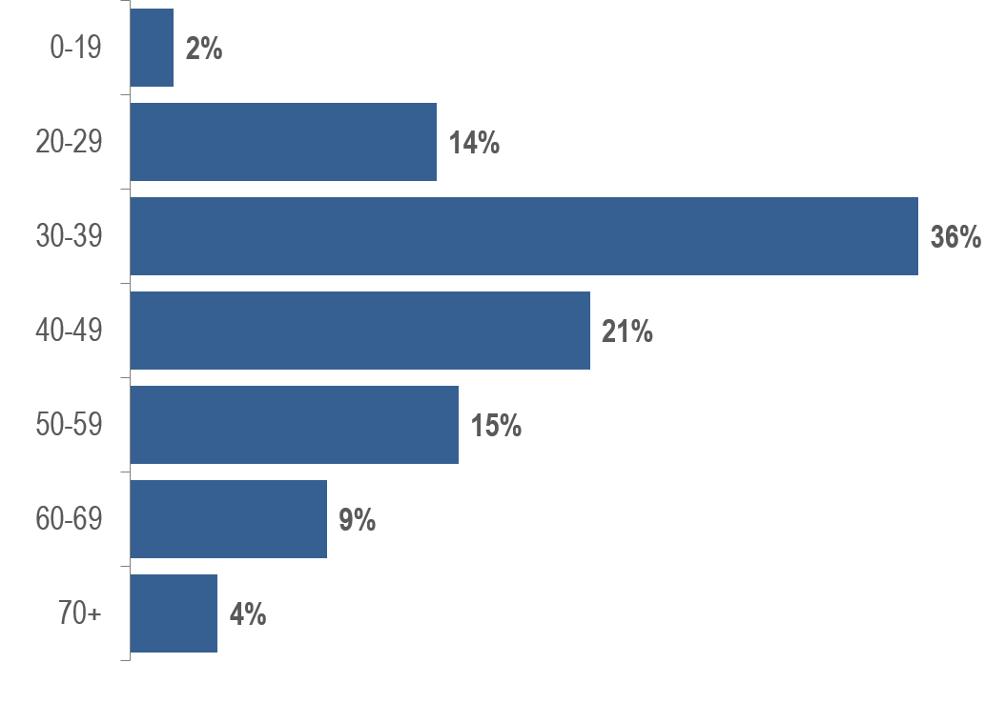
Percentage of individuals AFAB diagnosed with HIV infection by age at diagnosis (years), Massachusetts 2022–2024 (N=434)¹
¹ Please consider the impact of the COVID-19 pandemic on infectious disease screening, treatment, and surveillance in the interpretation of data from 2020 to 2022. AFAB = assigned female at birth
Data Source: Bureau of Infectious Disease and Laboratory Sciences, data are current as of 7/1/2025 and subject to change
Notes:
The figure is a bar chart displaying the distribution of recent HIV diagnoses by age at diagnosis.
Individuals AFAB newly diagnosed with HIV infection in Massachusetts during 2022 to 2024 were predominantly in their thirties and forties (36% 30–39 year-olds and 21% 40–49 year-olds).

