Slide 1
ESEA Flexibility
Changes to School & District
Accountability and Assistance
April 2012

Slide 2
Today’s agenda
Welcome & framing of the day
Overview of flexibility waiver & changes to accountability and assistance system
Using federal resources to support school improvement

Slide 3
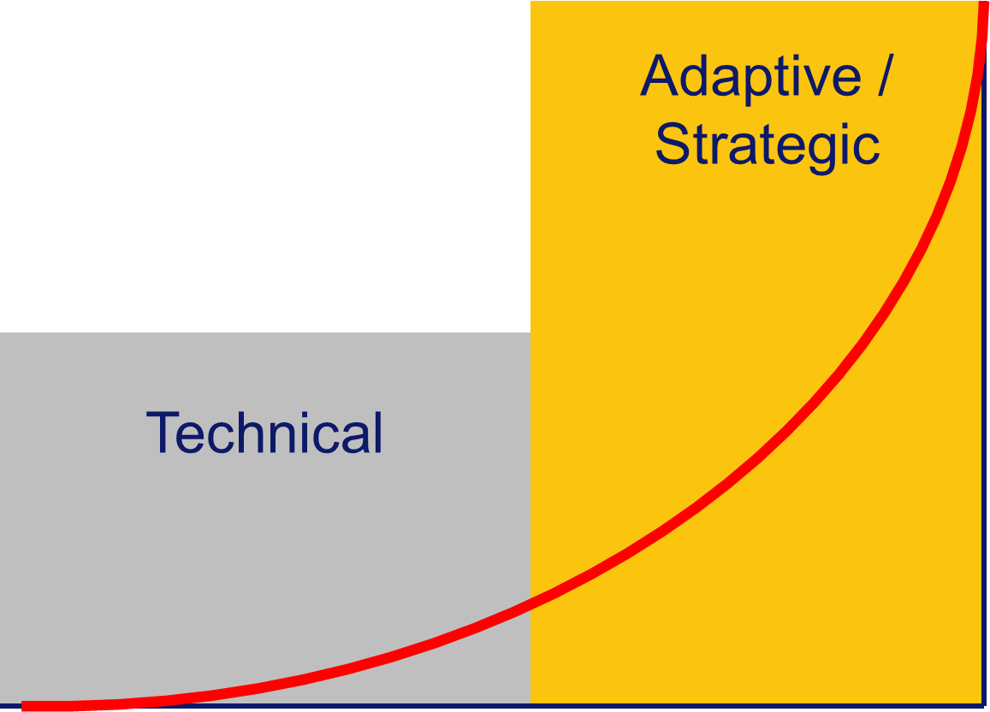
Framing the day…

Slide 4
Some of your questions may be…
Technical
How will ESE measure school & district performance next year?
How does ESE’s flexibility plan impact my district or school accountability status?
How much of my Title I grant will I have to set aside & for what?
Will I have to implement SES &/or school choice?
Can I continue to use my Title I funds as I have been?
What does the flexibility plan mean for my Title II-A funds?

Slide 5
Some of your questions may be…
Adaptive / Strategic
How do I know if I have been using my Title I funds effectively?
What data should I collect in order to answer that question?
How should I plan to use my set-aside funds?
Should I think about using my total Title I allocation differently to get better results for students in my low- performing schools?

Slide 6
Intended outcomes for today
We hope you will leave this meeting with:
Increased understanding of changes to MA school & district accountability and assistance system resulting from ESEA/NCLB flexibility waiver
Additional ideas about how your district might use federal resources to help support low-performing schools
Knowledge about where and when you can get more information

Slide 7
Why are we here?
This year – with broad stakeholder support & input – Massachusetts received a waiver of certain NCLB requirements
  Over 5000 survey responses; almost all in favor
Beginning in 2012-13, we will unify federal & state accountability requirements
  One classification system for all schools, using same indicators and measures
  Flexibility & opportunity to direct additional resources to schools with lowest achieving students

Slide 8
What are the major changes?
NCLB goal of 100 percent proficient replaced with new goal of reducing proficiency gaps by half by 2017
NCLB accountability status labels eliminated -> only using accountability & assistance levels for all schools
AYP replaced with new performance measure that incorporates student growth & other indicators
Enhanced focus on subgroups, including new
‘high needs’ group
SES & choice requirements replaced by supports & interventions responsive to identified needs

Slide 9
What did NCLB require?
100% proficiency in ELA & math by 2013–14
Adequate Yearly Progress (AYP) determinations for all schools & districts
Schools & districts identified for improvement, corrective action, & restructuring
Required actions linked to NCLB status
  20% reservation for school choice & supplemental educational services (SES)
  10% reservation for professional development

Slide 10
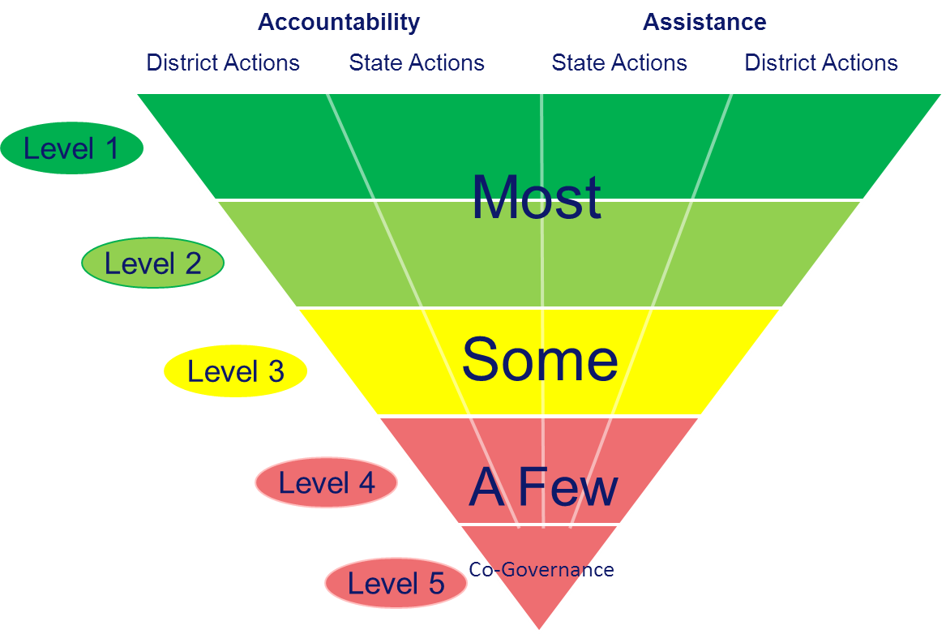
What is our state framework?

Slide 11
What were the waiver requirements?
Set new ambitious but attainable annual targets toward specific goals
  State, districts, schools, student groups
Implement system of differentiated recognition, accountability, & support
  Identify high performance &/or growth, persistent subgroup issues, lowest performance, schools not meeting annual targets
Adopt college- & career-ready standards & assessments
Implement educator evaluation system
Reduce duplication & burden

Slide 12
Why seek flexibility?
Unify accountability & assistance system
  Bring together state & federal requirements
  Better differentiate between schools
Maintain Massachusetts’ track record in setting high standards & expectations
  Goals that are ambitious & attainable
Incentivize improved student achievement in all schools
Identify schools that need the most assistance in the aggregate & for student subgroups, and recognize high achieving and improving schools
Focus more deliberately on proficiency gaps
Incorporate growth in accountability determinations

Slide 13
A revised goal
Reduce proficiency gap by half by 2016–17
Proficiency versus achievement gaps
Ambitious but achievable
Requires greater progress for students furthest behind
Focus on English language arts, mathematics, & science
Goal is same for all, but targets are differentiated
Applies to state, districts, schools, & groups
Notes:
In this construct, the proficiency gap represents how far all students are from Proficiency. We use the Composite Performance Index (CPI) to measure progress of all students toward Proficiency. The CPI gives schools & districts credit for students who are far from proficiency but move at least one step toward proficiency, thus narrowing the proficiency gap.

Slide 14
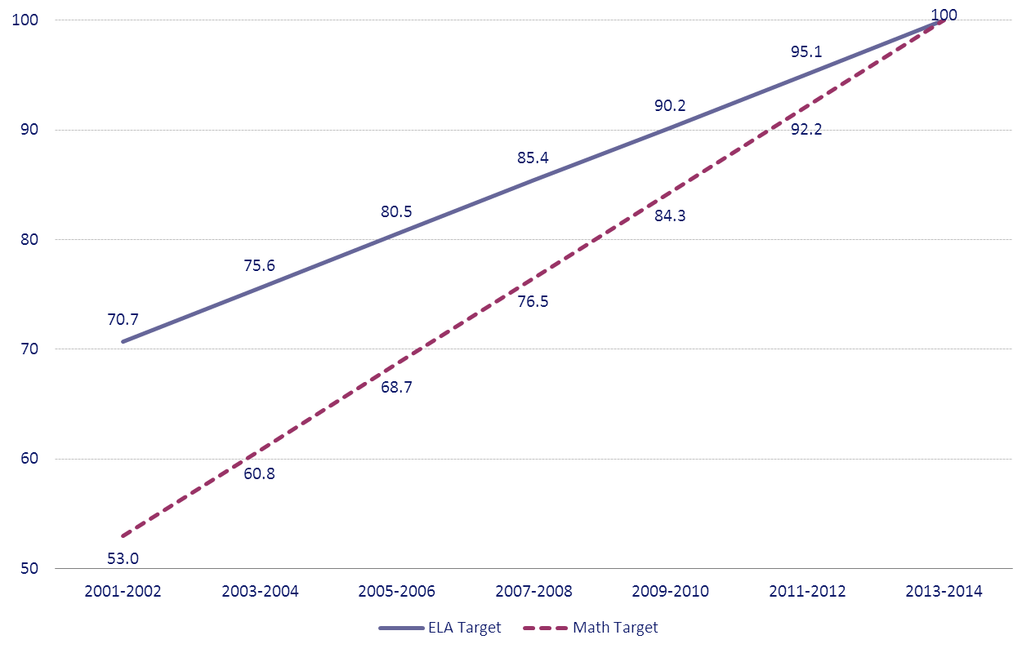
State Performance Targets Under NCLB

Slide 15
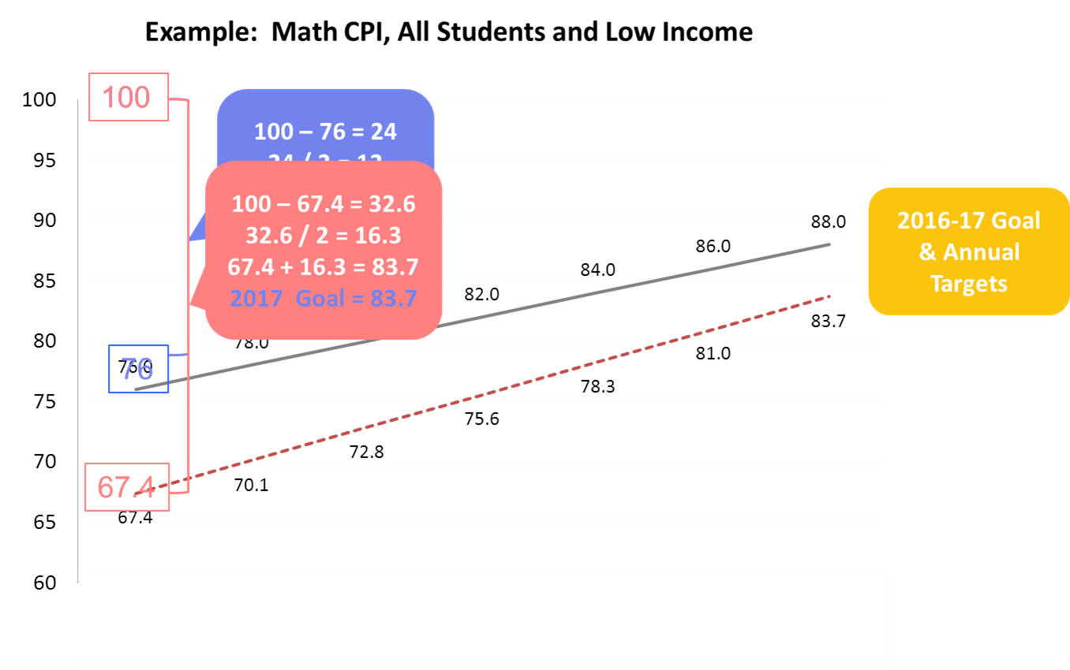
Reduce proficiency gap by half by 2016–17

Slide 16
What will ESE report?
Progress & Performance Index (PPI)
  Annual PPI: measure of district, school, & group progress
  Four-year PPI: comprehensive measure of progress, updated annually
    More recent years weighted the most (40%-30%-20%-10%)
    Reported at state, district, school, & subgroup level
School & district levels (1-5)

Slide 17
What does the PPI measure?
For elementary & middle schools
  Participation on MCAS
  Progress on CPI gap-closing in ELA, math, science
  Growth in ELA and math
  Improved performance at Advanced & Warning/Failing levels
For high schools
  Above, plus graduation & annual dropout rates

Slide 18
How is the PPI calculated?
Points awarded for each PPI indicator
Full credit for meeting goal, extra credit for exceeding target, partial credit for progress
  Exceed target
  Meet target
  Improve below target
  No change
  Decline
Additional details in folder
Notes:
100 point index, full credit = 75 points.

Slide 19
Which student groups are included?
All students (minimum of 20)
High needs students: low income, special education, former/English language learner (minimum of 30)
Low income
Special education
Former/English language learner
Seven racial/ethnic categories

Slide 20
High needs subgroup
Eliminates multiple counting of students who are in more than one subgroup
Holds over 300 additional schools accountable for low income, special education, & English language learner students
Most schools will be placed in levels based on the performance of all students & high needs group
Exception: schools with lowest performing subgroups statewide
Notes:
Using high needs group with a minimum n of 30 holds over 300 more schools accountable for low income, special education, and ELL students than by using traditional groups alone.
In addition, approximately 82% of African-American/Black students and 88% of Hispanic students are included in the high needs group.
Due to n sizes at the school level, using the high needs group allows us to hold more schools accountable for African-American/Black and Hispanic students than using the traditional racial/ethnic subgroups alone.

Slide 21
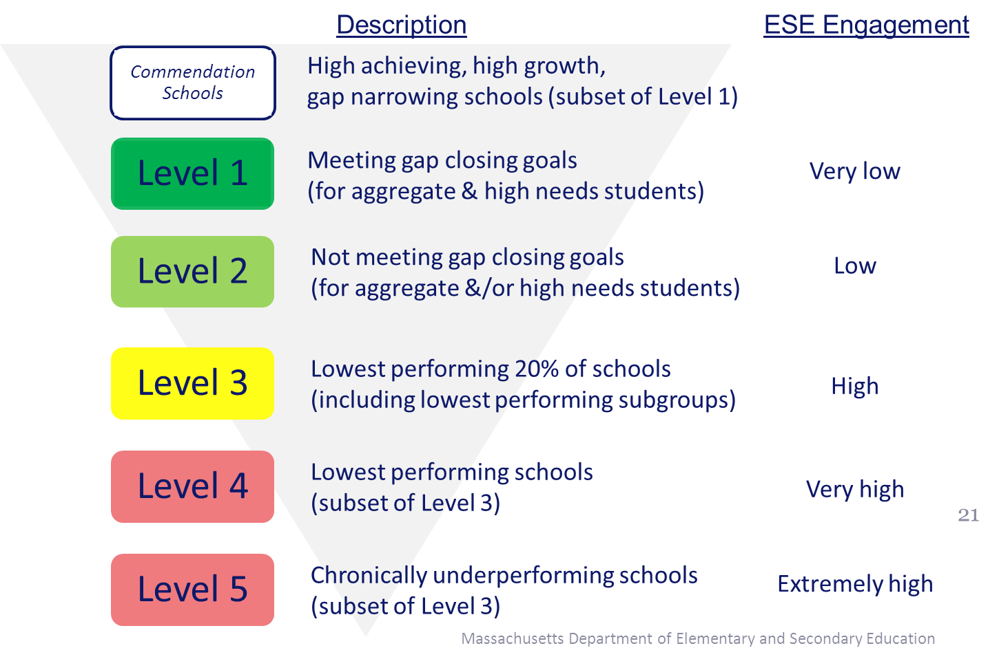
Classifying schools

Slide 22
Classifying schools & districts
Charter schools will be assigned levels
Districts will be classified based on their lowest-performing schools
  Exception for certain Level 4 and 5 districts designated based on Board action
Better alignment between levels & district accountability determinations for special education

Slide 23
Overview of waiver opportunities
In this section we will discuss:
Using federal funds strategically
Using Title I reservations to support most significant needs
Planning, implementing and measuring impact of high leverage strategies

Slide 24
Strategic use of Title I funds
You can use the flexibility granted by the waiver to help your lowest performing schools make their targets by…
  Serving lowest performing schools with Title I funds using available funding methods
  Designating any Level 3 or 4 school as a Title I schoolwide program school, even if the school does not have a poverty percentage of 40% or more
  Transferring up to 100% of your Title II-A funds into Title I
  & using them for Title I purposes
Notes:
Title II-A private school obligations remain, and are not impacted by transfer. If a district has private school participation for Title II-A, 100% transfer is not possible.

Slide 25
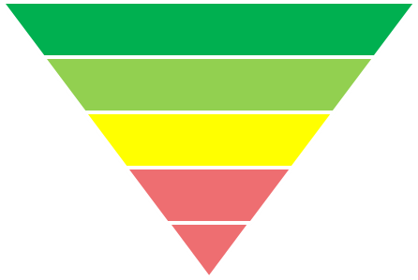
What are my continuing obligations?
Prioritize your lowest achieving students in your lowest performing schools
Reserve portion of Title I, Part A funds commensurate with the scope of the problem
Level 1 districts - No specific requirements
Level 2 districts – up to 20% of allocation must support Level 2 schools
Level 3 districts – at least 20% of allocation must support Level 2 & 3 schools
Level 4 districts – at least 25% of allocation must support Level 3 & 4 schools

Slide 26
How can reserving funds support my improvement strategies?
  Additional support for lower-performing Title I schools
  Additional support for low-performing students district-wide

Slide 27
How should I plan to use my reserved funds?
Self-assess identified needs using Conditions for School Effectiveness as the lens
Scan all Conditions, but focus on a few –
those closest to the instructional core
Link to analysis of data & other evidence of impact
Identify strengths & areas for improvement
Use high leverage strategies to guide plan development

Slide 28
High leverage strategies…
target your lowest achieving students in your lowest performing schools
aggressively address school performance & student achievement
are close to the instructional core, e.g.:
  Regular structures/systems for collecting & analyzing data that directly informs instructional practice
  Frequent teacher teaming & teacher-specific coaching linked to instructional practice
  Responsive systems of tiered instruction, especially Tiered II & Tier III interventions
are monitored for efficacy & impact

Slide 29
Conditions for School Effectiveness
Effective district systems for support & intervention
Effective school leadership
Aligned curriculum
Effective instruction
Student assessment
Principal’s staffing authority
Professional development & structures for collaboration
Tiered instruction & adequate learning time
Students’ social, emotional, & health needs
Family-school engagement
Strategic use of resources & adequate budget authority

Slide 30


Slide 31
In proposing use of reservation funds…
Describe how you will use the flexibility opportunities granted by the waiver to provide maximum support to lowest-achieving students in your lowest-performing schools
Describe how you assessed the needs of those schools using the Conditions for School Effectiveness as the frame for that analysis
Describe the high-leverage strategies you will use to aggressively address school performance and student achievement, & how you will know if they are working

Slide 32
Resources
All districts have access to redesigned online suite of district analysis, review, & assistance tools
Level 3 districts get priority assistance & must seek consultation of DSAC on district's proposed use of reservation funds prior to submitting Title I, Part A grant application
Level 4 districts engage with ESE Liaison

Slide 33
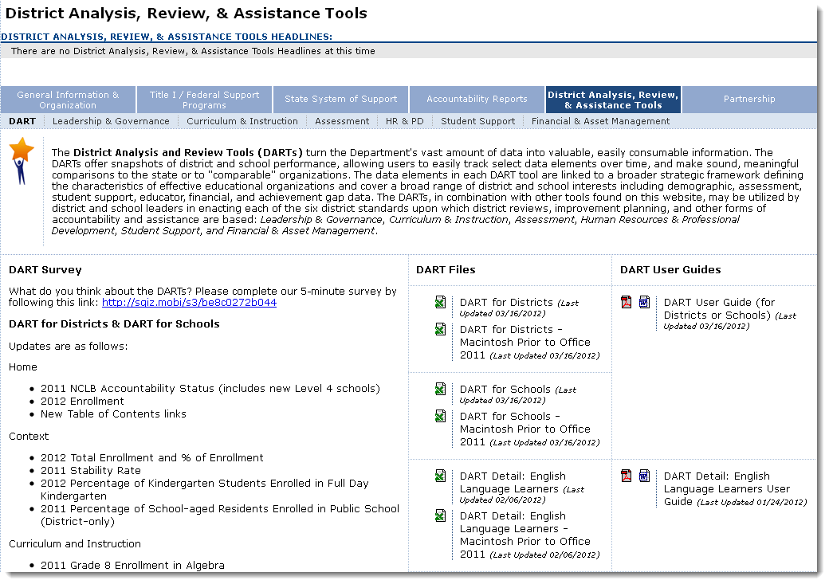
http://www.doe.mass.edu/apa/dart/default.html

Slide 34
SES/Choice: What comes next?
Spring 2012:
  Districts choosing not to continue offering SES or school choice in 2012-13 must provide parents with information to explain why & describe the interventions, incentives and supports that will replace those options
  Any student who has transferred into a school through NCLB choice must be allowed to remain in that school through the highest grade served by the school
  District obligations to fund transportation for such students based on state law & local transportation policies

Slide 35
Data: What comes next?
Spring 2012:
  ESE releases preliminary PPI data & levels for districts & schools based on data from 2009, 2010, and 2011
  Comprises 60% of official 2012 PPI
  Basis for determining Title I reservation amounts
  Intended to help districts plan use of Title I funds
  Districts “held harmless” if final level is lower than preliminary data

Slide 36
Info sharing: What comes next?
Spring/Early Summer 2012:
  Level 3 districts consult with DSAC on use of proposed reservation funds
  Statewide meeting of Title I directors to discuss changes to Title I / II-A grant application
  Title I, Part A allocations shared with districts upon receipt from US Department of Education

Slide 37
SY2012-13: What comes next?
Summer/Early Fall 2012:
  Waiver takes effect beginning with 2012-13 school year (FY13)
  ESE staff review & approve Title I / II-A grant applications; may request additional evidence prior to grant approval
  ESE releases official PPI data & levels for all districts & schools based on data from 2009, 2010, 2011, & 2012

Slide 38

Technical
Content
Adaptive / Strategic
Content
ESEA@doe.mass.edu | 781-338-3550
http://www.doe.mass.edu/apa/general/

