Slide 1
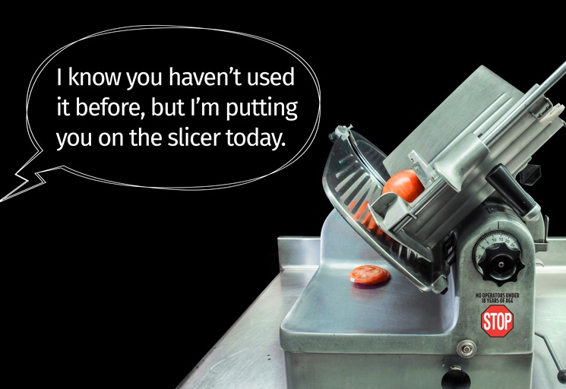
Getting hurt is not in your job description.
A Social Media Campaign by the
Massachusetts Youth Employment & Safety (YES) Team

Slide 2
Who is the Massachusetts YES Team?
YES Team = Youth Employment & Safety Team
An interagency workgroup that coordinates efforts to protect and promote the health & safety of young workers under age 25
Made up of 8 MA state and federal agencies

Slide 3
Who is the Massachusetts YES Team?
MA Dept. of Public Health
MA Office of the Attorney General
MA Dept. of Labor Standards
MA Dept. of Industrial Accidents
MA Dept. of Elementary & Secondary Education
Commonwealth Corporation
U.S. Dept. of Labor- Wage & Hour Division
U.S. Dept. of Labor-Occupational Safety & Health Administration

Slide 4
Getting hurt is not in your job description
A YES Team social media campaign to engage teen and young adult workers about workplace health and safety and their rights on the job

Slide 5
What are the campaign goals?
Raise awareness among workers ages 14-24 about their right to a safe and healthy workplace
Encourage young workers to ask questions or speak up if they are assigned to a task that seems unsafe

Slide 6
Why is this important?
Because young workers under age 25 are twice as likely* to be injured on the job as adults 25+
Because youth have less work experience, and do not always receive adequate training and supervision from their employers
* www.cdc.gov/mmwr/pdf/wk/mm5915.pdf

Slide 7
How can I help spread the word?
Share our campaign on social media, including:
Twitter
Facebook
Instagram
Google+
Included with toolkit:
3 graphics
Draft text for multiple social messages

Slide 8
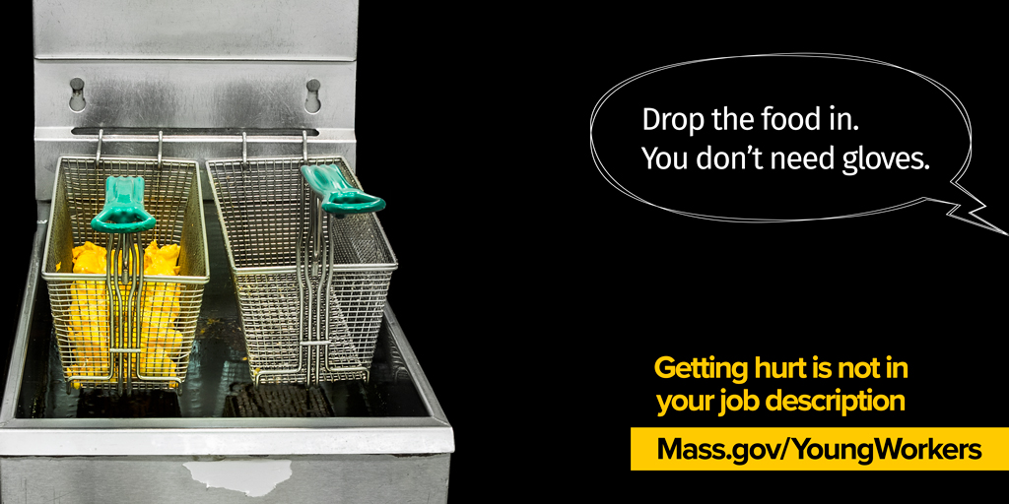
Toolkit – Graphics Overview
Fryolator
Problem: No personal protective equipment for hazardous exposure
Risk: Severe burns

Slide 9
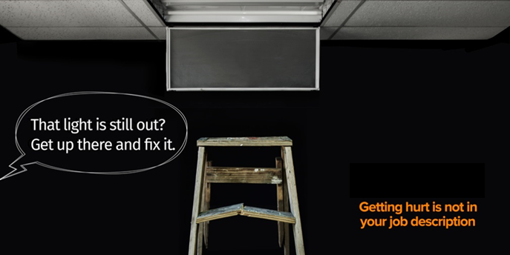
Toolkit – Graphics Overview
Ladder
Problem: Unsafe/broken equipment
Risk: Injury from falls or use of broken ladder

Slide 10
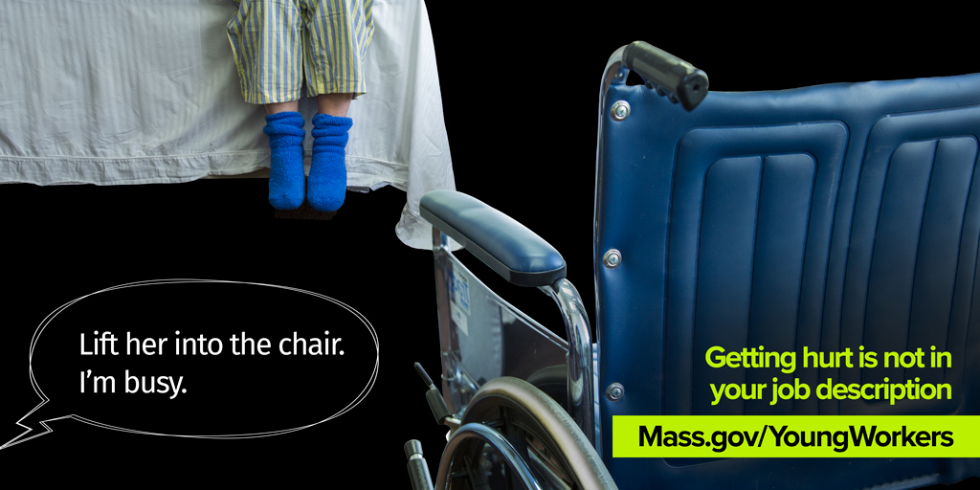
Toolkit – Graphics Overview
Patient Handling
Problem: No lift assist devices and team members to help with task
Risk: Back injuries and other sprains/strains

Slide 11
Tips for messaging
Mix and match supplied toolkit graphics and social messages
Create your own messages for specific graphics, as desired
Include the hashtag #WorkSafe in any posts

Slide 12
Tips for messaging
If possible, try to post messages
at least twice a day
Time messages with other initiatives:
Nat’l/state observances (e.g., Nat’l safety month)
Local/timely events (e.g. summer jobs)

Slide 13
I‘m in! How can I get the graphics?
If you would like to promote our campaign, e-mail us: teens.atwork@state.ma.us
We will send you a full Social Media Toolkit, including graphics and messages
Thank you for helping us to raise awareness about young worker health and safety!

Slide 14
Getting hurt is not in your job description.
A Social Media Campaign by the
Massachusetts Youth Employment & Safety (YES) Team

