Slide 1
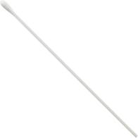
What If I Need to Be Tested
for COVID-19?
A Story about What to Expect During the Swab
by Kate Dansereau, BA, ATP and Shannon Sousa, MS, CCC-SLP of Community Autism Resources

Slide 2
Doctors and nurses are helping to keep us healthy by testing for COVID-19.

Slide 3
COVID-19 or Coronavirus is a virus that is spreading very quickly and making some people sick. Very tiny droplets of the virus can be transferred from person to person when you cough, sneeze or speak.

Slide 4
If I am exposed to the virus or start showing symptoms, I will need to be tested by a doctor who may listen to my lungs and heart through a stethoscope, and may take my temperature and blood pressure.

Slide 5
The test for COVID-19 is a called a nasopharyngeal swab, a long thin flexible stick with tiny soft bristles on the end.

Slide 6
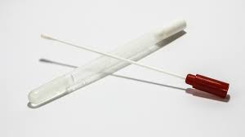
The swab looks like a long Q-tip. It comes in a plastic container that keeps it clean.
Photo from www.hpnonline.com

Slide 7
The swab traps germs to check if I have COVID-19. Germs can look like tiny round balls or droplets.

Slide 8
First, I will go to the doctor’s office or a testing site. Some places can test you in the car. I will need to wear a mask so I do not spread germs to others.

Slide 9
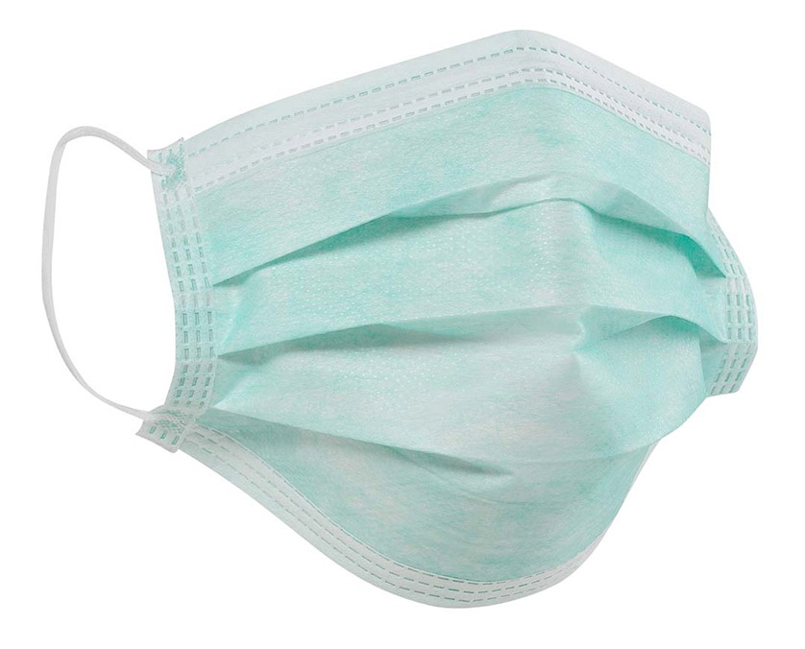
The mask will cover my nose and mouth. I can still talk and breathe. It is important to keep the mask on my face. One type of mask is rectangular, light blue, and made from a special paper material with elastic loops on each end to go around my ears.

Slide 10
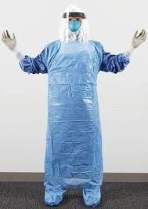
The doctor will be wearing a mask, gloves, gown, and face shield. The mask covers the doctor’s nose and mouth; gloves cover each of their fingers and hands; the gown covers their clothes, and the clear plastic face shield that the doctor can see through, covers their face and neck. Doctors see lots of patients so they need to protect everybody from germs.
Photo from www.nejm.org

Slide 11
I will sit down on a chair while the doctor gets the swab ready. It is okay to feel nervous. The doctor wants to make sure I am not sick.

Slide 12
The doctor will ask me to blow my nose into a tissue so that my nostrils are clear.

Slide 13
I will tip my head back so that my nose points up into the air. The doctor will gently push the swab into my nose.

Slide 14
The test does not hurt. The swab might feel uncomfortable because I am not used to having things in my nose. My eyes might water. I will be okay.

Slide 15
During the test, I breathe through my mouth and try to be calm. I can think of happy and fun thoughts like smiling and having a party.

Slide 16
The swab will touch the back of my throat through my nose. This is where COVID-19 germs live. The germs stick to the swab when the doctor twists it.

Slide 17
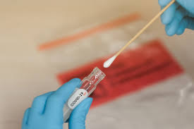
The COVID-19 test is quick. The doctor will pull out the swab from my nose, put it in a tube and seal it in a bag.
Photo from www.newslit.org

Slide 18
My swab will be sent to a lab for testing. Scientists will look at the germs through a microscope and see if I have COVID-19.

Slide 19
It will take a few days to find out if I have COVID-19. It is normal to have a runny nose after the test. While I wait, I should not get close to other people so I do not get them sick.

Slide 20
If the doctor calls and says I have COVID-19, I do not need to panic. The doctor will tell me what to do to get healthy. I will need to quarantine for 14 days. That means staying at my house and not being near other people at work, at programs or at school.

Slide 21
If I do not have COVID-19, I still need to practice social distancing by staying 6 feet away from other people, washing my hands with warm running water and soap in a sink, and taking care of myself.

Slide 22
I am very responsible for taking the COVID-19 test. I can tell my friends and family about the swab. I can help them know what to expect. This can make me feel happy and proud.

Slide 23
By getting a swab test, I am helping to keep myself and others healthy. We are working together to stop the virus. Together with doctors and nurses we are doing a great job.

Slide 24
- Thank You -
Audio
Talking Information Center Network (TIC)
Description
Ruth Bokulic
Orientation and Mobility Assistant, WDC
Karen Leger
Orientation and Mobility Assistant, SE Region/WDC
Lisa DiBonaventura, MA, COMS
Statewide Director, Vision and Vision Loss Services, DDS

