Slide 1
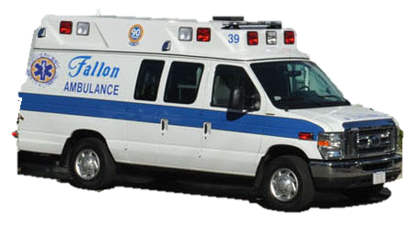

COVID-19 Testing at Home
A Story about What to Expect During the Mobile Testing Swab
by Shannon Sousa, MS, CCC-SLP of Community Autism Resources
Photo from www.fallonambulance.com

Slide 2
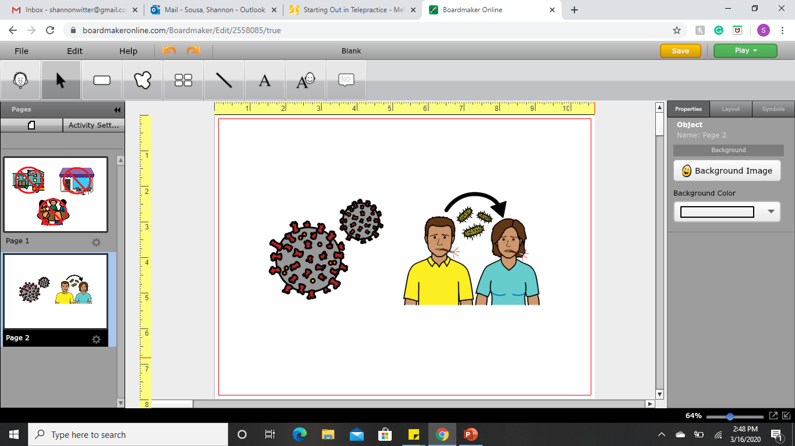
COVID-19, or Coronavirus, is a virus that is spreading very quickly and making some people sick. Very tiny droplets of the virus can be transferred from person to person when you cough, sneeze or speak. Testing for COVID-19 helps to keep us healthy.

Slide 3
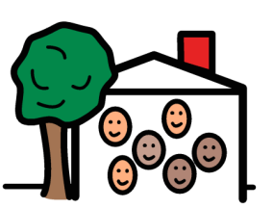
If myself, a staff member, or somebody in my house is sick, my house manager will help everybody in the house get tested.

Slide 4
Fallon Ambulance will come to the house. There will not be a siren or lights because this is not an emergency.
Photo from www.fallonambulance.com

Slide 5
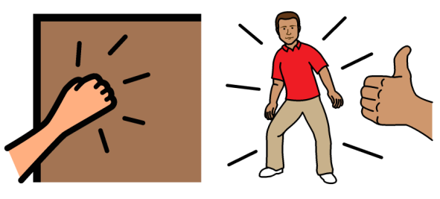
Two healthcare workers will test me right at our house. They will knock on the door. We don’t know exactly when they will come so we should try to be ready.

Slide 6
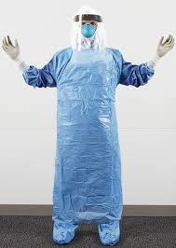
The healthcare workers will be wearing a mask, gloves, gown, and face shield. The mask covers the healthcare workers nose and mouth; gloves cover each of their fingers and hands; the gown covers their clothes, and the clear plastic face shield that the healthcare worker can see through, covers their face and neck. The healthcare workers see lots of patients, so they need to protect everybody from germs.
Photo from www.nejm.org

Slide 7
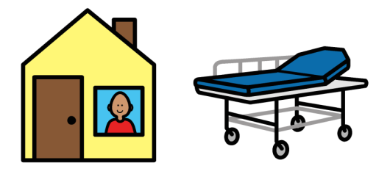
They will do the testing in my house or on a stretcher in the ambulance. Everybody will be tested. The healthcare workers are quick and efficient.

Slide 8
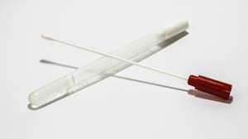
The test for COVID-19 is a called a nasopharyngeal swab. The swab looks like a long Q-tip, a thin flexible stick with tiny soft bristles at the end. It comes in a plastic container that keeps it clean.
Photo from www.hpnonline.com

Slide 9
The swab traps germs to check if I have COVID-19. Germs can look like tiny round balls or droplets.

Slide 10
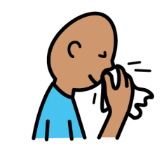
The healthcare worker will ask me to blow my nose into a tissue so that my nostrils are clear.

Slide 11
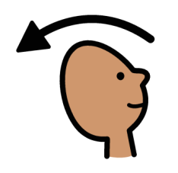
I will tip my head back so that my nose points up into the air. The healthcare worker will gently push the swab into my nose.

Slide 12
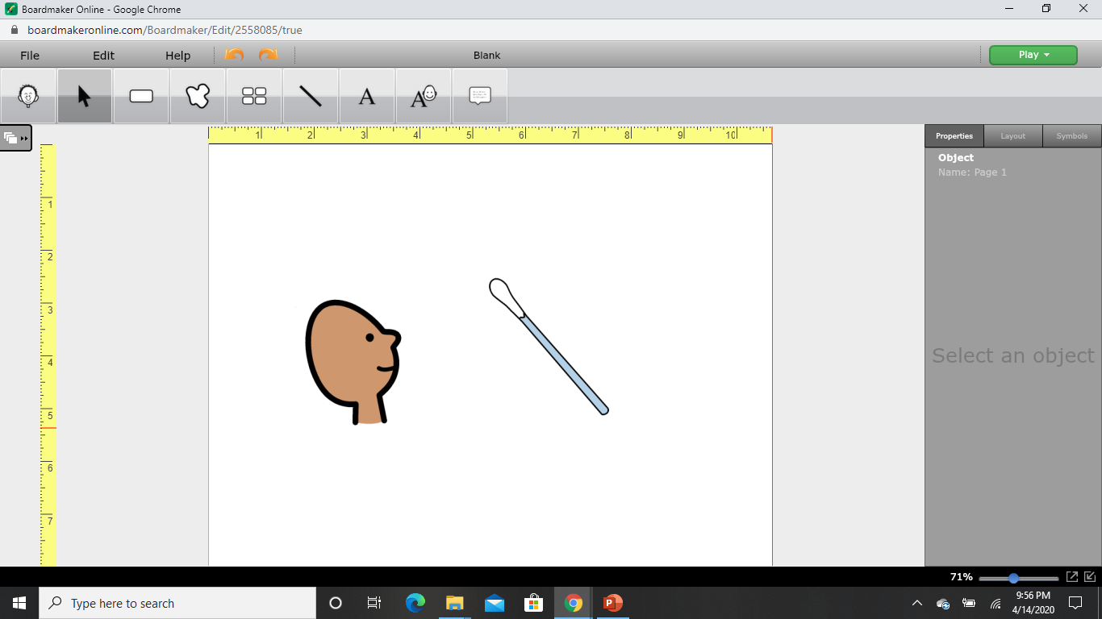
The test does not hurt. The swab might feel uncomfortable because I am not used to having things in my nose. My eyes might water. I will be okay.

Slide 13
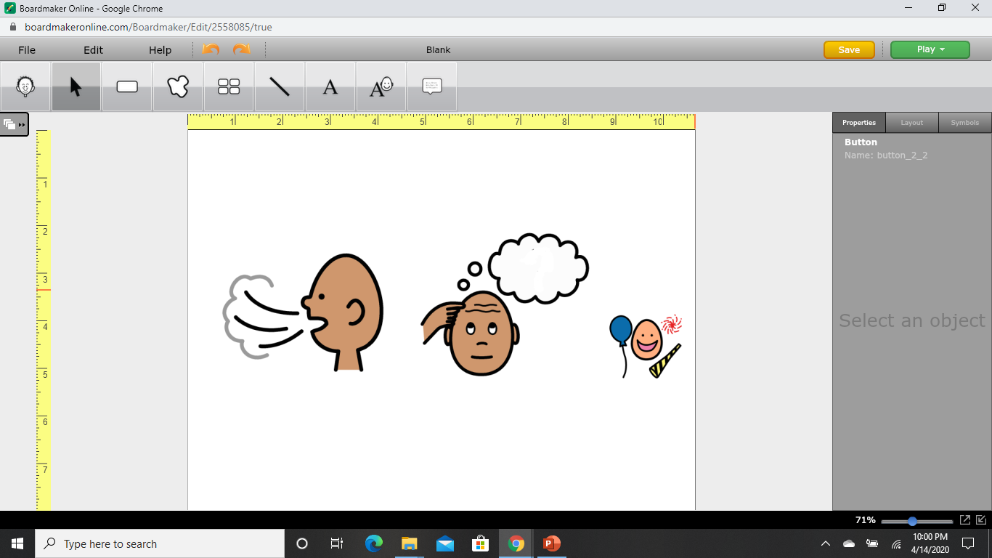
During the test, I breathe through my mouth and try to be calm. I can think of happy and fun thoughts like smiling and having a party.

Slide 14
The swab will touch the back of my throat through my nose. This is where COVID-19 germs live. The germs stick to the swab when the healthcare worker twists it.

Slide 15
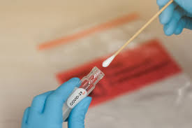
The COVID-19 test is quick. The healthcare worker will pull out the swab from my nose, put it in a tube and seal it in a bag.
Photo from www.newslit.org

Slide 16
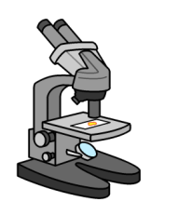
My swab will be sent to a lab for testing. Scientists will look at the germs through a microscope and see if I have COVID-19.

Slide 17
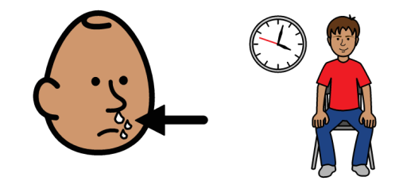
It will take a few days to find out if I have COVID-19. It is normal to have a runny nose after the test.

Slide 18
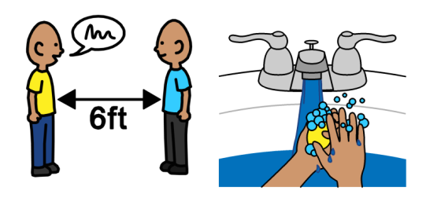
While I wait, I still need to practice social distancing, by staying 6 feet away from other people, washing my hands with warm running water and soap in a sink and taking care of myself.

Slide 19
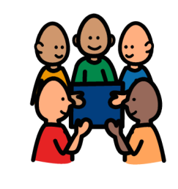
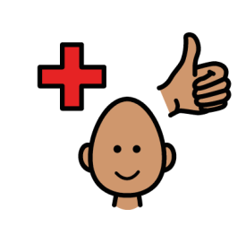
By getting a swab test, I am helping to keep myself and other people healthy. We are working together to stop the virus. Together with healthcare workers we are doing a great job.

Slide 20
- Thank You -
Audio
Talking Information Center Network (TIC)
Description
Ruth Bokulic
Orientation and Mobility Assistant, WDC
Karen Leger
Orientation and Mobility Assistant, SE Region/WDC
Lisa DiBonaventura, MA, COMS
Statewide Director, Vision and Vision Loss Services, DDS

