Slide 1
Having Visitors Over in a
Time of COVID-19
A Story about Recent Changes to the Visitor Policy
by Shannon Sousa, MS, CCC-SLP of Community Autism Resources

Slide 2
Now that COVID-19 is getting better, Governor Baker said that we can have visitors at our program homes. This is exciting news! We still need to be careful about COVID-19 germs, so there are going to be some rule changes in place.

Slide 3
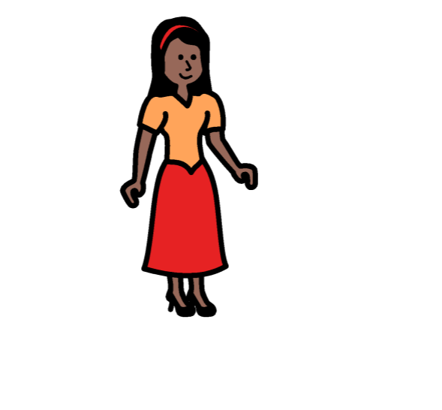
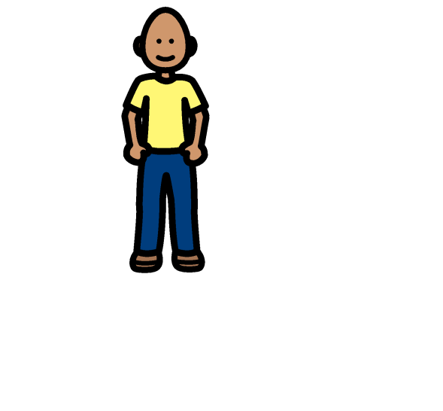
One rule is that I can only have two visitors at a time. Visitors who are very old or very young may need to stay home to stay safe.

Slide 4
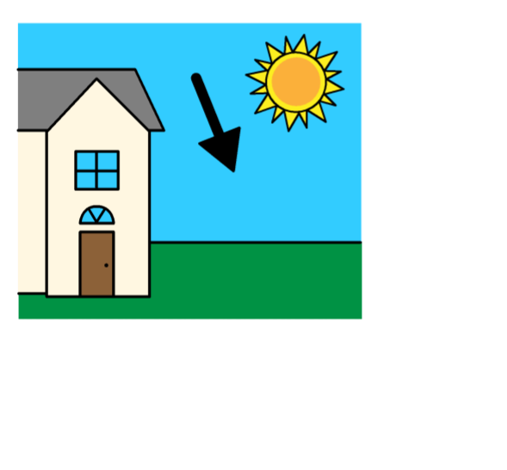
The visitors cannot enter the house like they usually do. There are going to be designated places outside where we can meet. Some places might include yards, porches, patios, picnic tables, or driveways.

Slide 5
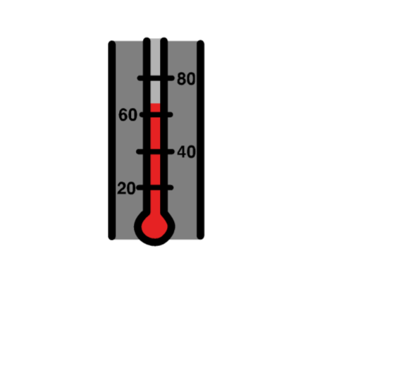
To be extra safe, all visitors will have their temperatures taken before the visit. If they have a fever or show other signs of being sick, they cannot visit. If I am feeling sick, I cannot have visitors either. We need to be very careful to not spread COVID-19.

Slide 6
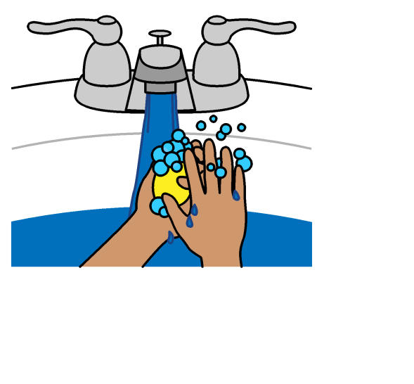
We will wash our hands with warm running water and soap in the sink or use hand sanitizer before the visit.

Slide 7
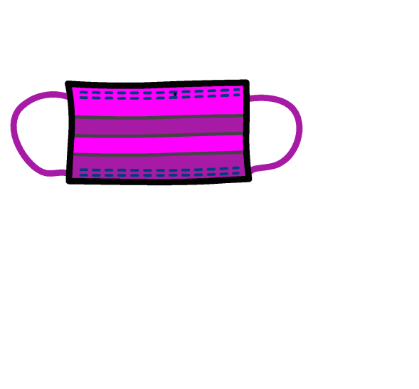
Another change is that everybody needs to wear a face mask covering nose and mouth during visits. My visitors, myself, and my staff will have masks on. These masks such as a rectangular cloth or paper mask with elastic ear loops or a circular stiff paper mask with an elastic band to go around your head, help to protect ourselves and others from germs.

Slide 8
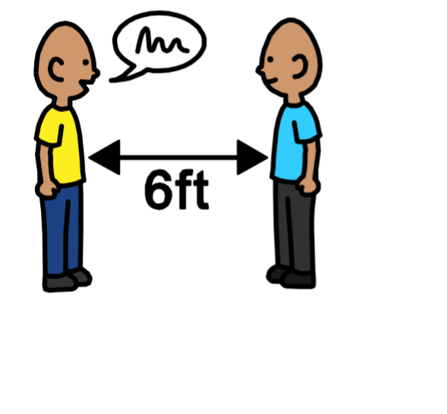
Even though we are outside, we will continue to practice social distancing. This means staying 6 feet apart from other people.

Slide 9
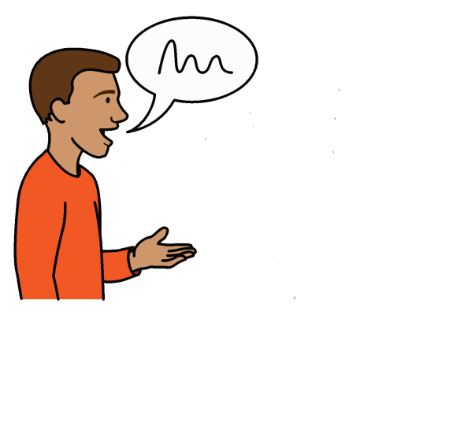
I can talk, share stories, and laugh with my visitors. We can play games that don’t involving touching game pieces, such as Eye Spy and guessing games. Even though we will be 6 feet apart, and wearing face masks covering nose and mouth, we can still see each other.

Slide 10
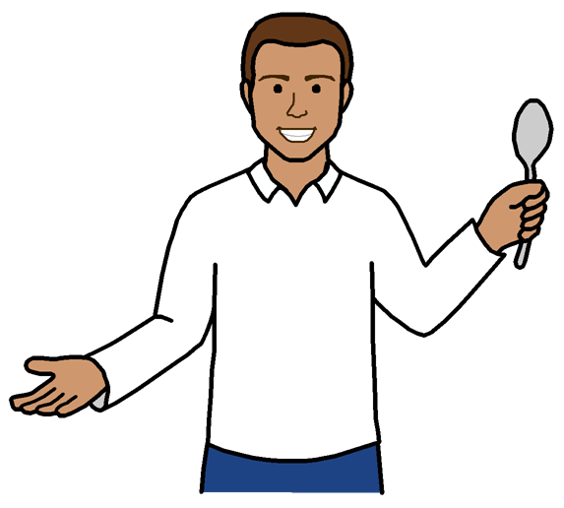
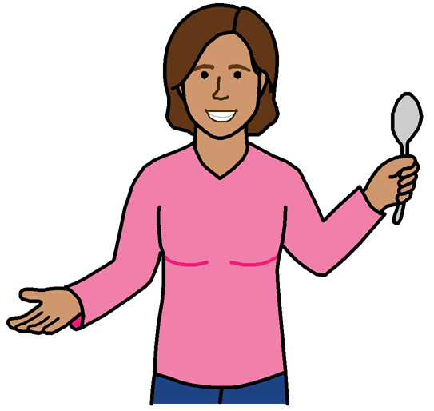
My visitor might bring food to share with me, but we cannot eat from the same plate or drink from the same cup. We need to have our own plates and utensils. I might not be allowed to keep the food if it has been touched.

Slide 11
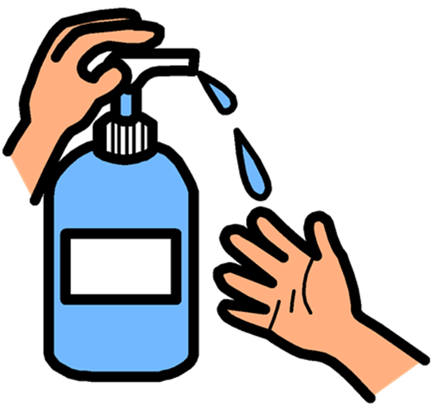
Because of COVID-19, we need to minimize touching. We can hug if we wear masks covering nose and mouth, turn our heads away from each other, and use hand sanitizer before and after touching.

Slide 12
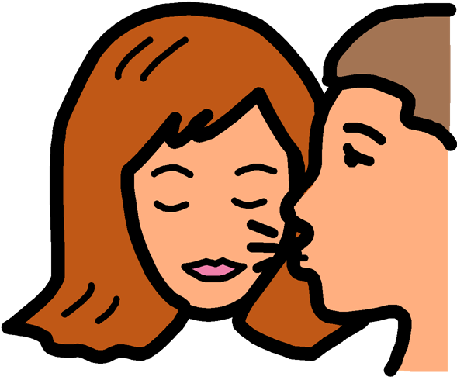
We will not kiss because this can spread germs quickly. Instead of kissing, I can blow a kiss, hug, wave, or say “I love you.”

Slide 13
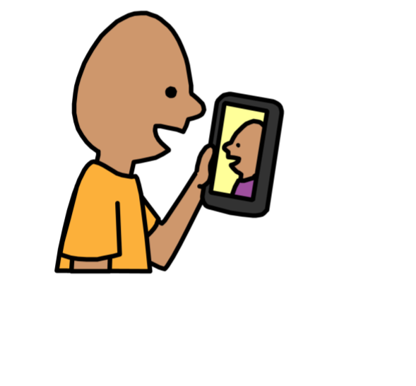
The visit might be short because lots of people have family and friends who want to see them. In between visits, I can call, text, or video chat my loved ones.

Slide 14
At the end of the visit, a staff member will clean and sanitize every surface with a cloth and cleaner.

Slide 15
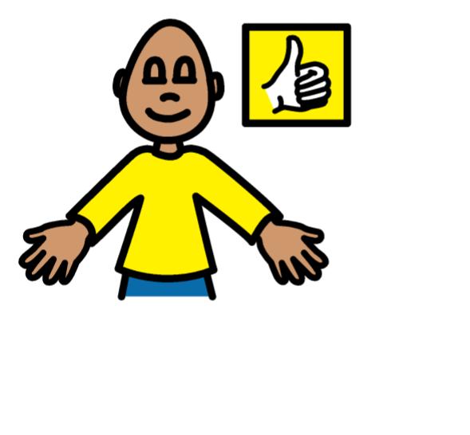
These changes are hard but the rules are to keep everybody safe and healthy. Sometimes it is hard to get used to changes in my routine but I will try to be flexible. Seeing my visitors in person is very exciting, which can make me smile and give a thumbs up.

Slide 16
- Thank You -
Audio
Talking Information Center Network (TIC)
Description
Lisa DiBonaventura, MA, COMS
Statewide Director, Vision and Vision Loss Services, DDS

