Slide 1
South station expansion tower 1 interlocking Early Action Project
Capital Programs Committee
September 11, 2019

Slide 2
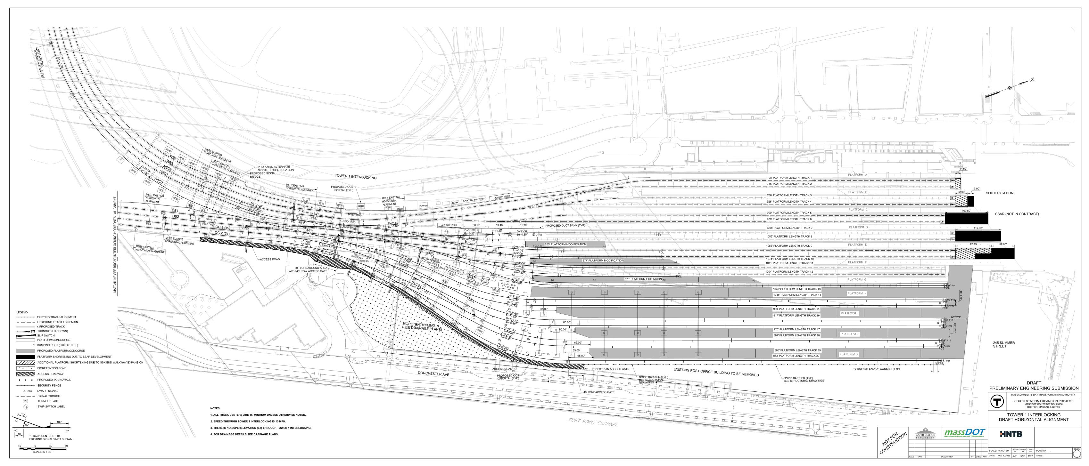
Overview
In November 2018, FRA issued a funding opportunity for Federal-State Partnership for State of Good Repair Program
MassDOT/MBTA applied for South Station Tower 1 Interlocking Early Action Project
Scope and purpose of the project is to limit the signal failures and provide immediate operational, reliability, and resiliency benefits to the MBTA and Amtrak

Slide 3
FRA Grant for Tower 1
On November 15th, 2018, FRA announced a NOFO for Federal – State Partnership for State of Good Repair Program, with more than $272 million in available grant funding.
Assist in funding capital projects to repair, replace, or rehabilitate publicly-owned railroad assets, and improve intercity passenger rail performance.
Benefit both Northeast Corridor (NEC) and publicly-owned or Amtrak-owned infrastructure, equipment, and facilities across the country.
March 18th, 2019 MassDOT/MBTA submitted an application for the Tower 1 Interlocking Early Action Project (EAP) in response to NOFO requesting 50% of estimated project construction funds = $41,183,845.
In late August, FRA awarded MassDOT/MBTA the grant funds!

Slide 4
Tower 1 Early Action Project Cost and Funding Breakdown
Funding Source | Project Contribution Amount | Percentage of Total Cost
FRA Grant | $41,183,845 | 50%
Grantee | $41,183,845 | 50%
Total Project Cost | $82,367,690 | 100%
Costs associated with final design are funded through the existing HSIPR grant
Grant award is for construction of Tower 1 Early Action Project including: trackwork, communications, and signal systems
Grantee funds are fully programmed in the 2020-2024 CIP
$32.4 million contribution from the MBTA through the Northeast Corridor PRIIA Baseline Capital Charge (BCC) program
$8.6 million contribution from Amtrak through the Attleboro Line Agreement Settlement Funds

Slide 5
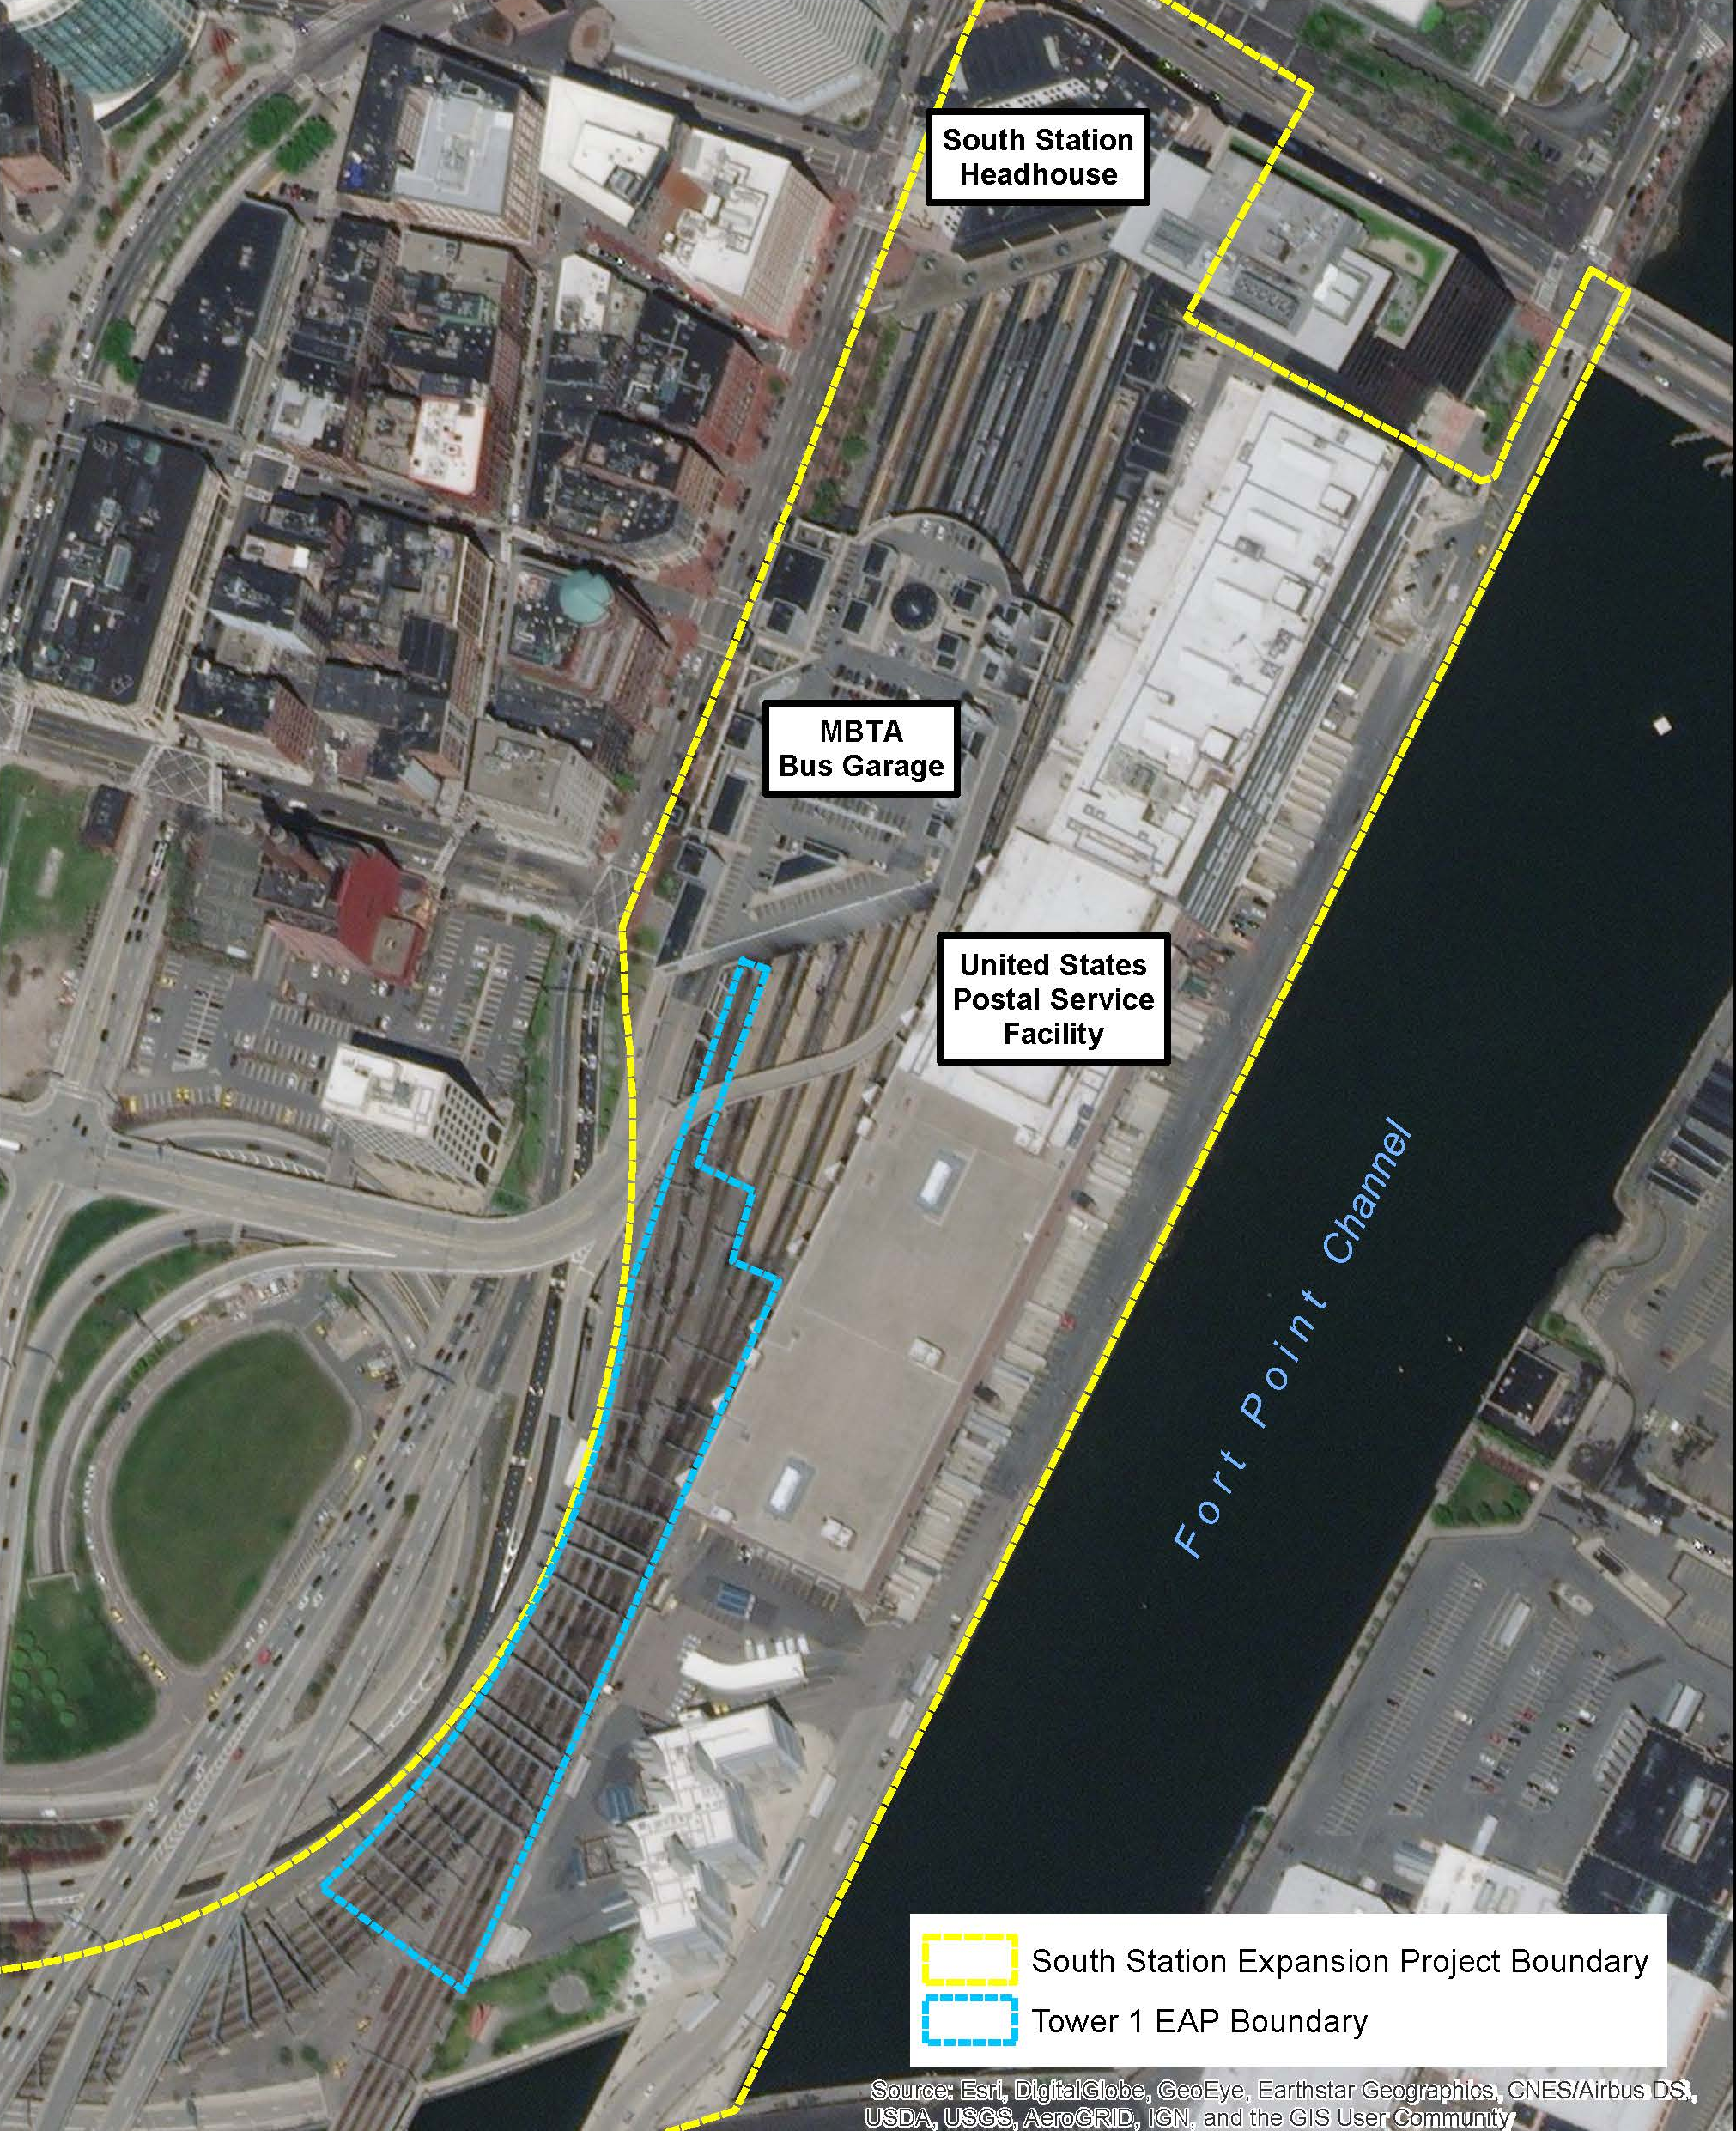
Tower 1 Interlocking Early Action Project (EAP)
CHALLENGES
The existing Tower 1 signal system is outdated and hinders service with recurring breakdowns.
A 5-minute shutdown during peak periods can create residual delays that affect thousands of passengers daily.
Upgrades to the Tower 1 Interlocking are necessary to maintain current services, as well as to support future growth anticipated by both the MBTA and Amtrak.
BENEFITS
Project will limit the signal failures and provide immediate operational and reliability benefits to the MBTA and Amtrak.
Project will improve the resiliency of Tower 1 to the effects of climate change (flooding, extreme rain/snow, heat stress).

Slide 6
Tower 1 Interlocking Early Action Project (EAP)
Tower 1 EAP includes:
Replace existing signal system with microprocessor system
Provide new Central Instrument House at a new location
Replace track infrastructure in-kind within the interlocking
Replace existing wayside shelters and cases
Install switch heaters
Provide trough systems to improve access to cables
Provide new emergency generator and transformer
Install new MBTA lighting system
Upgrade existing communications to CTEC

Slide 7
Next Steps
Design will be completed by end of the year
Develop plan to transition to MBTA for construction

