Slide 1
Initial Report: Single Integrated Children’s Behavioral Health Agency
Working Group 3: Lauren Almeida, Paul Hyry-Dermith, Lisa Morrow, Lee Robinson
March 18, 2026

Slide 2
Group 3 Charge
(ee) analysis of the feasibility and effects of creating a single integrated children’s behavioral health agency (SICBHA)
We’re not quite there yet ☺

Slide 3
Need to ensure that a single integrated agency is a solution to specific high priority problems, and not a solution in search of its problems
Example goals (based on Working Group 2) could include:
Establish a unified, child- and family-centered access system for behavioral health services – a single point of entry, i.e., front door.
Improve meaningful cross-agency and cross-sector collaborations among health care (physical and behavioral), child welfare, schools, juvenile justice, and payors (Medicaid, private insurers), etc.
Implement a coordinated workforce strategy to address provider shortages and improve culturally responsive care
Are these the right goals by which to assess a single integrated children’s behavioral health agency or are there others?

Slide 4
Additional considerations re: feasibility and effects
Degree of integration (e.g. all under one commissioner/secretary vs. coordinated)
Potential scope re: populations and functions (e.g. mental health, substance use disorder, autism, intellectual disability, complex medical conditions, age, any BH needs vs. more intense needs, child protective services, licensing, grant management, etc)
Potential costs, risks, and timeline

Slide 5
For additional context in helping to answer these questions, we offer three high level examples:
Colorado | Connecticut | New Jersey

Slide 6
Colorado: An integrated behavioral health agency
Dept of Public Health & Environment
4/2019- Governor directed creation of BH Task Force
9/2020- Task force releases blueprint
4/2021- Governor signs bill authorizing development of Behavioral Health Administration (BHA)
5/2022- Bill signed into law, creating BHA (cabinet-level)
7/2022- BHA formally launches
BH Safety Net contracting
Rule making
Dept of Human Services
Facility licensing
Clinical/Treatment oversight
Office of Behavioral Health
Behavioral Health Administration
Most programs/ functions
Office of Civil & Forensic Mental Health
Federal BH grants
Public grievances
Regional BH ASOs for consolidated crisis services (e.g. SUD and Mental Health crisis lines)
Multiple Agencies
4 Commissioners since 7/2022 (currently Lt Governor)
9/2020- Blueprint for Reform
11/2021- Plan for Creation of BHA

Slide 7
CONNECTICUT
DEPARTMENT OF CHILDREN & FAMILIES COMMISSIONER
BEHAVIORAL HEALTH & WELLBEING
CHILD PROTECTION & PERMANENCY
STRUCTURE
model is fully integrated
statutory responsibility for both child protection and children's behavioral health
responsible for prevention services, the oversight of juvenile justice education and diversion
all responsibilities are placed under different executive leads
DEGREE OF INTEGRATION
fully integrated
IMPACT
in practice, child welfare is the pressing priority due to emergent cases
child welfare children, juvenile justice children, families not involved in either system. No one is excluded
Admission criteria/eligibility can be adjusted for children involved with child welfare
children involved in child welfare access services at the expense of non-involved children

Slide 8
New Jersey
At present the Children’s System of Care is a Division within the Department of Children and Families; in one sense the CSOC is a single integrated children’s behavioral health agency (or close to it), and in another sense DCF is.
The CSOC integrates services and supports for children/youth with:
moderate/complex BH needs;
intellectual disabilities;
substance use challenges;
involvement with child protection;
involvement with juvenile justice;
any/all crises.

Slide 9
New Jersey
In addition to housing the CSOC, the wider Department of Children and Families integrates:
Division of child protection
Division of Family/ Community Partnerships (early childhood services, family support services, school-linked services)
Office of Education (runs and contracts for residential programs and schools)
Office of Family Voice (shared leadership and codesign)
Division on Women
Office of Adolescent Services (transition to adulthood)
Office of Advocacy

Slide 10
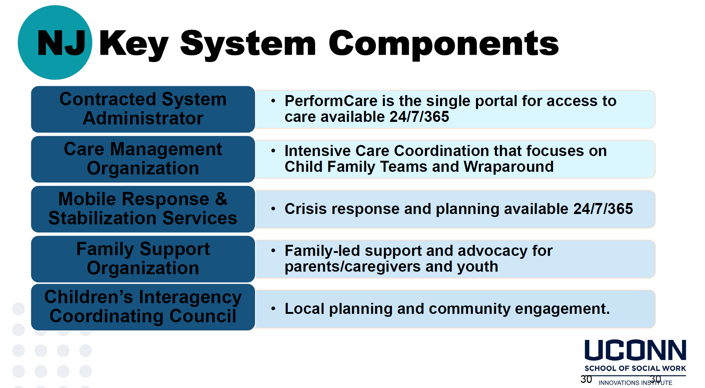

Slide 11
New Jersey
Evidence of Impact:
Robust systems utilization (number of kids/families accessing services has grown steadily)
Steady reduction of children in residential settings
Worth Noting:
The public education system was not involved in the initial roll-out, and only fairly recently (after 20+ years of implementation) has there been more proactive engagement of districts and schools

Slide 12
Discussion
How would the Commission members advise our working group on assessing the feasibility and effect of a single integrated behavioral health agency, as it relates to:
    Top priority goals for this agency to address in Massachusetts
    Scope re: populations and functions
As Working Group #3 further evaluates other state examples, would Commission members propose any additional questions we should try to answer?

