Slide 1
Supportive Planning and Operations Team (SPOT) Initiative Stakeholder Meeting
Bureau of Health Care Safety and Quality
January 11, 2017

Slide 2
Objectives
Overview of SPOT Initiative
Assessment Findings
Overall Findings from Quality Assurance and Performance Improvement (QAPI) Assessment
Findings from Five Elements of Assessment
Themes from Staff Comments
Targeted Training
“In-person” instruction with QAPI Resources &Tools
Safe Resident Handling
Continuing SPOT Activities

Slide 3
Overview—SPOT Initiative
Objectives:
Build upon Centers for Medicare and Medicaid Services (CMS) regulatory requirements
Utilize quality assurance and performance improvement (QAPI) as a framework addressing safety and quality
Implement practices and tools for sustainability
Activities:
Focus initiative in 40 nursing homes in Massachusetts
Utilize an evidence-based tool to conduct assessments and provide individualized reports with recommendations and technical assistance—best practices frameworks
Provide additional targeted in-person training to sub-group of nursing homes
Summarize findings in a report and share with stakeholders

Slide 4
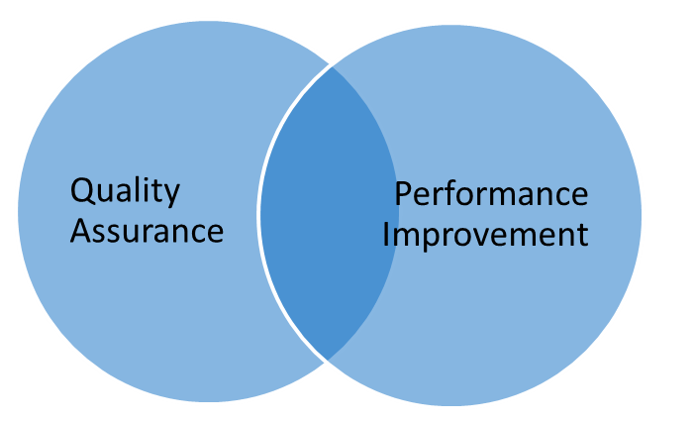
QAPI
A coordinated application of two mutually reinforcing aspects of quality management: Quality Assurance (QA) and Performance Improvement (PI)
Uses a systematic, comprehensive, and data-driven approach to maintaining and improving safety and quality in nursing homes, while involving all caregivers.

Slide 5
The Assessment Tool
Adapted CMS QAPI Self-Assessment Tool
Five Main Elements of Tool:
Design and Scope
Leadership and Governance
Feedback, Data Systems, and Monitoring
Performance Improvement Projects
Systematic Analysis and Systemic Action

Slide 6
Assessment Tool Scale
CMS uses five categories for each measure within the assessment tool:
Not Started — No evidence of activity as of yet
Just Starting — Evidence that initial steps are underway
On Our Way— Evidence that progress toward implementation is underway
Almost There — Evidence that tremendous headway has been made
Doing Great — Fully implemented—off & running!

Slide 7
Highlights of Overall Results of QAPI Assessment
Nursing homes that engaged with SPOT scored exceptionally high in the following measures within elements:
Open door policy—100% of nursing homes — Doing Great
Policy encouraging staff to report quality issues without fear of reprisal—100% of nursing homes — Doing Great
The Medical Director comes to QAPI Committee Meetings—98% of homes— Doing Great
The Steering Committee/QA Committee is interdisciplinary — 95% of homes —Doing Great

Slide 8
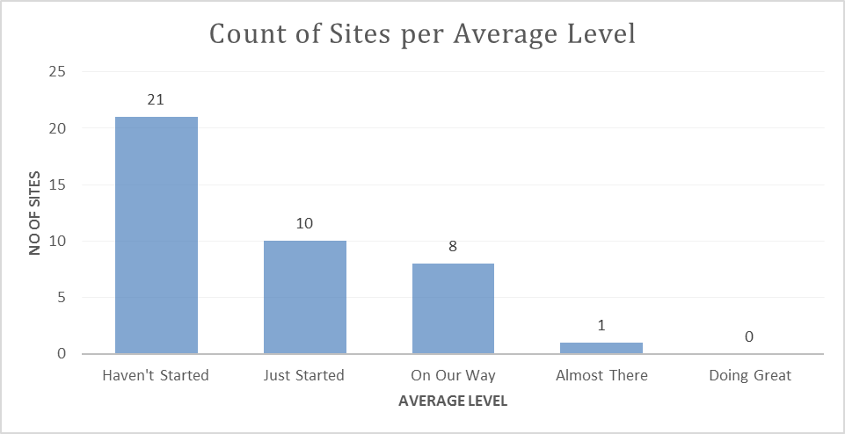
Highlights of Overall Findings of QAPI Assessment
78% of nursing homes that engaged with SPOT were in the early implementation stages of QAPI; either the “haven’t started” or “just started” categories.

Slide 9
QAPI Assessment Findings by Element
 | Not Started | Just Started | On Our Way | Almost There | Doing Great
Design and Scope | 100% | 0% | 0% | 0% | 0%
Governance & Leadership | 0% | 2% | 95% | 3% | 0%
Feedback, Data Systems & Monitoring | 7% | 70% | 23% | 0% | 0%
Perform. Improve. Projects | 70% | 23% | 3% | 4% | 0%
Systematic Analysis & Systemic Action | 45% | 50% | 5% | 0% | 0%

Slide 10
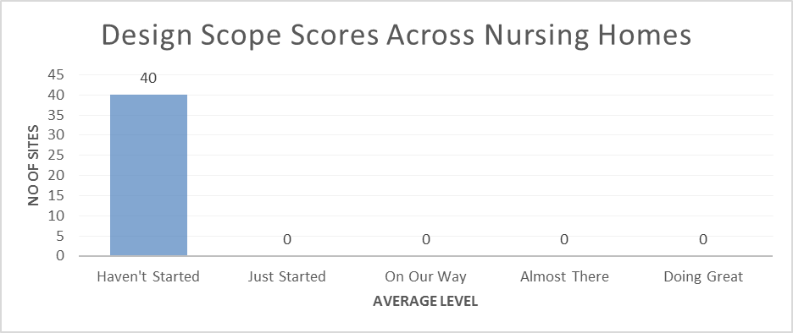
QAPI Assessment Findings-Design and Scope

Slide 11
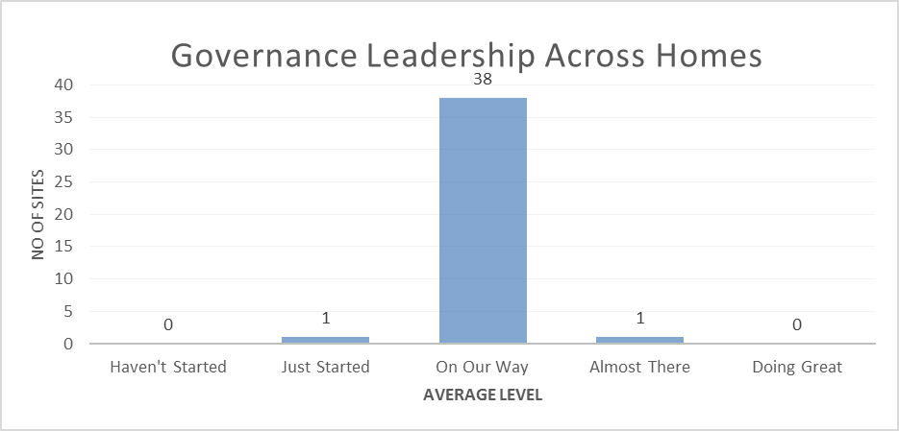
QAPI Assessment Findings-Governance and Leadership

Slide 12
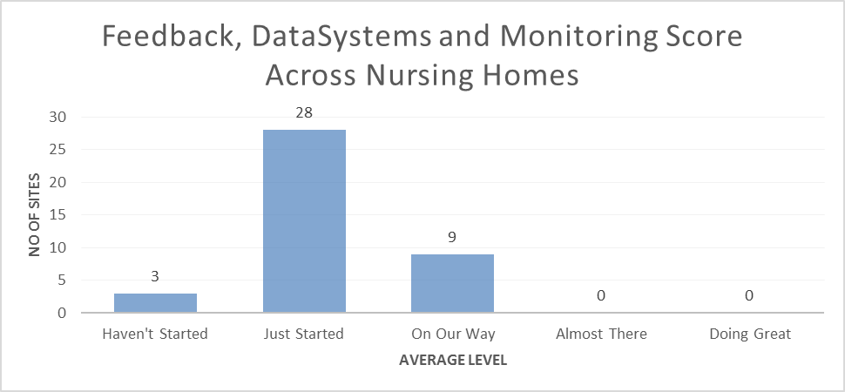
QAPI Assessment Findings-Feedback, Data Systems and Monitoring

Slide 13
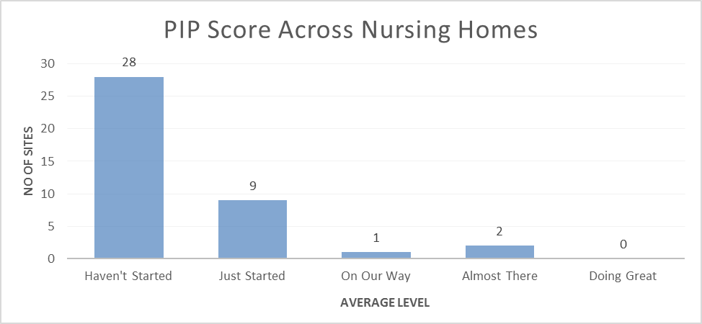
QAPI Assessment Findings- Performance Improvement Plans

Slide 14
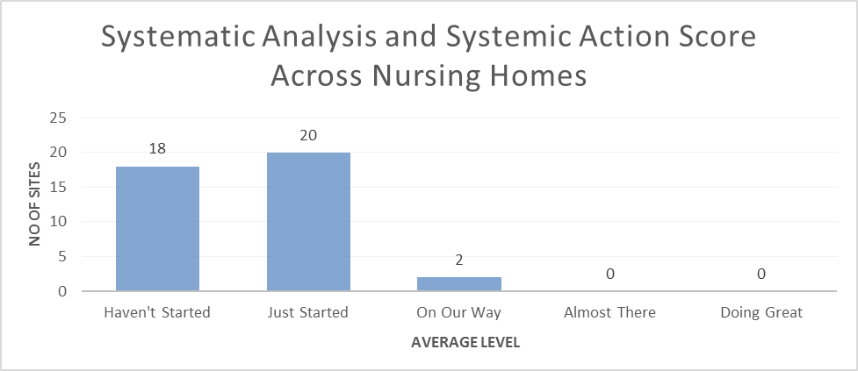
QAPI Assessment Findings- Systematic Analysis and Systemic Action Score

Slide 15
Themes from Staff Comments
SPOT captured staff comments while engaging them during the QAPI assessment
Comments were coded and grouped into themes
Themes are shared by topic area

Slide 16
Themes from Staff Comments
Staffing:
All but one of the nursing homes reported difficulty in recruiting and retaining of staff (particularly nurses and certified nurse aides).
Approximately half of the nursing homes reported a personnel change in the Administrator or Director of Nurses (DON) during the previous year.
QAPI Responsibility & Accountability:
Eleven homes reported that QAPI efforts have been or will soon be, assigned to appropriate staff persons at their facilities.

Slide 17
Themes from Staff Comments
QAPI Training/Communication and Tools:
Nearly all of the homes reported that, presently, training around “quality” is not QAPI-specific.
At one home, the Administrator incorporated QAPI throughout the residence. Upon speaking w/staff from all depts., each spoke to their QAPI-specific projects. They stated they regularly get numerous QAPI updates from the Administrator.
Senior Leadership at the residences overwhelmingly said the QAPI assessment feedback/sample QAPI tools, shared at the time of the assessment, were very helpful.

Slide 18
Themes from Staff Comments
QAPI Meeting:
Several Administrators reported using a shared drive for Dept. Heads to deposit their QAPI reports into, before the upcoming meeting. During the meeting, QAPI reports are projected on a screen, for each Dept. Head to present his/her report.
One Administrator shared his QAPI Meetings could be better. He struggles with how to get all the important things that should be routinely followed into one meeting.
QAPI Policies & Procedures / Initiatives:
Homes reported implementing a range of QI programs.

Slide 19
Training-in-person QAPI Resources 7 Areas of Training Focus
Specific training was provided to ten nursing homes:
1. Developing the QAPI Plan
2. Standardizing the QAPI Minutes Reporting Form
Set performance measures, goals, and benchmarks thresholds.
Monitor action plans (name responsible party(s) and set measureable goals).
Evaluate progress towards meeting goals
All items remain on radar until resolution.
Example :
_________________________________________ Issue Established Performance Action Plan Resp Timeframe Eval of
Measure/Current Standing Party Progress

Slide 20
Training-in-person QAPI Resources 7 Areas of Training Focus
3. Sustaining corrective actions
Necessary departmental audits put onto calendar
Performance- based training needs (put on calendar)—indicate whether conducted annually, quarterly, etc.
4. Implementing a Near-Miss Program
5. Developing a QAPI Communication Plan
Developing training for Performance
Improvement Projects (PIPs)
Developing training on root cause analysis

Slide 21
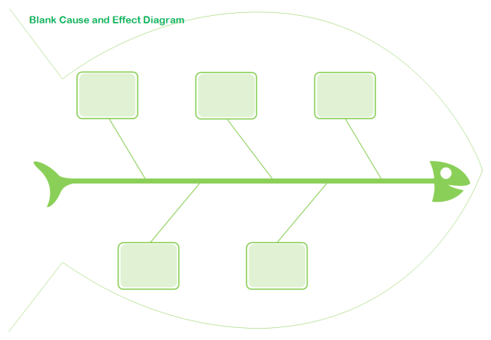
Training-in-person QAPI Resources 7 Areas of Training Focus
Root cause analysis training example
Fishbone Diagram—often thought to be an important first step, because many QI Teams jump into trying to fix one cause without assessing other possible causes (enters causes into categories).

Slide 22
Training-in-person QAPI Resources 7 Areas of Training Focus
Root cause analysis Training Example
The Five “WHYs” (use with Fishbone or Process Mapping)
Simple brainstorming tool that can help nursing home teams get to the root causes of a problem.
State the problem
Keep asking “WHY,” until it doesn’t make sense to ask it any longer—drill down to get to root causes.
By the time you get to the 4th or 5th “WHY,” you are looking squarely at management origins.
Stop treating symptoms—gets the right people in the room discussing all of the possible causes of a given problem
Allows to move beyond obvious answers and reflect on less obvious explanations.

Slide 23
Training-in-person QAPI Resources 7 Areas of Training Focus
Example of Implementing the Five Whys Strategy
Issue: Concern arose that CNAs were not all aware of the turning schedule for residents at risk for pressure ulcers.
WHY? Many are contracted staff members and not aware of where to access this information.
WHY are they unaware of how to see this info? They don’t ask, or we don’t ensure that they understand.
WHY? Practices don’t strongly support the orientation of contracted staff.
WHY don’t orientations better support contracted staff?...
Consider essential components of orientation that contracted employees need to demonstrate competency.

Slide 24
Training-in-person QAPI Resources Training Outcomes
Facility-specific QAPI Plan
Standardized QAPI Agenda/Minutes Reporting Form
Performance measures established
Measureable action plans
Departmental calendars of audits/performance-based training schedules
Near-Miss Program
Communication Plan
PIP Training on Staff Educator’s calendar (PDSA, etc.)
RCA Training on Staff Educator’s calendar
:

Slide 25
Training-Safe Resident Handling Train-the-Trainer Program
Two-day Train-the-trainer sessions (8:30-3:30)
Invited facility educator, CNAs, rehab aides
One training session held in December
Western part of the state
2-3 Participants each from four nursing homes
Three remaining sessions in process of being scheduled at in South, North and Metro-Boston regions

Slide 26
Training-Feedback on entire 2-day Train-the-Trainer program
How comfortable do you feel…
 | Very Comfortable | Somewhat Comfortable | Somewhat Uncomfortable | Not At All Comfortable
Using flip charts | 10/10
Facilitating small group activities/ exercises | 10/10
Leading discussions | 6/10 | 2/10 | 2/10
Explaining resident handling hazards | 7/10 | 3/10
Please rate your comfort level about training during the train-the-trainer course
 | Very Comfortable | Somewhat Comfortable | Somewhat Uncomfortable | Not At All Comfortable
Before your first presentation | 2/10 | 4/10 | 3/10 | 1/10
After your first presentation | 5/10 | 4/10 | 1/10
After first class feedback | 5/10 | 4/10 | 1/10
After second presentation | 8/10 | 2/10
At the end of the Train-the-trainer Course | 9/10 | 1/10

Slide 27
Findings
Nursing homes that engaged with SPOT have begun to implement components of QAPI that can serve as a foundation but have not established a robust framework.
There is strong interest among nursing home leadership in making progress with QAPI; this motivation was reflected in the Governance and Leadership element.
Nursing homes that received additional training demonstrated that they had implemented new QAPI meeting templates and standardized audit schedules.

Slide 28
Continuing SPOT Activities
SPOT uses civil monetary penalty funds that CMS makes available for up to three years;
The Department plans to continue SPOT’s work through December 2018;
Planned activities in Calendar Year 2017:
Continue to work with the 40 nursing homes that were engaged in 2016 on building a QAPI framework;
Monitor progress on achieving implementation of QAPI assessment elements and connect measures to publicly reported outcomes;
Incorporate an additional 20 nursing homes;
Conduct a QAPI assessment to identify targeted areas for improvement;
Implement monitoring measures to assess improvement;
In all 60 nursing homes SPOT plans to:
Provide technical assistance to develop and implement QAPI plans, PIPs and accountable communication strategies .

Slide 29
Questions

Slide 30
Thank you to all of the nursing homes who engaged with SPOT in 2016.

