Slide 1
The Supportive Planning and Operations Team (SPOT) Initiative
Stakeholder Presentation
December 11, 2018
Notes:
Kate

Slide 2
Thank you
The Massachusetts Department of Public Health would like to acknowledge the terrific support from Abt Associates in engaging in this work.
Notes:
Kate

Slide 3
SPOT Partners
Bureau Health Care Safety & Quality (BHCSQ), Massachusetts Department of Public Health
Katherine Fillo, PhD, MPH, RN-BC, Director of Clinical Quality Improvement
Katherine Saunders, MS, Manager of Data Analysis and Integrity
Chiara Moore, MPH, Data Analyst
Abt Associates Inc.
Rosanna M. Bertrand, PhD, Project Director
Teresa M. Mota, BS, RN, Task Lead
Gabrielle Katz, MPP, Data Manager
Terry Moore, MPH Project Quality Advisor
Notes:
Kate

Slide 4
SPOT Partners
Chapin Center
Samantha Fiore, Administrator
Webster Manor Rehabilitation & Health Care Center
Sandra M. Gillian-Germain, Registered Nurse, Director of Nursing Services
Notes:
Rosanna:

Slide 5
Presentation Overview
Background/Introduction
Objectives of SPOT Initiative
Review of QAPI
Background of the SPOT Initiative
2018 SPOT Initiative activities
SPOT Partner Stories
Engaging residents, families, and all levels staff
Applying SPOT resources and knowledge gained
Results of the overall SPOT Initiative (Years 1-3)
Lessons learned
Notes:
Rosanna:

Slide 6
Objectives of the SPOT Initiative
The aim of the SPOT Initiative was to foster quality care delivery in skilled nursing facilities across Massachusetts.
SPOT fostered quality care by supporting nursing home teams to develop and improve their quality assurance and performance improvement (QAPI) programs.
Effective QAPI programs can prevent adverse events, promote safety and quality, and reduce risks to residents and caregivers.
Notes:
Rosanna:

Slide 7
QAPI
Quality Assurance (QA)
Specification of standards for quality of service and outcomes.
Performance Improvement (PI)
The continuous study and improvement of processes with the intent to better services or outcomes, and prevent or decrease the likelihood of problems.
A process throughout the organization for assuring that care is maintained at acceptable levels in relation to those standards.
PI aims to improve processes involved in health care delivery and resident quality of life.
Notes:
Rosanna:

Slide 8
Background of the SPOT Initiative
SPOT was funded from civil monetary penalties (CMP) collected from nursing homes.
In 2016, SPOT Year 1, 40 nursing homes were selected.
In March 2017, BHCSQ engaged Abt to implement SPOT Year 2.
20 additional nursing homes were selected.
Abt was engaged to continue implementing SPOT in Year 3.
Fifty-five nursing homes remained in SPOT Year 3.
An advantage of SPOT was the opportunity to meet nursing home staff face-to-face on multiple occasions thus establishing a rapport and forming strong partnerships.
Notes:
Rosanna:

Slide 9
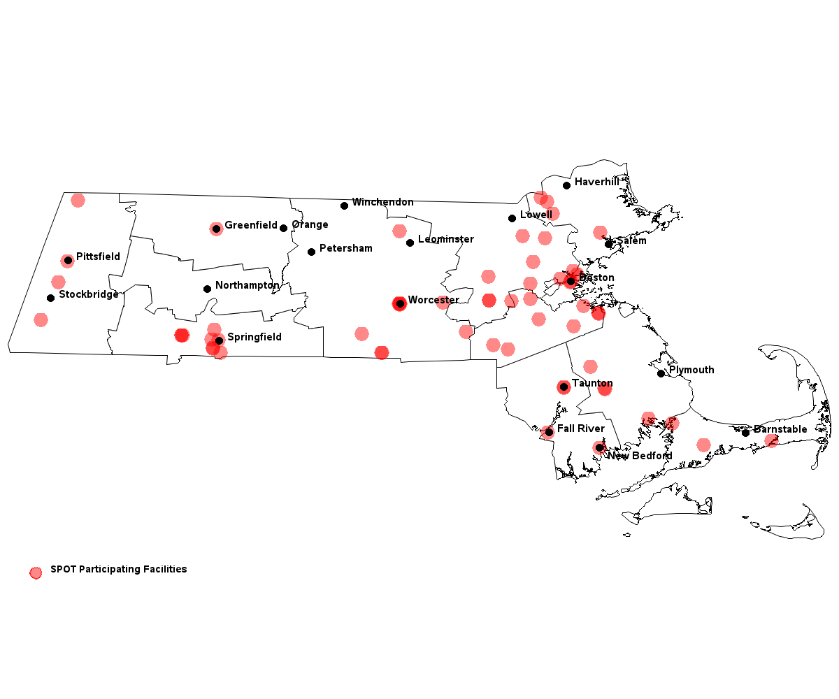
SPOT Nursing Home Locations
SPOT Nursing Homes
Notes:
Rosanna:

Slide 10
2018 SPOT Activities
Notes:
Rosanna:

Slide 11
2018 SPOT Activities
Three regional learning sessions
QAPI Fundamentals and Overview of Revised QAPI Requirements
Prevention of Adverse Events
Measuring Quality
On-site technical assistance visits
Review facility QAPI plan
Review Annual Facility Assessment
Facilitate the QAPI Assessment among three levels of staff
Provide technical assistance in identified QAPI areas
Telephone outreach and email support
Notes:
Terri:

Slide 12
Regional Learning Sessions Burlington, Raynham, Springfield, Woburn, Worcester
2018 SPOT Activities
Notes:
Terri:

Slide 13
2018 Regional Learning Sessions
Three learning sessions offered in different regions of the Commonwealth
Based on the adult learning theory
Interactive, task-oriented sessions
Capitalize on what participants already know
Participant interaction and short didactic presentations
Notes:
Terri:

Slide 14
Learning Session 1: Fundamentals and Revised QAPI Requirements
All-day sessions
Presented on April 24 and 25 in Springfield and Woburn, respectively
Key presentation components:
Identifying and correcting quality deficiencies
Using the SPOT Performance Improvement Project (PIP) process Adapting root cause analysis to evaluate quality issues
Enhancing communication and teamwork
Sustaining QAPI gains regardless of staff turnover
Developing steps in a PIP
Notes:
Terri:

Slide 15
Learning Session 2: Prevention of Adverse Events
Half-day events
Presented July 16 – 19 in Springfield, Raynham, Burlington and Worcester, respectively
Key presentation components:
Defining adverse events and understanding their significance in nursing homes
Differentiating adverse drug events from adverse drug reactions
Describing a prescribing cascade
Evaluating a facility protocol for high-risk medication using CMS’s Adverse Drug Event Trigger Tool
Notes:
Terri:

Slide 16
Learning Session 3: Measuring Quality
Half-day events
Presented October 15 – 18 in Worcester, Burlington, Raynham, and Springfield, respectively
Key presentation components:
Defining and identifying process and outcome measures
Identifying intended purposes of nursing home quality improvement quality measures
Identifying performance improvement topics in the CASPER reports
Determining process and outcome measures using a facility care protocol
Notes:
Terri:

Slide 17
Technical Assistance Visits
2018 SPOT Activities
Notes:
Terri:

Slide 18
On-Site Technical Assistance Visits
Conducted site visits to provide real-time technical assistance to SPOT partners in QAPI areas identified during the visit
Conducted an independent review of the QAPI plan and annual facility assessment
Met with leadership to:
Review QAPI plan
Discuss leadership QAPI concerns
Conduct leadership interview
Provide feedback and additional technical assistance during a debrief
Facilitated QAPI assessment with three levels of staff
Notes:
Terri:

Slide 19
Email and Telephone Support
2018 SPOT Activities
Notes:
Terri:

Slide 20
Email and Telephone Support
Email support was available to all SPOT participants via NursingHomeQI@state.ma.us
Members of the Team were available by telephone and email to address participant questions
Notes:
Terri:

Slide 21
SPOT Partner Stories
Notes:
Terri:

Slide 22
Engaging Residents, Families, and all Levels of Staff in QAPI
Chapin Center
Notes:
Terri:

Slide 23
Chapin Center: Overview
Introduction
Nursing home background
Non-profit owned by The Northeast Health Group, Inc.
Located in Springfield
Post-acute services, skilled nursing, rehabilitation programs, restorative and long-term care, respite care, palliative care, large behavioral health population
160 beds
Brief overview of experience with SPOT
SPOT program introduced to Chapin in 2017 (SPOT Year 2)
SPOT made us aware of the importance of engaging front line staff
SPOT stressed the effectiveness of implementing large plans in multiple steps to ensure sustainability.
Notes:
Sam Fiore

Slide 24
Chapin Center: Engaging Residents and Families
Challenges engaging residents and families in QAPI
Strategies to overcome the challenges
Inviting residents to quarterly QAPI meetings
Notes:
Sam Fiore

Slide 25
Chapin Center: Informing Residents and Families
Bulletin boards
Newsletter
Initial and quarterly care plan meetings
During the grievance process
Mass mailings
Notes:
Sam Fiore

Slide 26
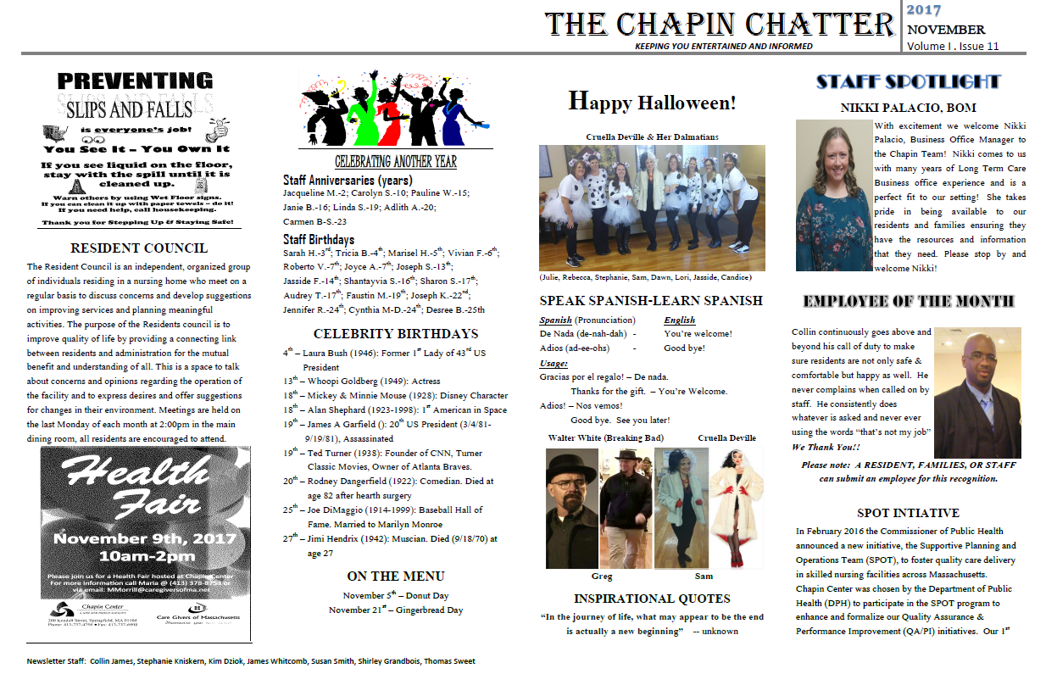
Chapin Center: Informing Residents and Families
Notes:
Sam Fiore

Slide 27
Chapin Center: Informing Residents and Families
Notes:
Sam Fiore

Slide 28
Applying SPOT Processes to Improve Quality
Webster Manor Rehabilitation &
Health Care Center
Notes:
Terri:

Slide 29
Webster Manor: Overview
Introduction
Nursing home background
Athena Healthcare
Webster
Advanced nursing & Therapy services
135 beds
Brief overview of experience with SPOT
SPOT was introduced to Webster in 2017 (SPOT Year 2)
Our first glimpse of SPOT was informative and caused us to look at our quality assurance program.
Notes:
Sandra

Slide 30
Webster Manor: Conducting a PIP
Prioritized a PIP that would create a home like environment
A reduction in noise by 75 percent by 2017 Quarter 4
Convening PIP Team
Administrator, Director of Nursing Services (DNS), Assistant DNS, maintenance director, recreation director, receptionist, staff development coordinator, two nurses, and two certified nursing assistants (CNAs)
Implementing the PIP
Staff education on the importance of noise reduction
Leadership informing reception of their location; receptionists only paging in case of emergency
Extending the PIP
New CNA rounding process
Educate team leaders, educate CNA staff
New process for nurse-to-nurse reporting
Educate nurses
Notes:
Sandra

Slide 31
Webster Manor: PIP Outcomes
Original PIP
Process measure
Tracked the number of leadership staff and receptionists educated – 100 percent
Outcome measure
Count of the number of daily pages – decreased by 75 percent
Extended PIP
Process measures
Tracked the number of CNAs and nurses educated – 100 percent
Observations by DON to track CNA rounding
Observations by DON to track adherence to the nurse-to-nurse reporting process
Outcome measures
Significant reduction in noise by limiting multiple reports conducted at the same time on the unit
Ongoing monitoring
The noise reduction PIP was successful but needs ongoing monitoring to ensure sustainability
Notes:
Sandra

Slide 32
Webster Manor: Challenges to PIP Implementation
Changing the culture of immediate gratification received through paging.
Changing the culture of department heads communicating their location throughout the work day.
Decreasing activity level of personnel and residents at the nurses station during report.
Notes:
Sandra

Slide 33
Webster Manor: Contributions to PIP Success
Perseverance of continuous communication
Co-operation of staff to achieve a homelike environment
Education of the staff to the purpose of creating a homelike environment
Notes:
Sandra

Slide 34
Impact of the SPOT Initiative
Impact of SPOT Across all Three Years
Notes:
Gabby:

Slide 35
Methods
Data Collection
Data collected by SPOT subject matter experts (SMEs)
QAPI assessment scores
Leadership interview data
Learning session evaluation results
Existing data accessed
Health inspection results
Analytic Approach
Used multiple strategies to explore trends and impact
Notes:
Gabby:

Slide 36
Characteristics of SPOT Nursing Homes
Nursing Home Ownership and Size |  | Number of Nursing Homes (N=60) | Percent of Total SPOT Nursing Homes
Ownership | For-Profit | 45 | 75%
 | Not For- Profit | 14 | 23%
 | Govt. Owned | 1 | 2%
Size (# of beds) | <50 | 4 | 7%
 | 50-99 | 14 | 23%
 | 100-199 | 37 | 62%
 | >199 | 5 | 8%
County | Barnstable County | 3 | 5%
 | Berkshire County | 4 | 7%
 | Bristol County | 4 | 7%
 | Essex County | 4 | 7%
 | Franklin County | 1 | 2%
 | Hampden County | 9 | 15%
 | Middlesex County | 10 | 17%
 | Norfolk County | 8 | 13%
 | Plymouth County | 4 | 7%
 | Suffolk County | 3 | 5%
 | Worcester County | 10 | 17%
Notes:
Gabby:

Slide 37
Results of the QAPI Assessment
Impact of SPOT Across all Three Years
Notes:
Gabby:

Slide 38
Key Assessment Items: Written QAPI Plan
Notes:
Gabby:

Slide 39
Key Assessment Items: Communication between and within Departments
Notes:
Gabby:

Slide 40
Key Assessment Items: Resident/Family Engagement
Notes:
Gabby:

Slide 41
Key Assessment Items: Informing Staff, Residents and Families
Notes:
Gabby:

Slide 42
Results of Health Survey Outcomes
Impact of SPOT Across all Three Years
Notes:
Gabby:

Slide 43
Relevant Health Survey Outcomes
No change in health inspection survey results associated with SPOT participation
No evidence of a relationship between leadership turnover and change in tags cited
Caveats to these results:
Low power due to the small sample size and the low number of deficiency tags assigned, limited our ability to detect differences
Changes to the long-term care survey process in 2017 may have impacted our findings
A limited number of nursing homes had a follow-up survey within our intervention window
Notes:
Gabby:

Slide 44
Results of 2018 Leadership Interviews
2018 Leadership Interview Results
Notes:
Gabby:

Slide 45
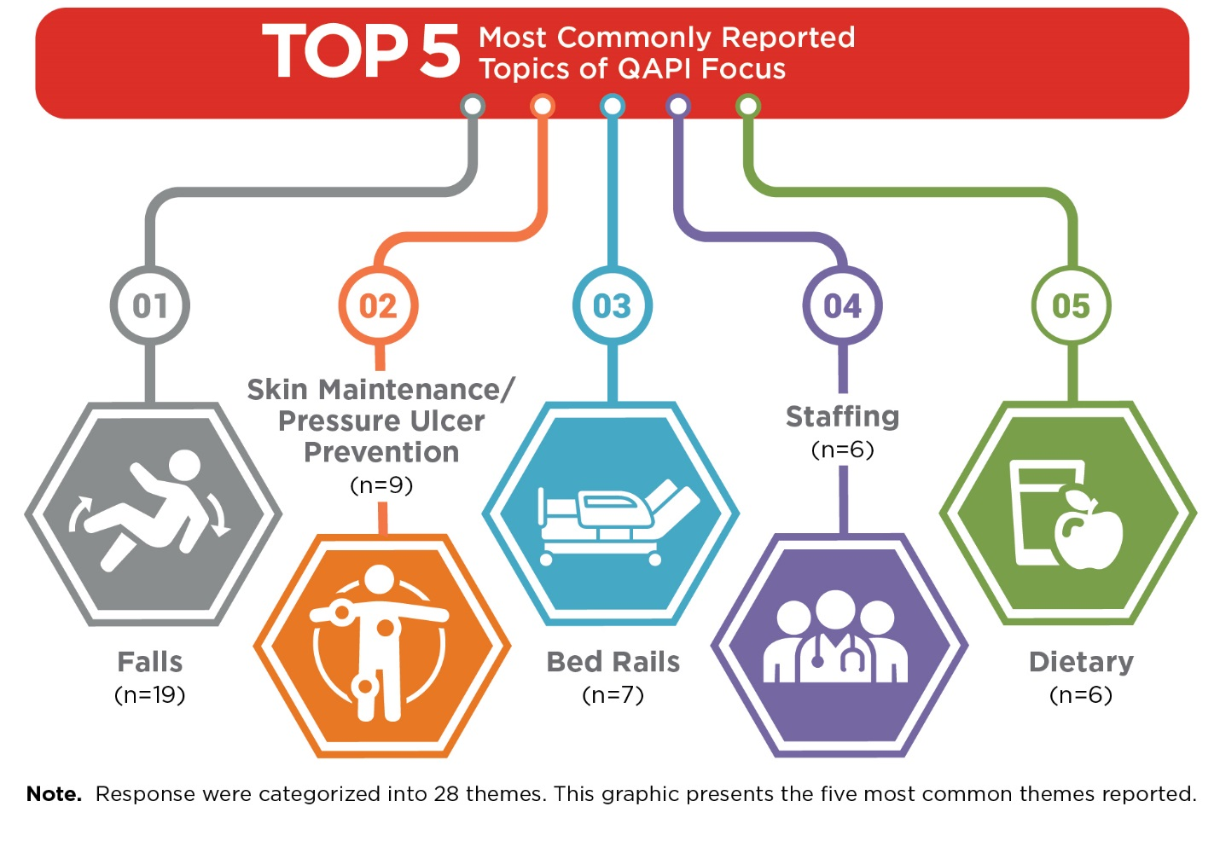
Current QAPI Focus Among SPOT Nursing Homes
Notes:
Gabby:

Slide 46
Contributors to PIP Success
Consistent leadership
Communication between and within departments
Dedicated PIP team
Audits
Involvement of residents and families
Notes:
Gabby:

Slide 47
Leadership Turnover Rate
Position | Range | Average | Median
Director of Nursing | 0 - 37 Years | 2.82 Years | 1 Year
Administrator | 1 Month - 36 Years | 2.51 Years | 0.8 Year
Notes:
Gabby:

Slide 48
Relationship between Leadership Turnover and PIP Status
Notes:
Gabby:

Slide 49
Relationship between Leadership Turnover and QAPI Preparedness
Higher rates of leadership turnover were related to lower levels of QAPI preparedness (indicated by an overall QAPI assessment score).
With every turnover of Administrator, QAPI scores were lower by 0.12 points.
With every turnover of DON, QAPI scores were lower by 0.10 points.
Notes:
Gabby:

Slide 50
Learning Session Feedback
2018 Learning Session Results
Notes:
Gabby:

Slide 51
Most Important Aspect of the Learning Sessions as Identified by Participants
Learning Session 1
Using the SPOT tools to create sustainable PIPs
Understanding QAPI
Learning Session 2
How to focus on QAPI priorities
Evaluating adverse drug event protocols
Tools provided such as guidance on what CMS/DPH uses to guide their survey process
Learning Session 3
Calculating measures
Identifying trends and correlations between measures
Using process measures to improve outcomes
Notes:
Rosanna:

Slide 52
Aspects of the Learning Sessions that Participants will Apply to Their Processes
Learning Session 1
Use of SPOT processes to create sustainable PIPs
New SPOT tools
Learning Session 2
Adverse drug event audits
Better monitoring tools
Staff and family education
Learning Session 3
Identifying and tracking process measures
Monthly review of quality measures, including utilizing the CASPER reports to identify high risk residents
Notes:
Rosanna:

Slide 53
Participant Suggestions for Future Learning Topics and TA
Offer QAPI tools to monitor residents with substance use disorders within the long-term care setting
Topics related to providers’ roles in regulations
Navigating the survey process and improving residents’ quality of life
Assistance on staffing and securing competent staff; CNA recruitment ideas
Education on basic CNA documentation
Continuing Education Units (CEUs) for session attendance
Notes:
Rosanna:

Slide 54
Participant Feedback from Learning Sessions
“The SPOT Initiative has been very helpful, I would love this program to continue.”
“Very informative, and educational. Love leaving with links/references to look back to.”
“Excellent learning opportunity.”
“Speakers were very knowledgeable and dynamic.”
“I’m really glad that I have attended this meeting!”
“Excellent session!”
“We will adjust current PIPs to include more process measure data.”
“A lot of fun sharing.”
Just wanted to take the time out and thank you ladies for the wonderful experience. I am aware that this is your final conference as SPOT, however I am looking forward to attending many more of your next endeavors.
Notes:
Rosanna:

Slide 55
Lessons Learned Across Three Years of SPOT
Results emphasize the success of SPOT
Consistent leadership staffing fosters PIP sustainability
Effective communication between/ within departments is essential for effective quality improvement, yet this is an area in which participants struggled
Accurate documentation and measurement are key to making successful improvements
Ongoing support is needed to encourage the inclusion of all levels of staff, residents, and families
Offering CEUs may improve participation in future programs
Notes:
Rosanna:

Slide 56
Questions and Discussion
Notes:
Rosanna:

