Slide 1
Incarceration Diversion and the Role of Vocational Rehabilitation
Presented by Christine Tosti and Heather Wood
Artwork by Matteo Bertelli description: White men in suits with elongated ties that appear like jail bars imprisoning people
Notes:
Slides 1-3 = 2 minutes

Slide 2
What am I presenting?
Marginalized Identities are Overrepresented in Incarceration Settings
Employment = Economic Security
The Path from Arrest to Pretrial Detention
Vocational Rehabilitation Example: Good Will Hunting
Impact of College Education Example: Video
How Exposure to Vocational Training During Incarceration Lowers Unemployment and Recidivism
Wrap Up & Call to Action
Notes:
Slides 1-3 = 2 minutes

Slide 3
Marginalized Identities are Overrepresented in Incarceration Settings
Study: The Links Between Disability,
Incarceration, And Social Exclusion
“66% of incarcerated people self-reported a disability, with Black, Hispanic, and multiracial disabled men especially overrepresented in prisons.”
“A higher estimated percentage of incarcerated women reported disability (79.5%) compared with incarcerated men (64.6%).”
Notes:
Slides 1-3 = 2 minutes

Slide 4
Employment = Economic Security
A disproportionate amount of marginalized identities are economically insecure
An article from the Prison Policy Initiative website, “Detaining the Poor: How money bail perpetuates an endless cycle of poverty and jail time” explains if individuals start life poor, they will have less access to economic or educational opportunities and healthcare
Without support, individuals are more likely to experience unemployment, trauma, homelessness, etc.
They may also encounter more negative experiences with law enforcement
Notes:
Slides 4-5 = 4-5 minutes

Slide 5
Source
Article and Lawsuit: Section 35 individuals sent to jail rather than medical facilities
COURT ORDERED TREATMENT
Section 35: Substance Use Disorder
Section 12: Mental health

Slide 6
Vocational Rehabilitation Example:
Good Will Hunting
Connection to disability: Early exposure to violence and trauma in childhood
Released with Conditions (did not have to serve lengthy sentence)
Math with Professor
Counseling with therapist
Find a Job
He stays out of jail
1. Arrest
2. Arraignment
3. Detained
4. Release conditions
Notes:
1 min

Slide 7
Impacts of Education While Incarcerated
Video: Melissa McKee Prison Pet Partnership
Video: College Behind Bars by Lynn Novick
Things to Think About:
How did college education contribute to the development of self esteem?
How did Melissa’s experience with prison education lead to employment?
Christine’s service dog in training, David Bowie
Notes:
5 min

Slide 8
HOW EXPOSURE TO VOCATIONAL TRAINING DURING INCARCERATION LOWERS UNEMPLOYMENT & RECIDIVISM
Source
Up to 89% of those who return to prison are unemployed (Kimmitt, 2011).
In a study of 3,000 released Virginia offenders, re-incarceration was reduced by 24% for those who participated but did not complete vocational training and by 57% for those who completed their training (Hull, Forrester, Brown, Jobe, & McCullen, 2000).
Research Study:
Disabling Incarceration:
Connecting Disability to Divergent Confinement in the USA
“Class based analysis of disability urges us to shift our understanding of disability oppression from discussions of stigma and deviance to that of systematic economic exclusion of people with disabilities.”
In other words, people with disabilities want to work, they just do not have opportunities and/or fear the loss of social security benefits.
Notes:
2-3 min

Slide 9
Wrap Up
Call to Action
Incarceration should be an entry point for individuals with disabilities to learn about vocational rehabilitation. Individuals without diagnosed disabilities could receive medical evaluations. Those evaluations could then be used to determine VR eligibility.
Statistics show that vocational training has the potential to drastically improve individuals’ lives.
Employment = Economic Security
Massachusetts Rehabilitation Commission could have a significant role in keeping individuals with disabilities out of jails and prisons.
The SRC could recommend that the MRC hold virtual/in-person educational forums to explain VR services to individuals with disabilities who are incarcerated or on probation and parole. MRC consumers who have been incarcerated may help to lead the forums/discussions if staff capacity is low.
The SRC could consider ways to engage individuals with disabilities who have experienced incarceration.
The SRC could recruit voting members who have experienced incarceration.
The SRC could consider creating a committee that would collaborate with the MRC to support individuals with disabilities who are returning citizens.
Notes:
2-3 min

Slide 10
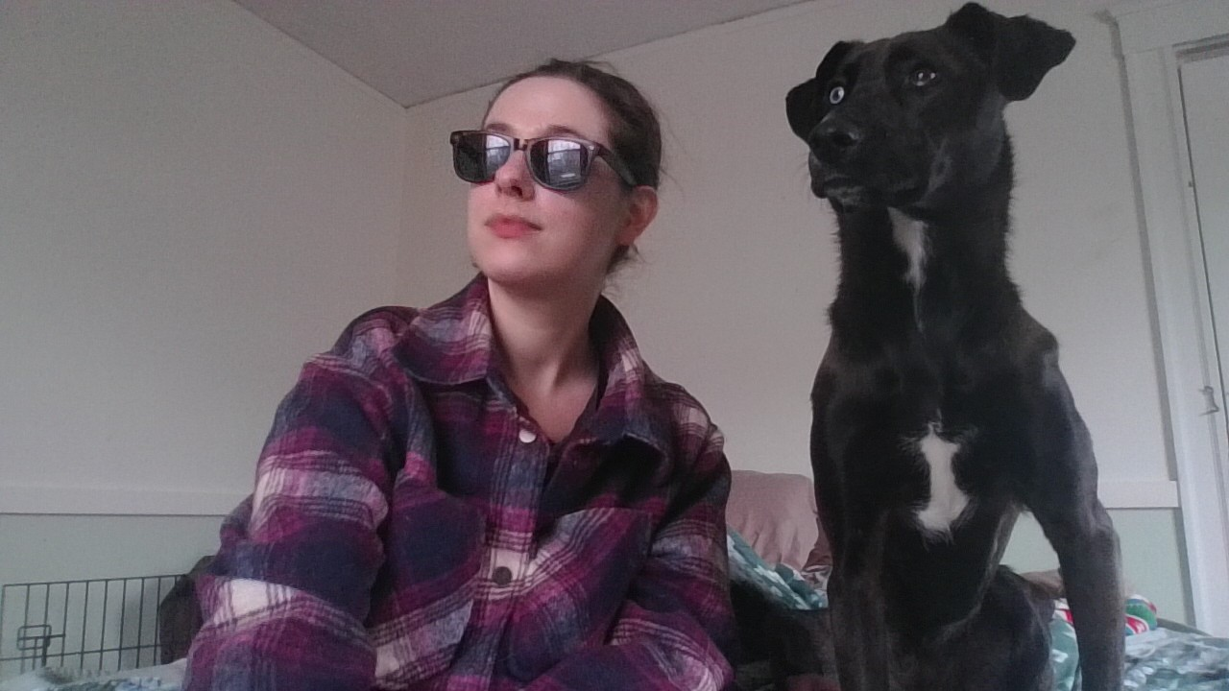
Questions and comments?

