Slide 1
Safe Routes Trivia
AN INTERACTIVE SAFETY REVIEW GAME
Notes:
Please refer to the User Guide for a more detailed list of tips/tricks/and directions! Other notes about specific answers will be this “Notes” section of the PowerPoint game

Slide 2
Signs, Lines, and Signals
Pedestrian Safety
Bike Safety
Let’s Talk Numbers
Fun Facts
200
200
200
200
200
400
400
400
400
400
600
600
600
600
600
800
800
800
800
800
1000
1000
1000
1000
1000

Slide 3
Column 1: Signs and lines and signals

Slide 4
How many sides does a STOP sign have? A) Three B) Four C) Eight D) Ten
ANSWER
200

Slide 5
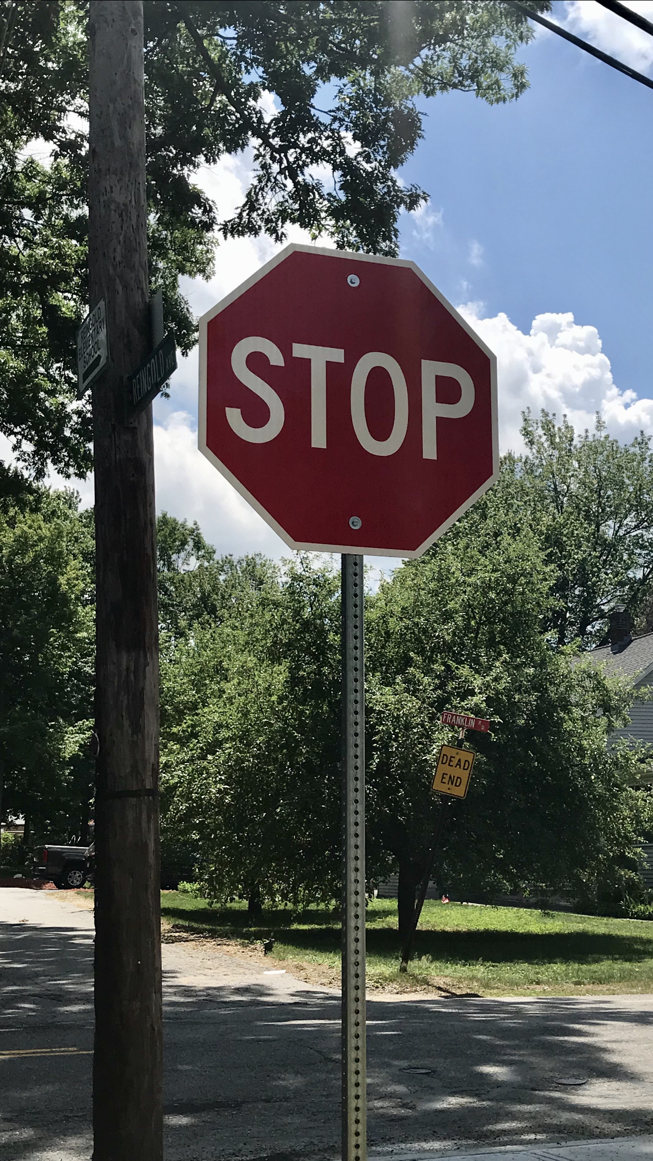
C) Eight
HOME

Slide 6
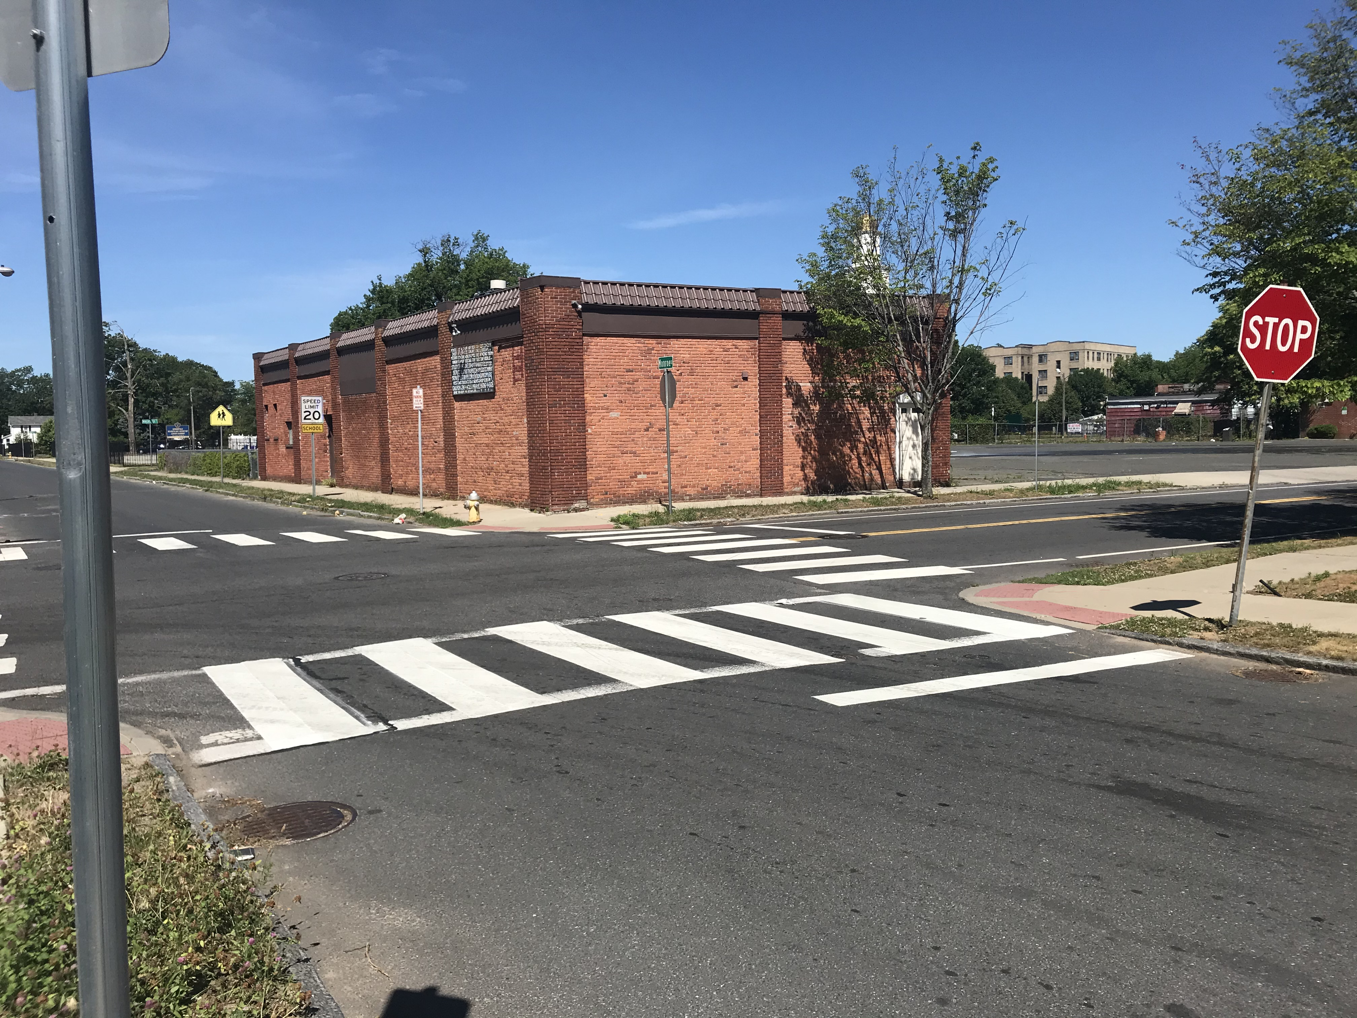
Which style(s) of crosswalk(s) do you see in the picture? A) Ladder B) Zebra C) Both D) Neither
ANSWER
400

Slide 7
C) Both Ladder and Zebra
HOME

Slide 8
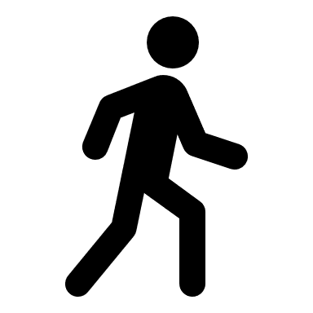
You’re in the middle of the crosswalk when the signal changes from a walker to a flashing hand…what do you do?
ANSWER
600

Slide 9
Keep walking to the other side
HOME
Notes:
Don’t turn around and walk back! This is simply a warning to say that if you are not already in the crosswalk, please don’t go. If you are in the crosswalk, continue walking.

Slide 10
If green means go and red means stop, what should you do if you are riding your bike and the light turns yellow?
ANSWER
800

Slide 11
STOP
HOME
Notes:
Bikes don’t travel as fast as cars. Since the yellow light is about 4 seconds long, the bike would not make it through the intersection in time.

Slide 12
Match the letter with each hand signal for biking (left, right, stop)
ANSWER
A
C
B
1000

Slide 13
A
B
C
STOP
LEFT
RIGHT
HOME

Slide 14
Column 2: Pedestrian safety

Slide 15
TRUE/FALSE: It is safe to wear headphones while walking
ANSWER
200

Slide 16
FALSE
HOME

Slide 17
When you are in a parking lot, on a sidewalk, or crossing the street, should you be walking or running?
ANSWER
400
Notes:
It’s called a SideWALK and CrossWALK

Slide 18
Walking
HOME

Slide 19
What should you do if you drop something while crossing the street?
ANSWER
600

Slide 20
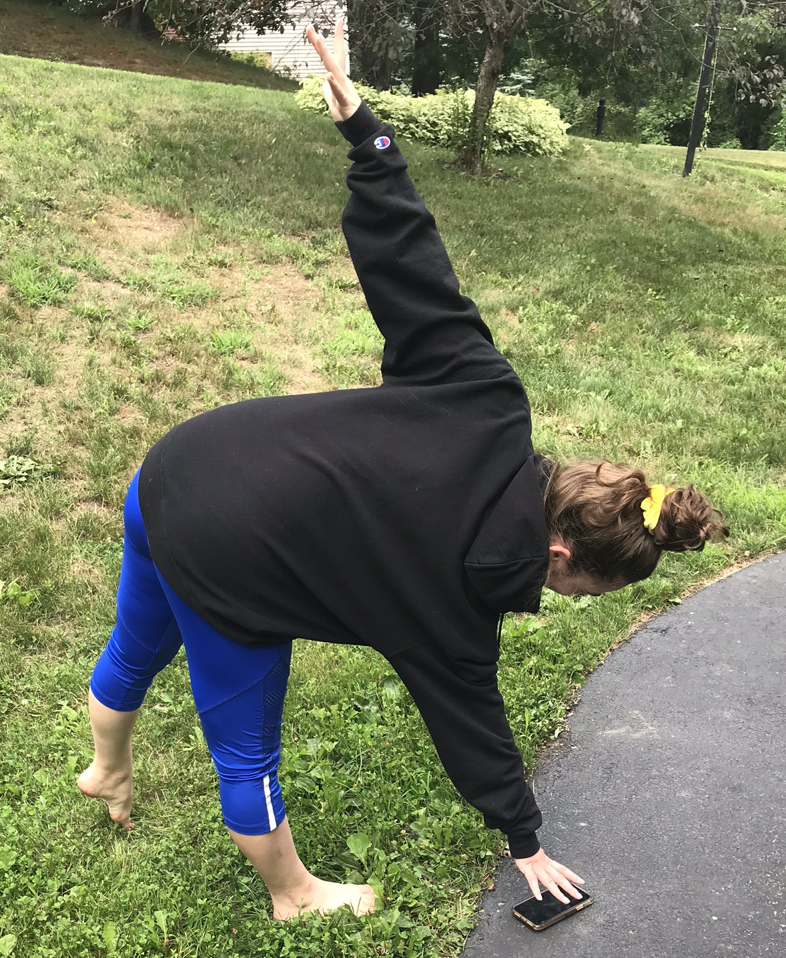
Leave it and wait until it’s safe to go back for it
HOME
Notes:
Acceptable answers include telling an adult. Also mention that if a student does go back for it, they need to look left, right, and all around, wait for the cars to stop, and then make the star move (above) to help make themselves stay visible when bending down.

Slide 21
Before you cross the street, which way should you look? A) Left B) Right C) Left and Right D) Left, Right, and All Around
ANSWER
800

Slide 22
D) Left, Right, and All Around
HOME

Slide 23
If there is no sidewalk, which side of the road should you walk on?
ANSWER
1000

Slide 24
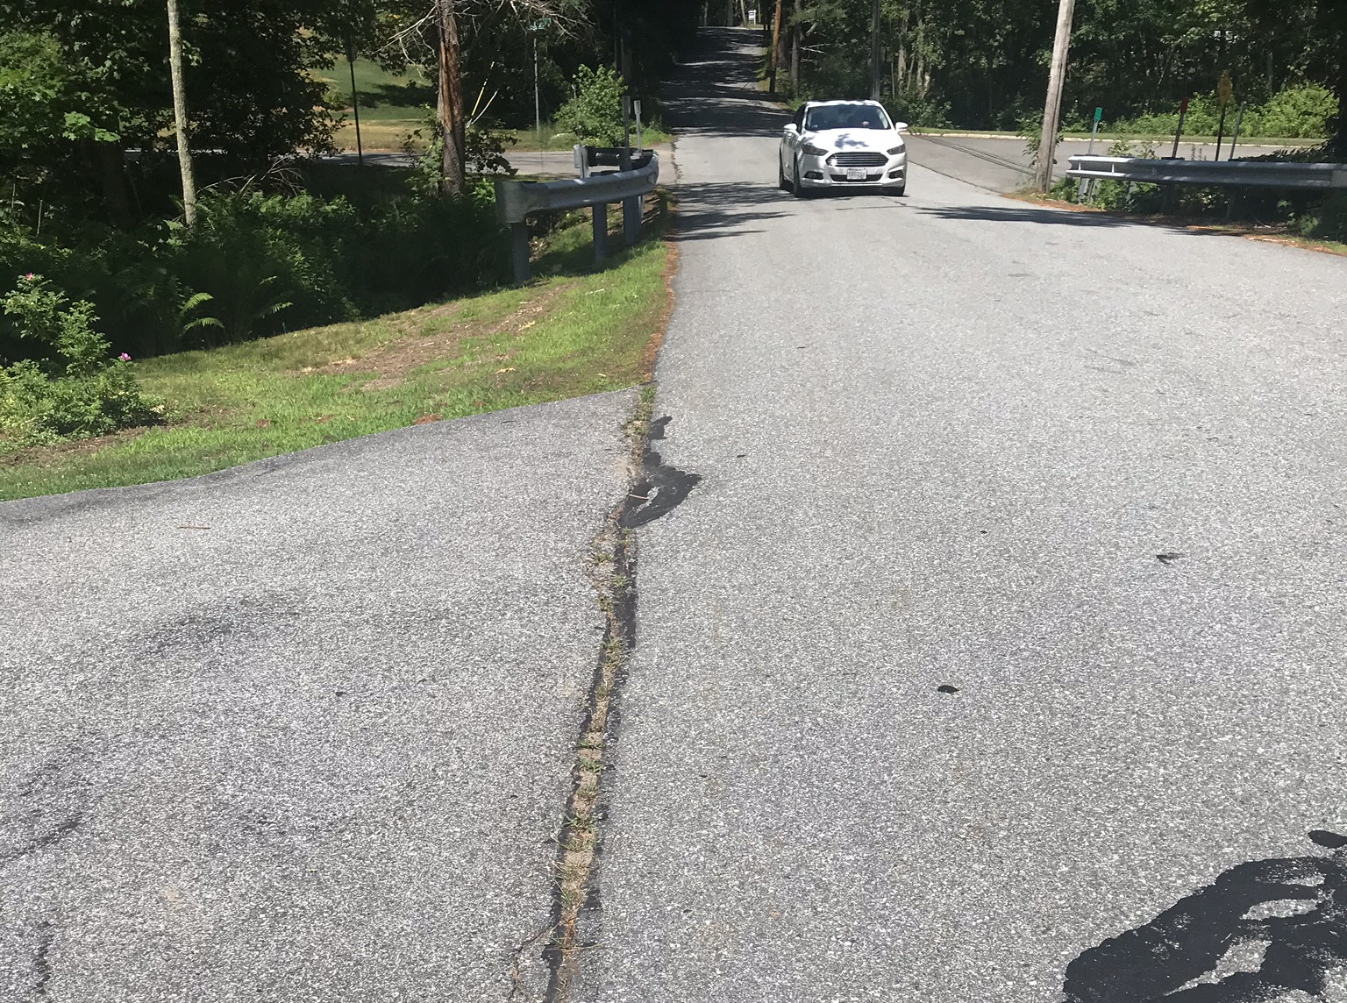
On the left, facing traffic
HOME

Slide 25
Column 3: Bike safety

Slide 26
When riding a bike, do you need to stop at STOP signs?
ANSWER
200

Slide 27
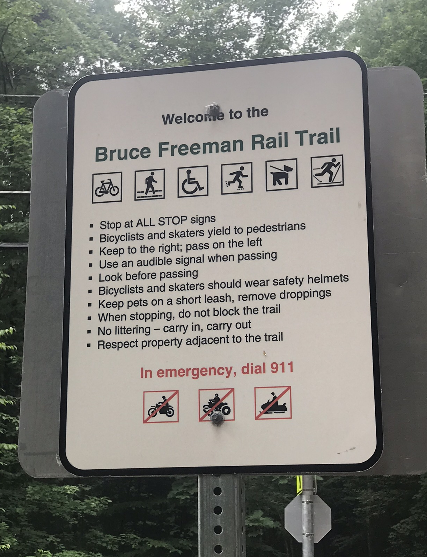
YES
HOME
Notes:
A bike is considered a slow moving vehicle, so cyclists need to obey the same rules as cars.

Slide 28
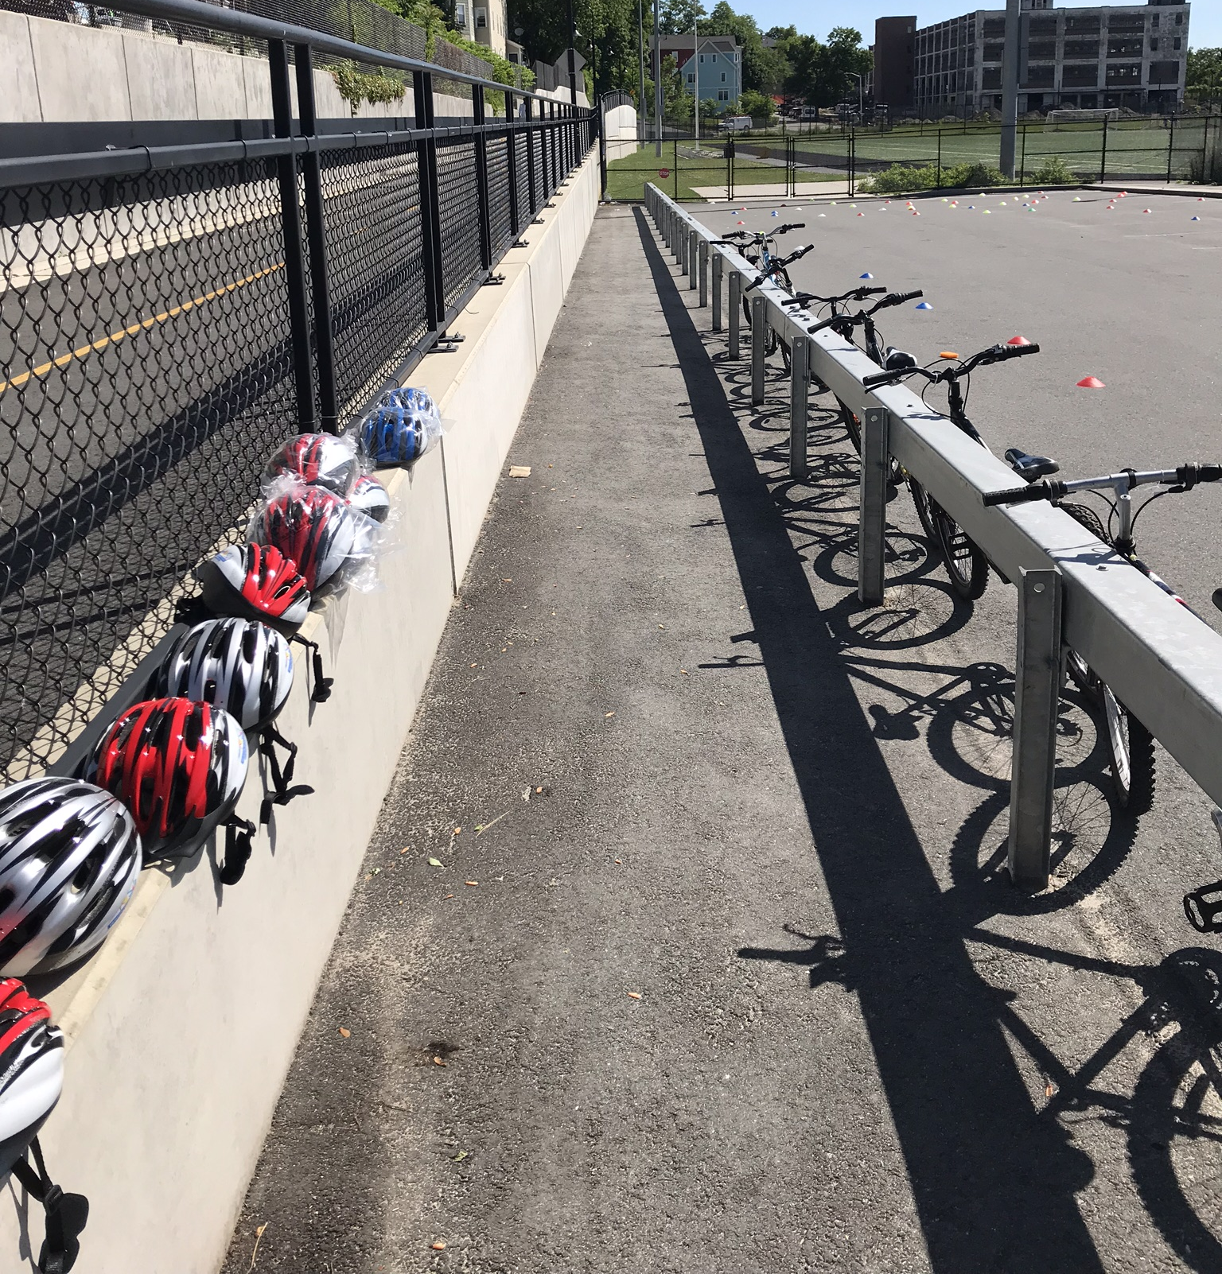
TRUE or FALSE: It is the law in Massachusetts that anyone under the age of 16 must wear a helmet when on wheels (bicycle, scooter, skateboard, etc.).
ANSWER
400

Slide 29
TRUE
HOME

Slide 30
What type of shoes should you wear when riding a bicycle?
ANSWER
600

Slide 31
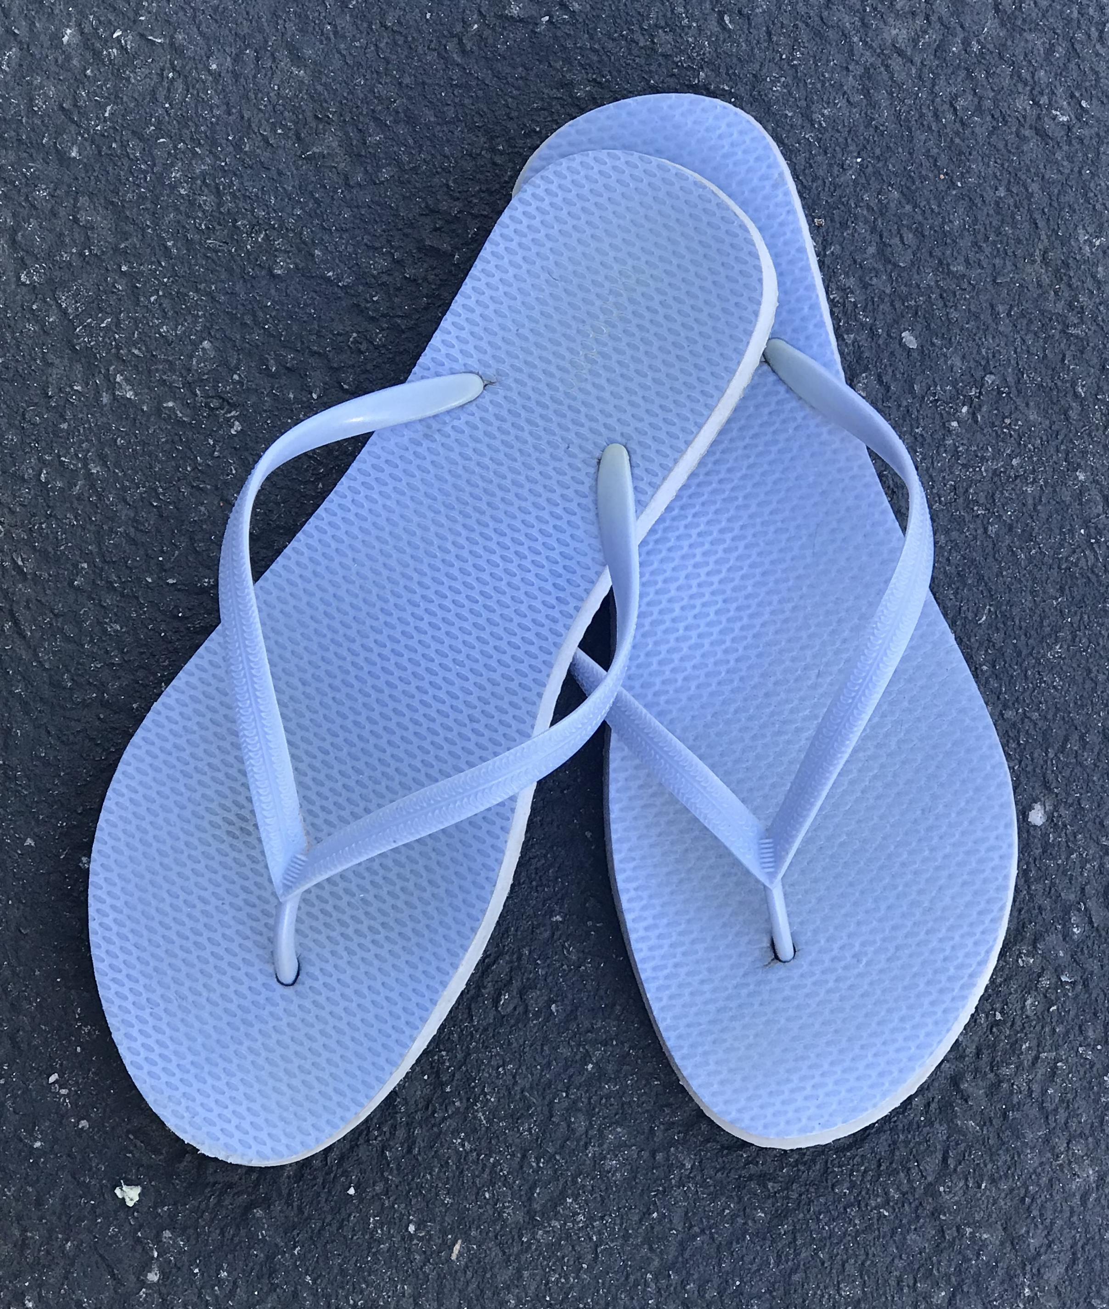
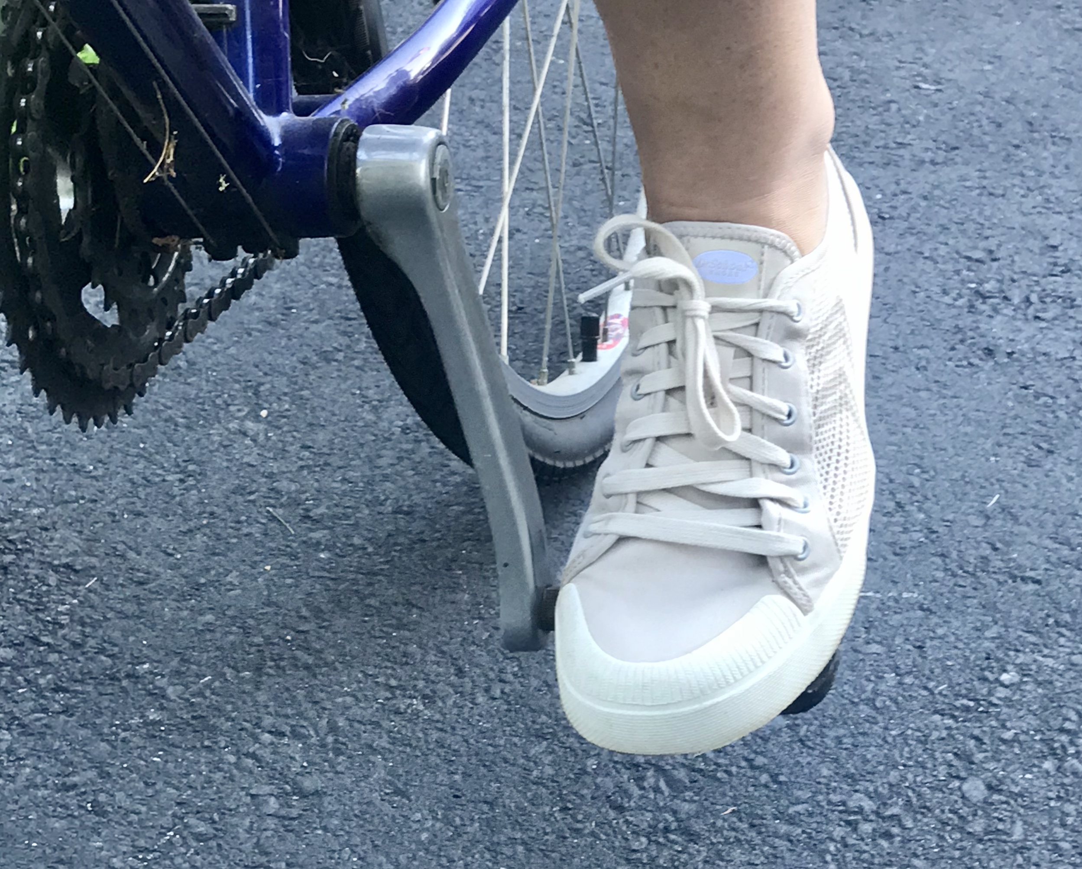
Closed toed shoes
HOME

Slide 32
On which side of the road should you be riding your bicycle in the United States?
ANSWER
800

Slide 33
On the right, with traffic
HOME

Slide 34
If you are riding your bike at night, what two types of lights do you need and where do they go?
ANSWER
1000

Slide 35
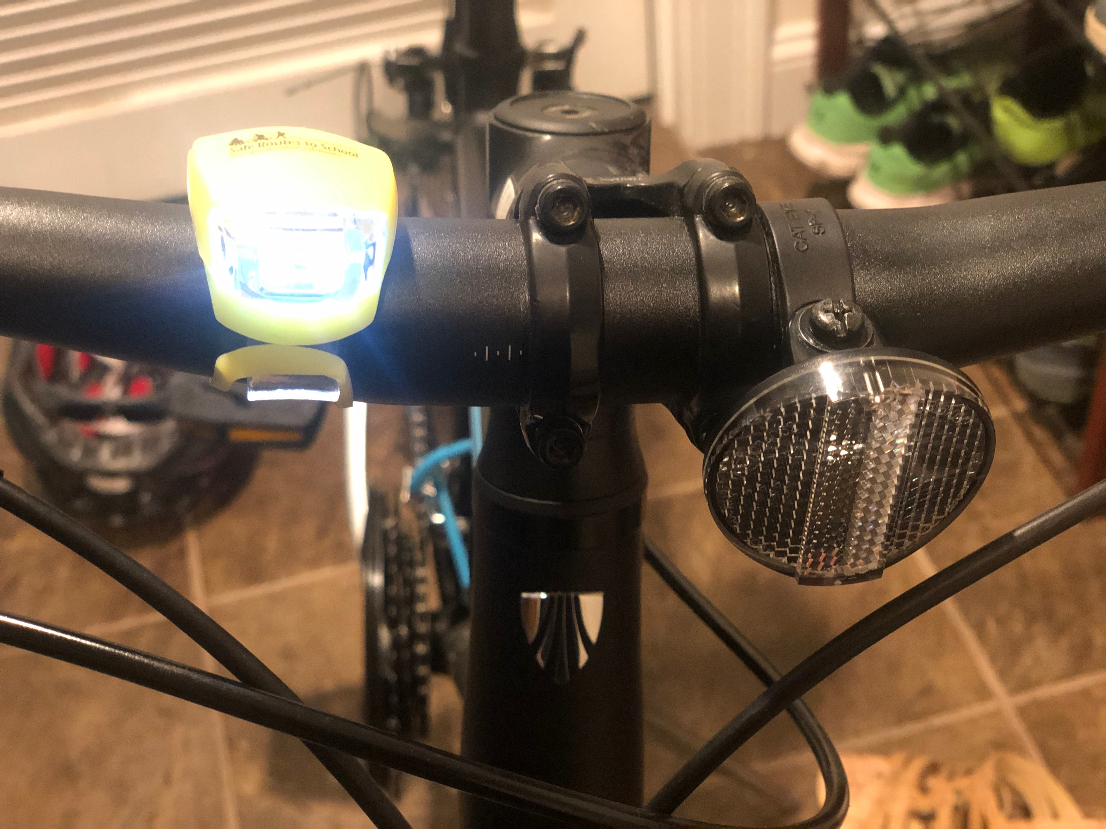
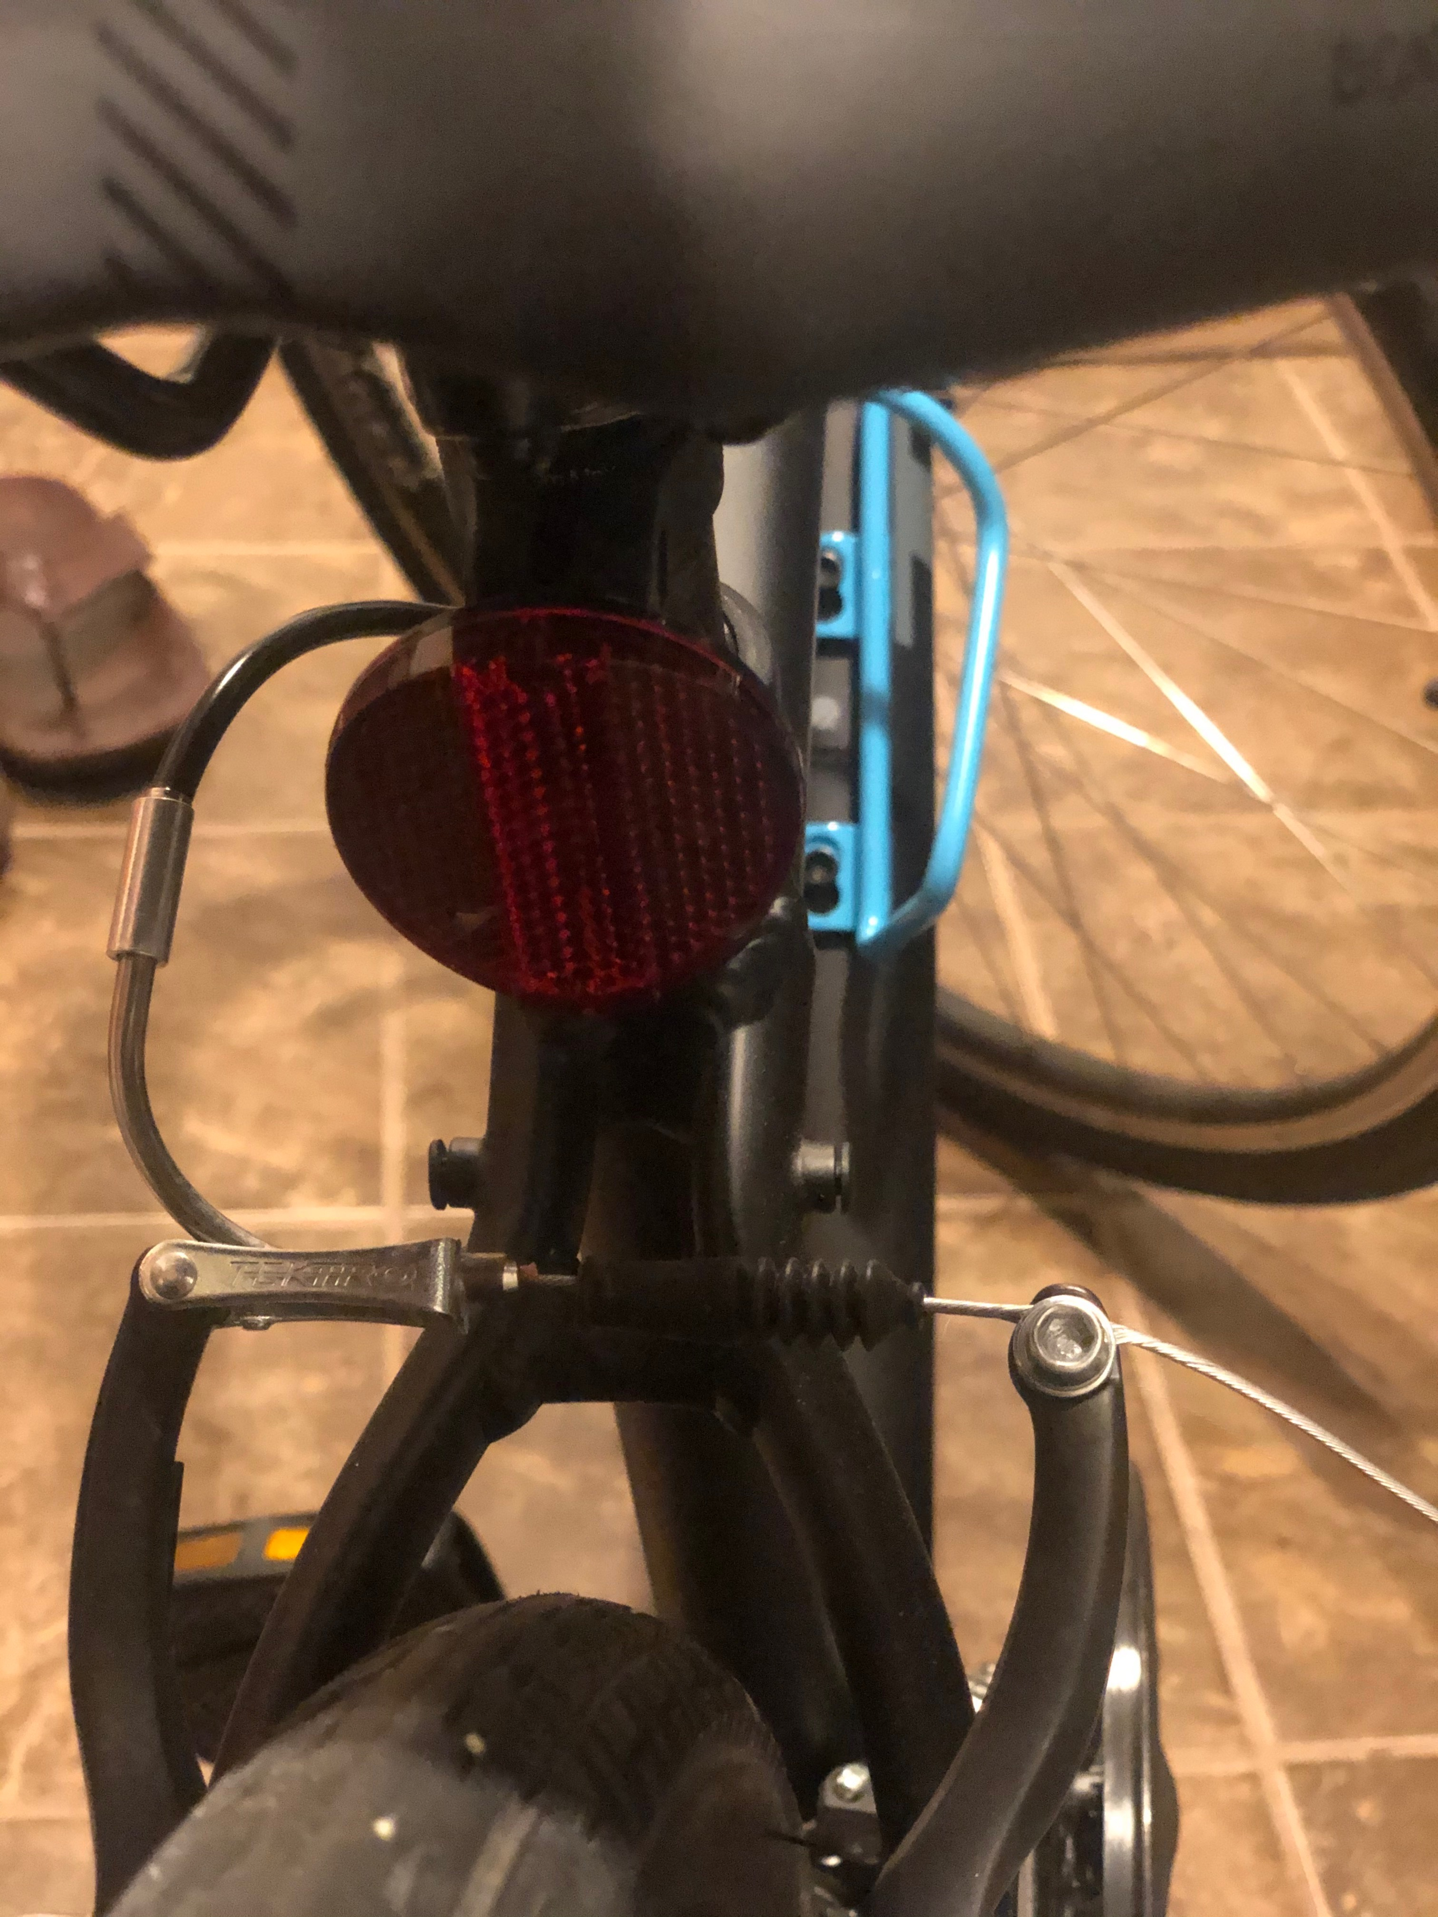
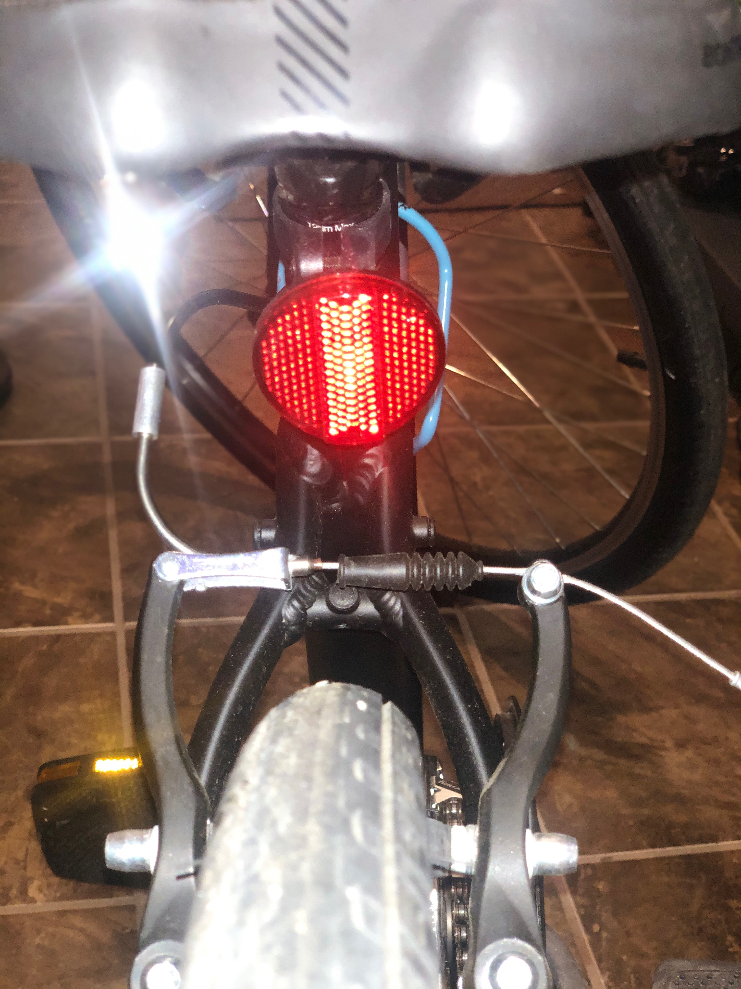
1. White light in the front 2. Red light/reflector in the back
HOME
Notes:
The picture on the right is just from a flash (it shows how a reflector works with car headlights).

Slide 36
Column 4: let’s talk numbers

Slide 37
What is the speed limit in school zones? A) 5 mph B) 10 mph C) 15 mph D) 20 mph
ANSWER
200

Slide 38
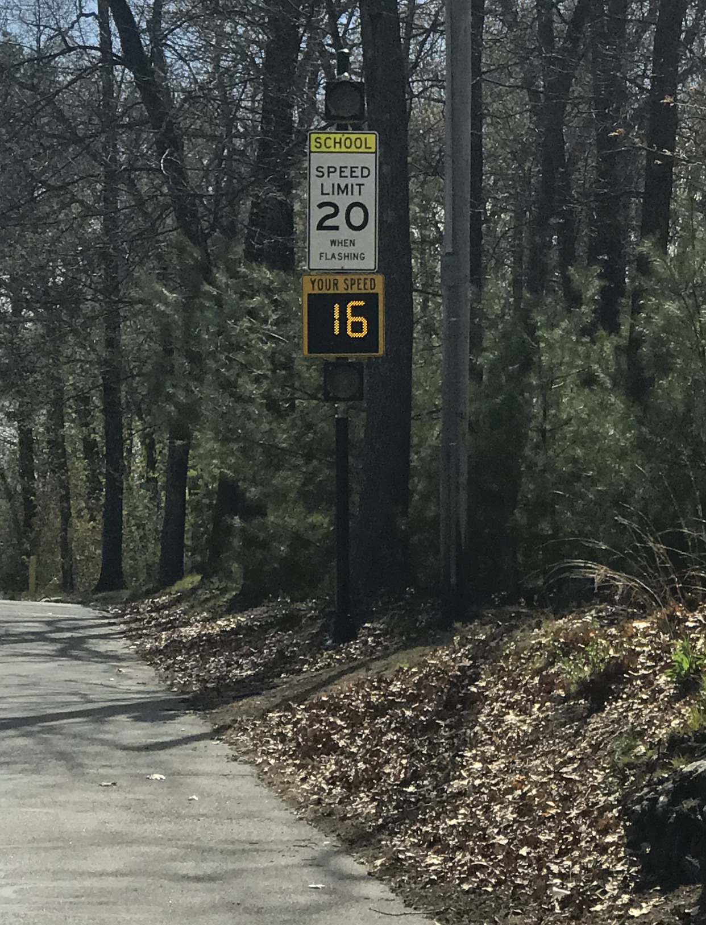
D) 20 mph
HOME

Slide 39
What is the minimal amount of physical activity should you get every day? A) 10 minutes B) 60 minutes C) 90 minutes
ANSWER
400

Slide 40
B) 60 minutes
HOME

Slide 41
After how many years does your helmet expire? A) 2 years B) 5 years C) 10 years
ANSWER
600

Slide 42
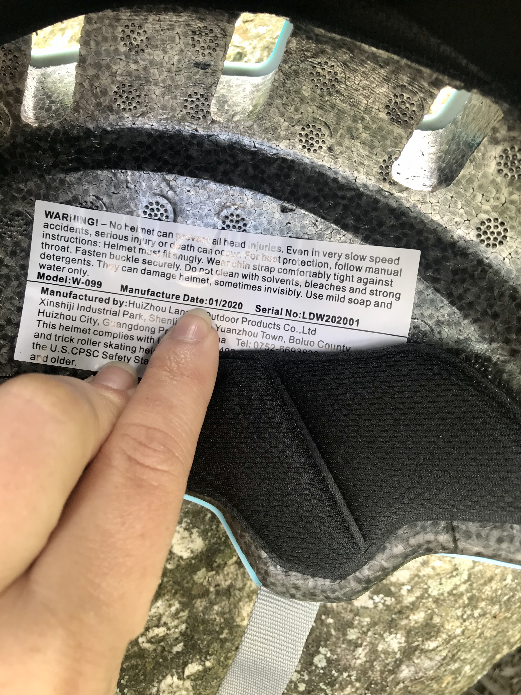
B) 5 years
HOME
Notes:
You can find the manufacture date on the inside of the helmet. The helmet will expire 5 years after that date!

Slide 43
What is the average walking speed of an adult? A) 3 mph B) 5 mph C) 10 mph
ANSWER
800

Slide 44
A) 3 mph
HOME

Slide 45
On average, how many steps are in a mile? A) 100 steps B) 500 steps C) 1,000 steps D) 2,000 steps
ANSWER
1000

Slide 46
D) 2,000 steps
HOME

Slide 47
Column 5: fun facts

Slide 48
TRUE or FALSE: Research says walking or biking to school will help students do better in school.
ANSWER
200

Slide 49
TRUE
HOME

Slide 50
What type of clothing should you wear when walking or biking?
ANSWER
400

Slide 51
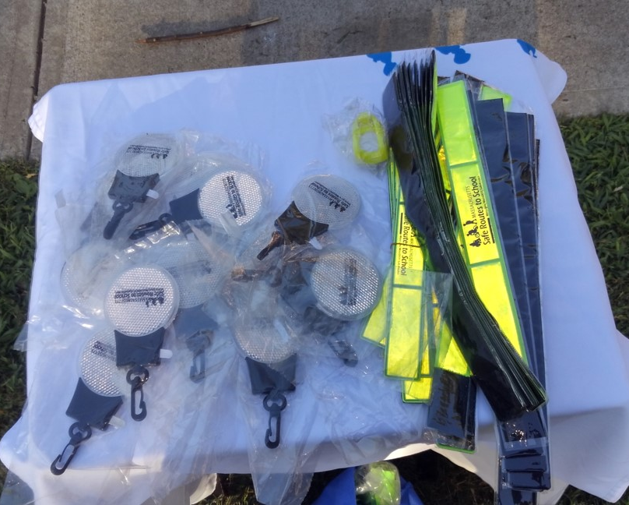
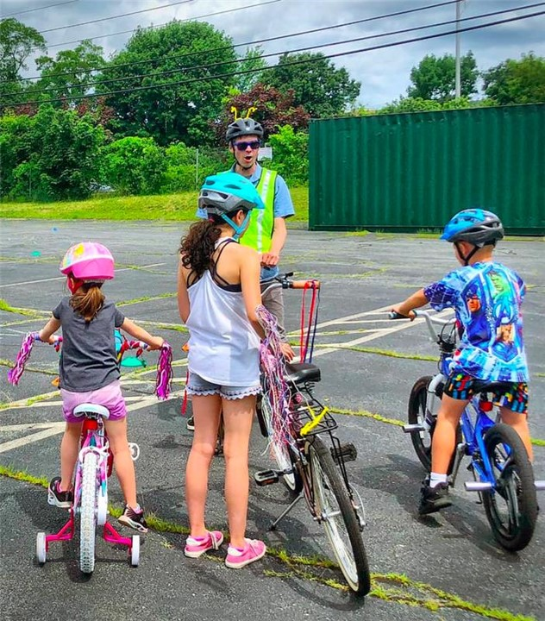
Bright, Reflective, Dress to be Seen
HOME
Notes:
Please clarify with students that they do not need a special wardrobe in order to bike. Anything that they have in their closet to help be seen is better than wearing head-to-toe dark clothing!

Slide 52
If you get a crack in your helmet, what should you do?
ANSWER
600

Slide 53
Replace it!
HOME
Notes:
The helmet has done it’s job, but now that it’s compromised, it might not protect your head a second time.

Slide 54
Who has the right of way on the road? List in order of who gets to go first: Bicycle, Horse, Vehicle, Pedestrian
ANSWER
800

Slide 55
Horse, Pedestrian, Bicycle, Vehicle
HOME

Slide 56
What does ABC stand for during a bike safety check?
ANSWER
1000

Slide 57
A = Air B = Brake C = Chain
HOME
Notes:
Make sure you have air in the tires
Make sure you have working brakes
Make sure your chain is on and clean

Slide 58
Bonus Question

Slide 59
List 3 good reasons why you should walk or bike
ANSWER

Slide 60
1. Health/Exercise 2. Transportation 3. Environmental 4. Economical
DONE
Notes:
This is more open ended but a good discussion question!

Slide 61
THANKS FOR PLAYING!
For more information and safety resources, please visit
https://www.mass.gov/safe-routes-to-school

