Slide 1
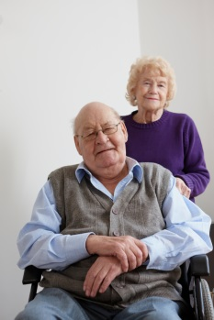
The Supportive Planning and Operations Team (SPOT) Initiative
Stakeholder Presentation
January 10, 2018 – Boston, MA
January 11, 2018 – Springfield, MA
Disclaimer: Participation in this educational offering is not mandatory for regulatory compliance nor do actions or tools and resources discussed in it ensure regulatory compliance.

Slide 2
Today’s Speakers
Eric Sheehan, JD, Bureau Director, Bureau of Health Care Safety & Quality (BHCSQ), Massachusetts Department of Public Health (MDPH), eric.sheehan@state.ma.us
Katherine T. Fillo, PhD, RN-BC, Director of Clinical Quality Improvement, BHCSQ, MDPH, katherine.fillo@state.ma.us
Jen Pettis, MS, RN, WCC, Associate, Abt Associates, Abt SPOT Initiative Project Director, jennifer_pettis@abtassoc.com
Rosanna Bertrand, PhD, Associate, Abt Associates, rosanna_bertrand@abtassoc.com

Slide 3
Presentation Objectives
Upon completion of this presentation, attendees will be able to:
Describe the objectives of the SPOT Initiative.
Review the 2017 SPOT Initiative activities.
Discuss the methods used to assess the status of QAPI in participating nursing homes.
Describe the technical assistance provided to participating nursing homes.
Outline the results of the 2017 SPOT Initiative activities.

Slide 4
Objectives of the SPOT Initiative
The aim of the SPOT Initiative is to foster quality care delivery in skilled nursing facilities across Massachusetts.
SPOT fosters quality care by supporting nursing home teams to improve their quality assurance and performance improvement (QAPI) programs.
Effective QAPI programs can prevent adverse events, promote safety and quality, and reduce risks to residents and caregivers.

Slide 5
QAPI
Quality Assurance (QA)
Specification of standards for quality of service and outcomes.
Performance Improvement (PI)
The continuous study and improvement of processes with the intent to better services or outcomes, and prevent or decrease the likelihood of problems.
A process throughout the organization for assuring that care is maintained at acceptable levels in relation to those standards.
PI aims to improve processes involved in health care delivery and resident quality of life.

Slide 6
Background of the SPOT Initiative
In 2016, the initial year of SPOT, 40 nursing homes (Year 1 nursing homes) participated in the SPOT Initiative.
In March 2017, BHCSQ engaged Abt Associates to implement the second year of the program.
In collaboration with BHCSQ, the Abt Team identified 20 additional nursing homes to participate in SPOT (Year 2 nursing homes).
SPOT is funded from civil monetary penalties (CMP) collected from nursing homes.

Slide 7
2017 SPOT Initiative Activities
Selection of 20 Year 2 nursing homes.
Introductory webinar and QAPI self-assessments for the 40 Year 1 nursing homes.
Unannounced on-site QAPI assessment visits to the 20 Year 2 nursing homes.
Four one-hour training webinars.
On-site technical assistance visits to all participating nursing homes.
Telephone outreach and email support.

Slide 8
SPOT-Participating Facilities (as of May 2017)

Slide 9
Introductory Webinar and QAPI Self-Assessments
Webinar offered to 40 Year 1 participating nursing homes to:
Introduce Abt and the year’s planned activities.
Launch the self-assessment.
Provide education regarding the benefits of self-assessments and how to conduct a self-assessment.
Self-assessments included four domains:
Design and scope.
Governance and leadership.
Feedback, data systems, and monitoring/systematic analysis.
Performance improvement projects (PIPs) and systematic analysis/systemic action.

Slide 10
Unannounced On-Site QAPI Assessment Visits
In April and May 2017, the Abt Team made unannounced site visits to conduct QAPI assessments at the 20 Year 2 nursing homes.
During the site visits, the Team interviewed groups of similar-level staff:
Frontline staff (e.g., certified nursing assistants, dietary aides, activities aides).
Mid-level staff (e.g., unit managers, housekeeping supervisors).
Leadership (e.g., director of nursing, administrator, QAPI coordinator).

Slide 11
Unannounced On-Site QAPI Assessment Visits
During interviews, staff were asked to rate their nursing home team’s performance on various aspects of QAPI development and implementation.
Assessors utilized an assessment tool that closely aligned with the QAPI self-assessment provided to the 40 Year 1 nursing homes.
Assessors held an exit conference with leadership at the conclusion of each site visit.
Leadership received a report of findings and recommendations within 30 days of the visit.

Slide 12
Four One-Hour Training Webinars
Quality Assurance and Performance Improvement – An Overview (June 1, 2017).
Root Cause Analysis (July 20, 2017).
Team Communication (September 28, 2017).
Engaging Residents and Families in Quality Assurance and Performance Improvement (November 16, 2017).
Webinars were recorded and links made available to SPOT participants to view at their convenience.

Slide 13
On-Site Technical Assistance Visits to All Participating Nursing Homes
Nursing home teams selected the PIP area of focus.
The technical assistance visits lasted four hours, on average.
Visits provided nursing home teams with a systemic approach to identifying and improving quality concerns.
Each visit was a collaborative effort between an Abt subject matter expert (SME) and the nursing home team.

Slide 14
On-Site Technical Assistance Visits to All Participating Nursing Homes
With the guidance and recommendations from the SME, nursing homes teams were able to:
Define a key opportunity for improvement.
Generate a problem statement and specific measureable goals.
Identify the root causes of the issue and select potential intervention(s) to address the root causes.
Identify specific process and outcome measures to evaluate the intermediate and final success of the intervention(s).

Slide 15
On-Site Technical Assistance Visits to All Participating Nursing Homes
The approach to the visits was to build in utility and sustainability.
Nursing home teams were able to develop a PIP and generate an actionable end product, while receiving training.

Slide 16
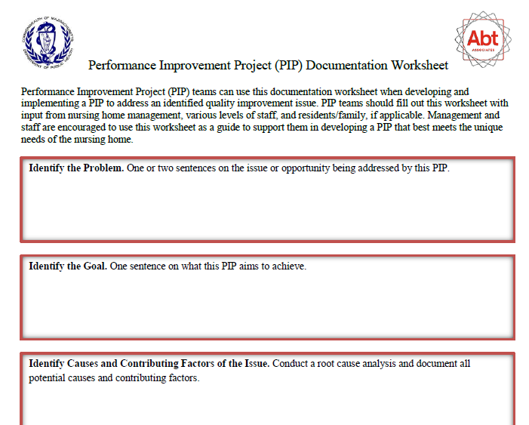
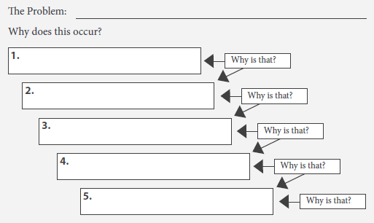
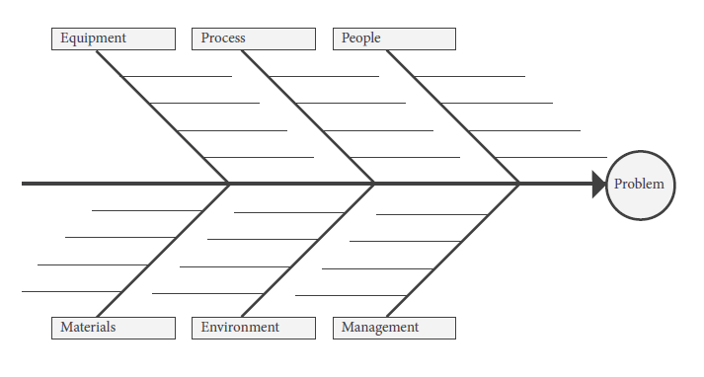
On-Site Technical Assistance Visits to All Participating Nursing Homes

Slide 17
Selected PIP Topics
Number of SPOT-Participating Nursing Homes
Source: Observations made by Abt Associates during technical assistance visits.

Slide 18
PIP Team Composition
Team sizes ranged from two to 22 participants, with an average PIP team having eight participants.
Most included a director of nursing (97%) and/or administrator (80%).
Certified nursing assistants (CNAs) participated in 53% of meetings.
Other members of the care team such as social workers (42%) or activities staff (37%) participated less frequently in the PIP.

Slide 19
PIP Team Composition

Slide 20
Lessons Learned from the Technical Assistance Visits
Convening a multi-disciplinary PIP team is vital to uncovering root causes and developing meaningful, feasible interventions.
Developing a meaningful PIP takes staff time, and time constraints make devoting the necessary time difficult.
Conducting root cause analysis is critical to developing meaningful improvement plans.
Nursing home teams are accustomed to developing outcome measures and less familiar with process measures.
Most nursing home teams do not regularly involve all levels of staff, residents, and families in QAPI.

Slide 21
The Importance of Convening a Multi-disciplinary Team
The inclusions of multi-disciplinary staff in all types of quality improvement efforts was observed on many occasions during our technical assistance visits.
Gathering a variety of perspectives from a multi-disciplinary team (clinical and non-clinical staff) in all scenarios enriches the pool of ideas and critical thinking regarding the root cause and feasibility of solutions.

Slide 22
The Challenge of Time Constraints
Oftentimes, after the staff participated in the guided PIP-development process, they acknowledged the value of problem solving as a group and devoting the time necessary to develop a comprehensive PIP.
However, many would go on to indicate that time constraints and competing priorities prevent them from routinely doing so.

Slide 23
Root Cause Analysis
The most collaborative and fruitful part of the technical assistance process was the exercise of conducting a root cause analysis.
This process was eye opening for many nursing home teams who had not previously considered deep exploration of the underlying causes of a problem prior to generating a solution.
This exercise led to spontaneous problem solving and creativity among staff, and it provided a platform from which staff at all levels from all departments were able to share their perspectives.

Slide 24
Outcome and Process Measures
Nursing home teams could readily understand outcome measures, particularly if they selected topics that can be directly measured such as falls or pressure ulcers.
It was more challenging for them to identify process measures.
Abt subject matter experts stressed the importance of using process measures to determine if staff carry out specific steps in care processes aimed at achieving a particular outcome.

Slide 25
Involving Residents, Families, and Direct Care Staff in QAPI
Not a single resident or family member was invited to any of the SPOT technical assistance visits.
Very few nursing home teams reported having shared their QAPI efforts with residents and families.
Some nursing home teams continue to struggle with embracing an all-inclusive staff approach to improving quality.
Teams that did not include CNAs cited the necessity of CNAs to remain on the floor and the irrelevance of the topic to front-line staff as reasons for failing to include them.

Slide 26
Involving Residents, Families, and Direct Care Staff in QAPI
Regardless of PIP topic, team members generally identified points where the CNA could provide useful insights.
For example, CNAs might not have been involved in a PIP focusing on antibiotic stewardship; however, their perception regarding reporting and addressing subtle changes in resident condition indicating a potential infection is a vital consideration when addressing antibiotic stewardship.

Slide 27
Email Support and Telephone Outreach
Email support is available to all SPOT participants via NursingHomeQI@massmail.state.ma.us.
Members of the Team contacted all participants following in-person visits to:
Provide participants the opportunity to ask questions about QAPI and the SPOT Initiative.
Collect information regarding the nursing home team’s progress toward implementing the PIP and QAPI.

Slide 28
Key Findings from Follow-Up Calls
The Team reached out to all 59 SPOT nursing home teams who participated in a technical assistance visit approximately one to two months after the visit.
The Team was successful in conducting almost 90 percent (n=52) of the potential 59 interviews.
Most teams were continuing to implement the PIP, one had aborted, and one completed their PIP.

Slide 29
Key Findings from Follow-Up Calls
Forty-two percent of the teams reported that they shared their PIP with all staff, residents, and families, through various methods.
Seventeen percent said that they shared the PIP during a resident council meeting while 19 percent said that they created a bulletin board or poster to inform residents and families.
Five nursing home teams included an announcement about the PIPs in their newsletters, and four shared it during a family council meeting.

Slide 30
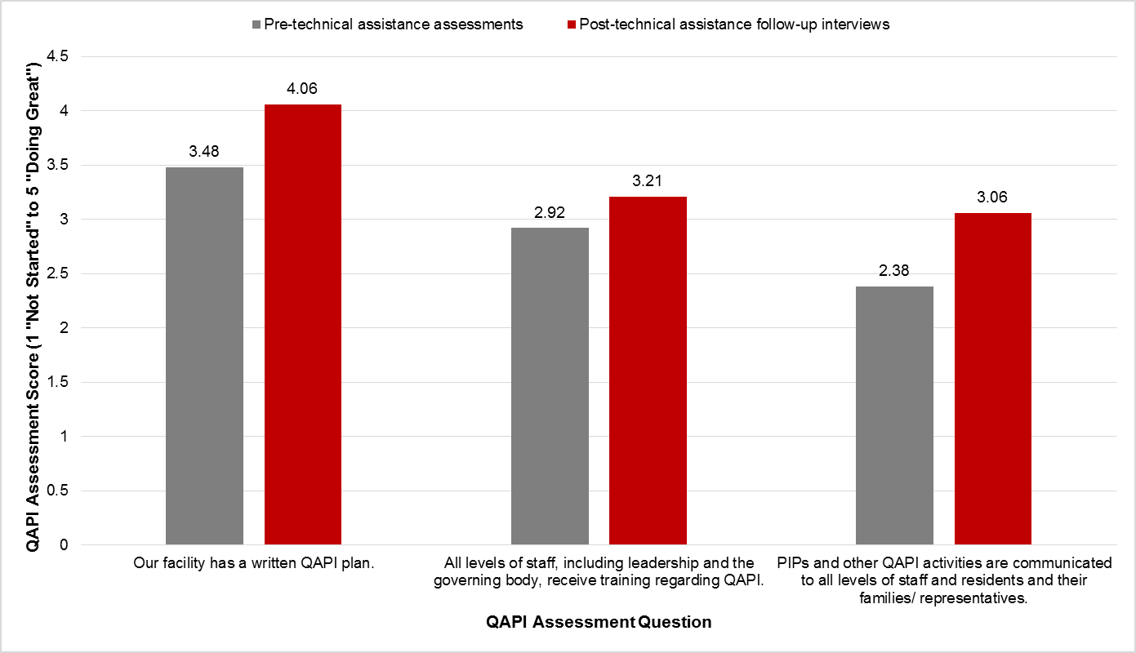
Key Findings from Follow-Up Calls
Source: Abt follow-up telephone interviews with SPOT nursing home teams.

Slide 31
QAPI Bulletin Board Example #1

Slide 32
QAPI Bulletin Board Example #1
Many thanks to Genesis HealthCare® Milford Center for sharing the photos of their bulletin board!

Slide 33
QAPI Bulletin Board Example #2

Slide 34
QAPI Bulletin Board Example #2
Many thanks to Sweetbrook Rehabilitation and Nursing Center for sharing the photos of their bulletin board!

Slide 35
QAPI Newsletter Example #1

Slide 36
QAPI Newsletter Example #1
Many thanks to Catholic Memorial Home for sharing their newsletter!

Slide 37
QAPI Newsletter Example #2

Slide 38
QAPI Newsletter Example #2
Many thanks to Chapin Center for sharing their newsletter!

Slide 39
Questions and Discussion

