Slide 1




Marielle Baldwin, MD
Medical Director, START Clinic
Boston Medical Center

Slide 2
Start: Stimulant treatment and recovery
Street-level addiction treatment for stimulant use disorder.
June 2021:1419 appts scheduled, 672 visits completed. Open Mon-Fri 8-4pm (evening hours available)
Utilizes contingency management through Recovery Rewards Program
  Engagement, Exercise
55% of patients identify as a person of color
35% of patients identify as part of the LGBTQ+ community
Figure 5: An intersectional look at racial identity and sexual orientation of patients who completed intakes, based upon EIM/ESM data. (N=68)

Slide 3
Recovery rewards program
Contingency management is an evidenced-based practice that utilizes positive incentives to promote cessation or reduction of stimulant use and engagement in treatment.
START uses voucher-based and fish-bowl contingency management methods with patients.

Slide 4
exercise
START patients are encouraged to exercise as part of exercise-supported recovery.
Recommended to attend gym, collaboration with peer-run sober gym.
Engaged Physical therapist created exercise curriculum varying intensity

Slide 5
Engagement
Intakes
Engaged
Figure 1: Intakes refers to patients who have completed one appointment, regardless of intake paperwork submitted. Engaged refers to patients that completed intake, a follow-up appointment, and enrolled. Referrals refers to any patient referred to the program by any provider.

Slide 6
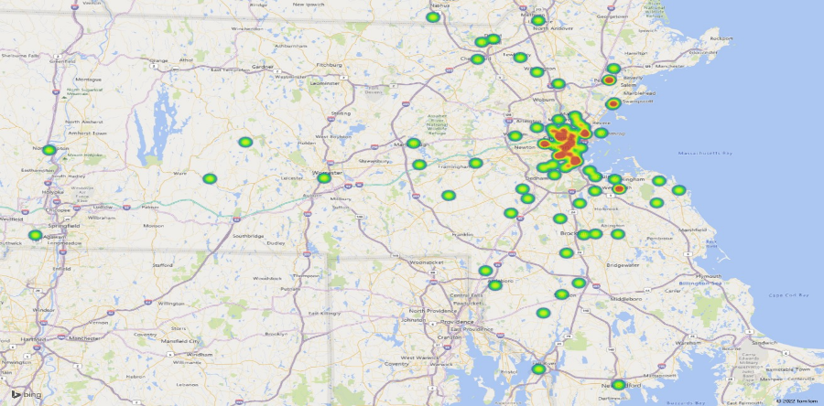
Where do our patients come from?
Methuen
Northampton
Worcester
Springfield
New Bedford
Figure 2: This heat map represents the zip codes of all patients referred to the START clinic, as indicated within the patient’s chart. (N=233)

Slide 7
Patient Demographics (Cont.)
Figure 6: The ages of patients who agreed to begin services at START as indicated on the EIM/ESM assessment. (N=68)
Figure 7: The racial demographics of patients who agreed to begin services with START as indicated on the EIM/ESM assessment. (N=68)

Slide 8
Patient Demographics (Cont.)
Figure 8: The ethnic demographics of patients who agreed to begin services with START as indicated on the EIM/ESM assessment (N=68).
Figure 9: The multi-racial demographics of patients who agreed to begin services with START as indicated on the EIM/ESM assessment (N=68).

Slide 9
Substance UsE
Alcohol
Other
Alcohol
Opiates
Cocaine
Methamphetamine
Methamphetamine
Figure 3: Primary substance use of patients who have completed intake at START as indicated on the EIM/ESM assessment (N=68).
Figure 4: Secondary substance use of patients who have completed intake at START as indicated on the EIM/ESM assessment (N=68).

Slide 10
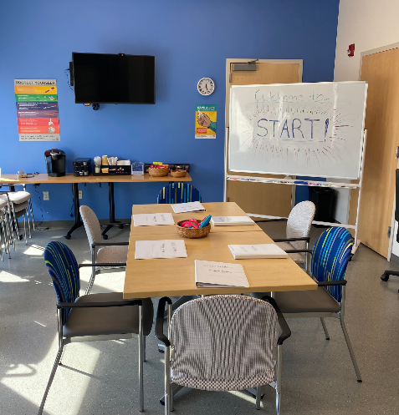
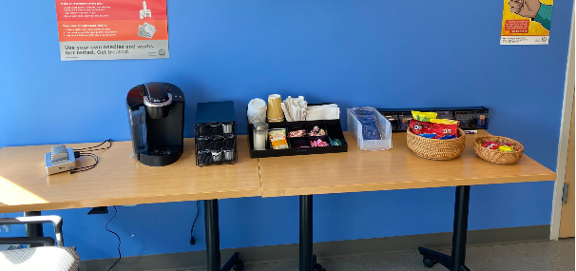
Tour of start clinic group space
Hybrid group setup
Safe sex supplies
Coffee + tea
Naloxone pouches
Snacks
Phone charging station
Not pictured here includes….
  In-clinic naloxone
  Hygiene kits
  Harm reduction kits

Slide 11
Self Reported Overdose
32% of patients have reported at least one opioid-involved overdose
Not including stimulant overdoses
Patients reported an opioid-involved overdose, 33% reported overdosing four or more times
Figure 10: The breakdown of lifetime opioid-involved overdoses of patients who reported at least one overdose during their intake EIM/ESM assessment (N=21).

Slide 12
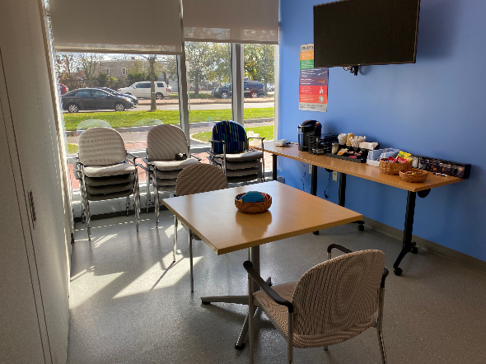
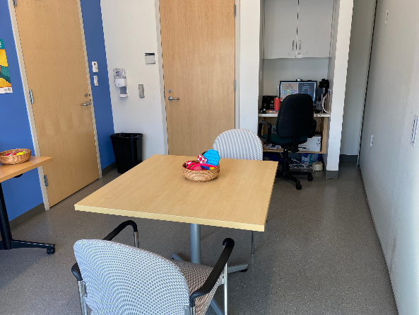
Tour of START clinic individual visit space
Moveable wall to create two rooms
Fidget toys

Slide 13
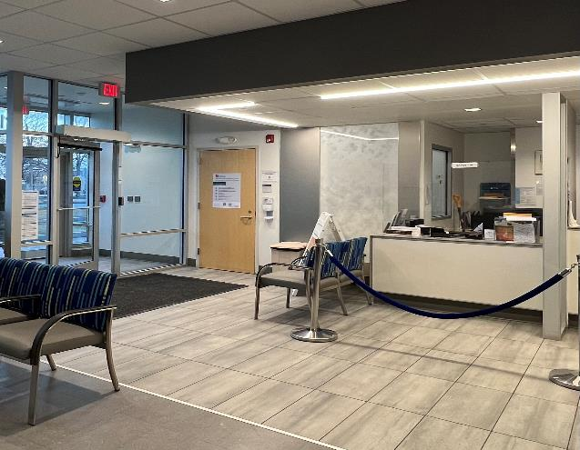
Cool down space: entrance Low barrier

Slide 14
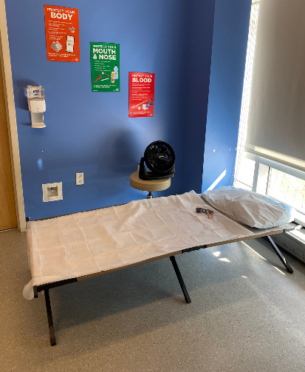
Cool-down space
Symptoms of overamping are promptly brought to our “cool-down” space, patients are provided with supplies (below) to reduce symptoms:
  Sunglasses and ear plugs to reduce external stimuli
  Electrolyte water and chewing gum to reduce dehydration
  A cot with blankets and pillows to address symptoms of sleep deprivation
Cool-down space is typically used twice a week
Goal: Improve patient outcomes and engagement in health care system. In addition, decrease ED visits, admissions, and costs.

Slide 15
Hospitalizations and ED utilization
Significant time spent in ED or hospital due to untreated medical conditions and stimulant-induced symptoms
28% of referred patients no assigned PCP
Roughly 50% with PCPs are not engaged
76% at least one visit to the ED in the last year prior to intake.
Figure 11: ED visits of patients in the past year prior to intake. These values were patient-reported during the EIM/ESM intake assessment and verified through chart review. (N=59)

Slide 16
Medical needs of patients
Figure 13: Nights patients were hospitalized in the past year prior to intake. These values were patient-reported during the EIM/ESM intake assessment and verified through chart review. (N=58)
Figure 12: Medical comorbidities of patients referred to START, as documented in the Boston Medical Center EMR. (N=233)

Slide 17
Success stories
“START is a really good mix of scientific medicine with an interpersonal almost spiritual side. A lot of programs I have gone to haven’t been educated around stimulants, which are very different from alcohol or heroin. More importantly, you don’t shut doors for folks who use stimulants but rather open them. I’ve seen a lot of times on the news that other drugs are mentioned freely, but as soon as stimulants are mentioned people don’t want to help you. For me, it’s felt good because the providers here are educated on stimulants and my identities – LGBTQ+, adopted, POC, HIV-positive, etc. This is the first place where all of these parts of me were understood and part of my treatment plan. I also love the diverse staff that includes LGBTQ+ and POC. Counselors at [other program] didn’t understand my methamphetamine use or its history within the LGBTQ+ community, but you do. START gets it and it gets me.”
30 y/o, Hispanic and Indigenous, Malden, MA

Slide 18
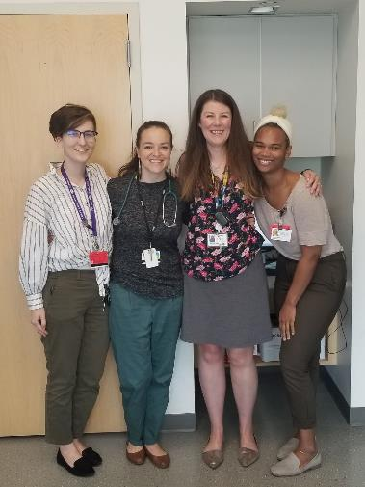
Questions?
Marielle.Baldwin@bmc.org
Faith.Puleikis@BMC.org

Slide 19
START staff
Marielle Baldwin, MD, MPH – Medical Director
Meghan Brett, LICSW – Behavioral Health Clinician
Stephanie Taormina, MD - Psychiatrist
Ann Claude, RN – Lead Addiction Nurse
Faith Puleikis – Program Coordinator
Rachel Xue – Data Coordinator
Justin Alves, RN, MSN, ACRN, CARN, CNE – Expert Consultant, Educator
Colleen LaBelle MSN, RN-BC, CARN Director OBAT, TTA

Slide 20
Budget and Staff Breakdown for Pilot at Academic Urban hospital site
Category | Description
Personnel | Medical Director: provider with primary care and addiction expertise Addiction consultant expert Program coordinator Admin support RN Addiction nurses 1.5 Case management: outreach, concrete services support LICSW: groups and individual Psychiatrist with psychosis training Data coordinator
Program Supplies | Includes contingency management, snacks, clothes, hygiene supplies, raffles, transportation
Currently funding = $495,000 serving 64 individuals; amendment in process to increase enrollments due to demand
*includes admin, reporting requirements, start up and rapid expansion 5-10 intakes a week TOTAL $495,000. Cost variable based on demand, location, other requirements.

Slide 21



Bsas funded Samhsa State opioid response

