Slide 1


State Ethics Commission
Conflict of Interest Law Seminar:
Massachusetts
Home Care Consumer Directed Care (CDC) Workforce Council
2026

Slide 2
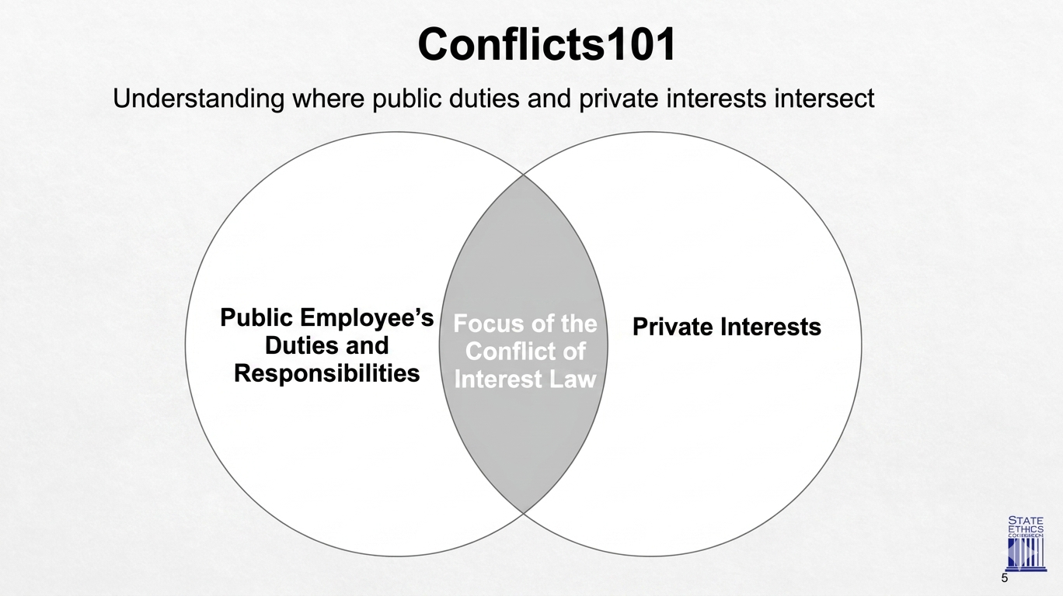


Conflicts 101
To foster integrity in public service in state, county and local government, to promote the public's trust and confidence in that service, and to prevent conflicts between private interests and public duties. We strive to accomplish this mission by conducting ongoing educational programs, providing clear and timely advice, and fairly and impartially interpreting and enforcing the conflict of interest and financial disclosure laws.

Slide 3
The State Ethics Commission’s Attorney-of-the-Day
Free, Confidential, Expert Advice On How The Conflict Of Interest Law Applies
To Your Specific Situation.
(617) 371-9500
State Ethics Commission
One Ashburton Place, Room 619
Boston, MA 02108
www.mass.gov/ethics
Free, confidential advice is available ONLY before you act

Slide 4
The State Ethics Commission is an independent state agency with an important mission:
To foster integrity in public service in state, county and local government, to promote the public's trust and confidence in that service, and to prevent conflicts between private interests and public duties.
Public Education
Legal Advice
Enforcement
The Commission's Public Education Division informs public officials and the community on ethics laws and best practices.
The Commission provides free, confidential, and binding legal advice.
The Commission has the authority to investigate and civilly enforce the conflict of interest and financial disclosure laws.
5 Member Non-Partisan Commission: administers & civilly enforces 268A

Slide 5
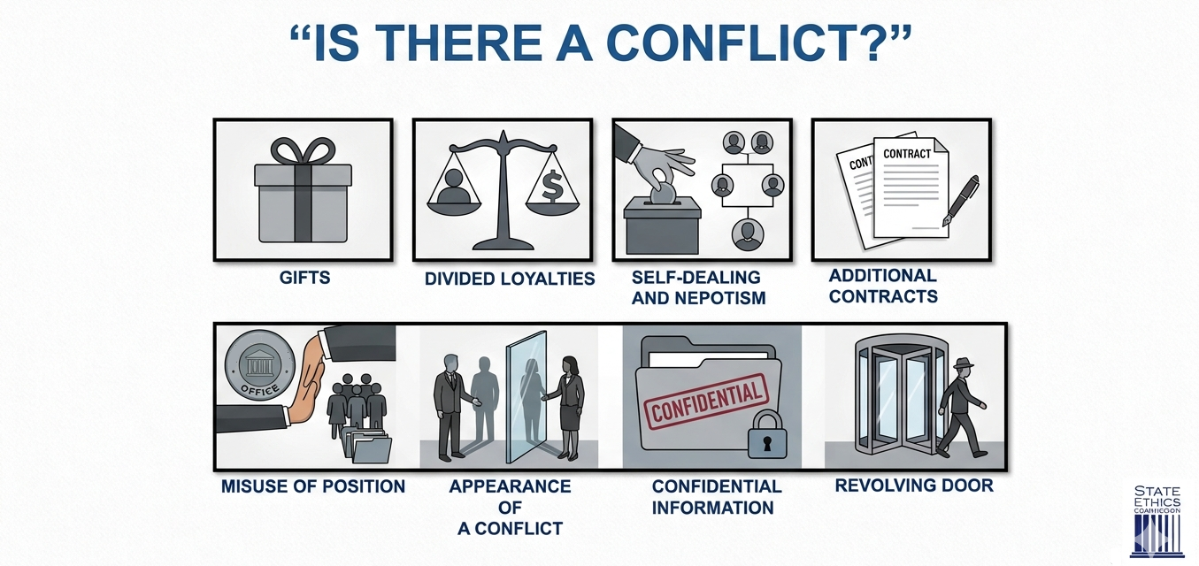



RED FLAG SITUATIONS
“IS THERE A CONFLICT?”
GIFTS
DIVIDED LOYALTIES
SELF-DEALING
AND NEPOTISM
ADDITIONAL CONTRACTS
MISUSE OF POSITION
APPEARANCE OF
A CONFLICT
CONFIDENTIAL INFORMATION
REVOLVING DOOR

Slide 6
Why It Matters
You are subject to Mass. G.L. 268A the Conflict of Interest Law.
The law fosters integrity in public service in government.
The Commission may investigate, adjudicate, and impose civil penalties.
Violations can result in:
  Public Education Letters.
  Adjudicatory proceedings resulting in civil penalties of up to $10,000 per violation, bribery up to $25,000 per violation.
  Restitution or forfeiture of any financial gain.
  Referral for Criminal prosecution.

Slide 7
Self-Dealing & Nepotism
Participation & Financial Interests
The law prohibits participating in financial matters involving or affecting:
    Immediate family
    Business partner(s)
    Business in which you serve as director, officer, trustee, partner, or employee
    Potential future employer
    You
    Disclosure required and determination by appointing authority prior to participating.
    Elected officials must abstain.
    False claims: Presenting a false claim to your employer for a payment or benefit, or causing someone else to do so is prohibited.
    Nepotism can create an appearance of undue influence and favoritism.
See Advisory 86-02: Nepotism
See M.G.L. c. 268A , §§ 6, 13, 19
On The Job

Slide 8
Unwarranted Privileges
The Code of Conduct Section
Do not:
Use your official position to secure an unwarranted privilege of substantial value ($50 or more) for yourself or others.
Use your position to give someone an advantage that someone else in the same situation would not get.
Engage in business or financial transactions with people or entities you deal with officially. There can be exceptions.
Disclose confidential information you learned in the course of your public employment to anyone not authorized to receive it or use such information for your own private purposes.
Ask your subordinates to work for you in a private capacity or to contribute to any private interest or organization.
Seek or receive compensation for hours not actually worked.
Do apply usual standards, act impartially and objectively.
See Advisory 05-01 Standards of Conduct
On The Job

Slide 9






























WOULD A REASONABLE PERSON,
KNOWING THE FACTS, SUSPECT FAVORITISM?
GIFTS
FAMILY CONNECTIONS
Is that “Thank You” really just a “Thank You”?
Did your cousin get the contract on merit or relation?
REVOLVING DOOR
OUTSIDE JOB
You just left government and are working on the same project?
Are you *really* working two jobs that don’t overlap?
THE “REASONABLE PERSON” TEST

Slide 10
Appearance of Conflict
Code of Conduct §23(b)(3)
Do not act in a manner that would cause a reasonable person who knows the relevant facts to think you would be improperly influenced by or would unduly favor or disfavor anyone when you take governmental action, even if no actual wrongdoing occurs.
If a relationship or affiliation could be perceived as a conflict e.g., close friend,
non-immediate family, position where you serve as director, officer, trustee, partner, or employee:
Do not participate, abstain if you feel that you cannot be fair and objective; OR
• Written disclosure required with your appointing authority before taking government action.
• Elected officials must file this disclosure in a public manner with the city or town clerk.
• Participate only if proper written disclosure is made and you can act impartially.
See Advisory 05-01 Standards of Conduct
On The Job

Slide 11
GIFT RESTRICTION RULES
Do not solicit or receive anything of "substantial value"
Gifts and Gratuities- the law prohibits gifts or items of value given to public employees that are valued at $50 or more and given:
  For or because of some official act performed or to be performed (applies to both the giver and public employee), or
  For or because of official position (applies to the public employee only).
Gifts valued at less than $50 are not prohibited, but if the gift creates the appearance that your public service could be improperly influenced, filing a written disclosure with your appointing authority may be required. Some agencies have a more restrictive policy.
See Advisory 19-1: Gifts and Gratuities
On The Job

Slide 12
GIFTS THAT MAY BE PROHIBITED
Partial List:
Lottery Tickets.
Gifts offered through sales promotions.
Gifts from subordinates.
Employee “discounts” not offered broadly.
Elected state and county officials, along with appointed state and county employees in major policymaking positions, are prohibited from soliciting or accepting gifts of any kind from registered lobbyists. Lobbyists are also prohibited from offering such gifts.
Event Tickets (See Advisory 04-01).
Meals.
Free travel or Expense Reimbursements - unless a legitimate government interest is served, prior approval from appointing authority.
Gift Certificates.
Floral Arrangements/Fruit Baskets (unsolicited perishable items – unless shared with office).
See Disclosure forms on SEC website
See Advisory 19-1: Gifts and Gratuities
On The Job

Slide 13
Public Resources
You may not use your government title (unless you are elected), or time, or government recourses for a personal or political purpose. Section 23(b)(2)(ii) restricts the extent to which public employees may engage in political activity in their public roles or use public resources.
Public resources may not be used for campaign or political purposes.
Appointed employees may not use their title or worktime to support or oppose candidates or ballot questions. Elected officials may use their title, but without use of public resources.
You may engage in political activity on your own time (breaks, vacation, after hours) and with your own resources.
No political activity on paid public time.
Do not use public space, equipment, email, worktime, department seal, copy machines etc.
Keep public resources and political activity separate.
ELECTED
POLICY-MAKING
APPOINTED
See Advisory 11-1: Public Employee Political Activity
On The Job & After Hours

Slide 14
Divided Loyalties
Prevent "divided loyalties" caused by serving parties with conflicting interests e.g. taking a second paid job that conflicts with the duties of your municipal job.
Prohibited or Restricted Activities:
Taking private work and acting as agent or attorney before or involving any agency of your level of government even if not paid for your actions.
Paid work involving people or entities you deal with officially (divided loyalties).
Doing legal work for someone else in relation to official matters.
Representing others: You cannot appear or advocate for a private party before your own board or department or at ANY agency in your level of government (unless exempted e.g. as a ‘special employee’).
Applies regardless of whether you abstain from official duties or if the private and public interests align in a matter in which the government has a direct and substantial interest.
See §§ 4, 11 and 17
See Educational Materials Related to Divided Loyalties Restrictions
On The Job & After Hours

Slide 15
Divided Loyalties
You may:
Serve in elected or unpaid roles, if allowed by statute or regulatory exemption (930 CMR 6.00).
Hold a paid position in another level of government, with some restrictions.
Earn outside income from private sector work unrelated to your public duties or agency.
The law applies less restrictively to public employees who are "special" employees. A special employee may receive compensation from, or act as agent or attorney for, someone other than the state/county/municipality in connection with a particular matter in which the level of government they serve has a direct and substantial interest so long as:
  She has not participated in the matter at any time as a public employee,
  The matter is not, and in the last year has not been, a subject of her official responsibility, and
  The matter is not pending in the agency in which she is serving, if she is serving for more than 60 days in the last 365 days.
See Advisory 14-1: Public Employees’ Private Business Relationships & Other Private Dealings
On The Job & After Hours

Slide 16
Financial Interest in Government Contracts
Examples of Exemptions
Holding any number of elected or unpaid positions.
Exemptions for certain positions – examples:
  State employees teaching at state colleges.
  Municipal employees serving as call firefighters.
Examples of regulatory exemptions at 930 CMR 6.00 Exemptions Unrelated To Gifts:
Adding an uncompensated position.
For state employees:
Tax preparation for Department of Revenue tax filers.
National Guard service.
Service for the Committee for Public Counsel Services.
Personal services for social services clients.
On The Job & After Hours

Slide 17
Post-Employment Restrictions
The “Revolving Door” Rules
Prohibits former employees from using unfair advantages by improperly using friendships & associations formed, or confidential information obtained, while serving the government.
One-year cooling off period on appearing before any agency at your former level of government on behalf of someone else on matters under your official responsibility during your final 2 years.
Even if you did not actually participate in it, you may not appear personally before any agency on behalf of a private party in connection with that matter for one year.
Forever ban prohibits you from forever acting as agent or receiving compensation from anyone other than your former level of government on matters you personally participated in. Ensures fairness and prevents misuse of insider knowledge.
If you become a partner after leaving public work, your partners will also be restricted for one year.
Your confidentiality obligations continue after public service ends.
See Advisory 15-1 Seeking a Job & After Public Employment
After You Leave The Job

Slide 18
Disclosure Basics — How and When to File
Transparency and Protection
How:
Put it in writing — use the Commission’s form. Submit to your appointing authority before acting. Be specific, describe all relevant facts, the relationship, and how you plan to handle it.
When:
File a disclosure when an exemption in the law or regulation requires it. Some disclosures require appointing authority approval before acting, some do not.
Appointed employees file with appointing authority. Elected municipal officials file with Town/City Clerk.
Elected state and county officials file with agency and/or Ethics Commission.
See File or view disclosures
The disclosure becomes a public record.

Slide 19
Top Ten ‘Rules’ Public Employees Need to Know
10. Whether elected or appointed, paid or unpaid, part-time or full-time, you are a public employee subject to the conflict of interest law — even private sector consultants may be considered public employees. 8. Don’t accept meals, tickets or gifts from anyone to thank or reward you for any official action you have taken or may take or to influence you in any official action. 6. Don’t use your official position to get special benefits for yourself or anyone else that are not available to the general public. | 9. Don’t accept bribes (don’t sell or trade your official actions). 7. Be loyal to the government: Don’t accept money from or represent anyone other than the state for work involving the state. Don’t accept paid, private work that is incompatible with your public duties. Don’t disclose or use confidential information you obtained as a public employee. 5. Don’t create appearances of conflicts of interest: Publicly disclose significant relationships or circumstances that might cause a reasonable person to think that you might be unfair or biased in your official actions.

Slide 20
Top Ten ‘Rules’ Public Employees Need to Know Cont.
4. Don’t act on any matter affecting your own financial interests or those of family members, partners or organizations with which you have a private relationship. 2. After you leave state service: Don’t accept money from or represent anyone other than the state if the private work involves a matter that you participated in or worked on as a state employee. Strictly observe the one-year “cooling off” rule: Don’t represent or appear before state agencies for a private party on matters that were under your “official responsibility” when you were a state employee. | 3. Don’t double dip. Don’t accept an additional (even unpaid) state position before seeking legal advice. AND THE NUMBER ONE RULE IS … GET ADVICE!

Slide 21

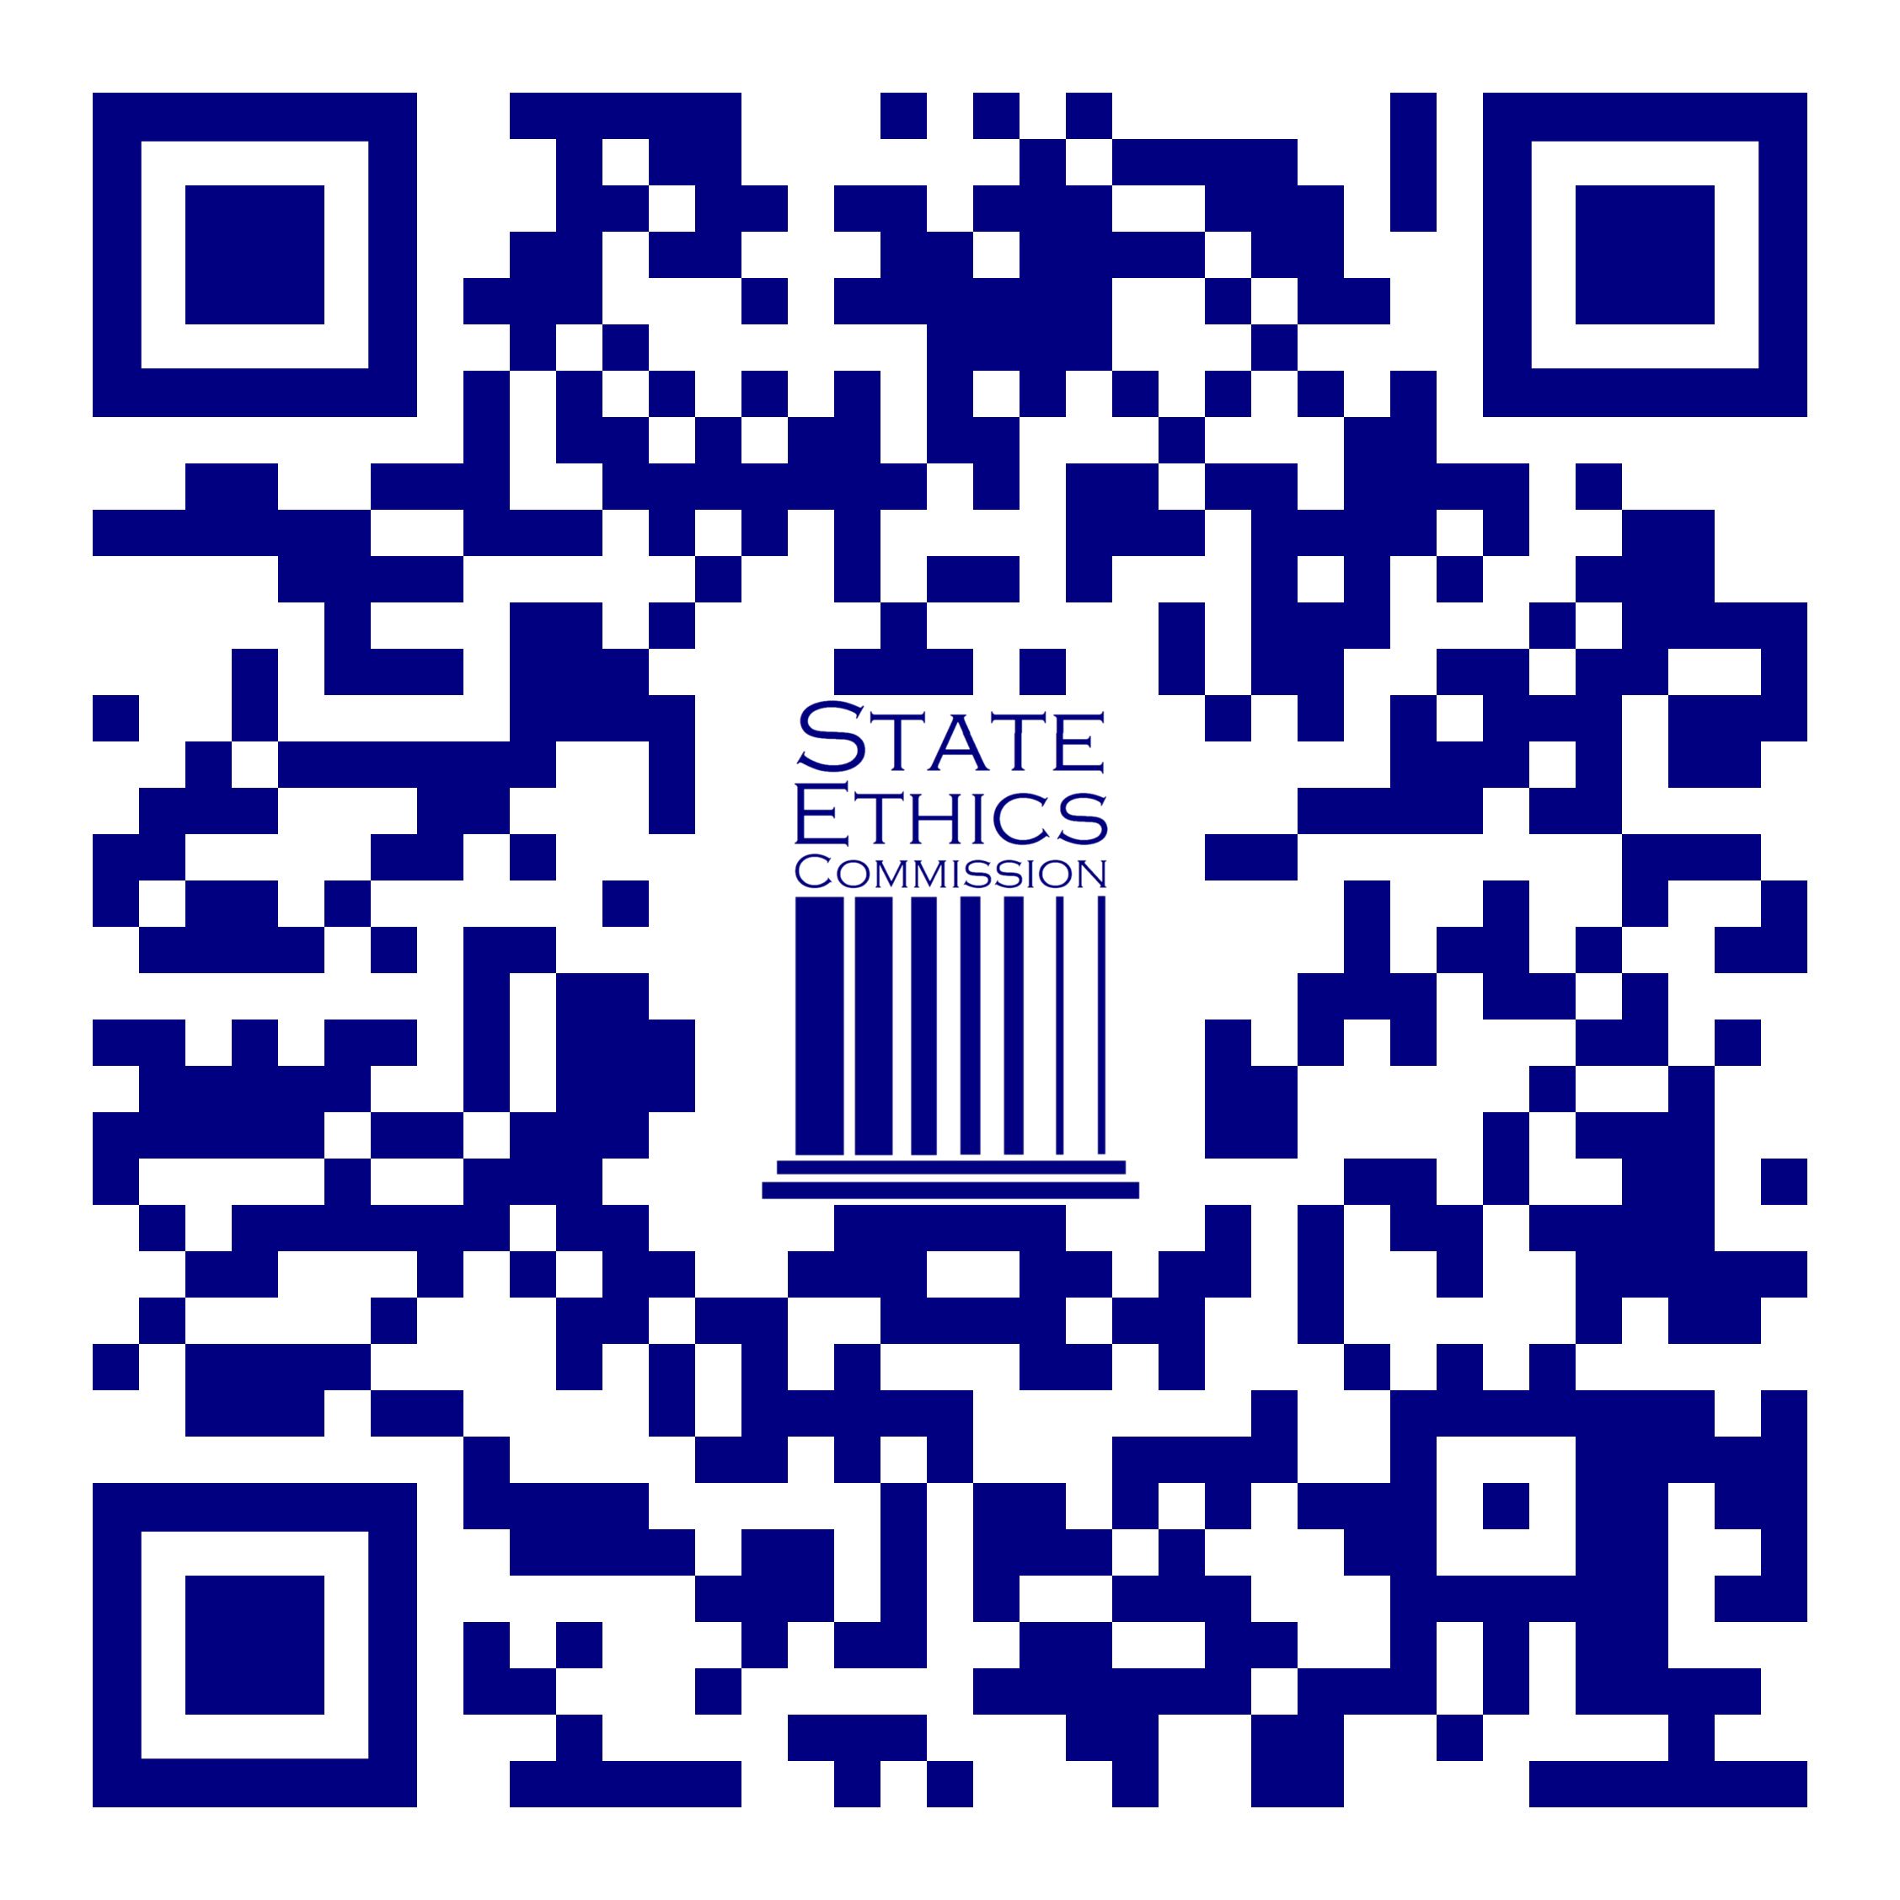

Thank You
Don Siriani
Public Education and Communications Division Massachusetts State Ethics Commission
Don.Siriani@mass.gov
617-371-9500
www.mass.gov/ethics
Survey

