Slide 1
Draft Pre-Kindergarten Science, Technology, and Engineering Standards
Presentation to the Board of Early Education and Care
February 9, 2016

Slide 2
Purpose of PreK STE Standards
In an effort to emphasize the importance of science, technology, and engineering in early education curricula, EEC drafted Science, Technology, and Engineering (STE) Learning Standards for Pre-Kindergarten.
The Pre-Kindergarten STE Standards:
  Connect with the Curriculum Framework for English Language Arts (ELA) and Literacy, the Curriculum Framework for Mathematics, and the Head Start Child Development and Early Learning Framework; and
  Align with existing guidelines, including the Early Learning Guidelines for Infants and Toddlers; the Guidelines for Preschool Learning Experiences; and the Kindergarten Learning Experiences.

Slide 3
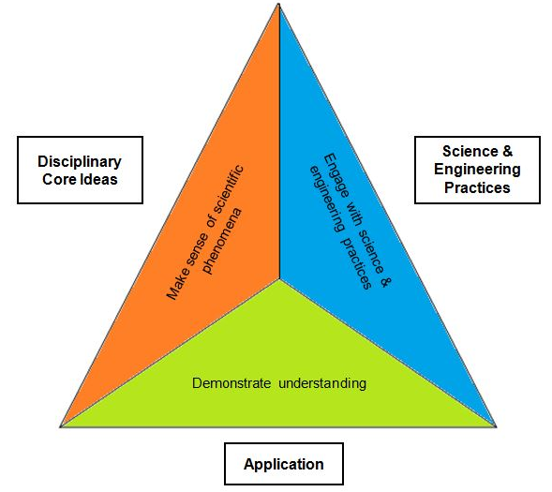
PreK STE Standards Framework
The Pre-Kindergarten STE Standards align with the revised K-12 STE Standards to demonstrate progression of learning
The K-12 STE Standards are based in the NRC framework A Framework for K-12 Science Education (NRC, 2011), and incorporate two of the domains:
  Practices of science and engineering
  Disciplinary core ideas
*
* National Research Council (NRC). (2012). A Framework for K-12 science education: Practices, crosscutting concepts, and core ideas. Washington, DC: The National Academies Press.
Notes:
.

Slide 4
Development of Pre-Kindergarten STE Standards
August 2012 to June 2013: EEC worked with Wheelock College to develop the PreK STE Standards
  EEC offered the draft Pre-Kindergarten STE Standards as optional guidelines to the field.
May 12, 2015: EEC Board voted to solicit public comment on the proposed Pre-Kindergarten STE Standards.
October 21 to November 20, 2015: EEC and ESE jointly distributed a survey to submit for public comment on the proposed Pre-Kindergarten STE Standards along with ESE’s Kindergarten-12 revised STE Standards.
  The Departments received 69 responses on the Pre-Kindergarten Standards and based on the responses individual comments were provided on specific standards that improved clarity.
February 9, 2015: Present proposed final PreK STE Standards to Board of Early Education and Care for vote.

Slide 5
Engagement with Field on Draft PreK STE Standards
  Created a crosswalk with the Guidelines for Preschool Learning Experiences.
  Held three information sessions and two webinars on the draft PreK STE Standards
  Highlighted the PreK STE Standards at STEM Summit
  Held train-the-trainer sessions with EEC’s Educator and Provider Support networks.
  Hold professional learning opportunities through the Educator and Provider Support Grantees in each region on understanding the proposed STE standards.

Slide 6
Update: Engagement with Field on Draft PreK STE Standards
  Participated in the Science Ambassador program on January 25, 2016 created by the Department of Elementary and Secondary Education. The Educator and Provider Support Grantees identified six early childhood educators who do training on STE practices to participate in this opportunity.
  Funded WGBH through Race to the Top to develop professional development on various content areas and there are resources for educators and families on STE practices and activities. http://www.resourcesforearlylearning.org/fm/about/
  EEC continued holding professional learning opportunities through the Educator and Provider Support Grantees in each region on understanding the proposed STE standards.

Slide 7
Next Steps
  Board of Early Education and Care vote to adopt the proposed Pre-Kindergarten STE Standards
  Send final Pre-Kindergarten STE Standards to Joint Committee on Education; Senate Committee on Ways and Means and the House Committee on Ways and Means at least 60 days before adoption.
  Once the Pre-Kindergarten STE Standards are adopted:
    Continue to support the early childhood field to understand the Standards and their implications for curriculum development.
    Continue to support families in their understanding of the Standards.

Slide 8

Pre-K Science, Technology, and Engineering Standards
  Draft PreK STE Standards are online at:
  http://www.mass.gov/edu/docs/eec/2013/20131009-pk-sci-tech-standards.pdf
Discussion and Questions

