Slide 1
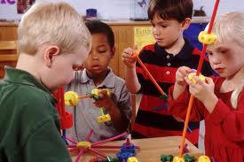
Department of Early Education and Care Board Meeting September 10, 2013
STEM Innovative Curriculum in Preschool Programs
Competitive Grant Initiative

Slide 2
Science,Technology,Engineering&Mathermatics
Is one of Governor Patrick’s major state initiatives;
Is a national priority for the United States and;
Is an economic growth and future workforce priority.
For every preschooler in Massachusetts STEM Education matters-
An early introduction to a purposeful STEM education & planned skill development can help to decide a child’s lifelong passion and career pathway for future success.

Slide 3
Background Information
According to the U.S. Commerce Department, STEM occupations are projected to grow by 17 percent, compared to 9.8 percent growth for other occupations, throughout the next decade. In addition, STEM workers earn, on average, 26 percent more and are less likely to experience joblessness. 1
In the Massachusetts State STEM Plan 2.0- Goal 1 of the plan focuses on increasing student interest in STEM – The work we do at EEC uniquely positions us to be able to be very effective at that with this initiative and in alignment with other projects we are currently working on.
Senate President Therese Murray said the following: “It is important that we emphasize STEM education from the early beginnings, STEM careers drive our nation’s innovation and competitiveness and a solid foundation in math and science programs will give our children a strong start in life. Our future relies on new ideas, new companies and new industries and, by prioritizing these innovations in our curriculums, Massachusetts will continue to lead the nation in overall achievement, and the world in math and science.”
1.From press release issued by Senate President Murray’s Office on May 24,2013

Slide 4
STEM and EEC
EEC continues to work hard to lead the field in early STEM education resources, we continue to bring more tools to early STEM education;
Increasing STEM professional development opportunities, and trainings across the state;
Continued presence in the Governor’s STEM Council and continued participation in the State’s STEM Summit;
New STE Standards in final development will be discussed at the October EEC Board Meeting; and
More planned resources for children, educators and parents through EEC’s Race To the Top Initiative.

Slide 5
Preschool STEM Curriculum
In this year’s state budget there is a line item for EEC to post a competitive bid this fall for
$250K
We will seek grant proposals from formal and informal child care programs to develop new innovative preschool STEM curricula to be used to support children and educators for learning STEM concepts and enhance skill development and introduce our youngest students to a dynamic STEM education.
All grants proposals will have to provide a dollar for dollar match for each dollar dispersed to them.

Slide 6
Who can apply and/or be a partner for this grant opportunity
EEC licensed program in good standing or license exempt;
Minimum QRIS standing at Self Assessed Level 2;
Must have EEC subsidy contract and or voucher children;
Organizations applying will be able to partner with other community based organizations to allow for creative, new partnerships and innovative ideas;
Informal organizations applying must be a 501 c (3) recognized non-profits, a recognized public agency or a Library, Museum, Readiness Center, Family Child Care System, local STEM-net, IHE, CFCE, EPS Grantee, local town or city government, local public pre-school program.

Slide 7
Goals of Project
EEC seeks to award grants to both formal and informal early education and care programs, to Innovative Curriculum on Science, Technology, Engineering, and Mathematics (STEM), for use with preschool children from 2 years and 9 months until they are kindergarten eligible.
The Innovative STEM Curriculum will align with EEC’s Preschool (STE) and Massachusetts Curriculum Frameworks for Mathematics Standards and will become the foundations for introducing children to STEM.
For educators that work with preschool children and their families, these tools will be used to enhance the learning in their classroom.

Slide 8
Project Objectives
The STEM Curriculum must:
Be applicable to all types of settings and educators that care for children ages 2 years and 9 months until they reach kindergarten age in EEC’s mixed delivery system;
Reflect current research and best practices for learning experiences for preschool children by linking research to daily classroom practice;
Provide enriching examples of curriculum that integrate STEM concepts into memorable preschool activities;
Be content rich, and easily accessible to all EEC educators and adult learners;
Be available in multiple languages; and
Be shared and able to be replicated by other programs.

Slide 9
Project Objectives
The innovative STEM curriculum must:
Align with the following EEC regulations, standards and guidelines:
Guidelines for Preschool Learning Experiences for Three and Four Year Olds;
Quality Rating and Improvement System (QRIS) standards;
Core Competencies for Early Education and Care Educators;
Align with the Massachusetts Curriculum Frameworks (“Common Core”) established by EEC and ESE for English Language Arts and Math for preschool and Kindergarten;
Science and Technology/Engineering Standards; and
Massachusetts’ Plan for Excellence in STEM Education.

Slide 10
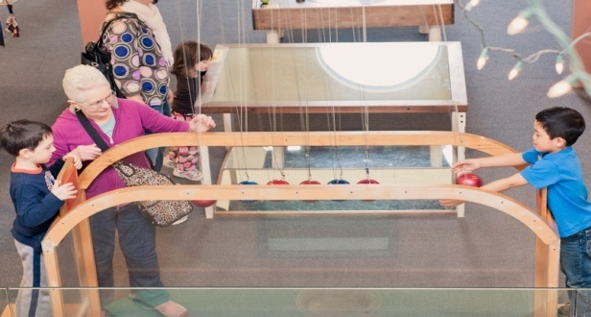
Process Timeline
Post request for grant proposals: end of September 2013;
Deadline for response: mid- October 2013;
Award grants: by mid-November 2013; and
Grants will run until August 31st 2014.

Slide 11
Wrap-up
Questions and or comments;
Thank you for your time and attention.

