Slide 1
Strengthening Resident and Family Councils Initiative December 21, 2017 Stakeholder Presentation

Slide 2
Project Team
Mass. Coalition for the Prevention of Medical Errors
Paula Griswold, MS; Amelia DeFelice, MS
Susanne Salem-Schatz, ScD Collaborative Director
Maureen Connor, RN, MPH, Person and Family-Centered Care Consultant
Sharon Benjamin, PhD Organizational Behavior Consultant
Mass Senior Care: Carolyn Blanks, Helen Magliozzi, RN
Experience
QI Collaboratives with nursing homes, other settings
Patient/Family Engagement
Adaptive learning and change

Slide 3
Our Guests Today
Samantha Bennett, ADC, CDP, Activity Director at Wingate at Norton
Shannon Looney, Activities Director at Woodbriar Health Center

Slide 4
Goals for Today
Overview of the process and findings of the Initiative.
Review of innovative strategies to increase engagement of Resident and Family Councils.
Guidance on the use of tools to support the engagement of residents and families in nursing home facilities.

Slide 5
Initiative Aim
Increase the engagement of residents and families in Massachusetts nursing homes to:
create an environment that is responsive to resident needs and preferences; and
build a sustainable partnership between residents, families, staff, and facility leadership.
Improve the quality of residential life and person-centered care.

Slide 6
Plan of Action
Identify Best Practices
Learning Collaborative: Spread & Support
Dual Focus on Basics and Increased Partnership
Data Gathering: Resource Scan, Interviews & Site Visits

Slide 7
Supporting Learning & Improvement through Content and Action
51 total participating facilities at the start
45 total participating facilities at the completion of the Initiative
2 Workshops
4 Webinars
4 Participatory Activities
Monthly Learning & Sharing Calls
Limited 1:1 Coaching
35 Site Visits

Slide 8
Early Activities
Recruited 51 skilled nursing facilities
Asked participants to create teams with residents/families
Met with Ombudsman Program Directors Group
Conferred with partners at Massachusetts Senior Care Association & Culture Change Coalition
Met with Advisory Council
Found Resident/Family Council “Guides” & other resources
Fielded an online survey to assess current practice
Began site visits and conversations with residents & family members

Slide 9
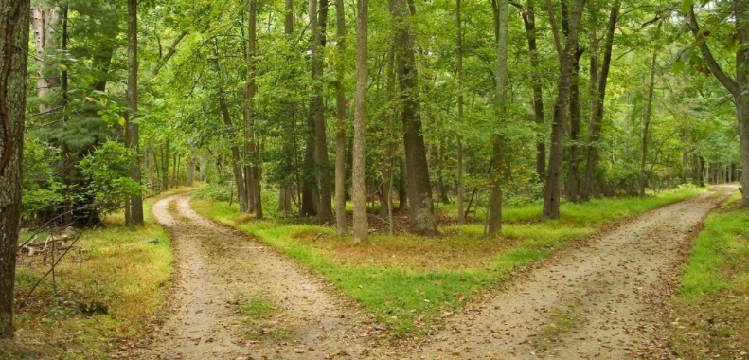
Two Different Paths for Resident and Family Council

Slide 10
An Emerging Perspective on Resident Engagement
Facilities are doing a good job with the Resident Council “basics.”
There are a limited range of concerns and topics raised in Resident Council meetings.
There is a wide range of levels of resident engagement across the facilities.

Slide 11
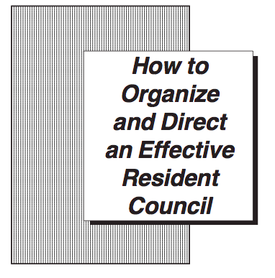
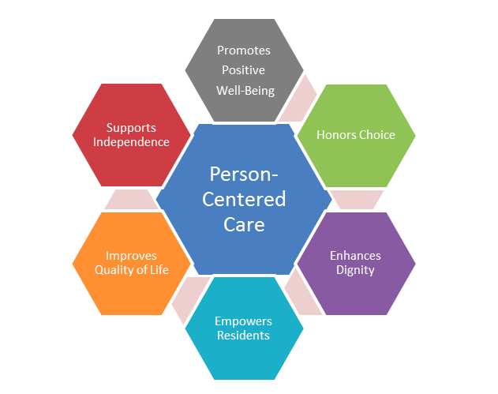
?

Slide 12
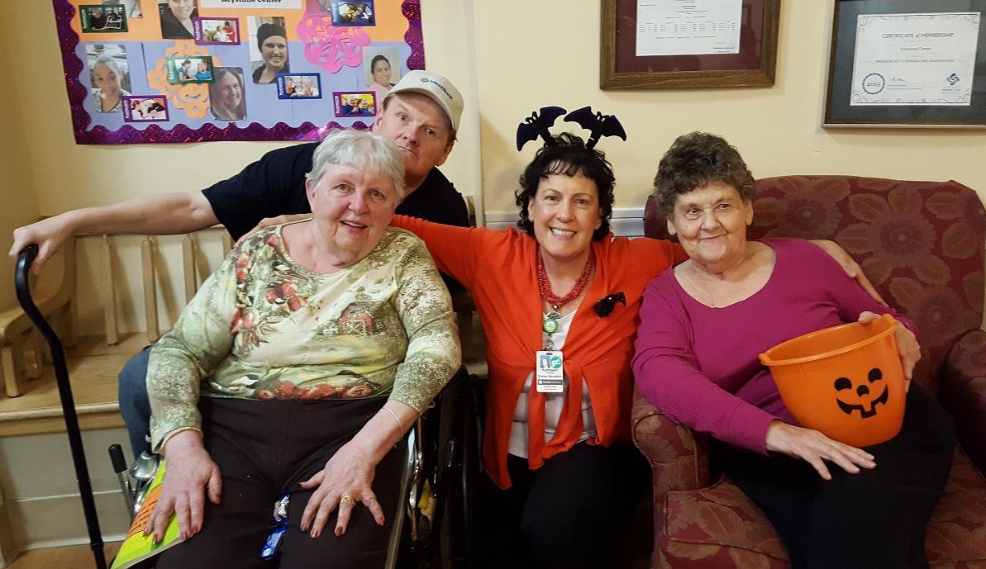
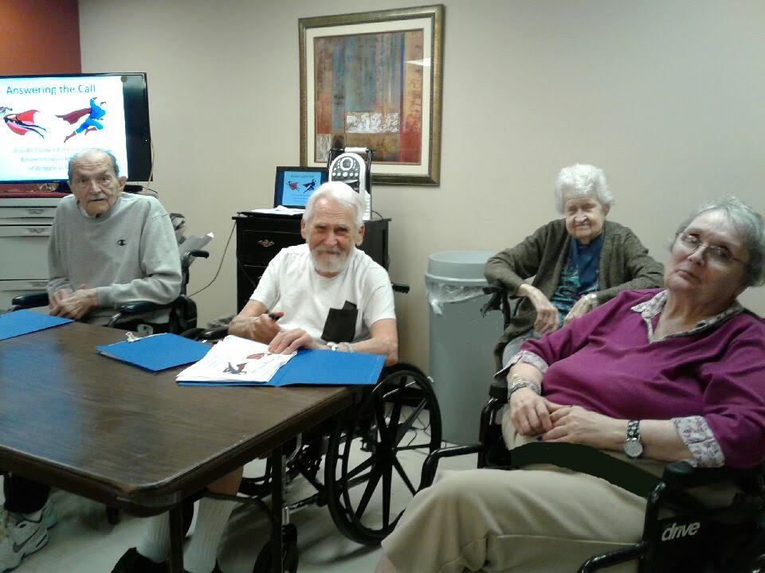
Working Hypothesis
Expanding engagement and opening up conversations about changes would improve quality of life.
Shifting focus from a “deficit-based” orientation to looking for and identifying what is possible, available and desired, could profoundly enhance meaning and engagement for residents.

Slide 13
Content Development

Slide 14
Learning Approach
Baseline and follow-up online surveys
Monthly written reports
Coaching conversations
Resident Council survey
Weekly sensemaking conversations
What are we seeing, hearing?
How does that impact our view of reality?

Slide 15
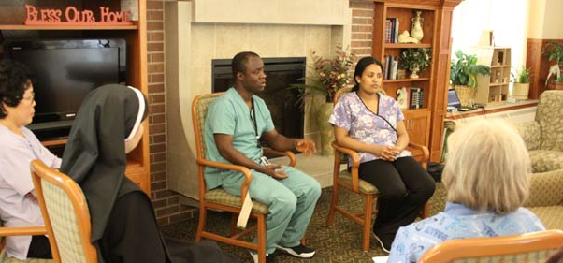
Learning In Relationship to Create Meaningful Conversations in Resident and Family Councils
Small Changes and New Questions Can Produce Astonishing Outcomes

Slide 16
Resident Council Changes Tested: Hospitality and Meeting Design
How agendas were used (61%)
Seating arrangement (50%)
“The circular seating arrangement is more conducive for sharing since everyone can engage face to face.”
How minutes are shared (44%)
Accommodations and adaptations (40%)
“Using the whiteboard and microphone resulted in residents referencing the board and staying on topic. Less repeating was needed.”

Slide 17
Resident Engagement Outside of the Council: Changes Tested
New or increase in informal or scheduled 1:1 staff/resident conversations (91%)
New conversations between leadership/staff and residents between meetings (49%)
Added Town Hall or unit-based meetings in addition to Resident Council (24%)

Slide 18
First Activity: Gratitude and Discovery
The Theory
Research from positive psychology approaches suggests: If you don’t like the outcome you are getting, change the question.
When we use a gratitude practice a curious thing happens, it grows naturally and it opens the space for other possibilities to emerge.

Slide 19
Gratitude and Discovery Questions
Shifts the question from: Who has a complaint about....
To:
What are you grateful for about living here?
What would make living here even better?

Slide 20
Gratitude and Discovery Activity Results
Better meeting
Positive tone
Residents are more engaged in Resident Council
Residents more likely to raise concerns and express desires
Joy!
“I don't know if anyone had ever asked my seniors what they were grateful for. Just asking the question changes the thought process. Instead of a litany of complaints, we start our meeting with laughter and joy...we're seeing great results throughout the month. It's empowering to all!”

Slide 21
Gratitude and Discovery Gets to the Heart of What Matters
The question “What could be better?”
“ has been such an important issue for us. Before I’d ask generally and people weren’t responding. So I’d go through the list of departments. Which was really asking leading questions. It's beneficial to not do the list. Because now we are getting the real issues. More things that are shared experience rather than an individual problem are coming up.”

Slide 22
Resident Engagement Creates Meaning at Woodbriar

Slide 23
Moving from Gratitude and Discovery to Action
Activity 2: Discovery and Action
Encouraged engaging residents in change
Reinforced QI approach – PDSA/Small Tests of Change
Gratitude and Discovery naturally led to change
“Residents were delighted to be invited to become a part of planning their own lives!!!! The energy and enthusiasm displayed by these residents are both wonderful and amazing! There has been a great deal of interest in joining committees and an overall sense of optimism that their interests and ideas will bear fruit and their voices will be heard.”

Slide 24
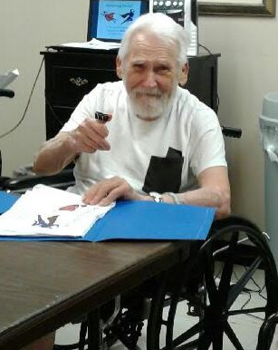
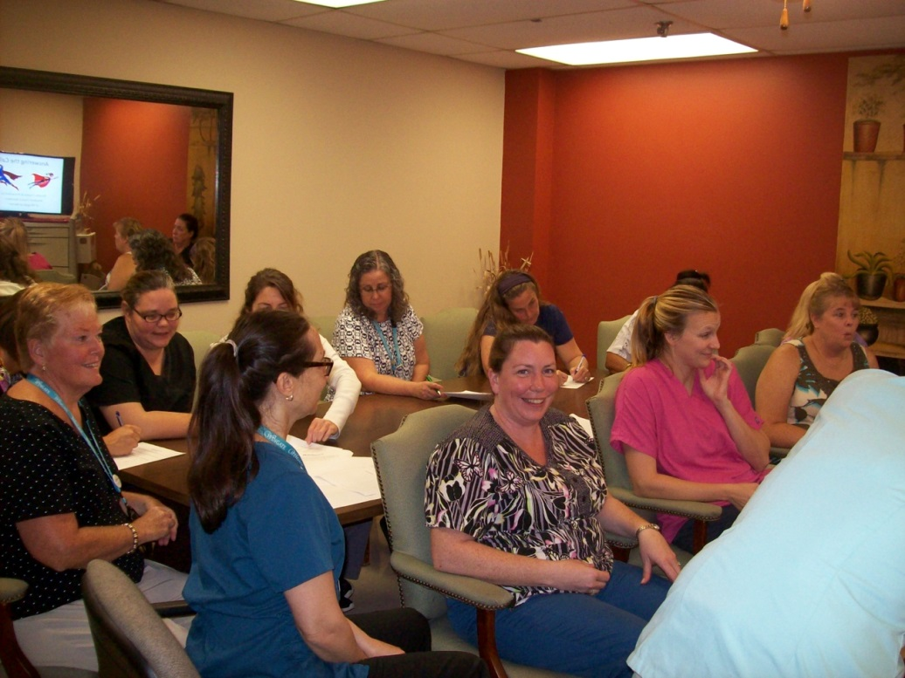
Shaking Things Up at Wingate Norton

Slide 25
Resident Council Results: Positive Impact on Individuals & Community
Increased participation & leadership in activities
Enhanced relationships among residents
Enhanced resident/staff relationships
Volunteering in facility and greater community
“Residents are more interested in volunteering and helping inside our community as well as helping those outside of the community as they are able. It has been a great experience to watch the domino effect of the changes we have been making.”

Slide 26
Resident Council Results: Involvement & Leadership
“More residents have participated in the council and it has grown. The residents are definitely more engaged. They seem more interested in resident council.”
“Residents more freely offer their ideas, suggestions and concerns, and want to be a part of improving the quality of life at the facility.”
“Residents are more outspoken with more self-initiation. Residents appear to feel more empowered to suggest changes.”
“Getting more involvement and having them talk about it as opposed to the facility running the meetings and events.”
“President and Vice President demonstrate more empowerment and leadership .”

Slide 27
Moving Toward Person-Centered Care
“Person-centered care” not familiar part of the dialogue
Activity 3 & Webinar raised awareness
“Once we learned more about Person-Centered Care the residents had more insight to things and wanted/needed more; so many more issues/complaints.”
Evidence emerging
“Overwhelmingly positive feedback from the residents and their family members have made it clear that this is a big step for us in the right direction towards improving their lives and making them feel needed, heard, and involved.”

Slide 28
Measure for Improvement: Voice of the Resident

Slide 29
Resident Council Recommendations
Use the power of gratitude and other positive psychology approaches.
Better questions lead to better outcomes
Include residents in making changes to increase person-centered care through action and meaning.
Use the Activity Guide to assist the facility’s work.
Create a learning community among residents, family and staff.

Slide 30
A Different Road for Family Council and Engagement

Slide 31
Family Council: Engagement
Nine (9) started with Family Council or Family meeting.
3 of these were currently family-led.
Ten (10) launched a Family Council or meeting over the course of the project.
2 of these are currently family-led.
Both had staff support to get up and running.
Seven (7) are in the process of starting or trying to start a Family Council or Family meeting.

Slide 32
Family Council: Experience
Person-centered care /culture change was reported as most frequently discussed topic (71%).
Some surprises with Gratitude & Discovery questions.
Engaging the ombudsman.
One-to-one conversations with facility staff.
Encouraging participation in joint resident/family activities.

Slide 33
Family Council: Challenges
Attendance – multiple reasons
Don’t perceive value/clear purpose of the meeting
Need a common purpose as part of invitation
Group dynamics – requires strong facilitation
Confusion about regulations

Slide 34
Family Council: Recommendations
Invite families to talk to one another and have individual conversations with staff.
Inform families of their right to form a Family Council and provide the necessary support if families choose.
Create partnership/shared leadership between facility leaders and families, with the families’ permission.
Employ strategies to enhance communication for families unable to attend in-person meetings. These may include email, Skype, etc.

Slide 35
Family Engagement: Recommendations
Provide training in active listening to staff and families (see educational materials).
Offer a webinar on meeting facilitation skills for families and staff.
Engage the ombudsman in this effort.
Share successful strategies broadly within and across facilities.

Slide 36
Next Steps
DPH will be distributing key materials in early 2018 to assist all facilities with this work.
Activity Modules
Workshop Content
Webinars

