Slide 1
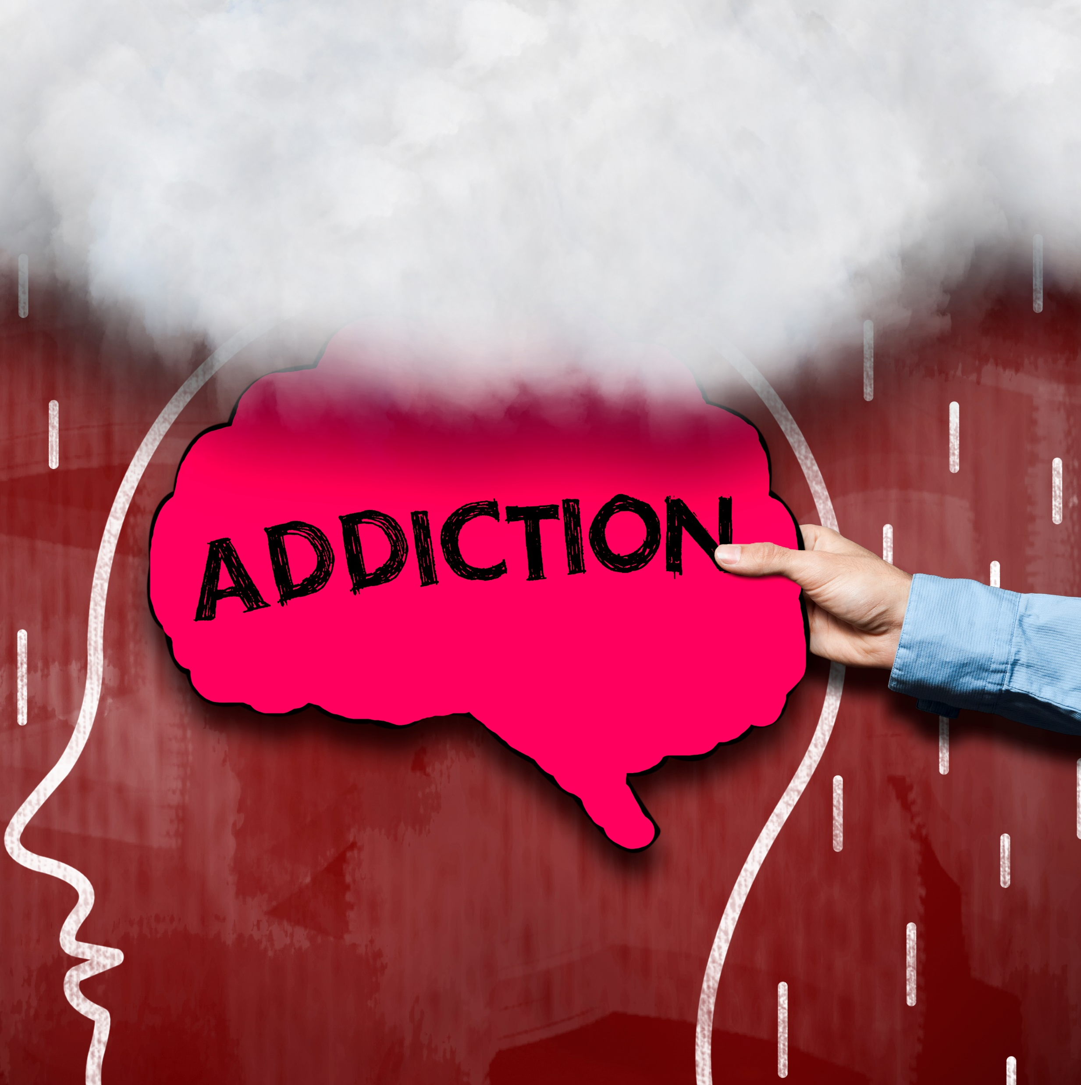
SBIRT (Screening, Brief Intervention, and Referral to Treatment) Substance Use and Addiction
ACCS Principles
Notes:
Introduce Trainers

Slide 2
Learning Objectives
During this module you will:
01
Consider
why people use substances
02
Understand
the SBIRT practice for identifying and briefly intervening with substance use concerns
03
Learn
and apply concepts from at least two appropriate treatment strategies
Notes:
Explain:
During this module you will:
Consider why people use substances
Understand the SBIRT practice for identifying and briefly intervening with substance use concerns
Learn and apply concepts from at least two appropriate treatment strategies

Slide 3
Activity
What is a substance use disorder, substance abuse, and addiction?
Notes:
(definitions on next slide)

Slide 4
Substance use disorder (SUD):
A maladaptive pattern of substance use leading to clinically significant impairment or distress.
Severe Substance Use or Substance Abuse:
When someone continues to use substances or alcohol even when it causes problems, such as trouble with work, family, or their health.
Addiction:
A treatable, chronic medical disease; that involves interactions between the brain, genetics, environment and individual life experiences; and results in compulsive behavior that continues despite harmful consequences
https://www.asam.org/quality-care/definition-of-addiction
Notes:
Slide 4: Substance use disorder (SUD), Severe Substance Use, Addiction
Explain:
Substance use disorder(SUD):
Defined by the Diagnostic Statistical Manual (DSM) as a maladaptive pattern of substance use leading to clinically significant impairment or distress.
Indicators of an SUD are: dysfunction in major life roles, use to the point of hazard (drunk driving), other social or interpersonal problems (conflicts, abusive or violent behavior), or repeated attempts to control use or quit.
Severe Substance Use or Substance Abuse:
When someone continues to use substances or alcohol even when it causes problems, such as trouble with work, family, or their health. For instance, continuing to use substances knowing they can be fired if they fail a drug test is a sign of abuse.
Can cause chemical changes in the brain that lead to addiction.
Addiction:
Defined by the American Society of Addiction Medicine as “a treatable, chronic medical disease; that involves interactions between the brain, genetics, environment and individual life experiences; and results in compulsive behavior that continues despite harmful consequences.” ASAM Definition of Addiction

Slide 5
Substance Abuse or Addiction?
Although substance abuse and addiction are distinct, they are often used synonymously.
Substance Use Disorders, abuse, and addictions are characterized by periods of recovery & relapse.
Usually, behavior change and sometimes medication is needed to manage and treat/self-regulate the disorder.
Notes:
Slide 5: Substance abuse or addiction?
Explain:
Although substance abuse and addiction are distinct, they are often used synonymously.
It can be challenging to tell when substance use has crossed the line into a disorder or addiction.
Depends on the seriousness of the issues that substances have caused in an individual’s life as well as how they have affected the individual socially, professionally, psychologically, and physically.
Substance Use Disorders, abuse, and addictions are characterized by periods of recovery & relapse.
Usually, behavior change and sometimes medication is needed to manage and treat/self-regulate the disorder.

Slide 6
Activity
Based on your experience, what would lead people to misuse substances?
Notes:
Ask:
Based on your experience, what would lead people to misuse substances?

Slide 7
Why do people use, misuse, or become addicted to substances?
To feel good: to have novel feelings, sensations, and experiences and to share them.
To feel better: to lessen pain, anxiety, worries, fears, depression, and hopelessness.
Notes:
Explain:
To feel good: to have novel feelings, sensations, and experiences and to share them.
To feel better: to lessen pain, anxiety, worries, fears, depression, and hopelessness.
People with mental health condition may use substances to manage, cope with or self-regulate their psychiatric symptoms.
Substances change the brain, causing a much larger dopamine increase (pleasure response) than say food, sex, or video games.

Slide 8
Why do ACCS providers screen, assess, and treat substance use disorders?
About half of those who experience a mental health condition during their lives will also experience a substance use disorder
Mental health conditions may precede a substance use disorder
Notes:
Explain:
Multiple national population surveys have found that about half of those who experience a mental health condition during their lives will also experience a substance use disorder and vice versa. People with schizophrenia have higher rates of alcohol, tobacco, and substance use disorders than the general population.
Some research has found that mental health condition may precede a substance use disorder, suggesting that better diagnosis of youth mental health condition may help reduce comorbidity.

Slide 9
Using the SBIRT Approach:
SBIRT is a comprehensive, integrated, public health approach to the delivery of early intervention and treatment services for persons with substance use disorders, as well as those who are at risk of developing these disorders
Screening quickly assesses the severity of substance use and identifies the appropriate level of treatment.
Brief intervention focuses on increasing insight and awareness regarding substance use and motivation toward behavioral change.
Referral to treatment provides those identified as needing more extensive treatment with access to specialty care.
https://www.samhsa.gov/sbirt#:~:text=SBIRT%20is%20a%20comprehensive%2C%20integrated,risk%20of%20developing%20these%20disorders
Notes:
(see TAPS handout)
Explain:
Screening, Brief Intervention, and Referral to Treatment (SBIRT). “SBIRT is a comprehensive, integrated, public health approach to the delivery of early intervention and treatment services for persons with substance use disorders, as well as those who are at risk of developing these disorders.”
· Screening quickly assesses the severity of substance use and identifies the appropriate level of treatment.
· Brief intervention focuses on increasing insight and awareness regarding substance use and motivation toward behavioral change.
· Referral to treatment provides those identified as needing more extensive treatment with access to specialty care.
https://www.samhsa.gov/sbirt#:~:text=SBIRT%20is%20a%20comprehensive%2C%20integrated,risk%20of%20developing%20these%20disorders
We use the SBIRT approach to identify substance use concerns and intervene as needed- This is a model designed to provide universal screening, secondary prevention (detecting risky or hazardous substance use before the onset of abuse or dependence), early intervention, and timely referral and treatment for people who have SUDs. Specific actions are described below.
Facilitator notes: (see TAPS handout) Your agency will have a specific screening tool for substance misuse. One is the Tobacco, Alcohol, Prescription medication, and other Substance use (TAPS) Tool which consists of a combined screening component (TAPS-1) followed by a brief assessment (TAPS-2) for those who screen positive. TAPS https://nida.nih.gov/taps/#/. Distribute TAPS handout.

Slide 10
Responding To Substance Use Disorders: Present-day Methods
12 step model
Relapse Prevention:
Medication-assisted treatment (MAT) and Medication for Opioid Use Disorder (MOUD):
Views SUD as a “disease” from which one can “be in recovery”
Offers a completely voluntary, peer run, and anonymous social support group
Individuals addicted to substances should aim to abstain from use
Sometimes a difficult approach for person’s served because they may feel it is not okay to use their medication
Cognitive-behavioral approach that requires persons served and their clinicians to identify situations that place them at greater risk for relapse – both:
Internal experiences
External cues
Use of medications, in combination with counseling and behavioral therapies, to provide a “whole-patient” approach to the treatment of substance use disorders
Notes:
**FACILITATOR NOTE: click to show each present-day method**
12 step or disease model – a common approach but not everyone prescribes to it:
Views SUD as a “disease” from which one can “be in recovery”.
Offers a completely voluntary, peer run, and anonymous social support group which provides a program of recovery.
Individuals addicted to substances should aim to abstain from use.
Sometimes a difficult approach for person’s served because they may feel it is not okay to use their medication
Relapse Prevention:
A “skills-based, cognitive-behavioral approach that requires persons served and their clinicians to identify situations that place them at greater risk for relapse – both:
1) internal experiences (e.g., positive thoughts related to substance use or negative thoughts related to sobriety that arise without effort, called “automatic thoughts”) and 2) external cues (e.g., people that the person associates with substance use).
Then, the person served and their clinician work to develop strategies, including cognitive (related to thinking) and behavioral (related to action), to address those specific high-risk situations. With more effective coping, the person served develops increased confidence to handle challenging situations without alcohol and other Substances (i.e., increased self-efficacy)”. Relapse Prevention (RP) (MBRP) - Recovery Research Institute (recoveryanswers.org)
Medication-assisted treatment (MAT) and Medication for Opioid Use Disorder (MOUD):
The use of medications, in combination with counseling and behavioral therapies, to provide a “whole-patient” approach to the treatment of substance use disorders. Medication-Assisted Treatment (MAT) | SAMHSA.

Slide 11
Responding To Substance Use Disorders: Present-day Methods
Harm Reduction
Connect individuals to overdose education, counseling, and referral to treatment for infectious diseases and substance use disorders.
Distribute opioid overdose reversal medications to individuals at risk of overdose
An approach that emphasizes engaging directly with people who use drugs to prevent overdose and infectious disease transmission, improve the physical, mental, and social wellbeing of those served, and offer low-threshold options for accessing substance use disorder treatment and other health care services
Lessen harms associated with substance use and related behaviors that increase the risk of infectious diseases, including HIV, viral hepatitis, and bacterial and fungal infections
Reduce infectious disease transmission among people who use substances, including those who inject substances by equipping them with accurate information and facilitating referral to resources
Reduce overdose deaths, promote linkages to care, facilitate co-location of services as part of a comprehensive, integrated approach
Reduce stigma associated with substance use and co-occurring disorders
Promote a philosophy of hope and healing by utilizing those with lived experience of recovery in the management of harm reduction services, and connecting those who have expressed interest to treatment, peer support workers and other recovery support services
https://www.samhsa.gov/find-help/harm-reduction...
Notes:
Explain:
Harm Reduction is a good example of coordinated and integrated care with other systems that reduces barriers to care. Harm reduction is part of the continuum of care and is an effective approach to addressing the public health epidemic involving substance use as well as infectious disease and other harms associated with substance use.
From slide (green block):
“Harm reduction is an approach that emphasizes engaging directly with people who use drugs to prevent overdose and infectious disease transmission, improve the physical, mental, and social wellbeing of those served, and offer low-threshold options for accessing substance use disorder treatment and other health care services.”
“Harm reduction services save lives by being available and accessible in a matter that emphasizes the need for humility and compassion toward people who use drugs.” https://www.samhsa.gov/find-help/harm-reduction
Explain:
Specifically, harm reduction services can:
Connect individuals to overdose education, counseling, and referral to treatment for infectious diseases and substance use disorders.
Distribute opioid overdose reversal medications (e.g., naloxone) to individuals at risk of overdose, or to those who might respond to an overdose.
Lessen harms associated with substance use and related behaviors that increase the risk of infectious diseases, including HIV, viral hepatitis, and bacterial and fungal infections.
Reduce infectious disease transmission among people who use substances, including those who inject substances by equipping them with accurate information and facilitating referral to resources.
Reduce overdose deaths, promote linkages to care, facilitate co-location of services as part of a comprehensive, integrated approach.
Reduce stigma associated with substance use and co-occurring disorders
Promote a philosophy of hope and healing by utilizing those with lived experience of recovery in the management of harm reduction services, and connecting those who have expressed interest to treatment, peer support workers and other recovery support services (SAMSA, 2020)

Slide 12
Activity
Which of these approaches do you have experience with, if any? Did you find it effective? What worked well and what did not?
Notes:
Ask:
Which of these approaches do you have experience with, if any?
Did you find it effective?
What worked well and what did not?

Slide 13
Responding To Substance Use Disorders: Present-day Methods
Treatment for co-occurring mental health conditions:
This approach recognizes that SUD often co-occurs with mental health conditions
It is premised on the need to have an integrated approach of recovery from both conditions.
While recovery approaches for SUD and serious mental health conditions have developed independently, a clinician will understand that a “whole person” approach as used by other interventions leads to better success
(Reference: Substance Abuse and Mental Health Services Administration. (2021). Substance Use Disorder Treatment for People with Co-Occurring Disorders, Advisory.
Publication No. PEP20-06-04-006.)
Notes:
Handout: SAMHSA’s Practice Principles of Integrated Treatment for CODs
Explain:
Treatment for co-occurring mental health conditions: This approach recognizes that SUD often co-occurs with mental health conditions (hence often referred to as “co-occurring mental health conditions”. It is premised on the need to have an integrated approach of recovery from both conditions. While recovery approaches for SUD and serious mental health conditions have developed independently, a clinician will understand that a “whole person” approach as used by other interventions (e.g., motivational interviewing, harm reduction, housing first) leads to better success compared to interventions that treat conditions in silos.
Facilitators notes:
Distribute Handout:
SAMHSA’s Practice Principles of Integrated Treatment for CODs. Summarize these points:
SUDs and mental health conditions are treated concurrently to meet the full range of symptoms.
Motivational techniques (e.g., motivational interviewing, motivational counseling) are integrated into care to help persons served reach their goals, particularly at the engagement stage of treatment.
Addiction counseling is used to help persons served develop healthier, more adaptive thoughts and behaviors in support of long-term recovery.
Pharmacotherapy is discussed in multidisciplinary teams, offered to persons served when appropriate, and monitored for safety (e.g., interactions with other medications), adherence, and response.
(Reference: Substance Abuse and Mental Health Services Administration. (2021). Substance Use Disorder Treatment for People with Co-Occurring Disorders, Advisory.
Publication No. PEP20-06-04-006.)

Slide 14
Activity
Notes:
Facilitator note:
This is a video that conveys the attitude and style of motivational interviewing to address substance misuse.
https://youtu.be/SsNgZ47o2I4 - Lifting the Burden in Motivational Interviewing

Slide 15
Activity
What are my responsibilities for addressing substance use among the people I serve?
Notes:
(next slides will explain)

Slide 16
What are my responsibilities for addressing substance use among the people I serve?
1. Reduce the stigma of addiction
Person-centered care and shared decision making are essential for delivery of substance use disorder treatments such as:
Helping individuals better understand their medical conditions and the need to make treatment decisions
Providing information about the benefits and adverse effects of treatment options
Supporting persons served while they clarify their values and preferences and make a decision, even if it is for no treatment
Providing support while persons served implement their decisions
Engaging persons served in such a way as to enhance and facilitate future interaction
Notes:
Explain:
As ACCS staff it is key for all team members to reduce the stigma of addiction.
Note that the use of the word addiction is ok. But it’s stigmatizing to be called an addict.
It’s important to emphasize that person-centered care and shared decision making are essential for delivery of substance use disorder treatments such as:
helping individuals better understand their medical conditions and the need to make treatment decisions;
providing information about the benefits and adverse effects of treatment options;
supporting persons served while they clarify their values and preferences and make a decision, even if it is for no treatment;
and providing support while persons served implement their decisions
engaging persons served in such a way as to enhance and facilitate future interaction.

Slide 17
What are my responsibilities for addressing substance use among the people I serve?
2. Apply the Screening-Brief Intervention-Referral-Treatment (SBIRT) approach – required in ACCS
Screening: Begin by developing an impression of the nature and extent of one’s use.
Referral and Treatment: If the person served is assessed as having an SUD in a nonemergency situation, then the treatment plan should contain goals that are specific to reducing SUD
Brief Intervention: if the person served is screened-in as having an SUD; a brief intervention can ensue.
Brief intervention focuses on increasing insight and awareness regarding substance use and motivation toward behavioral change.
Notes:
Additionally:
Handout: “Opioid Safety and how to use Naloxone”
Explain:
If the person served is assessed as having an SUD in an emergency situation (the persons served is intoxicated or high), one should contact their supervisor and the clinician immediately and monitor the person served until further assistance arrives.
Managing a crisis involving a person served with CODs, should involve seeking assistance by others trained to handle certain aspects of such crises. This may include emergency treatment, such as referrals to detoxification units or use of Narcan in case of overdose or other emergency intervention.
Make sure you know the protocol for your agency of how to deal with active substance use when you are working with a person served, and how and whether to involve law enforcement.
Facilitator Note:
It is not ACCS policy to remove individuals in need of these interventions from housing or programming.
Discuss pamphlet:
Distribute handout “Opioid Safety and how to use Naloxone”. Discuss that this is an example of a brief intervention

Slide 18
What was a new learning for you?
Activity

