Slide 1
Suicide Prevention
ACCS Principles
Notes:
Introduce Trainers

Slide 2
Learning Objectives
how a safety plan is used to manage suicide risks
how a safety plan is used to manage suicide risks
During this module you will:
01
Learn to apply a shared alertness approach with suicidal individuals
02
Recognize how to use evidence-based screening and assessment tools to identify suicide risk
03
Learn to apply at least two methods for preventing suicide
Notes:
Explain:
During this module you will:
Learn to apply a shared alertness approach with suicidal individuals
Recognize how to use evidence-based screening and assessment tools to identify suicide risk
Learn to apply at least two methods for preventing suicide

Slide 3
Suicide
is a primary clinical risk we want to monitor and prevent for all ACCS persons
Notes:
Explain:
Indicate we do this by identifying risk factors early and continually re-evaluating their presence using the Columbia-Suicide Severity Rating Scale (C-SSRS) and by training all staff in a protocol for how to respond to risks (e.g., maybe QPR, it means reaching out to a clinician/supervisor).

Slide 4
What are my personal thoughts, beliefs, attitudes about suicide and how do they impact my work with suicidal individuals?
Notes:
Ask:
What are your personal thoughts, beliefs, and attitudes about suicide and how do they impact my work with suicidal individuals?
Facilitator Instructions:
Invite participants to self-reflect on this question.
Participants do not have to share, but the facilitator should prompt a general discussion about this.
For example, if a helping professional has strong religious values that make it difficult for them to understand how a person could think about taking their own life, how might that affect working with suicidal individuals?
If a helping professional has lost a loved one to suicide, how might that impact their work with suicidal clients?

Slide 5
Approaching Your Work
How do I react when a client talks about suicide?
Dismissive
Alarmed
Concerned
Notes:
Explain:
Be careful not to go into “alarm” mode or to be “dismissive”
The person needs a steady, kind, and reasonable response
Recognize the conflict between a person’s desire to end their psychological pain and your desire to prevent suicide and community culture
Be comfortable asking questions that open a conversation
Facilitator Notes: Review the following information:
Dismissive - Examples of being dismissive
“If you really want to end your life, you would not be here talking to me about it.”
“If you really wanted to die, you would’ve done it already.”
“You’re just looking for attention.”
Potential Outcomes of Dismissiveness:
May lead to ignoring or minimizing the client’s risk of suicide
May lead to minimizing the concern and pain of the client
May lead to a failure to conduct as thorough an evaluation as would be indicated
Alarmed – Examples of Being Alarmed
This reaction focuses on the fear of the client dying
May lead to an over-interpretation of the client’s statement as a meaning of imminent risk of death
May lead to intrusive interventions that are clinically contraindicated
May cause client to withhold suicide thoughts

Slide 6
Concerned Alertness
In Your Mind
In The Space
In Your Words
Notes:
Facilitator Instructions:
Explain you want them to explore how a treatment team member can show concerned alertness in any or all of the three areas on the slide:
in your mind,
in the space,
in your words.
Allow participants to self-reflect on this and then share their thoughts. If training is:
-In-person: have them use post-it notes and put their written responses into each of those categories
-Virtual: can use Google board to display participants’ responses, annotate, or have them use the chat - without hitting enter until you tell them to so it is all shared at once
Facilitator may provide some of these examples if needed:
In Your Mind:
Respect and honor their vulnerability; understand how suicidal thoughts make sense for this person; understand the psychological pain; understand the underlying factors; understand the family; recognize conflict between the client’s desire to end their psychological pain and your desire to prevent suicide and community culture; remain hopeful
In the Space:
Provide a safe atmosphere of sharing (welcoming, compassionate, non-judgmental); build rapport; listen thoroughly; validate; be empathic; provide understanding; provide time for a thorough evaluation; show your commitment to their recovery (provide information, resources, options)
In Your Words:
How would you voice the above? (Consider making the point to avoid saying ‘but’ – anything before the word but doesn’t matter)

Slide 7
Question – Persuade – Refer
Question, Persuade, Refer, or QPR is a Suicide Prevention Training designed to increase one’s ability to recognize suicidal thoughts and behaviors, and to refer the person at-risk to a professional resource.
Question
Persuade
Refer
If you believe someone is considering suicide, ask them directly
Are you thinking about suicide or wanting to kill yourself?
Persuade the persons served to allow you to assist them in getting help right now
Will you go with me to get help? or Will you let me assist you to get help?
Personally escort the person to crisis agency
Notes:
Explain:
Question, Persuade and Refer (QPR) is not an intervention or assessment – it is a way to gather information and then pass that information to the appropriate party
Question:
If you believe someone is considering suicide, ask them directly "Are you thinking about suicide or wanting to kill yourself?”
Don’t say “Do you want to hurt yourself?” as self-harm can be non-lethal and it’s not the same as wanting to die.
Also remember that if you ask someone if they want to kill themselves, this does NOT drive them toward that action. That’s a myth and is not accurate.
Don’t be afraid to ask the question.
Persuade:
Persuade the persons served to allow you to assist them in getting help right now. Say “Will you go with me to get help?” or “Will you let me assist you to get help?”
Demonstrate caring concern. Another option can be to enlist their promise not to kill themselves until you’ve arranged help for them.
If persuasion doesn’t work, call a local mental health center, crisis hotline, or emergency services.
Refer:
Personally escort the person to __________[agency trainer - fill in your specific crisis options here]

Slide 8
Suicide Risk Factors
STATIC
DYNAMIC
Notes:
Facilitator note: this activity uses 2 slides – show this blank slide first
Explain:
Static risk factors are things we cannot change. These generally pertain to something in one’s history (e.g., childhood trauma).
Dynamic risk factors are malleable and may be addressed/improved through intervention.
Facilitator Instructions: Show the blank slide (# 8)
Ask:
What are some static risk factors?
What are some Dynamic risk factors?
Have the group state out loud, write in the chat, or annotate onto the slide if the training is virtual.
After responses – move to next slide

Slide 9
Suicide Risk Factors & Intervening
Static Risk Factors
Dynamic Risk Factors
Childhood Trauma
Active Substance Use
Divorced or Widowed
Lack of Social Supports
Previous Suicide Attempt
Few Reasons for Living
Static
Dynamic
Static
Dynamic
Static
Dynamic
Notes:
Facilitator Note:
Review the risk factors on the slide to provide examples of static and dynamic risk factors
Discuss the relevance to intervention:
Indicate that ITT members should think of focusing on the dynamic risk factors and how they can intervene as a team to help reduce/treat these risks.
Example:
If a person served feels they are lacking purpose, what can the team do to help shift that thinking to get them thinking about their purpose?

Slide 10
WARNING SIGNS (ASAD)
Drastic intent to kill oneself over the past few hours or day
Social isolation: feeling disconnected from or disgust with other people
Self-alienation: feeling like a burden to others or hatred towards self
Notes:
Explain:
There are also warning signs for suicide risk that may be imminent. It is important all staff working with ACCS persons served be aware of the signs:
A drastic increase in suicidal intent over the course of hours or days (not weeks or months);
Marked social isolation (e.g., social withdrawal, perceived liability on others) and/or
Self-alienation (e.g., self-hatred, perceptions that self is an onerous burden);

Slide 11
WARNING SIGNS (ASAD)
Hopelessness: belief that things won’t / can’t get better
Over-Arousal Symptoms:
Nightmares
Insomnia
Irritability
Agitation
Notes:
Warning Signs (continued)
Continue Explaining:
Perceptions that the above criteria are hopelessly intractable;
Two or more manifestations of overarousal:
agitation, irritability, insomnia, nightmares.

Slide 12
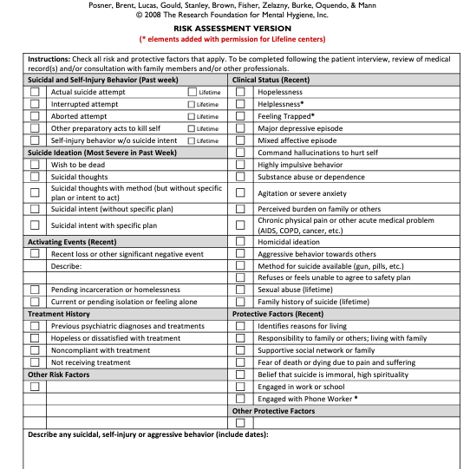
Screening: C-SSRS (Columbia-Suicide Severity Rating Scale)
Everyone is screened for suicide risk upon intake
Everyone who ‘screens in’ will receive a full assessment of suicide risk from their clinician
The C-SSRS will continue to be administered to all persons served whenever there is ‘cause for concern’
Notes:
Facilitator Note: This slide uses animation to advance the bubbles on the left. Remember to advance the slide after each point below.
Explain:
As discussed in the risk management module, all persons served must receive a screening for suicide risk with the C-SSRS upon intake into the program.
Those who ‘screen in’ (meaning they score moderate to high) on the C-SSRS will receive a full assessment of suicide risk from their clinician to determine the intensity, length, and lethality of suicidal thoughts
Remember from the Risk Management training – the
C-SSRS also should be administered whenever there is “cause for concern” and all treatment members should be familiar with administering the screen

Slide 13
Rationale for Safety Planning
Effective July 1, 2019, Joint Commission implemented new requirements as part of the National Patient Safety Goal (NPSG) 15.01.01, designed to improve the quality and safety of care for those who are being treated for behavioral health conditions and those who are identified as high risk for suicide.
Studies have shown that developing a safety plan with a patient prior to discharge from an IPU or ED setting can decrease suicidal behavior
Provides sense of empowerment and control
In 2020, suicide was among the top nine leading causes of death for people ages 10-64
Suicide was the second leading cause of death for people ages 10-14
Comparison of the Safety Planning Intervention With Follow-up vs Usual Care of Suicidal Patients Treated in the Emergency Department - PubMed (nih.gov)
Notes:
Explain:
All persons served who ‘screen in’ on the C-SSRS and are assessed as ‘safe to remain in the community’ should develop a Safety Plan with their team.
Review points on the slide

Slide 14
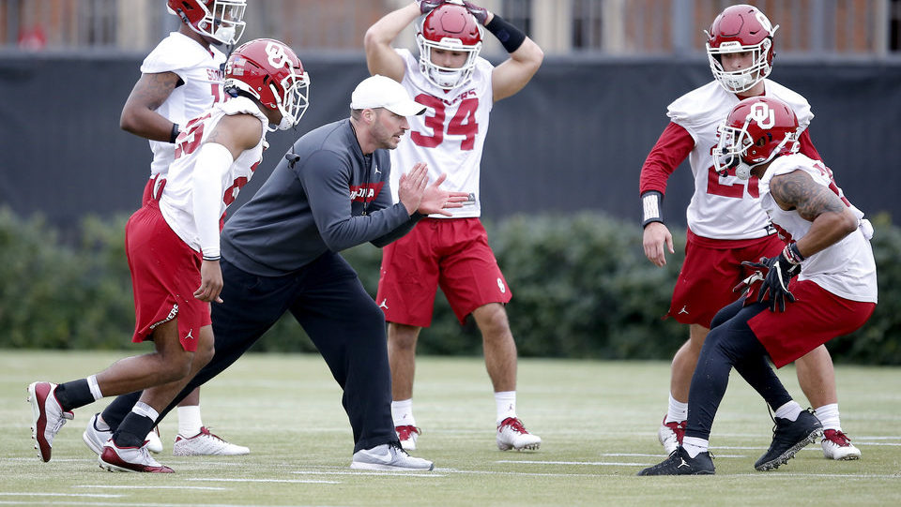
When Do We Introduce Safety Planning and How Often do We Review it?
Notes:
Explain:
Repeat: All persons assessed for suicide risk and deemed to be safe to remain in the community will get a safety plan
If the person scores very low or low, a safety plan ideally would still be completed within the first 30 days of intake into the program. A person has a right to refuse - completion of the plan should be collaborative. A safety plan is always completed with a client, never for a client. The mitigation plan is from the client’s point of view in their words (no jargon).
At the very least, safety plans should be reviewed after a crisis event: In what ways was the plan useful? What might need to be changed to make it more effective?

Slide 15
Involvement of IIT Members in Safety Planning
Every member of the ITT working with the person served should have a copy of the person’s safety plan and be aware of their warning signs
Encourage persons served to review their plans as needed and when warning signs occur
When a person served is doing well, this should be reinforced by the ITT in connection with the safety plan
Coping skills listed on the safety plan should be known by the ITT to reinforce its practice regularly
See yourselves as coaches! You are the ones cheering them on, helping them practice their safety planning, etc.
Notes:
Explain:
Every member of the ITT and every staff person working with the person served should have a copy of the person’s safety plan and be aware of their warning signs
Encourage persons served to review their plans as needed and when warning signs occur (Where will they keep it? How will they remember to use it in a crisis?)
When a person served is doing well, this should be reinforced by the ITT in connection with the safety plan.
Coping skills listed on the safety plan should be known by the ITT to reinforce its practice regularly. Otherwise, the plan may be ineffective during a crisis event.
See yourselves as coaches! You are the ones cheering them on, helping them practice their safety planning, etc.

Slide 16
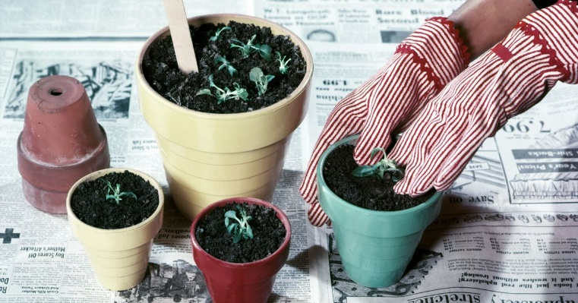
Six Components of a Safety Plan
Warning Signs
A safety plan is only useful if the individual can recognize their warning signs
Include sensations, thoughts, images, mood, behaviors
Coping Skills
Emphasize how use of “solo coping skills” increases self-efficacy, self-reliance, and a sense of power over suicidal urges
Keeping busy, positive thinking, doing something good for oneself
Distractions
The goal is distraction from suicidal thoughts and feelings
Safe places the individual can go to be around people
Notes:
Facilitator note: Slides 16 & 17 each list 3 components
Explain:
Briefly review the 6 components of a safety plan:
mainly the warning signs, coping skills and distractions, and the need for the plan to include supports

Slide 17
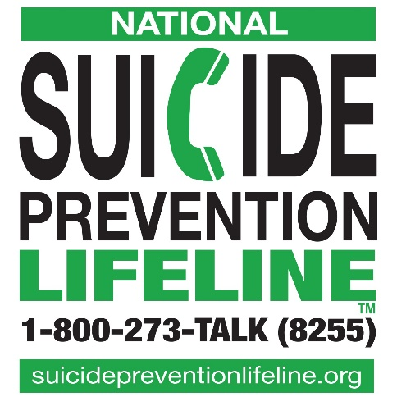
Trevor Project
(LGBTQ Youth)
Text: 678-678
Call: 866-488-7386
Natural Supports
Family and friends they will call for help
Plan should include the person’s name and phone number
Professional Supports
Name and contact information for mental health professionals
May include case manager, clinician, local ESP, suicide hotlines
Safer Environment
What needs to be removed? (lethal means; substances)
What needs to be added? (lock box; reminders of reasons for living)
Crisis Text: 741741
Hey Sam 1-877-832-0890
(up to age 24)
Recovery Learning
Centers
Warm Lines:
877-733-7563

Slide 18
Caring Contacts
A form of reaching out like a card, written message, or text (use technology)
Notes:
Explain:
Caring contacts can be very effective and may include some form of reaching out like a card, written message, or text (use technology)
Facilitator note: next slide gives examples

Slide 19
Examples
Jeff – Thank you for coming in today and for answering all the questions. I know you weren’t comfortable. Based on our brief time together, I can see that you know how to get through hard times. I wish you didn’t have to be – but it seems to me you very strong.
– Ursula
Danyelle,
I have much hope for you. I think that what we worked on today and this website will be helpful. I look forward to seeing you again. I’ll remember what you said about your daughter.
With care. - Xiaoshan
Notes:
Facilitator note: Read through examples on slide

Slide 20
Have you ever used a caring contact?
How did it go?
Notes:
Ask:
Have you ever used a caring contact? How did it go?
Request a few responses from those who have experience with caring contacts.

Slide 21
Case Scenario: Alex
When you arrive to Alex’s house, you notice a strong smell of marijuana as he opens the door. It’s evident that he has not showered in several days, his apartment is unusually cluttered, and all of the blinds are closed.
When you ask Alex if everything is OK, he tells you that he and his girlfriend of one year broke up over the weekend and he hasn’t felt like leaving the house. He admits that has not taken his medication in several days and instead has been smoking weed and occasionally drinking beer.
You ask Alex if he has wished he could go to sleep and not wake up, to which he replies: “A few times this week. This really sucks.”
You then ask him if he has actually had any thoughts of hurting himself, to which he replies: “No, I would never do that. My mom is sick and needs me.” Alex has no prior self-harm or suicide attempts of any kind.

Slide 22
Case Scenario: Alex
1.Identify 3 risk factors that Alex is displaying.
2.How would you continue this conversation with Alex in a caring and concerned way?
3.After completing the C-SSRS with Alex, he scores “low”. What would you do next?
Notes:
Refer to Handout: Alex Scenario
(10 minutes breakout + discussion)
Facilitator Instructions
Explain that this will be a group exercise to practice how to work with persons served around suicide risk.
Read the scenario out loud
Split participants into groups of 3 or 4
Instruct them that in their groups they will:
Pick a recorder/reporter for the group
Identify 3 risk factors that Alex is displaying.
Discuss how they would continue this conversation with Alex in a caring and concerned way.
After completing the C-SSRS with Alex, he scores “low”. What would you do next?
Breakouts go approximately 10 minutes
Bring groups back together and ask a few to report what they decided.
Then:
Indicate that Alex scored low for suicide risk, but he is still left with risk factors that need to be addressed.
One approach would be to encourage development of a safety plan.
If Alex is not interested, ask what coping skills he has tried in the past that worked for him? If none, suggest one or two coping skills (e.g., staying busy, doing an activity that interests him).
Also, identify with Alex people he can use for support.
Ask what else they can do to address some of his risk factors?
Encourage use of medication – example: Ask how he has felt since he stopped taking it (e.g., insomnia).
It is essential to report this situation and how you handled it to the ITT and his primary care.

Slide 23
What is one tip you learned today that you can apply to your work?

