Slide 1

Summer 2026
Mega Events Analysis
September 23, 2026
Jen Elise Prescott, PhD
Senior Director, Office of Performance Management and Innovation (OPMI)

Slide 2
Table of Contents
Transportation Goals
Travel Behavior Monitoring and Analysis
Key Findings
Thank You to Fans, Volunteers and Riders
Appendix

Slide 3
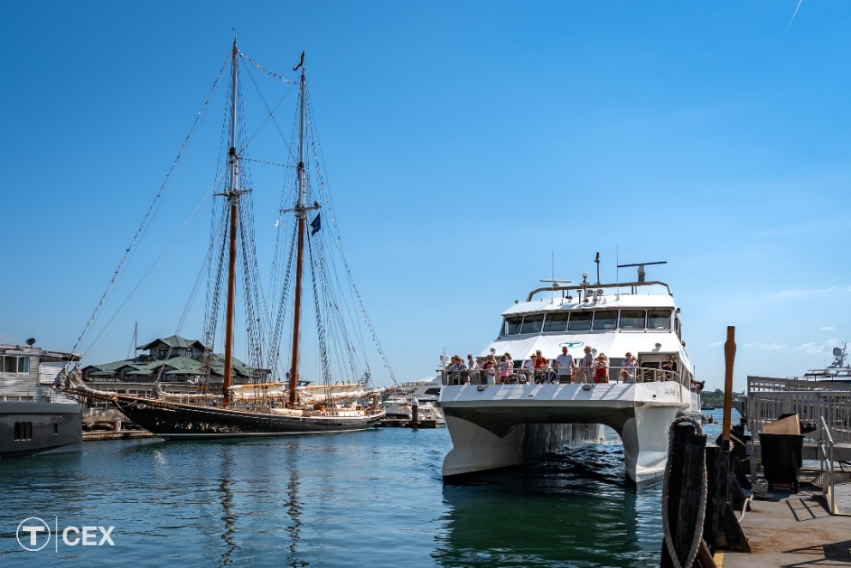
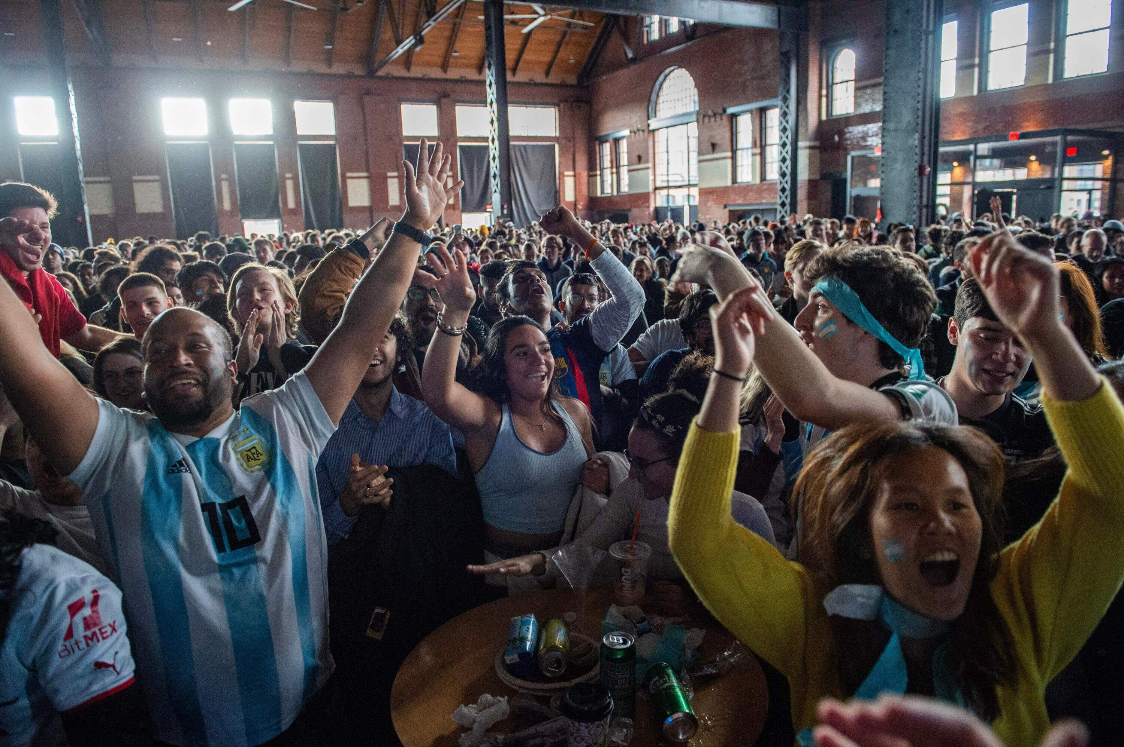
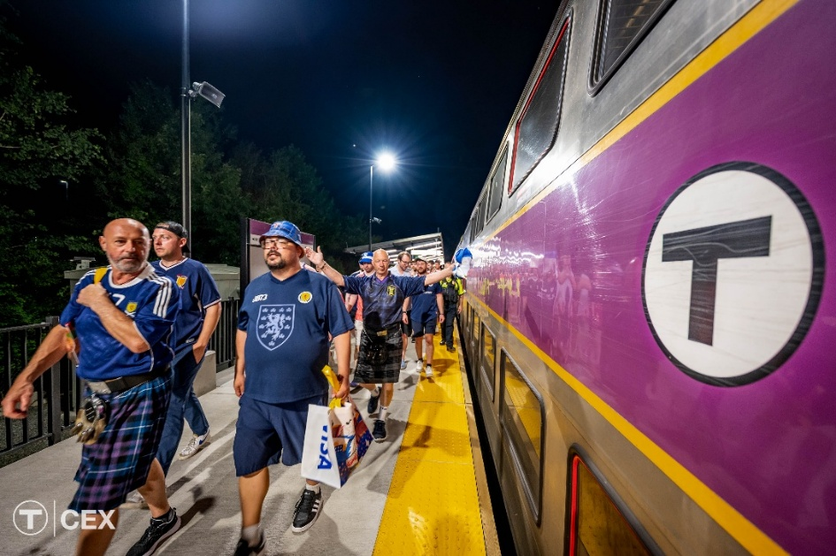
Transportation Goals during 2026 Mega Events
3
Safely, reliably, and efficiently transport people throughout the Commonwealth to major events, including the FIFA Men’s World Cup, America 250, and Sail Boston
Support the economic benefit of major events by enabling spectators and other visitors to travel when, where, and how they need to go without thinking too much about how they were going to get there
Manage and minimize impacts to the rest of the transportation network to allow essential travel to continue for residents and visitors not participating in major events

Slide 4
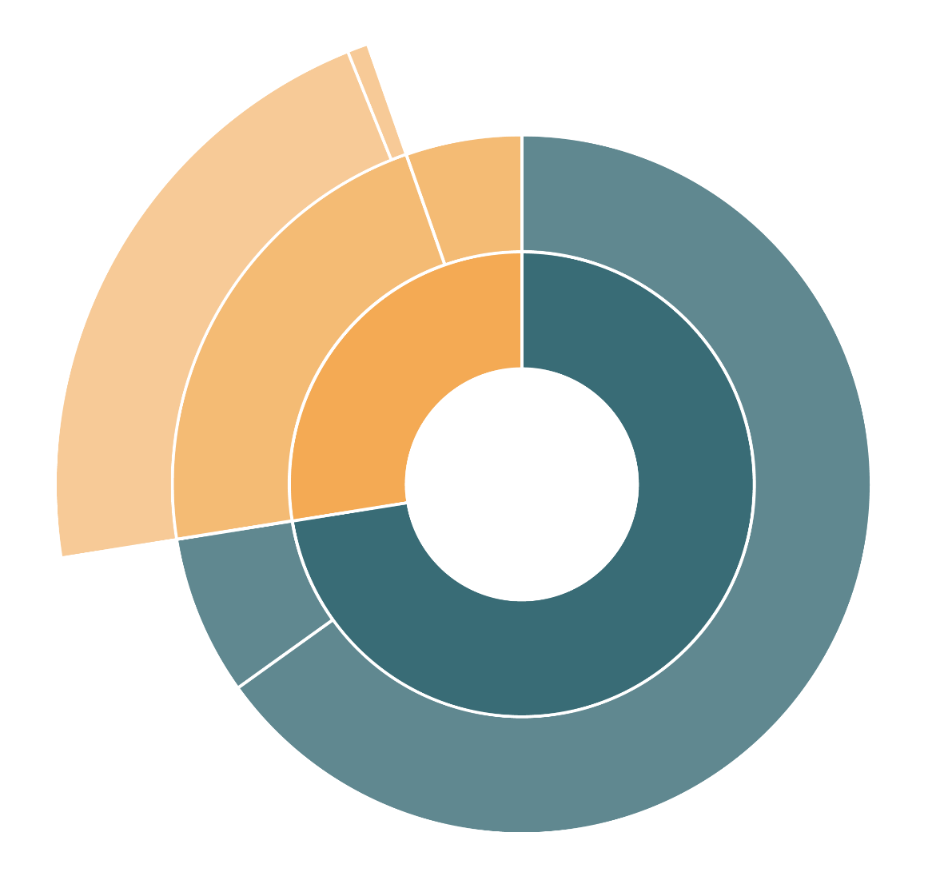

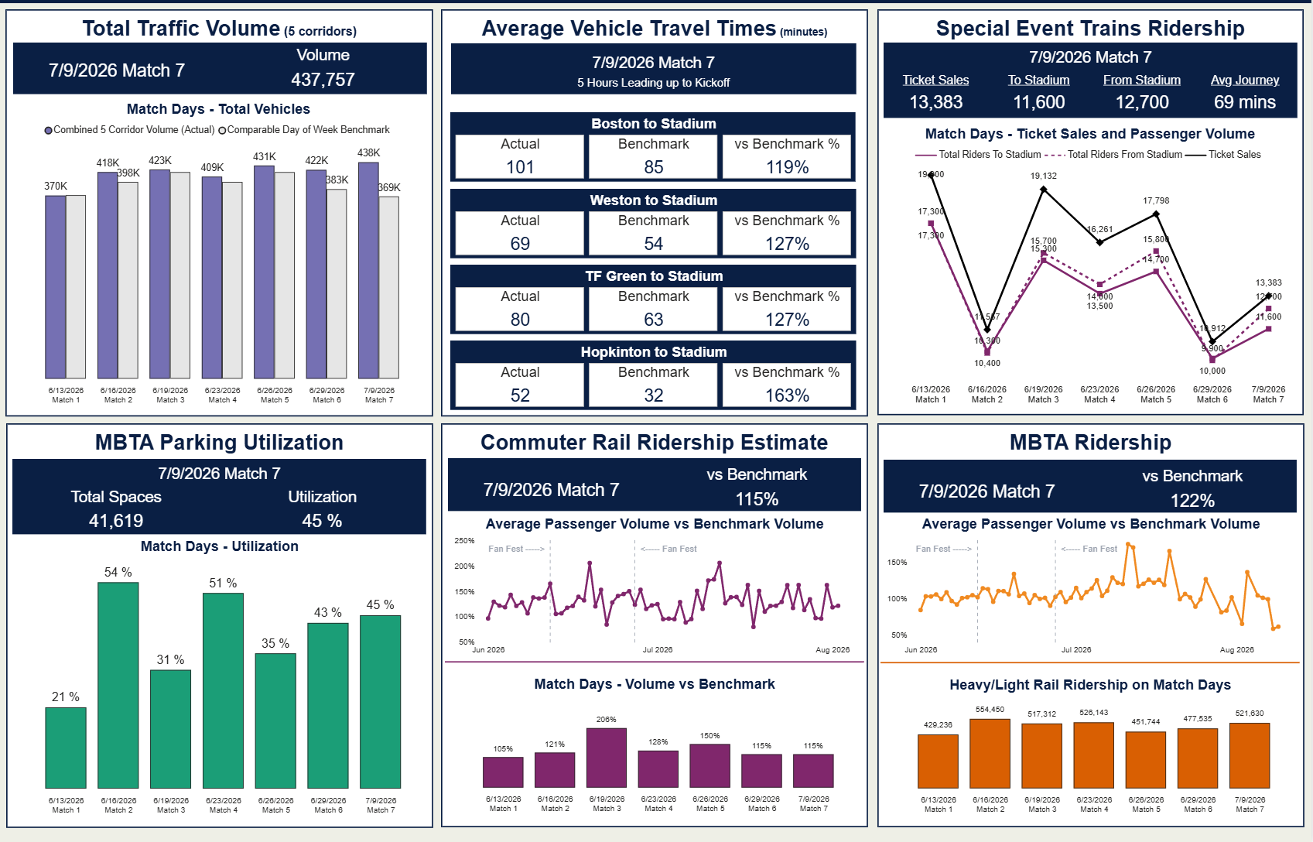
Travel Behavior Monitoring and Analysis
June 13 – August 28, 2026
4
FIFA Men’s World Cup Post-Match Observation Dashboard
Estimated Mode Split
(Average of June World Cup matches)
GATRA Shuttles
0.7%
Stadium Express
Shuttles
5%
MBTA Special Event Train
21%
Public Transit
22%
Transit
28%
TNC*
7%
Driving
72%
Personal Auto
65%
* Transportation Network Companies, like Uber or Lyft

Slide 5

Key Findings: FIFA Men's World Cup Mode Split
June 13 - 29, 2026 (Average across first six matches)
5
        This is the highest share of transit usage to a special event in the history of the stadium
          28% transit usage vs. 5% Taylor Swift
        Low wait times for queues for the Special Event Trains
          An average of 17 minutes across all trains and all events
          Queuing strategy of boarding groups was successful
        Roadway impacts were minor
            Travel times were faster to Men’s World Cup matches than other similar events (e.g., average of 46-minute drive vs. 62-minute drive for Taylor Swift Eras Tour)
            Volume of the total Transportation Network Company (TNC; e.g., Uber, Lyft, etc.) trips to and from World Cup matches was about 2x higher than comparison events at the stadium
        No major rest-of-network disruptions observed for roadways or transit

Slide 6
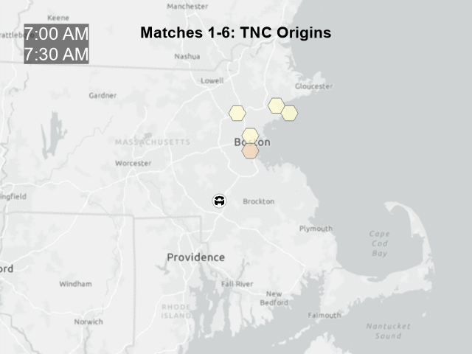
Key Findings: FIFA Men's World Cup TNC Travel
June 13 – June 29, 2026 (Data only available for first six matches)
6
On average, TNC trips to Boston Stadium were about twice as high as comparison events – likely due to high out-of-state attendees and ¼ the usual stadium parking capacity.

Slide 7
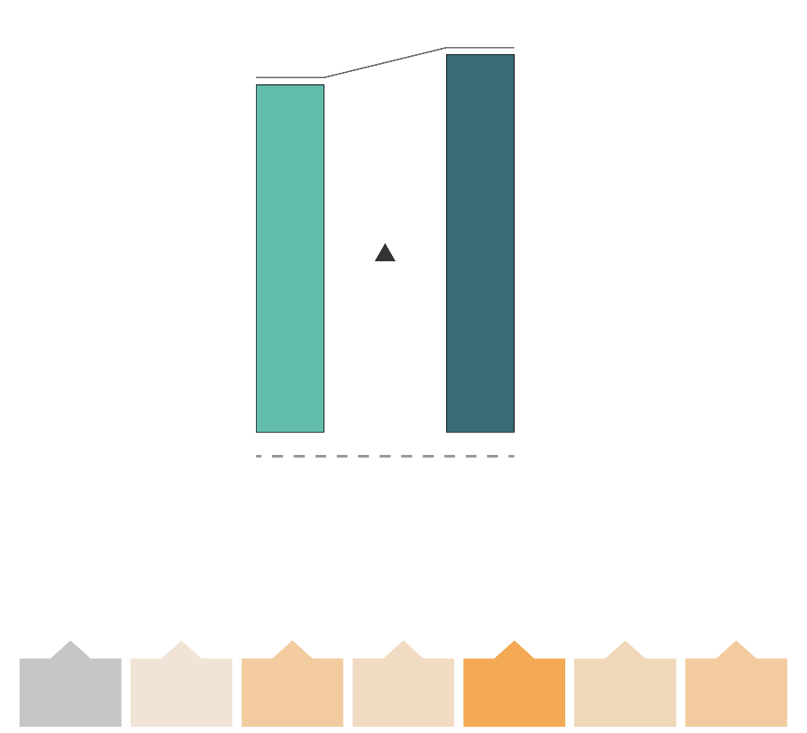

Key Findings: Mega Events Subway Ridership
June 13 – July 9, 2026
7
Subway Ridership Growth by Day
during FIFA Men’s World Cup
(June 13 to July 9, 2026)
Ridership on Heavy and Light Rail was up about 9% during the period Boston was hosting FIFA Men’s World Cup matches
Weekends with fan events saw an increase in rapid transit ridership over weekends without fan events
During the Parade of Sail, Rapid Transit ridership was up 60% and Commuter Rail nearly 70% over what we would expect to see on a summer Saturday.
  Sunday sustained similarly elevated volumes (+52% for Rapid Transit and +62% for Commuter Rail) before activity quickly tapered off for the remaining festival days.
11.26m
12.25m
Estimated Ridership Baseline*
Observed Ridership
9%
Overall Ridership on Subway
0%
+4%
+12%
+7%
+23%
+8%
+12%
Mon
Tue
Wed
Thu
Fri
Sat
Sat
* The estimated baseline is calculated based on the typical seasonal fluctuation in ridership between Spring and Summer. It is what might be expected in absence of the World Cup and other summer mega events.
+8%
Weekday

Slide 8
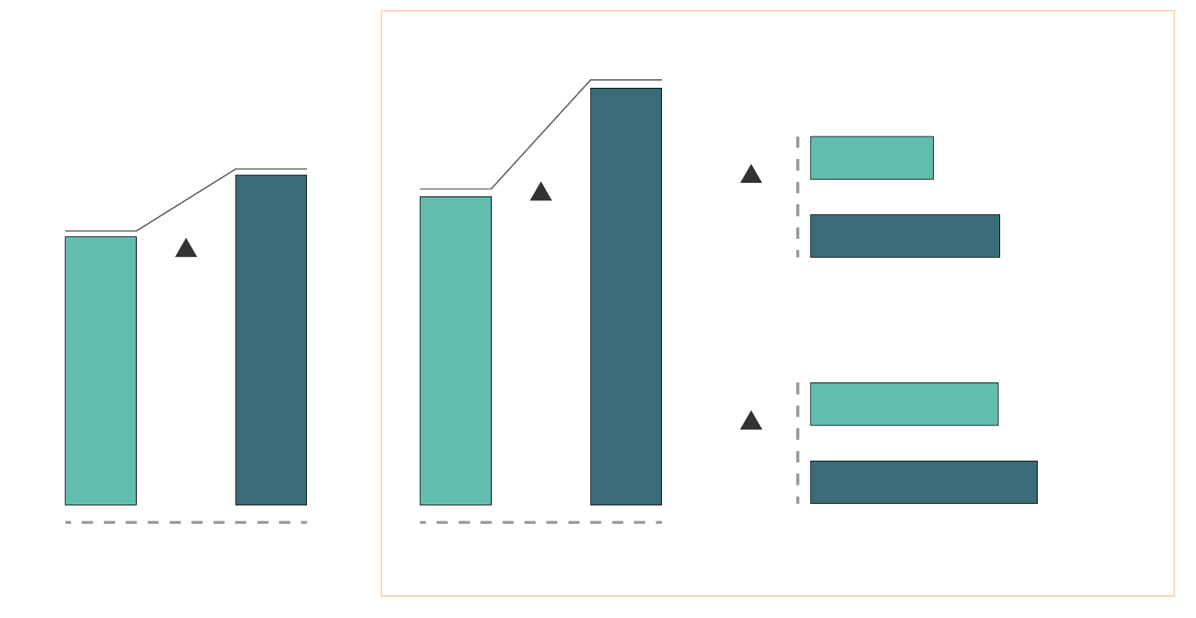
Key Findings: Mega Events Commuter Rail Ridership
June 5 – August 28, 2026
8
Summer 2026 Passenger Volumes
Compared to Estimated Baseline
Commuter Rail weekly ridership has been elevated about 23% over baseline throughout the summer, even on days when fares were collected.
Consistent with findings presented at July’s MBTA board meeting, Free Summer Fridays were associated with a 35% increase in Commuter Rail ridership this summer
The increase was most pronounced at North Station, where Friday ridership increased by 54%.
10,000+ people rode Commuter Rail with $1 “Companion Fares” this summer
Estimated Ridership Baseline
Observed Ridership
76,500
North Station
60,500
56,500
22,500
49,000
35%
54%
34,500
23%
South Station
34,500
21%
41,500
All Days
Excluding Fridays
Free Summer Fridays

Slide 9
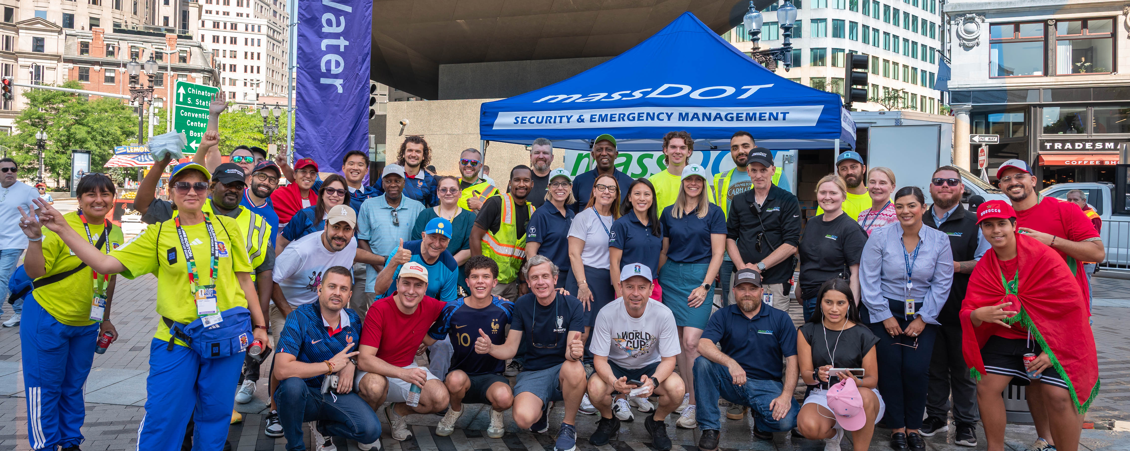
Thanks to Fans, Volunteers, and Riders!
9

Slide 10
Thank you

Slide 11
Appendix

Slide 12
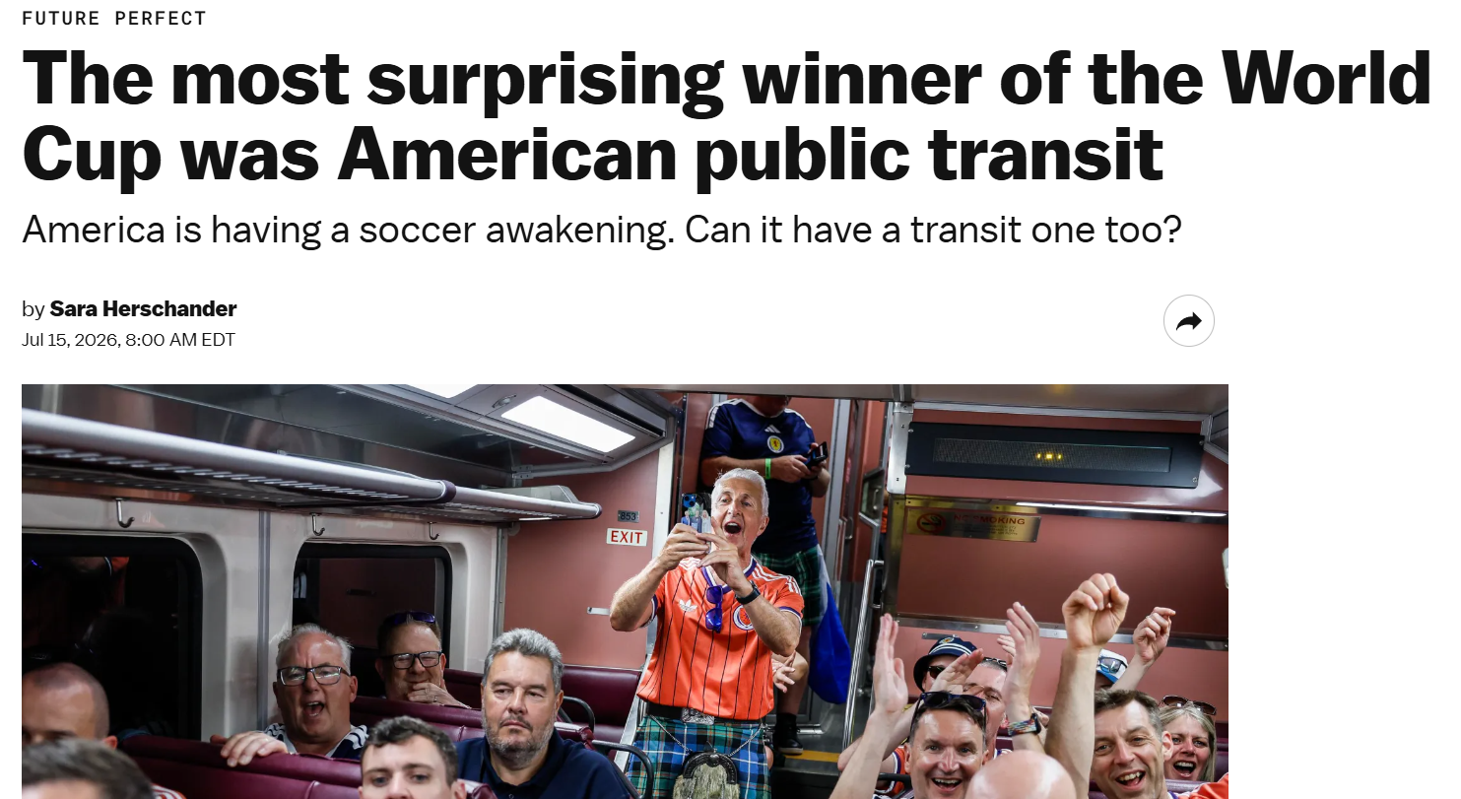
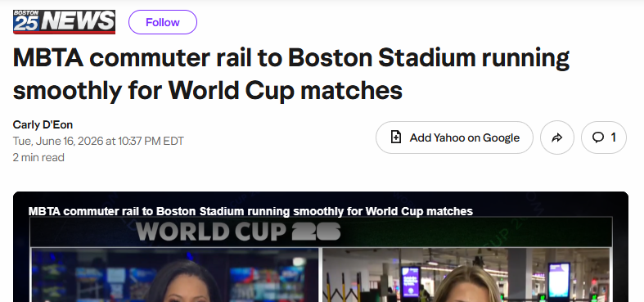
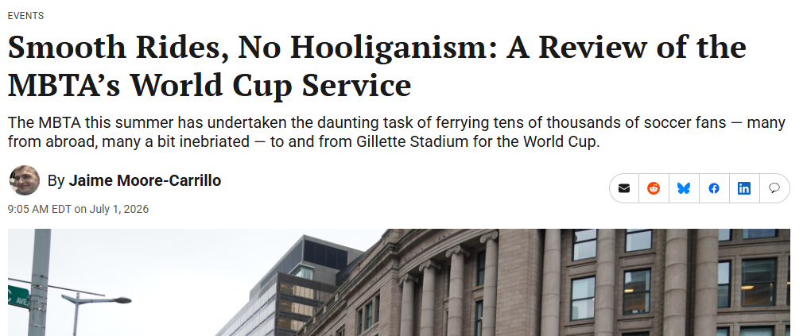
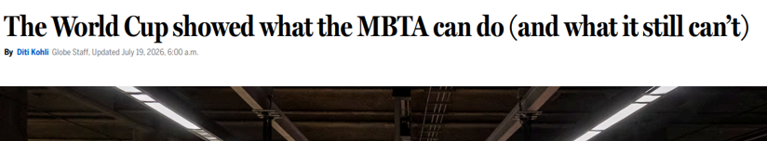
What we observed
Sources: https://mass.streetsblog.org/2026/07/01/smooth-rides-no-hooliganism-a-review-of-the-mbtas-world-cup-service; https://www.yahoo.com/news/us/articles/mbta-commuter-rail-boston-stadium-023705159.html ; https://www.vox.com/future-perfect/495394/world-cup-public-transit; https://www.bostonglobe.com/2026/07/19/metro/mbta-commuter-rail-world-cup-foxborough/

Slide 13
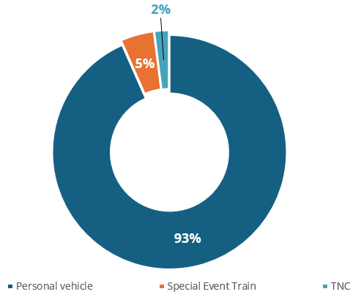
Taylor Swift Sunday night comparison
The Average travel time across all highways to the stadium for the 2023 Taylor Swift concert was: 62 mins (compared to an average of 46 mins for the FIFA Men’s World Cup matches).

