Slide 1
Massachusetts CBHI:
Supporting youth and Their Parents in Crisis
TRAINING FOR IHT AND ICC TEAMS
Facilitated by Kappy Madenwald
part One
Notes:
Kappy Madenwald is an independent consultant. Unless otherwise indicated, the materials in the presentation were developed by Kappy. You are free to use the materials as long as credit is given.
INTRODUCTION OF OTHER TRAINERS:

Slide 2
Introductory Notes
This is not intended to be a passive training—a few requests:
Please change your profile to include preferred name, title, agency
Video generally on, understand you may need to briefly turn off at times
  We will take 1, 15-minute break each day
Mute generally on, but please interrupt with questions, comments by taking yourself off mute, doing a ‘handwave” or notifying the administrator via chat if I miss all of those other signals
Use the Chat box to comment, amplify, acknowledge other’s work in some of the areas we cover
Participate in Zoom polls

Slide 3
Note about CE Credits
CE credits are approved for the following licenses: LADC, LMFT, LMHC, Psychology, Social Work
CE credits are available to attendees who meet the following requirements:
Attend the entire training (both halves)
Complete the evaluation and CE application in Survey Monkey
Active Participation Code
All attendees must actively participate in the entire training in order to receive CE credit. This is typically done via sign-in and sign-out sheets during in-person trainings. However, since these trainings are virtual, we need to track engagement differently.
We are using a code, given letter-by-letter throughout each session, to track engagement.
WRITE DOWN & SAVE THE LETTERS. Then enter the code in the Training Evaluation and CE Application survey you receive following the training. Note that the codes are unique for each 3-hour block. You cannot receive CE credit unless you enter the codes.

Slide 4

10+ years of CBHI
Remarkable achievement!
Implementation is hard, but sustaining change is even harder
Lots of leadership and line staff changes throughout CBHI
It has been quite some time since there has been training focused on crisis intervention

Slide 5

Poll Question #1
How many years have you worked in CBHI program(s)?
  Less than 1 year
  1-2 years
  3-5 years
  5-9 years
  I have worked in CBHI since its launch in 2009!

Slide 6
Poll Question #2
What best describes your position?
  Family Partner
  Clinical Director
  Program Manager, IHT
  Program Manager, ICC
  Team Supervisor IHT
  Team Supervisor, ICC
  Clinician, IHT
  Therapeutic Training and Support Specialist, IHT
  Intensive Care Coordinator, ICC

Slide 7

Introductory notes
This training was developed for IHT and ICC teams.
It complements the crisis training provided to MCI Teams
Though the topics we cover today may seem basic, they are not
Some content may feel personal or provocative
May unearth deeply held beliefs
Candor is important
Psychological safety is important in training and coaching…and is a parallel process

Slide 8
Introductory Notes
In Massachusetts, there is an emphasis on crisis responses responses that are:
  Early,
  Voluntary
  Local
  Community-based
Using approaches that are resolution-focused and that reduce the likelihood of needing:
  Law enforcement involvement
  Section 12 initiation
  Inpatient hospitalization

Slide 9
Four primary competencies
To achieve those results, it is essential that the delivery of crisis support and intervention is:
Youth and family-centered
Strength-based,
Resolution-focused, AND that,
The services are delivered within the context of the broader crisis system of care—

Slide 10
Introductory Notes
Today’s session
We are going to start with the 4th competency,
Then we will spend the bulk of this session building some contextual, and system’s level understanding of why these approaches are so important
Part II
We will turn our attention to the application of the first 3 competencies to crisis support and intervention—the focus is on our individual approach
We will have an immersive experience—crisis care as experienced from the “shoes” of parents
We will end with some safety planning strategies

Slide 11
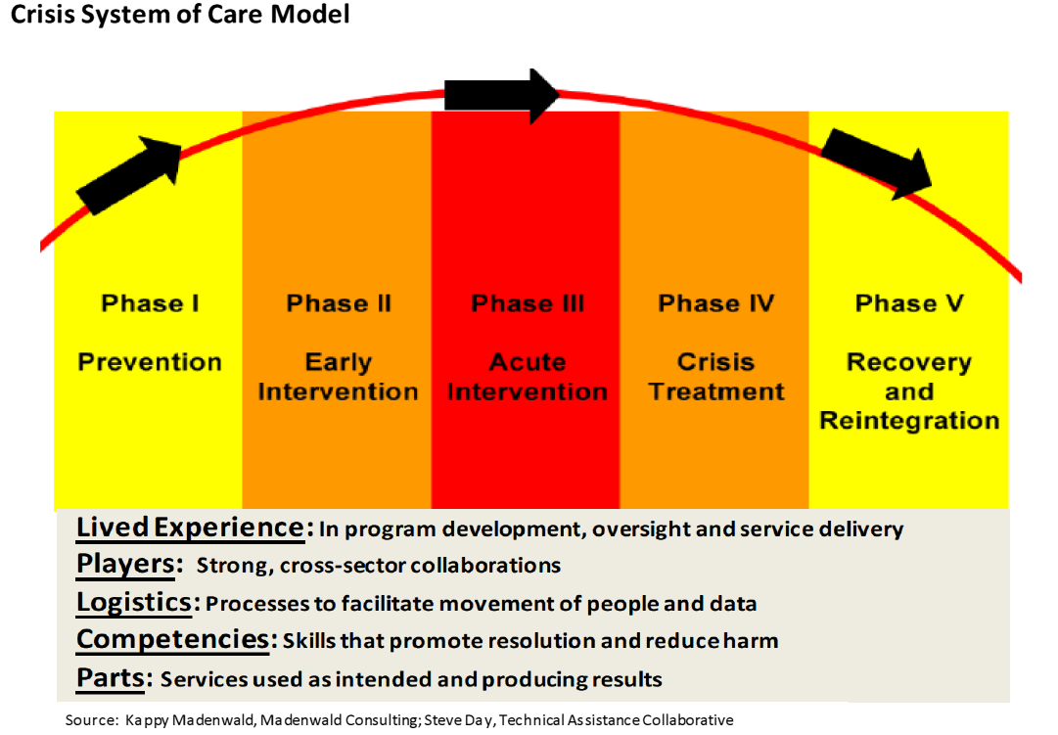
Crisis Systems of Care Framework
A Crisis System of Care is the organized whole of a behavioral health crisis system.
CSOCs are not naturally present in communities—they must be built
Crisis work is necessarily systemic—it cannot be effectively addressed by a single person, system or agency.
Let’s look at a familiar analogy…

Slide 12

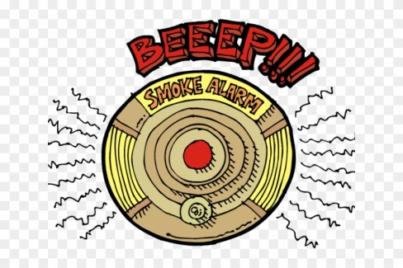
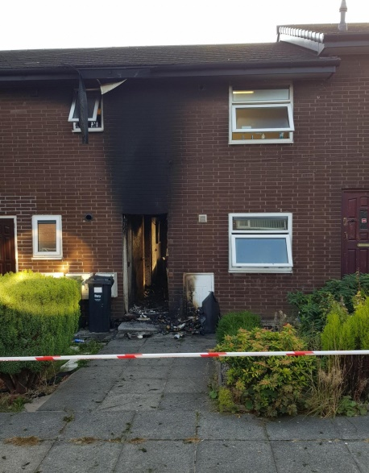
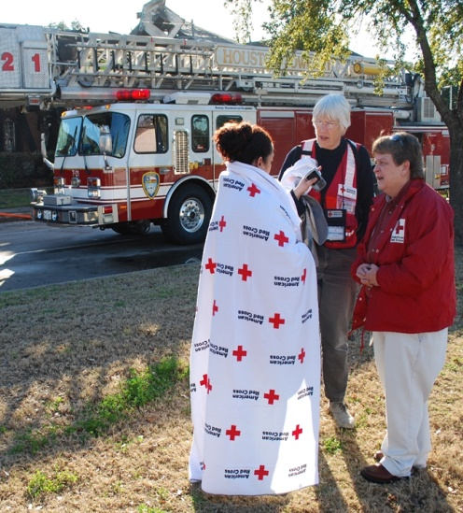

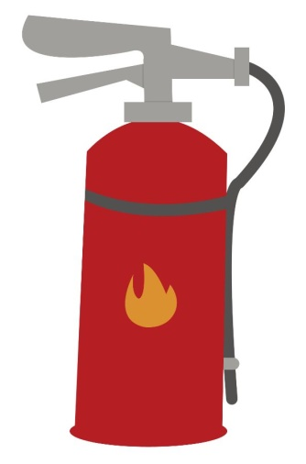

Why are prevention and intervention important?
Fire Prevention | Early Intervention | Acute Intervention | Post-Fire | Fire Recovery
Notes:
A comprehensive crisis system of care is important the way public fire safety and response is important. Consider this analogy (use successive clicks to add pictures)
If we don’t intervention until there is a blazing fire, even when there is an effective response it is costly and harmful to people and/or property. At that point all that can be done is investigation, clean up, offering temporary resources and finding new housing.
If we focus attention upstream, there is a lot that can be done to prevent fires in the first place, and to intervene early before too much damage has been done.

Slide 13
Crisis System of Care Model
This is an organizing and planning framework that offers ten points of opportunity for building depth and breadth into a crisis system: within five “phases” and five “key components”
Tendency can be to narrowly focus on acute crisis response
Tendency can be to narrowly focus on crisis system “parts”
Notes:
The crisis systems of care framework is a way of thinking about/planning/investing in a robust and effective crisis system of care. The framework offers ten ways to think about expanding a system and want to consider a balance of investments in each of the areas.
A system can think about and invest in each of the five phases (prevention, early intervention, acute intervention, crisis treatment, recovery/reintegration).
(CLICK to get pop-up)
However, often 90% of the thinking/investment is on acute crisis intervention.
Sometimes crisis systems are highly reliant on law enforcement, 911, Emergency departments, child protective services and jails—these are default responses and signal an underdeveloped crisis system.
Sometimes crisis system responses are narrowly focused around screening individuals for some higher level of care and performing evaluations like ITA’s to see if involuntary treatment is warranted.
However crises have to get pretty bad for these kinds is systems to get activated—risks are higher, costs are higher, harm may have already occurred.
When a community invests in Crisis Prevention (not the same as illness prevention) and Early Intervention it can prevent crises from escalating to an acute phase where more intensive and intrusive measures may be needed.
Investing in Recovery/Reintegration supports individuals following a crisis event or hospitalization to assure effective care coordination, modification of care plans, intensified support, etc. during this high risk period.
Questions for group:
For MCI: in which phase do these teams have the most leverage? (Acute intervention)
For IHT and ICC: in which phase do these teams have the most leverage?
All crisis teams highly reliant on other service providers including service providers in other systems to deliver effective upstream (prevention, early intervention) and downstream (recovery/reintegration) work including effective crisis prevention and planning and early response to crises.
In addition, communities can bring depth and breadth to the crisis system of care by considering/investing in each of five key components:
(CLICK to get next pop-up)
However, often 90% of the thinking and investment is on adding new “parts” like the new programs and services being provided for children in Philadelphia.
But, parts, in and of themselves are not automatically useful to a system. They can be very expensive, but not achieving desired results, not serving the right people, have logjams at front door/back door. Each part has to work as intended, producing excellent health outcomes, a satisfying care experience (from the shoes of the children and their families that are using it).
Each part has to work within the context of the broader system.
Parts need commensurate competencies, strong logistics and collaboration with key players to bring greatest value to a crisis system.
And the whole of the system must be informed by lived experience.
Lived Experience: Individuals who have/have experienced mental health and substance use conditions and crisis episodes and family members of those individuals are an INVALUABLE resource in building, evaluating and providing resolution-focused systems and services. Peer specialists, including Parent Peer Support Partners, and Youth Peer Supports provide direct support. Individuals with these experiences are increasingly being recruited onto interdisciplinary crisis teams.
If a system or program has been operating with a traditional medical model orientation, it is extremely difficult to shift to a person/family-care orientation WITHOUT substantial inclusion of individuals with lived experience.
Players: The strongest crisis systems have a broad cross section of active players (rather than a broad audience that is watching and waiting for the traditional crisis players to get it all done)
Think well beyond traditional crisis players like police, hospital EDs and Mobile crisis teams to a much broader group of entities/individuals who can influence crisis events like schools, child protective services workers, pediatricians, probation officers, foster parents, group home staff, advocacy organizations, religious leaders.
Helpful to think of behavioral health crises through a public health lens like disaster planning and response with FEMA, Red Cross, National Guard trained as leadership but with all entities prepared to prevent and mitigate the harms of a disaster. USA has come a long way in this area since Hurricane Katrina—and in more recent events we see evidence of the benefit when local, state and federal agencies work together, and when individual businesses are able to activate their own well-thought crisis plans.
This room represents a group of crisis FIRST RESPONDERS and crisis treatment providers—it is why you were hired. Many of the folks in other systems have their own areas of full-time focus, but can play a strong and essential role in crisis management.
Logistics: Again, throughout a crisis episode a child/family may come in contact with numerous entities/service providers and the child him/herself may need to move from one place to another.
Strong logistics help with safe, rapid flow of data and people.
This includes the logistics to support bringing a team to a child wherever he/she may be in crisis with the technology to work remotely.
Transparent, real time, and forecasted data is incredibly valuable in operating a well-developed crisis system of care.
Think of the value difference:
Last month there was a hurricane
A hurricane hit yesterday
A hurricane is hitting right now
A hurricane is coming
ASK: WHAT KIND OF REAL TIME or FORECASTED DATA would be useful to you in your crisis work? HOW WOULD DATA TRANSPARENCY HELP THE CRISIS SYSTEM FUNCTION?
Competencies: This includes crisis competencies for the core crisis providers, but also for other systems. Examples—
Mental Health First Aid (for mental health laypersons. There are now specialized curriculum for youth MHFA and law enforcement MHFA). MHFA teaches basics about mental health conditions and strategies for supporting a person in crisis.
Crisis Intervention Team (CIT) for law enforcement: 40 hr intensive training, again with training on mental health conditions and also medication, ride-alongs with MH workers, hearing from individuals with lived experience, de-escalation role plays. Usual law enforcement approach of “Show of Force” can be non-productive/dangerous if a person is in crisis state, psychotic, manic, intoxicated.
Trauma Informed Care—is being learned across a broad range of settings.
Sanctuary Model in residential care settings—a trauma informed approach that improves the climate/safety of a congregate care setting for residents and for staff
CRISIS RESPONSE ADVANCED PRACTICE
Crisis comes in many forms and broad skills are essential in meeting the needs of individuals with MH, Substance-use related, Intellectual-disability-complicated crises.
Crisis support for a person who has witnessed/experienced a traumatic event like a shooting/unexpected death/disaster/student suicide is a wholy different set of expertise and it is important to build this expertise

Slide 14
Intervening in crises is complex for individuals and teams
Because we are working with some youth whose health care crises are life threatening, it is natural to be concerned about personal liability or corporate liability.
It is important to have a broad understanding of the ways that crises put families at risk,
But, we also have to understand the ways that a system’s response to crises can put families at risk, and
Individually and as a system, work to minimize iatrogenic harm
Notes:
There have been previous iterations of mobile crisis in Philadelphia, and there have been previous youth-specific crisis services. There is an element of “what once was old is new again” and some people in the training group might remember those previous initiatives and program models
CBH and DBH are most appreciative of the hard work and dedication of all of these crisis providers and programs whose work precedes the redesign.
Like all of healthcare, behavioral healthcare must continually self-evaluate, change, innovate, modernize. Increasingly, there is national attention being paid to the development of effective models of community based crisis services and thinking about the broader, Crisis System of Care as a whole
It isn’t personal, but it can feel personal to bravely examine current practices and to consider how children and families are EXPERIENCING those services that we work very hard to provide. It can feel dangerous to rely less on intensive and restrictive services and more on less restrictive and even informal strategies for supporting children and their families through a crisis.
While we want the change to occur as soon as possible, the transformation in practice should not be rash or rushed. It is important to be deliberate, introspective, and to continuously seek feedback from families using the services, from others with lived experience and from our community partners.
This is complex change, not “this week we use the blue form and next week we are switching to the red form”. This will more likely be experienced as a developmental change process that occurs over a period of months and years.
Each agency and individual provider must think through the elements of change, figure out the “business reason” for making the changes, and consider risk management, due diligence.

Slide 15
Iatrogenic Harm
Harm caused by treatment
Generally unintended
Often avoidable
Iatrogenesis: Brought forth by a healer
ANY intervention, regardless of provider intention introduces a risk of harm that would not otherwise be present
Use CHAT to share examples of iatrogenic harm in the behavioral health field

Slide 16

Iatrogenic Harm
When there is iatrogenic harm, it implicates us, as providers of the treatment and it implicates the systems in which we operate
But, this also gives us power
We are in the driver’s seat to find ways to reduce risk of harm
It requires continuous improvement of our craft, policies and processes
Iatrogenic harm is easiest to recognize when we orient ourselves to the care experience of the youth and his/her family—when we view from their shoes

Slide 17
Poll Question #3
How familiar are you with the term, and in considering the risk of iatrogenic harm in crisis response?
  I am familiar, and risk of iatrogenic harm is routinely considered by me/the team in a crisis situation
  I am somewhat familiar, and risk of iatrogenic harm is occasional considered by me/the team in a crisis situation
  The term is familiar, but not generally considered by me/the team in a crisis situation
  This is mostly a new concept for me
Use CHAT to make additional comments

Slide 18
Diminishing the need for coercive practices
Though there may be a guise of safety, coercive practices sometimes have less to do with imminent risk and more to do with one or more of the following:
  Habit
  Convenience
  Cost
  Transportation
  Concern about personal or corporate liability
  “this is how we do it here”

Slide 19
Diminishing the need for coercive practices
Watch for patterns that suggest a risk of greater iatrogenic harm
  Referring entity or admitting facility preference for involuntary hold/admission
  Routine use of security guards, seclusion or restraints
  Restrictions by rule rather than exception, such as gowning, 1:1, loss of belongings, visitor restrictions
  Carrot/stick behavioral systems
  Unscheduled and/or AMA discharge
  High volume referrals to youth/adult protective services

Slide 20


Storytelling

Slide 21
When responding to crises: what stories are impacting our efficacy?
This may get clearer throughout the training…
Historic stories of individuals with behavioral health conditions
Stories about how families use the system/treatment
Stories about our (intervener/treatment provider) role in a youth’s treatment
Stories about the parents of those individuals— we are going to spend extra time on this--
Stories predispose actions

Slide 22
Retraining the brain
Our brains are our number one resource
Can be trained to aid our work
Must be vigilant to any deficit stories we tell, and actively work to change them
For example, we can train our brains to believe this story:

Slide 23
Perceptions of Parents in the Mental Health Field
Since the 1970’s there are four major categories that these perceptions fall into:
The Cause: Parents are seen as the primary cause of the child’s issue and are therefore seen as the primary target for change. This is the most common view. Family dysfunction is viewed as the cause of the child’s problems.
Lacking Education: Parents are seen an incompetent to appropriately address the needs of their child because of deficits in their knowledge and they need to be “taught” how to express themselves.
The Client: Parents are in need of support services themselves. This approach is a shift from the first 2 categories and seeks to support families without blaming them. However, it is problem-focused and dismisses their strengths, abilities and keeps them at the mercy of the “expert”.
Collaborator: Parents are viewed as collaborators in the education and treatment of their child. This approach develops a relationship with parents aimed at finding workable solutions to the child’s problems. However, one of the difficulties with the collaborative approaches is that neither academic training nor clinical training prepares professionals for this perspective.
SOURCE: Child Study Center at New York University (New York, NY)
Notes:
As human beings we tell stories—it is part of our nature. In the grocery store, in restaurants, in our neighborhoods, while driving down the street; we tell stories based on limited information. Our stories may be influenced by a person’s appearance, by stereotype, by personal projection, by habit.
Sometimes the stories are flattering and sometimes they are anything BUT flattering to the person being discussed.
In the mental health field, the professional’s view of parents whose children have mental health conditions becomes part of the story.
Professionally, the stories are influenced by beliefs, experiences, formal training, informal on-the-job learning, workplace climate and culture and our own personal journey.
The problem is not so much that we tell stories, but that we believe the stories we tell are factual—or the only interpretation—and we start acting accordingly. And as described earlier in this training, the perceptions many mental health professionals have of parents whose children have mental health conditions are not positive:
Parent as the cause of their child’s condition
Parent as lacking in education
Parent as client in need of own treatment
These perceptions lead to stories (i.e. The apple doesn’t fall far from the tree, We have the wrong identified client, This kid doesn’t stand a chance, The parent is looking for a place to dump the kid, etc).
The first three “deficit” perceptions are seemingly reinforced every time the treatment team meets a new family and assesses the family and the situation that led to treatment so it is very easy to fall into the trap of identifying and focusing on the perceived deficit. The deficit approach will quickly lead a team off-course as demonstrated in the following example.

Slide 24
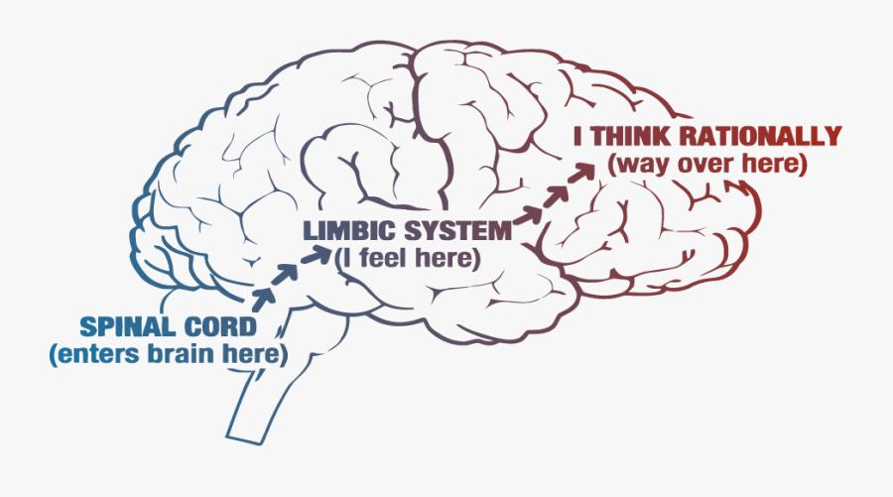
“Credible, Capable, Intuitive and able to Collaborate”

Slide 25
Parents as collaborators
Provider engagement and activation of parents as informed and intuitive drivers of their children’s health care is an under-developed skill set
This is particularly true in the mental health field because of concern about the ability of parents whose children have mental health and other behavioral conditions to make competent decisions
  Providers are often not trained in collaborative and shared decision-making models
  Parents are generally not experienced participants in the same
To the degree that it is not already occurring, this gives teams a great opportunity to change the crisis experience for youth and their families.
Notes:
We are in a field that has told the parent BARRIER story for decades
Most childrens behavioral health programs invest in training around treatment of children, but very few invest in training around engaging parents as parents and as collaborative partners in the treatment of their children.
Providers aren’t often trained in collaborative approaches
Families are not experienced participants in collaborative approaches
Some parents have been burned when they have tried to collaborate (FIND SOME EXAMPLES OF THIS FROM YOUR NETWORK OF PARENTS)
This is a largely untapped opportunity
Mastering the art of engaging parents as parents and as collaborators will greatly improve your efficacy and will change the crisis experience for kids and families

Slide 26
“Parents as collaborators” even in tough circumstances
When parents oppose treatment recommendations
When we are turned off by how a parent is treating a child
Parents with trauma history
When the parent appears “impaired”
When a 51A is filed
And WHY would we do this?
HOW is this even smart?
Stories predispose actions, and this is a 2-way street!

Slide 27
Re-thinking Hospitalization

Slide 28
The Allure of Inpatient Hospitalization
Within a lot of communities, there are deeply held views about hospitalization:
  It is the best and highest quality service (other care is lesser care)
  It is a safer place
  Inpatient treatment is something you do to a person: “He needs inpatient treatment”
  Fabulous tests will uncover the answer
  Excellent medication will treat the problem
  Sending to ED and subsequent inpatient treatment is always the best risk management and harm reduction strategy
  Individuals returning from inpatient treatment are now stable and can return to business as usual
  Individuals will be successfully linked to the proper, good and effective treatment services following ED or inpatient treatment stay.

Slide 29
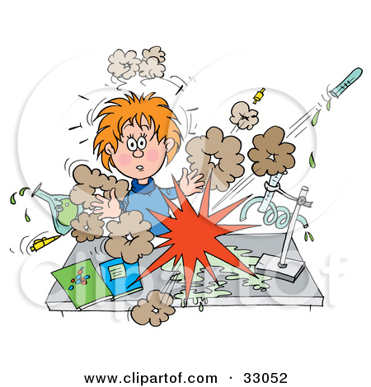
Efficacy of Inpatient Psychiatric Treatment
Some practice-based evidence…
Notes:
QUESTION FOR THE GROUP: Are you aware of the research on the efficacy of inpatient psychiatric treatment?
LET THEM OFF OF THE HOOK QUICKLY: There really ISN’T any research on it. Of course much of it depends on the expertise of a particular program since inpatient hospitalization in and of itself is a LEVEL OF CARE and not a description of the actual treatment to be delivered.
In the absence of good data, lets gather some practice-based evidence…
QUESTION TO GROUP: Based on your experience with inpatient psychiatric treatment, and the outcomes you have see for children and adolescents that have been hospitalized, from 0% to 100%, how would you rate the overall efficacy of inpatient psychiatric hospitalization. (go around the room as people shout out their numbers—there will often be a considerable range. People can pass if they want to pass)
NOTE TO TRAINER: HERE ARE SOME COMMON STICKING POINTS FOR AUDIENCE MEMBERS
Question: What do you mean by effective treatment?” (Answer: if you were the child or the parent of the child you would be satisfied with the effectiveness of the care OR if you paid the $30,000 for the treatment you would feel you got your money’s worth, OR that harms were actually lower when the child returned home and symptoms were decreased and health improved)
Comment: Well, if it keeps the kid alive I guess it is effective” Response: Do kids always stay alive if hospitalized? What are we hearing about suicide rates POST hospitalization?)
Personalize it: if it were your child—stand in those shoes for a minute…how would you characterize effectiveness?
HAVING FINISHED GATHERING THE %’s from participants roughly estimate the average. That it is not precise is not a big concern. Some groups land on the low end with a 15-20% average efficacy, some get higher in the 50-60% range. Where it lands doesn’t matter as long as there is some consensus that hospitalization is NOT 100% effective (I talk out loud about this). It isn’t 100% good and effective but we have longstanding practices that promote hospitalization and even compel it through 302 processes.
IMPORTANT TO NOTE: Hospitalization is a critical component of a comprehensive crisis system of care—this is not an attempt at hospital-bashing. Want to get clear however on the limits of its effectiveness and better at considering ahead of time, the potential benefit and risk for each specific child. OPEN HEART SURGERY is also a critical component in the cardiology field. Doesn’t mean it is best for my heart condition or that I will tolerate the procedure
ADDITIONAL INFORMATION FOR TRAINER:
JAMA Psychiatry. 2017 Jul 1;74(7):694-702. doi: 10.1001/jamapsychiatry.2017.1044.
Suicide Rates After Discharge From Psychiatric Facilities: A Systematic Review and Meta-analysis
Chung DT¹, Ryan CJ², Hadzi-Pavlovic D³, Singh SP⁴, Stanton C⁵, Large MM⁶
IMPORTANCE:
High rates of suicide after psychiatric hospitalization are reported in many studies, yet the magnitude of the increases and the factors underlying them remain unclear.
The suicide rate was highest within 3 months after discharge (1132; 95% CI, 874-1467) and among patients admitted with suicidal ideas or behaviors (2078; 95% CI, 1512-2856).
CONCLUSIONS AND RELEVANCE:
The immediate postdischarge period is a time of marked risk, but rates of suicide remain high for many years after discharge. Patients admitted because of suicidal ideas or behaviors and those in the first months after discharge should be a particular focus of concern.

Slide 30
Poll Question #4
Based on your experience and in talking to the families you work with, roughly what percent of time do youth experience a GOOD HEALTH BENEFIT from psychiatric hospitalization?
  100%
  80%
  60%
  40%
  20%
  Less than 20%
Use CHAT to make additional comments

Slide 31
Re-thinking hospitalization
Quadrant Model for Re-Thinking Psychiatric Hospitalization. Source: Madenwald Consulting, LLC
Notes:
This is a quadrant model which offers a chance look at the interplay of 2 critical factors when considering psychiatric hospitalization.
First, the vertical side is about expected health benefit. Overall this group said that X% of the time there is a good health benefit from hospitalization. That means that X% of the time there was NOT a good health benefit (corresponding to the low end of that arrow set).
QUESTION FOR GROUP: On a KID-SPECIFIC level, are there times that you are MORE optimistic about the benefit of hospitalization and times that you are LESS optimistic? Think of the last few times you have been involved in a hospitalization? What has made you more or less optimistic?
Prompters, as needed:
In what circumstances?
What crisis conditions/diagnostic conditions?
What social factors?
What cultural factors?
How does consent/vs non-consent (302) influence efficacy?
Location of facility?
Skills of program staff?
Now consider the horizontal part of the quadrant model. This is about the risk that the hospitalization will result in iatrogenic harm.
QUESTION: Are you familiar with the term?
It is talked about quite often in general medicine but not so much in the behavioral health field. It is roughly defined as Harm that is caused by the treatment. If not for the treatment, the harm would not have occurred.
Classic medical examples of iatrogenic harm:
Admitted to get tonsils removed and while I am there I acquire MRSA or some other hospital-borne pathogen
Go into surgery to get one knee operated on and they accidentally operate on the other
Acquiring bed sores, or feeding tube infections, …
Iatrogenic harm is GENERALLY UNINTENDED and OFTEN AVOIDABLE
A guiding principle for physicians: “First, do no harm.” It is a humbling reminder in practicing medicine that even when it is my intention to HELP my treatment may result in HARM.
In the behavioral health field this idea that we could deliver treatment that causes harm is unsettling to many providers who have not recognized the risk.
ASK: So what are some IATROGENIC risks of inpatient hospitalization for children?
(Try to get a good mix of responses—think whole health consequences). Answers might include:
Misdiagnosis, wrong medication
Stigma/shaming
Separation from family
Traumatizing experiences (being harmed in milieu environment, witnessing traumatizing events like restraints, a child with trauma history being triggered by the setting in some way)
Getting behind in school (there are a good number of kids waiting for months, even a year for “placement” this is a big deal)
Iatrogenic harms related to 302 process in Philadelphia—mandatory reporting from this, impact on firearm ownership for life, cannot pursue career in military or law enforcement. Think how big a deal this is especially if care could have been delivered voluntarily.
QUESTION FOR GROUP: On a KID-SPECIFIC level, are there times that you are MORE concerned about the risk of iatrogenic harm and times that you are LESS concerned? Think of the last few times you have been involved in a hospitalization? What has made you more or less concerned?
So, we end up with four boxes—not necessarily equal in number and lots of gradation (kids that don’t fall neatly into one box), but to keep it simple, there are green box kids (we anticipate high benefit and low risk) but also red box kids (We anticipate low benefit and high risk).
Not intended as a decision-making tool but as a tool that broadens the conversation. This broader thinking keeps us out of touting hospitalization as “good and effective and safe” and allows a more informed and youth-specific conversation with the child, parents, and other key stakeholders.

Slide 32
Poll Question #5
Based on your experience and in talking to the families you work with, roughly what percent of time do youth experience IATROGENIC HARM from hospitalization?
  100%
  80%
  60%
  40%
  20%
  Less than 20%
Use the CHAT feature to make additional comments

Slide 33
Does the individual meet criteria for psychiatric hospitalization?
What is the expected health benefit for THIS individual?
What are the risks of iatrogenic harm to THIS individual?
Are there alternatives that offer THIS individual equal/better potential health benefit, while decreasing risk?
Historic crisis Question
What hasn’t always been considered

Slide 34
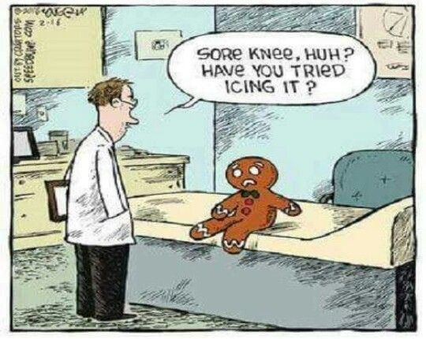
These are consequential considerations
What changes as you get more information?
You are eligible for knee replacement surgery
It is effective___% of the time
It causes iatrogenic harm ___% of the time
Here are alternatives that could be considered…

Slide 35

Getting to the essence of the Distress
Notes:
The Massachusetts crisis system as it has operated historically, has been fairly narrowly focused on assessment and referral as the primary crisis deliverable
The assessment leads to some conclusion around presenting problem, diagnosis, mental status AND whether criteria is met for referral/admission to some level of treatment service.
It might even lead to use of a Section 12
This is not unlike many other crisis programs that operate in the USA today.
Massachusetts is invested in the delivery crisis intervention that is a brief treatment service, designed to relieve symptoms and reduce risk.
This is how you get the best bang for the buck from a crisis program.
For the youth and family—this is how they get an opportunity for rapid crisis relief at the earliest possibly point

Slide 36
Getting to the Essence of the Distress
We are collaborating with families who have led extraordinary lives
For a provider, it can be hard to sort it all out
Fortunately, we don’t have to understand all of the history in order to be of service
But, we do want to understand the essence of the crisis for the youth AND for the parent(s), and very often, for other players too—this is where a big opportunity for resolution lies
Essence isn’t fundamentally about the diagnosis
Nor is it fundamentally about the problem
Notes:
“Families who have led extraordinary lives” (note the language here. Not dysfunctional lives, extraordinary lives that are unique to each of them)
It is tempting as a provider to try to sort it all out
It is easy to get overwhelmed by the whole of the child/family’s story—and to feel the impossibility of being of service to a family
But, we don’t have to sort all of it out. In Solution-Focused therapy one of the tenets is : you don’t need to know much about the problem in order to solve it.
Instead of focusing on the nitty gritty of all of the “facts” we want to pay close attention to the ESSENCE of the distress.

Slide 37
Getting to the Essence of the Crisis
Fear Grief/loss
Sadness Pain
Anger/rage Exhaustion
Loneliness/isolation Hunger
Restlessness/boredom Lack
Hopeless/helpless Stuck
Uncertainty/ambivalence Misery
Anxiousness/nervousness Powerlessness
Guilt Shame
Notes:
When it comes right down to it, the ESSENCE of the distress is often among this list of normal (though uncomfortable) human experiences. Regardless of the nature of the crisis or the diagnosis, essence is how a crisis is being EXPERIENCED.
ASK: Can I have schizophrenia and NOT be in crisis? (yes)
Can I have suicidal ideation and NOT be in crisis (yes)
Can I have no diagnosable BH condition and BE in crisis (yes)
In Columbus, Ohio, peer specialists interviewed individuals who were frequently readmitted to the acute unit of the state hospital and asked: When it comes right down to it, what is the reason you were readmitted? The top two reasons (making up more than 50% of the responses) were loneliness and boredom. Some went further to say loneliness and boredom that led to…cutting, using, needing to get out of my home, crying, feeling anxious, feeling suicidal…)
So, the community addressed those factors of loneliness and boredom, invested in some peer drop in options during evenings and weekends, worked with individuals to find social supports, etc and it had a nice impact on reducing readmissions

Slide 38
Getting to the Essence of the Crisis
It can be easy for a service provider to hone in…
    Level of care assessment/disposition (sending them somewhere else as key deliverable)
    Diagnosis (as if all MSE changes/crises stem from a diagnosable condition)
    Unwanted behavior (chasing behavior rather than getting to the essence behind it)
    One’s own (service provider) priorities instead of youth/parent priorities
    …and miss identifying the essence of the crisis
This is where person-first and whole-health thinking is so important. People are more than their illness
Notes:
What happens with Louie if the first thing we do is asking about homicidal ideation? How accurate will our assessment be?
What happens with Louie’s parent if the first thing we do is talk about disposition?

Slide 39
Getting to the Essence of the Crisis
IMAGINE IF…
Notes:
PURPOSE OF EXERCISE: The purpose is to aid in learner understanding that the “problem” itself is not the crisis. The crisis is how the person is experiencing the crisis—the ESSENCE of the crisis state for the person. Participants are asked to individually jot down thoughts to avoid “group think.”
INSTRUCTIONS:
1. SAY: “I would like you to individually jot down your thoughts. Imagine if you have suddenly become completely and totally homeless—you have no housing options. What would the essence of the crisis be for you?”
2. After a few minutes, ask them to share. If 20 or fewer people, I will generally ask everybody to share. Keep a list of the array of unique answers and once you are finished soliciting answers read the list.
3. SAY: “The problem is the same—you are completely and totally homeless. But the essence of the crisis is different—and that crisis state is what has a person stuck. If we can help them shift from here

Slide 40
Getting to the Essence of the Crisis
Question:
If the facts haven’t changed, can there be resolution?
Notes:
Ask the question on the slide: If the facts haven’t changed, can there be crisis resolution for you?
Can you remain homeless and not be in crisis?
The problem doesn’t have to go away/facts don’t have to change in order to find relief (facts of the crisis are often unchangeable anyway)
EXAMPLES: what might change is my perspective, perception, interpretation, time passing helps, the steps I plan to take solidify, the degree of control I feel increases, how I feel about myself changes. Spiritual awakening may occur, ambivalence may have turned to a firm stance, I may have new knowledge that brings relief.
Resolution is usually evident in visible, palpable change in words, body language, mood, subjective self-evaluation of distress level .

Slide 41
Getting to the essence: SCENARIO
8 yr. old Louie was transported by police officers from his school to the Crisis Response Center where he is waiting to be seen in the ED. You call the school to get more information and are told:
Louie has been continuously disruptive in school. He is restless in his chair, he interrupts other children who are trying to focus on their work and he has repeatedly left the room without permission. Today he threatened another child with a ruler—holding it like a rifle and threatening to kill him. Louie’s mother has been very difficult and defiant. She won’t answer the phone when the school calls and has missed several meetings. She has gotten verbally abusive with school staff at previous meetings and the adjustment counselor thinks that Louie is subjected to similar verbal abuse at home and suspects that it is why he acts out so much in school. His dad left when Louie was 3 yrs old which probably contributes to the trouble at home. The school has asked repeatedly that she take Louie for an evaluation for medication and warned her that he is at risk of suspension.
You learn that the school has filed a neglect complaint with DCF previously and plans to file another one. The school also tells you that Louie needs a different school placement or partial hospitalization and medication for ADHD. Finally you learn that the school left a message for Louie’s mother informing her that Louie is now in the emergency department awaiting your evaluation.
Notes:
NOTE to presenter: This is an immersive exercise standing in the shoes of a child and then a parent. The goal is for participants to understand the essence of the crisis first for Louie and then for his mother and to recognize the normal human being-ness of their crisis experiences.
(A white board or flip chart is very helpful in this exercise to document key words from audience responses)
Read the scenario

Slide 42

Standing in The Shoes of a child in crisis…
Stand in Louie’s shoes. Using first person language, describe your experience…
Describe your experience
What are you feeling and thinking?
How are you acting?
How are you interpreting what is happening?
Notes:
Ask participants to take off their “service provider” hat and speak in first person. This is essential to gain a proxy understanding of the experience from Louie’s shoes—participants get more of a gut level understanding rather than 3rd person impression/interpretation.
USE QUESTIONS FROM THE SLIDE AND AUGMENT AS NEEDED TO GUIDE THE EXPERIENCE
How did Louie get from the school to the ED? How do most kids get there? (911, police transport, in handcuffs)
You (Louie) arrived in this way and now are in the ED…what are you experiencing
If the story participants are telling is derogatory, ask them to tell a better story that is still credible
If participants begin regurgitating facts, or talking in 3rd person refocus them on essence and prompt, “from your 8yr. old shoes—”how are you experiencing it?
You may want to flip back to the scenario so participants can continue to consider it
On the white board, capture Louie’s experience as the audience describes it, for example
This is terrifying
Why am I here?
Why did my teacher do this to me?
Am I in trouble with police? With my mom? With these doctors?
Etc
Prompt until you get a well-rounded set of answers that cover thoughts about school, mom, police, ED
ASK group to look at the list of responses and to identify the ESSENCE of the crisis for Louie
Answers might be: Fear, confusion, betrayal, worry, sadness…
ASK group to use scale of 1 (low) to 10 (high) to rate the severity of each of those items
ASK in Louie’s shoes, how much are you thinking about what happened with you and the other student right now? (answer is usually, ‘not at all’)
ASK how might ED staff be interpreting your behaviors’ knowing that you were referred over due to homicidal threats? (answers will likely include: sign of my condition, proof that I am aggressive0
Refer back to the Essence for Louie and the 1-10 ratings and ASK, “is your behavior (in Louie’s shoes) right now, better described as crisis state, symptom of MH condition, or character trait? Answer: The stuff they identified is by and large crisis state
Follow up comment to group: You may also be seeing symptoms related to the mental health condition, or some character traits, but what you identified is crisis state.
ASK: Is it pathological crisis state or normal human being crisis state? (answer: normal human being stuff)
NOTE TO THE GROUP THAT: on top of whatever diagnosis there might be, Louie is having a normal human being reaction to how this crisis event is getting managed in the system.
I can have a crisis, or a mental illness AND have a normal human reaction to events.
As treatment providers we want to recognize and address these crisis state elements that are hierarchically most important to him.
THEN we can start to address underlying conditions.
If we don’t do this, we misinterpret what we are seeing in our MSE and diagnosis.

Slide 43

Standing in The Shoes of a Parent…
Stand in the shoes of Louie’s parent who got the message from the school and is now in the ED. In first person language…
Describe your experience
What are you feeling and thinking?
How are you acting?
How are you interpreting what is happening?
Notes:
SAY TO THE GROUP: Now, we switch the focus to Louie’s mom who listened to a message, probably while she was at work. The message was from the school and we know from the scenario that this has not been a great relationship.
You may want to flip back to the scenario so participants can continue to consider it
Read the questions on the slide, remind to stay in first person.
On the white board, capture the mother’s experience.
I am FURIOUS with the school
How could they send him to the ED without my permission
They are trying to get rid of him
What is happening to Louie? What will they do to him?
I need to see him NOW
I am FURIOUS with Louie. Can’t believe he has done this again
I am fearful I will lose my job
The school bus comes in an hour. How will I ever get home on time
Prompt until you get a well-rounded set of answers that cover thoughts about school, Louie, ED
ASK group to look at the list of responses and to identify the ESSENCE of the crisis for Louie’s mother
Answers might be: Fear, confusion, anger at school, worry, sadness…
ASK group to use scale of 1 (low) to 10 (high) to rate the severity of each of those items
ASK: in mother’s shoes, how much are you thinking about the nature of Louie’s condition—if he his in fact, homicidal? (answer might be mixed. Anger at school, belief that Louie was misbehaving, or worry about work and other timetables for other children MAY BE OF PRIMARY IMPORTANCE)
ASK how might ED staff be interpreting your behaviors’ as you walk into the ED, knowing that your child was sent here because of his homicidal threats (She’s the problem, no wonder Louie is in crisis, apple doesn’t fall far from the tree)
Refer back to the Essence for Louie’s mother and ratings and ASK —is your parent behavior right now, better described as crisis state, or character trait? Answer: The stuff they identified is largely crisis state
Follow up to group: there may be character trait underlying the crisis state as well, but what you identified is crisis state. ASK: Is it pathological parent crisis state or normal parent crisis state to abnormal event? (answer: normal human parent stuff)
NOTE TO THE GROUP THAT: “Louie’s parent is having a normal human being reaction to how this crisis event unfolded. We want to address these crisis state elements that are hierarchically most important to her. THEN we can start engaging in collaboration on what is happening in school, if there is an underlying condition in Louie to address. If we don’t do this, we will not effectively engage and collaborate with her to reach a collective understanding and consensus plan for what should happen next

Slide 44
Stand in the shoes of a parent…
Periods of experiencing “parent/parenting” crisis states is an anticipated and normal component of the journey of any parent whose children experience mental health crises.
Can your “parent/parenting” crisis be resolved even if your child’s condition doesn’t stabilize or improve?
Why is this important?
Notes:
As a field, we can ANTICIPATE that parents will be having a NORMAL but crisis-state reaction when their child has a serious behavioral health condition, especially when the child is having a crisis
ASK: Can your “parent/parenting” crisis be resolved even if your child’s condition doesn’t stabilize or improve? (yes)
ASK: Why is this important?
NOTE IN SUMMARY: As it is less of a crisis state for the parent the better they are able to support, participate, address the needs of the rest of the family…it is no longer so engulfing of the parent’s emotions/behaviors.

Slide 45
Understanding the Essence of the Crisis
(Nature of the Distress)
Fear Grief/loss
Sadness Pain
Anger/rage Exhaustion
Loneliness/isolation Hunger
Restlessness/boredom Lack
Hopeless/helpless Stuck
Uncertainty/ambivalence Misery
Anxiousness/nervousness Powerlessness
Guilt Shame
Notes:
When it comes right down to it, the ESSENCE of the crisis is often among this list of normal (though uncomfortable) human experiences. Regardless of the nature of the crisis or the diagnosis, essence is how a crisis is being EXPERIENCED.
ASK: Can I have schizophrenia and NOT be in crisis? (yes)
Can I have suicidal ideation and NOT be in crisis (yes)
Can I have no diagnosable BH condition and BE in crisis (yes)
In Columbus, Ohio, peer specialists interviewed individuals who were frequently readmitted to the acute unit of the state hospital and asked: When it comes right down to it, what is the reason you were readmitted? The top two reasons (making up more than 50% of the responses) were loneliness and boredom. Some went further to say loneliness and boredom that led to…cutting, using, needing to get out of my home, crying, feeling anxious, feeling suicidal…)
So, the community addressed those factors of loneliness and boredom, invested in some peer drop in options during evenings and weekends, worked with individuals to find social supports, etc and it had a nice impact on reducing readmissions

Slide 46

For both child and parent, lead with RELIEF
Get to the essence of the crisis (understand the nature of the distress)
Seeing/understanding
  Not the same as agreeing
Learn, what is most important right now to the person?
What is the antidote?
  Don’t forget the basics
  Take care to not compound the crisis
Deliberately engage a credible, capable, intuitive person
  Get curious about what matters
  Get curious about what might help
  Do not underestimate the value of giving the person in crisis your full attention, unconditional regard, and actively listening
Notes:
The basics:
Food
Clothing
Shelter
Telephone
Bathroom
To see/talk to a loved one
To get information about what is happening

Slide 47
General Rule of Thumb
Think STATE
not TRAIT
Notes:
ASK –Why a suggestion that as a general rule you think STATE instead of TRAIT??
Addressing trait feels futile—feels unchangeable.
When we tell (in our own service provider minds) a STATE story, we remove any artificial ceiling on a person’s potential, we are hopeful about/seeking solutions…

Slide 48
Massachusetts CBHI:
Supporting youth and Their Parents in Crisis
TRAINING FOR IHT AND ICC TEAMS
Facilitated by Kappy Madenwald
part two
Notes:
Kappy Madenwald is an independent consultant who is working with CBH and DBH on the crisis system redesign. Unless otherwise indicated, the materials in the presentation were developed by Kappy. You are free to use the materials as long as credit is given.
INTRODUCTION OF OTHER TRAINERS:

Slide 49
Overnight reflections…let’s start some CHAT!
What stands out to you from yesterday?
Did anyone have a chance to try any of this out?
Did anyone use the word “iatrogenic” in a sentence?
Questions?

Slide 50
Back to the first three crisis competencies…
Delivery of crisis support and intervention that is…
Youth and family-centered
Strength-based,
Resolution-focused, AND that,

Slide 51

Youth and Family-Centered
Notes:
ASK –Why a suggestion that as a general rule you think STATE instead of TRAIT??
Addressing trait feels futile—feels unchangeable.
When we tell (in our own service provider minds) a STATE story, we remove any artificial ceiling on a person’s potential, we are hopeful about/seeking solutions…

Slide 52
Family-Centered Care
Family Nice
Family Centered
Family Driven
Notes:
If you look at the websites of child-serving mental health centers across the country you will see descriptions of treatment that is “family-centered”. To say a program is NOT family centered might feel akin to saying we are NOT culturally competent and we DO discriminate in who we treat—it just doesn’t have a good ring to it.
But are we really providing family-centered care in the behavioral health field? I suggest that by and large we are not, just as much of the rest of the health care field is not and that most of what we are doing would be better described as “family nice”
Family nice is perhaps a nicer way of delivering care than the way it has most often been delivered historically…in a provider-led, expert knows best fashion.
Family-friendly hours, easy parking, snacks while you wait, extended visiting hours, giving families things, using flex funds…this is nice and is often welcome by families, but it isn’t family-centered care.
In delivering FAMILY NICE care—there is still a power differential with treatment provider largely in the driver’s seat, making decisions, determining priorities, interpreting findings, guiding treatment…
Though providers of mental health treatment services (psychiatrists, psychologists, social worker, counselors, and psychiatric nurses) may have their own lived experience (as individual, family member or friend of a person) with a mental health conditions; many tend to rely primarily on expertise gained through formal training, work experience, shared professional beliefs and programmatic structure, climate and culture in delivering treatment services.
This “expert lens”, is inclusive of the service provider’s interpretations, deeply held beliefs, preferences, professional experience and expertise, with minimal attention to the interpretations, deeply held beliefs, preferences, experience and expertise of the service recipient, they are using a traditional treatment approach.
Sometimes called the “medical model” this approach is still widely (though not necessarily officially or consciously) used in much of healthcare including mental health care.
Tied to this approach is often a deeply held belief that the trained mental health professional knows what is best for the youth/family. The concept of a deeply held belief is important in understanding why the transition to family-centered care is quite complex for mental health providers. Deeply held beliefs seem irrefutable, logical, and factual—not much room in there for the belief-holder to seek alternate explanations.
To start doing care that is family-centered, we must stop doing care that is provider-centered/program-centered.
We are not giving up our EXPERTISE—families desperately want expertise.
We are giving up our expert stance and our power position
We give up one care orientation to gain from the other.
In family-centered care there is an equalization of the power—this is collaborative and co-creative work with each party bringing expertise.
Approaches are used that promote insight, introspection, new interpretation, aha moments, problem-solving by youth and family—the smart thinking happens THERE…in the brains of the child and family, not with the provider.
THEY have the giant stake in this and THEY are uniquely capable of finding their way through to a unique solution.
This family-centered care climate is one where empowerment and health activation are nurtured and strengthened
Where children and their parents become stronger in their belief that they have a voice in care and that their ideas are sound
A right to use their voice;
Where children and parents become clearer that the illness is not defining of child or family,
That it is possible to have the illness without the crisis, and
That they have power over their lives
CLICK once
Having mastered these skills children and parents are then equipped to drive care as smart intuitive users of the system, piecing together the elements of care that are useful and developing an instinct for the services and service providers that are not.
Person/family-centeredness is an essential core competency for achieving fidelity with the evidence based practices in our field: Motivational Interviewing, Solution-focused therapies, Cognitive behavioral, Wraparound care planning and when done well it is empowering, solution-creating, crisis relieving, harm reducing and health activating.
As youth and their parents get more empowered, find their voice, have confidence in their intuition and ideas, they gain self-efficacy and they gain agency:
“I am not my disease” “I can figure out this system and effectively advocate for the care my child needs”

Slide 53
Aligning with True North
The experience of consumers and families and communities must serve as True North
-Don Berwick
This means that the ordinal point (True North) for system quality is derived from the recipients’ reality -- our lived experience, our needs, our beliefs and strengths, as well as our reactions to services extended on our behalf.
-Joyce Burland
Berwick, D. M. (2002). A user’s manual for the IOM’s ‘‘Quality Chasm’’ report. Health Affairs, 21(3), 80–90. doi:10.1377/hlthaff.21.3.80.
Burland, Joyce, True North: The NAMI Provider Education Program Comes of Age. www.nami.org
Notes:
Berwick said If we are to achieve in transforming our healthcare system “then the experiences of consumers and families and communities must serve as true north”
In other words, you cannot build a working system without the wishes, preferences, knowledge of those that use the system. Let lead the thinking of consumers and families and
They will orient us towards WHAT IS HAPPENING
They will orient us towards WHAT IS WANTED
They will orient us towards WHAT WILL WORK
Let lead the thinking of a community and it will guide to
Where to start
What the strengths are
Ways of achieving a desired end
JOYCE BURLAND, who founded NAMI’s Family to Family program took it a step further and said
This means that the ordinal point (True North) for system quality is derived from the recipients’ reality -- our lived experience, our needs, our beliefs and strengths, as well as our reactions to services extended on our behalf.
This is a subjective measure but THE MOST IMPORTANT measure—how are people experiencing the care that we are delivering? Cannot measure success from the provider view, must be from the recipient view
A corporation puts out a shiny new product and thinks it is awesome, but what REALLY matters is the consumer response: is it functional and worth the money TO US
In a system that has held tremendous power over its service recipients, this can be a novel concept, because historically service recipients haven’t had sufficient power to influence practice.
In a system where we continue to tell deficit stories about those who receive our stories (poor judgment, not-motivated, attention seeking, etc) it is easy to excuse/explain away negative feedback

Slide 54
Aligning with True North
“I wish everyone else could see me in the way you see me. I don’t even know how you see me, but whatever it is, I want to feel this way forever. I feel like how normal people must feel. But if it doesn’t last forever, I’ll remember this period in time that I was respected and heard and appreciated for the rest of my life…”
Source: NAMI Advocate. Quote from a participant in a program developed by NAMI Georgia called, “Opening Doors to Recovery”
Notes:
Here is a quote that speaks to how it FEELS to receive treatment that is person-centered.
READ the quote, then ASK
Imagine you are the parent of a child in crisis. If THIS (quote) is how you feel about your/your child’s experience with the crisis team, WHAT BECOMES POSSIBLE? (Ask for 1st person responses)
Sample answers (probe further, as in the examples below)
Hope (hope in what? Hope resulting in what. What is possible if I have hope? What will I do differently when I have hope?)
Vulnerability (to do what? What is different if we can be vulnerable)
Trust (trust what? What happens if there is trust)
Belief in self (leading to what?)
Feel understood and accepted (leading to what?)
NOW, ASK the question in a different way: BECAUSE this is the care experience, what do you as parent, not have to WASTE TIME DOING?
Defending
Mistrusting
Avoiding
Wondering what is safe to say
Convincing
(again, probe further, asking WHY NOT? Why don’t you have to waste time…defending, mistrusting…)
Get a nice breadth of responses and then ASK: Thinking about the parents you know and how they have experienced the broader treatment system, what percent of the time are they having to WASTE (defending, not trusting)
NOTE TO THE GROUP:
Can you see how thinks like “mistrusting and defending” are an unfortunate use of time that should be spent receiving resolution-focused, effective intervention.
It may become necessary for the person to spend the time (defending, mistrusting) in order to protect self/child against the threat that the provider/service is posing (whether the provider or service is aware they are a threat or not)
NOTE TO THE GROUP: The person who wrote the quote that is on the slide didn’t have everything together in his life, but the service provider engaged him as whole, and wholly capable and it makes a world of difference in what is possible. This orientation results in PRECISION care with little to no time wasted in self-protection…

Slide 55
Aligning with True North
The parent (or youth…) and his/her experience is the orientation point for service delivery
It requires:
  Seeing youth and parent as credible, capable, intuitive and able to collaborate
    Honoring the journey
    Holding a belief in their recovery
  Joining youth and parent where they are
    Beliefs
    Culture
    Preferences
    Interpretation of experience
Notes:
Instead of expert care orientation (lens/worldview/skillset of service provider)
Care is oriented to the youth or the parent who is the focus of the particular situation/conversation/intervention.
Note to PRESENTER: provide a visual of this by raising your left hand into the ‘true north’ position. Say to the group—this is where the parent (child) is. Their worldview, culture, interpretation of the crisis, feelings they are having about it. It is where they are.
Then use your right hand slowly bringing it up from its resting position by your side until it is aligned next to your left hand. THIS (right hand) is a person/family-centered orientation. We SEE and align with what they are experiencing, how they view/interpret and very literally begin from where they are.
SEEING is not the same as AGREEING.
SEEING doesn’t mean ACQUIESCING (i.e. parents don’t want their child in the hospital, so because we are family-centered they won’t be hospitalized)
Family-centered care is NOT order fulfillment. It is the art and act of alignment through great expertise of the service provider and it becomes the STARTING POINT for meaningful, collaborative change
In SHIFTING OUT of my expert orientation (RIGHT HAND RESTING TO THE SIDE) I become open to the unique knowledge, experience and ideas of the youth/parent and the power potential that it holds. We work with children and families who have lived extraordinary lives and the solutions that will work for them will be unique and largely known only to them. We are not in a field where passive care (IV drip) or externally imposed approach (when we direct a person to “manage your crisis this way”) works.
As it relates to something like hospitalization, I (service provider) must remain OPEN to the possibility that my view that hospitalization is NECESSARY may be incorrect) and I use the True North orientation to GET CURIOUS rather than getting defensive.

Slide 56
Aligning with True North
It is easier said than done because it is such a shift in perspective
Rather than coming at a problem from my (service provider) lens, perspective and priority, I must re-orient so that I understand his/her (service user’s) lens, perspective and priority and start there.

Slide 57


Notes:
DESCRIBE AND DEMONSTRATE TO THE GROUP, USING YOUR HANDS.
Here is a visual of how it looks. This is a way to think about a traditional medical model or expert-driven service orientation.
The child/parent IS WHERE HE/SHE is (in true north position), but our world view is very different. (right hand by side) This is not collaborative care. If we had magic wand solutions we could probably get away with it (I didn’t like or trust the guy, but the treatment worked)
NOTICE how natural it is to have the right hand by one’s slide—it is a comfortable, natural and effortless position—seeing, doing, acting, interpreting from within our own world view
(note to trainers: this graphic is NOT reflective of the hierarchy that exists in the medical model where the service provider holds the balance of power)

Slide 58
Notes:
To shift to a youth/parent centered orientation requires intentional effort to step out of my worldview and shift to the view of the youth/parent using our best understanding of how they are seeing/experiencing the crisis event.
Again, SEEING how they see it is not the same as AGREEING with them.
Of course it is more complex because than this because the child and his/her parents and other family members are all in a tidy little circle, and in real life each holds their own unique view. As a service provider, I have a task of seeing, understanding aligning with multiple people in the course of one intervention WITHOUT TAKING A SIDE. I want to see the sides, but not take a side. There are no bad guys in this model. For change to happen, each person starts from where they actually are…

Slide 59

Notes:
And there are other players in the system that have a stake in the crisis episode or in the child’s treatment sometimes MANY players/systems. This model becomes important as an orienting tool for all of the players…
(MOVE THROUGH NEXT TWO SLIDES)

Slide 61
Notes:
No matter how many players, we all orient to the child and parent view and work from there.
(This thinking should align with System of Care principles, Fidelity Wraparound Care Planning principles)

Slide 62
Poll Question #6
Within the context of an acute crisis, how often does the team find it difficult or even unsafe to take a youth/family-centered approach?
  100%
  80%
  60%
  40%
  20%
  Less than 20%
Use the CHAT feature to make additional comments

Slide 63
Aligning with True North
Family-centered care requires a massive shift in the lens through which the service provider delivers treatment. Instead of a service provider viewing a problem, interpreting meaning, and making treatment decisions through his/her lens, the provider intentionally seeks to understand the lens of the youth AND the lens of the parent(s).
Both the youth and parent(s) are viewed as credible, capable, intuitive collaborators who bring their own expertise that must be jointly considered alongside professional findings and interpretations.
The difference between provider expert lens and youth/family centered lens can be extraordinary.
LARGE GROUP EXERCISE
Notes:
SAYTO GROUP: If we tell a deficit story about a child or parent (incapable, barrier, dishonest…) then it will not seem smart or safe to abandon our expert view and shift to a person-centered view. So, I need to do some internal work that allows me to make the shift. We will get into more detail about this on day 2, but basically, I need to shift the STORY I am telling about the child/parent until I can effectively view them as:
credible, capable, intuitive collaborators who bring their own expertise that must be jointly considered alongside professional findings and interpretations.
LARGE GROUP EXERCISE
Ask for a volunteer (he/she can stay seated) to do a little back and forth role play with you and say that others will be invited to jump in to help.
Scenario: You (VOLUNTEER) are a parent and I (PRESENTER as PROVIDER) am evaluating your child who is experiencing a crisis. Having completed my evaluation I come to meet with you to let you know that “It is very clear, having completed my evaluation that the only safe option is to hospitalize your child immediately. There is no other choice.” If your response is “Absolutely not, there is no way you are going to hospitalize my child”
AND if I am coming at it from traditional medical model (RIGHT HAND AT SIDE) orientation, then how will I NECESSARILY view (volunteer) as the parent? (This question goes out to the whole group)
Keep probing until you get most or all of the following: He/she is
a barrier
Incompetent
Neglectful
Has something to hide
Is in denial
NEXT QUESTION TO GROUP: “And , having quickly come to that conclusion that she (parent) is (reiterate what has been spoken, i.e. barrier, neglectful…) and her refusal to hospitalize, what am I (provider) from this traditional medical model orientation predisposed to do next?”
Probe until you get most of the following
Get more forceful
Threaten further action like 302 or DHS referral
Work around parent
Not listen to parent
NEXT QUESTION TO GROUP: And, can you see how logical that is for the provider and how ethical/smart it seems when coming from that medical model orientation? We have a parent seemingly posing danger to a child.
NEXT QUESTION IS TO THE VOLUNTEER: From your parent shoes, how are you reacting to this if it is clear to you your child should NOT be hospitalized? What are you thinking/feeling/doing? Would I (provider) know you are upset? What would I see?
(The response should be somewhere in the fight, flight, freeze category—whatever one it is play it out.
Then ASK broader audience— if you were in the parent shoes how would you react? Ask , ‘what do you notice about these various responses? What are these”reactions?
(ANSWER—Fight, flight, freeze—normal human responses to threatening events. AND we are, unintentionally, threat)
FIGHT—any verbal or physical response ”what would that look like? How will I (provider) interpret it? How will I be predisposed to act next?
FLIGHT—Attempt to take child and go…
FREEZE—Clam up, shut down…
ASK: BUT, if I provider notice the parent reaction and see it is a cue for me that I am NOT using a parent-centered orientation and I get myself up there (raise right arm to align with left arm). I remind myself that I am engaging a credible, capable intuitive parent, who is able to collaborate and when the parent says “Absolutely not, there is no way you are going to hospitalize my child” I am now predisposed to do/say what?
QUESTION TO THE VOLUNTEER : Ok, credible, capable, intuitive parent, “I got ahead of myself. You heard my recommendation and now I need to hear from you. What are the good reasons NOT to hospitalize your child today? And you (Parent/volunteer) might say what?”
TRAINER NOTES:
Keep prompting here and invite others to join in listing the GOOD reasons to not hospitalize a child. If this is hard for people, ask them to personalize it IF IT WERE YOUR CHILD, would you be quick to hospitalize if it were recommended? Why not?
ASK the group to consider the list of reasons to not hospitalize. Are these evidence of a (using earlier list of our story about the parent—neglectful, uncaring, in denial parent?)
NO, these are examples of what? (caring, protective parent) And what do you think of the parents instinct/intuition about hospitalization? (pretty on target) In fact, what did the parent identify that we, in expert (hand to side) mode did not identify? (The risks—the iatrogenic risks for this specific child)
SAY TO THE GROUP: AGAIN, this doesn’t mean we acquiesce to parents stance of not hospitalizing. This is the START of a shared decision making process. Our goal is consensus. The mental health professional now must proceed in collaboration with the family considering the credible risks and considerations raised by both mental health professional and parents. The final plan could in fact be hospitalization, or it could be a one-off (youth/family-specific) alternative, considered acceptable to all parties. Some of the concerns might be able to be mitigated to parent’s satisfaction (cost, participation, location of service) others might make it clear that the risk of hospitalization is quite high (example, previous admission was highly destabilizing) making the development of a reasonable, alternative plan worth pursuing.
ASK VOLUNTEER—What happened to you internally, emotionally, cognitively as I (provider) shifted to parent-centered orientation? As you articulated the good reasons not to hospitalize? (shift from primal processes—fight, flight, freeze, high emotive state to better cognitive processing/ shift to executive function state where problem-solving, decision making, introspection can more readily occur). And when you (parent) are in that cognitive state I can go further…
ASK: All of the reasons you have given not to hospitalize are valid and critical to consider. How did you come to this belief on hospitalization? Is there any scenario, where even given your concerns, you WOULD consider hospitalizing? (This gives a parent a chance to consider EXCEPTIONS) How close are things today to those “exceptions”? What would be the signs that things have reached that point?
ASK: NOW THAT I (provider) have listened, understood and validated I can bring forward more information based on my expertise as well. Here is why I think today is different, why I think the risks are higher…(the paranoia and its impact on judgment or the absence of any will to live coupled with agitation/seeking means. I (provider) might say to parent “Is there any other way to ensure her safety/treatment needs are met that would be acceptable to all of us?”
SAY to the group: The service provider still has the option to pursue a 302—nothing here takes that away. But, our goal is consensus 99% of the time.

Slide 64
Aligning with True North
EXAMPLE
A mental health professional evaluates a child and, based on the symptoms, mental status and assessed risk determines that it is imperative that the child be admitted to an inpatient psychiatric unit. But when he meets with the parents and explains the findings and treatment recommendations the child’s parents immediately and adamantly refuse to consider hospitalization.
If the mental health professional is coming from an expert lens and has a deeply held belief that it would be unsafe for the child to be anywhere but the hospital, and the parents are adamantly refusing to consent to the treatment, what must the mental health professional believe about the parents?
Notes:
Slides 51 through 53 gives the detail of the shift that the group just played out in the exercise. Note this to the audience and then move forward to slide 54

Slide 65
Aligning with True North
Believing the parent deficit to be true, the mental health professional, through the expert lens has no choice but to act to compel or coerce treatment and that action may include calling security to assure the parents do not take the child; making a referral to child protective services; or initiation of involuntary treatment procedures. Notice that this is a professional conscientiously doing what he thinks is clinically and ethically indicated.
If however, the mental health professional is aware of the family-centered care approach, the parents’ reaction to the recommendation of hospitalization will serve as a prompt for the professional to get curious about the parents’ very different belief about what happens next for the child. Instead of interpreting the refusal as a sign of ignorance, denial or neglect, the parents’ reaction is viewed as credible and critical to explore

Slide 66
Aligning with True North
Through the “expert lens” scenario when parents are in opposition to the mental health professional directed plan, the parental response is viewed as a parenting deficit that puts the child in harm’s way. The mental health professional now must proceed in opposition to do what he thinks will assure safety of the child even if that includes coercion.
Through the “family-centered lens” scenario when parents are in opposition to the plan, the parental response is viewed as credible, protective and important to explore. The mental health professional now must proceed in collaboration with the family considering the credible risks and considerations raised by both mental health professional and parents. The final plan could in fact be hospitalization, or it could be a one-off (youth/family-specific) alternative, considered acceptable to all parties.

Slide 67
Aligning with True North
Expertise is important. We want to get better and better at our work.
Expert lens and expert stance are risky
We don’t, won’t and can’t know it all
What we know is ever-evolving
Approaches believed to be best, are not necessarily “best for me”
Notes:
A clinician said during coaching:
“I don’t have a problem with that expert stuff because when I meet with a family I make it very clear, “we do family-centered care here, I AM NOT AN EXPERT”
Well, families don’t want that either! It is rather terrifying to them! They DO want our expertise, just not our expert stance.
It takes great expertise to be family centered and to amass knowledge of other EBPs that allow us to succeed in our work

Slide 68
Some notes about aligning with True North
Perfection isn’t possible
The True North for any individual is continuously shifting.
Providing services and supports in this fashion means you are operating somewhat in the dark—but at least you know it.
Notes:
I can’t FULLY stand in someone else’s shoes. I have to do the best I can and the more exposure to the diversity in thinking, experiences, cultures, communities THE BETTER. Even then, it is an imperfect act, but AT LEAST I KNOW IT IS IMPERFECT. When I am in expert stance, thinking I know best—it can be hard to see the misalignment and imperfection. Can be a blind spot for the provider
True North, family-centered alignment requires a strengths-based approach, and strengths aren’t always pretty

Slide 69
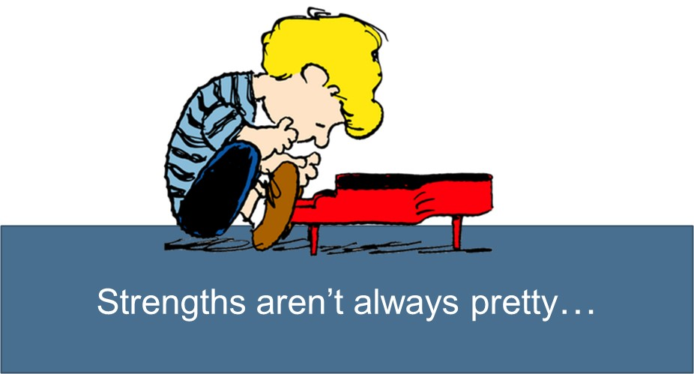
Strength-Based
Notes:
If a service provider/program/system tends towards identifying pathology and dysfunction, it can be a little disconcerting to be asked to identify strengths.
Early in my (Kappy) career I tended towards identifying ASSETS (Good at sports, verbal, can weave baskets) and missed a broader interpretation of STRENGTH. So lets look at some definitions
Review pages 55-58 (skim over some redundancies)
CAPACITY FOR EXERTION AND ENDURANCE
POWER TO RESIST FORCE
POWER OF RESISTING ATTACK
FORCE AS MEASURED IN NUMBERS (THINK NATURAL SUPPORTS, FOR EXAMPLE)
INTENSITY

Slide 70
Poll Question #7
Within the context of an acute crisis, how often does the team find it difficult or even unsafe to take a strength-based approach?
  100%
  80%
  60%
  40%
  20%
  Less than 20%
Use the CHAT feature to make additional comments

Slide 71
Strength—Defined
Capacity for exertion or endurance
Power to resist force—Solid, Tough
Power of resisting attack—impregnability
Strong attribute or inherent asset
Force as measured in numbers
Person/thing regarded as embodying or affording force or firmness—(something or someone that gives one strength)
A concentration, intensity, degree of potency of effect
Source: MERRIAM WEBSTER
Notes:
If a service provider/program/system tends towards identifying pathology and dysfunction, it can be a little disconcerting to be asked to identify strengths.
Early in my (Kappy) career I tended towards identifying ASSETS (Good at sports, verbal, can weave baskets) and missed a broader interpretation of STRENGTH. So lets look at some definitions
Review pages 55-58 (skim over some redundancies)
CAPACITY FOR EXERTION AND ENDURANCE
POWER TO RESIST FORCE
POWER OF RESISTING ATTACK
FORCE AS MEASURED IN NUMBERS (THINK NATURAL SUPPORTS, FOR EXAMPLE)
INTENSITY

Slide 72
Strength—Defined
The quality or state of being strong; ability to do or to bear; capacity for exertion or endurance, whether physical, intellectual, or moral; force; vigor; power; as, strength of body or of the arm; strength of mind, of memory, or of judgment
Power to resist force; solidity or toughness; the quality of bodies by which they endure the application of force without breaking or yielding; -- in this sense opposed to frangibility; as, the strength of a bone, of a beam, of a wall, a rope, and the like
Power of resisting attacks; impregnability
Source: Brainyquote.com
Notes:
ABILITY TO DO OR TO BEAR
STRENGTH OF MIND, MEMORY, OR JUDGMENT
TOUGHNESS
ENDURING WITHOUT YIELDING

Slide 73
Strength—Defined
That quality which tends to secure results; effective power in an institution or enactment; security; validity; legal or moral force; logical conclusiveness; as, the strength of social or legal obligations; the strength of law; the strength of public opinion; strength of evidence; strength of argument
One who, or that which, is regarded as embodying or affording force, strength, or firmness; that on which confidence or reliance is based; support; security.
Vigor or style; force of expression
Force as measured by amount, numbers, or power of any body
A strong place; a stronghold
Source: Brainyquote.com
Notes:
THE QUALITY THAT SECURES RESULTS
MORAL FORCE
STRENGTH OF SOCAL OBLIGATIONS, PUBLIC OPINION
STRONG PLACE, STRONGHOLD

Slide 74
Strength—Defined
The state, property, or quality of being strong
The power to resist attack; impregnability
The power to resist strain or stress; durability
The ability to maintain a moral or intellectual position firmly
Capacity or potential for effective action: a show of strength
A source of power or force
One that is regarded as the embodiment of protective or supportive power; a support or mainstay
An attribute or quality of particular worth or utility; an asset
Degree of intensity, force, effectiveness, or potency
Effective or binding force; efficacy: the strength of an argument
Source: Answers.com
Notes:
STANCES
STRONG HOLDS
CULTURAL BELIEFS
MORAL POSITIONS
IMPREGNABILITY
ENDURANCE
FORCE AS MEASURED BY NUMBERS
A parent saying NO WAY IS MY CHILD GOING INTO THE HOSPITAL or NO WAY MY CHILD IS TAKING PSYCHOTROPIC MEDICATION are examples of STRONG STANCES that are best not ignored! Strength-based intervention says GO THERE and GET CURIOUS. Put your own beliefs to the side and listen, hear and understand. If the parent is ever going to shift, must start with where they are. If provider is ever going to consider alternatives there is rich information to gather when we GET CURIOUS

Slide 75
See, understand, get curious about…
The strength of their perspective
The strength of their beliefs/culture
The strength that comes from lived experience (endurance, tenacity, survival, ability to withstand discomfort/pain, scrappiness)
The strength of where they are on their individual journey (youth, parent)
The strength of their priorities
The strength of the lines they have drawn in the sand

Slide 76

Achieving Precision: Resolution-Focused Care

Slide 77
“We aren’t providing crisis care, we are handing off crisis care.
And then they hand off and then they hand off…”
-Chris Tokarski, Executive Director
Mental Health Resources, Inc.
Notes:
Chris is talking about the underdeveloped crisis system of care in his community and how individuals in crisis are moved from place to place without ever getting interventions that are relieving
Chris is describing a system where the primary tasks are screen/assess/refer. The design of the Philadelphia children’s crisis system of care is about engagement, delivery of meaningful and relieving interventions.

Slide 78
Resolution-Focused Care
Family-centeredness is about a strength-based alignment
Resolution-focus means using approaches that are resolving/relieving
  Symptom reduction
  Empowerment/health activation
  Clarity
  Diminished risk/REAL harm reduction
  Diminished angst
  Increased hope
  Return to higher level functioning
Resolution-focused programs believe in their efficacy and their ca ability to provide an end-service
Notes:
Family-centeredness gets the train ON the track
Resolution-focused approaches power the train DOWN the track
Belief in one’s efficacy as a provider of crisis intervention: These are skills can be universally learned. As a crisis services provider, regardless of title, I have to believe I can be of use beyond gathering information for a psychiatrist or written assessment and beyond referring a child/family elsewhere, etc

Slide 79

Resolution-focused care
Provider intention will drive intervention (for better or worse)
Essential to differentiate:
  Assessment vs. treatment
  Disposition vs. resolution
Medical analogy makes this clearer…
If you are the person with the mangled foot, what are you in this for???
Notes:
A medical analogy is easier than a behavioral health scenario to understand and differentiate these actions
Guide the audience through this scenario…
Suppose you find yourself with a badly mangled foot after some sort of accident and you go to the emergency department where you are first seen by a triage nurse.
The triage nurse does a cursory assessment. “I see you have a badly mangled foot.” ASK What does that do for you/for your foot?
You move now to a treatment room, where a nurse comes in, does a more thorough nursing assessment and concludes, ‘ you certainly have a badly mangled foot” ASK How are you now? How is your foot?
The doctor comes in and does a more comprehensive assessment, perhaps a test or two and concludes “you have a particular sort of a badly mangled foot” ASK Are you feeling better yet? Foot giving you any trouble? “Don’t worry says the doctor, a mangled foot specialist is on the way!
The mangled foot specialist does a few more specialized mangled foot tests and now can tell you more specifically, in what ways your foot is mangled. ASK Now how are you feeling? How useful is the assessment to you?
Good news, says the specialist! I am referring you to a specialty mangled foot hospital! But, they don’t have a bed available today. I will come back every day until they do, to be sure you still have a mangled foot.
FINALLY! There is room in the specialty mangled foot hospital. When you get there you learn, that they are “a comprehensive assessment service” and after doing the comprehensive assessment, they will refer you to a community provider with instructions for how the REAL treatment should unfold.
ASK, is the analogy pretty clear by now?
(NOTE TO TRAINERS: The semantics are a little tricky on this slide. How I (Kappy) use these words can cause some conversation—often there is a heated defense of the value of assessments. And it can be valuable, if it leads to relieving intervention. Great that the dentist’s X-ray finds the cavity. But only if is treated.)
Assessment: me the provider, using tools and tests and gathering info to figure out what is wrong, to diagnose, to complete my assessment paperwork
Treatment: me the provider, using tools and strategies to treat resulting in relief, resolution, symptom reduction
(yes, some providers are quite adept at continuous assessment during the course of treatment. Encourage consideration of a black and white view here to get clear differentiation)
In any given moment, do I (provider) know, “what am I in the act of DOING? Assessment? Monitoring? Observing? Reporting? Or am I TREATING, delivering a course of care designed to ameliorate symptoms/crisis state?
Disposition: Me the provider determining what services are needed next and referring child to that next service
Resolution: The crisis in and of itself has diminished, symptoms have lessened, harm has reduced, relief is felt
The crisis system in Philadelphia has historically been focused on assessment and disposition as opposed to treatment and relief. This is what has been purchased. THIS CHANGES with the children’s crisis redesign. We don’t have to cure the illness to provide crisis relief (offering relieving medication, splints, crutches provides relief for the mangled foot for now, there will be more relieving actions that come down the road)
ASK: If it is you with the mangled foot (or experiencing the crisis) how long do you want it to take before you receive treatment and feel RELIEF?,
ASK: and if you are admitted to the mangled foot hospital, what are you in it for? Are you there for the fabulous mangled foot hospital experience? If it were up to you, how long would you stay??

Slide 80
Poll Question #8
Is admission to a psychiatric hospital an example of crisis resolution?
YES
NO
Use the CHAT feature to make additional comments

Slide 81
Poll Question #9
Within the context of an acute crisis, how often is the team delivering services that are RESOLUTION and not DISPOSITION focused?
  100%
  80%
  60%
  40%
  20%
  Less than 20%
Use the CHAT feature to make additional comments

Slide 82

Counterproductive Approaches
Notes:
This is a large group immersive exercise. Be sure everyone is back in the room for the exercise

Slide 83
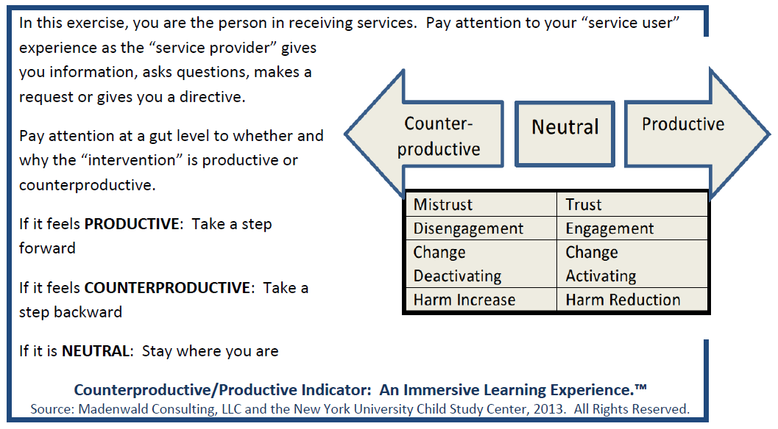
Notes:
INFO FOR THE TRAINER:
The goal of this exercise is to help providers develop greater insight into the CARE EXPERIENCE of a parent when a child is in crisis (can use similar exercises to get insight into care experience for the child in crisis). This includes illuminating the chasm between what providers might INTEND when they deliver services and how parents EXPERIENCE it. It also illuminates that we all use approaches that despite our good intention will be experienced as counterproductive. This might conflict with a belief that “maybe what I do doesn’t work, but at the worst it is a neutral/no impact.
From the vantage point of the mental health professional, it can be difficult to know when one has veered into an approach that is counterproductive. The reaction of the parent (or youth) is a clue but the professional may or may not recognize it as a sign of a counterproductive approach. Instead the reaction (anger, defensiveness, closing down) may be interpreted as symptom or evidence of pathology/character trait). It takes quite a bit of introspection for the professional to stop and think: Maybe that reaction was about something I said or did!
This exercise gives the participant the chance to experience, at a visceral level, the difference between approaches that are productive vs. counterproductive from the shoes of the parent receiving services. For the Parent Partner who is experiencing this exercise, some of the stories or feelings may be familiar. Even Parent Partners can inadvertently slip into counterproductive practices. It is important to remember how different the experience is when you are living it as the parent.
There is a supplemental word document for the trainer that details the exercise.
Introduction: this is a large group, immersive role play and will be easy—all you have to do is move.
Instructions:
Please stand up and find a space in the room where you can move forward and backward a few steps. In this exercise you are the parent. We will be doing 4 different scenarios. I will read the scenario and ask you to imagine being in THAT PARENT’s shoes, feeling the way they feel according to the scenario.
I (TRAINER) will be the provider. I will be saying things to you and asking questions. Consider each thing I say and decide if what I said or asked feels PRODUCTIVE. This means you find it useful, makes you trust me or the situation, it is engaging, empowering, harm reducing, makes you hopeful, etc. If what I say or ask is PRODUCTIVE take a step forward.
If I say something/ask something that you experience as COUNTERPRODUCTIVE, meaning you find it disengaging, upsetting, it makes you not trust me, it makes the crisis worse, then take a step backward.
If it has a neutral impact, stay where you are.
You will find yourself going back and forth in the exercise.
MOST IMPORTANT: You must take your provider hat off and set it aside. We want to isolate the parent experience and it is easy for the provider part of you to come in and rationalize what was said or asked. Go with your gut feel on this—don’t let your provider brain talk you out of it. For participants having a hard time imagining being a parent, think of a parent you know and love—personalizing it can be helpful.
Read the first scenario and then start the questions by saying, “here we go” or similar cue. Read each with an even keel and allow 10 seconds or so to pass between each line so people can consider and react. At the end of the set of questions suggest that people ‘shake it off’ and reposition for the next scenario. Each scenario creates a different experience.
Refer to the supplemental document for instructions on processing the exercise

Slide 84
Counterproductive Approaches
In the context of a research project on family-centered care, a number of counterproductive practices were identified.
Three of the indicators have universal implications
They are highly relevant in the context of safety planning and the provision of resolution-focused support and intervention
Olin, S.S. Kutash, K., Pollock, M., Burns, B.J., Kuppinger, A., Craig, N., Purdy, F., Armusewicz, K., Wisdom, J., & Hoagwood, K., (2013). Developing quality indicators for family support services in community team-based mental health care. Administration and Policy in Mental Health. Published online May 25, 1-14. Doi: 10.1007/s10488-013-0501-9
Olin, S.S., Williams, N., Pollock, M., Armusewicz, K., Kutush, K., Glisson, C. & Hoagwood, K., (2013). Quality indicators for family support services and their relationship to organizational social context. Administration and Policy in Mental Health. Published online May 25, 1-12. Doi: 10.1007/s10488-013-0499-z
Notes:
ASK: There are three approaches that a service provider can take that are almost universally counterproductive. Can you identify what they are? What type of questions/comments created a stepback experience?
These are detailed on the next slide. Audiences usually get pretty close to identifying the three

Slide 85
Counterproductive Approaches
  When a Service provider…
    Uses communication that indicates blame or criticism of the youth or caregiver
    Uses deficit-based language
    Is directive and makes decisions independent of the youth and caregiver about what is good for the family
…it is generally experienced as COUNTER productive

Slide 86
Counterproductive Approaches
From the provider shoes, consider:
  The absence of bad intentions
  The nuance of the counterproductive intervention—the language doesn’t seem so inflammatory when you are the provider that is saying it
  How easy it can be to NOT know you are doing it
  How hard it can be for the provider to recognize the impact—AND understand that he/she is the provocateur
Notes:
ASK: were any of the questions unusual? Is it likely that parents have heard some version of these comments/questions?
They can feel pretty neutral/non-threatening to us and be experienced in a wholly different way by parents. Imagining the question from parent shoes helps us to gain insight into WHY

Slide 87
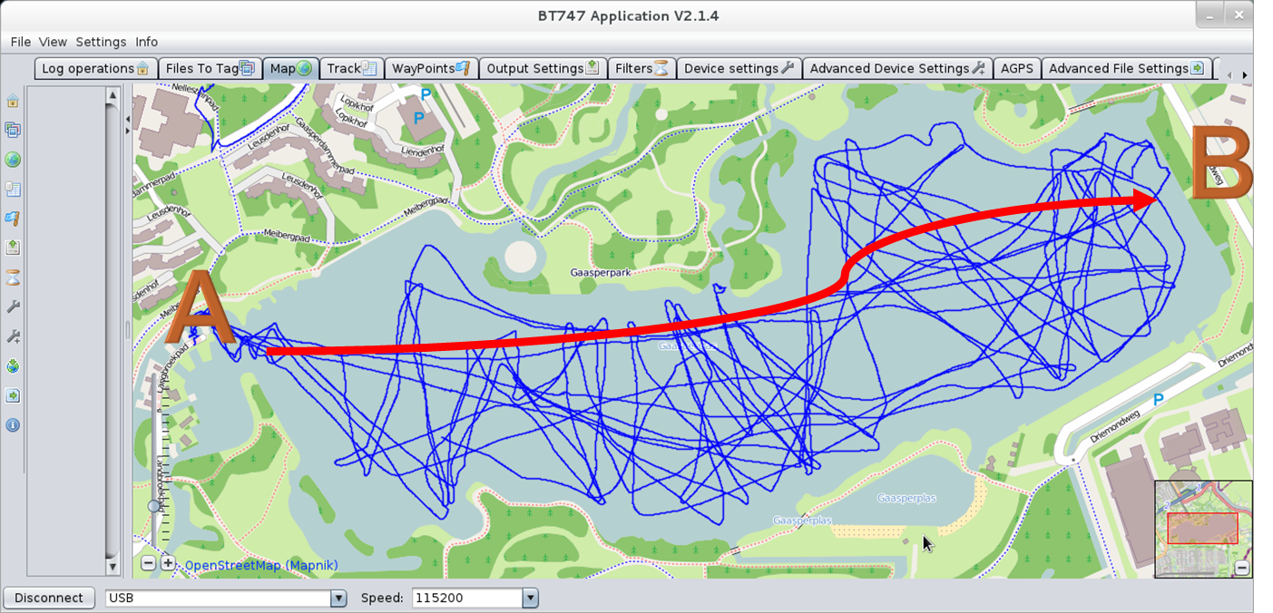
Resolution-focused care
Care quality and care experience are more about precision than about length, quantity or intensity
Precision includes choosing approaches that are productive and reducing approaches that are counterproductive
Notes:
This is a GPS chart that is showing the path of two different sailboats. One is going back and forth and up and down, taking a lot longer to get to the eventual destination (if it ever arrives). This is when we mix productive and counterproductive approaches—one step forward, two steps back, lull in progress, heading in wrong direction.
The red line shows precision sailing. A little adjusting, but on course to a clear destination. This is precision work. You get to the destination and you get there in less time.
Imagine if we could eradicate all counterproductive questions from our brain. Then we would be producing all step-forward work (demonstrate this). Feeling better, hope returning, ideas forming, introspection occuring, moods lightening…

Slide 88

Person/family-centeredness in safety planning

Slide 89
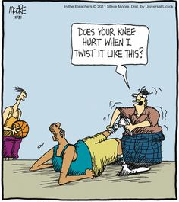
Iatrogenic risk in safety planning
What are some examples of harms that can come from safety planning and from written safety plans?

Slide 90
REAL harm reduction
Think about existing approaches to harm reduction/safety planning
Why is it being done? To serve what purposes?
How do you know when a plan is not aimed at REAL harm reduction?
What are the clues that safety planning will result in REAL harm reduction?
Examples of REAL harm reduction | Examples of approaches not aimed at REAL harm reduction

Slide 91
REAL Harm Reduction
Risk of harm is reduced when, for example, the child, parent, teacher, and/or other key parties:
Have an increased empathic understanding of what is happening
Have reframed from a deficit story to a more strength-based story
Have a greater understanding of the nature of a child’s distress
Have one or more viable and sustainable strategies (ready, willing, able approaches)
Feel empowered
When individuals are activated to change in ways that are health-promoting for the child
When skills are transferred to/developed by a child or an invested adult

Slide 92
REAL Harm Reduction
Watch for evidence that the deficit story has changed
  Language used about the child/parent/school has shifted (more empathic, measured)
  Expansion/clarity about the nature of the child’s distress
  Shift from ALWAYS/NEVER talk to SOMETIMES talk
    Example: “He never has good behavior” shifts to “he does well in these situations, has a harder time in those situations
  Expressed insight about child having a normal (even if disruptive) reaction to an uncomfortable situation
Watch for evidence of change activation
  Taking initiative,
  Motivated language,
  Jotting notes,
  Making a call to inquire
  Independently committing to an action (this is stronger than agreeing to)
*DOCUMENT THESE SHIFTS!

Slide 93
Safety and Support Plans
Those are the kinds of results that can come out of effective safety planning
A specific safety and support plan MAY result out of safety and support planning
Safety and support plans are best developed as a natural extension of youth and family-centered, resolution-focused intervention:
Resolution-focused interventions
LEAD TO
Safety and support planning, that may
LEAD TO
Development or revision of a plan

Slide 94

Safety and support plans as a natural extension of a resolution-focused intervention…
Example: Duane

Slide 95
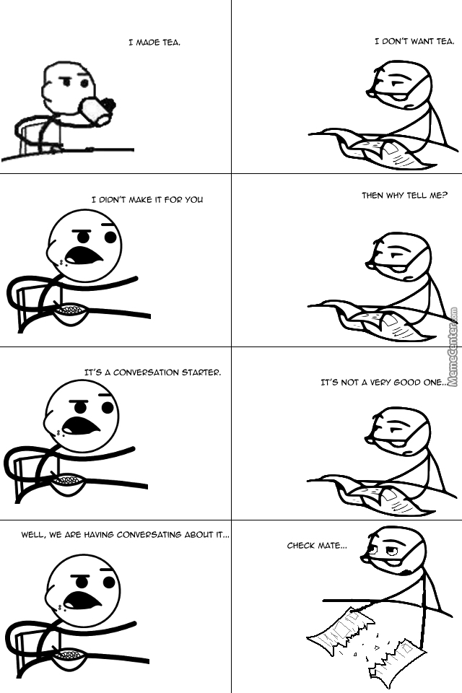
Conversation starters
Page 8-26

Slide 96
How to facilitate a productive conversation
Believe that you are engaging individuals that are CREDIBLE, CAPABLE, INTUITIVE, and ABLE TO COLLABORATE
These individuals are the ones who are best able to identify sustainable, effective solutions
Take a facilitative approach
Use Socratic (open-ended) questions
Listen attentively
Use simple techniques to further the brainstorming/problem-solving (“Could you say more about that?”)
Avoid any instinct to interpret or solve for others
Avoid a rush to a disposition (passing off to someone else to resolve)

Slide 97
Exploring resources with schools…
When did he/she first come to your attention?
What was happening before that?
What steps do you take when a student comes to your attention?
Are there particular resources available to you?
How do any concerns or suggestions that you have get discussed with the teachers and leadership?
What are the ways that you (school leadership) think about, plan for, discuss, and follow up after crises?
What options do you have for collaborating with parents whose children are likely to have a crisis?

Slide 98
Exploration with DCF/Foster Homes
How is it that he/she got to your home?
How is he/she experiencing being away from his home/school/siblings/community?
What part does he struggle the most with?
In what ways does his behavior make sense to you?
What parts of his behavior are you trying to sort out/struggling to understand?
How does it feel, to you to have him/her in your home?
When you feel (reflecting back, i.e. overwhelmed/uncertain) what are your options for seeking support? From foster care agency? DCF?
What would make it easier for you to continue to have him/her in your home?
What are the options for a foster parent who is struggling with a child?
What strategies do you use so that all parties understand the consent situation for any particular child?

Slide 99
Discussing support needs
Are there things that (you/your child/the student) struggle with or that cause problems for you (or are upsetting to your parents/teachers) either at home, school or in the community?
What is the nature of the struggle?
I am curious if there are issues in every period, or just a few?
Are there certain days of the week/hours of the day that are most difficult?
I am curious what you think this behavior is about?
What would you guess is leading to the distress? Disruption?
As you know, when kids brains are swamped by emotion, they go into fight, flight freeze mode. What are your thoughts about the emotion he is experiencing leading up to these events?

Slide 100

Look back at the questions on the last three slides…
What is the intention of asking these questions?

Slide 101
How are you experiencing…
Exploration with child
  How are you experiencing… school?
  …the school bus
  …those two hours before you parent gets home
  …this foster home
Exploration with adults about the child:
  How do you (adult) think he/she is experiencing school?
  Are the risks internal to the child?
  Related to how he feels in the environment? How he feels with classmates?
  What is his learning style?
  How do you think he would describe his school experience? What would you say he thinks is the hardest part? The best part?

Slide 102
Understanding family preferences and experiences
I am curious?
Has 911 ever been called because your child was having a mental health/behavioral crisis?
Has he/she been seen in an emergency department?
Has your child received crisis services from a mobile crisis team?
Have you brought in family, friends or other informal supports to help you manage a crisis?
For each of these actions:
  Was it your choice or did someone else make the decision?
  What happened?
  What was the experience like for the family?
  If it were up to you, would you choose to use ___________ again?

Slide 103
Addressing stances
If the talker (child, parent, teacher, etc) takes a STANCE or POSITION on a topic, probe further, ask:
  “Could you please say more about that?”
  “What are the good reasons to pursue/not pursue…?”
  “What concerns are you trying to address?”
  “What has your experience been with…?”
Listen attentively as the talker has a chance to discuss the reasons behind the stance, listen for the point where they stop to catch their breath, their mood/energy related to the stance shifts, or they begin to make their own counter-argument. Now you can probe a little differently
  “Even given all of the good reasons you mentioned, do you have any reservations?”
  “Do you see any potential risks (in holding onto the stance, i.e. “of not trying the medication?”

Slide 104

Final thoughts…use CHAT to describe some takeaways!!

