Slide 1
Surveillance Data Overview of Sexually Transmitted Infections, Brief Report, Massachusetts
2000-2025
Notes:
Picture description: logo for the Massachusetts Department of Public Health

Slide 2

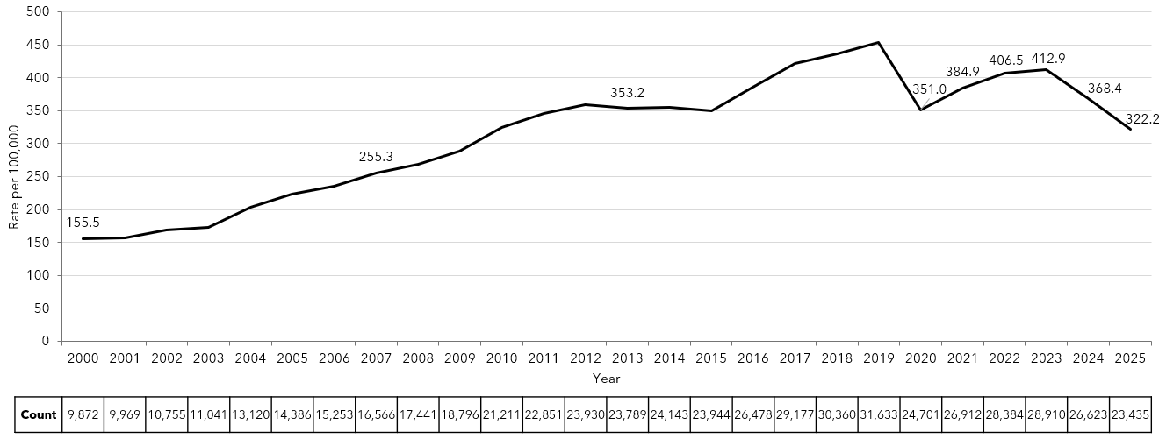
Rate of Confirmed Chlamydia Cases, Massachusetts,
2000-2025¹
Data are current as of 04/03/2026 and are subject to change.
Data Source: Massachusetts Department of Public Health/Bureau of Infectious Disease and Laboratory Sciences/ Division of STD Prevention and STD-HIV Surveillance.
Population denominators estimated by the University of Massachusetts Donahue Institute using a modified Hamilton-Perry model (Strate S, et al. Small Area Population Estimates for 2011 through 2020 report, Oct 2016; Strate S, et al. Small Area Population Estimates for 2021 through 2030 report, May 2025).
1. Please consider the impact of the COVID-19 pandemic on infectious disease screening, treatment and surveillance in the interpretation of 2020-2023 data.
Notes:
Rate of Confirmed Chlamydia Cases, Massachusetts, 2000 to 2025
Graph depicts the rate per 100,000 population of confirmed cases of chlamydia in Massachusetts between 2000 and 2025. It begins at low of 155.5 in 2000 and then climbs to a high of 454.1 in 2019. It drops to 384.9 in 2021, followed by a rise to 412.9 in 2023, and a decline to 322.2 in 2025.

Slide 3
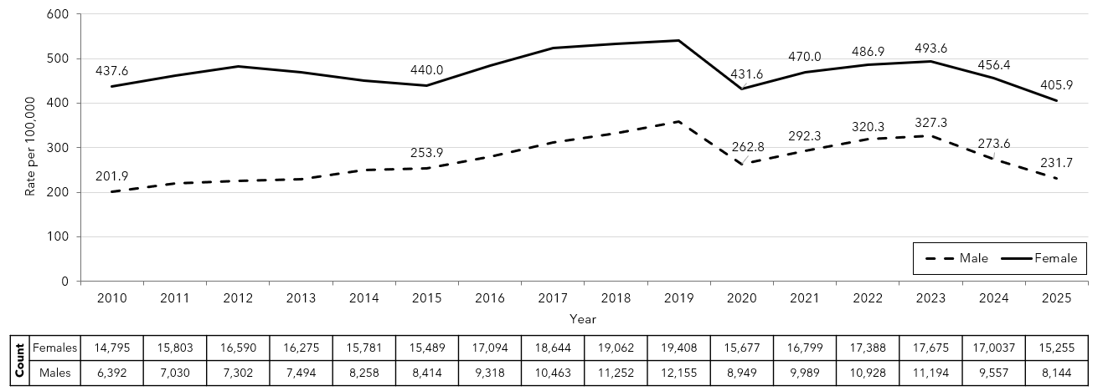
Confirmed Chlamydia Rates by Gender¹, Massachusetts, 2010-2025²
Data are current as of 04/03/2026 and are subject to change.
Data Source: Massachusetts Department of Public Health/Bureau of Infectious Disease and Laboratory Sciences/ Division of STD Prevention and STD-HIV Surveillance.
Population denominators estimated by the University of Massachusetts Donahue Institute using a modified Hamilton-Perry model (Strate S, et al. Small Area Population Estimates for 2011 through 2020 report, Oct 2016; Strate S, et al. Small Area Population Estimates for 2021 through 2030 report, May 2025).
1. In 2025, there were 15 individuals of transgender experience reported in our data system who do not have current gender documented. These cases were excluded since population estimates for individuals of transgender experience are not available at this time. There were 21 additional cases with unknown gender which are not included in this slide.
2. Please consider the impact of the COVID-19 pandemic on infectious disease screening, treatment and surveillance in the interpretation of 2020-2023 data.
Notes:
Confirmed Chlamydia Rates by Gender, Massachusetts, 2010 to 2025
Graph depicts the rates per 100,000 population of chlamydia in Massachusetts by gender identity between 2010 and 2025. There are two lines, one for females that begins at 437.6 in 2010 and climbs to 541.5 in 2019 and another for males that begins at 201.9 in 2010 and climbs to 359.4 in 2019. In 2025, females had a rate of 405.9 and males had a rate of 231.7.
Note: There were cases reported among transgender individuals in 2014 through 2025. In 2025, there were 15 cases of chlamydia among transgender identified individuals not included on this slide. There were 21 additional cases with unknown gender that were also excluded.

Slide 4
Chlamydia Among Individuals of Transgender Experience,^{1, 2}
Massachusetts, 2015-2025³
Data are current as of 04/03/2026 and are subject to change.
Data Source: Massachusetts Department of Public Health/Bureau of Infectious Disease and Laboratory Sciences/ Division of STD Prevention and STD-HIV Surveillance.
1. Prior to 2015 MA DSTDP was not able to capture expanded gender identity including individuals of transgender experience within our data system.
2. All individuals of transgender experience are included in this graph regardless of current gender.
3. Please consider the impact of the COVID-19 pandemic on infectious disease screening, treatment and surveillance in the interpretation of 2020-2023 data.
Notes:
Chlamydia Among Individuals of Transgender Experience, Massachusetts, 2015 to 2025
Graph shows the number of chlamydia cases among transgender individuals in Massachusetts between 2015 and 2025. The case counts 7, 21, 33, 57, 73, 64, 75, 78, 72, 51, and 43 for 2015, 2016, 2017, 2018, 2019, 2020, 2021, 2022, 2023, 2024, and 2025, respectively.

Slide 5
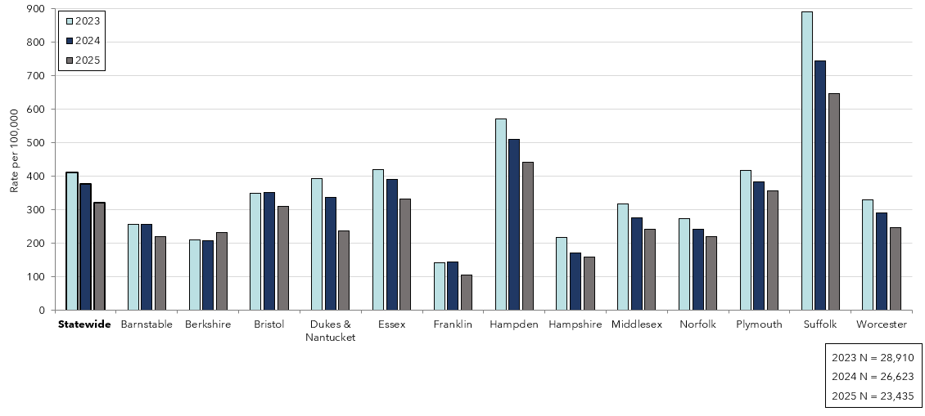
Confirmed Chlamydia Rates by County and Statewide,
Massachusetts, 2023-2025¹
Data are current as of 04/03/2026 and are subject to change.
Data Source: Massachusetts Department of Public Health/Bureau of Infectious Disease and Laboratory Sciences/ Division of STD Prevention and STD-HIV Surveillance.
Population denominators estimated by the University of Massachusetts Donahue Institute using a modified Hamilton-Perry model (Strate S, et al. Small Area Population Estimates for 2011 through 2020 report, Oct 2016; Strate S, et al. Small Area Population Estimates for 2021 through 2030 report, May 2025).
1. Please consider the impact of the COVID-19 pandemic on infectious disease screening, treatment and surveillance in the interpretation of 2023 data.
Notes:
Confirmed Chlamydia Rates by County and Statewide, Massachusetts, 2023-2025
Graph depicts rate per 100,000 population of chlamydia cases reported in Massachusetts by county comparing 2023 through 2025. The rate in 2025 is highest in Suffolk county with a rate of 646.8 followed by Hampden county with a rate of 442.4. The lowest rates were in Franklin and Hampshire county.

Slide 6
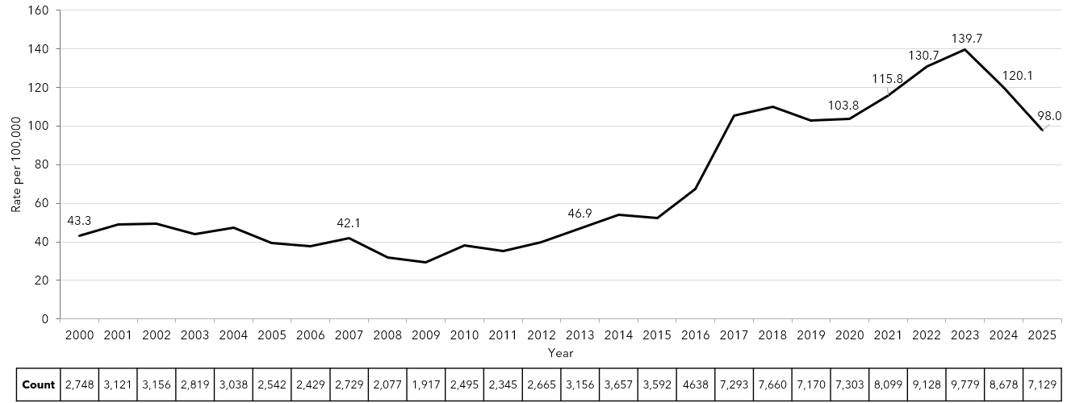
Rate of Confirmed Gonorrhea Cases, Massachusetts,
2000-2025¹
Data are current as of 04/03/2026 and are subject to change.
Data Source: Massachusetts Department of Public Health/Bureau of Infectious Disease and Laboratory Sciences/ Division of STD Prevention and STD-HIV Surveillance.
Population denominators estimated by the University of Massachusetts Donahue Institute using a modified Hamilton-Perry model (Strate S, et al. Small Area Population Estimates for 2011 through 2020 report, Oct 2016; Strate S, et al. Small Area Population Estimates for 2021 through 2030 report, May 2025).
1. Please consider the impact of the COVID-19 pandemic on infectious disease screening, treatment and surveillance in the interpretation of 2020-2023 data.
Notes:
Rate of Confirmed Gonorrhea Cases, Massachusetts, 2000 to 2025
Graph depicts the rate per 100,000 population of confirmed cases of gonorrhea in Massachusetts between 2000 and 2025. It begins at 43.3 in 2000, drops to a low of 29.4 in 2009 and climbs to a high of 139.7 in 2023, followed by a decline to 98.0 in 2025.

Slide 7
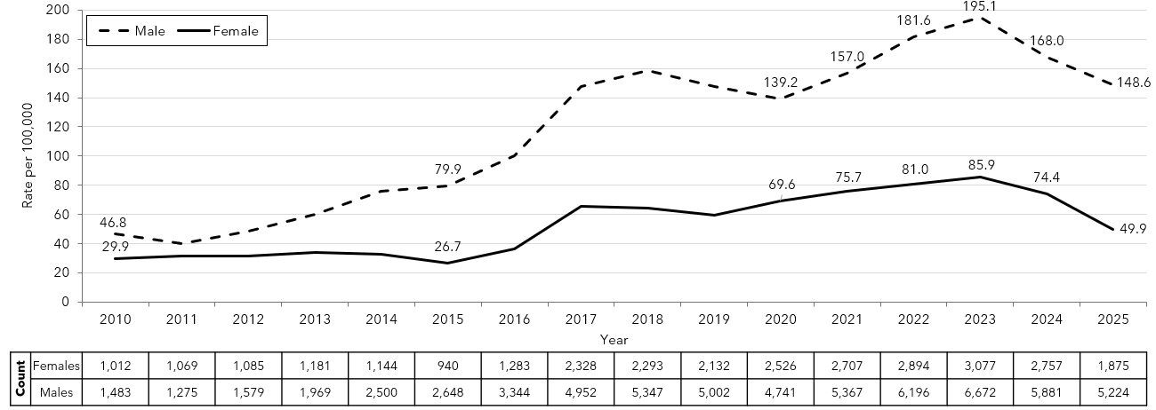
Confirmed Gonorrhea Rates by Gender¹, Massachusetts,
2010-2025²
Data are current as of 04/03/2026 and are subject to change.
Data Source: Massachusetts Department of Public Health/Bureau of Infectious Disease and Laboratory Sciences/ Division of STD Prevention and STD-HIV Surveillance.
Population denominators estimated by the University of Massachusetts Donahue Institute using a modified Hamilton-Perry model (Strate S, et al. Small Area Population Estimates for 2011 through 2020 report, Oct 2016; Strate S, et al. Small Area Population Estimates for 2021 through 2030 report, May 2025).
1. In 2025, there were 22 individuals of transgender experience reported in our data system who do not have current gender documented. These cases were excluded since population estimates for individuals of transgender experience are not available at this time. There were 8 additional cases with unknown gender which are not included in this slide.
2. Please consider the impact of the COVID-19 pandemic on infectious disease screening, treatment and surveillance in the interpretation of 2020-2023 data.
Notes:
Confirmed Gonorrhea Rates by Gender, Massachusetts, 2010 to 2025
Graph depicts the rates per 100,000 population of confirmed cases of gonorrhea in Massachusetts by gender identity between 2010 and 2025. There are two lines, one for females that begins at 29.9 in 2010 and climbs to 49.9 in 2025 and another for males that begins at 46.8 in 2010 and climbs to 148.6 in 2025.
Note: There were cases reported among transgender individuals in 2014 through 2025. In 2025, there were 22 cases of gonorrhea among transgender identified individuals not included on this slide. There were 8 additional cases with unknown gender that were also excluded.

Slide 8
Gonorrhea Among Individuals of Transgender Experience¹,
Massachusetts, 2015-2025²
Data are current as of 04/03/2026 and are subject to change.
Data Source: Massachusetts Department of Public Health/Bureau of Infectious Disease and Laboratory Sciences/ Division of STD Prevention and STD-HIV Surveillance.
1. All individuals of transgender experience are included in this graph regardless of current gender.
2. Please consider the impact of the COVID-19 pandemic on infectious disease screening, treatment and surveillance in the interpretation of 2020-2023 data.
Notes:
Gonorrhea Among Individuals of Transgender Experience, Massachusetts, 2015 to 2025
Graph shows the number of confirmed gonorrhea cases among transgender individuals in Massachusetts between 2015 and 2025. The case counts are 6, 31, 32, 49, 68, 58, 48, 68, 71, 91, and 63 for 2015, 2016, 2017, 2018, 2019, 2020, 2021, 2022, 2023, 2024, and 2025, respectively.

Slide 9
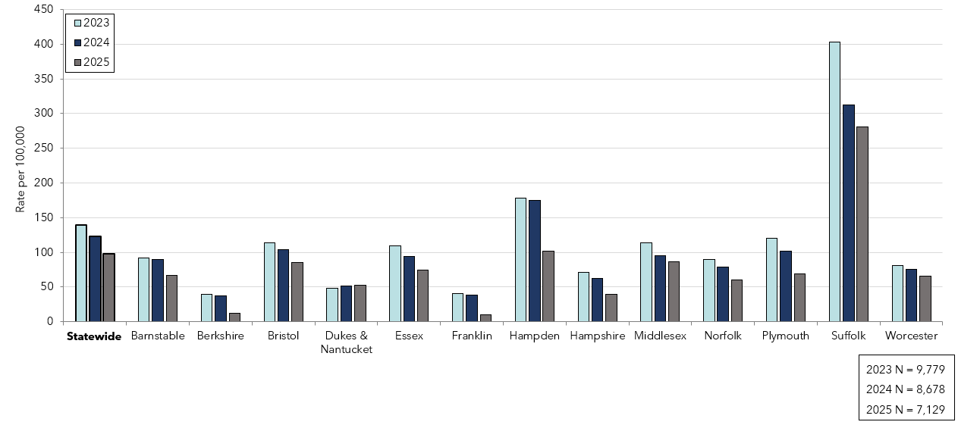
Confirmed Gonorrhea Rates by County and Statewide,
Massachusetts, 2023-2025¹
Data are current as of 04/03/2026 and are subject to change.
Data Source: Massachusetts Department of Public Health/Bureau of Infectious Disease and Laboratory Sciences/ Division of STD Prevention and STD-HIV Surveillance.
Population denominators estimated by the University of Massachusetts Donahue Institute using a modified Hamilton-Perry model (Strate S, et al. Small Area Population Estimates for 2011 through 2020 report, Oct 2016; Strate S, et al. Small Area Population Estimates for 2021 through 2030 report, May 2025).
1. Please consider the impact of the COVID-19 pandemic on infectious disease screening, treatment and surveillance in the interpretation of 2023 data.
Notes:
Confirmed Gonorrhea Rates by County and Statewide, Massachusetts, 2023-2025
Graph depicts rate per 100,000 population of gonorrhea cases reported in Massachusetts by county comparing 2023 through 2025. The rate in 2025 is highest in Suffolk county with a rate of 280.7 followed by Hampden county with a rate of 101.7. The lowest rates were in Berkshire and Franklin counties.

Slide 10
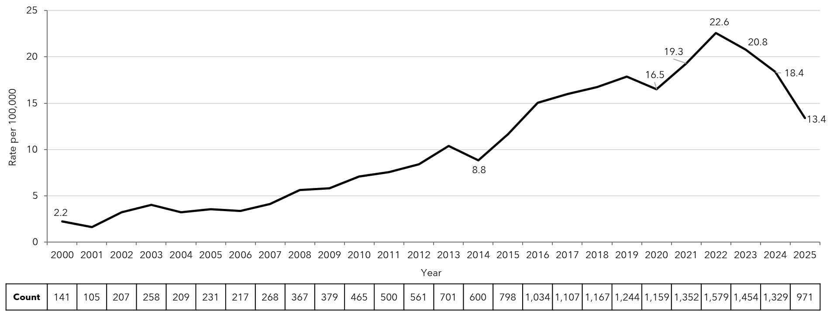
Confirmed and Probable Infectious Syphilis¹ Rates,
Massachusetts, 2000-2025²
Data are current as of 04/03/2026 and are subject to change.
Data Source: Massachusetts Department of Public Health/Bureau of Infectious Disease and Laboratory Sciences/ Division of STD Prevention and STD-HIV Surveillance.
Population denominators estimated by the University of Massachusetts Donahue Institute using a modified Hamilton-Perry model (Strate S, et al. Small Area Population Estimates for 2011 through 2020 report, Oct 2016; Strate S, et al. Small Area Population Estimates for 2021 through 2030 report, May 2025).
1. Infectious syphilis is defined as primary, secondary and early latent stages of syphilis within one year of infection.
2. Please consider the impact of the COVID-19 pandemic on infectious disease screening, treatment and surveillance in the interpretation of 2020-2023 data.
Notes:
Confirmed and Probable Infectious Syphilis Rates, Massachusetts, 2000 to 2025
Graph depicts the rate per 100,000 population of confirmed and probable cases of infectious syphilis in Massachusetts between 2000 and 2025. It begins at 2.2 in 2000, drops to a low of 1.6 in 2001, and climbs to a high of 22.6 in 2022, before falling to 13.4 in 2025.

Slide 11
Confirmed and Probable Infectious Syphilis¹ Rates by Gender,² Massachusetts, 2010-2025³
Data are current as of 04/03/2026 and are subject to change.
Data Source: Massachusetts Department of Public Health/Bureau of Infectious Disease and Laboratory Sciences/ Division of STD Prevention and STD-HIV Surveillance.
Population denominators estimated by the University of Massachusetts Donahue Institute using a modified Hamilton-Perry model (Strate S, et al. Small Area Population Estimates for 2011 through 2020 report, Oct 2016; Strate S, et al. Small Area Population Estimates for 2021 through 2030 report, May 2025).
1. Infectious syphilis is defined as primary, secondary and early latent stages of syphilis within one year of infection.
2. In 2025, there were 2 individuals of transgender experience reported in our data system who do not have current gender documented. These cases were excluded since population estimates for individuals of transgender experience are not available at this time.
3. Please consider the impact of the COVID-19 pandemic on infectious disease screening, treatment and surveillance in the interpretation of 2020-2023 data.
Notes:
Confirmed and Probable Infectious Syphilis Rates by Gender, Massachusetts, 2010 to 2025
Graph depicts the rates per 100,000 population of confirmed and probable cases of syphilis in Massachusetts by gender identity between 2010 and 2025. There are two lines, one for females that begins at 0.9 in 2010 and remains relatively stable with a high of 7.4 in 2023 before falling to 5.5 in 2025. Another line is for males that begins at 13.8 in 2010 and climbs to a high of 39.4 in 2022 before falling to 21.7 in 2025.
Note: Infectious syphilis is defined as primary, secondary and early latent stages of syphilis within one year of infection.
There were cases reported among transgender individuals in 2014 through 2025. They are classified on this slide based on their current gender. In 2025, there were 2 cases of infectious syphilis among transgender identified individuals not included on this slide as MA DSTDP does not have current gender information for those individuals.

Slide 12
Infectious Syphilis¹ Reported Cases by Race/Ethnicity²,
Massachusetts, 2015-2025³
Data are current as of 04/03/2026 and are subject to change.
Data Source: Massachusetts Department of Public Health/Bureau of Infectious Disease and Laboratory Sciences/ Division of STD Prevention and STD-HIV Surveillance.
Note: National Notifiable Diseases Surveillance System (NNDSS) Congenital Syphilis case definition was updated in 2014.
1. Infectious syphilis is defined as primary, secondary and early latent stages of syphilis within one year of infection.
2. Other Race/Ethnicity includes individuals who identify as American Indian/ Pacific Islander/ Alaskan Native and Multi-racial.
3. Please consider the impact of the COVID-19 pandemic on infectious disease screening, treatment and surveillance in the interpretation of 2020-2023 data.
Notes:
Infectious Syphilis Reported Cases by Race/Ethnicity, Massachusetts, 2015-2025
Graph depicts the proportion of Massachusetts reported confirmed and probable infectious syphilis cases broken down by race/ethnicity for the years 2015 through 2025. The highest percentage of cases for each year prior to 2024 identified as Non-Hispanic White making up a high of 50.0% of cases in 2017 and a resulting 33.7% in 2025. 2024 represents the first year the highest percentage of cases identified as Hispanic with a low of 22.0% in 2017 and a high of 38.3% in 2024 with a slight dip to 36.6% in 2025. In total, over the ten-year period, the proportion of cases by race/ethnicity were from highest to lowest: Non-Hispanic White, Hispanic, Non-Hispanic Black, Non-Hispanic Other, Unknown, and Non-Hispanic Asian.
Note: Infectious syphilis is defined as primary, secondary and early latent (non-primary/non-secondary) stages of syphilis within one year of infection.

Slide 13
Confirmed and Probable Infectious Syphilis¹ Among Individuals of Transgender Experience², Massachusetts, 2015-2025^{3, 4}
Data are current as of 04/03/2026 and are subject to change.
Data Source: Massachusetts Department of Public Health/Bureau of Infectious Disease and Laboratory Sciences/ Division of STD Prevention and STD-HIV Surveillance.
1. Infectious syphilis is defined as primary, secondary and early latent stages of syphilis within one year of infection.
2. All individuals of transgender experience are included in this graph regardless of current gender.
3. Please consider the impact of the COVID-19 pandemic on infectious disease screening, treatment and surveillance in the interpretation of 2020-2023 data.
4. In 2022, a retrospective verification project was conducted to improve data quality in capturing current gender information.
Notes:
Confirmed and Probable Infectious Syphilis Among Individuals of Transgender Experience, Massachusetts, 2015 to 2025
Graph shows the number of confirmed and probable infectious syphilis cases among transgender individuals in Massachusetts between 2015 and 2025. The case counts are 10, 11, 10, 27, 19, 23, 33, 58, 58, 50, and 34 for 2015, 2016, 2017, 2018, 2019, 2020, 2021, 2022, 2023, 2024, and 2025, respectively.
*Infectious syphilis is defined as primary, secondary and early latent stages of syphilis within one year of infection.

Slide 14
Confirmed and Probable Infectious Syphilis¹ Rates by
County and Statewide, Massachusetts, 2023-2025²
Data are current as of 04/03/2026 and are subject to change.
Data Source: Massachusetts Department of Public Health/Bureau of Infectious Disease and Laboratory Sciences/ Division of STD Prevention and STD-HIV Surveillance.
Population denominators estimated by the University of Massachusetts Donahue Institute using a modified Hamilton-Perry model (Strate S, et al. Small Area Population Estimates for 2011 through 2020 report, Oct 2016; Strate S, et al. Small Area Population Estimates for 2021 through 2030 report, May 2025).
1. Infectious syphilis is defined as primary, secondary and early latent stages of syphilis within one year of infection.
2. Please consider the impact of the COVID-19 pandemic on infectious disease screening, treatment and surveillance in the interpretation of 2023 data.
Notes:
Confirmed and Probable Infectious Syphilis Rates by County and Statewide, Massachusetts, 2023-2025
Graph depicts rate per 100,000 population of infectious syphilis cases reported in Massachusetts by county comparing 2023 through 2025. The rate is highest in Suffolk county with a rate of 56.5 in 2023 before falling to 28.2 in 2025, followed by Hampden county with a rate of 38.0 in 2023 which fell to 22.3 in 2025. In 2025 the lowest rates were in Berkshire and Dukes/Nantucket counties.

Slide 15
Confirmed and Probable Infectious Syphilis¹ Rates by
Stage of Infection, Massachusetts, 2010-2025²
Data are current as of 04/03/2026 and are subject to change.
Data Source: Massachusetts Department of Public Health/Bureau of Infectious Disease and Laboratory Sciences/ Division of STD Prevention and STD-HIV Surveillance.
Population denominators estimated by the University of Massachusetts Donahue Institute using a modified Hamilton-Perry model (Strate S, et al. Small Area Population Estimates for 2011 through 2020 report, Oct 2016; Strate S, et al. Small Area Population Estimates for 2021 through 2030 report, May 2025).
1. Infectious syphilis is defined as primary, secondary and early latent stages of syphilis within one year of infection.
2. Please consider the impact of the COVID-19 pandemic on infectious disease screening, treatment and surveillance in the interpretation of 2020-2023 data.
Notes:
Confirmed and Probable Infectious Syphilis Rates by Stage of Infection, Massachusetts, 2010–2025
Graph depicts the differences between the rate of infectious syphilis diagnosed in the primary and secondary stage compared to those cases diagnosed in the early non-primary and non-secondary stages reported in Massachusetts from 2010 to 2025. There are three lines on the graph. One line for primary and secondary cases starting with a rate of 4.2 per 100,000 in 2010 and peaking with a rate of 11.7 in 2022, before falling to 7.0 in 2025. Another line for non-primary non-secondary cases starting with a rate of 2.9 in 2010, peaking with a rate of 10.9 in 2022, before falling to 6.3 in 2025. The final line shows the total infectious syphilis starting with a rate of 7.1 in 2010 and peaking at a rate of 22.6 in 2022, before falling to 13.4 in 2025.
Note: Infectious syphilis is defined as primary, secondary and early latent (non-primary/non-secondary) stages of syphilis within one year of infection.

Slide 16
Infectious Syphilis¹ Reported Cases by Gender of Sex Partners, Massachusetts, 2015-2025²
Data are current as of 04/03/2026 and are subject to change.
Data Source: Massachusetts Department of Public Health/Bureau of Infectious Disease and Laboratory Sciences/ Division of STD Prevention and STD-HIV Surveillance.
Note: National Notifiable Diseases Surveillance System (NNDSS) Congenital Syphilis case definition was updated in 2014.
1. Infectious syphilis is defined as primary, secondary and early latent stages of syphilis within one year of infection.
2. Please consider the impact of the COVID-19 pandemic on infectious disease screening, treatment and surveillance in the interpretation of 2020-2023 data.
3. The MSM (men who have sex with men) category includes MSMT, MSMW, MSMWT, and MST with “W” referring to women and “T” referring to individuals of transgender experience.
Notes:
Infectious Syphilis Reported Cases by Gender of Sex Partners, Massachusetts, 2015-2025
Graph depicts the proportion of Massachusetts reported confirmed and probable infectious syphilis cases broken down by gender of sex partners for the years 2015 through 2025. The highest percentage of cases for each year reported male sex partners and are classified as MSM (men who have sex with men) making up a high of 77% of cases in 2017 and a resulting 52.1% of cases in 2025. In total, over the ten-year period, the proportion of cases by gender of sex partners were from highest to lowest: MSM, MSW (men who have sex with women), women, unknown males, and transgender individuals. A similar trend was seen for 2025 in isolation.
Note: Infectious syphilis is defined as primary, secondary and early latent (non-primary/non-secondary) stages of syphilis within one year of infection.

Slide 17
If you have questions or to request more information:
call the Massachusetts Department of Public Health, Division of STD Prevention, at 617-983-6940
Thank you!

