Slide 1
Surveillance Data Overview of Sexually Transmitted Infections, Massachusetts
2000-2024
Notes:
Picture description: logo for the Massachusetts Department of Public Health

Slide 2

Outline
Sexually Transmitted Infection (STI) Trends and Descriptions:
General STI Trends Through 2024
  Chlamydia
  Gonorrhea
  Infectious syphilis
Descriptions of 2024 STI Cases
  Social Vulnerability Index Trends (2024)
  HIV/STI Co-infection and Sexual Risk (2024)
2024 Summary
Technical Notes

Slide 3
Massachusetts STI Trends
Chlamydia: 2000 - 2024
Notes:
Picture description: logo for the Massachusetts Department of Public Health

Slide 4
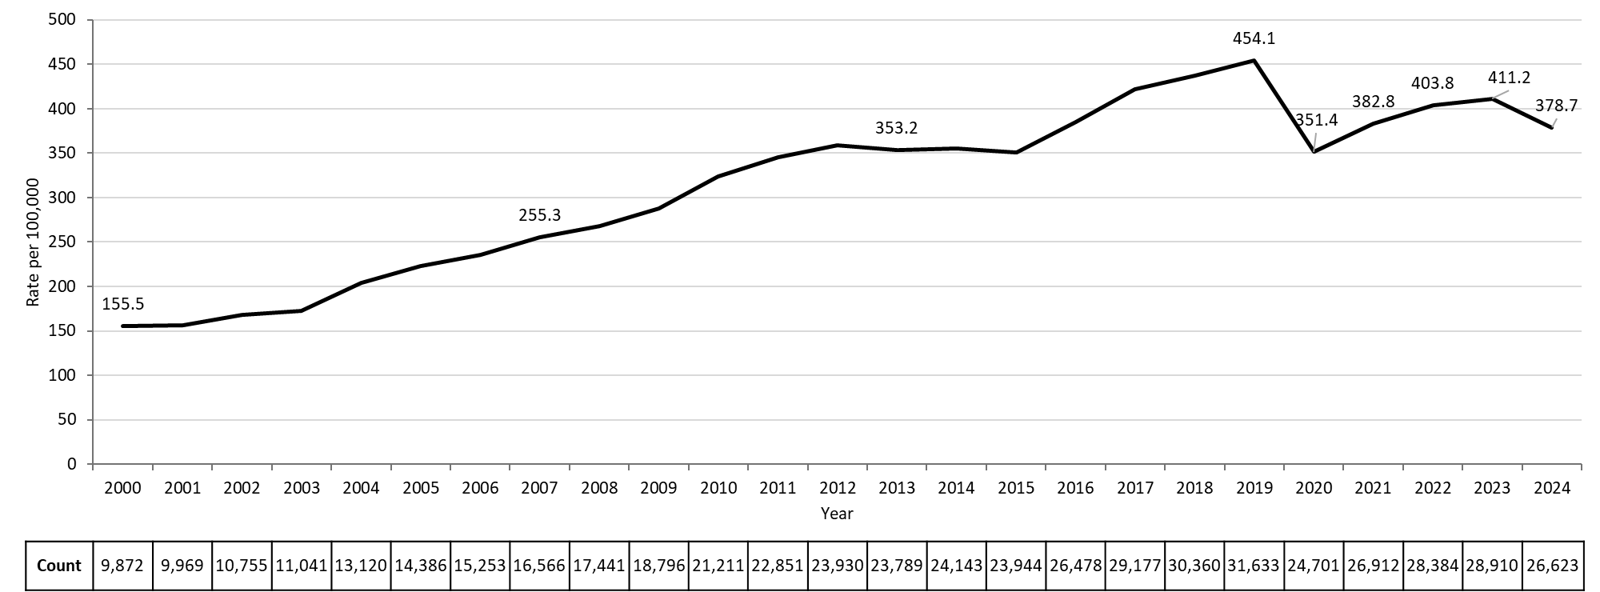
Rate of Confirmed Chlamydia Cases, Massachusetts, 2000-2024¹
Data are current as of 06/02/2025 and are subject to change.
Data Source: Massachusetts Department of Public Health/Bureau of Infectious Disease and Laboratory Sciences/ Division of STD Prevention and STD-HIV Surveillance.
Population denominators estimated by the University of Massachusetts Donahue Institute using a modified Hamilton-Perry model (Strate S, et al. Small Area Population Estimates for 2011 through 2020 report, Oct 2016).
1. Please consider the impact of the COVID-19 pandemic on infectious disease screening, treatment and surveillance in the interpretation of 2020-2022 data.
Notes:
Rate of Confirmed Chlamydia Cases, Massachusetts, 2000 to 2024
Graph depicts the rate per 100,000 population of confirmed cases of chlamydia in Massachusetts between 2000 and 2024. It begins at low of 155.5 in 2000 and then climbs to a high of 454.1 in 2019. It drops to 382.8 in 2021, followed by a rise to 411.2 in 2023, and another drop to 378.7 in 2024.

Slide 5
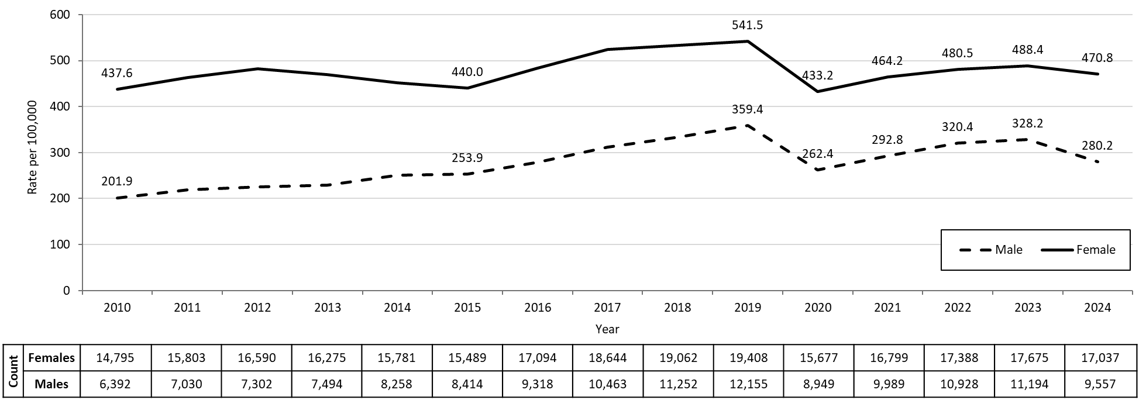
Confirmed Chlamydia Rates by Gender¹, Massachusetts, 2010-2024²
Data are current as of 06/02/2025 and are subject to change.
Data Source: Massachusetts Department of Public Health/Bureau of Infectious Disease and Laboratory Sciences/ Division of STD Prevention and STD-HIV Surveillance.
Population denominators estimated by the University of Massachusetts Donahue Institute using a modified Hamilton-Perry model (Strate S, et al. Small Area Population Estimates for 2011 through 2020 report, Oct 2016).
1. In 2024, there were 9 individuals of transgender experience reported in our data system who do not have current gender documented. These cases were excluded since population estimates for individuals of transgender experience are not available at this time. There were 17 other individuals with unknown gender which are not included in this slide.
2. Please consider the impact of the COVID-19 pandemic on infectious disease screening, treatment and surveillance in the interpretation of 2020-2022 data.
Notes:
Confirmed Chlamydia Rates by Gender, Massachusetts, 2010 to 2024
Graph depicts the rates per 100,000 population of chlamydia in Massachusetts by gender identity between 2010 and 2024. There are two lines, one for females that begins at 437.6 in 2010 and climbs to 541.5 in 2019 and another for males that begins at 201.9 in 2010 and climbs to 359.4 in 2019. In 2024, females had a rate of 470.8 and males had a rate of 280.2.
Note: There were cases reported among transgender individuals in 2014 through 2024. In 2024, there were 9 cases of chlamydia among transgender identified individuals and 17 other individuals with unknown gender not included on this slide.

Slide 6
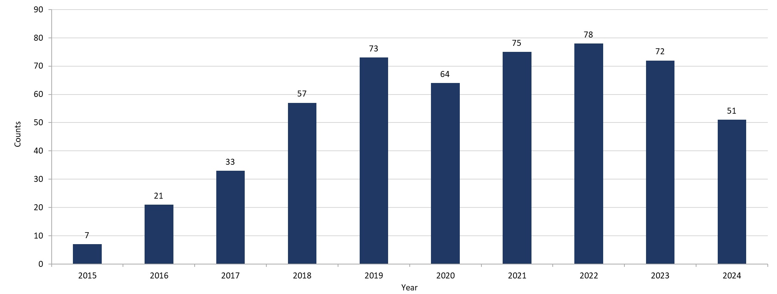
Chlamydia Among Individuals of Transgender Experience,^{1, 2}
Massachusetts, 2015-2024³
Data are current as of 06/02/2025 and are subject to change.
Data Source: Massachusetts Department of Public Health/Bureau of Infectious Disease and Laboratory Sciences/ Division of STD Prevention and STD-HIV Surveillance.
1. Prior to 2015 MA DSTDP was not able to capture expanded gender identity including individuals of transgender experience within our data system.
2. All individuals of transgender experience are included in this graph regardless of current gender.
3. Please consider the impact of the COVID-19 pandemic on infectious disease screening, treatment and surveillance in the interpretation of 2020-2022 data.
Notes:
Chlamydia Among Individuals of Transgender Experience, Massachusetts, 2015 to 2024
Graph shows the number of chlamydia cases among transgender individuals in Massachusetts between 2015 and 2024. The case counts 7, 21, 33, 57, 73, 64, 75, 78, 72, and 51 for 2015, 2016, 2017, 2018, 2019, 2020, 2021, 2022, 2023, and 2024, respectively.

Slide 7
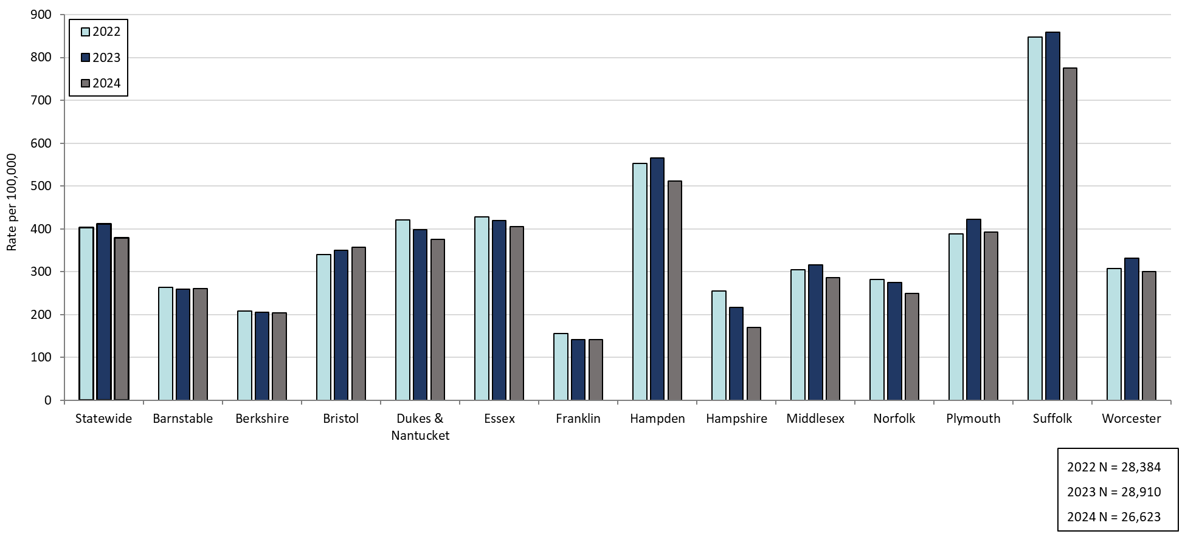
Confirmed Chlamydia Rates by County and Statewide,
Massachusetts, 2022-2024¹
Statewide
Data are current as of 06/02/2025 and are subject to change.
Data Source: Massachusetts Department of Public Health/Bureau of Infectious Disease and Laboratory Sciences/ Division of STD Prevention and STD-HIV Surveillance.
Population denominators estimated by the University of Massachusetts Donahue Institute using a modified Hamilton-Perry model (Strate S, et al. Small Area Population Estimates for 2011 through 2020 report, Oct 2016).
1. Please consider the impact of the COVID-19 pandemic on infectious disease screening, treatment and surveillance in the interpretation of 2022 data.
Notes:
Confirmed Chlamydia Rates by County and Statewide, Massachusetts, 2022-2024
Graph depicts rate per 100,000 population of chlamydia cases reported in Massachusetts by county comparing 2022 through 2024. The rate in 2024 is highest in Suffolk county with a rate of 776.0 followed by Hampden county with a rate of 511.1. The lowest rates were in Franklin and Hampshire county.

Slide 8
Gonorrhea: 2000 - 2024
Massachusetts STI Trends
Notes:
Picture description: logo for the Massachusetts Department of Public Health

Slide 9
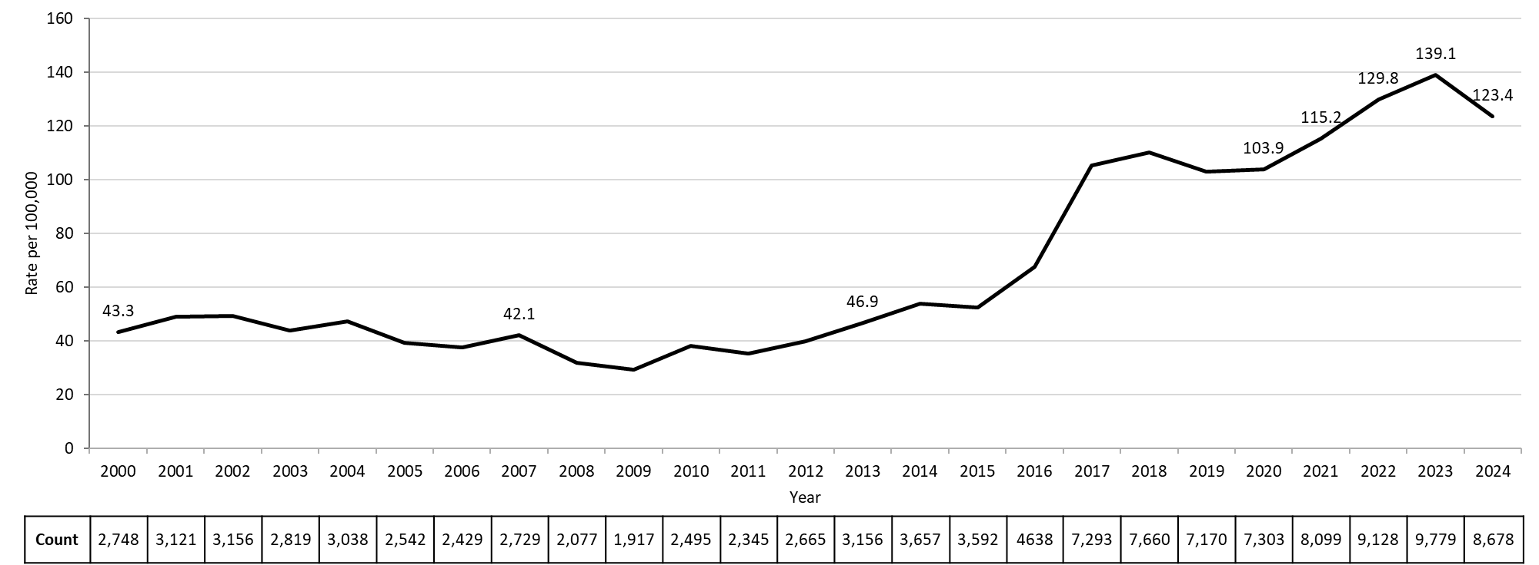
Rate of Confirmed Gonorrhea Cases, Massachusetts, 2000-2024¹
Data are current as of 06/02/2025 and are subject to change.
Data Source: Massachusetts Department of Public Health/Bureau of Infectious Disease and Laboratory Sciences/ Division of STD Prevention and STD-HIV Surveillance.
Population denominators estimated by the University of Massachusetts Donahue Institute using a modified Hamilton-Perry model (Strate S, et al. Small Area Population Estimates for 2011 through 2020 report, Oct 2016).
1. Please consider the impact of the COVID-19 pandemic on infectious disease screening, treatment and surveillance in the interpretation of 2020-2022 data.
Notes:
Rate of Confirmed Gonorrhea Cases, Massachusetts, 2000 to 2024
Graph depicts the rate per 100,000 population of confirmed cases of gonorrhea in Massachusetts between 2000 and 2024. It begins at 43.3 in 2000, drops to a low of 29.4 in 2009 and climbs to a high of 139.1 in 2023, followed by a drop to 123.4 in 2024.

Slide 10
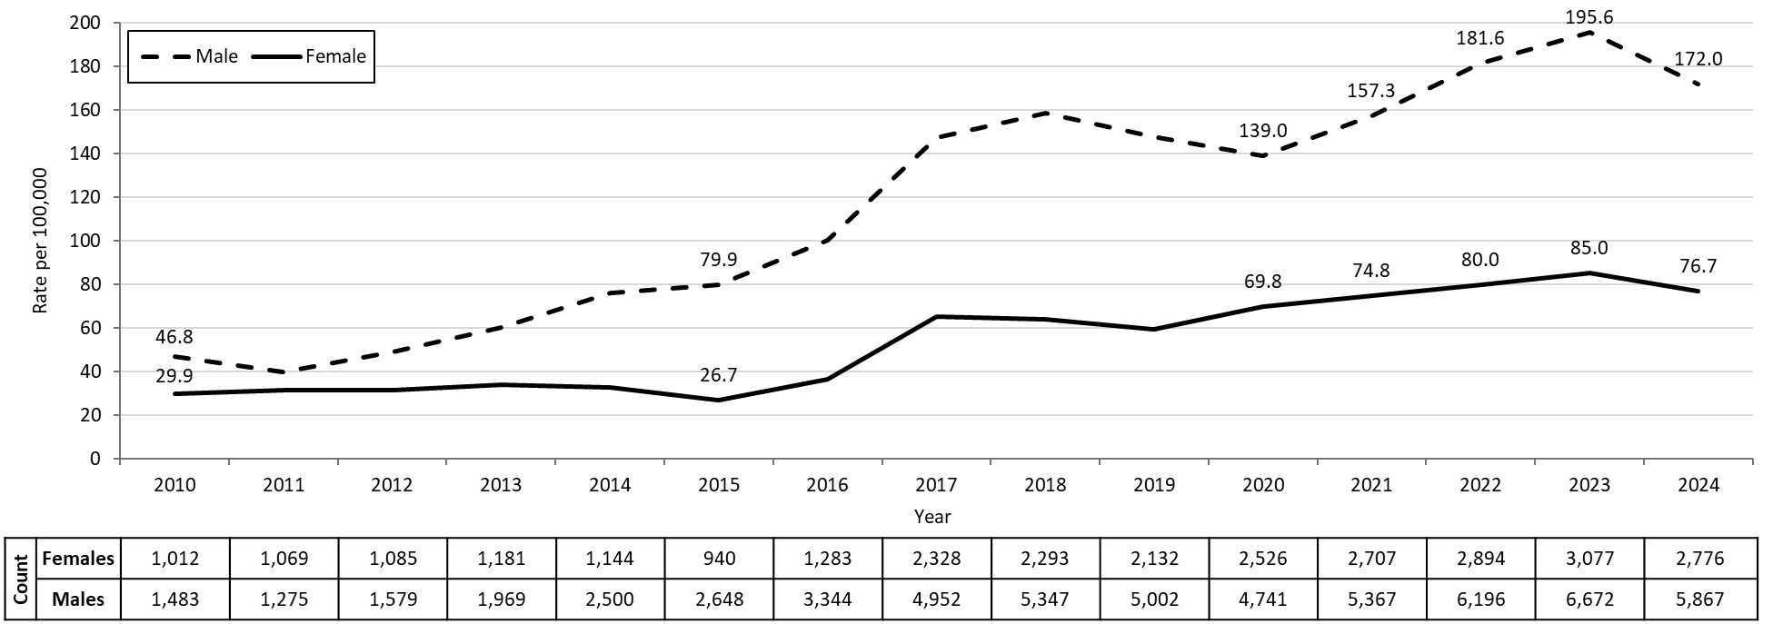
Confirmed Gonorrhea Rates by Gender¹, Massachusetts,
2010-2024²
Data are current as of 06/02/2025 and are subject to change.
Data Source: Massachusetts Department of Public Health/Bureau of Infectious Disease and Laboratory Sciences/ Division of STD Prevention and STD-HIV Surveillance.
Population denominators estimated by the University of Massachusetts Donahue Institute using a modified Hamilton-Perry model (Strate S, et al. Small Area Population Estimates for 2011 through 2020 report, Oct 2016).
1. In 2024, there were 26 individuals of transgender experience reported in our data system who do not have current gender documented. These cases were excluded since population estimates for individuals of transgender experience are not available at this time. There were 9 other individuals with unknown gender which are not included in this slide.
2. Please consider the impact of the COVID-19 pandemic on infectious disease screening, treatment and surveillance in the interpretation of 2020-2022 data.
Notes:
Confirmed Gonorrhea Rates by Gender, Massachusetts, 2010 to 2024
Graph depicts the rates per 100,000 population of confirmed cases of gonorrhea in Massachusetts by gender identity between 2010 and 2024. There are two lines, one for females that begins at 29.9 in 2010 and climbs to 76.7 in 2024 and another for males that begins at 46.8 in 2010 and climbs to 172.0 in 2024.
Note: There were cases reported among transgender individuals in 2014 through 2024. In 2024, there were 26 cases of gonorrhea among transgender identified individuals and 9 other individuals with unknown gender not included on this slide.

Slide 11
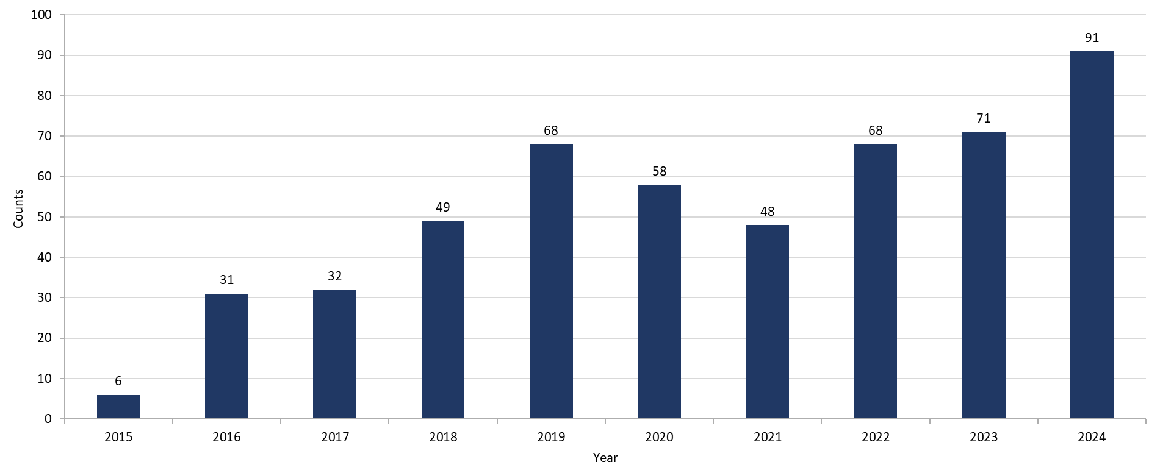
Gonorrhea Among Individuals of Transgender Experience¹,
Massachusetts, 2015-2024²
Data are current as of 06/02/2025 and are subject to change.
Data Source: Massachusetts Department of Public Health/Bureau of Infectious Disease and Laboratory Sciences/ Division of STD Prevention and STD-HIV Surveillance.
1. All individuals of transgender experience are included in this graph regardless of current gender.
2. Please consider the impact of the COVID-19 pandemic on infectious disease screening, treatment and surveillance in the interpretation of 2020-2022 data.
Notes:
Gonorrhea Among Individuals of Transgender Experience, Massachusetts, 2015 to 2024
Graph shows the number of confirmed gonorrhea cases among transgender individuals in Massachusetts between 2015 and 2024. The case counts are 6, 31, 32, 49, 68, 58, 48, 68, 71, and 91 for 2015, 2016, 2017, 2018, 2019, 2020, 2021, 2022, 2023, and 2024, respectively.

Slide 12
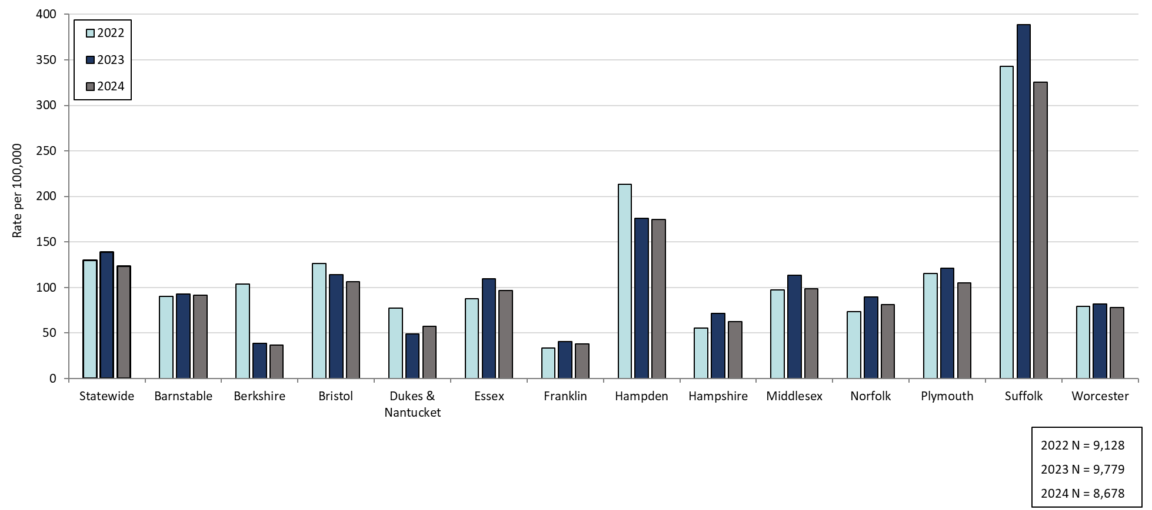
Confirmed Gonorrhea Rates by County and Statewide,
Massachusetts, 2022-2024¹
Statewide
Data are current as of 06/02/2025 and are subject to change.
Data Source: Massachusetts Department of Public Health/Bureau of Infectious Disease and Laboratory Sciences/ Division of STD Prevention and STD-HIV Surveillance.
Population denominators estimated by the University of Massachusetts Donahue Institute using a modified Hamilton-Perry model (Strate S, et al. Small Area Population Estimates for 2011 through 2020 report, Oct 2016).
1. Please consider the impact of the COVID-19 pandemic on infectious disease screening, treatment and surveillance in the interpretation of 2022 data.
Notes:
Confirmed Gonorrhea Rates by County and Statewide, Massachusetts, 2022-2024
Graph depicts rate per 100,000 population of gonorrhea cases reported in Massachusetts by county comparing 2022 through 2024. The rate in 2024 is highest in Suffolk county with a rate of 325.6 followed by Hampden county with a rate of 175.0. The lowest rates were in Berkshire and Franklin counties.

Slide 13
Infectious Syphilis: 2000 - 2024
Massachusetts STI Trends
Notes:
Picture description: logo for the Massachusetts Department of Public Health

Slide 14
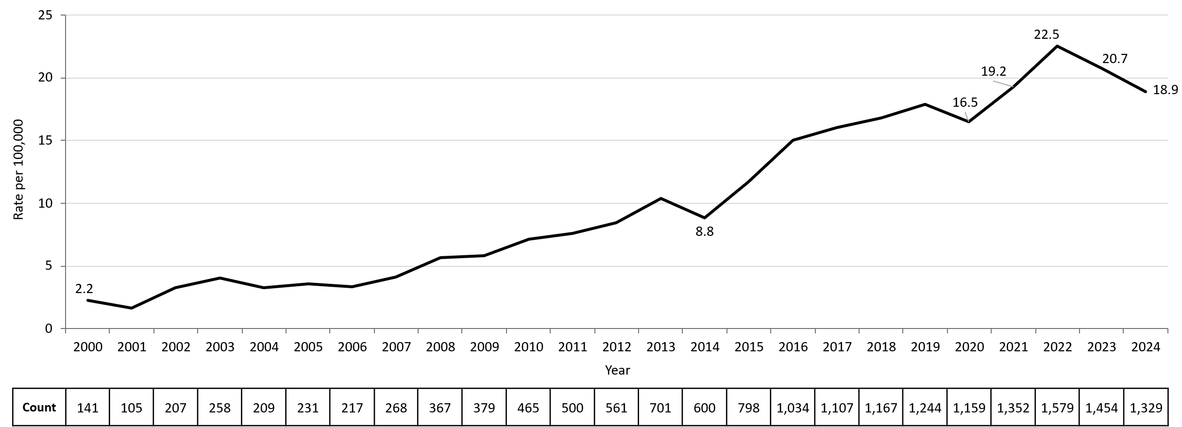
Confirmed and Probable Infectious Syphilis¹ Rates,
Massachusetts, 2000-2024²
Data are current as of 06/02/2025 and are subject to change.
Data Source: Massachusetts Department of Public Health/Bureau of Infectious Disease and Laboratory Sciences/ Division of STD Prevention and STD-HIV Surveillance.
Population denominators estimated by the University of Massachusetts Donahue Institute using a modified Hamilton-Perry model (Strate S, et al. Small Area Population Estimates for 2011 through 2020 report, Oct 2016).
1. Infectious syphilis is defined as primary, secondary and early latent stages of syphilis within one year of infection.
2. Please consider the impact of the COVID-19 pandemic on infectious disease screening, treatment and surveillance in the interpretation of 2020-2022 data.
Notes:
Confirmed and Probable Infectious Syphilis Rates, Massachusetts, 2000 to 2024
Graph depicts the rate per 100,000 population of confirmed and probable cases of infectious syphilis in Massachusetts between 2000 and 2024. It begins at 2.2 in 2000, drops to a low of 1.6 in 2001, and climbs to a high of 22.5 in 2022, before falling to 18.9 in 2024.

Slide 15
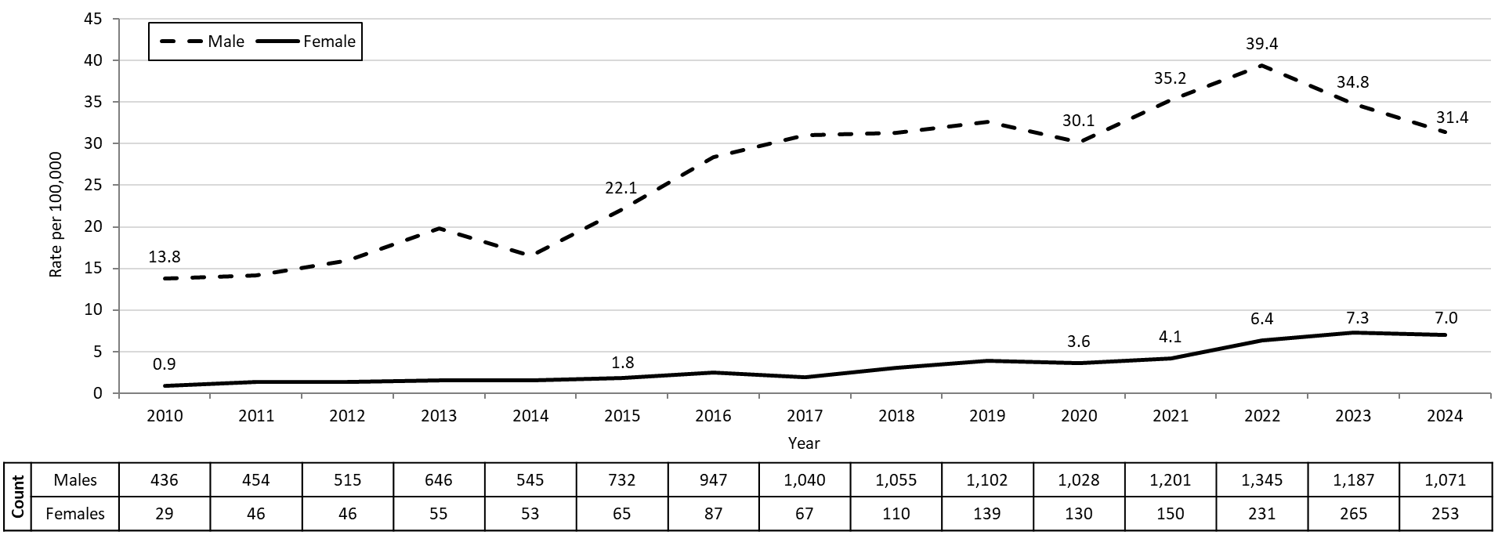
Confirmed and Probable Infectious Syphilis¹ Rates by Gender ², Massachusetts, 2010-2024³
Data are current as of 06/02/2025 and are subject to change.
Data Source: Massachusetts Department of Public Health/Bureau of Infectious Disease and Laboratory Sciences/ Division of STD Prevention and STD-HIV Surveillance.
Population denominators estimated by the University of Massachusetts Donahue Institute using a modified Hamilton-Perry model (Strate S, et al. Small Area Population Estimates for 2011 through 2020 report, Oct 2016).
1. Infectious syphilis is defined as primary, secondary and early latent stages of syphilis within one year of infection.
2. In 2024, there were 5 individuals of transgender experience reported in our data system who do not have current gender documented. These cases were excluded since population estimates for individuals of transgender experience are not available at this time.
3. Please consider the impact of the COVID-19 pandemic on infectious disease screening, treatment and surveillance in the interpretation of 2020-2022 data.
Notes:
Confirmed and Probable Infectious Syphilis Rates by Gender, Massachusetts, 2010 to 2024
Graph depicts the rates per 100,000 population of confirmed and probable cases of syphilis in Massachusetts by gender identity between 2010 and 2024. There are two lines, one for females that begins at 0.9 in 2010 and remains relatively stable with a high of 7.3 in 2023 before falling to 7.0 in 2024. Another line is for males that begins at 13.8 in 2010 and climbs to a high of 39.4 in 2022 before falling to 31.4 in 2024.
Note: Infectious syphilis is defined as primary, secondary and early latent stages of syphilis within one year of infection.
There were cases reported among transgender individuals in 2014 through 2024. They are classified on this slide based on their current gender. In 2024, there were 5 cases of infectious syphilis among transgender identified individuals not included on this slide as MA DSTDP does not have current gender information for those individuals.

Slide 16
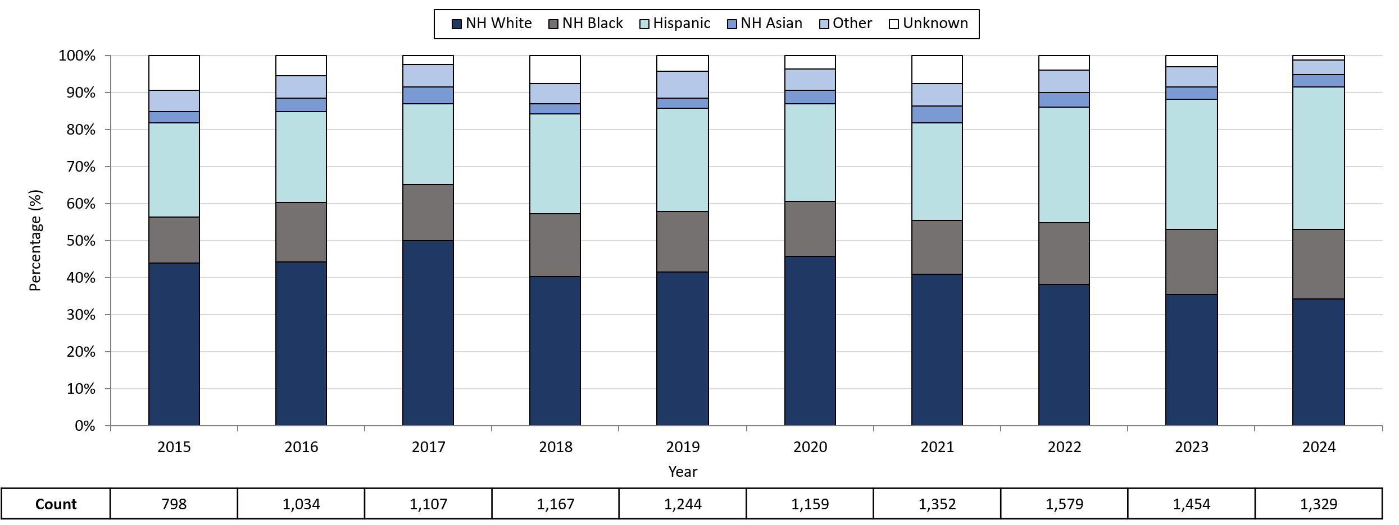
Infectious Syphilis¹ Reported Cases by Race/Ethnicity²,
Massachusetts, 2015-2024³
Data are current as of 06/02/2025 and are subject to change.
Data Source: Massachusetts Department of Public Health/Bureau of Infectious Disease and Laboratory Sciences/ Division of STD Prevention and STD-HIV Surveillance.
Note: National Notifiable Diseases Surveillance System (NNDSS) Congenital Syphilis case definition was updated in 2014.
1. Infectious syphilis is defined as primary, secondary and early latent stages of syphilis within one year of infection.
2. Other Race/Ethnicity includes individuals who identify as American Indian/ Pacific Islander/ Alaskan Native.
3. Please consider the impact of the COVID-19 pandemic on infectious disease screening, treatment and surveillance in the interpretation of 2020-2022 data.
Notes:
Infectious Syphilis Reported Cases by Race/Ethnicity, Massachusetts, 2015-2024
Graph depicts the proportion of Massachusetts reported confirmed and probable infectious syphilis cases broken down by race/ethnicity for the years 2015 through 2024. The highest percentage of cases for each year prior to 2024 identified as Non-Hispanic White making up a high of 50.0% of cases in 2017 and a resulting 34.2% of cases in 2024. 2024 represents the first year the highest percentage of cases identified as Hispanic with a low of 22.0% in 2017 and a high of 38.3% in 2024. In total, over the nine-year period, the proportion of cases by race/ethnicity were from highest to lowest: Non-Hispanic White, Hispanic, Non-Hispanic Black, Non-Hispanic Other, Unknown, and Non-Hispanic Asian.
Note: Infectious syphilis is defined as primary, secondary and early latent (non-primary/non-secondary) stages of syphilis within one year of infection.

Slide 17
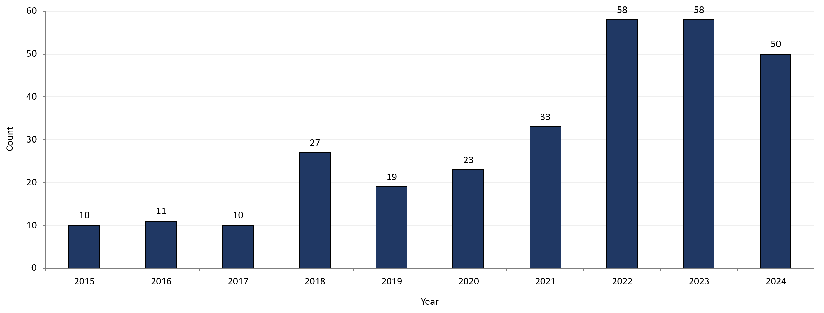
Confirmed and Probable Infectious Syphilis¹ Among Individuals of Transgender Experience², Massachusetts, 2015-2024^{3, 4}
Data are current as of 06/02/2025 and are subject to change.
Data Source: Massachusetts Department of Public Health/Bureau of Infectious Disease and Laboratory Sciences/ Division of STD Prevention and STD-HIV Surveillance.
1. Infectious syphilis is defined as primary, secondary and early latent stages of syphilis within one year of infection.
2. All individuals of transgender experience are included in this graph regardless of current gender.
3. Please consider the impact of the COVID-19 pandemic on infectious disease screening, treatment and surveillance in the interpretation of 2020-2022 data.
4. In 2022, a retrospective verification project was conducted to improve data quality in capturing current gender information.
Notes:
Confirmed and Probable Infectious Syphilis Among Individuals of Transgender Experience, Massachusetts, 2015 to 2024
Graph shows the number of confirmed and probable infectious syphilis cases among transgender individuals in Massachusetts between 2015 and 2024. The case counts are 10, 11, 10, 27, 19, 23, 33, 58, 58, and 50 for 2015, 2016, 2017, 2018, 2019, 2020, 2021, 2022, 2023, and 2024 respectively.
*Infectious syphilis is defined as primary, secondary and early latent stages of syphilis within one year of infection.

Slide 18
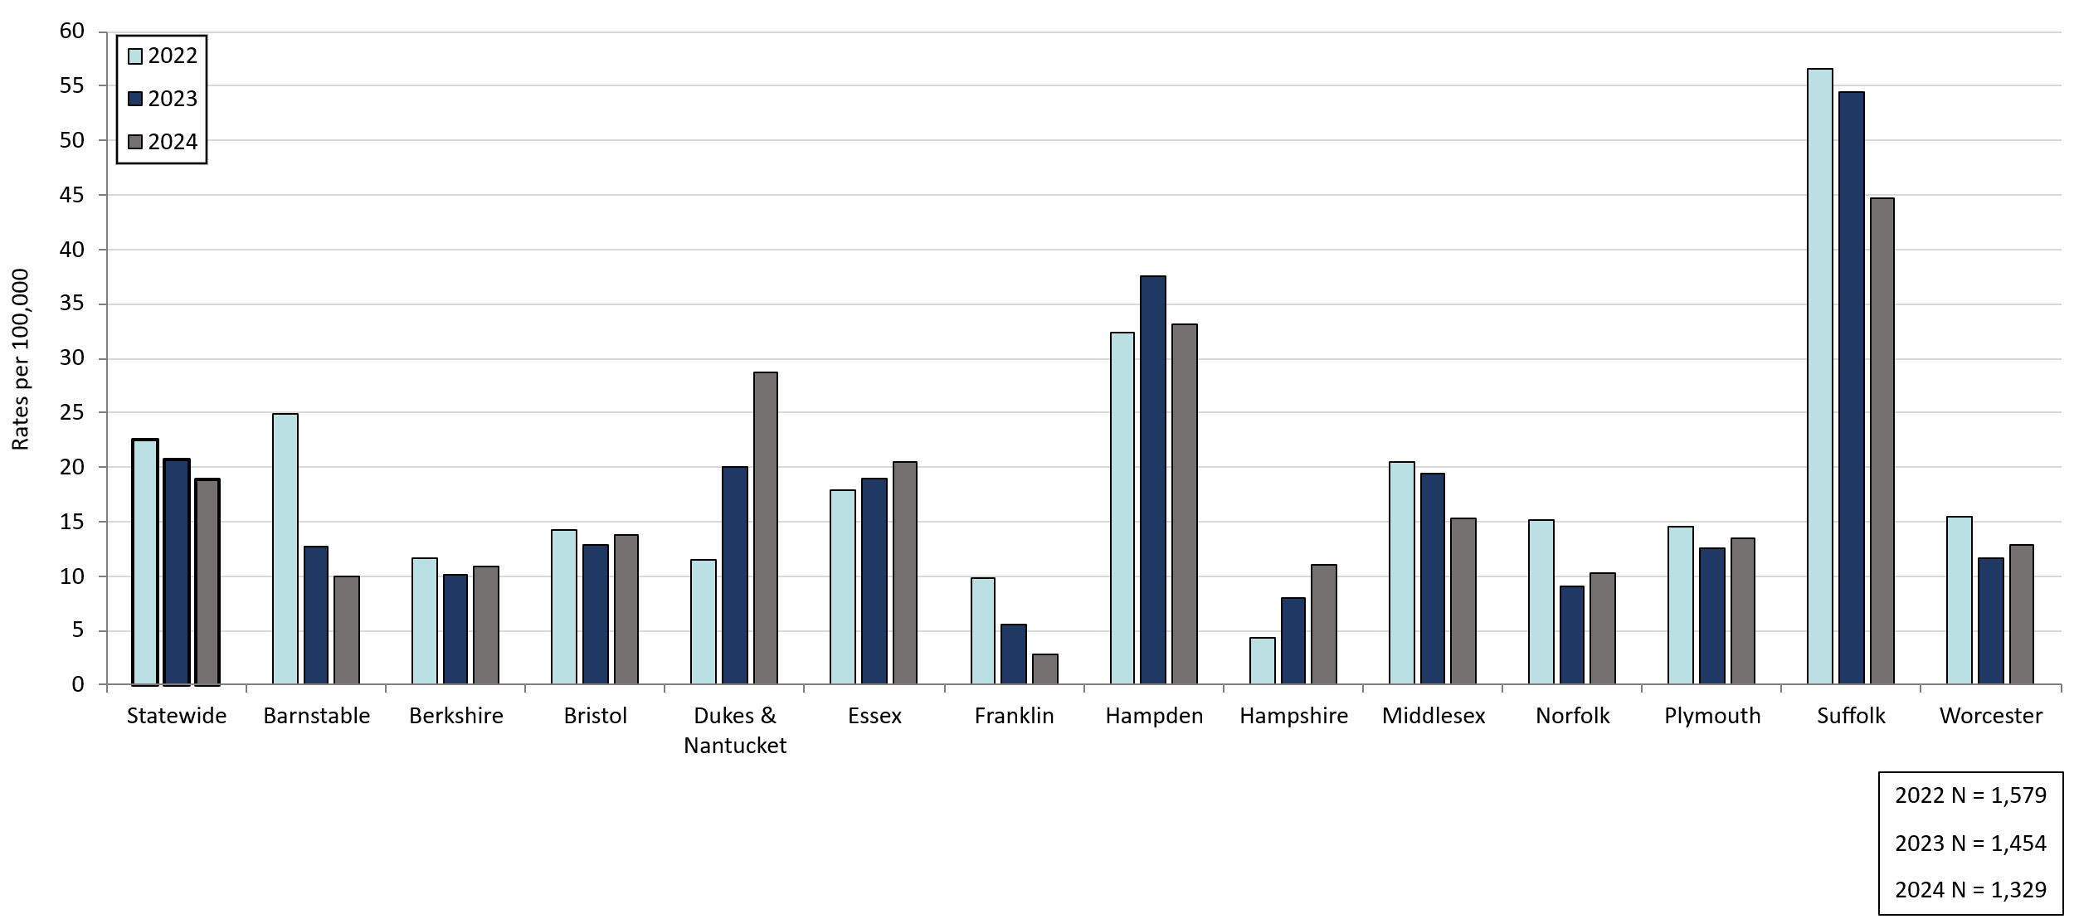
Confirmed and Probable Infectious Syphilis¹ Rates by County and Statewide, Massachusetts, 2022-2024²
Statewide
Data are current as of 06/02/2025 and are subject to change.
Data Source: Massachusetts Department of Public Health/Bureau of Infectious Disease and Laboratory Sciences/ Division of STD Prevention and STD-HIV Surveillance.
Population denominators estimated by the University of Massachusetts Donahue Institute using a modified Hamilton-Perry model (Strate S, et al. Small Area Population Estimates for 2011 through 2020 report, Oct 2016).
1. Infectious syphilis is defined as primary, secondary and early latent stages of syphilis within one year of infection.
2. Please consider the impact of the COVID-19 pandemic on infectious disease screening, treatment and surveillance in the interpretation of 2022 data.
Notes:
Confirmed and Probable Infectious Syphilis Rates by County and Statewide, Massachusetts, 2022-2024
Graph depicts rate per 100,000 population of infectious syphilis cases reported in Massachusetts by county comparing 2022 through 2024. The rate is highest in Suffolk county with a rate of 56.6 in 2022 before falling to 44.7 in 2024, followed by Hampden county with a rate of 37.6 in 2023 which fell to 33.1 in 2024. The lowest rates were in Hampshire and Franklin county.

Slide 19
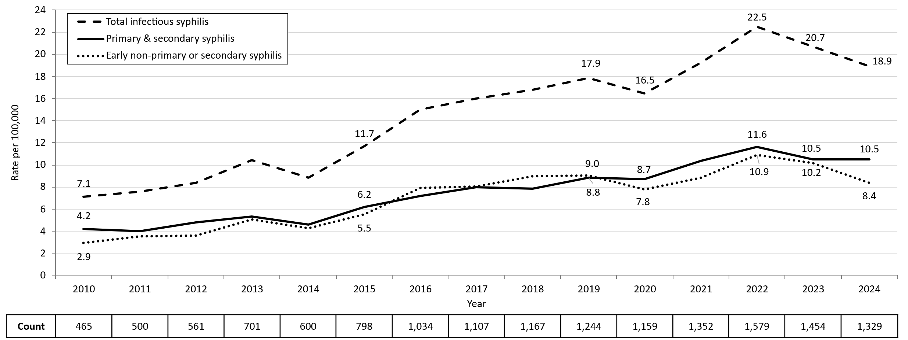
Confirmed and Probable Infectious Syphilis¹ Rates by Stage of Infection, Massachusetts, 2010-2024²
Data are current as of 06/02/2025 and are subject to change.
Data Source: Massachusetts Department of Public Health/Bureau of Infectious Disease and Laboratory Sciences/ Division of STD Prevention and STD-HIV Surveillance.
Population denominators estimated by the University of Massachusetts Donahue Institute using a modified Hamilton-Perry model (Strate S, et al. Small Area Population Estimates for 2011 through 2020 report, Oct 2016).
1. Infectious syphilis is defined as primary, secondary and early latent stages of syphilis within one year of infection.
2. Please consider the impact of the COVID-19 pandemic on infectious disease screening, treatment and surveillance in the interpretation of 2020-2022 data.
Notes:
Confirmed and Probable Infectious Syphilis Rates by Stage of Infection, Massachusetts, 2010–2024
Graph depicts the differences between the rate of infectious syphilis diagnosed in the primary and secondary stage compared to those cases diagnosed in the early non-primary and non-secondary stages reported in Massachusetts from 2010 to 2024. There are three lines on the graph. One line for primary and secondary cases starting with a rate of 4.2 per 100,000 in 2010 and peaking with a rate of 11.6 in 2022, before falling to 10.5 in 2024. Another line for non-primary non-secondary cases starting with a rate of 2.9 in 2010, peaking with a rate of 10.9 in 2022, before falling to 8.4 in 2024. The final line shows the total infectious syphilis starting with a rate of 7.1 in 2010 and peaking at a rate of 22.5 in 2022, before falling to 18.9 in 2024.
Note: Infectious syphilis is defined as primary, secondary and early latent (non-primary/non-secondary) stages of syphilis within one year of infection.

Slide 20
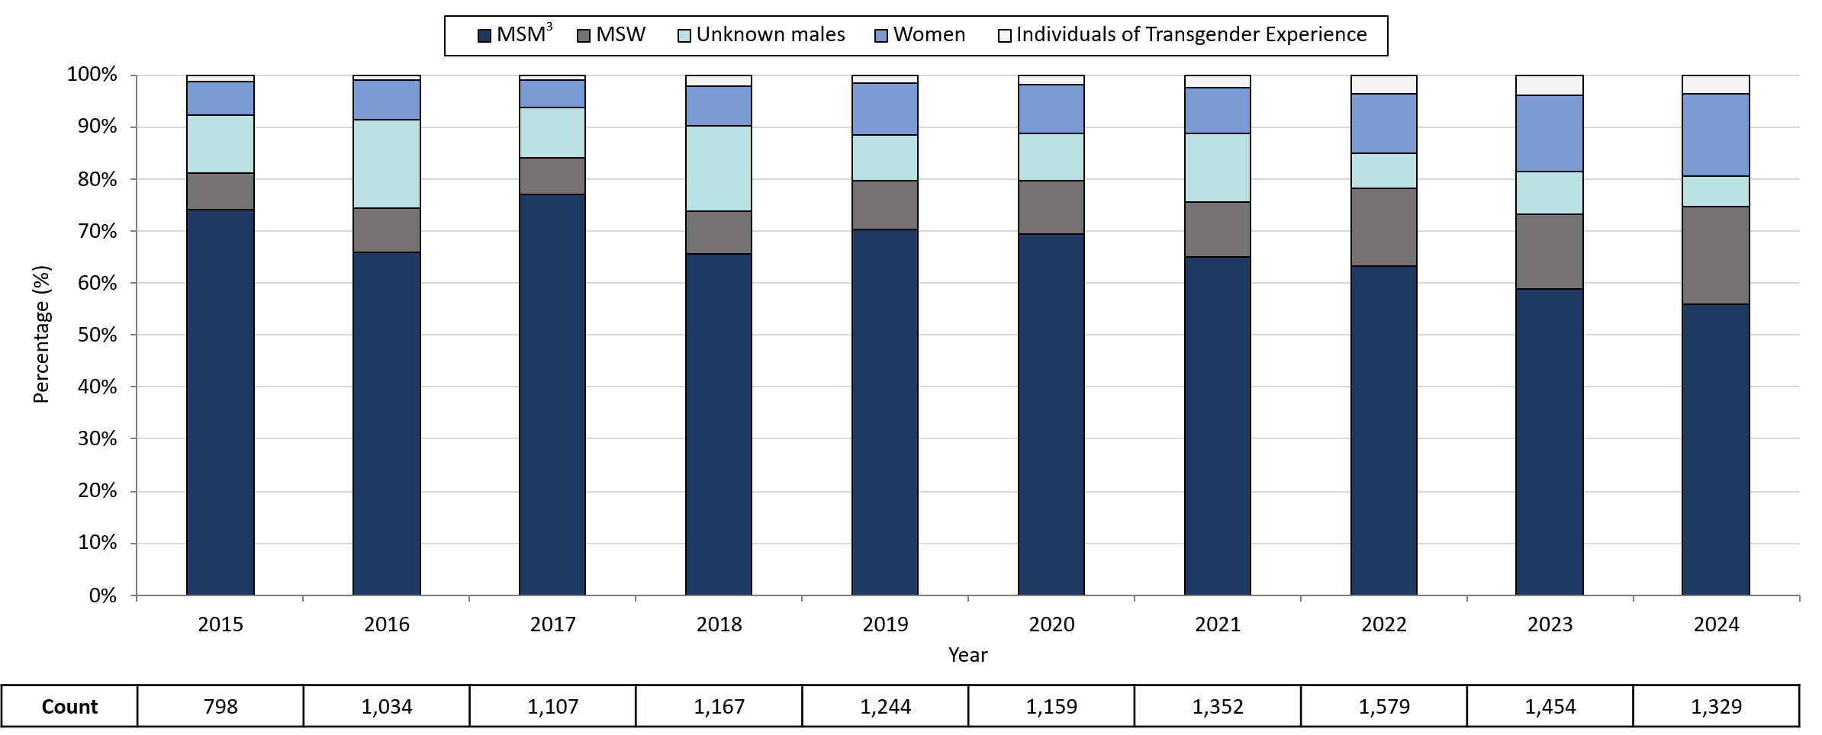
Infectious Syphilis¹ Reported Cases by Gender of Sex Partners, Massachusetts, 2015-2024²
Data are current as of 06/02/2025 and are subject to change.
Data Source: Massachusetts Department of Public Health/Bureau of Infectious Disease and Laboratory Sciences/ Division of STD Prevention and STD-HIV Surveillance.
Note: National Notifiable Diseases Surveillance System (NNDSS) Congenital Syphilis case definition was updated in 2014.
1. Infectious syphilis is defined as primary, secondary and early latent stages of syphilis within one year of infection.
2. Please consider the impact of the COVID-19 pandemic on infectious disease screening, treatment and surveillance in the interpretation of 2020-2022 data.
3. The MSM (men who have sex with men) category includes MSMT, MSMW, MSMWT, and MST with “W” referring to women and “T” referring to individuals of transgender experience.
Notes:
Infectious Syphilis Reported Cases by Gender of Sex Partners, Massachusetts, 2015-2024
Graph depicts the proportion of Massachusetts reported confirmed and probable infectious syphilis cases broken down by gender of sex partners for the years 2015 through 2024. The highest percentage of cases for each year reported male sex partners and are classified as MSM (men who have sex with men) making up a high of 77% of cases in 2017 and a resulting 55.9% of cases in 2024. In total, over the ten-year period, the proportion of cases by gender of sex partners were from highest to lowest: MSM, MSW (men who have sex with women), unknown males, women, and transgender individuals. For 2024, the order in frequency from highest to lowest is: MSM, MSW, women, unknown males, and individuals of transgender experience.
Note: Infectious syphilis is defined as primary, secondary and early latent (non-primary/non-secondary) stages of syphilis within one year of infection.

Slide 21
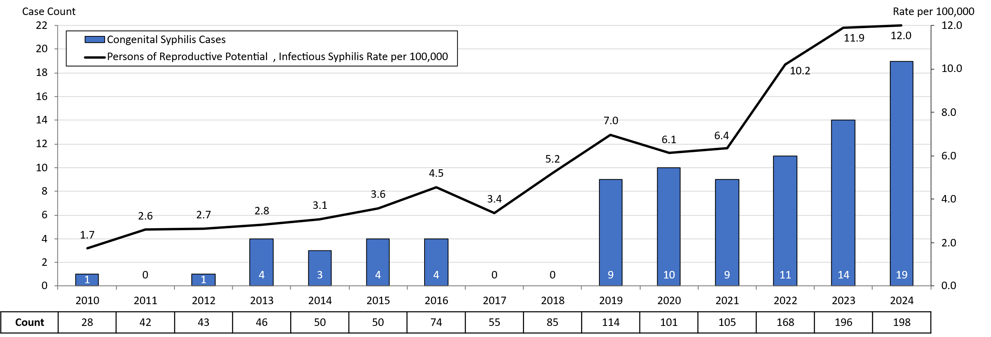
Congenital Syphilis Cases and Rate of Confirmed and Probable Infectious Syphilis¹ Among Persons of Reproductive Potential Ages 15 to 49 Years, Massachusetts, 2010-2024²
3
Data are current as of 06/02/2025 and are subject to change.
Data Source: Massachusetts Department of Public Health/Bureau of Infectious Disease and Laboratory Sciences/ Division of STD Prevention.
Population denominators estimated by the University of Massachusetts Donahue Institute using a modified Hamilton-Perry model (Strate S, et al. Small Area Population Estimates for 2011 through 2020 report, Oct 2016).
Note: National Notifiable Diseases Surveillance System (NNDSS) Congenital Syphilis case definition was updated in 2014.
1. Infectious syphilis is defined as primary, secondary and early latent stages of syphilis within one year of infection.
2. Please consider the impact of the COVID-19 pandemic on infectious disease screening, treatment and surveillance in the interpretation of 2020-2022 data.
3. Persons of Reproductive Potential refers to individuals thought to be capable of pregnancy ages 15 to 49 years and not known to be assigned sex male at birth.
Notes:
Congenital Syphilis Cases and Rate of Confirmed and Probable Infectious Syphilis Among Individuals Thought to be Capable of Pregnancy Ages 15 to 49 Years, Massachusetts, 2010-2024
Graph depicts the case count for confirmed and probable congenital syphilis cases reported in Massachusetts between 2010 and 2024. The case counts are 1, 0, 1, 4, 3, 4, 4, 0, 0, 9, 10, 9, 11,14, and 19 for 2010, 2011, 2012, 2013, 2014, 2015, 2016, 2017, 2018, 2019, 2020, 2021, 2022, 2023, and 2024, respectively. Additionally, the graph shows a line depicting the rate per 100,000 population of confirmed and probable infectious syphilis among individuals thought to be capable of pregnancy ages 15 to 49 years which starts with a rate of 1.7 in 2010 and peaks in 2024 with a rate of 12.0 cases per 100,000 population.
Note: Infectious syphilis is defined as primary, secondary and early latent (non-primary/non-secondary) stages of syphilis within one year of infection.

Slide 22
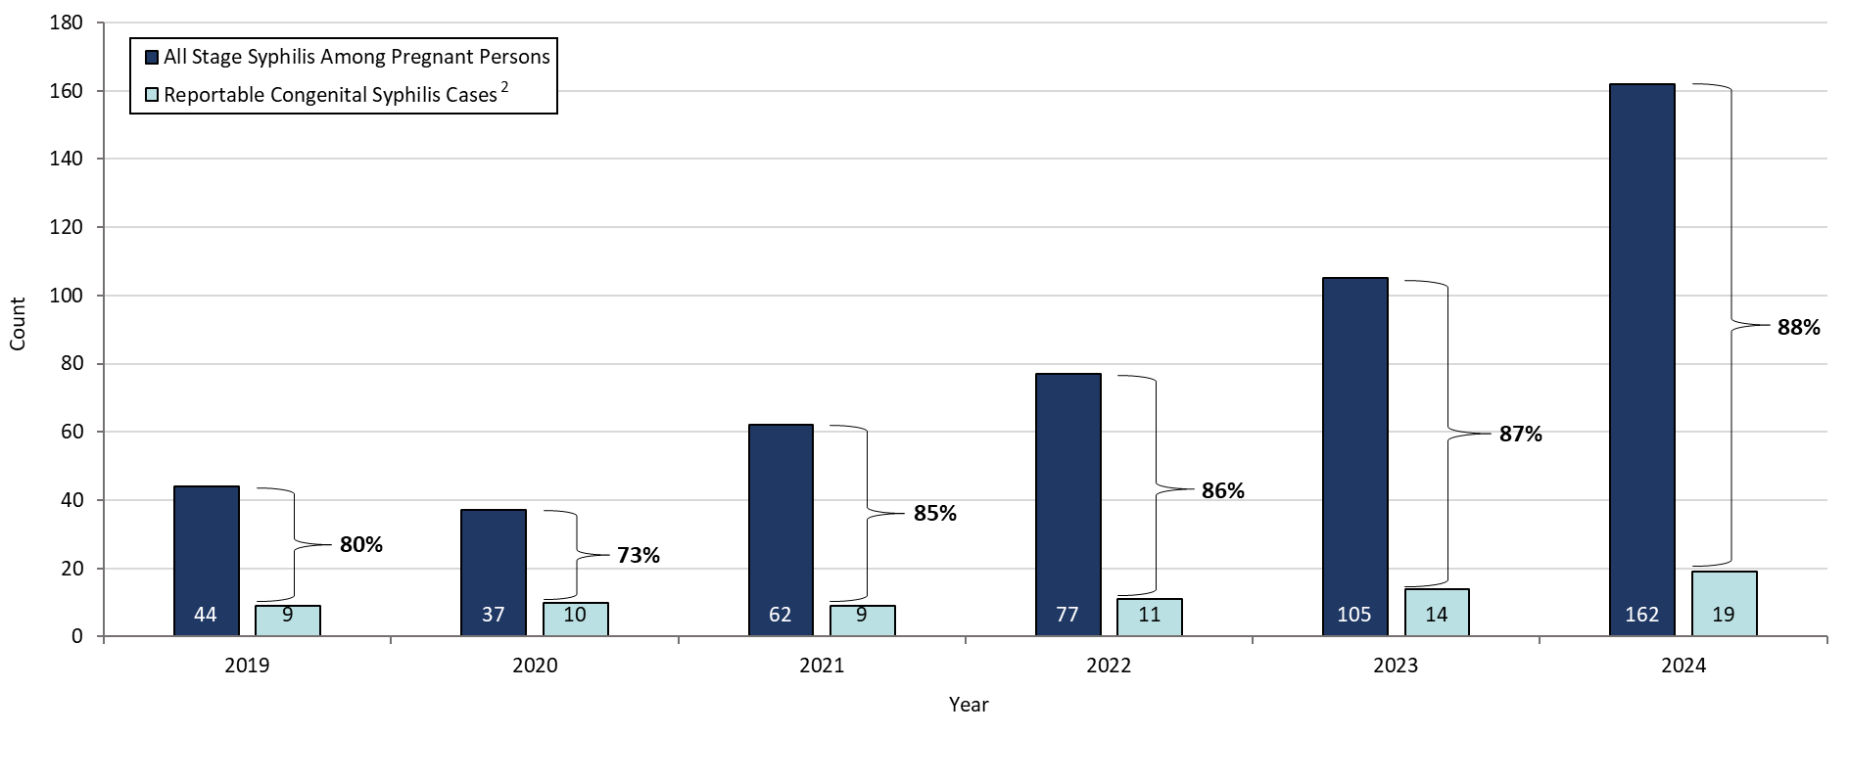
Congenital Syphilis Cases Averted, Massachusetts, 2019-2024¹
Data are current as of 6/02/2025 and are subject to change.
Data Source: Massachusetts Department of Public Health/Bureau of Infectious Disease and Laboratory Sciences/ Division of STD Prevention and STD-HIV Surveillance.
1. Please consider the impact of the COVID-19 pandemic on infectious disease screening, treatment and surveillance in the interpretation of 2020-2022 data.
2. To review the case definition for reportable congenital syphilis please visit, https://ndc.services.cdc.gov/case-definitions/congenital-syphilis-2015/
Note: “Cases averted” includes all pregnant persons who received treatment for any stage of syphilis during pregnancy. Individuals with uncertain or questionable treatment histories may also be included, as their risk status cannot be fully verified.
Notes:
Congenital Syphilis Cases Averted, Massachusetts, 2019-2024
Graph depicts the case count for confirmed and probable congenital syphilis cases as well as the case count for all probable and confirmed syphilis cases among pregnant persons reported in Massachusetts between 2019 and 2024. The percent of averted congenital syphilis cases is displayed with a low of 73% of congenital cases averted in 2020 and a high of 88% in 2024.

Slide 23
Massachusetts SVI Trends
Chlamydia, Gonorrhea, and Infectious Syphilis:
2000 - 2024
Notes:
Picture description: logo for the Massachusetts Department of Public Health

Slide 24
Social Vulnerability Index
Patient addresses were manually cleaned and geocoded utilizing SAS 9.4
Social Vulnerability Index (SVI) was based on the patient’s home address.
  It characterizes community resilience/ability to withstand external hazards.
  SVI incorporates 15 demographic and socioeconomic variables from the US census.
  Patients’ census tracts are given a percentile rank and grouped as low, moderately low, moderately high, and high.
  Higher percentile scores represent greater community vulnerability.
  The CDC/ATSDR SVI database from 2020 was matched to cases from 2020-2021.
  The CDC/ATSDR SVI database from 2022 was matched to cases from 2022-2024.

Slide 25
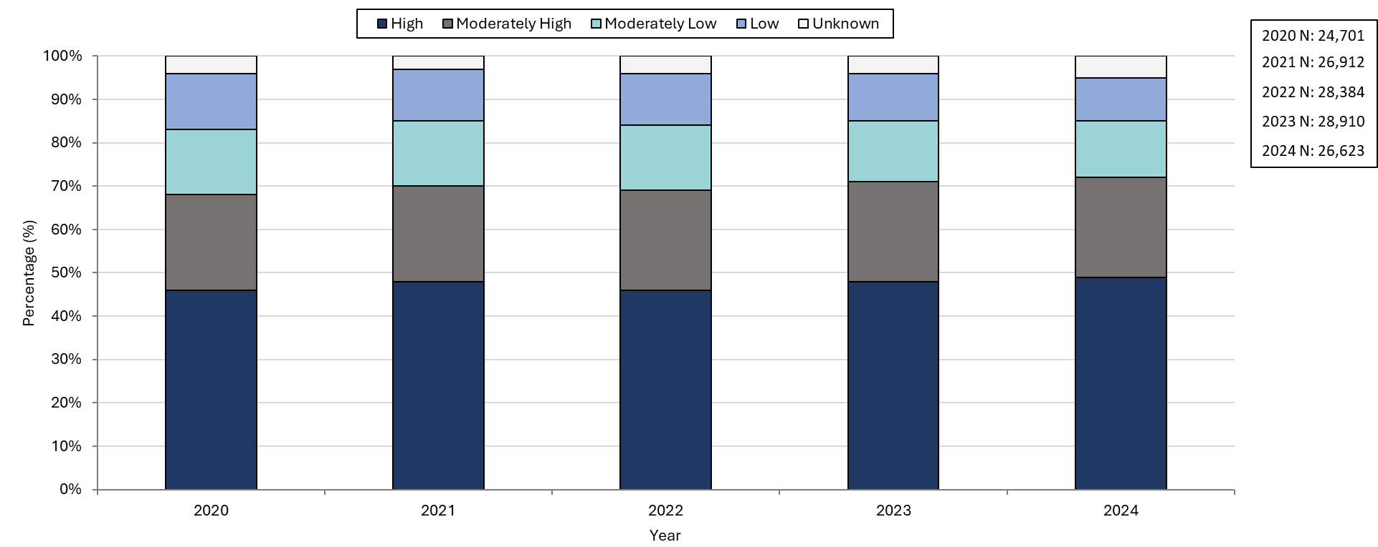

Confirmed Chlamydia Case Percentages by Social Vulnerability Index, Massachusetts, 2020-2024¹
Data are current as of 06/02/2025 and are subject to change.
Data Source: Massachusetts Department of Public Health/Bureau of Infectious Disease and Laboratory Sciences/ Division of STD Prevention and STD-HIV Surveillance.
1. Please consider the impact of the COVID-19 pandemic on infectious disease screening, treatment and surveillance in the interpretation of 2020-2022 data.
2. Unknown category is made up of cases with addresses that were missing, addresses that could not be geocoded, addresses associated with shelters or correctional facilities, or who reported homelessness.
Notes:
Confirmed Chlamydia Case Percentages by Social Vulnerability Index, Massachusetts, 2020-2024
Graph depicts the proportion of Massachusetts reported confirmed chlamydia cases broken down by SVI quartile for the years 2020 through 2024. The High SVI group is largest for each year, making up 41 to 49% of cases each year. Each year, the order in frequency from highest to lowest is: High, Moderately High, Moderately Low, Low, and Unknown SVI.

Slide 26
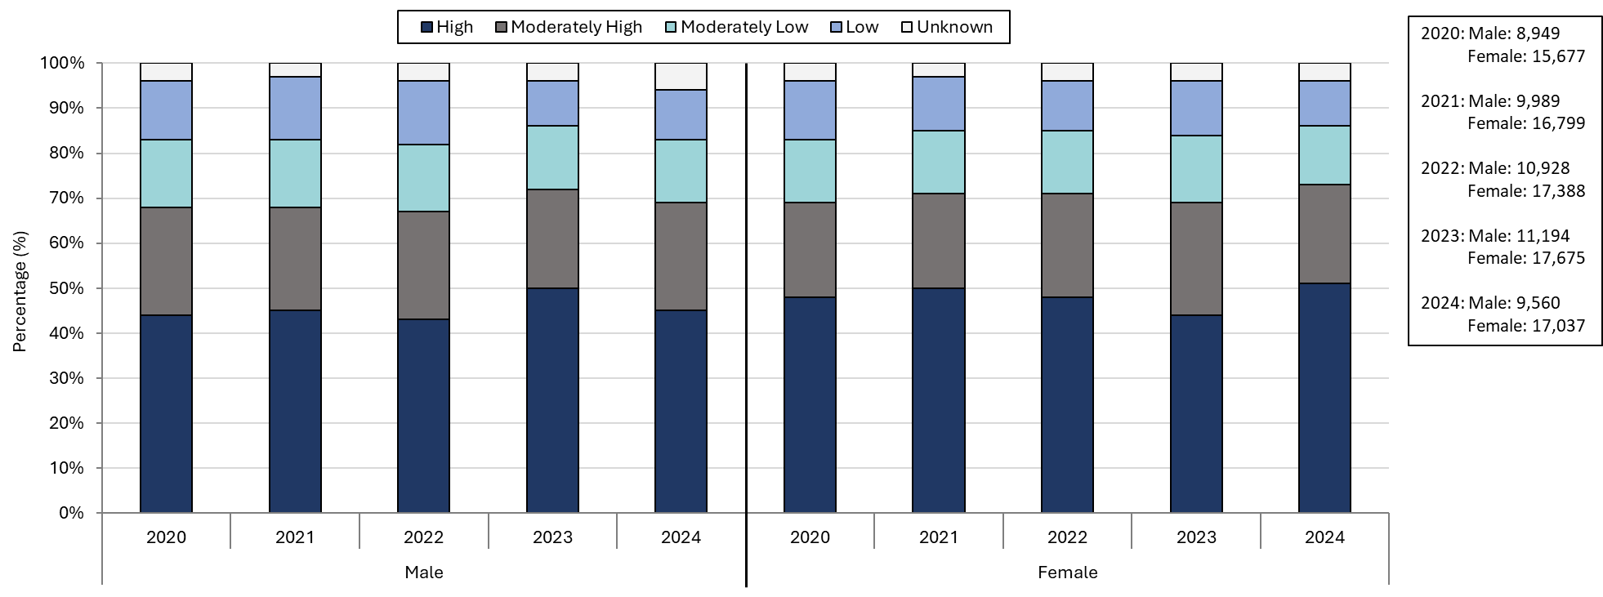

Confirmed Chlamydia Case Percentages by Social Vulnerability Index and Gender, Massachusetts, 2020-2024^{1, 2}
Data are current as of 06/02/2025 and are subject to change.
Data Source: Massachusetts Department of Public Health/Bureau of Infectious Disease and Laboratory Sciences/ Division of STD Prevention and STD-HIV Surveillance.
1. Please consider the impact of the COVID-19 pandemic on infectious disease screening, treatment and surveillance in the interpretation of 2020-2022 data.
2. Individuals of transgender experience that do not have complete gender data may not be included within this slide.
3. Unknown category is made up of cases with addresses that were missing, addresses that could not be geocoded, addresses associated with shelters or correctional facilities, or who reported homelessness.
Notes:
Confirmed Chlamydia Case Percentages by Social Vulnerability Index and Gender, Massachusetts, 2020-2024
Graph depicts the proportion of Massachusetts reported confirmed chlamydia cases broken down by SVI quartile and gender for the years 2020 through 2024. In 2024, 51% of female cases are High SVI, compared to 45% in males. 22% of female cases in 2024 are Moderately High SVI, 13% are Moderately Low SVI, 10% are Low SVI, and 4% are Unknown SVI. 24% of male cases in 2024 are Moderately High SVI, 14% are Moderately Low SVI, 11% are Low SVI, and 6% are Unknown SVI.

Slide 27
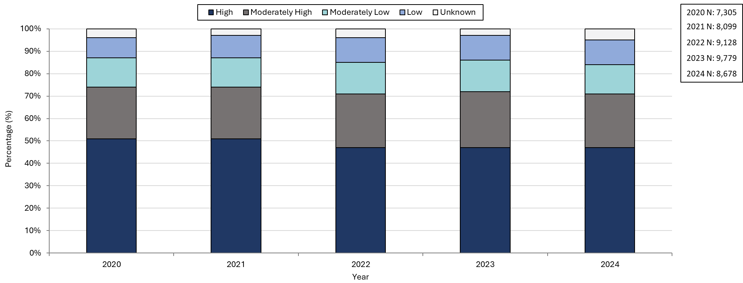
Confirmed Gonorrhea Case Percentages by Social Vulnerability Index, Massachusetts, 2020-2024¹
Data are current as of 06/02/2025 and are subject to change.
Data Source: Massachusetts Department of Public Health/Bureau of Infectious Disease and Laboratory Sciences/ Division of STD Prevention and STD-HIV Surveillance.
1. Please consider the impact of the COVID-19 pandemic on infectious disease screening, treatment and surveillance in the interpretation of 2020-2022 data.
2. Unknown category is made up of cases with addresses that were missing, addresses that could not be geocoded, addresses associated with shelters or correctional facilities, or who reported homelessness.
Notes:
Confirmed Gonorrhea Case Percentages by Social Vulnerability Index, Massachusetts, 2020-2024
Graph depicts the proportion of Massachusetts reported confirmed gonorrhea cases broken down by SVI quartile for the years 2020 through 2024. The High SVI group is largest for each year, making up 47 to 51% of cases each year. Each year, the order in frequency from highest to lowest is: High, Moderately High, Moderately Low, Low, and Unknown SVI.

Slide 28
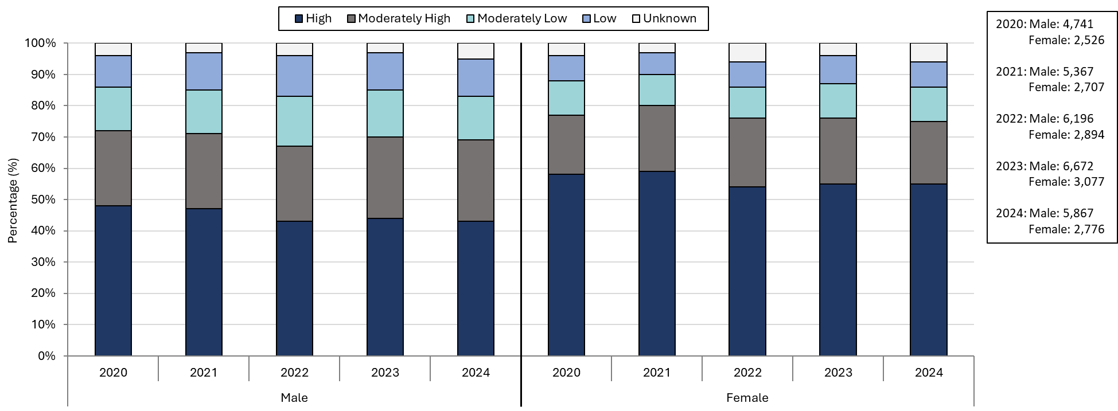
Confirmed Gonorrhea Case Percentages by Social Vulnerability Index and Gender, Massachusetts, 2020-2024^{1, 2}
Data are current as of 06/02/2025 and are subject to change.
Data Source: Massachusetts Department of Public Health/Bureau of Infectious Disease and Laboratory Sciences/ Division of STD Prevention and STD-HIV Surveillance.
1. Please consider the impact of the COVID-19 pandemic on infectious disease screening, treatment and surveillance in the interpretation of 2020-2022 data.
2. Individuals of transgender experience that do not have complete gender data may not be included within this slide.
3. Unknown category is made up of cases with addresses that were missing, addresses that could not be geocoded, addresses associated with shelters or correctional facilities, or who reported homelessness.
Notes:
Confirmed Gonorrhea Case Percentages by Social Vulnerability Index and Gender, Massachusetts, 2020-2024
Graph depicts the proportion of Massachusetts reported confirmed gonorrhea cases broken down by SVI quartile and gender for the years 2020 through 2024. In 2024, 55% of female cases are High SVI, compared to 43% in males. 20% of female cases in 2024 are Moderately High SVI, 11% are Moderately Low SVI, 8% are Low SVI, and 6% are Unknown SVI. 26% of male cases in 2024 are Moderately High SVI, 15% are Moderately Low SVI, 12% are Low SVI, and 3% are Unknown SVI.

Slide 29
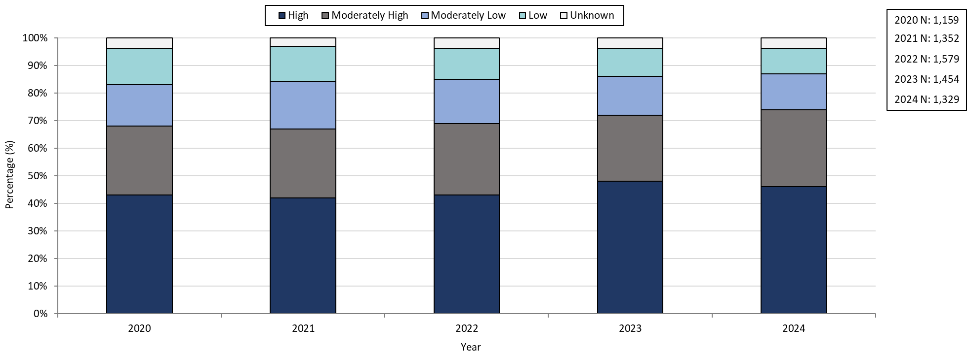
Confirmed and Probably Infectious Syphilis¹ Case Percentages by Social Vulnerability Index, Massachusetts, 2020-2024²
Data are current as of 06/02/2025 and are subject to change.
Data Source: Massachusetts Department of Public Health/Bureau of Infectious Disease and Laboratory Sciences/ Division of STD Prevention and STD-HIV Surveillance.
1. Infectious syphilis is defined as primary, secondary and early latent stages of syphilis within one year of infection.
2. Please consider the impact of the COVID-19 pandemic on infectious disease screening, treatment and surveillance in the interpretation of 2020-2022 data.
3. Unknown category is made up of cases with addresses that were missing, addresses that could not be geocoded, addresses associated with shelters or correctional facilities, or who reported homelessness.
Notes:
Confirmed and Probably Infectious Syphilis Case Percentages by Social Vulnerability Index, Massachusetts, 2020-2024
Graph depicts the proportion of Massachusetts reported confirmed and probable infectious syphilis cases broken down by SVI quartile for the years 2020 through 2024. The High SVI group is largest for each year, making up 42 to 48% of cases each year. Each year, the order in frequency from highest to lowest is: High, Moderately High, Moderately Low, Low, and Unknown SVI.

Slide 30
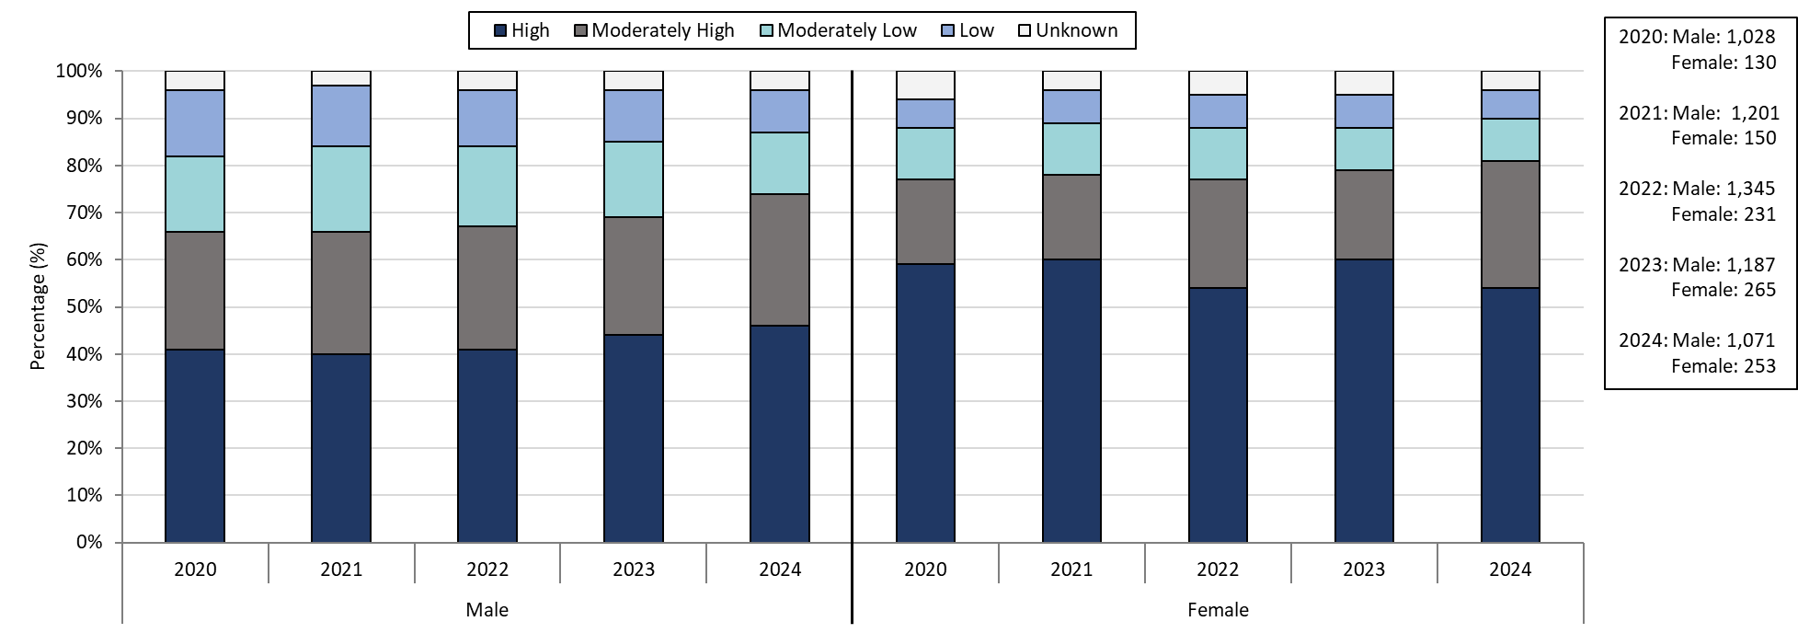

Confirmed and Probable Infectious Syphilis¹ Case Percentages by Social Vulnerability Index and Gender², Massachusetts, 2020-2024³
Data are current as of 06/02/2025 and are subject to change.
Data Source: Massachusetts Department of Public Health/Bureau of Infectious Disease and Laboratory Sciences/ Division of STD Prevention and STD-HIV Surveillance.
1. Infectious syphilis is defined as primary, secondary and early latent stages of syphilis within one year of infection.
2. Individuals of transgender experience that do not have complete gender data may not be included within this slide.
3. Please consider the impact of the COVID-19 pandemic on infectious disease screening, treatment and surveillance in the interpretation of 2020-2022 data.
4. Unknown category is made up of cases with addresses that were missing, addresses that could not be geocoded, addresses associated with shelters or correctional facilities, or who reported homelessness.
Notes:
Confirmed and Probable Infectious Syphilis Case Percentages by Social Vulnerability Index and Gender, Massachusetts, 2020-2024
Graph depicts the proportion of Massachusetts reported confirmed and probable infectious syphilis cases broken down by SVI quartile and gender for the years 2020 through 2024. In 2024, 54% of female cases are High SVI, compared to 46% in males. 27% of female cases in 2024 are Moderately High SVI, 9% are Moderately Low SVI, 6% are Low SVI, and 4% are Unknown SVI. 28% of male cases in 2024 are Moderately High SVI, 13% are Moderately Low SVI, 11% are Low SVI, and 4% are Unknown SVI.

Slide 31
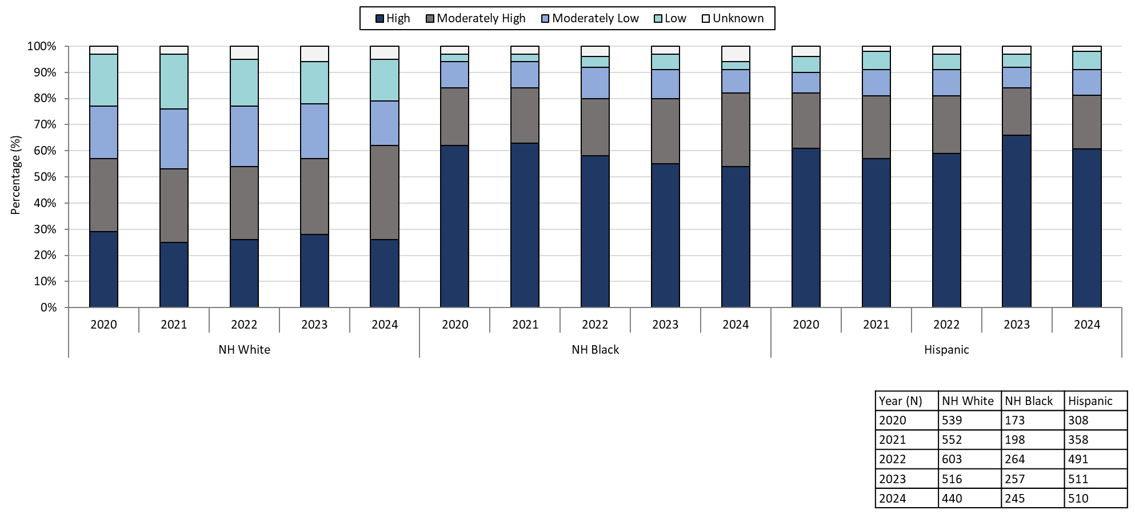
Confirmed and Probable Infectious Syphilis¹ Case Percentages by Social Vulnerability Index and Race², Massachusetts, 2020-2024³
Data are current as of 06/02/2025 and are subject to change.
Data Source: Massachusetts Department of Public Health/Bureau of Infectious Disease and Laboratory Sciences/ Division of STD Prevention and STD-HIV Surveillance.
1. Infectious syphilis is defined as primary, secondary and early latent stages of syphilis within one year of infection.
2. 98 individuals with reported race/ethnicity of NH Asian, Pacific Islander/American Indian/Alaskan Native, or Unknown were not included.
3. Please consider the impact of the COVID-19 pandemic on infectious disease screening, treatment and surveillance in the interpretation of 2020-2022 data.
4. Unknown category includes cases with missing addresses, addresses that couldn’t be geocoded, addresses linked to shelters or correctional facilities, or individuals reporting homelessness.
Notes:
Confirmed and Probable Infectious Syphilis Case Percentages by Social Vulnerability Index and Race, Massachusetts, 2020-2024
Graph depicts the proportion of Massachusetts reported confirmed and probable infectious syphilis cases broken down by SVI quartile and race for the years 2020 through 2024. Each year, NH White cases have a lower proportion of High SVI cases compared to NH Black and Hispanic cases. In 2024, 26% of NH White cases are High SVI, compared to 54% of NH Black cases and 61% of Hispanic cases.

Slide 32
Description of 2024 STI Cases
Geographic Distribution
Age, Gender, Sexual Risk Categories, and Race-Ethnicity
Notes:
Picture description: logo for the Massachusetts Department of Public Health

Slide 33
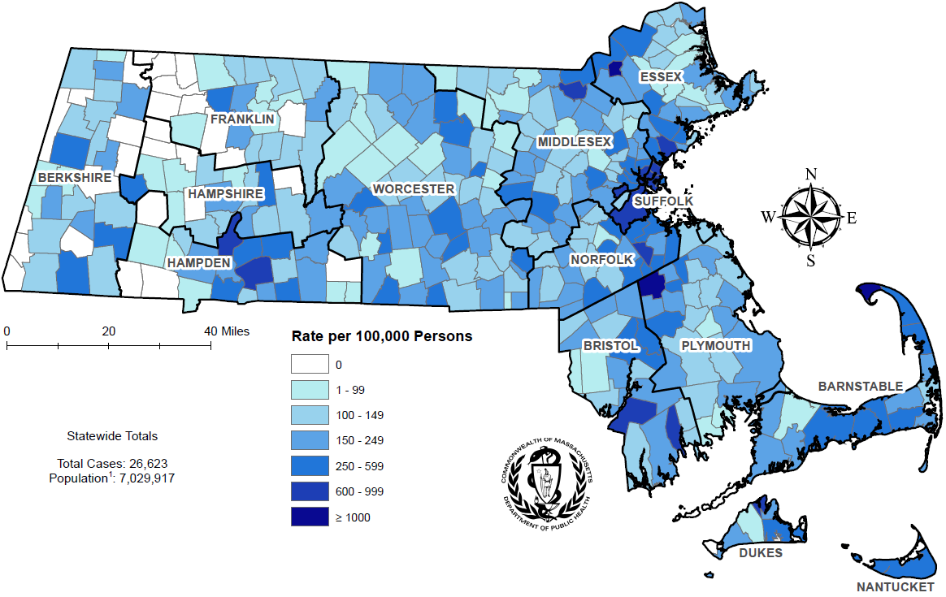

Incidence Rate of Confirmed Chlamydia Cases, per 100,000 Persons¹ by City/Town², Massachusetts, 2024
Data are current as of 06/02/2025 and are subject to change.
Data Source: Massachusetts Department of Public Health/Bureau of Infectious Disease and Laboratory Sciences/ Division of STD Prevention and STD-HIV Surveillance.
1. Population denominators estimated by the University of Massachusetts Donahue Institute using a modified Hamilton-Perry model (Strate S, et al. Small Area Population Estimates for 2011 through 2020 report, Oct 2016).
2. There are no city/towns with <10 cases of chlamydia that fall within the top two rate categories (≥600 cases per 100,000).
Notes:
Incident Rate of Confirmed Chlamydia Cases, per 100,000 Persons by City/Town, Massachusetts, 2024
Map of Massachusetts cities and towns color-coded to indicate the areas of the state with the highest chlamydia case rates in 2024. The cities that have the highest rates (greater than 600 per 100,000 persons) are Provincetown, Brockton, Lawrence, Chelsea, Springfield, Everett, Boston, Lynn, Lowell, Revere, New Bedford, Holyoke, Tisbury, Fall River, and Randolph.

Slide 34
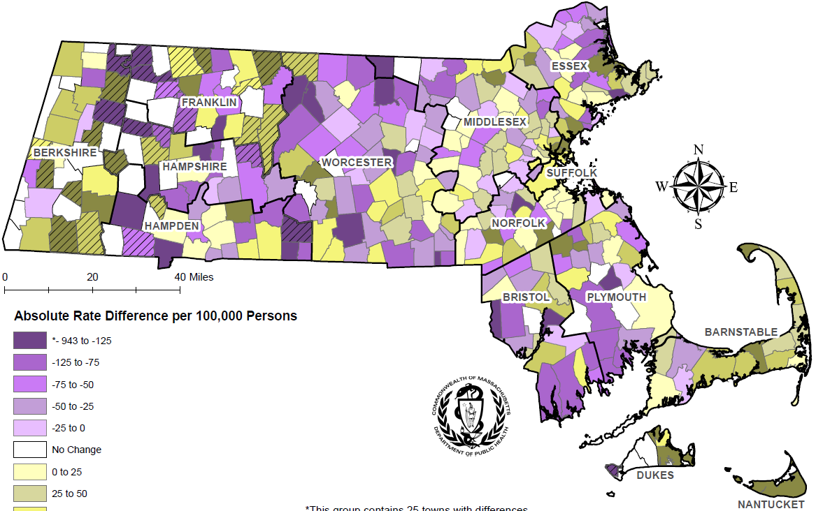
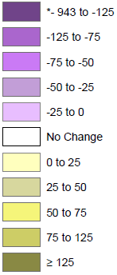


Absolute Rate Difference¹ Comparing 2024 to 2020 for Confirmed Chlamydia Cases, per 100,000 Persons² by City/Town, Massachusetts
Towns/cities with 0 cases in 2024 or 2020 and 1+ case in the opposing year
Data are current as of 06/02/2025 and are subject to change.
Data Source: Massachusetts Department of Public Health/Bureau of Infectious Disease and Laboratory Sciences/ Division of STD Prevention and STD-HIV Surveillance.
1. The darker the color in the scheme, the greater the difference between 2024 and 2020 chlamydia case rates with purple coloring indicating rates were higher in 2020 and gold coloring indicating rates were higher in 2024.
2. Population denominators estimated by the University of Massachusetts Donahue Institute using a modified Hamilton-Perry model (Strate S, et al. Small Area Population Estimates for 2011 through 2020 report, Oct 2016).
Notes:
Absolute Rate Difference Comparing 2023 to 2019 for Confirmed Chlamydia Cases, per 100,000 Persons by City/Town, Massachusetts
Map of Massachusetts cities and towns color-coded to indicate the range of absolute rate differences per 100,000 persons comparing 2024 chlamydia case rates to 2020 case rates. The darker the color in the scheme, the greater the difference between 2024 and 2020 case rates with purple coloring indicating rates were higher in 2020 and the gold coloring indicating rates were higher in 2024. The majority of cities and towns saw a drop in chlamydia case rates in 2024 compared with 2020 with the largest declines (less than -200 per 100,000 persons) occurring in Phillipston, Wales, and West Boylston; the greatest rate increases (greater than 200 per 100,000 persons) were seen in Brockton, Chelsea, East Brookfield, Edgartown, Lawrence, New Braintree, Otis, Provincetown, Stoughton, and Tisbury. The cities and towns that had zero cases for 2024 or 2020 and one or more cases for the opposing year are indicated on the map with a slash mark to acknowledge the absolute rate difference should be examined with caution.

Slide 35
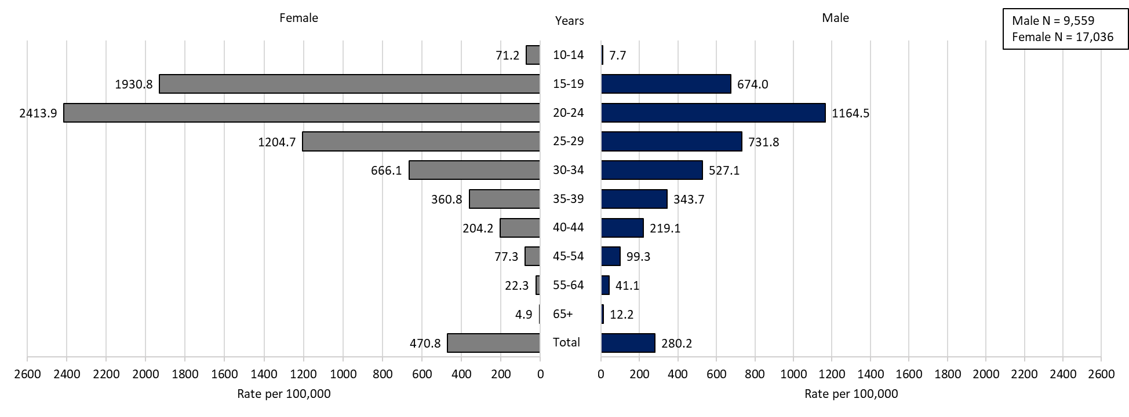
Confirmed Chlamydia Case Rates per 100,000 Population by Gender¹ and Age, Massachusetts, 2024
Data are current as of 06/02/2025 and are subject to change.
Data Source: Massachusetts Department of Public Health/Bureau of Infectious Disease and Laboratory Sciences/ Division of STD Prevention and STD-HIV Surveillance.
Population denominators estimated by the University of Massachusetts Donahue Institute using a modified Hamilton-Perry model (Strate S, et al. Small Area Population Estimates for 2011 through 2020 report, Oct 2016).
1. In 2024, there were 9 individuals of transgender experience and 17 other individuals documented in our data system that MA DSTDP does not have current gender information for. 2 individuals had unknown age. These cases were excluded since rate for this population cannot be calculated at this time.
Notes:
Confirmed Chlamydia Case Rates per 100,000 Population by Gender and Age, Massachusetts, 2024
Graph depicts chlamydia case rates per 100,000 population by age categories for the overall state, males, and females. For the overall state, the highest rate is among those 20-24 years. When looking at the gender specific rates, the age categories with the highest rates are 20-24 years for both males and females.

Slide 36
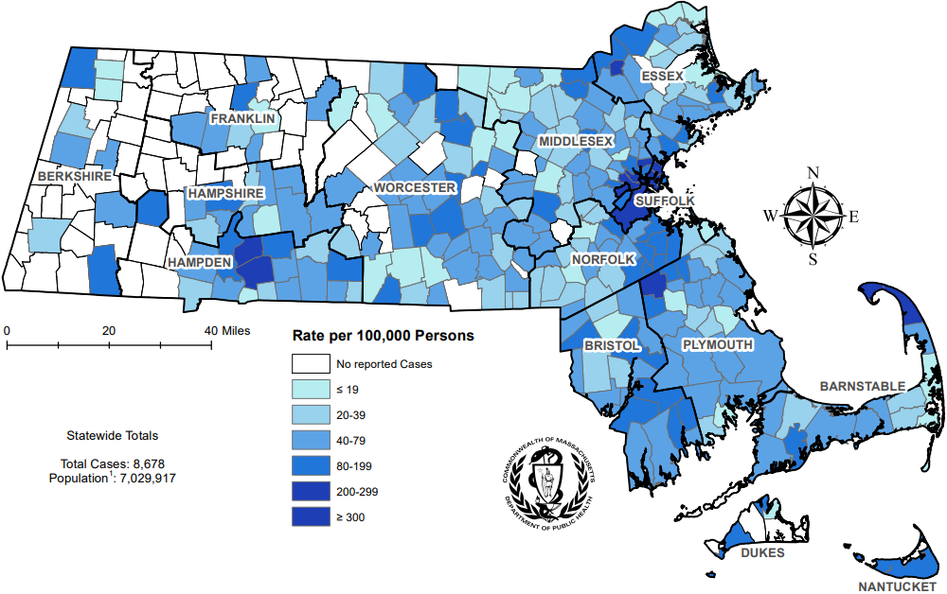
Incidence Rate of Confirmed Gonorrhea Cases, per 100,000 Persons¹ by City/Town², Massachusetts, 2024
Data are current as of 06/02/2025 and are subject to change.
Data Source: Massachusetts Department of Public Health/Bureau of Infectious Disease and Laboratory Sciences/ Division of STD Prevention and STD-HIV Surveillance.
1. Population denominators estimated by the University of Massachusetts Donahue Institute using a modified Hamilton-Perry model (Strate S, et al. Small Area Population Estimates for 2011 through 2020 report, Oct 2016).
2. There are two city/towns with <10 cases of gonorrhea that fall within the top two rate categories (≥200 cases per 100,000): Chesterfield and Tyringham.
Notes:
Incident Rate of Confirmed Gonorrhea Cases, per 100,000 Persons by City/Town, Massachusetts, 2024
Map of Massachusetts cities and towns color-coded to indicate the areas of the state with the highest gonorrhea case rates in 2024. The city with the highest rate (>500 per 100,000 persons) is Provincetown. Other cities that have the high rates (>300 per 100,000 persons) are Boston, Brockton, and Springfield.

Slide 37
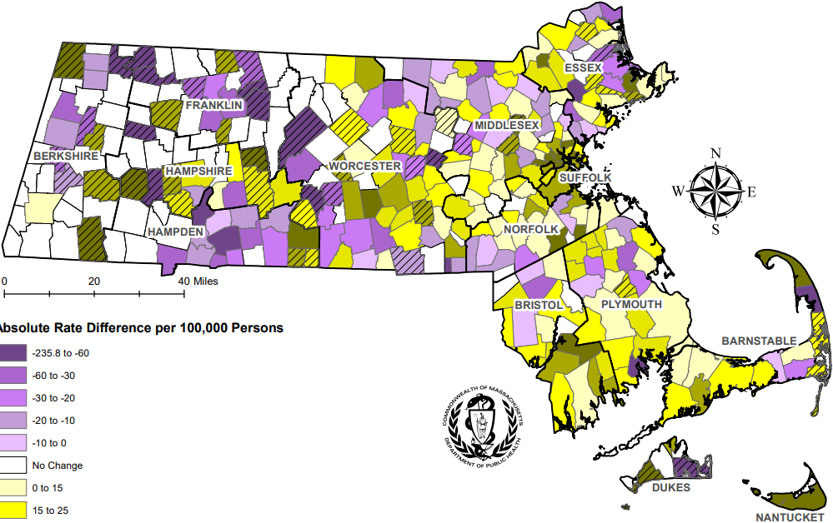
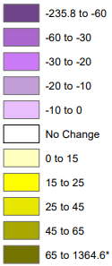


Absolute Rate Difference¹ Comparing 2024 to 2020 for Confirmed Gonorrhea Cases, per 100,000 Persons² by City/Town, Massachusetts
Towns/cities with 0 cases in 2024 or 2020 and 1+ case in the opposing year
Data are current as of 06/02/2025 and are subject to change.
Data Source: Massachusetts Department of Public Health/Bureau of Infectious Disease and Laboratory Sciences/ Division of STD Prevention and STD-HIV Surveillance.
1. The darker the color in the scheme, the greater the difference between 2024 and 2020 gonorrhea case rates with purple coloring indicating rates were higher in 2020 and gold coloring indicating rates were higher in 2024.
2. Population denominators estimated by the University of Massachusetts Donahue Institute using a modified Hamilton-Perry model (Strate S, et al. Small Area Population Estimates for 2011 through 2020 report, Oct 2016).
Notes:
Absolute Rate Difference Comparing 2024 to 2020 for Confirmed Gonorrhea Cases, per 100,000 Persons by City/Town, Massachusetts
Map of Massachusetts cities and towns color-coded to indicate the range of absolute rate differences per 100,000 persons comparing 2024 gonorrhea case rates to 2020 case rates. The darker the color in the scheme, the greater the difference between 2024 and 2020 case rates with purple coloring indicating rates were higher in 2020 and the gold coloring indicating rates were higher in 2024. The majority of cities and towns saw a rise in gonorrhea case rates in 2024 compared with 2020 with the greatest increases (greater than 100 per 100,000 persons) occurring in Provincetown and Truro; the largest rate declines (less than -100 per 100,000 persons) were seen in Holyoke and Marion. The cities and towns that had zero cases for 2024 or 2020 and one or more cases for the opposing year are indicated on the map with a slash mark to acknowledge the absolute rate difference should be examined with caution.

Slide 38
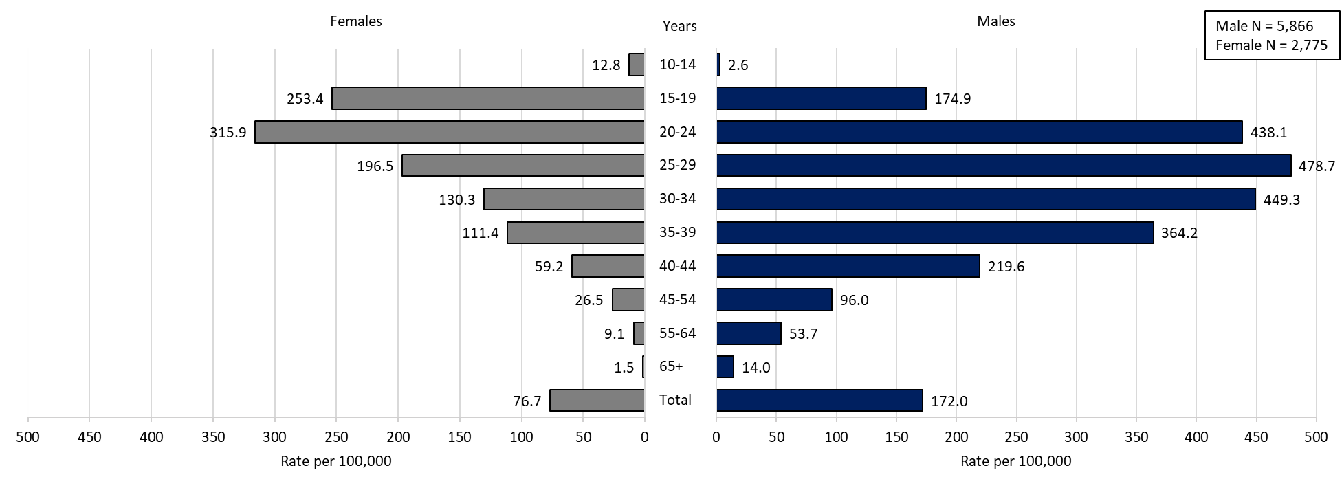
Confirmed Gonorrhea Case Rates per 100,000 Population by Gender¹ and Age, Massachusetts, 2024
Data are current as of 06/02/2025 and are subject to change.
Data Source: Massachusetts Department of Public Health/Bureau of Infectious Disease and Laboratory Sciences/ Division of STD Prevention and STD-HIV Surveillance.
Population denominators estimated by the University of Massachusetts Donahue Institute using a modified Hamilton-Perry model (Strate S, et al. Small Area Population Estimates for 2011 through 2020 report, Oct 2016).
1. In 2024, there were 26 individuals of transgender experience and 9 other individuals documented in our data system that MA DSTDP does not have current gender information for. 2 individuals had unknown age. These cases were excluded since rate for this population cannot be calculated at this time.
Notes:
Confirmed Gonorrhea Case Rates per 100,000 Population by Gender and Age, Massachusetts, 2024
Graph depicts gonorrhea case rates per 100,000 population by age categories for the overall state, males, and females. For the overall state, the highest rate is among those 20-24 years. When looking at the gender specific rates, the age categories with the highest rates are 20 to 24 years for females and 25 to 29 years for males.

Slide 39
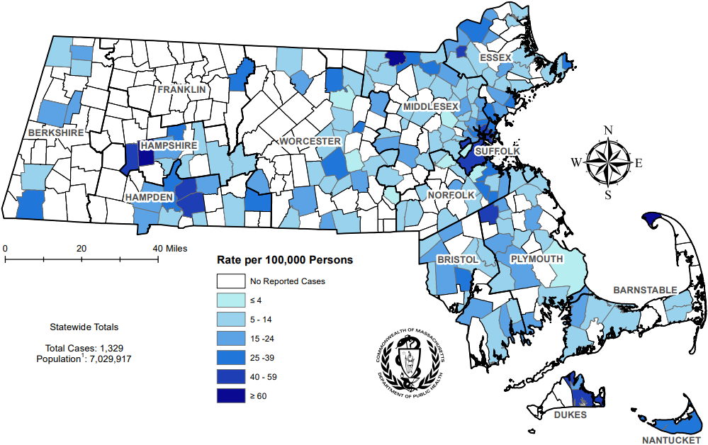
Incidence Rate of Infectious Syphilis¹ Cases, per 100,000 Persons² by City/Town³, Massachusetts, 2024
Data are current as of 06/02/2025 and are subject to change.
Data Source: Massachusetts Department of Public Health/Bureau of Infectious Disease and Laboratory Sciences/ Division of STD Prevention and STD-HIV Surveillance.
1. Infectious syphilis is defined as primary, secondary and early latent stages of syphilis within one year of infection.
2. Population denominators estimated by the University of Massachusetts Donahue Institute using a modified Hamilton-Perry model (Strate S, et al. Small Area Population Estimates for 2011 through 2020 report, Oct 2016).
3. There are seven city/towns with <10 cases of syphilis that fall within the top two rate categories (≥40 cases per 100,000): Chesterfield, Tisbury, Boxborough, Oakham, Becket, Huntington, and Winthrop.
Notes:
Incident Rate of Infectious Syphilis Cases, per 100,000 Persons by City/Town, Massachusetts, 2024
Map of Massachusetts counties color-coded to indicate the areas of the state with the highest infectious syphilis case rates in 2024. The cities that have the highest rates (greater than 40 per 100,000 persons excluding towns with less than 10 cases) are Provincetown, Lawrence, Springfield, Chelsea, Everett, Chicopee, and Boston.

Slide 40
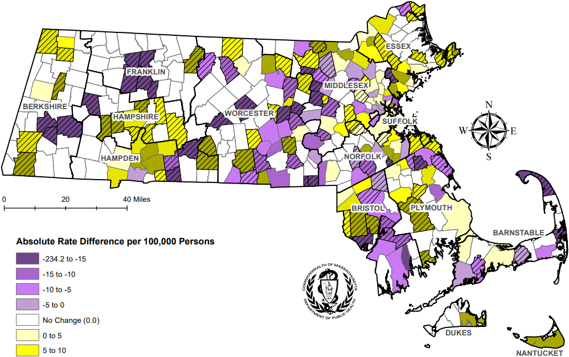
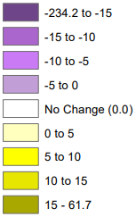

Absolute Rate Difference¹ Comparing 2024 to 2020 for Infectious Syphilis² Cases, per 100,000 Persons³ by City/Town, Massachusetts
Towns/cities with 0 cases in 2024 or 2020 and 1+ case in the opposing year
Data are current as of 06/02/2025 and are subject to change.
Data Source: Massachusetts Department of Public Health/Bureau of Infectious Disease and Laboratory Sciences/ Division of STD Prevention and STD-HIV Surveillance.
1. The darker the color in the scheme, the greater the difference between 2024 and 2020 infectious syphilis case rates with purple coloring indicating rates were higher in 2020 and gold coloring indicating rates were higher in 2024.
2. Infectious syphilis is defined as primary, secondary and early latent stages of syphilis within one year of infection.
3. Population denominators estimated by the University of Massachusetts Donahue Institute using a modified Hamilton-Perry model (Strate S, et al. Small Area Population Estimates for 2011 through 2020 report, Oct 2016).
Notes:
Absolute Rate Difference Comparing 2024 to 2020 for Infectious Syphilis Cases, per 100,000 Persons by City/Town, Massachusetts
Map of Massachusetts cities and towns color-coded to indicate the range of absolute rate differences per 100,000 persons comparing 2024 infectious syphilis case rates to 2020 case rates. The darker the color in the scheme, the greater the difference between 2024 and 2020 case rates with purple coloring indicating rates were higher in 2020 and the gold coloring indicating rates were higher in 2024. An approximately even number of cities and towns saw a rise and fall in infectious syphilis case rates in 2024 compared with 2020 with the greatest increases (greater than 20 per 100,000 persons) occurring in Chelsea, Chicopee, Fitchburg, Lawrence, Natick, Peabody, Randolph, Saugus, Tyngsborough, and West Springfield; the largest rate declines (less than -20 per 100,000 persons) were seen in Nahant and Provincetown. The cities and towns that had zero cases for 2024 or 2020 and one or more cases for the opposing year are indicated on the map with a slash mark to acknowledge the absolute rate difference should be examined with caution.

Slide 41
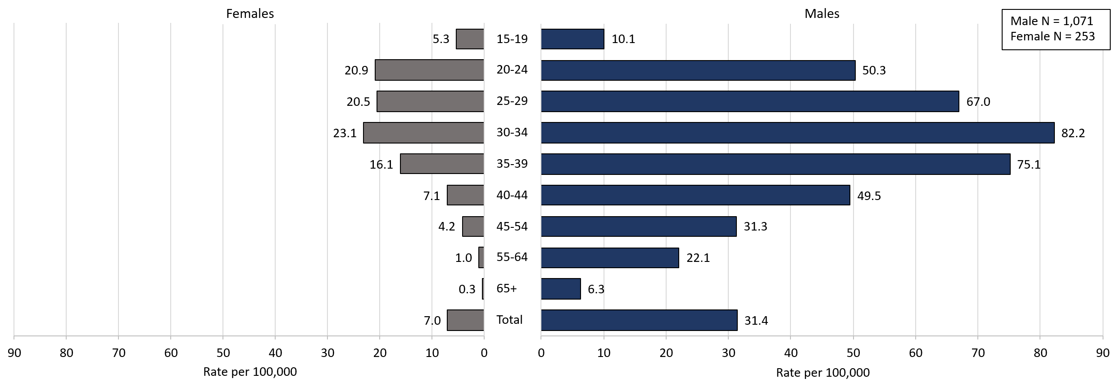
Confirmed and Probable Infectious Syphilis¹ Cases per 100,000 Population by Gender² and Age, Massachusetts, 2024
Data are current as of 06/02/2025 and are subject to change.
Data Source: Massachusetts Department of Public Health/Bureau of Infectious Disease and Laboratory Sciences/ Division of STD Prevention and STD-HIV Surveillance.
Population denominators estimated by the University of Massachusetts Donahue Institute using a modified Hamilton-Perry model (Strate S, et al. Small Area Population Estimates for 2011 through 2020 report, Oct 2016).
1. Infectious syphilis is defined as primary, secondary and early latent stages of syphilis within one year of infection.
2. In 2024, there were 5 individuals of transgender experience documented in our data system and MA DSTDP does not have current gender information for those individuals. These cases were excluded since rate for this population cannot be calculated at this time.
Notes:
Confirmed and Probable Infectious Syphilis Cases per 100,000 Population by Gender and Age, Massachusetts, 2024
Graph depicts infectious syphilis rates per 100,000 population by age categories for the overall state, males, and females. For the overall state, the highest rate is among those 30-34 years. When looking at the gender specific rates, the age categories with the highest rates are 30 to 34 years for both males and females.

Slide 42
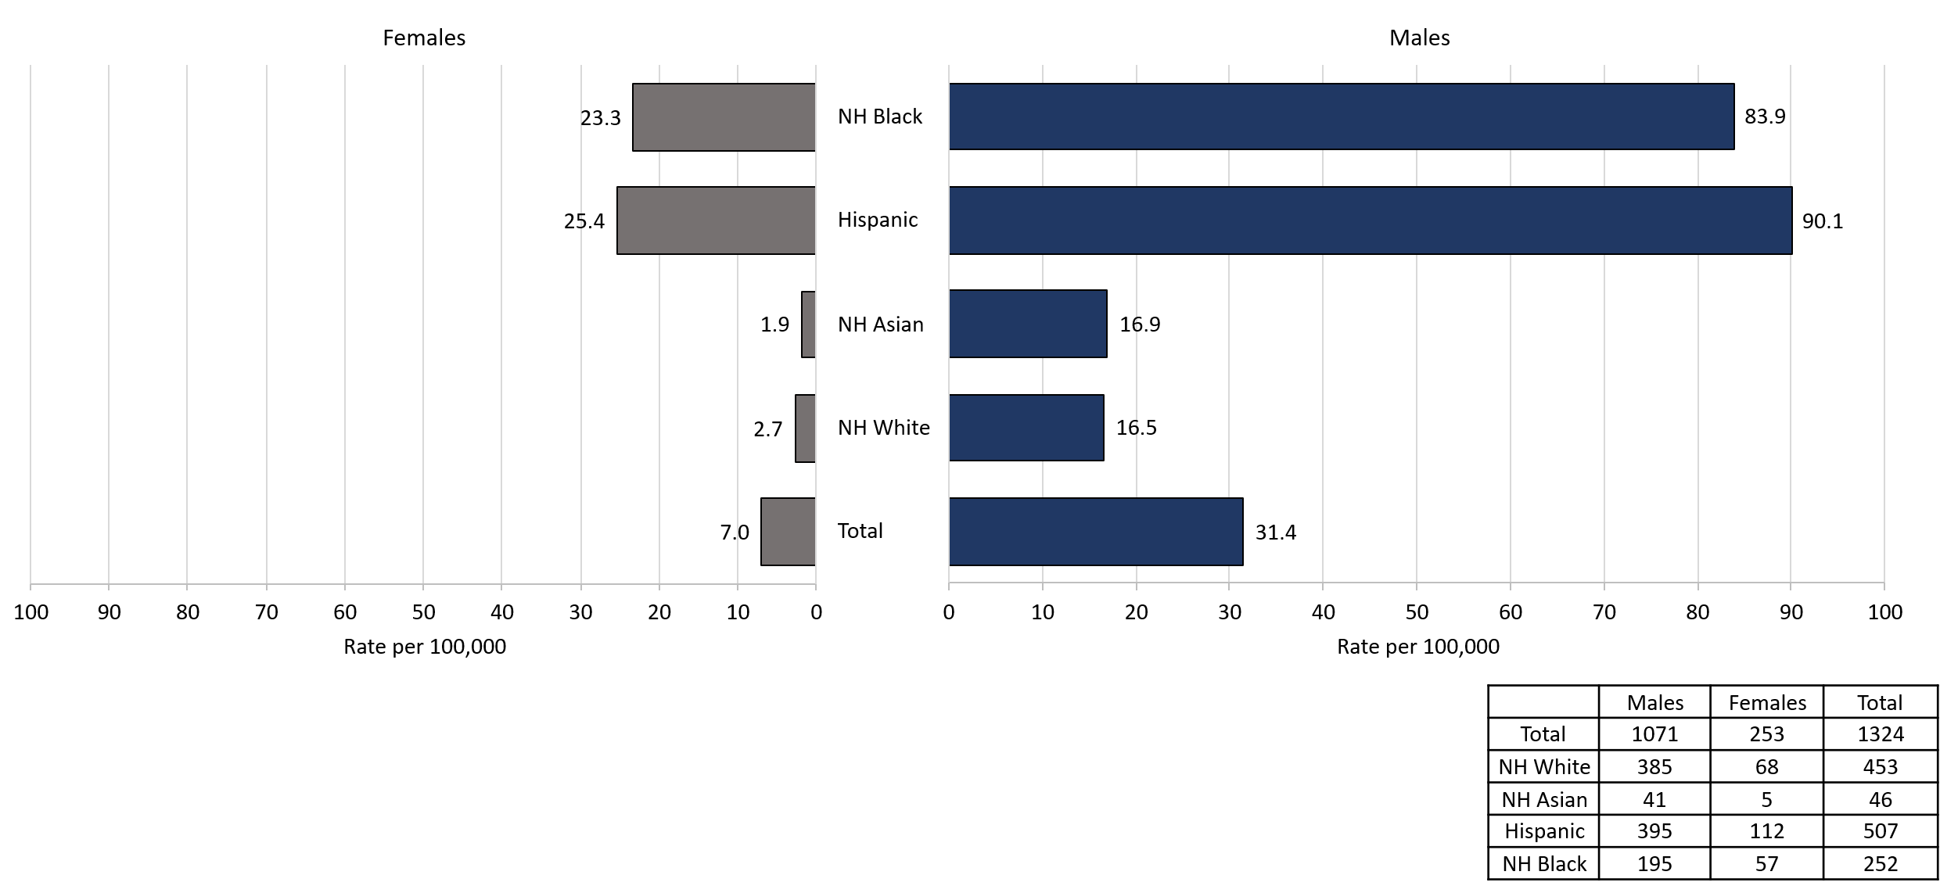
Comparison of the Rate of Confirmed and Probable Infectious Syphilis¹ Cases by Gender² and Race and Ethnicity³, Massachusetts, 2024
Data are current as of 06/02/2025 and are subject to change.
Data Source: Massachusetts Department of Public Health/Bureau of Infectious Disease and Laboratory Sciences/ Division of STD Prevention and STD-HIV Surveillance.
Population denominators estimated by the University of Massachusetts Donahue Institute using a modified Hamilton-Perry model (Strate S, et al. Small Area Population Estimates for 2011 through 2020 report, Oct 2016).
1. Infectious syphilis is defined as primary, secondary and early latent stages of syphilis within one year of infection.
2. In 2024, there were 5 individuals of transgender experience documented in our data system and MA DSTDP does not have current gender information for those individuals. These cases were excluded since rate for this population cannot be calculated at this time.
3. Those cases reported among non-Hispanic/Latinx individuals with other race categories were excluded based on small counts (3.8% of cases). Cases with unknown race and ethnicity were excluded because rates could not be calculated (1.2% of cases).
Notes:
Comparison of the Rate of Confirmed and Probable Infectious Syphilis Cases by Gender and Race and Ethnicity, Massachusetts, 2024
Graph depicts infectious syphilis rates per 100,000 population by age and race/ethnicity categories for the overall state, males, and females. For all infectious syphilis cases, the highest rate is among Hispanic/Latinx and Non-Hispanic/Latinx Black for both male and females.

Slide 43
HIV Co-Infection
Description of 2024 STI Cases
Notes:
Picture description: logo for the Massachusetts Department of Public Health

Slide 44
2024 HIV¹ Co-Infection with Chlamydia and Gonorrhea
Chlamydia with HIV Co-Infection
  2.1% of chlamydia cases were HIV co-infected (N = 26,623)
  As age increases, the proportion of HIV co-infection increases
    1.1% of cases in their 20s are HIV co-infected
    13.0% of cases 50+ are HIV co-infected
Gonorrhea with HIV Co-Infection
  8.0% of gonorrhea cases were co-infected with HIV (N = 8,678)
  As age increases, the proportion of HIV co-infection increases
    4.6% of cases in their 20s are HIV co-infected
    19.7% of cases 50+ are HIV co-infected
Data are current as of 06/02/2025 and are subject to change. Data Source: Massachusetts Department of Public Health/Bureau of Infectious Disease and Laboratory Sciences/ Division of STD Prevention and STD-HIV Surveillance.
1. HIV status is based on a full year match with HIV Surveillance data.

Slide 45
2024 HIV¹ Co-Infection with Infectious Syphilis²
25.8% of infectious syphilis cases were co-infected with HIV (N = 1,329)
As age increases, the proportion of HIV co-infection increases
  15.8% of cases in their 20s are HIV co-infected
  39.6% of cases 50+ are HIV co-infected
Of individuals co-infected with HIV and infectious syphilis, 79.9% were MSM³ (N = 343), compared with 47.5% for those with no known HIV diagnosis (N = 986).
Of known MSM individuals infected with infectious syphilis (N = 742), 36.9% were co-infected with HIV.
11.7% of co-infected individuals were newly diagnosed with HIV within 30 days of infectious syphilis event date; 88.3% had a prior HIV diagnosis.
Data are current as of 06/02/2025 and are subject to change. Data Source: Massachusetts Department of Public Health/Bureau of Infectious Disease and Laboratory Sciences/ Division of STD Prevention and STD-HIV Surveillance.
1. HIV status is based on a full year match with HIV Surveillance data.
2. Infectious syphilis is defined as primary, secondary and early latent stages of syphilis within one year of infection.
3. The MSM (men who have sex with men) category includes MSMT, MSMW, and MSMWT with “W” referring to women and “T” referring to individuals of transgender experience.

Slide 46
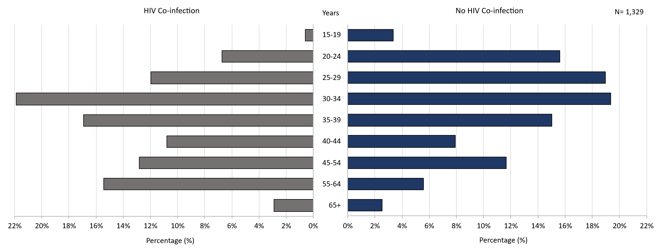
Comparison of Infectious Syphilis¹ Cases by HIV² Co-Infection and Age³, Massachusetts, 2024
Data are current as of 06/02/2025 and are subject to change.
Data Source: Massachusetts Department of Public Health/Bureau of Infectious Disease and Laboratory Sciences/ Division of STD Prevention and STD-HIV Surveillance.
1. Infectious syphilis is defined as primary, secondary and early latent stages of syphilis within one year of infection.
2. HIV status is based on a full year match with HIV Surveillance data.
3. Individuals younger than 15 years are not included within this slide due to low case counts.
Notes:
Comparison of Infectious Syphilis Cases by HIV Co-Infection and Age, Massachusetts, 2024
Graph depicts infectious syphilis case percentages for age categories by HIV co-infection status. The proportion of infectious syphilis cases with HIV co-infection were highest among those age 30 to 34 followed by those age 35 to 39. The proportion of cases with HIV co-infection were lowest among those 15 to 19 years followed by those over the age of 65 years.

Slide 47
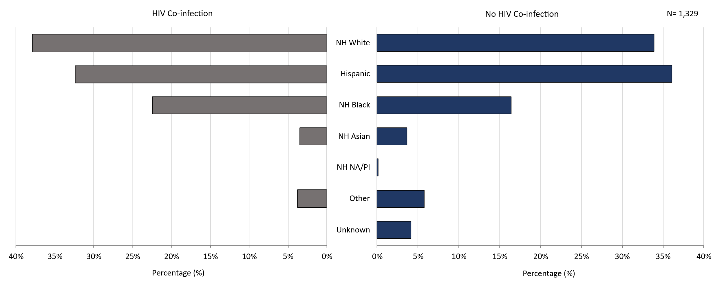
Comparison of Infectious Syphilis¹ Cases by HIV² Co-Infection and Race/Ethnicity, Massachusetts, 2024
Data are current as of 06/02/2025 and are subject to change.
Data Source: Massachusetts Department of Public Health/Bureau of Infectious Disease and Laboratory Sciences/ Division of STD Prevention.
1. Infectious syphilis is defined as primary, secondary and early latent stages of syphilis within one year of infection.
2. HIV status is based on a full year match with HIV Surveillance data.
Notes:
Comparison of Infectious Syphilis Cases by HIV Co-Infection and Race/Ethnicity, Massachusetts, 2024
Graph depicts infectious syphilis case percentages for race/ethnicity categories by HIV co-infection status. The proportion of infectious syphilis cases with HIV co-infection is highest among Non-Hispanic Whites followed by Hispanic and then Non-Hispanic Black individuals.

Slide 48
2024 Summary
Chlamydia: The 2024 Massachusetts state rate was 378.7 per 100,000
  The highest rate of chlamydia cases was among females 20 to 24 years with a rate of 2,413.9 cases per 100,000 population*
Gonorrhea: The 2024 Massachusetts state rate was 123.4 per 100,000
  The highest rate of gonorrhea cases was among males 25 to 29 years with a rate of 478.7 cases per 100,000 population
Infectious Syphilis: The 2024 Massachusetts state rate was 18.9 per 100,000
  The highest rate of infectious syphilis cases was among males 30 to 34 years with a rate of 82.2 cases per 100,000 population
Congenital syphilis cases maintained the increased number of reportable cases seen from 2019 to 2024
  The overall increases in infectious syphilis rates in individuals believed to be biologically capable of pregnancy and the increase in reportable congenital syphilis cases led to a recommendation for universal third trimester screening in 2020, on top of routine screening for syphilis upon entry into prenatal care in Massachusetts.
Data Source: Massachusetts Department of Public Health/Bureau of Infectious Disease and Laboratory Sciences/ Division of STD Prevention.
Data are current as of 06/02/2025 and are subject to change
* Population based on 2019 University of Massachusetts Donahue Institute Estimates

Slide 49
Technical Data Notes
  STI and HIV specific laboratory and case management information are reported directly to the Department of Public Health and maintained in the Massachusetts integrated disease surveillance and case management system, MAVEN
  The majority (>90%) of laboratory test results are reported via electronic laboratory reporting
  Case management information is reported via electronic medical record feeds, case reporting forms and collected by epidemiologists
  Data are routinely reviewed, cleaned, and analyzed by surveillance epidemiologists
  Routine reports are shared with internal and external stakeholders
  All data are collected and maintained according to strict confidentiality and security requirements

Slide 50
Technical Data Notes (Continued)
Case classifications (confirmed, probable or suspect) are based on CSTE/CDC case definitions for nationally notifiable infectious diseases.
  For full STI case classifications, see: https://www.cdc.gov/std/statistics/2019/case-definitions.htm
  All data in this report are accurate as of their analysis date and are subject to change. Common reasons for data changes include amendments to reporting and routine data cleaning.
Transgender individuals are included in current gender identity categories, except where noted due to incomplete information on current gender identity. Nonbinary gender identity is captured but suppressed according to Massachusetts privacy and confidentiality rules. Collection of transgender data categories began in mid-2014.
Gender of sex partners categories for this report include: MSM = men who have sex with men, MSW = men who have sex with women, WSM = women who have sex with men, Other = include transgender sexual risk categories and females who have sex with females or both male and female partners, and Unknown are cases reported without sexual risk. These categories are based on patient and provider report and do not necessarily reflect an individual’s sexual identity in relation to gender (i.e. gay, bisexual, heterosexual, etc).

Slide 51
Coronavirus 2019 (COVID-19): Impact of Other Reportable Infections
When reviewing 2020-2022 data for Massachusetts, please note the impact of the coronavirus 2019 (COVID-19) pandemic on infectious disease screening, treatment, and surveillance. Nationally, CDC observed a sharp decline in reported STD cases from March-April 2020, compared to March-April 2019.
Three factors were cited as likely contributing to the initial decrease in reported cases:
  Reduced screening – many health care clinics limited in-person visits to symptomatic cases or closed
  Limited resources – many state and local health department STD staff were redirected from routine STD responsibilities to COVID-19 activities, which affected STD tracking capacity and reporting
  Stay-at-home orders (March 24 through April 7th, 2020) – which were intended to reduce COVID-19 spread may have influenced sexual behaviors and reduced STD transmission¹
As the impact of the COVID-19 pandemic continues, it’s full effect on case reporting and efforts to control the spread of infectious disease in the Commonwealth has yet to be determined. As such, please interpret 2020 infectious disease data with caution.
CDC Press Release, July 16, 2021: Trends in STD case reports during the U.S. COVID-19 pandemic, January-December 2020 available at: https://www.cdc.gov/nchhstp/newsroom/2021/2020-std-trend-report.html”

Slide 52
If you have questions or to request more information:
call the Massachusetts Department of Public Health, Division of STD Prevention, at 617-983-6940
Thank you!

