Slide 1

Trade Adjustment Assistance Program (TAA Program) Overview
Services provided under the Trade Act are administered by MassHire Department of Career Services (MDCS) and Department of Unemployment Assistance (DUA).
Charlie Baker, Governor Karyn Polito, Lieutenant Governor Rosalin Acosta, Secretary Alice Sweeney, Director, MassHire DCS

Slide 2

Some History…
The TAA program was first established by the Trade Act of 1974, and has been amended several times.
It was amended in 2002 through the Trade Adjustment Assistance Reform Act of 2002.
In 2009 it was amended through the Trade and Globalization Adjustment Assistance Act of 2009.
In 2011 it was amended through the Trade Adjustment Assistance Extension Act of 2011 (TAAEA expired on December 31, 2013. Reversion 2014 took place until a new Act was signed into law)
On June 29, 2015, the Trade Adjustment Assistance Reauthorization Act of 2015 was signed into law (TAARA 2015 covers petitions approved on or after Jan 1, 2014)

Slide 3

Purpose
The TAA Program has and will continue to help workers who have lost their jobs as a result of foreign trade to quickly rejoin the workforce by providing them with the means to attain competitive and marketable skills for today’s increasingly competitive work environment.
Notes:
Mention that despite the multiple amendments, the purpose of the program has remains the same.

Slide 4
Benefits
The program offers a variety of benefits and services to eligible workers, including:
Job training
Income support (TRA)
Job search and relocation allowances
Tax credit to help with the costs of health insurance (HCTC)
Wage supplement to certain reemployed trade-affected workers that are at least 50 years of age or older (RTAA)
Notes:
Mention that this list is not comprehensive – just an overview. Tell participants that we will be going over each specific service later in the day.

Slide 5
Petitions v. Rules to Follow
2002 Act applies to… | Workers who are covered by petitions filed before May 18, 2009. Petition numbers are 69,999 and lower and Workers who are covered by petitions filed on or after February 15, 2011. Petition numbers 80,000 through 80,999
2009 Act applies to… | Workers who are covered by petitions filed on or after May 18, 2009. Petition numbers are 70,000 through 79,999
2011 Act applies to… | Workers who are covered by petitions filed on or after October 21, 2011. Petition numbers 81,000 through 84,999
2015 Act applies to… | Workers who are covered by petitions filed on or after January 1, 2014. Petition numbers are 85,000 and higher
Notes:
Stress that it is important to know both the 2002 Act and the 2009 Act as we will be providing benefits under two different sets of rules for workers covered by petitions filed before AND on or after May 18, 2009.
Mention that we are now going to go over some of the major differences between the two Acts. For current counselors, this will highlight the changes. For new counselors, this will give an overview of the services under the Trade program.

Slide 6
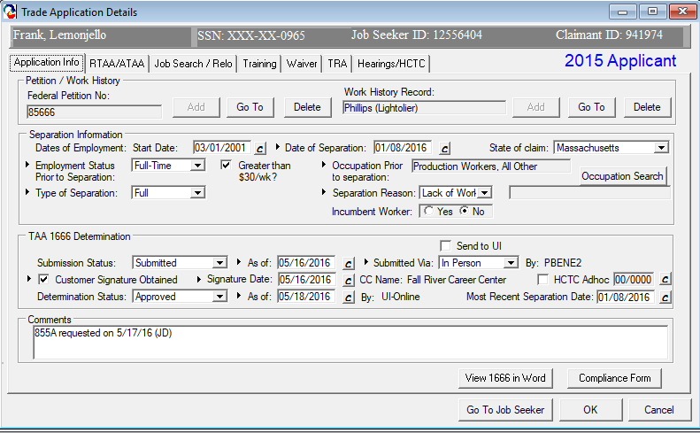
TAA Petition

Slide 7










WORKING TOGETHER
MassHire Career Centers Provide reemployment and career services
Department of Unemployment Assistance (DUA)
Administers TRA benefits
MassHire Department of Career Services (MDCS)
Administers TAA benefits
Notes:
Talk about how we help our customers return to the workforce by working together. Briefly mention the roles of each group.

Slide 8
Petitions
Once a petition is filed, DOL investigates and looks to issue a determination within 45 days.
If the petition is certified, DOL issues the following important criteria:
The Petition will cover all or some workers
Impact Date – normally a year prior to the petition filing date
Expiration Date – Two years after the certification date
A worker’s layoff must be from the covered group and must fall between these two dates in order to be covered.

Slide 9

List of Affected Workers
To ensure that DCS notifies all of the affected workers, the Trade Unit will:
Contact the company directly or contact Rapid Response to obtain lists of affected employees from the company, and
Receive a list of UI claimants (via an interface with UIO) from DUA who filed
a claim against the company
back to impact date.

Slide 10
What to do first?
File an Application for TAA Eligibility Determination (MA Form 1666) via MOSES. DUA will issue a determination.
If the worker worked at a company in a different state than where they reside and:
Their UI claim is in that other state, he/she must file this application in their state (MA is the agent state that pays training costs only).
Their UI claim is in MA, they will file a 1666 (MA is the liable state that pays UI and TRA benefits only).

Slide 11
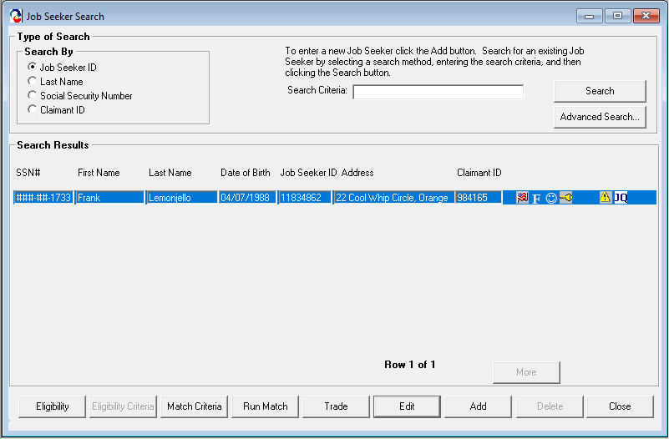
1666 Application in MOSES

Slide 12
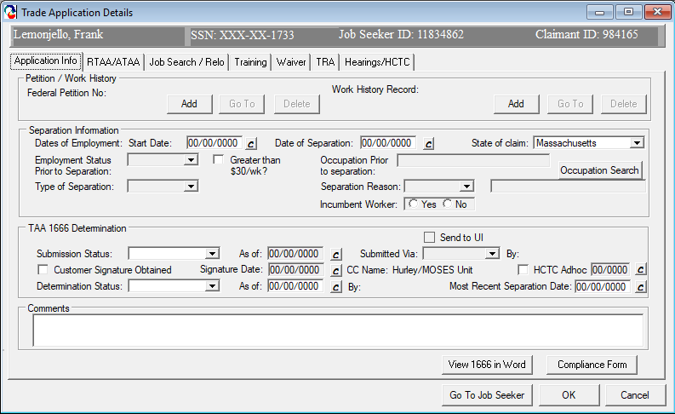
1666 Application in MOSES

Slide 13
Co-Enrollment
Co-enrollment allows trade-affected workers to receive supportive services that may assist in a quicker transition to work:
Career Centers should fully integrate TAA participants and resources into the One-Stop Career Center system, thereby maximizing and enhancing existing employment and career planning structures.
Wagner-Peyser
WIOA (Dislocated Workers)
Other (Adult, Veteran, MA Rehab, Etc.)
Notes:
Briefly talk about co-enrolling Trade customers

Slide 14
Deadlines
Watch out for those deadlines!
26/26 Weeks TRA
26 weeks after certification or 26 weeks after separation, whichever is later
RTAA
No deadline for reemployment, but must apply for RTAA Two years from the date worker exhausts UI (and any EUC) or two years from the date of reemployment, whichever is earlier
365 Days Job Search Allowance
Apply 365 days from separation/certification or 6 months (182 days) after training
425 Days Relocation Allowance
Apply 425 days from separation/certification or
6 months (182 days) after training
Notes:
ASK QUESTION:
RESEA
Notices posted around Career Center

Slide 15
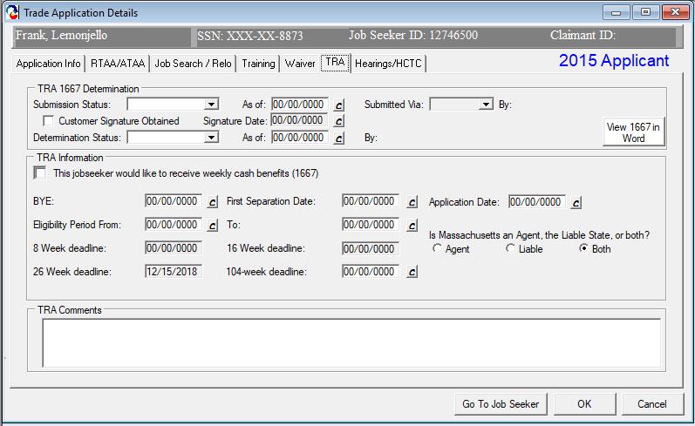
TRA Deadline

Slide 16
Extenuating Circumstances (EC)
The Extenuating Circumstances (EC) extension extends the 26/26 week deadlines by an additional 45 days.
“Extenuating Circumstances” must be circumstances beyond the control of the worker.
The “Secretary” determines if there are extenuating circumstances that justify an extension in the enrollment period – the state acts as the Secretary in this case.
Notes:
Can mention that all ECs will be reviewed on a case-by-case basis and applied uniformly.

Slide 17
Extenuating Circumstances (EC)
There is no single, universally endorsed definition of “extenuating”.
In general, the situation must be beyond the individual’s immediate control and must be unusual and/or infrequent, unexpected, and significantly disruptive. Examples include:
Hospitalization
Family bereavement
Incarceration
Domestic displacement
Etc.

Slide 18
Federal Good Cause
Effective with the 2011 and 2015 Program
A waiver for good cause of the time limitations applies “with respect to an application for TRA or enrollment in training”. This means the 26 week enrollment in training deadline.

Slide 19
Federal Good Cause Criteria
Worker acted reasonably prudent
Determination/Notice not received
Factors outside of the control of the worker
Worker sought extension in timely manner
Worker physically unable to take timely action
Intimidation, coercion, or harassment by employer
Worker misinformed by career center or state staff
Reasonable advice not provided to worker
Compelling reasons or circumstances
Neglect by the state
Illness or injury to worker or immediate family
Delay in mail
Natural catastrophe
Delay in employer providing information
Compelling personal affairs or problems
Communication not in worker’s native language
Loss or unavailability of records

Slide 20
Equitable Tolling May apply to all TAA customers
Equitable Tolling of a deadline may only apply in egregious circumstances where an individual acted with due diligence to meet the deadline.
Equitable Tolling should be applied in situations where it would be manifestly unfair to deny a worker TRA
Deadlines that can be Equitably tolled: Training (TRA purposes), Additional TRA, Job Search Allowances, Relocation Allowances
A 45 day EC and Federal Good Cause must be submitted and approved prior to Equitable Tolling being approved.

Slide 21
Equitable Tolling
Length of Time Allowed:
Training for TRA purposes
Start on the date the person knew or should have known + the latter of the last day of the 8th week or 56 days
Additional TRA*
Start on the date the person knew or should have known + 210 days
Job Search Allowances
Start on the date the person knew or should have known + 365 days OR if participated in TAA approved training + 182 days from the end date of training
Relocation Allowances
Start on the date the person knew or should have known + 425 days OR if participated in TAA approved training + 182 days from the end date of training
*Only 2002 rule customers have a 210 day deadline

Slide 22
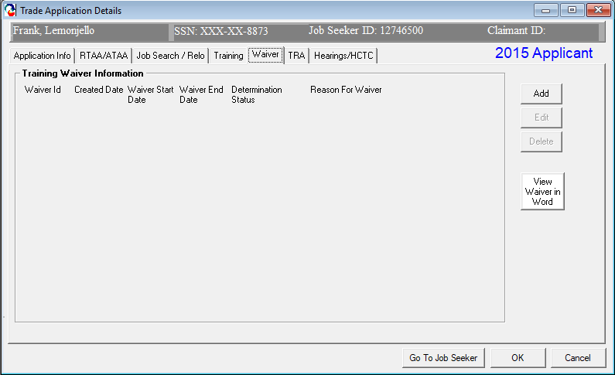
Extension Requests

Slide 23
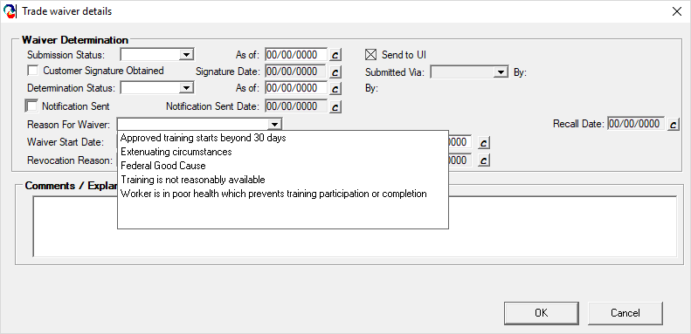
Extension Requests

Slide 24


Slide 25

Training

Slide 26
One Training Per Certification
A worker may only be approved for one training program per certification.
Therefore, a training program begun prior to separation counts as that one training program, and the training plan should be designed to meet the long-term needs of the worker.
Note: A training program may be comprised of several training components (i.e., remedial training first, then vocational training)
Notes:
Can provide example of a training program (eg, ABE, GED, then CNA)

Slide 27
Training
Trade’s rule of thumb:
The least amount of training at the lowest reasonable cost in the shortest amount of time to obtain the skills, credentials, resources, and support necessary to become suitably reemployed.

Slide 28
Training Package Tips
Ensure the 6 criteria are addressed within the customer’s record
If not choosing the lowest cost training, ensure the justification addresses quality, contents and results
Training packages CAN be submitted before 1666 is approved
Submit complete packages and in time to allow a proper review.
If for any reason you do not agree with the training being submitted please communicate with the TAA staff

Slide 29
6 Criteria for Approval of Training
There is no suitable employment (which may include technical and professional employment) available for the adversely affected worker.
The worker would benefit from appropriate training.
There is a reasonable expectation of employment following completion of such training.
Training approved by the Secretary is reasonably available to the worker from either governmental agencies or private sources.
The worker is qualified to undertake and complete such training.
Such training is suitable for the worker and available at a reasonable cost.
Notes:
Elaborate on the Assessments tools

Slide 30
Course Outlines for Certificate and Degree Programs at Colleges/Universities
The training course outlines must include accurate itemized cost estimates for each of the following elements:
Tuition
Fees Policy
Books 100 DCS 13.113
Supplies
Health Insurance
Other (such as an itemization of required tools, equipment, uniforms)

Slide 31
Course Outlines for Certificate and Degree Programs at Colleges/Universities
The MA TAA Unit requires submission of accurate training course outlines with cost breakdowns for ALL certificate and degree programs at any college/university.
Training course outlines must also specifically identify costs associated with any required remedial/developmental education components of the planned training program.
Therefore, local areas must assure that identification of any required remedial/developmental education needed by a TAA eligible individual is identified through appropriate assessment/testing prior to submission of the training request to the MA TAA Unit.

Slide 32
Training Reasonable Costs
Training programs are approvable for a total of up to 130 weeks
Incumbent training is allowed
Participants may attend Full or Part Time training
On-line, Pre-requisite and required Remedial level courses are approvable for all eligible participants
Reasonable Costs:
Remedial Training: $10,000 (per year)
Occupational Training: $20,000
Degree Programs: $28,000
MAX (including travel, subsistence, etc.): $35,000
These costs are for ALL TAA Participants, regardless of petition number
Notes:
No Retroactive Approval – after training is complete no requests for travel and subsistence allowances will be approved/backdated

Slide 33
Training-Related Costs
Allowable
All required tuition & fees;
Training Materials (required books, uniforms, basic supplies, equipment)
Basic supplies (pens, papers, pencils) *Workforce Issuance Policy No. 10-45
Transportation costs (mileage, mass transit)
Required laptops and software may be purchased if they are required for all students by the institution for the approved training program
Health insurance premium costs, if all students are required to carry health insurance to attend and they are not otherwise covered
Initial professional licensing fees and licensing exam fees
Not Allowable (under TAA funds)
Child care, Auto repair, etc.
May be allowable under WIOA, NWDGs and other partner programs

Slide 34

Allowable Training Materials Policy 100 DCS 13.113
The following categories describe items that may be paid for with TAA funds:
Textbooks
Tools
Basic Supplies and Materials
Uniforms
Special Supplies/Equipment (i.e. laptop)
Required test fees
Only those supplies, materials and equipment required of all students participating in the same training program may be covered.

Slide 35
Allowable Basic Supplies/Materials
The maximum amount that can be approved for basic supplies, materials for each customer is:
For a training program based on a semester schedule:
Thirty dollars ($30) per semester (full semester)
Fifteen dollars ($15) per intersession
For a training program based on a weekly, non-semester schedule:
$15 for a training program scheduled for 13 weeks, or less.
$30 for a training program scheduled for 14 to 26 weeks in length.
$60 for a training program scheduled for 27 to 52 weeks in length.
$90 for a training program scheduled for 53 to 78 weeks in length.
$120 for a training program scheduled for 79 to 104 weeks in length.
These material/supply costs must be pre-approved and receipts along with a completed REQUEST FOR REIMBURSEMENT form must be submitted for reimbursement.

Slide 36
PCs/Laptops
Maximum Cost Allowed | PC/Laptop
$1000 | one-time purchase of a required PC or laptop
Criteria for PC/Laptop Cost Approval
Customer must submit cost information on a minimum of two comparable models
2. Purchase cost will be covered only if use of a computer/laptop is a requirement of the training provider for participation in the specific training program and only if it is a requirement for all participants of the program
The Trade Unit understands that computers are required for most college level course work, but these could be computers used in a college’s computer lab.
Therefore, we will not be approving PCs/Laptops for all TAA customers that are approved for college level training and do not already have a computer.

Slide 37
Training Reasonable Costs
Keep training programs at a reasonable cost.
Training costs cannot exceed:
Remedial Training: $10,000 (per year)
Occupational Training: $20,000
Degree Programs: $28,000
MAX: $35,000
(“MAX” includes travel, subsistence, etc.)
If a training exceeds the maxium allowable cost, the training request will be denied.

Slide 38
Training Prior to Separation Adversely Affected Incumbent Workers
Training may be approved before separation for adversely affected workers covered under the 2009, 2011and 2015 Acts ONLY. The incumbent worker must be someone who:
Is a member of a group of workers that has been certified as eligible to apply for TAA benefits
Has not been totally or partially separated from employment, but has a layoff date verified by the company and
Is determined to be individually threatened with total or partial separation (will be monitored via career planning)

Slide 39

Breaks in Training
Avoid breaks in Training!!!
No Trade Readjustment Allowances (TRA) can be paid while on a break in Training that exceeds 30 business days
(Does not include Sat./Sun. and holidays)

Slide 40
Training Benchmarks
REQUIRED for Completion TRA eligibility (under 2011 and 2015)
Must be established at the beginning and is required of all training programs longer than 3 months
Reviews will be conducted at 60 day intervals from the start of the training
This will strengthen customer career planning efforts
Benchmarks will be documented in an Individual Employment Plan (IEP)/Customer Development Plan (CDP) and signed by the participant
Encourages early intervention and modification of unsuccessful training plans
Modifications can increase training completion and credential attainment
Modifications can include: tutoring, changing from a degree to certificate, etc.
Notes:
Individual employment plan

Slide 41
Training Modifications
If a customer needs a training modification due to discovery via benchmarks or notification from the vendor, TAA would review and make a determination.
Training Dates – Modifications to training dates must be submitted prior to the start date or end date of training. Any modification to training dates must be justified by the customer and/or the vendor.

Slide 42
Training Modifications
Training Costs Increases – Any increases to tuition, fees, books, or health insurance must be justified by the vendor. If the customer needs to take a retake, TAA will review the justification and make a determination.
Training Reimbursements/Purchase Orders – Costs for items required of all students to complete the training program must be submitted prior to purchase. TAA will review documentation from the vendor and make a determination.

Slide 43
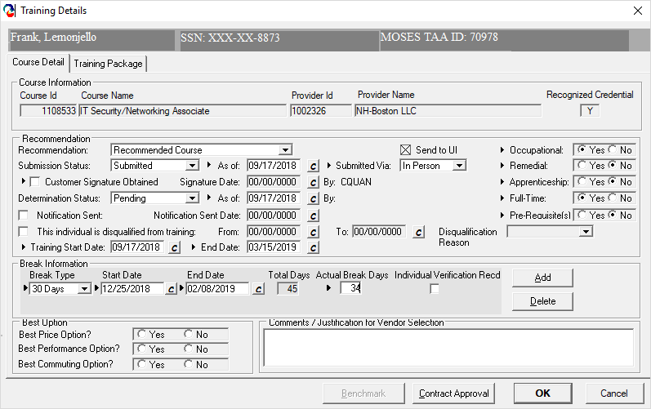
TAA Training Package

Slide 44
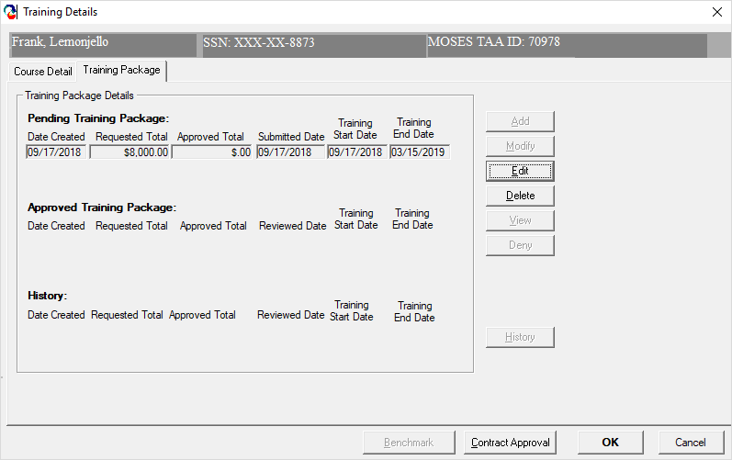
TAA Training Package

Slide 45
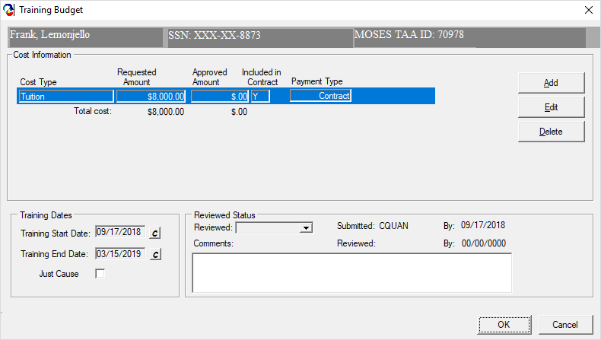
TAA Training Package

Slide 46
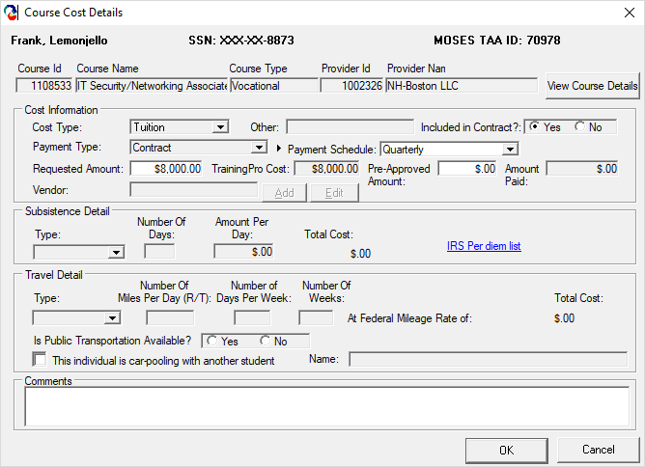
TAA Training Package

Slide 47
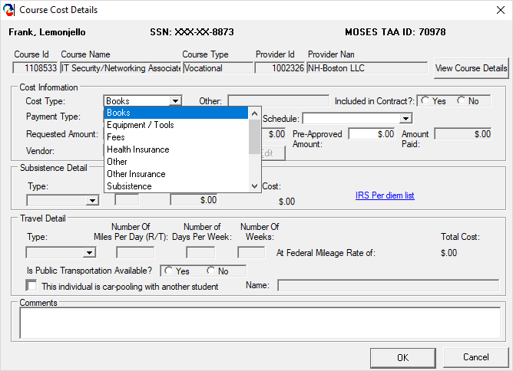
TAA Training Package

Slide 48
WIOA Performance Indicators
Measureable Skill Gain
Of those enrolled in education or training:
WIOA Positive MSG (Type #1) | WIOA Positive MSG (Type #2) | WIOA Positive MSG (Type #3) | WIOA Positive MSG (Type #4) | WIOA Positive MSG (Type #5)
Educational Achievement | Secondary School Diploma | Transcript/Report Card | Training Milestone | Skills Progression
# of participants that are basic skills deficient at program entry who achieve a gain of one or more educational functioning levels. | # of participants that do not have a secondary education diploma at program entry and who attain a high school diploma or equivalent. | # of participants enrolled in either secondary or post secondary whose transcript/report card for one (1) academic year is achieving the state unit’s policies for academic standards. | # of participants having a satisfactory or better progress report, towards established milestones, such as completion of OJT or completion of 1 year of an apprenticeship program or similar milestones, from an employer or training provider who is providing training | # of participants successfully completed an exam that is required for a particular occupation, or progress in attaining technical or occupational skills as evidenced by trade-related benchmarks (e.g. knowledge based exams)
Note: Measureable Skill Gain date will be the same as the approved training end date.

Slide 49
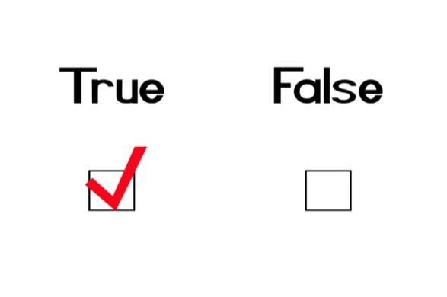


TRUE or FALSE
Part Time training is allowed under TAARA 2015.
John was notified that his last day at work will be in the next 2 months. He will not be able to apply for TAA training today because he is still working.

Slide 50
Waivers from Training
Waiver Type | 2002 & 2009 Programs | 2011 Program | 2015 Program
Health Condition | X | X | X
Enrollment in Training Not Available | X | X | X
No Training is Available | X | X | X
Recall | X | DOES NOT EXIST ANYMORE | DOES NOT EXIST ANYMORE
Marketable Skills | X | DOES NOT EXIST ANYMORE | DOES NOT EXIST ANYMORE
Retirement | X | DOES NOT EXIST ANYMORE | DOES NOT EXIST ANYMORE

Slide 51
Training Waivers Allowed under TAARA 2015
Health – The worker is unable to participate in training due to the health of the worker, except that this basis for a waiver does not exempt a worker from the availability for work, active search for work, or refusal to accept work requirements under Federal or State unemployment compensation laws.
Enrollment Unavailable – The first available enrollment date for the worker’s approved training is within 60 days after the date of the training determination, or, if later, there are extenuating circumstances for the delay in enrollment, as determined under guidance issued by the Secretary.
Training Not Available – Training approved by the Secretary is not reasonably available to the worker from either governmental agencies or private sources (which may include area vocational schools as defined in section 3 of the Carl D. Perkins Vocational and Technical Education Act of 1998 (20 USC 2302) and employers), no suitable training for the worker is available at reasonable cost.

Slide 52
Waiver Requests

Slide 53
TRUE or FALSE
The maximum funding allowed for training, including all allowable expenses, is $35,000.
Max has applied for SSDI and has been approved. He is not able to work as he is totally disabled. He can apply for a Waiver from training due to poor health or attend training, whichever he chooses and can provide documentation for.

Slide 54

Trade Readjustment Allowances
There are three types of TRA:
Basic TRA
Additional TRA
Completion TRA

Slide 55
TRA Eligibility Requirements Under
An individual must…
Meet the 26/26 week deadline
26 weeks from the date of the petition certification; OR
26 weeks from the worker’s most recent total separation from adversely affected employment
Have at least 26 weeks of employment at the Trade-certified company earning $30 or more
Be eligible for UI based on separation from Trade-certified company
Have exhausted all UI (on initial claim)
Be enrolled in TAA-approved training or have an approved waiver from training
Accept suitable work, actively seek work, be referred to suitable work
Notes:
Mention that ALL of these criteria must be met in order to receive any TRA

Slide 56
Basic TRA
UI/EUC and Basic TRA | = 52 weeks max
Available after worker has exhausted UI and any EUC
Any extensions of UI (e.g., EUC and EB) may reduce either the number of weeks one may be paid TRA benefits and/or the dollar amount of potential TRA benefits one may be entitled to
Worker must be in TAA-approved training or have an approved waiver from training
No Basic TRA can be paid if worker has a break in training of 30 days or more (excludes weekends and holidays)
Can continue to collect Basic TRA after training ends as long as worker is conducting job search

Slide 57
Additional TRA
Additional TRA (Only if in training) | = 65 weeks max
Worker must have exhausted all Basic TRA
Worker must be in approved training full-time (cannot be on a waiver from training)
Workers under the 2015 Act have 78 weeks to collect Additional TRA (65 weeks)
No Additional TRA can be paid during breaks in training longer than 30 days, or breaks during transition from remedial to vocational training
Once training ends, Additional TRA stops
Notes:
Wait for animation.
Talk about the 91 weeks (extra 13 weeks to allow for breaks, etc) Stress that customer must be in training (cannot be on a waiver).

Slide 58
Completion TRA
Completion TRA aligns with the Department’s larger aim to increase the completion of recognized credentials
provides participants with up to 13 additional weeks of income support while in full time training
must be applied for via UIO within the last 20 weeks of training
Conditions of Completion TRA:
The requested weeks are necessary for the worker to complete a training program that leads to a degree or industry recognized credential; AND
The worker is participating in full time training each week; AND
The worker has met the performance benchmarks established in the approved training plan; AND
The worker is expected to continue to make progress toward the completion of the approved training; AND
The worker will be able to complete the training during the period authorized for receipt of Completion TRA
Notes:
Introduced in 2011 and continues for TAARA 2015

Slide 59
Completion TRA Eligibility Period
While there are 13 weeks of Completion TRA payable to eligible TAA participants, these 13 weeks can only be collected if the customer will complete the training* and is within the last 20 weeks of training. The 13 weeks are payable anytime during the 20 week period. *Just Cause can be approved to extend the 20 week period
This 20 week time frame will begin with the first week in which a TAA participant files a claim for Completion TRA and not automatically at the end of Additional TRA.
If a participant has exhausted all other UI and TRA benefits, but will not be able to complete approved training within the allowable 20 week period, none of the 13 weeks of Completion TRA are able to be paid.

Slide 60
Summary: Maximum TRA Under TAARA 2015
UI/(Extensions) and Basic TRA | = 52 weeks
Additional TRA (if in training) (Payable within 78 weeks) | = 65 weeks max
Maximum of | = 117 weeks
Completion TRA (If benchmarks and other criteria are met, payable within the last 20 weeks of training) | = 13 weeks max
Maximum of | = 130 weeks

Slide 61
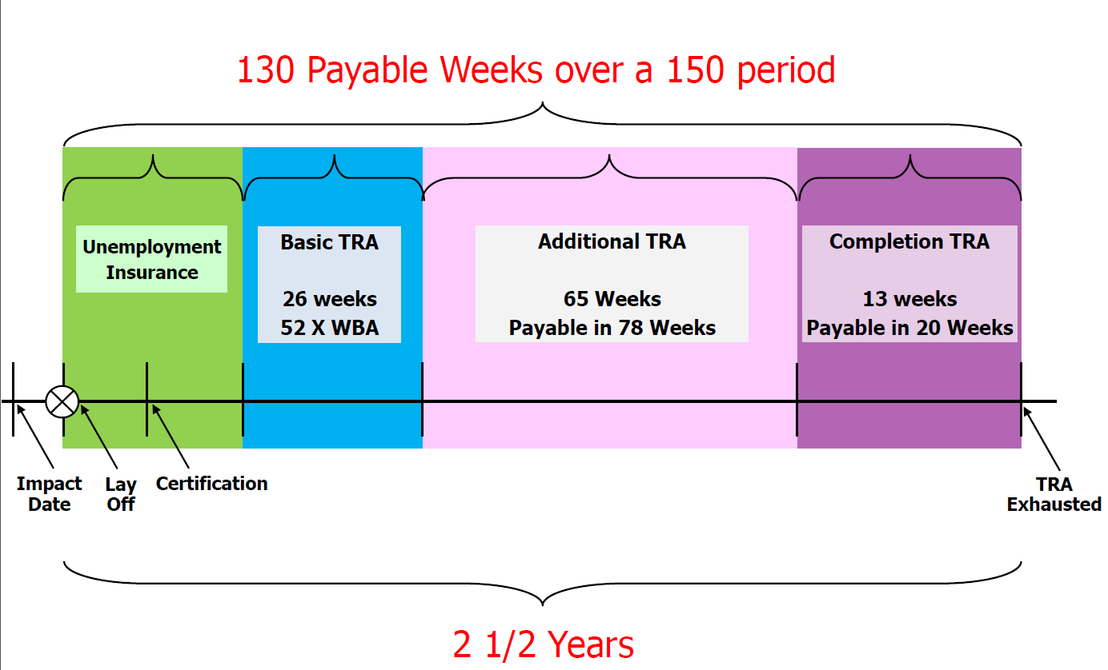
TAARA 2015 Program Benefits: TRA Timeline
There may be a gap in payments based on when Additional TRA is exhausted

Slide 62
TRA Benefits Matrix
TRA Type | 2002 TAARA | 2009 TAGAA | 2011 TAAEA | 2015 TAARA
BASIC + UI | 52 (reduced by any UI received) | 52 (reduced by any UI received) | 52 (reduced by any UI received) | 52 (reduced by any UI received)
ADDITIONAL | up to 52 weeks in 52 | up to 78 weeks in 91 | Up to 65 weeks in 78 | Up to 65 weeks in 78
(Total) | 104 weeks | 130 weeks | 117 weeks | 117 weeks
REMEDIAL | UP TO 26 weeks | UP TO 26 weeks | DOES NOT EXIST ANYMORE | DOES NOT EXIST ANYMORE
*COMPLETION | ___________ | ___________ | UP TO 13 weeks if established benchmarks are met and still in training | UP TO 13 weeks if established benchmarks are met and still in training
TOTAL NUMBER OF WEEKS | 130 weeks | 156 weeks | 130 weeks | 130 weeks
*Completion TRA is only payable within the last 20 weeks of training

Slide 63

Unique TRA Advantages
Earnings UP TO TRA WBA – A worker may earn up to 133% of their WBA while working and in full time training before deductions are made.
Election of TRA or UI – A worker can choose between TRA or UI when IN TRAINING and a new UI benefit year claim is made and determined eligible (new claim must be based on new employment)

Slide 64
TRA Deadline

Slide 65
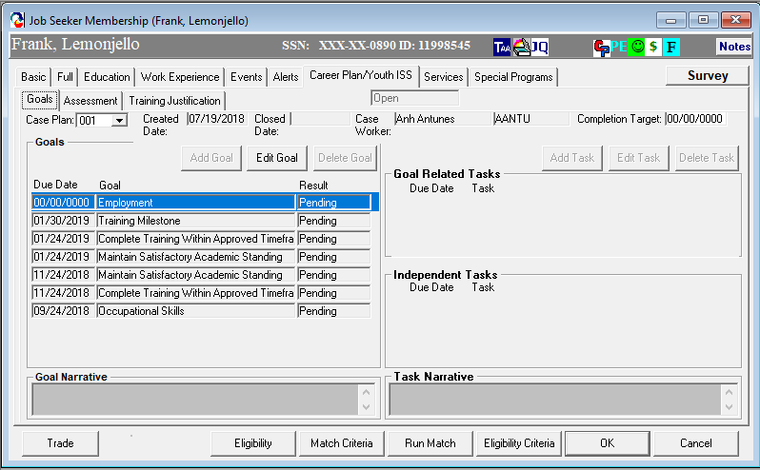
Benchmarks and Measureable Skills Gain

Slide 66
Knowledge Check
How many types of TRA benefits may a participant potentially collect throughout their training period?
3
Basic
Additional
Completion
If a participant’s Additional TRA is exhausted, and they still have 25 weeks left of training, would they be eligible to immediately claim Completion TRA?
NO
The maximum 13 weeks of Completion TRA are only payable in the last 20 weeks of training

Slide 68
Case Study Exercise
Danny Dante worked for Management Operation LLC from 2/25/1995 – 7/28/2017. The company was trade certified on 12/12/2017. The career counselor submitted a Training package for the Six Sigma Green Belt Certification on 3/8/2018. Classes will start 4/16/2018 and end 5/11/2018. Total training cost is $23,000.00.
Question 1
Can this training be approved? Elaborate …
No… It exceeds the reasonable cost.
Question 2
Does this training require benchmarks?
No

Slide 69

Reemployment Trade Adjustment Assistance (RTAA)
The following rules apply:
Available to workers age 50 or older
No deadline for reemployment (ATAA was 26 weeks)
Must apply for RTAA Two years from the date worker exhausts UI (and any EUC) or two years from the date of reemployment, whichever is earlier
Must earn less than they did from the certified company and cannot earn more than $50,000 annually in gross wages
Workers may receive up to $10,000 over the course of the 2 year eligibility period
Not be with the same division/facility from which he/she was separated
Workers may choose between TRA or RTAA (cannot go from RTAA to TRA once TRA has been collected)
RTAA participants may participate in training full or part-time
And be reemployed at least 20 hours per week
Notes:
Workers participating on the ATAA need a Certification from the USDOL

Slide 70

Reemployment Trade Adjustment Assistance (RTAA)
NOTE: If an individual has already received Trade Readjustment Allowances (TRA), the RTAA eligibility period will begin with the date of qualifying reemployment and will be reduced by the number of weeks of TRA received.
Prior TRA receipt will also reduce the maximum amount of RTAA potentially payable.
Notes:
Workers participating on the ATAA need a Certification from the USDOL

Slide 71

RTAA - Reminders
RTAA/ATAA - If there is a change in employer a redetermination is required. In order to do so all the paystubs must be entered from the old employer before TAA can close the current RTAA Application. Once the Application is closed then a NEW RTAA Application will be submitted for new employment. TAA will review and make a determination.

Slide 72
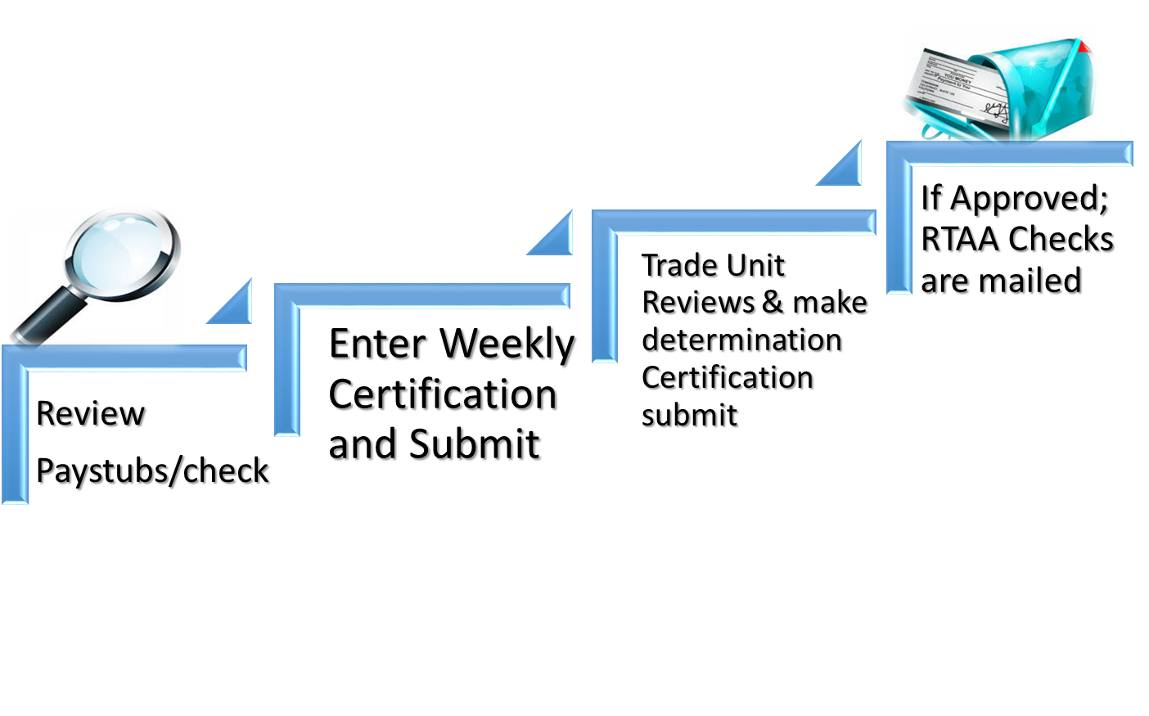
RTAA - Reminders

Slide 73
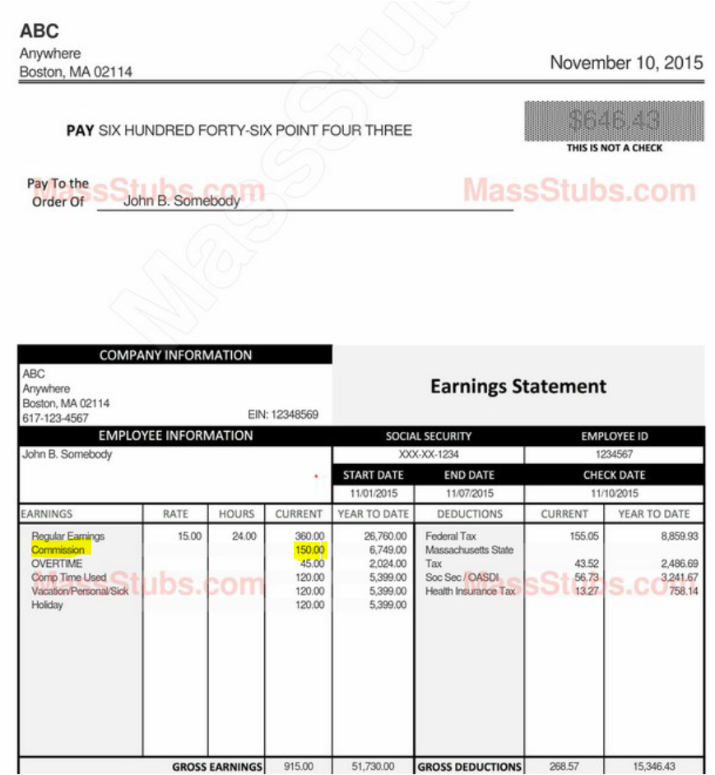
RTAA - Reminders
How to Add Monthly RTAA Certification in MOSES with Commission earned

Slide 74
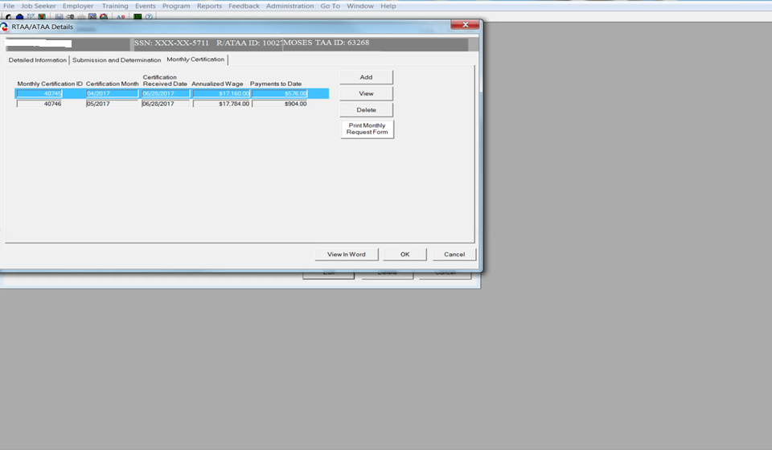
Review of Monthly RTAA Certification
in MOSES with Commission earned
Commissions earned reduces the weekly RTAA benefit amount. If commission earned is greater than the weekly RTAA amount then worker is not eligible for RTAA for that particular week.

Slide 75
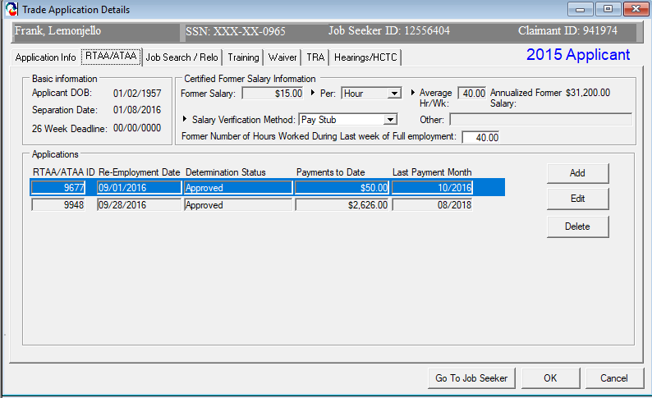
RTAA Application

Slide 76
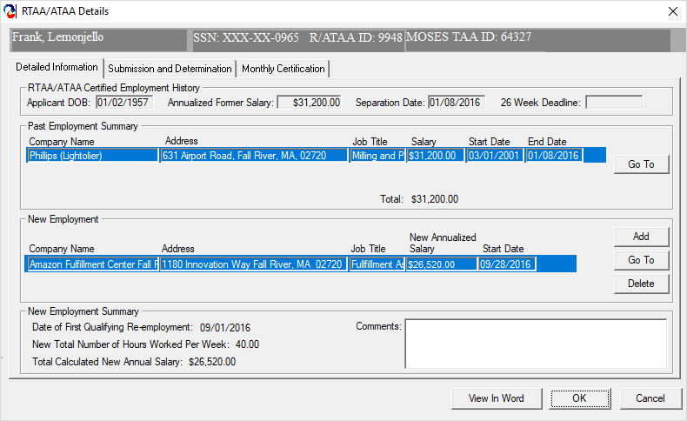
RTAA Application

Slide 77
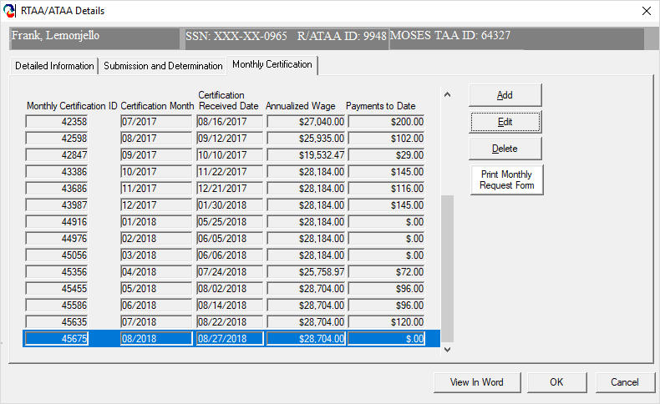
RTAA Application

Slide 78
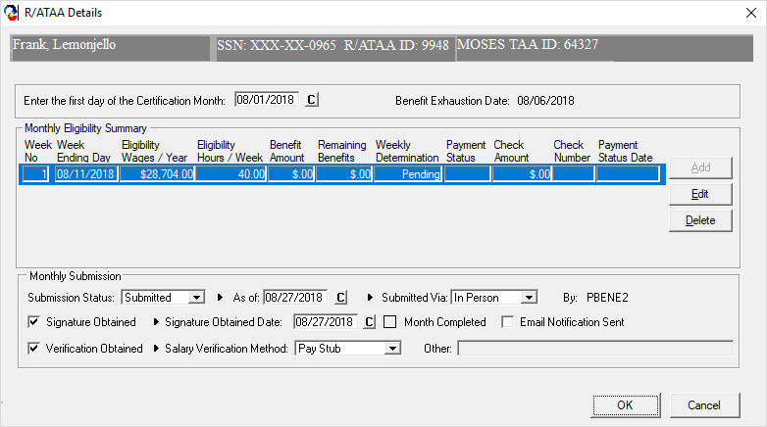
RTAA Application

Slide 79
Job Search and Relocation Allowances
Job Search:
90% of total allowable costs, up to a maximum of $1,250
An application for a job search allowance must be submitted before job search begins, and within 365 days of layoff or certification (whichever is later), or
Within 182 days after the conclusion of training.
Relocation:
90% of total allowable and reasonable costs
Provides an additional lump sum payment of up to $1,250
An application for a relocation allowance must be submitted before relocation begins, and within 425 days of layoff or certification (whichever is later), or
Within 182 days after the conclusion of training.

Slide 80
Health Coverage Tax Credit (HCTC)
The IRS initiated its outreach efforts on December 1, 2015, to inform taxpayers that it will accept amended returns for tax year 2014 from potentially eligible individuals seeking HCTC.
HCTC is only available to the following:
An eligible trade adjustment assistance (TAA) recipient, alternative (ATAA) recipient, reemployment (RTAA) recipient. Or
Eligible Pension Benefit Guaranty Corp (PBGC) pension payee. Or
The family member of a TAA, ATAA, or RTAA recipient or PBGC pension payee who is deceased or who finalized a divorce with you.
For more information, please visit
https://www.irs.gov/Credits-&-Deductions/Individuals/HCTC
https://wdr.doleta.gov/directives/corr_doc.cfm?DOCN=4983
Notes:
Emphasize that the new 65% coverage for HCTC is for workers under BOTH the new and old Acts.

Slide 81

Knowledge Check
Can a customer continue to collect Additional TRA while job searching after they have completed training?
John Brown wants to attend a CIS degree Training that costs $29,500.
Would this cost be approved?
No
A customer can only collect Basic TRA while job searching until it exhausts.
NO
Maximum Costs
Occupational = $20,000
Remedial = $10,000 (per year)
Degree = $28000
Will a 35 business day break in training impact a participant’s TRA?
TRUE or FALSE
Worker must be 50 years old when reemployment occurs for RTAA
YES
If a 35 day break is entered in MOSES, it triggers an issue in the UI Online system that affects TRA Payments.
(Note: Breaks less than 30 days should not be entered in MOSES)
FALSE
Worker must be 50 years old at the time of RTAA Application
Notes:
IF a 30 day break is added in the break section of TRADE Course Detail screen in Moses, then this creates an Issue in the UI Online system that holds TRA payment from being disbursed. Ensure that only breaks greater than 30 week days are added to MOSES.

Slide 82

ONLINE RESOURCES www.mass.gov/dcs/trade

Slide 83
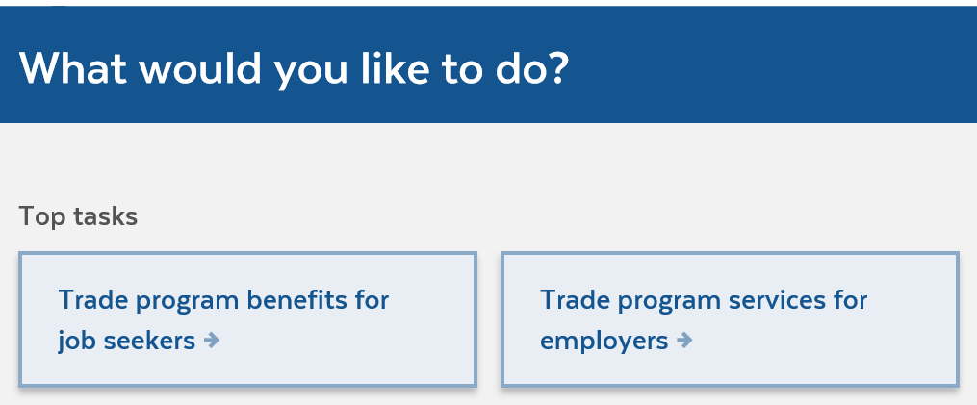
ONLINE RESOURCES www.mass.gov/dcs/trade

Slide 84
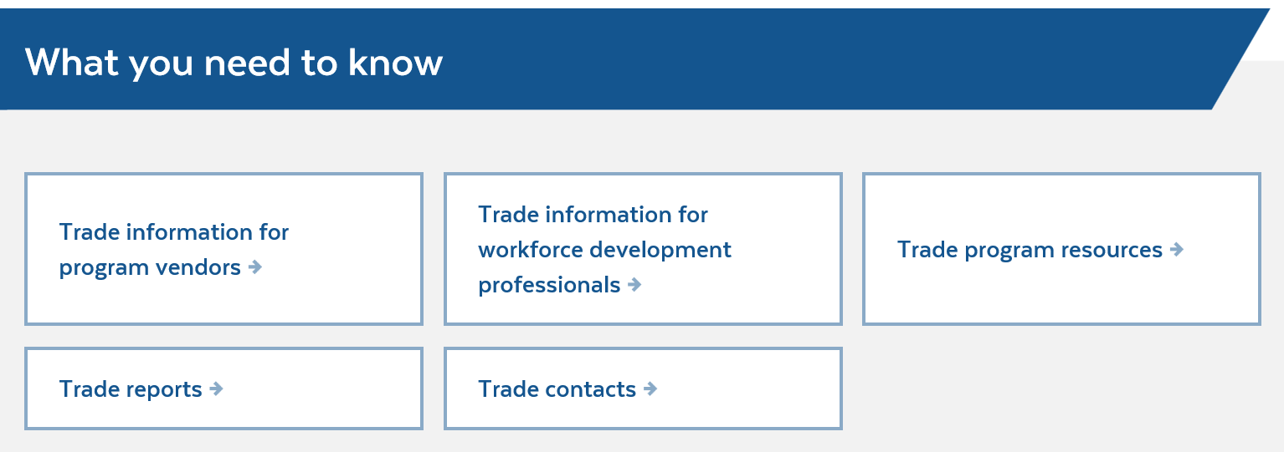
ONLINE RESOURCES www.mass.gov/dcs/trade

Slide 85

We would like to thank you for your time!
Are there any questions?

Slide 86
Contacts
Maynor Acevedo
Maynor.Acevedo@Detma.org
Christopher Quan
Christopher.Quan@Detma.org

