Slide 1
Transitions from Acute Care to Post-Acute Care (TACPAC) Task Force
February 5, 2025
10:30am - 12pm

Slide 2
Recognizing the Issue

Slide 3

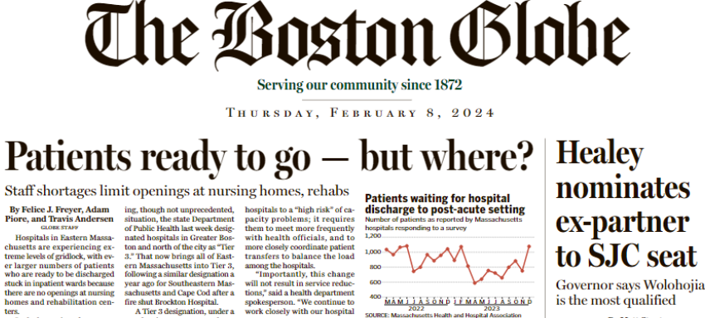

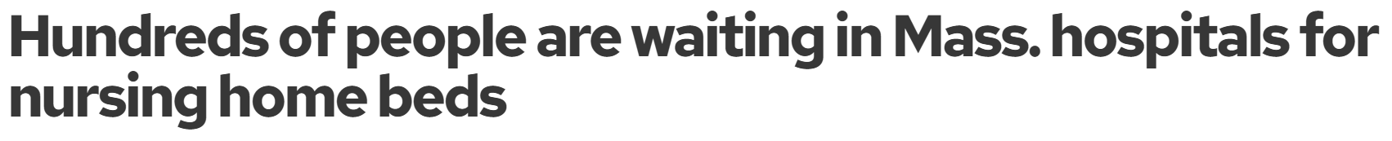
What is a Stuck Patient?

Slide 4
Why are Patients Stuck?
On any given day, 2,000+ patients are “stuck” in Massachusetts hospital beds because they cannot access the post-acute care placement they need.
Consequences:
  The patient does not get the specialized care they need.
  Acute care beds are tied up for other patients in need, worsening wait times and access challenges.
  Massachusetts hospitals are devoting more than $400 million annually to care for patients who are occupying beds while awaiting placement at the next level of care.

Slide 5
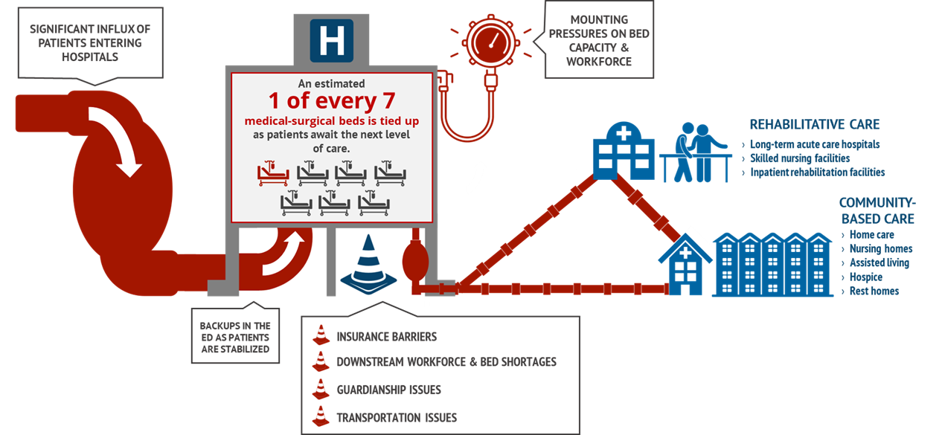
A Clogged System: Keeping Patients Moving Through Their Care Journey

Slide 6
Measuring the Issue

Slide 7
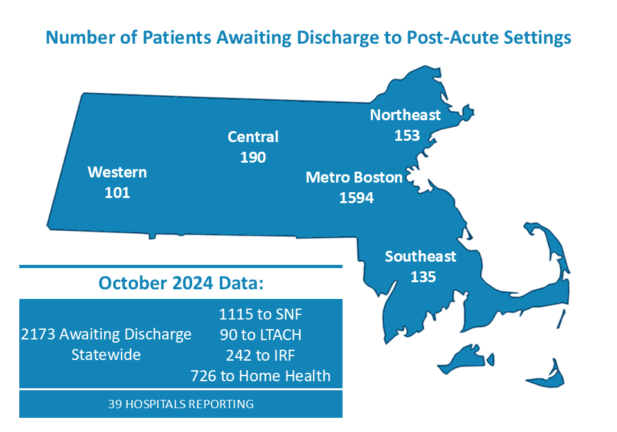

Monthly Hospital Throughput Surveys
Notes:
In response to severe throughput challenges, worked with colleagues to develop and administer a monthly throughput survey – launched in March 2022.
The survey has run each month since then – with about 40 hospitals responding each month.
Following the first full year of data collection, MHA published a broader report on the key challenges and solutions identified through the data and in collaborations with members
Data are shared publicly on MHA’s website, via email to members and other stakeholders, and in several MHA council and workgroup meetings.
Data has been critical to advocacy efforts in addressing the many challenges causing the throughput delays

Slide 8
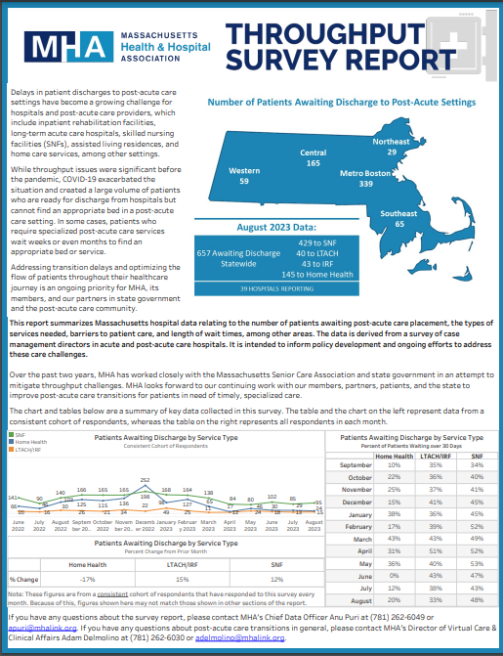
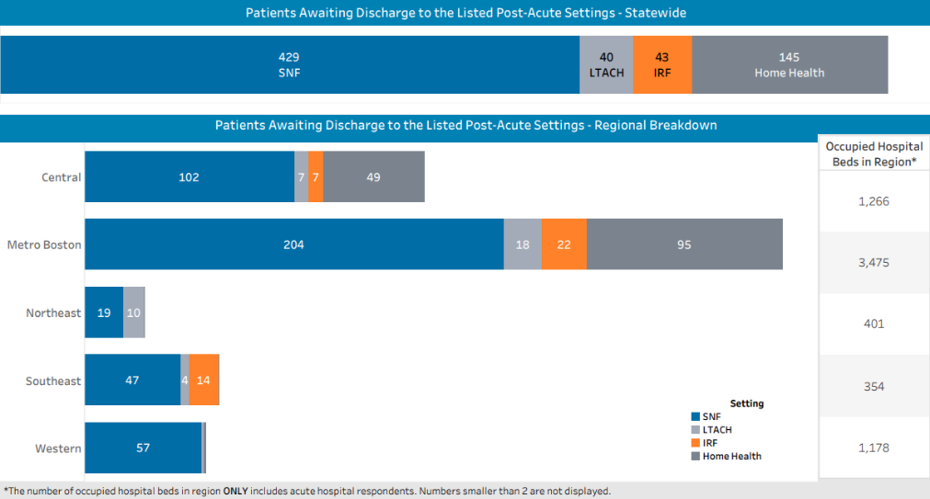
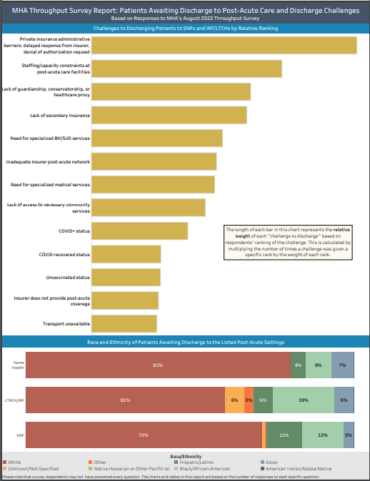
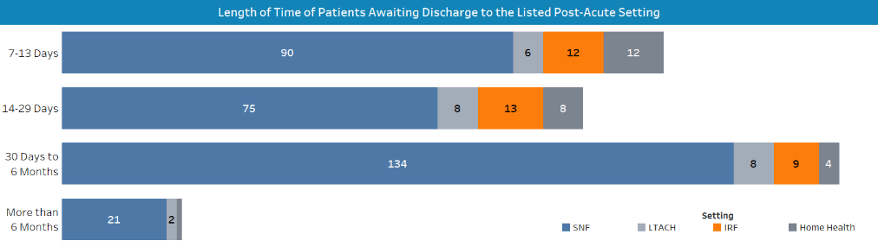
Patient Throughput: Acute to Post-Acute Care
See all reports at mhalink.org/throughputreports

Slide 9
October 2024 Throughput Data
Our data indicates that:
On a month-to-month basis, 40% of patients who are awaiting discharge to skilled nursing facilities are waiting 30 days or more.

Slide 10
October 2024 Throughput Data: Regionally
In Metropolitan Boston region alone, more than 700 patients are awaiting discharge to skilled nursing facilities. And more than 500 patients are awaiting discharge to home care services.

Slide 11
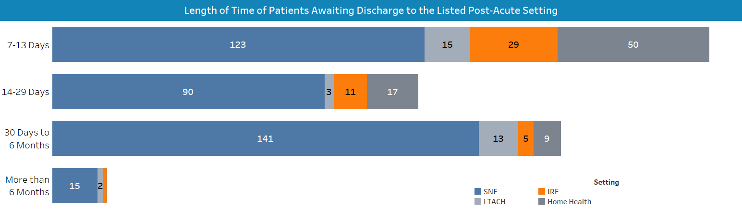
October Throughput Data: Long Stays

Slide 12
October Throughput Data: Bed Demand

Slide 13
October Throughput Data: LTC Challenges

Slide 14
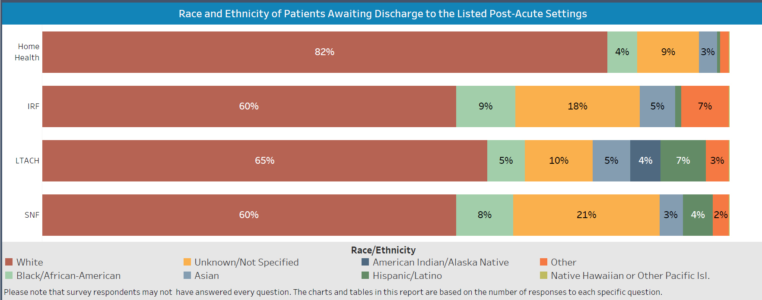
Race & Ethnicity of Patients Awaiting Discharge

Slide 15
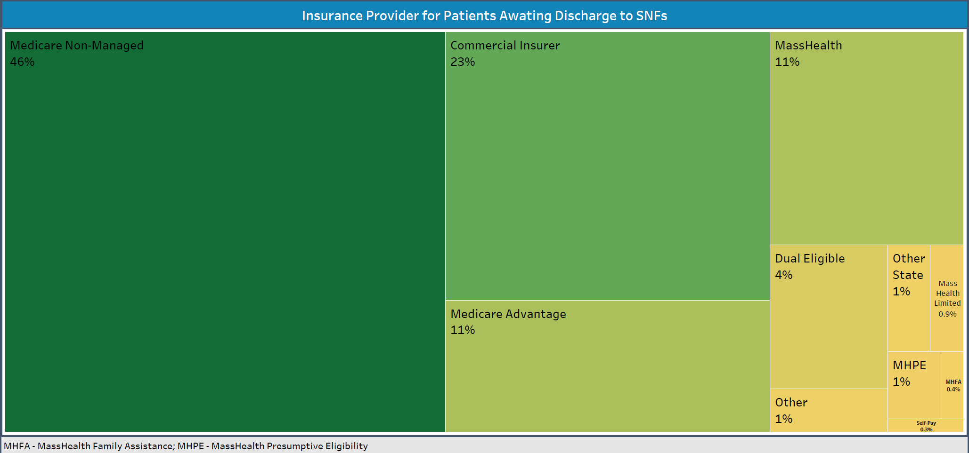
Throughput Data: Insurance Composition

Slide 16
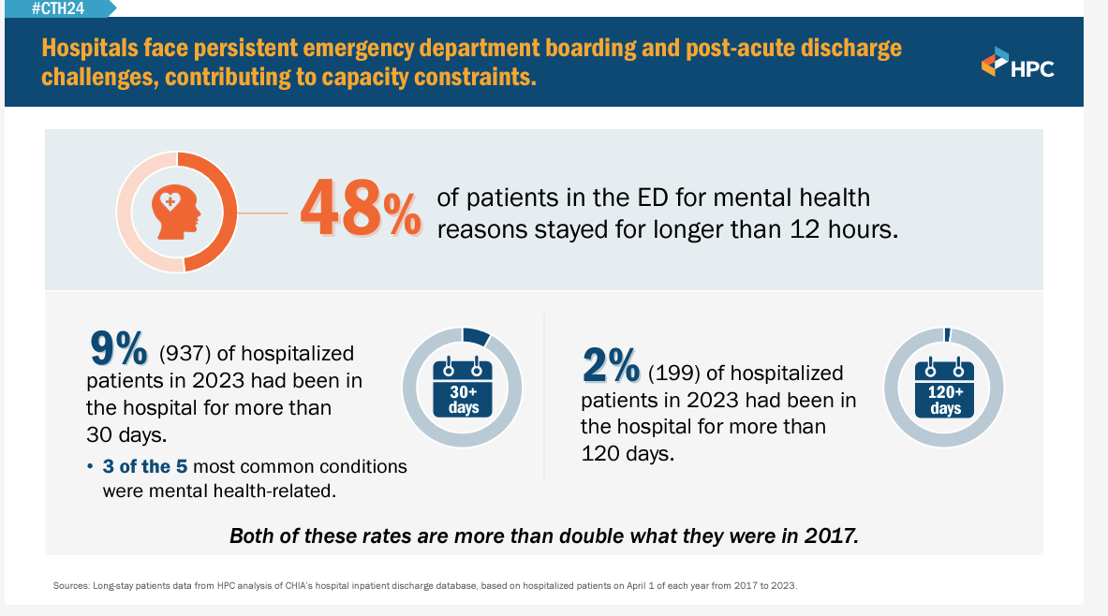
Health Policy Commission Data

Slide 17
Identifying the Causes

Slide 18
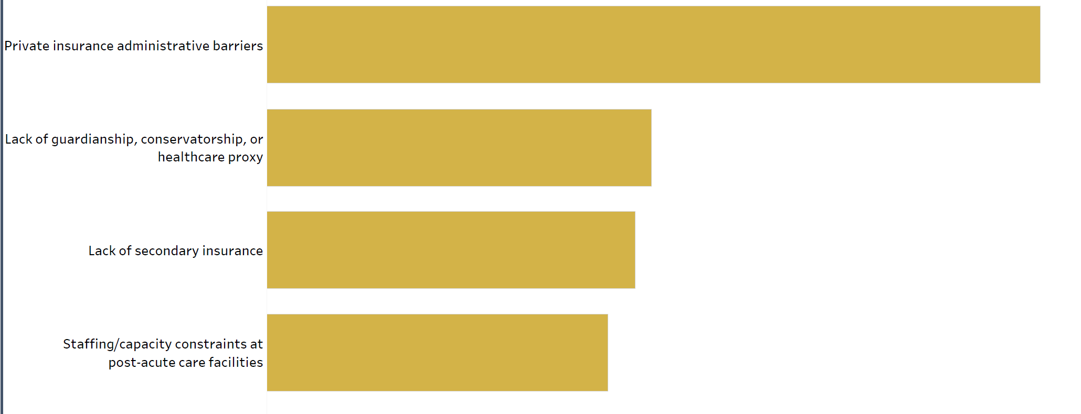
Challenges to Discharging Patients to SNFs, IRFs, LTACHs

Slide 19
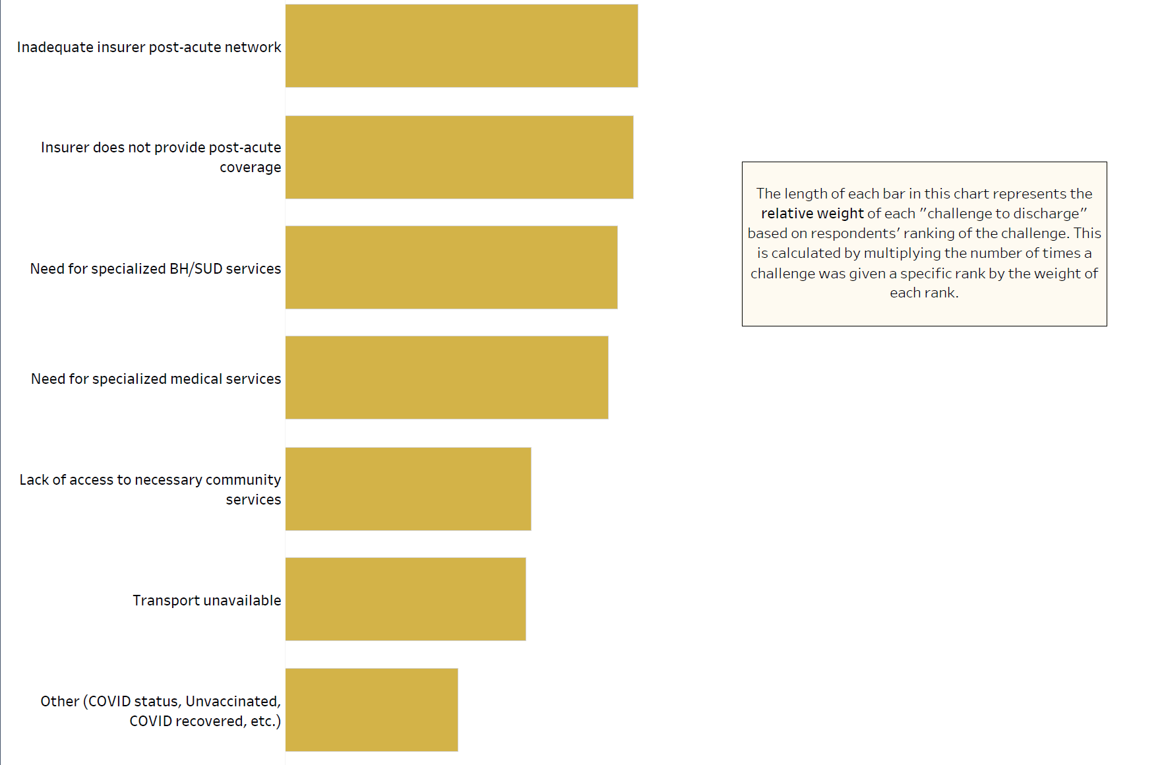
Challenges to Discharging Patients to SNFs, IRFs, LTACHs (continued)

Slide 20
The Workforce Challenge

Slide 21
Workforce Challenges for Post-Acute Hospitals
Key Facts:
In FY22, the aggregate vacancy rate for positions in surveyed Massachusetts post-acute care hospitals was 9.4%.
In FY22, the change in the average hourly wage for employees in post-acute care hospitals increased by 10.4% between FY19 and FY22.

Slide 22
Temporary Staffing in Post-Acute Facilities
Licensed Beds – FY23
Due to lack of staffing available,
there were a total of 190 unstaffed licensed beds at post-acute hospitals in Massachusetts.
Licensed Beds staffed - only Directly Employed Staff
Additional Licensed Beds Staffed - with Temporary Staff
Unstaffed Licensed Beds due to Lack of Available Staffing

Slide 23
Temporary Staffing
Average Hourly Wage (AHW) for Temporary RNs at Post-Acute Hospitals
89% increase from Pre-Pandemic AHW to Post-Pandemic AHW

Slide 24
Temporary Staffing
Total Expenditure on All Contract Labor at Post-Acute Hospitals; FY2019 - FY2022

Slide 25
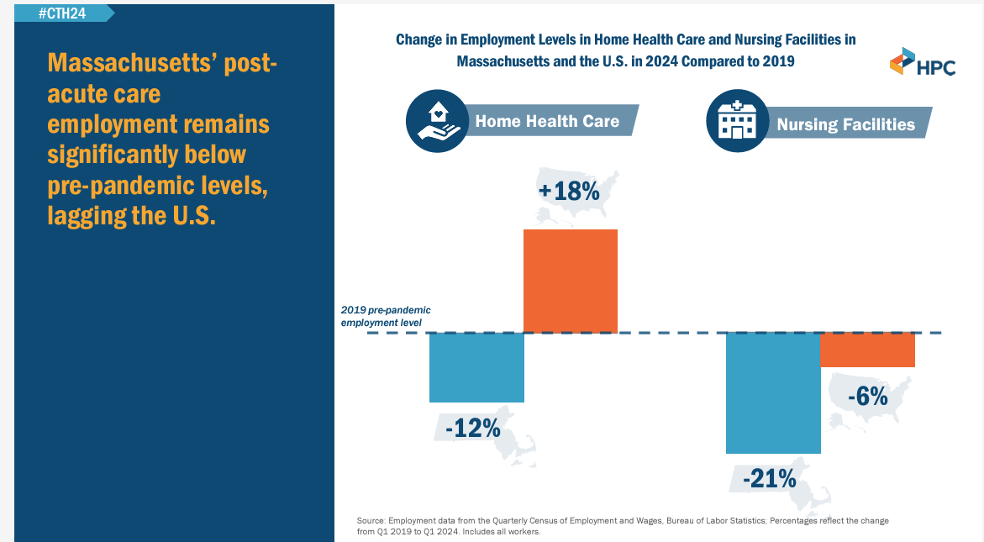
Post-Acute Care Discharge Challenge

Slide 26
Addressing the Issue

Slide 27
Chapter 197 of the Acts of 2024:
An Act to Improve Quality & Oversight of Long-Term Care
Passed the Legislature on August 29 and signed by Governor Healey on September 6th, the new law puts in place additional oversight of long-term care, puts in place:
protections for the LGBTQ+ residents,
makes permanent the COVID flexibility that allows assisted living residences to offer certain basic health services; and
requires the licensure of small house nursing homes.
The law also:
Establishes a two-year pilot program that requires GIC plans, MassHealth and commercial insurers licensed in Massachusetts to approve or deny requests for prior authorization for post-acute care services by the next business day following receipt by the payer of all necessary information to establish the medical necessity of the requested post-acute care services (home care, SNF care, post-acute hospital care).

Slide 28
Chapter 197 of the Acts of 2024:
An Act to Improve Quality & Oversight of Long-Term Care
Instructs MassHealth to establish a skilled nursing facility rate add-on program for bariatric patient care and a rate add-on program for 1-on-1 staffing of at-risk residents requiring 24-hour monitoring and supervision for their safety and the safety of other residents and staff.
Directs the Division of Insurance to develop and implement a uniform prior authorization form for the admission of patients from an acute care hospital to post-acute care settings to be used by all insurers, including MassHealth;
Directs DPH to create a program for the certification, training, and oversight of certified medication aides to administer medications to long-term care patients, subject to oversight from nurses or physicians;
Requires DPH to study and report, by July 31, 2025, on the feasibility of having qualified professional guardians give informed medical consent for indigent persons and whether such guardians would reduce hospital discharge issues.

Slide 29
Chapter 197 of the Acts of 2024:
An Act to Improve Quality & Oversight of Long-Term Care
Requires MassHealth to study reducing the time applicants spend at acute-care hospitals awaiting long-term care eligibility determinations. The study will consider improvements to the eligibility determination process; establishing a rebuttable presumption of eligibility; guaranteeing payment for long-term care services for up to one year; and expanding the undue hardship waiver criteria.
Creates a fund to recruit and retain a dedicated long-term care workforce, including grants to develop new Certified Nursing Assistants (CNAs), career ladder grants for direct care workers to train to become Licensed Practical Nurses (LPNs), along with leadership and supervisory training for nursing home leaders.
Establishes a no interest or forgivable capital loan program to off-set certain capital costs, including the development of specialized care units, and to fund other capital improvements at nursing homes.

Slide 30


Enhanced Short-Term Rehabilitation Program
The Executive Office of Health and Human Services (EOHHS) and Department of Public Health (DPH) implemented a temporary program that added short-term rehabilitation capacity in all regions of Massachusetts.
GOAL: Support patient care transitions and reduce the number of patients who are medically ready for hospital discharge but are not able to be transferred due to capacity constraints at SNFs and to help transition them back to the community.
2 skilled nursing facilities in each of the 5 Emergency Medical Service (EMS) regions of the state were provided with additional, state-contracted nursing teams to augment existing SNF staffing.
The SNFs were required to accept all hospital referrals for patients that require short-term rehabilitation skilled nursing services as a requirement of participating and receiving state-funded nursing staff.
Thousands of discharges were supported through this program

Slide 31
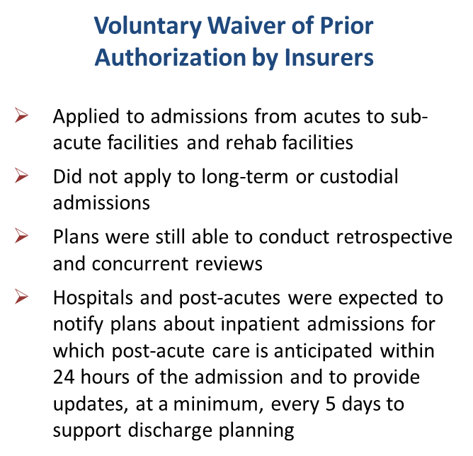
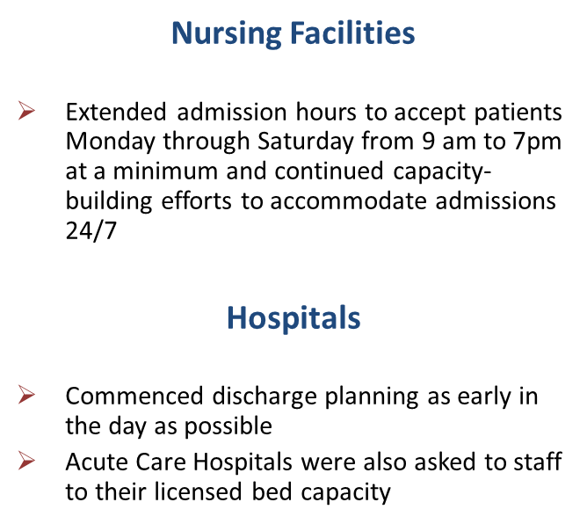
Voluntary Strategies to Address Capacity

Slide 32

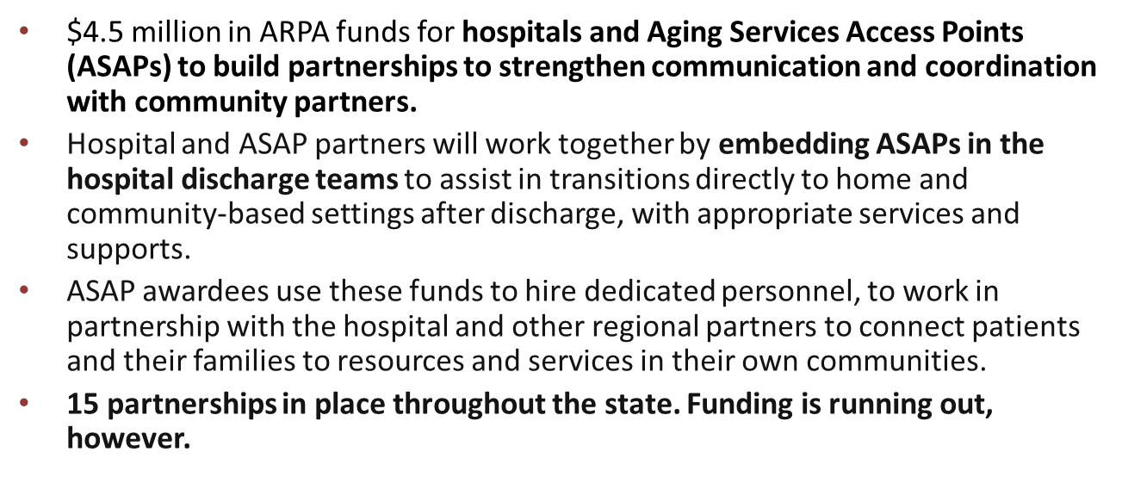

Slide 33

Healthcare Proxy Completion

Slide 34
Thank You!
Don’t Hesitate to Reach Out:
Adam Delmolino
Senior Director, Virtual Care & Clinical Affairs
Massachusetts Health & Hospital Association (MHA)
adelmolino@mhalink.org | (781) 262-6030

